Slide 1


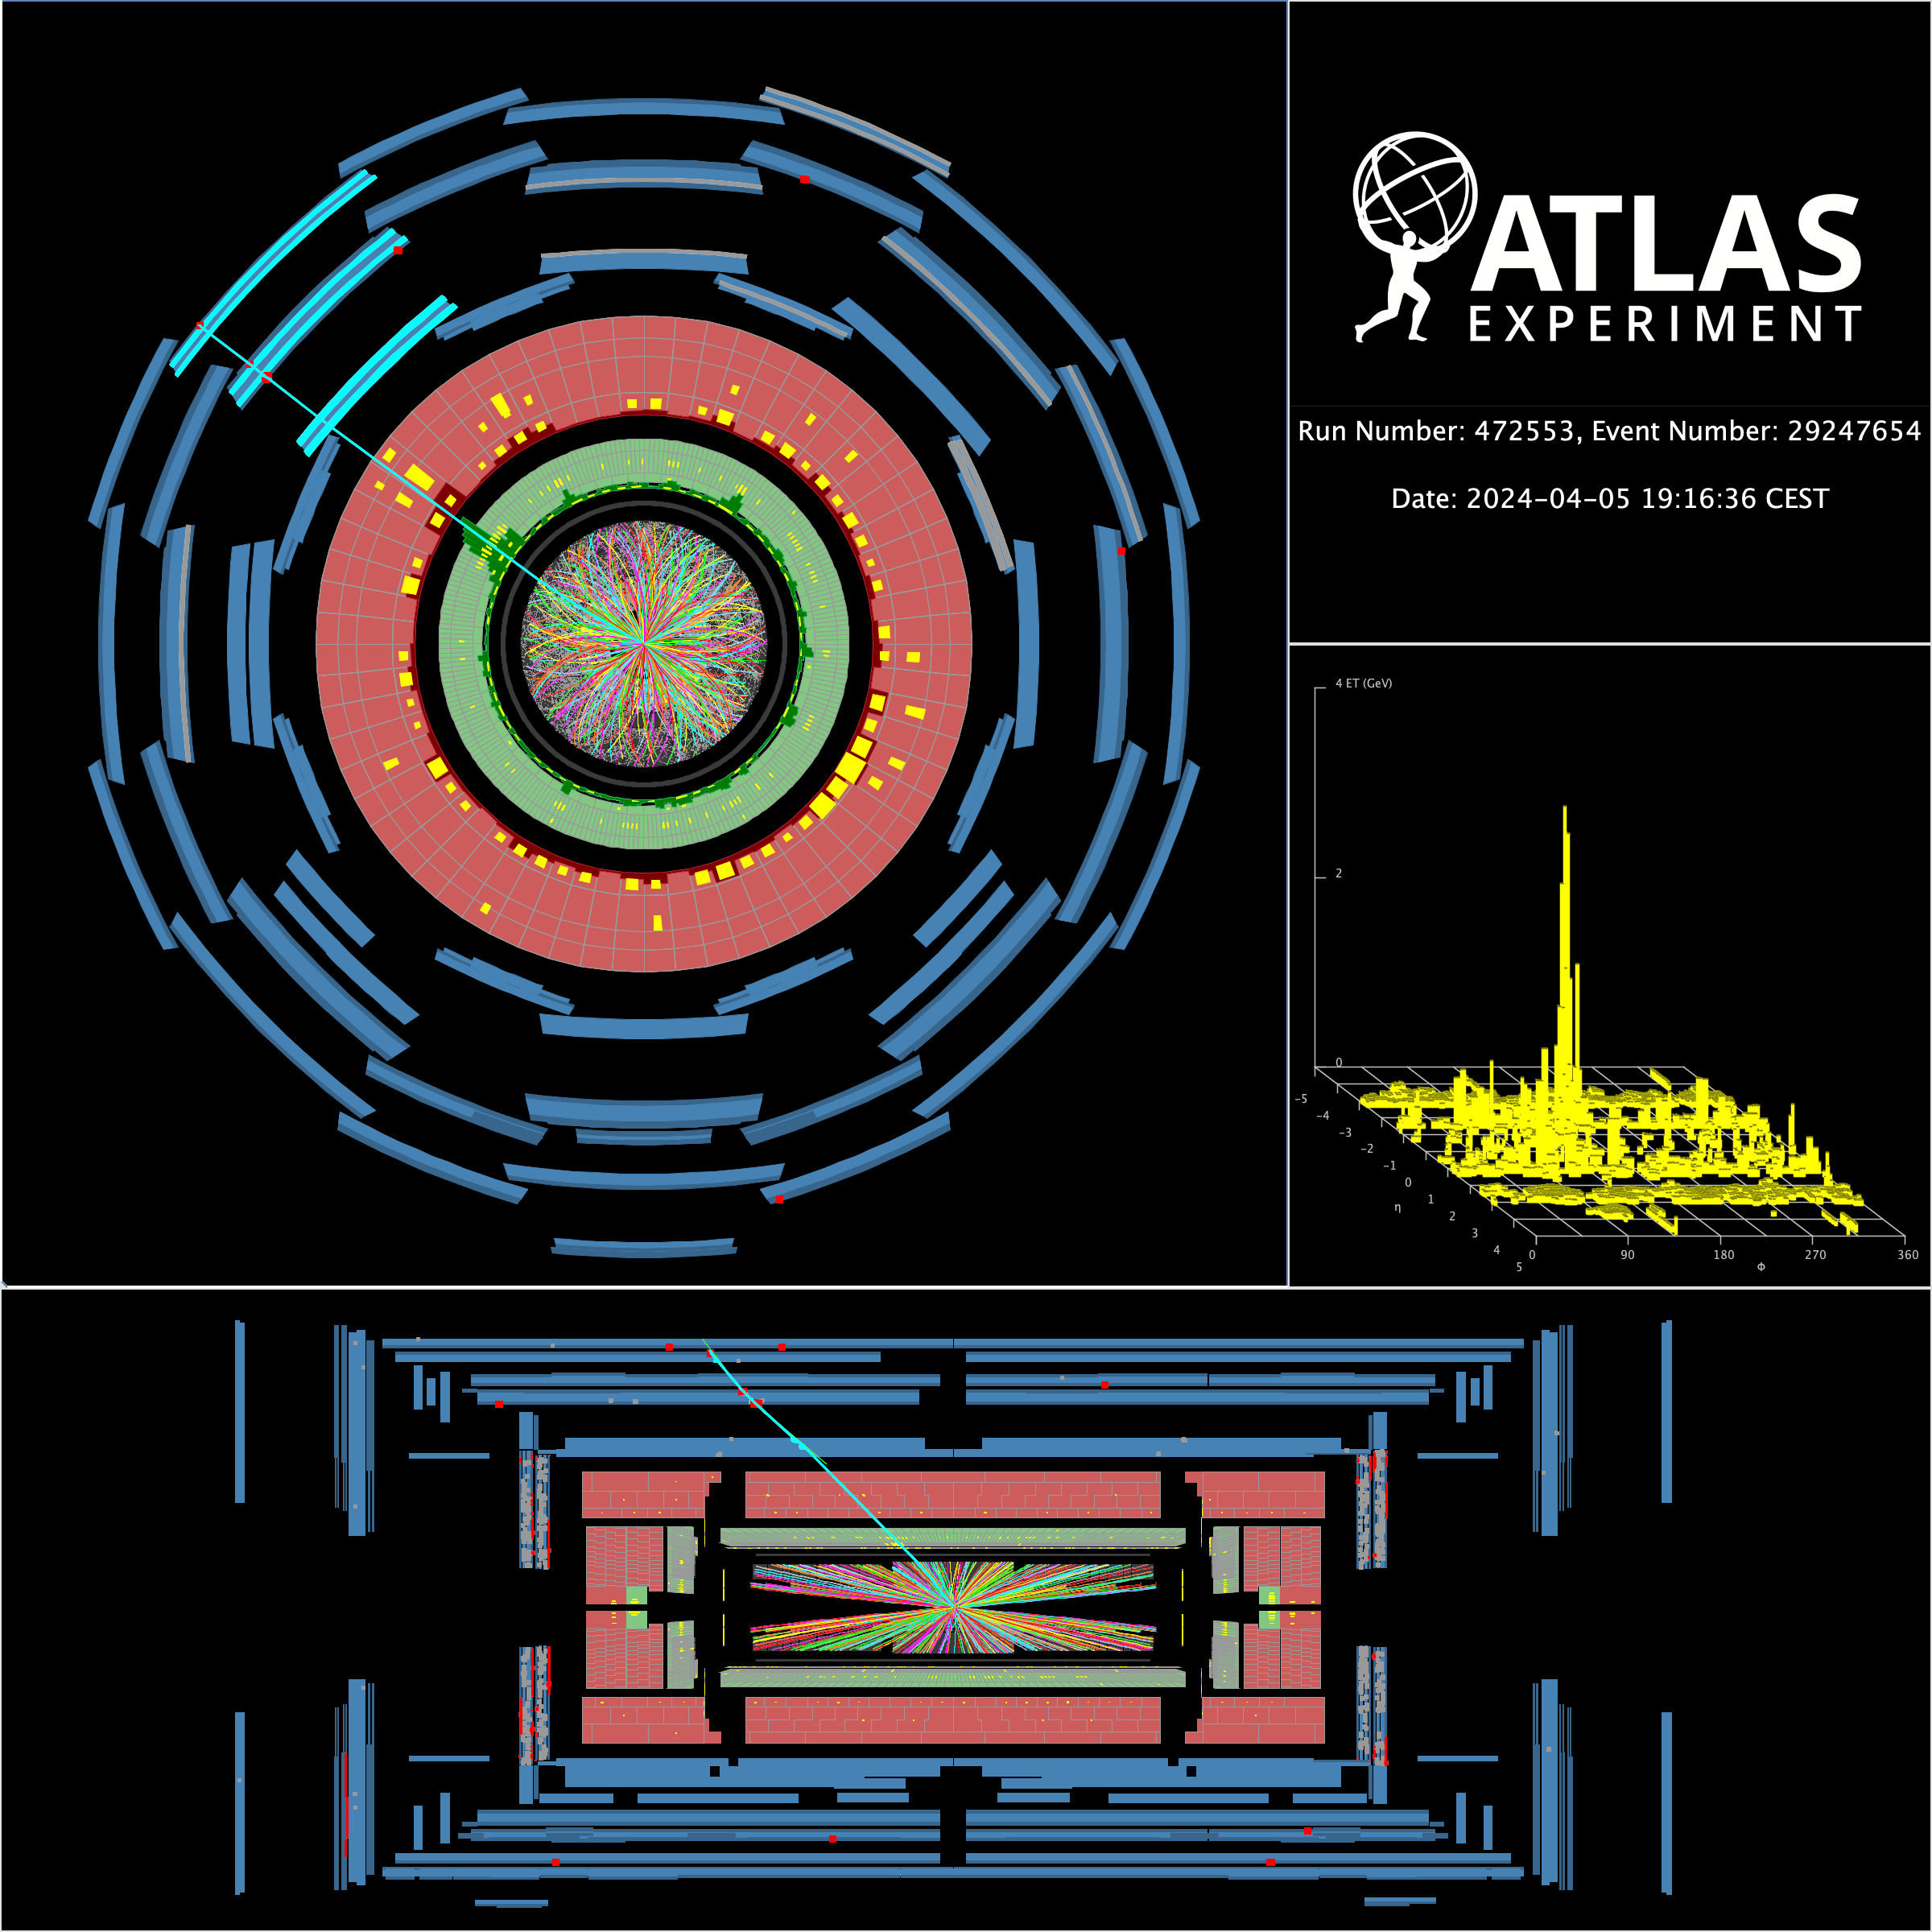
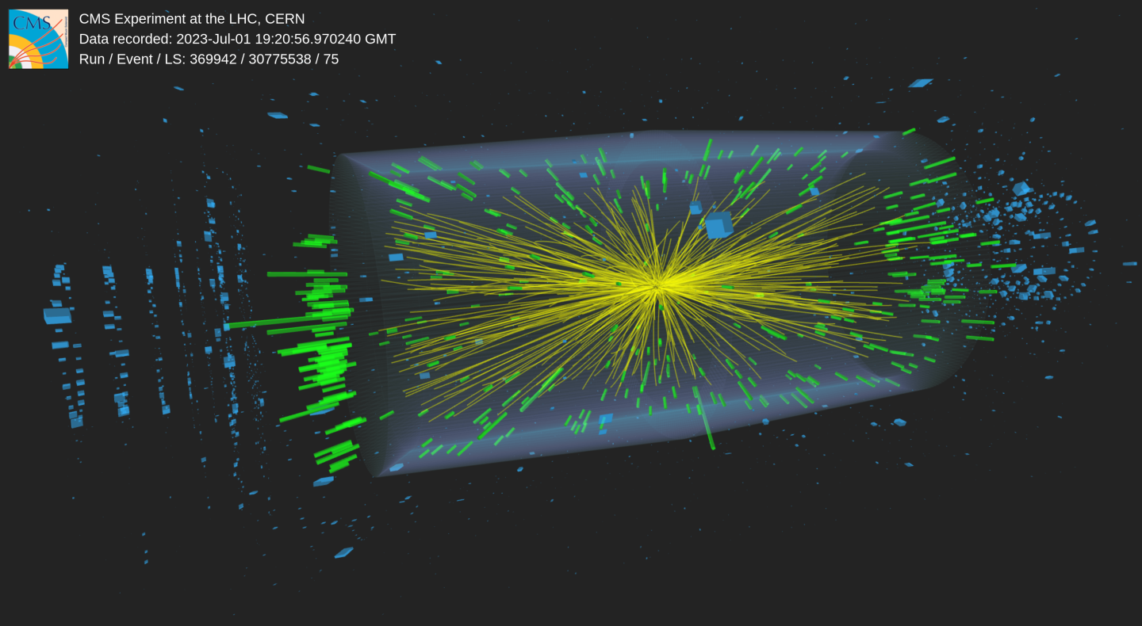
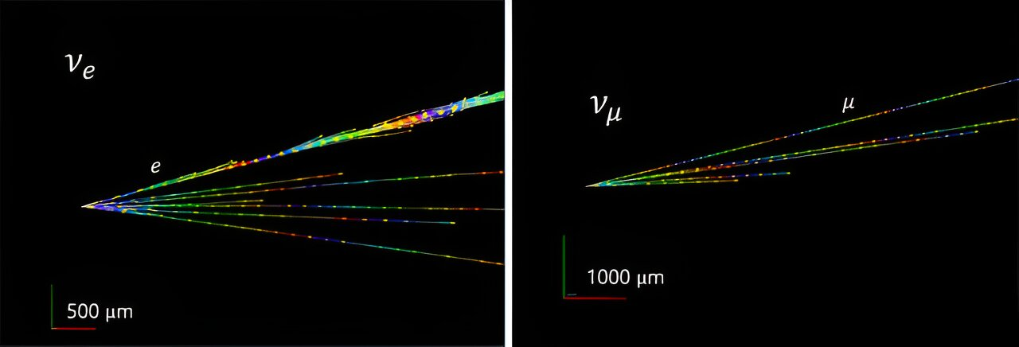

Energy frontier:
ATLAS and CMS (+FASER) and their upgrades
R-ECFA Visit to the UK, Royal Society London, 13/9/2024
CMS Run 3 event with 55 vertices
FASER neutrinos
Monica D’Onofrio, University of Liverpool

Slide 2
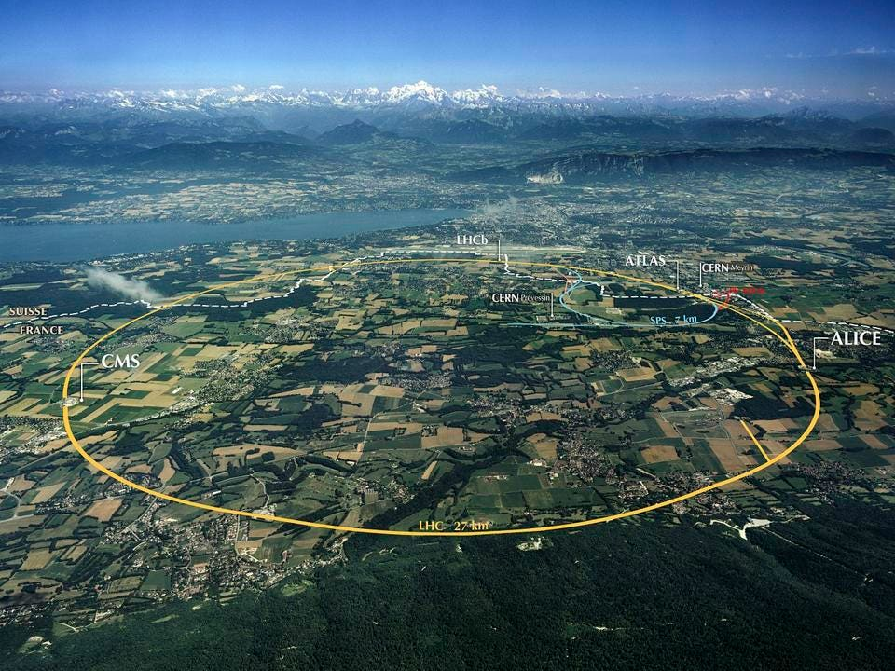
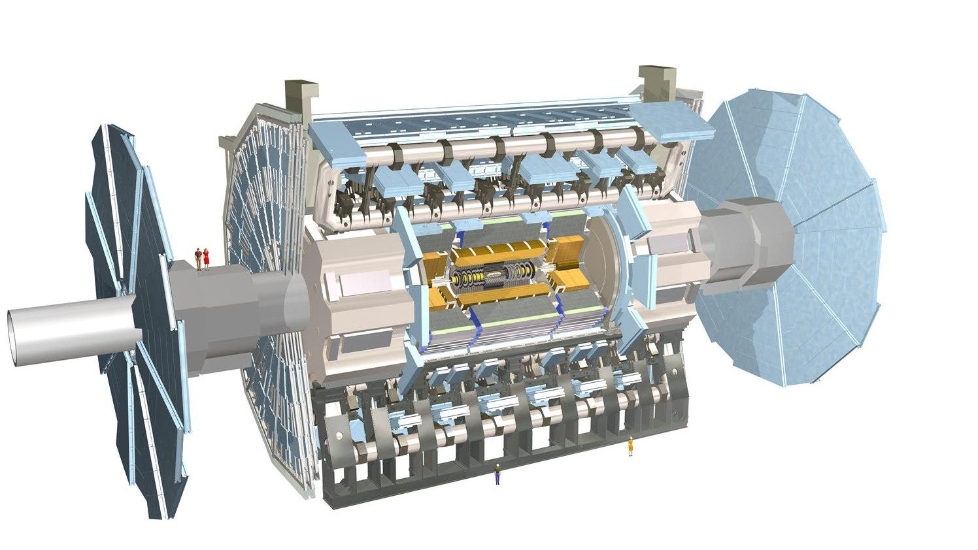
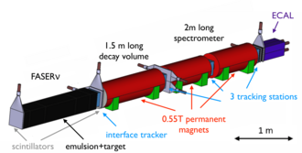
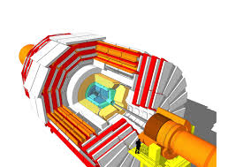
Outline
ATLAS
https://cds.cern.ch/record/1095924
ATLAS, CMS and FASER experiments in Run 3:
  status and physics highlights
Towards the HL-LHC:
  exploitation of the physics potential
  Phase II upgrades
with a detailed view of UK efforts and contributions
~ 5900 active members
(2870 scientific authors, 183 Institutes)
FASER
https://arxiv.org/pdf/2207.11427
2014 J. Phys.: Conf. Ser. 513 (2014) 022032
CMS
102 active members
(27 Institutes)
The UK has also a small participation in SND@LHC (UCL, Imperial) - see W. Barter’s talk
~ 6300 active members (2166 scientific authors, 247 Institutes)

Slide 3
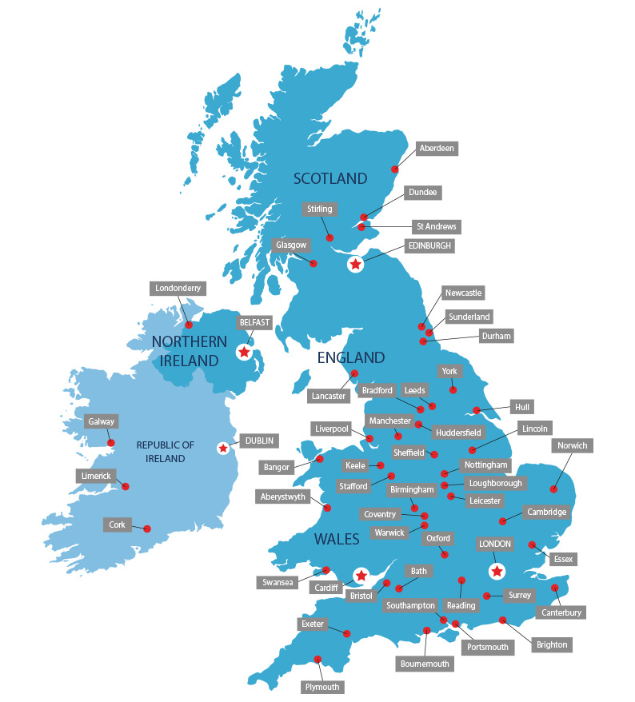
UK Institutions
14 universities + STFC Rutherford Lab
11.7% of ATLAS active authors
260 Physicists and 108 engineer/tech/admin
142 current doctoral students
3 universities + STFC Rutherford Lab
3.6% of CMS active authors
82 Physicists and 38 engineer/tech/admin
21 current doctoral students
+ around 6-7 “associated” institutes (mostly CMS)
4 universities
6.3% of FASER authors
5(6) Physicists, 5 current doctoral students
UCL
RHUL
Queen Mary
RAL
Imperial
Brunel
Project Funding: mainly from STFC
Additional funding: EPSRC, UKRI, Royal Society, ERC, Marie Curie, Schmidt Family Foundation, Leverhulme Trust
Sussex

Slide 4
UK major commitments
Run 3 Operations and performance (include Phase I upgrade) | Run 4: Phase II upgrade
Phase I: hardware, firmware and software upgrades for L1Calo and HLT&DAQ systems Operations: Inner Tracker (SCT), L1 trigger, , HLT & DAQ systems, data quality, alignment, forward detector Physics performance: luminosity, beam background, Monte Carlo generators, e/γ, μ, τ reco/ID, flavour tagging and b/c calibration, global particle flow, machine learning | ITk-Pixels ITk-Strips Calorimeter Trigger (eFEX & Global) High Level Triggering & DAQ Upgrade software
Phase I: L1 Trigger Operations: Silicon Strip tracker, ECAL, Calorimeter trigger system Physics performance: e/γ and τ reconstruction and ID, statistics tools, machine learning | ASICs for new tracking system Electronics and algorithms for trigger for: Tracker, ECAL, high granularity endcap calorimeter and L1 trigger
Commissioning and Run 3: test beam 2021-22, scintillator veto system for trigger, ECAL, tracking spectrometer, new pre-shower in preparation for 2025 → no major upgrades foreseen for Run 4
Operations and Physics performance: Run coordinators, Track reco, e/γ reco/ID
Computing: underpins all our research → Tier1 and Tier2 centers, core support, software development, also through coordinated projects relevant for HL-LHC and beyond (see D. Costanzo’s talk)

Slide 5
Management and coordination roles
Major roles (management)
  ATLAS:
    Spokesperson: Dave Charlton (2013-2017, deputy 2009-2013)
    Physics Coordinator: Dan Tovey (2016-2017); Bill Murray (2014-2015); Dave Charlton (2008-2009)
    Collaboration Board Chair: UK provided 3 out of the 14 CB Chairs, latest: Max Klein (2017-2020)
    Project leaders for Inner Tracker, ITK, Trigger and Run coordinators
  CMS:
    Spokesperson: Jim Virdee (2007-2009, deputy 1993-2006)
    Collaboration Board Deputy Chair: Claire Shepherd-Themistocleous (2014), Gavin Devies (2017-2019)
    Project leaders for L1-Trigger, HLT, HGCAL, ECAL and Run coordinators
  FASER:
    Physics Coordinator: Carl Gwilliam (2022-2024)
Impact on international physics and upgrade activities through coordination:
  Since 01/2021: ATLAS counts 14 Level-1 coordinators, 15 Physics and Combined Performance group conveners (and >40 sub-group conveners) in diverse areas, ~55 Level-3 coordinators; CMS counts 2 Level-1 coordinators and 4 operations and physics group coordinators around trigger and searches for new physics, plus >10 L3 coordinators. In FASER, the UK counts 1 Run Coordinator, 2 Physics Analysis leads

Slide 6
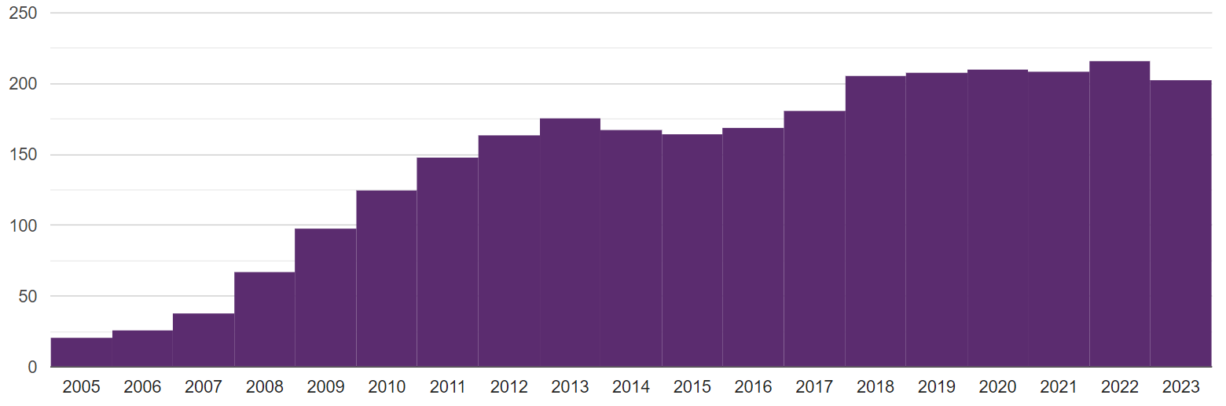
Engagement, ECR and PhD students
This is a very dynamic community, engaged in developing new ideas at all levels
  Shown also through awarded European Research Council Advanced grants, individual fellowships from UKRI (Future Leader), STFC (ERF) and Royal Society (URF)
Early Career Researches are essential for physics exploitation, actively participate in operations and maintenance of the experiments, held regular physics meetings, dedicated workshops and fora:
  Significant decline observed in number of postdocs funded for Energy Frontier exploitation in the past decade, partially mitigated by 2023 uplift on STFC-CGs → a threat if not adequately addressed
PhD students: a healthy profile overall, to be watched-out closely
  Number of PhD students enrolled in ATLAS-UK since 2005 → considering length of PhD of 3.5 yr, this corresponds to ~ 650 students awarded PhD
Supported by STFC, CDTs, matched-funding partners (e.g. RAL, DESY, industry)
More than 110 PhD students enrolled in CMS in the past decade
6 PhD enrolled in FASER students since 2020 (1 graduated, 1 finishing)
N PhD/year - ATLAS
Some difficulties experienced in enrolling PhDs on Energy Frontier experiments → diverse possible reasons

Slide 7
New ideas and cutting-edge technologies
Amazing results achieved thanks to deployment of new ideas of UK members, e.g.:
Data Scouting/Trigger Level Analysis
Enhance sensitivity by pushing thresholds – huge UK involvement
Respect bandwidth limits by only storing reduced event content
Analysis performed with trigger-level objects
Flavour tagging: b and c jets
Novel Graph Neural Network approaches → optimised all the discriminating information for b-/c-jets
Auxiliary tasks: tracks classification and vertex association
arXiv:2403.16134
ATL-PHYS-PUB-2022-027
Significantly improved b-tag/c-tag efficiency and light-jet rejection
https://cms.cern/news/same-lhc-same-cms-more-physics
Bristol, Imperial, RAL
Liverpool, Oxford, UCL, Warwick

Slide 8
Physics highlights
CMS Run 3 event with 55 vertices
FASER neutrinos

Slide 9
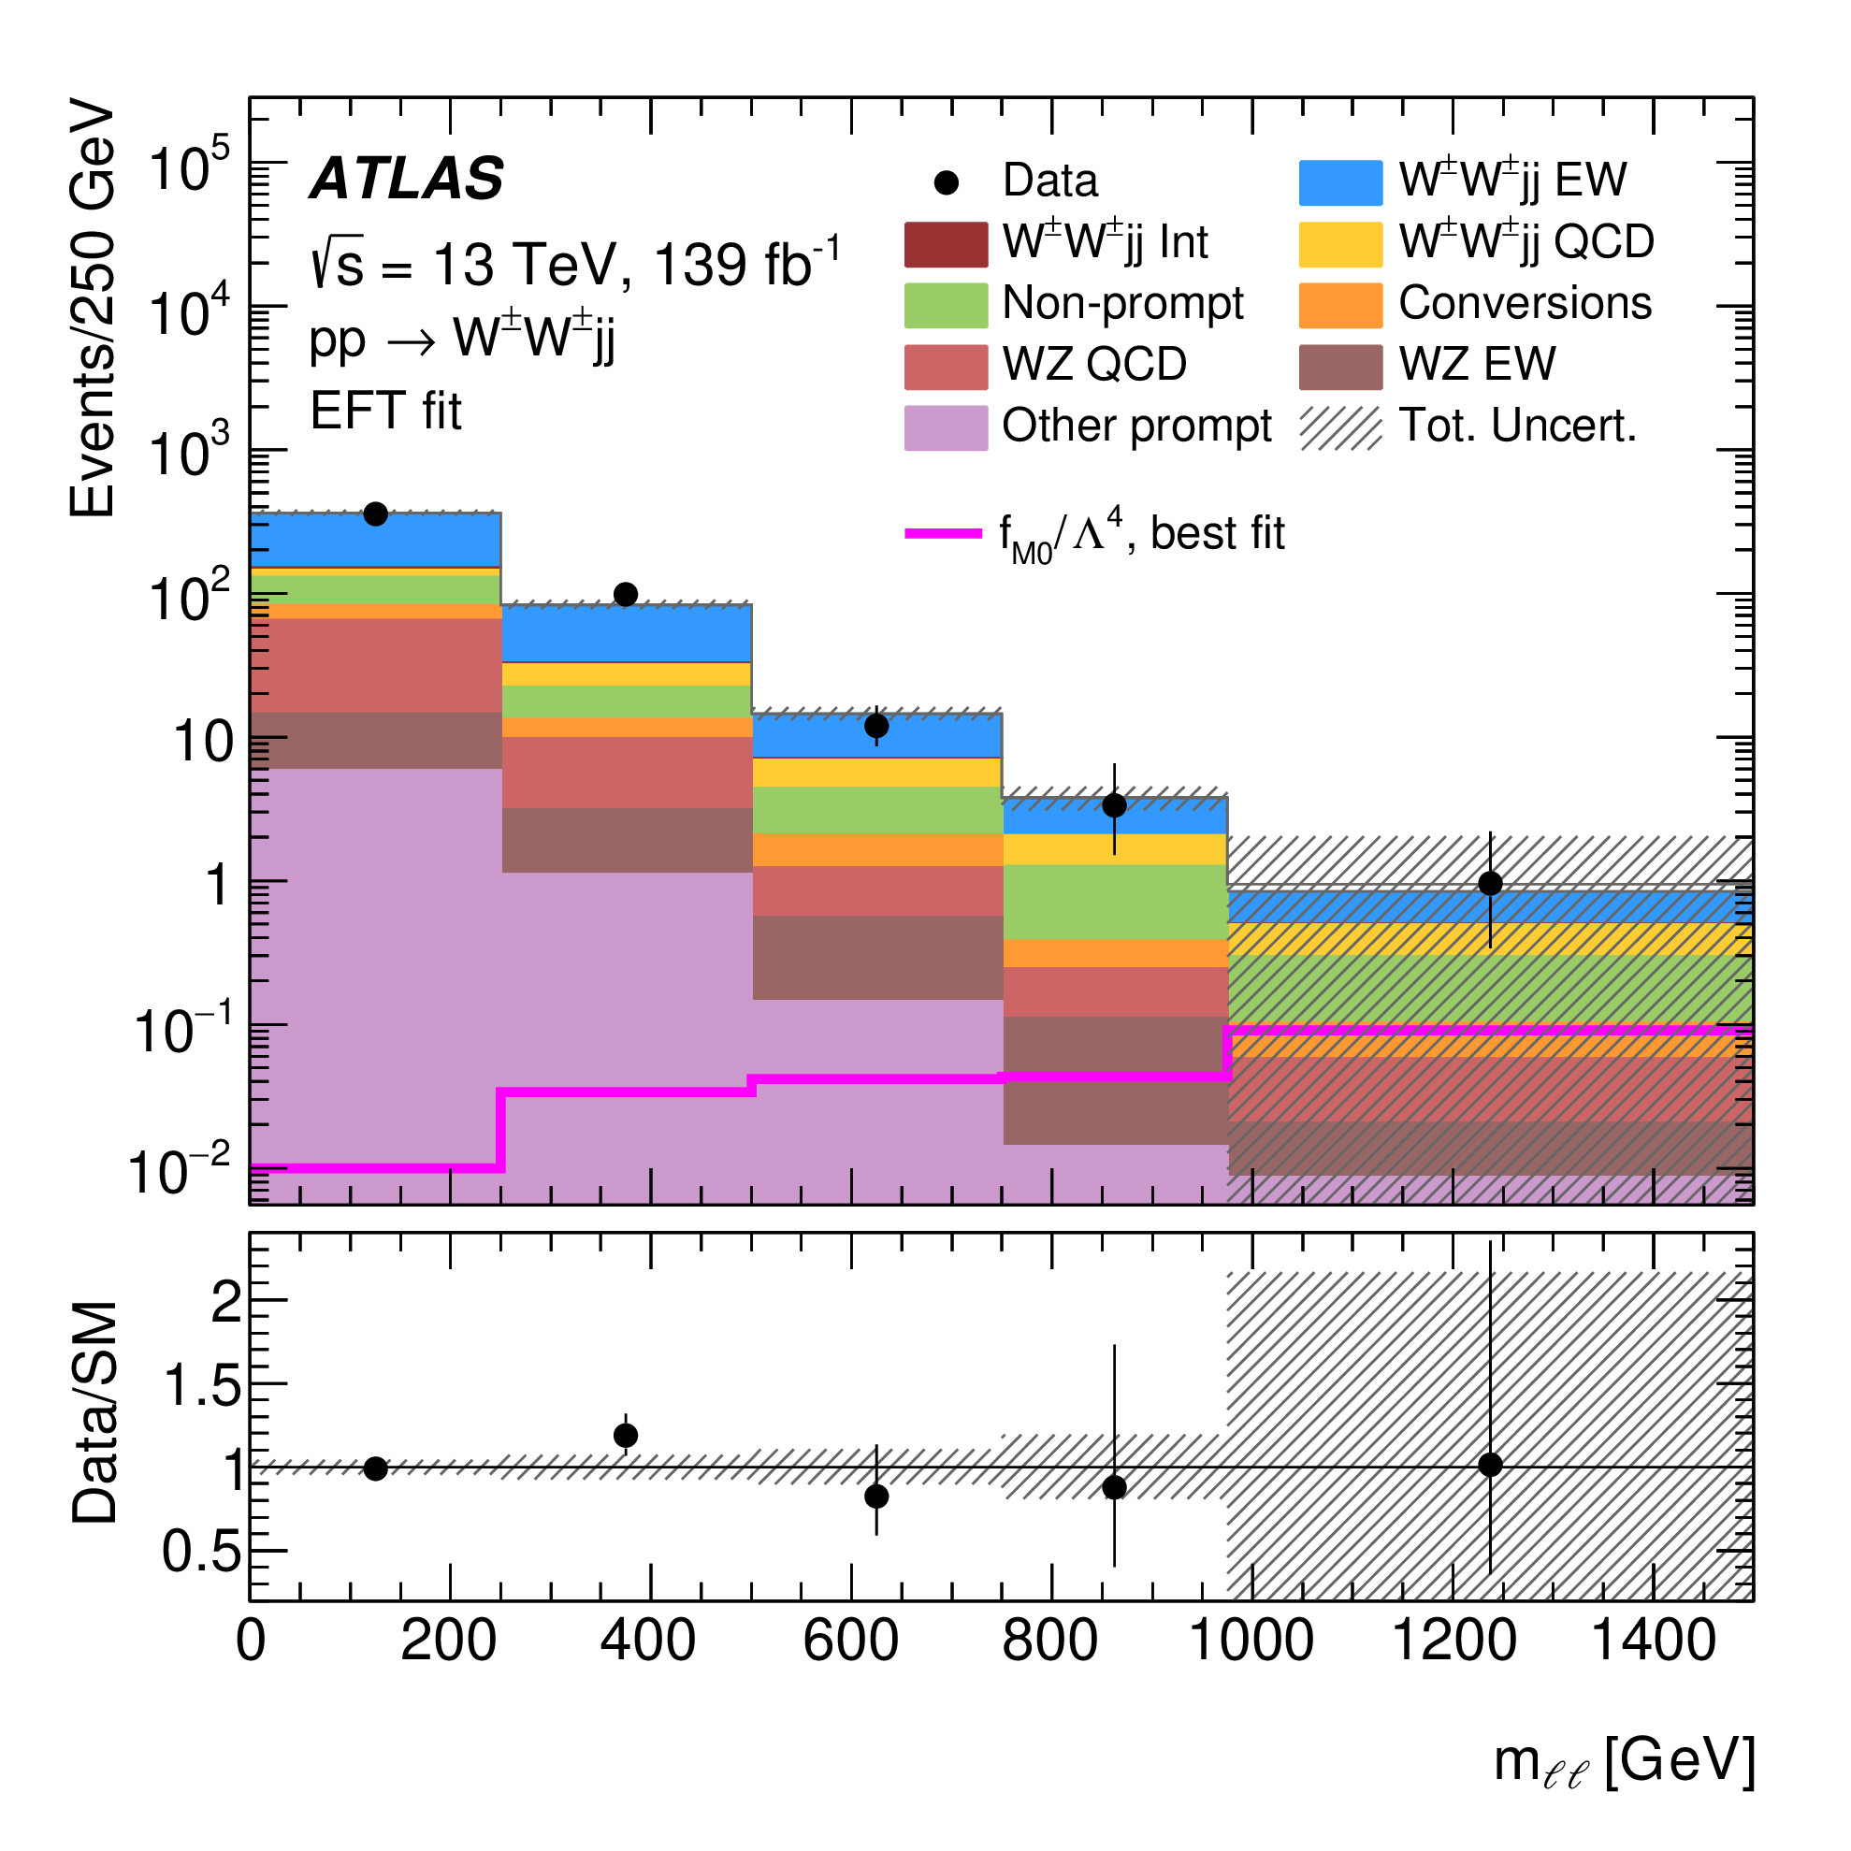
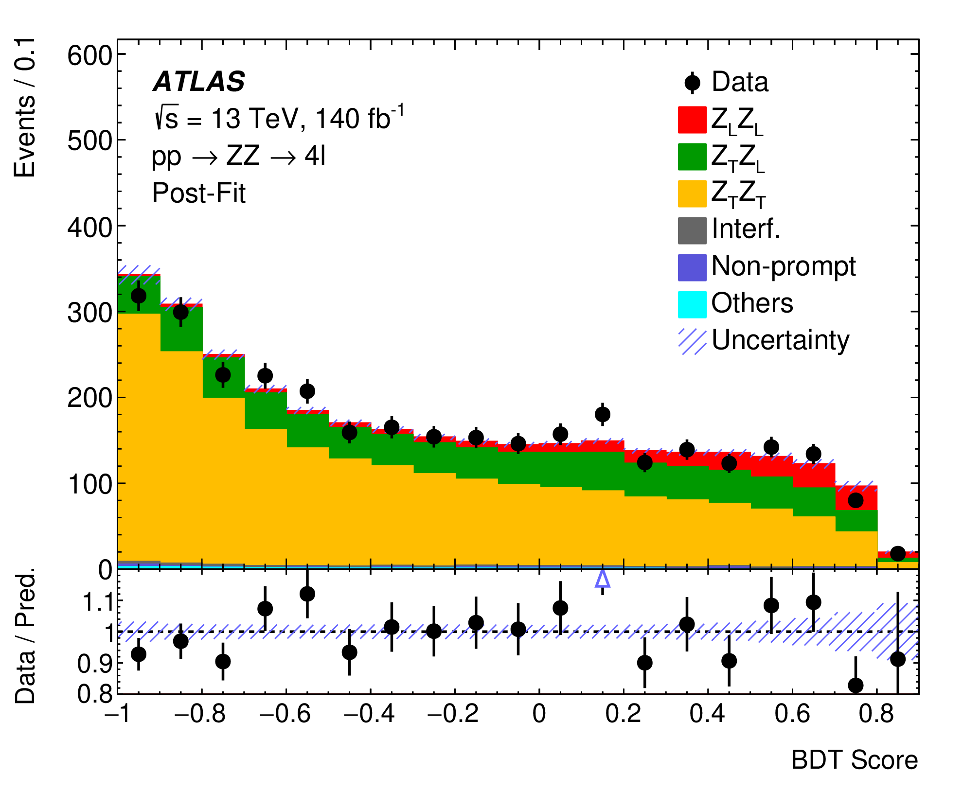
Physics strengths and highlights: ATLAS
ATLAS-UK contributes to all areas of the physics programme, from SM precision measurements to Higgs studies and searches for new physics:
  Within the period 01/2021-12/2023, out of the 255 papers released by ATLAS, 50% had UK members contributing, and 25% had UK leadership (source: glance).
  Strong support to tasks crucial for optimising and measuring physics object performance and dedicated involvement in computing and software
SM precision measurements
Multi-boson measurements
Evidence of longitudinally polarised vector bosons (ZZ to 4l)
Same-sign WWjj in VBF
W boson mass, and first width measurement at the LHC
JHEP 04 (2024) 026
2403.15085
JHEP 12 (2023) 107
Birmingham, Liverpool
Manchester
Warwick

Slide 10
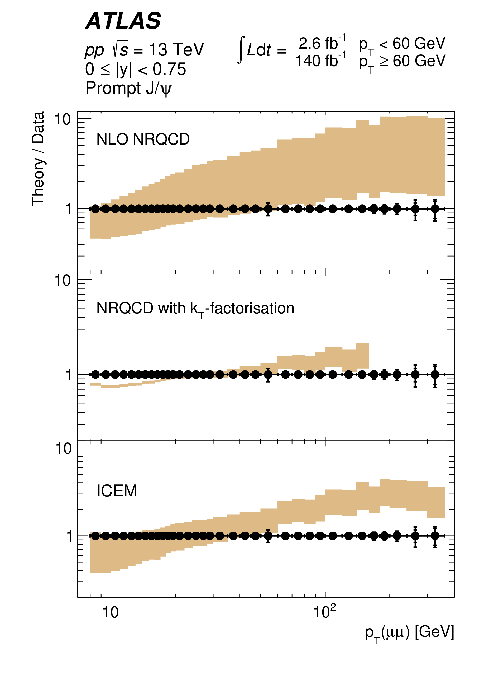
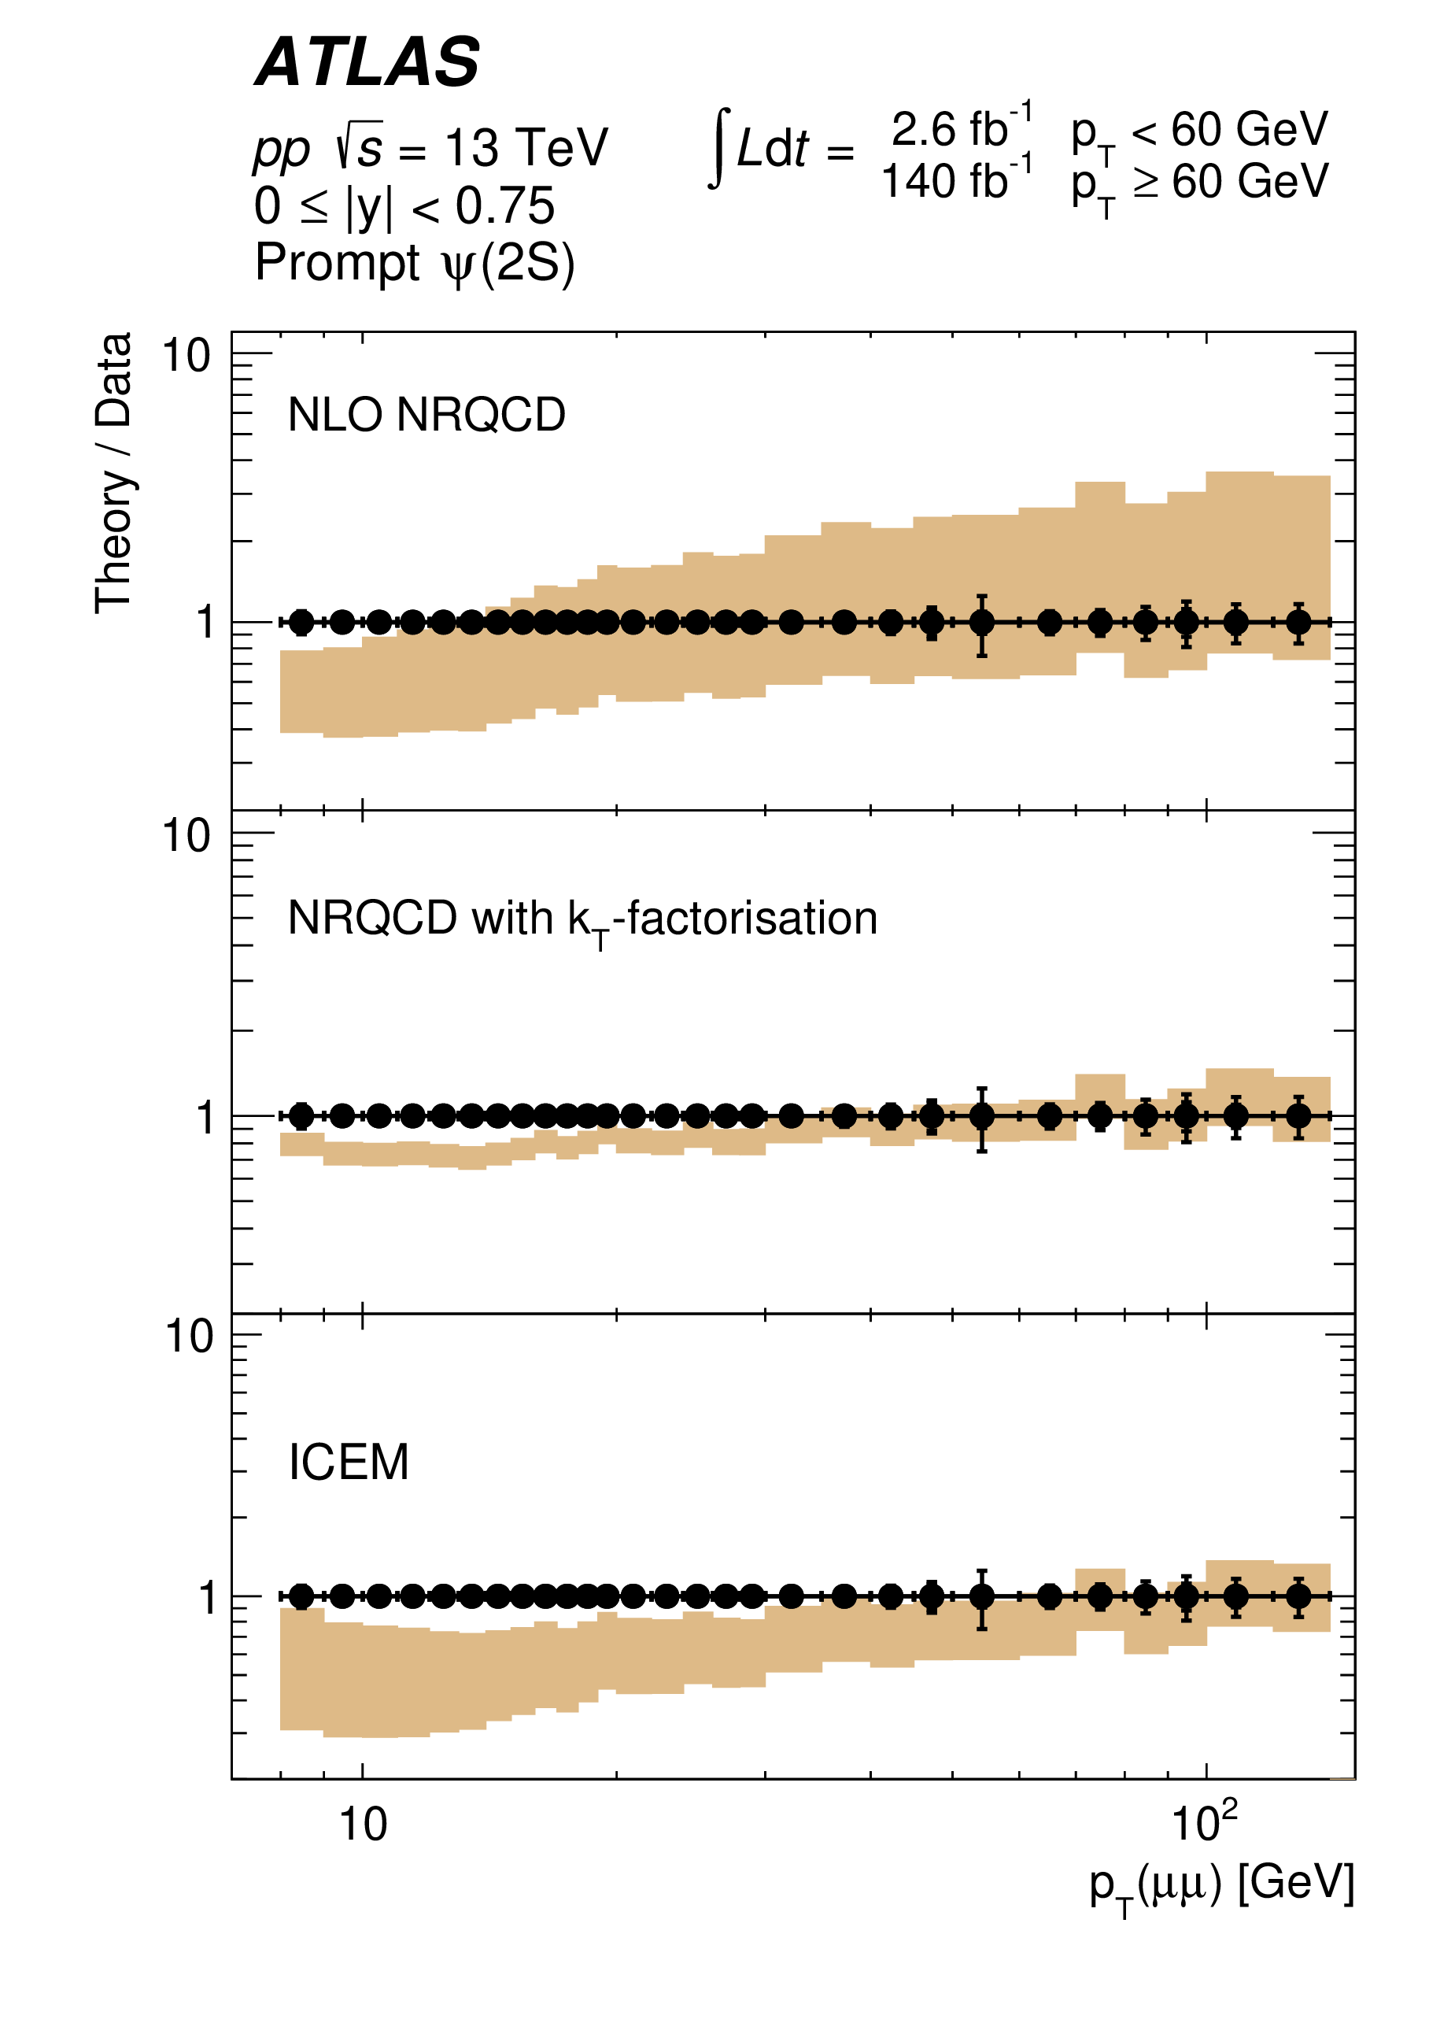
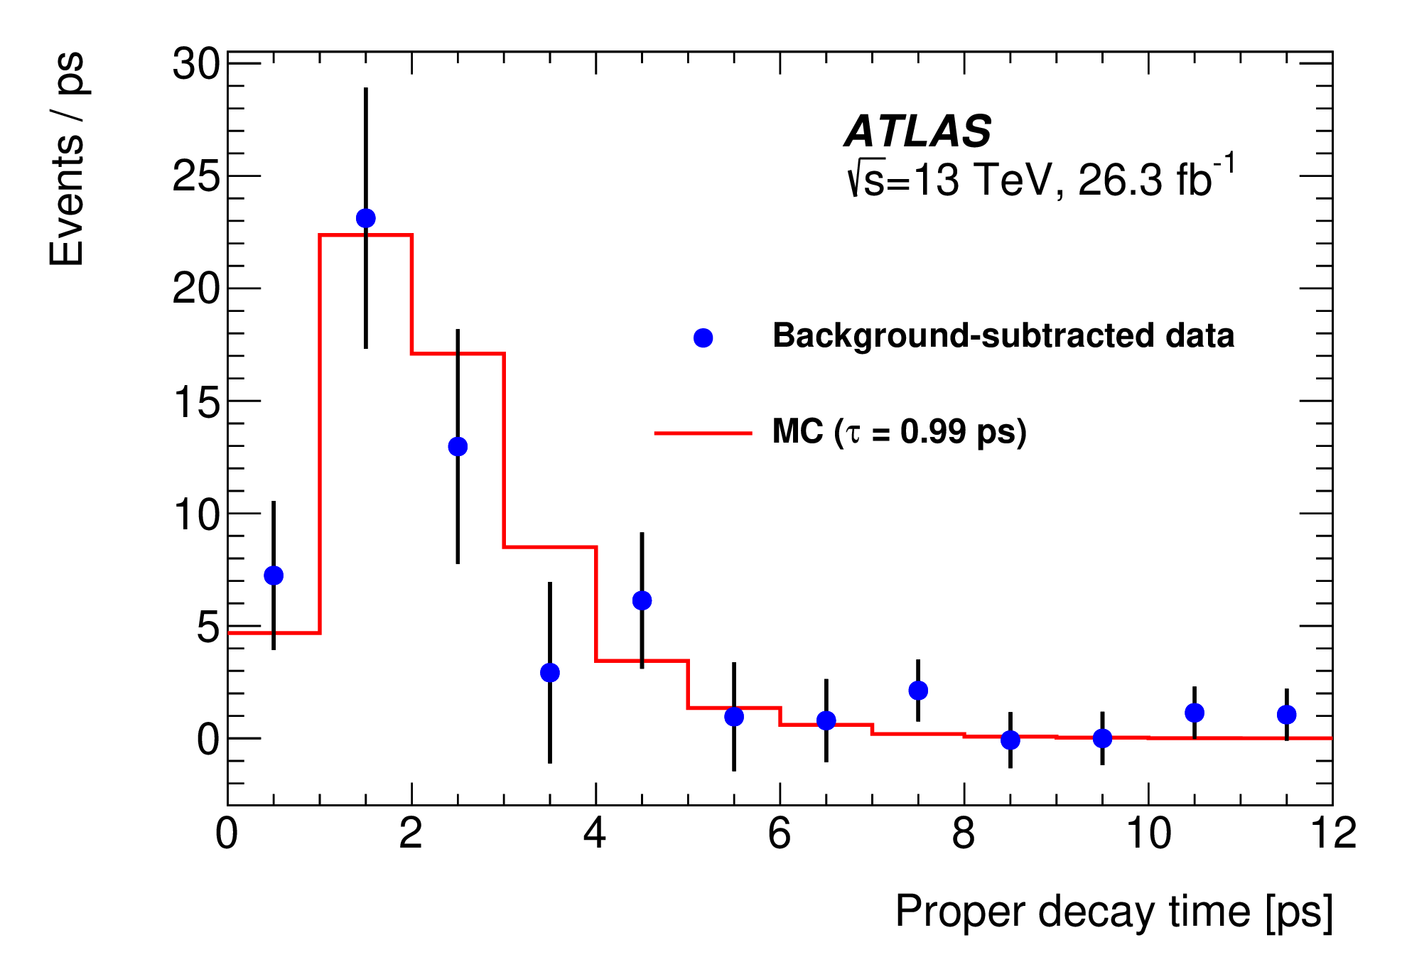
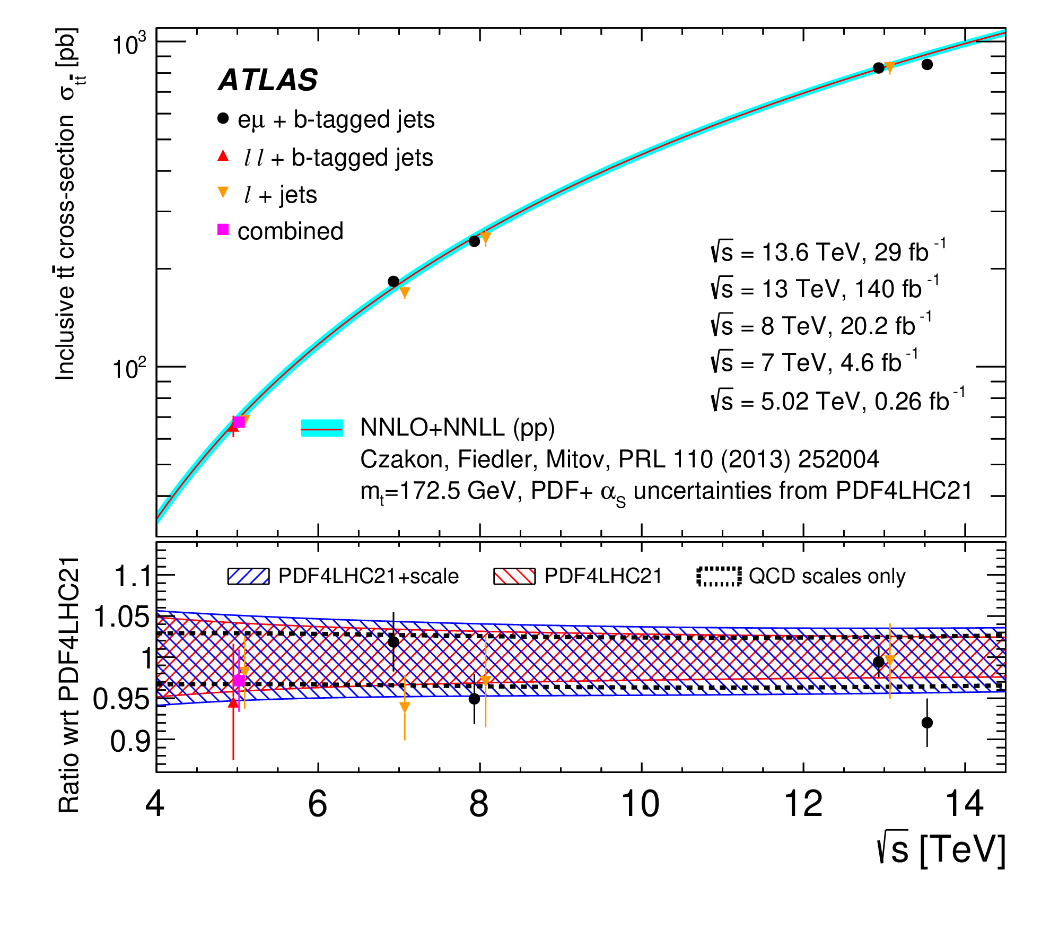
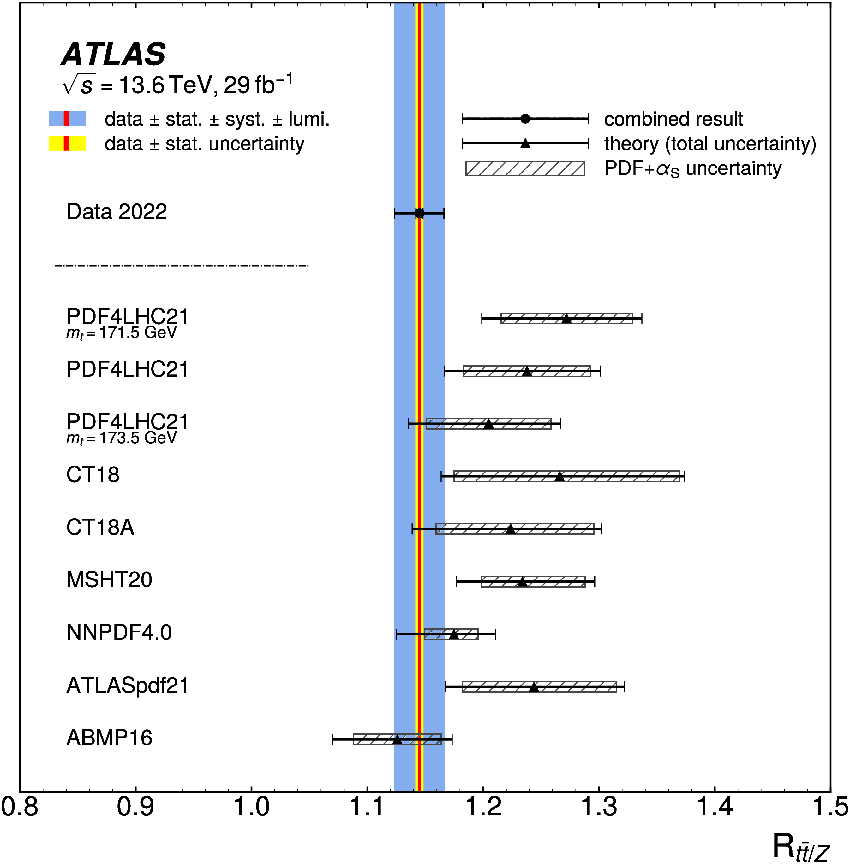
Highlights: ATLAS B and Top physics
B physics: UK-led flagship analyses such as B_{s}⁰ → μ+μ− effective lifetime and measurements of the production cross-sections of J/ψ and ψ(2S) mesons (widest momenta range to date).
Top physics:
  Run 3 top-pair cross section and ratio with Z production cross section
Eur. Phys. J. C 84 (2024) 169
J/ψ
ψ(2S)
JHEP 09 (2023) 199
Lancaster, RAL
Sussex
  Strong involvement in top physics from the UK (UK sub-group and group conveners for long time)
Birmingham, Edinburgh, Lancaster, QMUL, Manchester, RHUL, Sussex
Phys. Lett. B 848 (2024) 138376
Birmingham, Edinburgh, Lancaster, QMUL, Sussex

Slide 11
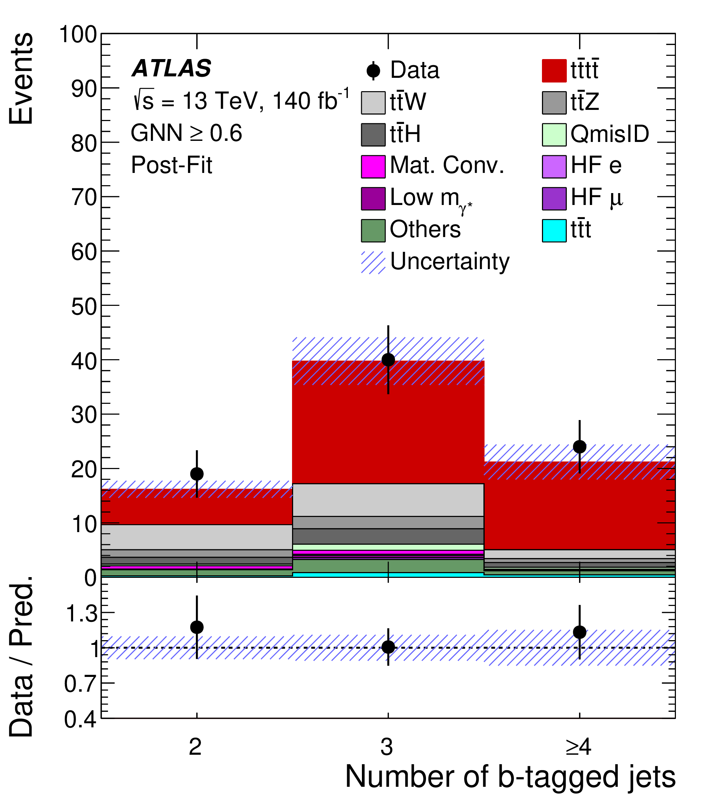
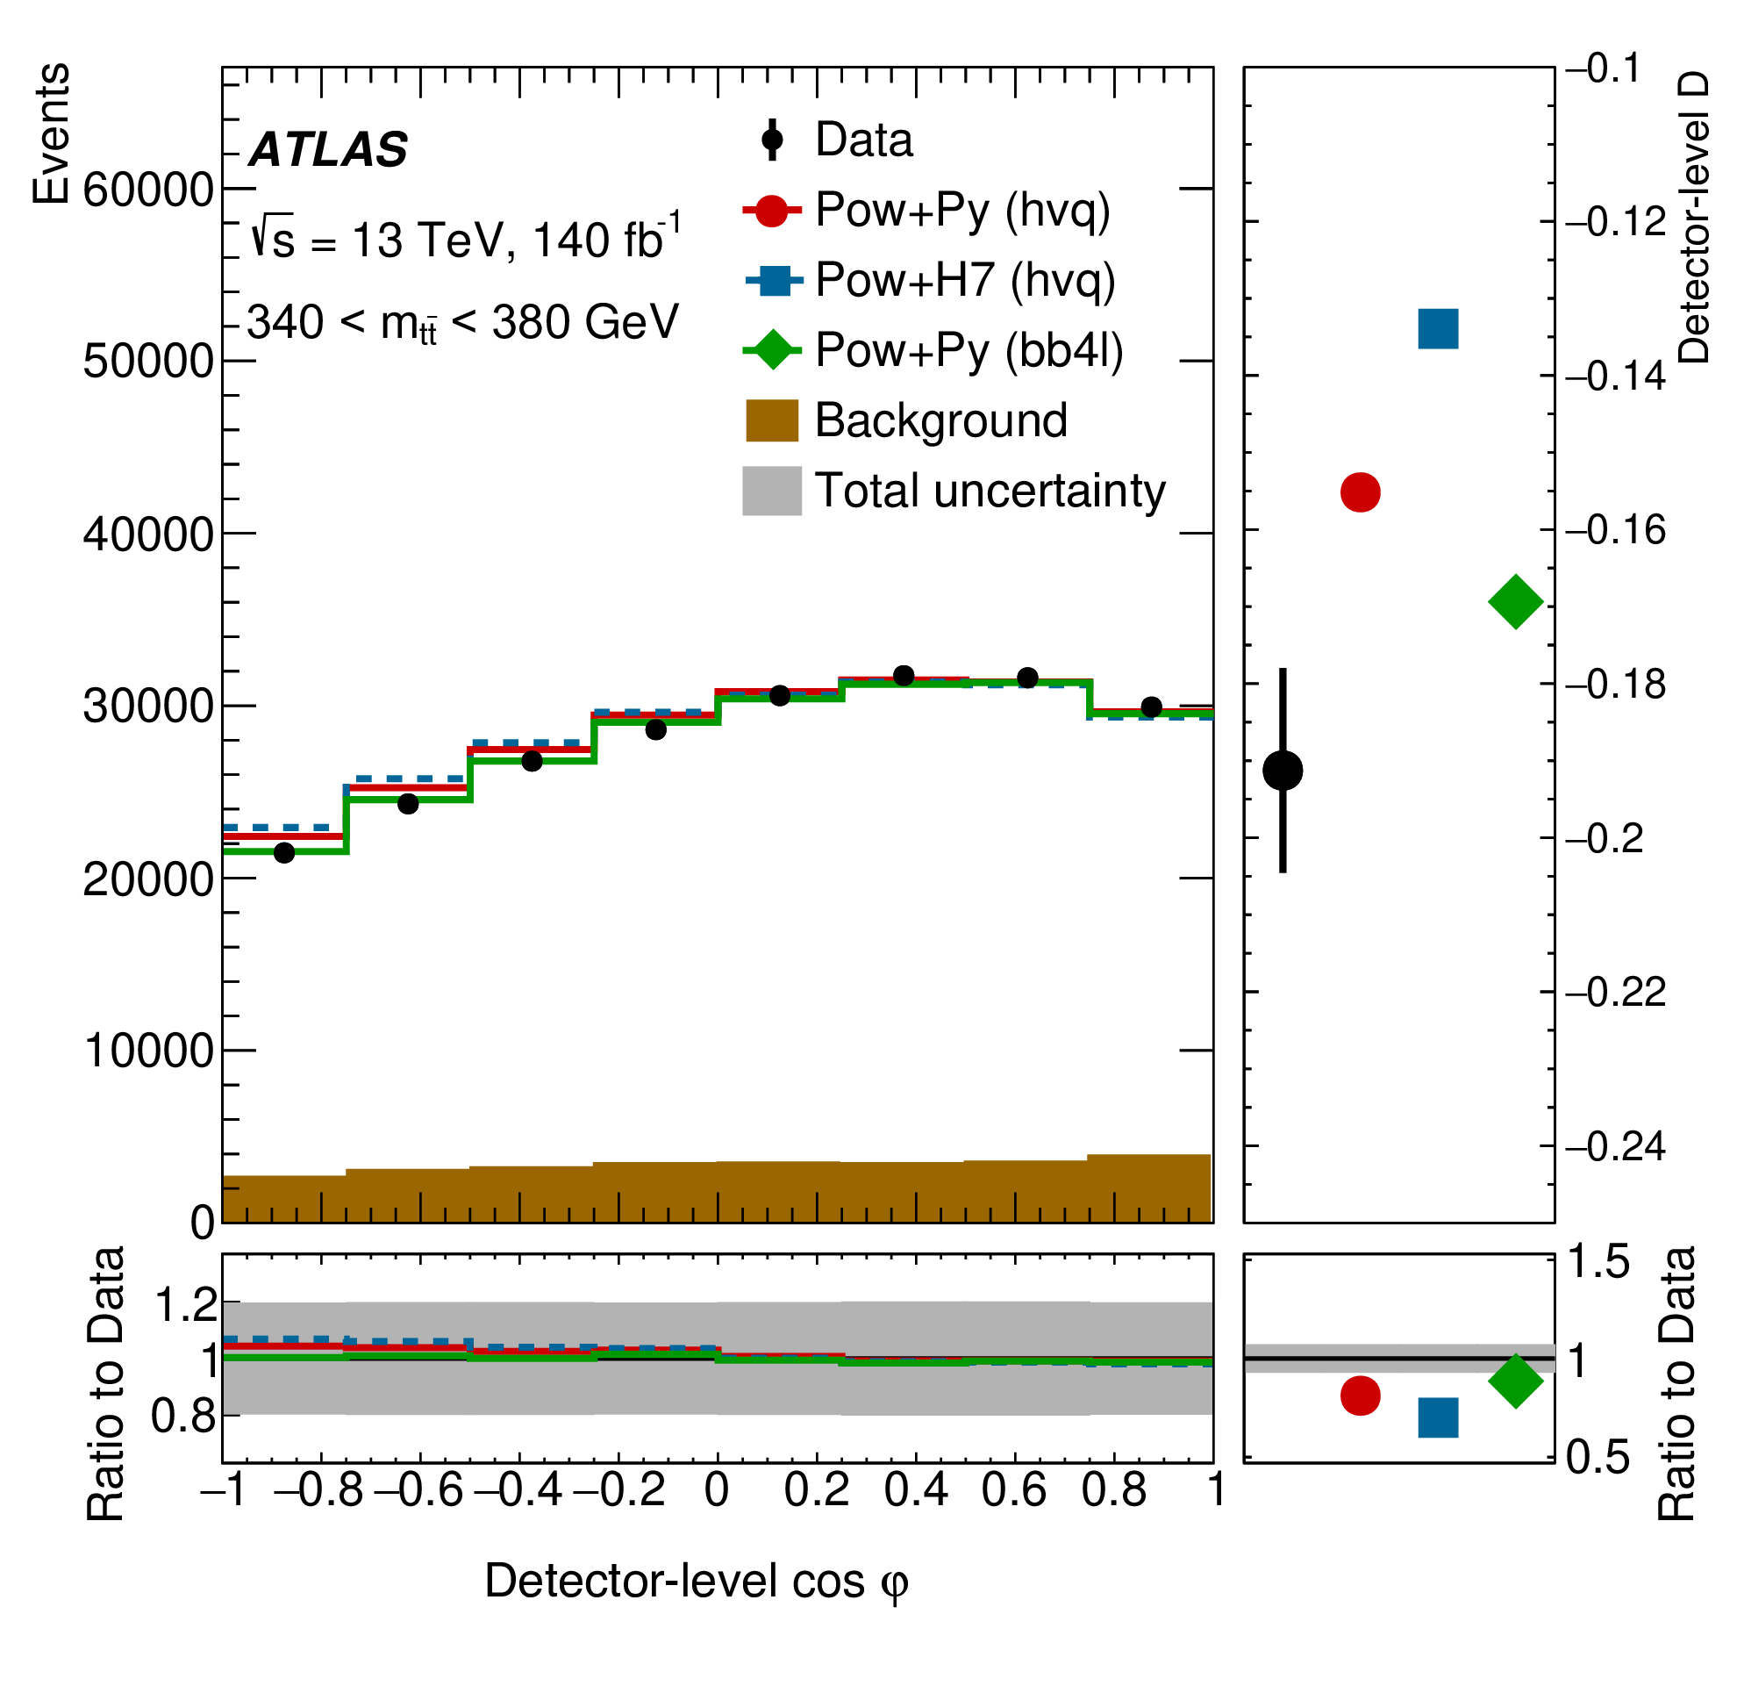
Highlights: ATLAS B and Top physics
B physics: UK-led flagship analyses such as B_{s}⁰ → μ+μ− effective lifetime and measurements of the production cross-sections of J/ψ and ψ(2S) mesons (widest momenta range to date).
Top physics:
  Observation of 4-top process
  Observation of quantum entanglement
  in top-quark pairs
Eur. Phys. J. C 84 (2024) 169
J/ψ
ψ(2S)
Lancaster, RAL
JHEP 09 (2023) 199
Sussex
4-top
Entanglement in tt
Eur. Phys. J. C 83 (2023) 496
Manchester
arXiv:2311.07288
Birmingham, Glasgow, Manchester
Notes:
Spin entanglement detected from measurement of observable D, inferred from the angle between the charged leptons in their parent top- and antitop-quark rest frames.

Slide 12
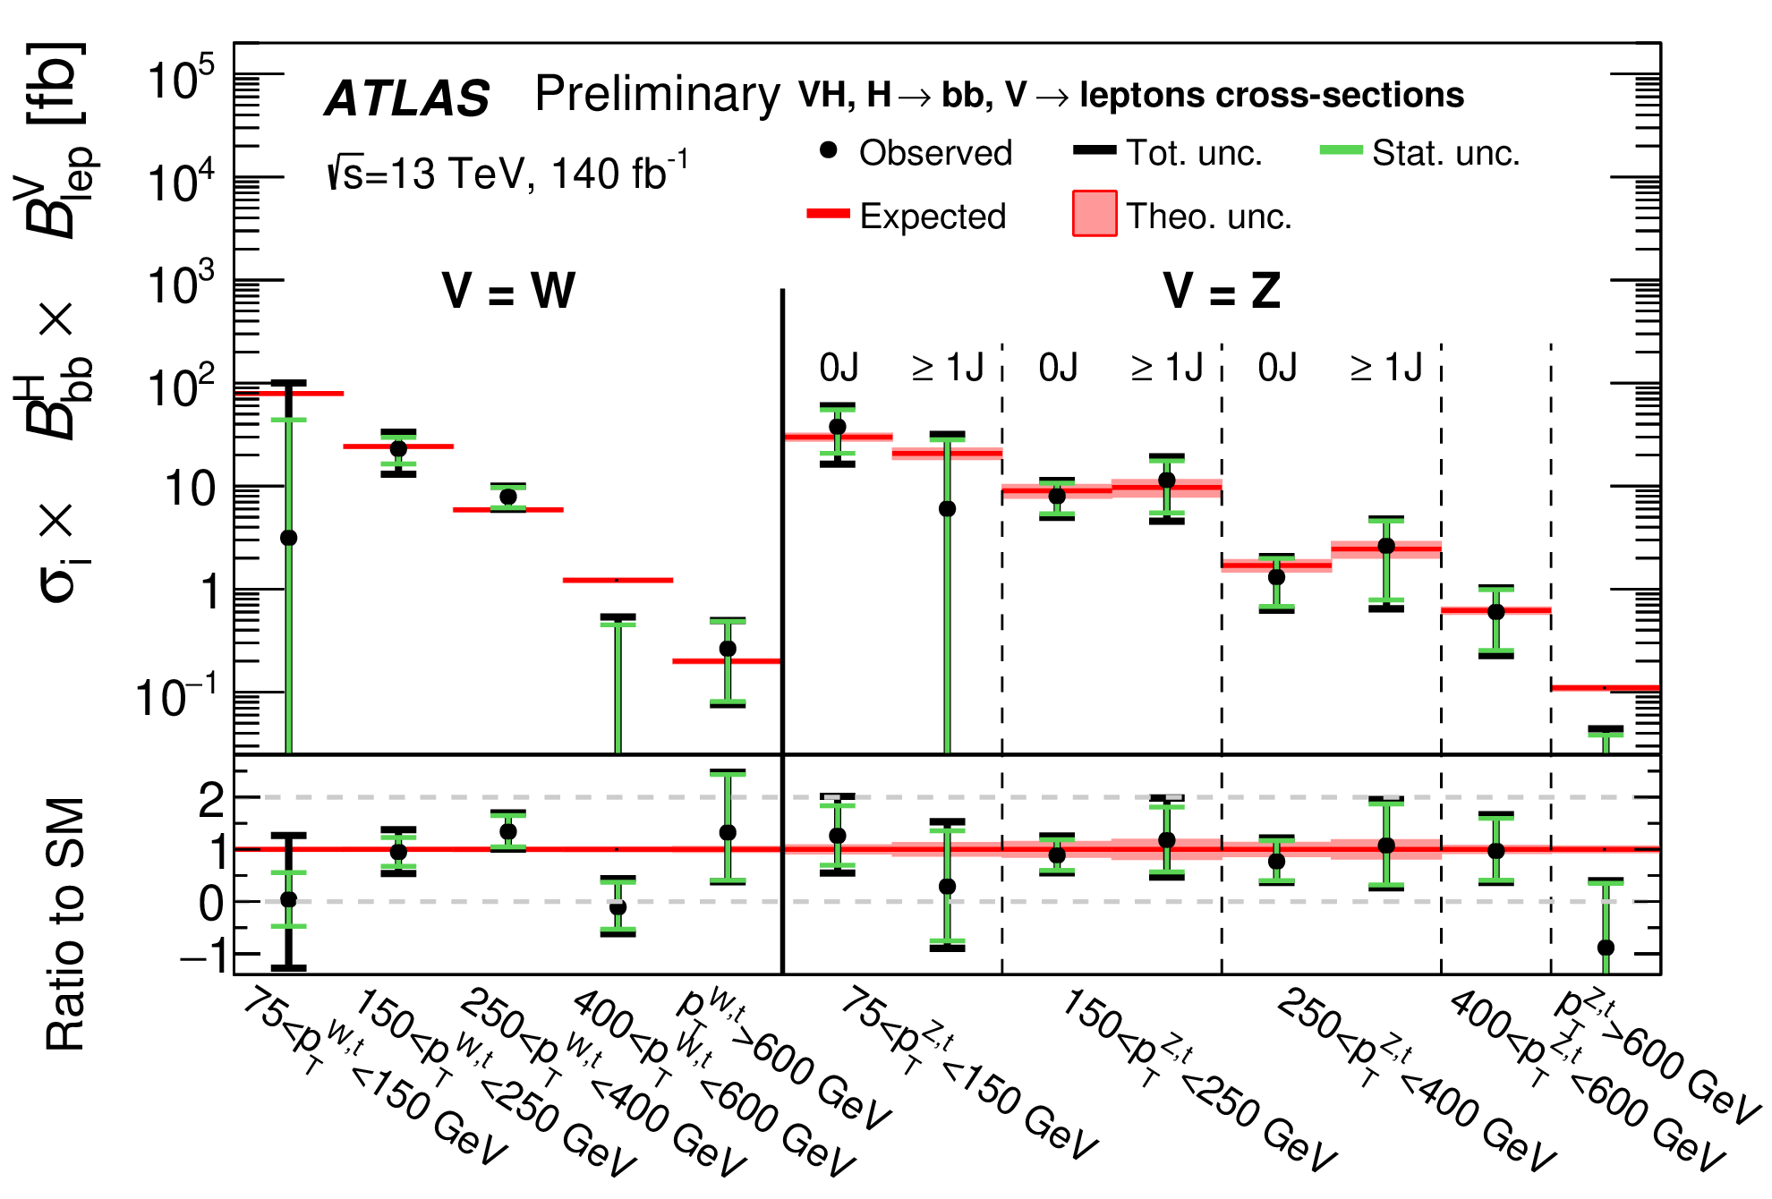
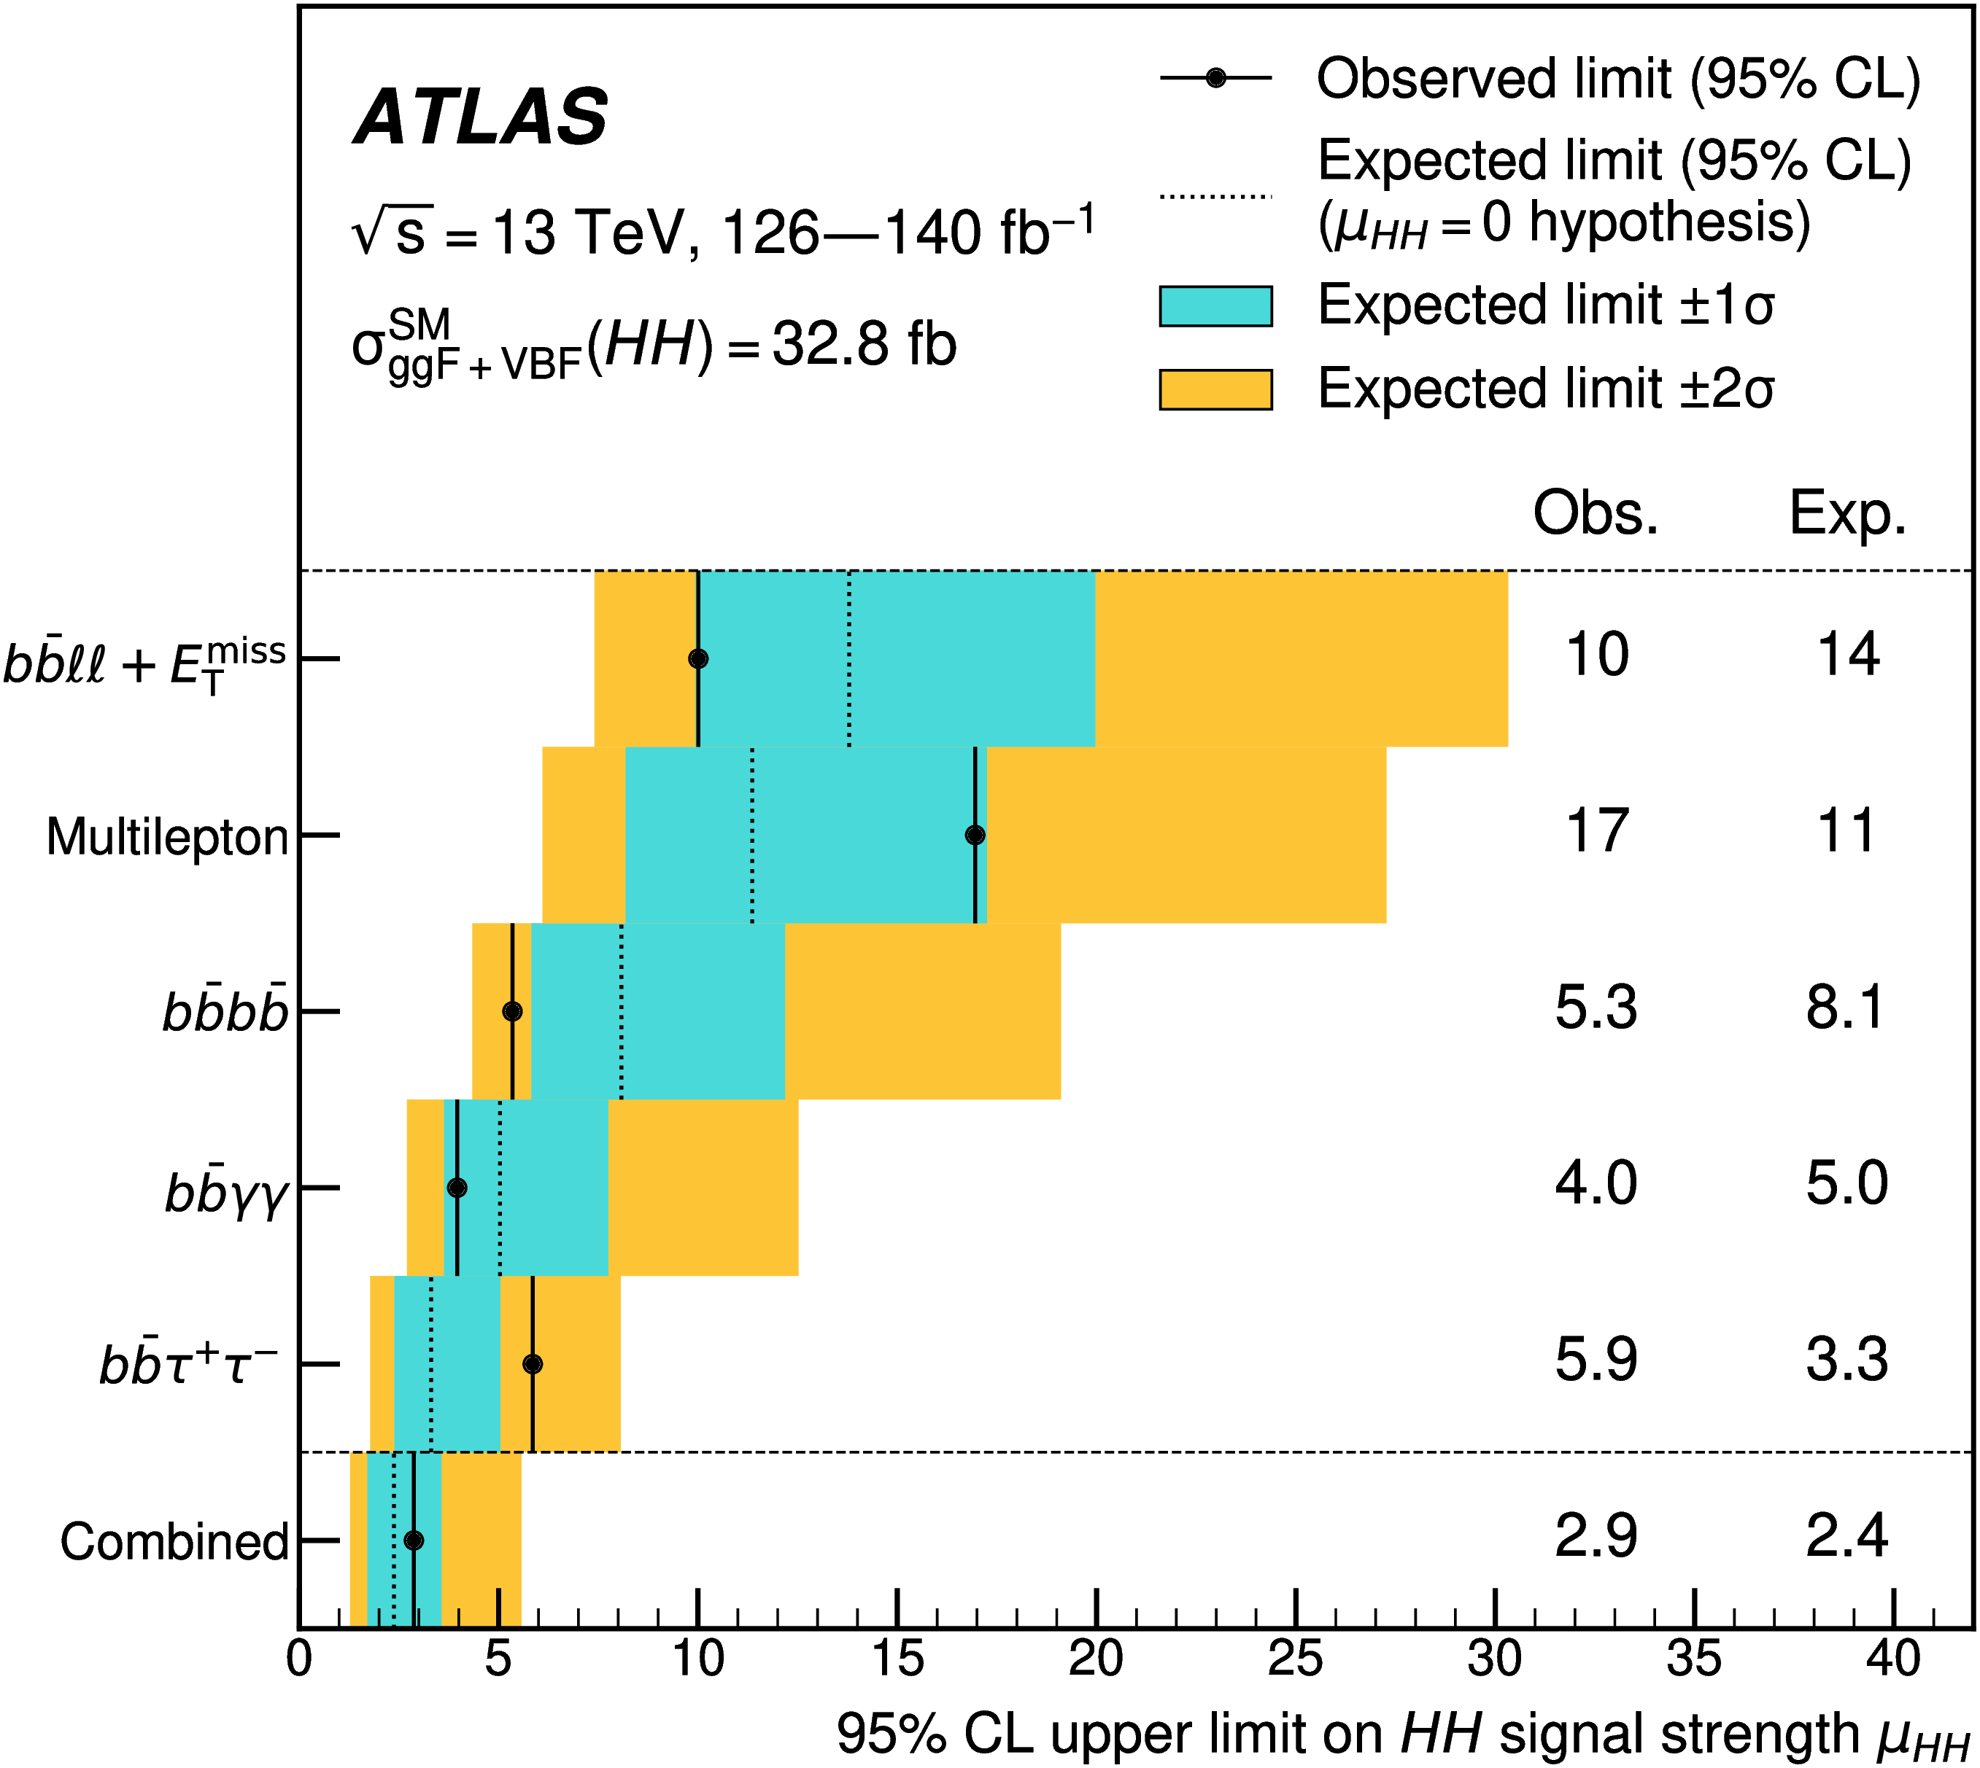
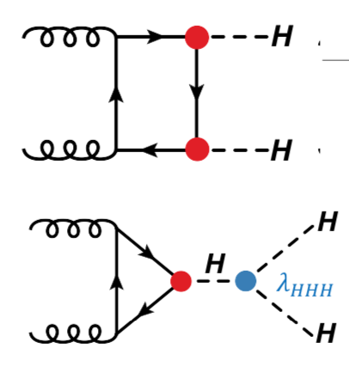
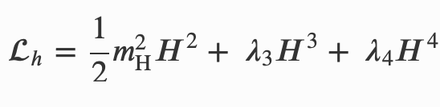
Physics highlights: Higgs physics
Simultaneous measurement of WH/ZH with Higgs to cc/bb
→ legacy of Run 2 results:
  H→bb improved by 15%, H→cc by a factor of 3.
  Cross section measurements in bins of p_{T} boson
UK leadership also in ttH; H → ττ, rare H decays
EWSB and Higgs-self coupling: a flagship analysis, with strong commitment from UK institutes in Run 2 and now in Run 3 → Focus mostly on Run-3 bb and ττ decays (4b, bbττ,bbll)
ATLAS-CONF-2024-010
Birmingham, Glasgow, Liverpool, QMUL, Oxford, Sheffield, UCL
Birmingham, Cambridge, Glasgow, Liverpool, Oxford, RHUL, UCL, Warwick
Self-coupling
coupling modifier parameters

Slide 13
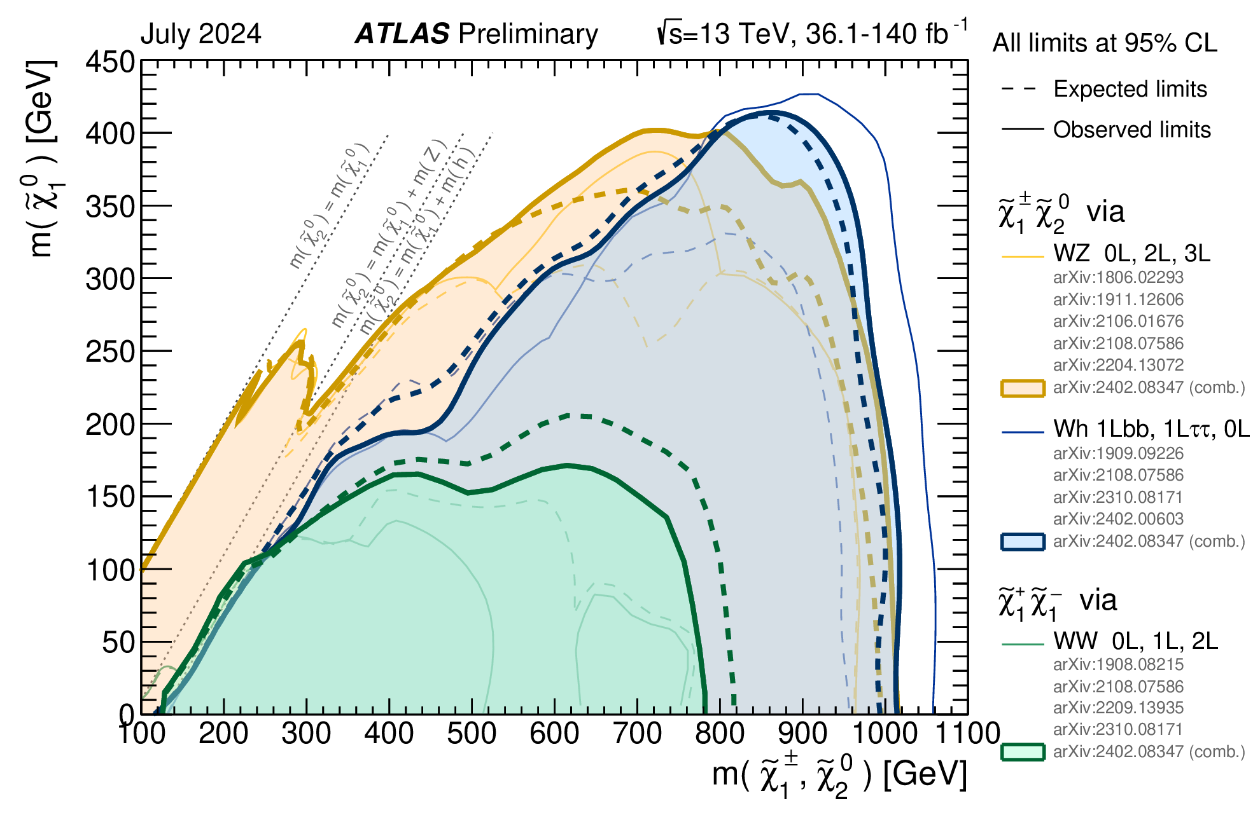
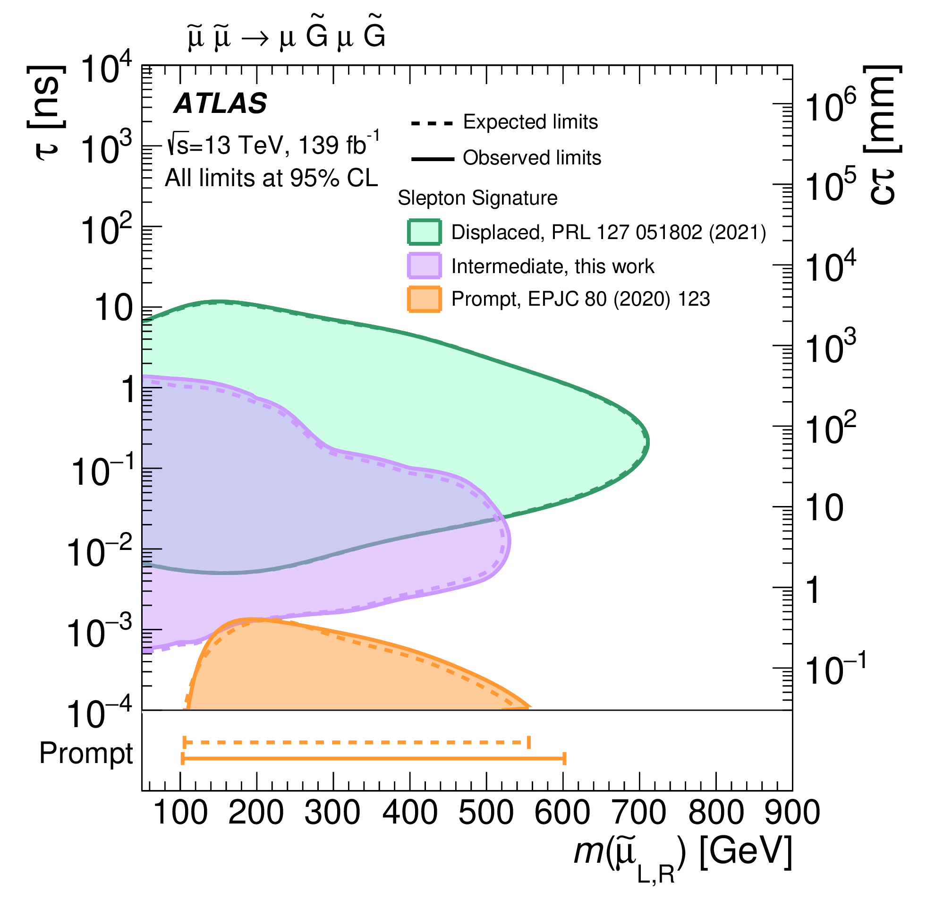
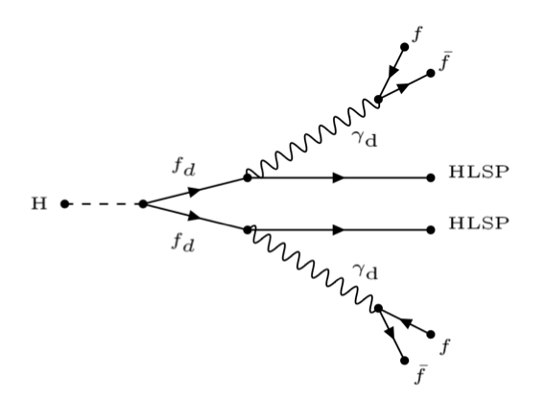
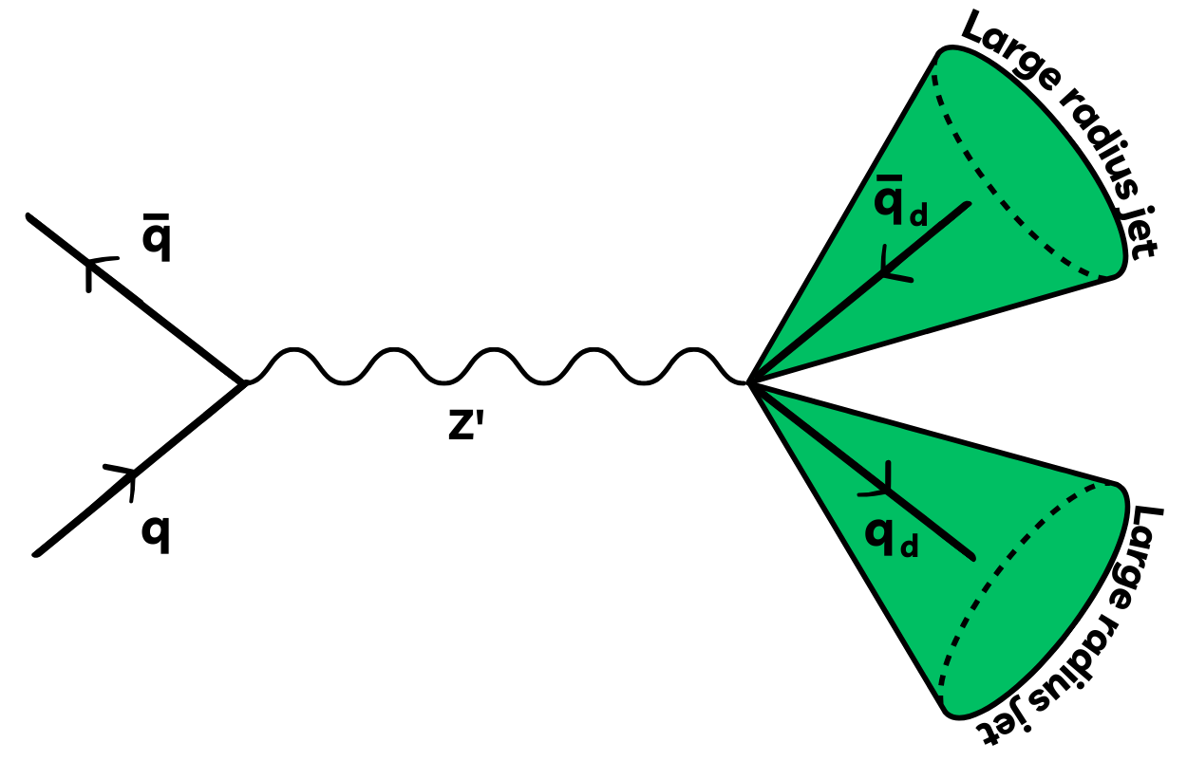
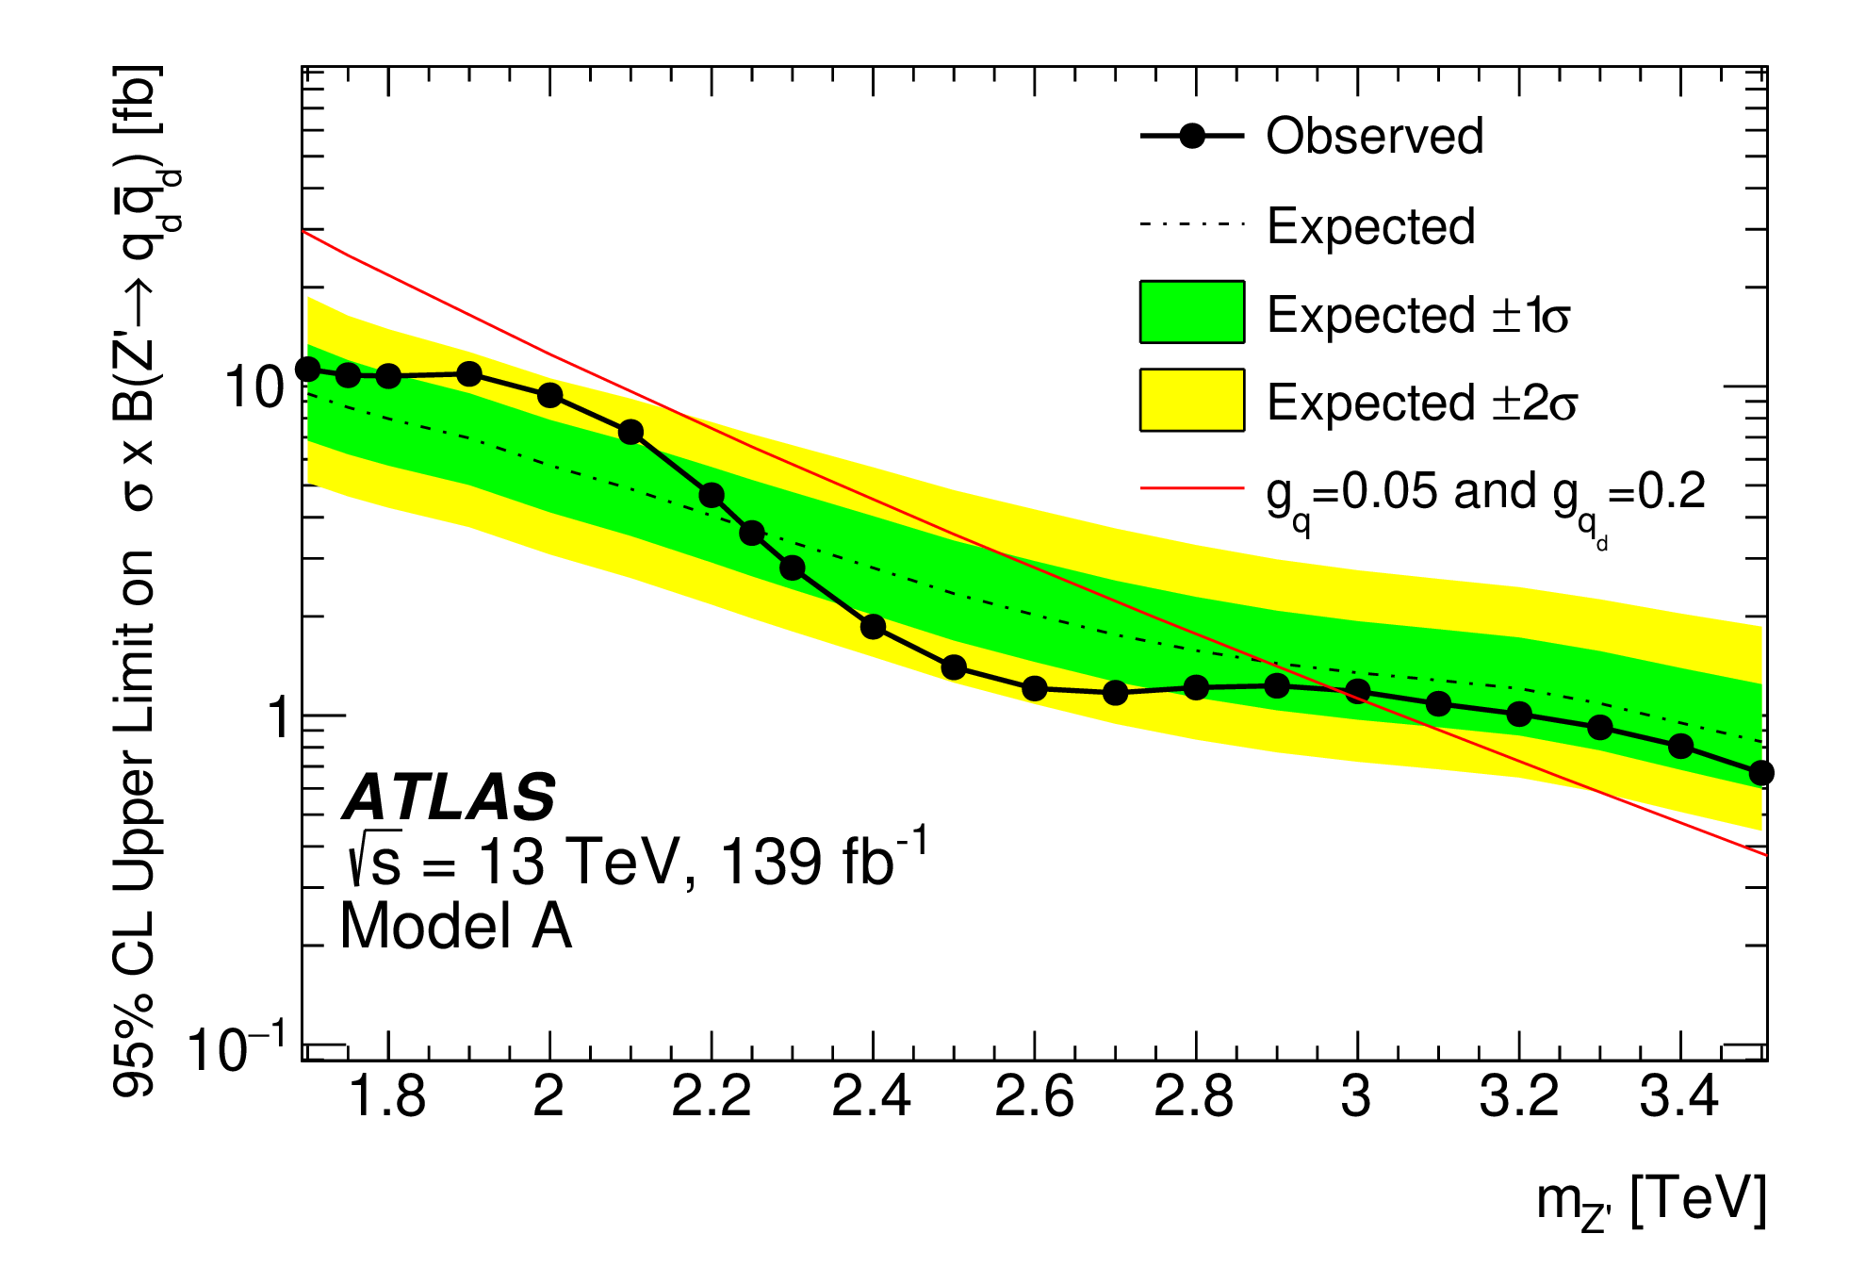
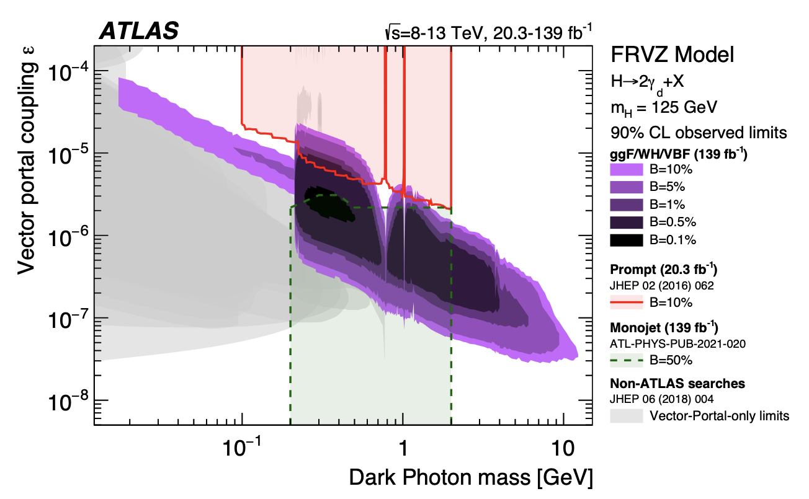
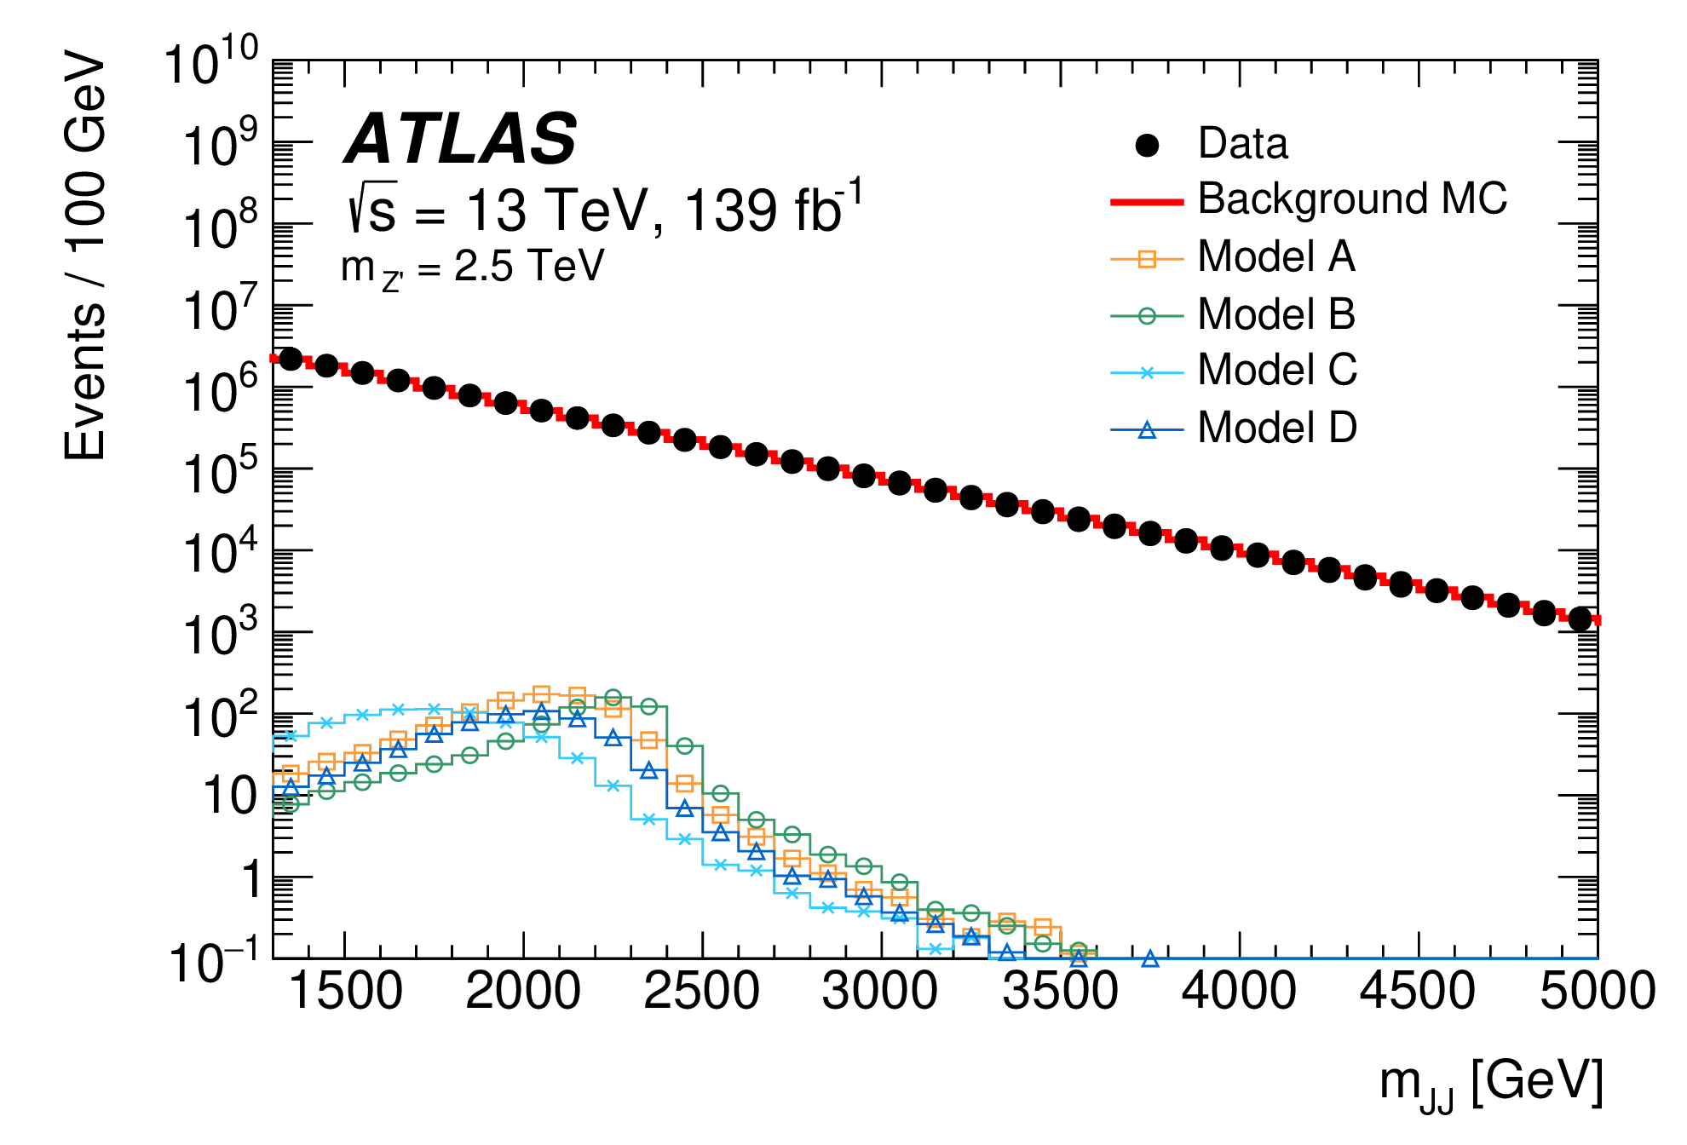
Highlights: ATLAS Searches for new physics
Vast programme of BSM searches for supersymmetry, leptoquarks, exotic Higgs boson decays, long-lived particles (LLP) and other unconventional signatures (‘dark jets’ or ‘lepton-jets’) predicted in dark-sectors.
SUSY:
  Since Run-1, several UK-led searches for top and bottom squarks, charginos and neutralinos, and sleptons
Phys. Lett. B 846 (2023) 138172
Lancaster
Cambridge, Edinburgh, Liverpool, Oxford, QMUL, Sheffield, Sussex
millimeter-displaced slepton
Dark-matter and hidden sectors → LLP
JHEP 02 (2024) 128
Manchester, QMUL
Eur. Phys. J. C 84 (2024) 719
Higgs decaying through dark photons
→use lepton-jets
Dark jets
Edinburgh, Liverpool

Slide 14

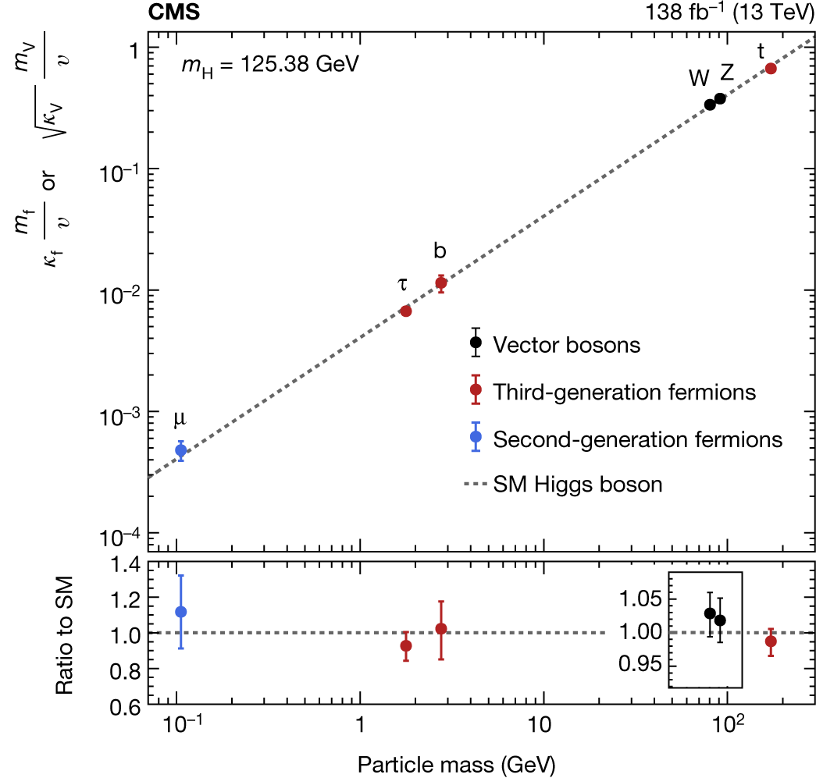
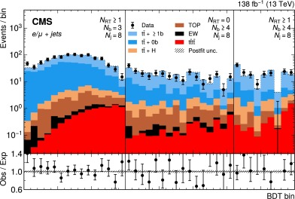
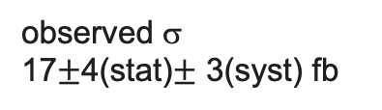
Physics strengths and highlights: CMS
UK-CMS is strongly engaged in top physics (Brunel, Bristol, RAL), Higgs physics (Imperial), and searches for new physics (Bristol, Imperial, RAL) including SUSY, dark matter, extended Higgs-sectors, long-lived particles and new resonances
  Thanks also to huge advancement in techniques and close collaboration with UK phenomenologists
Top physics: long-standing contributions on top-pair and single-top cross sections, top MC modelling etc.
Recent highlight – 4-top process
  UK part of first evidence of this important process (later superseded by observation)
Higgs physics: strongly engaged in H→γγ, ττ, e⁺e⁻, the UK has also led every single-Higgs combination effort since Higgs discovery
PLB.2023.138076
Bristol, Brunel
observed σ 17$±$4(stat)$±$ 3(syst) fb
Nature 607, pages60–68 (2022)
(featuring with ATLAS)
Imperial
13/09/2024

Slide 15
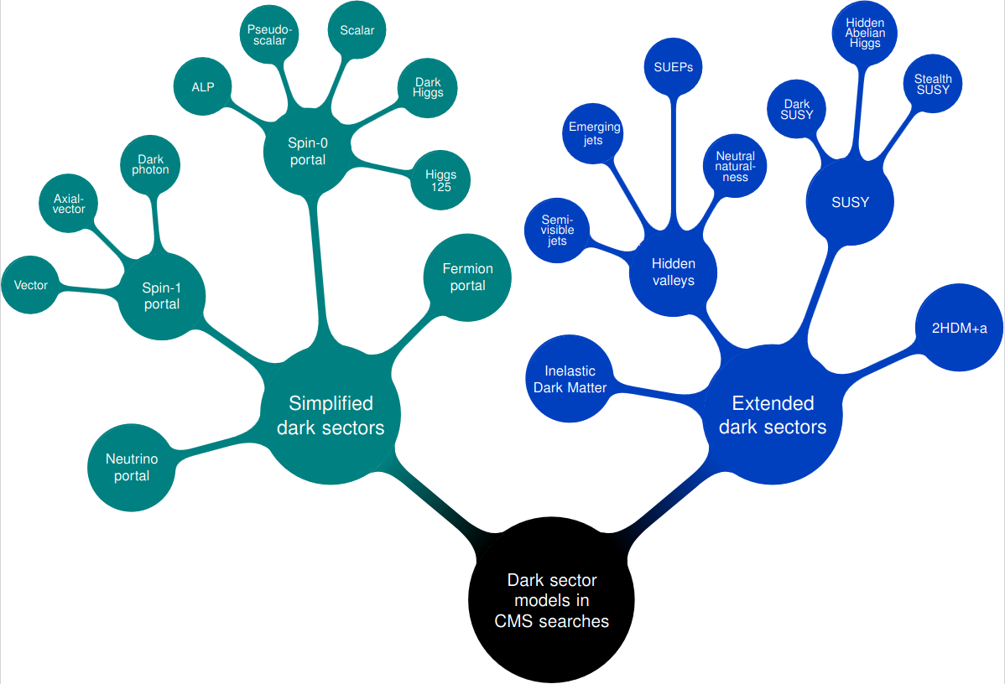
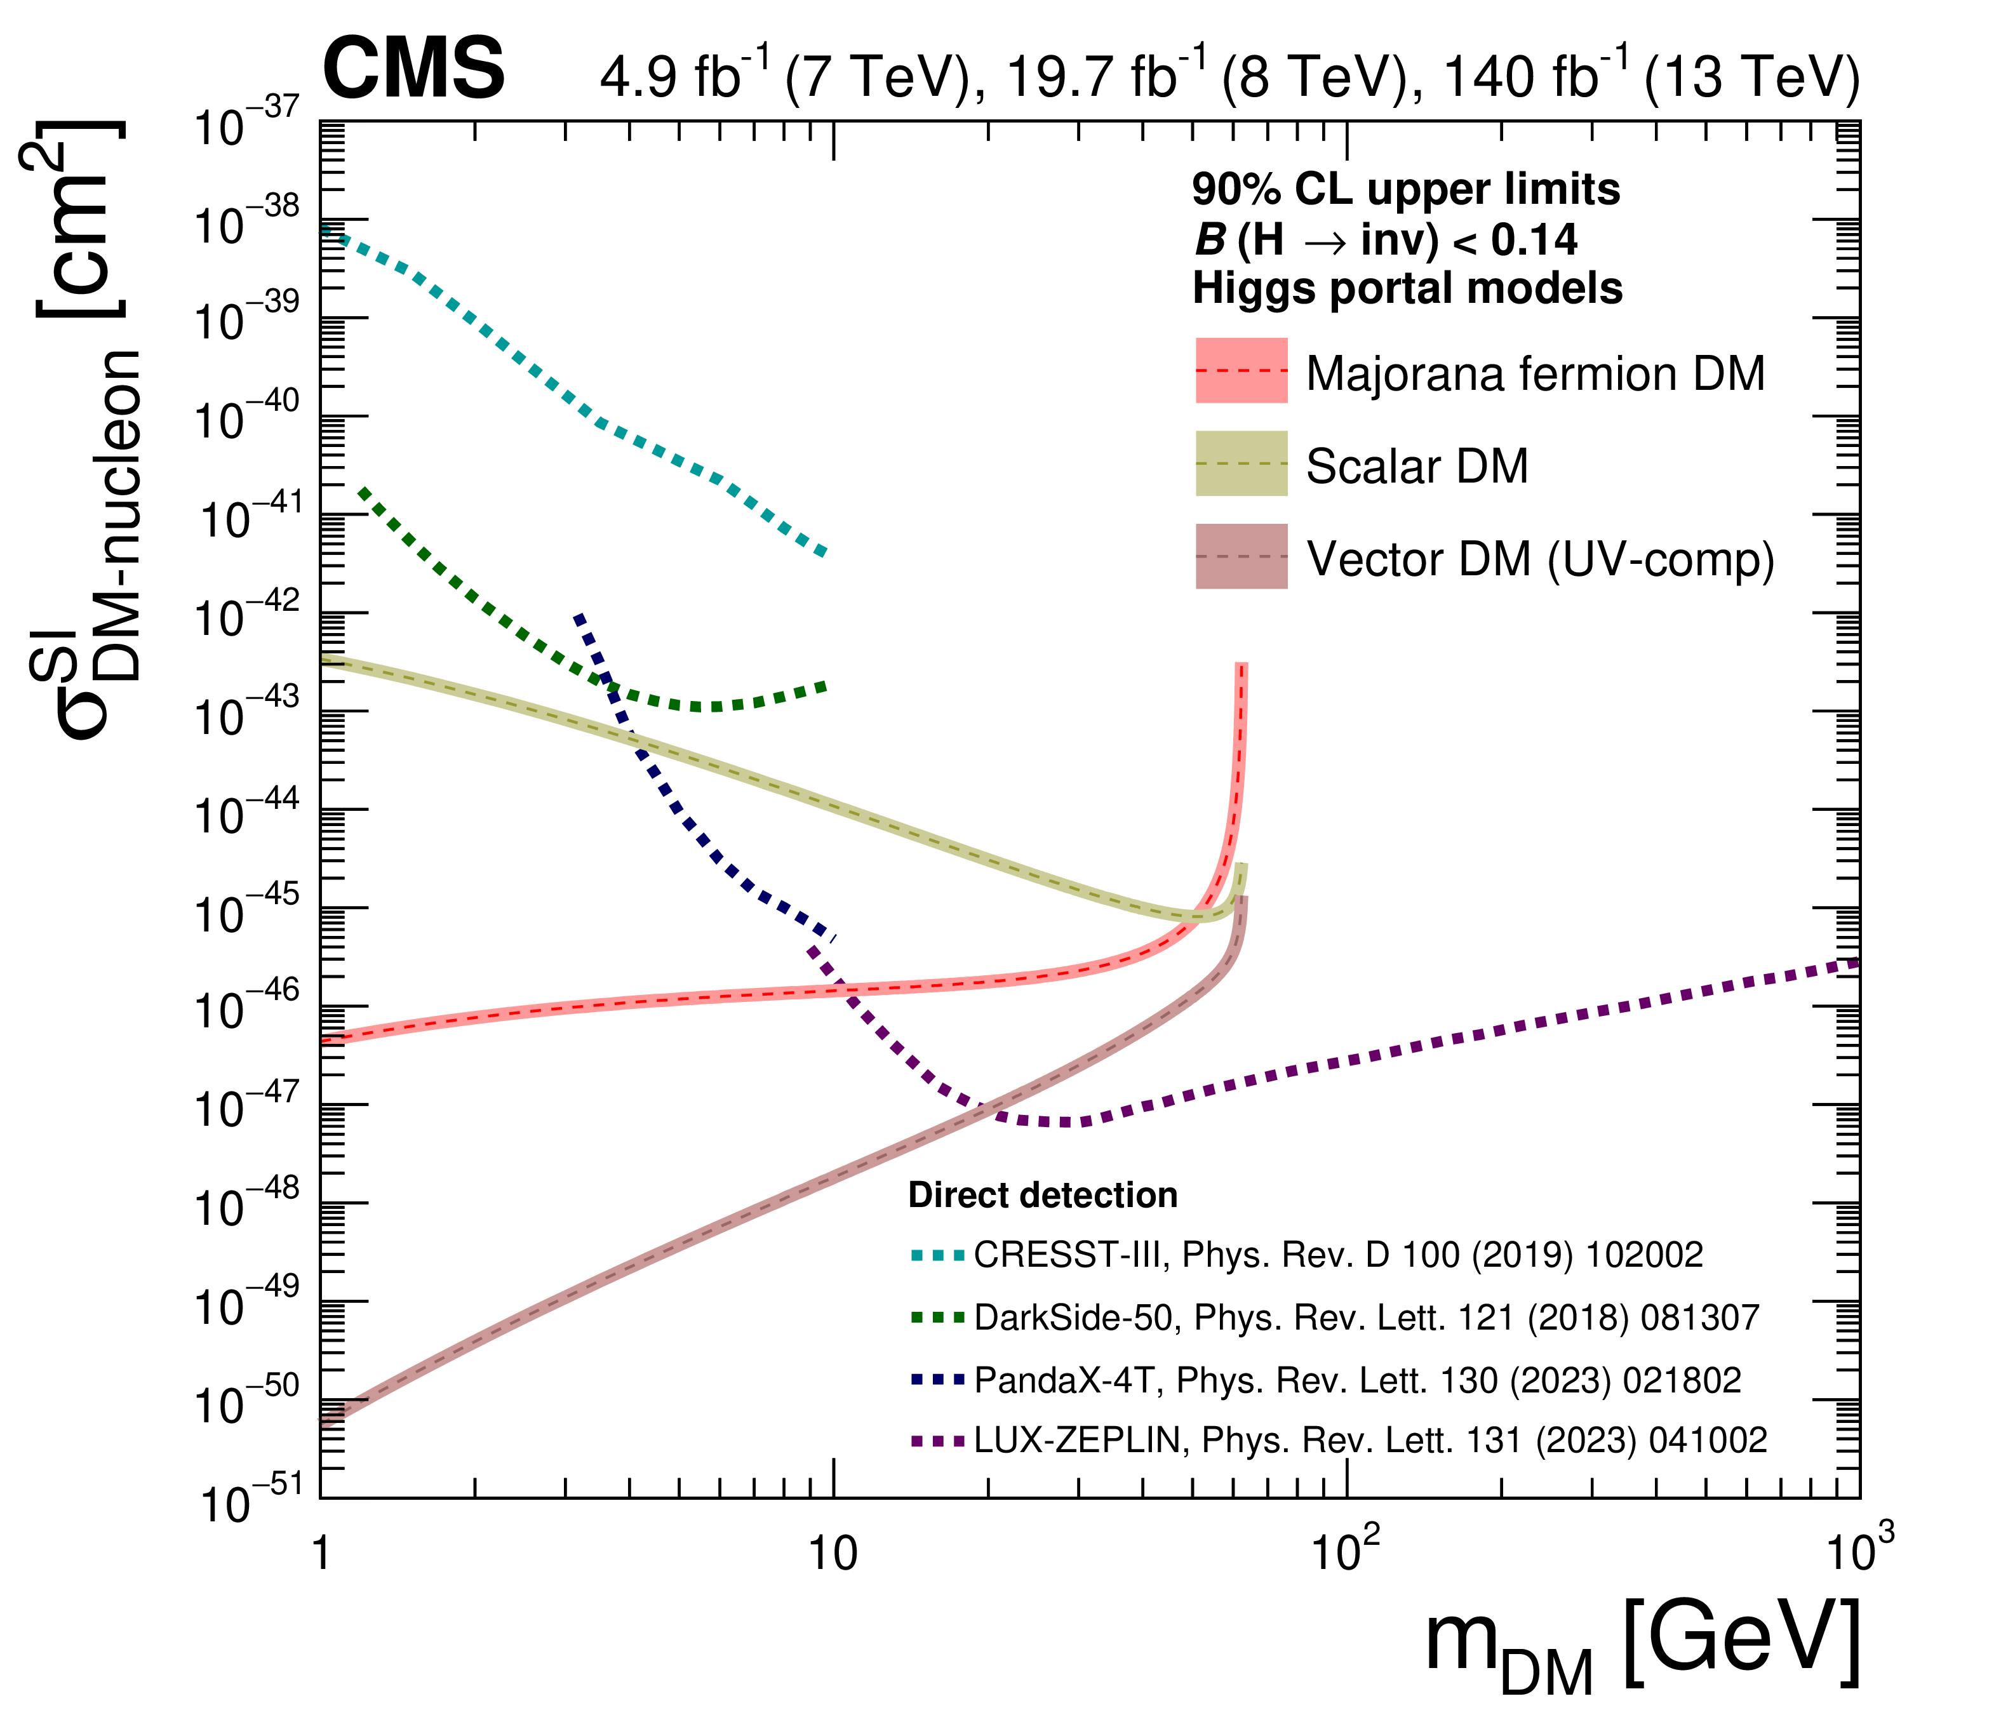
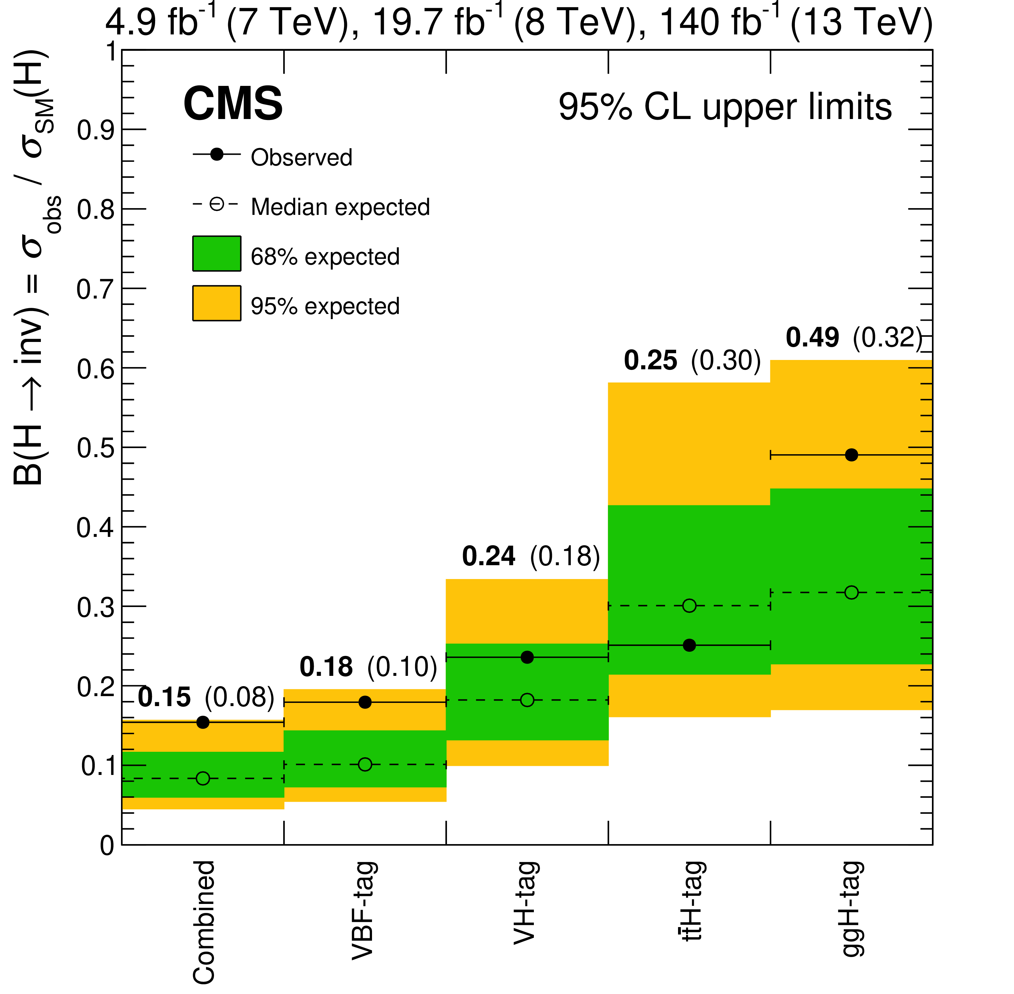
Physics strengths and highlights: CMS
Among searches for new physics, the UK led recent report on dark sectors → huge effort to map over 40 results and produce new interpretations
Include Higgs decaying in WIMP-like DM (Higgs-portal)
Bristol, Imperial
arXiv:2405.13778
Imperial
Other searches include e.g. Heavy neutrinos (HNL)
→ based on a special “parked data” stream collected in 2018
JHEP 03 (2024) 105
N long-lived, constraints depending on couplings and mass
Imperial
13/09/2024

Slide 16
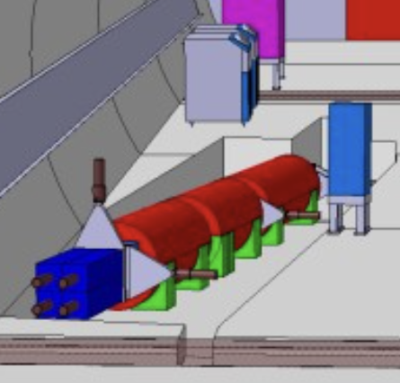
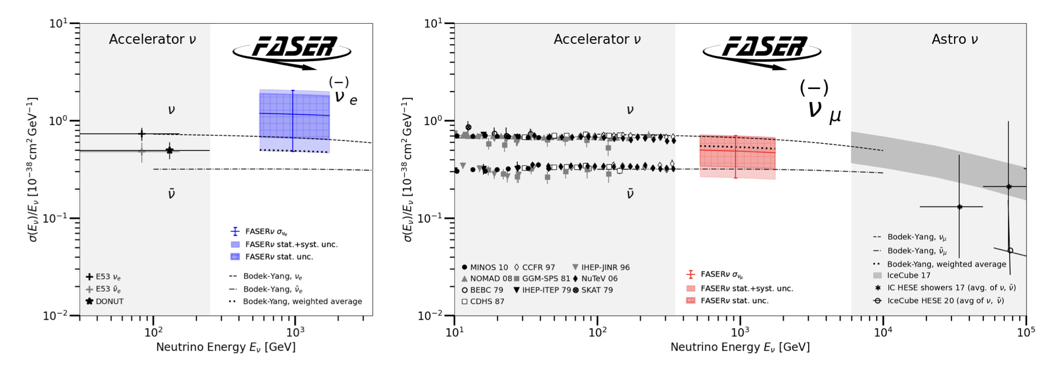
Physics highlights: FASER
Built in 2021, in operation since 2022 Run 3 start, FASER targets new light, weakly interactive particles and high-energy neutrinos produced at the ATLAS collision point
high-rate: forward-peaked meson production
LHC magnets and 100 m of rock shielding
Built with left-over, e.g. ATLAS SCT modules for tracker
Strong UK contributions
STFC-funding PhDs
UK institutes also on ATLAS
π, K, D, B → LLP(A’, ALPs…)
ν_{e} ν_{μ} ν_{τ}
480 m
Search for dark photon (A’) in e⁺e⁻
Search for axion-like particles (ALPs) in γγ
First direct observation of ν and ν_{e} and ν_{μ} interaction measurements
Phys. Lett. B 848 (2024) 138378
Liverpool
Liverpool, Manchester, Sussex
CERN-FASER-CONF-2024-001
PRL 131 (2023) 3, 031801
Liverpool, Manchester,
RHUL, Sussex
PRL. 133, 021802 (2024)
First constraint in DM thermal relic region @ low coupling for 30 yrs!
Access very challenging region
4ν_{e} and 8ν_{μ} candidates observed in TeV range

Slide 17
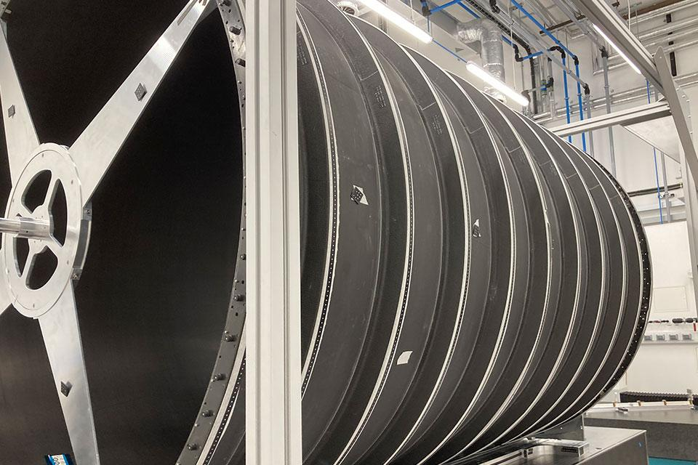
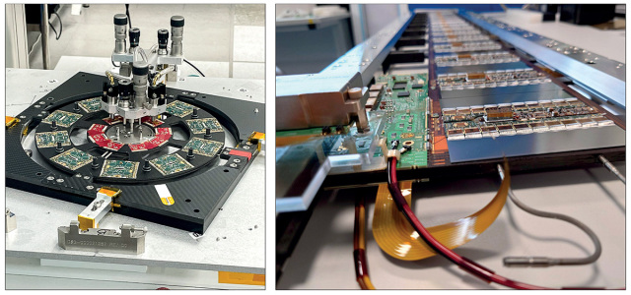
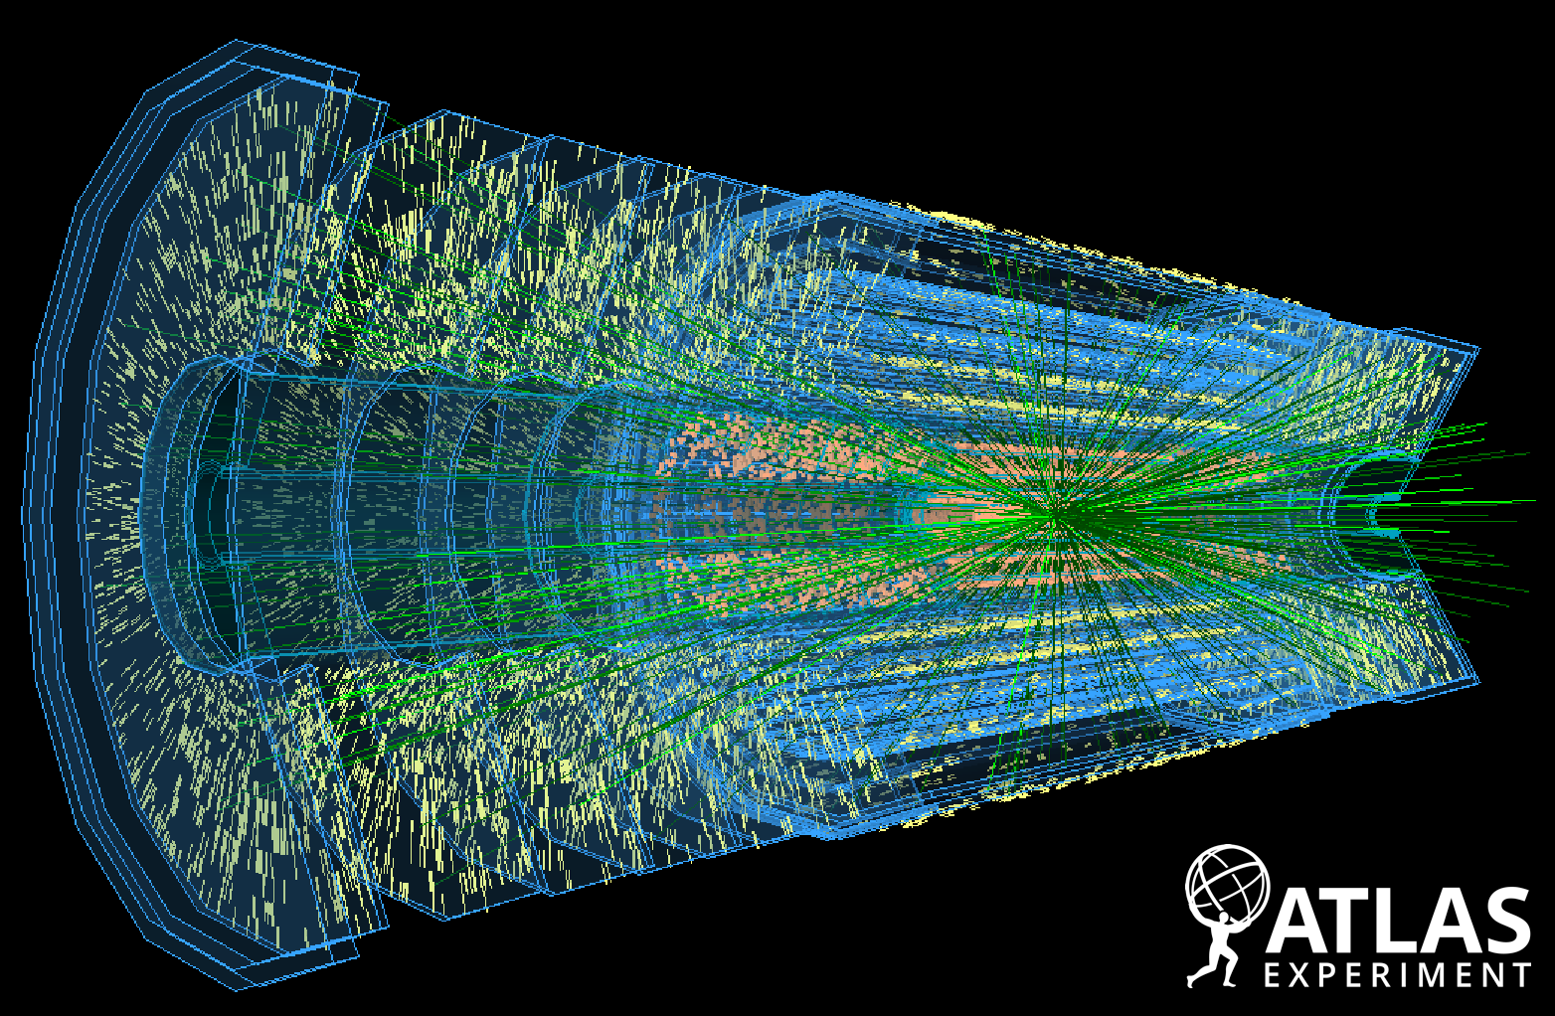
The Phase II upgrades

Slide 18
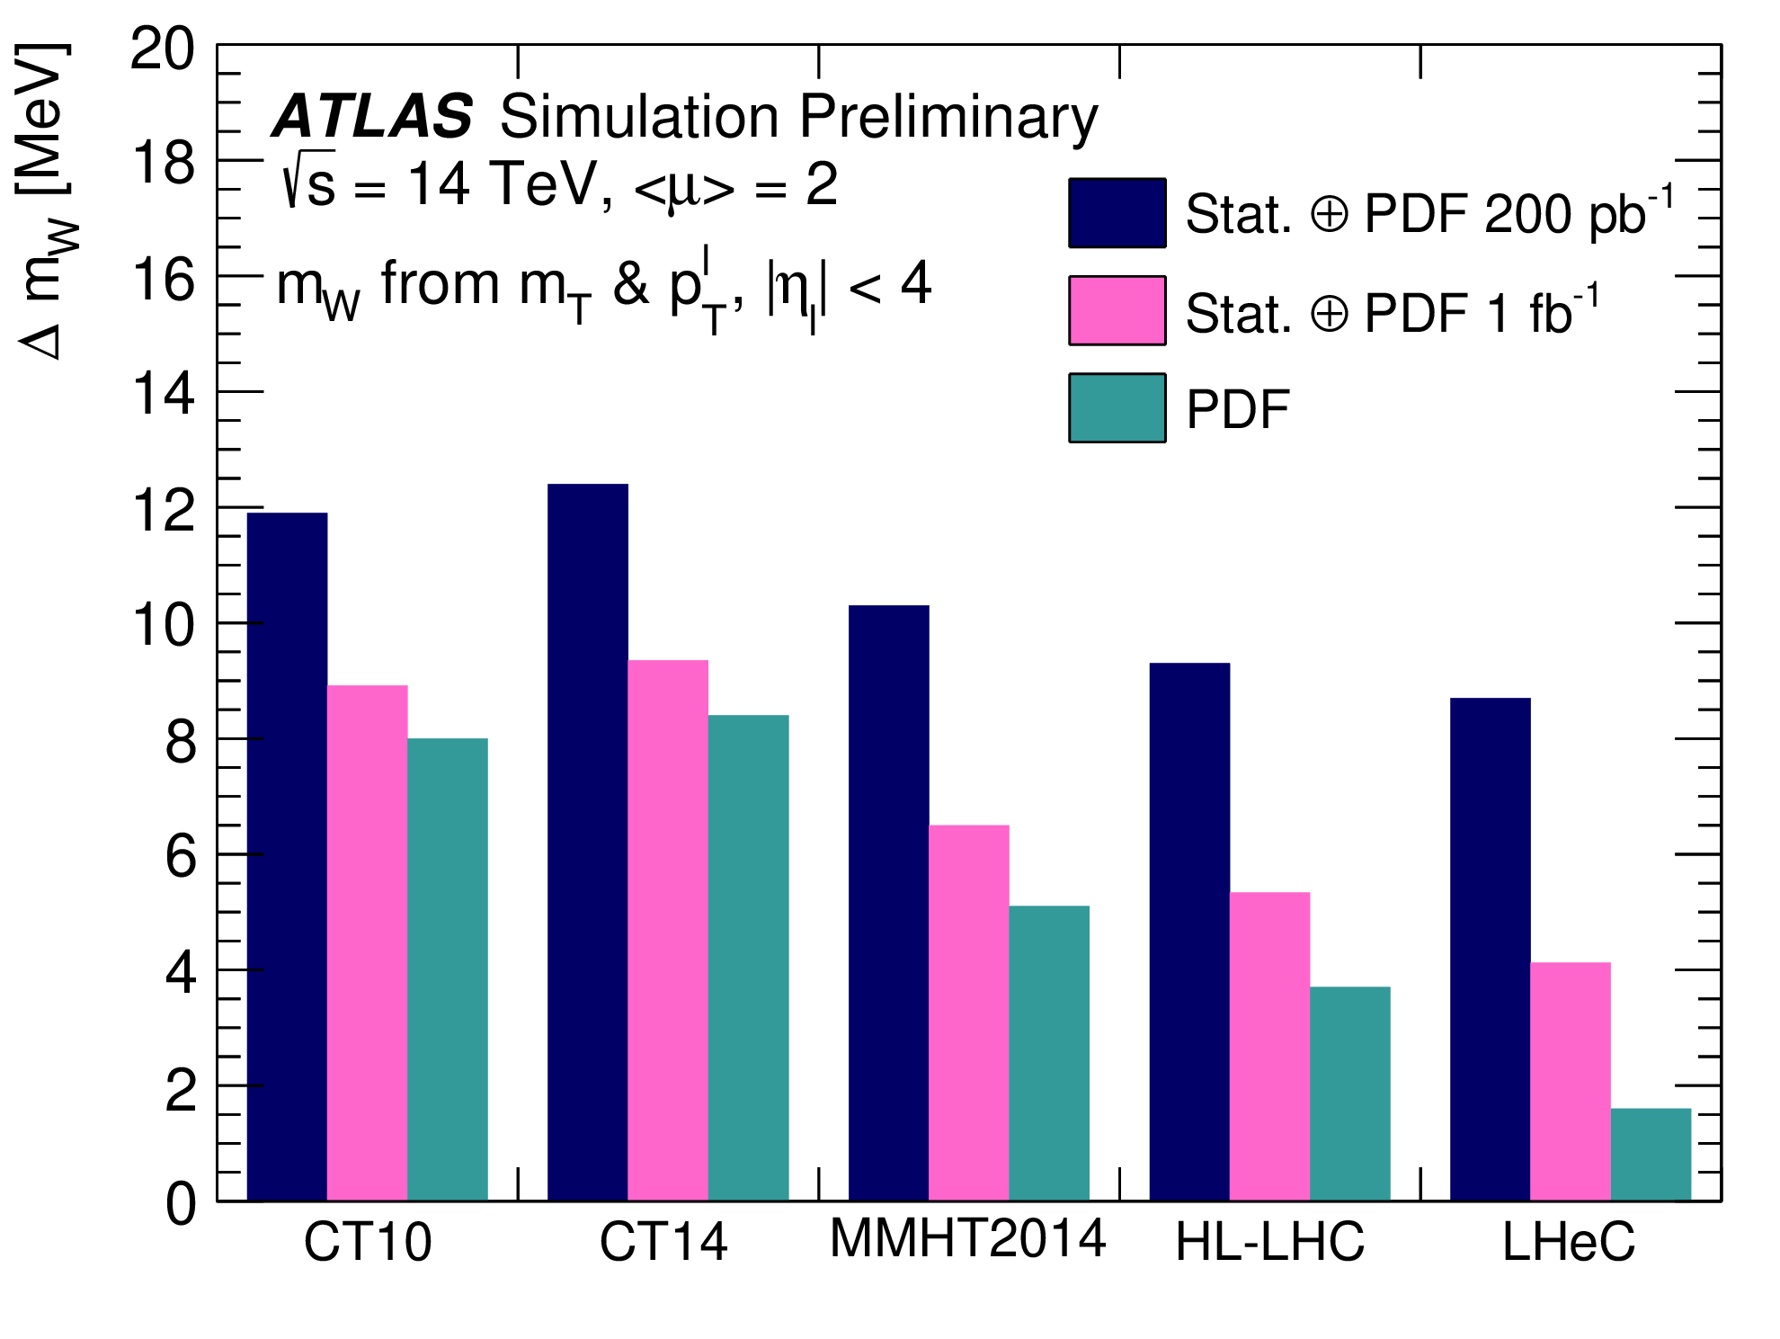
Pushing towards the energy frontier: HL-LHC
HL-LHC prospect studies, done also to understand the impact of the detectors' performance → strong engagement of UK-ATLAS and UK-CMS for the Yellow Book reports (2017-19)
  From SM precision measurements to di-Higgs and new physics searches, huge potential
Report on the Physics at the HL-LHC, and Perspectives for the HE-LHC
For NP, increase the present reach in mass and coupling by 20-50%
At least a factor of 2 expected in precision for W mass
Contribution of many UK institutes…
EWKS and Higgs-self coupling evidence

Slide 19
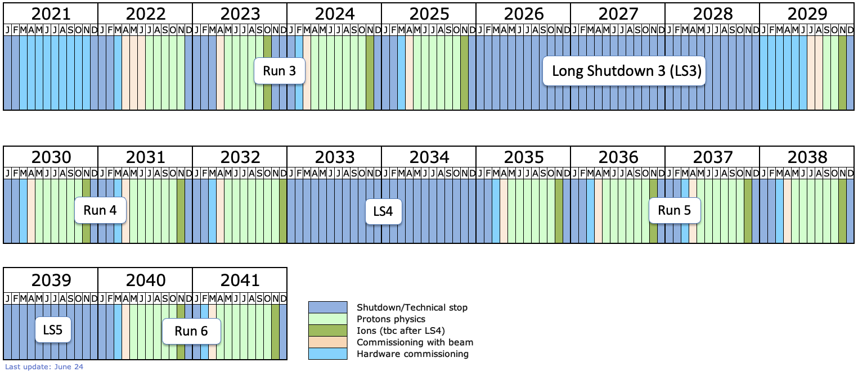
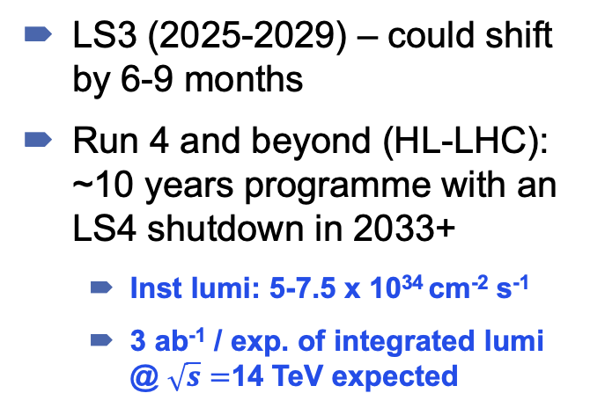
The Phase II upgrades timeline
HL-LHC
LS3 (2025-2029) – could shift by 6-9 months
Run 4 and beyond (HL-LHC): ~10 years programme with an LS4 shutdown in 2033+
  Inst lumi: 5-7.5 x 10³⁴ cm⁻² s⁻¹
  3 ab⁻¹ / exp. of integrated lumi @ $\sqrt{s}=$14 TeV expected
lhc-commissioning.web.cern.ch
Challenges and solutions
High instantaneous lumi (pileup) → improve granularity and timing information
High integrated lumi = high radiation environment → replacement of tracker and endcap calorimeter
Huge amount of data (computing, storage) → new trigger & DAQ systems

Slide 20
GPDs upgrade programs at glance
Funding: mainly STFC, capital contribution to upgrade in line with fair share. Current:
ATLAS: £128M for 12 years (2014-2026)
CMS: £13.6M for 6 years (2019-2025)
Still have to secure funding for the completion of the projects
Retention of expert personnel crucial (technicians, engineers, detector experts)

Slide 21
ATLAS upgrade: Inner Tracking Detector (ITk)
One of the main UK deliverables for ATLAS
  Complete replacement of the current inner detector
    Larger angular coverage (η: 2.5 ◊ 4)
    High radiation tolerance (up to 1 x 10¹⁶ neq/cm²)
    Reduced material budget
  Very large total surface for Pixel and Strip sensors
  UK is responsible to build 40% of the strip modules and 50% of the strip local supports (cores) + strip service modules
  UK deliverables in pixel include assemble and test 20% of ATLAS Pixel modules and build one endcap
  UK providing a lot of the leadership in the ITk

Slide 22
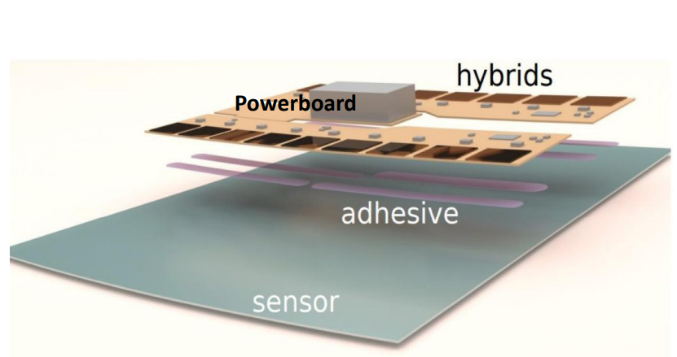
Inner Tracking Detector (ITk): status
Schedule remains challenging, but lot of good progress has been made
  ITK strips:
    huge work to understand and solve module cracking problems in collaboration with US and other institutes
    UK Institutes ready for production – now on track to start bulk production before the end of 2024
  ITK pixels:
    Assembly site, construction processes and quality insurance tests in place at all sites - PRR November
    Joint task force ATLAS-CMS expert for ASICs to study challenges in hybridization process and ASICs
Preparation in SR1 in full progress with deliverables from UK getting to CERN…
Birmingham, Cambridge, Glasgow, Lancaster, Liverpool, Oxford, QMUL, RAL PP, RAL TD, Sheffield, UCL, Warwick
“Interposer” solution, module design modified
Interposers fabricated in the UK
14 interposed modules on stave under Cold tests in UK (-70ºC)
Edinburgh, Glasgow, Lancaster, Liverpool, Manchester, Oxford, QMUL, RAL PP, RAL TD, Sheffield, UCL, Warwick

Slide 23
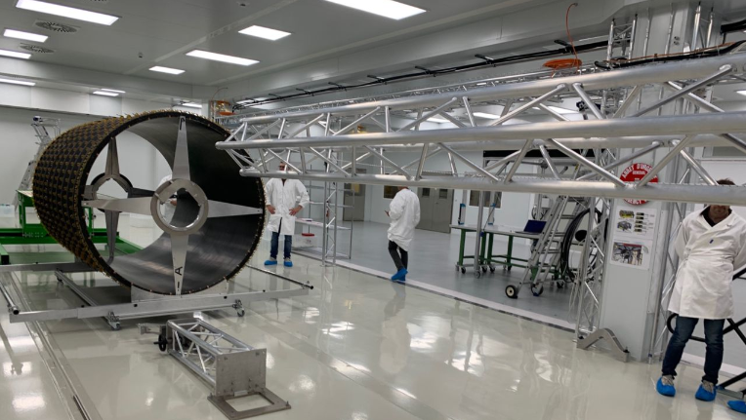
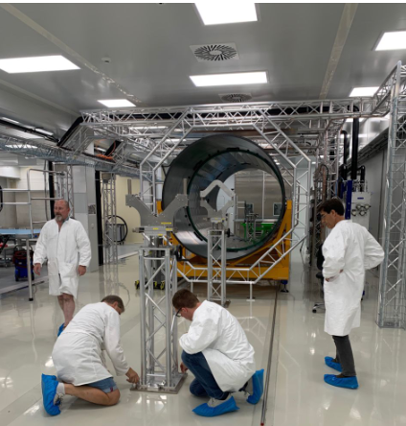
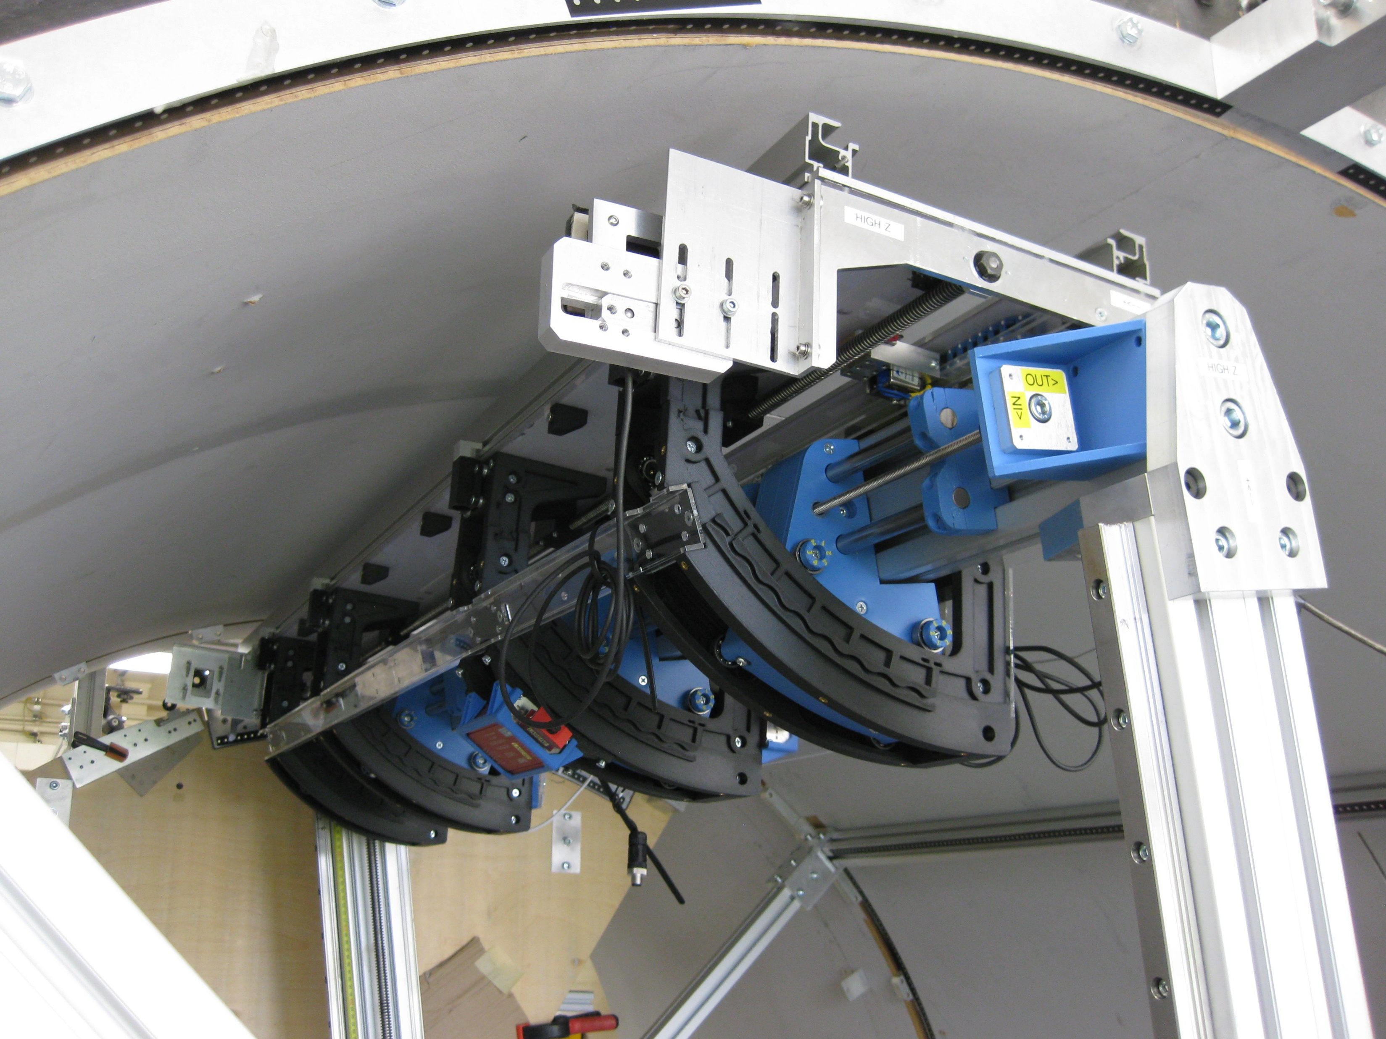
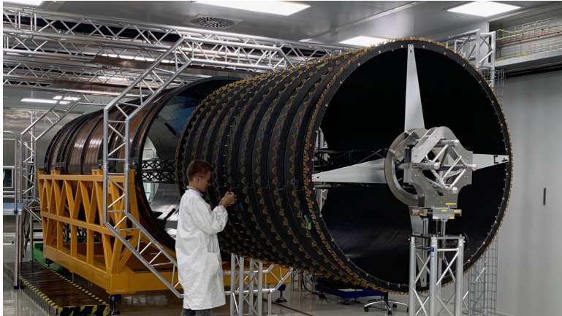
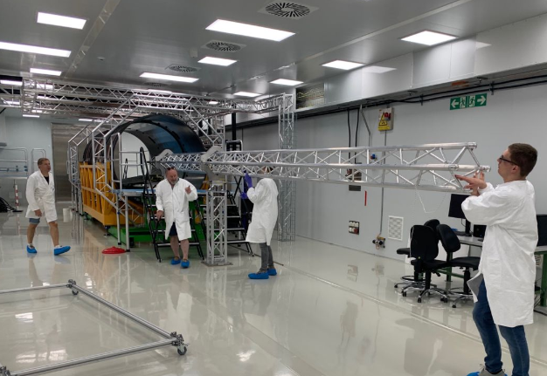
Preparation for I&C in SR1
Left Cylinders made in US
dressed in UK, sent to CERN
Above stave loading into cylinders in the UK
Sent to CERN end of 2024
Loading starts in Q1-2025
UK provide service modules

Slide 24
ATLAS upgrade: Trigger and DAQ
DAQ: FELIX prototype testing on-going
Event filter: demonstrators progressing well and on track, very good progress on GPU and FPGA support in ATLAS software
Another major UK deliverable
Phase II TDAQ specifications are challenging:
  L0 rate 1 MHz with 10us latency
  EF output rate 10 kHz
  Estimate event size of 4.6 MB
Birmingham, RHUL, UCL, RAL, QMUL
L0 Trigger: prototyping and testing

Slide 25
ATLAS upgrade: Trigger and DAQ
DAQ: FELIX prototype testing on-going
Event filter: demonstrators progressing well and on track, very good progress on GPU and FPGA support in ATLAS software
Another major UK deliverable
Phase II TDAQ specifications are challenging:
  L0 rate 1 MHz with 10us latency
  EF output rate 10 kHz
  Estimate event size of 4.6 MB
Birmingham, RHUL, UCL, RAL, QMUL
Overall: ALTAS-Phase II upgrade work is also relevant for
  training of qualified personnel: 55 PhD students have graduated in the past 5 years with activities on upgrade, apprenticeship programs for technical staff, research and development spin-off..
  Industry engagement: collaborations with national and international partners, including Micron Superconductor, ZOT, Graphic, INTEL …
L0 Trigger: prototyping and testing

Slide 26
CMS upgrade UK contributions
The CMS detector upgrade for HL-LHC comprises a totally new tracking system with hardware trigger capability and a new High-granularity calorimetry (HGCAL)
Main UK-deliverable: common electronics platform contributing to tracker, barrel electromagnetic calorimeter, and endcap calorimeter(s), and to L1 trigger
Based on 8 years of R&D activities
Successfully UK-delivered “building-blocks”
MP7 processor board (Phase I)
New time-multiplexed trigger Architecture
FPGA-based track finding
JINST 12 P12019
Bristol,Brunel, Imperial, RAL
p_{T}-modules on OT
shown to work in 2017!
Since then ..
Outer tracker
Notes:
FPGA-based track finding needed to have ability to reconstruct all charged particle tracks with transverse momentum above 2–3 GeV within 4 µs so they can be used in the Level-1 trigger decision

Slide 27
CMS upgrade UK contributions: ASICs and board
ASICs successfully delivered by UK
  QA of all wafers completed
Common technology: off-detector electronics board
  Founded Serenity Collaboration (UK-led)
  Serenity board can be used in different capacities across many sub-detectors
  Produced 27 prototypes with partners, currently in pre-production
  Used in test-beam for tracker and HGCAL
  Being integrated with detector components
production yields meet expectation
Large UK involvement including students

Slide 28
CMS upgrade UK contributions: work ahead
Complete delivery of common off-detector electronic board Serenity
For Tracker:
  Install back-end system, complete development and validation for the Trigger Primitive Generator systems
  Complete development and validation of the online software needed to coordinate, commission and operate the systems
  Testing and commissioning before/after installation
For ECAL
  Algorithm firmware → key UK-deliverables to reject APD spikes at L1
  Installation of new readout electronics and associated service (2026-27)
  Installation and commissioning of optical fibre router to transmit crystal data between off-detector boards
For HGCAL
  Install the Trigger Primitive Generator system in final location
  Test and commission the full system thoroughly
For L1 Trigger
  Fully test, install and commission the 36 Serenity boards for the Global Track Trigger and Correlator L1T subsystems
  Operate and commission system and algorithms ready for beam

Slide 29
FASER @ HL-LHC
FASER has been recently approved to run in Run 4 as is. Great additional physics potential in studies of hidden sectors and measurements of high-energy neutrino. No major upgrades foreseen BUT:
  New pre-shower system would have been operational since 2025 by then
  FASERν emulsion detector not as efficient – discussions about replacements/alternatives in progress
Liverpool supporting Geneva (Lead)
Resolve diphoton events
Improve sensitivity for searches of LLP→γγ
Several ideas from UK groups, in particular the possibility of a silicon/tungsten emulsion detector using uninstalled SCT modules
Current emulsion detector
(being studied by Manchester)
A different scenario if the Forward Physics Facility (FPF) will be supported → FASER-2 (see back-up)
Liverpool, Manchester, Oxford, RAL, RHUL, Sussex

Slide 30
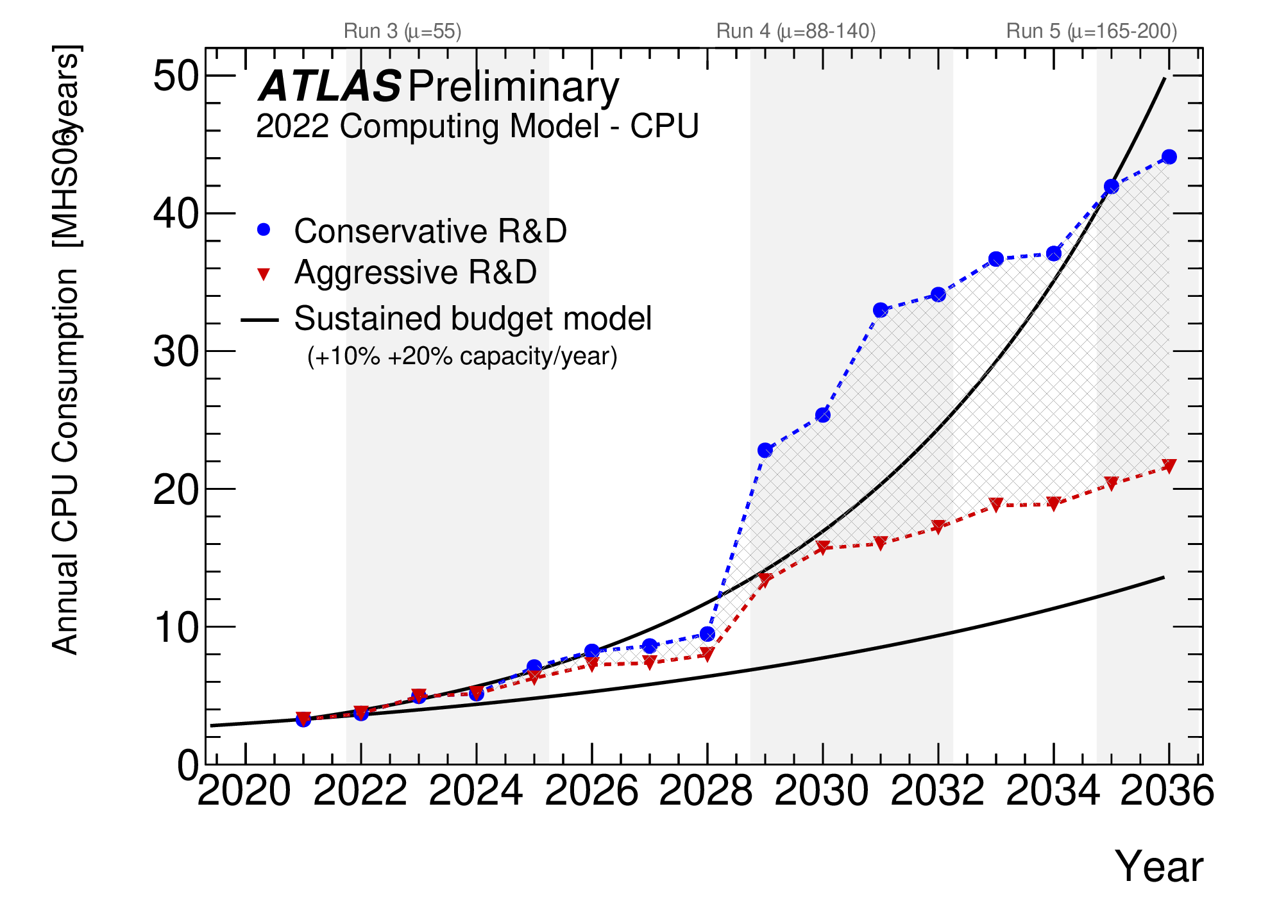
Phase-II Computing
https://atlas.web.cern.ch/Atlas/GROUPS/PHYSICS/UPGRADE/CERN-LHCC-2022-005/
The HL-LHC presents significant computing challenge
  A lot of work on-going to address this → manageable, exploiting rapidly changing technology landscape (see Davide’s talk)
  The UK play a key role within the international LHC community with coordinated efforts (i.e. within the SWIFT-HEP project)
  E.g.: MC simulation improvement (for Run 3)
But also: extensive use of GPUs needed for development and deployment of new AI-based approaches for trigger and analysis
e.g.: CMS: improved computing capabilities of the HLT system exploiting GPUs → crucial for UK-led data scouting approach
CERN courier article
Computing (infrastructure/software) is essential to exploit future experiments. Limited investments on strategic areas (e.g. AI/ML) and limited support for qualified personnel are considerable threats

Slide 31
Summary & Outlook
UK community contributes crucially to ATLAS, CMS and FASER, in operations and maintenance, and producing many results key to understand the SM and explore beyond
The UK is a very dynamic community, with ECR fora and initiatives, exploitation of cutting-edge techniques – it is crucial to maintain/uplift physics exploitation support
[not discussed here] Scientific outcomes can be ‘enriched’ with additional small experiments ‘using’ GPDs, with UK-initiatives such as ANUBIS
Physics prospects for HL-LHC offer incredible opportunities:
  Upgrades of the ATLAS and CMS detectors progressing, UK-deliverables substantial and well on-track, but still facing challenges in funding and expertise retention; strong engagement of UK institutes also on FASER @ HL-LHC
  Computing is a key enabler for all we do, which the UK is targeting also through collaborative efforts
Huge thanks to (alphabetic order) Joel Goldstein, Steve McMahon, Claire Shepherd-Themistocleous, Alex Tapper, Pedro Teixeira-Dias, Sarah Williams

Slide 32
Back up

Slide 33

Physics strengths and highlights: CMS dark sectors
Imperial
13/09/2024

Slide 34

Physics highlights: FASER searches
Search for Dark Photon (A’) in e+e-
Phys. Lett. B 848 (2024) 138378
Liverpool, Manchester, Sussex
First constraint in thermal relic region @ low coupling for 30 yrs!
Search for axion-like particles (ALPs) in γγ
CERN-FASER-CONF-2024-001
Liverpool

Slide 35
Physics highlights: FASER (2)
First direct observation of neutrinos and measurement of ν_{e} and ν_{μ} interactions
PRL 131 (2023) 3, 031801
Liverpool, Manchester,
RHUL, Sussex
Interactions in emulsion detectors (FASERν)
PRL. 133, 021802 (2024)
Observed: 153+12-13 ν_{m} interactions
4ν_{e} and 8ν_{μ} candidates observed, also in TeV range
First cross section measurements in the TeV range

Slide 36


CMS ECAL upgrade
ECAL Barrel upgrade for Phase 2
  New on-detector and off-detector electronics
    shorter pulse shaping and faster sampling
      improved pileup suppression and precise timing measurements, targeting 𝛔t ~ 30ps for H→𝛾𝛾 photons
      much improved rejection of APD spikes
    finer granularity information available at L1
      allows for improved algorithms in more powerful FPGA boards
UK contributions
  Algorithm firmware to reject APD spikes at L1
    using improved pulse shape discrimination
  Optical fibre router to transmit crystal data between off-detector boards
    to allow for the computation of more advanced shower-shape/cluster variables at L1
50 75 100 125
Time [ns]
APD spike and EM signal pulse shapes
APD spike
Signal
Spike rejection via pulse shape discrimination

Slide 37

FASER @ HL-LHC: a totally different scenario
FASER has been recently approved to run in Run 4 as is. Nonetheless:
In the assumption that a totally new facility, the Forward Physics Facility, is supported and goes ahead, a totally new, different scenario of opportunities arise
FASER-2
FASER-2 as part of a suite of experiments host at the FPF
Feasibility and potential detector layout studies carried out by UK-FASER institutes, Oxford, RAL.

