Slide 1

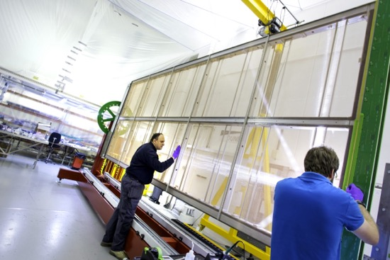
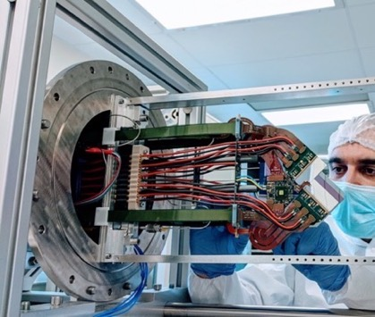
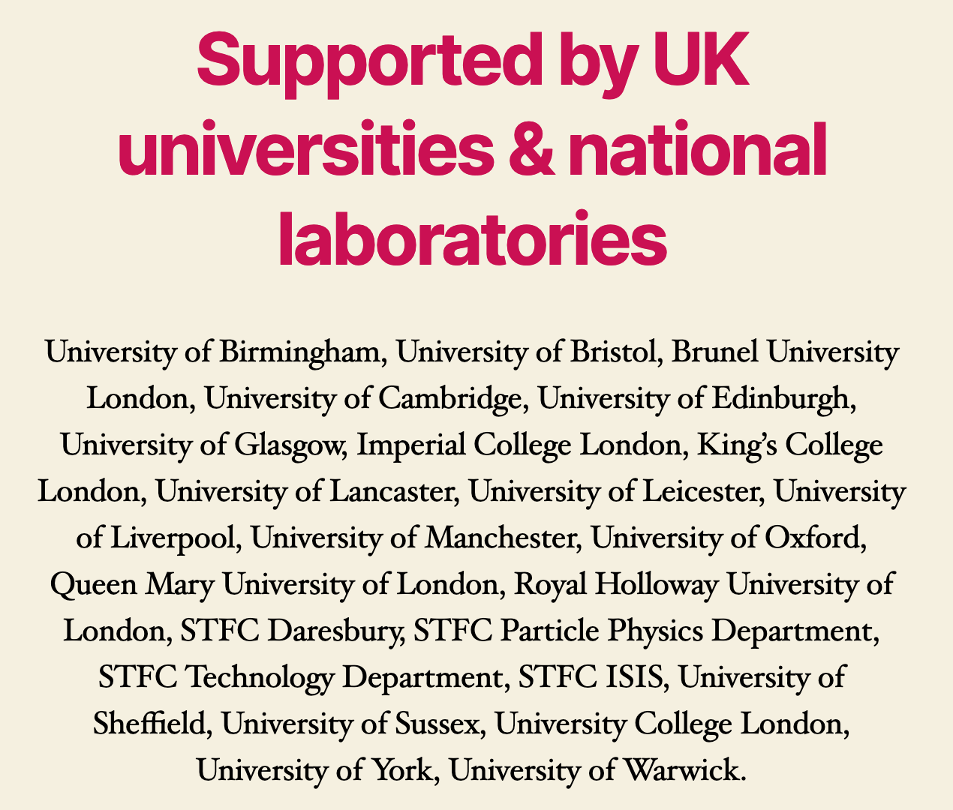
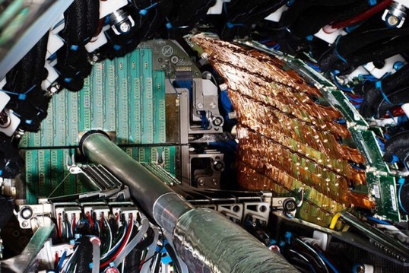
Detector Research & Development
DRD-UK Activity
UK Organisation
Funding Status
DRD: 1-Gas; 2-Liquid; 3-Solid State; 4-PID; 5- Quantum; 6-Calo; 7-Electronics/DAQ; 8- Integration
+ Training, Industry
Chris Parkes, DRD-UK, RECFA, September 2024

Slide 2

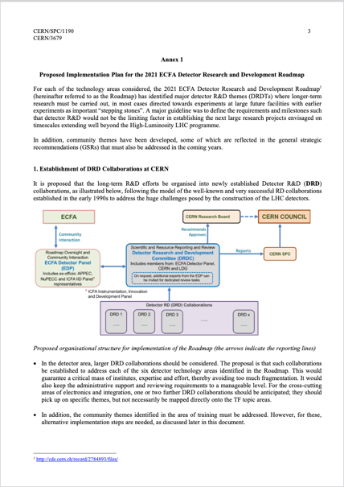
Concept
“The success of particle physics experiments relies on innovative instrumentation and state-of-the-art infrastructures. To prepare and realise future experimental research programmes, the community must maintain a strong focus on instrumentation...The community should define a global detector R&D roadmap.”
European Particle Physics Strategy 2020 Update
Roadmap
Implementation
Strategic R&D in detector systems for particle physics, particle astrophysics, and related nuclear physics activities.
Setup under the auspices of ECFA, with CERN as host.
Expand upon and replace existing CERN RD collaborations
First collabs started Jan. 2024
Chris Parkes, DRD-UK, RECFA, September 2024

Slide 3
Why ? And why not ?
Entering new Era –post-ATLAS/CMS U2 construction
Medium/small scale projects and, potentially, FCC on 20+ yr horizon
Needs:
Costs: technology costs are rising rapidly while the field remains – by commercial standards – a low-volume, niche market with complex requirements.
Complexity: pooling of resources needed, and negotiation with vendors as larger-scale organisations.
Long-term strategic funding programmes to sustain research and development in order for the technology to mature for FCC and other large-scale longer term projects
DRD structures will have the necessary critical mass
Risks:
Must ensure that creativity is maintained
Must benefit the medium-term experiments
  keep thriving community, learn through deploying technology
Chris Parkes, DRD-UK, RECFA, September 2024

Slide 4
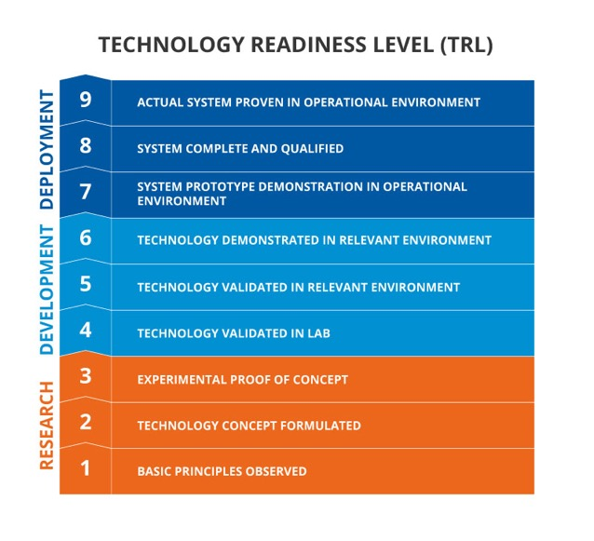
DRD-UK Aims
R&D programme will:
Provide international coordination to identify and target common technological goals that will underpin the next generation of experiments facilitating long-term developments
Provide and coordinate instrumentation training and skill development for the next generation of experimental particle physicists, engineers and technical staff
Provide methods of establishing meaningful longer-term relationships with industrial partners
DRD primarily aimed at mid-TRL levels
Development of technology to a level where it can then be applied by specific experiments
UK strong in recent / current construction
Falling behind international competitors
in instrumentation development
DRD is opportunity to catch-up
  Lack of longterm R&D funding at
  this TRL level
Chris Parkes, DRD-UK, RECFA, September 2024

Slide 5
UK R&D Prior funding landscape
Consolidated grant – fractions of staff with no formal UK wide coordination
Project R&D call – annual 2/3 year R&D call. was terminated in 2016. Early-stage R&D call started in 2022.
Much of longterm R&D was done under auspices of large construction programmes, particularly ATLAS.
Collider community clearly recognizes that detector R&D has declined in past decade.
Balance with successful delivery of major detector construction projects in past years & financial challenges.
Chris Parkes, DRD-UK, RECFA, September 2024

Slide 6
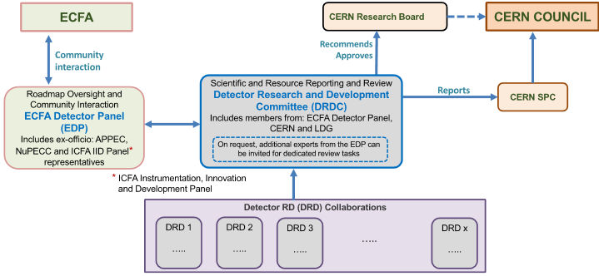
Organisation - International
DRD Collaborations – with coordinators
  Major UK roles
DRDC Review committee
Replaces collaborations such as:
RD50: underpinned most silicon developments that enabled LHC detectors and beyond
RD53: where a common ATLAS/CMS Upgrade II pixel chip basis was developed
RD42: Diamond detectors, RD51: gaseous detectors…
Chris Parkes, DRD-UK, RECFA, September 2024

Slide 7
Major Roles in International Projects
ECFA Detector Panel: Phil Allport,Ian Shipsey (ex-officio)
DRDC: Mark Pesaresi
DRD1:
DRD2:
DRD3: coord: Eva Vilella, Alex Oh
DRD4: CB chair: Guy Wikinson, coord: Jon Lapington, Sajan Easo
DRD5:
DRD6:
DRD7: Steer committee: Marcus French, coord: Iain Sedgwick, Mark Willoughby
DRD8: Dep. Spokes: Georg Viehhauser, coord: Adam Lowe, Oscar Augusto De Aguiar Francisco
Awaiting input
Long-term Leadership of RD50: Gianluigi Casse
ECFA Detector Panel Leadership in DRD process: Phil Allport
Deputy spokes AIDAinnova: Daniela Bortoletto
Chris Parkes, DRD-UK, RECFA, September 2024

Slide 8
DRD Collaborations (1-8)
1. Gaseous
2. Liquid
3. Semiconductor
4. PID & Photon
e.g.
time/spatial
resolution;
environment
friendly gases
e.g. Light/charge readout;
low background materials
e.g.
CMOS pixel sensors;
High time resolution
(10s ps)
e.g.
spectral range of photon sensors;
Time resolution
5. Quantum
6. Calorimetry
7. Electronics
8. Integration
quantum sensors
- R&D, incl. beyond QFTP in conventional detectors
e.g.
Sandwich;
noble liquid;
optical
e.g.
ASICs;
FPGAs;
DAQ
tracking detector mechanics

Slide 9
DRD-UK Organisation
24 UK universities & National Laboratories,
Particle, Astro-Particle & (some) Nuclear physics
Steering Board
Coordinators
Institution | Representative
Birmingham | ALLPORT, Philip Patrick
Bristol | GOLDSTEIN, Joel
Brunel | KHAN, Akram
Cambridge | WILLIAMS, Sarah
Edinburgh | GAO, Yanyan
Glasgow | BATES, Richard
Imperial | TAPPER, Alex
King's | DI LODOVICO, Francesca
Lancaster | O’KEEFFE, Helen
Liverpool | VOSSEBELD, Joost
Manchester | PARKES, Chris (UK PI)
Oxford | BORTOLETTO, Daniela (UK Steering board Chair)
QMUL | HOBSON, Peter
RAL – PPD & DL | WILSON, Fergus
RAL - TD | FRENCH, Marcus Julian
RHUL | BOISVERT, Veronique
Sheffield | VICKEY, Trevor
Sussex | HARTNELL, Jeffrey John
UCL | KORN, Andreas
Warwick | RAMACHERS, Yorck
Institution | Representative
DRD-1 [Gas] | BRANDT, Oleg; MAJEWSKI, Pawel;
DRD-2 [Liquid] | GUENETTE, Roxanne; MONROE, Jocelyn; SAAKYAN, Ruben; SCOVELL, Paul;
DRD-3 [Si] | DOPKE, Jens; GONELLA, Laura; HYNDS, Daniel; VILELLA FIGUERAS, Eva
DRD-4 [PID] | BLAKE, Thomas; ROMANO, Angela
DRD-5 [Quantum] | BUCHMULLER, Oliver; DAW, Ed
DRD-6 [Calo] | SALVATORE, Fabrizio; WATSON, Nigel
DRD-7 [Electronics] | FITZPATRICK, Conor; FRENCH, Marcus; POTAMIANOS, Karolos; PRYDDERCH, Mark; ROSE, Andrew
DRD-8 [Systems] | GOLDSTEIN Joel; VIEHHAUSER, Georg
Training | LAZZERONI, Cristina; BATES, Richard
Industry Engagement | FARROW, Richard; CASSE, Gianluigi
Contributions to all DRDs, though at different levels
Email list: uk-detector-rd@cern.ch
Web site (with all submitted documents): https://drd.hep.ac.uk/
Meetings indico https://indico.cern.ch/category/17626/
Chris Parkes, DRD-UK, RECFA, September 2024

Slide 10
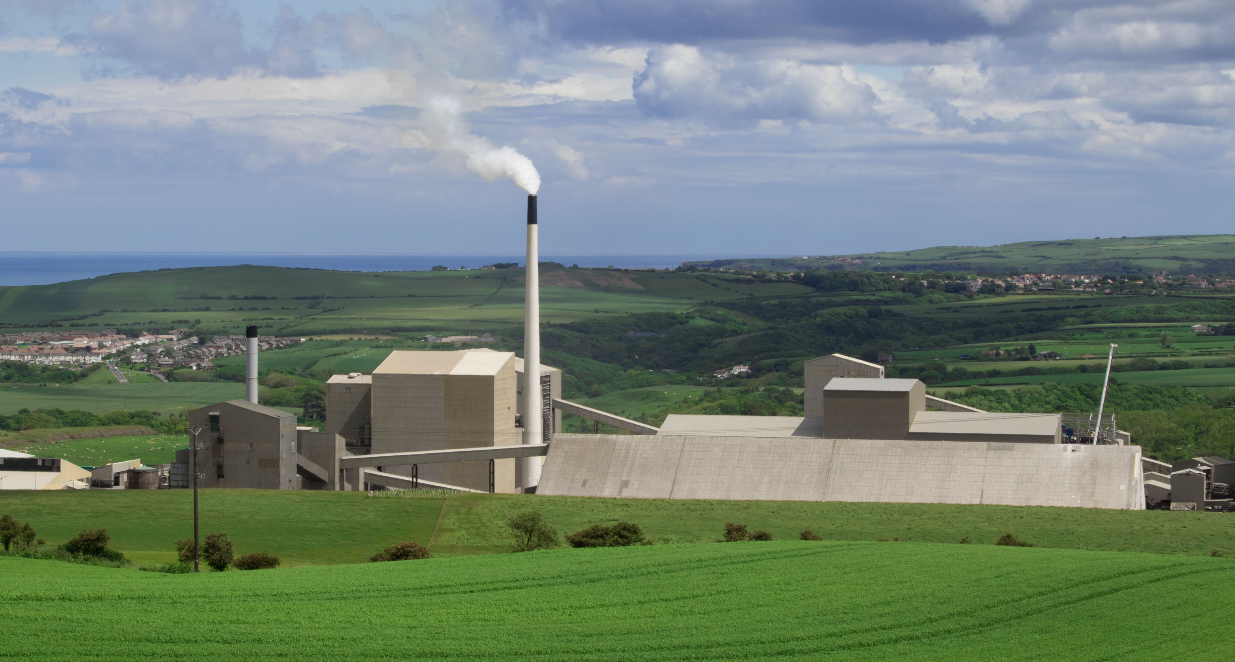
Role of UK National Laboratories in R&D
RAL particle physics division (PPD)
RAL technical division (TD)
Daresbury laboratory
Boulby underground laboratory
Play an important role in detector development alongside the larger university groups – equal partners
major infrastructure outside (e.g. Liverpool semiconductor centre, Birmingham Cyclotron)
Expertise and facilities of TD available on contract basis
RAL PPD/TD impression more integrated with geographically closer region than the northern universities
Opportunity to level-up with Daresbury development?
Important initiatives to build-up world-class science in low-background science (DRD2) at Boulby
Chris Parkes, DRD-UK, RECFA, September 2024

Slide 11
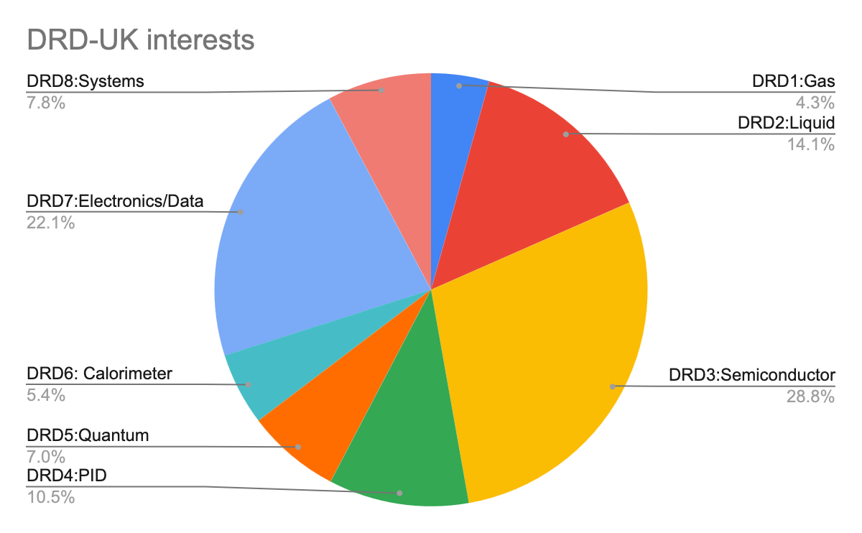
UK Interests
Survey of UK particle physics groups through steering board
Caveats: DRD5&8 were at earlier stage, numbers may not be representative
Opportunity to develop new areas
Presentations from most major UK projects on technology needs
Chris Parkes, DRD-UK, RECFA, September 2024

Slide 12
Workplans & Task Lists
All DRD-UK groups have identified their task lists
Clearly too many / too wide for the available funding
Awaiting feedback from STFC on funding envelope that will then facilitate devising a tailored programme
Examples:
1. Light sensors; 2. Light collection and detection efficiency over a broad wave-length; 3. Development of charge-to-light and charge+light readouts; 4. Material screening and low-background materials.
Monolithic CMOS devices; 2. 4D tracking systems.
3. 3D stacked detectors. 4. Extreme radiation tolerance.
Chris Parkes, DRD-UK, RECFA, September 2024

Slide 13
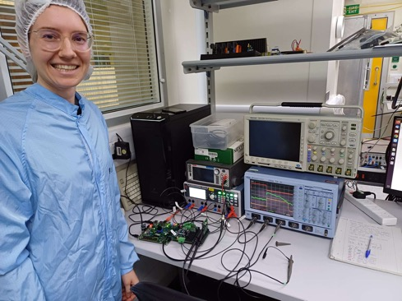
Recent DRD-UK Documents
Briefing Document for STFC, Oct. 2023
  Case for DRD-UK funding, positive feedback led to
DRD-UK Particle Physics Consolidated Grant, Feb. 2024
  Experiment like proposal to foster community
  Request for fractions of (largely) existing core posts
  Travel funds, industry engagement fund, training
DRD-UK Statement of Interest, submitted to STFC PPAN Science Board May 2024
  Request for DRD-UK project funding (level 5% of PP funds)
  Request for Doctoral training school
Five submissions to early stage R&D research call, July 2024
  Photon detector for vacuum ultraviolet frontier; 4D tracking detectors; Radiation Tolerant monolithic pixels; novel vacuum photon detectors for PID; common interface ASIC
  No mid stage R&D call – fit to existing call
Chris Parkes, DRD-UK, RECFA, September 2024

Slide 14
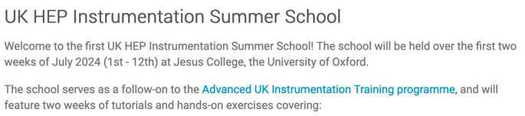
Industry / Infrastructure / Training
Training
  UK system often generating physicists with limited instrumentation experience
    Academic hires from tenure track fellowships – largely data analysis based
  Need for Doctorate Training
  graduate training programme – summer school bid planned
Industrial engagement
  CERN to UK industry return not well balanced
Silicon
Photo from summer school – have asked Daniel
  CG submission recommends UK industry programme board, database UK ‘trusted’ suppliers, proof of concept technology fund
Major Infrastructure identified
  e.g. Diamond, ISIS, B’ham Cyclotron, Boulby
Chris Parkes, DRD-UK, RECFA, September 2024

Slide 15
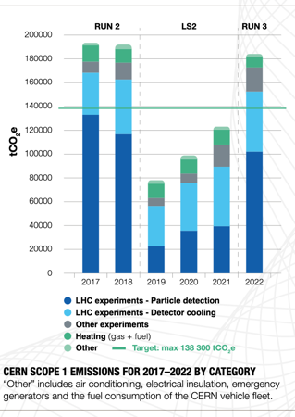
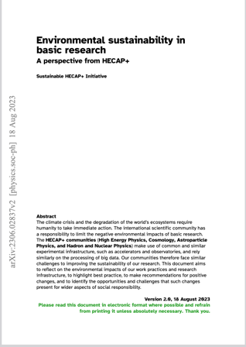

Sustainability
STFC considering sustainability policy, SOI options
DRD-UK:
  low-GWP gases for detectors
  Low-GWP and non-PFAS liquid coolants
  (Computing farm power consumption)
UK Leadership
UK Leadership
Detector aspects discussed in DRD PPAN Science Board SOI
Broad sustainability submission also made by community members (not DRD specific)
UK-HEP sustainability forum in November
Chris Parkes, DRD-UK, RECFA, September 2024

Slide 16

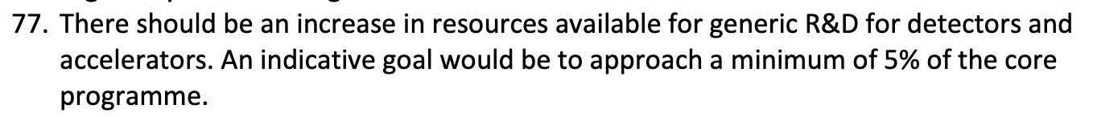
Selected Take home messages
UK organisation of DRD activities in place
Lack of longterm funding for mid-TRL R&D in UK
Funding schemes disfavour academic hires in instrumentation
Awaiting feedback from STFC on proposals
  facilitate progress with planning, MoU commitments
  Aware that with major construction projects ongoing, and schedule slippage, funds will need to ramp-up over time
Encourage early establishing of DRD RRB for cross-country funding agency discusions
Strategic Review Particle Physics, December 2022
Chris Parkes, DRD-UK, RECFA, September 2024

Slide 17
Backup

Slide 18
Group dimensions: Number of members (doctoral students, senior members, technicians, engineers, etc.)
Group financing: Details of funding over the last 7 years
Group responsibilities: Key roles in collaborations and significant results from recent years
Scientific output: Number and relevance of publications, coordination positions in collaborations, theses, etc.
Difficulties and limitations: This is crucial as RECFA will make recommendations to the STFC, so it is important to present our challenges.

Slide 19
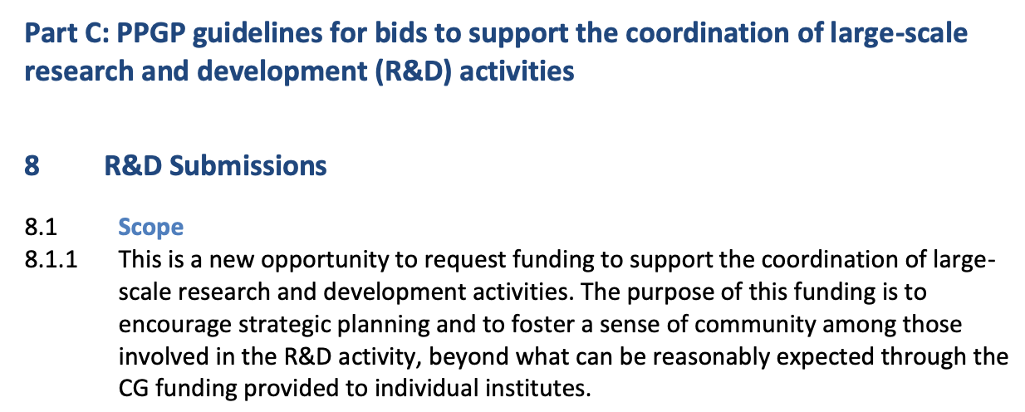
Consolidated Grant – DRD-UK
Following briefing document, asked to submit to CG in an “experiment-like” proposal

Slide 20

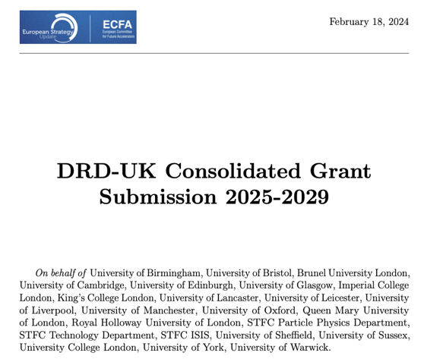
Consolidated Grant – DRD-UK
CG submission
  Fractions of posts to support detector R&D
  List of UK project activities for all DRDs
  Travel
    DRD workshops
    Coordinators
    Testbeam & irradiation
  Training
  Industry links
FTE yrs
Need dedicated project funds to effectively leverage

Slide 21
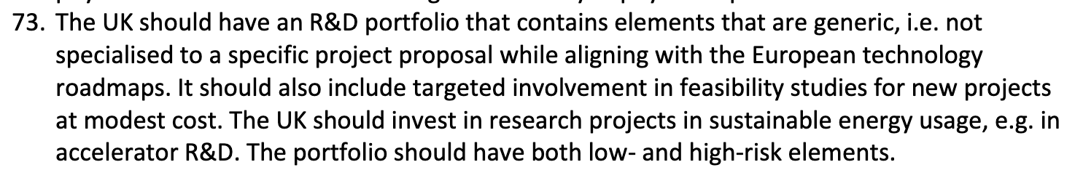
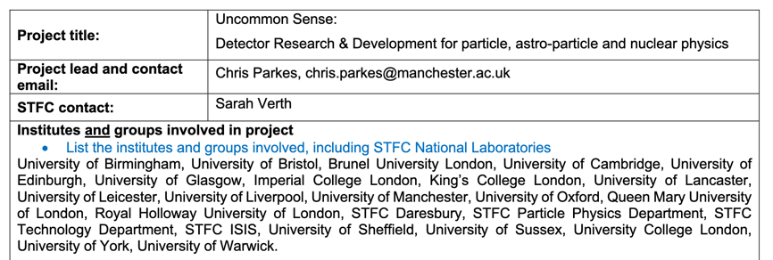
PPAN Science Board SOI
Strategic Review Particle Physics, December 2022
[ core ~£55m per annum thus 5% is £2.75m]
PPAN Science Board, May 2024
Establish:
DRD-UK
Research programme
average 2.9M/yr, 4 yrs
Centre for doctoral training
Recognition of need – big success of community efforts need to translate into funding – with longterm strategy

Slide 22
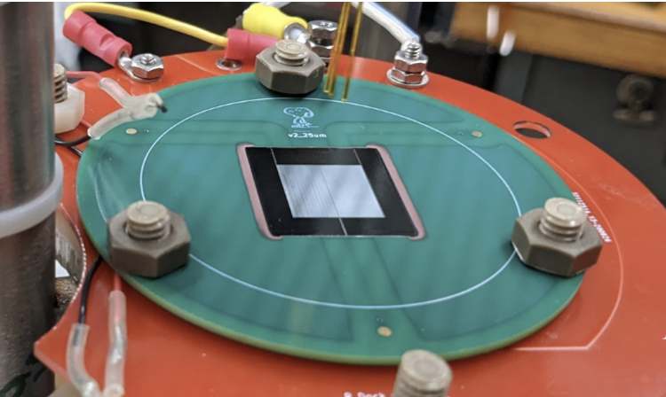
Early Stage R&D- UK initial priority projects
Photon Detector for Vacuum Ultraviolet Frontier
PI: Elena Gramellini
Most light emitted in argon and xenon is in the VUV (vacuum ultraviolet) range - DUNE, DarkSide, LZ, nEXO…
Silicon Photomultipliers (SiPMs) have typical efficiency < 20%:
    - aim for factor two (and potentially more) improvement
Apply strategies proven in astro and medical:
CCD, quantum optics,
and digital mammography
Use metasurfaces and
novel graphene coatings
on silicon and selenium

Slide 23
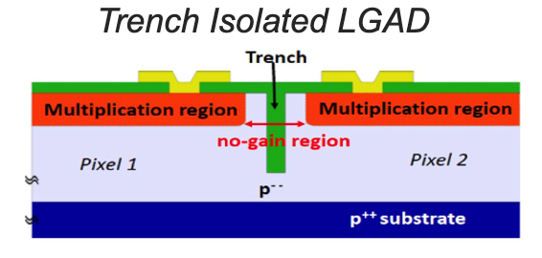
Early Stage R&D- UK initial priority projects
4D Tracking detectors
PI: Richard Bates
Hybrid pixel detectors, LGADs, with 10ps picosecond timing with few micrometre position resolution.
Detector with internal gain produced by impact ionisation operated at a bias where the signal to noise ratio is maximal.
UK industry: Teledyne e2v, Micron Semiconductor Ltd
UK companies produced LGADs with the required gain, though small pixel devices are non-trivial due to controlling the device’s high-field.

Slide 24
Early Stage R&D- UK initial priority projects
RAD-PIX:RADiation-tolerant monolithic PIXel
PI: Eva Vilella
CMOS MAPS widely recognized as future of tracking detectors
UK expertise in High Voltage CMOS sensor technology
High radiation tolerance (≥10¹⁶ n_{eq}/cm²) and low-mass (200 μm), high spatial resolution, high data rate and low-power
Use cases: ATLAS inner tracking replacement beyond Phase II, LHCb Upgrade II (mighty tracker), proton therapy
Builds on/with RD50&DRD-3
& long relationship with CMOS foundry

Slide 25
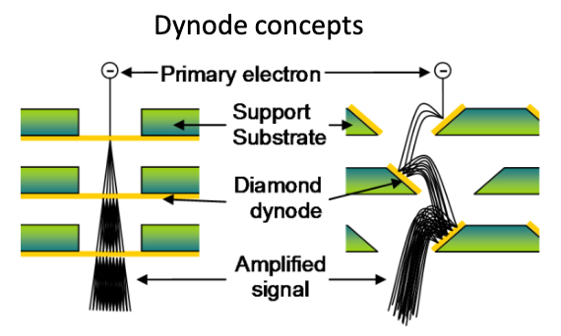
Early Stage R&D- UK initial priority projects
Novel vacuum photon detectors for PID
PI: Jon Lapington
large area, good radiation hardness, excellent timing resobut limited lifetimes and rate capability.
Develop novel gain structures using transmission dynode geometries to address the limitations.
MCP-PMT with a single diamond transmission layer.
Use cases: LHCb Upgrade II (TORCH), Belle II, SHIP, non-HEP
Link to UK industry: Photek

Slide 26
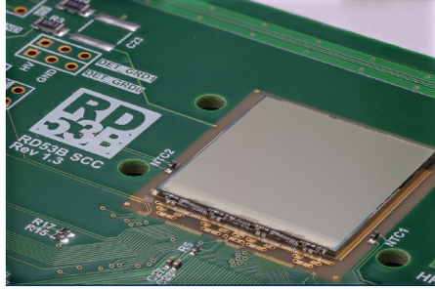
Early Stage R&D- UK initial priority projects
Common interface ASIC
PI: Mark Prydderch
Interface ASIC for detector readout, timing, and control.
System-on-Chip (SoC) approach to the assembly of
configurable, scalable interface ASICs from a library of verified sub-blocks.
Enable experiment tailored ASICs to connect a range of specialised front-end ASICs to a common industry-standard off-detector interface (Ethernet)
Use cases: SOLAIRE, next-generation
high-intensity fixed target experiments.

Slide 27
PPAN Science Board SOI
Strategic Review Particle Physics, December 2022
[ core ~£55m per annum thus 5% is £2.75m]
PPAN Science Board, May 2024
Establish:
DRD-UK
Research programme
average 2.9M/yr, 4 yrs
Centre for doctoral training
Recognition of need – big success of community efforts need to translate into funding – with longterm strategy

Slide 28

STFC Early Stage R&D
Many thanks to STFC, advised to also use existing funding structures and make ~ five submissions.
Full community discussions by UK coordinators, lead to around 30 distinct proposals.
Steering board selected five proposals on short time scale
Took account of: strategic importance to UK; scientific potential;
timeliness to UK.
Proposals each have PI and core team and are integrated with and will support the full UK communities working in their areas.
This is not the DRD-UK programme – it is a first set of interests
DRD is mid-TRL levels. Strategic long-term programme.

