Slide 1
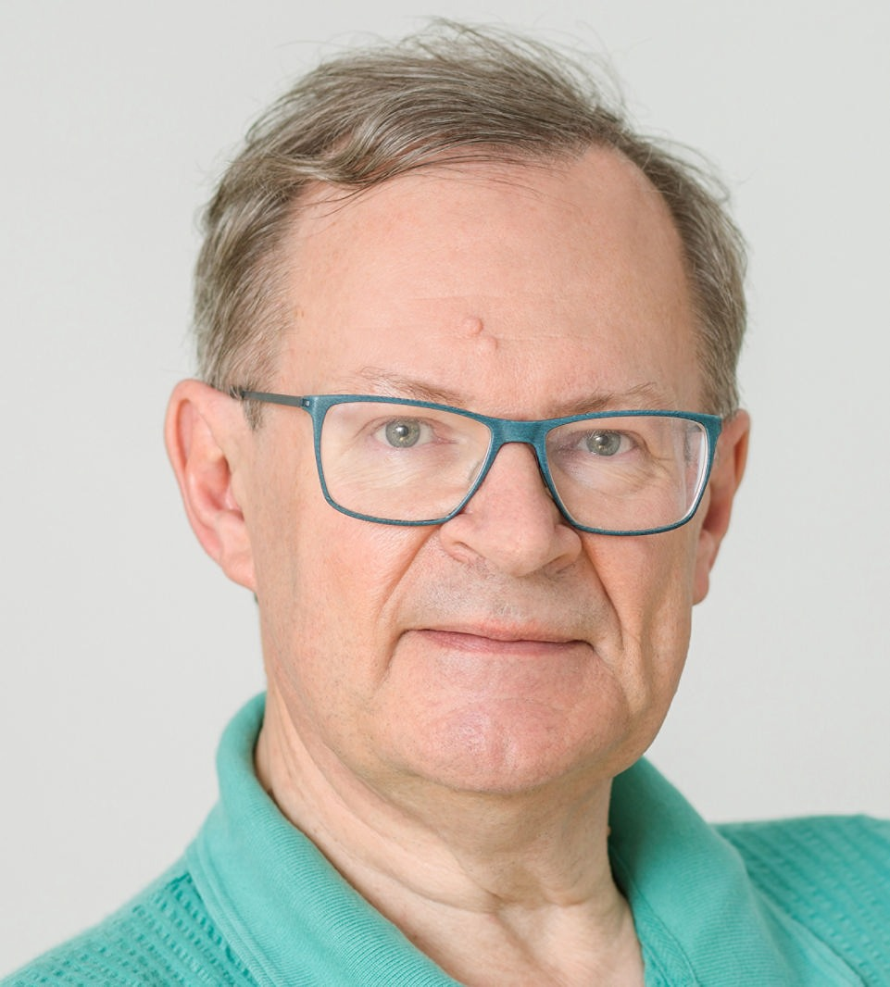
FosterFest Oxford 11th September 2024
Greetings and good wishes from absent friends.

Slide 2
FosterFest Oxford 11th September 2024
From Arnulf Quadt:
Dear Brian,
Congratulations to your 70th birthday and your "official" retirement! It was always a pleasure and fun working for and with you. I always enjoyed very much the productive and creative atmosphere while working
towards goals and deadlines but certainly also the time afterwards where we celebrated the achievements. I always felt a lot of appreciation for my and all our scientific and non-scientific work, the results and the
effort made to get to it. I am grateful for so many discussions on physics and beyond and the time you always took to give valuable advice on physics, career development and life in general.
I wish you a wonderful day and evening today and all the best for your upcoming new phase of your life! I am sure you will enjoy it!
Best wishes and viele liebe Grüße
Arnulf

Slide 3
FosterFest Oxford 11th September 2024
From Wendy Flavell
Dear Brian,
I saw that something called your 'official' retirement is approaching, so just a note to wish you all the best. I do hope that you have a wonderful time during the event planned this week. Knowing you, I'm assuming that there is a big difference between 'official' retirement and taking up gardening, so I'm sure you will be enjoying Physics projects for some time to some!
I thoroughly enjoyed working with you during REF - certainly the team spirit that you built was the only thing that made the task bearable! Being able to count you as a friend has been a source of support since, and I've always very much appreciated your straight-talking pithy commentary on events inside and outside academe - long may it continue!
Wishing you everything that you wish for yourself,
Very best wishes
Wendy

Slide 4
FosterFest Oxford 11th September 2024
From Pete Renton
Hi Brian
I was hoping to attend your Fest next week, but I will be in Switzerland, so unfortunately unable to attend. I congratulate you on your long standing career and thank you for all you have done for Particle Physics.
I remember when you coordinated our response to Kendrew!
Anyway I hope you enjoy your "retirement" !
best regards, Pete
From Akira Yamamoto
Dear Neville and Norman, ……….. I am hoping to express my sincere thanks for his (Brian’s) outstanding effort for guiding us, on the day, in timely manner……………
With my best regards,
Akira Yamamoto

Slide 5
FosterFest Oxford 11th September 2024
From Hugh Montgomery
Brian,
I can’t be there on the 11th but would like to note that three successive victories (at the time of writing) cannot but make us hopeful for this season. I’m not a Makem original but was there on Boxing Day 1962 when the Bury goalkeeper took out Clough’s knee. Also, Jim Montgomery was in goal in the 1973 Cup Final, and arguably won them the game.
So, I have some credentials….
Congratulations on a fine career, and may it never end.
Mont
From Alan Watson
Dear Brian, Congratulations on getting a year older! Sorry not to be able to get to your Fest but we are in Scotland at our cottage near St Andrews and Oxford seems a long way off.
I’m sure that it will be an enjoyable event.
All good wishes, Alan

Slide 6
FosterFest Oxford 11th September 2024
From Pete Watkins
Brian,
Sorry I won't be able to join you at the FosterFest but I look forward to reading the lectures later.
Congratulations on your many important contributions to Particle Physics research worldwide during your long career.
You also played an important role in getting the IOPHEPP group started and developed which has contributed significantly to the strength of the UK HEP community over the years.
All of my best wishes for your retirement
Pete Watkins
From Venki Ramakrishnan
Dear Brian,
I just want to wish you a great celebration of your 70th next month. I am sorry I will not be there to be part of the festivities. I’m looking forward to your book when it comes out, especially as you’ve assured me that a failed physicist will understand it.
All the best, Venki

Slide 7
FosterFest Oxford 11th September 2024
From Gerald Myatt
Hello Brian
On the day of your Fest I will be in Canada on a family visit arranged long ago. I am sure your Fest will be a big success. Best wishes for a long and happy ‘retirement’. I published my last DELPHI paper when I was 78!
Good luck
Gerald
From Juan Fuster Verdu
Dear Organisers,
I am very sorry but I will not be able to attend Brian´s Fest on this date 11th September. I would have been very happy to attend the event but is impossible for me several meetings I cannot skip are happening this date and during the week. I am very, very sorry.
If there is possibility to send some written statement to congratulate Brian I would happy to do so.
Best wishes, Juan

Slide 8
FosterFest Oxford 11th September 2024
From Alan Martin
Dear Brian,
I am very sorry I will not be able to attend FosterFest on Sept.11th, but I would like to wish you, what I am sure will be, a VERY HAPPY 70th BIRTHDAY, and to thank you for all that you have done for the Particle Physics Programme over many, many years. The remarkable FosterFest programme is, in itself, a tribute to this.
I do hope that you will not be leaving the field, and I look forward to seeing you in the future.
All the very best, Alan
From Grahame Blair
Hello, I’m afraid this event conflicts with the annual STFC leadership away day, which I need to attend. So, I’m afraid I’ll have to turn down the FosterFest. I’m very sorry about this – please send Brian my best wishes for this auspicious day!
Best wishes, Grahame

Slide 9
FosterFest Oxford 11th September 2024
From Maury Tigner
Dear Brian,
Upon receiving the announcement of your imminent retirement I was swept by a cloud of remembrances of the adventures we had together. Most prominent was the ICFA committee on linear collider that Sugawara assigned us to and how you got us over the bar by calming the gent who seemed to want to obstruct everything. Then, l remember our times at DESY meetings of some kind and the very pleasant dinners we had afterwards. Prominent too were the musical events at which you played either solo or with your violinist friend – here at Cornell too.
As a small memento of our times together I’d like to send you a book. Can you please send me the address to which it should be sent?
All the very best for an active and happy retirement. If by chance you should find yourself on this side of the Atlantic please give me a ring so we can get together for some reminiscinces.
Yours ever, Maury

Slide 10
FosterFest Oxford 11th September 2024
From John Dainton
Apols about missing this………..
.
There is I see an anecdote session. If there is still time available there I could then pass on my anecdote concerning the success or not that Zeus spokesperson Brian eventually had with DESYaners in explaining the framed photograph he had on his office wall of a famous Test player (I remember not whom)! The matter even spilled over into one or two H1 DESYaners asking me to explain what the picture was about which led me to have to begin the inexplicable in my experience, namely the rules of cricket to mainland Europeans!

Slide 11
FosterFest Oxford 11th September 2024
From Dieter Haidt
Dear Brian,
You are entering in statu emerito and thus in a phase of increased freedom . Rightly a celebration at Oxford takes place to spend a day appraising your great achievements. Unfortunately, I cannot be with you at this outstanding moment, so I like to express to you my thanks for a long common path in form of a letter.
Our first personal encounter was in the HERA era. Soergel created an inspiring atmosphere. You were the spokesman of ZEUS and I was in H1. We had good and regular contacts, since I happened to be editor-in-chief of EPJC and so I got to know all of your excellent analyses. I remember only one event which may have caused an uneasy feeling. It was the publication by Schlenstedt, where he pretended a precise determination of an electroweak parameter. I had to object, because the precision was not a genuine result of the ZEUS data alone, but rather came about through external information and provided therefore only a marginal improvement over the current knowledge. I felt very sorry for Schlenstedt, however his contribution was nevertheless published after appropriate modifications.
.

Slide 12
FosterFest Oxford 11th September 2024
From Dieter Haidt (contd)
I remember with pleasure our musical contribution to Robert Klanner’s retirement. We were performing the trio sonata by Händel HWV 391 together with Elena Donegani. By the way, she is now with great success part of the ESS project and remained active in music. Music is a marvelous part in a physicist’s life. A famous example is Albert Einstein. As a little thought I have sent a CD by separate post.
I was listening with great interest to your presentation at the recent memorial meeting in honor of Don Perkins. I learned a lot about his time as astrophysicist. Colin Ramm, then director of the NPA Division at CERN, was very impressed by him and persuaded Don to join the Neutrino Bubble chamber experiment. This is how Don became a neutrino physicist. When I came to CERN at the end of the 60s I met Colin right at the moment, when he left and quickly his division changed from “english to french”. I met Don Perkins first during a seminar at Faissner’s Institute, when he presented the burning results from SLAC on partons. The subject was so novel to me, that I was wondering, whether he didn’t mean “proton” rather than “parton”. During all the time Don was an exciting and influential person to me and surely to you too. You had the privilege to continue and maintain this stimulating spirit.
With my best wishes, Dieter
.

