Slide 1

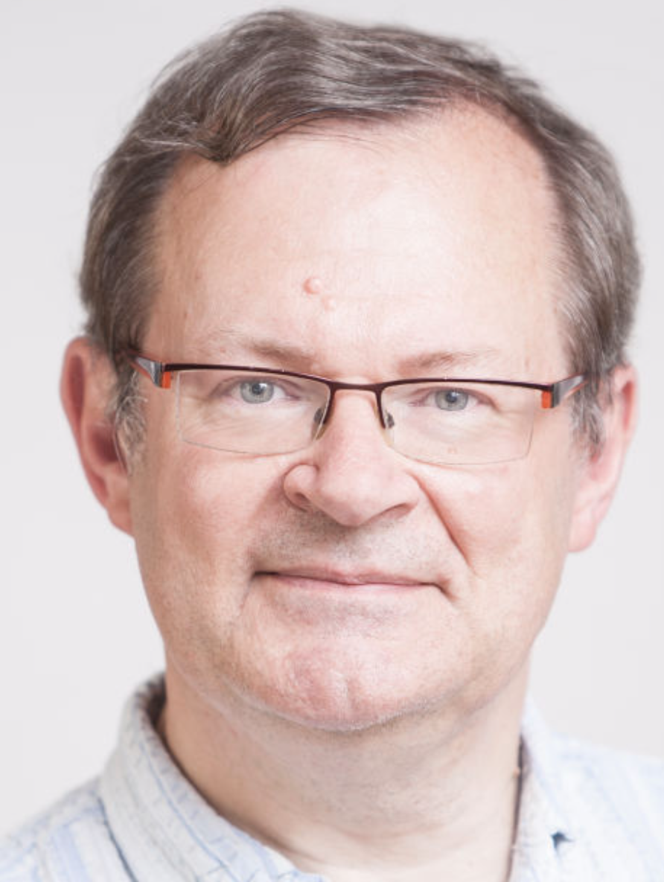
And
N.B. ?!

Slide 2
Outline
Not in order, but weaved throughout…
Introduction to BaBar
The UK in BaBar
Brian’s contributions

Slide 3
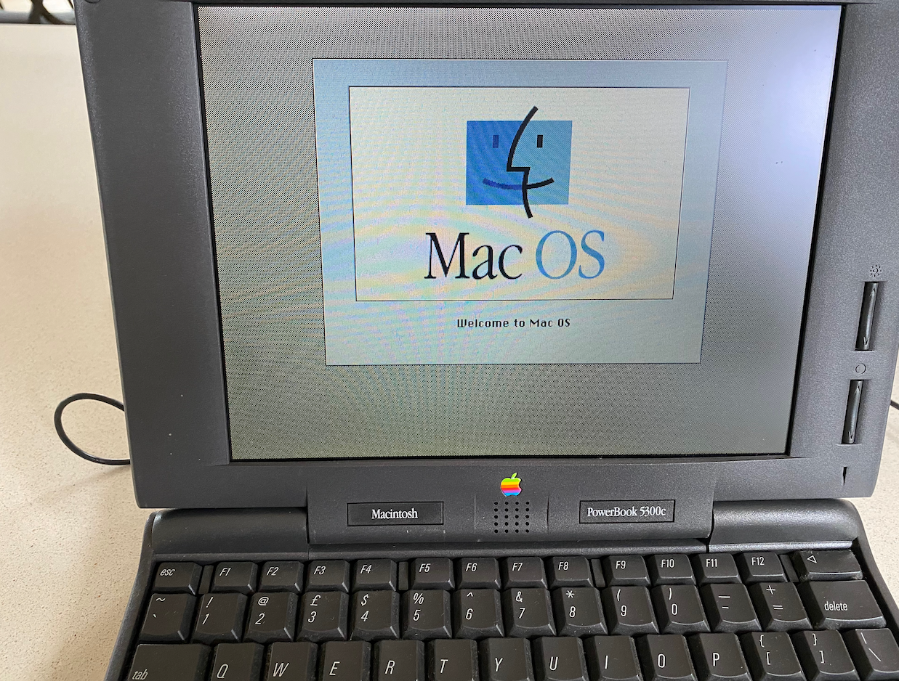
Preliminaries – a note on giving these sorts of talks
Like many physicists of my generation, I had an office full of file cabinets, full of transparencies, and photocopies of other people’s transparencies.
This was the record of events, and we all lived in fear that some day we would have to give a talk like this, and having these old files would ease the burden of trying to remember what in the world happened thirty years ago in a BaBar meeting.
I of course had copies of every talk from every BaBar collaboration meeting since the first meetings.
Then I moved to Australia, and decided I really didn’t need to carry all this paper to the other side of the world.
Happily my 1990s laptop was still able to boot …

Slide 4
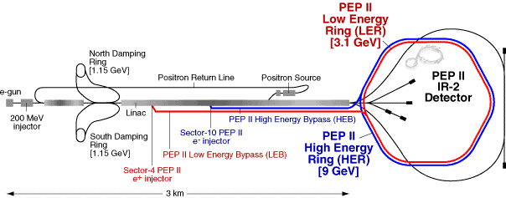
The BaBar Project
In the late 1980s, early 1990s – the Stanford Linear Accelerator Center (SLAC) was looking for a new project to follow on from the PEP II Storage ring, and the Stanford Linear Collider (SLC).
A study was launched to reuse PEPII as a high energy ring and build a new low energy ring in the same tunnel to create an asymmetric e⁺ e⁻ collider.
This collider would produce pairs of B mesons at the Upsilon(4S) which would be boosted in the lab frame.

Slide 5
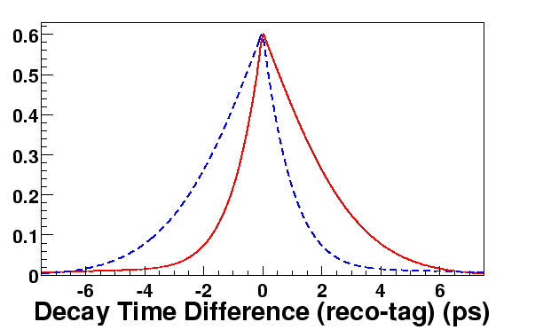
BaBar’s primary physics goal
Measuring CP Violation in b quark decay
Exclusive
B Meson Reconstruction
Very high luminosity, low background conditions.
Fully reconstruct B mesons (in CP eigenstates).
The boost due to the asymmetric collider separated the vertices of the decaying b mesons.
boost of Y(4S) in lab frame : βγ=0.56 (Δz ~ 250 μm)
Flavour tagging in the other B meson to measure CP violation.
The decay rates to the different CP eigenstates with different tagged are sensitive to sin(2β).
B-Flavor Tagging
B
0
=
B
0
tag

Slide 6
BaBar – The project timeline
It is hard today to imagine the speed at which this project came together.
The context at the time:
  SLAC had built the linear collider, which started operation a few months before LEP at CERN.
  The PEP storage ring had stopped operating in the late 1980s.
  It could not compete with the LEP luminosity, but it did have polarization of its beams which gave SLD the possibility of some unique measurements.
  The SSC lab which had been approved in the late 80s, and started hiring, constructing in 1989 was cancelled in October 1993 by Bill Clinton.
  Particle physics in the US was in turmoil.
  SLAC had a plan and acted quickly. So did Cornell, and there was a “shoot-out” between SLAC and Cornell to determine who would get the b-factory project. There was a danger SLAC could close.
  SLAC was chosen

Slide 7
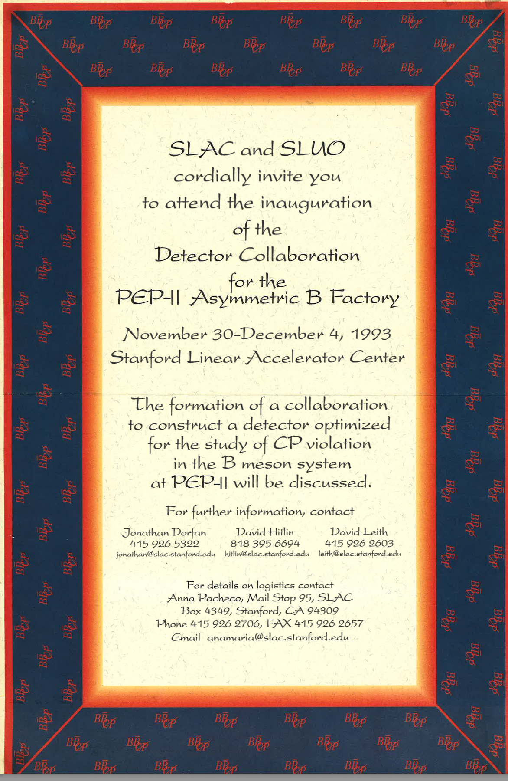
BaBar is launched
Via: UK.AC.RUTHERFORD.IBM-B; Wed, 27 Oct 93 9:11 GMT
From: Chris Damerell NEWS RE. SLAC B FACTORY
The following may be of interest. If you want the further details referred to in the note, I can send them to you. If you want any advice about SLAC as a place to work, I'd be happy to tell you about the experience of my group over the past 10 years. It has been hard work, but very interesting and rewarding.
From: Jonathan Dorfan, David Hitlin and David Leith
Dear Colleague:
Following the site selection for the US asymmetric B Factory by the Clinton Administration, SLAC, together with its user organization - SLUO - invites you to attend a workshop to begin the formation of the collaboration that will design, build and exploit a detector for the broad physics program opened up by the PEP-II facility.
The House/Senate Conference Committee compromise of last week retained construction funds for the start of PEP-II in FY1994. This Bill was passed by the House today and will be voted on by the Senate tomorrow. The proposed funding profile for the accelerator should allow completion in five years.

Slide 8
Accelerator and detector delivered in a decade
Feb 1991
Jun 1993
Jun 1994
Mar 1995

Slide 9
Building a UK collaboration
A small number of us attended the November meeting at SLAC.
We then began organizing a series of meetings and workshops in the UK as well as engaging with the emerging collaboration.
The proposed UK contributions were focused on the CsI electromagnetic calorimeter system.
  A “northern” grouping working mainly on the forward endcap mechanical construction
  A “southern” grouping working on the electronics and trigger for the calorimeter
Meeting at Imperial March 3, 1994
(I seem to have signed this in invisible ink)

Slide 10
Brian brings Bristol into BaBar – June 94
I am circulating a contribution from Brian Foster outlining the expertise of the Bristol group and how it might be applied to the UK effort on DAQ/Trigger.
----------------------------Original message----------------------------
The bunch crossing period at PEP-II is 4 ns, so that pipelined data acquisition and triggering are essential. It is currently intended to use 60 - 120 MHz 8 bit pipelined FADCs to readout the central drift chamber, while the readout of the calorimeter is via a pipelined 1 - 10 MHz 8 - 10 bit FADC. Clearly the experience of the Bristol group in building and commissioning the ZEUS Central Tracking Detector FADC system which has many of the required features, although a shorter pipeline length, will be useful in these designs.
Some aspects of the first level trigger are also likely to be implemented on the front end cards. Again, our experience in the design of the ZEUS CTD FLT, which is a pipelined first level trigger processor with 48 ns processing steps, will be very relevant. Many of the problems which we have solved on ZEUS, such as interconnections between modules in order to cope with tracks crossing boundaries, also need to be solved here. The likely solution for the segment finding of the drift chamber involves programmable gate arrays, another area in which the ZEUS FLT has given us much relevant experience. Similar solutions are likely to be of use in the calorimeter first level trigger. We would wish to be involved in the calorimeter trigger, which fits in well with the UK's involvement in the CsI calorimeter construction.

Slide 11
Calorimeter readout and trigger in the early 90s a transition from analogue to digital
Computing power was still growing rapidly in the early 90s and it was becoming possible to move to more digital solutions for front end electronics and triggers.
The proposed B factory had a very high luminosity (3 x 10^³³ cm⁻² s⁻²). Bunch spacing was 1.2m.
The calorimeter needed excellent energy resolution to deliver the physics requirements.
  A crystal calorimeter was chosen to give this performance.
The high interaction rate meant that the dominant source of noise in the calorimeter was not the electronics, but rather background photons.
The high rate of backgrounds also meant the crystals would be damaged, and a low noise electronics was needed to calibrate the crystals to correct for this damage.
  A neutron gamma source was used to provide low energy calibration photons.
The electronics and trigger had to deal with both sets of requirements.

Slide 12
Solution: an all-digital electronics system

Slide 13
Digital filtering
Short shaping time in the pre-amplifier
Digitisation on the front end (on detector)
Optical readout from the detector
Optimal filtering for data taking/triggering/calibration

Slide 14
Defining the UK contributions to the BaBar electronics – 7/94
There was huge demand on RAL electronics expertise at this time (LHC prototype work for example)
Brian of course knew everyone – this was my first meeting with Peter Sharp who was head to TD at the time.
Peter was convinced that this was a good project for TD to be involved in, and we scoped the involvement in the project.
In the end there were a lot of engineers involved! (not FTE, just lots of different engineers)

Slide 15
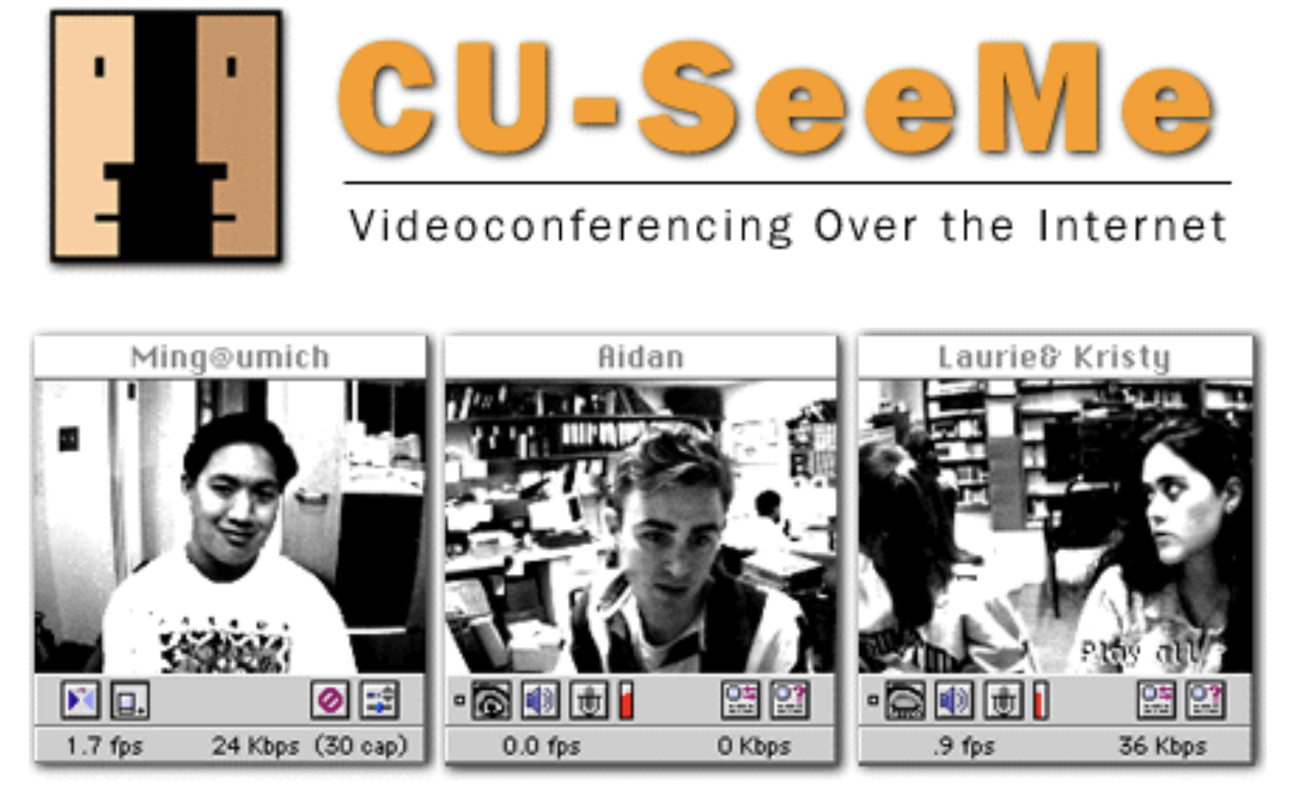
Collaborating with Bristol/RAL
Brian in the background doing emails
The rapid pace of the project meant frequent meetings.
We started using the video-conferencing between the three sites on a regular basis to meet more regularly.
Date: 1 October 1995 at 3:58:40 pm AEST
To: bf@siva.bris.ac.uk (Brian Foster)
Hi Brian,
I managed to buy one of these little cameras from Fry's ($85 only), and also to get the sound working. The trick for getting the sound working with CU-Seeme is to have something called sound manager 30 in your system folder (Extensions). I also managed to get this reflector set up on our machine here and have tested it sending my picture to macs all over the lab.

Slide 16
Brian working behind the scenes
From: Brian Foster
Subject: Disucssion with David Saxon...
Date: 9 January 1995
Dear All,
I had a chat to David Saxon yesterday about various things related to BaBar, some of which were of general interest which I thought I should pass on to you. Firstly we discussed the question of how worried we should be to ensure that individual group efforts should appear "viable". His feeling was that this was still an important point, though perhaps the rumours that were circulating a few months ago about Swindon coming down really hard on this were now not so strong. Obviously however, he encouraged us to maximise individual group efforts, to ensure that it was clearly indicated which areas groups would contribute to and that the effort seemed adequate to do them, and that if there were some question about this it might be sensible to try to "link together" groups, preferably with other groups which were geographically close, to bring their effort up to some "critical mass". We then discussed the question of the timescale for approval. I emphasised the serious consequences for us and for BaBar if PPARC could not move to an approval with all deliberate speed. He accepted this and gave the strong impression that he thought that as far as the PPESP/PPC end was concerned there should be no problem with this. He was also rather upbeat about the possibility of PPARC itself coming to a conclusion before all the details of the LHC experiments were settled. There is certainly a feeling inside PPARC that there needs to be greater breadth of the particle physics programme and all the indications are that they in general and Ian Corbett in particular are well disposed in principle to BaBar,

Slide 17
Presentation to the PPESP March 95

Slide 18
1995 the first crack at budget
Back in the day when George wrote a number on the blackboard …
Dear David,
I am reporting to you the results of the UK meeting with Corbett and
Kalmus on June 5 to discuss the UK funding of commitments.
1. The amount of money we have been given is 2.4 M pounds, and we can only make
commitments for that amount of money. We can therefore make no commitment
to stage any part of the detector.
2. This money allows us to finance in full our previously agreed electronics
commitment, (excluding the CARE chip), the mechanics for the endcap together
with some beamtest and radiation damage studies of crystals, and 315 of the
900 crystals for the endcap.
3. The 585 unfunded crystals must be regarded as a shortfall
for the collaboration as a whole and not solely the UK.
Note from JRF to D. Hitlin – June 1995

Slide 19
Getting the funding - 95
There was tension between funding for the various parts of the project.
The UK would pay for the mechanics and some crystals for the endcap, but couldn’t afford all the crystals.
Working on the electronics would bring much more to the UK than just paying for crystals.
Brian was essential in getting this message across to the collaboration and to Swindon …
Date: 5 July 1995 at 7:01:56 pm AEST
Dear Jordan,
I think we should now be very hard-nosed. This possible extra money on the "optimistic" line should go into crystals, with all provisos in case it doesn't turn up, allowing us to keep all the electronics we currently have. I know from my brief discussions at Swindon that Ian Corbett and the office are aware of the tendency of SLAC to like to drag all the interesting things back and are concerned that all the UK money shouldn't go into crystals. So I think we now are in a strong position vis a vis arbitrary demands based on money issues to transfer things back to US. However, we may still be under pressure wrt "commonality" type arguments and certainly the further we are ahead there the better.

Slide 20
A hitch in funding …
Brian’s email to me told a slightly different story, but contains inappropriate language …
Dear Colleagues,
Whilst the news from PPARC Council is not the brightest, we should congratulate Brian Foster for doing a superb job in presenting and defending BABAR. Approval in Principle was granted to us, and we should accept that for what it is.
Ian Corbett phoned me this morning and emphasised that he would do all he could to assist us. In particular, he said that if the PPC re-affirmed BABAR then he would give the OK from the Office and write to Ken Pounds with a firm recommendation for approval The timescale for achieving this is 4 to 6 weeks ... ie before the BABAR Collaboration meeting.
After a tense few weeks, funding was granted

Slide 21
Building the electronics
No Analog signal cables coming from the detector

Slide 22
Triggering using the digital data stream

Slide 23
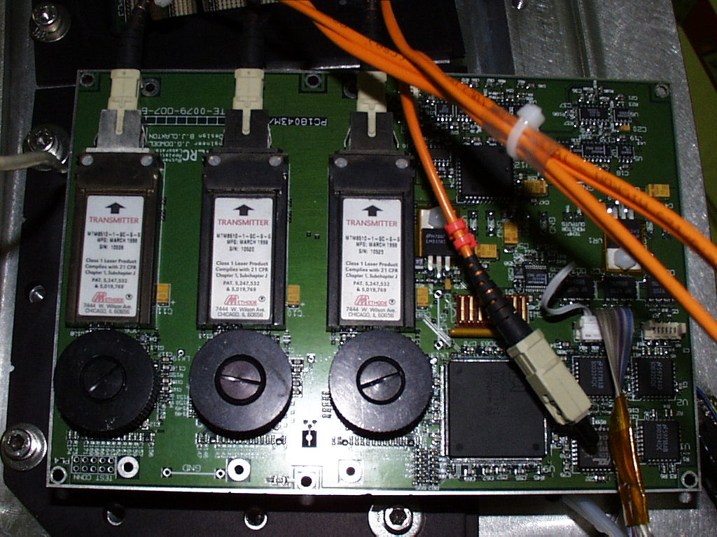
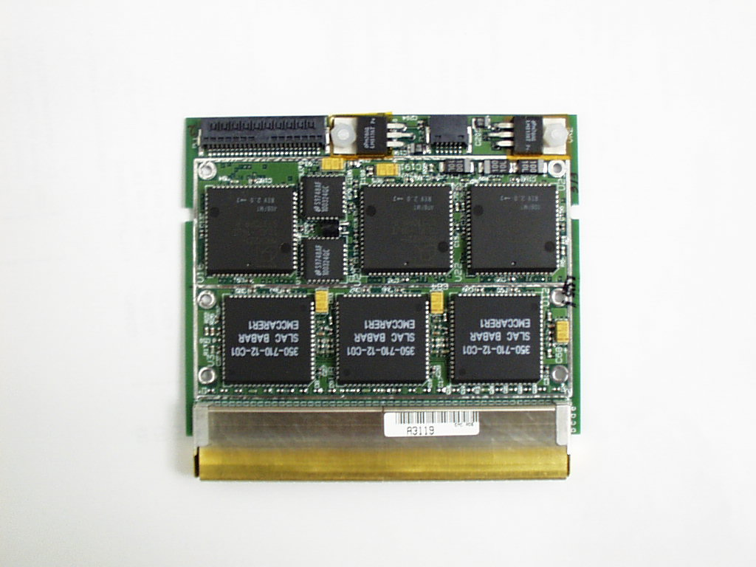
Innovation
Fibre-optic readout of all front end data.
100s of optical fibres from the detector
Pipelines, filtering, DAQ all performed in custom Read Out Modules (PPC commercial modules with a custom mezzanine)
RAL Engineering a key piece of making this happen.
IO Board
Prototype Optical Link
Front end digitizer card

Slide 24
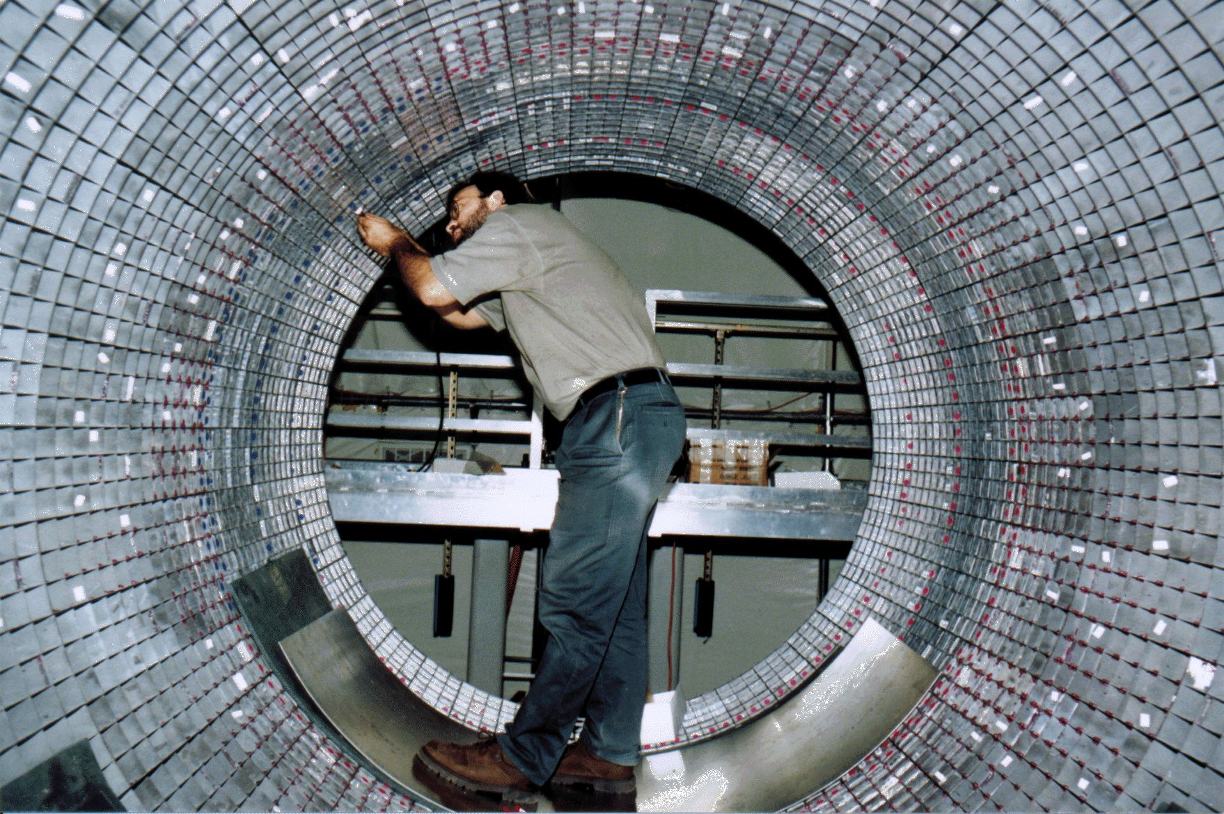
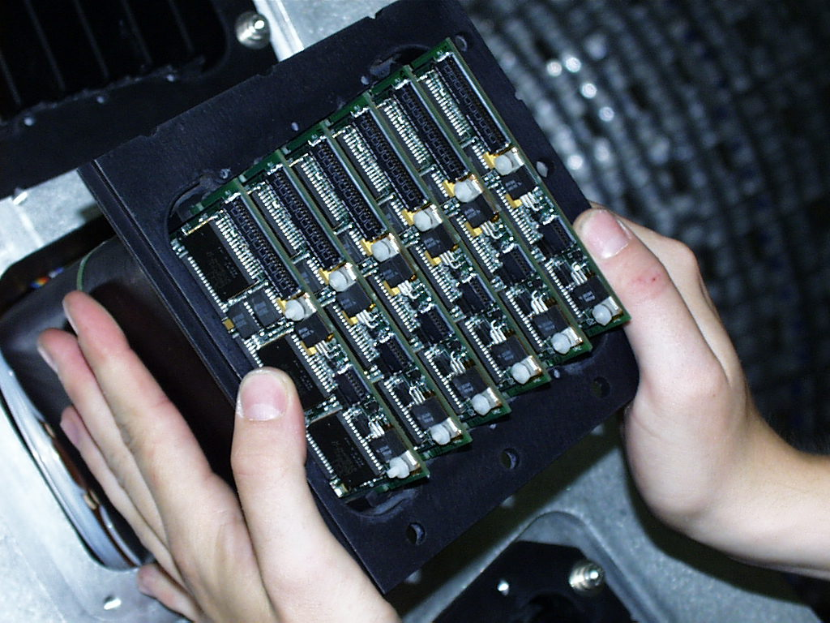
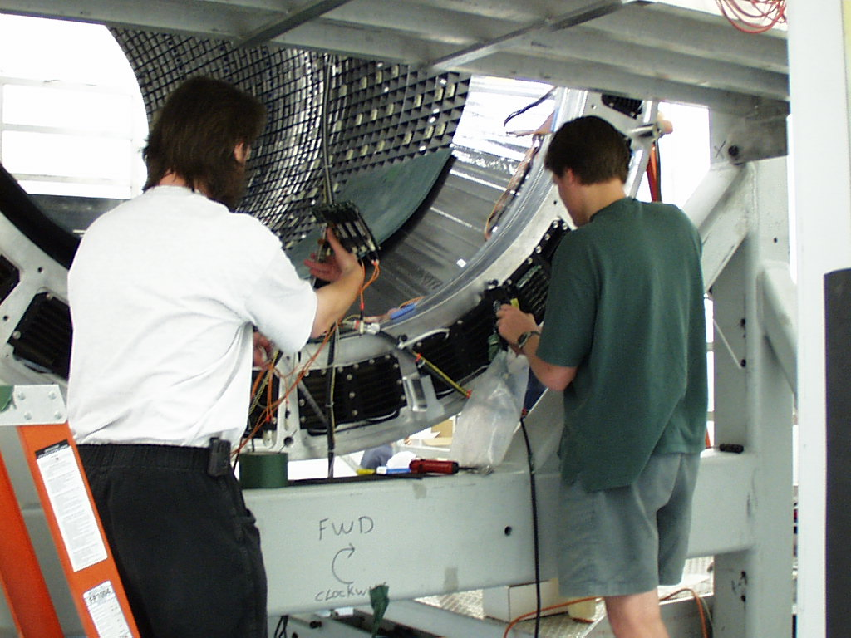
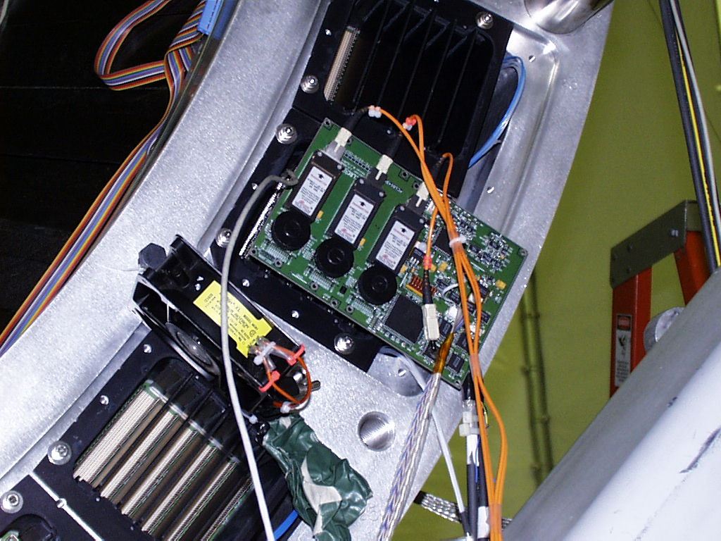
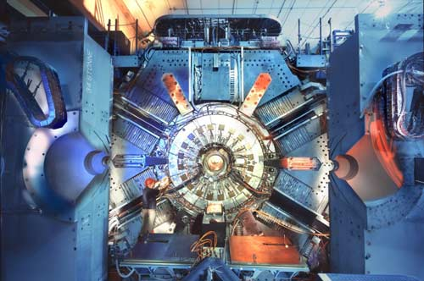
Installation and completing the detector

Slide 25
Data Arrives
Early 2000
Look at π⁰ s in the Calorimeter
First collisions were seen in May 1999
By the end of 1999, the accelerator was up and running, and in early 2000 data taking began in earnest.
There was a long saga with object- oriented databases (“objectivity”) which couldn’t cope with our data volumes and the collaboration moved to using Root.

Slide 26
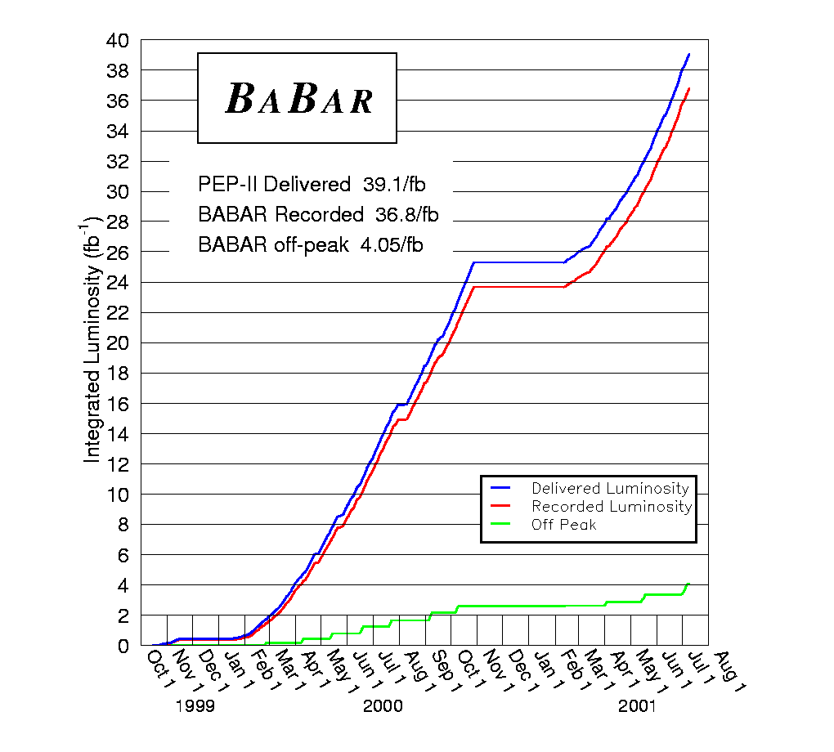
Measuring CP Violation
By the time of the summer conferences in 2001, the collaboration was showing results observing CP violation.

Slide 27
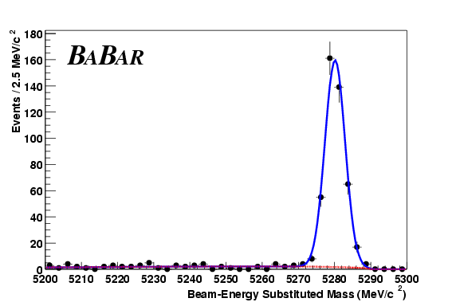
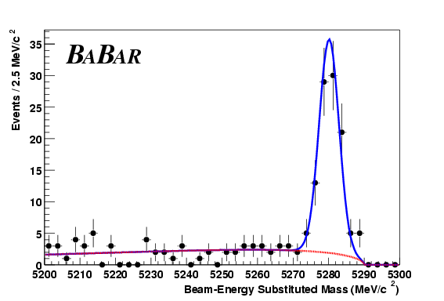
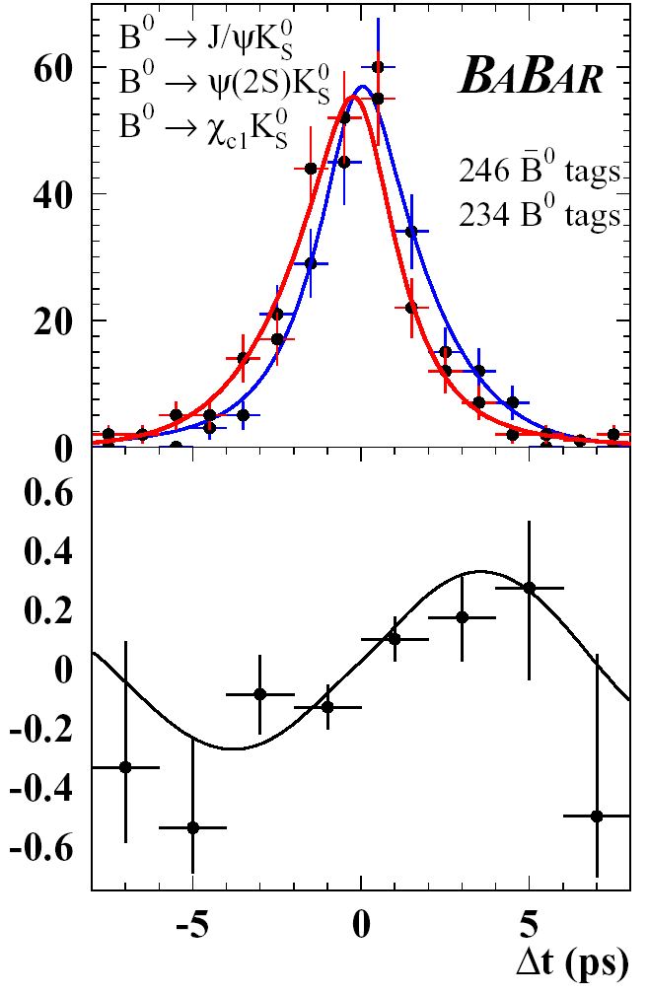
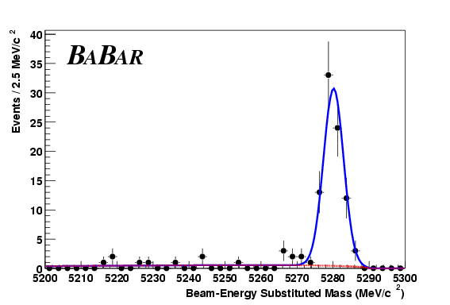
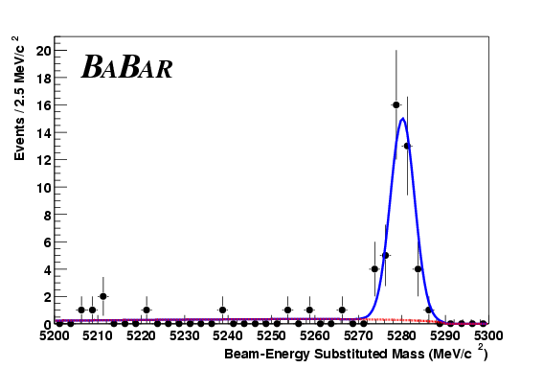
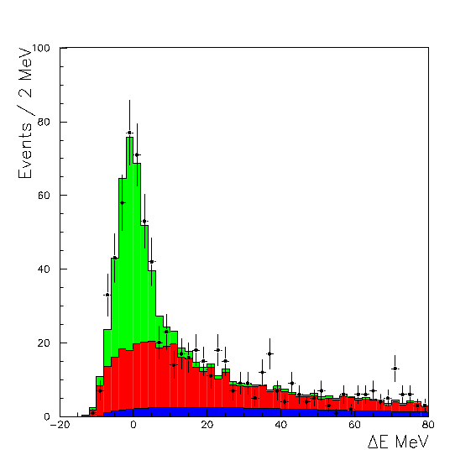
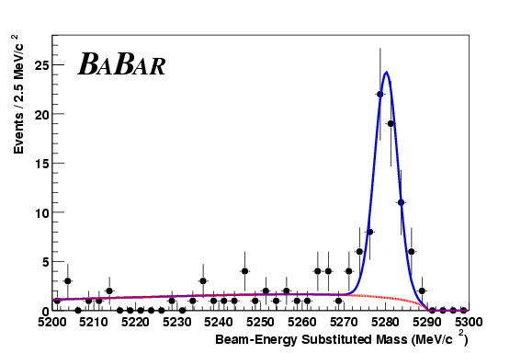
BABAR
29 fb⁻¹
J/ψ K_{S}
Events: 316
Purity: 98%
Events: 64
Purity: 94%
K_{S}→π⁺ π⁻
K_{S} → π⁰ π⁰
Events: 67
Purity: 98%
ψ(2S) K_{S}
Events: 33
Purity: 97%
χ_{c1} K_{S}
1999-2001 data 32x10⁶ BB pairs, 29fb⁻¹ on peak
Events: 273
Purity: 51%
Events: 50
Purity: 74%
J/ψ K_{L}
J/ψ K*
Sample | tagged events | Purity | CP
[J/ψ, ψ(2S), χ_{c1}] K_{S} | 480 | 96% | -1
J/ψ K_{L} | 273 | 51% | +1
J/ψ K*⁰(K_{S}π⁰) | 50 | 74% | mixed
Full CP sample | 803 | 80%
sin2β=0.56±0.15
Raw Asymmetries

Slide 28
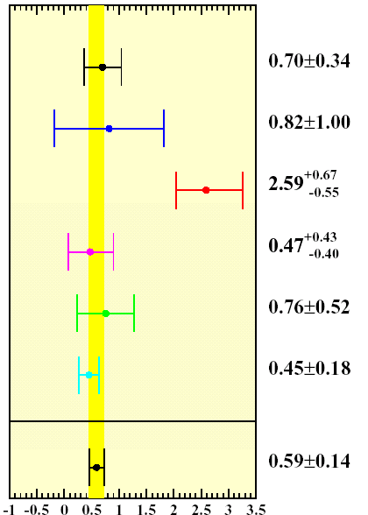
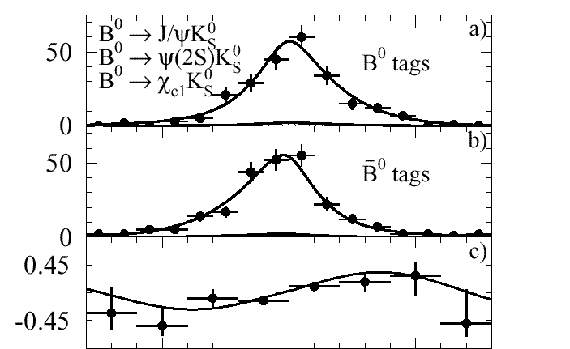
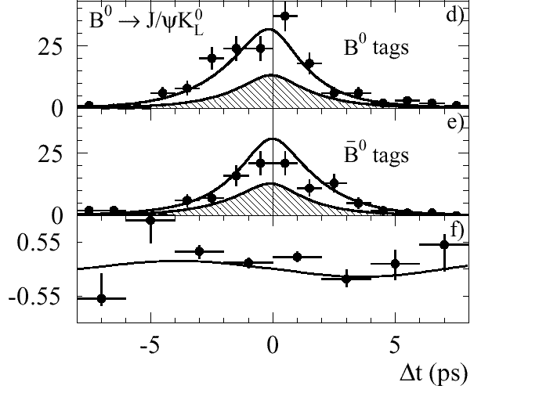
Sin(2β) result (2001)
sin 2β by decay mode
Submitted to PRL
on July 5, 2001
BABAR
29 fb⁻¹
sin(2β) = 0.59 ± 0.14_{stat} ± 0.05_{syst}
all modes
sin2β

Slide 29
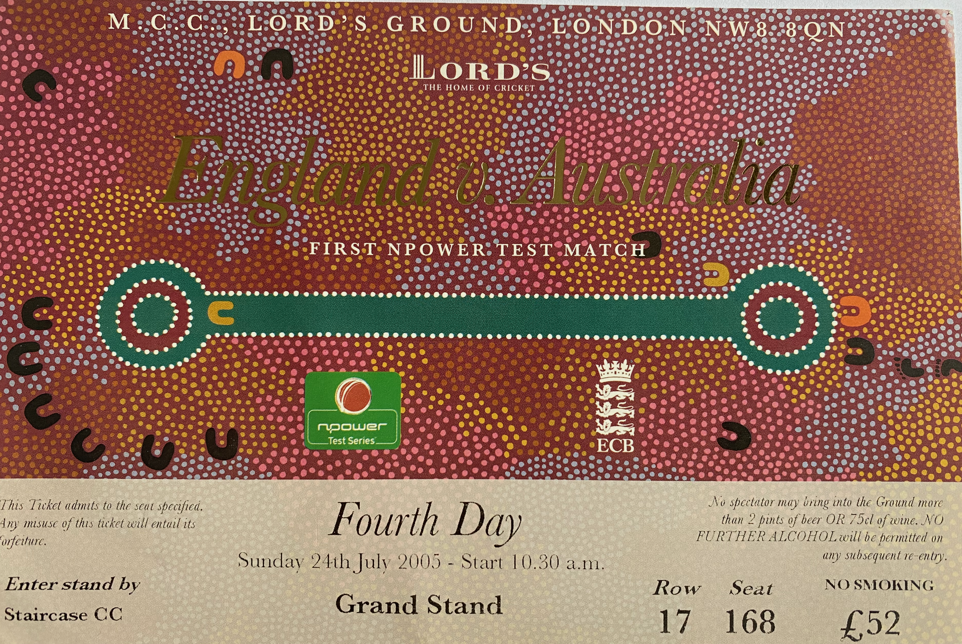
Final Words
In 1999, Brian became Zeus spokesperson and was winding back participation on BaBar.
Then he moved to in 2003 Oxford, and left BaBar.
I moved to CERN in 2003 to work on CMS and left BaBar.
Participation on BaBar was the last project I worked on which moved on such a timescale, and those of us involved felt a real sense of achievement.
I had a great time working with Brian who was a colleague, mentor, and always willing to head off for a swifty.
With Brian’s help, I Learned about bringing a project into existence from concept, to building collaborations, to getting funding, to solving the technical and personnel issues, debugging, commissioning, and getting the data out.
I also learned the proper decorum to maintain for a day at Lord’s for the cricket…
Probably the latter influenced the quality of my memories of the former, but those that I still hold remain an excellent chapter of my physics journey.

