Slide 1
Electra at LEP and
SDC at the SSC or
‘The ones that got away’
Roger Cashmore CMG, FRS

Slide 2
The Historical context …. 1
1970’s …. Very successful e+e- colliders .. SPEAR,PETRA , PEP,
DORIS, CESR,
…. SppS at CERN
Discovery of c, tau and b and g, W and Z
Designs of detectors refined …. Mainly solenoids with cylindrical detector systems

Slide 3
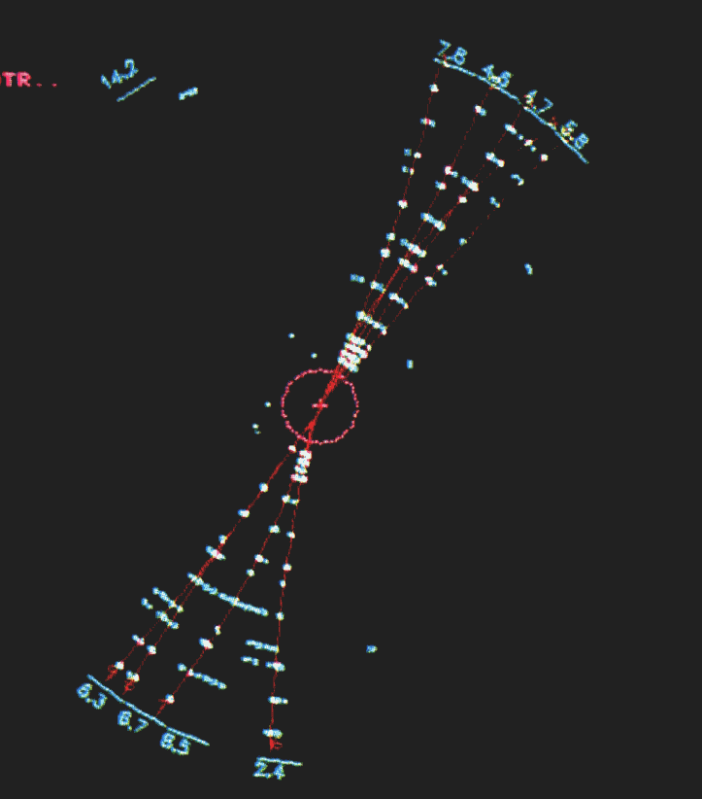
Quarks and Gluons and Taus in TASSO
Quarks

Slide 4
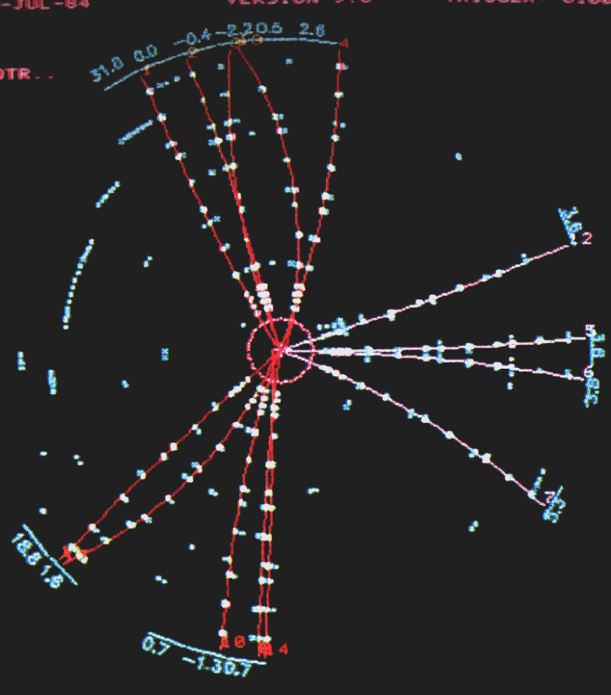
Gluons

Slide 5
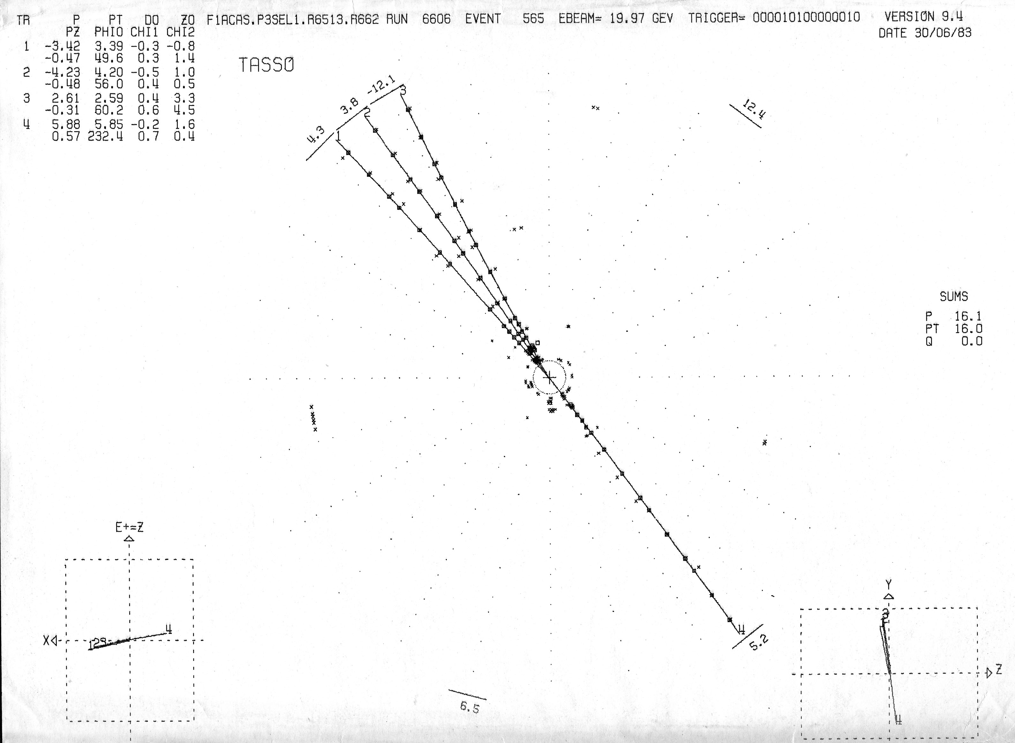
Tau lepton

Slide 6
The Historical context …. 2
Study W,Z and possibly discover Higgs and top quark
Led to Tevatron, LEP, and the SSC/LHC
1976 … B.Richter first proposed LEP (in NIM article)
1985 … SSC proposed in US
1980’s … LHC at CERN

Slide 7
Electra at LEP and
SDC at the SSC or
‘The ones that got away’
Roger Cashmore CMG, FRS

Slide 8
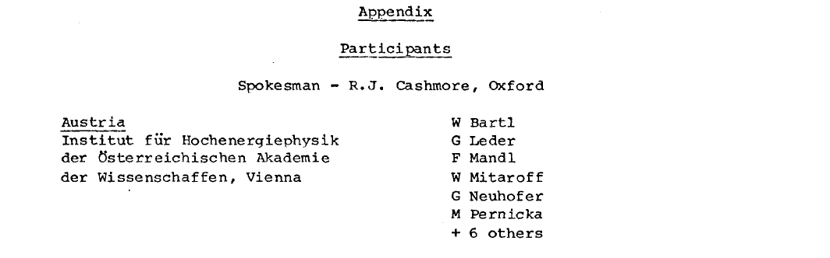
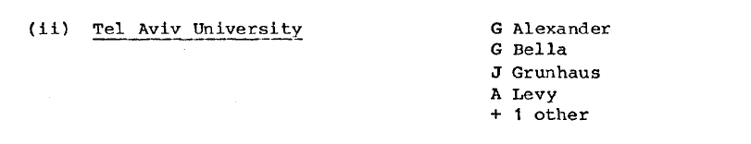
Electra

Slide 9
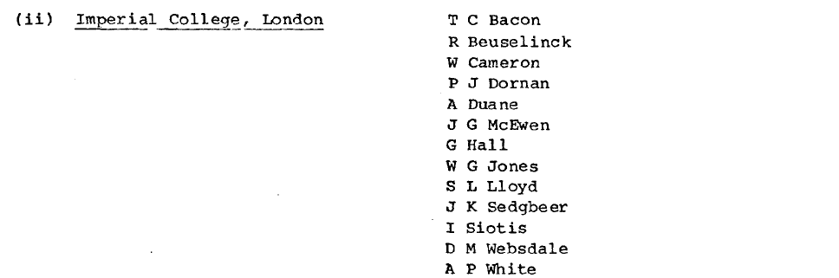
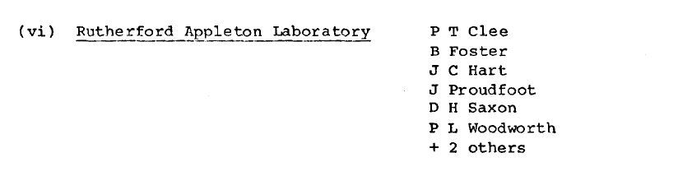
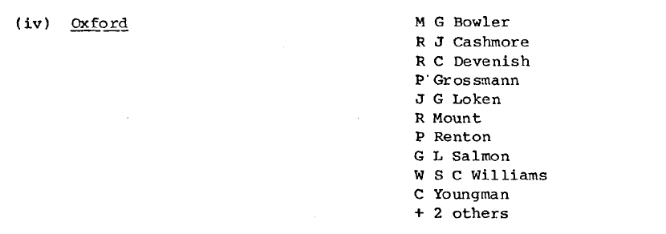

Slide 10
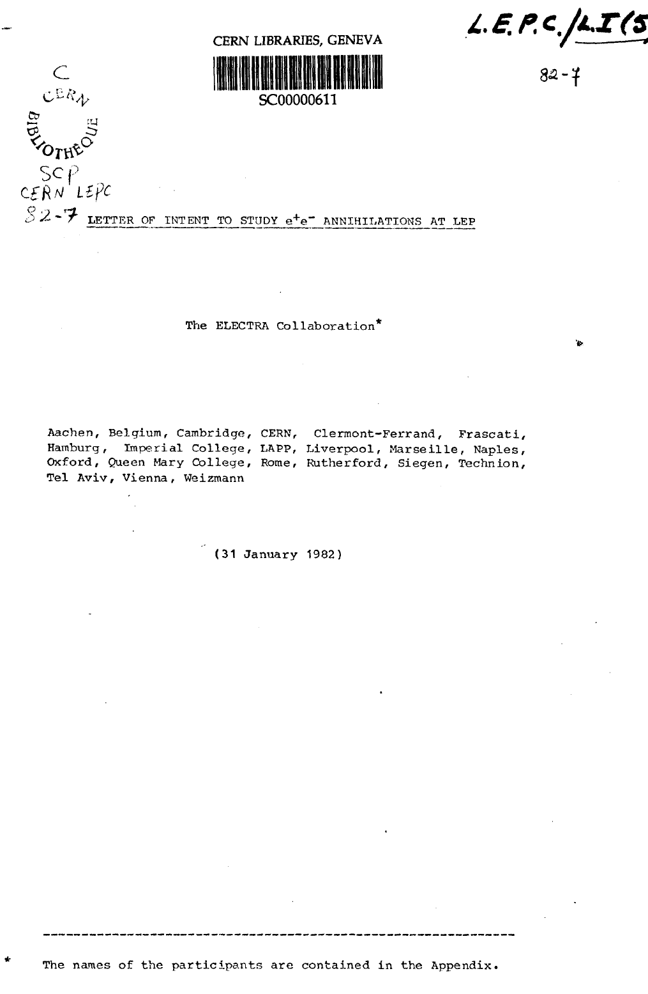
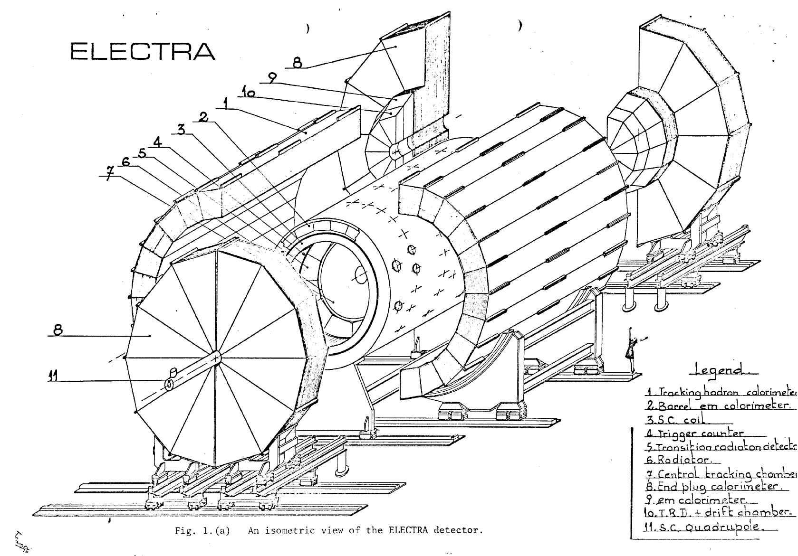
Electra

Slide 11
After ELECTRA
4 expts accepted for the 4 interaction regions at LEP
ALEPH,DELPHI,L3,OPAL
Benefits to other LEP experiments
RAL S/C magnet group …….. DELPHI
IC group …….. ALEPH

Slide 12
After ELECTRA
ep DIS, proton structure,QCD and EW(NC/CC) unification
HERA (BW) and ZEUS (GW)
96nsec ep crossing time
UK provided central tracker (borrowing from CDF)
and also
developed pipelined electronics and trigger
(BF and Peter Sharp/RAL)

Slide 13
The SSC in the USA
A High Energy p p collider was proposed in 1984/85
and eventually approved
This was the Superconducting Super Collider ( a name coined by D.Jackson)
The energy was to be 20 Tev x 20 Tev

Slide 14
SSC in Texas
Very High Energy( 20x 20 Tev) pp collisions
54 mile circumference! (cf FCC at CERN)
Roy Schwitters (Project Leader/Director)
A ‘green field’ site was chosen near
Waxahachie in Texas
the state providing support in attracting the project
Construction and tunnelling was begun ~1990

Slide 15
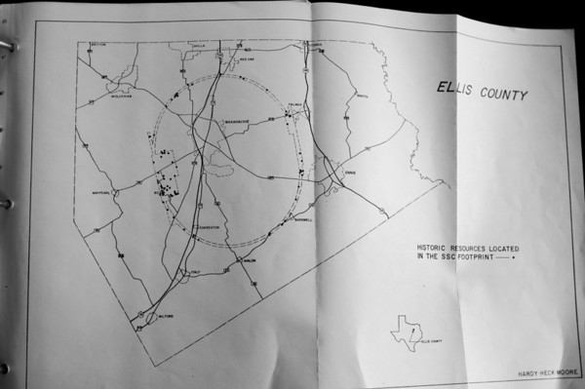

Slide 16
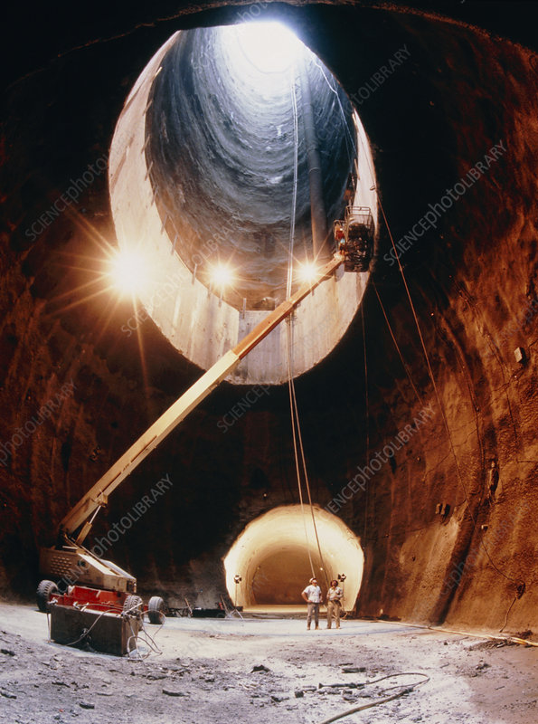
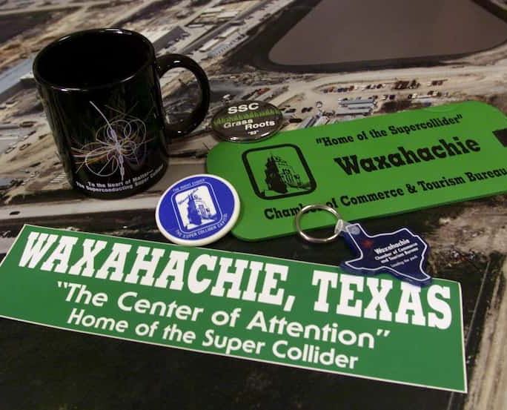

Slide 17
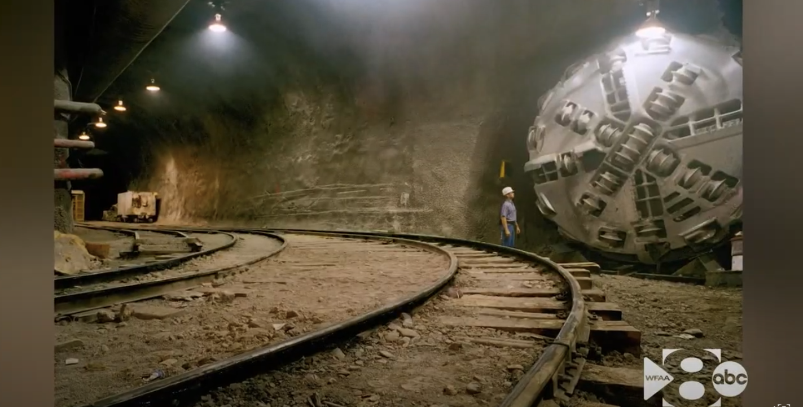
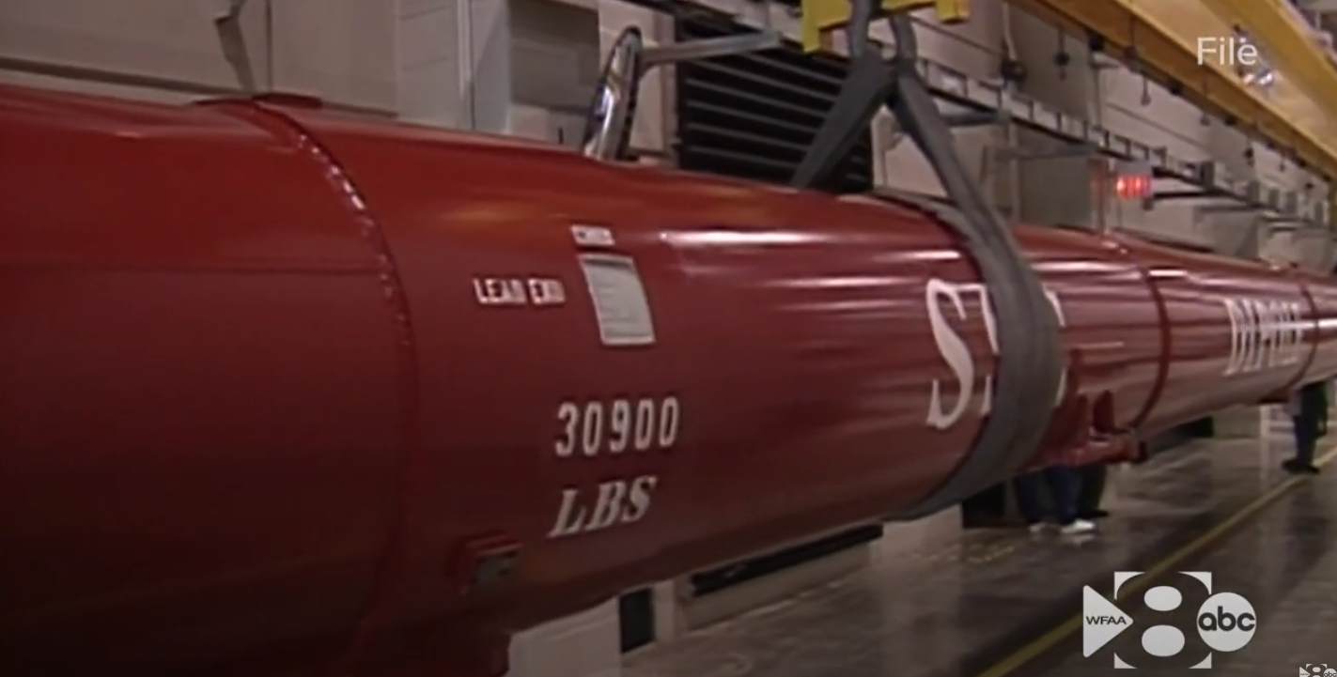
Constructing the tunnel
SSC Dipole Magnets

Slide 18
UK involvement in the SSC
UK joined the
Solenoid Detector Collaboration (SDC)
to propose and help construct an all purpose detector
exploiting experience from
PETRA and HERA
and
H1 and ZEUS

Slide 19
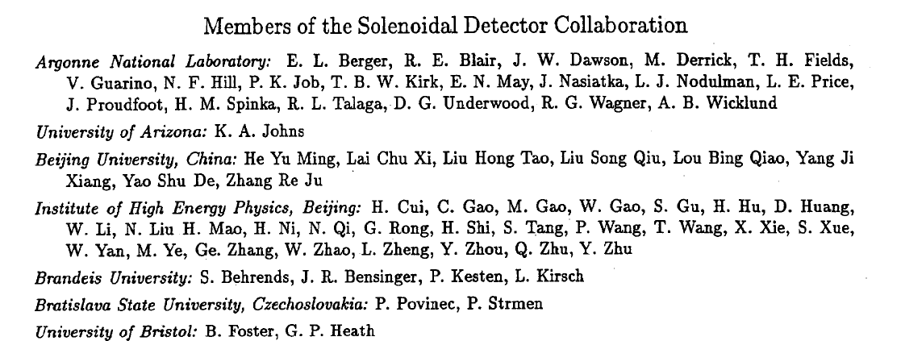
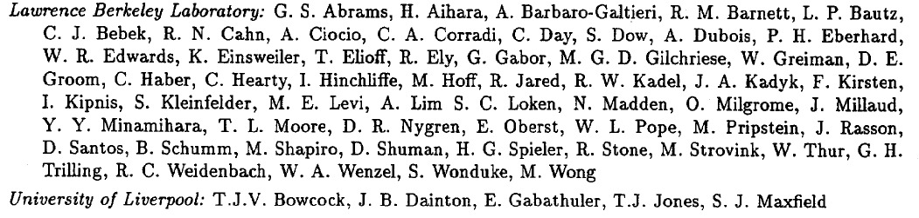
SDC

Slide 20
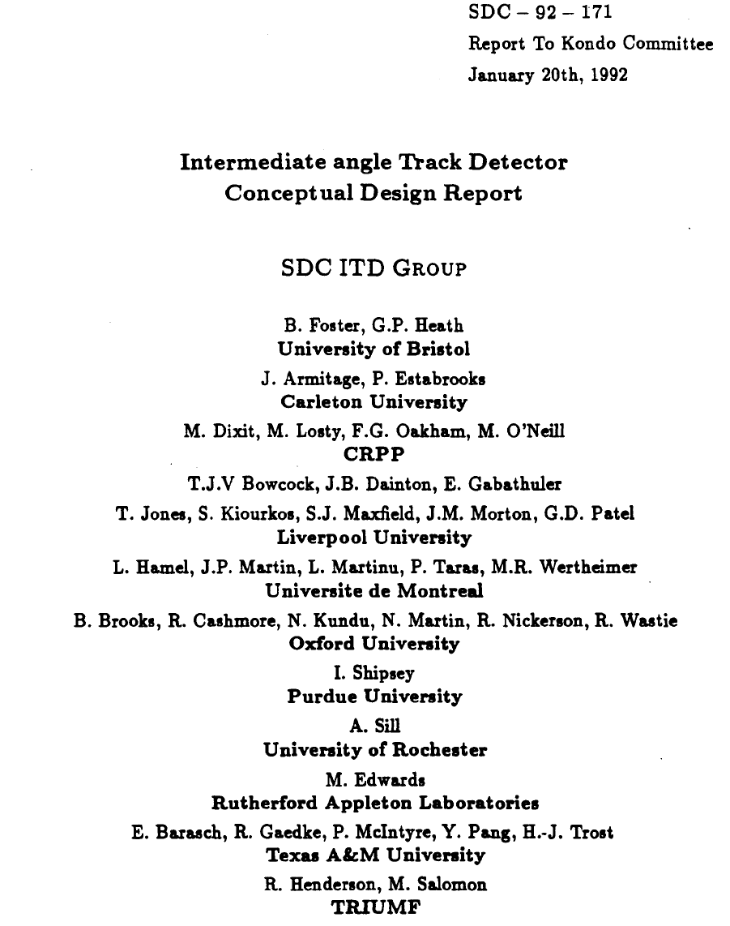
SDC

Slide 21
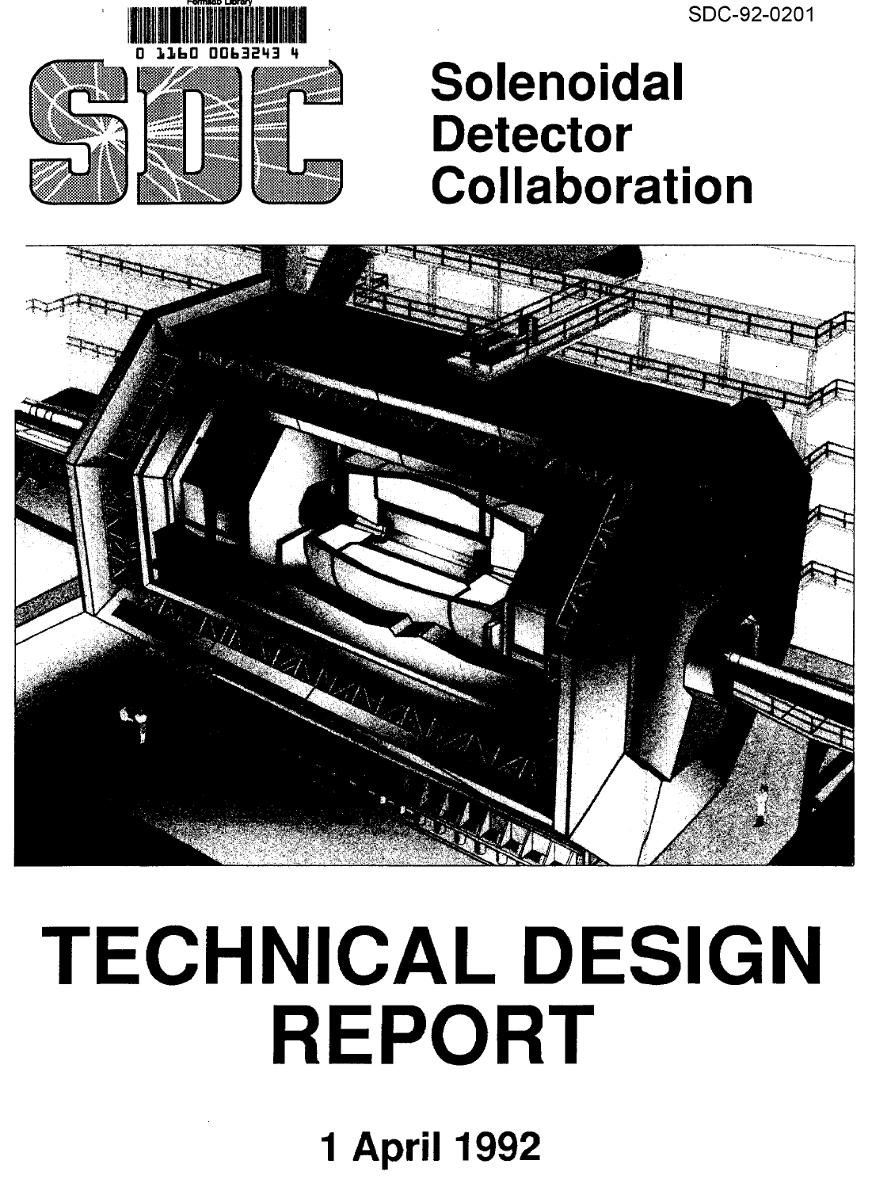
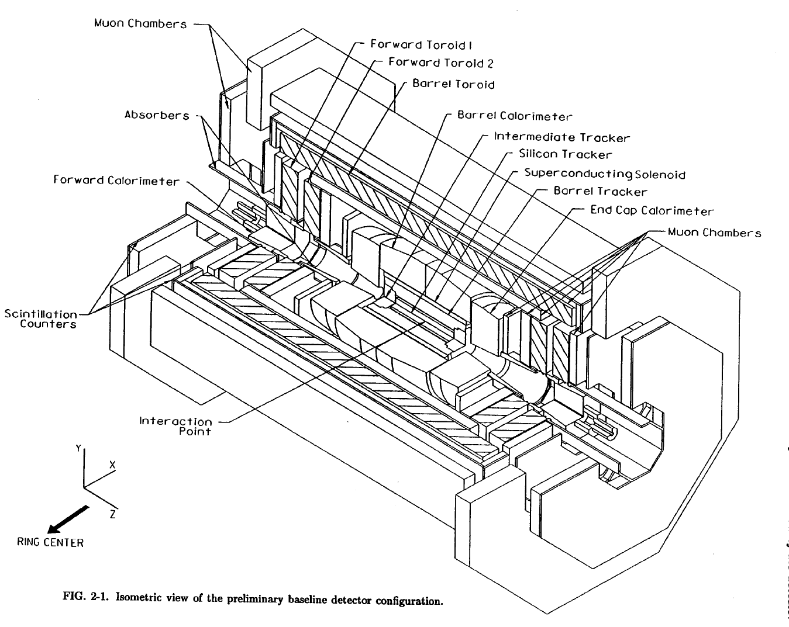
SDC @ SSC

Slide 22
Underestimating the politics!!
US (Bush snr) attempted to get Japan to collaborate and contribute ~$1.0B
Unfortunately This Failed!!
Texas was intending to contribute a large sum
1992 … US Presidential Election .. Democrats/Clinton won
Major arguments in US/Science circles in ’93/’94
In 1994 Clinton ‘canned the SSC’
This time the accelerator ‘failed’ not the expt !!
AND
fortunately the LHC still ‘existed’ at CERN

Slide 23
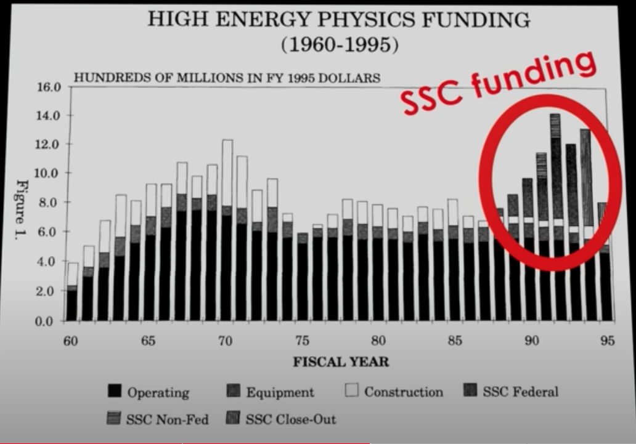
Asking price for the SSC site in 2011 was $6.5M.

Slide 24
Meanwhile in Europe
AT CERN
The LHC,a much lower energy machine ,was promoted by Rubbia
Later to be picked up and carried forward by Chris Llewelyn Smith and Lyn Evans
And the LHC in the LEP tunnel was eventually approved and BUILT
AT DESY
Bjorn Wiik had decided to remain promoting S/C Rf cavities
For use in a Linear Collider and/or FEL

Slide 25
??? An after thought ???
Had Bush achieved a large Japanese contribution
and/or Republicans won in 1992
We might already have had
a 20Tev pp collider
and
a ~ 80 km circumference tunnel
and
a high energy e+e- linear collider!!

Slide 26
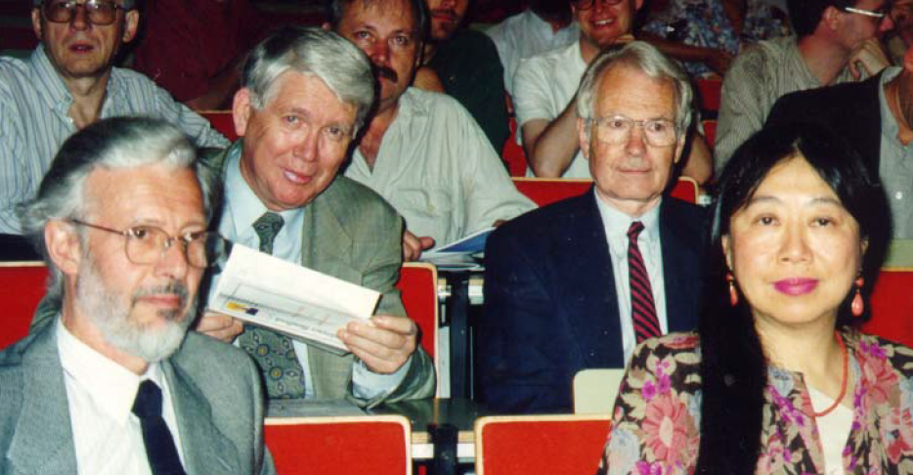
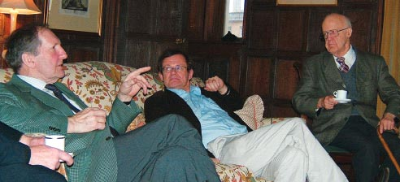
In summary…. A few Friends

Slide 27
The person and lab context
A short history and a few names
SLAC / SPEAR (~1965 – 1980)
Pf/Burt Richter/ Roy Schwitters
Gunter Wolf/ Bjorn Wiik /Paul Soding(LBL)
CERN(~1970 –Now)/SPS,SppS,LEP and LHC
BR(1976),Carlo Rubbia,Herwig Schopper,CLS
DESY/DORIS/PETRA/HERA/LC and FEL
GW/BW/PS (Tasso) …. (ZEUS)
Tevatron/SSC(Texas)
RS(… 1993)

