Slide 1
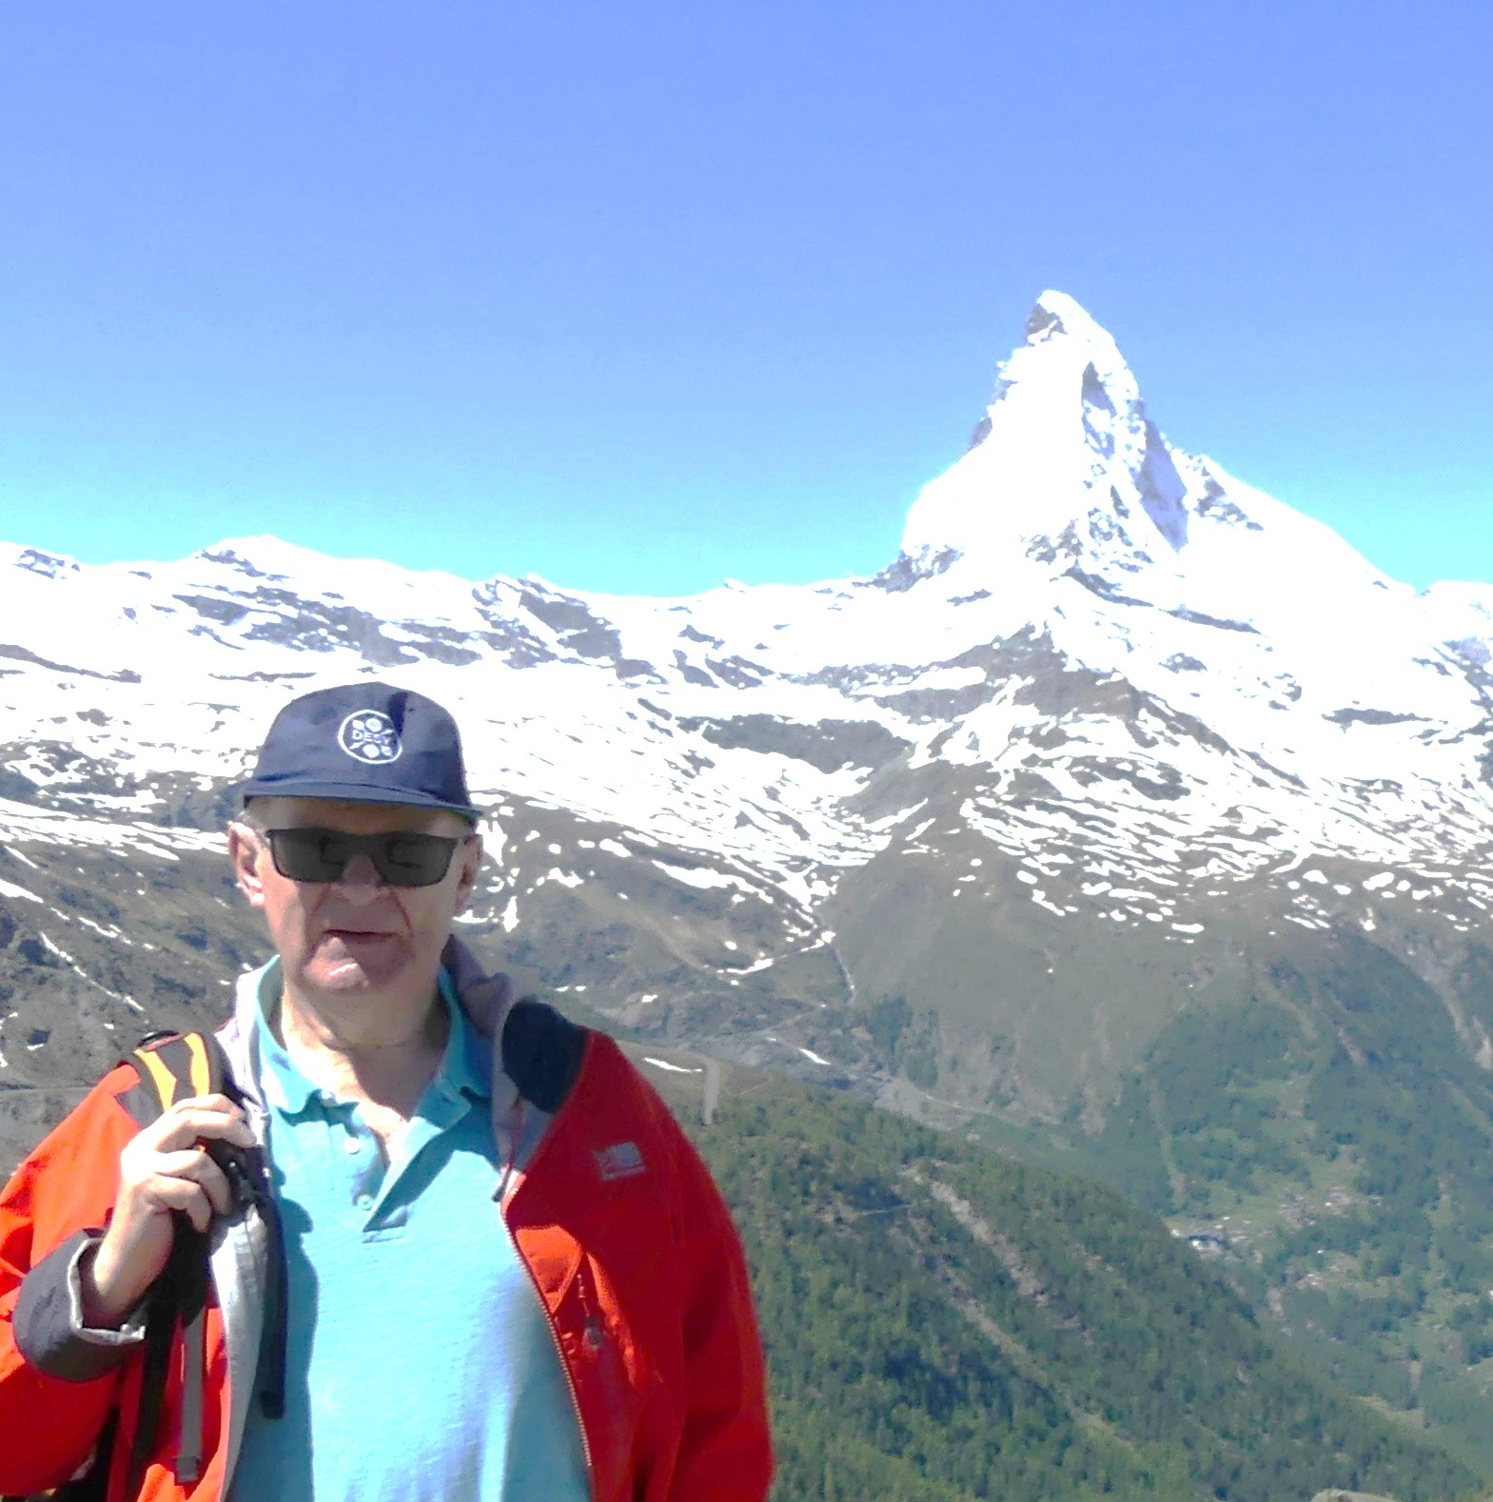

FosterFest Oxford 11th September 2024
2024
Brian and PETRA
First close encounter with electrons and positrons
and with Hamburg
Albrecht Wagner, DESY and UHH
1954

Slide 2
Leading up to PETRA
While Brian was working on his PhD thesis……
DESY, Frascati and the UK (RHEL) were competing as early as 1973 to build a large e+ e-/proton e- collider.
On 30.11.1973 Herwig Schopper reported to the DESY Administrative Council, “that at the last meeting of the ECFA Working Group, which dealt with the long-term plans for new accelerators in Europe, plans were announced by RHEL and Frascati which aimed at building a large e+e-/pe- storage ring in these laboratories in the 1980s.“

Slide 3
1973 at DESY
Schopper continued: “The conditions for the realisation of such a project are most favourable at DESY, especially as existing facilities would serve as part of the new project without any significant changes.
The British are pressing ahead with their project with the aim that the decision on the location of a large e+e-/p e- storage ring, which would undoubtedly be made at a political level, will be taken in the course of next year.
If DESY does not want to be eliminated from this competition from the outset, then the considerations for a long-term expansion of DESY in the 1980s must be continued. This would require a favourable statement from the Administrative Board.”

Slide 4
The UK Plans
Norman McCubbin in his memoirs of Godfrey Stafford (RAL Director from 1969-1981):
“By the end of 1973 a very ambitious project had been conceived for the Rutherford site: a first phase would consist of an electron–positron collider of energy 14 + 14 GeV, to be followed later by a proton ring, of up to 200 GeV if superconducting magnets were available, for electron–proton collisions. The plan had a suitably ambitious name: Electron– Positron/Proton Intersecting Complex, EPIC. ….”

Slide 5
Europe and PETRA
There was general agreement that only one such facility should be built in Europe and that the laboratory that took the first step in this direction would also create the best conditions for a later e-p project.”
After J/Psi discovery in 1974 focus on e+e- storage rings
DESY, with its experience from DORIS and the existing infrastructure, was chosen as site in 1975. That killed the EPIC proposal.
At the same time, the international use of DESY as national lab was implemented with strong guidance from the German research ministry.

Slide 6
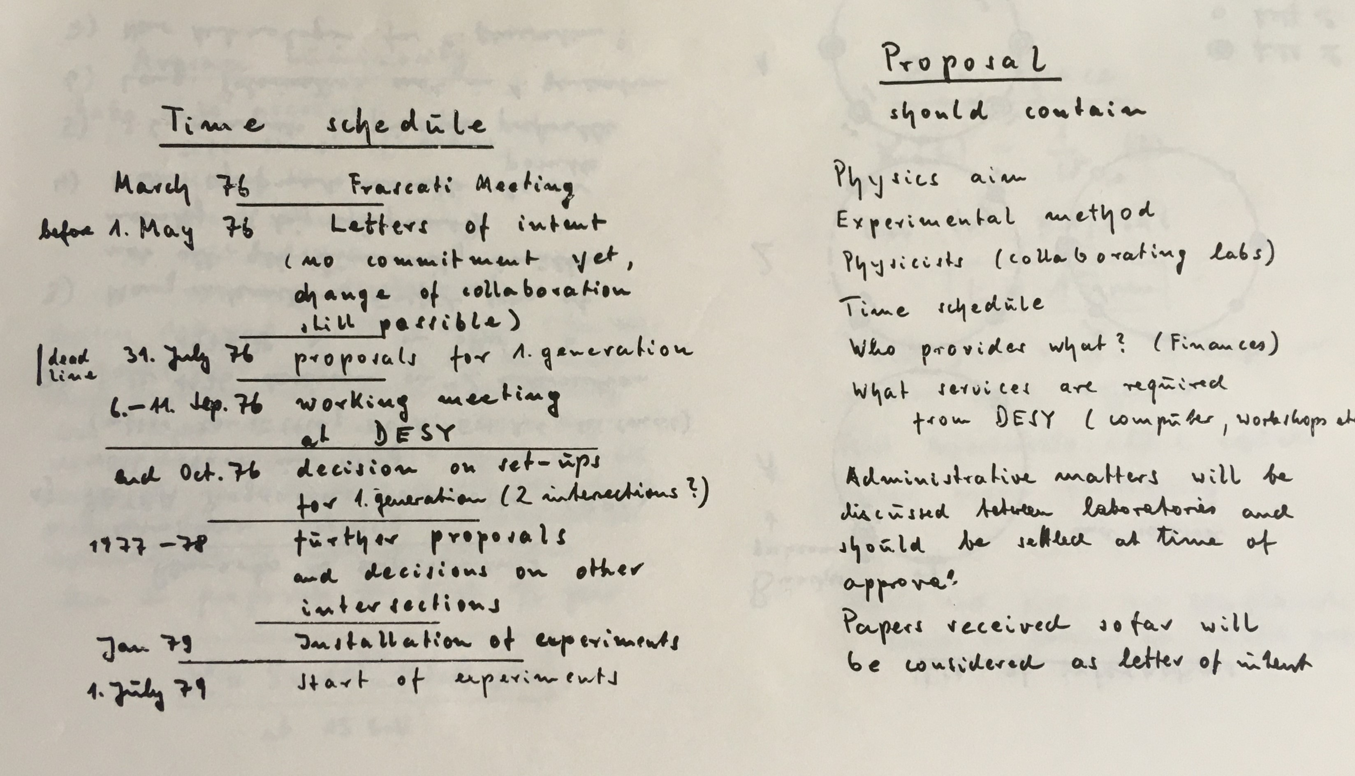
Frascati Meeting March 1976
Conclusions by H. Schopper

Slide 7
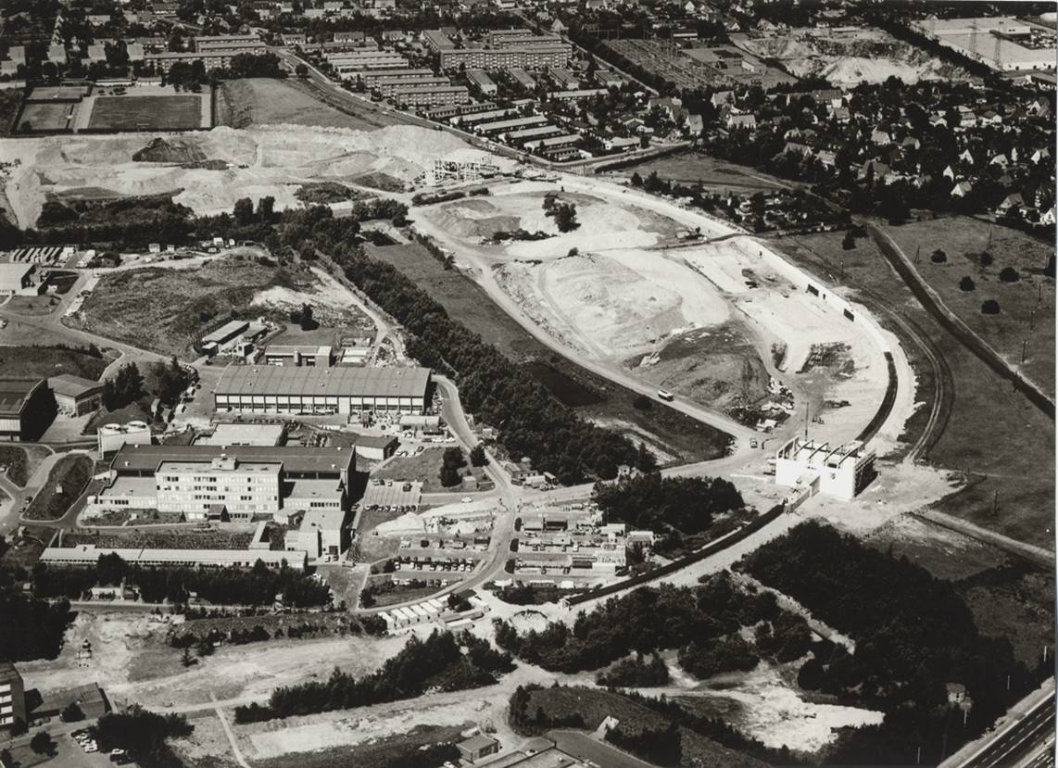
PETRA 1976 - 1986
Construction started in 1976
The project advanced very fast
Construction completed in 1978, > 12 months ahead of schedule (and 20 M under budget of 100 MDM)
First stored beam in July 1978
First Bhabhas seen end Nov. 78
With PETRA DESY became international

Slide 8
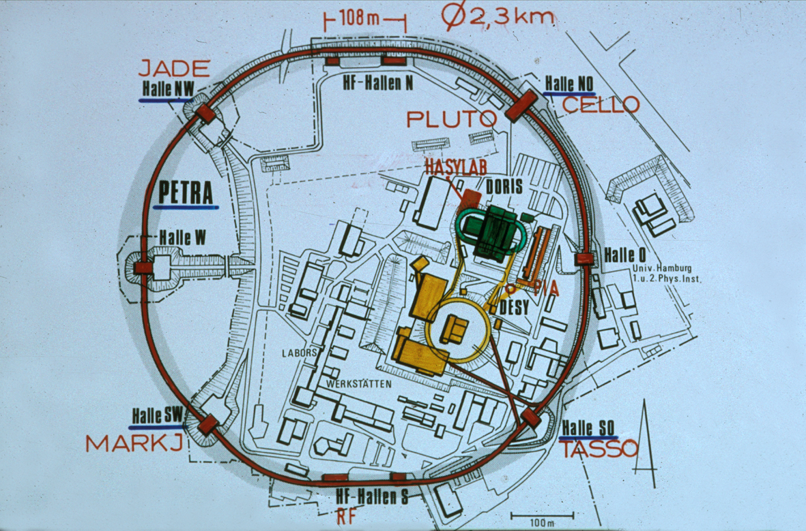
The Experiments
Five experiments approved
CELLO, JADE, Mark J,
PLUTO, TASSO
There were two UK teams involved involved:
South and North

Slide 9
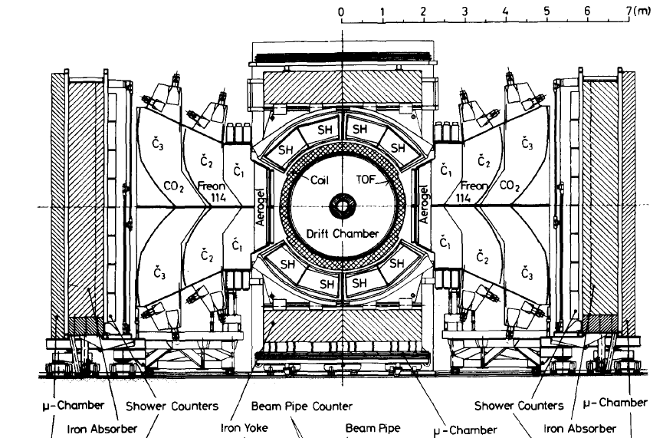
The TASSO Detector Layout
Essential features:
Hadron arms
Large solid angle
Good tracking
Muon detection
UK Groups
Imperial
Oxford
RAL
Albrecht Wagner DESY and UHH FosterFest Oxford 11th September 2024

Slide 10
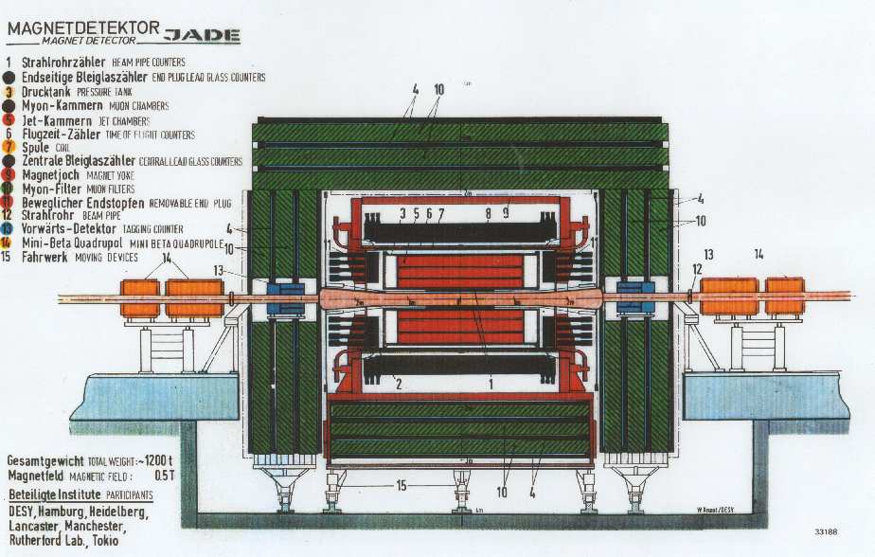
The JADE Detector Layout
Essential features:
Large solid angle
Excellent tracking
Good energy measurement
Muon detection
UK Groups
Lancaster
Manchester
RAL

Slide 11
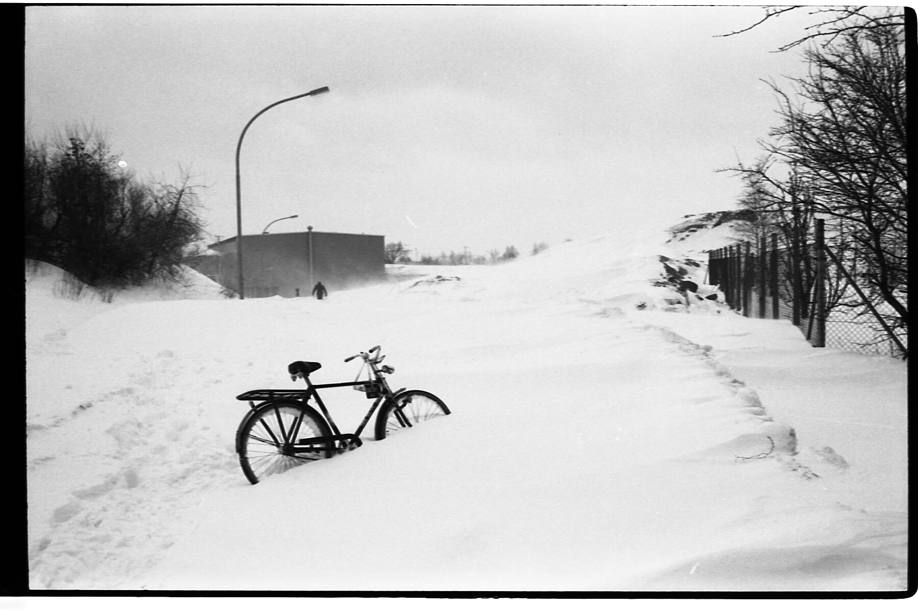
Brian at PETRA - 1
Brian, in 1978, having finished his PhD got a position for 3 years in the group of David Saxon at RAL
In Nov 1978 he moved to HH, lived in the RAL flat at the DESY Guesthouse, it drizzled all the time
1979

Slide 12
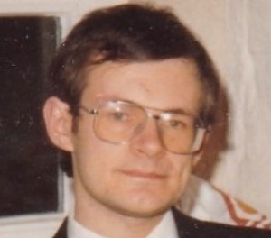
Brian at PETRA - 1
Worked first on the TASSO hadron arms
Moved in early 1979 on to online DAQ under David Quarry, with Chris Youngman with much time in control room
Brian moved on to important Monto Carlo work, with Steve Lloyd, Ian Proudfoot, Chris Youngman, called “Simple”, originally designed for the drift chamber
1983

Slide 13
Physics: Proposed Programme at PETRA
Measurement of magnitude and energy dependence of hadronic cross section
Search for new quarks and leptons
Measurement of magnitude of electroweak interference
Study of hadronic final states, prove existence or non-existence of jets
Is QED correct at high energies?
Study decays of heavy quarks
Study photon-photonon interactions
…but nothing about gluons

Slide 14
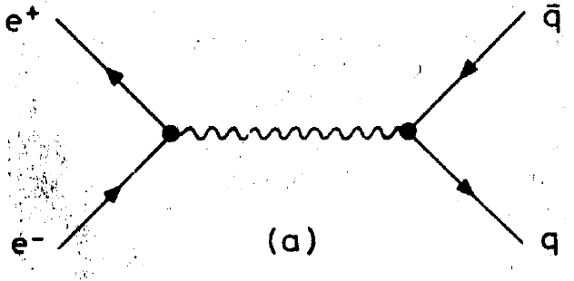
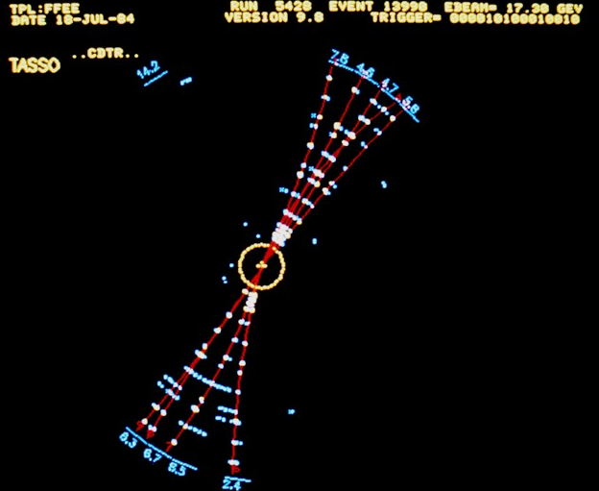
Predictions for e+e- -> Hadrons
In 1979 it was widely accepted that e+e- -> hadrons proceeded via
The final state hadrons would appear in two well collimated back to back jets of hadrons with small transverse momentum and growing momenta parallel to the jet axis

Slide 15
Discovery of Gluon
Nobody thought seriously of gluon jets until a seminal paper appeared:
J. Ellis, M. K. Gaillard and G. G. Ross, Nucl. Phys. B111 (1976) 253
First to suggest the existence of hard gluon bremsstrahlung leading to gluon jets:
“Motivated by the approximate validity of the naive parton model and by asymptotic freedom, we suggest that hard gluon bremsstrahlung may be the dominant source of hadrons with large momenta transverse to the main jet axes. This process should give rise to three-jet final states.”
The title of this paper was:
“Search for Gluons in e⁺e⁻ Annihilation” !

Slide 16
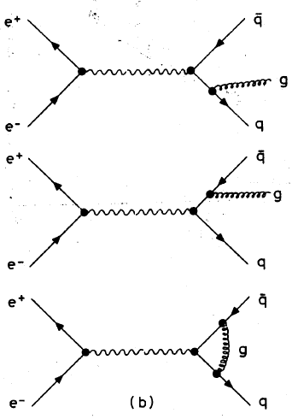
Discovery of Gluon
The basis of the prediction was field theory, i.e. that the outgoing quarks radiate field quanta (gluons)
The probability for radiation is ~ a_{s}(q²)/p, which at PETRA energy is ~ 10%.

Slide 17
Discovery of Gluon
Experiments were facing two major problems:
How to distinguish gluon bremsstrahlung from the production of heavy quarks, which would be leading to jet broadening also.
Even if this problem could be solved, would one be able to see and verify the perturbative QCD signatures directly, in view of the strong nonperturbative effects that had totally dominated all the measured distributions until then.

Slide 18
Discovery of Gluon
Among several important papers inspired by the ideas of Ellis et al, the following two were particularly relevant :
P. Hoyer, P. Osland, H. G. Sander, T. F. Walsh and P. M. Zerwas, Nucl. Phys. B161 (1979) 349
-> produce detailed predictions of transverse momentum distributions and many other observables in e⁺e⁻ -> hadrons.
S. L. Wu and G. Zobernig, Z. Physik C (Part. and Fields) 2 (1979) 107
-> designed a fast algorithm to detect, present and investigate planar events and three-jet topologies in the data.

Slide 19
Experimental Implications of Gluon Bremsstrahlung
The average transverse momentum with respect to the jet axis should increase with energy. As a_{s}(q²) < 1 at PETRA, only one jet should broaden
Hadrons from q-fragmentation should be uniformly distributed around the jet axis
The topology defines a plane
Presumably also gluons fragment into hadrons with limited transverse momentum. Therefore the planarity is retained by the hadronic final state
-> One should observe planar events with small transverse moment in the event plane. A small fraction of events should have a three jet structure.

Slide 20
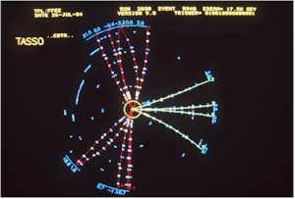
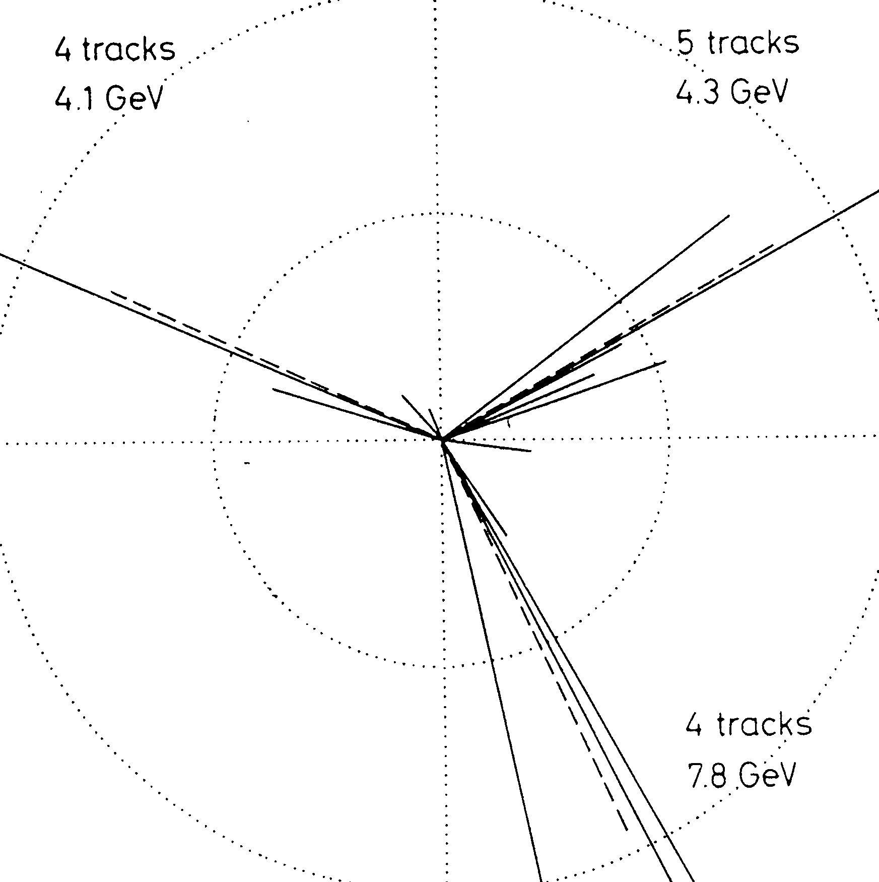
3-jet Events
B. Wiik, Bergen, 18 June 1979

Slide 21
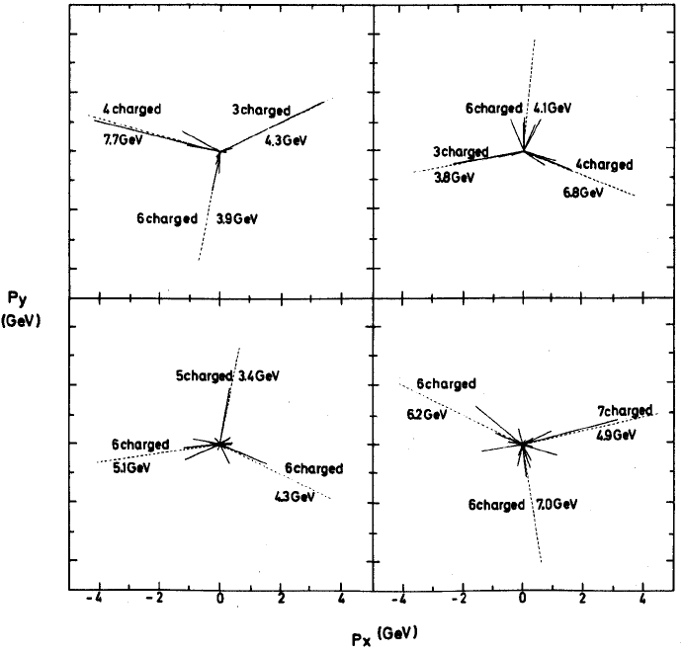
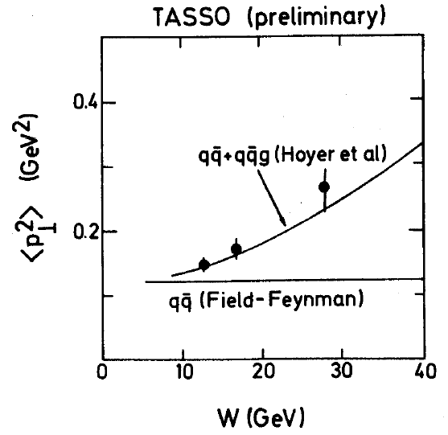
3-jet Events
More events at EPS Geneva conference - with an estimated qq background of 0.3.
Paul Soeding, EPS Geneva conference, 27 June – 4 July 1979

Slide 22
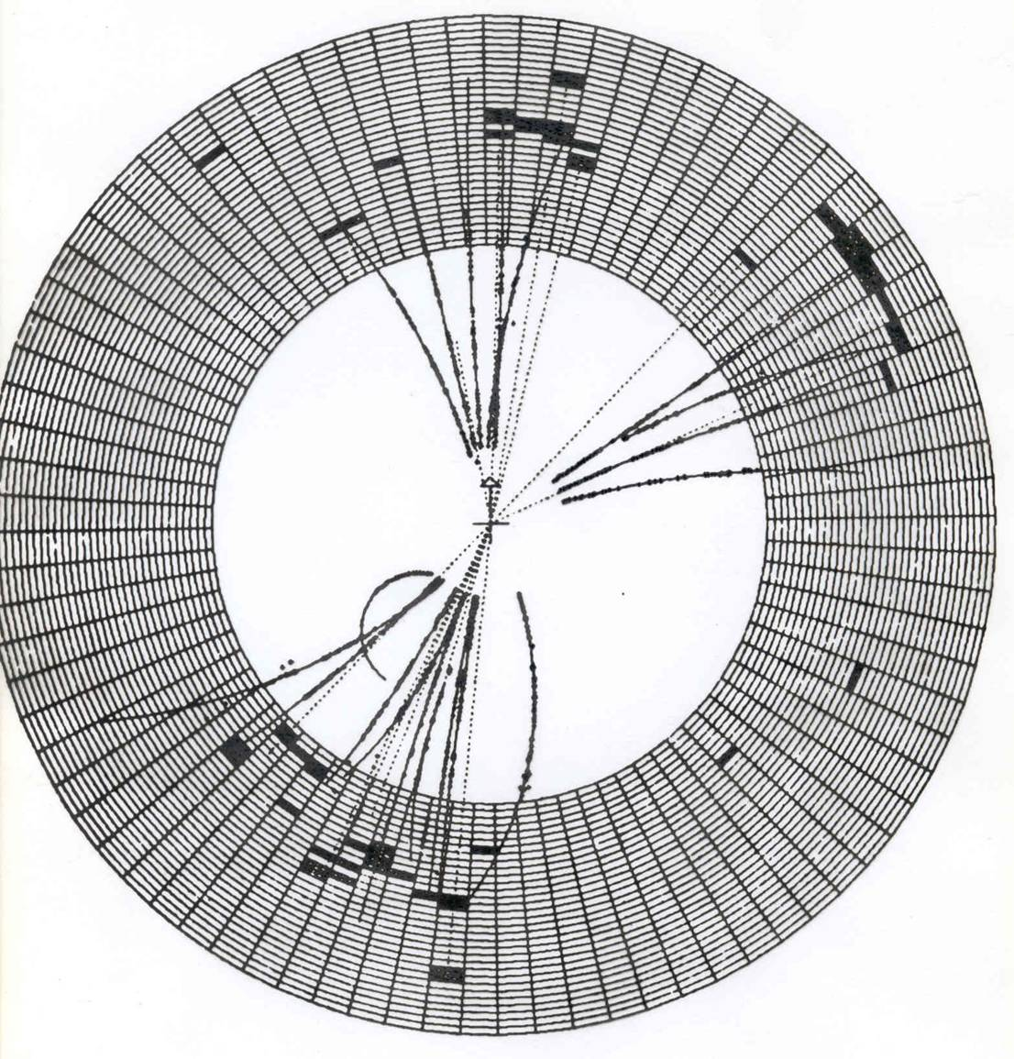
Particle and Energy Flow
Jade Experiment

Slide 23
Lepton Photon Symposium 1979
Fermilab 23– 29 August 1979
The conclusion of all four PETRA experiments (JADE, Mark J, PLUTO and TASSO) was very similar.
To cite Haim Harari from his summary talk in 1979:
5.3. Gluons Exist
(a) Have we really seen three-jet events in e+e- collisions?
(b) If we did, does that confirm the existence of the gluon?
- Our answer to both questions is a cautious, qualified yes.
- Our tentative conclusion is that the experimental evidence for three jets is quite good
- The most likely explanation is the gluon.
- It is absolutely crucial to confirm the spin of the gluon.
“We believe, however, that five years from now, when we look back, we will all agree that the gluon was discovered in the summer of 1979.”

Slide 24
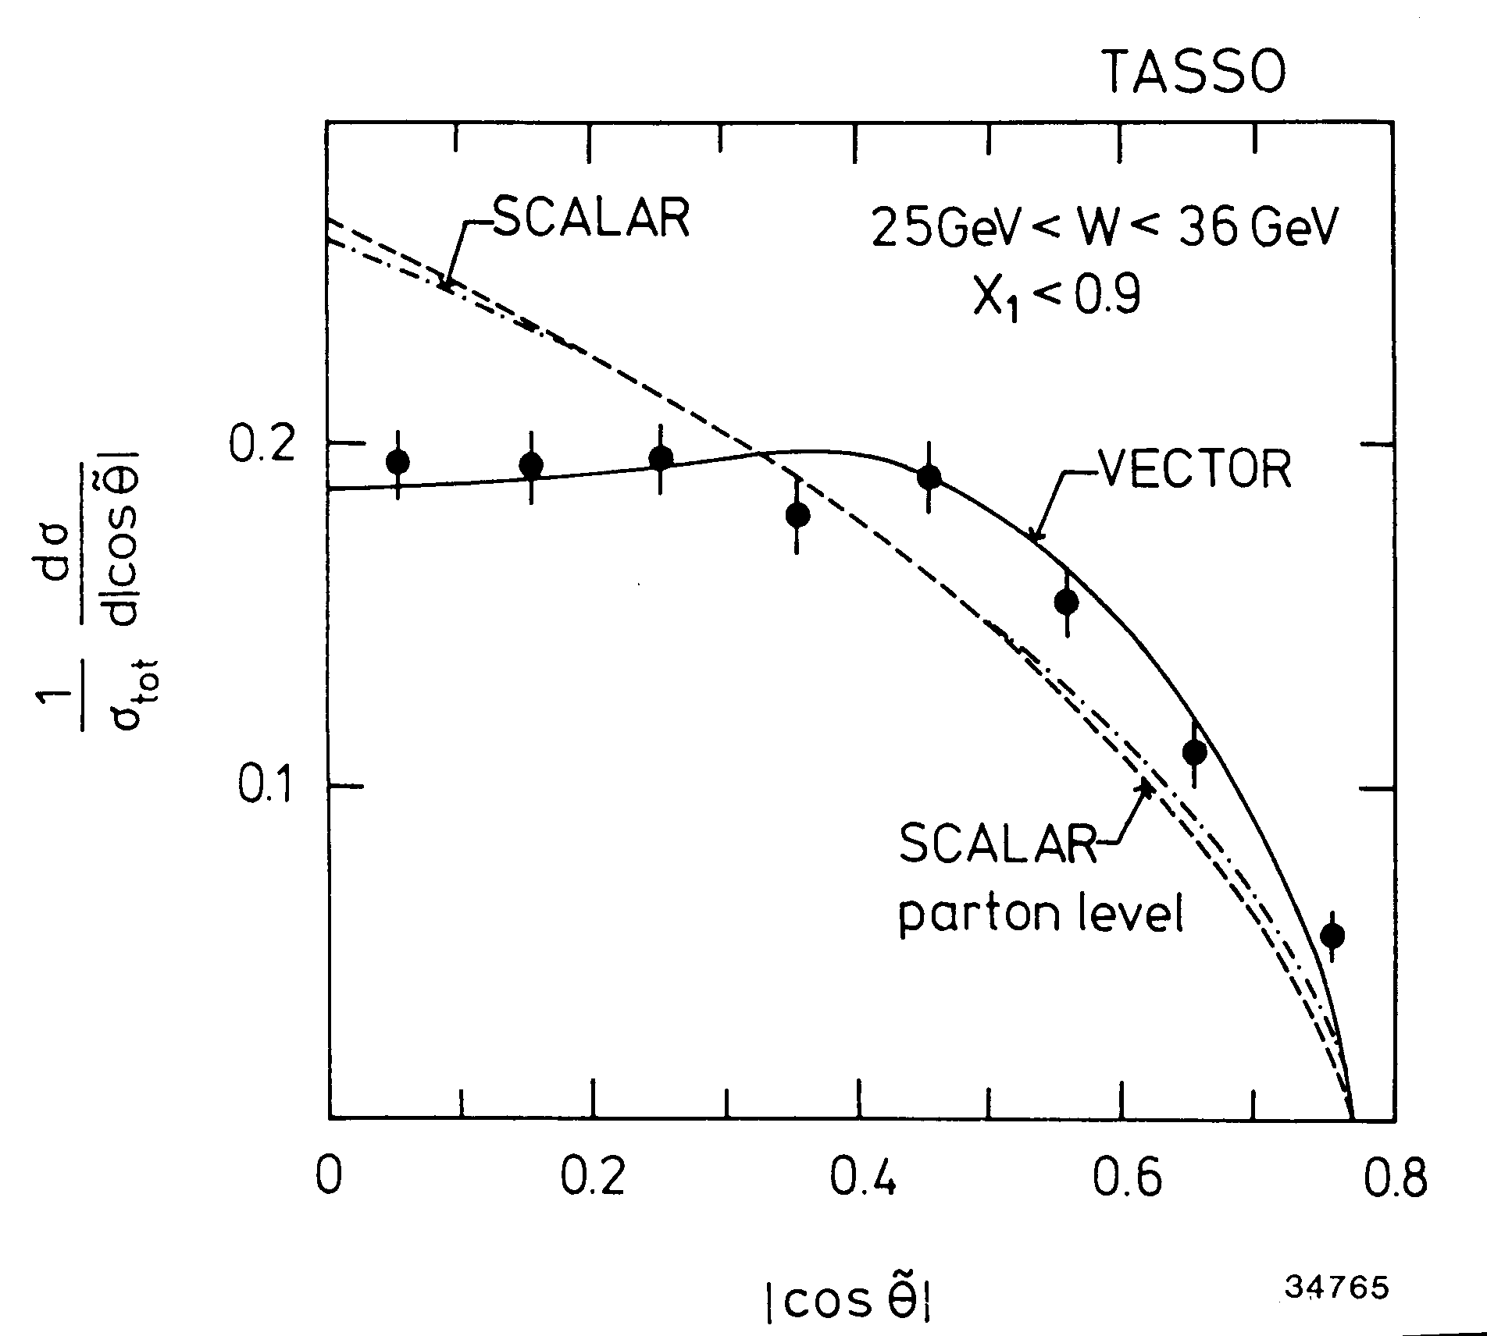
Gluon Spin
TASSO: R. Brandelik et al, Phys. Lett. 97B (1980) 453:
(The data shown are from a later paper when higher PETRA energies were available.)

Slide 25
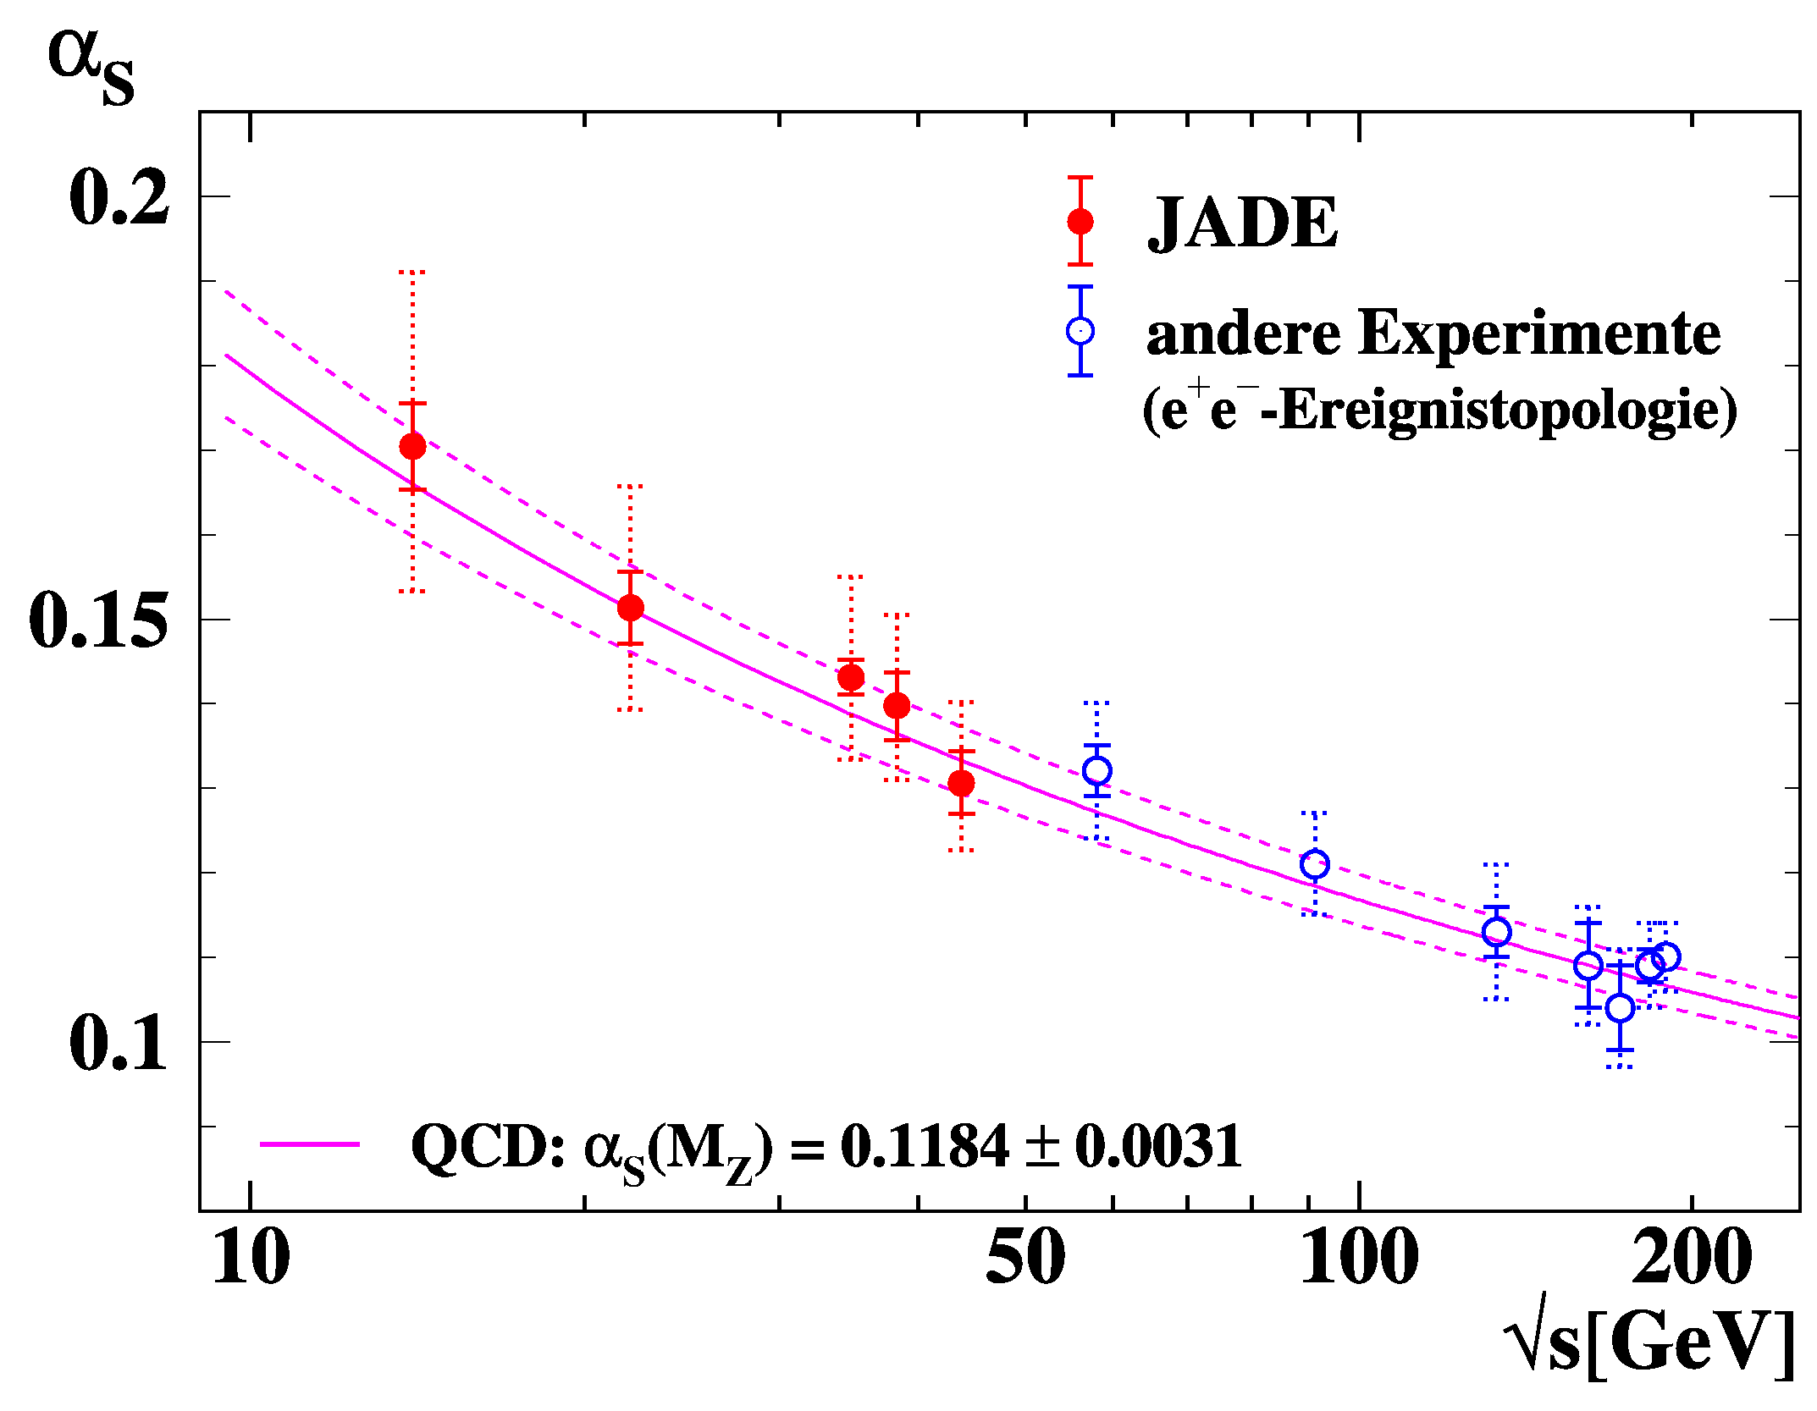
Determination of α_{S (}OPAL/JADE )
Study “event shapes”
in e⁺e⁻ → hadrons
Compare with simulation
⇒ good agreement
Compare with QCD
prediction ⇒ α_{S}(√s)
Compare α_{S}(√s) with
QCD prediction for
running strong coupling
S. Bethke et al.

Slide 26
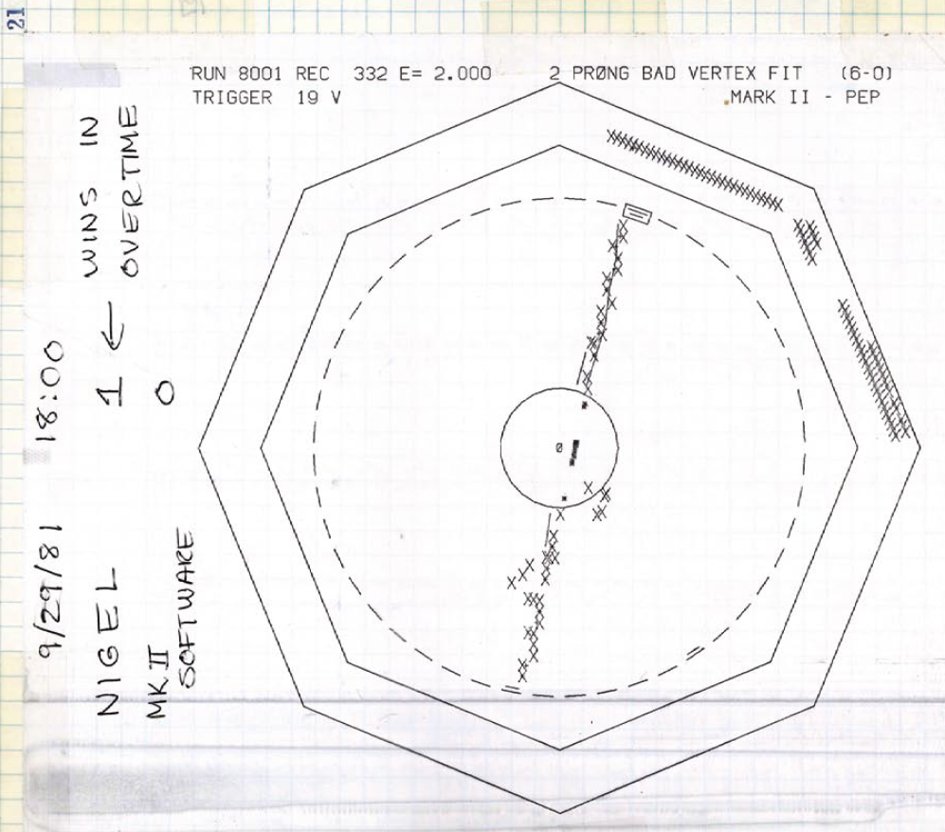
Brian at PETRA – Phase 2
In 1982 Brian moved to Imperial for 2 years
John Jaros at Mark II built vertex chamber (1980 - 1981) to detect heavy quarks and in particular to measure τ lifetime.
Decision to build vertex detector for TASSO
Built at Imperial, Brian worked first on the Monte Carlo, then became responsible.
A few tiny obstacles…..

Slide 27
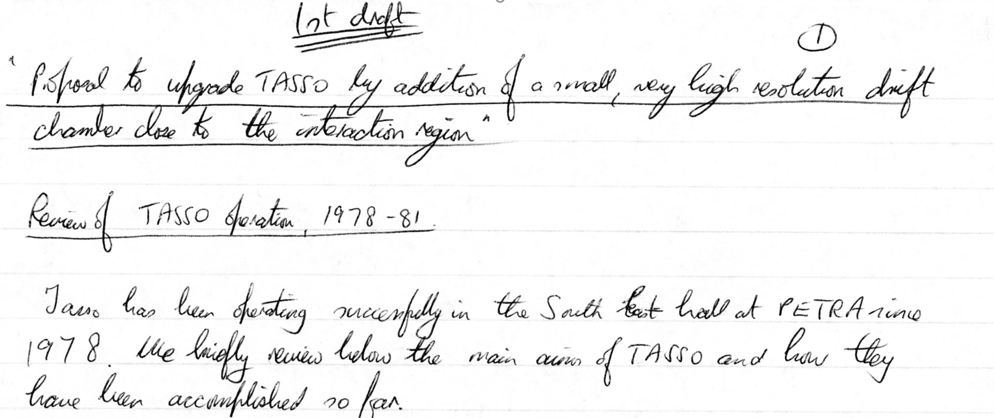
TASSO Vertex - Detector
Draft Proposal

Slide 28
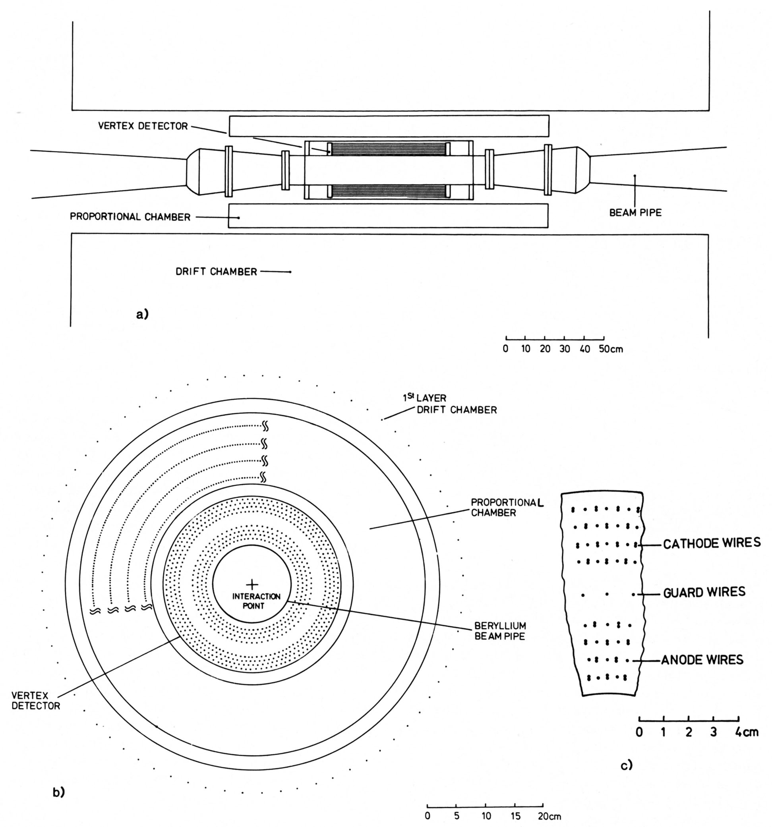
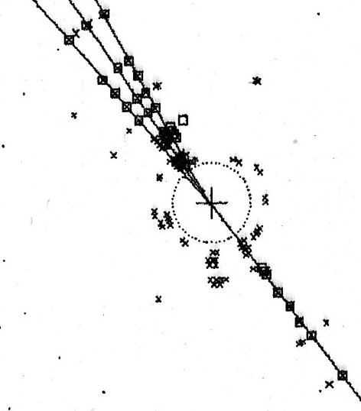
TASSO Vertex - Detector
VXD installed inside TASSO and
taking data by mid-December 1982 - less than 2 years since inception.

Slide 29
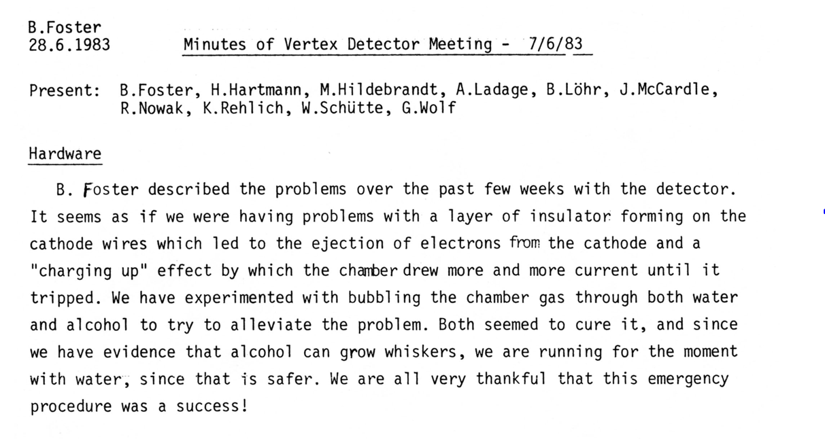
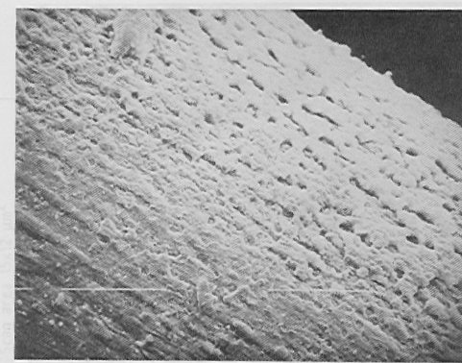
TASSO Vertex - Detector
Whisker growth: change gas from Argon-Ethane (50:50) to Argon-CO₂ (95:5) and add water

Slide 30
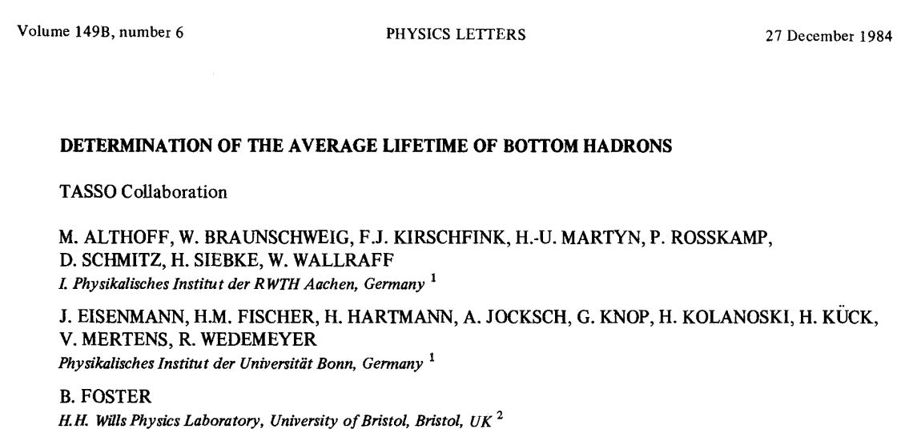

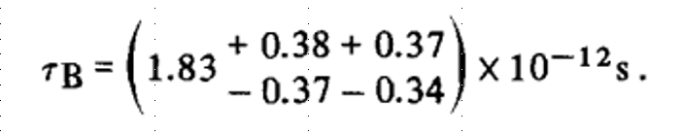
TASSO Vertex – Detector Results

Slide 31
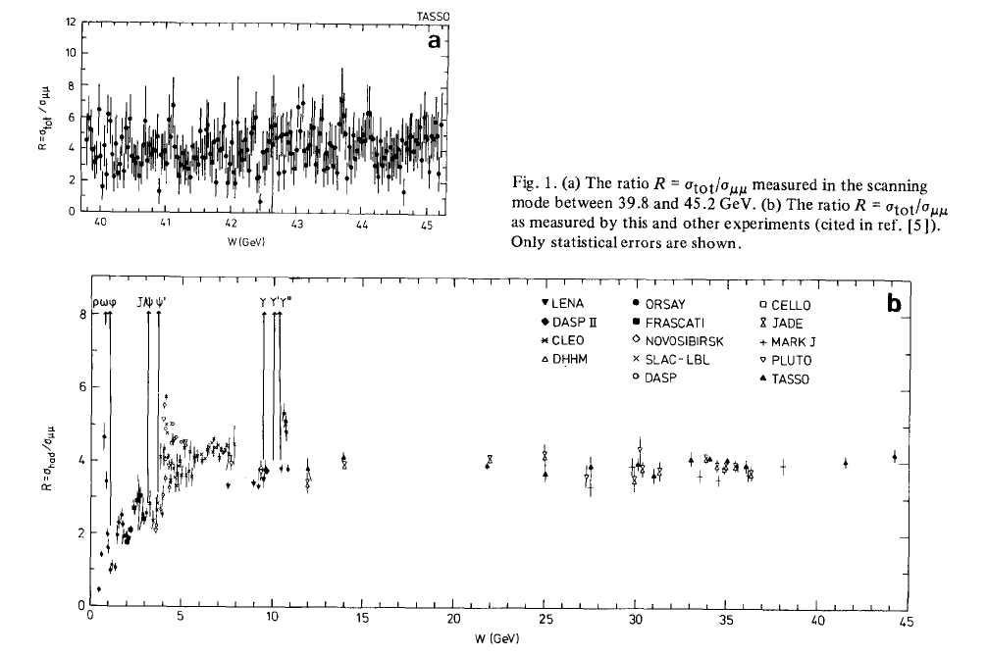
The Elusive Top
R = σ(tot)/σ(μμ) as function of enery
40
45
0
10
20
30
40

Slide 32
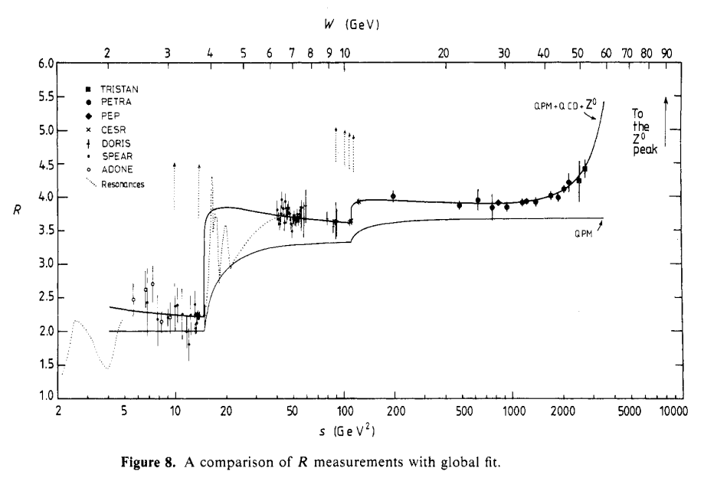
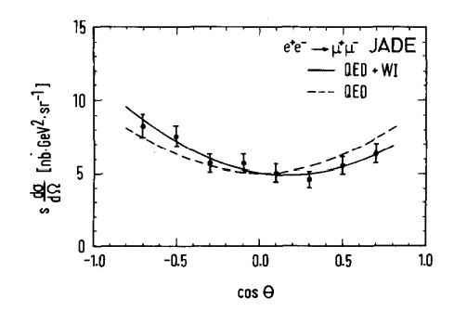
Electroweak Effects
R = σ(tot)/σ(μμ) as function of energy, including TRISTAN
Forward-backward asymmetry in muon production

Slide 33
Brian at PETRA – Phase 3
1983 appointed as Lecturer at Bristol (on tenure track)
In parallel simulation for Electra at LEP (82-83) and SSC in parallel

Slide 34
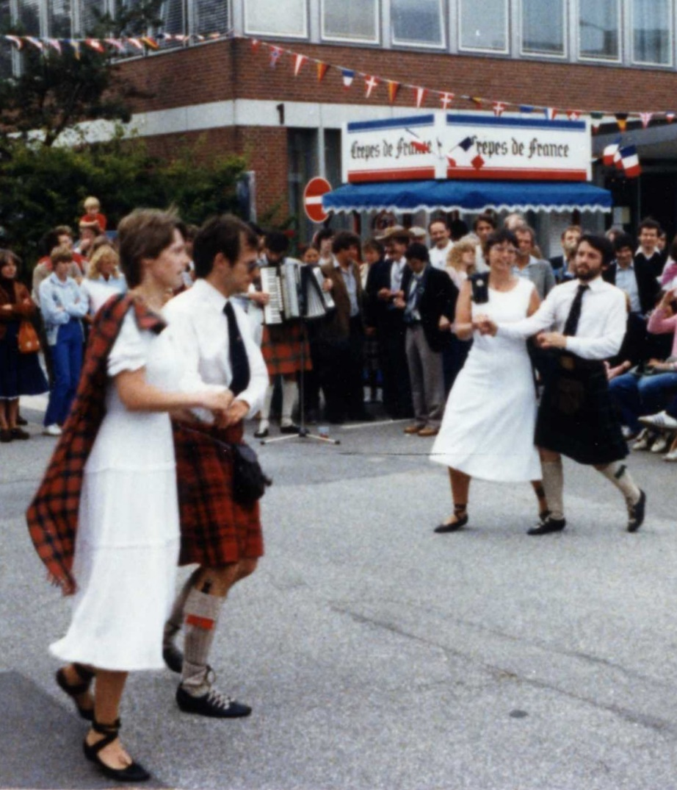
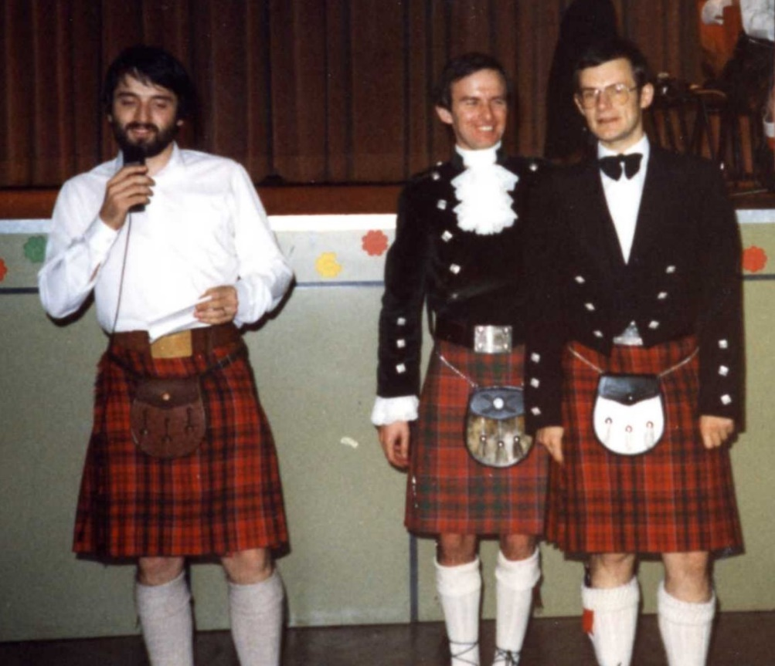
First Close Encounter with Hamburg
DESY Open Day

Slide 35
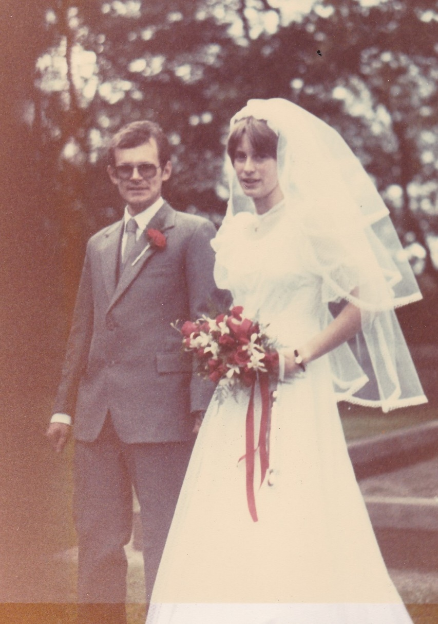
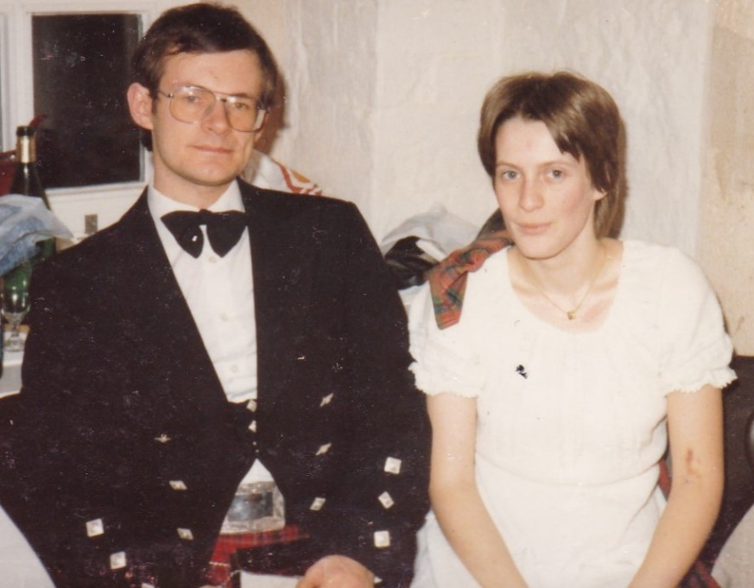
Meeting Sabine
1983

Slide 36
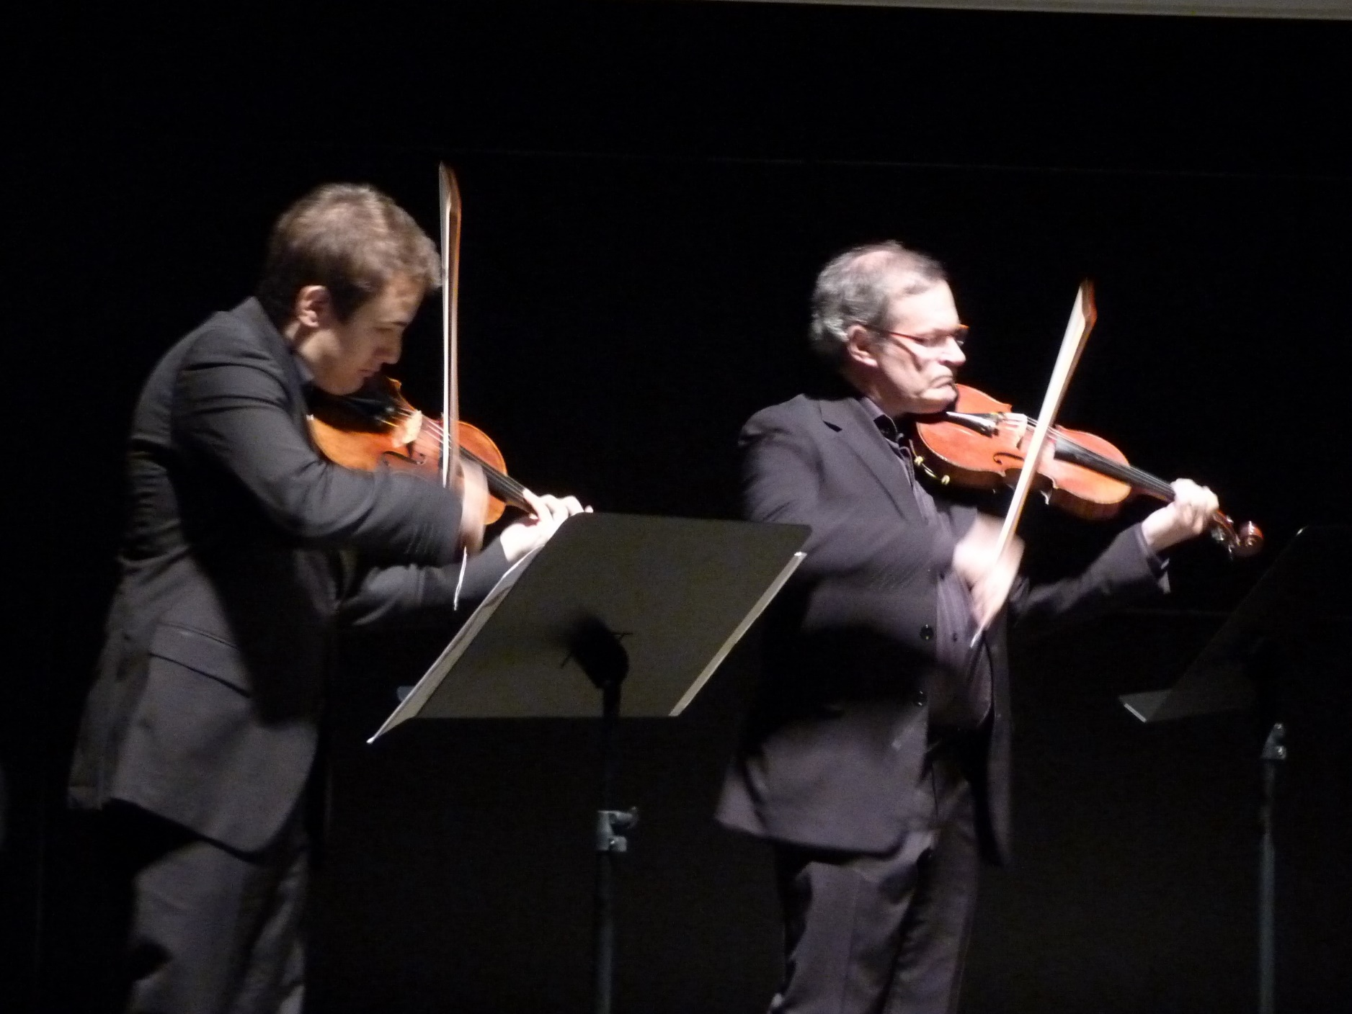
Brian and Music
Brian, like Einstein, loves playing his violin
In Hamburg,
Brian was a member of the DESY orchestra
Okinawa 2012
Since 2005:
Brian and Jack Liebeck toured the world with
„Einstein and music“

Slide 37
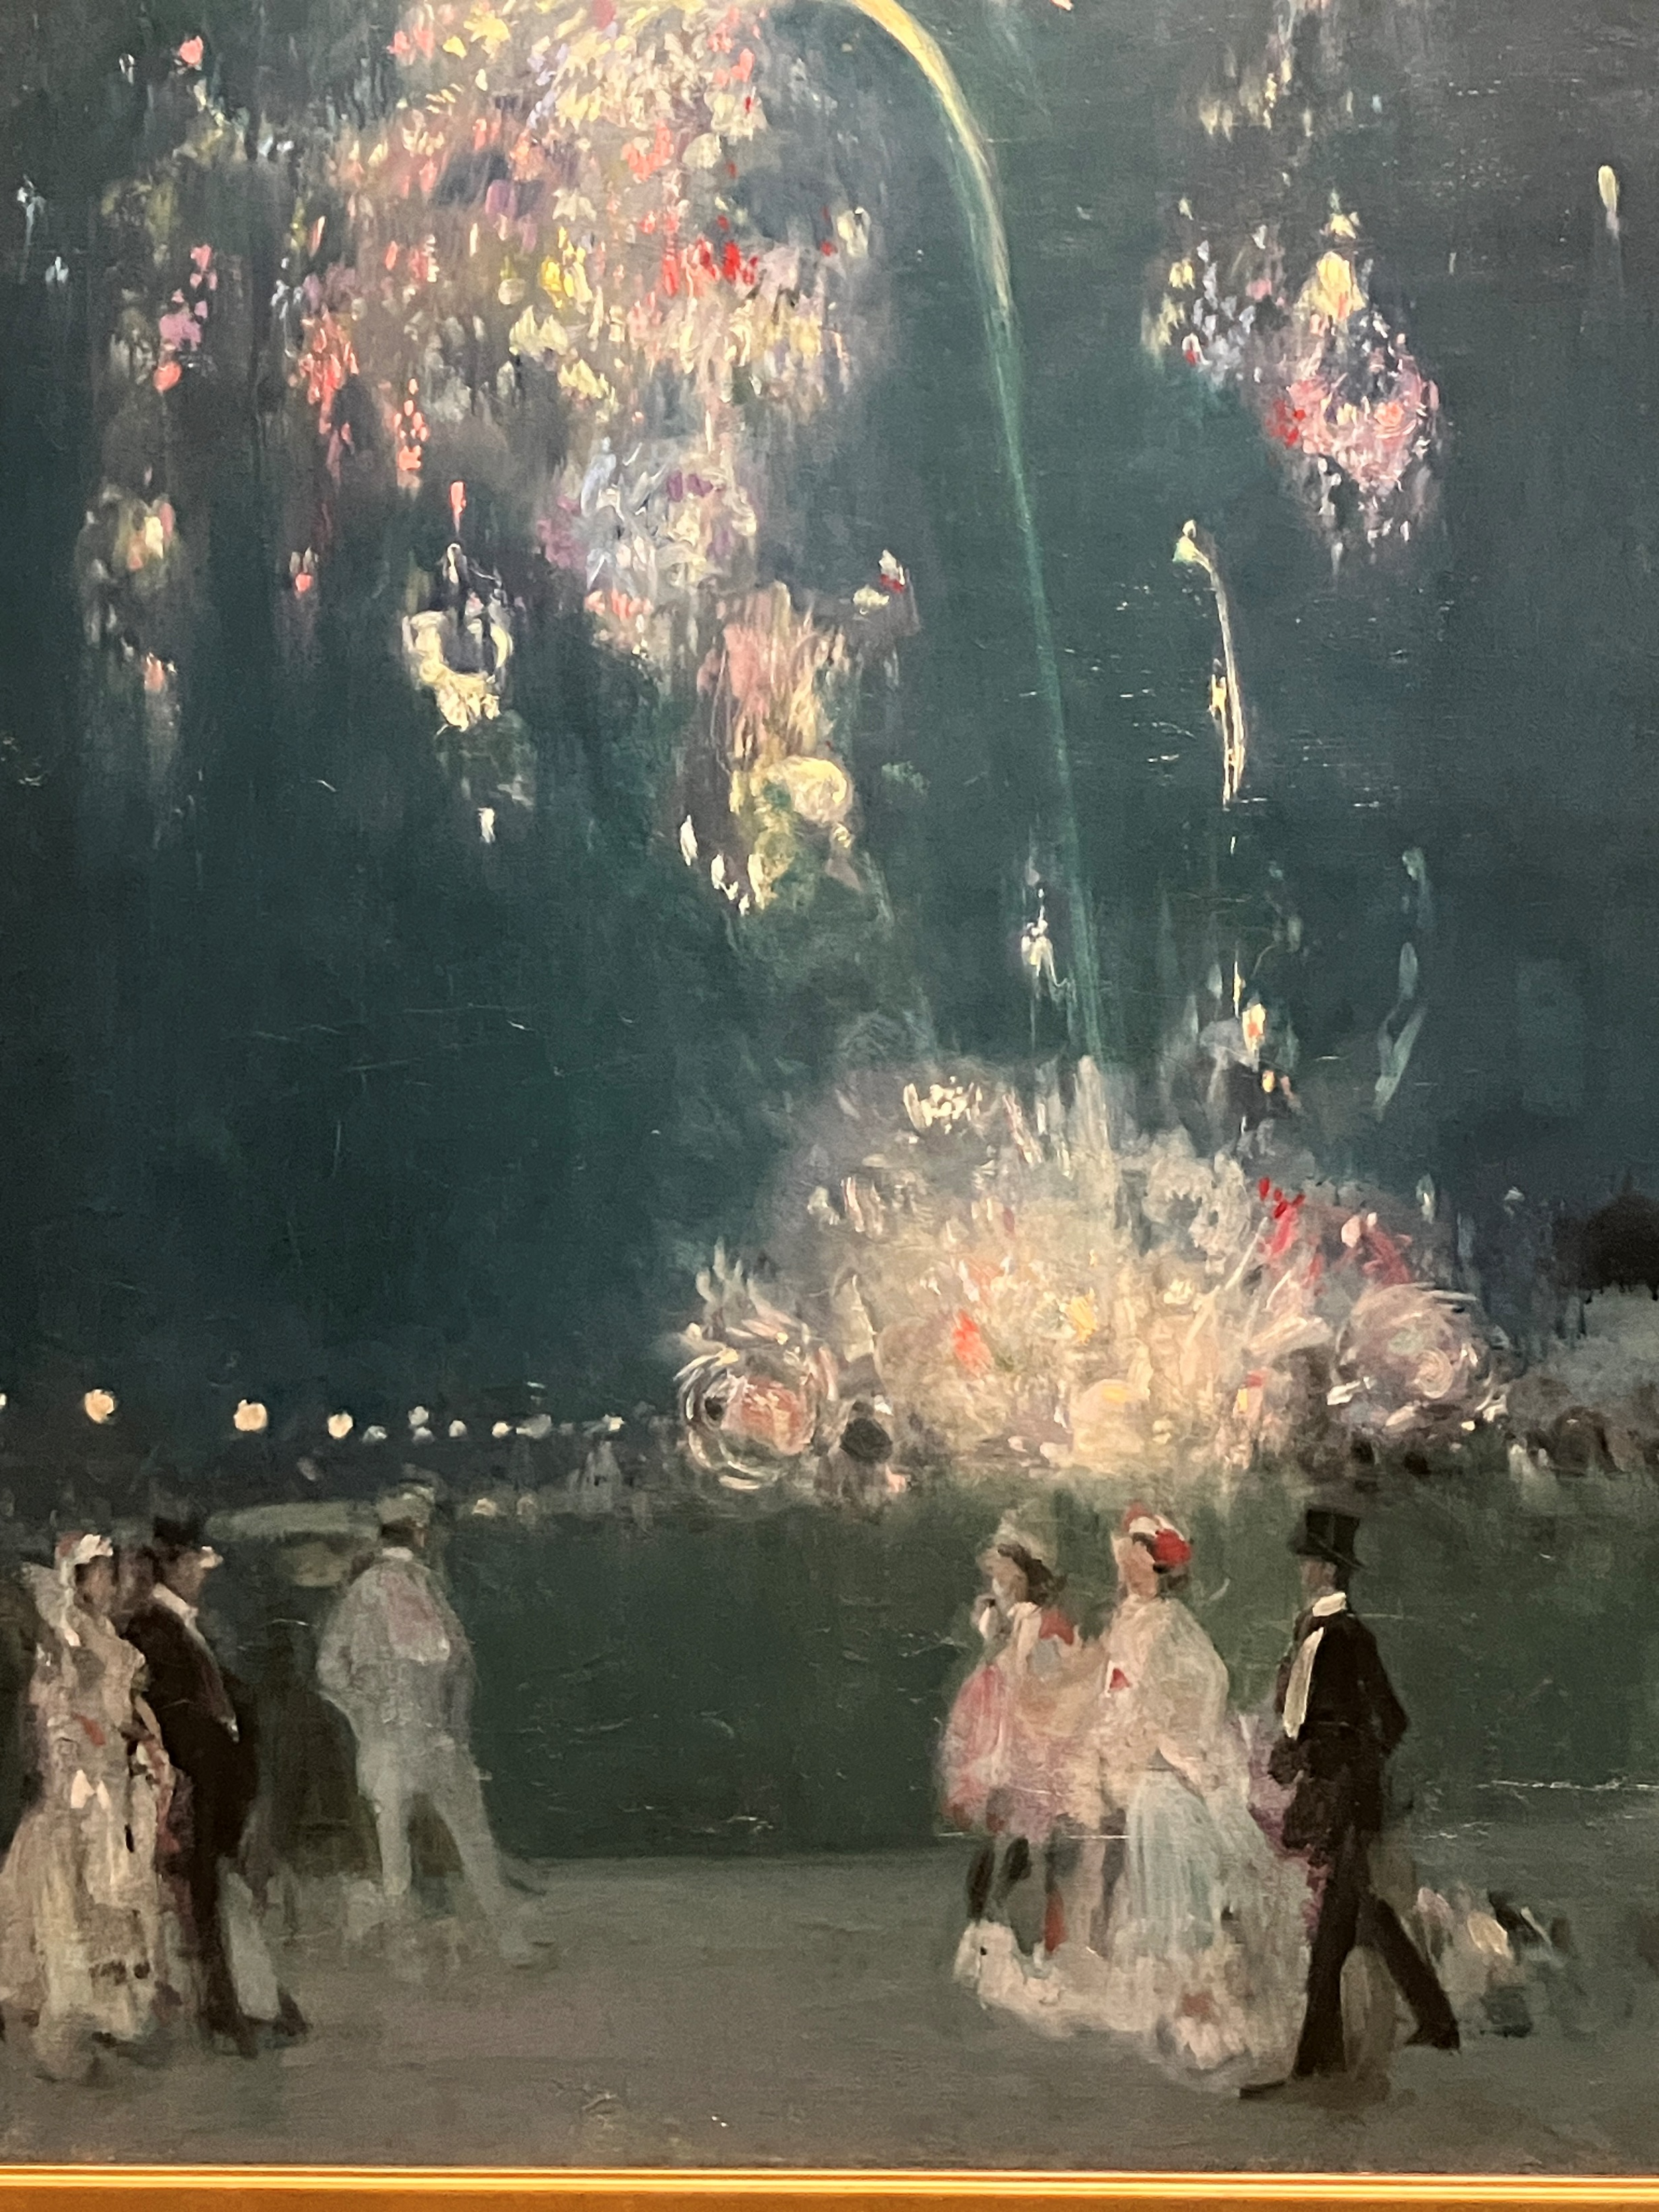
Birthday Wishes
A firework of talks reminding you of your highly productive past
A brilliant time with your old friends
A day with no „nugatory toil“
And an inspired future with lots of music

