Slide 1
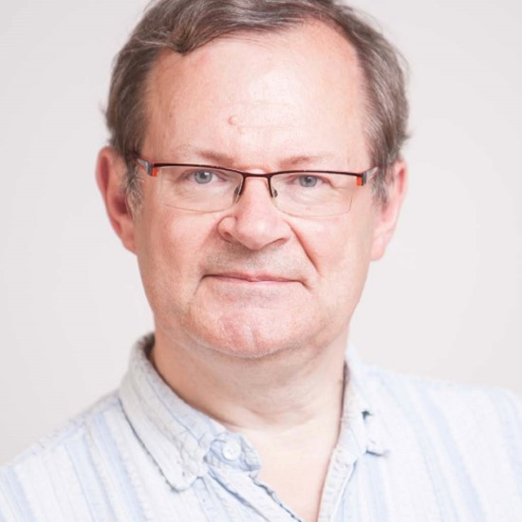
FosterFest!
Ian Shipsey FRS
Henry Moseley Centenary Professor & Head Oxford Physics
Notes:
My name is Ian Shispey I’m Head of Oxford Physics and a colleague of Brian’s since 2013
Welcome to you all.
We all know why we are here so lets start by showing our apprecitation of Brian and his scientific achievements,.

Slide 2
FosterFest!
Brian Foster OBE FRS HonFInstP
Donald H Perkins Professor of
Experimental Physics
Professorial Fellow Balliol College
University of Oxford
Notes:
We have sepcatular series of talks today and my job is to give a short biography and then mention a few things that will not get covered in the science talks

Slide 3
Brian born 4th January 1954
Notes:
About 11 billion years aftre the birth of the UNIverse

Slide 4
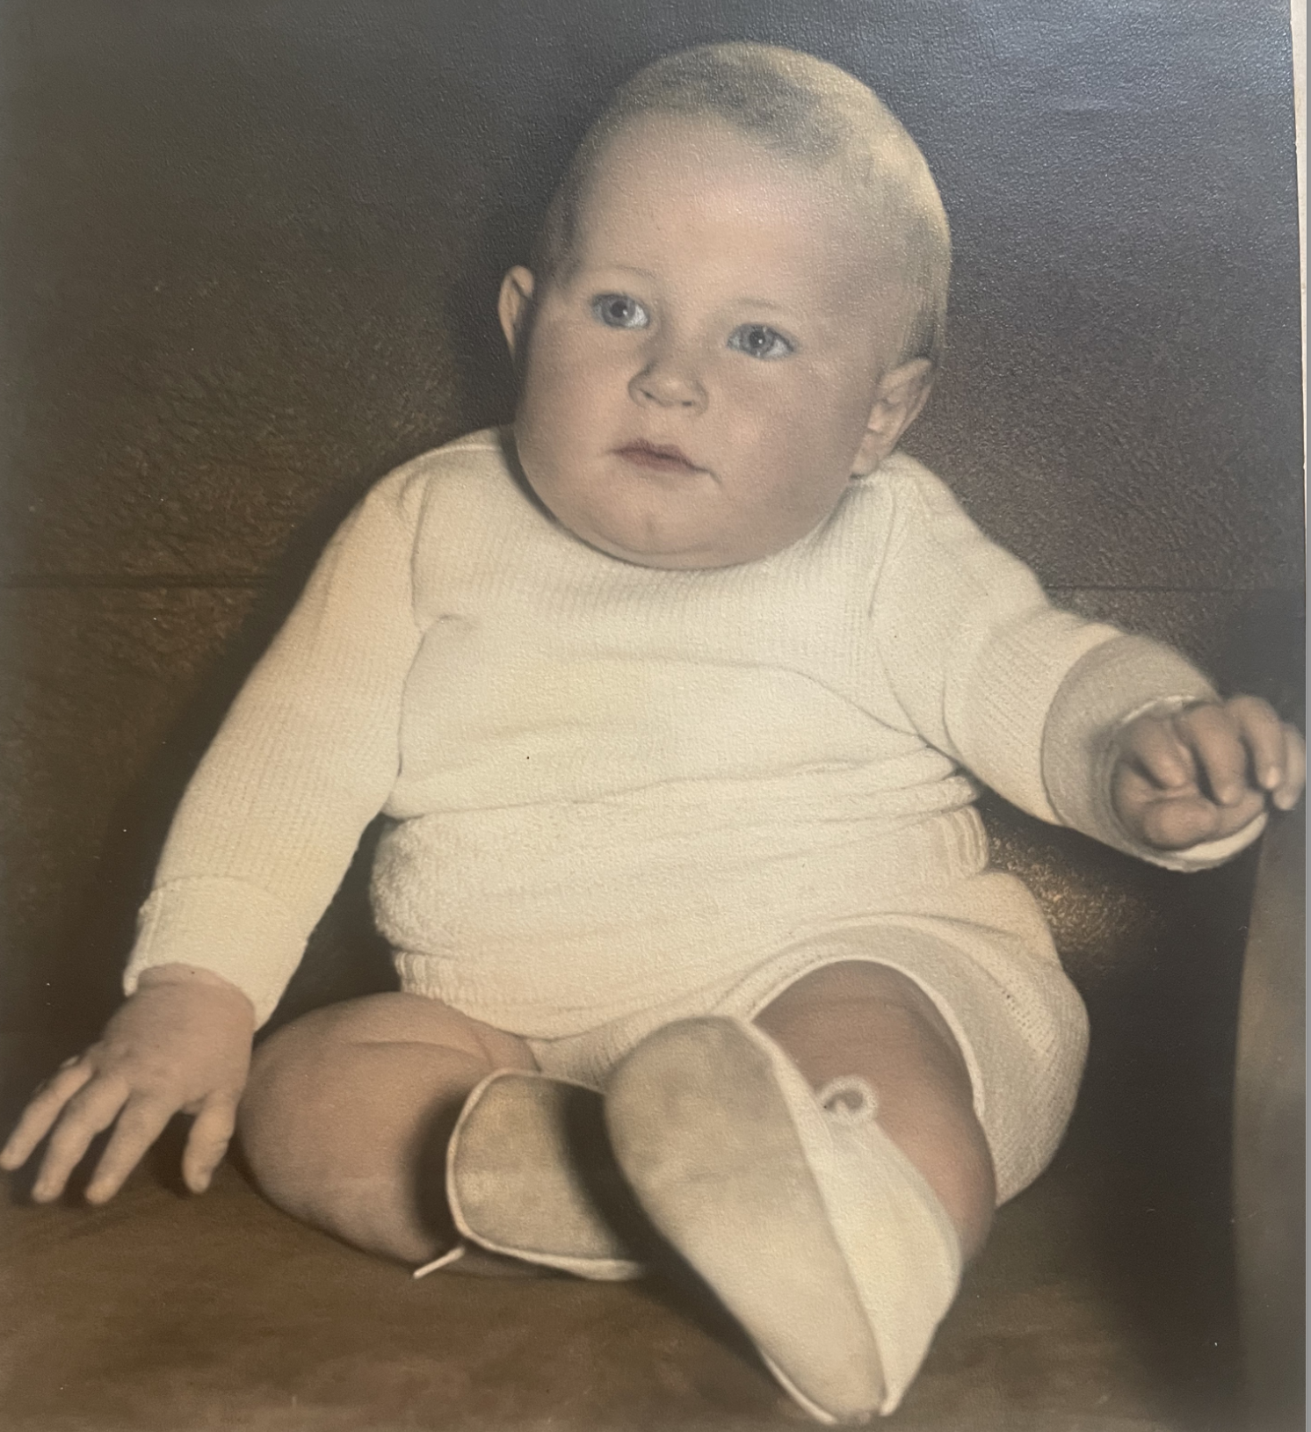
Brian born 4th January 1954

Slide 5
Brian born 4th January 1954
in Crook, Co. Durham.
Notes:
Brian is no crook

Slide 6
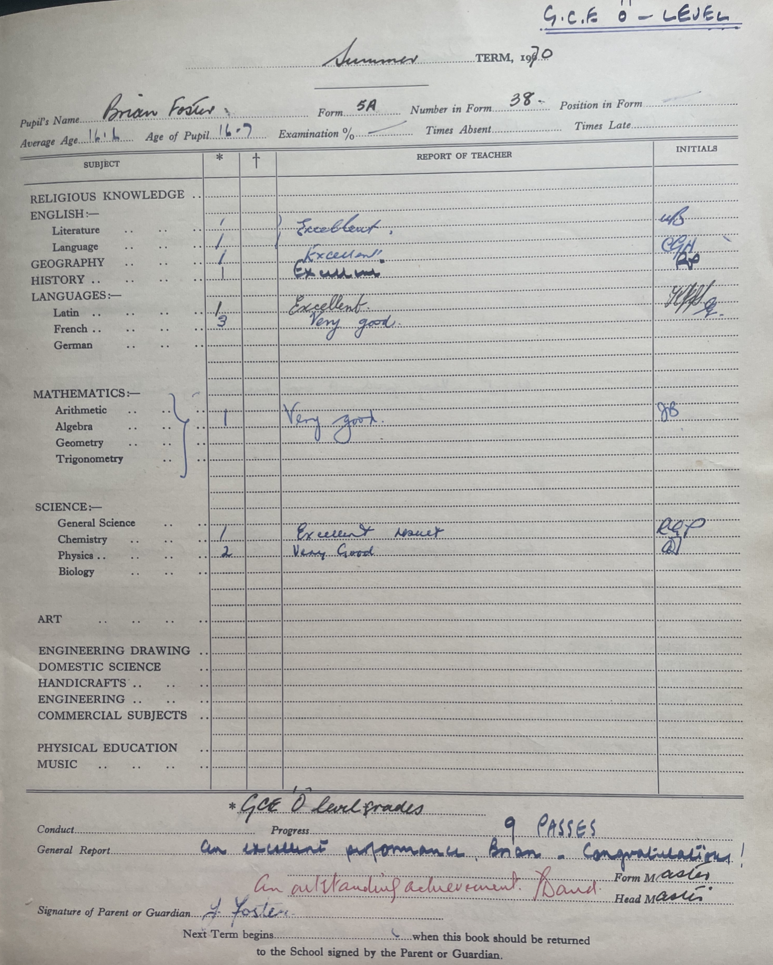
Attended Wolsingham Secondary
School County Durham, 1965-1972.
Notes:
He took his GCSEs at the age of 16 in 9 subjects 7 excellents show here
It was originally a grammar school but converted to a comprehensive after Labour reforms - so no 11+

Slide 7
Attended Wolsingham Secondary
School County Durham, 1965-1972.
Notes:
Very good in French

Slide 8
Attended Wolsingham Secondary
School County Durham, 1965-1972.
Notes:
Very good in physics
I really don’t have any photos of this period - sorry. I don’t know that I had a motivation to be head boy - I was asked so I did it. It was good for university applications.
I suppose I did a reasonable job - I can’t for the life of me remember.

Slide 9
Attended Wolsingham Secondary
School County Durham, 1965-1972.
Head Boy, 1972
Notes:
I really don’t have any photos of this period - sorry. I don’t know that I had a motivation to be head boy - I was asked so I did it. It was good for university applications.
I suppose I did a reasonable job - I can’t for the life of me remember.

Slide 10
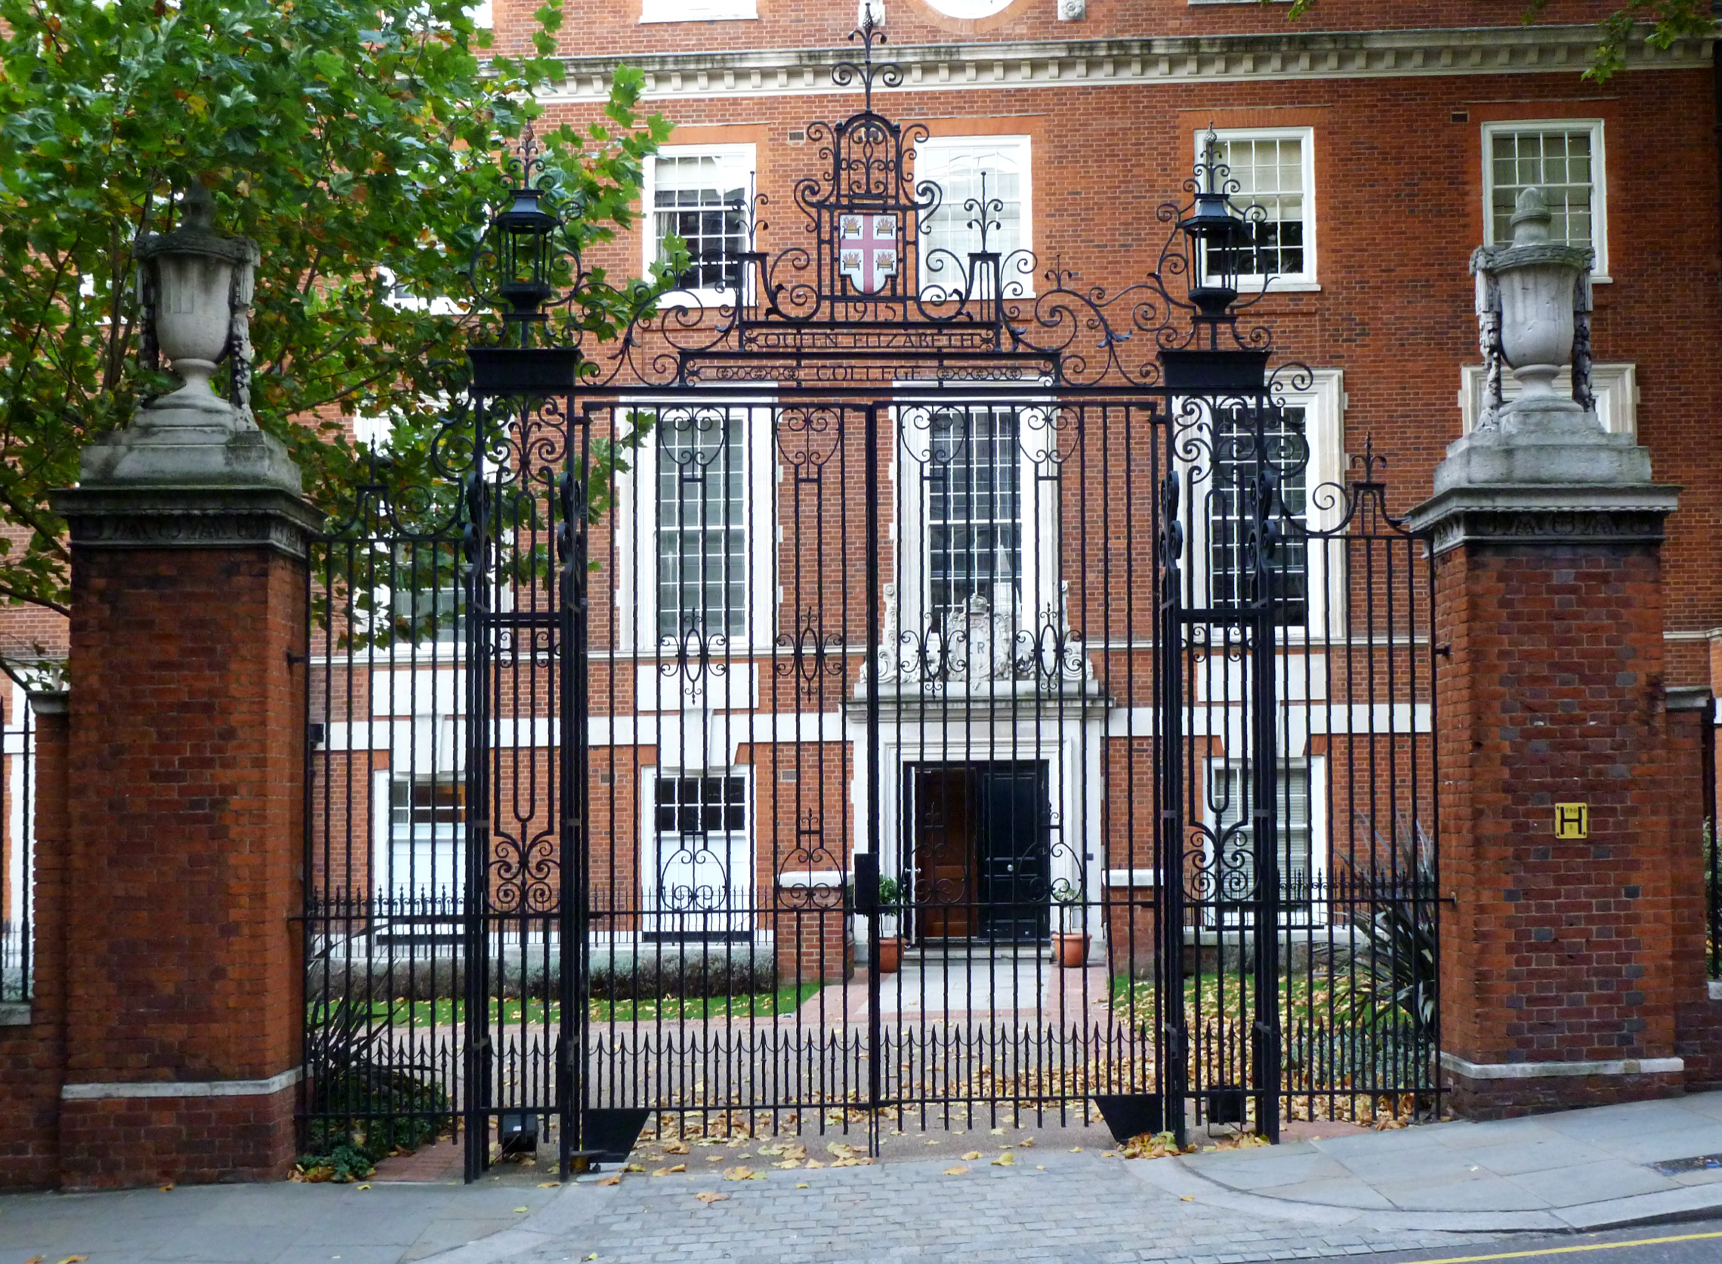
Queen Elizabeth College,
London University 1972 – 1975;
1st Class Honours
in Physics, 1975.
Dillon Prize, 1974
and Andrewes Prize, 1975
for best performance in year.
Notes:
Brian is skilled at chairing meetings.

Slide 11
Honorary Life Member,
Queen Elizabeth College Students
Union 1975.
For “general contribution to college life”
Secretary of the Union
Member of College Council.
Very interested in history & politics &
very left wing.
Notes:
Brian is skilled at chairing meetinsg

Slide 12
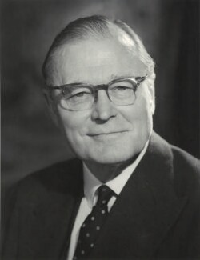
“Lots of what I know about chairing
meetings I learnt from the Chair of College council, Sir Hedley Atkins, a medic.”
How to ensure that a meeting behaved in an orderly fashion
How to ensure that everyone felt that their opinion had been heard
and taken on board
How to scan a meeting to be sure that people were ready to decide
and move on
“The whole gamut of how to chair a meeting properly,
which these days seems to be less and less understood
It is an art that has to be both studied and practiced.”
Notes:
Brian is skilled at chairing meetings. President of the Royal College of Surgeons and President of the Royal Society of Medicine

Slide 13
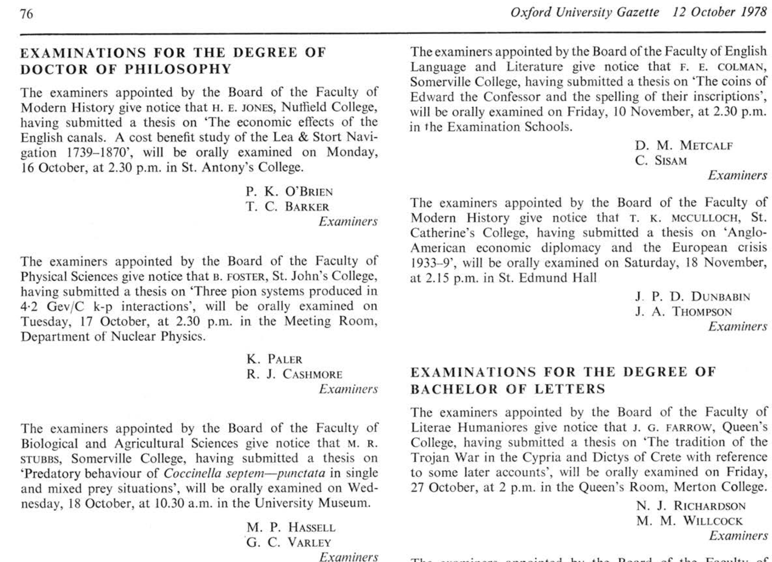
Oxford DPhil 1978
Notes:
The spellin of insciptions of the coins of Edward the Confessor the ecomomic effects of the English Canals , the tradition of the trojan war in the Cypria and Dictys for Crete and the predatory behavior of the Coccinella Septum puntata

Slide 14
Oxford DPhil 1978
Three pion systems
in 4.2 GeV k-p
interactions
Supervisor:
Pavel Grossman
Talk of Jos Engelen

Slide 15

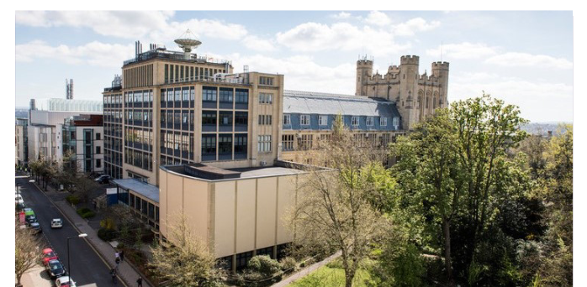
Research Associate, Rutherford Appleton Laboratory, 1978–82;
& Imperial College, 1982-84 ACNO, TASSO (see talk of Albrecht Wagner)
Lecturer, Dept. of Physics, Bristol University, 1984 – 1992;
Reader 1992 – 1996;
Head of Bristol Particle Physics Group, 1992 – 2003;
Professor of Experimental Physics, Bristol, 1996 – 2003
(Emeritus, 2003);
PPARC Lecturer Fellow 1999 – 2000
TASSO, ZEUS, SDC, BaBar
(Talks of Albrecht, Mandy, Brian, Jordan)
Built the group up to be one of the
strongest small groups in the country
Notes:
yes - although I was only paid to do TASSO - ACNO papers I did in my spare time. I did online DAQ, ToF calibrations, analysis and after a few years the VXD -
but Albrecht will cover all that.

Slide 16
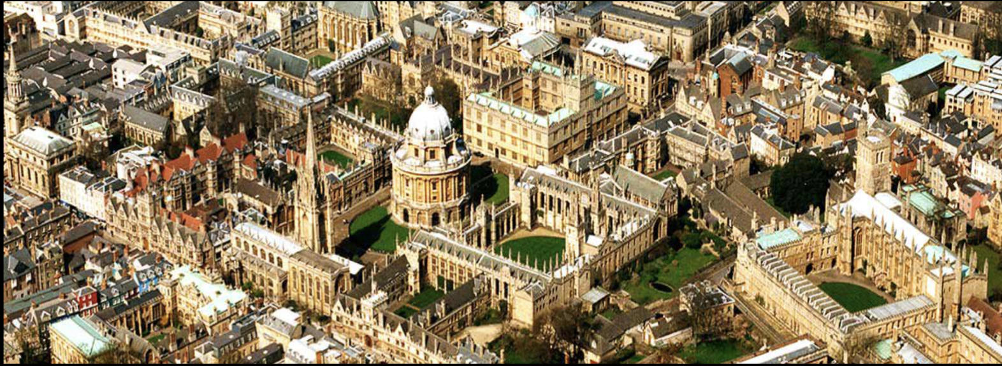
Professor of Experimental Physics in the University of Oxford 2003 – 2016
Head of the Subdepartment of Particle Physics (PP) 2004 – 2011
Professorial Fellow of Balliol College 2003 – 2022, now Emeritus
Donald H. Perkins Professor of Experimental Physics, 2016 – 2022, now Emeritus

Slide 17
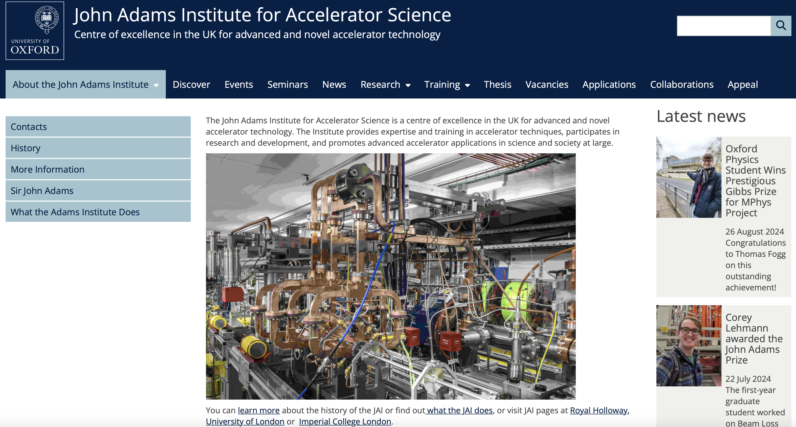
Architect of the John Adams Institute for Accelerator Science

Slide 18
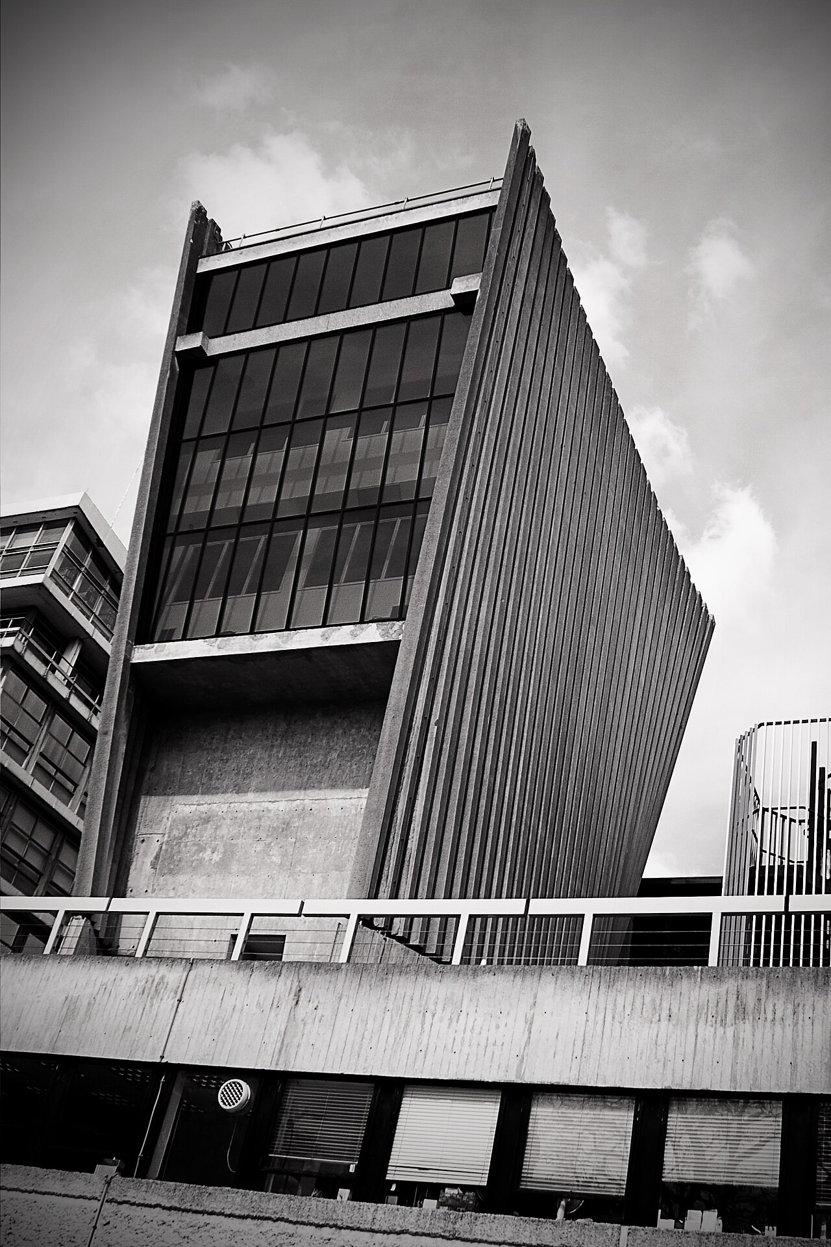
Introduced biweekly PP Executive Committee management
meetings in their current form
Chaired PP Graduate Studies Committee, which coordinated
teaching of particle physics to experimental graduate
students (involved both PP & Theory subdepartments.)
Responsible for the well-being & academic progress of
around 50 - 60 PP graduate students.
Supervised the admissions process & interviewed all
prospective D. Phil. students before entry
These practices have been followed ever since.

Slide 19
Introduced biweekly PP Executive Committee management
meetings in their current form
Chaired PP Graduate Studies Committee, which coordinated
teaching of particle physics to experimental graduate
students (involved both PP & Theory subdepartments.)
Responsible for the well-being & academic progress of
around 50 - 60 PP graduate students.
Supervised the admissions process & interviewed all
prospective D. Phil. students before entry
These practices have been followed ever since.
PP biggest contributor of overhead to Oxford Physics
when Brian arrived, dropped to average by the time he left.

Slide 20
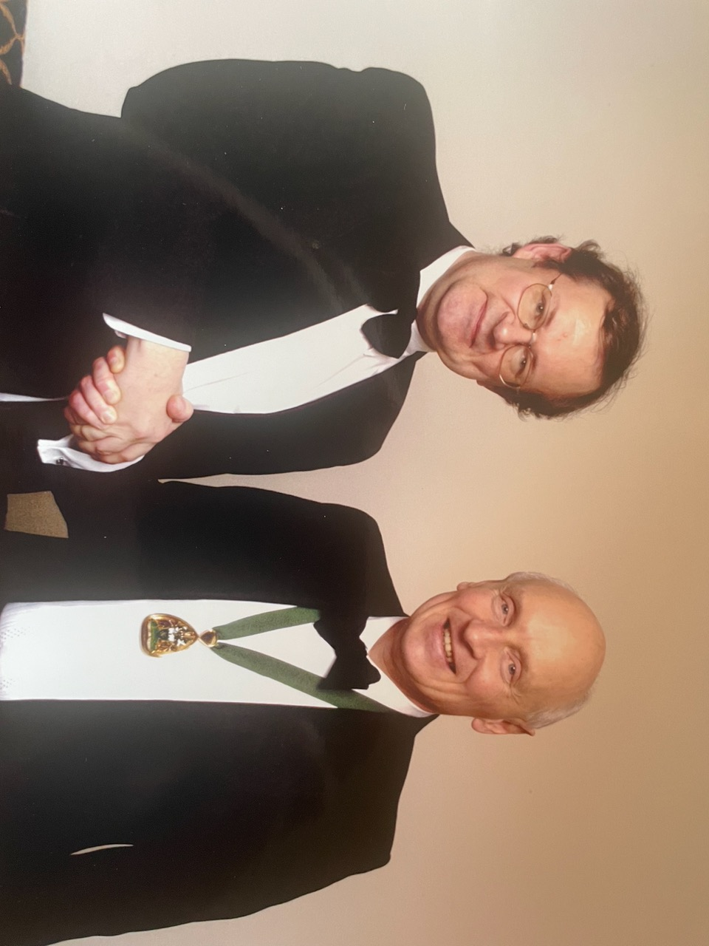
Max Born
Medal & Prize
2003
IOP & DPG

Slide 21
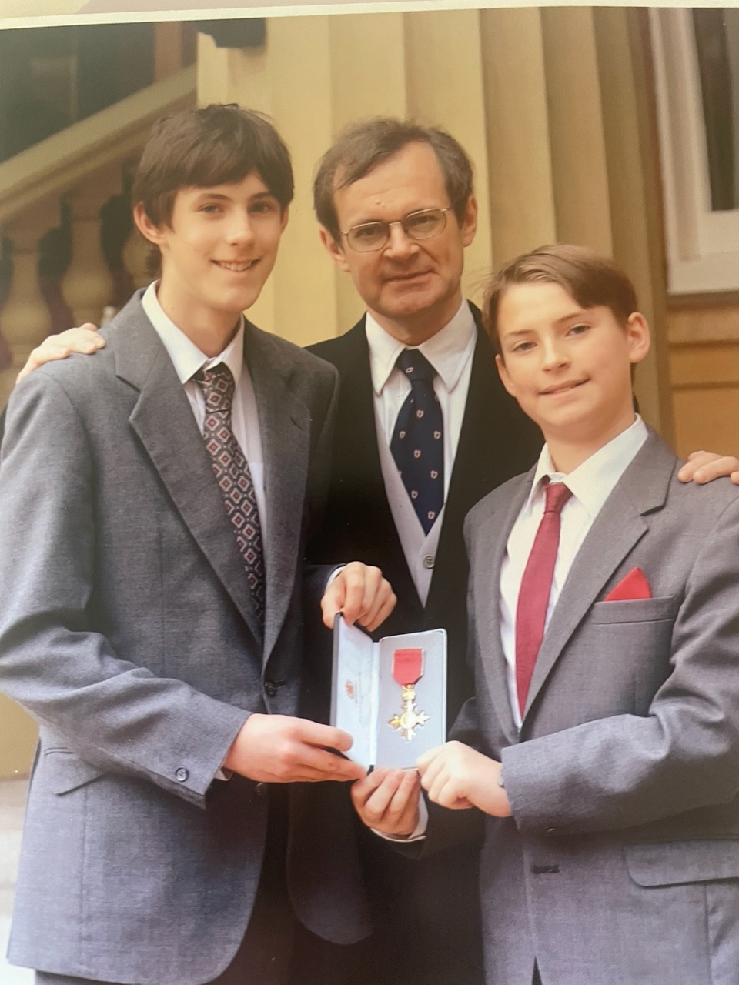
OBE
2003

Slide 22
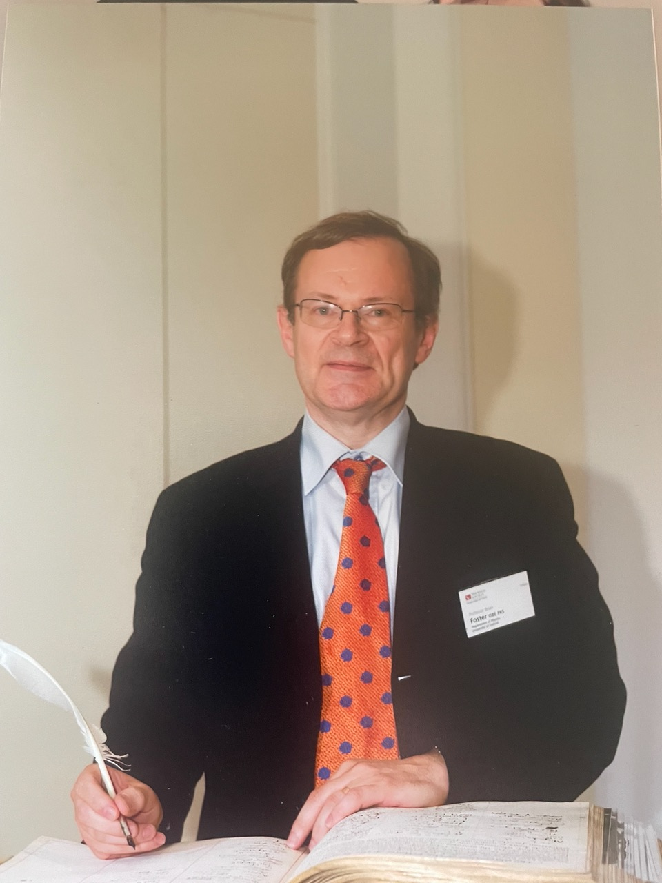
FRS
2008

Slide 23
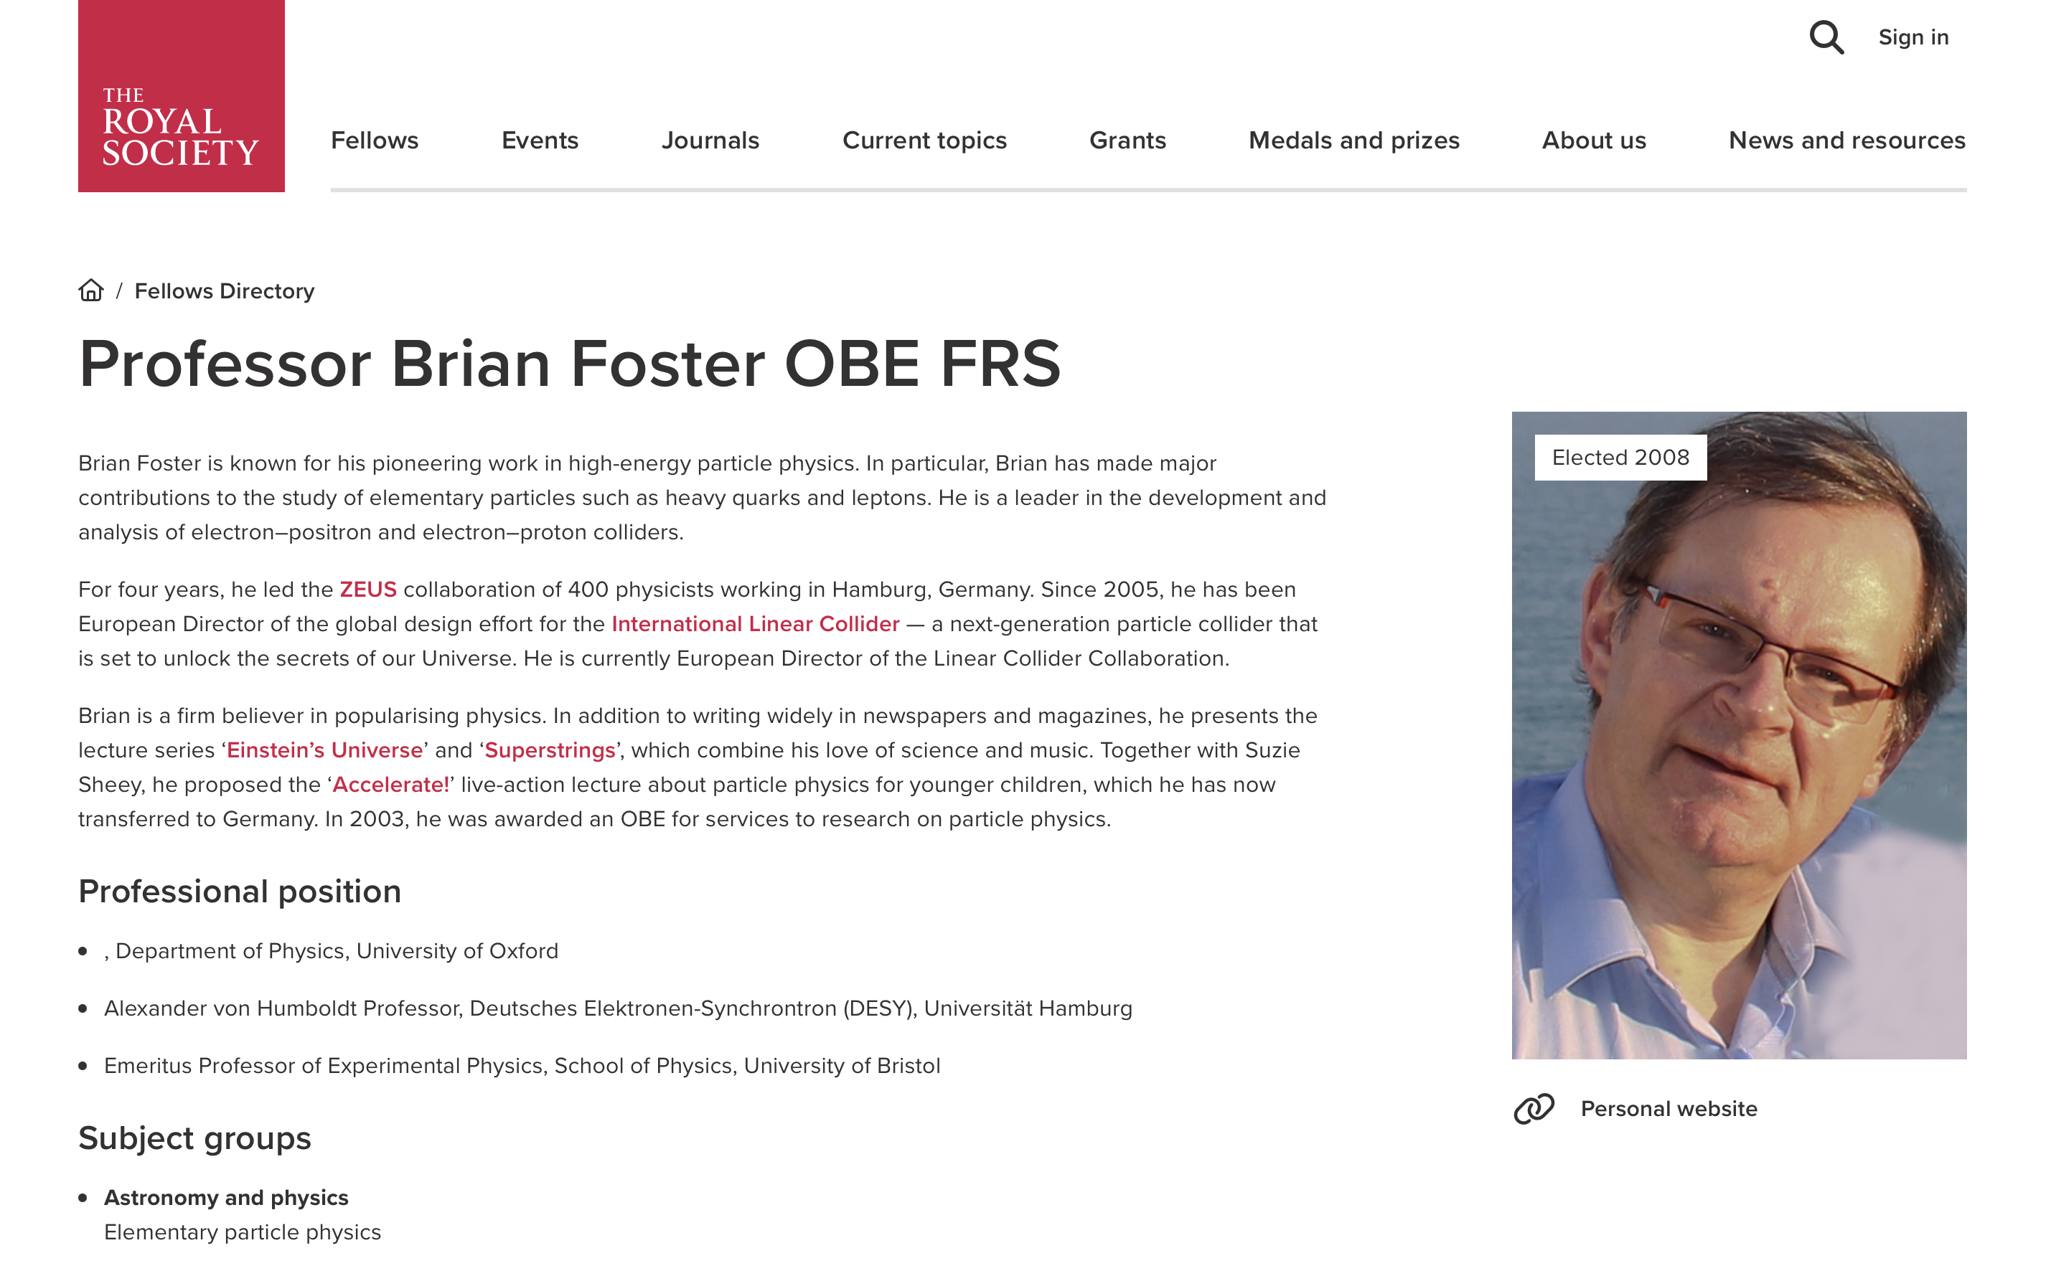

Slide 24
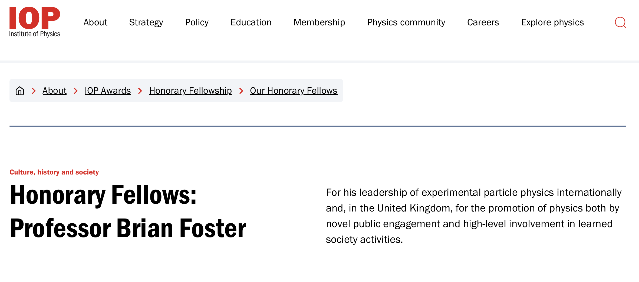
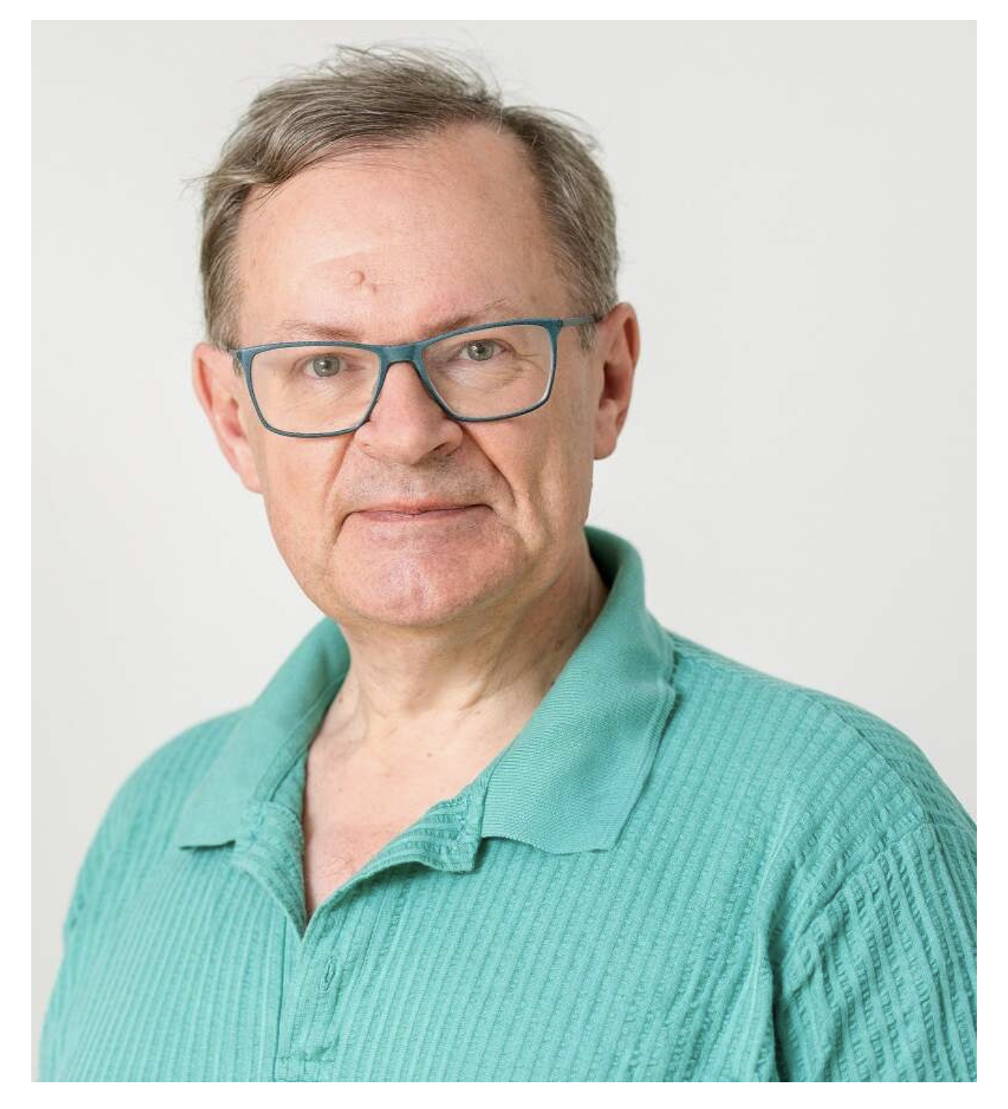
HonFInstP (2020)

Slide 25
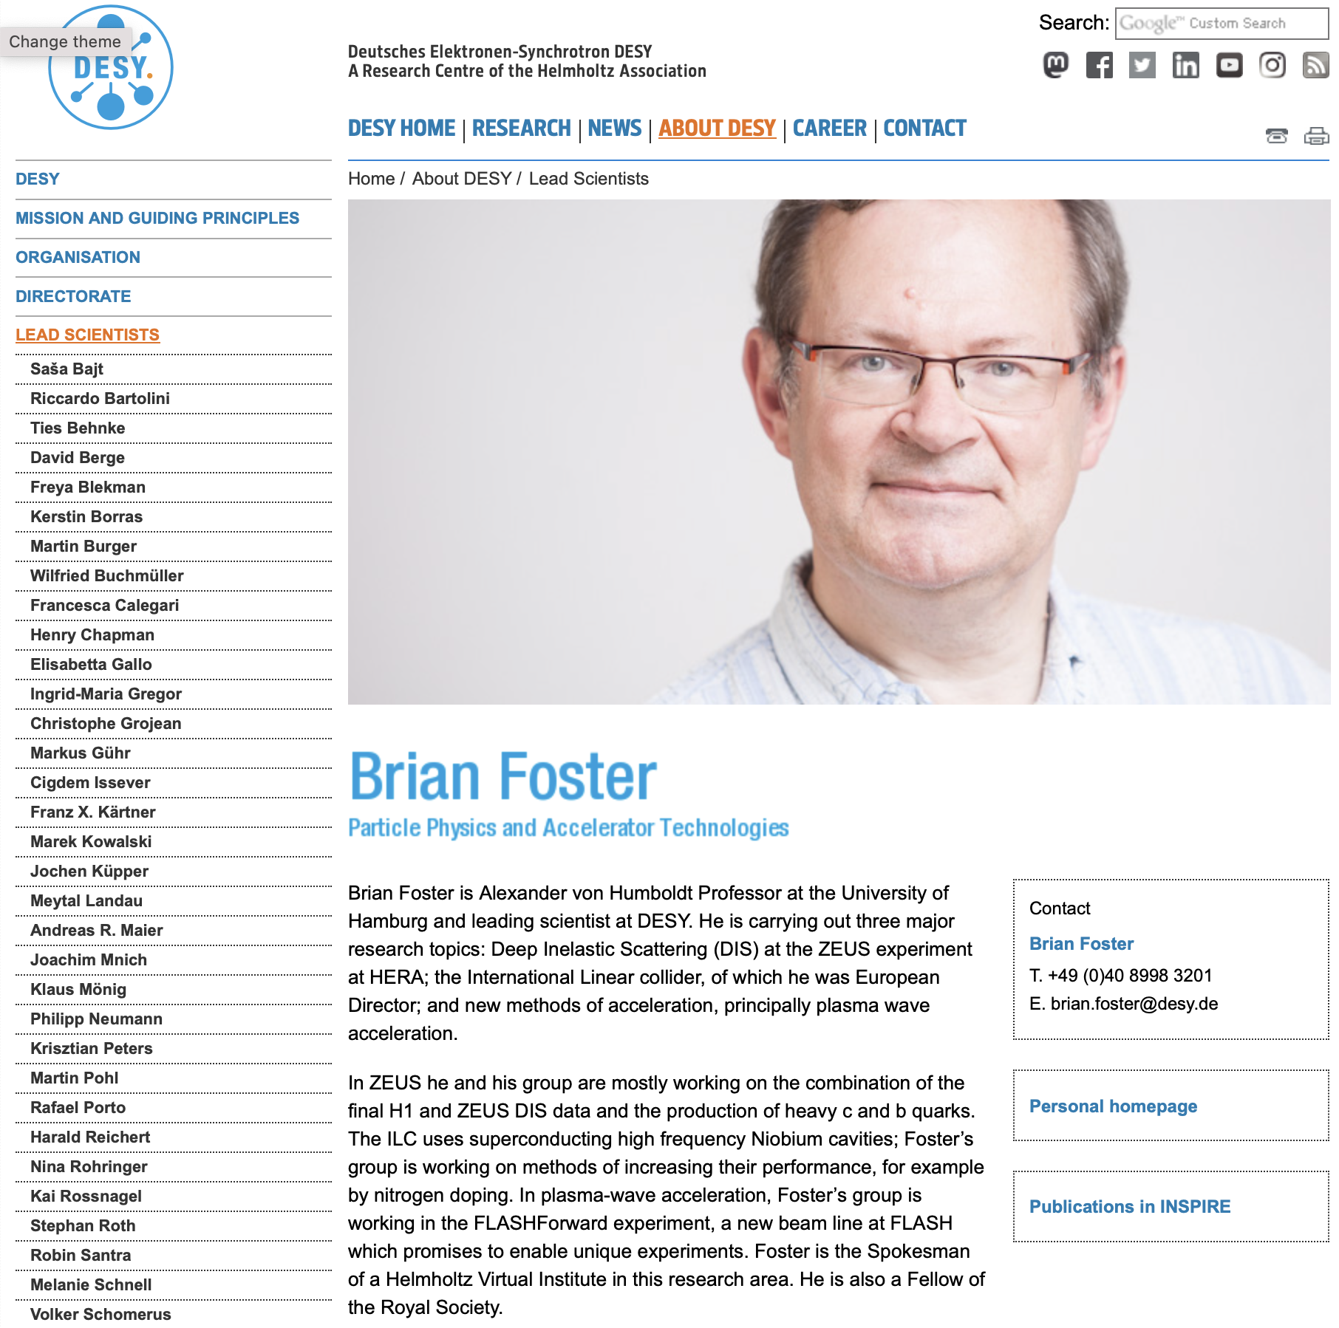
Humboldt Research Prize 1999
Humboldt Research Professorship 2011
at University of Hamburg/DESY on leave
of absence from Oxford.
ZEUS, ILC, FLASHForward, HALHF
(see Plasma Accelerators and Compact Colliders
talk of Carl Lindstrøm)
Notes:
A hybrid, asymmetric, linear Higgs factory based on plasma-wakefield and radio-frequency acceleration

Slide 26

Member of SC2 – a key role in electing new PP Fellows
Council member
Vice-President - established electronic voting on new Fellows!
Got an important report on “Greenhouse Gas Removal”
ISBN: 978-1-78252-349-9 through the hurdles.
Much government advice given
Many foreign delegations entertained
Member, RS Public Engagement Committee
Member of the Research Community of Interest
Founder member of the International Committee
Notes:
- I remember the Chinese Vice-minister
for science being astonished when I mentioned CEPC and flapping around to his advisors trying to get some information on it. I was for many years

Slide 27
Role in external things in pp
– (talk of Ian Halliday Science Government & Brian)
Organising the response to the Kendrew Report on CERN
Founding the IoP HEPP group
Chairing the IoP Nuclear and Particle Physics Division
Member of IoP Council
Honorary Fellow IoP
Member of LHCC in its earliest days, Chief Referee for LHCb.
Chair of ECFA (2002-2005), which led to European Director of ILC (talk of Barry)
sometimes acting as CERN Council delegate
for Ken Pounds as CEO of PPARC
Scientific Council of DESY
Currently Chair of CEPC IAC
Einstein’s Violin (Jack Liebeck)
Notes:
When I was chair of ECFA. At my last meeting as chair, we needed to appoint a European Director for ILC - of course I walked right
into it by asking for nominations and they all insisted I should do it. But of course I began to be involved as ECFA chair but it was
as ILC director that I really became properly involved.

Slide 28
Brian & the REF
Ian Shipsey, Head Oxford Physics
Notes:
I was unfmailar wit RFE havings ent most of my career in the US Whne I became HoD a REF in sept 2018 a REF submiiosn was due in 2019 and as HOD I was responsible, did not know much about it taked to Brian, he was an authority and adviser to varius UK universites and even spoke at conferencs on the topiec

Slide 29
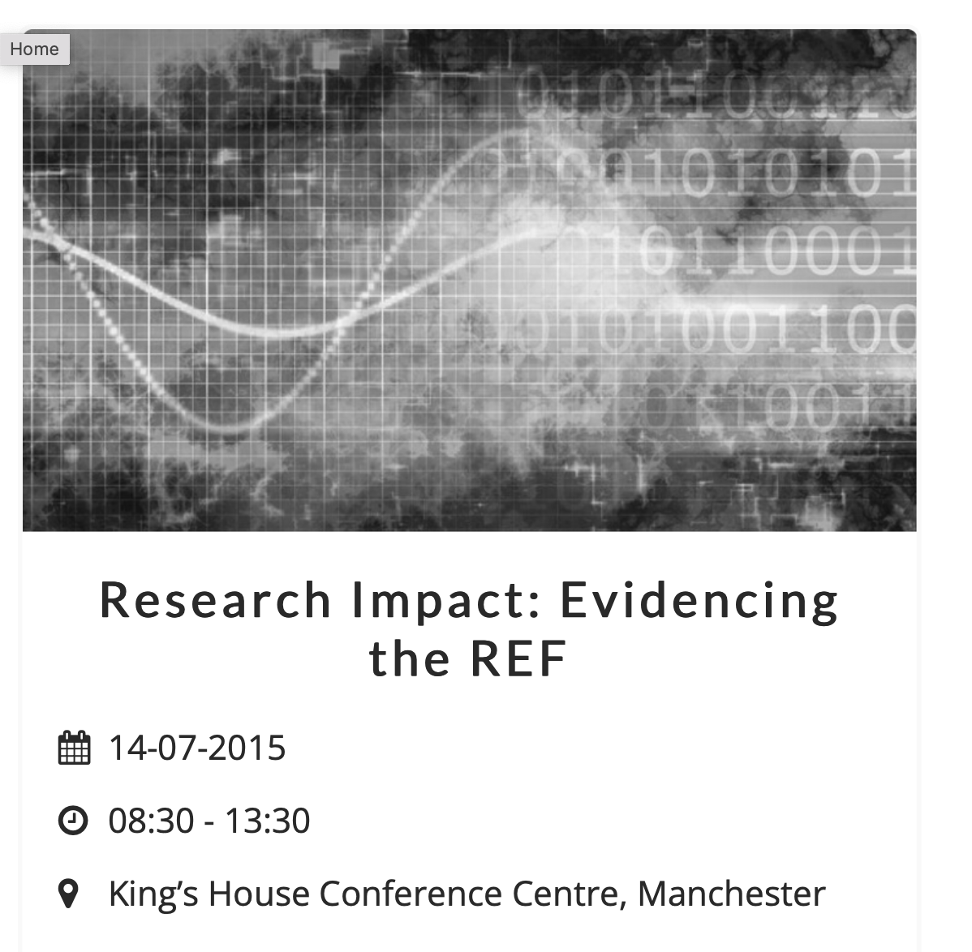

FosterFest!
Ian Shipsey, Head Oxford Physics
Notes:
I tok s look on the web and found this

Slide 30
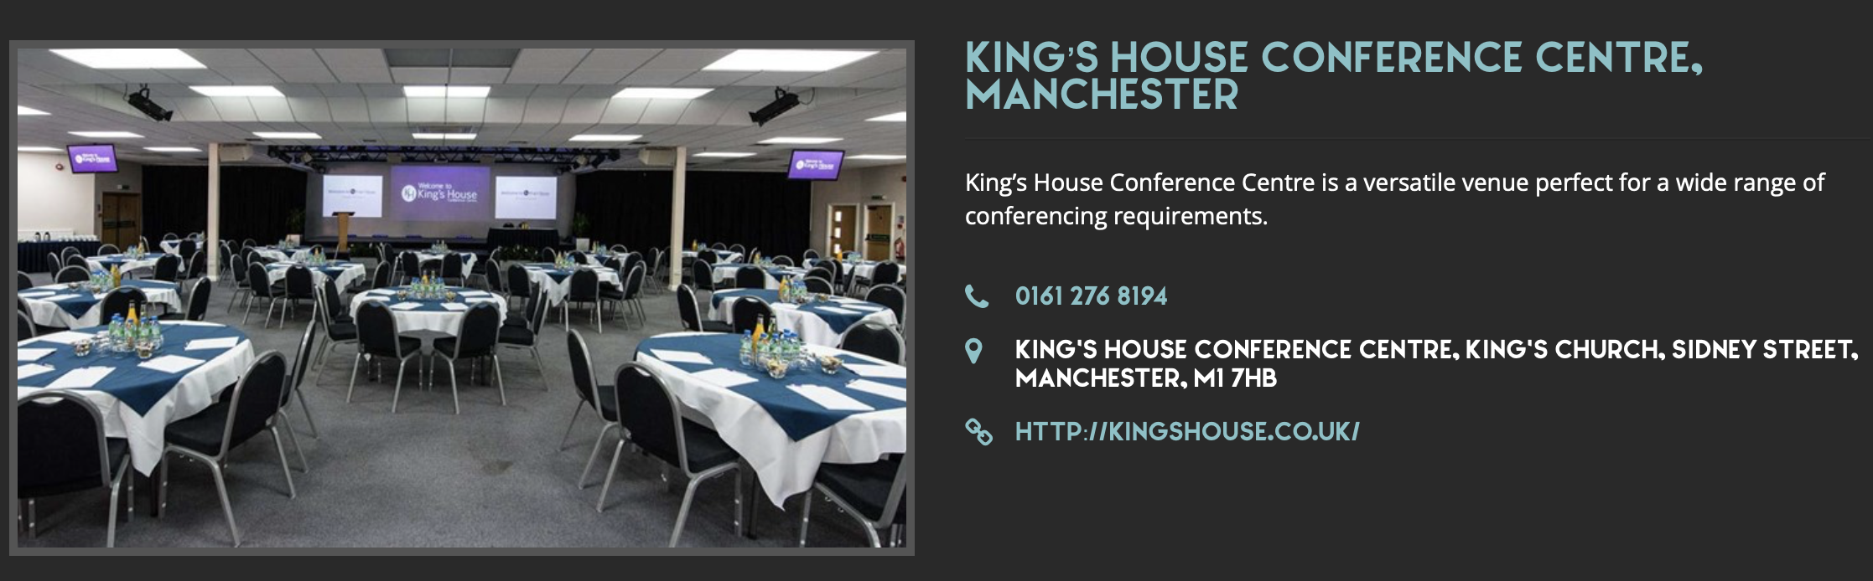
FosterFest!
Ian Shipsey, Head Oxford Physics

Slide 31
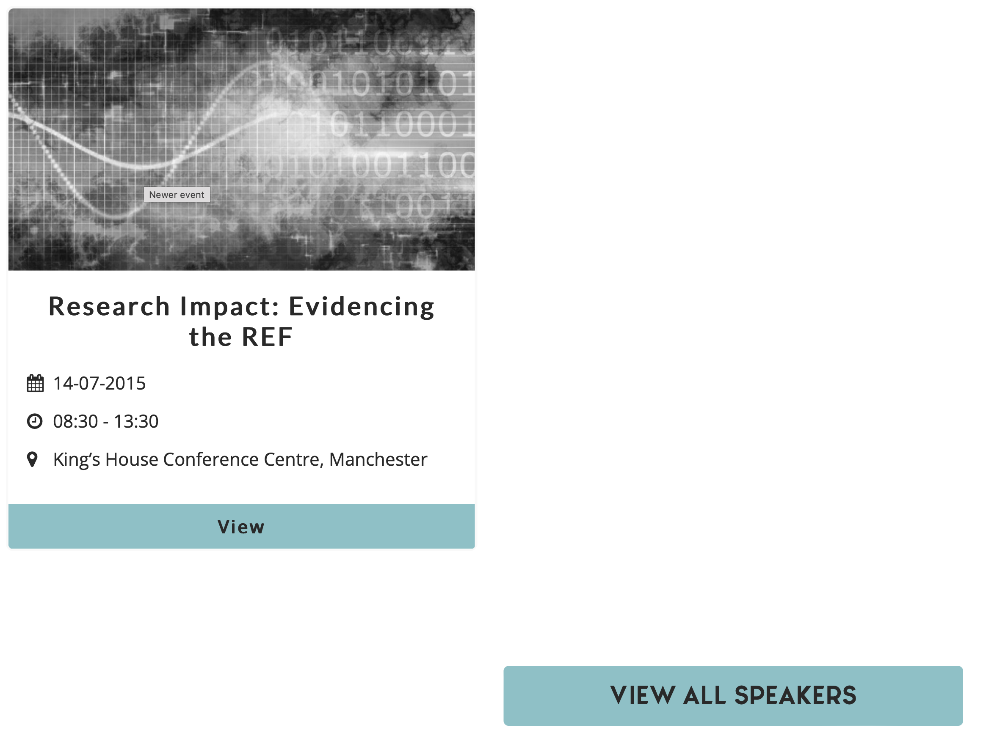
FosterFest!
Ian Shipsey, Head Oxford Physics

Slide 32
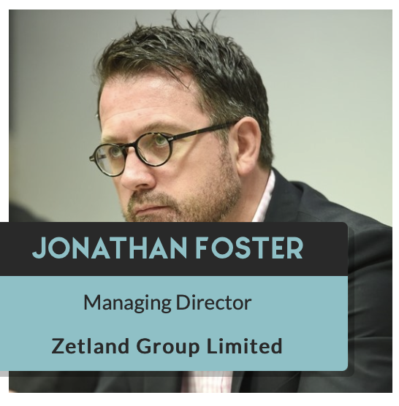

Slide 33
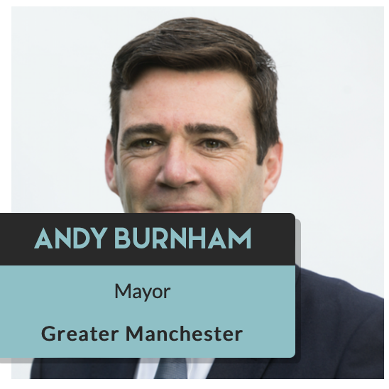

Slide 34


Slide 35
BRIAN FOSTER
Professor of Physics
Oxford University

Slide 36
FosterFest!
Ian Shipsey, Head Oxford Physics

Slide 37
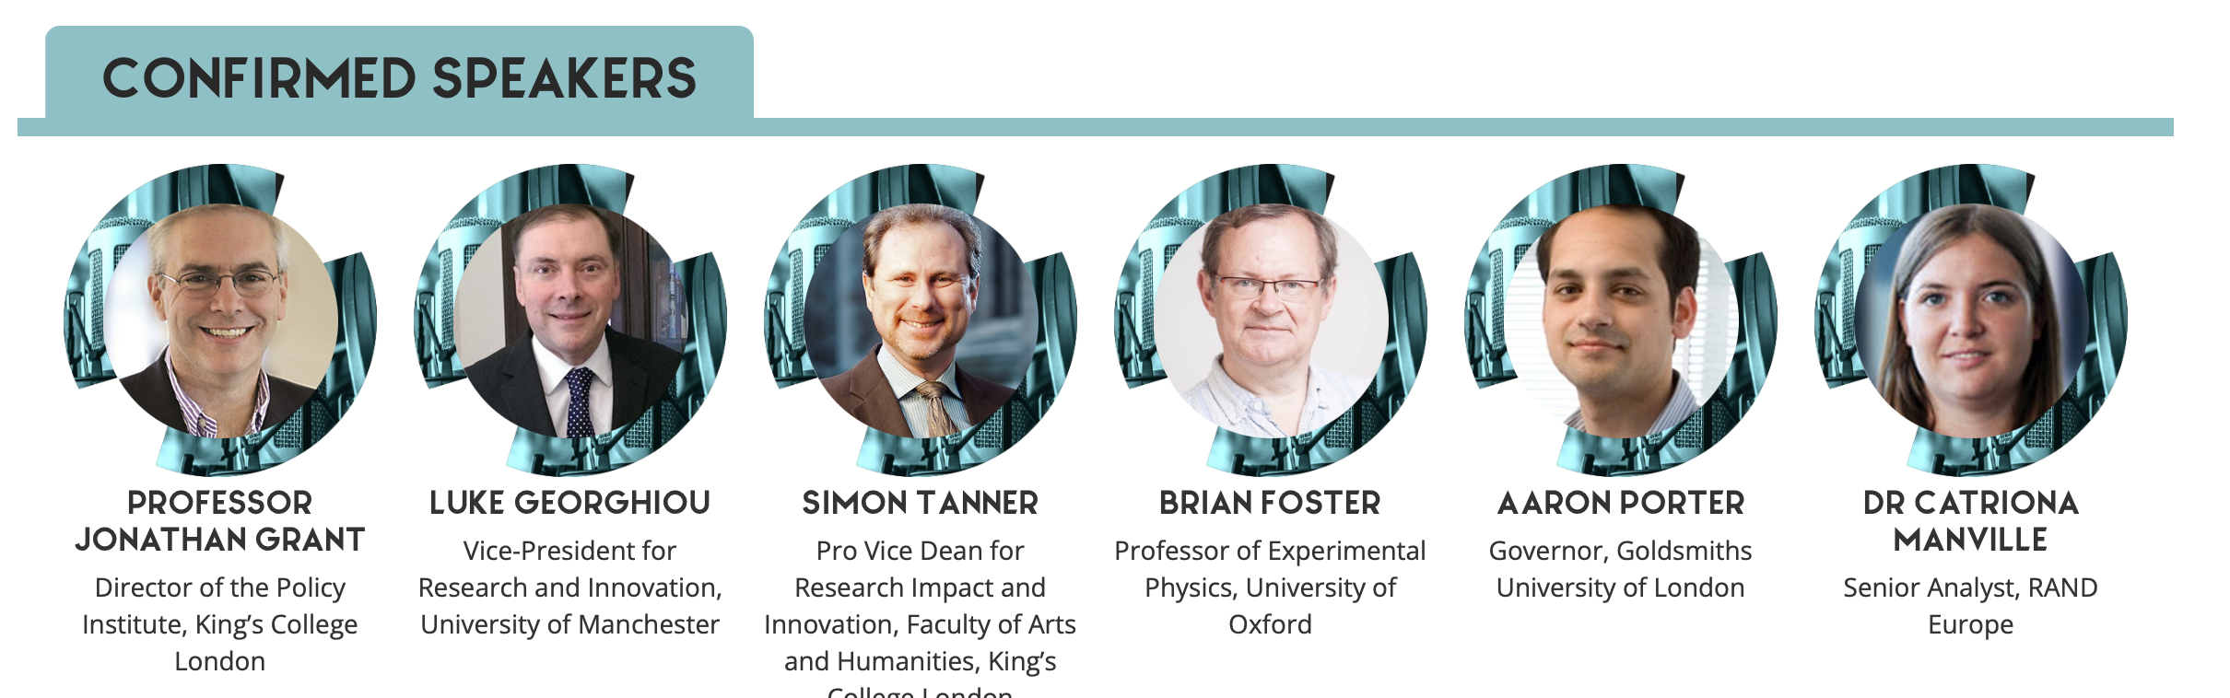

Slide 38
FosterFest!
Ian Shipsey, Head Oxford Physics

Slide 39
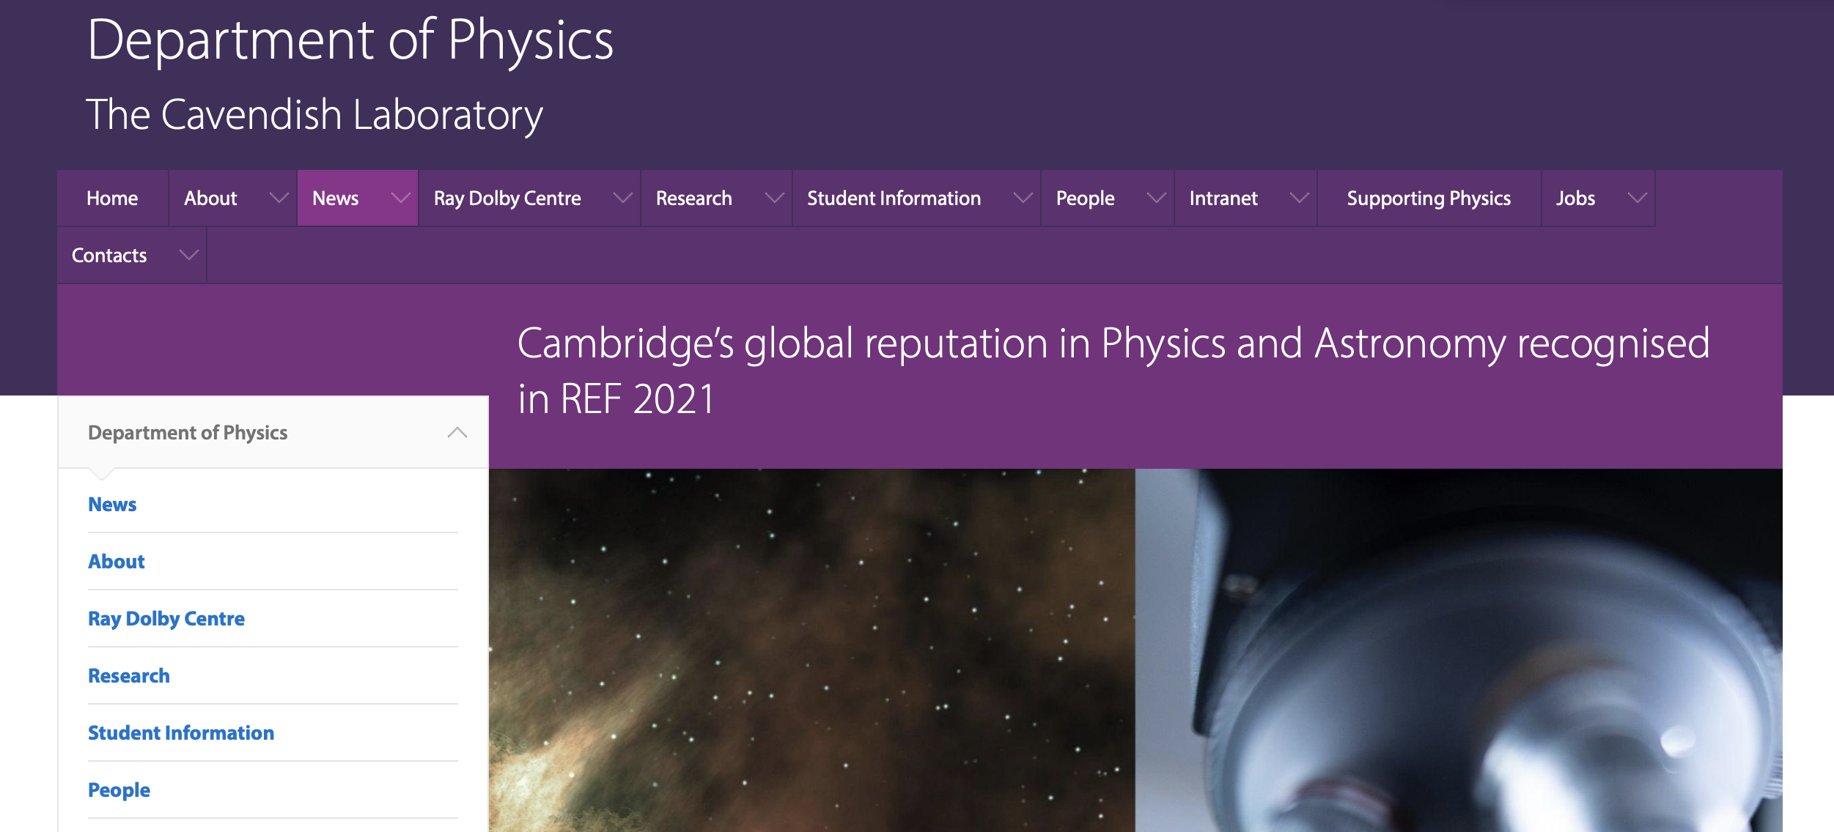

REF2021 PHYSICS

Slide 40
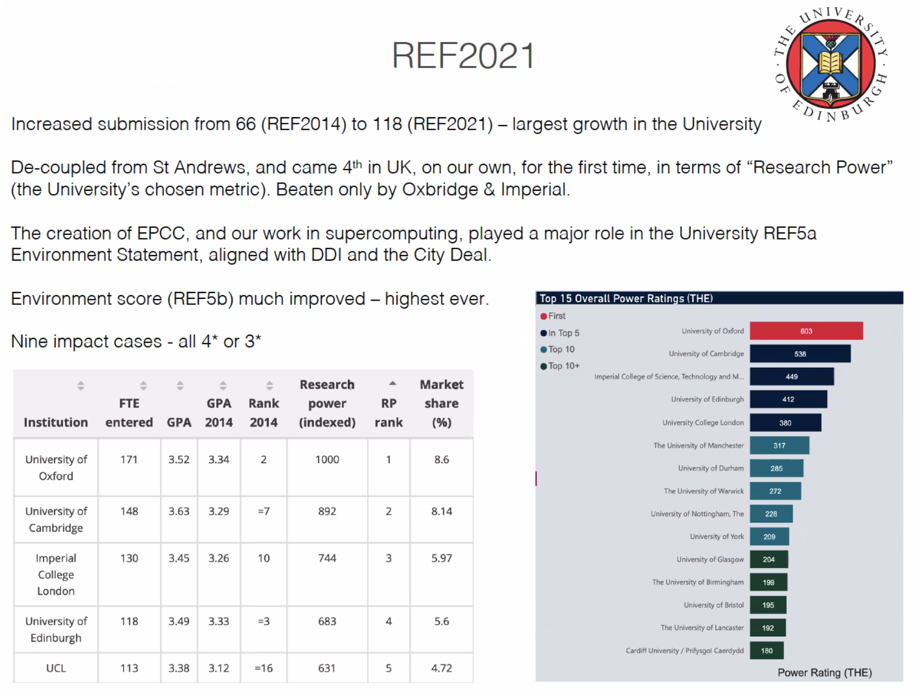
UK Government Assessment of
UK Physics Departments 2022
Notes:
I am still coming across these this is from head the school of Phyiscs and Astronmy in Edinburgh two moths ag o We havea bigger market share

Slide 42
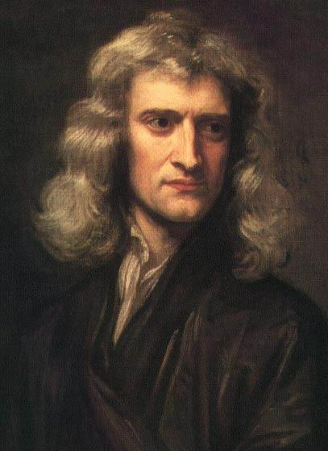
“What we know is a droplet, what we don’t know is an Ocean”
Sir Isaac Newton (1643-1727)
Notes:
Newton said it beter

Slide 43
The ocean is for all of us and future generations
to explore.
Notes:
Its an incredible privilge to do this and we shoud never foget that it is a privilege
Sunset over the pacifc ocean form the intrenationl spaec station

Slide 44
Stopping working so hard would be my plan for the next two decades although I am not sure I want to be around that long!
Still, Herwig Schopper is a role model here.

Slide 45
Stopping working so hard would be my plan for the next two decades although I am not sure I want to be around that long!

Slide 46
The ocean is for all of us and especially
future generations to explore.
Brian has played a key leadership role in particle
physics for more than four decades
And this will continue well into his retirement
Notes:
Its an incredible privilge to do this and we shoud never foget that it is a privilege
Sunset over the pacifc ocean form the intrenationl spaec station

Slide 47
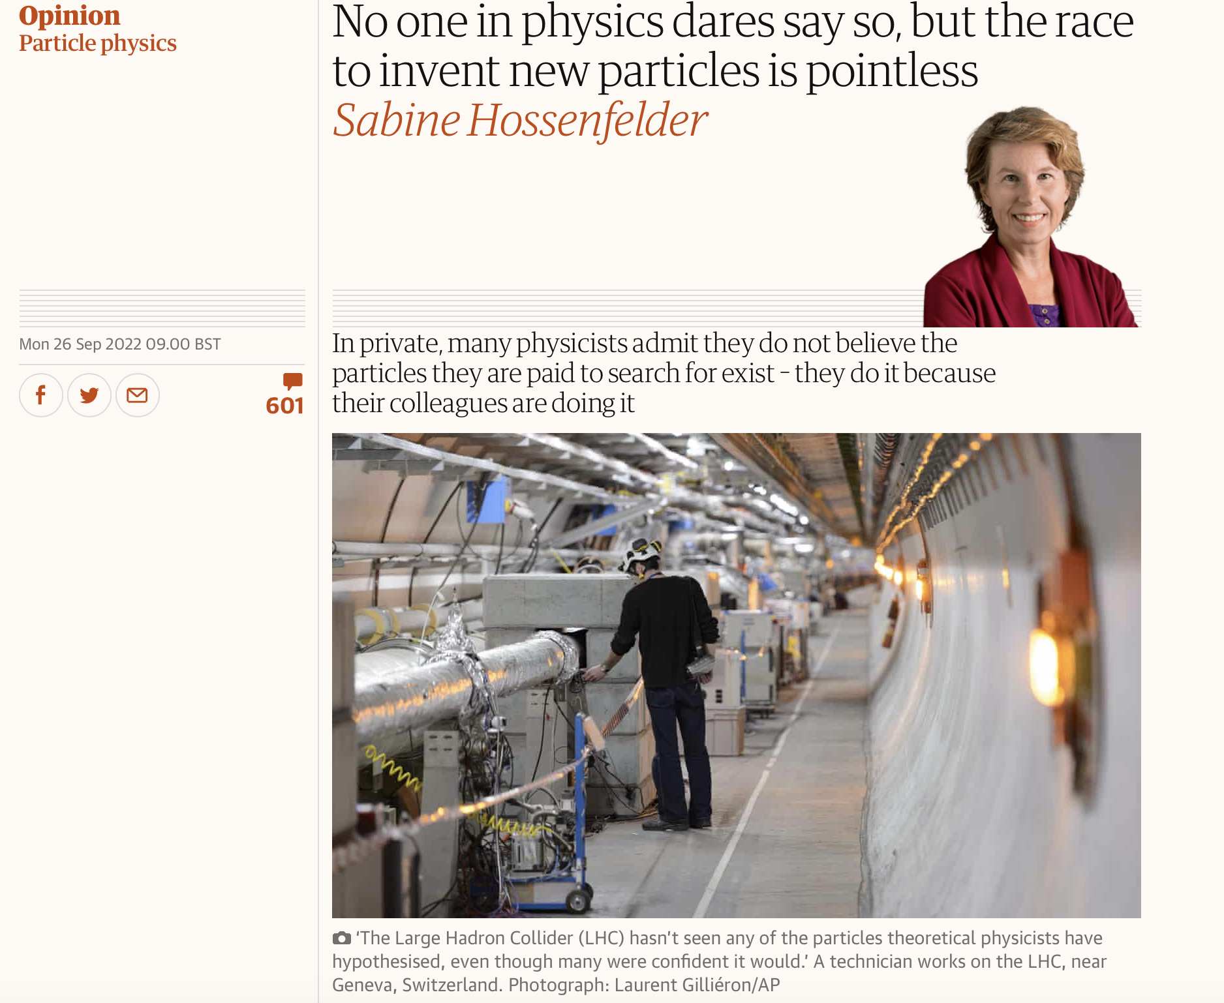

Slide 48
Neville as your Head of Department (for just a few more days) – a request that you take the lead and draft a response,
circulate it the particle physics community for signatures and then send to the Guardian

