Slide 1

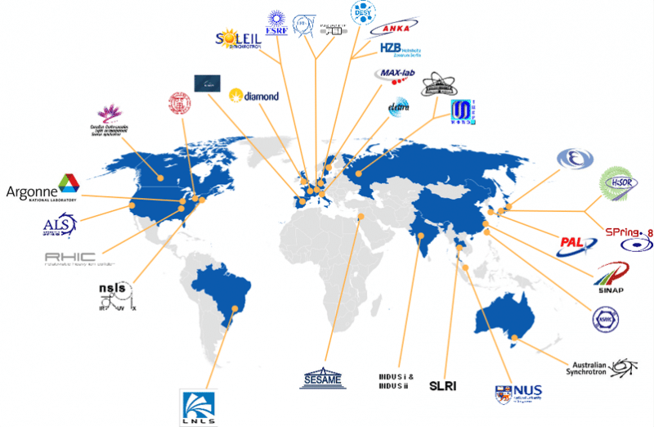
Advanced light sources in the world
WHY LAAAMP?

Slide 2




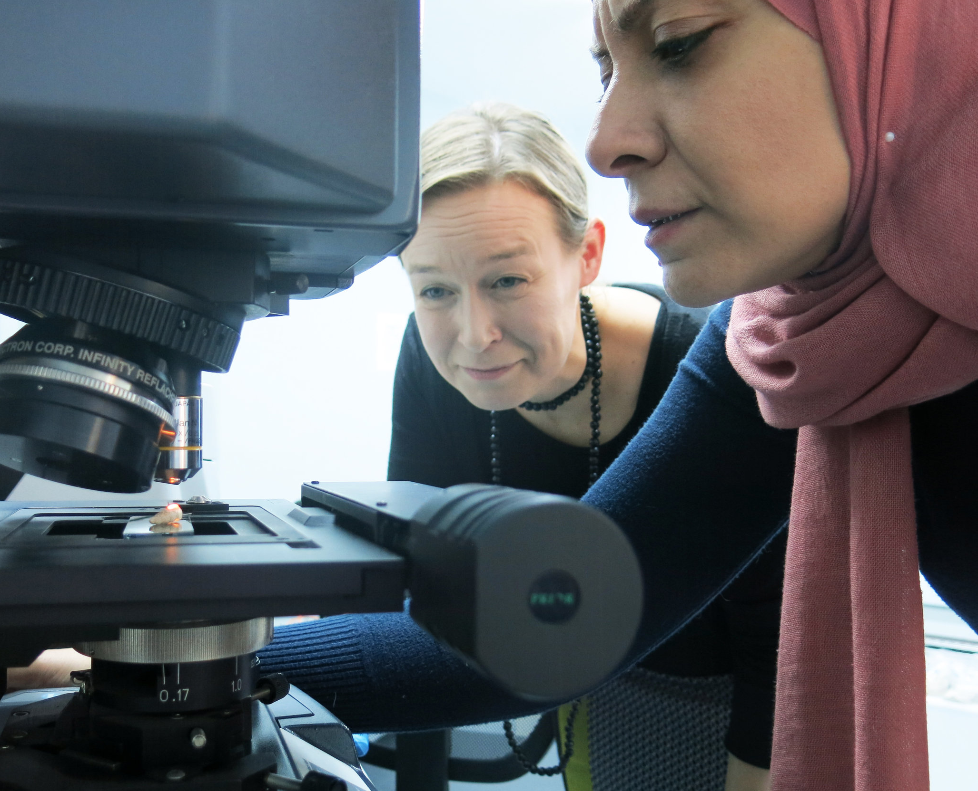
Current members:
Light Sources for Africa, the Americas, Asia, Middle East and the Pacific Project
GOALS:
Develop Regional Strategic Plans
Colloquia on lightsource sciences
Support Researcher+Student 2-month visits at partner facilities (20+ worldwide)
SIRIUS joined LAAAMP as partner in 2022
IUPAP contributes with 7,500 CHF/year
laaamp.iucr.org

Slide 3
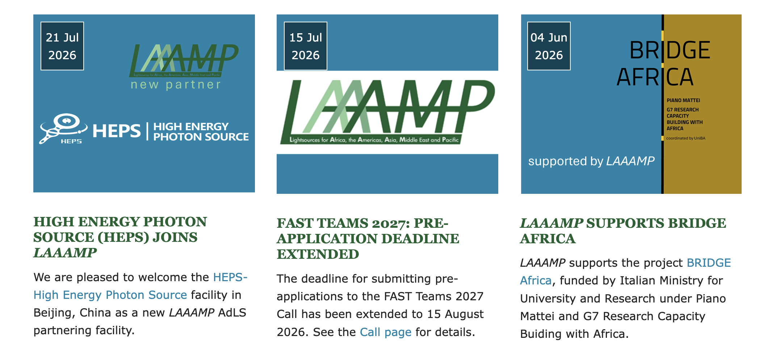

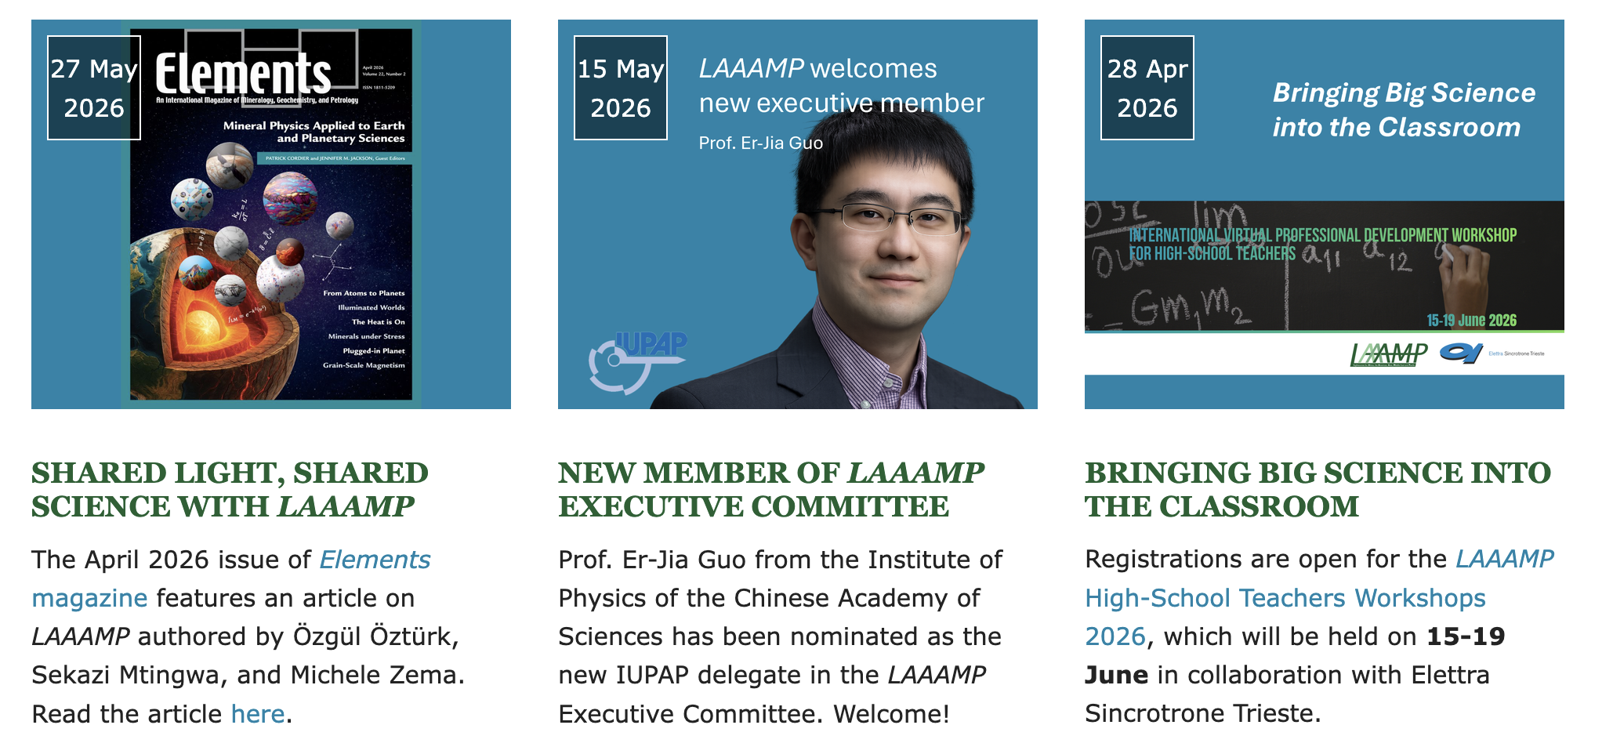
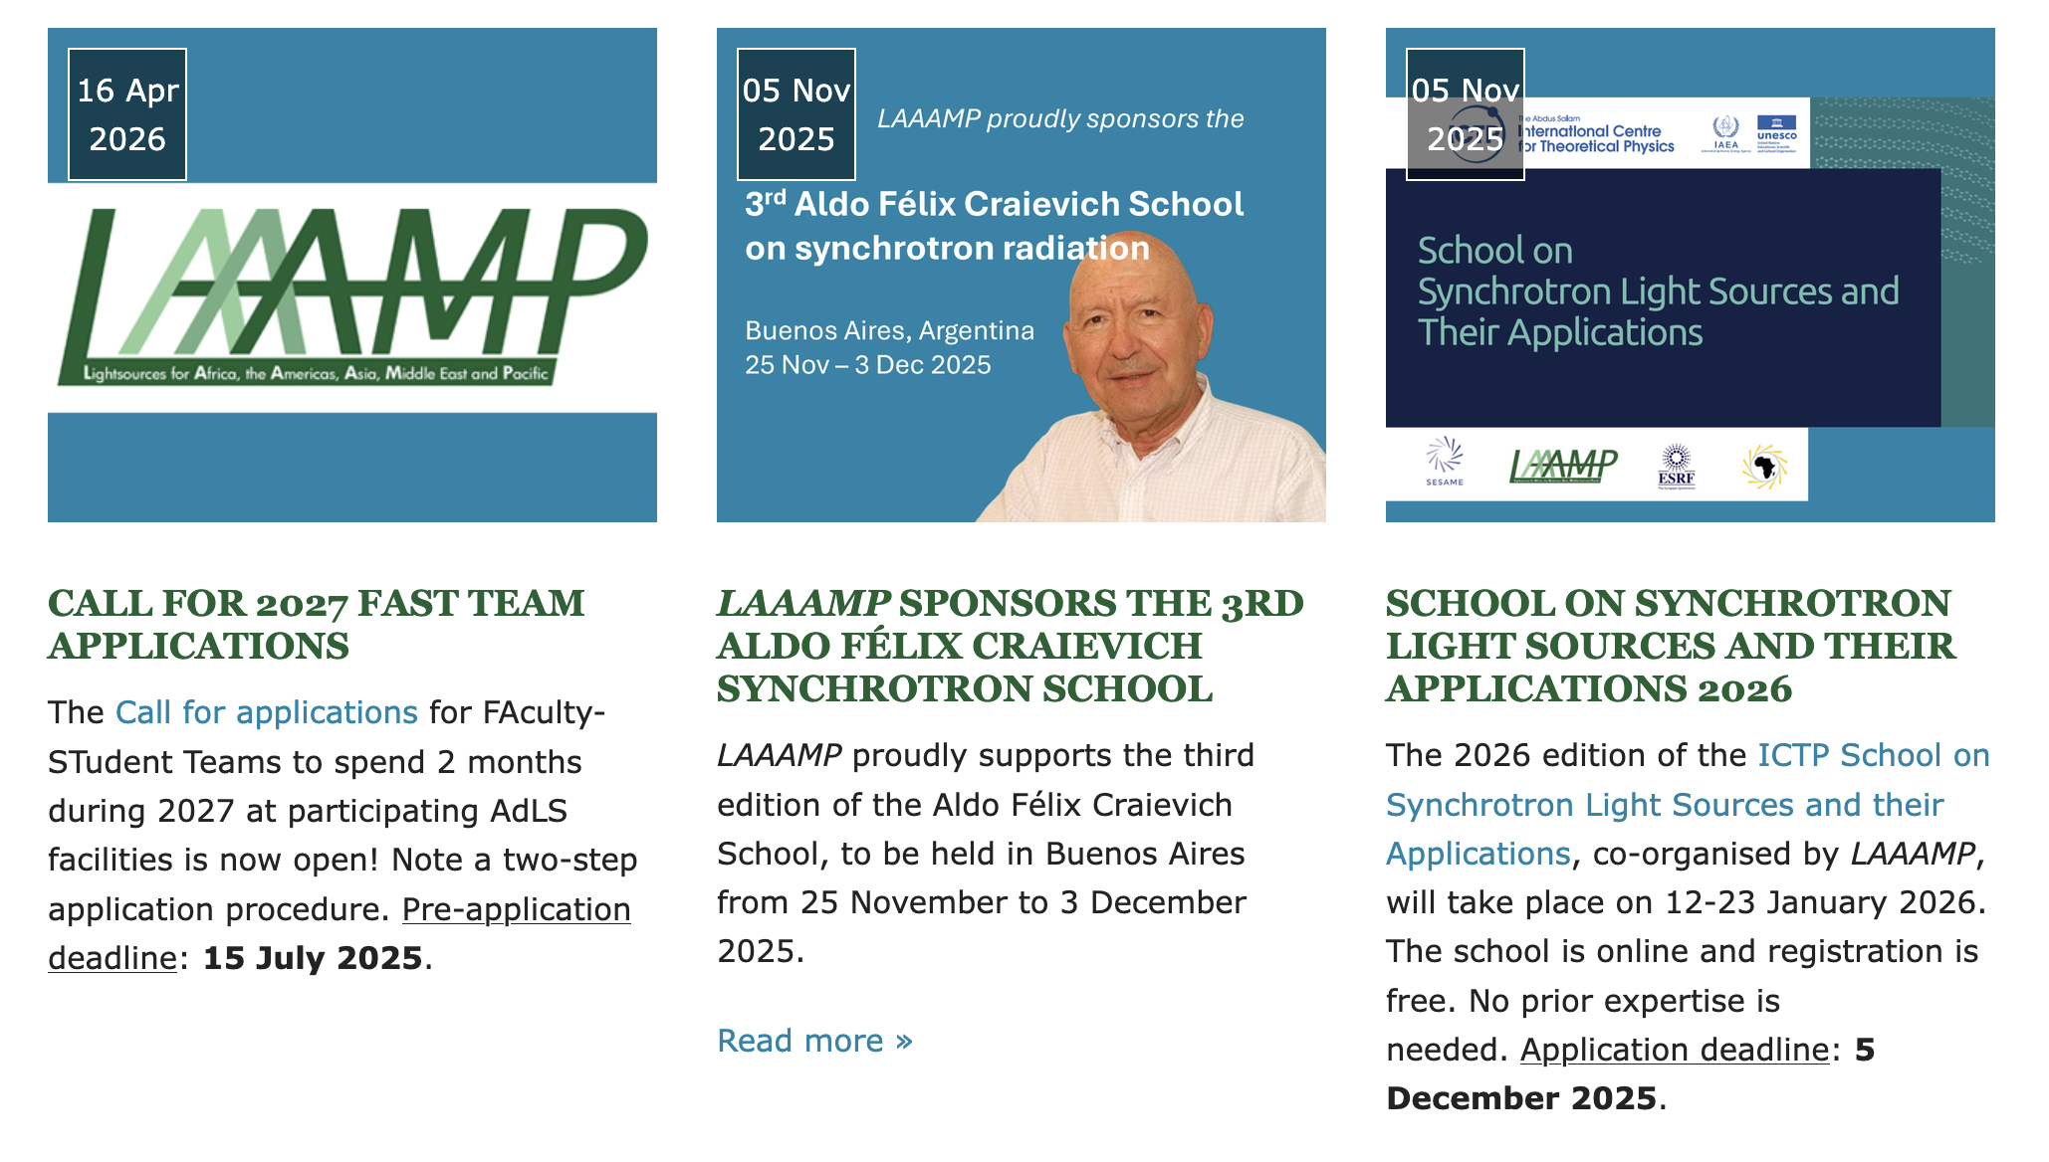

Slide 4
