Slide 1
The Latin American Strategy Forum for Research Infrastructure (LASF4RI)
Rogerio Rosenfeld
IFT-UNESP/ICTP-SAIFR
On behalf of the LASF4RI-HECAP Preparatory Group
IUPAP Executive Council and Commission Chairs
October 27, 2026

Slide 2
Sizeable, well organized and vibrant Latin American community in High Energy, Cosmology and Astroparticle Physics:
Latin American Association for High Energy, Cosmology and Astroparticle Physics (LAA-HECAP)
Latin American Symposium on High Energy Physics (SILAFAE)
Latin American Strategy Forum for Research Infrastructure (LASF4RI)

Slide 3
The Latin American Strategy Forum for Research Infrastructure (LASF4RI) is a recent effort: it aims at developing a community-driven strategy to strenghten the Latin American scientific collaborations and their impact.
We focused on HECAP areas. Organized in a Preparatory Group and a High-Level Strategy Group.
Inspired by the Snowmass/P5 process in the US and the ESPP in Europe.

Slide 4
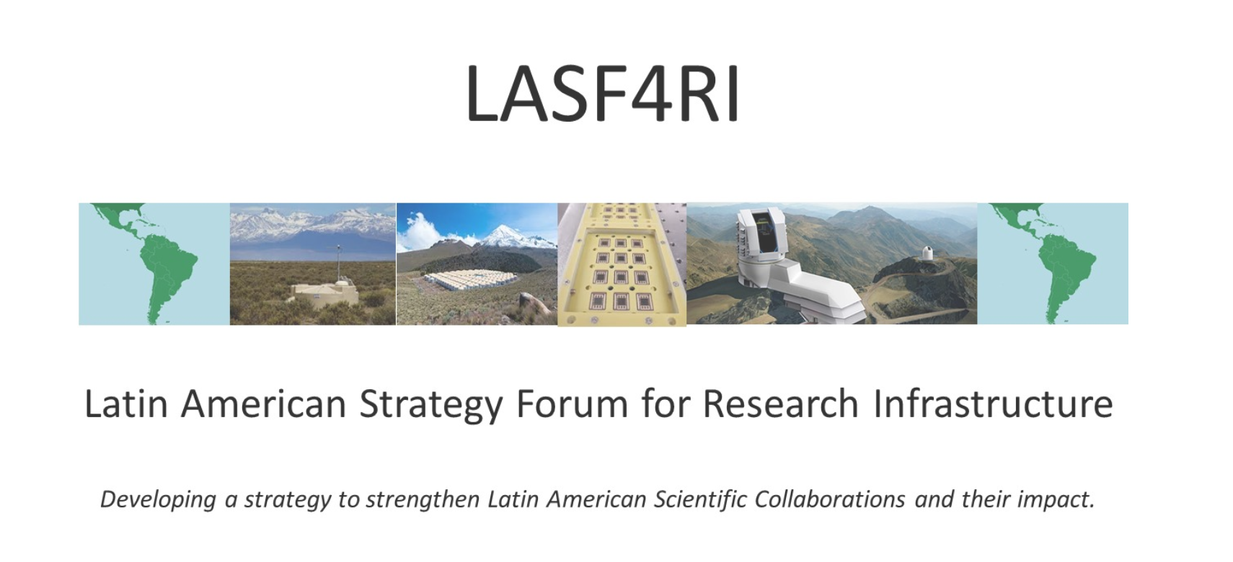
lasf4ri.org

Slide 5
Main Goals of the Process
To chart the landscape of existing infrastructure and expertise already developed in the region.
To build consensus and support a strategy-based approach for the participation in, and development of, large-scale research infrastructure projects in Latin America.
To make a call to Latin American scientific communities to establish a strategic scientific forum in order to coordinate Latin American activities in the area.
To set-up the LA scientific roadmap based on actual participation in large-scale research infrastructures and the inherent need for long term planning and funding implementing an open call for input from the scientific communities.
To enable a more effective development of Latin American research groups, facilitating multilateral participation in regional and global research infrastructures, increasing their impact.
To inform the Ministerial meetings of the development, implementation and impact of the strategy for HECAP.

Slide 6
1st Strategic Planning in Latin America
Based on 39 white papers submitted by the community. Finished in 2021.
Three main documents produced:
LA-HECAP Physics Briefing Book (2104.06852)
Strategy Document with recommendations
Endorsement letter from HLSG
lasf4ri.org

Slide 7
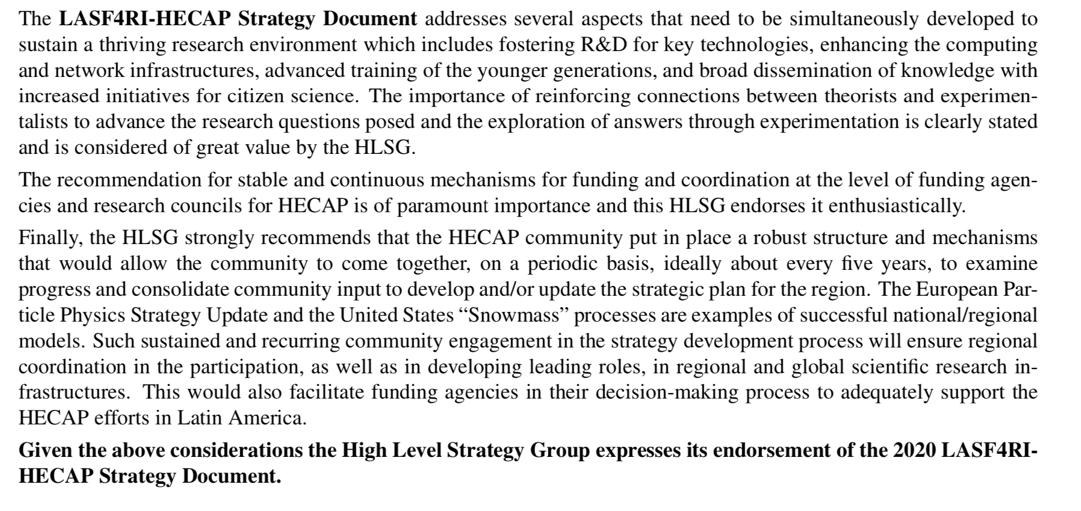
Endorsement by the High-Level Strategy Group

Slide 8
Update process of the HECAP Strategic Planning in Latin America
Call for new or updated white papers was issued in November 2023 with a deadline for submission of July 26, 2024.
The submitted contributions were presented at the “III LASF4RI for HECAP Symposium: Update of the Strategic Plan“, held at ICTP-SAIFR in São Paulo in August 26-29, 2024, with the participation of the Preparatory Group, High Level Strategy Group, Funding Agencies and representatives of similar efforts around the globe.

Slide 9
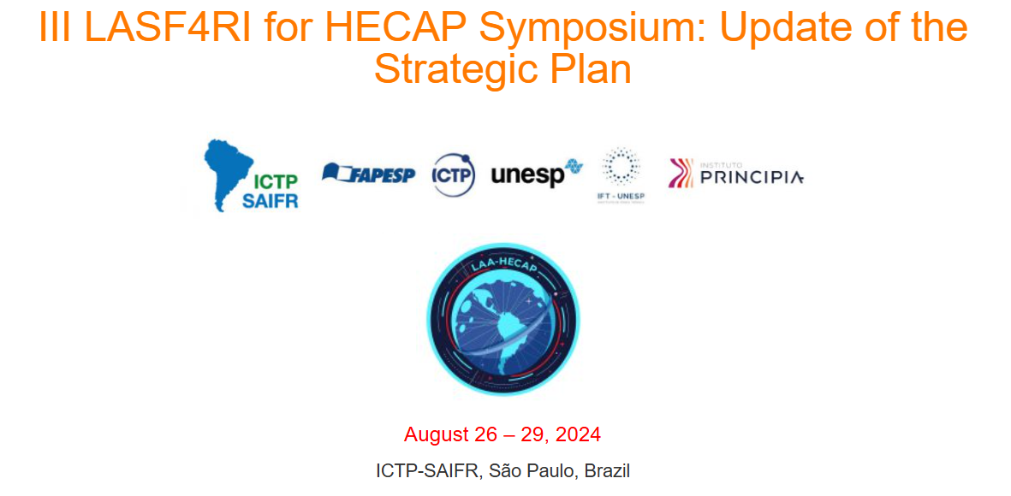
Slides and videos are available on the website www.ictp-saifr.org/hecap2024

Slide 10
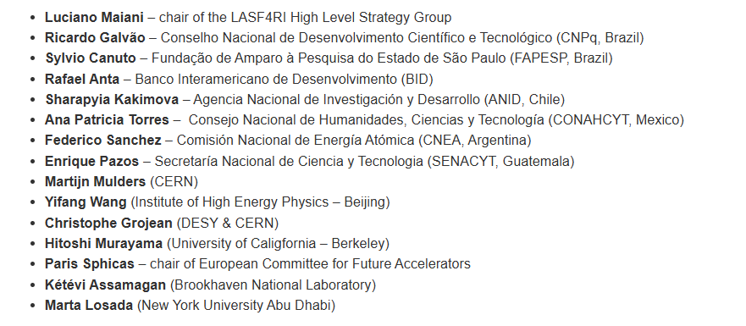
Invited speakers:

Slide 11
LASF4RI-HECAP Preparatory Group 2024-2026
Argentina
Diana López Nacir
Belén Andrada
Fernando Monticelli
Bolivia
Martín Subieta
Brazil
Sandro Fonseca
Farinaldo Queiroz
Rogerio Rosenfeld
Chile
Alfonso Zerwekh
Mauro Cambiaso
Colombia
Deywis Moreno
Costa Rica
Esteban Jimenez Moya
Ecuador
Andrés Baquero Larriva
Edgar Carrera
Guatemala
Juan Ponciano
Honduras
Melissa Cruz Torres
Mexico
Malena Tejeda Yeomans
Alexis Aguilar Arévalo
Luis Nunes
Paraguay
Diego Stalder
Peru
Alberto Gago
Uruguay
Lucía Duarte
Venezuela
Luiz Nuñes
Arturo Sánchez Pineda
José Antonio López
International
Juan Estrada (Fermilab)
Martijn Mulders (CERN)

Slide 12
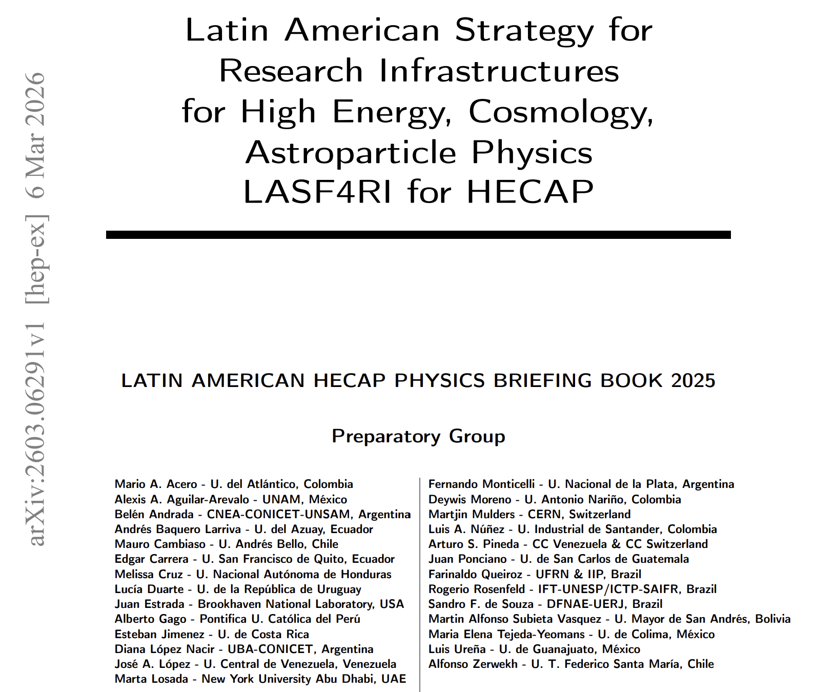
An updated Physics Briefing Book based on 48 white papers was concluded in 2025.

Slide 13
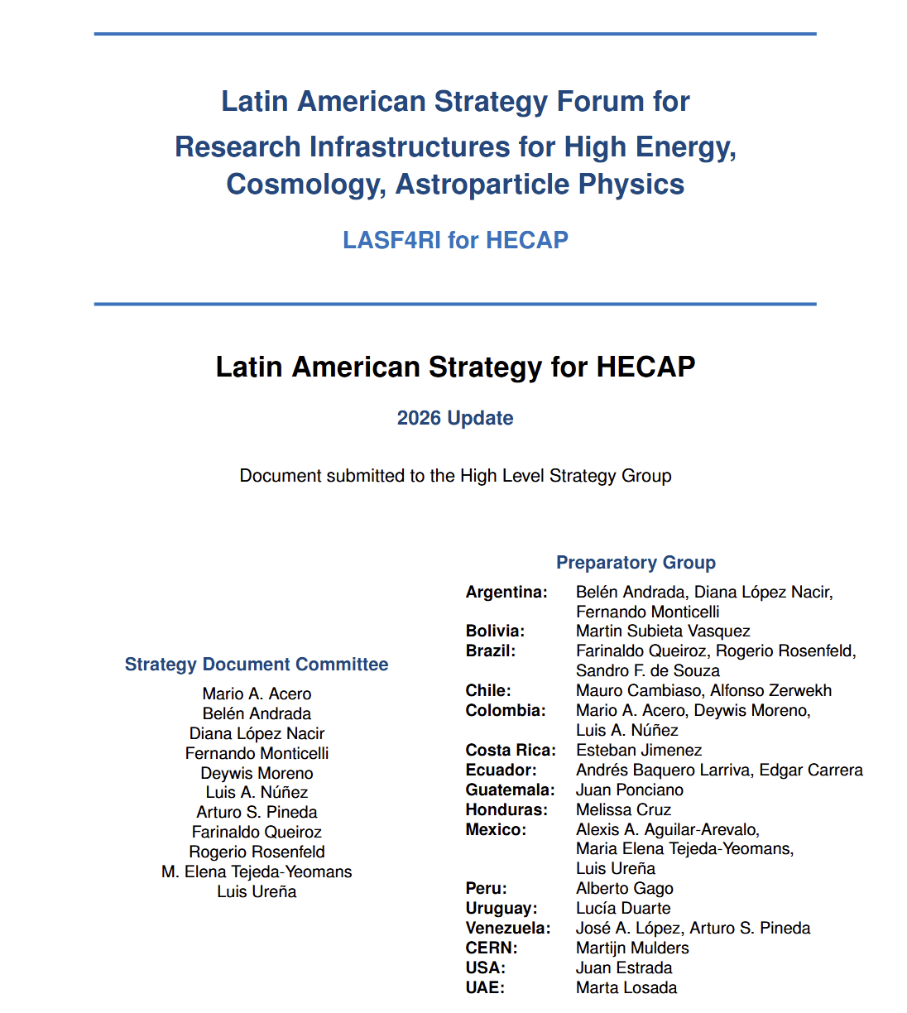
An updated Strategy Document was drafted:

Slide 14
Update of the HECAP landscape in Latin America:

Slide 15
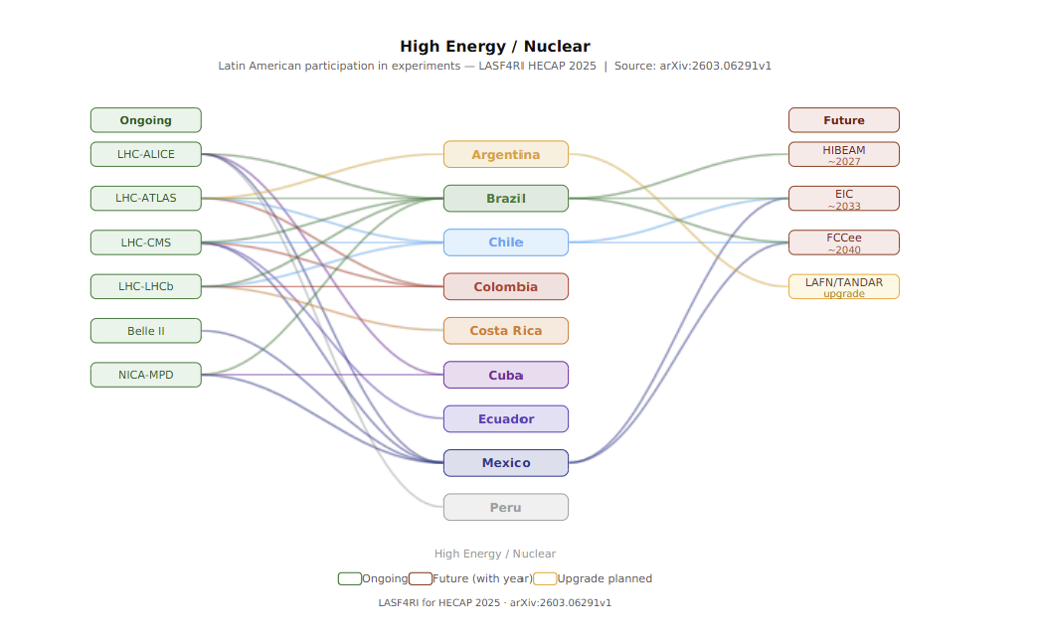

Slide 16
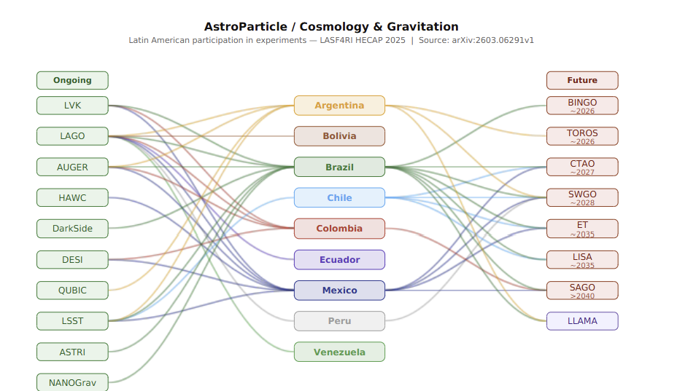

Slide 17
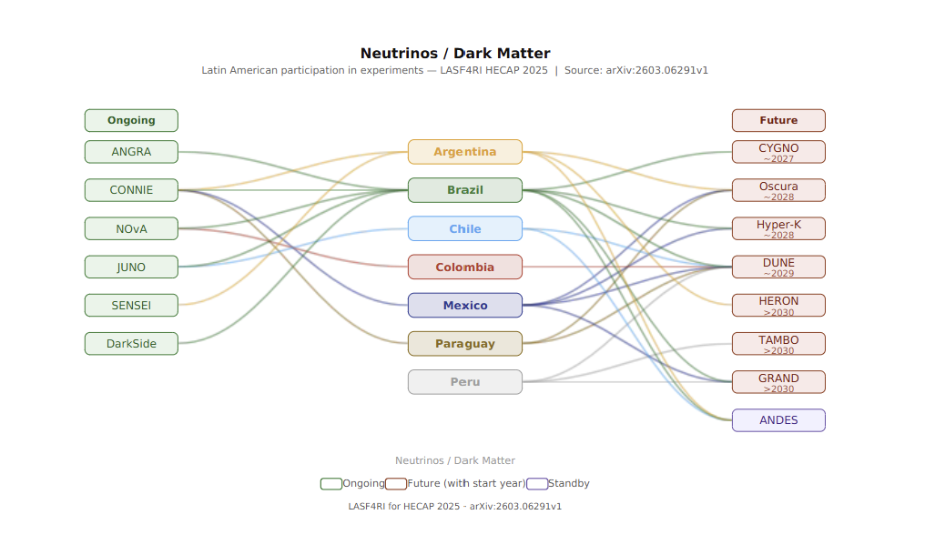

Slide 18
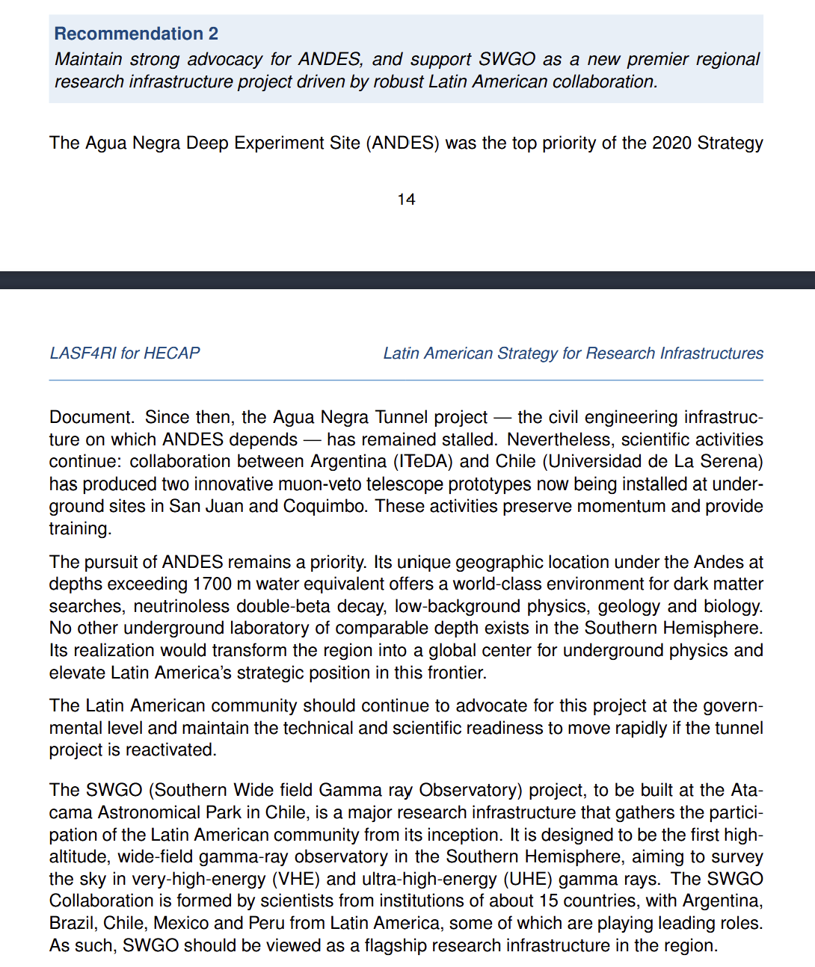
A set of 10 recommendations
was made
The Strategy Document was sent to the High Level Strategy Group

Slide 19
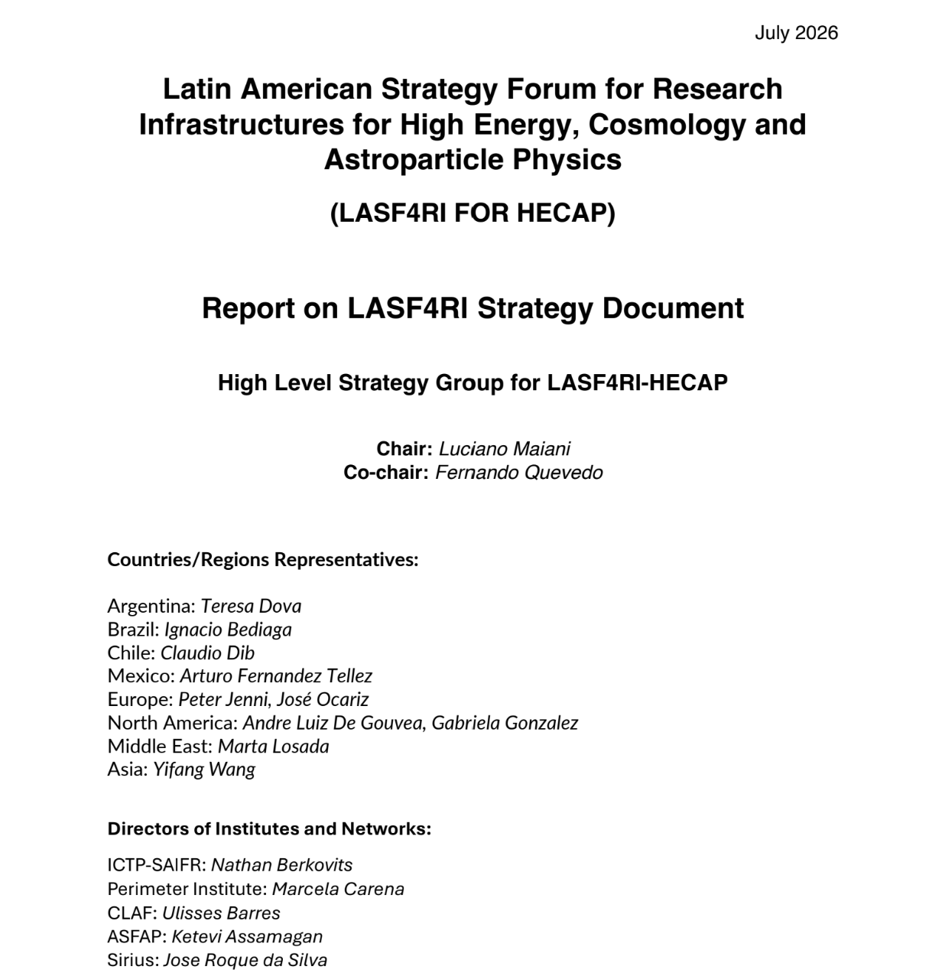

Slide 20
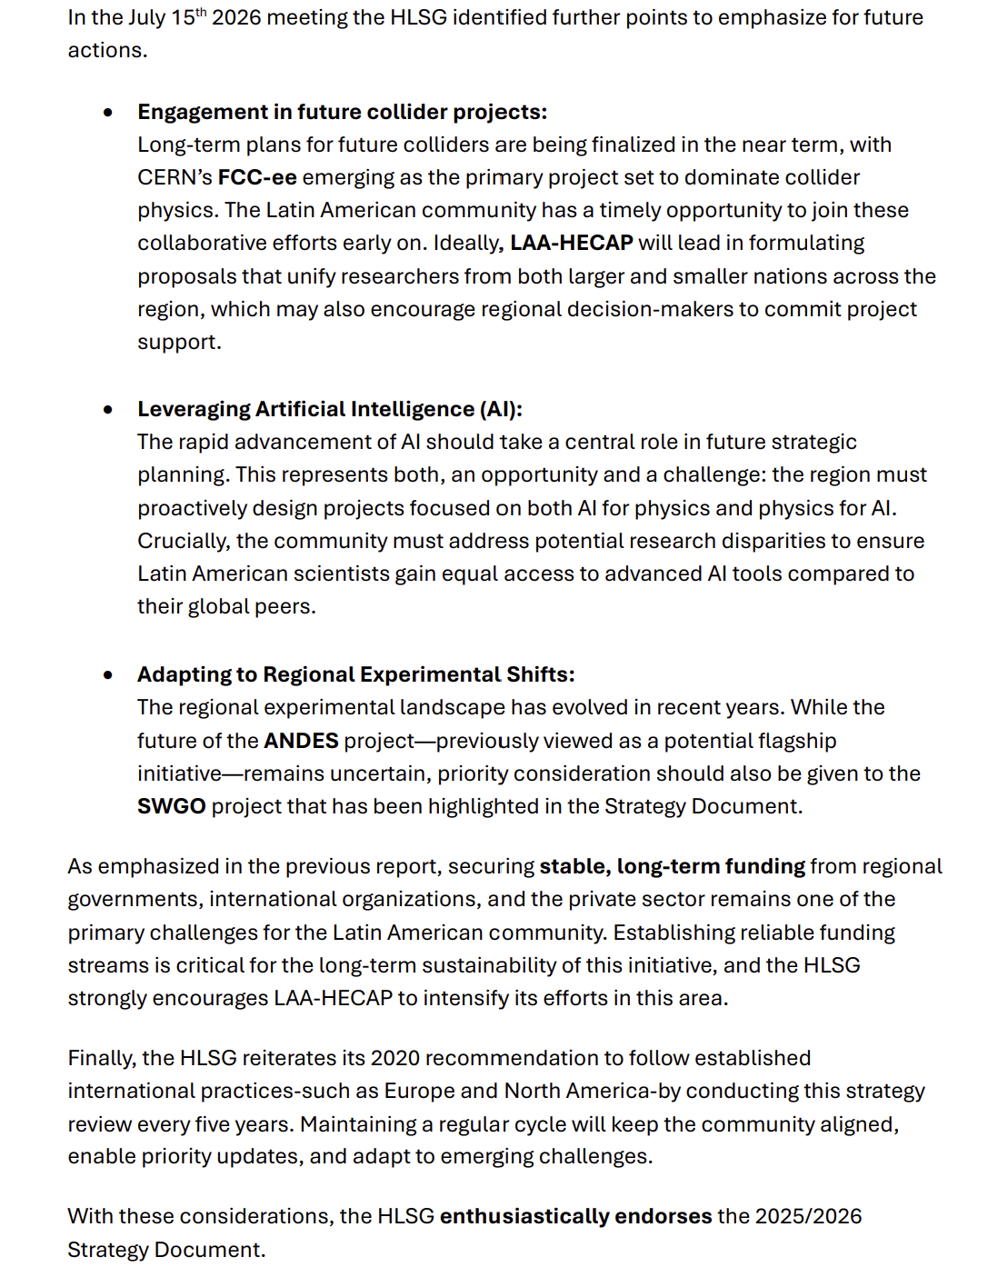

Slide 21
All documents are publicly available at lasf4ri.org site.
We are seeking recognition and visibility of our efforts:
Declaration in the "VII Reunión de Ministras, Ministros y Altas Autoridades de Ciencia, Tecnología e Innovación“ , October 21, 2026 in Alicante, España:
Os progressos na consolidação do Fórum Estratégico Ibero-Americano para as Grandes Infraestruturas Científicas, com a conclusão, em 2026, da primeira atualização da estratégiano domínio da física de altas energias, das astropartículas e da cosmologia, cujo novodocumento estratégico foi aprovado pelo seu Grupo Estratégico de Alto Nível e renova asrecomendações e o roteiro adotados em 2020, bem como a constituição da AssociaçãoLatino-Americana de Física de Altas Energias, Cosmologia e Astropartículas (LAA-HECAP).
Resolution submitted by C11 to the IUPAP General Assembly in October 30, 2026 in São Paulo, Brazil:
We recognize the value of the process for the development of a Latin American Strategy for High Energy, Cosmology and Astroparticle Physics conducted by the Latin American community organized in the Latin American Strategy Forum for Research Infrastructures (LASF4RI), that resulted in a Physics Briefing Book based on submitted white papers showcasing a landscape of the acitivites in these areas of research, a Strategy Document with recommendations and an endorsement from a High-Level Strategy Group.

Slide 22
Presentation of the Strategy documents to the Global Research Council Americas Regional Meeting in November 18-19, 2026 in Kingston, Jamaica.

Slide 23
CONCLUSIONS
The High Energy, Cosmology and Astroparticle Physics (HECAP) Latin American community has experienced rapid growth;
A first bottom-up Strategy Planning in HECAP in Latin America was done by LASF4RI in 2019-2020 which revealed a rich landscape;
Community created LAA-HECAP in 2020 to coordinate efforts in the region;
Many results already reached: mobility programs within LA, visibility in HECAP for LA (ICHEP in LA, representatives in committees), …
First update of the Strategy Planning concluded in 2026;
We are seeking recognition of our efforts;
An engaged HECAP community in LA is being developed and organized. Let’s keep the effort going!

Slide 24
AstroParticles/Cosmology
ALPACA
LAGO
AUGER
HAWC
DarkSide
DAMIC
TOROS/ABRAS
QUBIC
BINGO
LLAMA
LSST
ASTRI
CTA
SWGO
SAGO
Argentina
Bolivia
Neutrinos/DM
Neutrinos/DM
SBND
Brazil
ANGRA
ANGRA
CONNIE
High Energy/Nuclear
Chile
CONNIE
NOvA
LAFN Tandem Acc., CNEA Tandar
NOvA
Colombia
SENSEI
SENSEI
(HL)LHC-ALICE
DUNE
Ecuador
DUNE
(HL)LHC-ATLAS
JUNO
(HL)LHC-CMS
JUNO
Hyper-K
(HL)LHC-PPS
Mexico
Hyper-K
KM3NeT
(HL)LHC-LHCb
KM3NeT
Paraguay
vIOLETA
RHIC (Phenix, Star)
vIOLETA
GRAND
Jlab (CLAS)
Peru
GRAND
Belle 2
Deep Valley
TAMBO
FCC/ILC/CEPC
Venezuela
ANDES
ANDES

