Slide 1
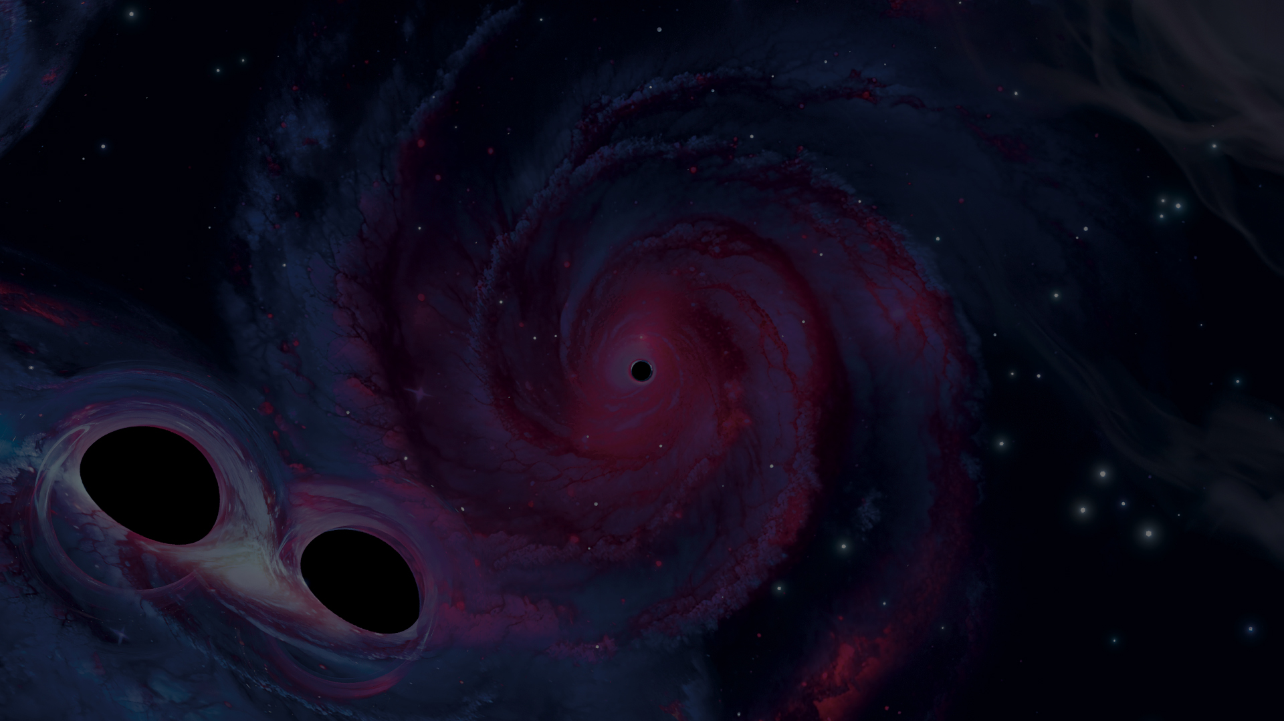




















GWIC REPORT TO IUPAP 2024–2026
Gravitational Wave International Committee · IUPAP Working Group 11
  MATTHEW BAILES
  GWIC CHAIR · SWINBURNE UNIVERSITY OF TECHNOLOGY
  WITH DAVID SHOEMAKER (MIT), GWIC SECRETARY
Notes:
Thank you. I'm reporting on behalf of GWIC, IUPAP Working Group 11, for 2024 to 2026, with David Shoemaker of MIT, our Secretary. I was re-elected as Chair in June 2025; GWIC elects its chair every two years.

Slide 2





GWIC connects the whole GW community
Oversees the field's key meetings
Amaldi, LISA Symposium, GWADW, Dawn
15
~300
Awards the Braccini Prize
Best PhD thesis in gravitational waves
member projects & communities, plus IUPAP AC2 and IAU liaisons
events seen by LIGO, Virgo and KAGRA
Advises funding agencies
Briefed the GW Agency Committee, May 2026
1000+
100+
Supports early-career scientists
New GWECS network: online career meetings
participants at Amaldi 16 + GR24, Glasgow
millisecond pulsars timed worldwide
Notes:
GWIC's role is to bring the different gravitational-wave communities together. We oversee the major meetings, award the Braccini Prize for the best PhD thesis, give input to funding agencies — I presented an overview of the field to the Gravitational Waves Agency Committee, chaired by NSF's Pedro Marronetti, in May 2026 — and we now have an early-career network, GWECS. Membership spans 15 projects and communities, from LIGO and Virgo to the pulsar timing arrays and LISA, plus liaisons to IUPAP AC2 and IAU Commission D1.

Slide 3

One science, four frequency bands
frequency →
Nanohertz
Millihertz
Decihertz
Audio band
Pulsar timing arrays
Space: LISA, TianQin
Future: DECIGO
Ground: LIGO, Virgo, KAGRA, GEO600
EPTA/InPTA, NANOGrav, PPTA, MeerKAT, Chinese PTA
Hellings–Downs evidence up to ~4σ
Gamma-ray PTA: a new, independent probe
LISA adopted by ESA & NASA
Launch mid-2030s
White dwarfs, massive black holes
Ambitious lunar and space concepts
Bridges space and ground bands
~300 events through O4
Most are binary black holes
GW150914 · GW170817
Notes:
Gravitational-wave science now spans four frequency bands. In the nanohertz band, five pulsar timing arrays have published evidence for a stochastic background from supermassive black-hole binaries, up to about four sigma on the Hellings–Downs curve; the gamma-ray PTA probes it in a completely new way, and the work now is on rigour and on combining data sets through the IPTA. In the millihertz band, LISA is adopted as a joint ESA–NASA mission for launch in the mid-2030s. Decihertz is the future, with DECIGO and lunar concepts. And on the ground, LIGO, Virgo and KAGRA have seen around 300 events, most of them binary black holes, since GW150914 and the neutron-star merger GW170817.

Slide 4
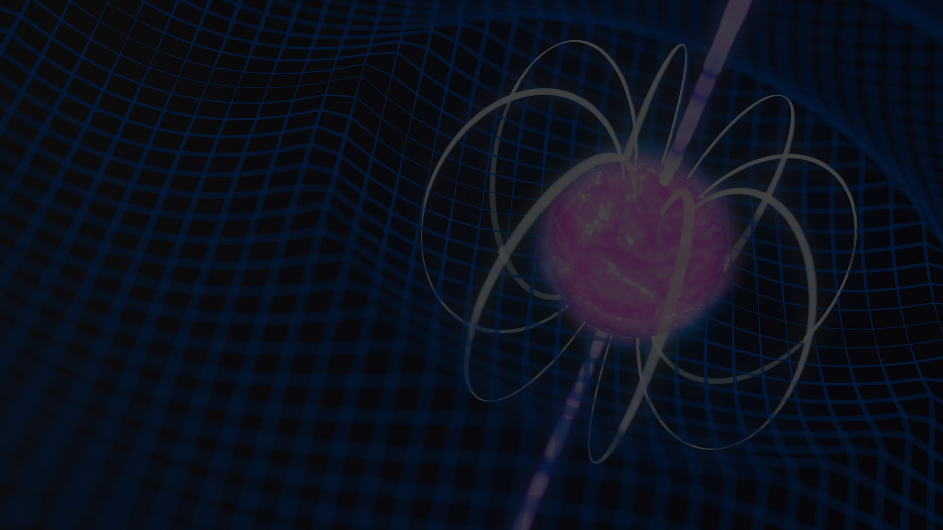
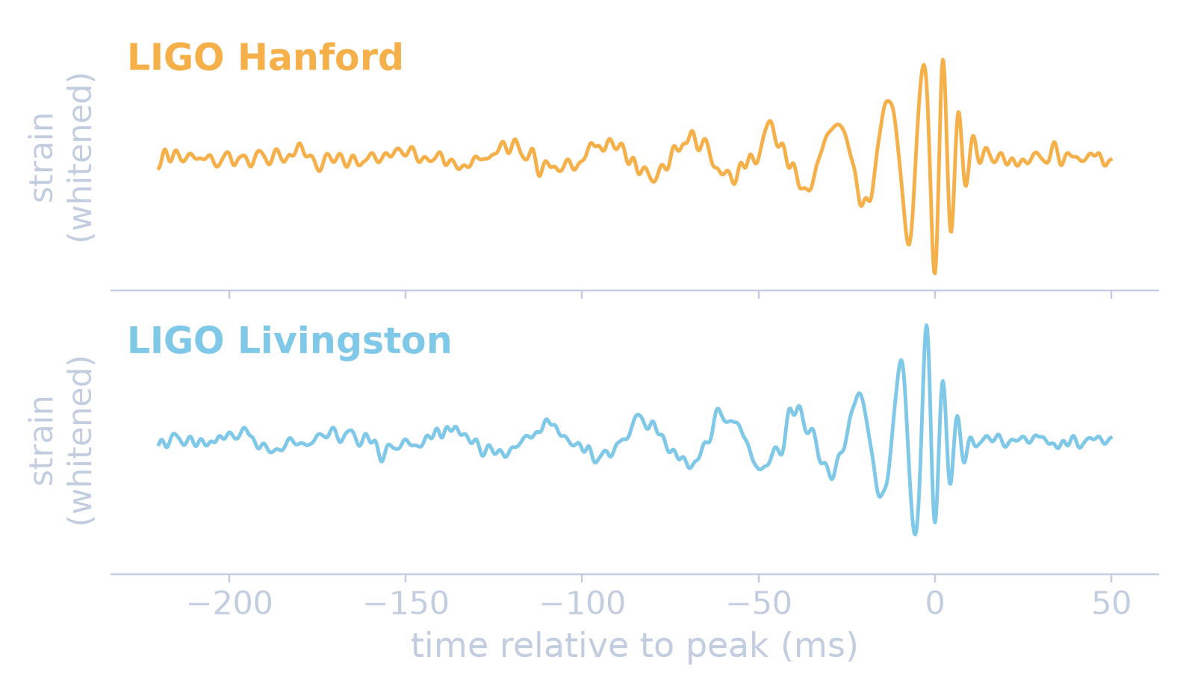
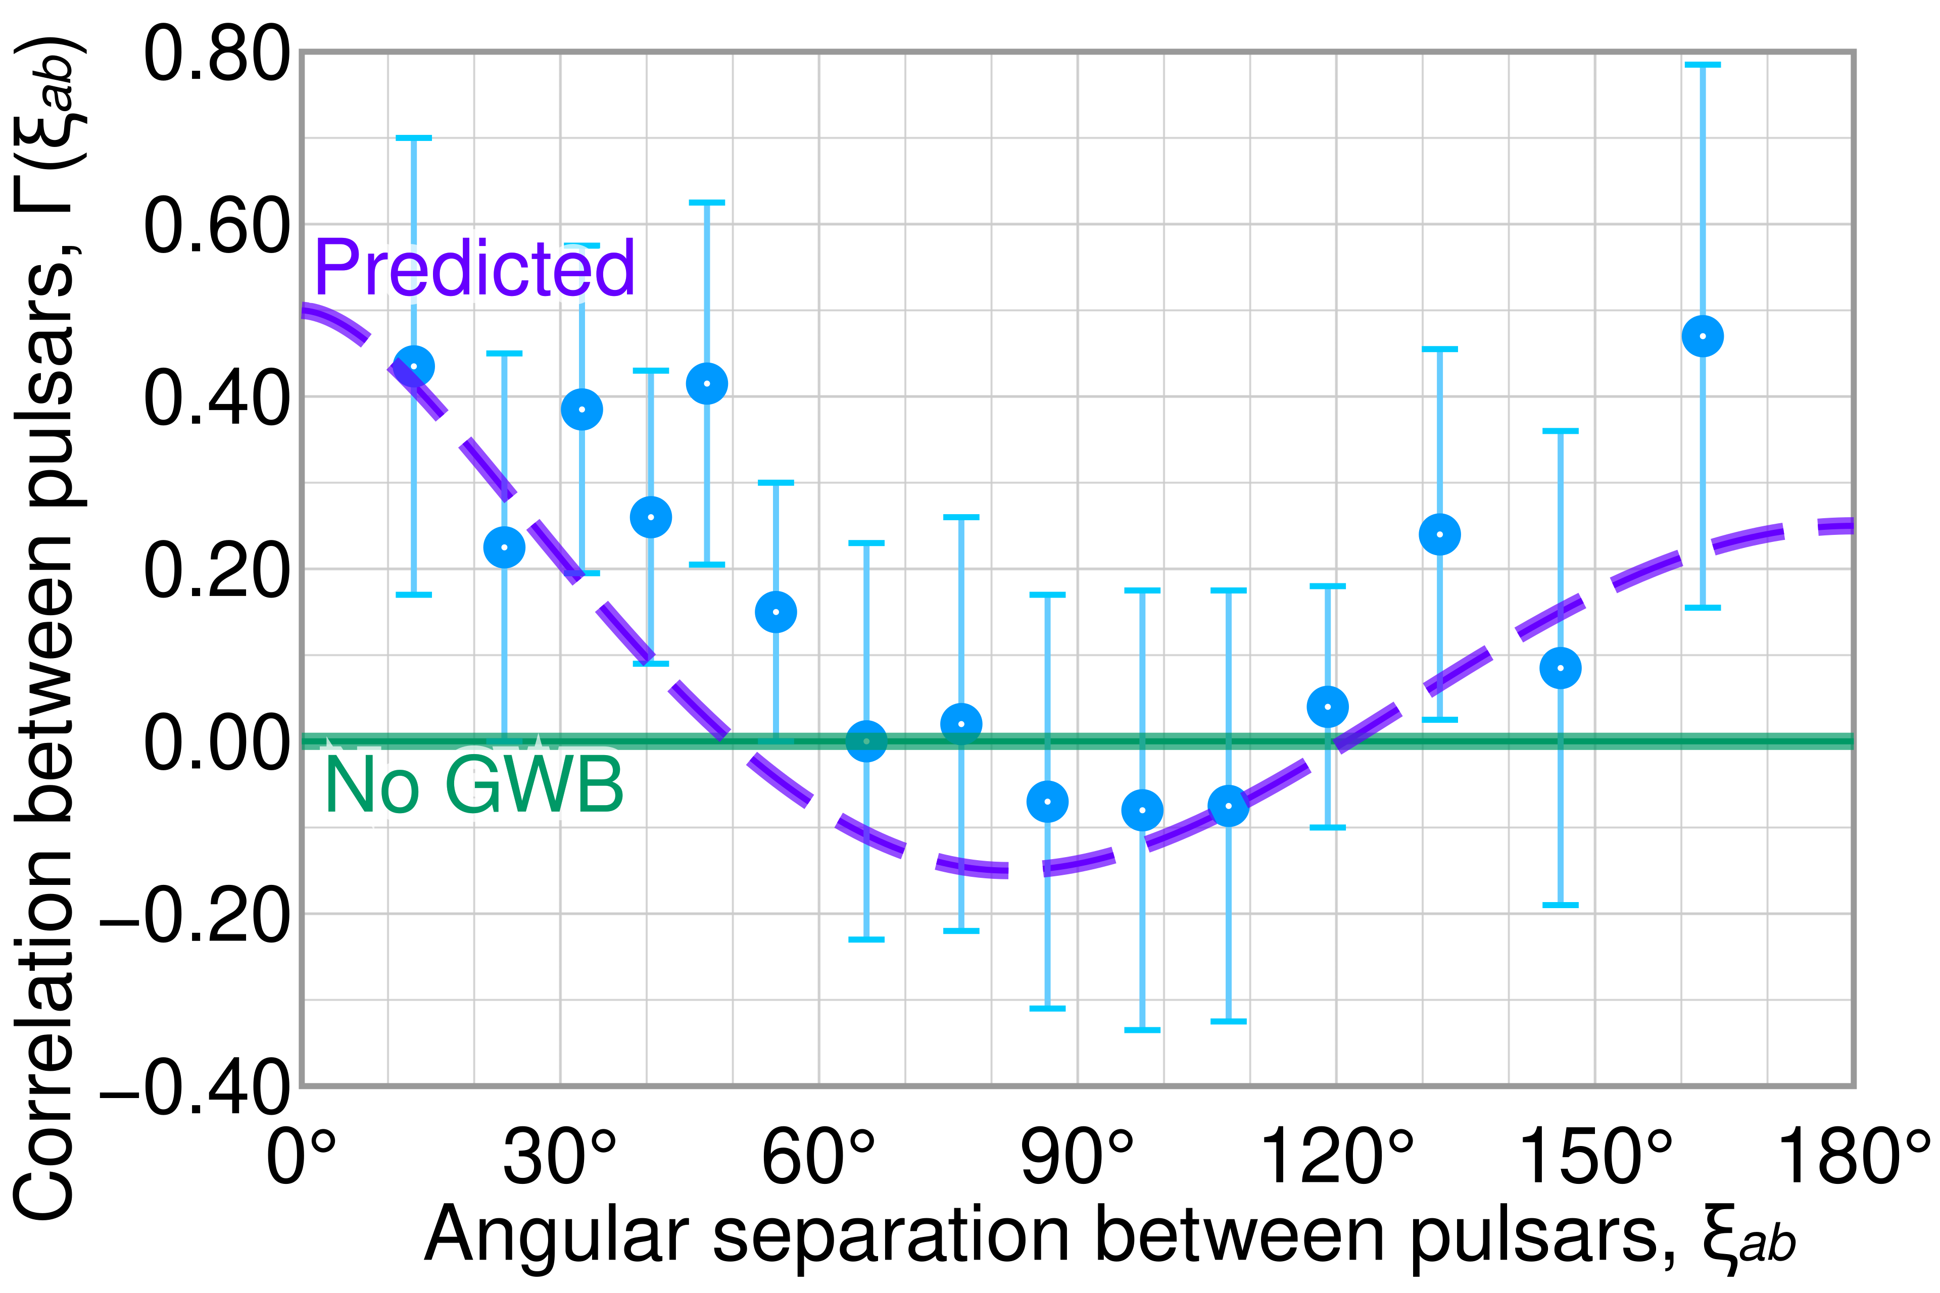

Headline science
GW250114: the loudest signal yet
Hellings–Downs correlation
Network SNR 80 (GW150914: 26) · two ~33 M☉ black holes at ~400 Mpc · Hawking's area theorem confirmed
LIGO open data (GWOSC), whitened, 30–350 Hz
Pulsar-pair correlations vs. angle (NANOGrav 15-yr) follow the predicted curve
Figure: Cmglee, CC BY-SA 4.0, Wikimedia Commons
2017 Nobel Prize in Physics · Weiss, Barish & Thorne, for LIGO and the observation of gravitational waves
Notes:
Two headline results. On the left is GW250114, recorded in January 2025: the loudest gravitational-wave signal yet, with a network signal-to-noise ratio of 80, three times GW150914. It is two black holes of about 33 solar masses each, about 400 megaparsecs away, and it is clean enough to confirm Hawking's area theorem. This is the public LIGO data, whitened — you can see the chirp by eye in both detectors. On the right is the nanohertz fingerprint: correlations between pulsar pairs against their angular separation follow the Hellings–Downs curve expected from a gravitational-wave background. And a reminder of how far we've come: the 2017 Nobel Prize in Physics went to Weiss, Barish and Thorne for LIGO and the first observation.

Slide 5

Meetings that GWIC oversees
Jun 2024
Dawn meeting
UBC, Vancouver · ~150
2026
LISA Symposium
Greenbelt, MD (UMD + NASA GSFC)
May 2027
GW Advanced Detector Workshop
Hokkaido, Japan
Jul 2025
Amaldi 16 + GR24
Glasgow · 1000+
2026
GW Advanced Detector Workshop
Elba, Italy
Jun 2027
Amaldi 17
DZA, Görlitz, Germany · SOC forming
2026
IPTA conference
Drakensburg, South Africa
● Held ○ Upcoming Also: IPTA annual meeting (South Africa, 100+)
Notes:
The Amaldi meetings are the most important on the GW calendar. Amaldi 16 in Glasgow ran alongside GR24 and drew over 1000 participants. Amaldi 17 will be hosted in June 2027 by the new Deutsches Zentrum für Astrophysik in Görlitz; its SOC is forming now. The LISA Symposium is growing in importance — the 2026 one was in Greenbelt, hosted by Maryland and Goddard. The detector workshop was on Elba in 2026 and goes to Hokkaido in May 2027. The Dawn meeting on future instruments, at UBC in 2024, is well attended by funding agencies.

Slide 6

Next decade: new structure, new detectors
LIGO-India
Funded, site secured, construction underway
LVK → IGWN (2027)?
Early 2030s
International Gravitational Wave Network
LISA
Adopted ESA–NASA mission
Mid-2030s
New collaborative structure for science and facility coordination
Transition from late 2026; fully operational 2027
Next LIGO–Virgo–KAGRA run organised with the IGWN perspective
Saves on infrastructure
Einstein Telescope
European site selection well advanced
3rd gen.
Cosmic Explorer
US site exploration; global R&D
3rd gen.
Australian detector ?
AAL exploratory funding: sites & industry
Study
Notes:
Two big changes are under way. First, the LIGO–Virgo–KAGRA collaboration, which oversaw the birth of the field, is moving to a new structure, the International Gravitational Wave Network, with a transition starting late 2026 and full operation in 2027; the next joint run will be organised that way. Second, new facilities: LIGO-India is funded, has its site and is under construction for the early 2030s; LISA is adopted for the mid-2030s; and for third-generation detectors, Einstein Telescope site selection is well advanced in Europe and Cosmic Explorer is exploring US sites. In Australia, Astronomy Australia Limited has approved exploratory funding for a detector study.

Slide 7
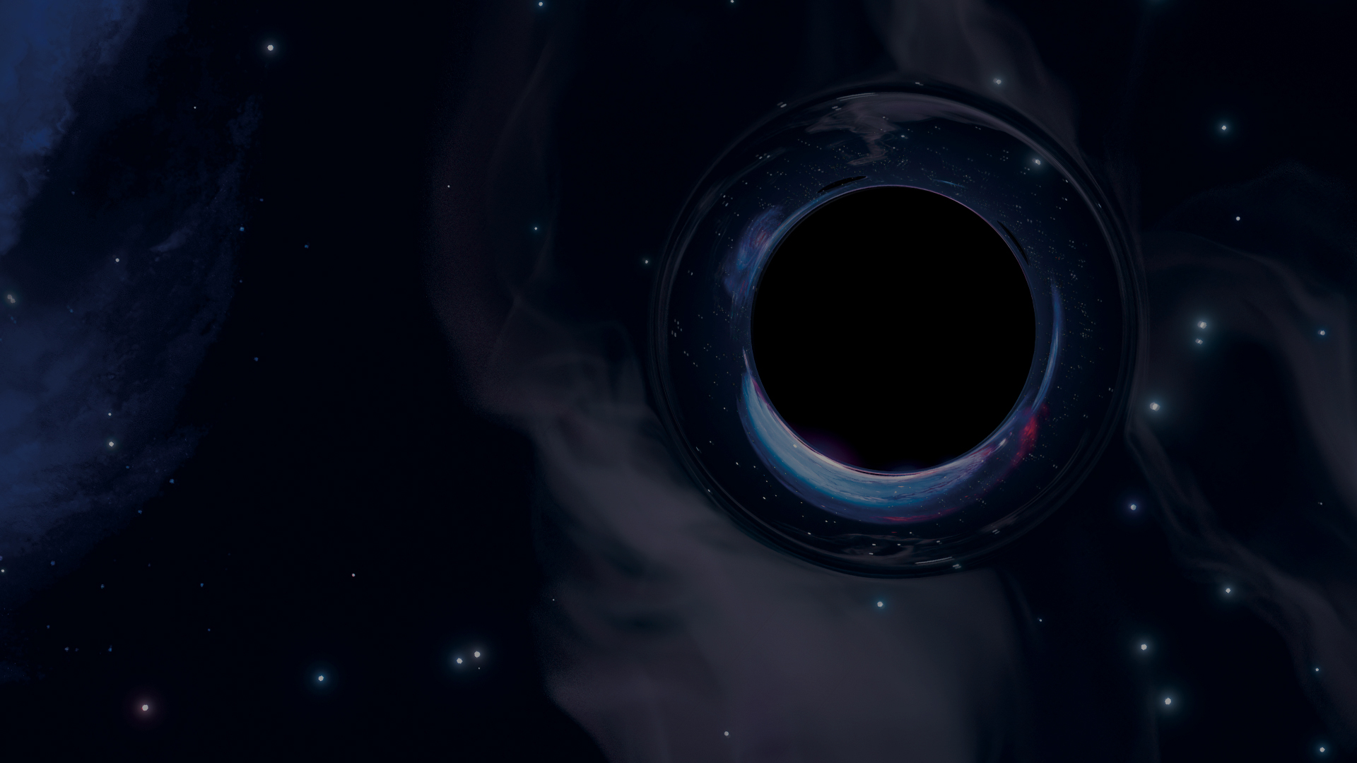
Summary
1
A thriving field in every band
Hundreds of detections, PTA evidence, LISA adopted
2
GWIC connects the community
Meetings, Braccini Prize, Agency Input, GWECS
3
Coordination matters more than ever
IGWN, LIGO-India and 3rd-generation detectors
Thank you! David Shoemaker will take questions.
Notes:
To sum up: the field is thriving in every band; GWIC keeps its communities connected through meetings, the prize, agency input and our early-career network; and as the field moves to IGWN and to new and third-generation detectors, international coordination — GWIC's core role — matters more than ever. Thank you; happy to take questions.

