Slide 1
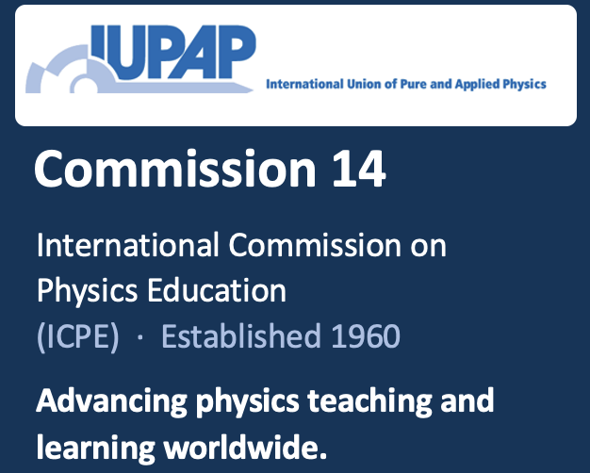
Students
Teachers
Physics Education
C14
Milieu
Curriculum
Lifelong learning, formal, informal to workforce

Slide 2
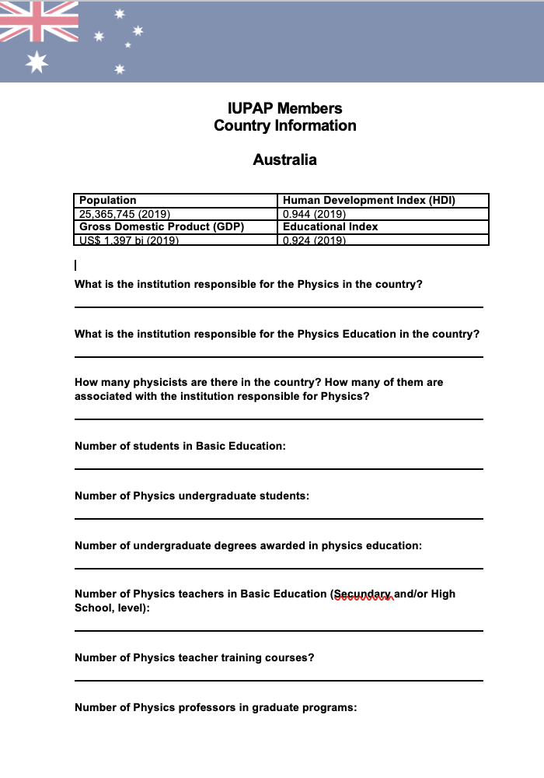
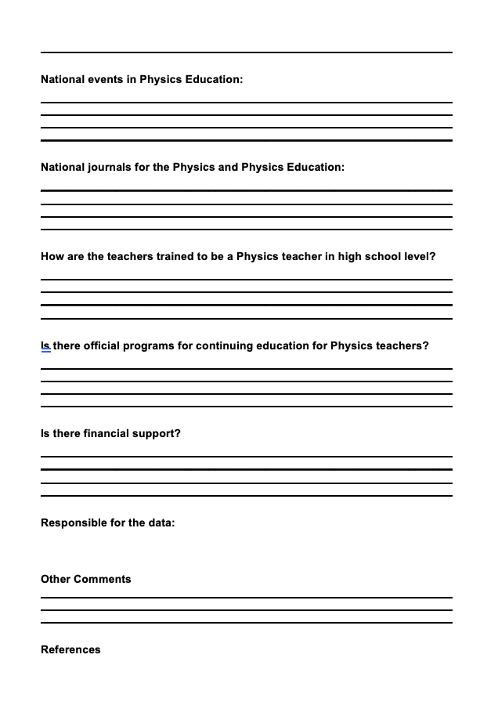
Argentina
Australia
Brazil
China: Taipei
Czech Republic
Finland
France
Germany
Iran
Ireland
Italy
Japan
South Korea
Pakistan
Philippines
Romania
Slovenia
Switzerland
United Kingdom
United States of America
Silvina Ponca
2026
Brazil
South Korea
Slovenia
United Kingdom
…
Physics Panorama
(2018-20)
64 approached
20 responded
Roberto Nardi
Fabiano Parma
(C14 Chair, PhD student)
Similar issues
Diverse contexts
Diverse solutions
National level

Slide 3
Physics education (and communication) are increasingly critical to the health of physics.
Does physics education remain confined to C14?
Physics education @ IUPAP
Can we apply the WiP model to physics education?
International Physics Conference 2027
Focus on sustainability (EMC & student voice)

