Slide 1

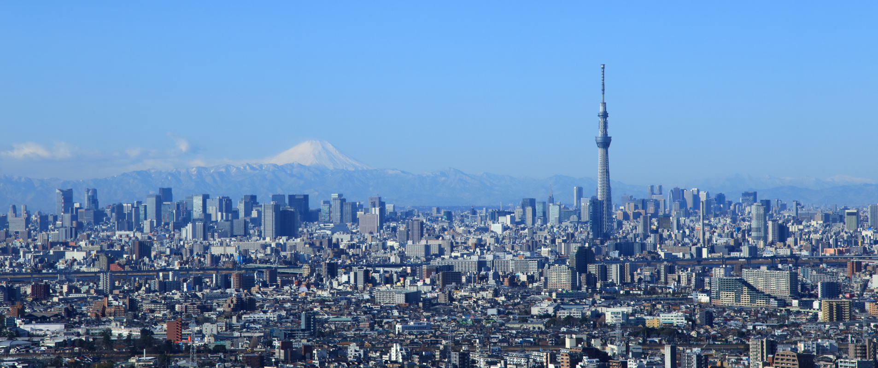

ICPS2026
Tokyo
The 37th International Conference on the Physics of Semiconductors 2026

Slide 2
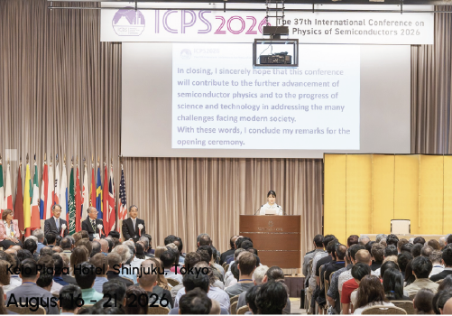
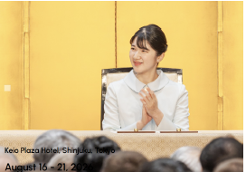
Imperial princess Aiko participated in the Opening of the ICPS 2026. Her visit gave rise to visibility of ICPS in the media.
In the opening, different authorities of Japan, included the Chair of the conference and the Governor of Tokyo gave a speech.
Afterwards, I introduced the IUPAP.
Finally, the princess gave a speech as well, remarking the importance of semiconductors: https://www.youtube.com/watch?v=W7wumJSPn4Q.
I was receiving the princess at the entrance of the Hotel, with the Chair of the conference and other authorities, and I was also asked to say her goodbye at the hotel entrance when the presentations finished.
She was very close, gave me the hand and spoke to me in spanish. She said that she would like to come to Spain.

Slide 3

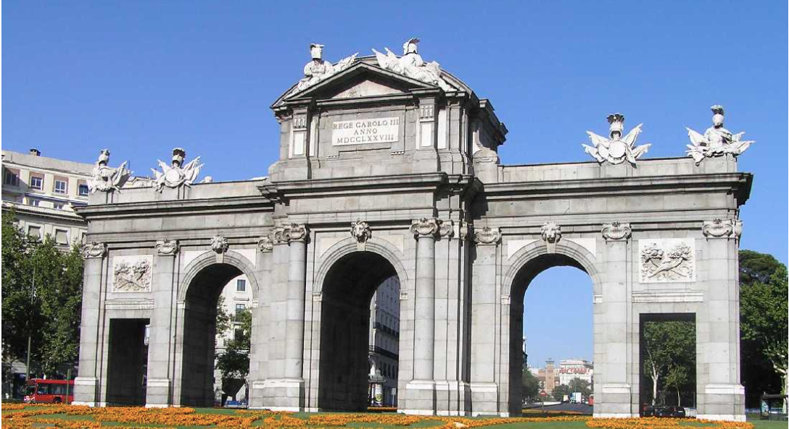
ICPS 2028 Madrid (Spain)
The next semiconductor conference , ICPS 2028, will take place in Madrid.
It was already decided in 2024 at the ICPS 2024 in Ottawa.
We are now working on this. We expect many people coming to ICPS 2028, as in Japan there were over 870 participants.
Chair: Gloria Platero, Spanish Research Council (CSIC)
Co-Chairs: Local organizing committee: Prof. Ana Cremades (UCM)
Local program committee: Prof. Leonor Chico (UCM)

Slide 4
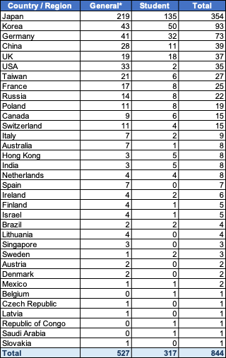
ICPS2026
Number of Participants by Country
Large participation from:
Japan 354
Korea 93
Germany 73
China 39
UK 37
USA 35
Taiwan 27
France 25
Russia 22
Poland 19
Canada 15
Switzerland 15
….
Participants: 844
(from 34 countries)
(incl. 317 students)
Exhibitors: 30
Total: 874

Slide 5
ICPS 2030
Every 2 years the tradition is to organize the conference in a different continent. In 2024 it took place in Ottawa, for 2030 it would be expected in America (or Australia, or New Zeeland) .
We did receive already in Ottawa a very good proposal from Korea (Seul), Prof Yong-Hoon Cho, for ICPS2030
From this time till now we did not receive any proposal from America, nor from Canada, USA, Australia, New Zeeland or Latino América.
We decided in a C8 on-line meeting, to wait till January. If we will not get any application from America or Australia we will accept the proposal from Korea.

