Slide 1
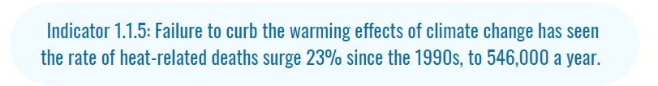
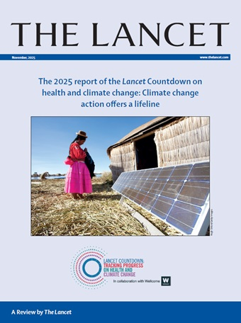
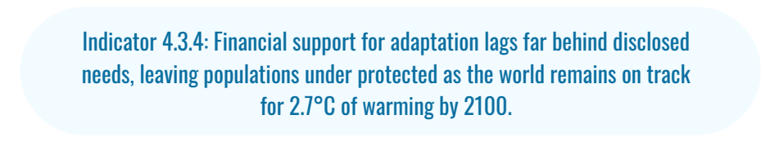

The Lancet Countdown 2025

Slide 2
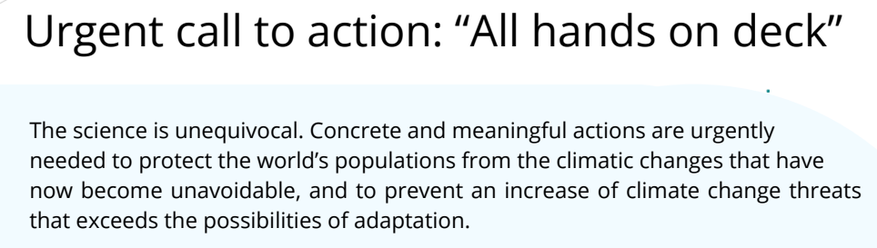

Slide 3










Slide 4
Background
The purpose of the WG
  is to promote and grow the unique role that physics is,
  and should be,
  playing in climate change action and sustainable development.

Slide 5
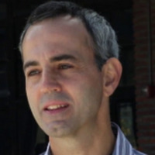
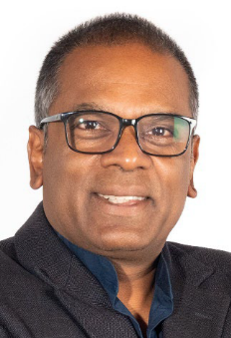
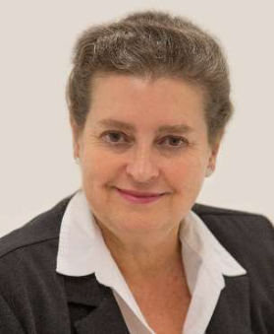
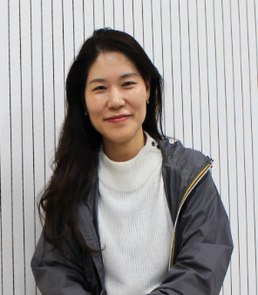
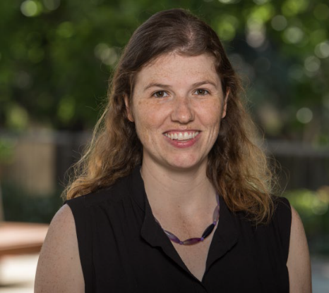
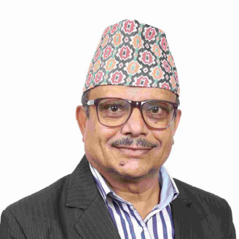

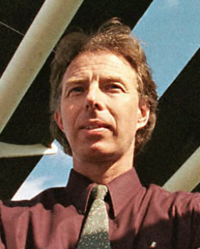
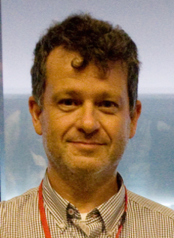

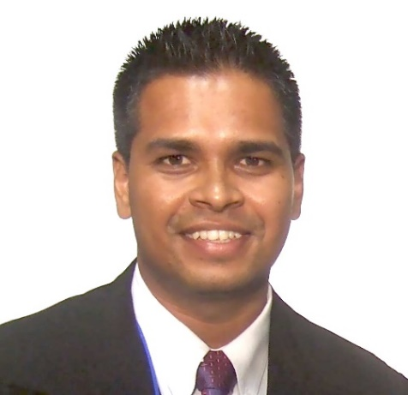
Marcelo Barreiro Uruguay | Nithaya Chetty South Africa | Igle Gledhill South Africa | HyunJung Lee Korea | Morgan O’Neill Canada
Ram Prasad Regmi Nepal | Jon Samseth Norway/SCOPE | Jean-Louis Scartezzini Switzerland | Tomás Sintes, Spain | Gry Merete Tveten, Norway
Awnesh Singh
Fiji

Slide 6
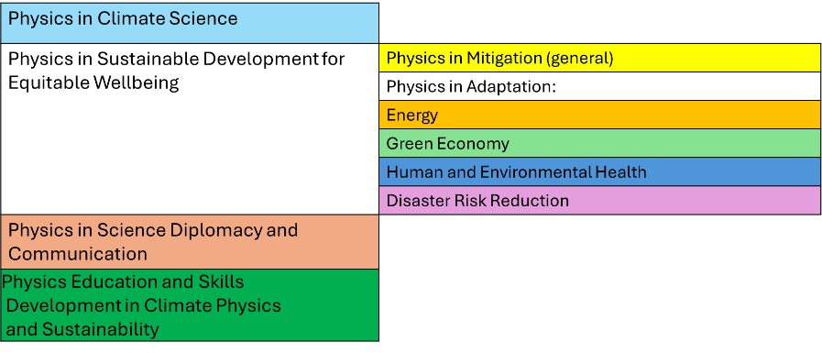
WG21: disentangling a complex field

Slide 7
WG21: examples are not always obvious
Nobel Prizes in Physics 2021: Ising networks, stochastic forcing in complex systems
integrated mobile sensor systems
transmission network stability
Superconductors
low-cost cold chains
financial sector stability
DFT, synchrotrons in vaccine design
Earth Observation, wildfire early warning, soil sensors

Slide 8
WG21: illustrative examples
  Policy
  Climate finance
  Community interaction
  Understanding and practice of communication
  The future of humanity
  Critical thinking
  Climate change and women
  Entrepreneurial thinking

Slide 9
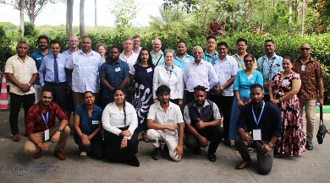
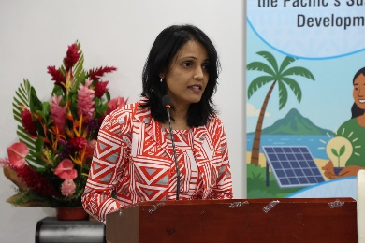
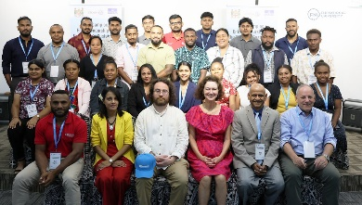
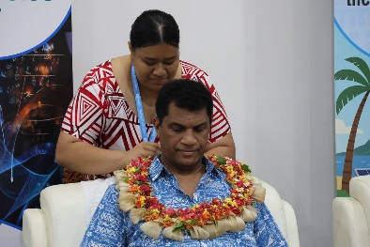
Crisis-related events
2024 Inter-Commission Symposium
  Prof Giorgio Parisi
2025 Pacific Island Nations Physics week
  UNESCO-IUPAP Entrepreneurship
  IUPAP-UNESCO Pasifika Physics Summit
IDSSD themed IUPAP-UNESCO colloquia
2027 International Conference on Physics:
  Physics for sustainable development of a healthy, lively planet
IUPAP-UNESCO Physics Summit
Artika Devi, UNESCO Pacific
Representative from Tonga formally welcomes Minister the Honourable Aseri Radrodro
Image credits Artika Devi
UNESCO-IUPAP Entrepreneurship

Slide 10
Historic times: IUPAP’s new directions matter
IUPAP has multidisciplinary relations
  ISC; COSPAR, IUGS, IUGG, IUPAC, IMU, IUBS,….
  IUPAP has transdisciplinary experience
    Women in Physics, the Gender Gap in Science Project
Evolve as an essential transdisciplinary partner
AND:
Deep impact comes from pure physics
Foundational physics is essential!

