Slide 1
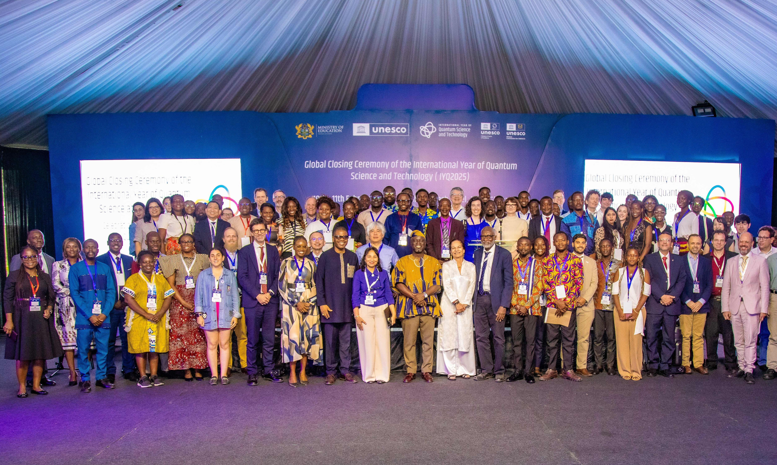
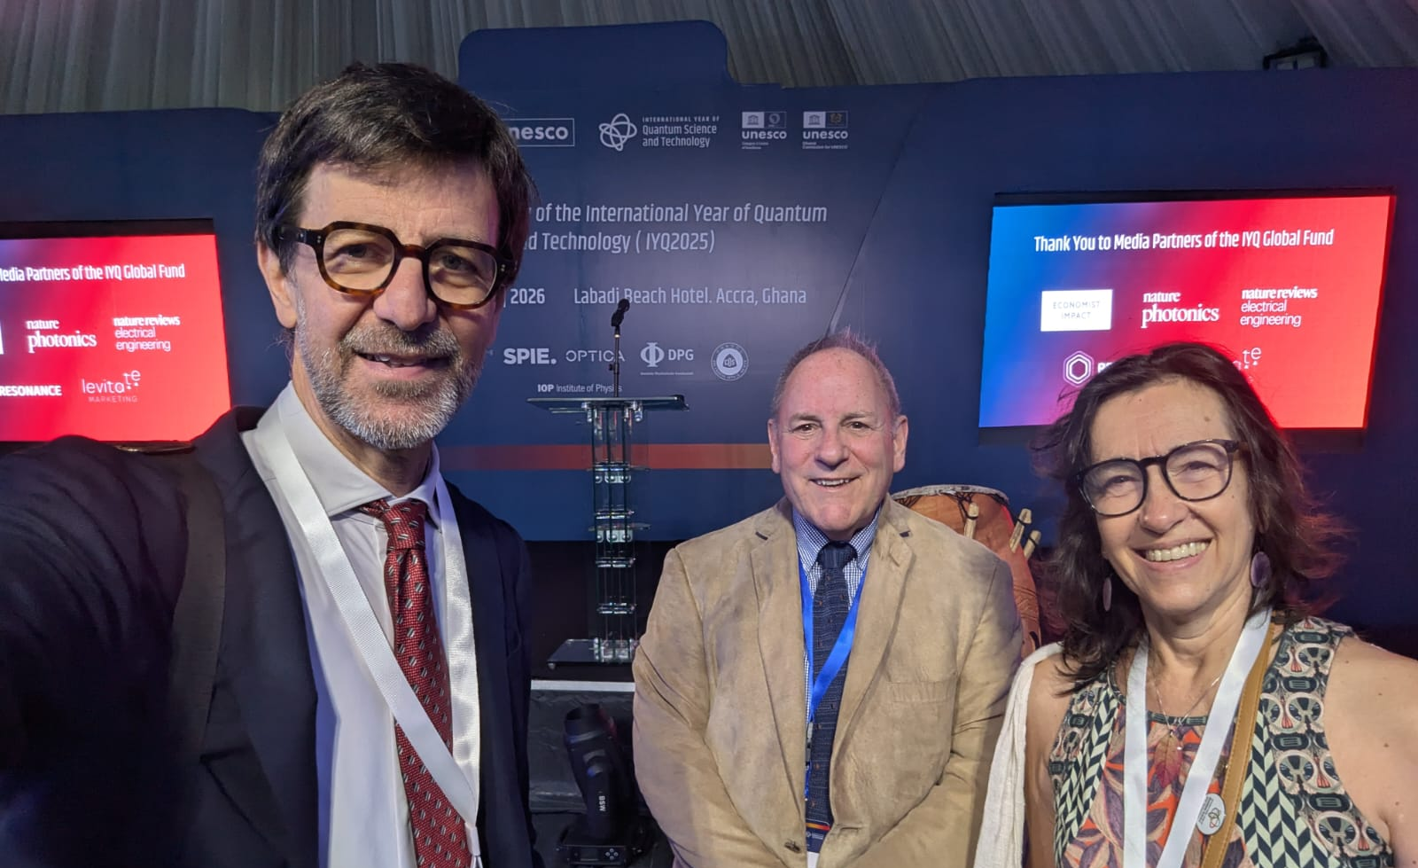
International Year of Quantum Science and Technology 2025 – Closing Ceremony
Accra, Ghana (10–11 February 2026)
Africa’s central role: Ghana spearheaded the UN resolution, co-sponsored by 71 countries
Equitable access and capacity building: Strong focus on education, training, entrepreneurship, and creating opportunities for Africa’s young population, highlighted by Peter Haynes (Imperial College London).
Keynotes by Michele Dougherty (University of Cambridge, UK Astronomer Royal) and Heike Riel (IBM Research, President-elect of the German Physical Society), + panels on innovation, international cooperation, and education.
IUPAP–IYQ 2025 photo competition, winning entries were exhibited in Accra.
Looking beyond 2025: Launch of the UNESCO-led Global Quantum Initiative

