Slide 1
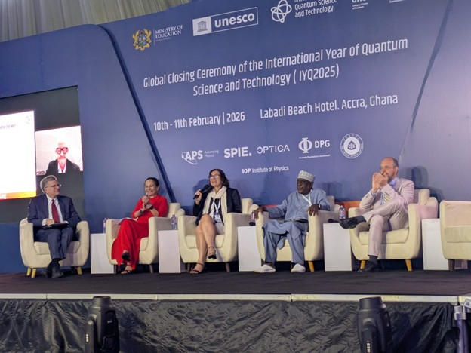
The Global Quantum Initiative
An introduction for the IUPAP community
Global Quantum Initiative for
Sustainable Development (GQI)
A UNESCO-led partnership connecting governments,
research institutions, educators, industry and civil society
to widen access to quantum knowledge and resources.
Launched in Accra, Ghana, in February 2026, following
the International Year of Quantum Science and Technology
2025 (IYQ 2025). Initial programme: 2026–2028.
Presenter: Jaewook Ahn, Chair of IUPAP C15
Sources: UNESCO GQI; IUPAP IYQ2025 overview. Photo: Sandro Scandolo / IUPAP.
Notes:
GQI stands for Global Quantum Initiative for Sustainable Development. UNESCO launched it during the IYQ closing ceremony in Accra, Ghana, on 10–11 February 2026. The initiative brings together governments, researchers, educators, industry and civil society. Its initial programme covers 2026–2028. IUPAP is one of its founding partners. Photo courtesy of Sandro Scandolo, published by IUPAP.
Sources: https://www.unesco.org/en/global-quantum-initiative
https://iupap.org/strategic-plan/outreach/iyqst25/
Image: https://iupap.org/wp-content/uploads/2026/05/Immagine1.jpg

Slide 2
Why GQI: closing the quantum divide
43%
Nearly 1 in 3
of survey respondents identified a shortage
of skilled researchers as the main barrier.
surveyed institutions reported no access
to quantum research facilities.
What the quantum divide means
Unequal access to skills and facilities limits who can conduct research,
develop applications and help shape quantum policy. GQI seeks to address
these barriers through education, resource sharing and international cooperation.
Survey scope: institutional responses across 72 countries; these are respondent statistics.
UNESCO Global Survey on Quantum Research and Infrastructure, 2026 report
02
Notes:
These statistics describe respondents to UNESCO’s survey, not all researchers or all institutions worldwide. The survey received institutional responses across 72 countries. The quantum divide concerns skills, facilities and the ability to participate in decisions. GQI links these capacity needs with sustainable development.
Source: https://www.unesco.org/en/articles/quantum-moment-global-report

Slide 3
GQI’s five strategic objectives
01
Education and capacity
Develop curricula and training so researchers, educators and institutions can participate.
02
Sustainable infrastructure
Expand access to facilities, software and computing through resource-sharing partnerships.
03
Public awareness and engagement
Help students and the public understand quantum science and its implications for society.
04
Science diplomacy and cooperation
Connect countries and institutions, with particular attention to participation from the Global South.
05
Responsible innovation
Consider benefits, risks and ethical questions early, while technologies and policies are developing.
03
Sources: UNESCO GQI objectives; IUPAP GQI update, 2 October 2026.
Notes:
The five objectives connect education, infrastructure, society, diplomacy and governance. The July 2026 thematic session outlined corresponding working-group plans. Shared infrastructure includes access and training, not only construction of new facilities. Responsible innovation concerns how benefits and risks are considered as technologies develop.
Sources: https://www.unesco.org/sites/default/files/medias/fichiers/2026/02/GQI%20brochure_web_0.pdf
https://iupap.org/2026/10/02/iupap-advances-inclusive-quantum-cooperation-as-a-founding-partner-of-the-global-quantum-initiative/

Slide 4
GQI governance and current programme
UNESCO coordination and shared governance
UNESCO hosts the Secretariat and serves as standing Co-Chair. The Steering
Committee sets strategy and oversees the work plan through consensus.
A partner Co-Chair rotates every four months. GESDA/OQI serves Sep–Dec 2026.
Working groups turn objectives into activities
The Steering Committee agreed a “5+1” working-group structure. Groups
develop work plans and measurable targets for 2027–2028, then report progress
to the Steering Committee through the Secretariat.
Implementation status as of October 2026
WG2 has prepared its work plan and is contacting potential contributors.
Its general kick-off is planned for November, with targets still in preparation.
GQI runs through 2028. Any future Global Quantum Agenda remains open.
04
Source: GQI Master WG Tracker, 28 October 2026. Programme status as of October 2026.
Notes:
UNESCO provides the Secretariat and standing Co-Chair. The partner Co-Chair rotates every four months. The master tracker identifies GESDA/OQI for September–December 2026, following the September Steering Committee decision naming Mira Wolf-Bauwens. The Steering Committee agreed a 5+1 WG structure in March. The tracker identifies WG1–WG6, with participation by expression-of-interest respondents in WG1–WG5. The five strategic objectives on slide 3 remain the programme framework. The WG2 work-plan milestone is marked completed, its kick-off and KPIs in progress. The 21 October update describes direct outreach and a general kick-off planned for November. The tracker targets 17 November for these milestones. These are plans, not completed access services. The governance summary of the 3 March meeting explicitly describes a three-year initiative with no predetermined Global Quantum Agenda, superseding the stronger outlook in the January proposal.
Source: GQI_Master_WG_Tracker.xlsx, Governance and WG Milestone Update sheets, governance as-of date 28 October 2026. Shared source folder: https://drive.google.com/drive/folders/1At45-fgKUjuz49VFj0_zq0e3NqVpVAYU

Slide 5
IUPAP’s participation and contribution
Founding partner and Steering Committee representation
Silvina Ponce Dawson, IUPAP President
Gloria Platero Coello, Chair of C8 (Semiconductors)
WG2: Quantum Infrastructure and Resource Sharing
Co-leads: Amal Kasry (UNESCO) and Jaewook Ahn (IUPAP C15 Chair).
C15 represents atomic, molecular and optical physics.
The WG2 strategy proposes three linked activities
1. Remote quantum access through UNESCO’s laboratory-access initiative, UNESRALE.
2. An infrastructure registry and map, developed jointly by UNESCO and IUPAP.
3. An IUPAP-led evidence report on barriers to equitable infrastructure access.
IUPAP members can help identify shareable facilities and contribute expertise
to the registry and evidence report. Contact: iyq2025@unesco.org
05
Sources: IUPAP, 2 October 2026. UNESCO WG2 Engagement Strategy and Master WG Tracker.
Notes:
IUPAP is a founding partner. IUPAP’s 2 October article identifies Silvina Ponce Dawson and Gloria Platero Coello (C8) as Steering Committee members. WG2’s engagement strategy explicitly names UNESCO’s Dr Amal Kasry and IUPAP’s Prof Jaewook Ahn as co-leads. Its heading is Quantum Infrastructure and Resource Sharing, corresponding to the sustainable-infrastructure objective. UNESRALE means UNESCO Remote Access to Laboratory Equipment. Track 1 proposes a GQI Quantum Access Programme through UNESRALE, led by UNESCO. Track 2 proposes a quantum infrastructure registry and map, led by UNESCO and IUPAP with WG4. It may develop toward a Global Quantum Observatory over time. Track 3 proposes an IUPAP-led report on barriers to equitable quantum infrastructure, drawing on the registry and collaborating with WG4 and WG5. These are proposed activities. Providers, access terms, deadlines and outputs remain subject to confirmation and relevant approvals. The master tracker marks the work plan completed while the launch and targets remain in progress.
Sources: CN_WG2-Engagement Strategy_v2_PR_AK.docx, prepared by Prajit Rawte, UNESCO: https://docs.google.com/document/d/1zPWxokL5bRrdARwGdKTtXpRqmUaDt2zF/edit
GQI_Master_WG_Tracker.xlsx, 28 October 2026: https://drive.google.com/drive/folders/1At45-fgKUjuz49VFj0_zq0e3NqVpVAYU
https://iupap.org/2026/10/02/iupap-advances-inclusive-quantum-cooperation-as-a-founding-partner-of-the-global-quantum-initiative/
https://www.unesco.org/en/global-quantum-initiative

