Slide 1
Special Projects and Sponsorship Project to strengthen the relations with IAEA and the accelerator science community
Christine Darve & Boris Sharkov
IUPAP Executive Council and Commission Chairs
October 2026

Slide 2
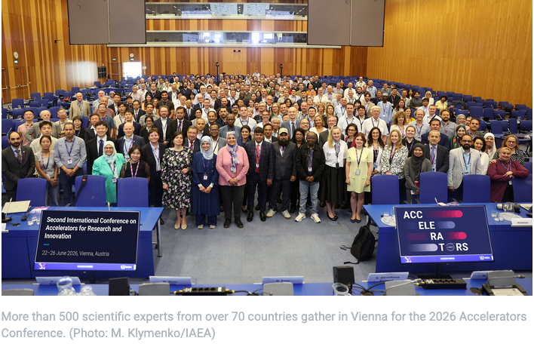
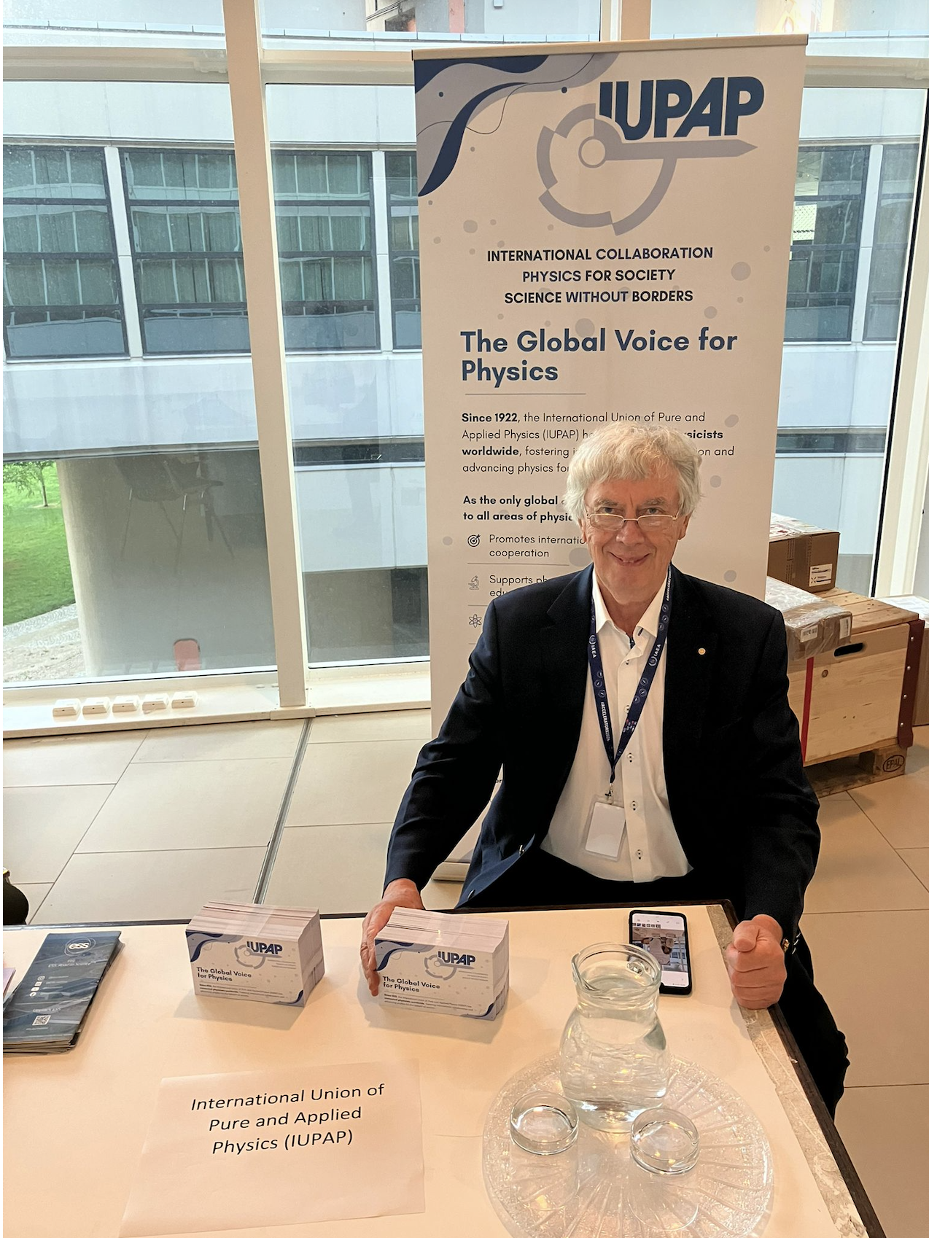
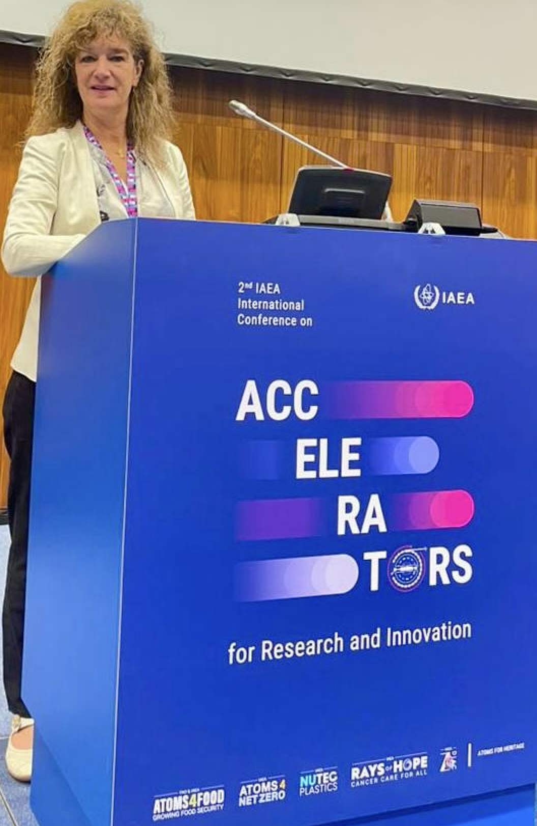
2nd Inter. Acc. Conf. on Research and Innovations, IAEA
Vienne, 24 June 2026.
Article "IAEA Hosts Conference on Accelerators for Research and Innovation"

Slide 3
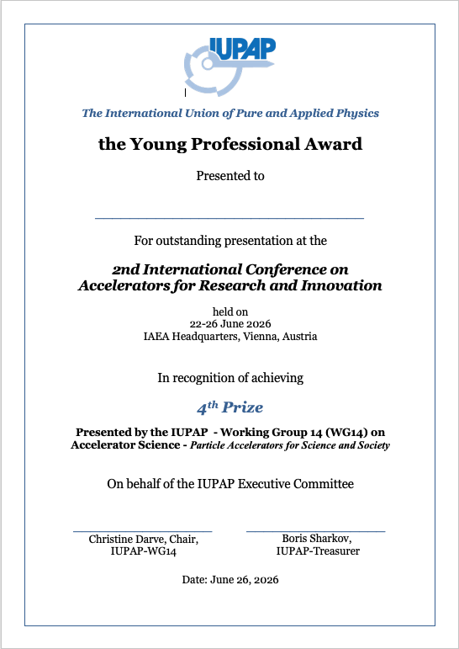

Young Professional Award Winners
Presented jointly by the IAEA
and the International Union of Pure and Applied Physics (IUPAP)

Slide 4
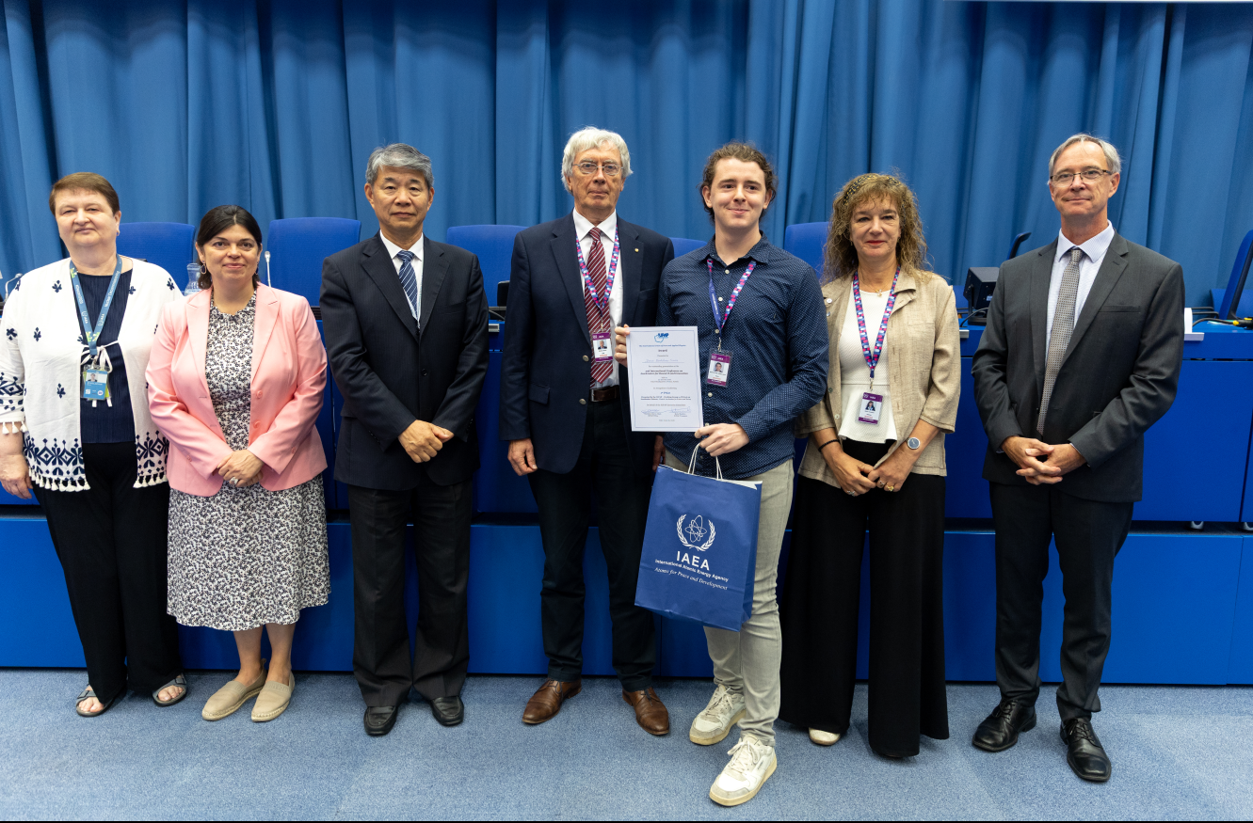
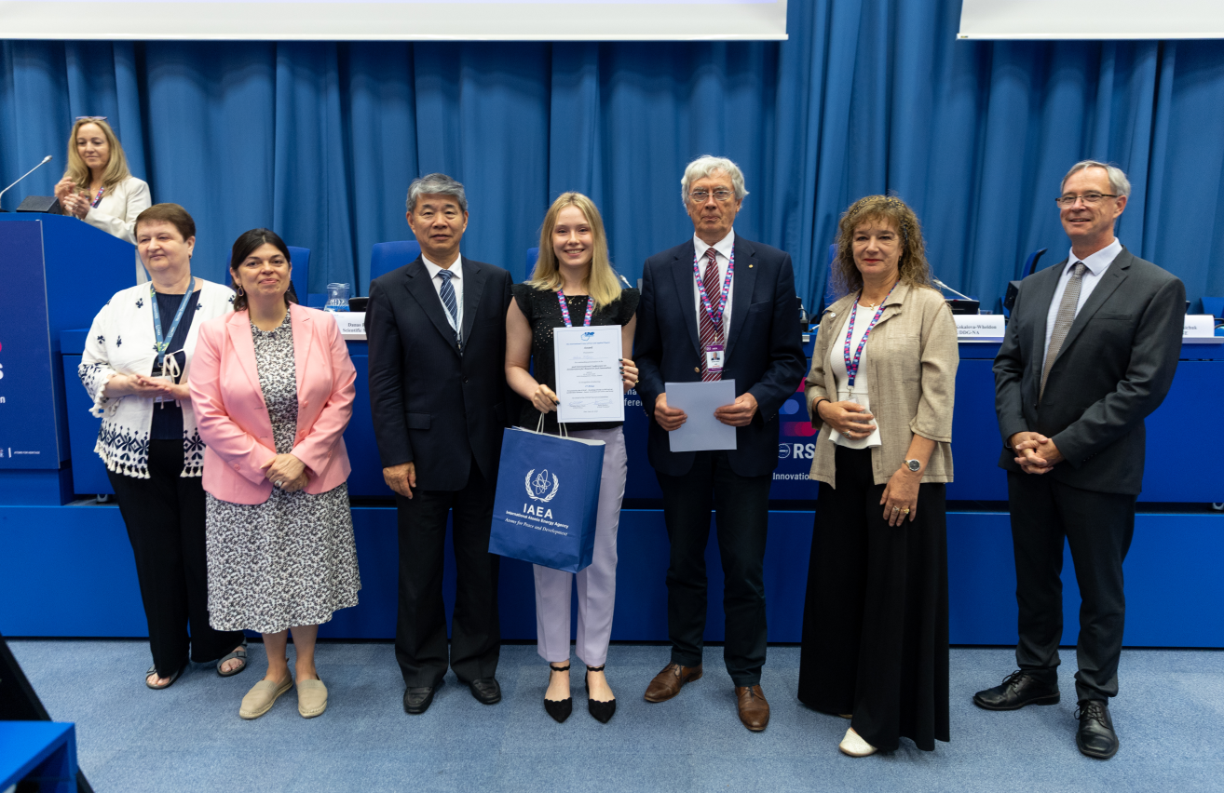
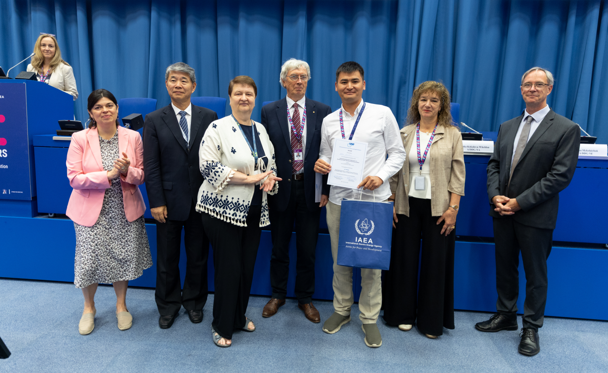
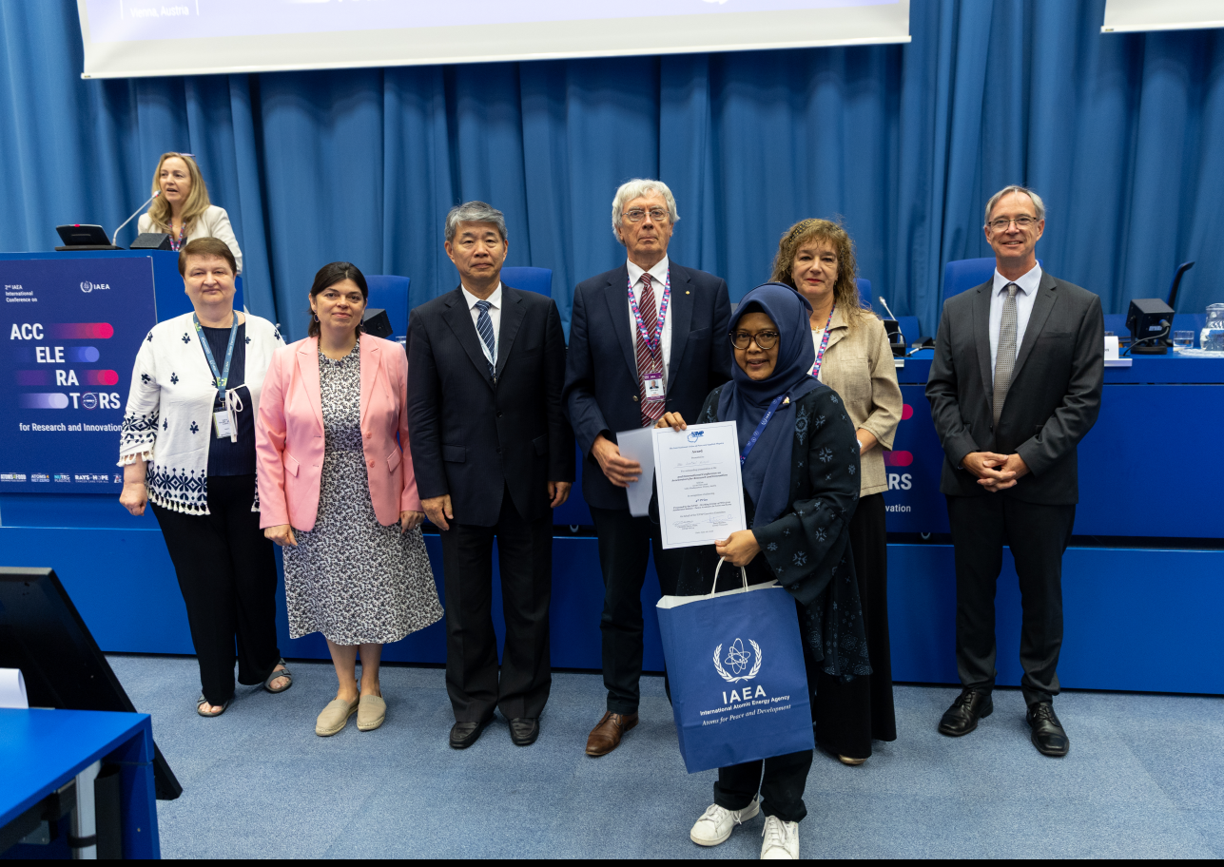
Young Professional Award Winners
1st Prize
3rd Prize
2nd Prize
4th Prize

Slide 5

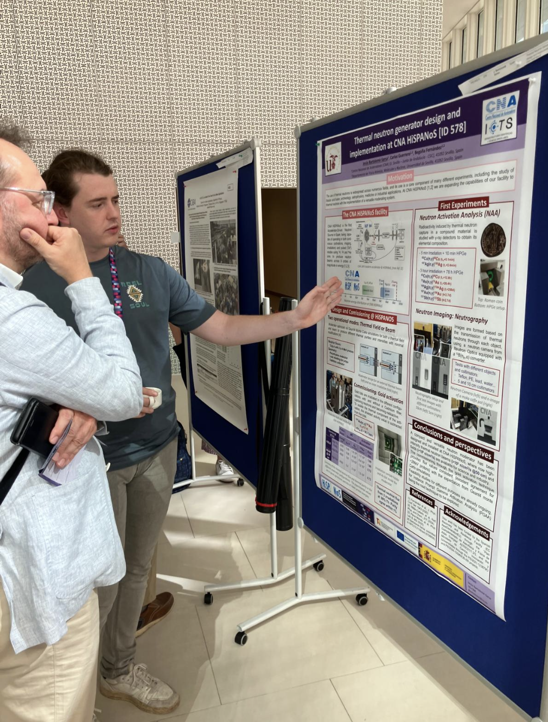
Young Professional Award Winners
ID 578
Thermal Neutron Generator Design and Implementation at CNA HiSPANoS
Jesús Bartolomé Sarsa Centro Nacional de Aceleradores, Universidad de Sevilla, Spain

Slide 6
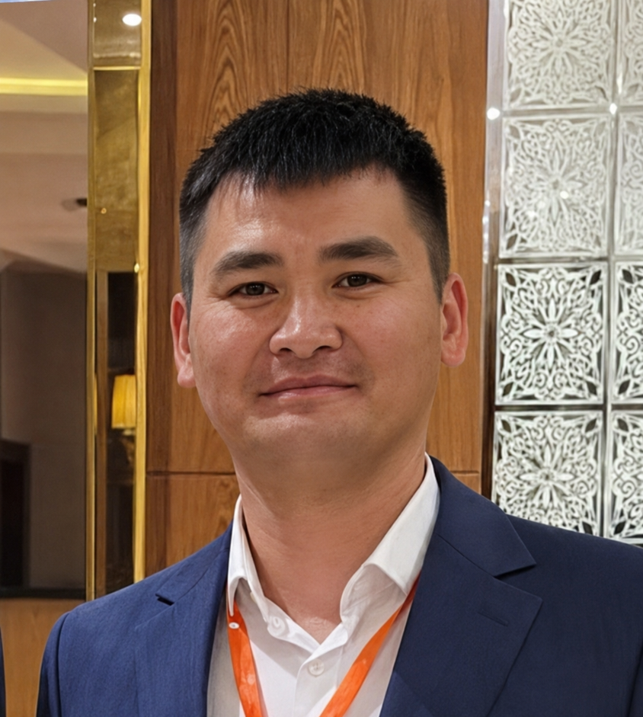
Young Professional Award Winners
ID 624
Heavy Ion Beam Diagnostics at the JINR FLNR Accelerator Complex: State Of Art
Askar Issatov
Joint Institute for Nuclear Research (JINR)

Slide 7

Young Professional Award Winners
ID 311
Electron Beam-induced Surface Engineering of Calcium Carbonate for Enhanced Performance in Polymer Composites
Helena Biljanić
Ruđer Bošković Institute, Croatia

Slide 8

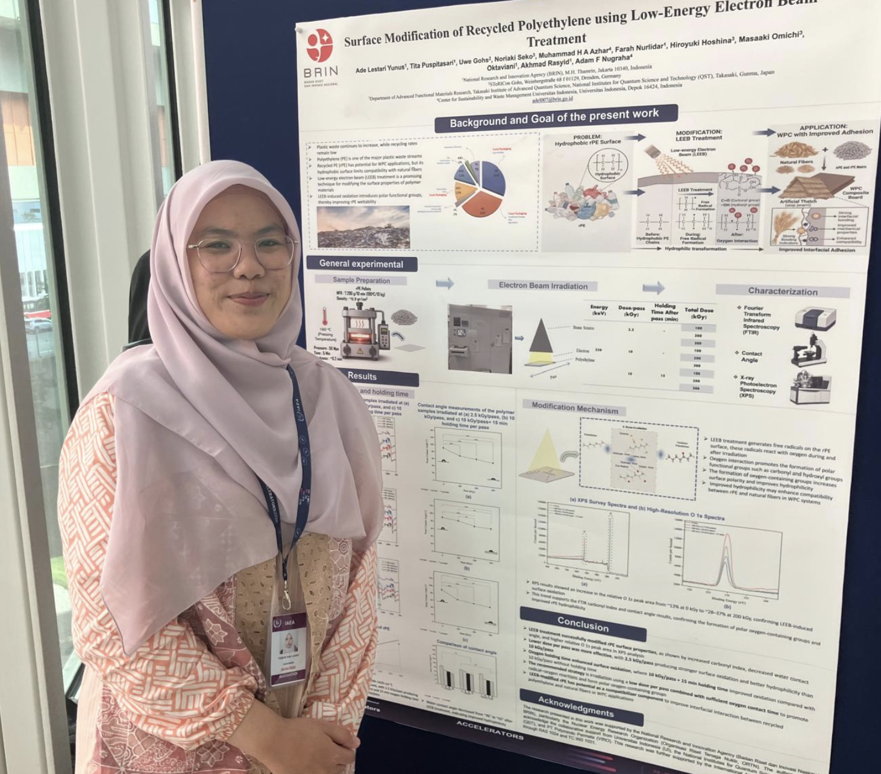
Young Professional Award Winners
ID 289
Surface Modification of Recycled Polyethylene by Low-Energy Electron Beam for Potential Application in Wood–Polymer Composites
Ade Lestari Yunus
National Research and Innovation Agency of Indonesia (BRIN)
Indonesia

Slide 9
Additional IUPAP Award Winners & Accelerating Talents

Slide 10
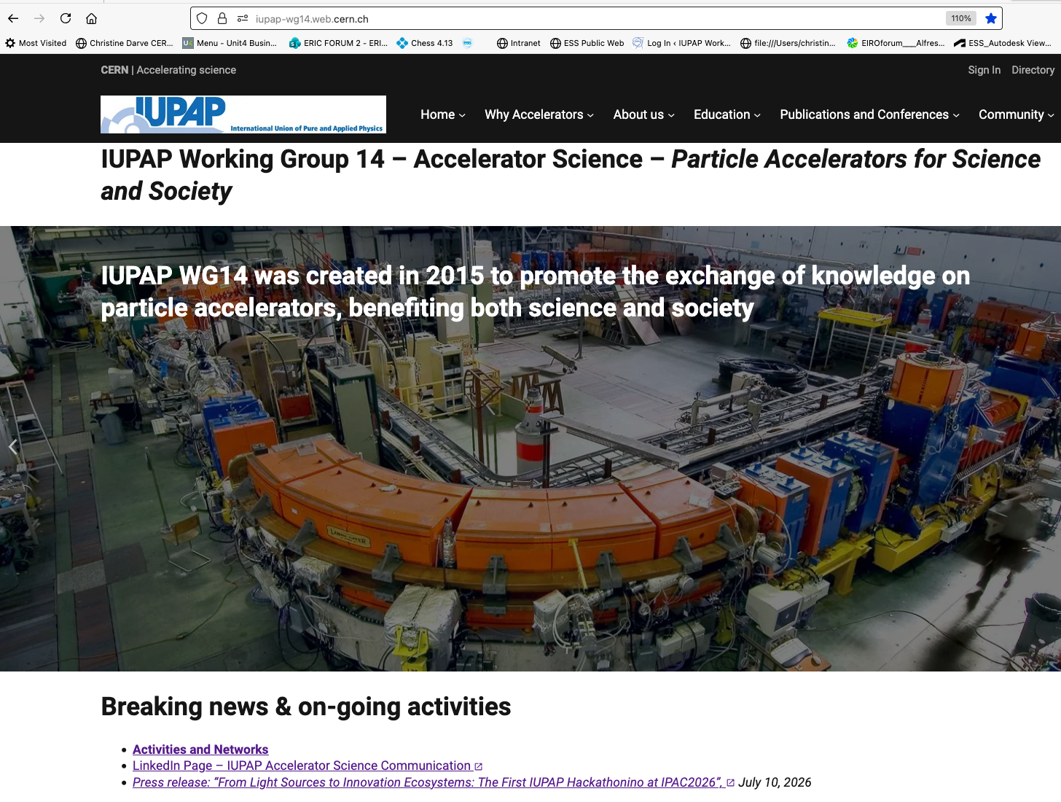
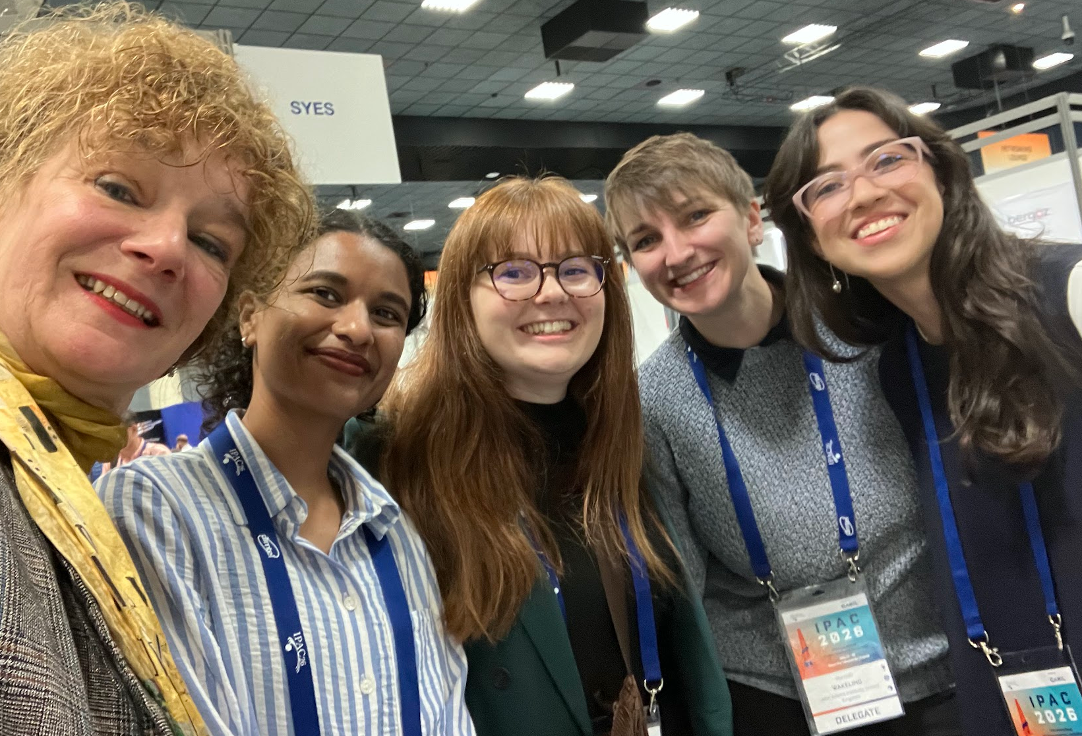
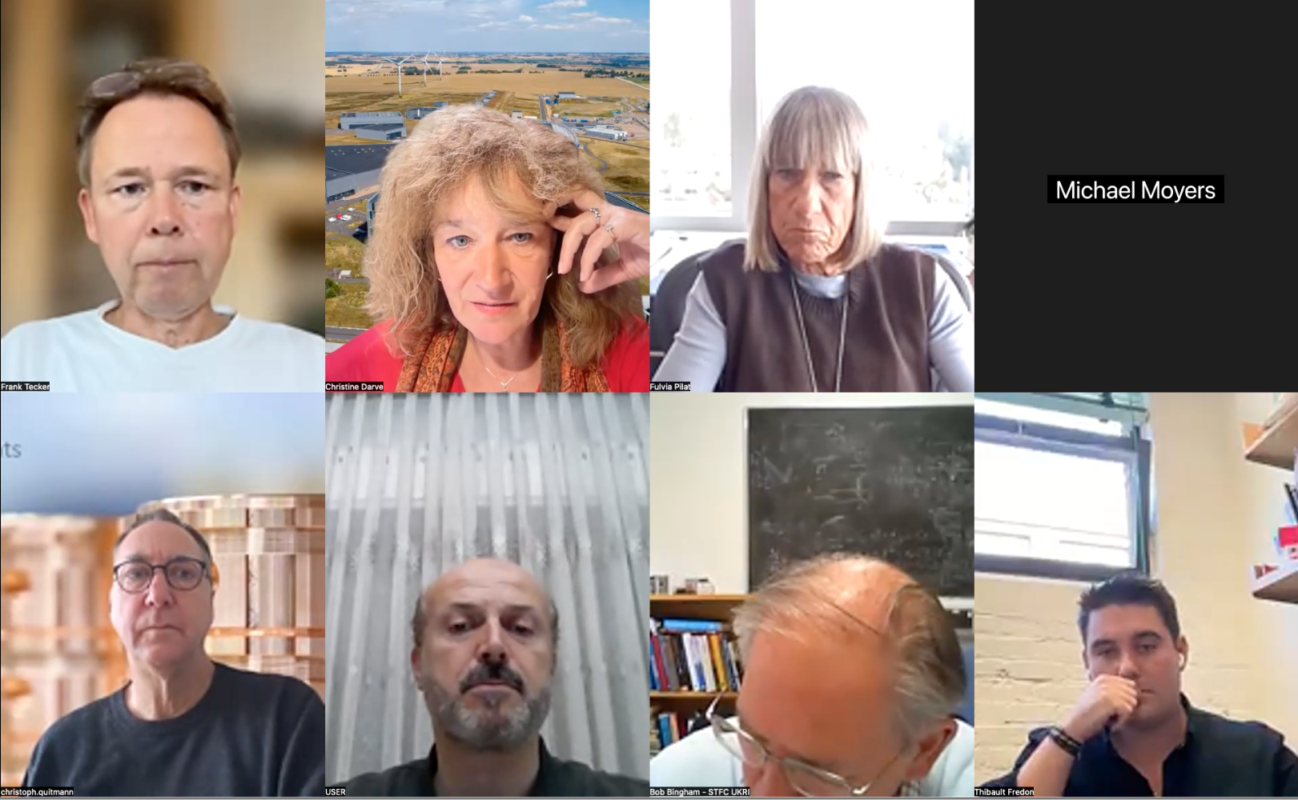
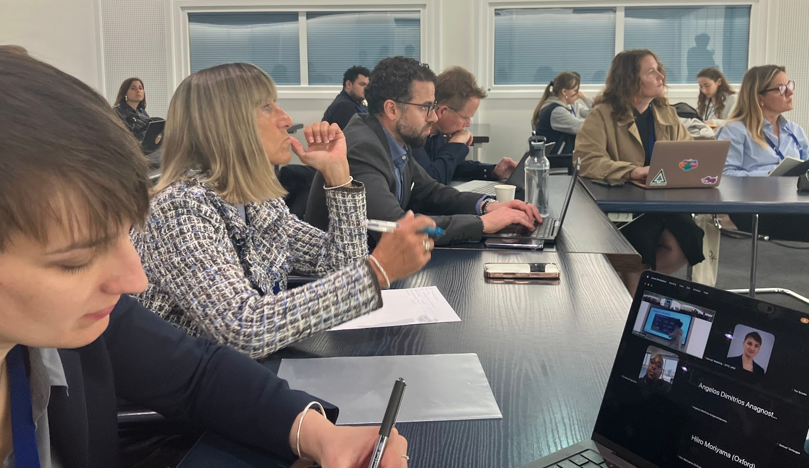
Selected IUPAP WG14 Activities:
- Accelerator Engagement Ambassadors Initiative
- Hackathonino (IUPAP-WG14) at IPAC2026
Working Group 14 – Accelerator Science – Particle Accelerators for Science and Society
Expert Committee of the International Union of Pure and Applied Physics (IUPAP), under Commission C11 (Particles & Fields ), and in close collaboration with C12 (Nuclear Physics) and other IUPAP bodies.
The objective of WG14 is to strengthen global collaboration in accelerator science among laboratories, universities, industry and international organisations, while promoting its applications in scientific discovery, innovation, education and societal benefit.
WG14 focuses on the following key areas:
Global knowledge sharing and partnerships
Societal impact and sustainable applications
Talent development and resource sharing
Notes:
The “Working Group 14 – Accelerator Science – Particle Accelerators for Science and Society” is an Expert Committee of the International Union of Pure and Applied Physics (IUPAP), under Commission C11 (Particles & Fields ), and in close collaboration with C12 (Nuclear Physics
) and other IUPAP bodies.
The objective of WG14 is to develop and strengthen the global strategy for collaboration in accelerator science by supporting collaborative ventures between laboratories, universities, industry, and international organizations; and promote accelerator science and its cross-disciplinary applications for scientific discovery, innovation, education, and societal benefit. To reach this objective, the WG14 commitee shall:
Knowledge exchange: Strengthen the global accelerator community by uniting scientists and lab leaders through collaborative platforms, fostering knowledge exchange and accelerating innovation worldwide.
Promote applications: Support accelerator uses in industrial, medical, energy, and environmental sectors.
Sustainability alignment: Map and review accelerator applications supporting SDGs, including life sciences, healthcare, research, and technology.
Accelerate progress: Facilitate information sharing, joint procurement, and exchange of equipment, ideas, and personnel among labs globally.
Talent development: Verify feasibility to train early-career scientists through lab-university collaborations, schools, MOOCs, providing access to leading experts, equipment, and techniques.
Resources & communication: Develop networks (e.g., Ambassadors), webpages, and conference presence to share scientific advancements and societal impacts.

Slide 11

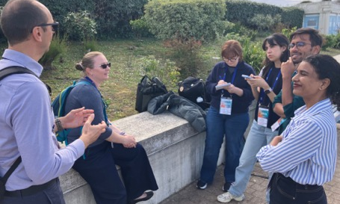
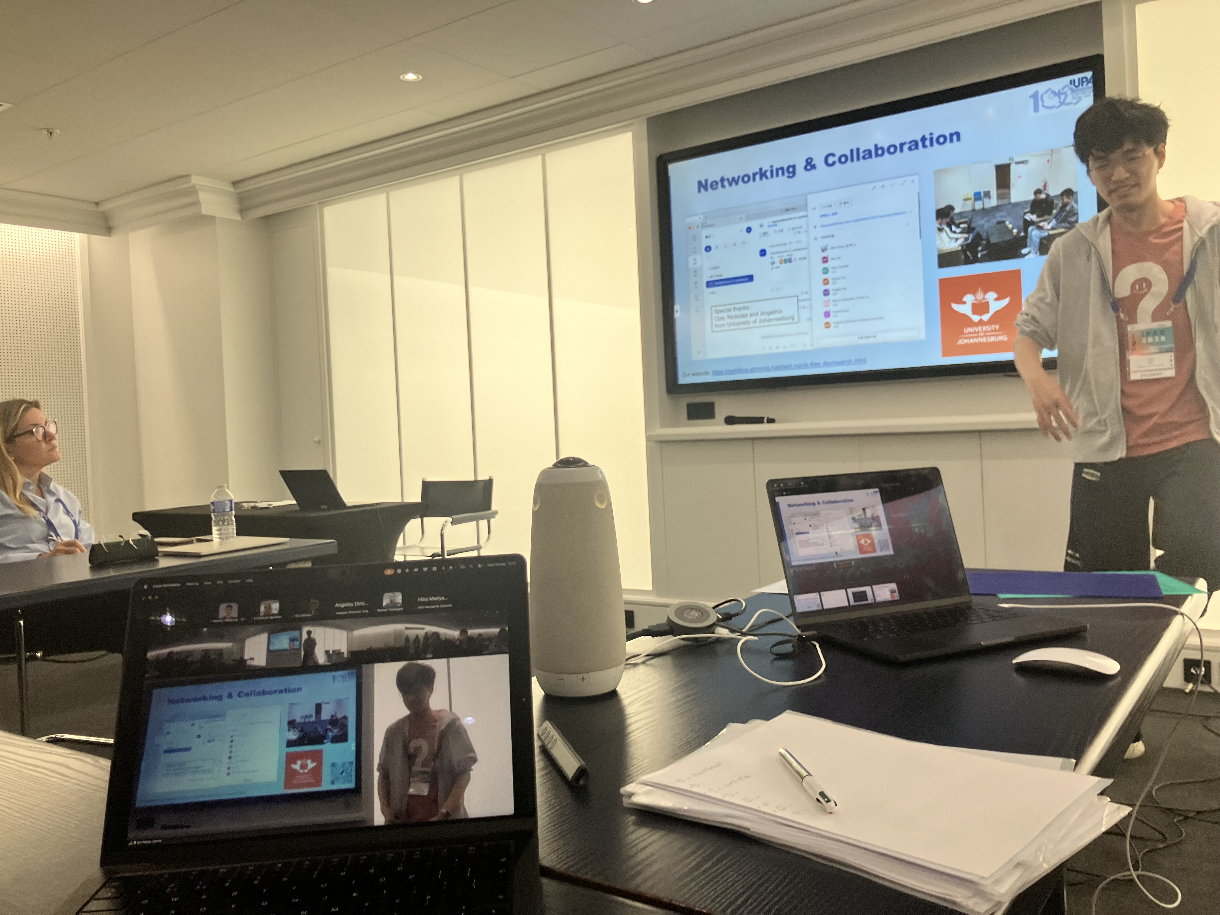
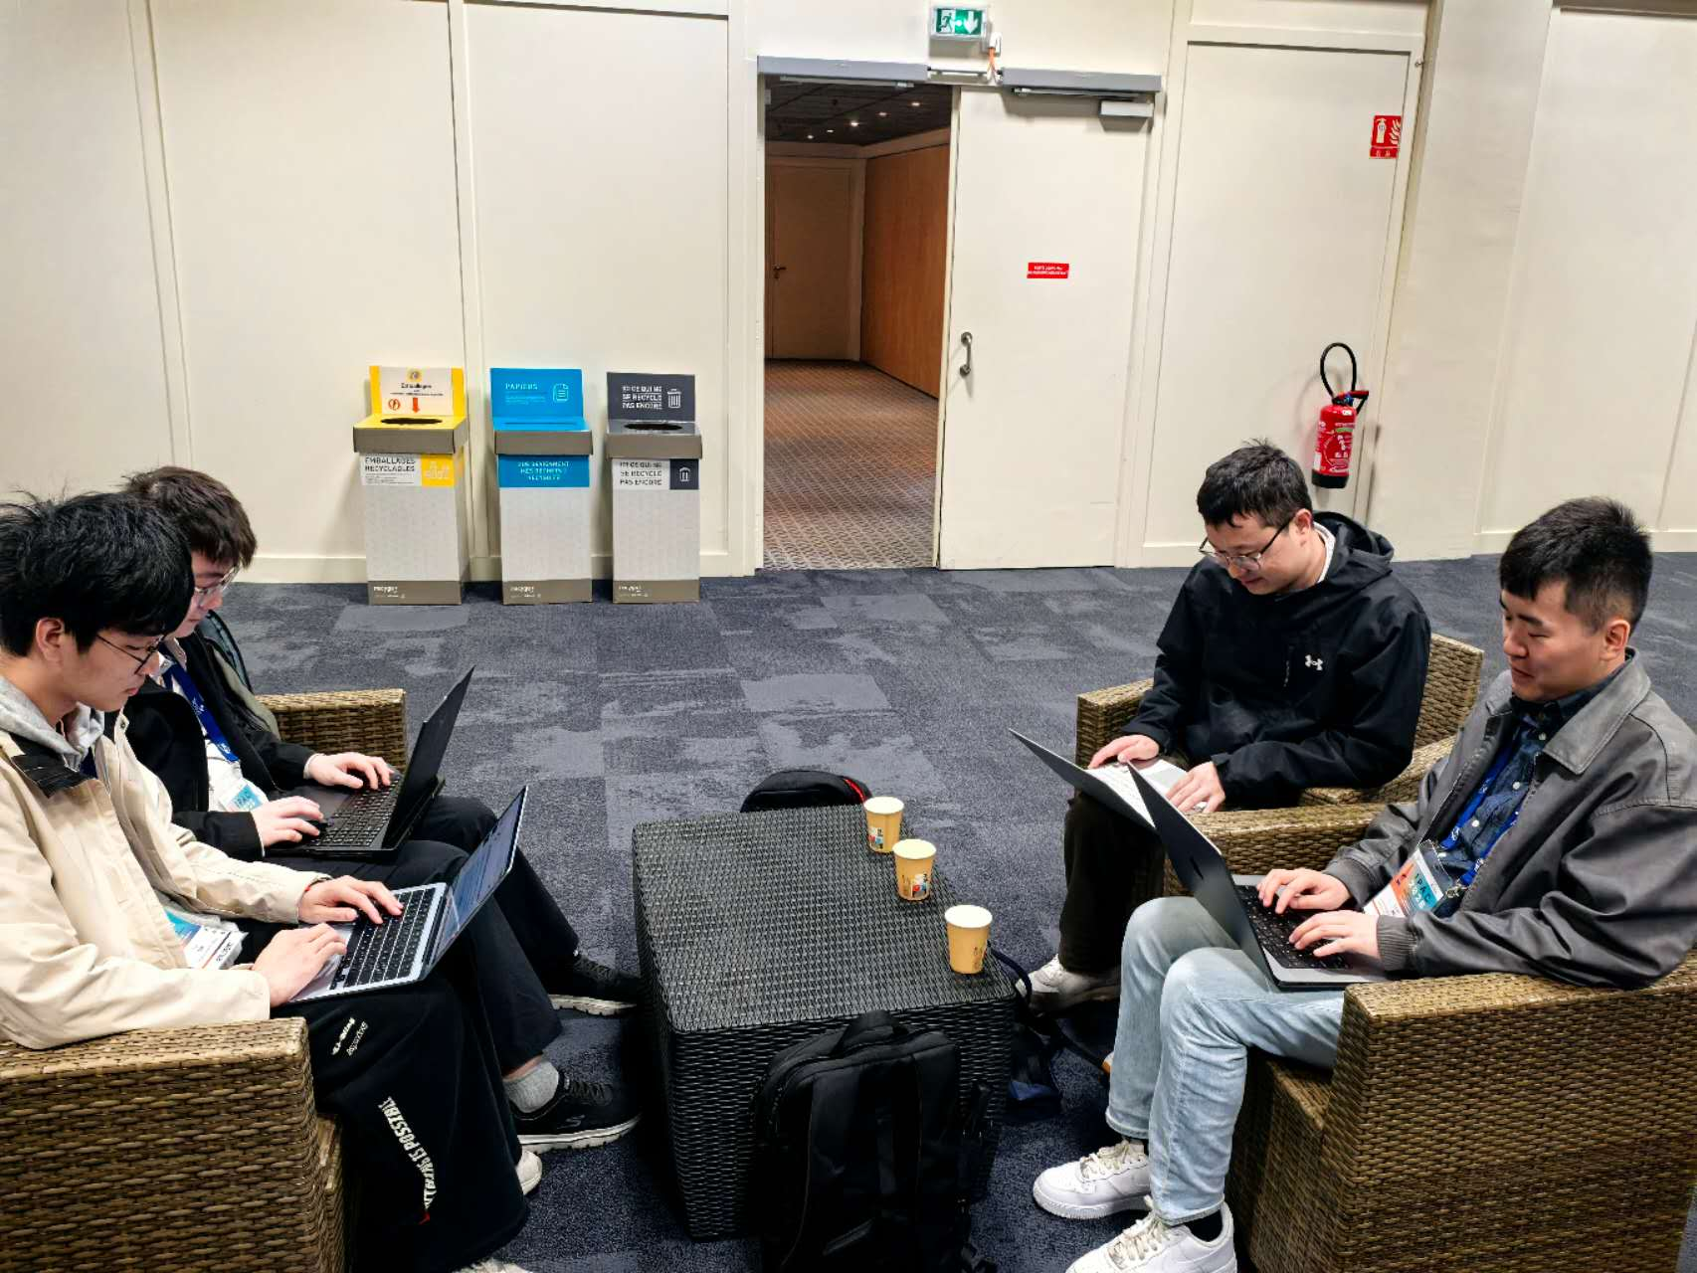
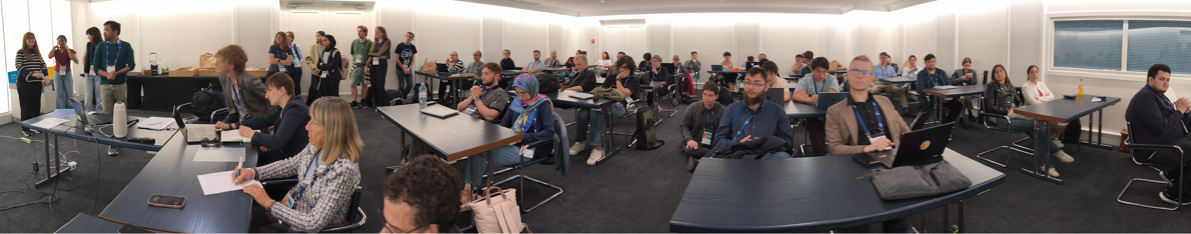
Hackathonino@IPAC2026
More than 65 participants from 19 countries, and 9 challenges solved in 3 days !
Proof of concept established during IPAC2026 to strengthen synergies among students, research mentors, and companies, ensuring meaningful learning and engagement.
Activities are designed to build:
– Technical problem-solving skills
– Teamwork & collaboration
– Communication & presentation skills
– Insight into accelerator design and professional design tools
Website: [IUPAP-WG14 Hackathonino ]
Article: “From Light Sources to Innovation Ecosystems: The First IUPAP Hackathonino at IPAC2026”, July 10, 2026
Notes:
(further integration of companies, IP)
Using diverse comms. Signal, meeting,

Slide 12
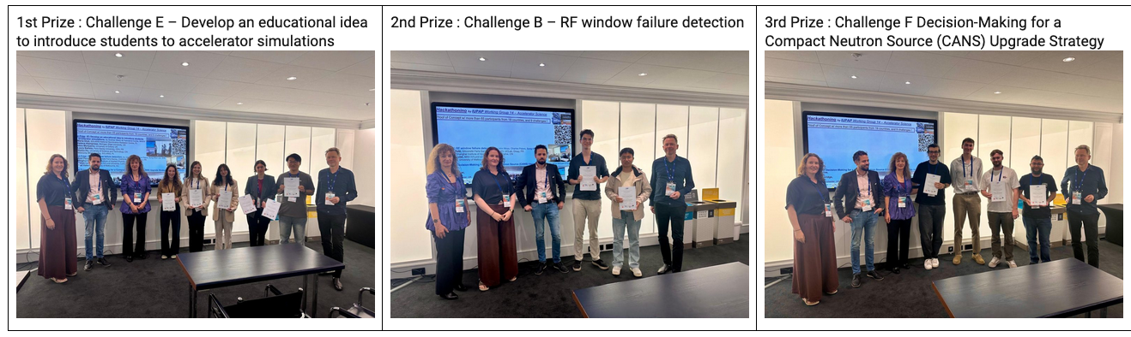
The 3 winning teams!
by Sverker Werin & Francesca Curbis, MAXIV
Maria Ünal, SOLARIS National Synchrotron Radiation Centre, PL
Helena Alamprese, Michigan State University, US
Hiiro Moriyama, University of Oxford, UK
Laury Batista, Paris Saclay University, CEA, FR
Weibo Hu, University of Science and Technology, CN
Wiktoria Wiatrowska, SOLARIS, PL
by John Moss, Charles Peters, Sung-Woo Lee, SNS
Axel Perez Ruiz, Université Paris-Saclay, CNRS/IN2P3, IJCLab, Orsay, FR
Dinghui Su, Shanghai Institute of Applied Physics, Shanghai, CN
Johan Lundquist, MAX IV/Lund University, Lund, SE
Joel Valerian, University of Melbourne, AU
by Mina Akhyani (FZJ)
Jordan Byrne,
Aras Amini,
Oliver Betteridge,
Filip Peczek
University of Manchester

Slide 13
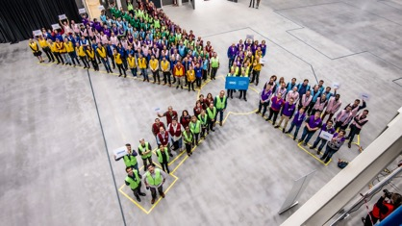

Concluding comments
Support emerging talent through sponsorships, visibility and future opportunities. Poster sessions and Hackathonino
Use accelerator science as a common discipline to strengthen collaboration between IUPAP and IAEA.
WG14 to propose follow-up activities to support the development of award-winning young professionals.
Thank you for your attention!
christine.darve@ess.eu
https://cdarve.web.cern.ch/
2026/02/26

