Slide 1
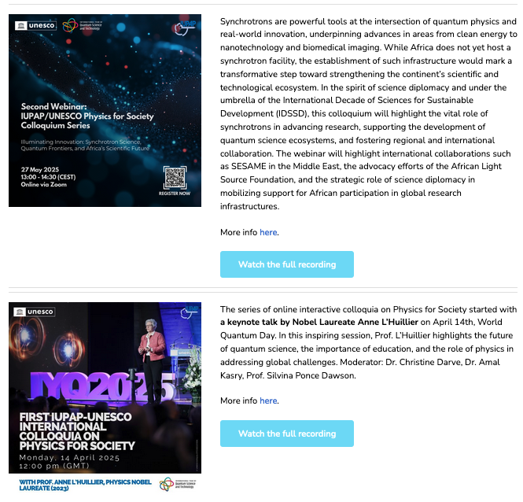
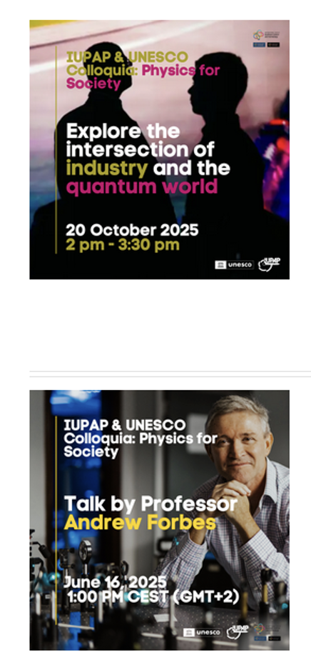
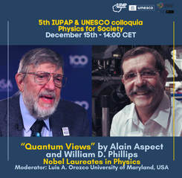

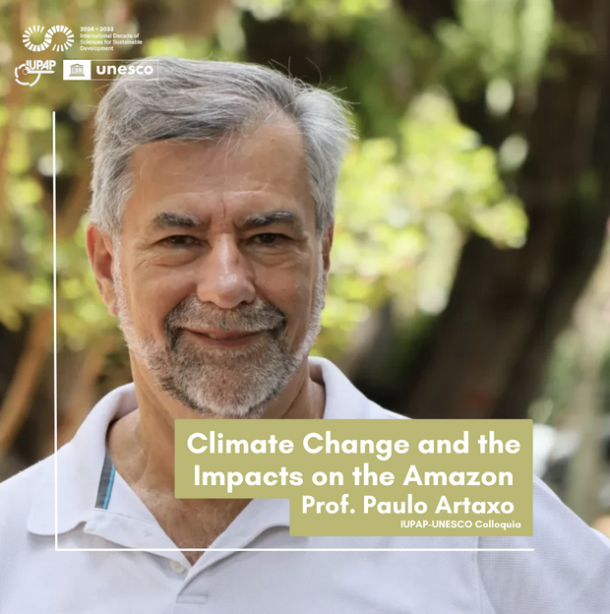
IUPAP&UNESCO International Colloquia on Physics for Society
Launched within the framework of the
International Year of Quantum Science and Technology (IYQ 2025), and the International Decade of Sciences for Sustainable development (IDSSD 2024-2033)
The series brings together global experts to explore advances in quantum science, foster cross-disciplinary collaboration, and support progress toward the UN Sustainable Development Goals.

