Slide 1
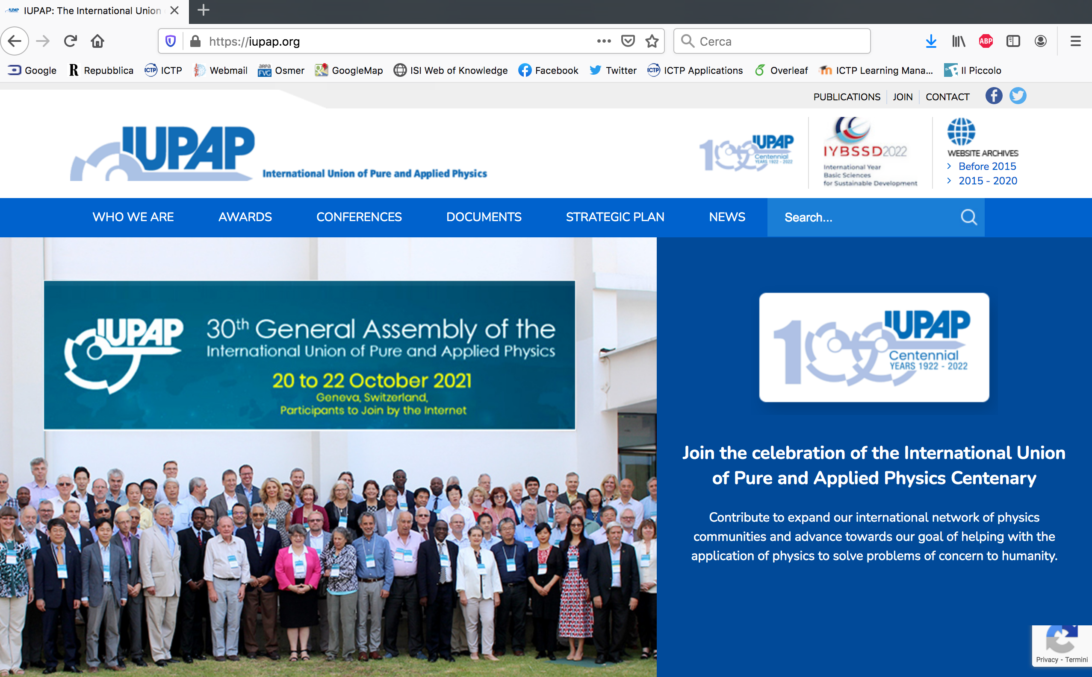
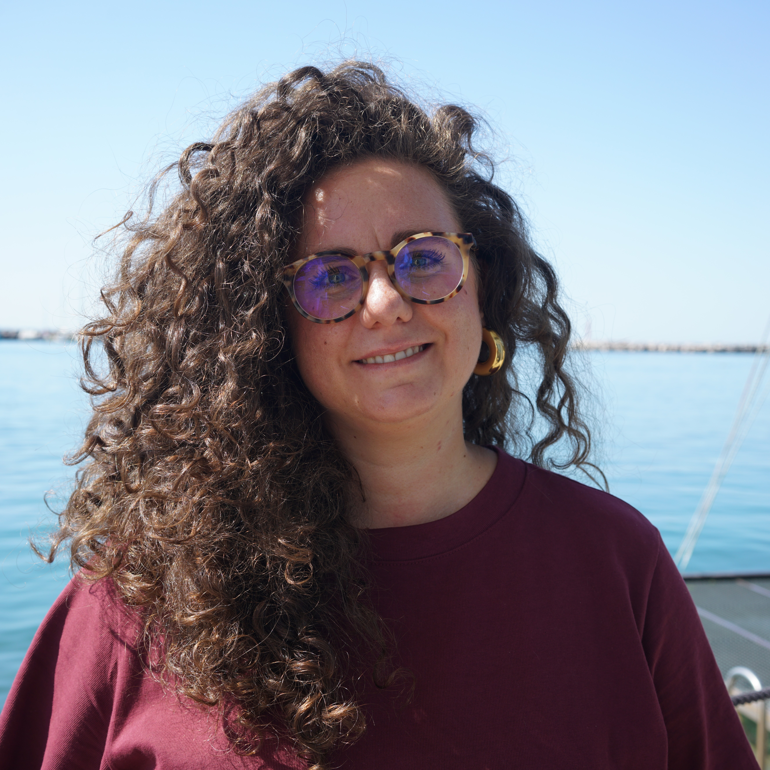
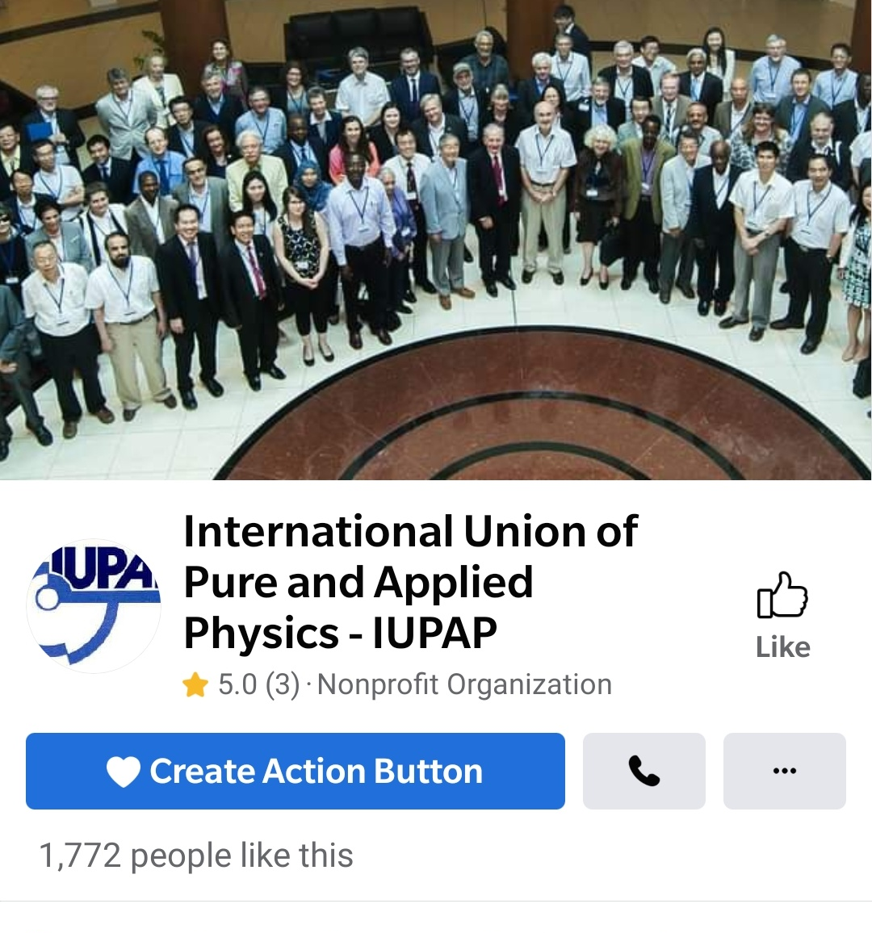



IUPAP Communication EC&CC October 2026
Francesca Zavino
communication@iupap.org

Slide 2
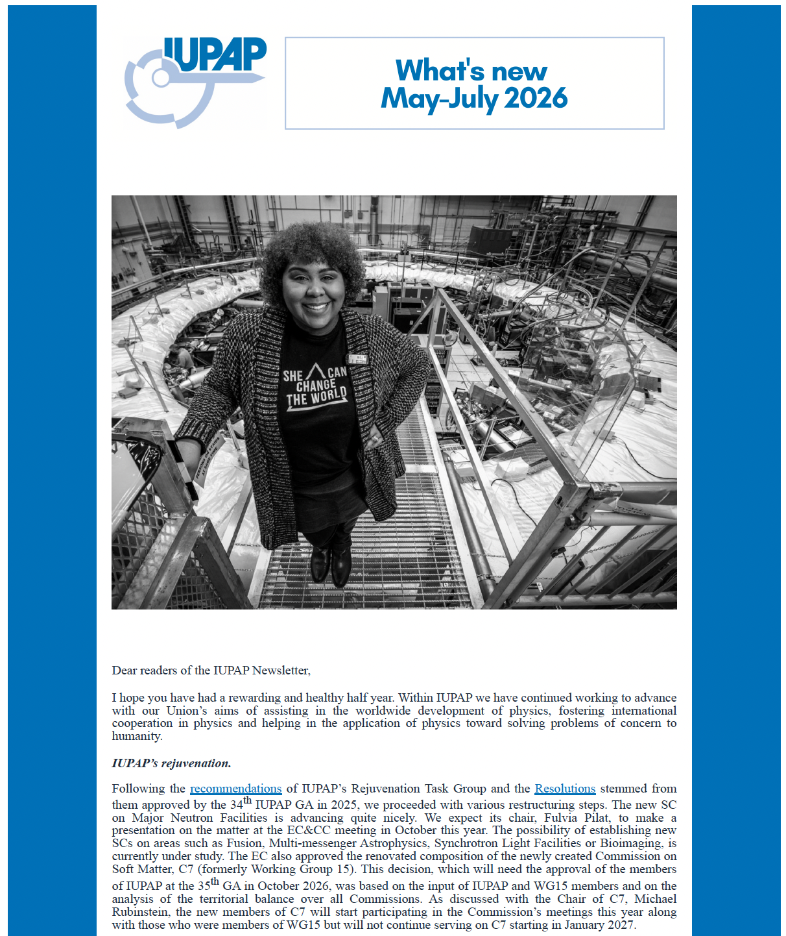
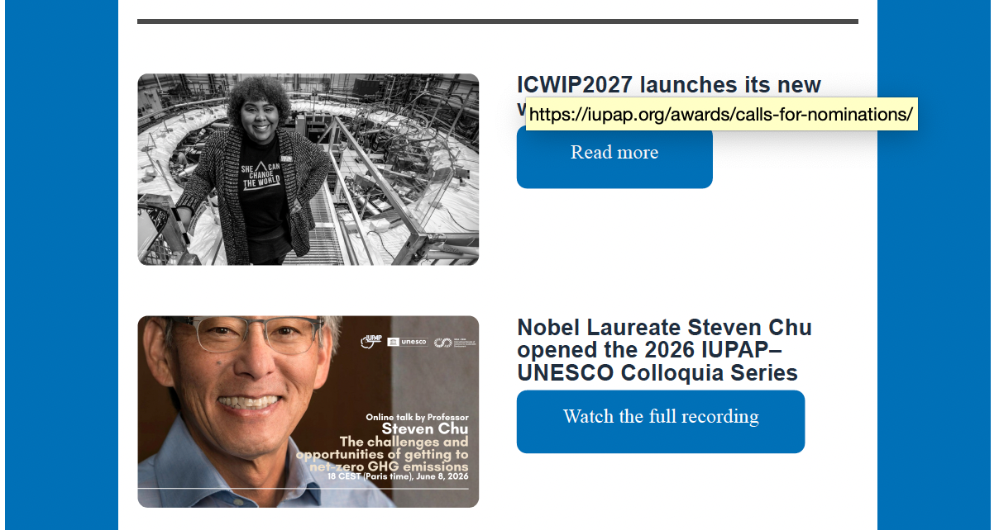
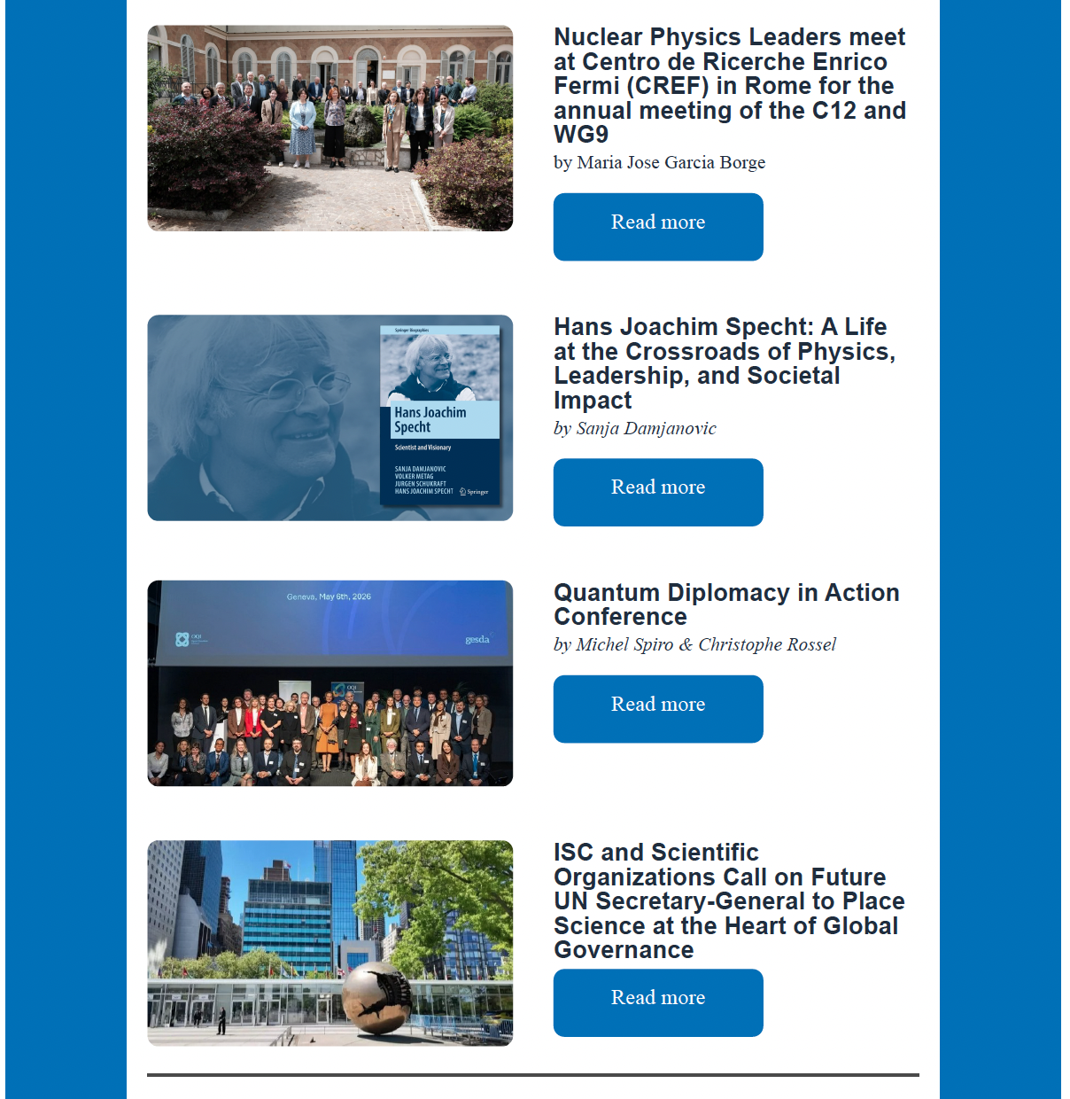
IUPAP Communication
e-Newsletter
e-newsletter
(almost) quarterly
pdf posted on website
3,009 contacts
(+589 from 2025)
  48% read (opened) the message
  4,95% clicked on link

Slide 3
IUPAP Communication
e-Newsletter
April - 2026
About: President’s Note, John Torrence Tate Medal for Leadership, Ethics and Peace in Physics, International Year of Quantum Science and Technology closing ceremony, The Pacific Island Nations and IUPAP, Early Career Scientist Prize, 2026 Approved Conferences.
August – 2026
About: President’s Note, ICWIP2027, Colloquia by Nobel Laureate Steven Chu, annual meeting of the C12 and WG9, book about Hans Joachim Specht, Quantum Diplomacy in Action Conference, Call on Future UN Secretary-General to Place Science at the Heart of Global Governance, Early Career Scientist Prize.
Mail abount Iupap – Unesco Online Colloquia
- May 2026: Steven Chu opens 2026 IUPAP–UNESCO Colloquia
- August 2026: IUPAP–UNESCO Colloquium with Paulo Artaxo

Slide 4
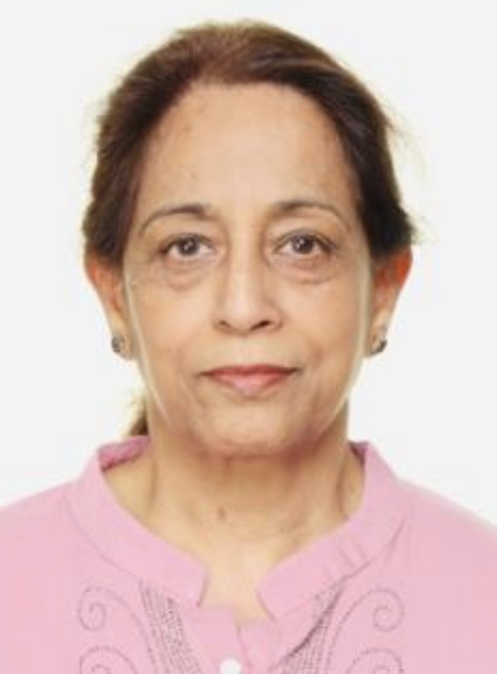
IUPAP Communication
e-Newsletter’s new Editor
Manjit Kaur
Member, CMS Collaboration
Department of Physics, Panjab University
Chief Editor (since 2015): Monthly Physics Bulletin of Indian Association of Physics Teachers (IAPT), 8000 copies monthly.

Slide 5

IUPAP Communication
Social media
Facebook: followers: 3294 (+162 from Oct 2025)
LinkedIn followers: 3496 (+1166 from Oct 2025) – 63565 impressions
Collaboration with communication teams at other organizations (ICTP, CERN, IYBSSD, other Unions, UNESCO, etc) for post re-sharing

Slide 6

IUPAP Communication
Website
Updated by communication team
Commissions/AC/WG are responsible for their content on website
please send your content/updates to communication@iupap.org
Experiment with C14 entering content independently was successful, C12 next
Francesca
Hari
Silvina

Slide 7

IUPAP Communication
Homework for you (especially Chairs)
Please send us (to communication@iupap.org):
  Content updates for website from Commissions / AC / WG
  Newsworthy updates (e.g. conferences, events) - send pics & brief text
  Early Career Scientist Prize winner information (and other awards)
  Commissions will be contacted for rotating «feature» in newsletter
  Any other suggestions to improve the communication
Please help us sharing news on social media and involving local communication officers when relevant (please tag @iupap in your posts!!)

Slide 8
IUPAP Communication
Who’s who
Francesca Zavino
A special thanks to Hari Haran (GRAPES-3 experiment, Tata Institute of Fundamental Research) for help with web site
communication@iupap.org: News and web items
[managed by Francesca Zavino]
secretariat@iupap.org: All types of «business» messages
[managed by Gabriella Marra, read by entire EC]

