Slide 1
IUPAP Membership and Development
October 2026
Vice President for Membership and Development: Igle Gledhill

Slide 2

Types of members
Territorial Members
  Represent physics communities across the world
  Categories 1 to 19
Personal members
  Chairs of Commissions and Affiliated Commissions
Associate Territorial Members
  Relatively small physics communities; developing territories
  Prelude to Territorial Membership
  Affordable dues but Limited Number, do not vote
Corporate Associate Members
  Companies or International research organisations

Slide 3
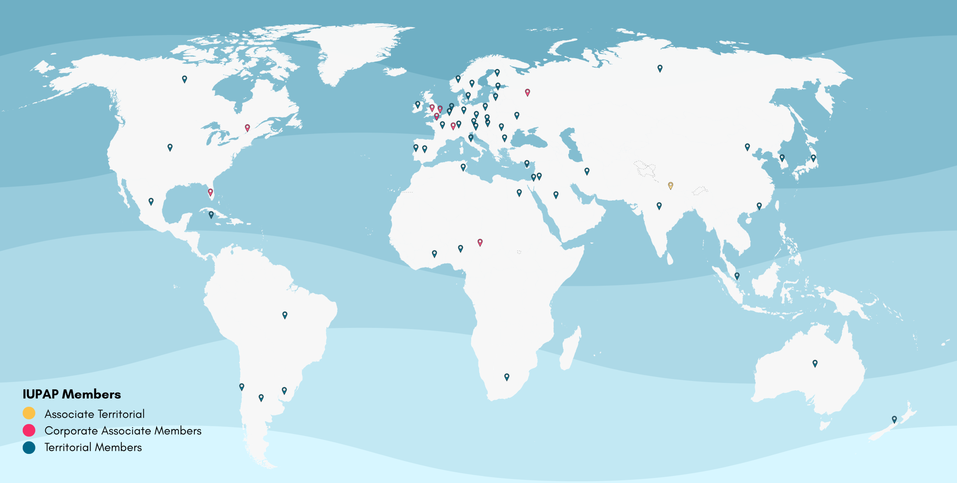

Slide 4
Membership October 2026
Territorial members
Associate Territorial member
Corporate Associate Members
Total
52
1
8
61

Slide 5
Territorial members: Current status
52 current territorial members
  Exclusions after 6 years of arrears: none for 2026
  Arrears of more than 3 years: 8
  Action: VP refreshing contacts and following up
New territorial members
  2+1 Potential
Associate Territorial Members
  Nepal deployed on C13 (development) and WG21 (climate)

Slide 6
Territorial members: Current status
52 current territorial members
  Exclusions after 6 years of arrears: none for 2025
  Arrears of more than 3 years: 8
  Action: VP refreshing contacts and following up
Associate Territorial Members
  Nepal

Slide 7
Territorial members and Associate TMs
The Liaison Committee maintains relations between physics community and IUPAP.
  Represents the physical societies,
  Designates delegates to the General Assembly.
The Adhering Body is a legal body in the territory, typically an Academy or a national research council; it may be a physical society.

Slide 8



Corporate Associate Members
Square Kilometre Array Observatory
Innovations Investment Management, India
Sensors and Instrumentation
Sensors and Instrumentation

Slide 9

Corporate Associate Members
MOU signed with IUPAP: to be ratified by General Assembly

Slide 10
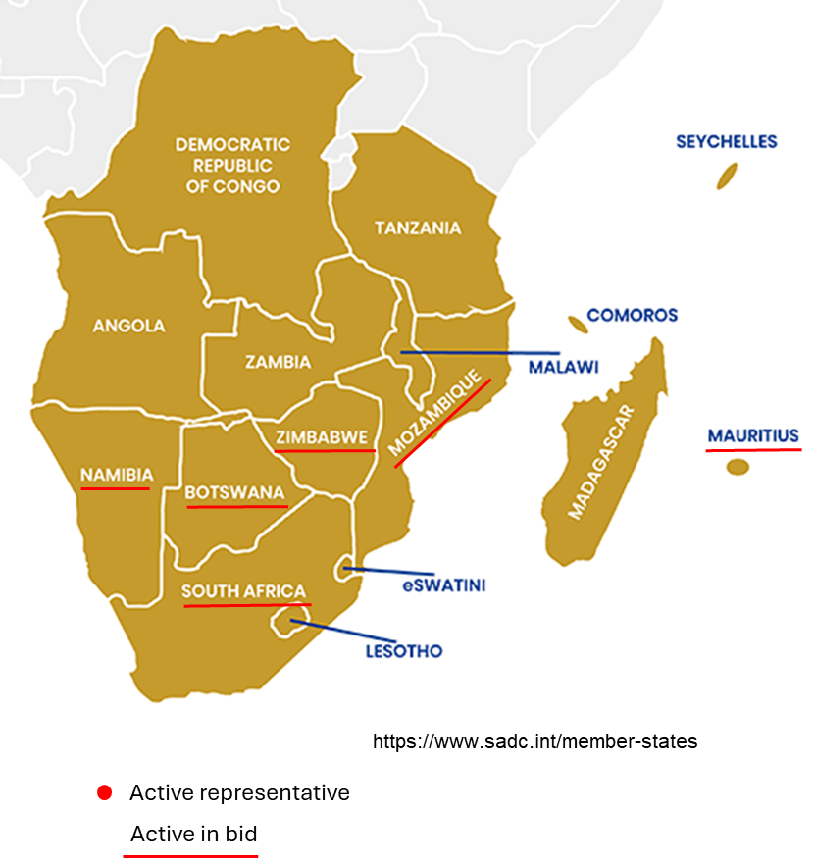
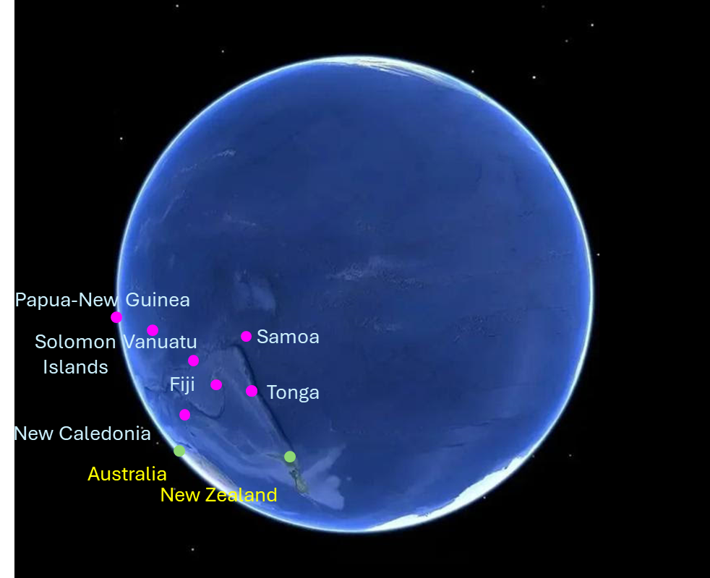
Regional development: possible ATMs
Southern Africa “SAPhysNet”
Pacific Island Nations

Slide 11

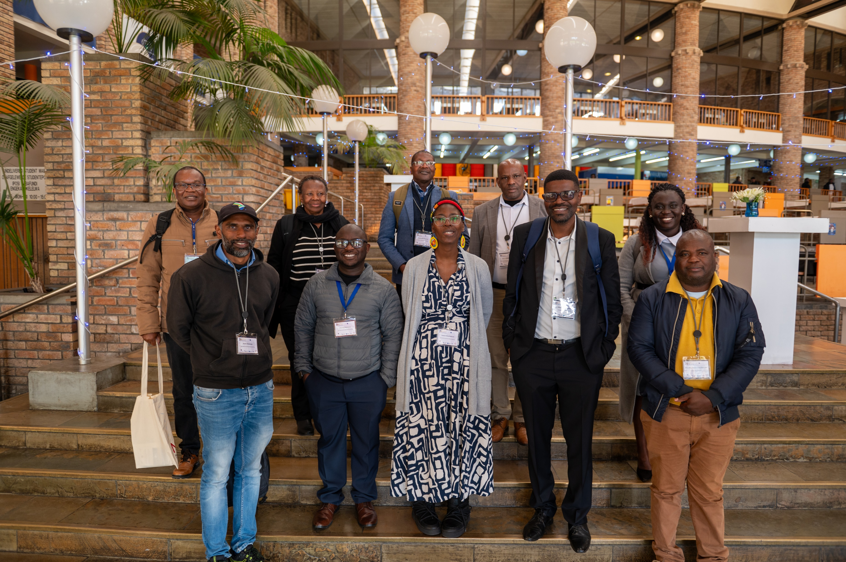
Regional development: progress
Southern Africa “SAPhysNet”
Task Team
Met July 2026, hybrid
Bid partners for 2027 GA-ICP

Slide 12
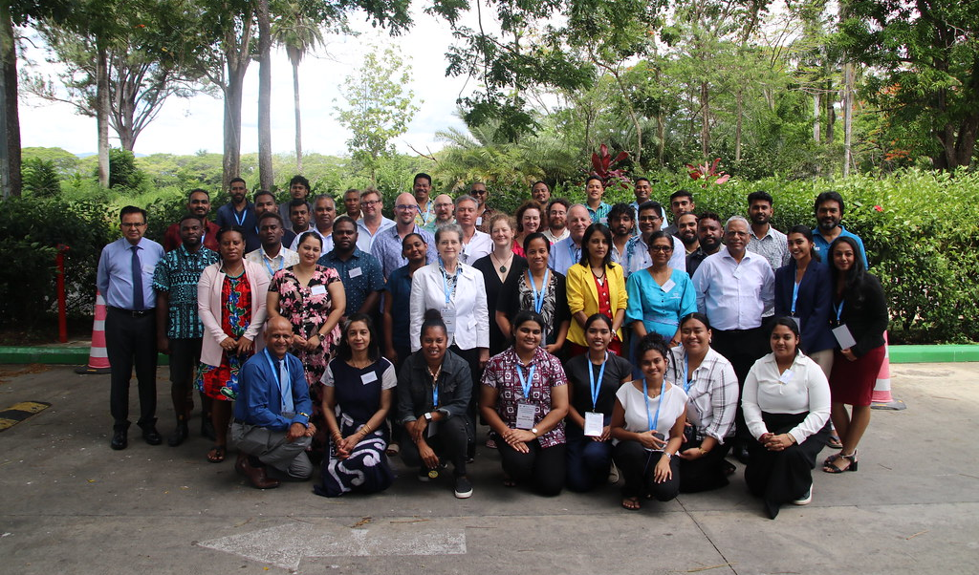
Regional development: progress
Pacific Island Nations Physics Week, with UNESCO-Pacific
IUPAP-UNESCO Pasifika Physics Summit
Task Teams and South Pacific Physics Society

Slide 13
Strategy
TM membership: retain
Adhering Bodies cancelling or lowering dues payments
  USA: NAS to APS
  Europe: Academies
  Following up
No national Adhering Bodies
  Physical Societies as AB struggle
New TMs
IAPS, International Association for Physics Students, very helpful
Negotiations proceeding

Slide 14
Strategy
CAMs: find them
CLAF: thank you, Silvina
ATMs: prioritise
Nepal – extend
Pacific, Southern Africa in process
Limitation to 10% of number of TMs

Slide 15
Strategy
Defaulting members and excluded members
  Often no suitable national Academy or National body
  Physical Societies are small, low fees for individuals
  Excluded and defaulting TMs cannot repay the arrears that have mounted
Developing Countries
Low Income and Lower Middle Income
  The time scale for moving across World Bank classes is of the order of decades
  The time scale envisaged for ATM development is 6 years

Slide 16
Two notes
The professionally friendly spirit in which IUPAP approaches problem-solving is of vital importance
Thank you to each member of the Standing Committee
To Jens Vigen and Gabriella Marra
Your commitment does not go unnoticed

