Slide 1
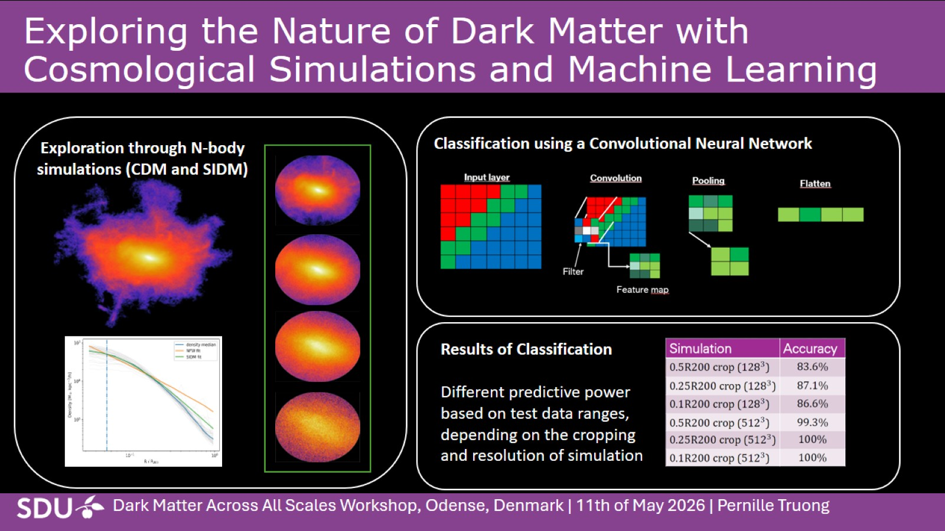
Exploring the Nature of Dark Matter with Cosmological Simulations and Machine Learning

