Slide 1
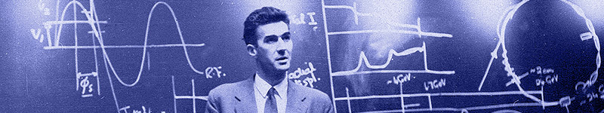

Update on Education & Training and Public Engagement at JAI
Emmanuel Tsesmelis
CERN & JAI University of Oxford
JAI Advisory Board 2026
16 April 2026

Slide 2

Introduction
The JAI programme is organised around three pillars:
Research & development for advanced and novel accelerator technology.
Training of next generation of accelerator scientists in accelerator techniques.
Advanced accelerator applications in science & society, impact and public engagement / outreach.

Slide 3
Education and Training

Slide 4
Guiding Strategy
Training in accelerator science & technology is one of the pillars of JAI mission and recognised by JAI Advisory Board to be world-leading.
Objective is to develop skills of next generation accelerator scientists.
JAI has provided graduate & undergraduate training in accelerator science & technology since first course delivered in 2005 (for more than 20 academic years).
Students participate in comprehensive core formal training through academic courses & projects and 3 years of cutting-edge research at state-of-the-art facilities (national & international).
Many JAI academic staff invited to give courses & lectures at international accelerator schools.

Slide 5
JAI Graduates & Careers
JAI training is well aligned with STFC strategic aims to address national demand for scientifically-skilled workforce to sustain UK’s world-leading position in research & technology and JAI’s unique aspect of academic training for PhD students as addressed in 2017 STFC Accelerator Strategy Review & 2019 Accelerator Programme Evaluation.
PhD graduates total more than 130; all obtained fruitful employment; about 20% female.
Alumni consistently pursue careers in science & technology
Destinations include research positions in universities, ASTeC, BNL, CERN, CI, DESY, LBNL, LLNL, NPL, RAL, SLAC, PSI etc.
Some reached full academic positions; about 15% work in industry.

Slide 6
JAI CERN Fellows / Staff
2011:
Robert Apsimon
Ben Constance
2015:
Ewen Maclean (now staff)
2016:
Davide Gamba (now staff)
2017:
Neven Blaskovic
Alex Gerbershagen (staff)
2019:
Michele Bergemaschi
Swann Levasseur
Leon van Riesenhaupt
2020:
Jan Paszkiewicz
Eugenio Senes
2021:
Andrey Abramov
Rebecca Ramjiawan
2022:
Daniele Butti
Luke Dyks
Lawrence Wroe
2023:
Jake Flowerdew
Helen Guerin
Collette Pakuza
Pablo Arutia Sota (staff)
2024:
Max Topp Mugglestone
Laurence Nevay (staff)
Rebecca Taylor
2025:
Florian Stummer
Daniel Harryman (staff)
2026:
Jack Salvesen
Bjoern Lindstrom (staff)
22 Fellows + 5 Staff in ATS
2 Fellows now Staff

Slide 7
Graduate Destinations – Research Institutes
Since JAI foundation in 2004: >130 PhD graduates (+ 48 in progress)
Graduates secured positions at: e.g. CERN, DESY, ESS, SLAC, FNAL, BNL, LBNL, STFC, universities
CLF: Nicolas Bourgeois, Steven Dann, Kirill Fedorov, Benjamin Spiers, Christopher Thornton
Diamond: Ian Martin, Lorraine Bobb, Neven Blaskovic
ISIS: Ben Pine, Rob Williamson, Steven Brooks, Scott Lawrie, Ciprian Plostinar
DESY: Andreas Walker, Rob Shalloo, Emily Archer, John Dale, Tony Hartin, Jon Wood, Kristjan Poder
MAX IV: Steve Molloy, Francis Cullinan, Neven Blaskovic
ESS: Neven Blaskovic, Ciprian Plostinar
PSI: Alex Gerbershagen
SLAC: Christine Clarke, Glen White, Robbie Watt, Elias Gerstmayr, Savio Rozario
Fermilab: Rob Ainsworth
BNL: Christina Swinson
LBNL: Tony Gonsalves, Alex Picksley
LLNL: Johannes Van de Wetering

Slide 8
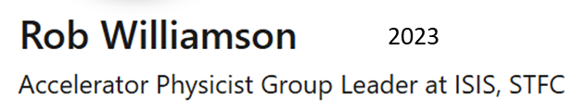
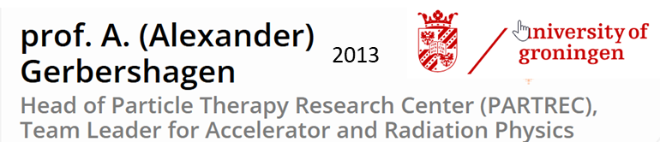
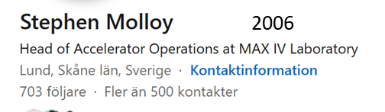
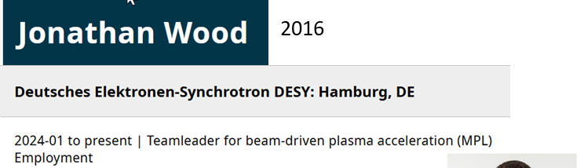

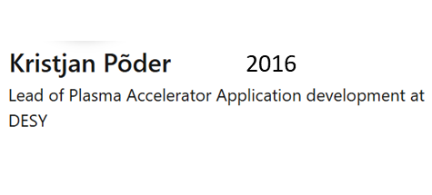
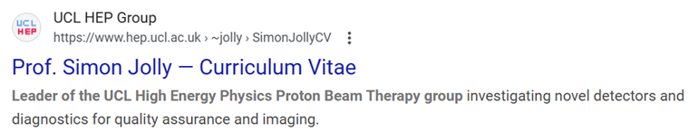
Group Leaders
Ian P. S. Martin 2011
Head of Accelerator Physics Group
Diamond Light Source
Ciprian Plostinar
Head of Accelerator, ESS
Lorraine Bobb
Head of Diagnostics, DLS

Slide 9
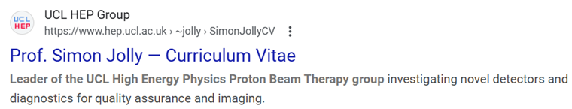

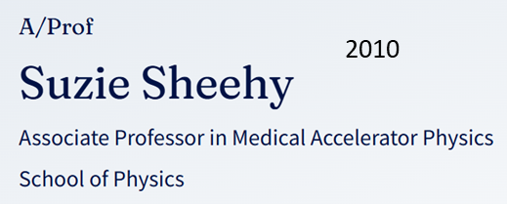

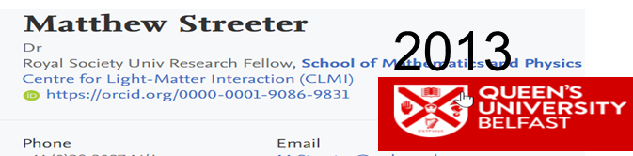


University Faculty
William Shields
Centre for Particle Physics and Astronomy
Lecturer in Accelerator Physics, Department of Physics

Slide 10
Graduate Destinations – Commerce / Industry
Michael Davis UBS
Alex Savin Patent lawyer
Peter Tudor Metaboards Oxford
Alex Lyapin Oxford Quantum Circuits
Talitha Bromwich Wild Business
Rebecca Ramjiawan Luffy AI
Gavin Cheung Sports analyst
Theodorus Christodoulou Lab4Crypto (startup)
Gian Luigi D’Alessandro Unakin (AI startup)
Dan Harryman Tokamak Energy
Carlo Mussolini Fractile (startup)
Alexander von Boetticher Cogram (AI starup)
Muhammad Kasim Living Optics (startup)
Aimee Ross ASML
Cary Colgan Tokamak Energy
Jan-Nicolas Gruse D-Fine
Jan Paszkiewicz Infleqtion UK
Kristian Poeder Mu-ray.tech

Slide 11
Graduate Accelerator Physics Course Term I October-December 2025
Lectures (24)
Types of Accelerators*
Applications of Accelerators*
Live Connection – LHC Control Centre*
Transverse Optics (2)
Longitudinal Dynamics
Momentum Effects
Lattice Design
Hamiltonian Dynamics (2)
Beams & Imperfections
Basic Plasma Physics Concepts for Plasma Accelerators
Plasma-based Electron Acceleration
Plasma-based Ion Acceleration
RF Cavities (4)
Beam Diagnostics & Instrumentation
Synchrotron Radiation
Wigglers & Undulators
Radiation Damping & Excitation (2)
Parameters for Muon Collider RCS Student Project
Exercise Classes (6)
Introduction to Accelerators*
Transverse Dynamics
Longitudinal Dynamics
RF Cavities
Hamiltonian Dynamics
Synchrotron Radiation
* Combined Particle Physics & Accelerator Physics cohort
Course carried out in hybrid format
(in person & Zoom)
Visit to Diamond Light Source (or ISIS)
at the beginning of academic year

Slide 12
Graduate Accelerator Physics Course Term II January-March 2026
Lectures (22)
Magnet Design (2)
Non-linear Dynamics (2)
Beam-beam Effects
Space Charge Tune Shift
Injection, Beam Transport and Extraction
Linear Colliders (4)
Instabilities (2)
Beamlines for Fixed-target Experiments
Cyclotrons for Various Applications
Particle Sources
Free Electron Lasers
Vacuum and Surface Science
Accelerator Science & Particle Therapy
Introduction to Radiobiology & its Applications to Accelerator Science
Particle Accelerator Sustainability
Commercialisation of Accelerator Technologies
Exercise Classes (2)
Magnet Design
Introduction to Muon Collider RCS Student Project
Tutorials (6)
Muon Collider RCS Student Project
JAI Seminar (1)
Muon Collider RCS Student Project
Course carried out in hybrid format
(in person & Zoom)

Slide 13
Graduate Accelerator Physics Course 2025-2026
Number of Students
University of Oxford
JAI Accelerator Physics (2)
Atomic & Laser Physics (Plasma Physics, 1)
Particle Physics* (10) - Only first three lectures, first tutorial & DLS visit in Term I
Royal Holloway, University of London (1)
Imperial College London (2)
One UCL student audited lectures

Slide 14

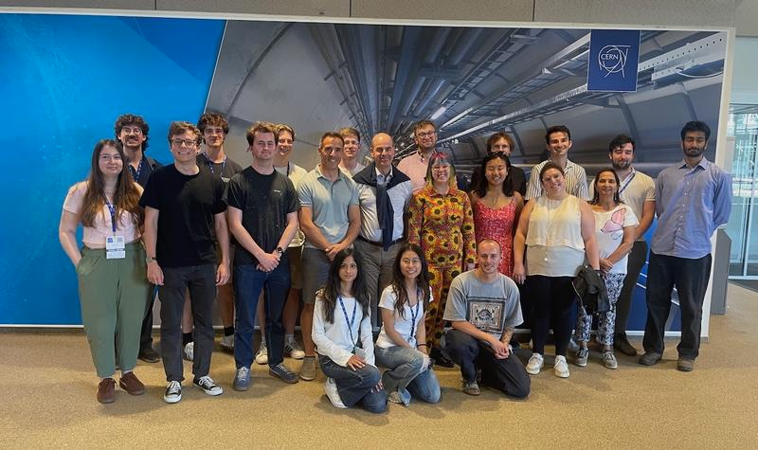
Accelerator Design Project
Accelerator Design Study for
FCC-ee Positron Damping Ring: 2022-2023
LhARA Stage I: 2023-2024
HALHF: 2024-2025
Design work consisted of study of the lattice, magnet systems and RF cavities.
“The design project significantly contributes to the value of a PhD at the JAI and is a very effective learning tool ... it played an essential role in helping me to find a postdoc.”
“To me, the design project was by far the best part of the course. It puts the material taught into context and bridges the gap between lectures ... and a DPhil project ... .”
2024-2025: HALHF Design Report to be published on CDS
and students delivered JAI Seminar (March 2025) and visit to CERN (July 2025)
2025-2026: Muon Collider RCS Design Report to be published on CDS and students delivered JAI Seminar on 12 March 2026; Visit to CERN planned for 3 July 2026

Slide 15
Consolidated Accelerator Course
Graduate lecture course includes plasma research training.
Lectures provided by ICL, as part of development of integrated accelerator-laser-plasma training,
Training in ‘Centre for Postgraduate Training in Plasma Physics & High Energy Density Science’ – established in 2014 by ICL, Oxford, and Warwick.
Plasma-related lecture courses also provided in Oxford.
Graduate students take additional courses in related subjects – statistics, EM, safety, particle physics and astrophysics.
Universities offer courses on transferable skills – Research Management, Critical Thinking, Personal Effectiveness, Research Skills & Techniques, Written & Oral Communication, Team Working, Career Development, Entrepreneurship, Ethics, and Advanced IT.
Lecturers & Instructors
J. Bauche (CERN), M. Dosanjh (Oxford), M. Fraser (CERN), H. Garcia-Morales (CERN/Oxford), A. Gerbershagen (Groningen/Oxford), D. Kelliher (RAL), B. Kyle (RAL), S. Mangles (ICL), I. Martin (Diamond/Oxford), Z. Najmudin (ICL), S. Patel (RAL), C. Plostinar (ESS), D. Posthuma de Boer (RAL), M. Schippers (PSI), P. Tait (Oxford), O. Tarvainen (RAL), F. Tecker (CERN), E. Tsesmelis (CERN/Oxford), H. Wakeling (Oxford), Rob Williamson (RAL)
Lecturers / instructors from JAI universities and from external institutes – CERN, Uni. Groningen, DIAMOND, ESS, PSI, RAL.

Slide 16
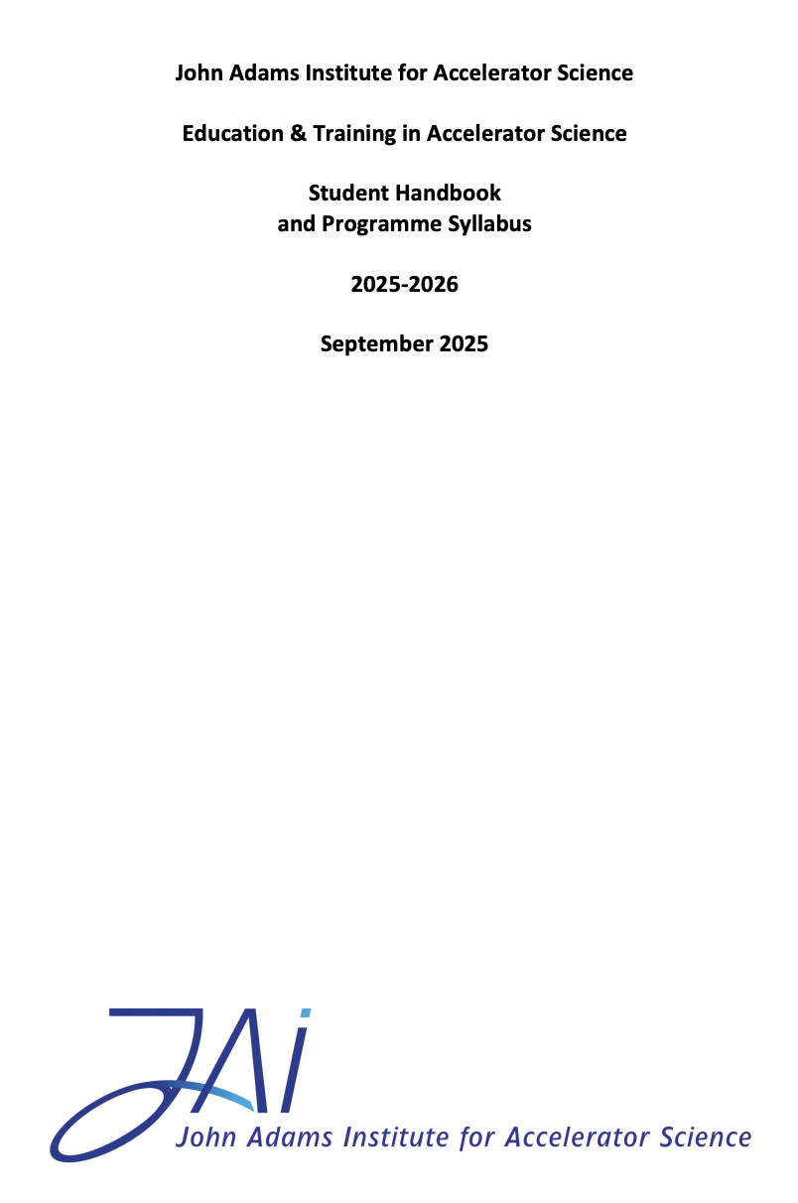
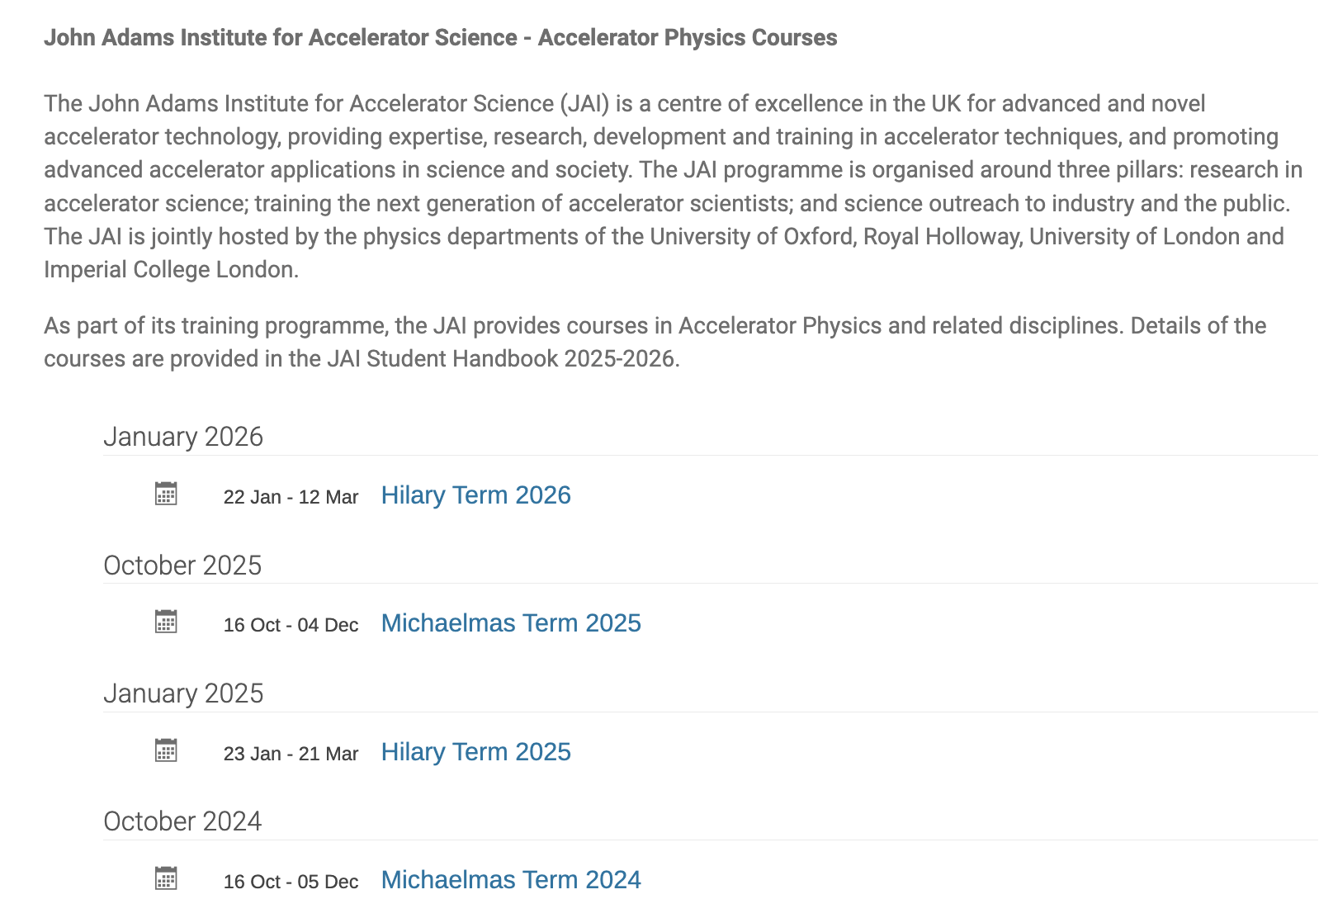
JAI Student Resources
Student Handbook provides information to the students of the training programme in accelerator science at JAI.
Syllabus & course content, course resources, assessment, evaluation, recommended textbooks.
Supplementary information (public engagement, lecture series, summer student programme etc.)
Dedicated site on INDICO
https://indico.cern.ch/category/5869/
Timetable, slides / documents, Zoom connection

Slide 17
Graduate Student Funding
JAI is included in STFC quota PhD studentships scheme
Prior to 2026, JAI received three studentships per year (exceptionally four in 2024).
For 2026, this has been reduced to two studentships.
This leverages additional funding sources allowing JAI to recruit a few additional PhD students / year.
Various funding sources include most recently JAI universities + grant, the Royal Society, EPSRC Industrial CASE & Centres for Doctoral Training, the CERN Doctoral Student programme, ISIS, Diamond Light Source, the Ada Lovelace Centre, and the Central Laser Facility.
Successful in collaborating with external universities through cooperation agreements, such as University of Oxford with Humboldt University, Berlin, whose students have attended the JAI course, and other non-UK sources. Discussing with Humboldt University to re-launch collaboration.
Continue to explore wide range of possibilities for sustainable funding.

Slide 18
JAI / CERN Doctoral Students
2010:
Alex Gerbershagen
2012:
Davide Gamba
Jack Roberts
2015:
Swann Levasseur
2016:
Chetan Gohil
Pierre Korysko
Jan Paszkiewicz
2017:
Eugenio Senes
2018:
Gian Luigi D'Alessandro
Luke Dyks
2019:
Daniele Butti
Helene Guerin
Carlo Mussolini
2020:
Robert Murphy
Pablo Arutia Sota
Rebecca Taylor
2021:
Florian Stummer
2022:
Sasha Horney
Emily Howling
Vlad Musat
Jack Salvesen
2024:
Lewis Kennedy
Giusy Passarelli
2026:
Federica Murgia
24 Doctoral
Students

Slide 19
New Graduate Students 2026-2027 Academic Year
Oxford
Federica Murgia: Beam physics models for CERN accelerator complex (P. Burrows); CERN Doctoral Studentship + JAI Grant + Physics Dept. funding
Robert Simpson: Intense hadron beams (A. Oeftiger); ISIS + GSI + Particle Physics funding
Markus Soerqvist: Beam-driven WFA (R. D’Arcy); STFC + EU + Particle Physics funding
ICL
N.N.
RHUL
Recruiting to one studentship; 2/3 STFC funding.
Process for graduate student selection on-going at JAI universities
Matching funding and international fee waivers to support non-UK applicants for CERN Doctoral posts are increasingly difficult to obtain from UK universities.

Slide 20
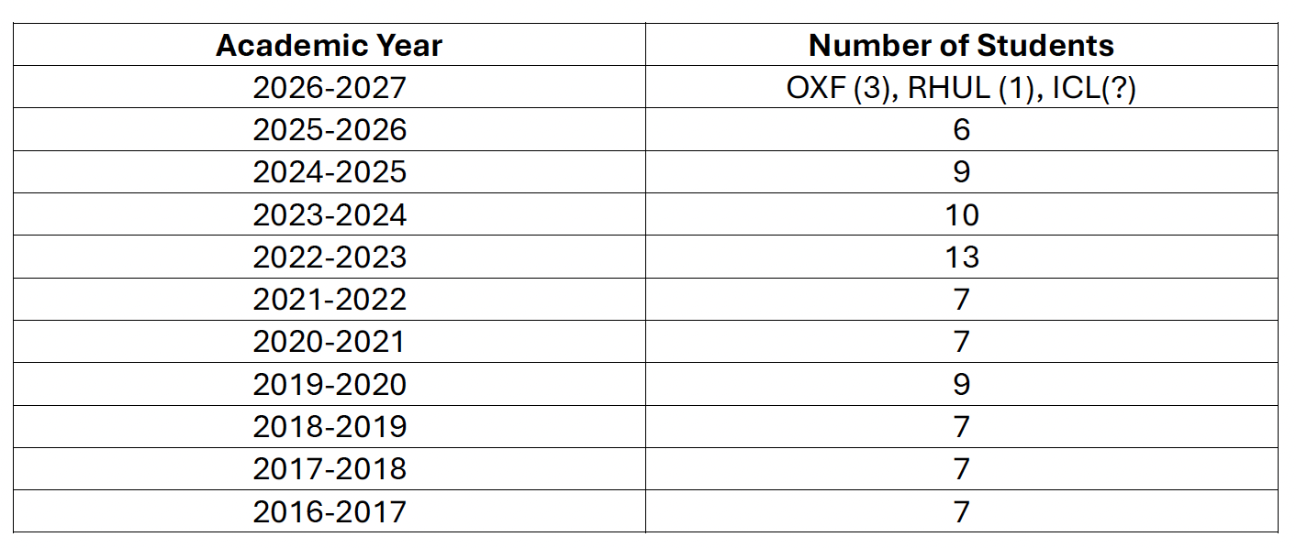
Number of JAI Incoming 1st-Year Graduate Students
Students that have completed the full first-year graduate course (including the student design project)
2022-2023 & 2023-2024 were exceptional years due to successful funding from sources beyond STFC quota.

Slide 21
Undergraduate Accelerator Physics Courses
RHUL
Short option course (12hr) for 3rd year students.
Annual intercollegiate course for 4th year MSc students from the University of London and as well as BSc/MSc project students.
University of Oxford
Undergraduate course was revised and becomes available as of 2025-2026 academic year.
‘Short option’ in Year 3, consisting of 12 lectures (6 detectors and 6 accelerators).
4th year undergraduate projects undertaken annually (e.g. plasma accelerators, medical accelerators).
Expect programmes to attract undergraduate students to accelerator science.

Slide 22
Undergraduate Accelerator Physics Summer Student Internships
Oxford University
Internship Programme (CERN in July/August annually; around 25 students have joined programme since its launch in 2014).
Two students to join CLEAR accelerator project supervised by Oxford faculty & graduate students in 2026.
Participate in CERN Summer Student lecture series & in accelerator project.
Sub-department of Particle Physics Internship Programme
Imperial College
Around 4 students appointed annually.
Spend 8 weeks working at Imperial College & RAL.
RHUL
Around 2 students appointed annually.
Carry out research work at RHUL.
Expect programmes to attract undergraduate students to accelerator science.

Slide 23
UK Accelerator Institutes Seminar Series
JAI, together with ASTeC and the Cockcroft Institute, organise jointly the UK Accelerator Institutes Seminar Series https://indico.cern.ch/category/13863/
Delivered by distinguished speakers from the participating institutes and from laboratories / universities world-wide.
Seminars held in person and via videoconference and scheduled so that the graduate student body can attend.
Latest Session in January – March 2026
Title | Speaker
Muon Collider Progress and Plans | Daniel Schulte (CERN)
British Cryogenic Council Prize Talk – From Bulk Niobium to Thin Films: Advancing SRF with High Throughput Cryogenic RF Characterisation | Daniel Seal (Lancaster University)
LUXE: A New Experiment to Study Non-perturbative QED and Searcg for New Particles in Electron-Laser and Photon-Laser Collisions | Mathew Wing (UCL and DESY)
Upgrade of the CMS Experiments for HL-LHC | Anne Dabrowski (CERN)
A 100 Hz, 10 TW Laser Facility at QUB for Fundamental Science and Applications | Gianluca Sarri (Queen’s University Belfast)

Slide 24
External Training Commitments (Abridged)
JAI academic staff invited to provide training & to contribute to various international forums:
EU Integrating Activity Projects on Training, Communications & Outreach in Accelerators – TIARA 2011-2014, ARIES 2017-2021, I.FAST 2021-2025 (P. Burrows serves as WP Leader). Will coordinate new European panel on education & training in accelerator science – EPITA.
TIARA - Chair of Task Force on Training in Accelerator Science for Europe (P. Burrows).
CERN Accelerator School CAS (various JAI faculty and staff, P. Burrows serves on CAS AB).
Joint Universities Accelerator School (JAI is partner institute, P. Burrows serves on JUAS AB).
US Particle Accelerator School (USPAS, various JAI faculty and staff).
Cockcroft Institute graduate accelerator physics course (S. Gibson).
University of London intercollegiate undergraduate & graduate accelerator physics courses (S. Gibson, P. Karataev).
University of Melbourne Medical Accelerator Physics Programme (S. Sheehy).
Nanyang Technological University undergraduate lectures on accelerator physics (E. Tsesmelis).
Culham Summer School on Plasma Physics - Laser Wakefield Accelerators (S. Mangles)
EuPRAXIA-DN School on Plasma Accelerators, Introduction to Plasma Diagnostics, (Z. Najmudin)
Winter School on Intense Laser Science WiSILS 2024), Indian Institute of Technology (Z. Najmudin)
Public IOP Evening Lecture on Sustainable Accelerators (H. Wakeling)
Public lecture on STELLA at the Pontifical Academy of Sciences in Vatican (M. Dosanjh)

Slide 25
Future Programme - Training
Proposal & plan for the future education & training programme at JAI:
Continue to deliver an outstanding training programme both within JAI and via our contributions to CAS, JUAS and other schools.
Consolidate, strengthen and augment our programme by:
further integrating lectures and seminars across our three universities;
augmenting focus on sustainability in accelerator design and construction;
strengthening focus on commercialisation and impact;
linking to dedicated training in AI/ML techniques provided via our universities.
Continue to promote a pipeline of graduate students via our undergraduate portfolio of courses, summer internship programmes and research projects.
Aim to strengthen our collaboration on training with the CI on advanced topics and to continue support of the UK Accelerator Institutes Seminar Series.
Continue to support student participation in relevant specialised external training courses (e.g. Advanced CAS) and presentation of their research work at international conferences and workshops.

Slide 26
Public engagement

Slide 27
Introduction
JAI continues to develop its high-profile, in-person public engagement in post-Covid environment.
Covid pandemic devastated in-person events, throwing them into online events.
In-person events have reached pre-pandemic levels.

Slide 28
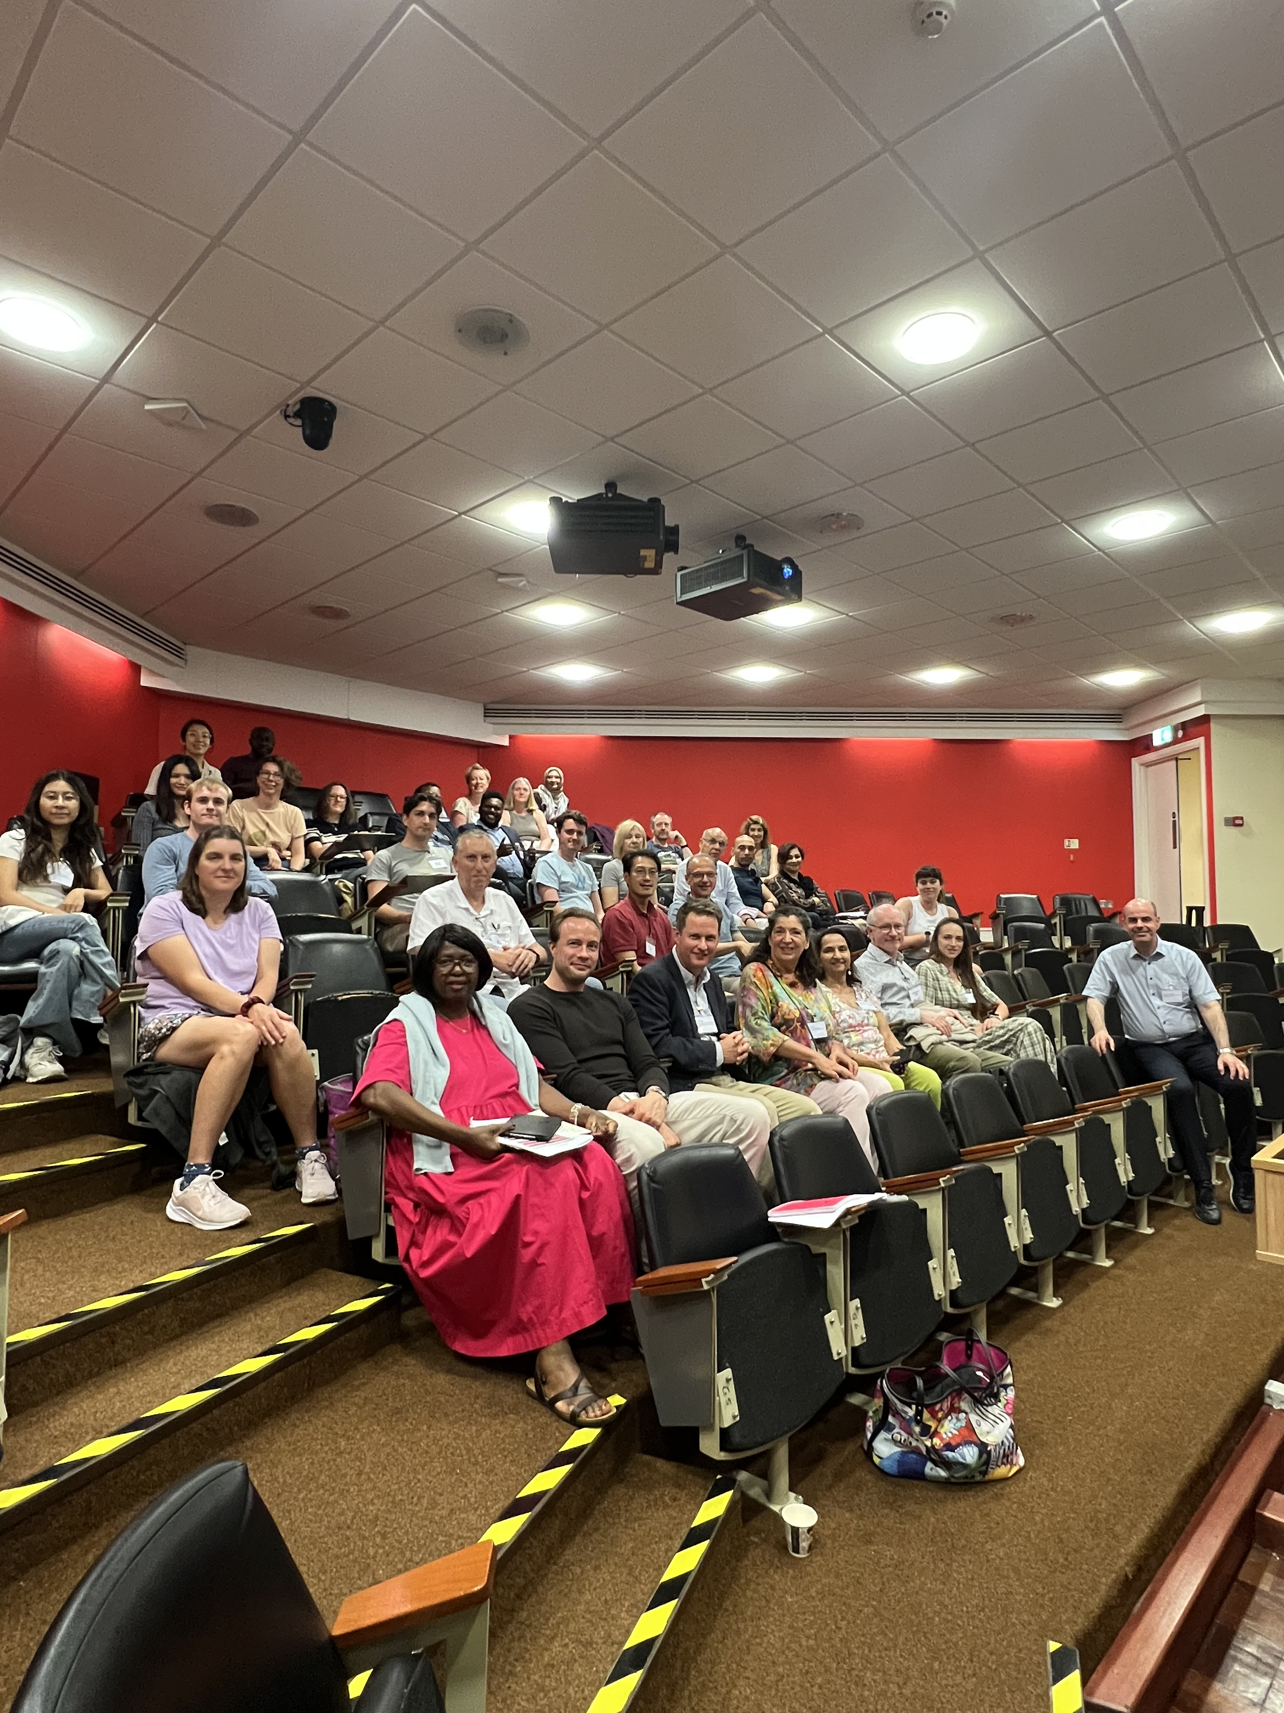

Public Engagement & Schools
Accelerator and Particle Physics Education at A-Level (APPEAL)
Regular training since 2010
APPEAL-11 2025: Accelerators for Particle Therapy in Medicine
Outreach in Schools
‘Particle Accelerators: from Higgs Bosons to Curing Cancer’ for Visiting Students from China & at University of the Third Age (P. Burrows; 1200 attended).
‘Einstein’s Universe’ at Marlborough College (B. Foster; 300 attended)
APPEAL-11 in 2025 at Oxford
Consisted of lectures and MasterClass

Slide 29
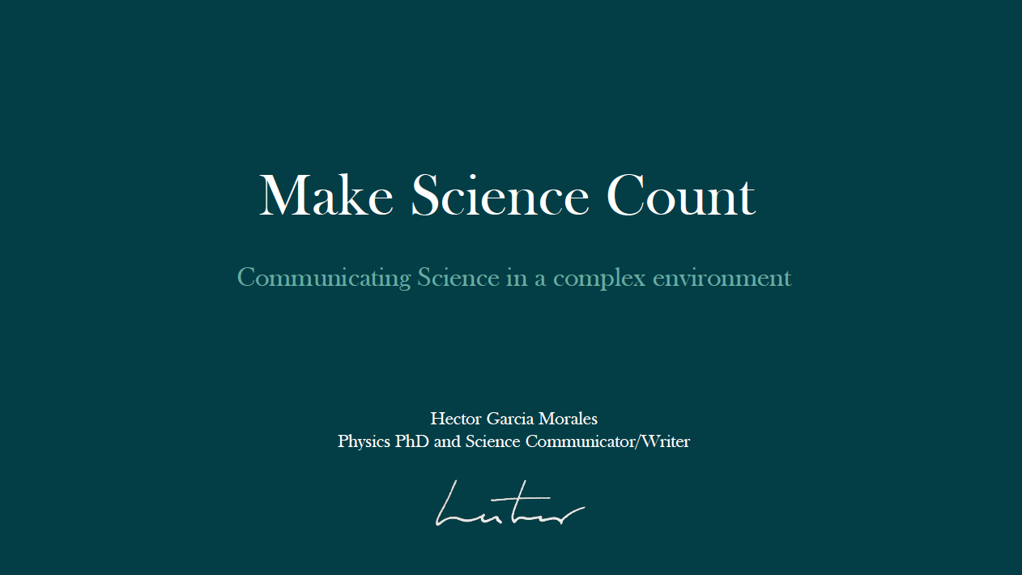
Public Engagement & Students
Science Communication Lectures & Workshops for JAI DPhil Students
Underlined the importance of:
Communication skills are essential.
Use of Elements of Storytelling.
Engage with different audiences.
Writing is special.
Trust, ethics and uncertainty in scientific narratives.
Pilot initiative by Suzie Sheehy & Hector Garcia Morales
Next session planned for July 2026 at CERN

Slide 30

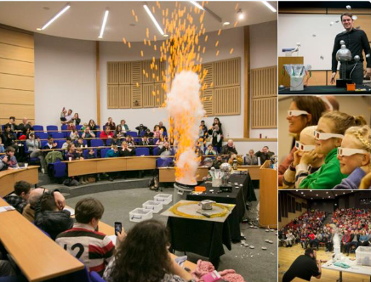
Public Engagement & The Big Bang Experience!
Brief history and future of the LHC revealing wonders of the LHC at CERN and how it is unravelling mysteries of the universe.
Big Bang Experience at British Science Week (March 2025)
S. Gibson (RHUL)

Slide 31

Public Engagement & Literature
Einstein: A Life in Science and Music by Brian Foster
Comprehensive survey of Einstein's contributions to physics.

Slide 32
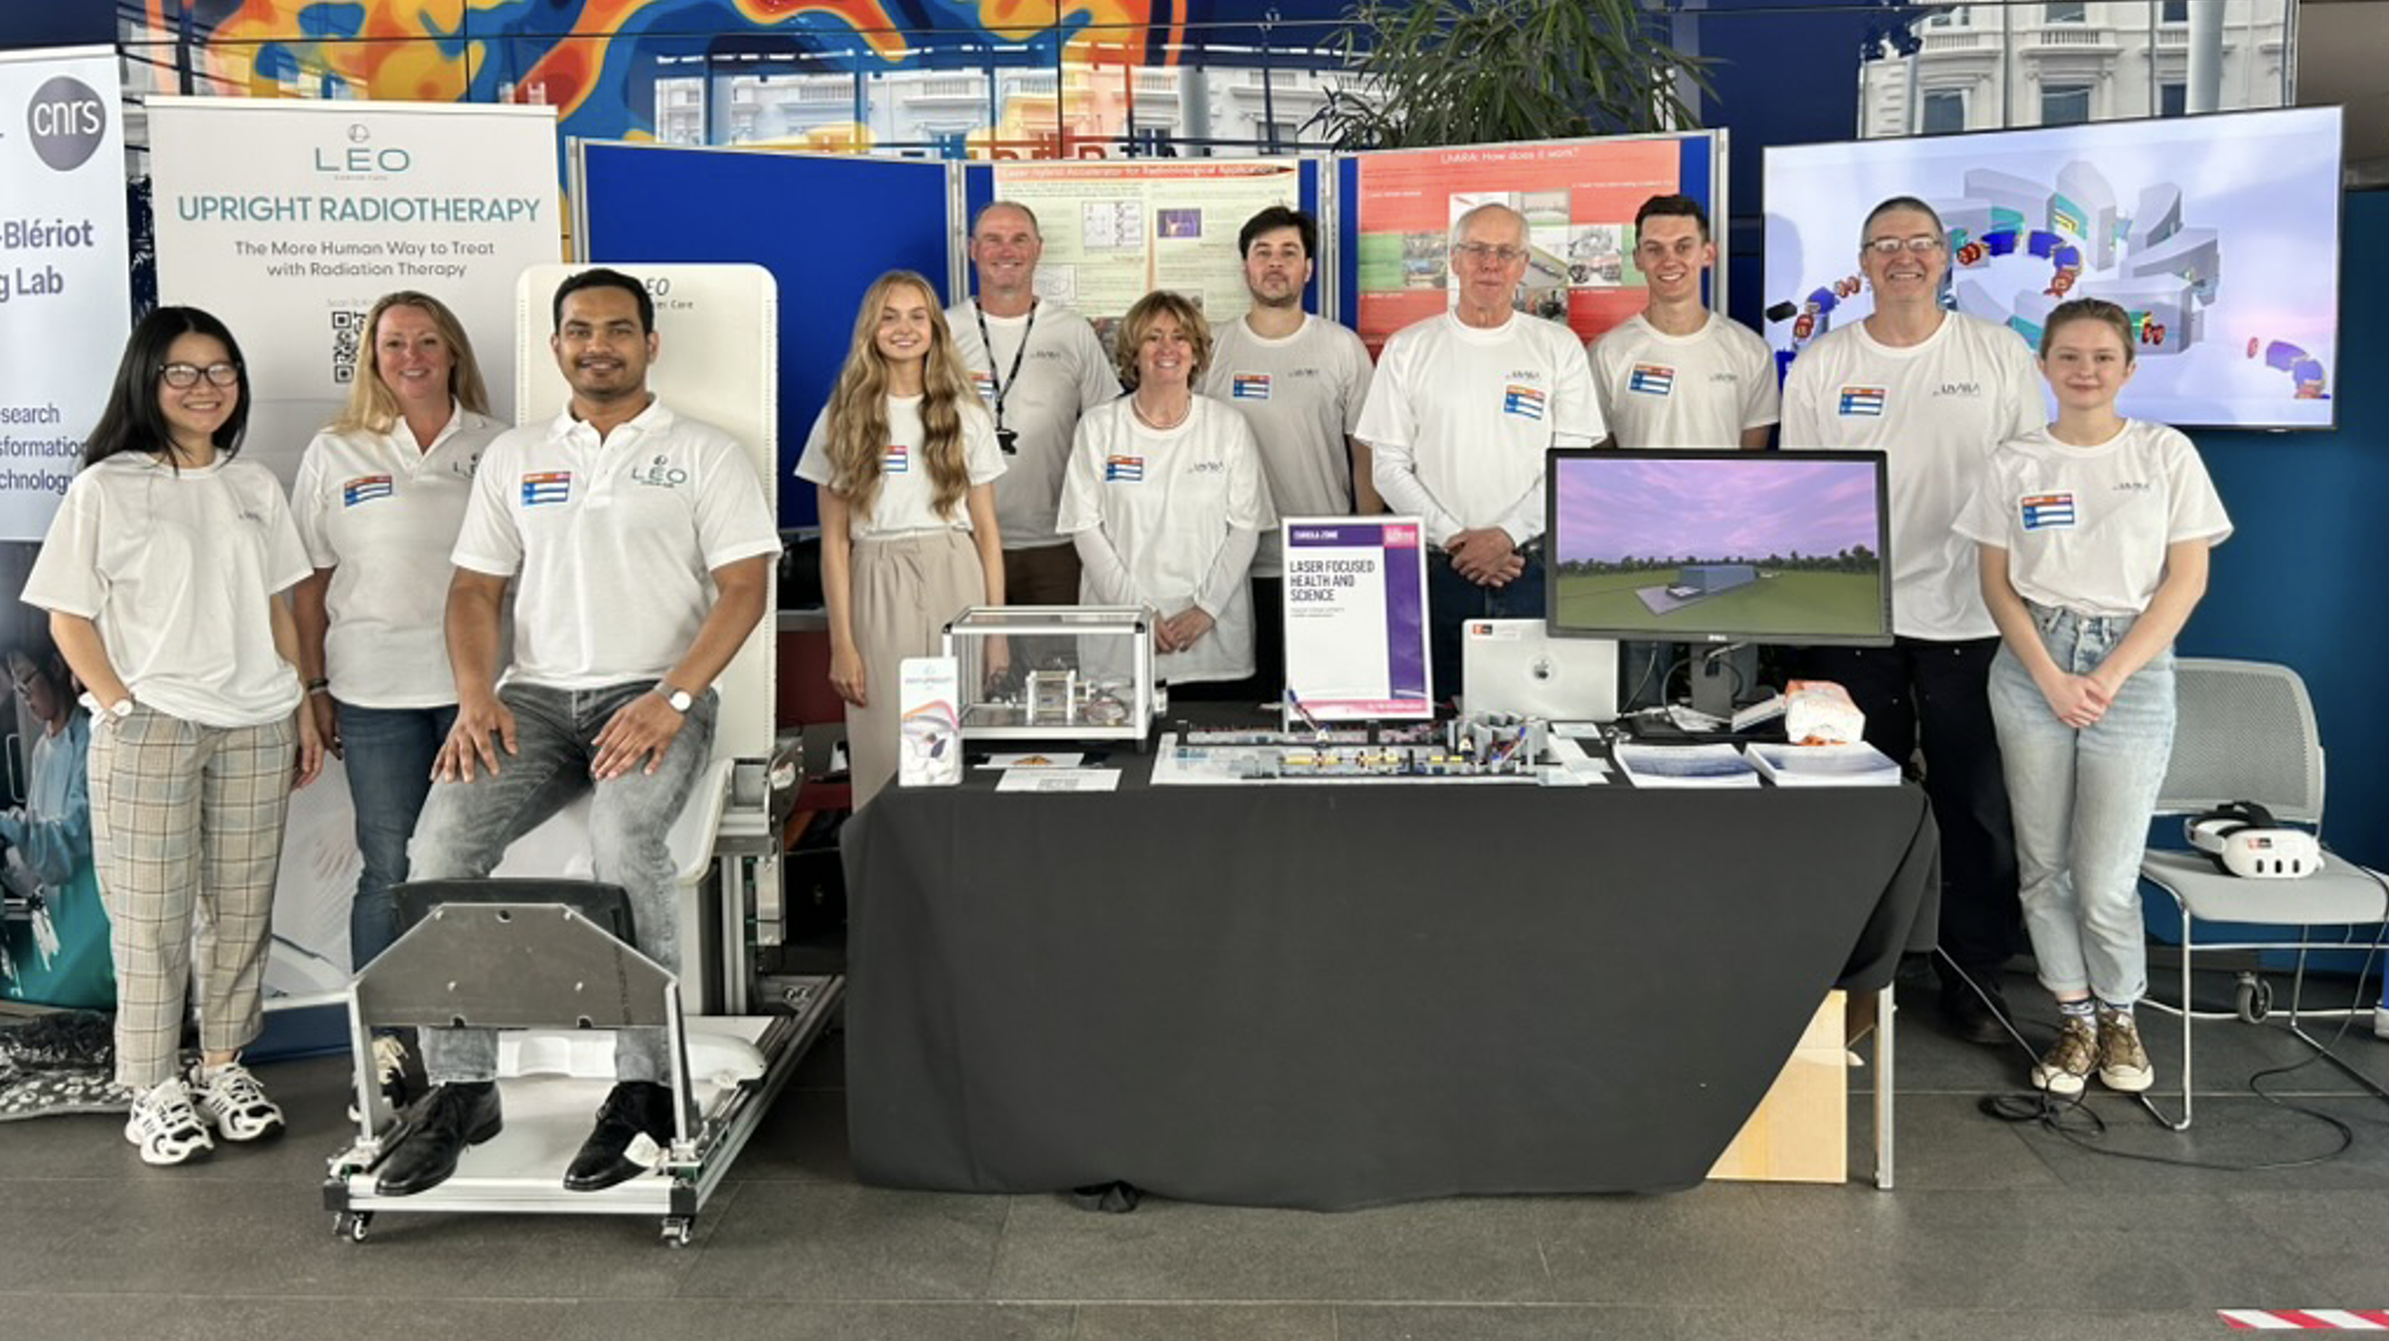

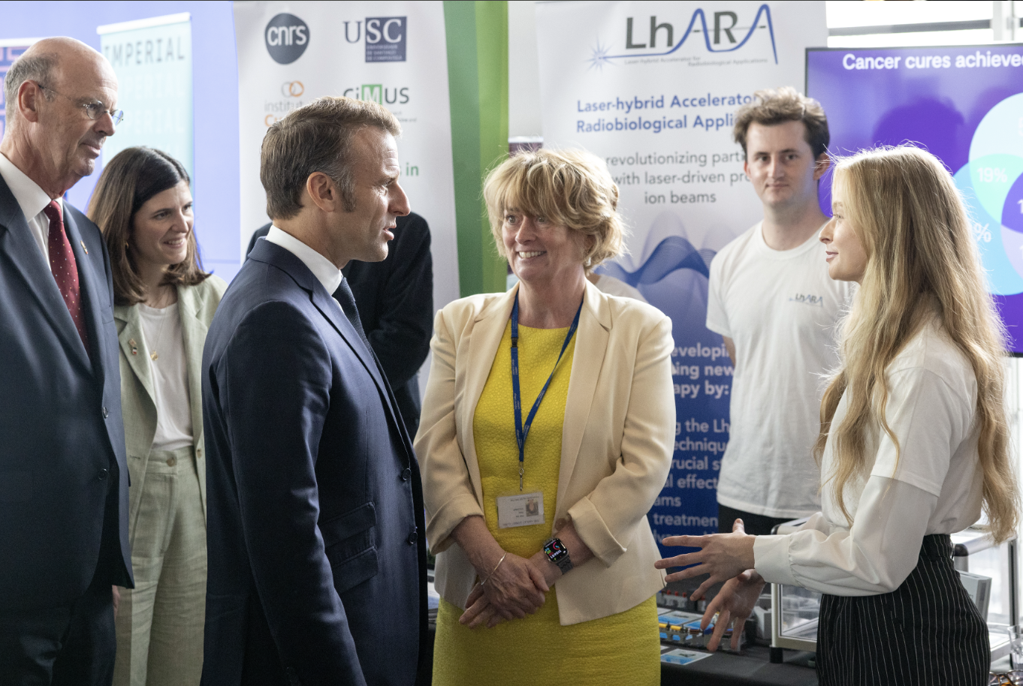


Public Engagement & Festivals
Great Exhibition Road Festival (June 2025)
Hugely successful event
700+ visitors over 2 days
Imperial-CNRS event
Visit by French President Emmanuel Macron
LhARA will exhibit at the Royal Society, June/July 2026
8-9 June 2025 at Imperial
May 2025 (16th season) – B. Foster
4-day event with attendance of around 900.
9 July 2025 at Imperial
32

Slide 33
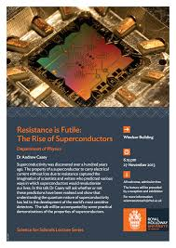
Public Engagement & Festivals
Resistance is Futile: The Rise of Superconductors (Including Accelerators)
Recurring, popular live physics demonstration and lecture topic, covering the fundamental properties of superconductors and showcases their "rise" from scientific curiosities to critical technological components.
At British Science Week and at RHUL Science Festival (S. Gibson and A. Casey, March 2026)

Slide 34

Public Engagement & International Forums
Accelerator Engagement Ambassadors Initiative (IUPAP WG14)
The Accelerator Engagement Ambassadors Initiative invites passionate early- and mid-career researchers to help bring the world of particle accelerators closer to society.
The programme empowers volunteer ambassadors to design and deliver creative public-facing activities that highlight the impact of accelerator science.
Hannah Wakeling & Suzie Sheehy
are involved in this initiative
Created LinkedIn community for those
interested in public engagement around
accelerators.

Slide 35
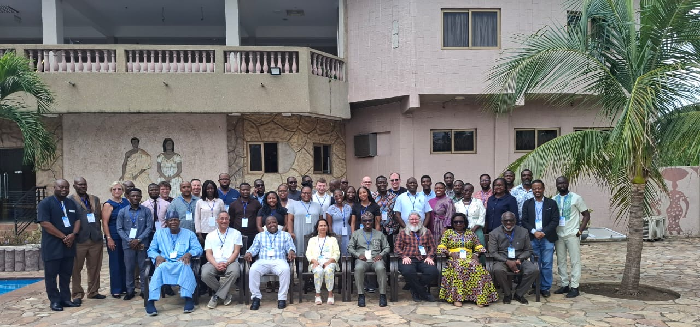
Public Engagement & Medicine
SAPPHIRE Accelerator Training Workshop in Accra,13-16 April 2026

Slide 36
Proposal and Plan for Future
JAI continues to be leader in communicating accelerators & associated physics.
Activities for future include:
Training days for teachers (APPEAL – Accelerator and Particle Physics at A-Level) for science teachers.
Long-standing schools programmes – ‘Particle Accelerators: from Higgs Bosons to Curing Cancer’, ‘Einstein’s Universe’ and ‘Big Bang Experience’.
High-profile collaborative public engagement attracting new audience to science – Resistance is Futile, Accelerator Engagement Ambassadors Initiative

Slide 37
Summary
JAI continues to deliver world-class accelerator science education & training and public engagement programmes.
Intense accelerator physics course.
Innovative and educational accelerator design projects.
Successful placement of students once they enter professional careers.
Recognised and award-winning public engagement activities with global reach - continue strengthening existing portfolio and encourage new & innovative ideas.

