Slide 1
Commercialisation & Impact
Dr Phillip Tait
Innovation & Enterprise Manager
Department of Physics, Oxford
16th April 2026

Slide 2
Contents
Strategy
JAI approach to Commercialisation
Highlight Projects
Frequency Scanning Interferometry
Novel accelerator based cancer therapy systems
Composite Beampipe
Precision cavity beam position monitors
Beam Delivery Simulation
Other
Spinouts
Student training
LinkedIn
Feedback

Slide 3
Contents
Strategy
JAI approach to Commercialisation
Projects
Frequency Scanning Interferometry
Novel accelerator based cancer therapy systems
Composite Beampipe
Precision cavity beam position monitors
Beam Delivery Simulation
Other
Spinouts
Student training
LinkedIn
Feedback

Slide 4
Strategy
The John Adams Institute for Accelerator Science is a centre of excellence in the UK for advanced and novel accelerator technology. The Institute provides expertise and training in accelerator techniques, participates in research and development, and promotes advanced accelerator applications in science and society at large.
Seeking applications of accelerators in industry – developing new technology – engaging with industry / users when relevant
No direct funding for commercialisation activity in JAI budget.
JAI staff encouraged to apply to STFC funds inc:
STFC Impact Acceleration Account £50k p.a. to each university (On Hold)
STFC’s Early Stage R&D (TRL 1-5) (On Hold since 2024)
STFC CASE – industry studentship funding (On hold since 2023).
STFC Proof of Concept (TRL 5-7)
Notes:
Seeking applications in industry – developing new technology – engaging with industry / users when relevant
No direct funding for commercialisation – resources are available at each university – I support those people in the in my dept who are in JAI
To understand commercial potential and develop tech toward commercial application – apply for additional funding from STFC – we get £50k p.a IAA – very helpful
EPSRC is £5M for 3yrs

Slide 5
Contents
Strategy
JAI approach to Commercialisation
Projects
Frequency Scanning Interferometry
Novel accelerator based cancer therapy systems
Composite Beampipe
Precision cavity beam position monitors
Beam Delivery Simulation
Other
Spinouts
Student training
LinkedIn
Feedback

Slide 6
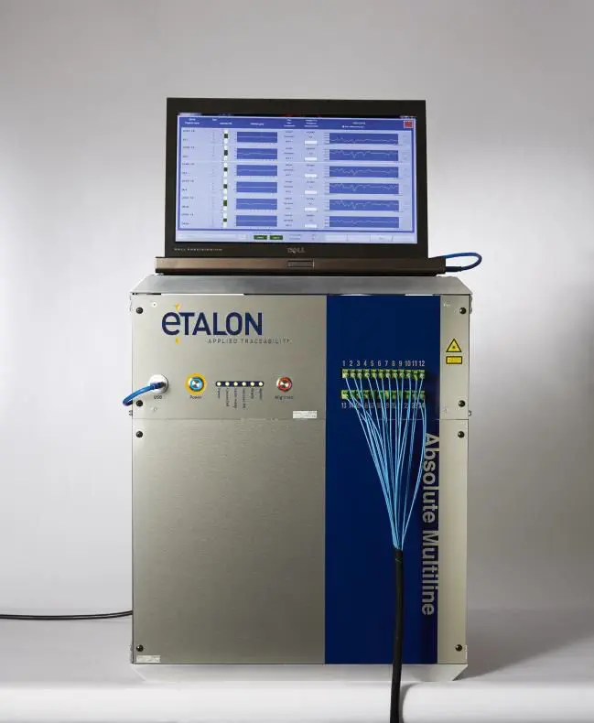

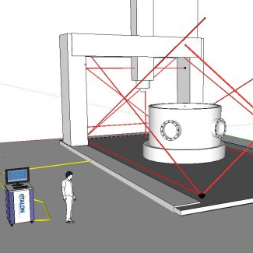
Projects - Frequency Scanning Interferometry
Developed and patented frequency scanning (FSI) and phase modulation interferometry (PaMIr). Initially for ATLAS detector and ILC.
Companies use Absolute Multiline for improved machining – knowing where all your machine tools are 0.5 µm per meter uncertainty.
Commercialised through collaboration with Etalon, who licence, make and sell the Absolute Multiline product for industrial and scientific applications with sales ~£4M to customers inc. Siemens, General Electric
The data acquisition elements further developed in collaboration with VadaTech UK, who now licence and make the MicroTCA – based DAQ system
Collaboration is ongoing for further improvements (PaMIr)
Also deployed at national standards laboratories (NPL, PTB, le cnam, INRiM), helping organisations around the world by improved calibration.
Absolute Multiline

Slide 7
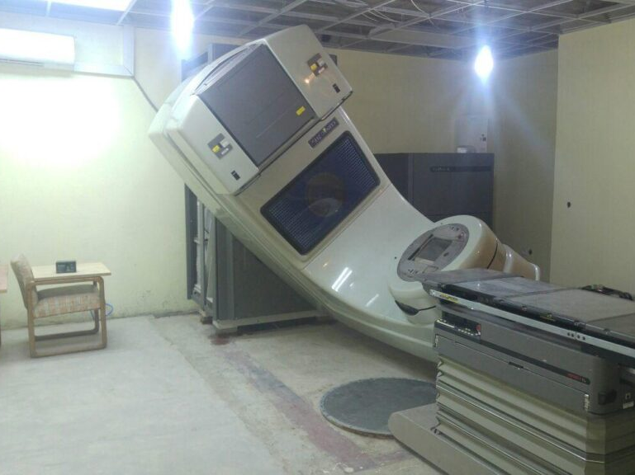
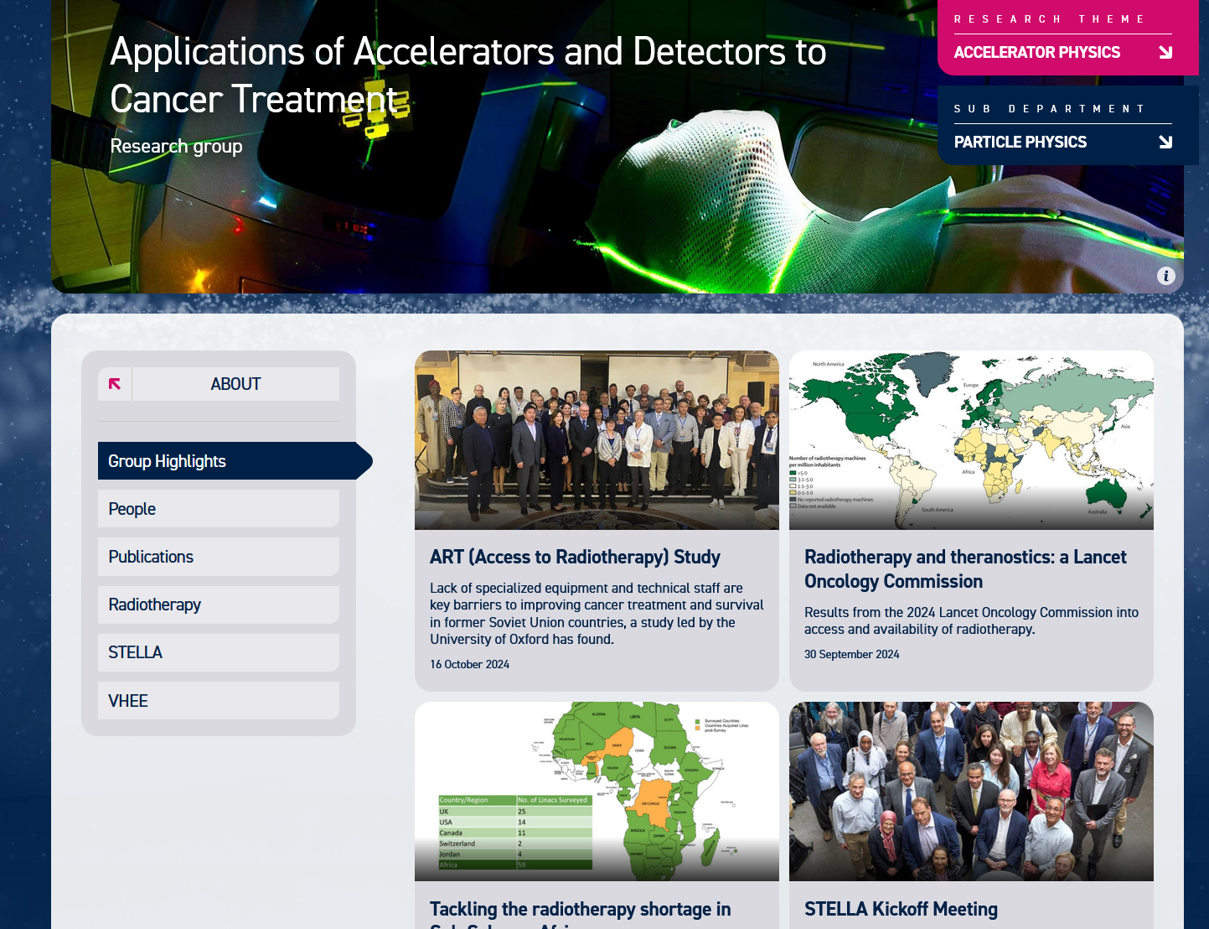
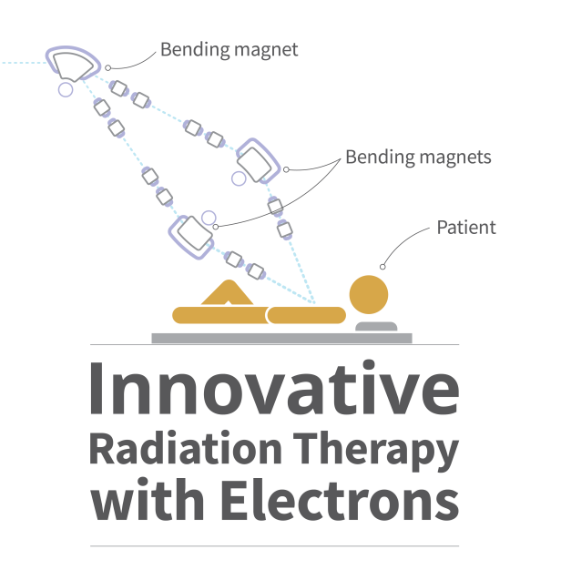
Projects - Novel accelerator based cancer therapy systems
STELLA / SAPPHIRE
Collaboration with Exeter, Cambridge and Oxford Hospitals
Designing and prototyping fault-resilient multileaf collimators (MLCs)
Early fault prediction in Linac
VHEE
Collaboration with CERN and Lausanne Hospital
Beam Dosimetry
Dose delivery
First Radiotherapy linac in Cameroon
Notes:
Foucus on the IP commercialisation activity potential

Slide 8
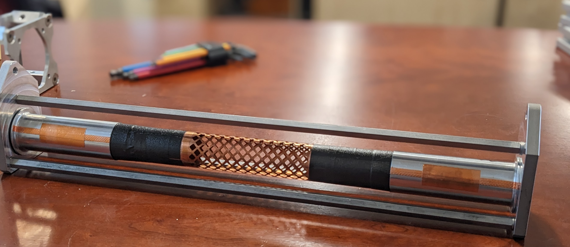

Projects – Composite Beampipe & RF Shield
Originated from work on ultra-lightweight tracking detector structures for the LHCb Upgrade
Developed novel composite while tackling outgassing and geometric stability
Used STFC IAA fund to develop prototype demonstrators for industry
Led to patent application and then a licensing deal with local company Brick Kiln Composites and also consulting contract for lead engineer
Applications / customers tbc

Slide 9
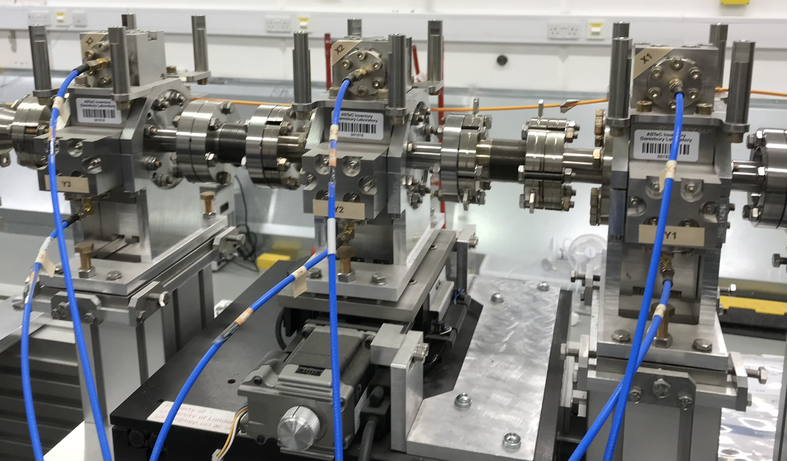
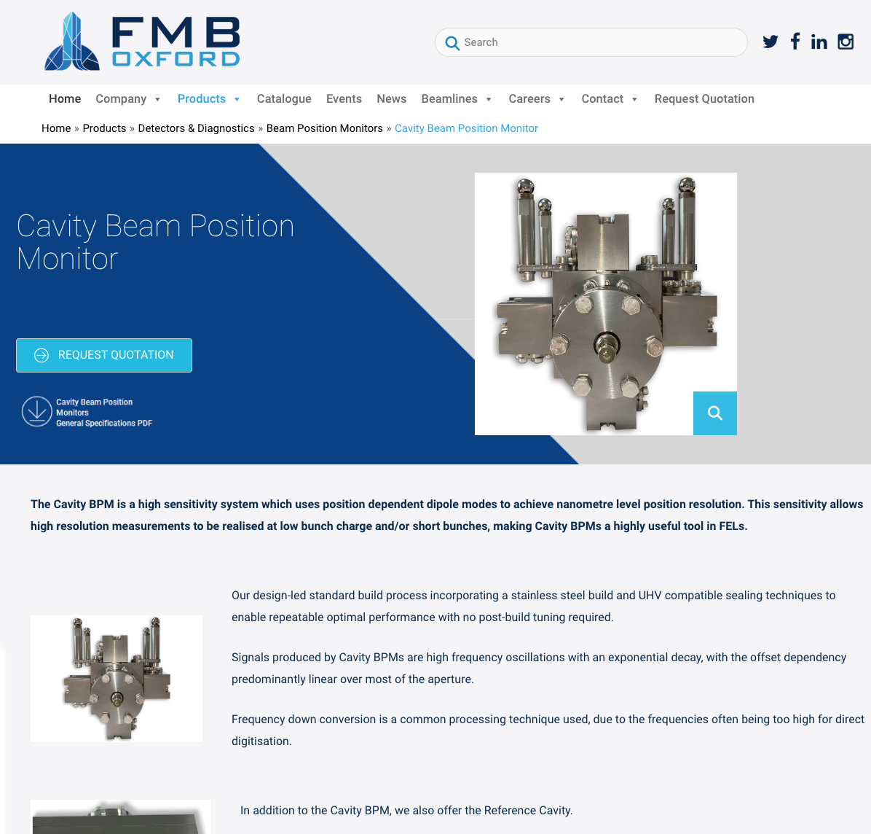


Projects - Cavity Beam Position Monitors for FELs
Cavity BPMs originally developed for linear colliders, now designed for FELs.
Sensitivity allows high resolution measurements to be realised at low bunch charge and/or short bunches
Offer complete off-the-shelf system in partnerships with XDS-Oxford (FMB-Oxford) and iTech. Deployed at ELI-BL
Looking for further potential partners and new applications
Not widely taken up
Lead researcher moved to quantum computing industry
CBPM triplet at CLARA, Daresbury Laboratory

Slide 10


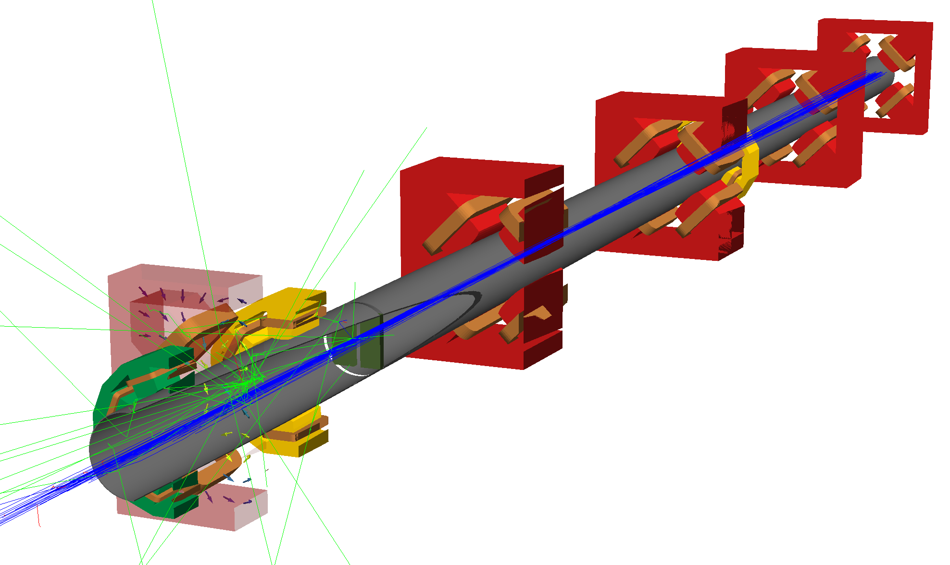









Projects - Beam Delivery Simulation
BDSIM program simulates movement of particles in a particle accelerator – create a computation model (Geant4)
Growing worldwide adoption, applied to many machines & experiments: CERN, CLIC, XFEL, Diamond, LhARA, PSI …
Applications of BDSIM: Detector backgrounds, Beam transport in vacuum/air/gas, Beamline design, Collimation system efficiency, Secondary radiation transport, Beam losses and energy deposition, Laserwire diagnostics, Shielding activation, Beam shaping, Permanent magnet degradation, and many more …..
Attempts to encourage commercial application is ongoing – medical citations growing quickly
Notes:
Beam Delivery Simulation (BDSIM) is a program that simulates the passage of particles in a particle accelerator. It uses a suite of standard high energy physics codes (Geant4, ROOT and CLHEP) to create a computation model of a particle accelerator that combines accurate accelerator tracking routines with all of the physics processes of particles in Geant4. This unique combination permits radiation and detector background simulations in accelerators where both accurate tracking of all particles is required over long range or over many revolutions of a circular machine, as well as interaction with the material of the accelerator.

Slide 11
Contents
Strategy
JAI approach to Commercialisation
Projects
Frequency Scanning Interferometry
Novel accelerator based cancer therapy systems
Composite Beampipe
Precision cavity beam position monitors
Beam Delivery Simulation
Other
Spinouts
Student training
LinkedIn
Feedback

Slide 12


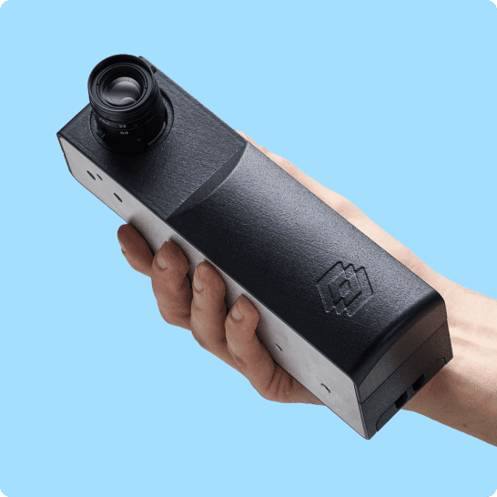
Spinouts
Started with development of a 3D laser spectrometer as a plasma wakefield diagnostic tool
Mach42
Founded by Sam Vinko, Muhamad Kasim, Gianluca Gregori & Brett Larder (2019)
Secured £4.5M. Using ML optimisation, the company aims to cut analogue semiconductor development time in half. Offices in Oxford and USA.
Living Optics
Founded by Robin Wang, Peter Norreys, Muhammad Kasim (2020)
Launched first product – portable hyperspectral camera (VIS-NIR video-rate spectral imaging camera) for applications inc. agriculture, security, healthcare
Raised £20M in series A funding round and moved into new premises to house growing team of 30 employees based in Abingdon and office in Taiwan.
Notes:
A 3D laser spectrometer - the concept was initially developed for plasma wakefield diagnostic tool

Slide 13
University Spinout Policy
Academic Founders of a spinout receive:
80% founding shares in spinout, 20% to the university
Opportunity to convert equity to cash early
Opportunity for Academic Consulting to spinout (30 days+)
Opportunity for Joint Appointment
Royalty returns on IP licensed to spinout
Total net revenue | Researcher(s) | University | Department
Up to £50K | 85.7% | 14.3% | 0%
£50K to £500K | 45% | 30% | 25%
Over £500K | 22.5% | 40% | 37.5%

Slide 14
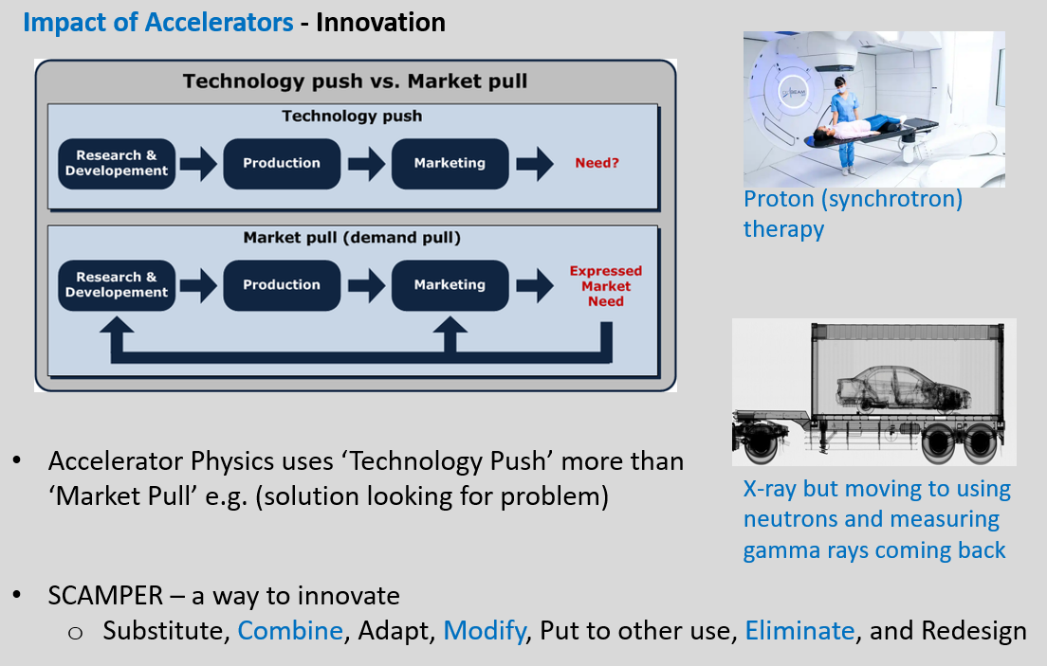
Training Course - Commercialisation of Accelerator Technologies
Recommended by AB members
Lecture delivered by P Tait to 1st yr JAI students (open to any JAI member)
Benefits to Science - Benefits to Society
Impact of Accelerators
Role of Academia to Innovate
Pathways to Commercialisation
Future opportunities / Support
Positive feedback
Acts as introduction - more support available within universities

Slide 15
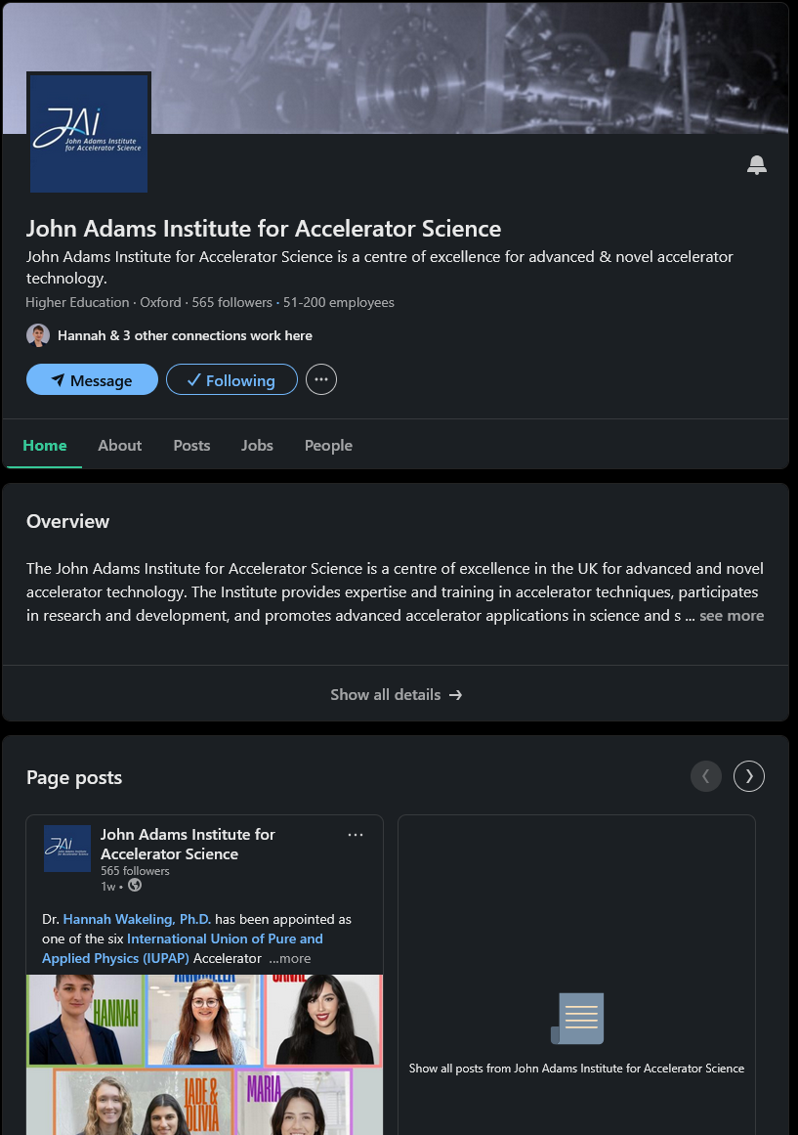
JAI now on LinkedIn
Recommended by AB
Help capture career destinations of JAI students to inform potential Applications and Impact of JAI accelerator research
Raise awareness of the expertise and impact of JAI
Currently managed by P Tait
559 followers with 20k+ impressions in last year
New stories every 2 weeks

Slide 16
Feedback
Advisory Board Comments 2025
Increase commercialisation benefits to academics to incentivise more activity
Continue to raise awareness of commercialisation externally via LinkedIn and internally via student training
STFC Accelerator International Review: Report 2025
Closer involvement with industry on accelerator programme WITH associated funding uplift
Agree with all comments

Slide 17
Questions?

