Slide 1
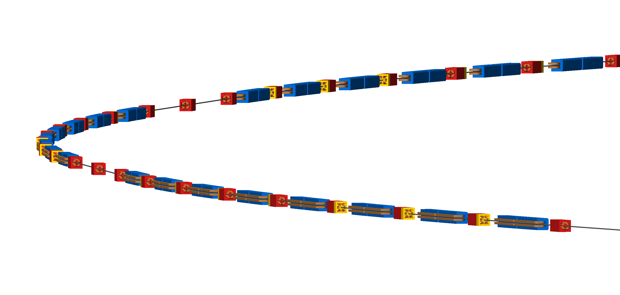



Development of the Rapid Cycling Synchrotron 1 (RCS1) for the Muon Collider
John Adams Institute for Accelerator Science
T. Fernandes de Nobrega
T. Hirt Madden
M. Savage
F. Straniero
G. Weis
A. Yousif
12th March 2026

Slide 2
Overview
Introduction
Lattice
Magnets
RF Cavities
Environmental
and Societal Considerations
Conclusions
2
John Adams Institute | RCS1 Design for Muon Collider | 16/04/2026

Slide 3

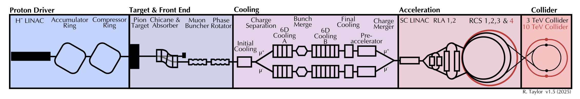
Introduction
Why a Muon Collider?
10TeV CM energy collider with broad physics potential (Higgs coupling, electroweak studies, BSM).
Muon collider ‘best of both worlds’ combining benefits of lepton and hadron colliders.
Higher energy reach and less synchrotron radiation than electron-positron collider.
Point-like collisions at the full centre-of-mass energy with clean initial states.
Key Challenges
Muon beam production is a tertiary process (protons->pions->muons) so need high intensity proton beam
Muon beams require cooling to reduce emittance
Short muon lifetime (2.2μs) means high accelerating gradients are required
RCS1
Source: R. Taylor, MuCOL consolidated parameters report (Oct 2025)
3
John Adams Institute | RCS1 Design for Muon Collider | 16/04/2026

Slide 4
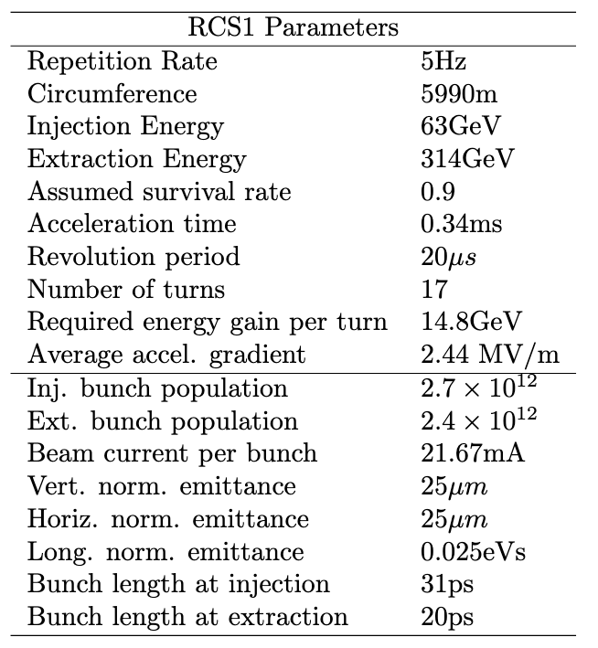
Introduction
Rapid Cycling Synchrotrons
Due to short muon lifetime, muons must be produced, cooled, and accelerated extremely quickly to higher energies where lifetimes are longer due to time dilation.
The current design uses a chain of four ‘Rapid Cycling Synchrotron’ (RCS) rings to rapidly accelerate the muons in early stage of the chain before injection into main collider ring.
This design study focuses on the RCS1 ring, considering lattice, magnet and RF cavity design.
RCS1 Parameters specified by MuCOL consolidated parameters report (Oct 2025)
4
John Adams Institute | RCS1 Design for Muon Collider | 16/04/2026

Slide 5
Lattice Design
T. Fernandes de
Nobrega
M. Savage
5
John Adams Institute | RCS1 Design for Muon Collider | 16/04/2026

Slide 6
Lattice
Overview
Started with lattice file from a previous RCS1 design study and analysed using Xsuite.
Ring consists of 34 repeating cells.
2 RF cavities per cell.
Analysed beam aperture and optics to inform magnet and RF cavity design.
Performed particle tracking on single muon and example muon bunch to assess lattice performance.
6
John Adams Institute | RCS1 Design for Muon Collider | 16/04/2026

Slide 7
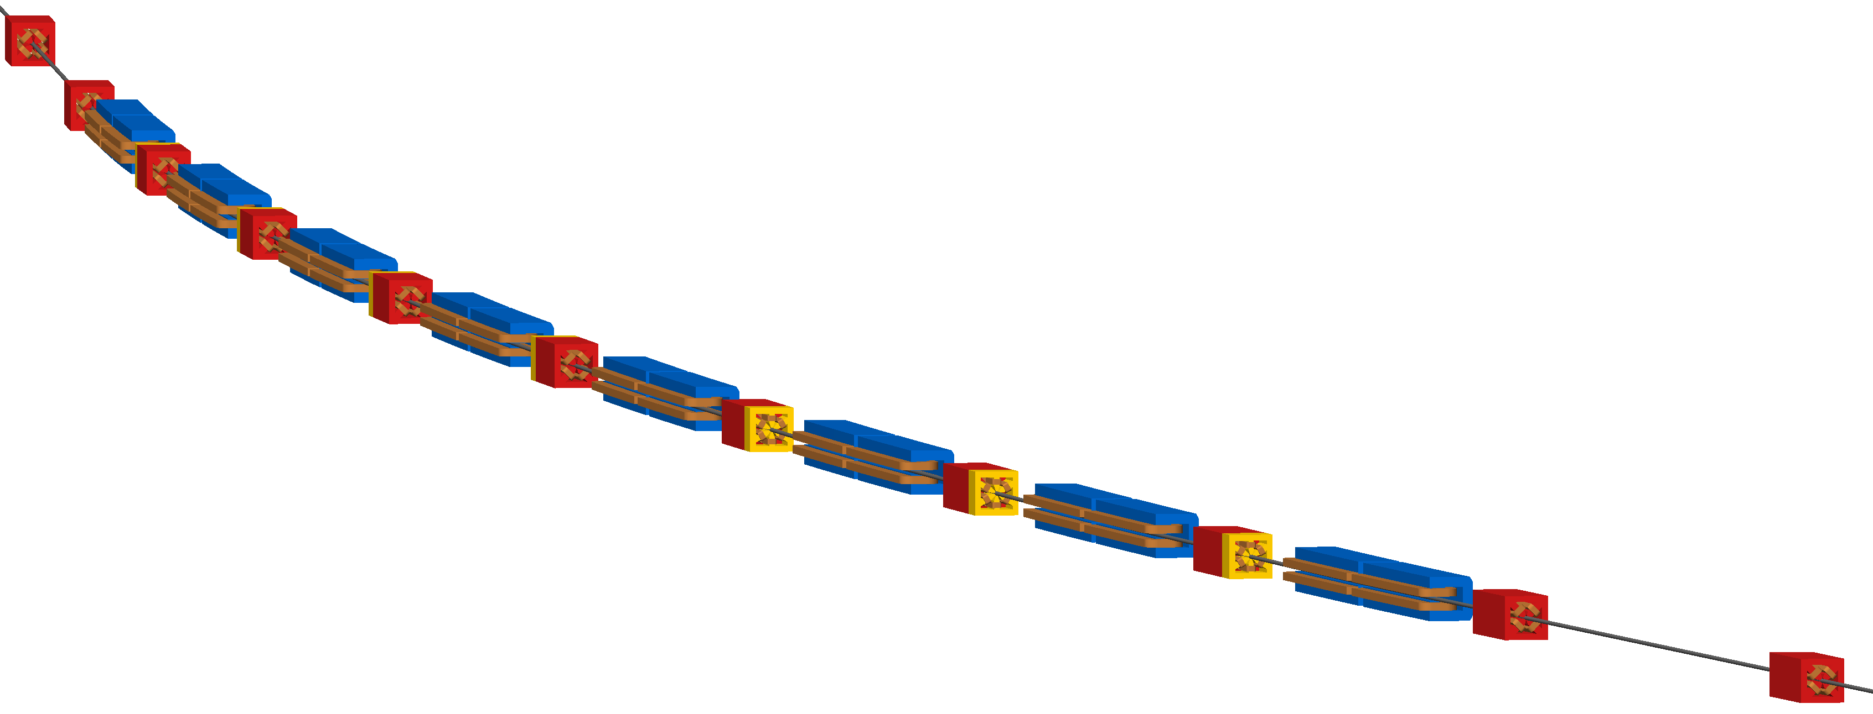


Lattice
The Single Arc Cell
The single arc cell consists of 16 dipole magnets, 10 quadrupole magnets and 7 sextupole magnets.
Plot (left) of the RCS1 arc created using Xsuite.
Visualisation (right) of the RCS1 single arc cell were created using
Beam Delivery Simulation (BDSIM) software.
Quadrupole
Dipole
Sextupole
Location of RF cavities
7
John Adams Institute | RCS1 Design for Muon Collider | 16/04/2026

Slide 8
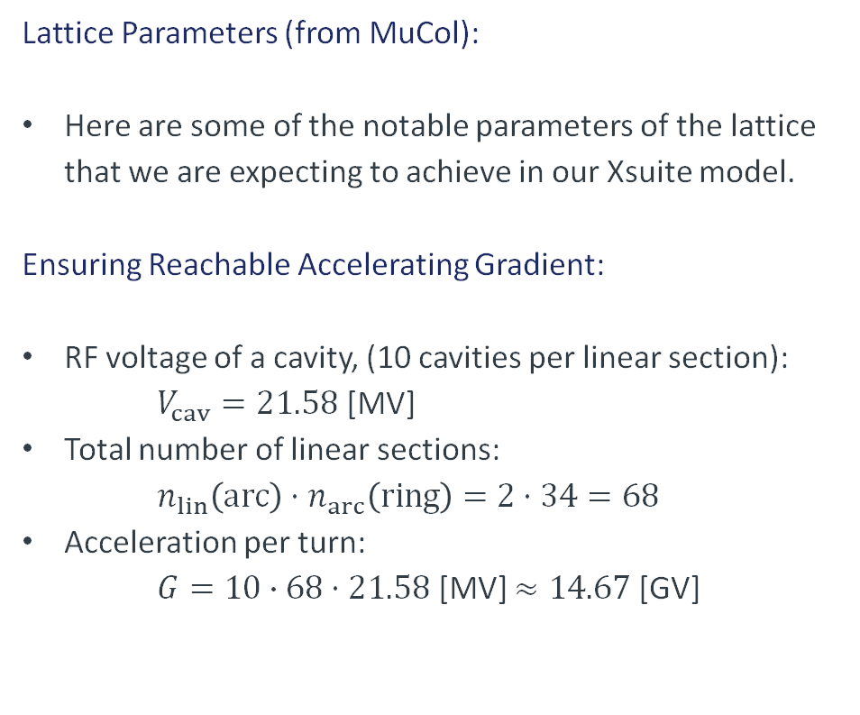
Lattice
Lattice Parameters (from MuCol):
Here are some of the notable parameters of the lattice that we are expecting to achieve in our Xsuite model.
Ensuring Reachable Accelerating Gradient:
RF voltage of a cavity, (10 cavities per linear section):
$V_{cav}=21.58$ [MV]
Total number of linear sections:
$$n_{lin}\left(arc\right)⋅n_{arc}\left(ring\right)=2⋅34=68$$
Acceleration per turn:
$G=10∙68⋅21.58$ [MV] $≈14.67$ [GV]
RCS1 Parameters specified by MuCOL consolidated parameters report (Oct 2025)
8
John Adams Institute | RCS1 Design for Muon Collider | 16/04/2026

Slide 9
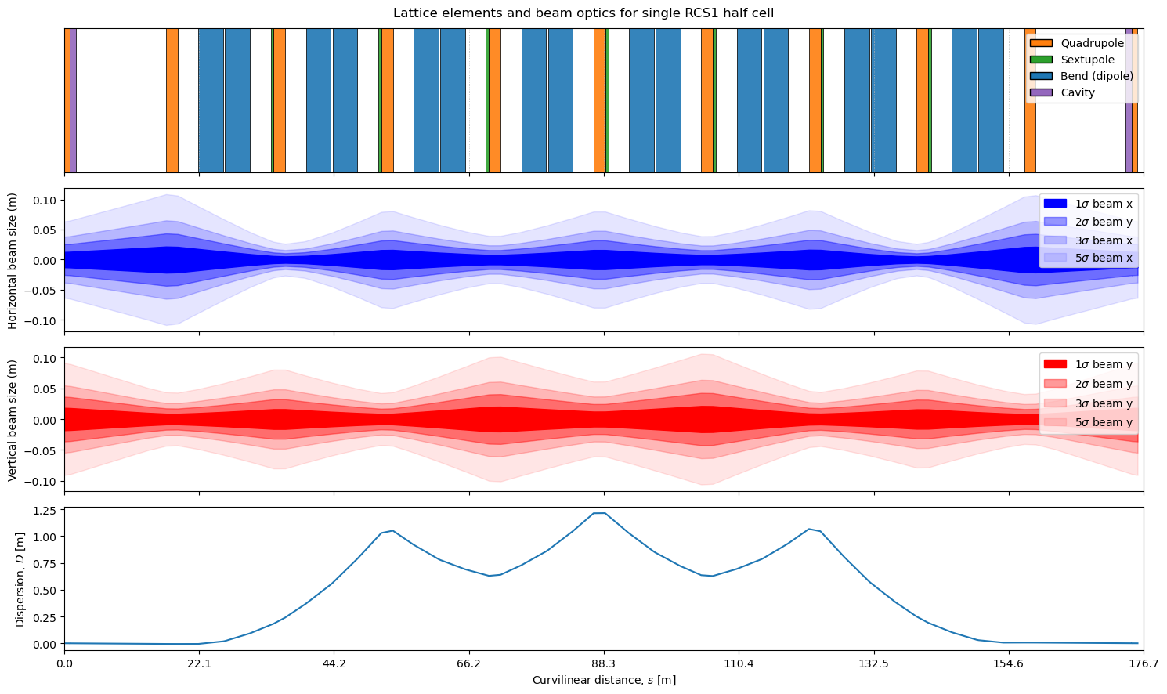
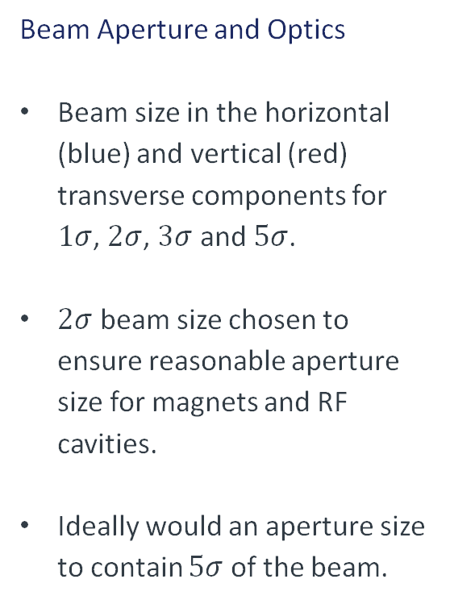
Lattice
Beam Aperture and Optics
Beam size in the horizontal (blue) and vertical (red) transverse components for $1σ$, $2σ$, $3σ$ and $5σ$.
$2σ$ beam size chosen to ensure reasonable aperture size for magnets and RF cavities.
Ideally would an aperture size to contain $5σ$ of the beam.
9
John Adams Institute | RCS1 Design for Muon Collider | 16/04/2026

Slide 10
Lattice
Twiss Parameters for the Single Arc Cell
Alpha is as expected focusing in one direction and defocusing in the other.
Beta is as expected comparing with lattice results produced by L. Soubirou.
Gamma larger in x-direction than in the y-direction, suggesting larger angular spread in horizontal plane, as expected.
Short arc length requires dispersion suppression, hence explaining the fluctuations.
10
John Adams Institute | RCS1 Design for Muon Collider | 16/04/2026

Slide 11
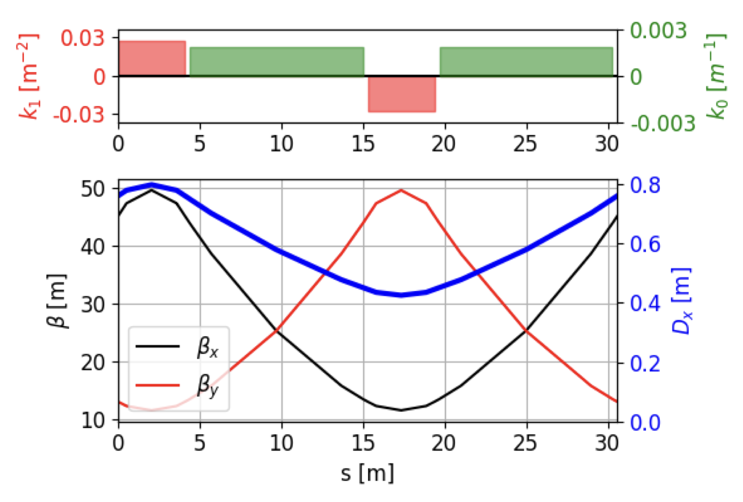
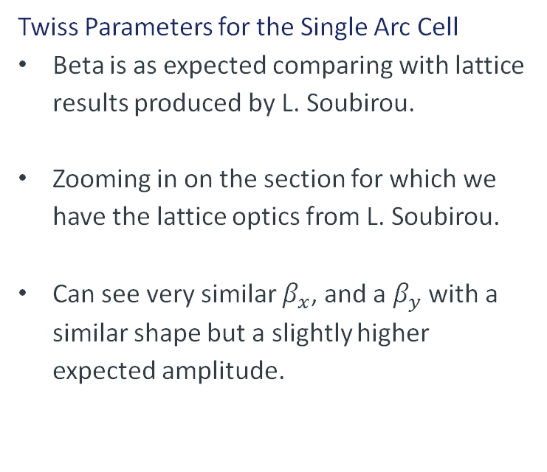
Lattice
Twiss Parameters for the Single Arc Cell
Beta is as expected comparing with lattice results produced by L. Soubirou.
Zooming in on the section for which we have the lattice optics from L. Soubirou.
Can see very similar $β_{x}$, and a $β_{y}$ with a similar shape but a slightly higher expected amplitude.
Soubirou L, et al. Optics design status for the muon collider rapid cycling synchrotrons (2025) doi:10.1088/1742-6596/3094/1/012004.
11
John Adams Institute | RCS1 Design for Muon Collider | 16/04/2026

Slide 12
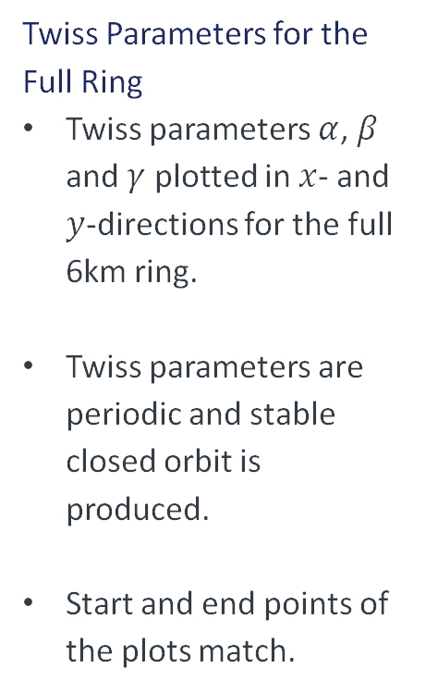
Lattice
Twiss Parameters for the Full Ring
Twiss parameters $α$, $β$ and $γ$ plotted in $x$- and $y$-directions for the full 6km ring.
Twiss parameters are periodic and stable closed orbit is produced.
Start and end points of the plots match.
12
John Adams Institute | RCS1 Design for Muon Collider | 16/04/2026

Slide 13
Lattice
Investigating the Introduction of Straight Sections
Other variations of ring structure were considered to have dedicated locations for the RF cavities.
The cavities under consideration have lengths that allow them to fit within the zero-dispersion region of the lattice.
Therefore, straight sections no longer needed to be considered.
13
John Adams Institute | RCS1 Design for Muon Collider | 16/04/2026

Slide 14
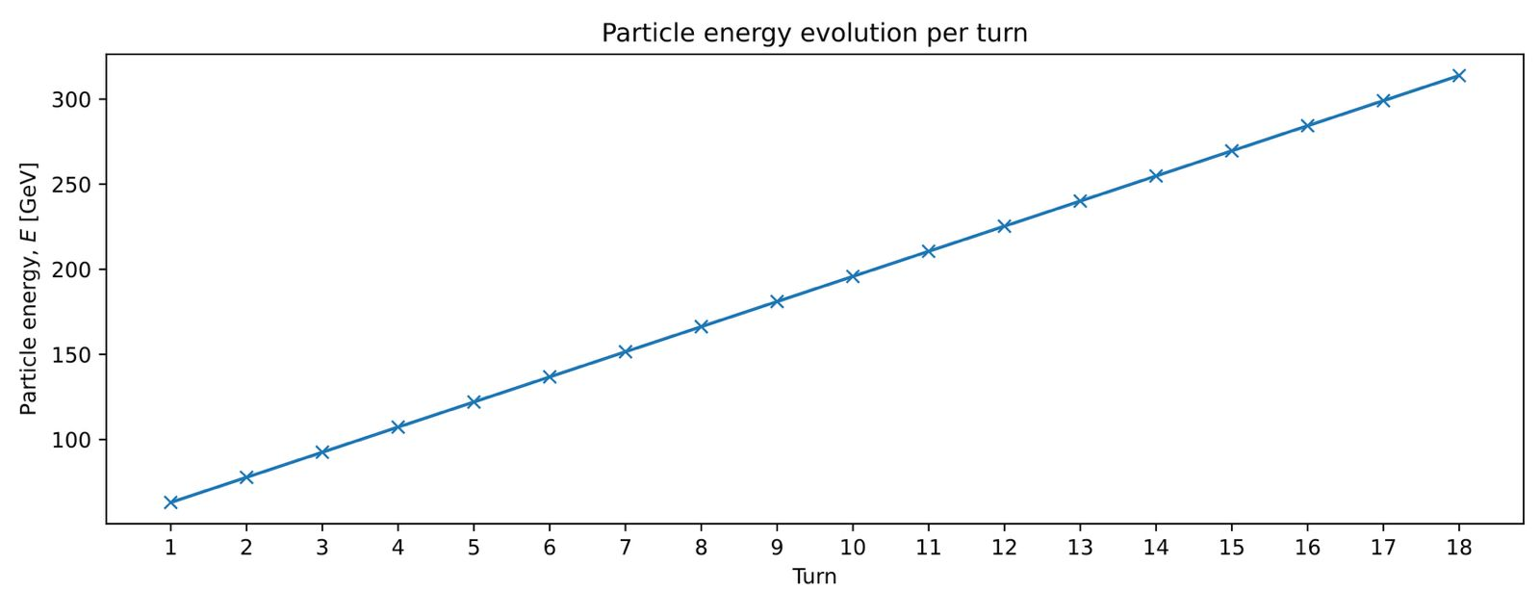
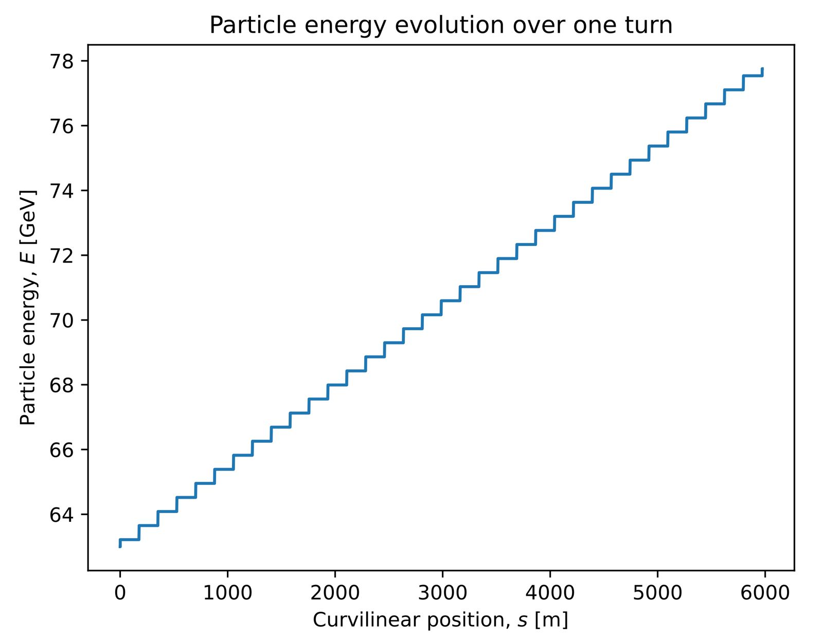
Lattice
Single Particle Tracking
Particle energy evolution over a single turn.
Energy gained only at locations of the cavities, as expected.
For first turn, energy starts at 63 GeV and reaches 78 GeV.
Particle energy evolution over multiple turns.
Require 17 turns to reach energy of 314 GeV.
Both plot show the expected energy gains required per turn.
Suggests that the lattice can reach its expected performance.
14
John Adams Institute | RCS1 Design for Muon Collider | 16/04/2026

Slide 15
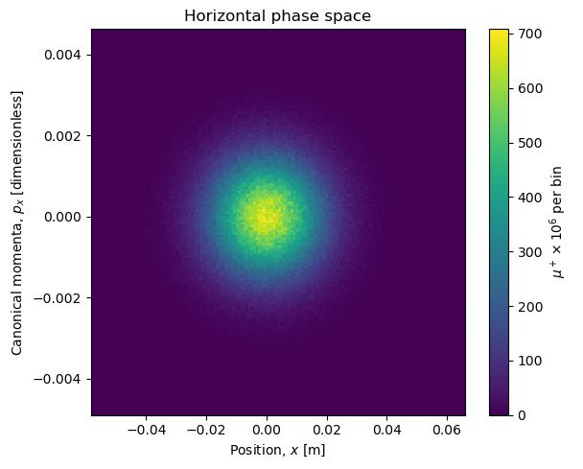
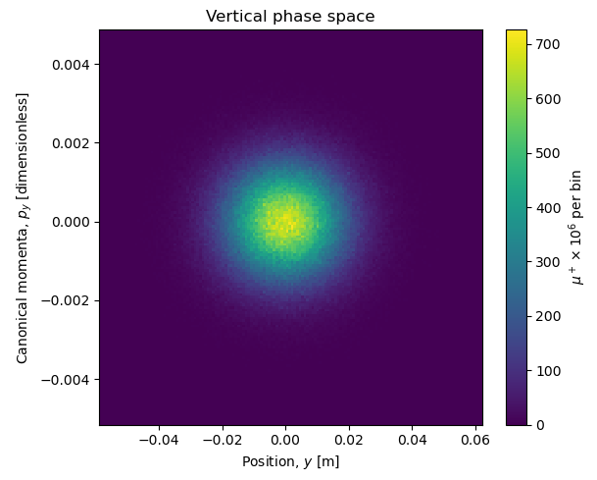
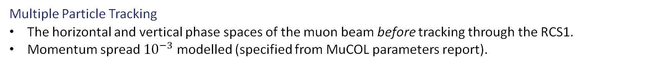
Lattice
Multiple Particle Tracking
The horizontal and vertical phase spaces of the muon beam before tracking through the RCS1.
Momentum spread ${10}^{−3}$ modelled (specified from MuCOL parameters report).
15
John Adams Institute | RCS1 Design for Muon Collider | 16/04/2026

Slide 16
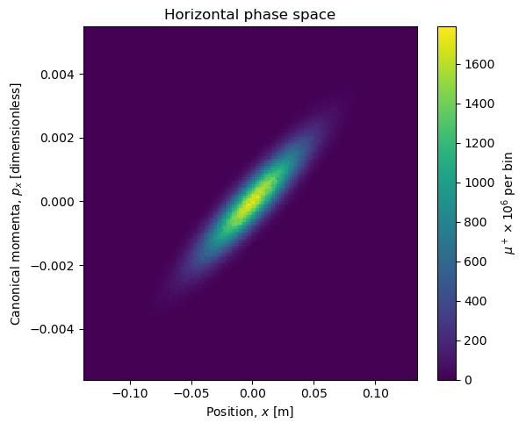
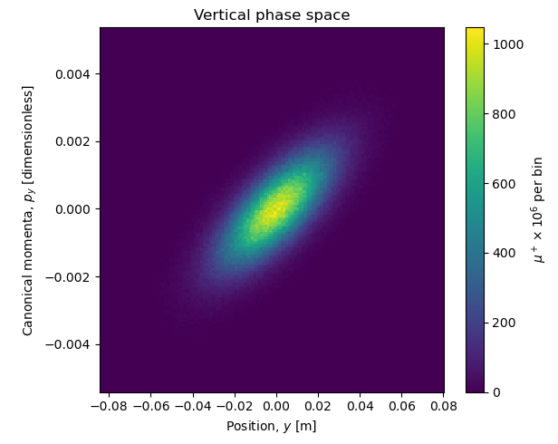
Lattice
Multiple Particle Tracking
The horizontal and vertical phase spaces of the beam after tracking through the RCS1 (17 turns).
Beam is diverging at the end of tracking (not ideal for closed loop).
No significant emittance growth visible.
16
John Adams Institute | RCS1 Design for Muon Collider | 16/04/2026

Slide 17
Lattice
Conclusions
Single particle tracking successfully performed showing expected optics.
Transverse beam size determined to provide aperture sizes for magnet and RF teams.
Expected energy gains over a single turn and over all turns needed to reach ejection energy.
Beam is seen to be diverging after tracking through the RCS1 but showing no significant emittance growth.
Future work
Optimisation of the lattice to produce more realistic beam size to minimise the aperture size.
Further investigation with multiple particle beam tracking.
Considering other lattice designs such as the hybrid-FODO and combined-function cells*.
*Soubirou L, et al. Optics design status for the muon collider rapid cycling synchrotrons (2025) doi:10.1088/1742-6596/3094/1/012004.
17
John Adams Institute | RCS1 Design for Muon Collider | 16/04/2026

Slide 18
Magnet Design
T. Hirt Madden
G. Weis
18
John Adams Institute | RCS1 Design for Muon Collider | 16/04/2026

Slide 19
Dipole Magnet – Specification
Requirements for RCS1
Initial requirements from the muon collider annual meeting (Breschi et. al):
Magnetic field in aperture 1.8T
Good Field Region (GFR) 30x100mm
1ms ramp from -1.8T to 1.8T
This work focusses on a dipole with H-topology.
GFR was updated to 43.4x43.4mm towards the end of the project
after updates from the lattice team.
Breschi, M. 2025 et.al (2025) , NC magnet configuration (dipoles and quadrupoles) [PowerPoint]. IMCC and MuCol Annual Meeting. May 13th
19
John Adams Institute | RCS1 Design for Muon Collider | 16/04/2026

Slide 20
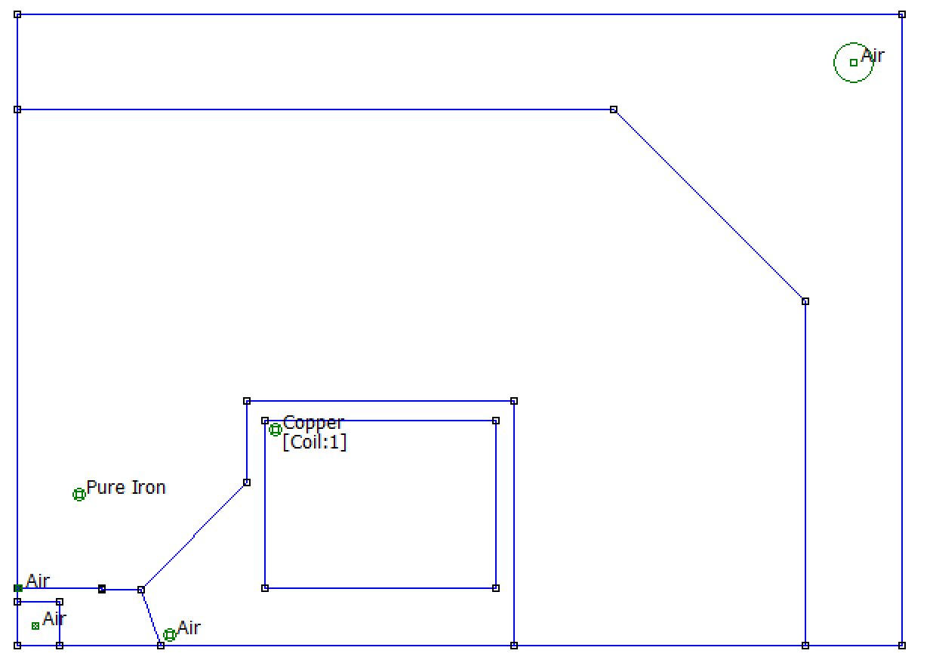
Dipole Magnet – Geometry
pole
external chamfer
Only one quadrant of magnet required
Coordinates generated using 12 input parameters (eg. pole height, aperture height, pole chamfer width)
Magnet simulation created in FEMM using the pyFEMM interface
Visualisation produced using FEMM (Finite Element Method Magnetics) software.
shim
pole chamfer
conductor
yoke
Good Field Region
20
John Adams Institute | RCS1 Design for Muon Collider | 16/04/2026

Slide 21
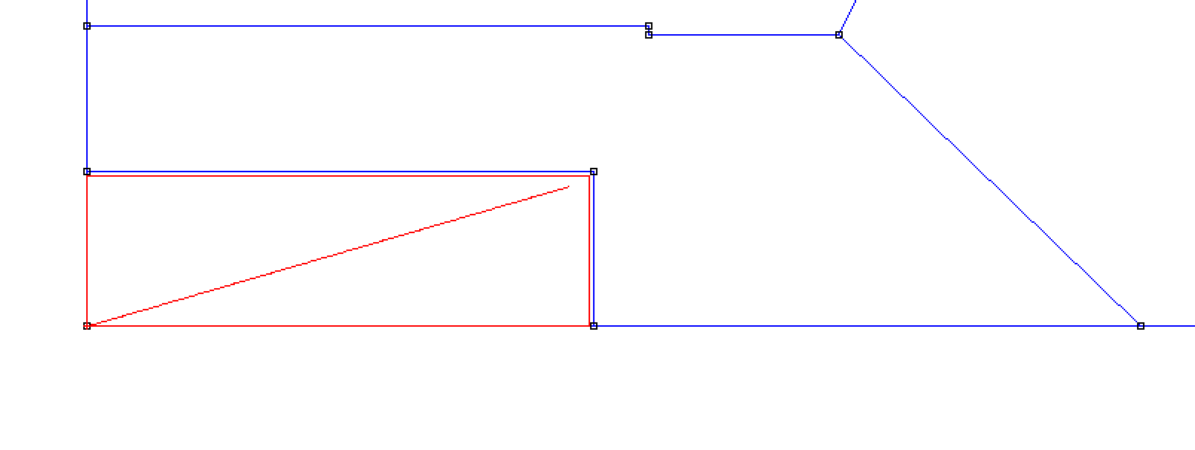
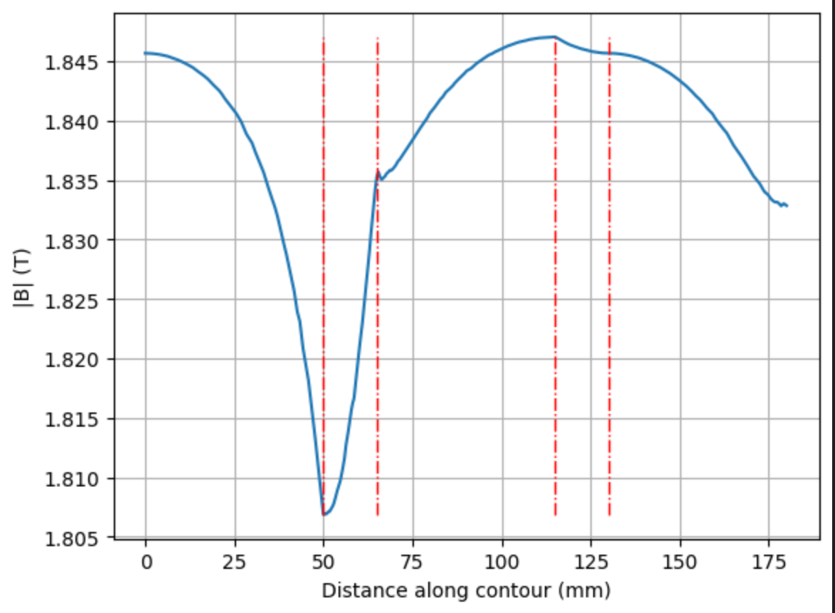
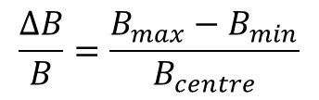
Dipole Magnet - Analysis
3
Post process analysis
4
5
2
Method to extract central field strength and field quality.
1
Contour traced in red
$$\frac{ΔB}{B}=\frac{{B_{max}−B}_{min}}{B_{centre}}$$
1
2
3
4
Similar approach used to measure:
Field parallelism
Yoke saturation
Block integrals used to measure:
Magnet/coil area
Magnetic field energy
5
21
John Adams Institute | RCS1 Design for Muon Collider | 16/04/2026

Slide 22
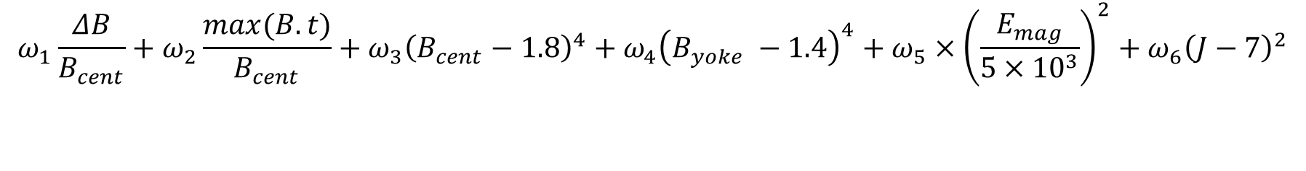
Dipole Magnet – Optimisation process
Cost function designed, with minimum at desired outcomes.
Bayesian optimisation (gp_minimize from skopt) used to vary parameters and optimise cost function.
Example cost function
$$ω_{1}\frac{ΔB}{B_{cent}}+ω_{2}\frac{max⁡(B.t)}{B_{cent}}+ω_{3}{\left(B_{cent}−1.8\right)}^{4}+ω_{4}{\left(B_{yoke} −1.4\right)}^{4}+ω_{5}×{\left(\frac{E_{mag}}{5×{10}^{3}}\right)}^{2}+ω_{6}{\left(J−7\right)}^{2}$$
Field quality
Field direction
Field strength
Yoke saturation
Magnetic energy
Current density
T. Head et al., scikit-optimize: Sequential model-based optimization in Python, 2018. https://scikit-optimize.github.io/
22
John Adams Institute | RCS1 Design for Muon Collider | 16/04/2026

Slide 23
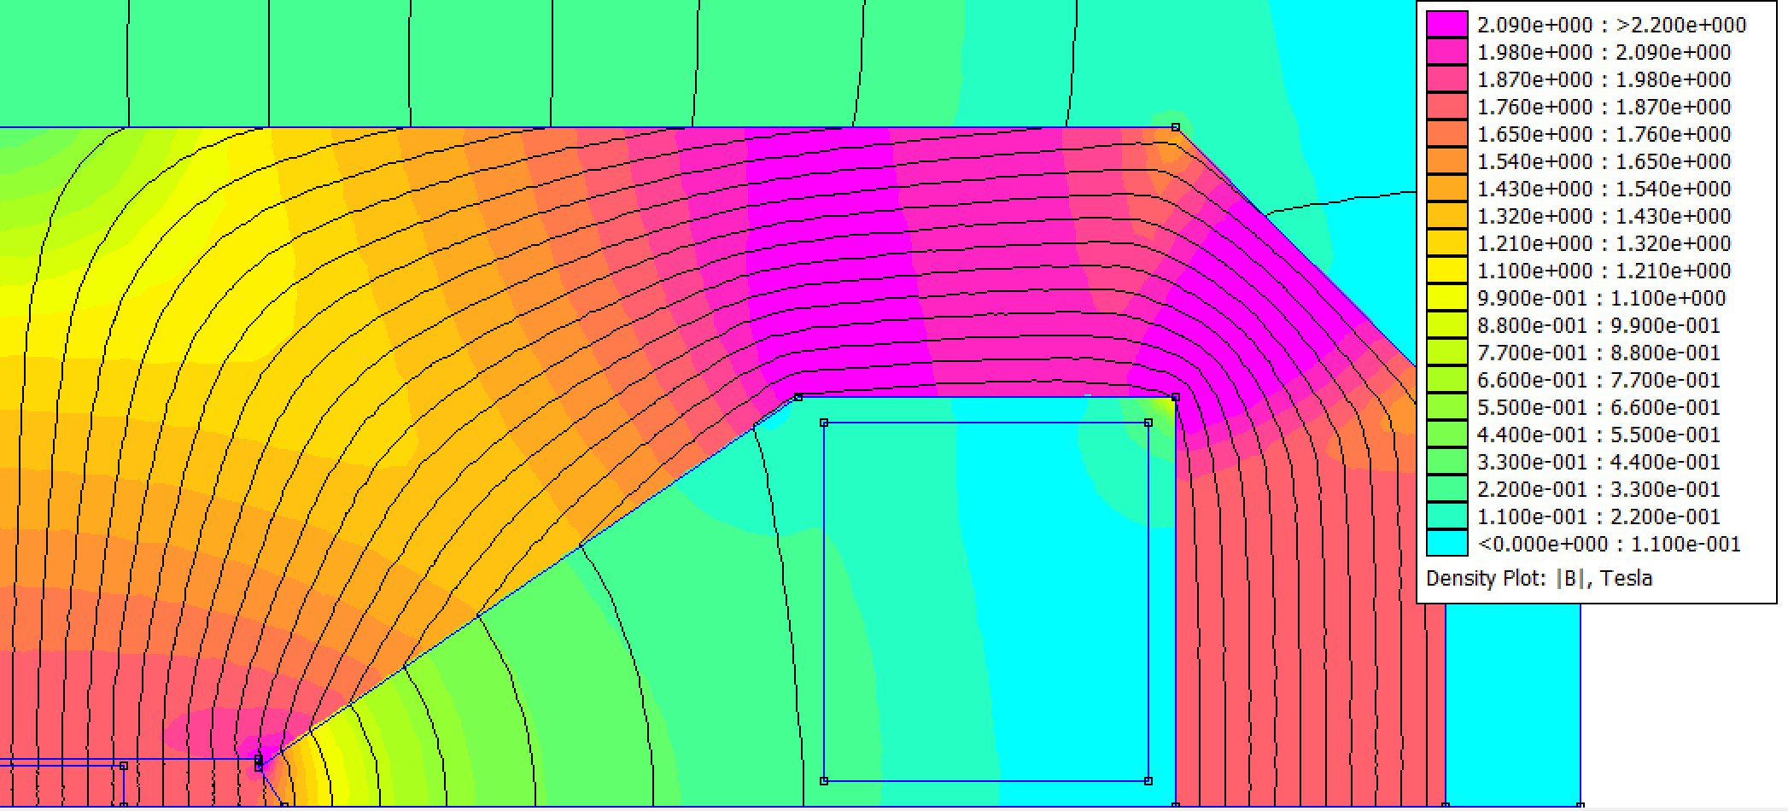
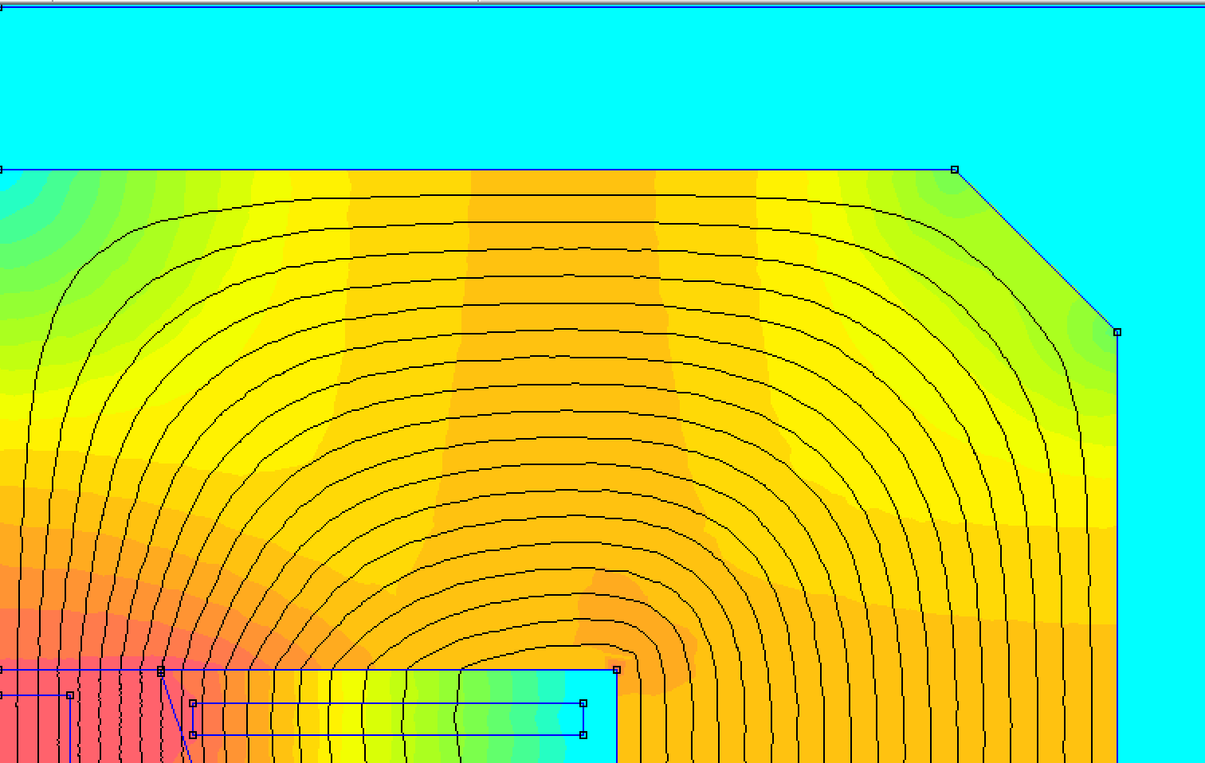
Dipole Magnet - Results
Failed optimisations
Weights and forms of the penalties had to be constantly adjusted
Input parameters and search ranges had to be altered
Yoke oversaturation penalty too low
No penalty for current density
23
John Adams Institute | RCS1 Design for Muon Collider | 16/04/2026

Slide 24
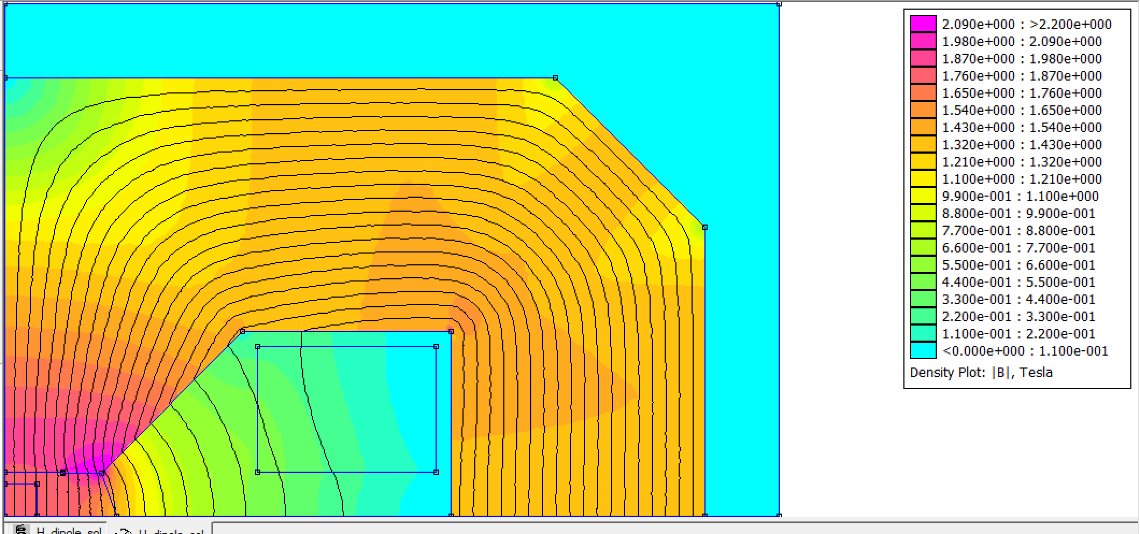
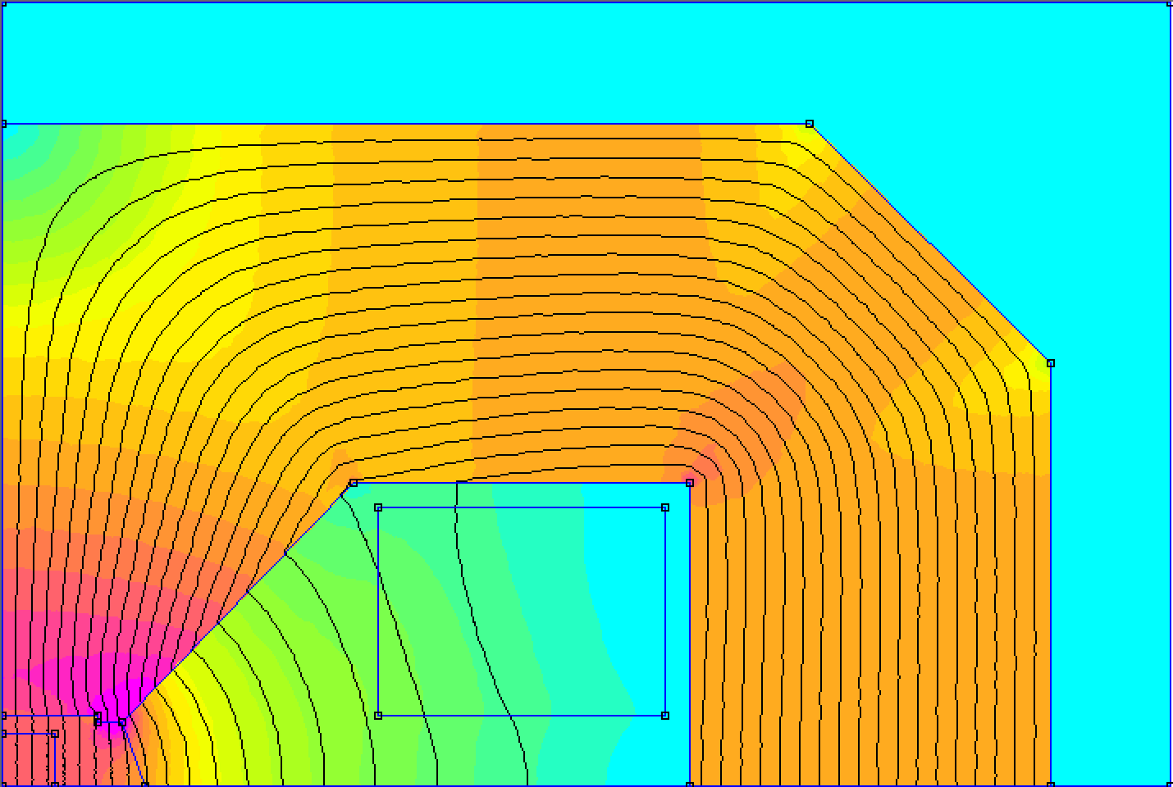
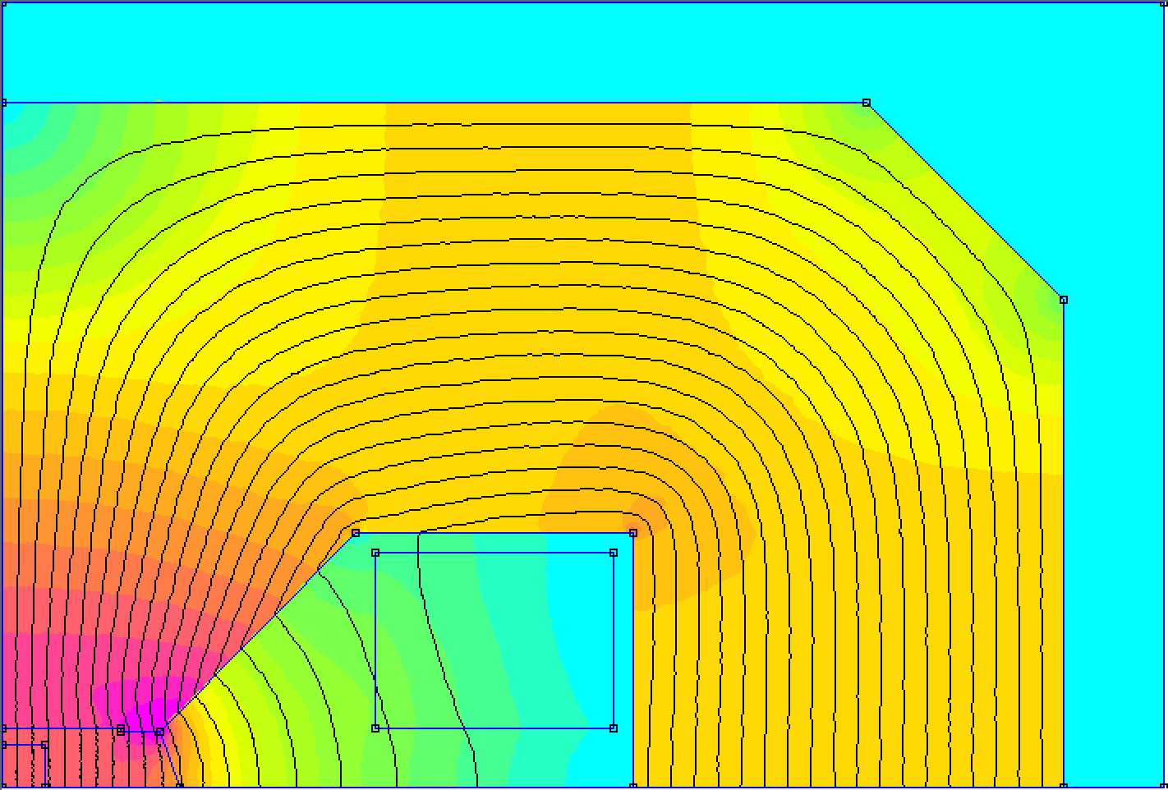
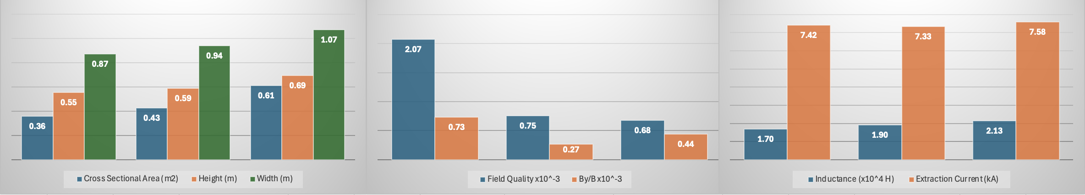
Dipole Magnet – Results
Optimisation outcomes with new GFR specification with various Pole Widths
100mm
130mm
160mm
100mm
130mm
160mm
100mm
130mm
160mm
100mm
130mm
160mm
24
John Adams Institute | RCS1 Design for Muon Collider | 16/04/2026
(With 6 turns)

Slide 25
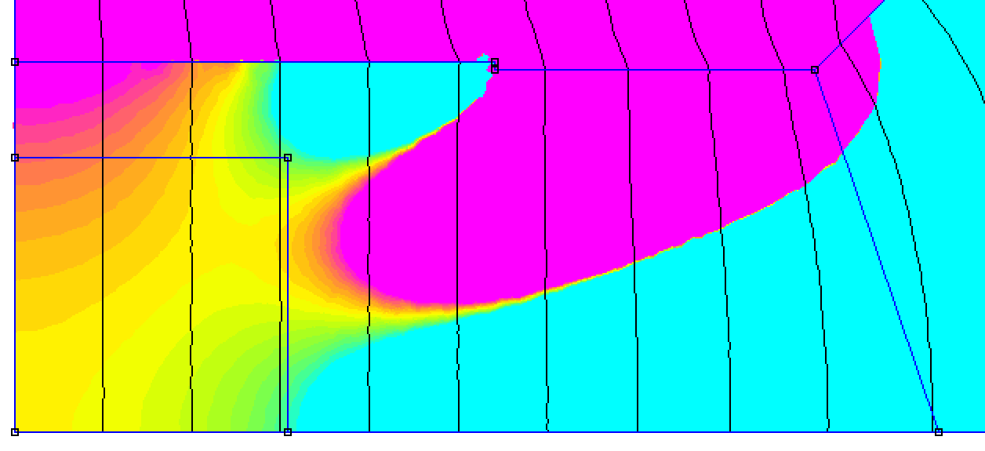
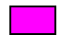


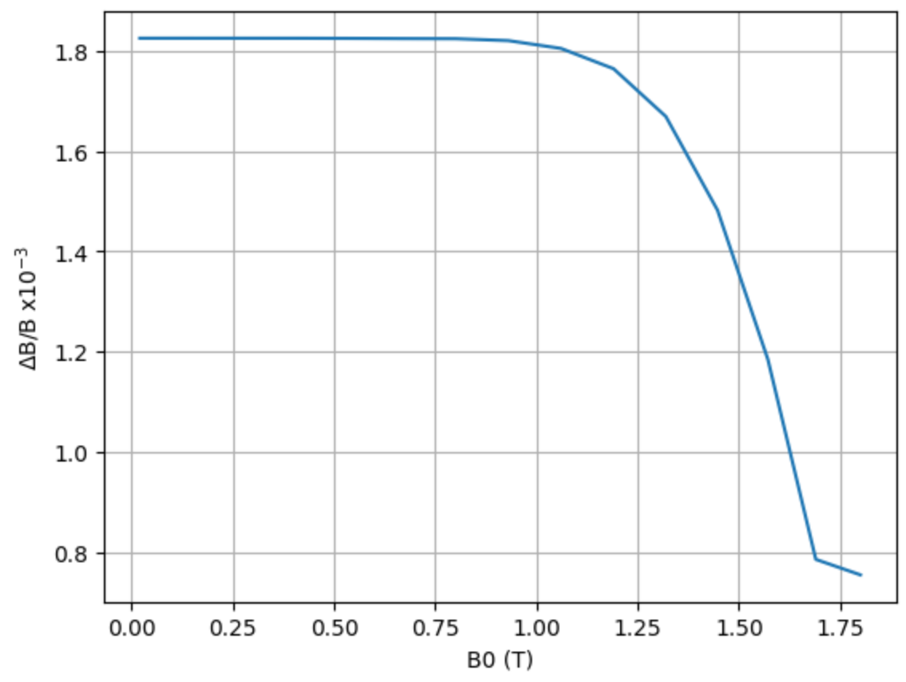
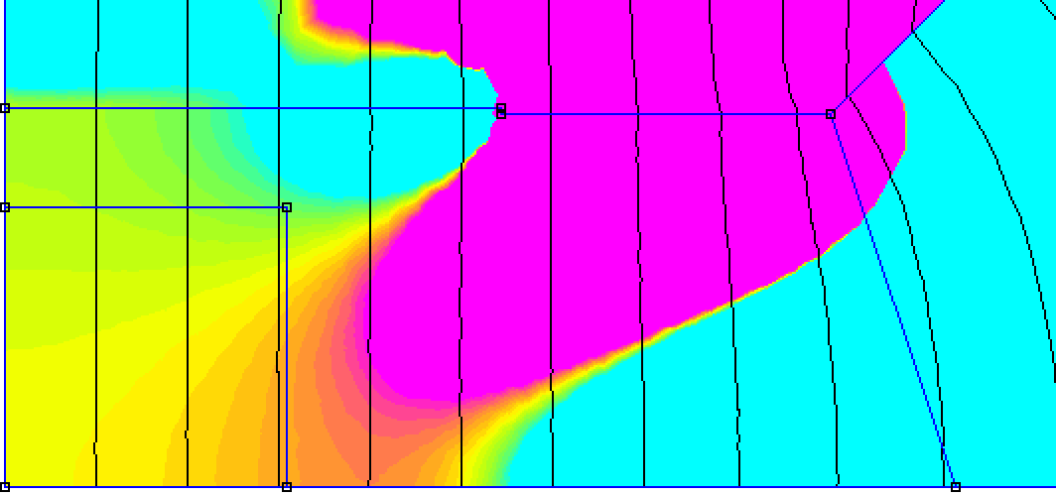
Dipole Magnet
Ramping considerations
≥1.801T
=1.800T
≤1.799T
Using optimal 130mm design
At B = 1.800T
≥0.501T
=0.500T
≤0.499T
Field quality worsens at lower B-Fields
At B = 0.500T
25
John Adams Institute | RCS1 Design for Muon Collider | 16/04/2026

Slide 26
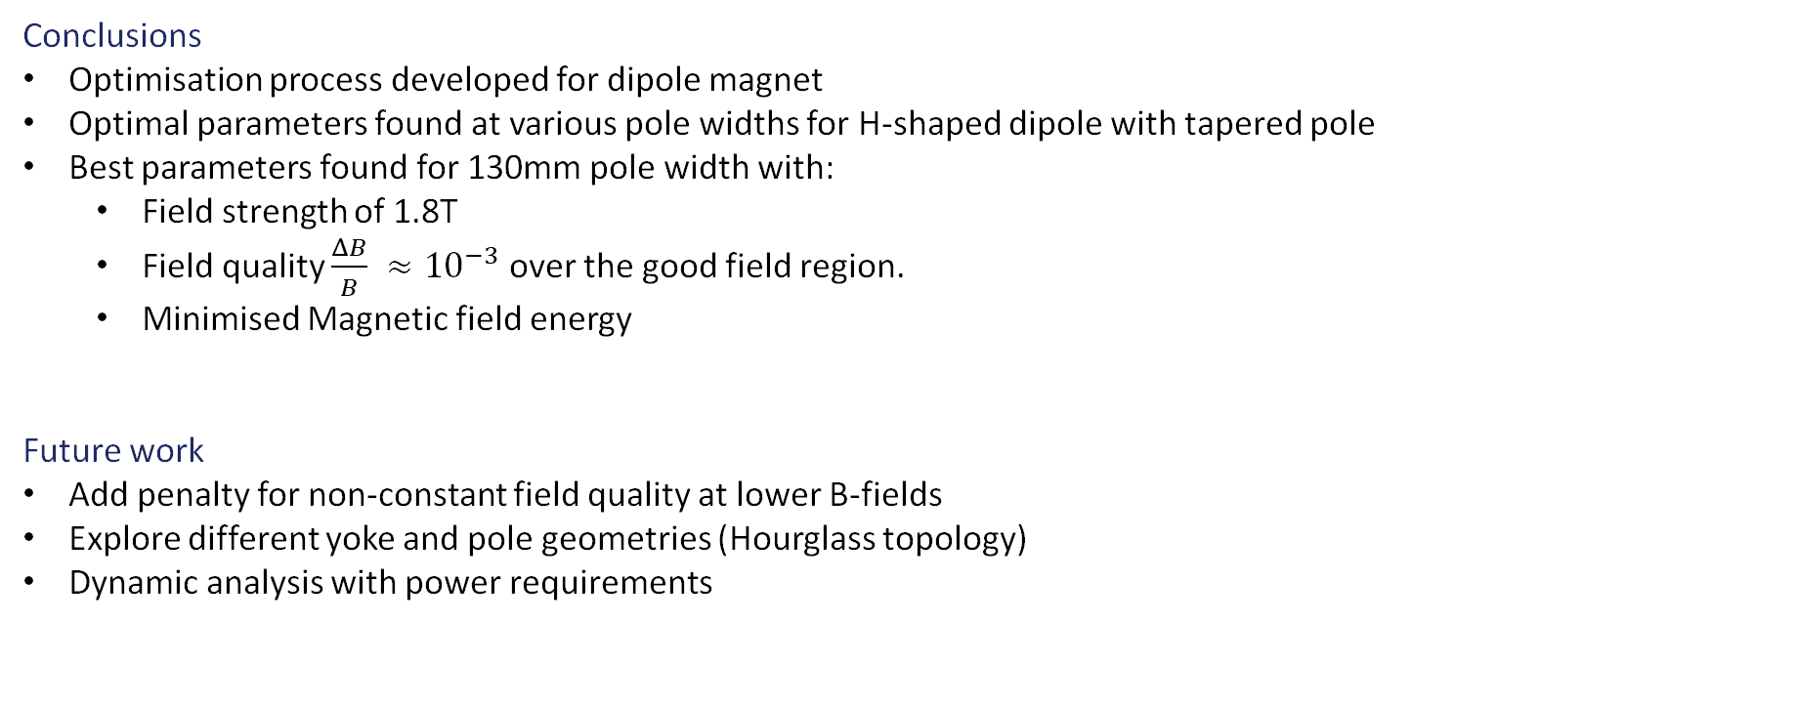
Dipole Magnet
Conclusions
Optimisation process developed for dipole magnet
Optimal parameters found at various pole widths for H-shaped dipole with tapered pole
Best parameters found for 130mm pole width with:
Field strength of 1.8T
Field quality $\frac{ΔB}{B} ≈{10}^{−3}$ over the good field region.
Minimised Magnetic field energy
Future work
Add penalty for non-constant field quality at lower B-fields
Explore different yoke and pole geometries (Hourglass topology)
Dynamic analysis with power requirements
26
John Adams Institute | RCS1 Design for Muon Collider | 16/04/2026

Slide 27

Quadrupole
Design Parameters
Muon Collider annual meeting*
Field Gradient of approx. 30[T/m]
Field homogeneity of at least ${10}^{−3}$
Ramp times of about 1[ms]
Aperture size 40[mm]
Lattice team $2σ$ beam size – 45[mm]
*Breschi, M., A. Macchiagodena, P. L. Ribani, et al. NC Magnet Configuration (Dipoles and Quadrupoles). IMCC and MuCol Annual Meeting, 13 May 2025. https://indico.desy.de/event/45968/contributions/186232/
27
John Adams Institute | RCS1 Design for Muon Collider | 16/04/2026

Slide 28
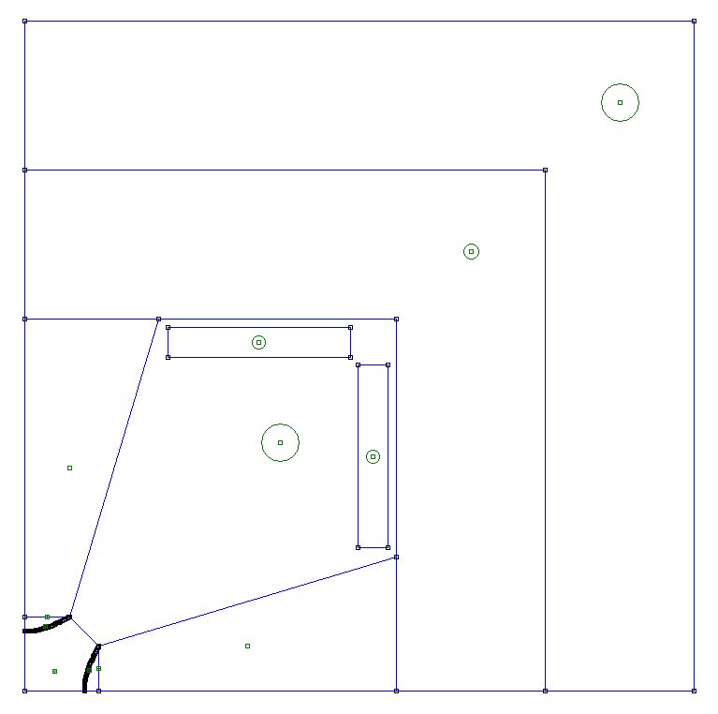
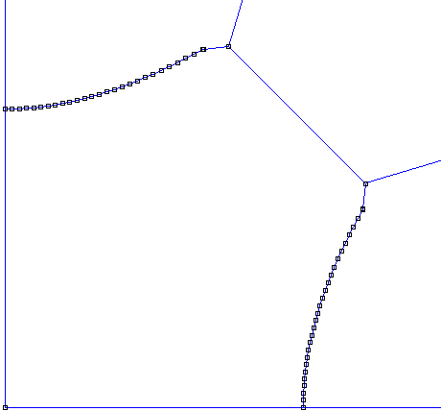
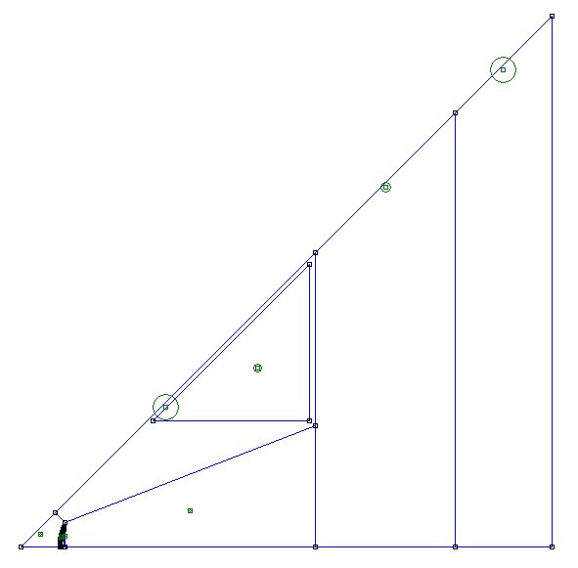
Quadrupole
Iron Yoke
Air Boundary
Magnetic Pole
Configuration
MAP Configuration
Based on a design at MuCol annual meeting*
Built in Python
7 Varying parameters define whole geometry (e.g. pole width, nose width, yoke width)
Shims
Conductor
- Copper
Hyperbolic Profile
Designs from femm
Alternative triangular coil geometry
*Breschi, M., A. Macchiagodena, P. L. Ribani, et al. NC Magnet Configuration (Dipoles and Quadrupoles). IMCC and MuCol Annual Meeting, 13 May 2025. https://indico.desy.de/event/45968/contributions/186232/
28
John Adams Institute | RCS1 Design for Muon Collider | 16/04/2026

Slide 29
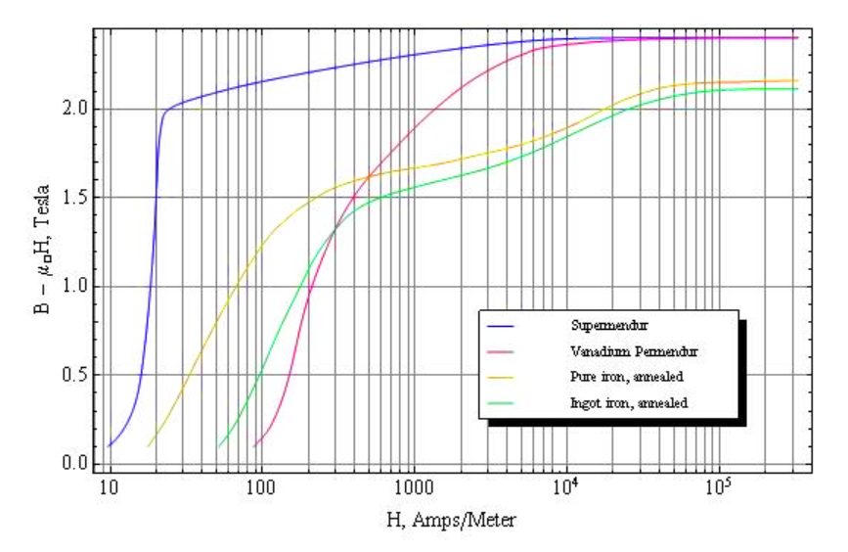
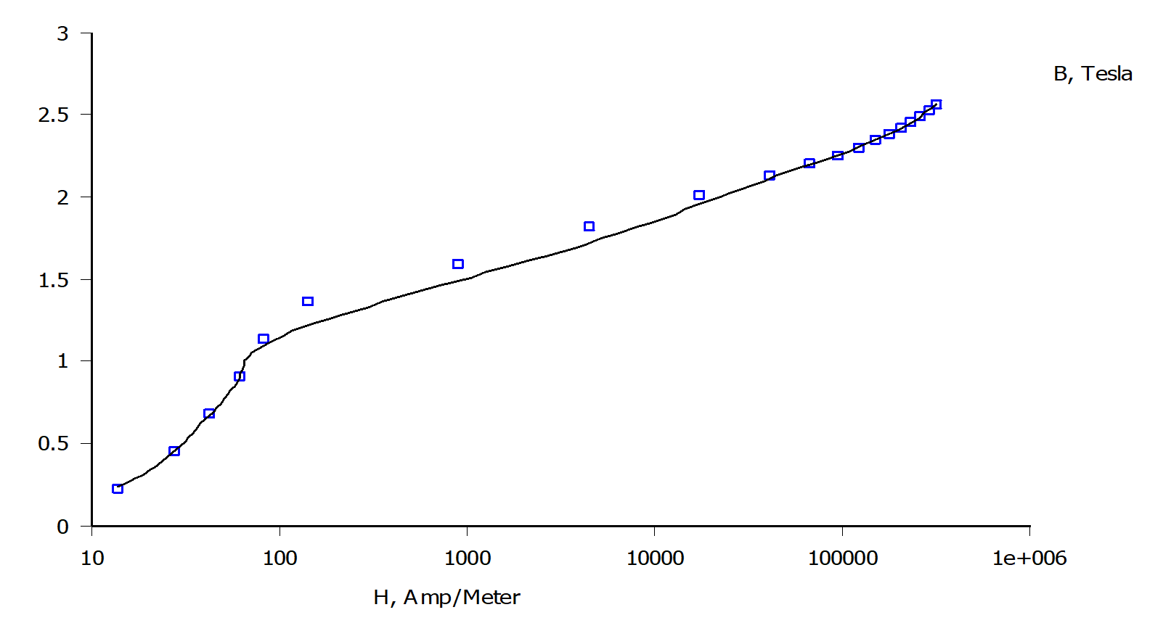

Supermendur*
Quadrupole
Pure Iron
Design Considerations
Good field region
$\frac{2}{3}⋅\text{aperture} \text{size}$ ($r$)
Gradient = $G$[T/m]
Pole tip field $=Gr$
$40[mm]→30⋅40⋅{10}^{−3}=1.2$[T]
$2σ beam width=45[mm]$
$r=\frac{3}{2}⋅45=67.5$[mm]$→30⋅67.5⋅{10}^{−3}=2.03$[T]
Use Supermendur for magnetic poles
49% cobalt
49% iron
2% vanadium
Possible pole saturation
Choose a higher saturation material for Poles
Saturation!
*‘DC Magnetization Curves of Soft Magnetic Materials: Finite Element Method Magnetics’. Accessed 8 March 2026. https://www.femm.info/wiki/SoftMagneticMaterials.
29
John Adams Institute | RCS1 Design for Muon Collider | 16/04/2026

Slide 30
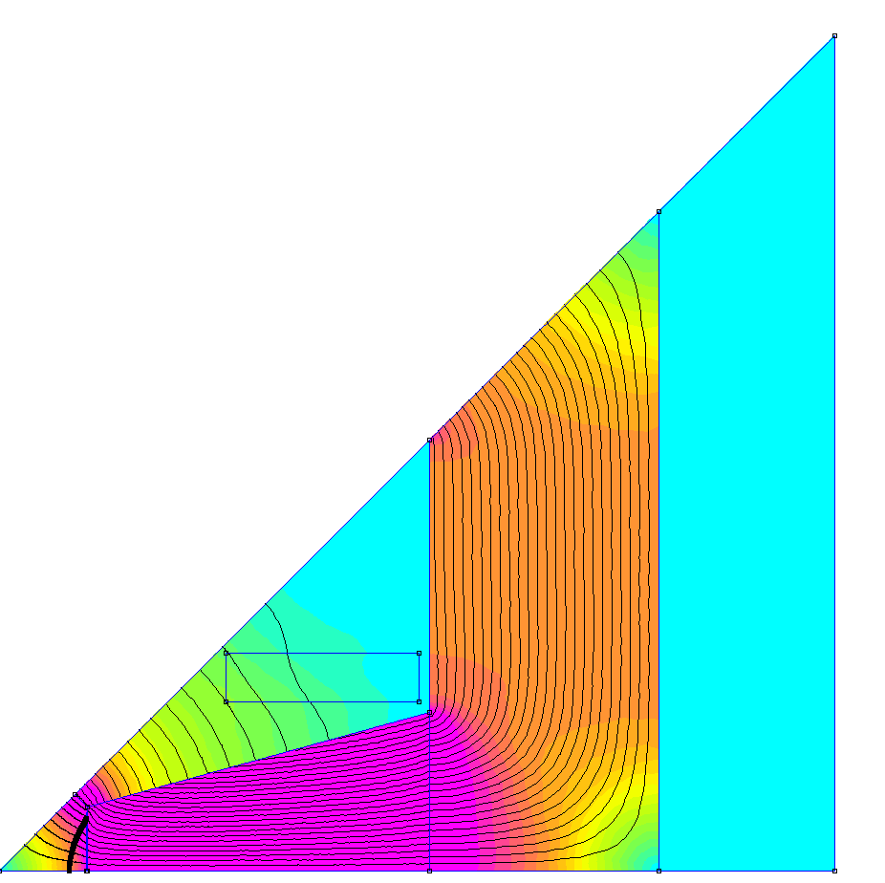
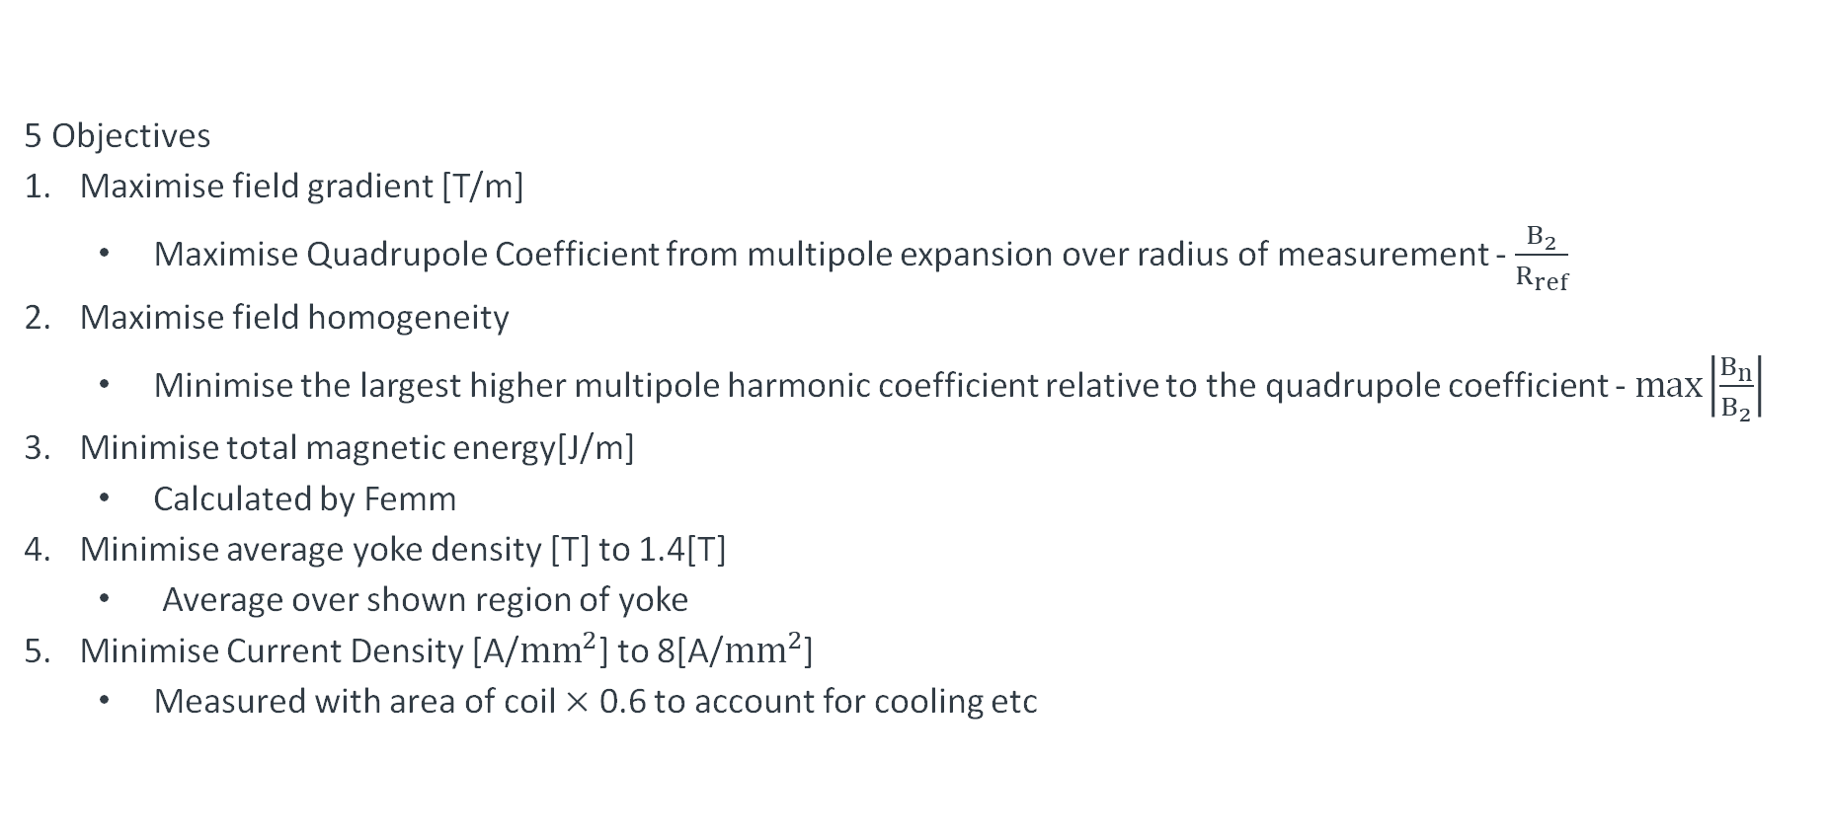
Quadrupole
5 Objectives
Maximise field gradient [T/m]
Maximise Quadrupole Coefficient from multipole expansion over radius of measurement - $\frac{B_{2}}{R_{ref}}$
Maximise field homogeneity
Minimise the largest higher multipole harmonic coefficient relative to the quadrupole coefficient - $\max\left|\frac{B_{n}}{B_{2}}\right|$
Minimise total magnetic energy[J/m]
Calculated by Femm
Minimise average yoke density [T] to 1.4[T]
Average over shown region of yoke
Minimise Current Density [A/${mm}^{2}$] to 8[A/${mm}^{2}$]
Measured with area of coil $×$ 0.6 to account for cooling etc
Multi Objective Bayesian Optimisation with Optimas[*, **]
*Ferran Pousa, A., S. Jalas, M. Kirchen, et al. ‘Bayesian Optimization of Laser-Plasma Accelerators Assisted by Reduced Physical Models’. Physical Review Accelerators and Beams 26, no. 8 (2023): 084601. https://doi.org/10.1103/PhysRevAccelBeams.26.084601.
**Hudson, Stephen, Jeffrey Larson, John-Luke Navarro, and Stefan M. Wild. ‘libEnsemble: A Library to Coordinate the Concurrent Evaluation of Dynamic Ensembles of Calculations’. IEEE Transactions on Parallel and Distributed Systems 33, no. 4 (2022): 977–88. https://doi.org/10.1109/TPDS.2021.3082815.
30
John Adams Institute | RCS1 Design for Muon Collider | 16/04/2026

Slide 31
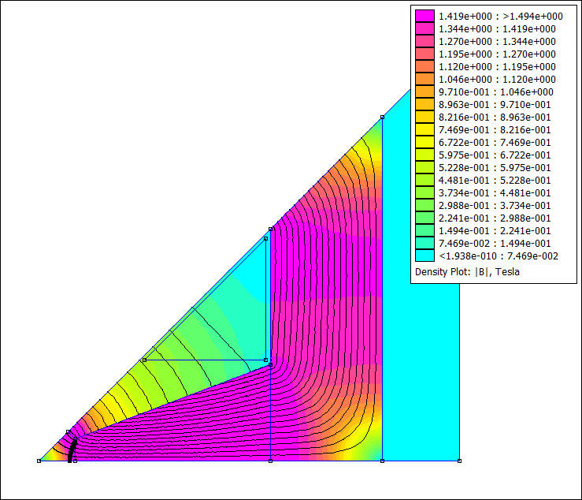
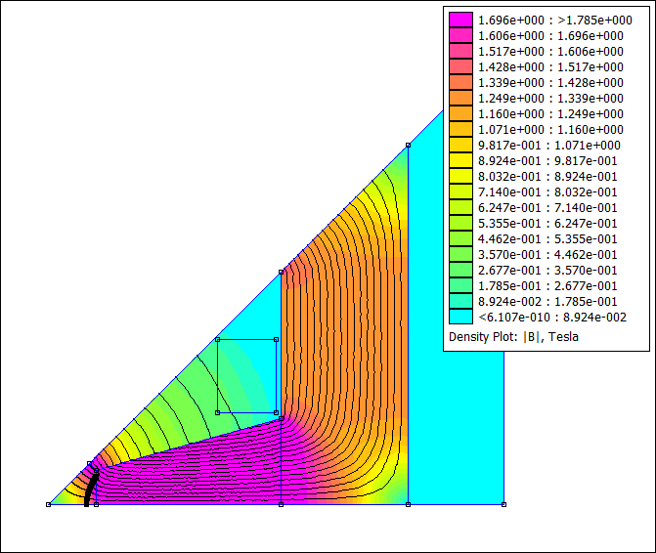
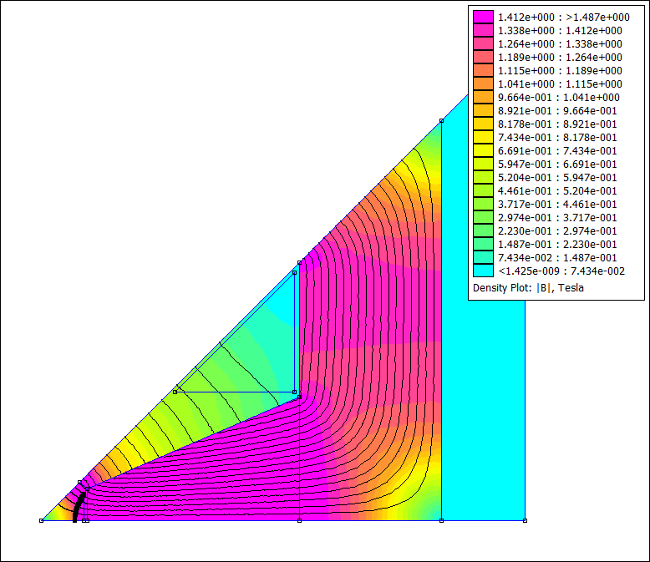
Quadrupole 40mm Aperture Design
Supermendur poles max gradient
Supermendur poles 30 [T/m]
Iron Poles 30 [T/m]
Expensive Material
Higher running cost
Maximises higher material saturation
Expensive material
Cheaper running cost
Cheap Material
Higher running cost
Objective | Value
Field Gradient [T/m] | 35.1
Field Homogeneity[10^x] | -3.37
Total Magnetic Energy [J/m] | 2324
Yoke Density [T] | 1.42
Current Density [A/mm^2] | 3.41
Objective | Value
Field Gradient [T/m] | 30.9
Field Homogeneity[10^x] | -3.33
Total Magnetic Energy [J/m] | 1703
Yoke Density [T] | 1.33
Current Density [A/mm^2] | 7.6
Objective | Value
Field Gradient [T/m] | 30.1
Field Homogeneity[10^x] | -3.67
Total Magnetic Energy [J/m] | 2496
Yoke Density [T] | 1.27
Current Density [A/mm^2] | 4.16
Parameter | Value | Parameter | Value
yw [mm] | 144.7 | ss | 0.125
nw [mm] | 57.2 | sg | 5.58
pw [mm] | 249.1 | mpf [T] | 1.49
cw [mm] | 156 | NI [A] | 24989
x [mm] | 886.8
Parameter | Value | Parameter | Value
yw [mm] | 132 | ss | 0.1498
nw [mm] | 72.49 | sg | 10
pw [mm] | 180.2 | mpf [T] | 1.241
cw [mm] | 60 | NI [A] | 20786
x [mm] | 750
Parameter | Value | Parameter | Value
yw [mm] | 171.5 | ss | 0.142
nw [mm] | 76.3 | sg | 1
pw [mm] | 297.2 | mpf [T] | 1.57
cw [mm] | 145 | NI [A] | 26135
x [mm] | 965.5
31
John Adams Institute | RCS1 Design for Muon Collider | 16/04/2026

Slide 32
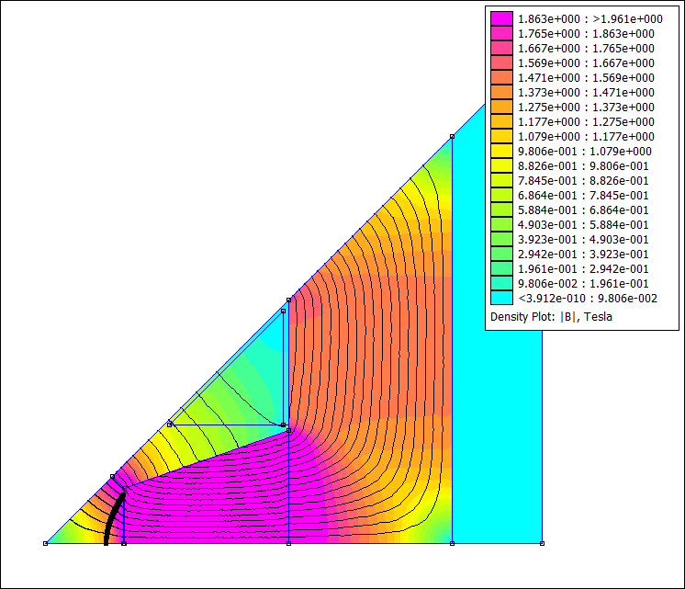
Quadrupole 67.5 mm Aperture Design
Objective | Value
Field Gradient [T/m] | 19.5
Field Homogeneity[10^x] | -3.73
Total Magnetic Energy [J/m] | 4800
Yoke Density [T] | 1.46
Current Density [A/mm^2] | 8.27
Larger aperture size not able to reach target gradient
Approx. twice magnetic energy
Almost twice the current turns compared to 40mm
This is the trade off for a larger aperture
Parameter | Value
yw [mm] | 191
nw [mm] | 123
pw [mm] | 250
cw [mm] | 126
x [mm] | 920.6
ss | 0.0951
sg | 5.516
mpf [T] | 1.4
NI [A] | 39579
32
John Adams Institute | RCS1 Design for Muon Collider | 16/04/2026

Slide 33
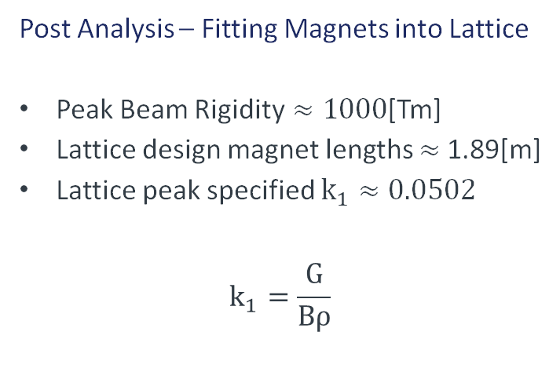
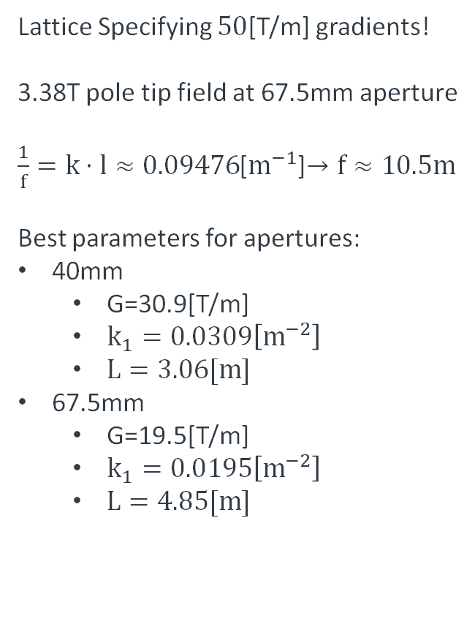
Quadrupole
Post Analysis – Fitting Magnets into Lattice
Peak Beam Rigidity$≈1000$[Tm]
Lattice design magnet lengths $≈$1.89[m]
Lattice peak specified $k_{1}≈0.0502$
$$k_{1}=\frac{G}{Bρ}$$
Lattice Specifying $50$[T/m] gradients!
3.38T pole tip field at 67.5mm aperture
$\frac{1}{f}=k⋅l≈0.09476$[$m^{−1}$]$→f≈10.5m$
Best parameters for apertures:
40mm
G=30.9[T/m]
$k_{1}=0.0309\left[m^{−2}\right]$
$L=3.06[m]$
67.5mm
G=19.5[T/m]
$k_{1}=0.0195\left[m^{−2}\right]$
$L=4.85[m]$
Magnet Length
33
John Adams Institute | RCS1 Design for Muon Collider | 16/04/2026

Slide 34
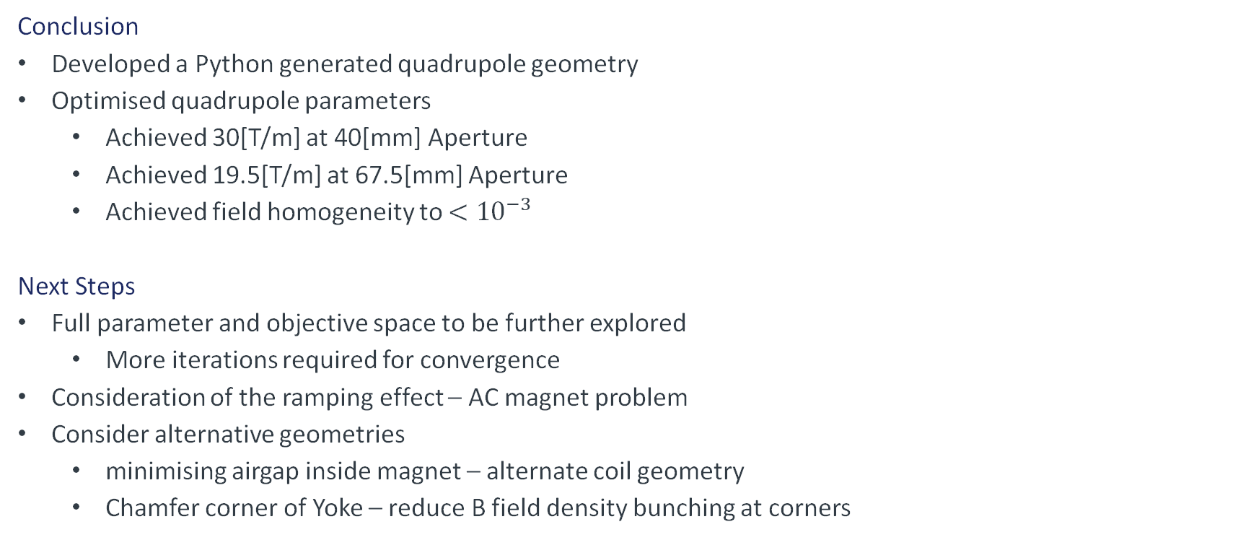
Quadrupole
Conclusion
Developed a Python generated quadrupole geometry
Optimised quadrupole parameters
Achieved 30[T/m] at 40[mm] Aperture
Achieved 19.5[T/m] at 67.5[mm] Aperture
Achieved field homogeneity to $<{10}^{−3}$
Next Steps
Full parameter and objective space to be further explored
More iterations required for convergence
Consideration of the ramping effect – AC magnet problem
Consider alternative geometries
minimising airgap inside magnet – alternate coil geometry
Chamfer corner of Yoke – reduce B field density bunching at corners
34
John Adams Institute | RCS1 Design for Muon Collider | 16/04/2026

Slide 35
RF Cavity Design
F. Straniero
A. Yousif
35
John Adams Institute | RCS1 Design for Muon Collider | 16/04/2026

Slide 36
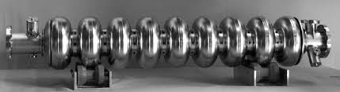
Why Superconducting Elliptical Cavities?
Advantages
High gradient is necessary to quickly accelerate muons.
Well established technology, so no need for much R&D.
Lower breakdown rate, compared to normal-conducting.
Disadvantages
Much higher energetic cost, due to higher currents and refrigeration.
Require extra-space for cryomodule.
Experimental Investigations on Superconducting Niobium Cavities at Highest Radiofrequency Fields, L. Lilje et al, https://www.researchgate.net/publication/48409802_Experimental_Investigations_on_Superconducting_Niobium_Cavities_at_Highest_Radiofrequency_Fields
36
John Adams Institute | RCS1 Design for Muon Collider | 16/04/2026

Slide 37
Why Superconducting Elliptical Cavities?
Advantages
High gradient is necessary to quickly accelerate muons.
Well established technology, so no need for much R&D.
Lower breakdown rate, compared to normal-conducting.
Disadvantages
Much higher energetic cost, due to higher currents and refrigeration.
Require extra-space for cryomodule.
Frequency (MHz) | Bore radius (cm) | Length cell(cm) | Previous designs: | Notes
352 | 8.52 | 37.474 | LEP* | The cavities would be quite long and large, requiring much refrigeration and space in linear sections
1300 | 3.5 | 11.530 | TESLA, ILC** | The aperture radius is smaller than 352, hence need a very narrow beam.
*A superconducting 352MHz Prototype cavity for LEP, G. Arnold-Mayer et al., https://cds.cern.ch/record/878555/files/cer-002551711.pdf
**The superconducting TESLA cavity, B. Aune et al., https://cds.cern.ch/record/429906/files/0003011.pdf
37
John Adams Institute | RCS1 Design for Muon Collider | 16/04/2026

Slide 38

How Much Accelerating Field Do We Need?
From lattice group: RF cavities distributed along the ring (683 cavities in 6km).
Need to go from 63GeV to 313.6GeV in17 turns.
Each cavity is 1.038m (in the accelerating part) → 708.95m of accelerating sections.
$<E_{acc}>$= $\frac{\text{(313.6−63)}\text{GeV}}{\text{(17}\text{×}\text{708.95}\text{m}\text{×}\text{e}\text{)}}=20.79 MV/m$ (this is considerable).
Transit time factor $T=\frac{∫(E\left(0,z\right)\cos\left(kz\right)dz)}{∫\left(E\left(0,z\right)dz\right)}$ and $<E_{real}> =<E_{acc}>/T$
In Superfish $<E_{real }> =E0$
38
John Adams Institute | RCS1 Design for Muon Collider | 16/04/2026

Slide 39
Superfish vs CST Solvers
Superfish
2D solver*
Finite differences method.
Optimizes geometry.
Iteratively directly solves the linearized matrix problem.
Uses hexagonal 2D meshing.
CST
3D solver**
Finite elements method.
Does not optimize geometry.
Solves the eigenvalue problem through Advanced Krylov subspace method.
Tetrahedral mesh.
*SUPERFISH-A COMPUTER PROGRAM FOR EVALUATION OF RF CAVITIES WITH CYLINDRICAL SYMMETRY, K.Halbach, R.F. Holsinger, Particle Accelerators 1976, Vol. 6, pp 213-222
** https://www.3ds.com/products/simulia/cst-studio-suite/electromagnetic-simulation-solvers (last accessed 10/03/2026)
39
John Adams Institute | RCS1 Design for Muon Collider | 16/04/2026

Slide 40
Why 1.3 GHz?
Upsides:
1.3GHz cavities are a mature, well-established technology, which has been already modelled and tested for the TESLA cavities and for ILC*.
Superconducting 1.3GHz cavities allow us to reach some of the highest gradients attainable, which is a strong-requirement in the muon collider, given the muons short lifetime.
1.3 GHz cavities require smaller cryomodules, as a rule of thumb the cavity resonant frequency scales with the inverse of the cavity diameter.
Downside:
Their compactness results in a smaller bore radius, currently set at 35mm. From lattice group the beam size is 45mm at 2σ, hence a good proportions of particles will be lost per cavity.
*The superconducting TESLA cavity, B. Aune et al., https://cds.cern.ch/record/429906/files/0003011.pdf
40
John Adams Institute | RCS1 Design for Muon Collider | 16/04/2026

Slide 41

Cavity Geometry – 9 Identical Cells (Except Endcups)
End-cup
D/2= 109.250mm
B_dome = 15.480mm
A_dome = 18.576mm
R_bore = 35.000mm
B_iris = 77.657mm
A_iris = 38.829mm
L/2 = 57.652 mm
Middle-cup
D/2= 109.250mm
B_dome= 16.000mm
A_dome= 19.200mm
R_bore = 35.000mm
B_iris = 76.017cm
A_iris = 38.009mm
L/2 = 57.652 mm
A Design for a 3 TeV Rapid Cycling Synchrotron for Muon Acceleration in the SPS Tunnel. T. Dascalu et al. https://cds.cern.ch/record/2723310/files/JAI%20Muon_RCS.pdf
41
John Adams Institute | RCS1 Design for Muon Collider | 16/04/2026

Slide 42


Superfish Design
Figures of merit:
r/Q = 433.455 Ohm F = 1300.0015MHz
Q = 0.728042E+10. Shunt Impedance = 1.055e7 Ohm
Maximum H (at Z,R = 0.0,8.92828) = 94926.5 A/m,
Maximum E (at Z,R = 0.0,0.565685) = 39.0705 MV/m
Ratio of peak fields Bmax/Emax = 3.0531 mT/(MV/m)
Peak-to-average ratio Emax/E0 = 1.5077
Transit-time factor = 0.7592616
42
John Adams Institute | RCS1 Design for Muon Collider | 16/04/2026

Slide 43

Superfish Design
Field properties
Transit time = 0.7593
E0 = 27.38MV/m
E_peak = 40.44 MV/m
Figures of merit:
r/Q = 433.455 Ohm
F = 1300.0015MHz
Q = 0.728042E+10
Shunt Impedance = 1.055e7 Ohm
Maximum H (at Z,R = 0.0,8.92828) = 94926.5 A/m,
Maximum E (at Z,R = 0.0,0.565685) = 39.0705 MV/m
Ratio of peak fields Bmax/Emax = 3.0531 mT/(MV/m)
Peak-to-average ratio Emax/E0 = 1.5077
Transit-time factor = 0.7592616
43
John Adams Institute | RCS1 Design for Muon Collider | 16/04/2026

Slide 44







CST Designs
HOM were also observed, far enough from TM01
Single cell designs
TE11 – 2.042GHz
TM11 – 1.778GHz
TM010 mode and on axis field
TM – 2.325 GHz
TM – 2.5234 GHz
44
John Adams Institute | RCS1 Design for Muon Collider | 16/04/2026

Slide 45


9 Cell 3D Design – 1299.4 MHz
45
John Adams Institute | RCS1 Design for Muon Collider | 16/04/2026

Slide 46




Simulating Right Endcup and Beampipe is Important
Field with beampipe and optimized endcup:
Field without beampipe and no endcup:
46
John Adams Institute | RCS1 Design for Muon Collider | 16/04/2026

Slide 47
Simulating Right Endcup and Beampipe is Important
Field with beampipe and optimized endcup:
Field without beampipe and no endcup:
Lossy mode,
While the frequency is right, the amplitude decreases, showing field leakage.
47
John Adams Institute | RCS1 Design for Muon Collider | 16/04/2026

Slide 48

Some Discrepancies Between Field Properties:
Figure | Superfish | CST
Frequency (GHz) | 1.3000 | 1.2994
Shunt Impedance (MΩ) | 1.055e7 | 1.756e7
R/Q (Ω) | 433.455 | 865.101
Peak field/E0 | 1.5077 | 2.3994
48
John Adams Institute | RCS1 Design for Muon Collider | 16/04/2026

Slide 49



352 MHz Superfish
Single Cell Cavity shape 352 MHZ
We started by existing designs that are relatively close in resonant frequency values to our required values of: 352 MHZ.
List of tuneable parameters:
By employing the general relation:
$$frequency∝1/radius$$
Tuned the bore radius and cavity diameter.
Frequency
Diameter
DOME_B
LEFT_DOME_B
RIGHT_DOME_B
DOME_A/B
LEFT_DOME_A/B
RIGHT_DOME_A/B
WALL_Angle
LEFT_Wall_angle
RIGHT_Wall_angle
RIGHT_BEAM_tube
BORE_radius
E-field within Cavity 352 MHZ
49
John Adams Institute | RCS1 Design for Muon Collider | 16/04/2026

Slide 50



352 MHz CST Design
Single Cell Design
Multicell Design
50
John Adams Institute | RCS1 Design for Muon Collider | 16/04/2026

Slide 51
RF Cavities
Conclusions
Both 352MHz and 1300MHz cavities were investigated, with 2D optimization and 3D design to confirm the results. More realistic models with extra beampipe were studied as well.
Cavities would reach the required gradient to rapidly accelerate muons over 17 turns.
The ideal cavity, given spatial constraints and previous work, would be the 1300MHz one.
Further Work
Cryomodule design and study of packing factor for multicell cavities.
Feasibility study to reuse SPS tunnel, given cryomodule size.
Study of parasitic higher order modes, which could damage the beam.
Design of klystron and waveguides complex.
Further studies on how to reduce environmental impact of RF.
51
John Adams Institute | RCS1 Design for Muon Collider | 16/04/2026

Slide 52
ESG Considerations
52
John Adams Institute | RCS1 Design for Muon Collider | 16/04/2026

Slide 53
Environmental and Social Considerations
Like any other large experimental project, we must consider the environmental and social impact of a project like the muon collider.
Capex costs: building new infrastructure, new tunnels, new beamlines, new magnets and RF cavities. Advantages: could reuse already built tunnels (eg SPS)*.
Opex costs: running continuously superconducting refrigeration, for both magnets and RF, Klystron powering for RF, plus human needed costs (heating, computing etc). Advantages, could reuse heat from to heat homes in winter like at CERN**.
Radiation safety problems: the decay of muons in the accelerator would produce a significant emission of neutrinos, which would travel to the surface of the earth. Hence the accelerator rings would need to be positioned so that no major human settlement is impacted.
*C. Accettura et al., Interim report for the International Muon Collider Collaboration (IMCC), arXiv:2407.12450 [physics], Jan. 2025. doi: 10.48550 arXiv.2407.12450. Accessed: Jan. 12, 2026. [Online]. Available: http:arxiv.org/abs/2407.12450
**https://home.web.cern.ch/news/news/cern/heating-homes-worlds-largest-particle-accelerator (last accessed 10/03/2026)
53
John Adams Institute | RCS1 Design for Muon Collider | 16/04/2026

Slide 54
Environmental and Social Considerations – Construction and Capital Expenditure
Building new infrastructure, new tunnels, new beamlines, new magnets and RF cavities.
Materials needed to build the components have an associated Global Warming Impact (GWI) index which is the carbon footprint associated with the production of material.
For example, we estimate that the project requires 16 dipole magnets per arc cell and there are 34 repeating single arc cells, amounting to a total of 344 dipole magnets.
Hence, calculating the total mass of the dipole magnets to be 12,040 metric tons of steel and steel has a GWI of 2.05kg, which amounts to roughly 25,000 metric tons of carbon dioxide.
Mitigation: Could reuse already built tunnels (eg SPS)*.
Using steel sourced using renewable power
*C. Accettura et al., Interim report for the International Muon Collider Collaboration (IMCC), arXiv:2407.12450 [physics], Jan. 2025. doi: 10.48550 arXiv.2407.12450. Accessed: Jan. 12, 2026. [Online]. Available: http:arxiv.org/abs/2407.12450
54
John Adams Institute | RCS1 Design for Muon Collider | 16/04/2026

Slide 55
Environmental and Social Considerations – Operational Expenditure
Running continuously superconducting refrigeration, for both magnets and RF, Klystron powering for RF.
It is estimated that LHC consumes 10,000 tonnes of liquid nitrogen to cool its 36,000 tonnes of cold mass magnets to 80 K, which is double the cold mass magnets of this project of 14,325 tonnes.
Human needed costs such as heating and computing.
Radiation safety problems: the decay of muons in the accelerator would produce a significant emission of neutrinos, which would travel to the surface of the earth. Hence the accelerator rings would need to be positioned so that no major human settlement is impacted.
Mitigation: a. Could reuse heat from to heat homes in winter like at CERN**.
b. Using energy recovering linacs where the kinetic energy of beam particles is used to increase the RF intensity of the linac and hence accelerates newly injected particles.
**https://home.web.cern.ch/news/news/cern/heating-homes-worlds-largest-particle-accelerator (last accessed 10/03/2026)
55
John Adams Institute | RCS1 Design for Muon Collider | 16/04/2026

Slide 56
Conclusions
56
John Adams Institute | RCS1 Design for Muon Collider | 16/04/2026

Slide 57


Conclusions
Lattice
Single particle tracking successful with expected optics.
Determined transverse beam size for aperture constraints for magnet and RF teams.
Expected energy gains per turn and over 17 turns met.
Multiple particle tracking achieved showing minimal emittance growth but diverging.
Magnets
Optimised both dipole and quadrupole magnets.
For dipole, best configuration with 130mm pole width with field strength of 1.8T, field quality $ΔB/B$ $≈{10}^{−3}$over good field region.
For quadrupole:
achieved 30 T/m at 40mm aperture,
achieved 19.5 T/m at 67.5mm Aperture
achieved field homogeneity to $<{10}^{−3}$
RF Cavities
Investigated 352MHz and 1.3GHz, optimised in 2D and confirmed with 3D designs.
Cavities capable of producing required accelerating gradients achieved.
Ideal cavity determined to be the 1300 MHz.
Environmental and Social Considerations
Need to consider effective policies to protect the environment and minimise negative social effects.
57
John Adams Institute | RCS1 Design for Muon Collider | 12/03/2026

Slide 58

Conclusions
Design Study Report
The report covering the design study of the RCS1 has been completed.
Not yet available.
Will be published on the CERN document servers.
58
John Adams Institute | RCS1 Design for Muon Collider | 12/03/2026

Slide 59
Acknowledgements
A big thank you to all the following people for time, help and support:
J. Bauche
C. Plostinar
R. Taylor
L. Soubirou
H. Wakeling
Also, cannot miss to mention
Emmanuel Tsesmelis for his dedication,
help and support throughout the project.
59
John Adams Institute | RCS1 Design for Muon Collider | 16/04/2026

Slide 60
Any Questions?
60
John Adams Institute | RCS1 Design for Muon Collider | 16/04/2026

Slide 61
Backup Slides
61
John Adams Institute | RCS1 Design for Muon Collider | 16/04/2026

Slide 62





















$$m_{s}=\frac{dy}{dx}=sg⋅m_{0}$$
Quadrupole
$$t_{shim}=t_{max}⋅\left(1−ss\right)$$
$$t_{max}=\operatorname{arcsinh}\left(\frac{nw}{2⋅r}\right)$$
$$m_{0}=\frac{dy}{dx}=\frac{1}{\tanh\left(t_{shim}\right)}$$
Design Generation in Python
Hyperbolic nose profile*
$2xy=±r^{2}$
$\left({x \atop y}\right)=$ $\left({rcosh⁡(t) \atop r\sinh\left(t\right)}\right)$
Geometry Reduced to 9 parameters
$\left\{r, x, yw, pw, nw, ss, sg, cw, d_{0}\right\}$
$nt=r\left[\cosh\left(t_{shim}\right)+\frac{\left(\sinh\left(t_{max}\right)−\sinh\left(t_{shim}\right)\right)}{m_{s}}−1\right]$
$pl=x−yw−nt−r$
$d_{1}=\frac{2⋅d_{0}+cw}{x−yw−pw}$
$cl=\frac{1−d_{0}−d_{1}}{x−yw−pw}$
$r$ and $d_{0}$ fixed
7 Varying geometry variables
$$d_{0}=6mm$$
$$nt$$
$$yw$$
$$d_{1}$$
$$x$$
$$nw$$
$$cl$$
$$d_{0}$$
$$r$$
$$nt$$
$$pw$$
$$cw$$
$$pl$$
*Bauche, Jérémie. ‘An Introduction to Magnets for Accelerators’. https://indico.cern.ch/event/1621143/contributions/6831399/
62
John Adams Institute | RCS1 Design for Muon Collider | 16/04/2026

Slide 63







Multipole Expansion[***,****]:
$$B_{r}\left(r,θ\right)=\sum_{n=1}^{∞}{C_{n}{\left(\frac{r}{R_{ref}}\right)}^{n−1}\sin\left(n\left(θ−α_{n}\right)\right)}$$
$$C_{n}=\sqrt{B_{n}^{2}+A_{n}^{2}}$$
Geometry designed skew $∴$ $B_{n}=0$
Quadrupole
5 Objectives
Maximise Field Gradient [T/m] = $\frac{A_{2}}{R_{ref}}$
Minimise Field Homogeneity = $\max\left|\frac{A_{n}}{A_{2}}\right|$
Minimise Total Magnetic Energy[J/m] – Calculated by Femm
Minimise Yoke Density [T] to 1.4[T] - $\left|\left\langle \left|\vec{B}\right|\right\rangle −1.4\right|$
Minimise Current Density [A/${mm}^{2}$] to 8[A/${mm}^{2}$] - $\left|j−8\right|$
Multi Objective Bayesian Optimisation
with Optimas[*, **]
Normal Pole
Skew Pole
Block integral over entire geometry
$$E=\frac{1}{2}LI^{2}$$
$S$ defined as rectangle of half yoke width and between the pole base and top part of yoke
$$\left\langle \left|\vec{B}\right|\right\rangle ≈\frac{1}{m}\sum_{n=0}^{m}{\sqrt{B_{x}^{2}\left(x_{n}, y_{n}\right)+B_{y}^{2}\left(x_{n},y_{n}\right)}}$$
$$\{\left(x_{n},y_{n}\right)∈S\}$$
$$NI=\frac{Gr^{2}}{2ημ_{0}}$$
$$j=\frac{NI}{cw⋅cl⋅0.6}$$
*Ferran Pousa, A., S. Jalas, M. Kirchen, et al. ‘Bayesian Optimization of Laser-Plasma Accelerators Assisted by Reduced Physical Models’. Physical Review Accelerators and Beams 26, no. 8 (2023): 084601. https://doi.org/10.1103/PhysRevAccelBeams.26.084601.
**Hudson, Stephen, Jeffrey Larson, John-Luke Navarro, and Stefan M. Wild. ‘libEnsemble: A Library to Coordinate the Concurrent Evaluation of Dynamic Ensembles of Calculations’. IEEE Transactions on Parallel and Distributed Systems 33, no. 4 (2022): 977–88. https://doi.org/10.1109/TPDS.2021.3082815.
Allow 40% of area for cooling etc
***Bauche, Jérémie. ‘An Introduction to Magnets for Accelerators’. https://indico.cern.ch/event/1621143/contributions/6831399/
****Breschi, M., A. Macchiagodena, P. L. Ribani, et al. NC Magnet Configuration (Dipoles and Quadrupoles). IMCC and MuCol Annual Meeting, 13 May 2025. https://indico.desy.de/event/45968/contributions/186232/
63
John Adams Institute | RCS1 Design for Muon Collider | 16/04/2026

