Slide 1


LhARA
William Shields
(william.shields@rhul.ac.uk)
JAI Advisory Board Meeting
16th April 2026

Slide 2
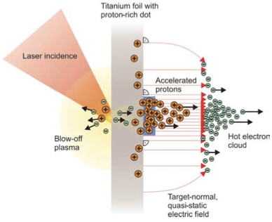
LhARA Initiative
Our mission is to:
Prove the feasibility of laser-driven hybrid acceleration
Deliver a systematic and definitive radiation biology programme
Lay the foundations for the transformation of PBT
  Automated, patient-specific proton and ion beam therapy
Notes:
Proposed Radiobiology research facility

Slide 3
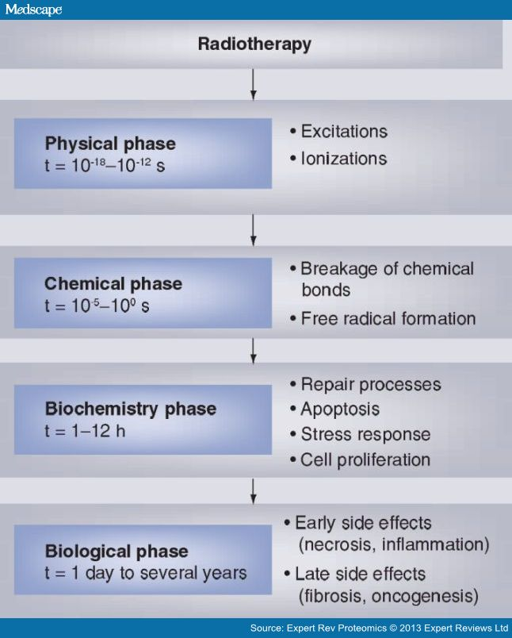
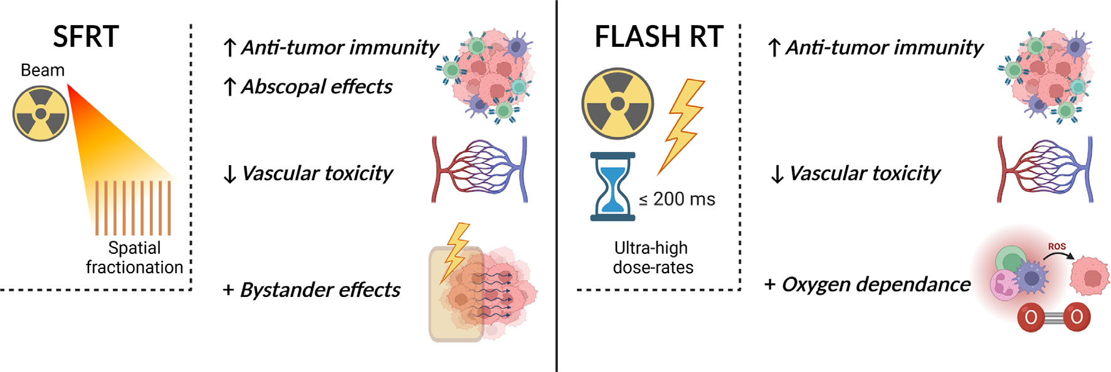
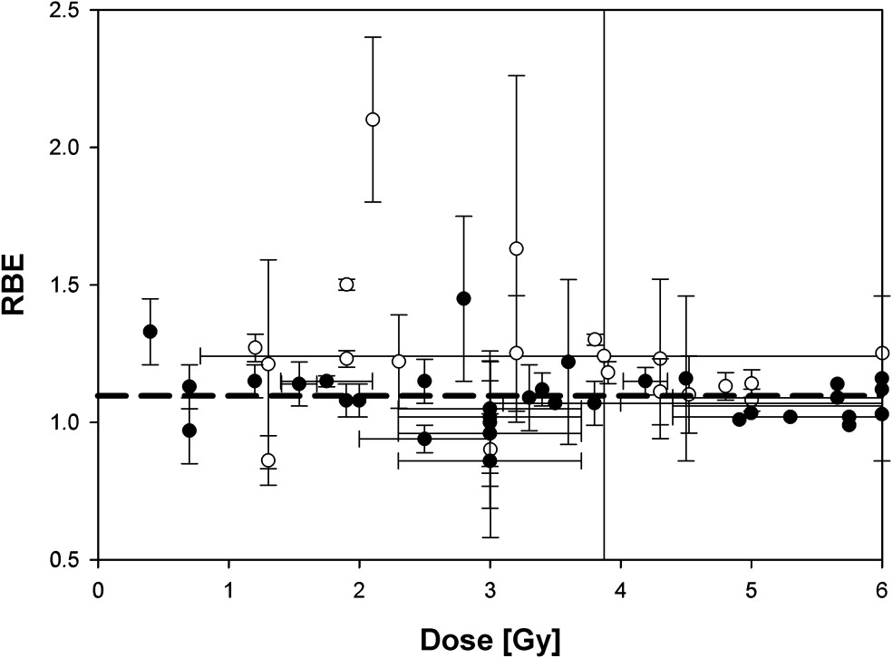
Radiobiology in New Regimens
Time
domain
Space
domain
The ideal
flexible beam facility
can deliver it all!
⇒ substantial
opportunity for a
step-change in
understanding!
T. Schneider, et al.
Improve understanding of RBE & maximise treatment efficacy.
Promising novel treatments
Mini-beams
FLASH RT (>40 Gy/s)
Ion
species
Energy
In combination
and with chemo/immuno therapies
Paganetti, van Luijk (2013) SemRadOncol
A multidisciplinary approach is essential
3

Slide 4
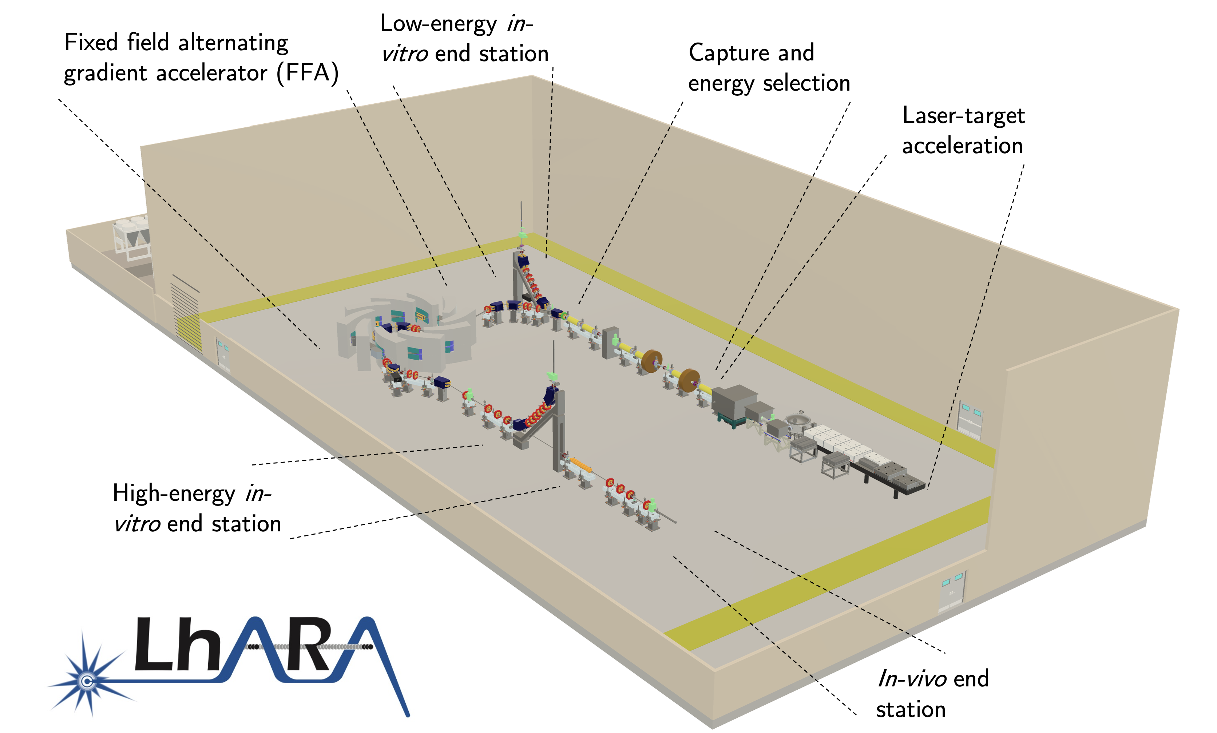
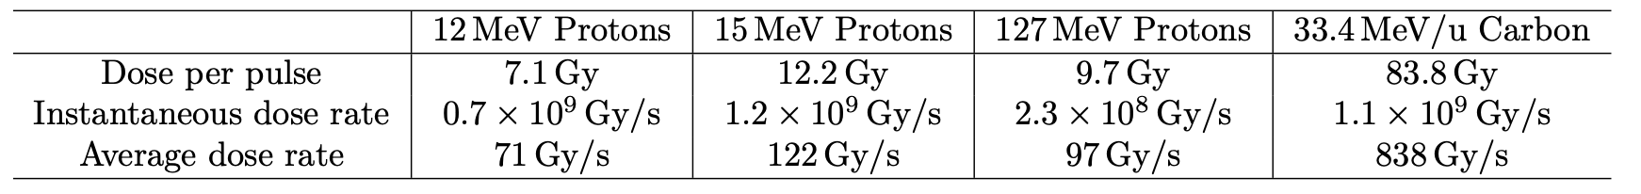
LhARA
Laser-driven, high-flux proton/ion source
  Overcome instantaneous dose-rate limitation
    Capture at >10 MeV
  Delivers protons or ions in very short pulses
    Bunches as short as 10—40 ns
  Triggerable; arbitrary pulse structure
Novel “electron-plasma-lens” capture & focusing
  Strong focusing (short focal length) without high-field solenoids
Fast, flexible, fixed-field post acceleration
  Variable energy
    Protons: 15—127 MeV
    Ions: 5—34 MeV/u
4

Slide 5
Funding Status
Transition period
  UKRI -> multi-funder portfolio approach
Resourcing model portfolio of co-investment and co-creation:
  Industrial partnership
    Including entrepreneurial/venture capital
  Research council:
    UKRI, EU, ERC, …
  Philanthropic/Foundation
Business plans:
  LhARA business plan
    Embodies common purpose
  Business plan for each partner or stakeholder
    Meets ambitions and KPIs of each partner
Submittable bid prepared by end of 2026.
LhARA
collaboration
Institutes
UKRI
EU/ERC
Industry
partners
Philanthropists
Foundations
…
5
Notes:
UKRI funding period ended May 2025
Co with stakeholders

Slide 6

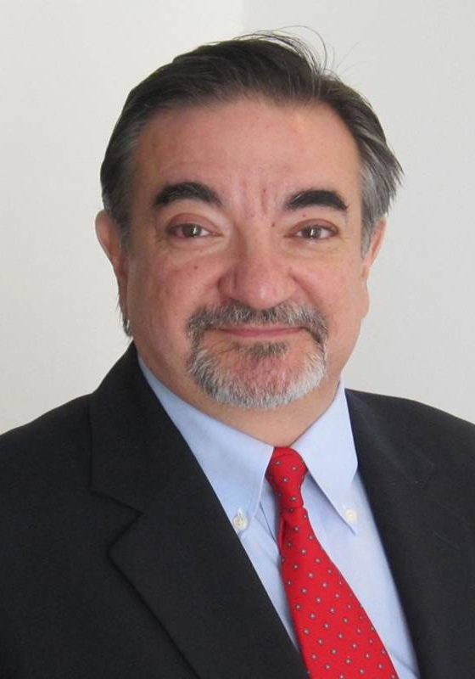
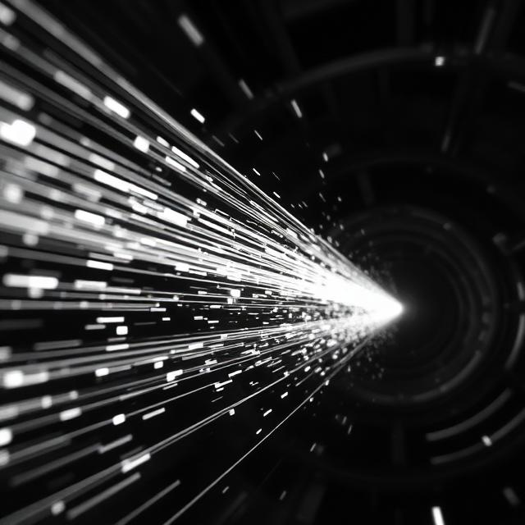
Project Structure
Co-spokes people:
Kenneth Long (IC) & Amato Giacca (Oxford)
Radiobiological Science and Technology
Institute Board Chairs:
Timothy Greenshaw, Yolanda Prezado
Programme managers:
Jason Parsons, Patricia Price, Colin Whyte
Science Board Chairs:
R. Bingham, K. Prise
Co-opted: Charlotte Jamieson
LhARA Project
Being refreshed!
50+ institutes as of April 2026
Leaders: R. Wilson (Strathclyde/CI),
Project Management, Outreach, & Engagement
6
Notes:
Arizona State
Ludwig-Maximilians-Universitat at Munich
Amato : Radiation Oncologist

Slide 7
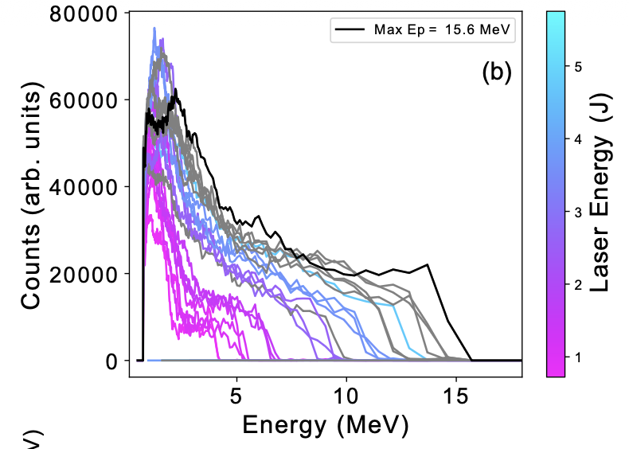
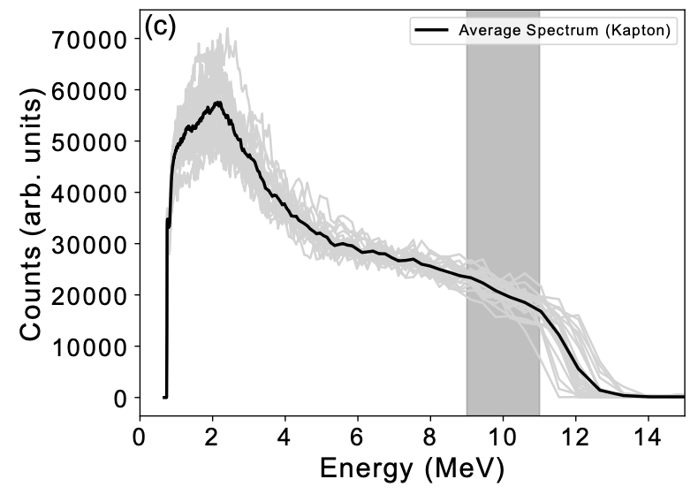
Laser-Driven Protons at SCAPA
TNSA mechanism
LhARA laser specification:
  800nm laser
  >10 J
  <50 fs
  <3μm (FWHM)
  10 Hz
Aim: 10⁹ protons at 15 MeV
LhARA laser source R&D :
  “Full-scale” tests in conditions approaching LhARA specification
    LhARA-focused diagnostic and target development
    High-repetition rate, automation and longevity studies
    Accurate numerical modelling 3D simulation codes
  Develop understanding and demonstration of ion beam production
Nick Dover (IC)
7

Slide 8
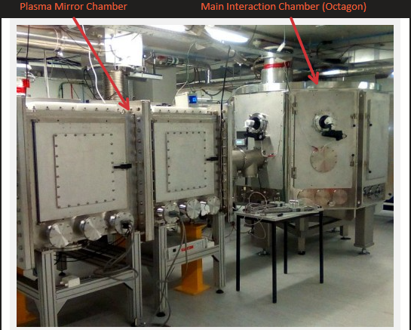
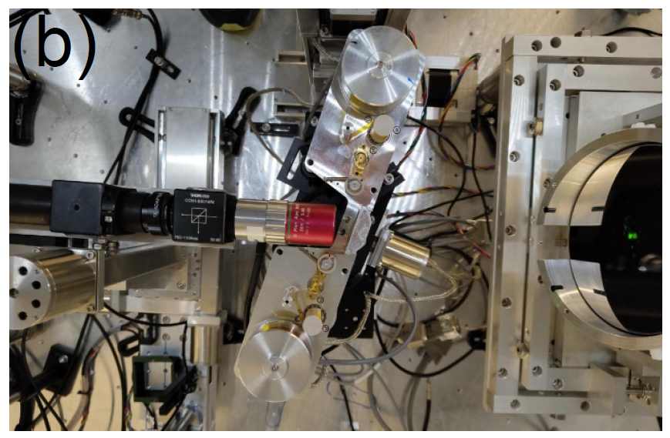
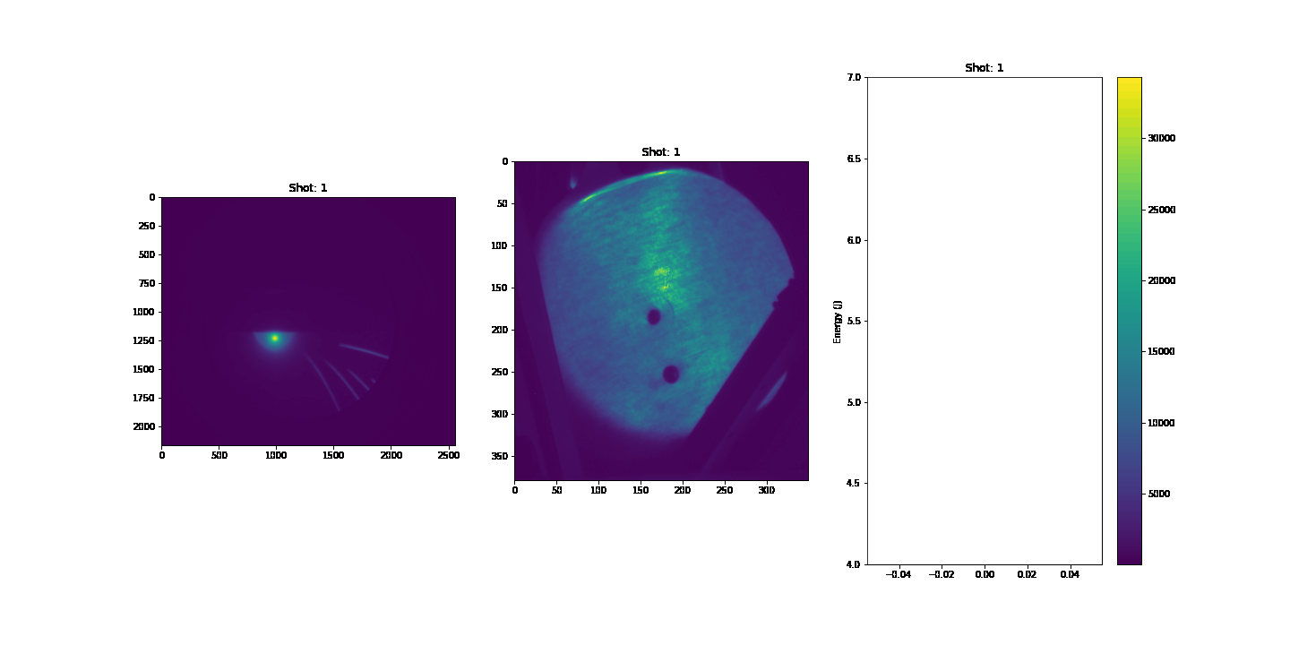
SCAPA Laser Stability
Endpoint energy
Shot number
8
Notes:
Scottish Centre for the Application of Plasma-based Accelerators
Higher energy stability more problematic – debris damaging focusing optics
Seen in poplar

Slide 9
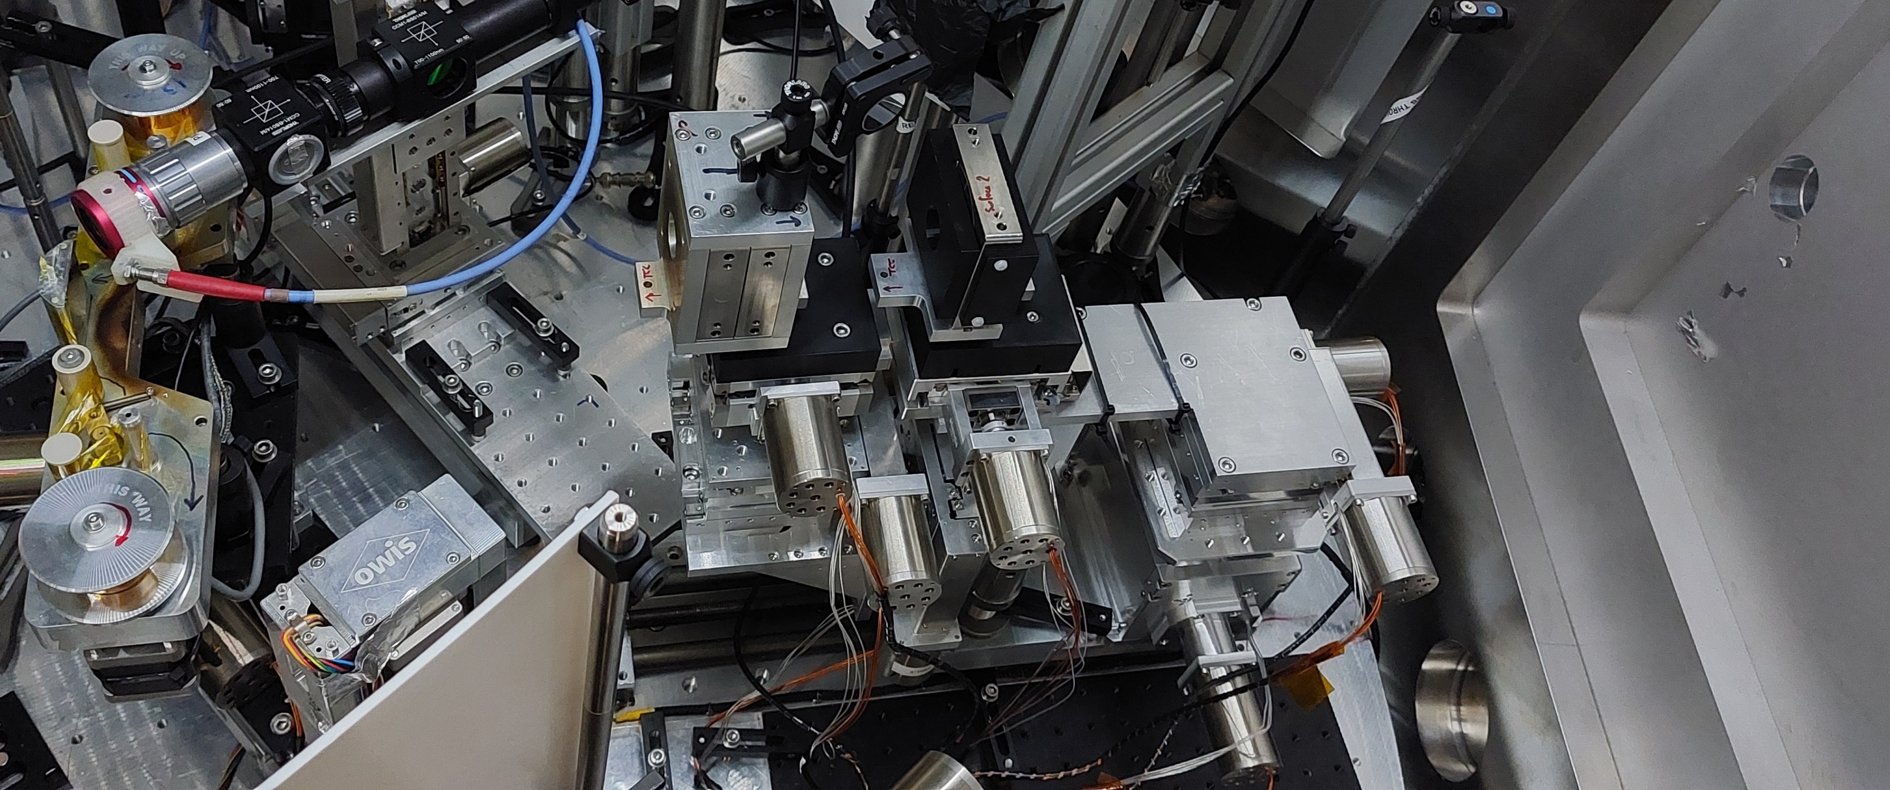
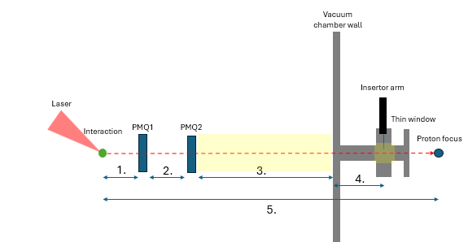
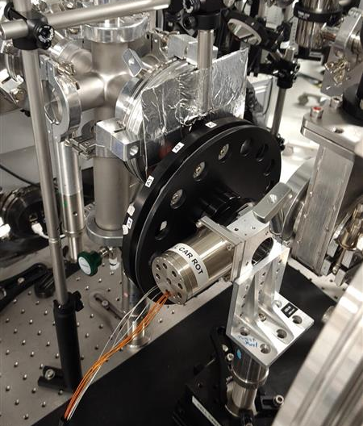
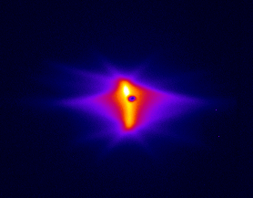
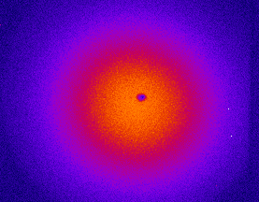
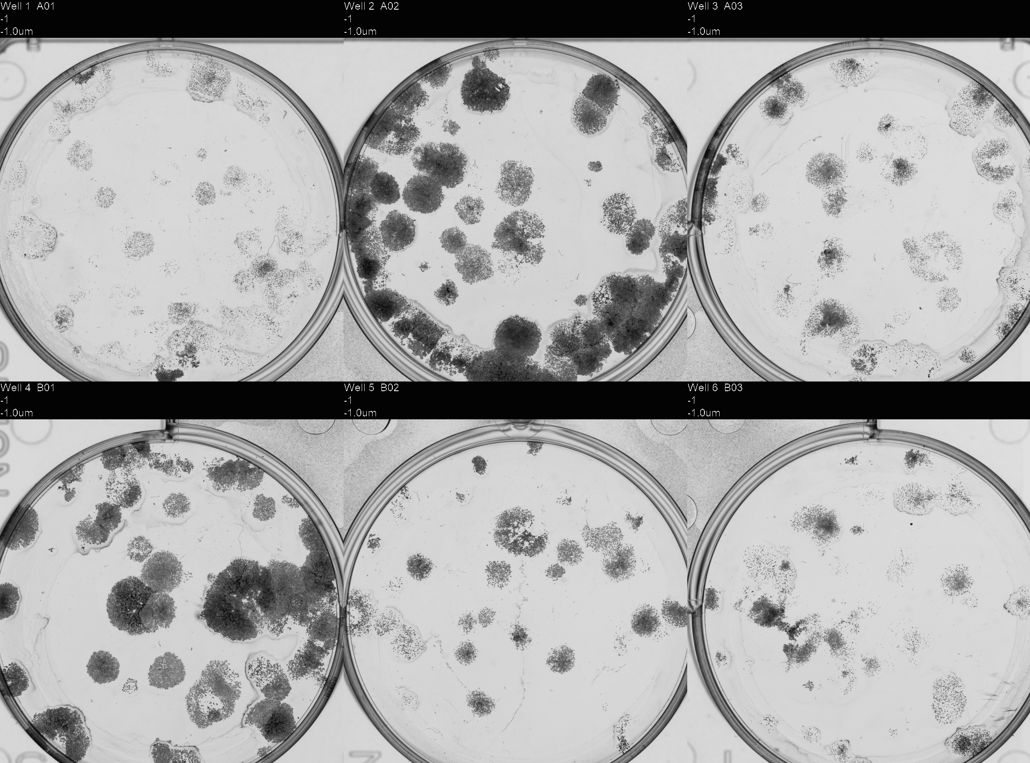
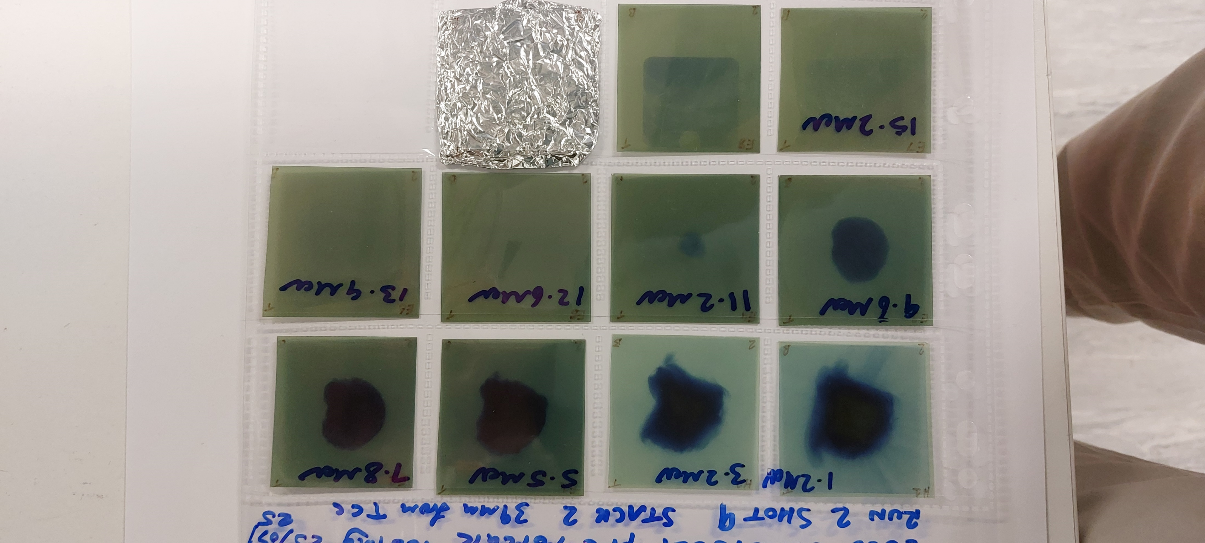
PoPLaR at SCAPA
Capture with 2 PMQs
RCF stack - dose delivery estimation
Carousel sample holder
Proton focus – Without Scattering foil
Proton focus – With Scattering foil
Irradiation experiments to determine cell survival curves
  Reproduce results from Birmingham cyclotron
  0, 1, 2, & 4 Gy
  Promising results, some uncertainty in delivered dose
J. McGarrigle (IC), Calvin Dyson (IC)
9
Notes:
Proof of Principle LhARA Radiobiology,
MRC bid unsuccessful, noted lack of biological data
Thomson parabola spectrometer
HeLa (cervical cancer) & FaDu (carcinoma)
Max energy ~ 10 MeV – grow cells on 2.5 µM Mylar in glass rings

Slide 10
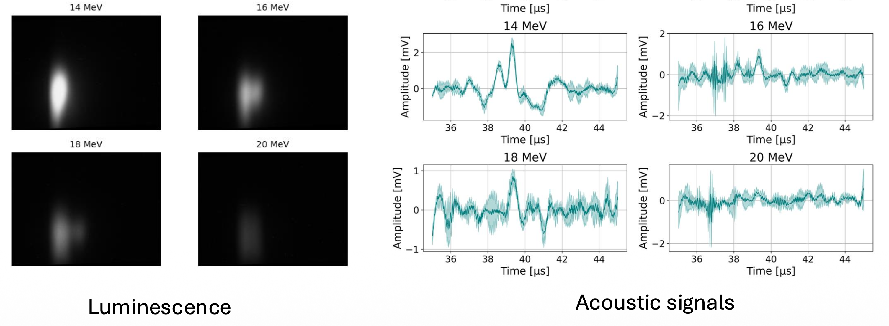
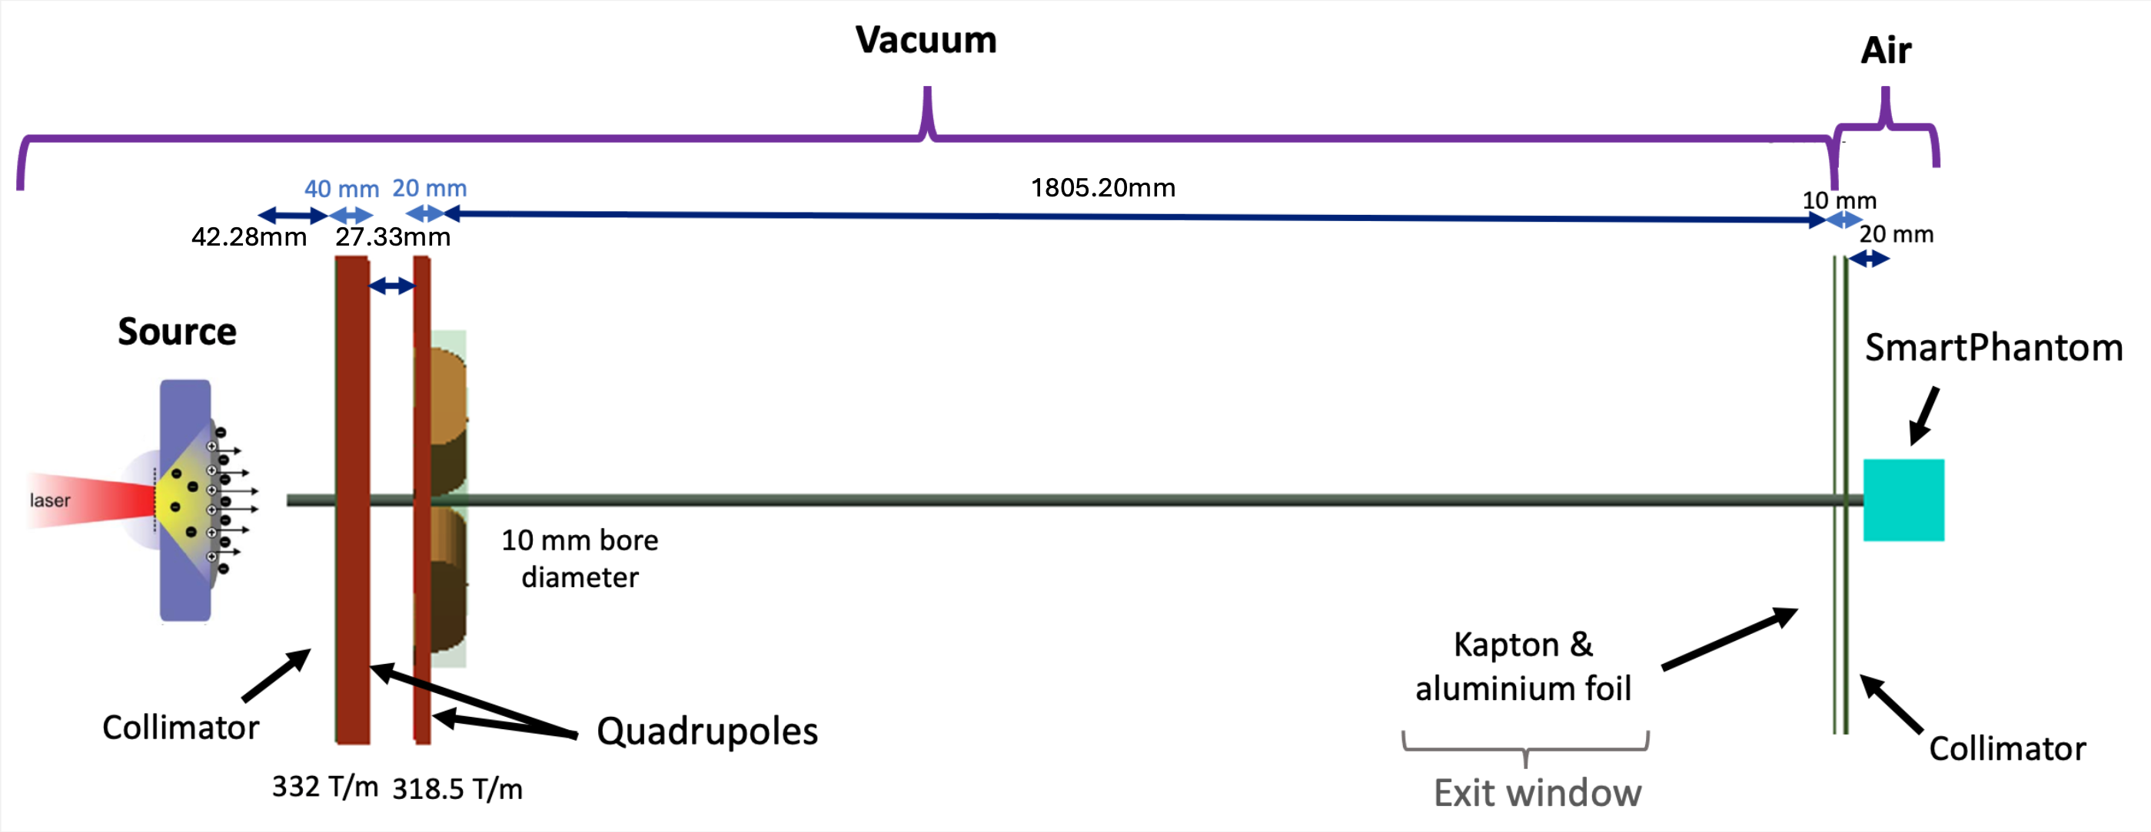
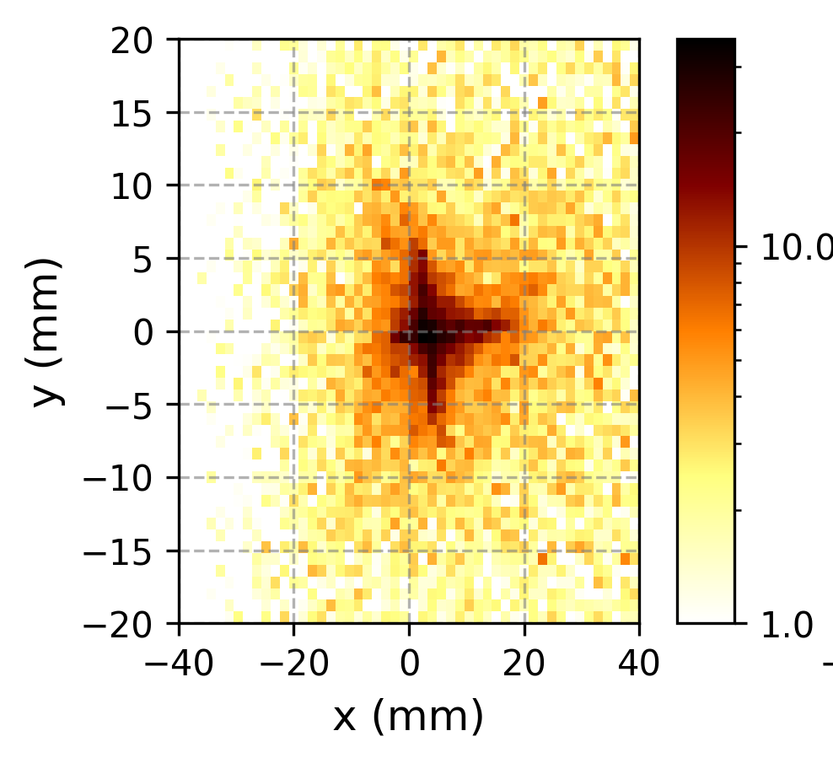
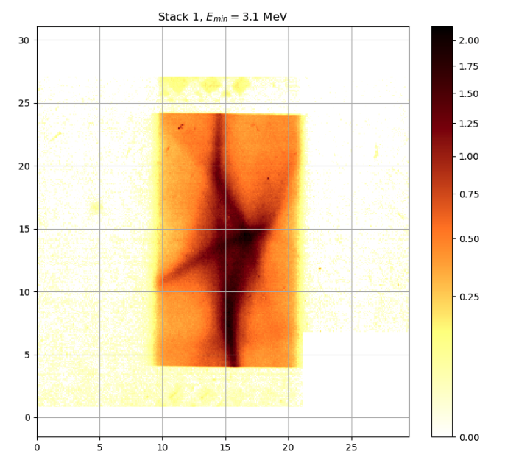
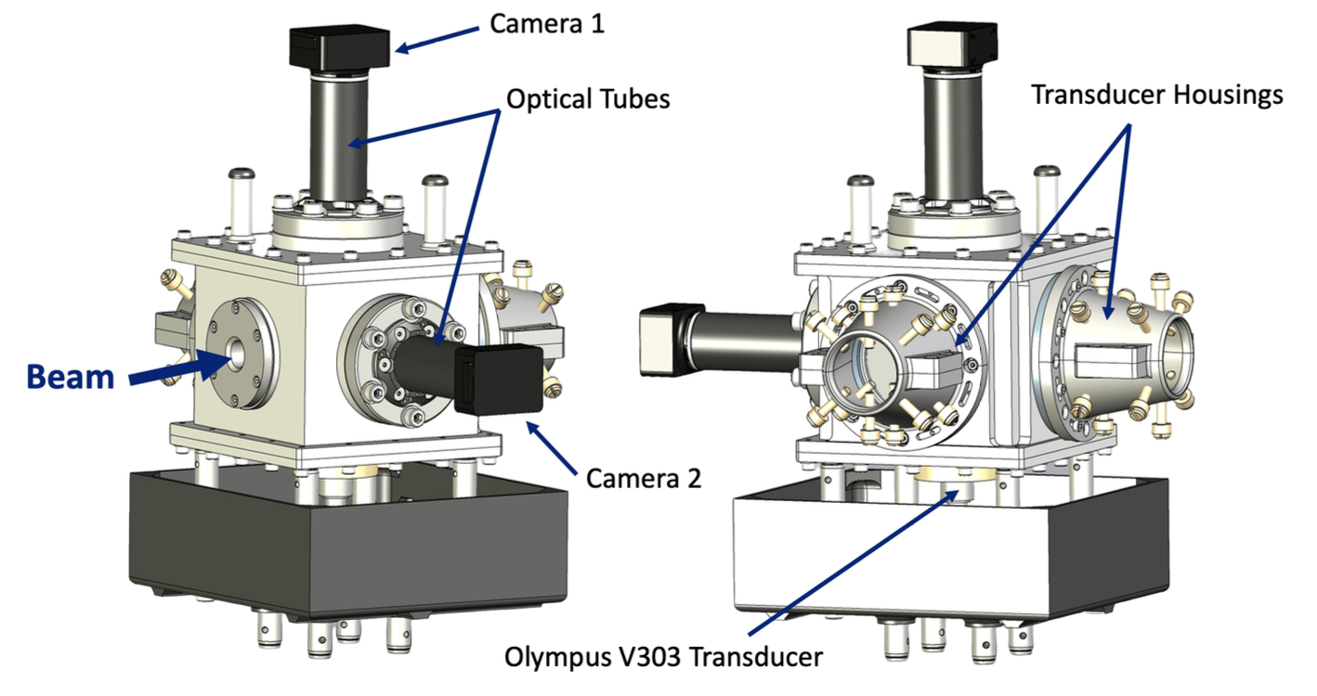
Ion Acoustic Dose Profiling
Energy deposited (MeV)
Test exposure on LION at LMU
Correlation: liquid scintillator and acoustic signal (transducer)
Match experimental data to simulation (k-Wave & Geant4)
Beamline modelling quad shifts & tilts, optics modelling
Closer working with PoPLaR experiments
M.Maxouti (IC), J. McGarrigle (IC), C. Dyson (IC)
10

Slide 11
LhARA Accelerator
W. Shields (RHUL), M. Pereira (RHUL), J. Pasternak (IC), T-J Kuo (IC), R. Razak (IC)
11

Slide 12
Gabor Plasma Lenses
Peak densities:
140V trap ≈ 8x10¹³ m⁻³
400V trap ≈ 1x10¹⁵ m⁻³
Demonstrate plasma size and stability for LhARA Gabor Lens
Match to simulations
Integration into LhARA beamline modelling
Optimise: e-gun bias, magnetic field, trap potential, RF amplitude, dimple depth …
Calvin Dyson (IC)
12

Slide 13
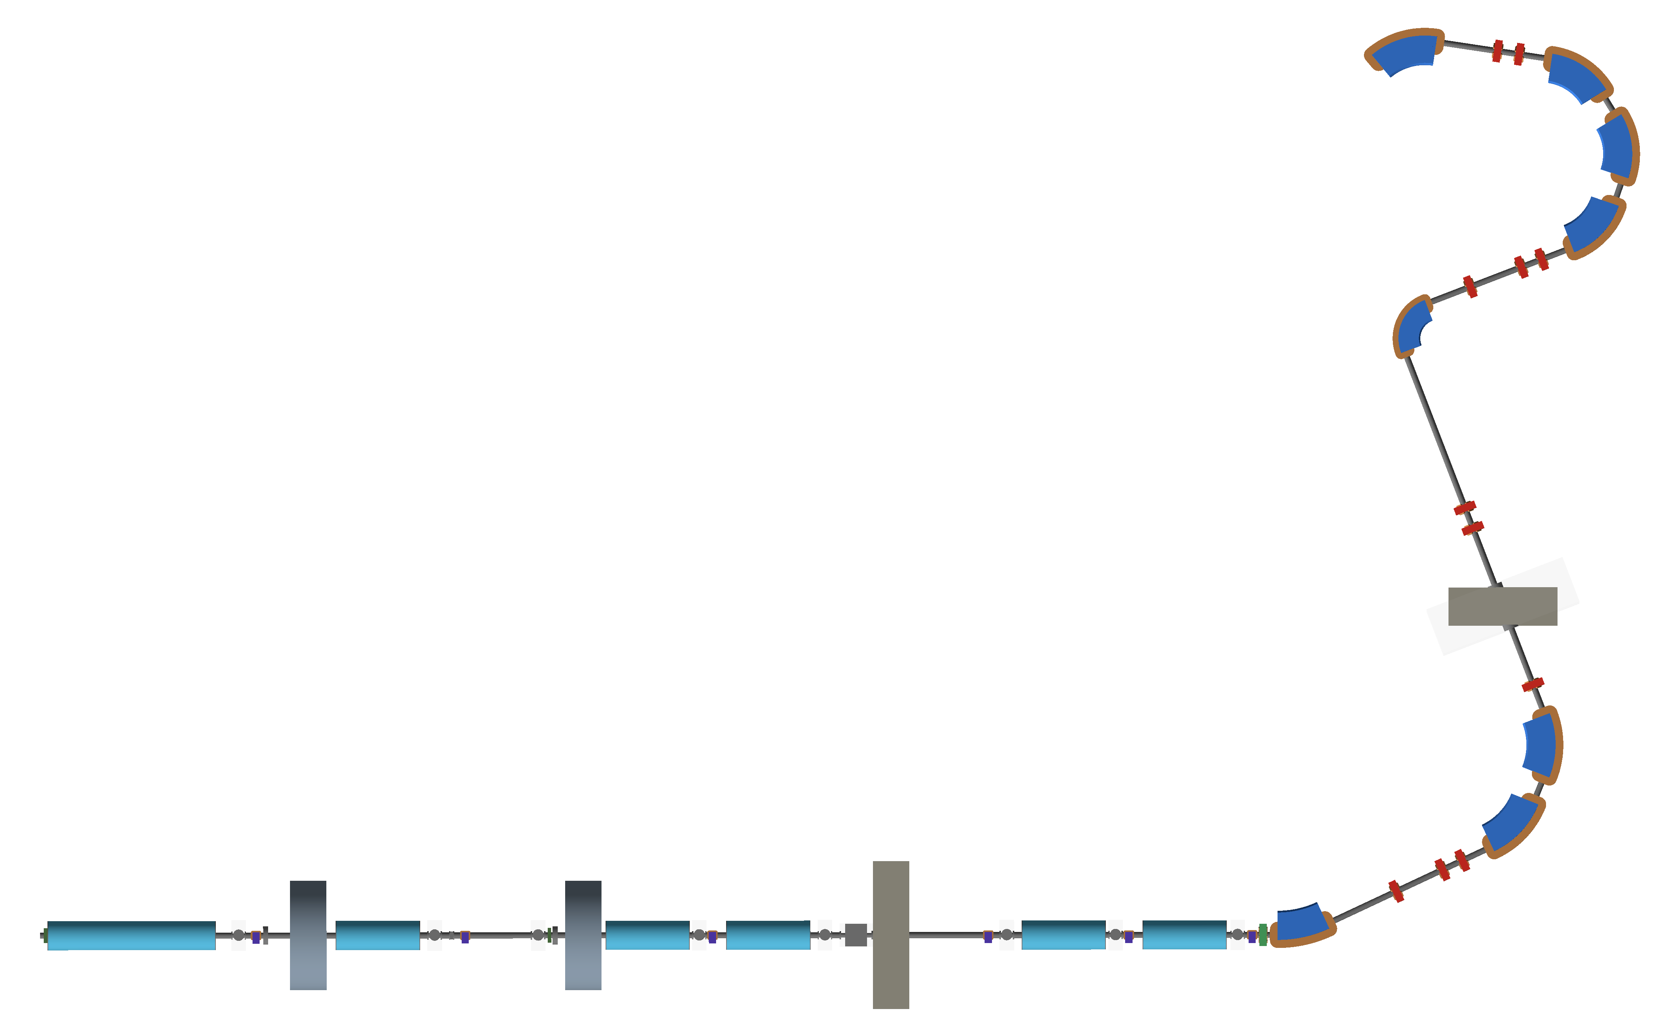
FFA Injection Line Design
New simulation strategy: BDSIM– RF-Track coupling - in development
  Losses (BDSIM) with space-charge tracking (RF-Track)
  Injection line optimization required.
M. Pereira (RHUL), W. Shields (RHUL)
13

Slide 14
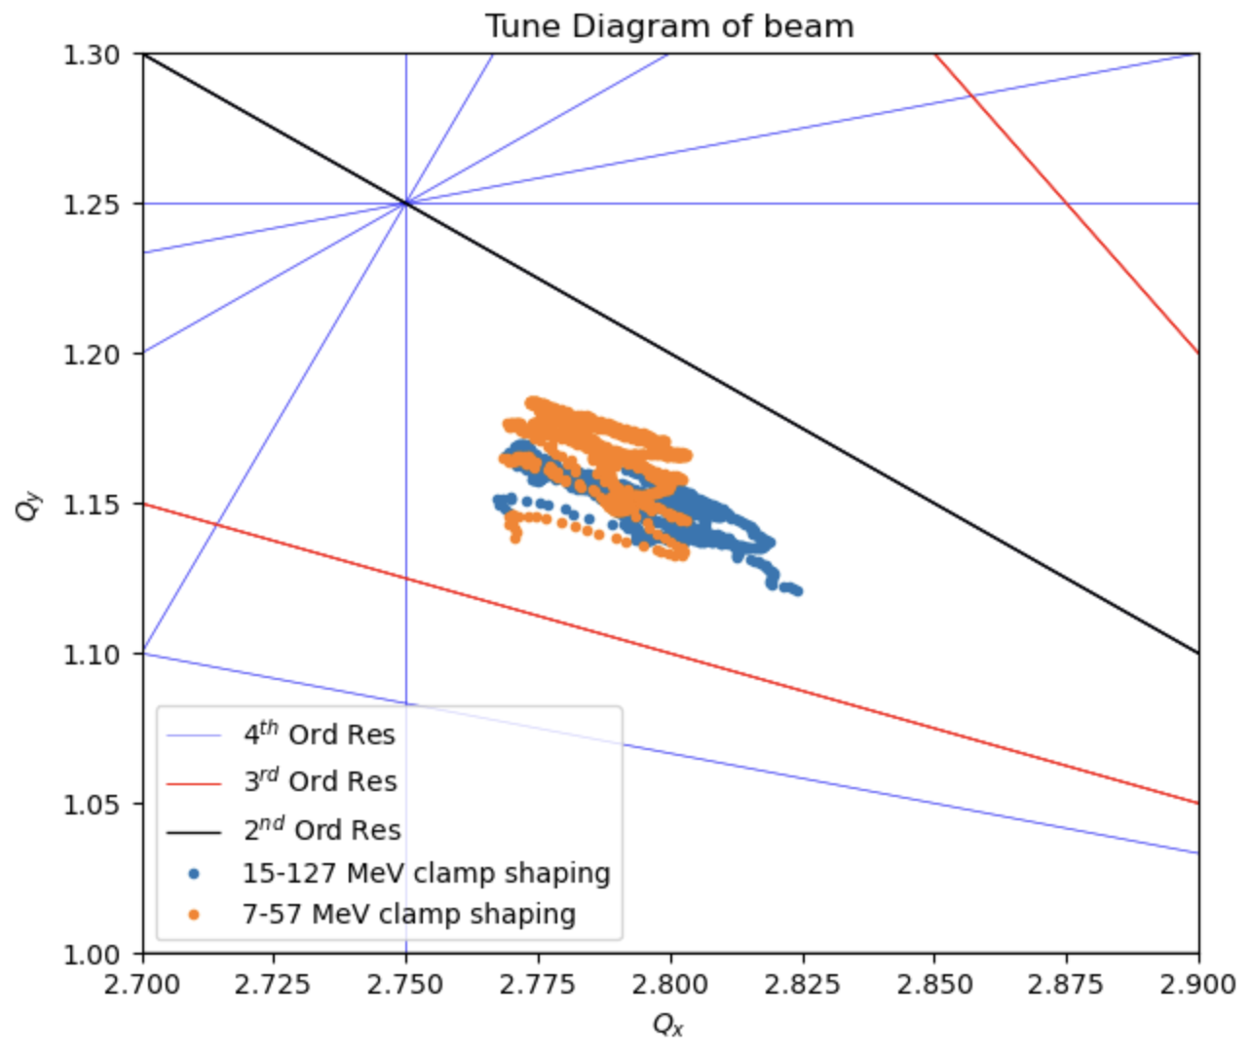
FFA Design and Tracking
LhARA FFA
10 cells
2 MA loaded RF cavities
Variable-energy FFA
10 cell, single spiral design
Multi-ion capability
Single spiral design
Max field ~1.4 T
  Tunable
2 MA/ferrite loaded RF cavities
Tracking:
No tune crossing up to fourth order
Transverse dynamics (4D) are well modelled
Space-charge & longitudinal dynamics requires further effort
T.J. Kuo (IC), J. Pasternak (IC)
14

Slide 15
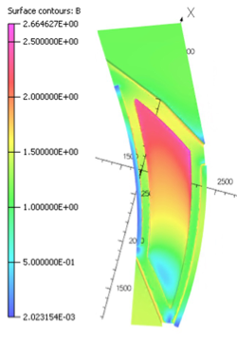
FFA Magnet Design and Simulation
OPERA 3D magnet model
Optimised configuration of field clamps and trim-coils
T.J. Kuo (IC)
15

Slide 16
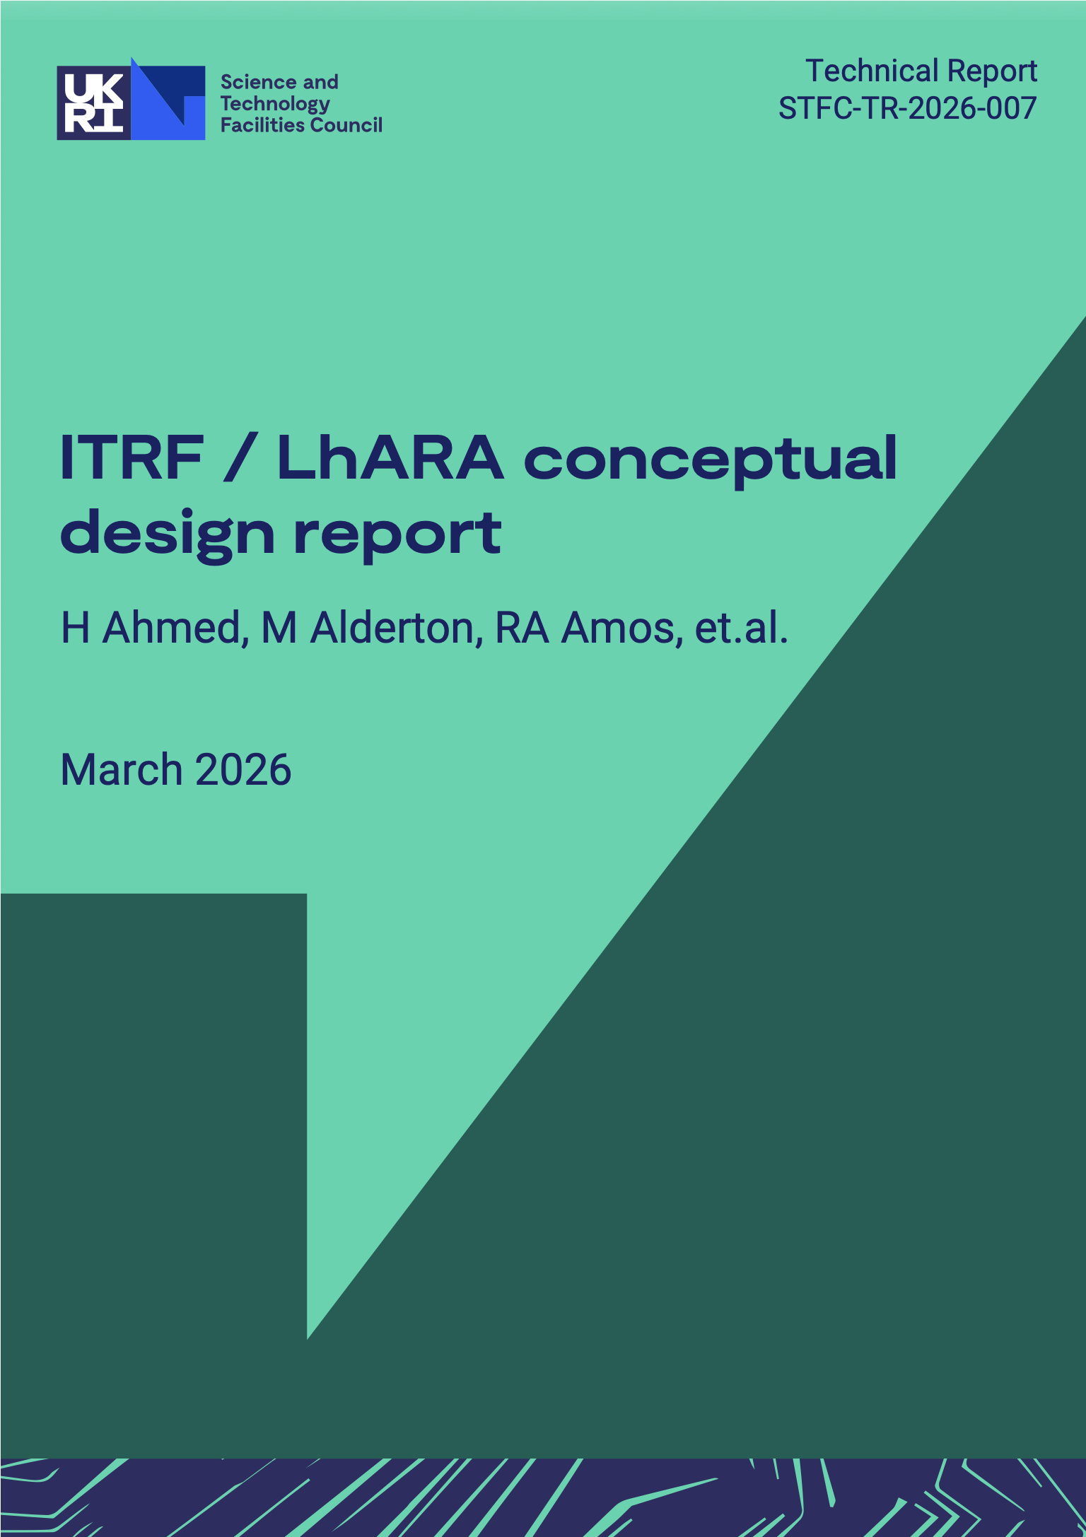
Publications
The LhARA Conceptual Design Report has been published!
  https://epubs.stfc.ac.uk/work/64272701
Publication drive:
  LhARA – Frontiers
  Plasma Physics and Controlled Fusion
  Ion-acoustic
  Accelerator papers
16

Slide 17
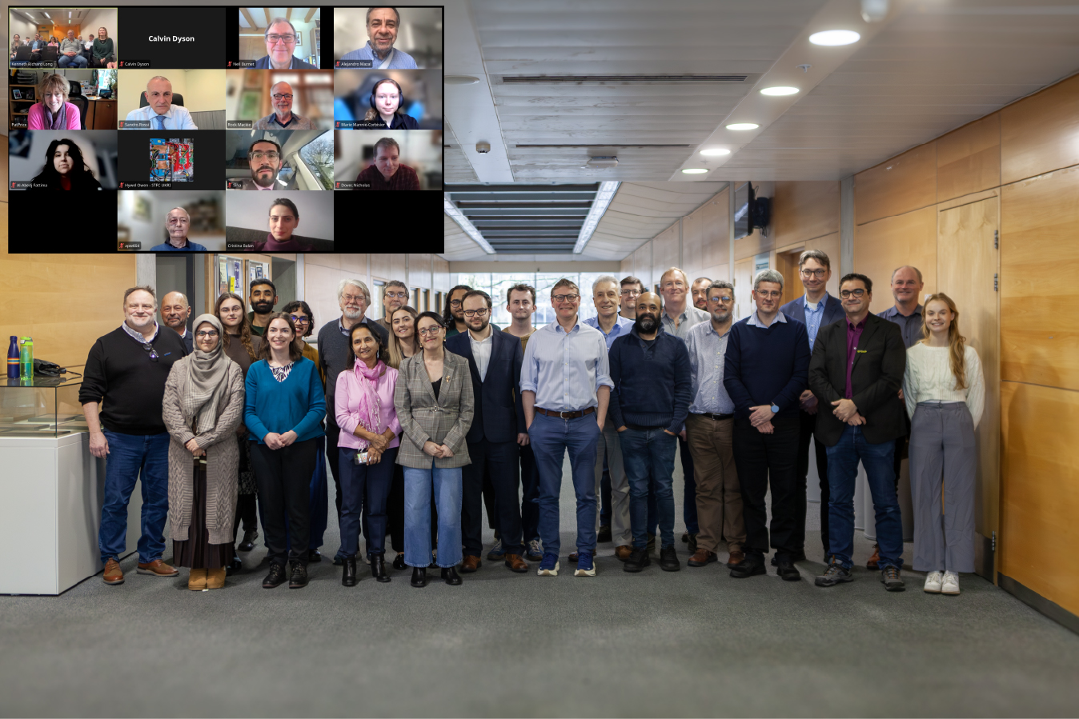
Peer-Group Meetings
Engagement: International stakeholders: clinical, biological science, industry, policymakers
Aim: Establish strategy for the development of laser-driven charged particle beams for cancer therapy.
Outcome: “white paper” publication and road map.
Workshop series:
LhARA Particle Therapy Workshop - 27/02/26
Cylindrically-symmetric strong focusing of ion beams;
Novel time-resolved and high-resolution imaging; and
Biology, measurement, simulation and interpretation of ion beams.
LhARA Particle Therapy Workshop
Review state of the art in particle beam therapy
Discuss benefits of laser-driven beams and its potential to revolutionise particle therapy
Identify key biological & clinical science to be addressed for personalized laser-driven ion therapy.
Invited talks: Alejandro Mazal, Sandro Rossi, Yolanda Prezado, Joao Seco, Marco Durante, Manjit Dosanjh, Konrad Nesteruk, Thomas (Rock) Mackie, Alexander Gerbershagen.
https://indico.stfc.ac.uk/event/1703/
17

Slide 18
LhARA Future
Systematic programme including PoPLaR, ion-acoustic dosimetry, automation, ...
Radiobiological Science and Technology
LhARA Project
Laser-driven source, Gabor Lens, FFA, LhARA design and integration, ...
Co-creation: engagement, impact,
& business planning
Peer-group meetings, business plans,
resource portfolio
18
Notes:
Consultant: Christopher Townsley – STFC

Slide 19
Summary
Committed and growing collaboration despite funding uncertainty
Excellent progress on
  Radiation biology programme:
    Development of PoPLaR at SCAPA
  LhARA project:
    Source (rep rate, stability), capture (10¹⁵/m³), ion-acoustic, diagnostics, design and integration
  Engagement:
    Industry, peer-group workshops, public, …
Continue undertaking LhARA initiative, build business plan.
  Multi-funder resourcing portfolio model
19

Slide 20



Thank you for listening!
William Shields
william.shields@rhul.ac.uk
JAI Advisory Board 2026
16th April 2026

