Slide 1

STELLA and FLASH therapy Manjit Dosanjh
JAI Advisory Board Meeting
16 April 2026

Slide 2
Update on STELLA and VHEE
STELLA (Smart Technologies to Extend Lives with a Linear Accelerator)
Global multidisciplinary collaboration with CERN, Cambridge, Oxford, Lancaster, STFC, Europe, USA, Canada and ART Study (former Soviet-Union Countries funded by NNSA-DOE) under ICEC (International Cancer Expert Corps) an NGO in USA
One year STELLA Status and Strategy 9-10 July, CERN
Linac and MLC fault analysis: Oxford, Exeter and Cambridge
ML and AI in speeding up treatment (Cambridge, Lancaster, Oxford) grass-roots data from Ghana and Pretoria
SAPPHIRE (Supra-African Physics Partnership for Health Innovation and Radiotherapy Expansion)
Funded by STFC –UKRI a training grant for 2 years lead by Oxford with Cambridge and Lancaster to train young medical/physicists in state of art radiation therapy technologies in Pretoria, South Africa and Ghana.
Visit by CEOs of STFC, IoP and APS to discuss SAPPHIRE in Accra, Ghana
First Training workshop on hardware in Accra 13-17 April lead by Graeme Burt (Lancaster)
Second workshop on software in Pretoria, 7-11 September will be organised by Raj Jena (Cambridge)
VHEE FLASH Activities (Very High Energy Electrons (50-250 MeV)
CLEAR Collaborations with CERN, Geneva, CLARA, Daresbury (Roberto Corsini and Deepa Angal-Kalinin groups)
VHEE UHDR Dosimetry and Beam Monitoring (CLEAR, UCL and Oxford LWFA (Laser Wake Field Accelerator)
VHEE Dose Delivery (CERN, Oxford, UViC, Canada, Magdalena Bazalova-Carter group)
Biological effects (HUG-Marie-Catherine Vozenin’s group)

Slide 3
STELLA project
Smart Technologies to extend lives with linear accelerators

Slide 4


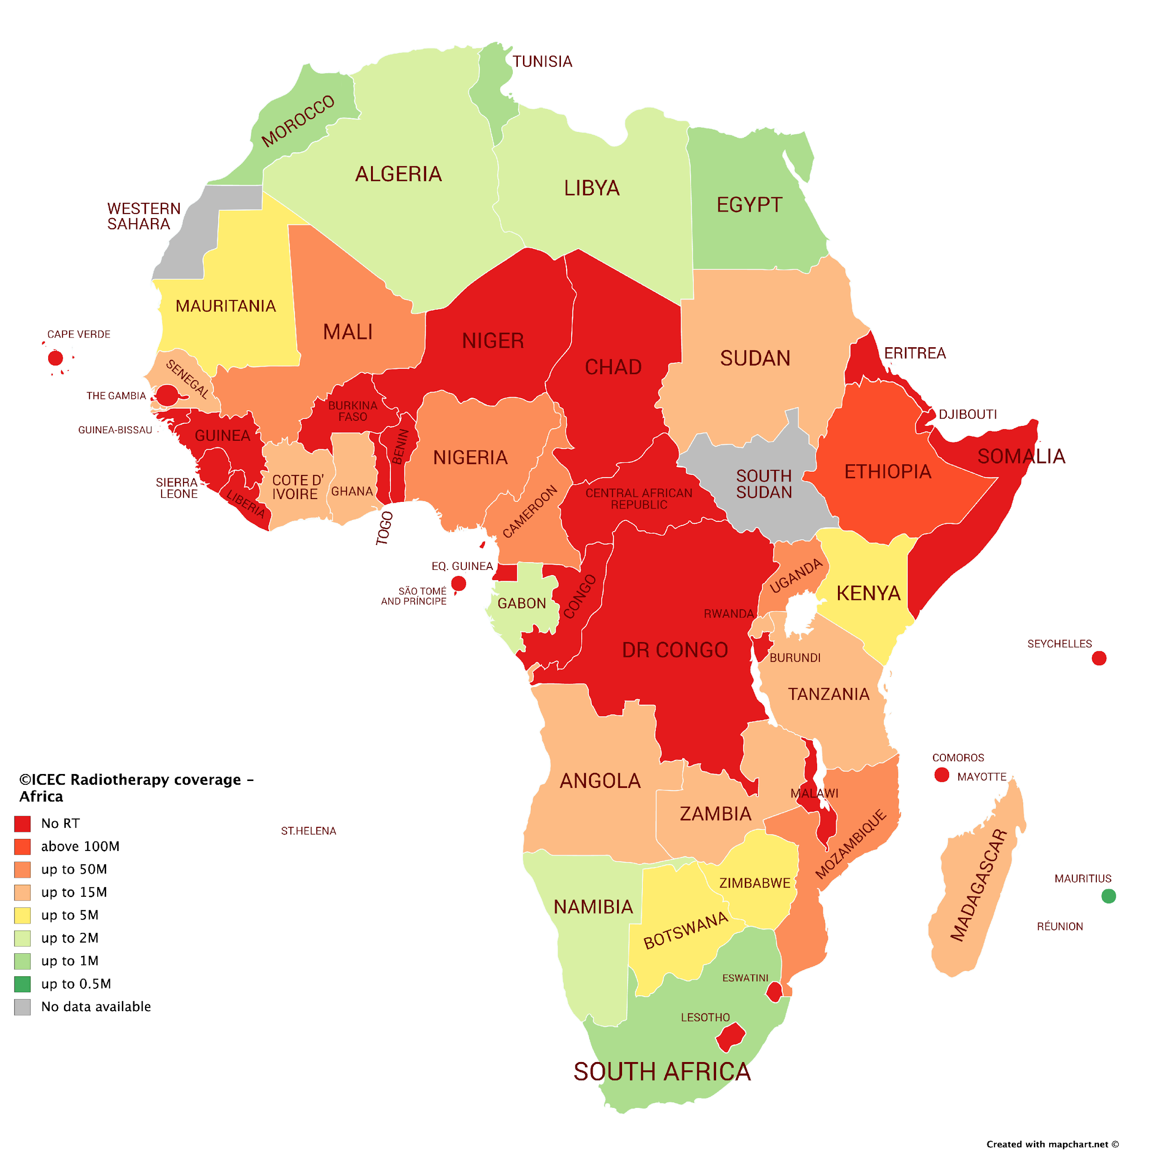
The Project STELLA is dedicated to:
Expanding access to high-quality cancer treatment globally
Transforming LINAC radiotherapy with new hardware and AI
Reducing the cost barrier of RT and cancer care
An enhanced training, education and mentoring program that catalyses RT implementation in the global context

Slide 5
STELLA – Current Status
MD is the STELLA coordinator, STELLA global meeting at CERN, 9-10 July 2025
Work on-going in Developing STELLA facility at UK Universities:
Design specification of the STELLA machine: hardware (accelerator, Collimator)
Designing an AI powered smarter radiotherapy machine: increase reliability and reduce the number of experts needed and improve uptime
Impact opportunities for STELLA
Presented at the Pontifical Academy in the Vatican
Ugo Amaldi’s 90th anniversary as one of the founders
Armanc Karakoyun new PDRA for MLC work at Oxford

Slide 6
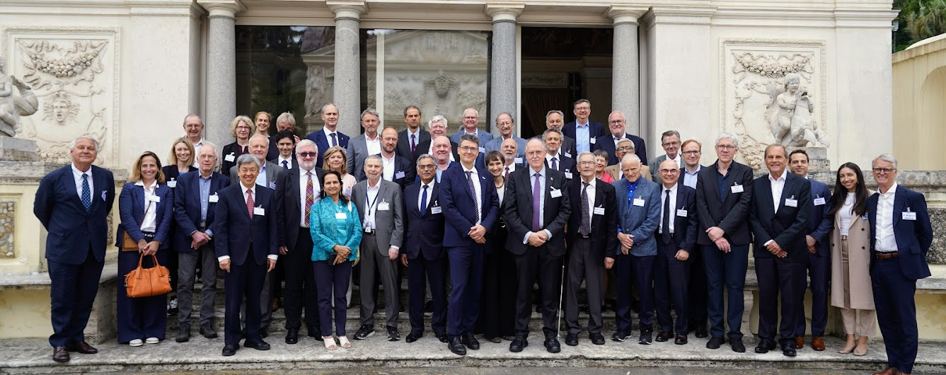

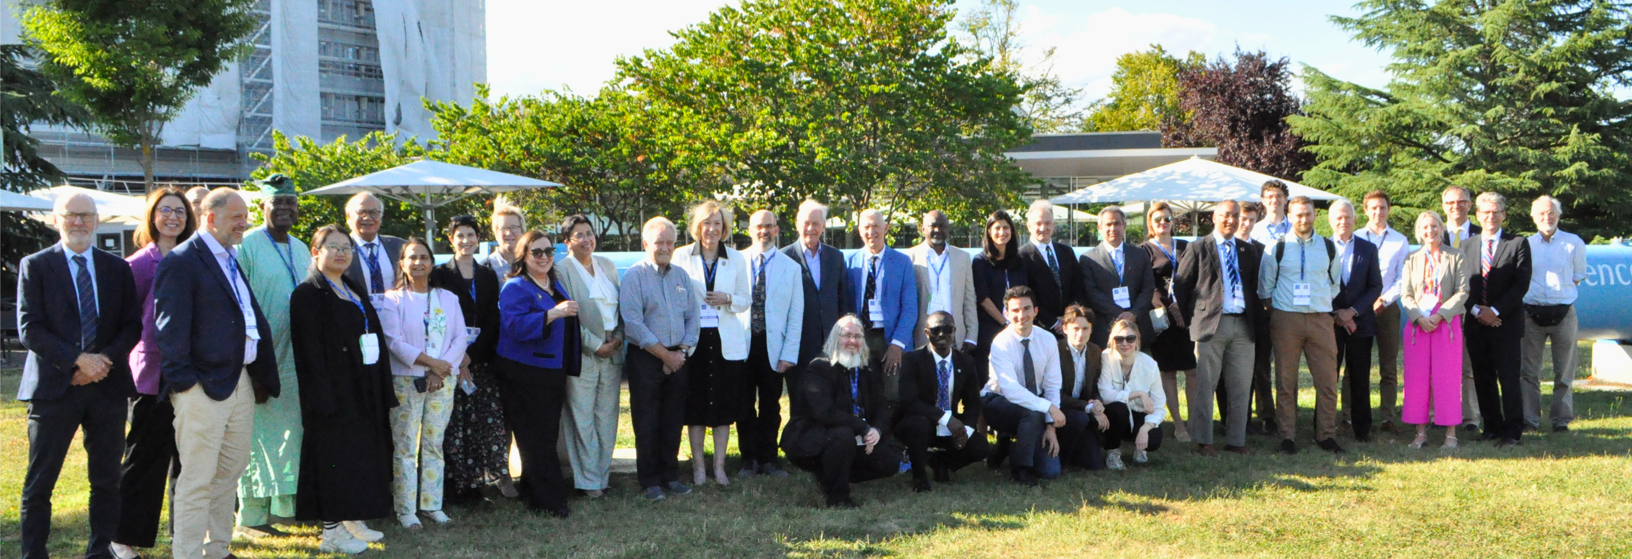
STELLA at Vatican and CERN

Slide 7
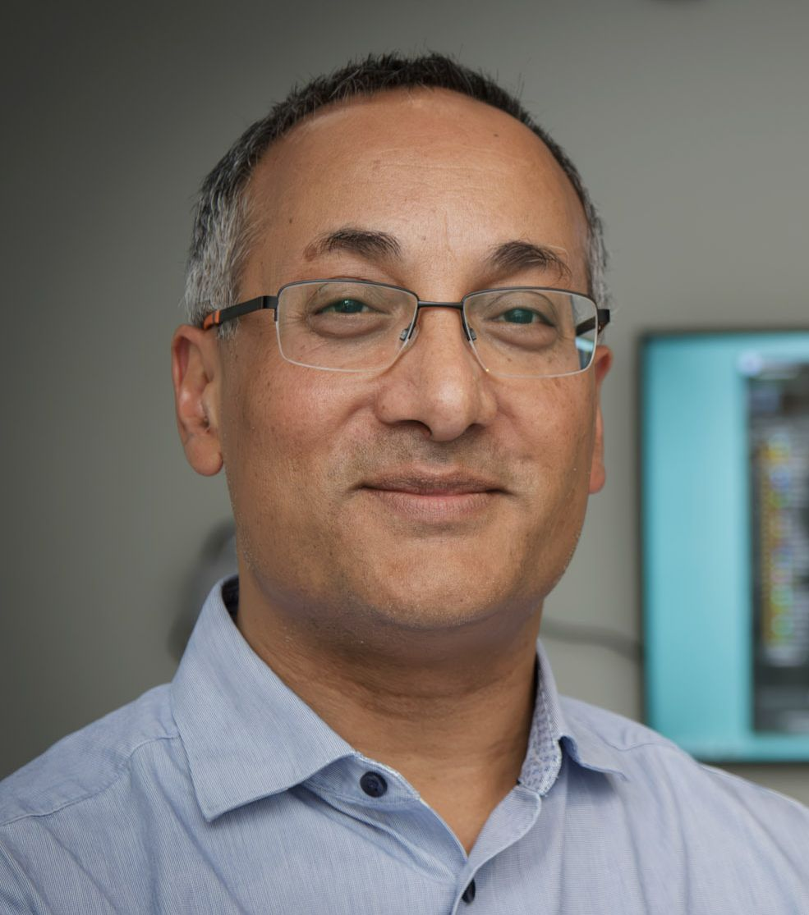

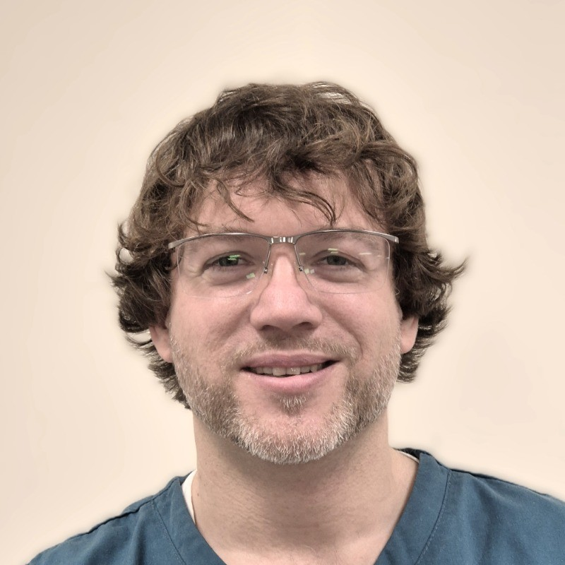
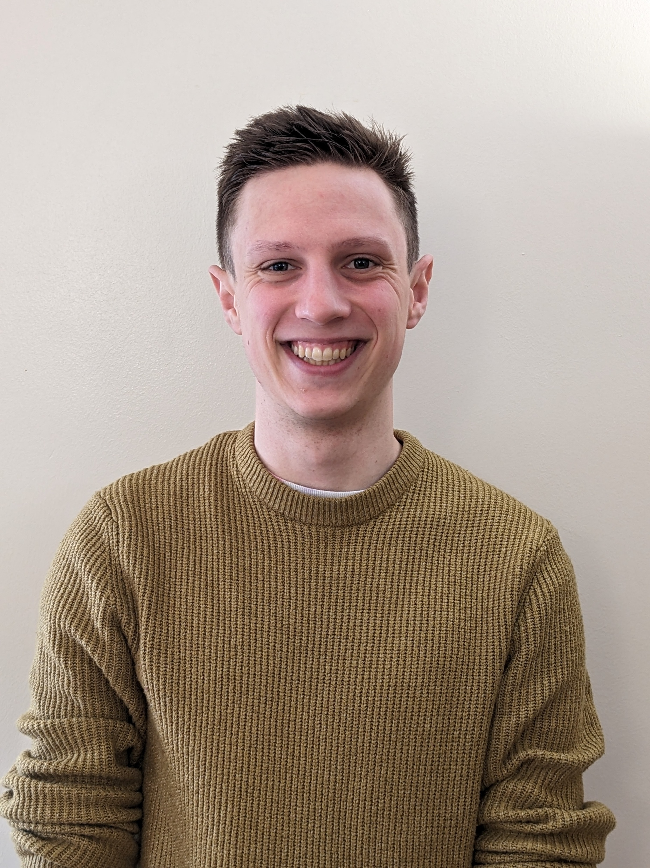
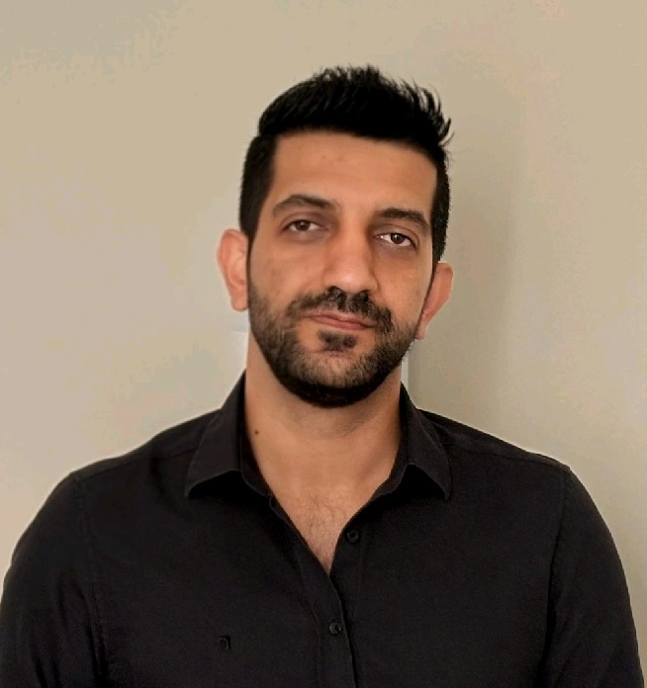
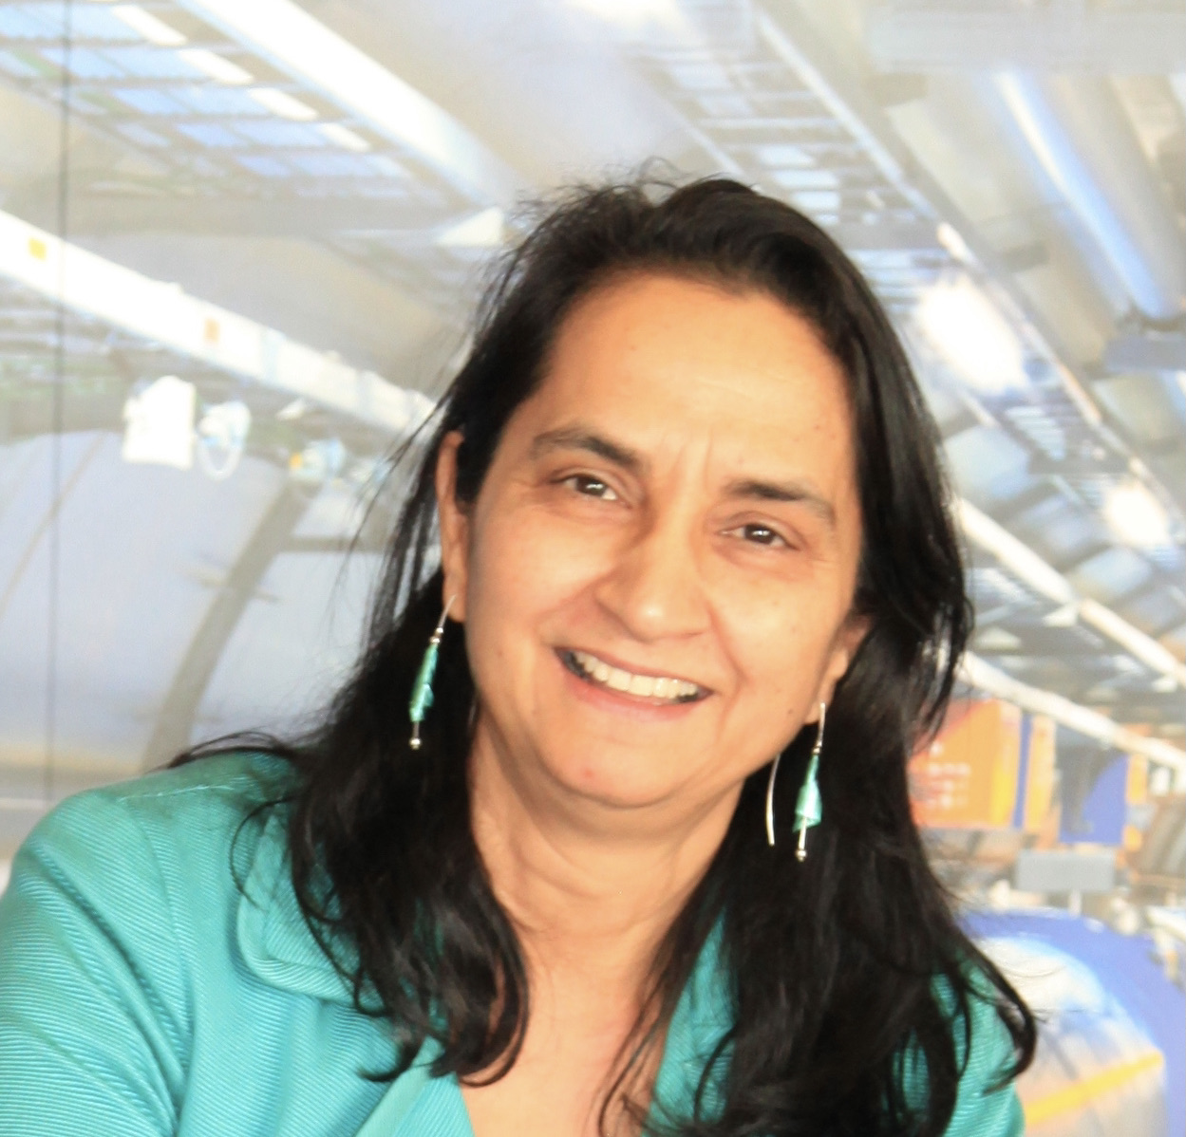



Examining role of AI and ML in cancer treatment STELLA Collaboration between Cambridge, Exeter, Oxford and CERN
Raj Jena, Cambridge
Xin (Doris) Du, Cambridge
Torsten Liebig, Royal Devon NHS, Exeter
Samuel Leadley, Oxford
Armanc Karakoyun, Oxford
Manjit Dosanjh, Oxford

Slide 8



Armanc Karakoyun | (PDRA, JAI, Oxford)
PhD in medical robotics at Heriot-Watt University (Thesis Defence: 9 April 2026)
Thesis Topic: Design, Miniaturization, and Robotic Integration of a Spiral-scanning Endoscopic Probe for Laser Ablation
MSc in AI & Robotics at Korea Institute of Science and Technology
Thesis Topic: Design and Development of Surgical Instruments for Robot- Assisted Biportal Endoscopic Spine Surgery (BESS)
Role at Oxford
Designing and prototyping fault-resilient multileaf collimators (MLCs) tailored for medical linear accelerators in challenging environments.
Performing computational simulations (e.g., Monte Carlo, CAD kinematic analysis) and mechanical stress tests to optimize leaf profiles and drive mechanisms, minimizing radiation leakage and ensuring long-term operational reliability.
Collaborating with multidisciplinary international consortiums to define system requirements, integrate mechatronic components, and translate laboratory prototypes into viable, low-maintenance clinical solutions for low-resource settings.

Slide 9
STELLA AI and Machine Learning
Large language models to read medical reports and predict optimum treatment pathway for each patient
Computer vision algorithms to process images and automate production of high-quality radiotherapy plans
Physics informed neural networks to enhance quality of images produced by linacs (cone beam CT)
Fault prediction from radiotherapy linac telemetry to reduce unscheduled downtime

Slide 10
Fault Prediction in Radiotherapy Linacs (Sam Leadley)
Variational Autoencoder machine learning model can take in radiotherapy machine data and predict future machine faults
Optimised dual-classifier model can distinguish upcoming faults with 86+% overall accuracy, including probabilistic predictions
Collaboration with Exeter, Oxford and Cambridge hospitals
Presented research at VHEE25’ conference in Daresbury, September 2025

Slide 11
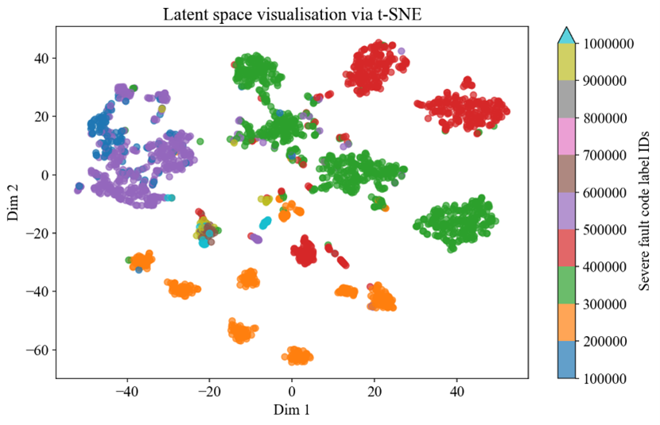
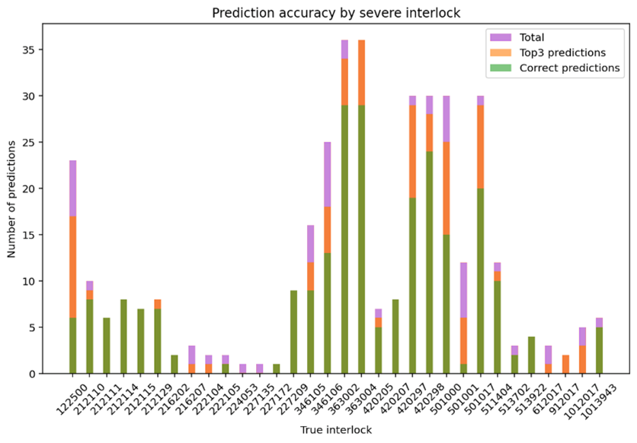
Prediction with VAE model shows distinction between similar fault modes (right)
Accuracy varies by fault mode, but remain generally high
Correct fault mode almost always in top-3 most likely predictions

Slide 12
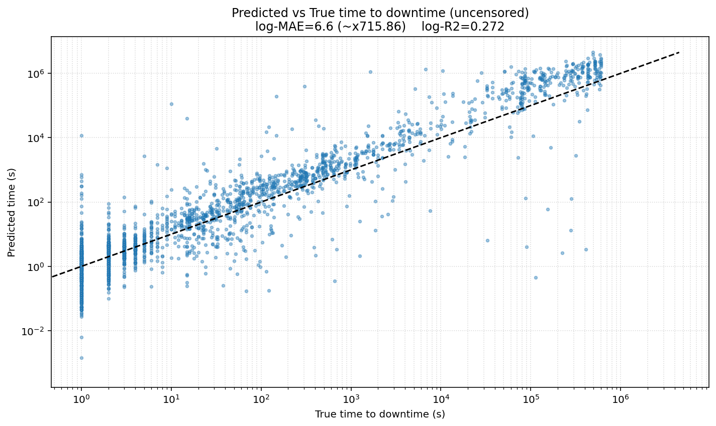
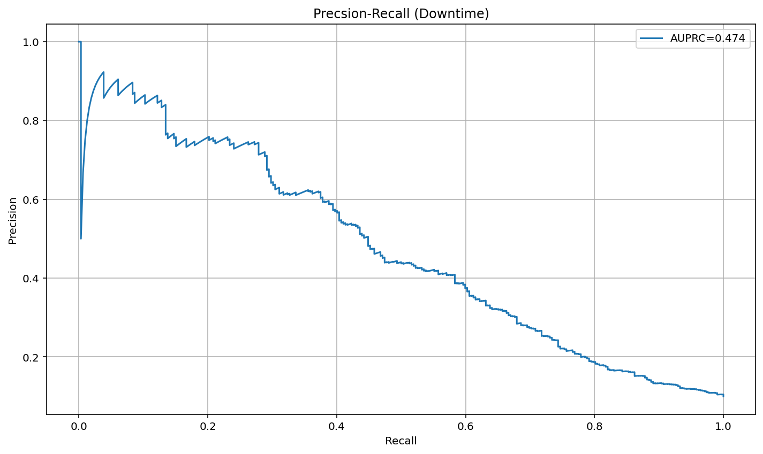
New transformer-based method can predict time-to-downtime of radiotherapy machines
Current model accuracies are low-medium, but with significant scope for improvement
Focus is on prediction of downtime modes AND times.

Slide 13
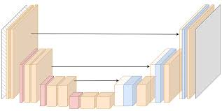
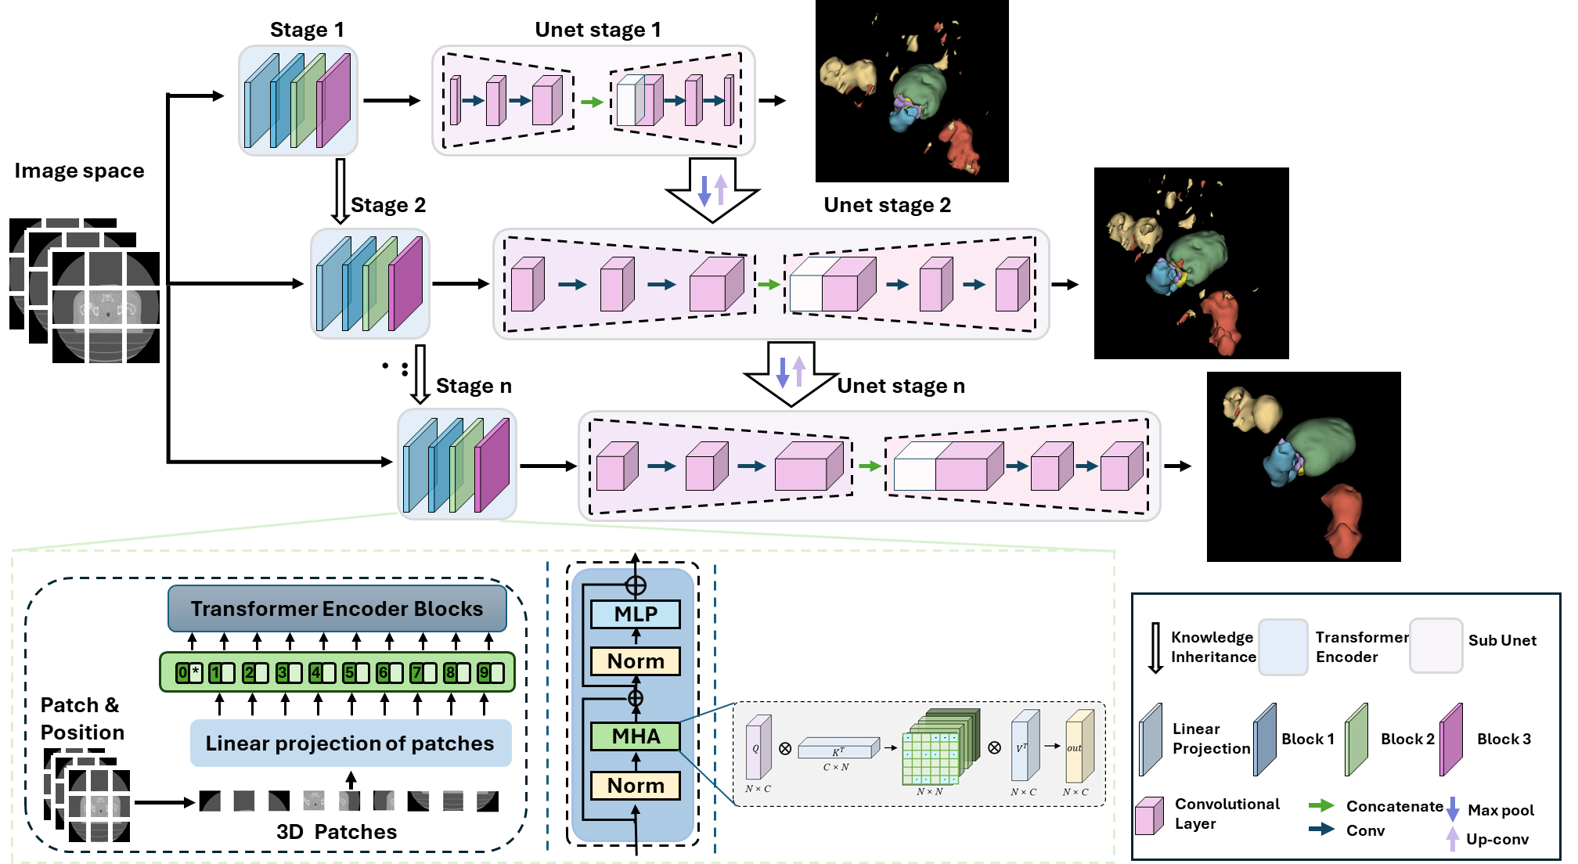
Leveraging vision-language models to accelerate RT planning Xin (Doris Du), Cambridge
Current radiotherapy workflow
Planning CT Scan
AI Autosegmentation of healthy anatomy
Oncologist segments tumour target
Radiotherapy treatment plan design
U-net model
STELLA radiotherapy workflow
Joint autosegmentation of tumour and healthy anatomy
Planning CT Scan
Oncologist refines target with AI assistance
Radiotherapy treatment plan design
Diagnostic radiology report
Reinforcement learning from human feedback
Natural language processing model

Slide 14
STELLA RAGWort: Retrieval Augmented Generation for Workflow Optimisation in radiotherapy
Hypotheses
Can a large language model can be trained read a clinical referral letter for radiotherapy?
Can it apply knowledge from the letter to a clinical treatment protocol for radiotherapy?
Can it determine when key information is missing from the referral letter?
How well can it perform this task compared to trainee oncologists?
Can it be used as a ‘cross check’ in a physics department for quality assurance
RAGWORT works in breast and head and neck cancer protocols from UNC Chapel Hill (US) and Cambridge (UK)

Slide 15
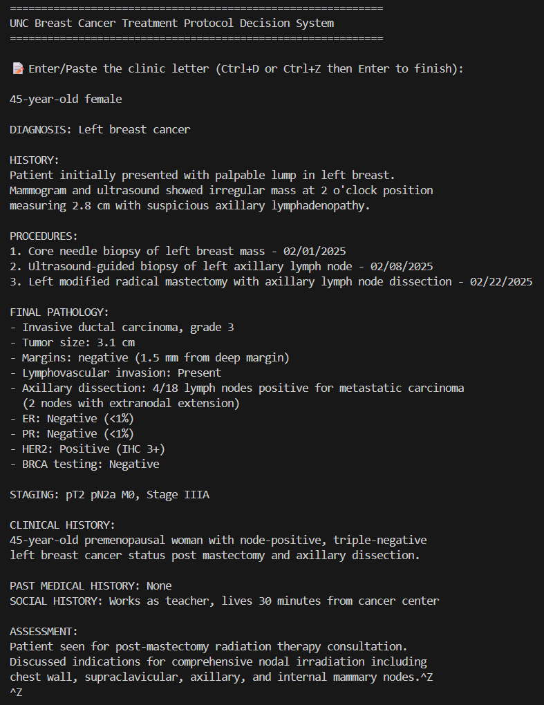
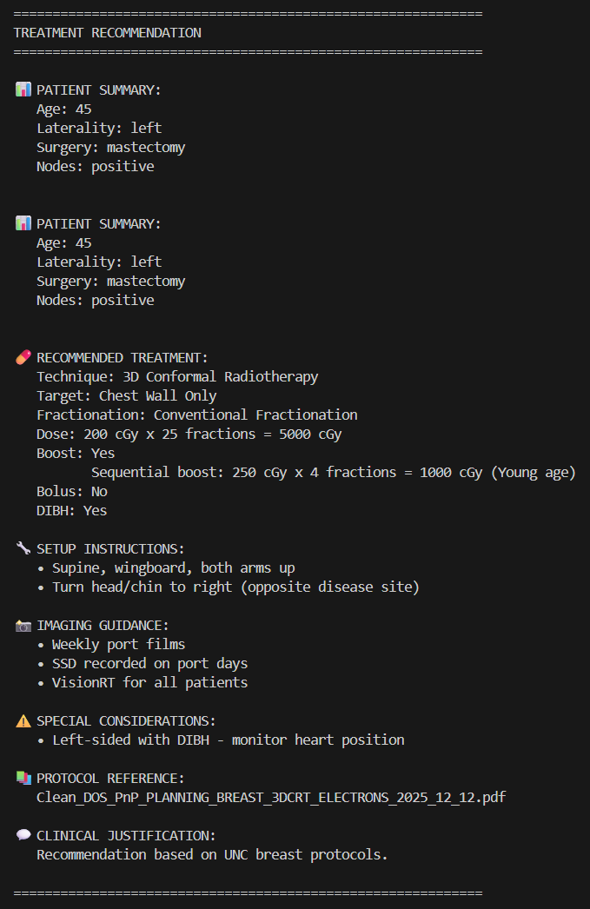
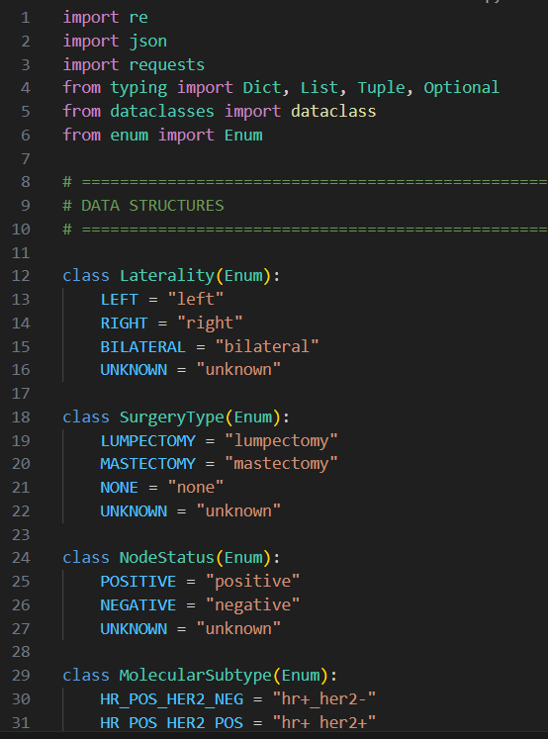
Input clinic letter
Treatment recommendation
Coding snapshot
RAGWort

Slide 16

Collaboration Oxford Churchill Hospital
Oxford University Hospitals NHS Foundation Trust
Investigating scenarios where beam modulation is simplified:
1) to reproduce the MLC used in their Linacs and reduce the number of movement steps they are allowed to make during treatment in a systematic fashion: generating data on how reduction in MLC movement affects treatment plan quality.
2) to replace the existing MLC with a ‘virtual MLC’ which is a Python script. This will allow more complex modification of linac features including the number of leaves, maximum maximum acceleration, and the maximum travel distance permitted.
These clinical studies should inform the design constraints of the mechatronics simulation for our research work specially for Armanc.

Slide 17

Project SAPPHIRE
Supra-African Physics Partnership for Health Innovation and Radiotherapy Expansion

Slide 18







About Project SAPPHIRE
Funded by Africa-UK Physics Partnership programme
Goal is to train and network together young medical/physicists in state of art radiation therapy technologies
Partnership betrween Pretoria, South Africa (Nethwadzi) and Ghana RT centres (Hasford), Oxford (Dosanjh) with Cambridge (Jena) and Lancaster (Burt)
1. Deploy Redmine software to track MLC faults and gather data from 3 sites (Accra, Kumasi and Pretoria) and Pretoria
2. Analyze MLC mechanical faults and propose improved, more durable designs
3. Organize training workshops in Accra and Pretoria on failure modes and maintenance of LINACs

Slide 19


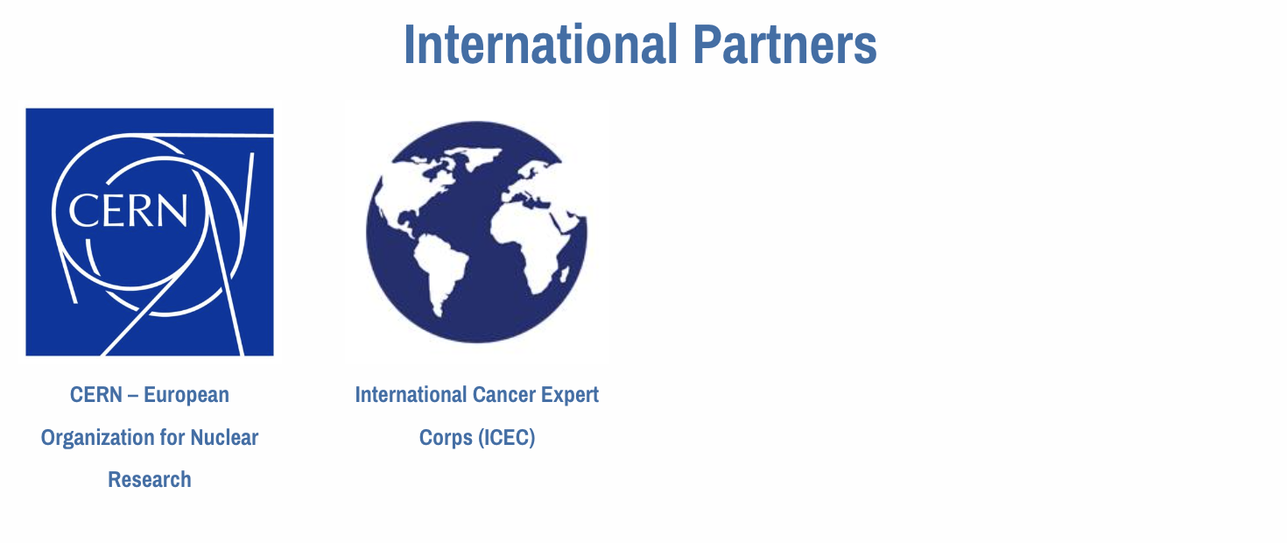
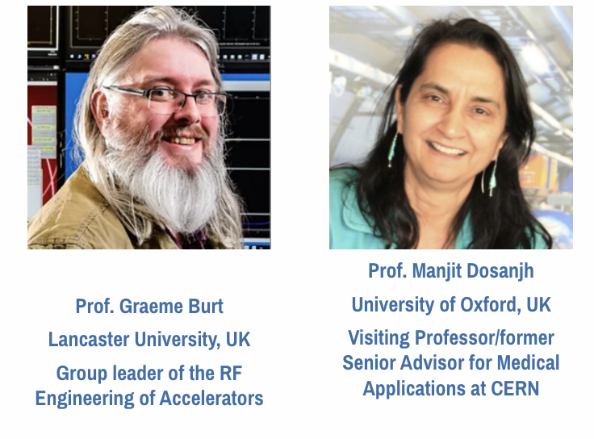
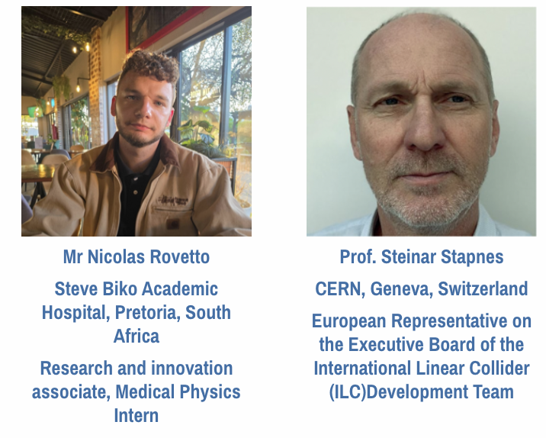
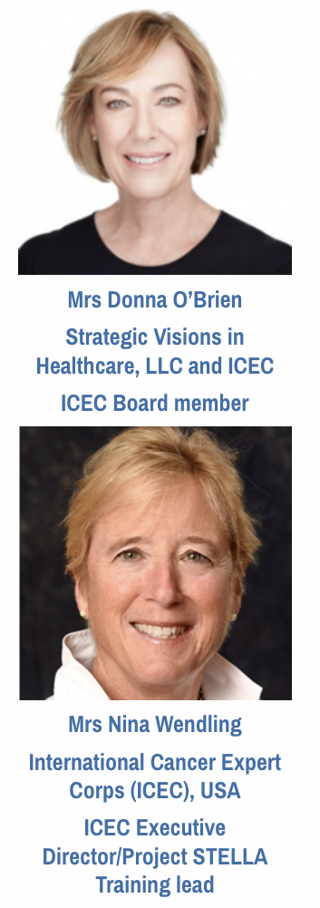
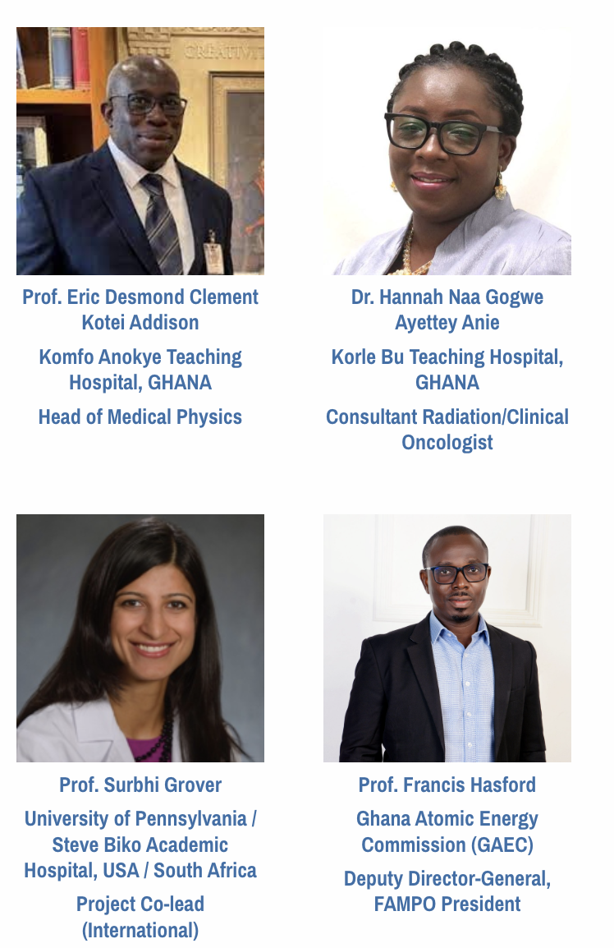
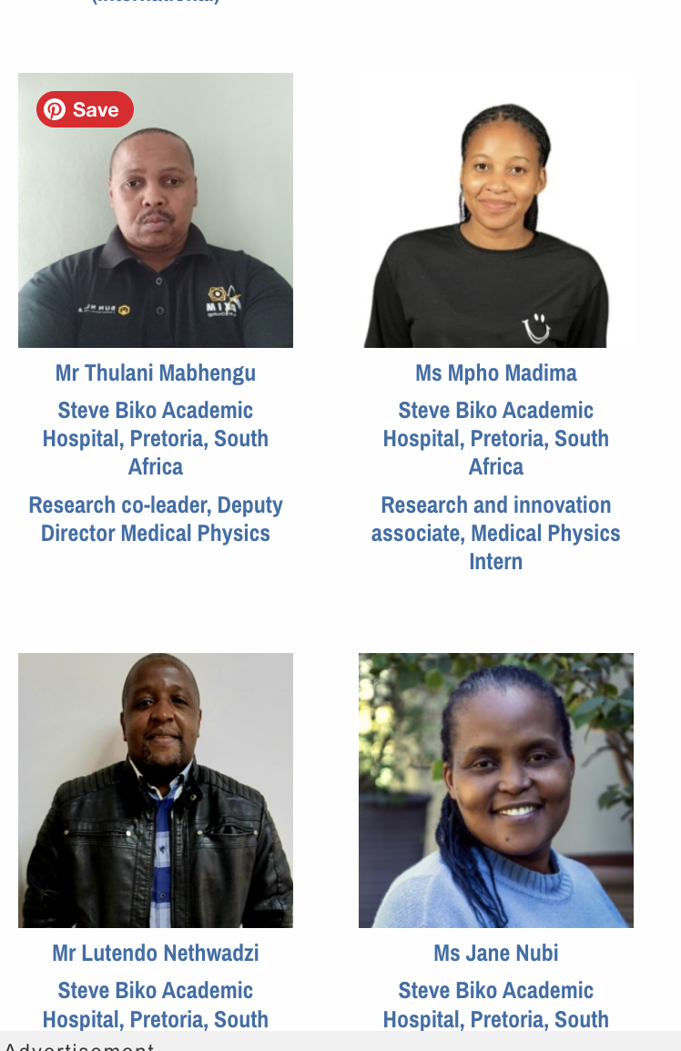
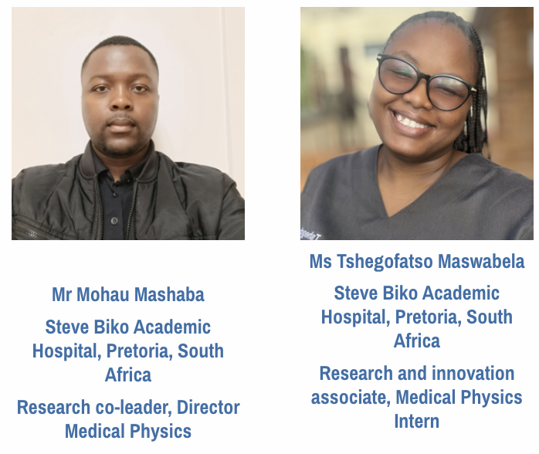
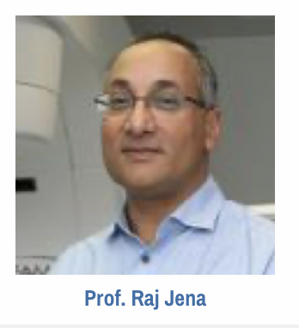
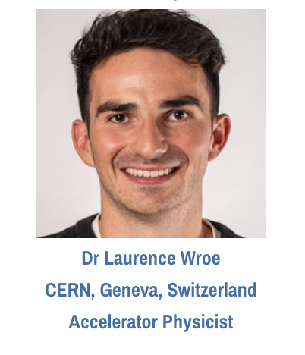
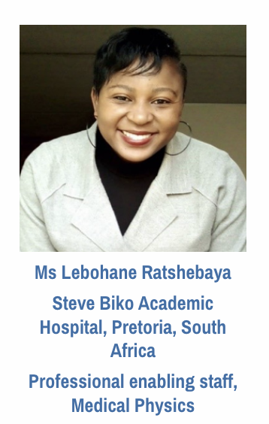
Collaborators & Team

Slide 20
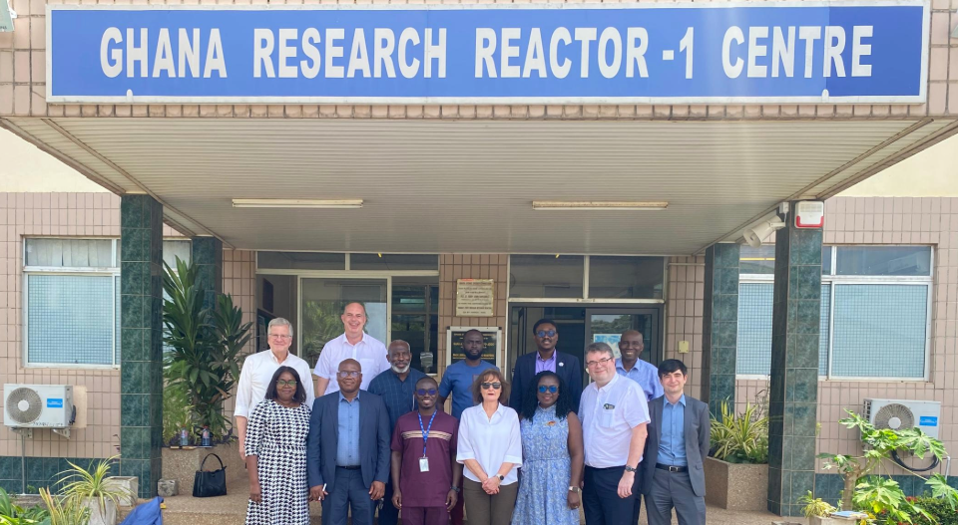
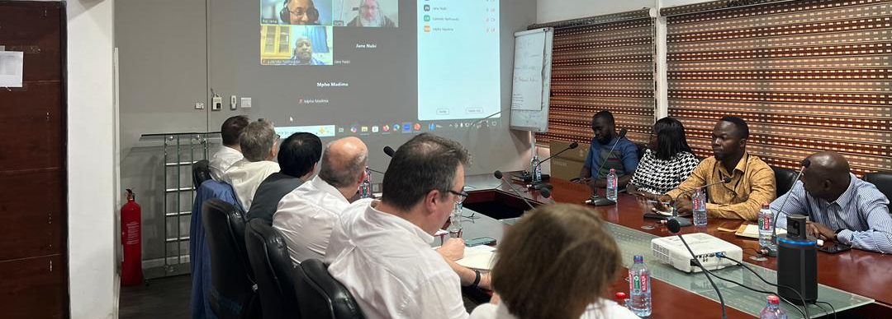
Visit by STFC, IoP and APS to Ghana Atomic Energy Commission

Slide 21


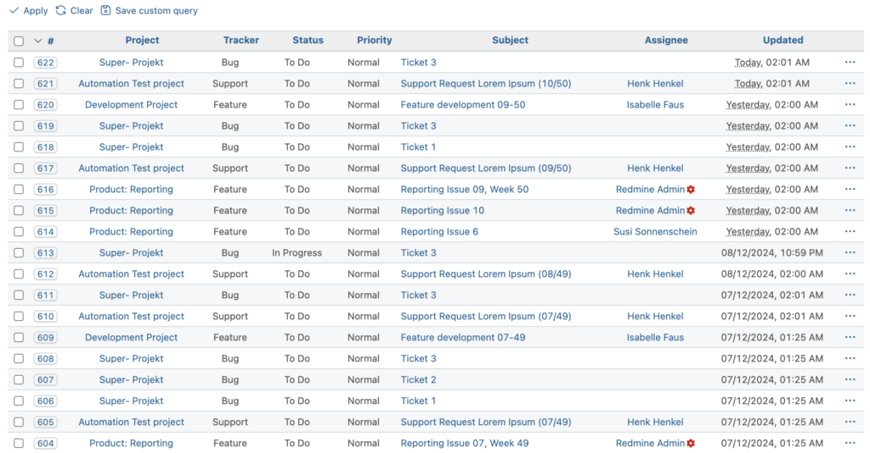

Electronic data capture and clinical tools
REDMINE – Electronic data capture for M-LINAC faults
Raystation – plan automation via scripting
Open-source system available to all project members
Electronic capture of faults via tickets allows issues to be tracked and analysed easily
Learn how palliative and VMAT plans are greatly accelerated through the use of scripting in Raystation

Slide 22


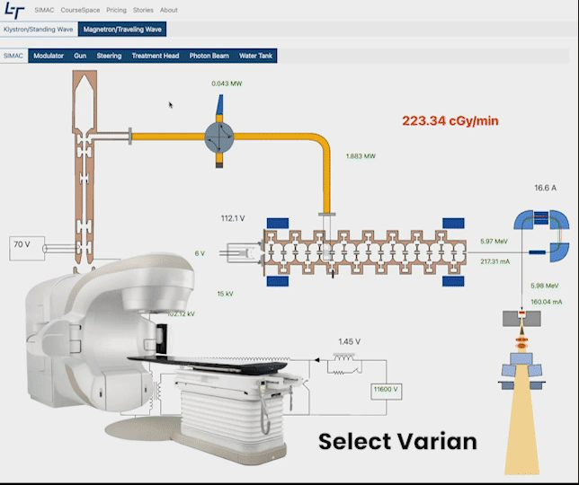
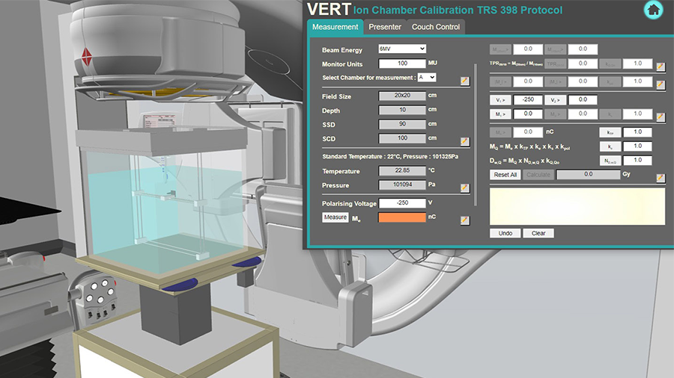
Innovative Simulation Tools
VERT virtual radiotherapy machine simulation
Simac – Linac simulation tool
Simulate a wide range of M-LINAC faults
Web based simulation tool available to all project members
Practice both QA and clinical setups for VMAT treatment

Slide 23
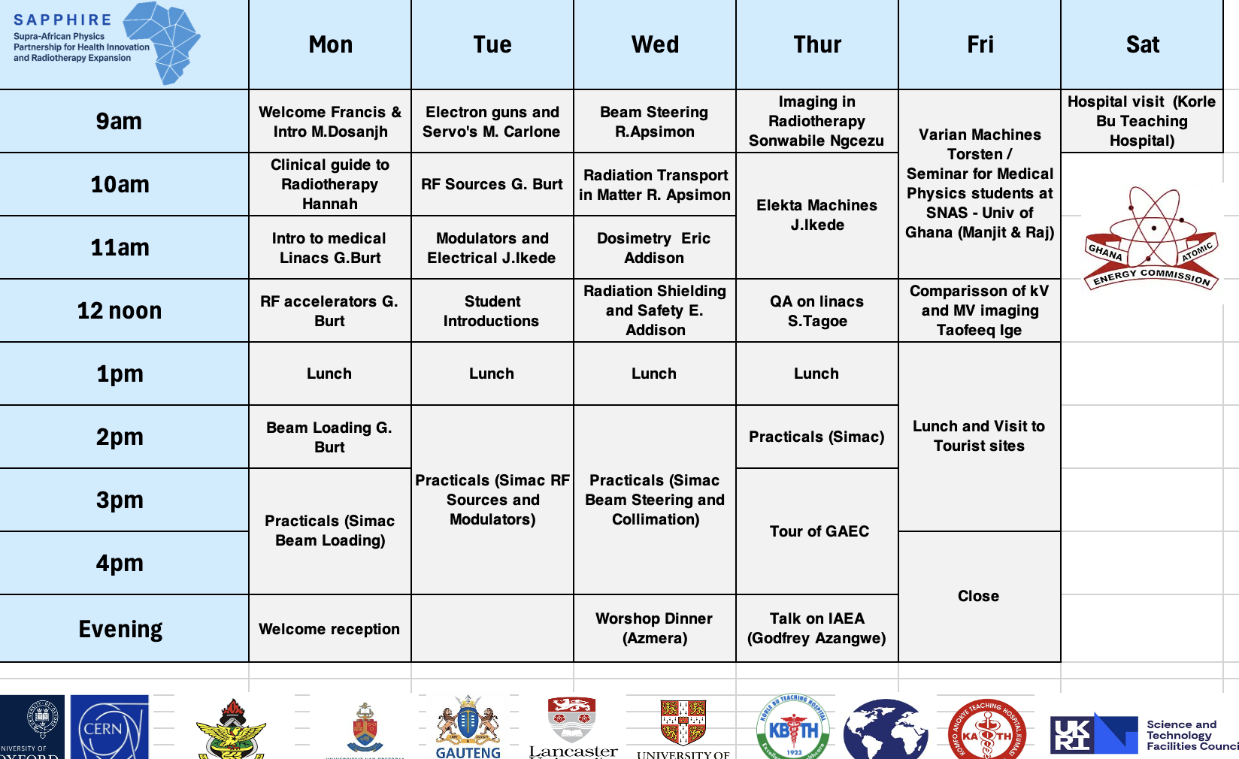
Co-design of hardware focused workshop in Ghana

Slide 24

Key Objectives for SAPPHIRE
Increased availability of well-trained RTTs and MPs in LMICs with sufficient technical expertise.
Collecting and analysing real-world data from M-LINAC machines.
Improved designs of LINAC hardware, where key components (e.g. MLCs) are more fault tolerant.
Developing robust, smart LINAC systems suited for LMIC settings.
Maximizing uptime of LINACs in LMICs.
https://project-sapphire.org

Slide 25
VHEE
Progress towards FLASH radiotherapy in the clinic

Slide 26
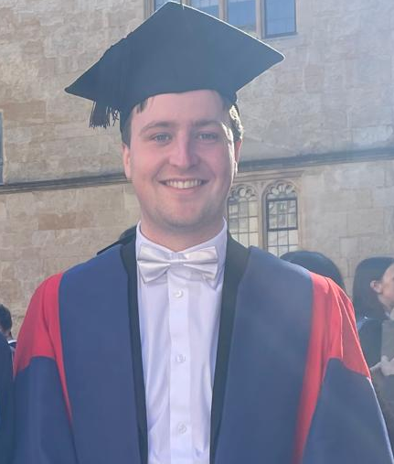
VHEE Dual-Scattering Systems (Cameron)
Beam magnification and flattening for conformal VHEE Radiotherapy - passive scattering
Modelling of flattened beams with or without collimation
Dual-scattering foil design and optimisation at 200MeV
Cameron Robertson,
JAI Oxford Graduate
(NHS Radiotherapy Physics Trainee)

Slide 27
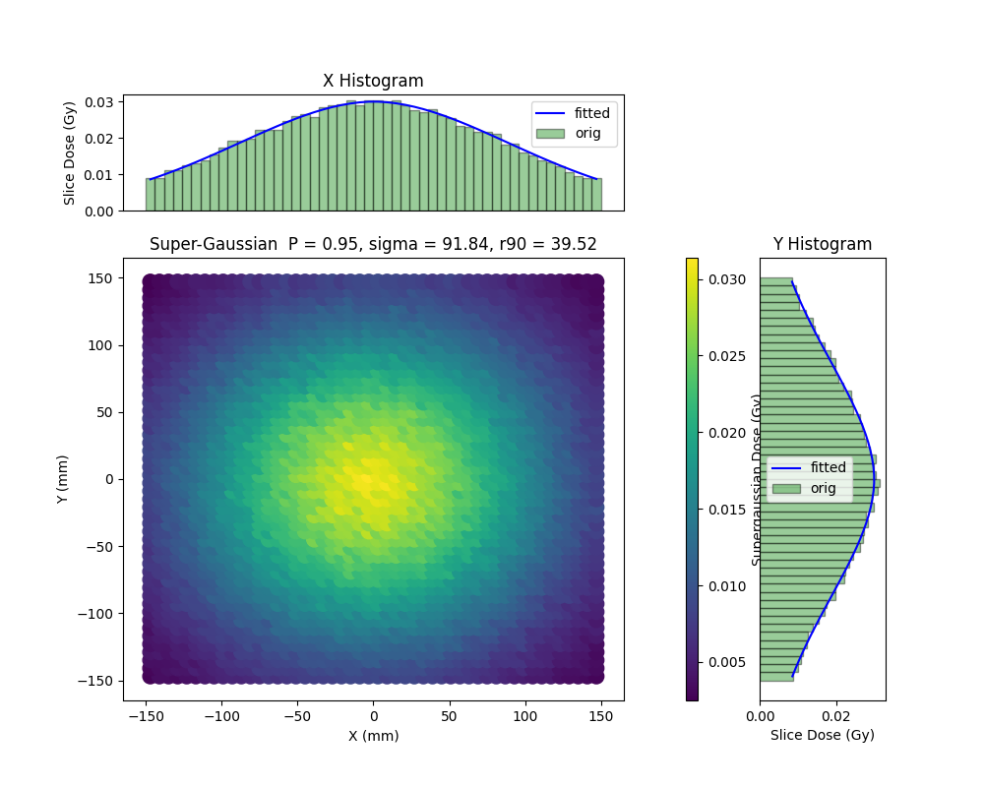
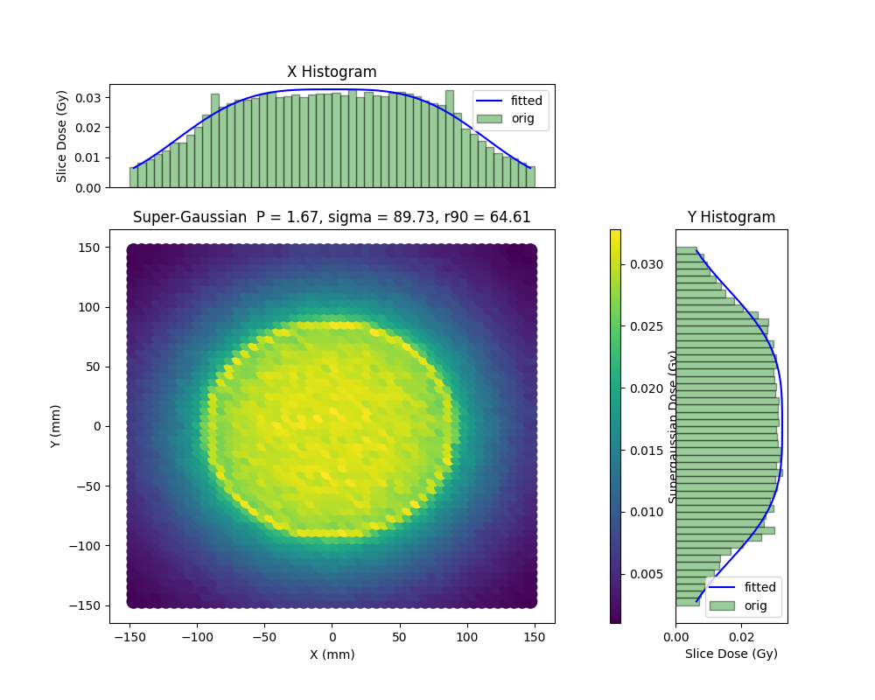
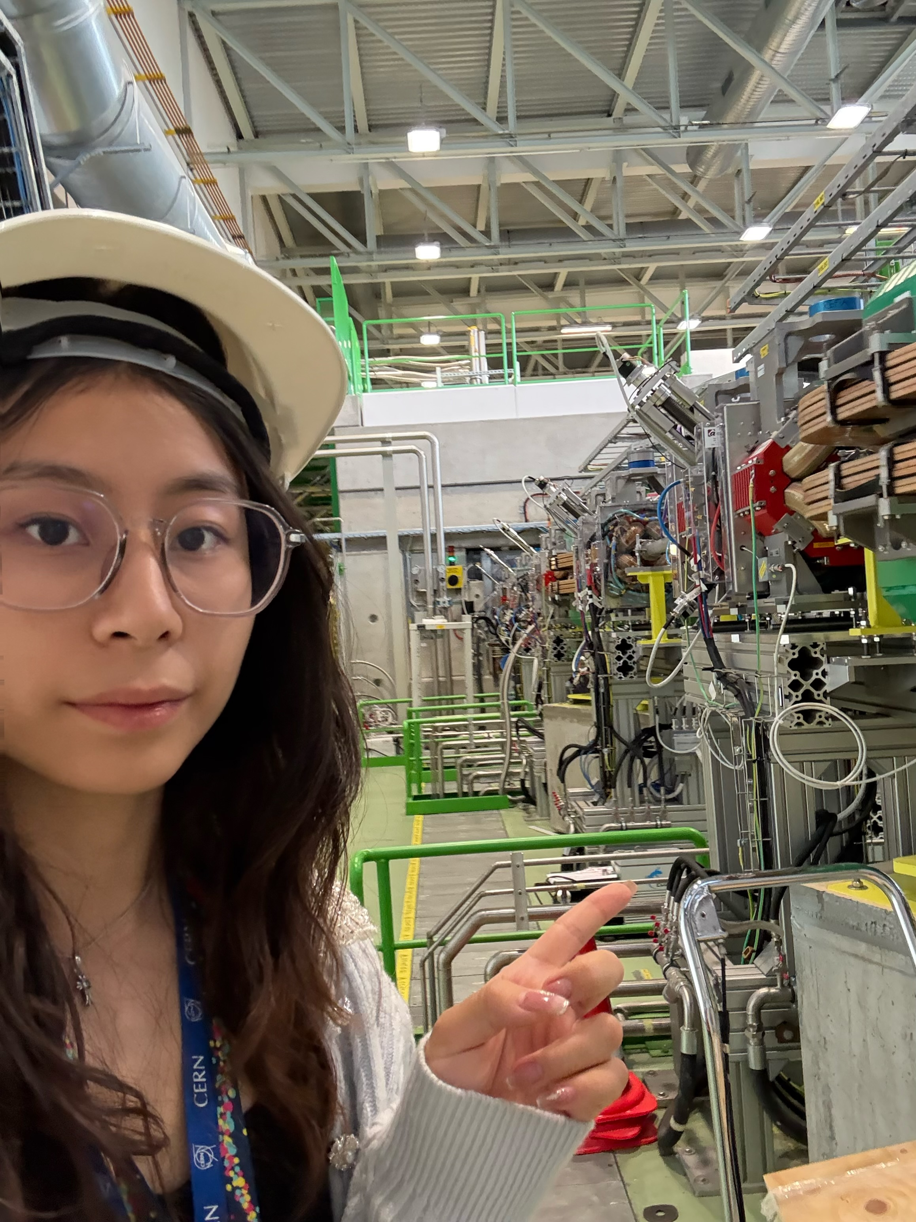
Sabrina Wang continuing on from Cameron’s research
Replacing the pre-scatterer in a dual-scattering system with quadrupoles to reduce photon contamination
TOPAS and RF-Track simulation of 4 quadrupole lattice + scatterer system
Dual-scattering system
Quad-scattering system
S. Wang
JAI Oxford 2nd year DPhil
Awarded John Adams Prize for her 1St year work

Slide 28
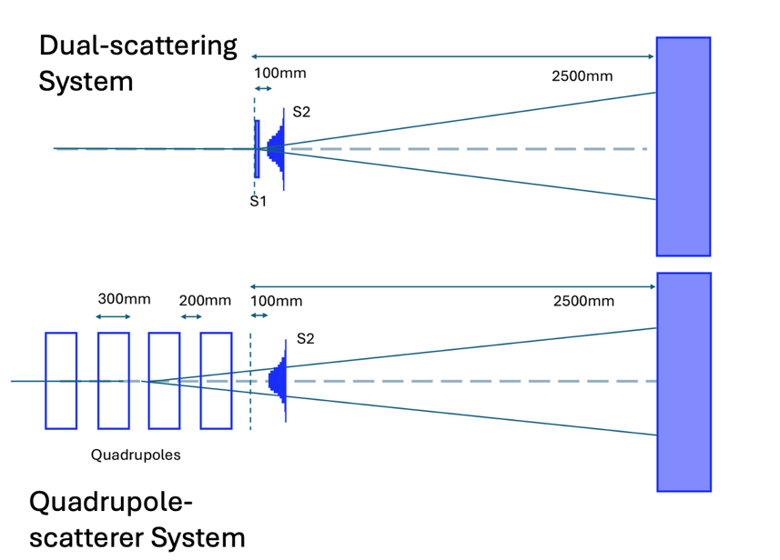
Sabrina’s Project: building on previous research
Homogeneous beam production for clinical translation of VHEE/FLASH
Developing sophisticated simulation, modelling and design optimisation
Building off previous JAI research on dual-scattering foils for VHEE,
Studies on novel quadrupole-scattering systems for reducing photon production
Experimental studies at CLEAR and CLARA facilities

Slide 29
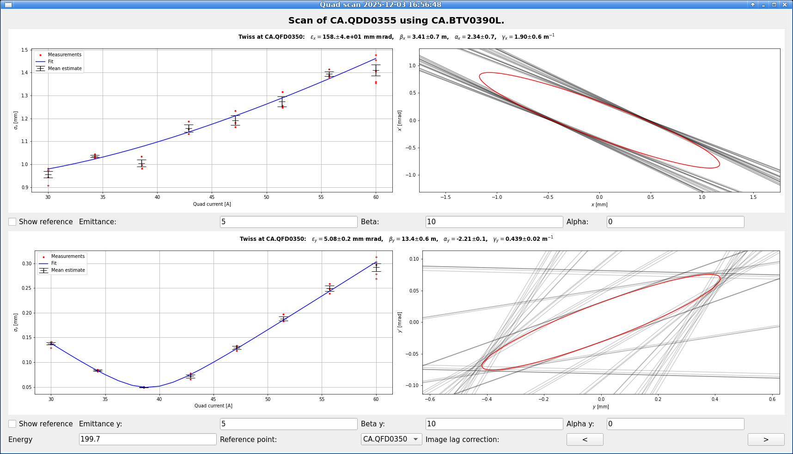
LTA at CERN: CLEAR Facility Studies
Studies for optimisation of CLEAR dual-scattering foil
Quadrupole scans for input to RF-Track/TOPAS simulations to study dependence on transverse parameters
Design of scattering foils for CLEAR second beamline
Coverage of larger samples for FLASH/UHDR studies
Potential testbed for quad-scattering foil studies

Slide 30

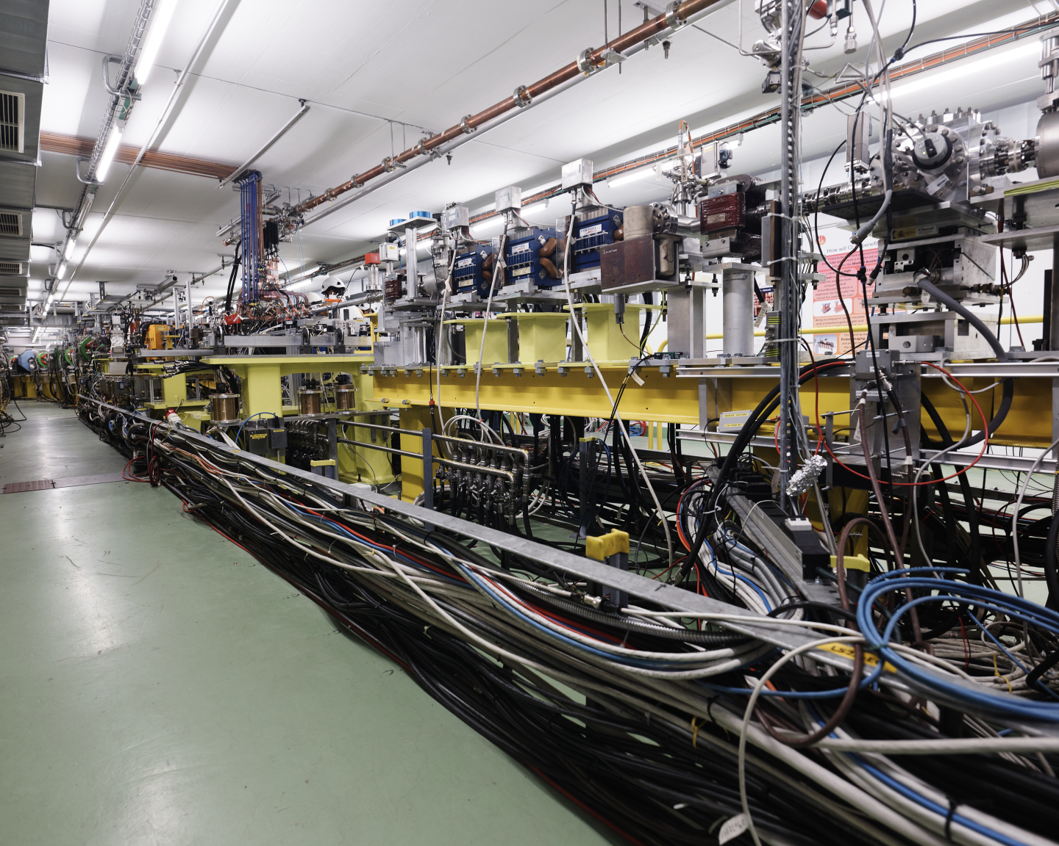
CLEAR Accelerator and Beam Parameters (CERN Linear Electron Accelerator for Research)
Parameter | Value
Energy | 60 – 220 MeV
Energy spread | < 0.2 % rms (< 1 MeV FWHM)
Bunch length | 0.1 – 10 ps RMS
Bunch charge | 10 pC – 1.5 nC
Normalised emittance | 3 – 20 μm
Bunches per pulse | 1 – 200
Max. charge per pulse | 86 nC
Repetition rate | 0.833 – 10 Hz
Bunch spacing | 1.5 or 3.0 GHz

Slide 31
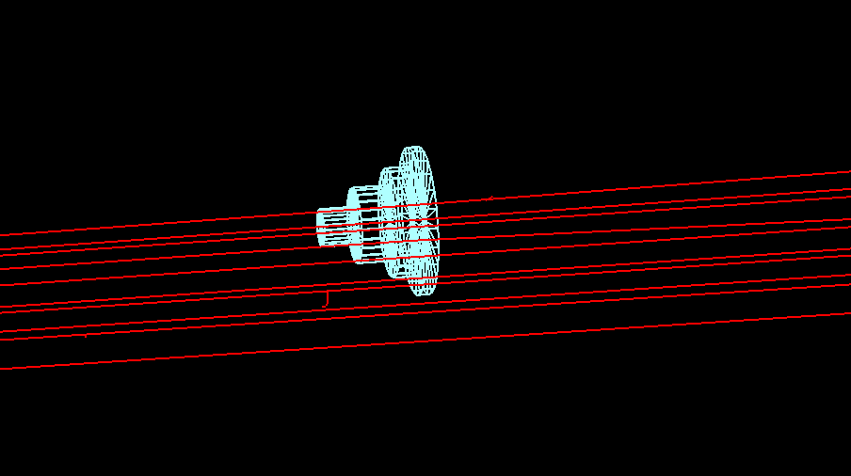
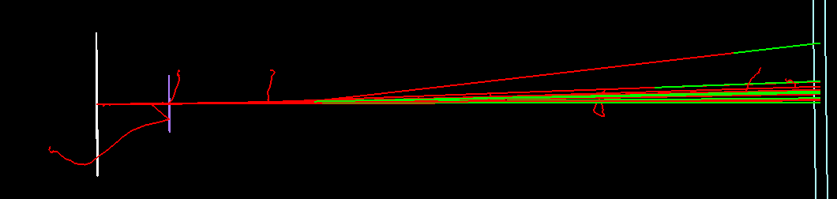
Computational and Design Studies
Development of optimiser for uniform beam production
Capable of rapid foil design for arbitrary initial beam, setup/facility constraints
RF-Track used for rapid simulations during automated optimisation
TOPAS Monte Carlo for verification

Slide 32
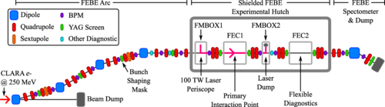
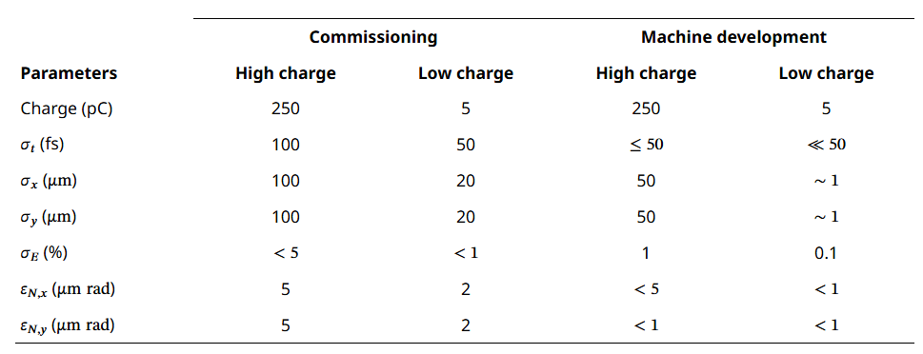
CLARA: FEBE Specifications
Capable of hosting a wide range of experimental programmes
Beam energy up to 250 MeV
Flexibility in delivered beam parameters and charge structure
In-air hutches for experiment installation (and additional diagnostics if required)
Figures from Snedden et al (2024), Phys. Rev. Accel. Beams 27, 041602

Slide 33
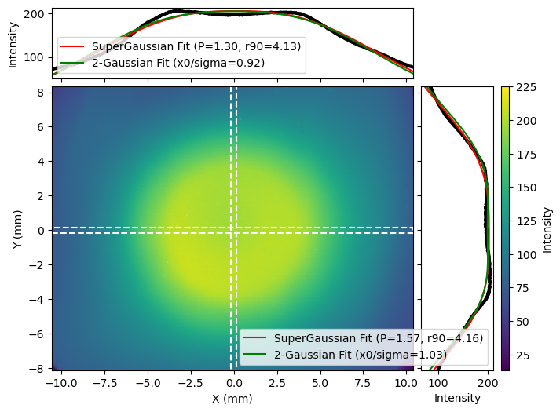
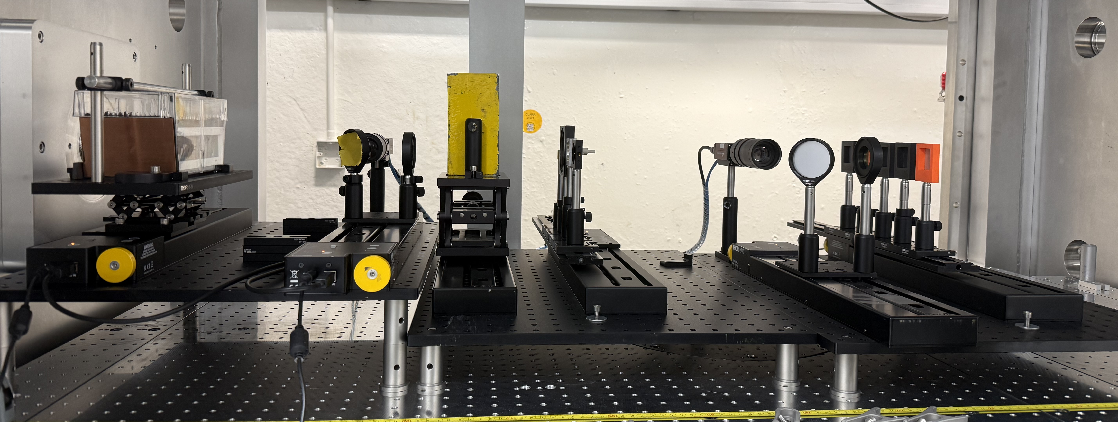
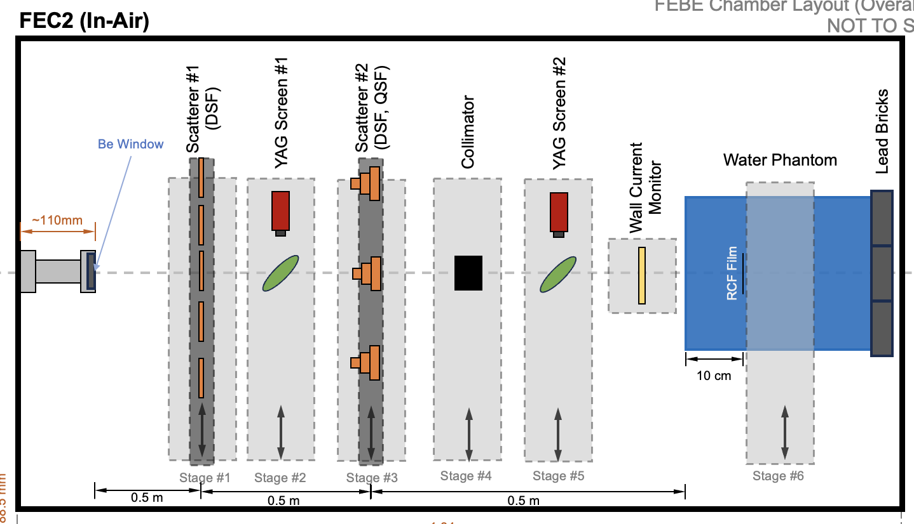
Experimental programme at CLARA
Dual and quad-scattering systems designed and manufactured within FEC2
Flexibility of design space and operating team expertise to ensure installation accurate to simulations
Beam uniformity for all systems demonstrated at 250 Mev and 200 MeV
Radiochromic film and YAG data acquired, with analysis in progress

Slide 34
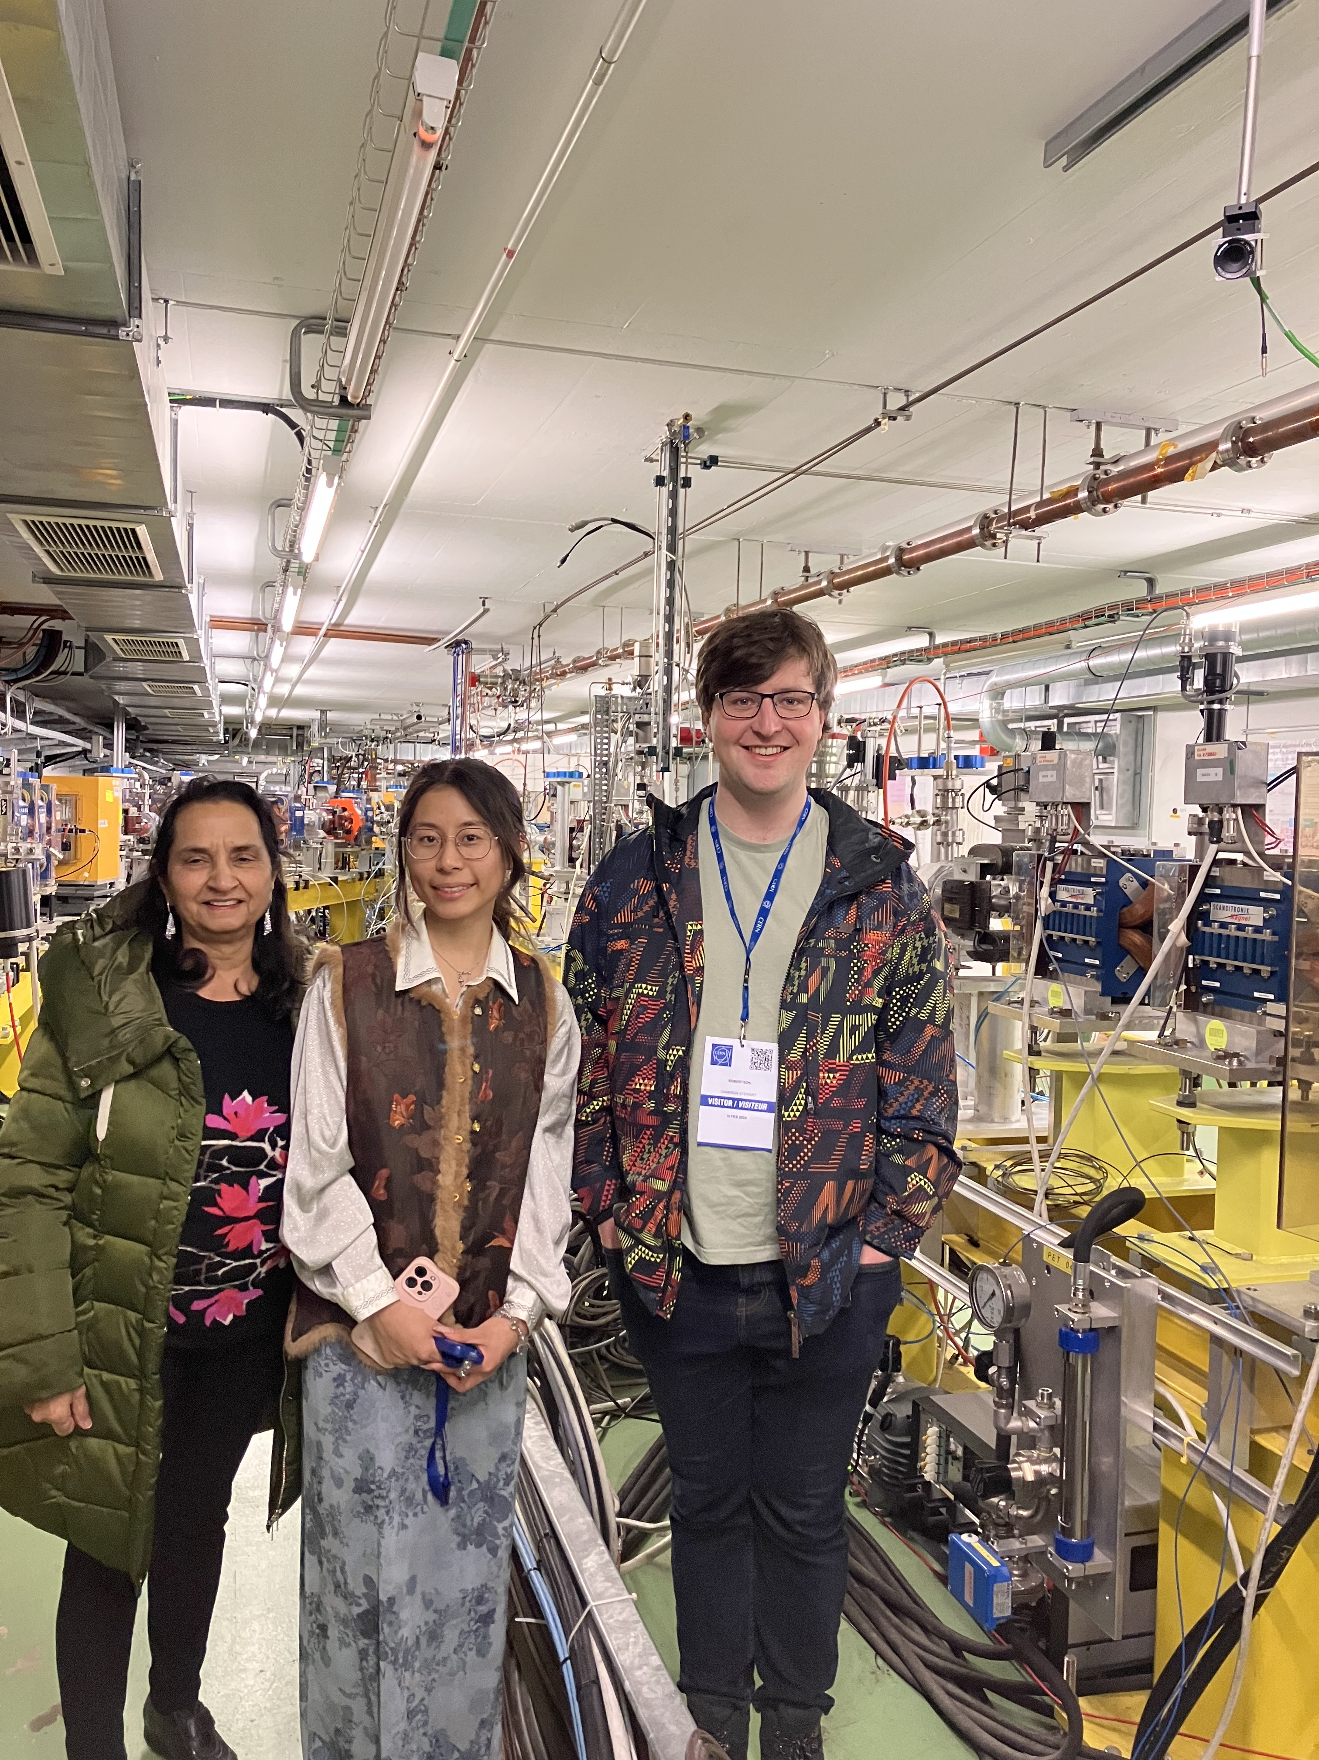
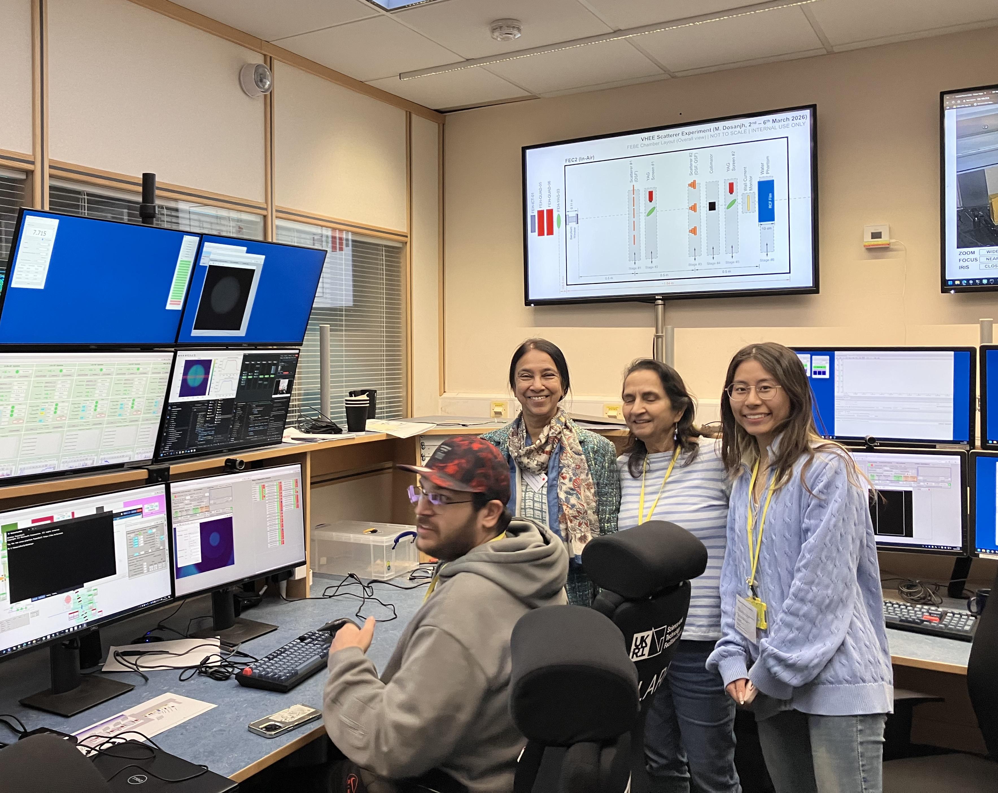
From CLEAR to CLARA

Slide 35
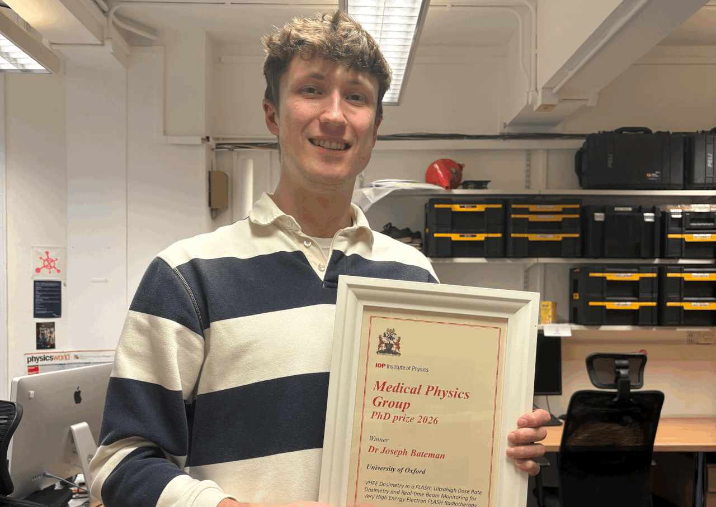
VHEE UHDR (Ultra High Dose Rates) Beam Dosimetry
Dr Bateman won IOP Medical Physics Group PhD Prize for his work on developing new dosimetry measurement techniques by creating a novel detector using silica fibres that can monitor the radiation beam pulse-by-pulse, at dose rates needed for FLASH.

Slide 36




VHEE UHDR Beam Dosimetry @ Oxford
Started collaboration with Simon Hooker’s group where we are using the expertise and fibre optic monitor for VHEE UHDR dosimetry at CLEAR for initial dosimetric characterisation of Oxford LWFA (Laser Wake Field Accelerator) beam.
MPhys student (Emma Stratford) is working on characterising fibre array detector using Monte Carlo simulations and preparations for initial measurements at Oxford LWFA
Initial measurements planned to be taken soon.
J. Bateman
JAI Oxford Graduate
(Now postdoc at UCL)
E. Stratford
Oxford MPhys 4th year
L. Feder
Oxford PDRA

Slide 37





VHEE UHDR Beam Dosimetry @ Oxford
Continuing collaboration with Simon Hooker’s group for initial dosimetric characterisation VHEE beams from Oxford LWFA (Laser Wakefield Accelerator) beam, using fibre array beam monitor (developed at Oxford + CLEAR) and film dosimetry.
MPhys student (Nimisha Bica) is using Monte Carlo simulations to characterise a fibre array detector (FOFM) for real-time beam profile and dose monitoring for VHEE beams, in preparation for the first experimental measurements at Oxford LWFA.
Initial measurements planned to be taken soon.
N. Bica
Oxford MPhys student
J. Bateman
JAI Oxford Graduate,
postdoc at UCL
L. Feder
Oxford PDRA
Silica Optical Fibre Array
CMOS Camera
M. Dosanjh

Slide 38




Simulations for a Dual-Modality Beam Generation Device for FLASH-RT
TOPAS simulations of photon and electron beams in 20-200 MeV range for different target designs.
Evaluating dose characteristics before and after collimation for photon-only and dual-modality beams.
After setting FLASH requirements, assessing thermal loading on the bremsstrahlung target.
S. Martin
Oxford MPhys
M. Dosanjh
A. Gerbershagen

Slide 39
In summary
Training
Train the next generation of medical physicists and technologies in the Global South
SAPPHIRE
(STELLA)
Access
Design and develop next generation hardware and software to make radiotherapy accessible
STELLA
Innovate
Develop technology that makes FLASH radiotherapy a reality in the clinic
VHEE
CLEAR
CLARA
students and early career researchers are key

Slide 40

SAPPHIRE Accelerator Training workshop in Accra,13-16 April 2026

Slide 42







LiRR lab UNIGE Collaboration VHEE FLASH Radiobiology and Physico-Chemistry Experiments
VHEE FLASH Radiobiology Studies: Investigating Mechanisms Behind the FLASH Effect.
Water Radiolysis: Measurement of ROS generation in water following FLASH and CONV-RT.
DNA Damage Assessment: Plasmid irradiations to quantify radiation-induced DNA lesions.
Zebrafish Embryos as Biodosimeters: Modelling normal tissue sparing post-FLASH-RT.
Cell Irradiation Studies: Comparative analysis of normal and cancerous cell responses.
Manuscript currently under review.
Prof. M. C. Vozenin
Head of Radiobiology and Radio-oncology, HUG, Geneva

Slide 43






University of Victoria Collaboration
VHEE Spatial Fractionation – Scintillator Dosimetry – Drosophilae Biodosimeters
VHEE Spatial Fractionation using tungsten GRID collimator.
(paper published in Phys. Med. Bio.)
VHEE UHDR Real-time dosimetry using plastic scintillator-coupled fibres at MedScintTM CCD spectrometer.
(paper published in IEEE Sensors)
In vivo radiobiology studies on drosophila melanogaster larvae as biodosimeters to investigate VHEE RBE and FLASH mechanisms/parameter space.
Prof. M. Bazalova-Carter
Head of XCITE Lab, UVic, Canada

