Slide 1

Light Sources Update
Ian Martin
John Adams Institute Advisory Board Meeting
16th April 2026

Slide 2
Contents
Updates on Diamond-II Project
Project status (Procurement, Diamond Extension Building)
Kick-and-cancel injection scheme: prototyping and testing
Outline commissioning plan
Timeline
Updates from JAI members
Feasibility Studies of Incoherent Cherenkov Diffraction Radiation BPMs (A. Clapp, RHUL/DLS)
Optimising Injection at Diamond with Sample Efficient Bayesian Optimisation (S. Preston, UO/DLS/ALC)
Fast Beam Loss Monitor System for Diamond-II and Machine Learning Applications (C. Lehmann, UO/DLS)
Collective effects in Diamond-II (M Rakic, UO/DLS)
Conclusions
Ian Martin, Light Sources, JAI AB, 16/04/2026

Slide 3
Updates on Diamond-II Project
Ian Martin, Light Sources, JAI AB, 16/04/2026

Slide 4
Project Status
Pre-series girders
Series sextupoles
Procurement for Diamond-II machine continues to progress:
Pre/main series sextupoles - 51 of 321 magnets delivered
4 of 52 storage ring girders have arrived
Pre-series DQ dipole delivered, DL dipole yokes / PM magnet blocks delivered to site and being assembled
All pre-series main vacuum vessels delivered, main series in production
5 of 6 Solid-State Amplifiers delivered (2 have passed SATs); 2 of 5 main EU-HOM-damped RF cavities due to be delivered in June; passive SC harmonic cavity due for delivery in September
Recent contracts placed: stripline kicker pulsers, thin septum magnets, booster kickers, fast corrector magnets, EBPM readout electronics, horizontal and vertical collimators, APPLE-II IDs
Tenders in-progress / imminent: PM/EM DC main septum, K18 3-pole wigger, K14 multipole wiggler
Main concerns regarding the schedule are delays to the storage ring quadrupole magnets and vacuum vessels - conversations on-going with suppliers for how to recover.
Ian Martin, Light Sources, JAI AB, 16/04/2026

Slide 5
Diamond Extension Building
Hand-over completed Dec`25, occupied since Feb/Mar`26
Generally complete; some snagging items still to be resolved (delivery door heights, cranes in magnet lab, etc.)
Official opening on 4th March
L-R: Gianluigi Botton (DLS CEO)
Sir Leszek Borysiewicz (Chair of DLS Board)
Roger Eccleston (STFC Exec Director)
Beamline assembly
Magnet lab
Vacuum vessel assembly
Vacuum vessel bakeout
Girder assembly
DEB2 Building
Ian Martin, Light Sources, JAI AB, 16/04/2026

Slide 6
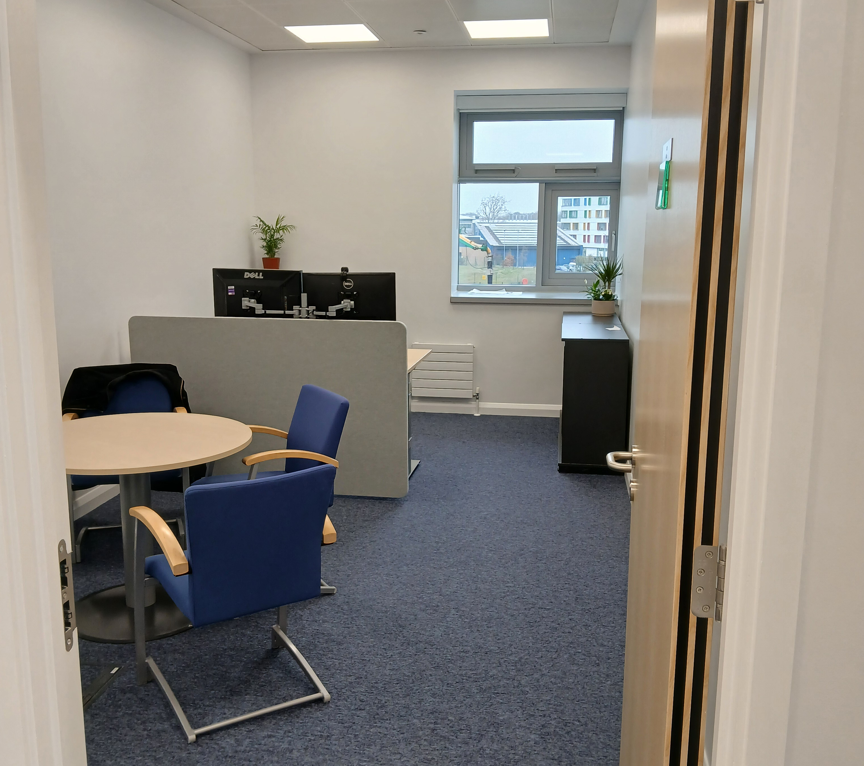
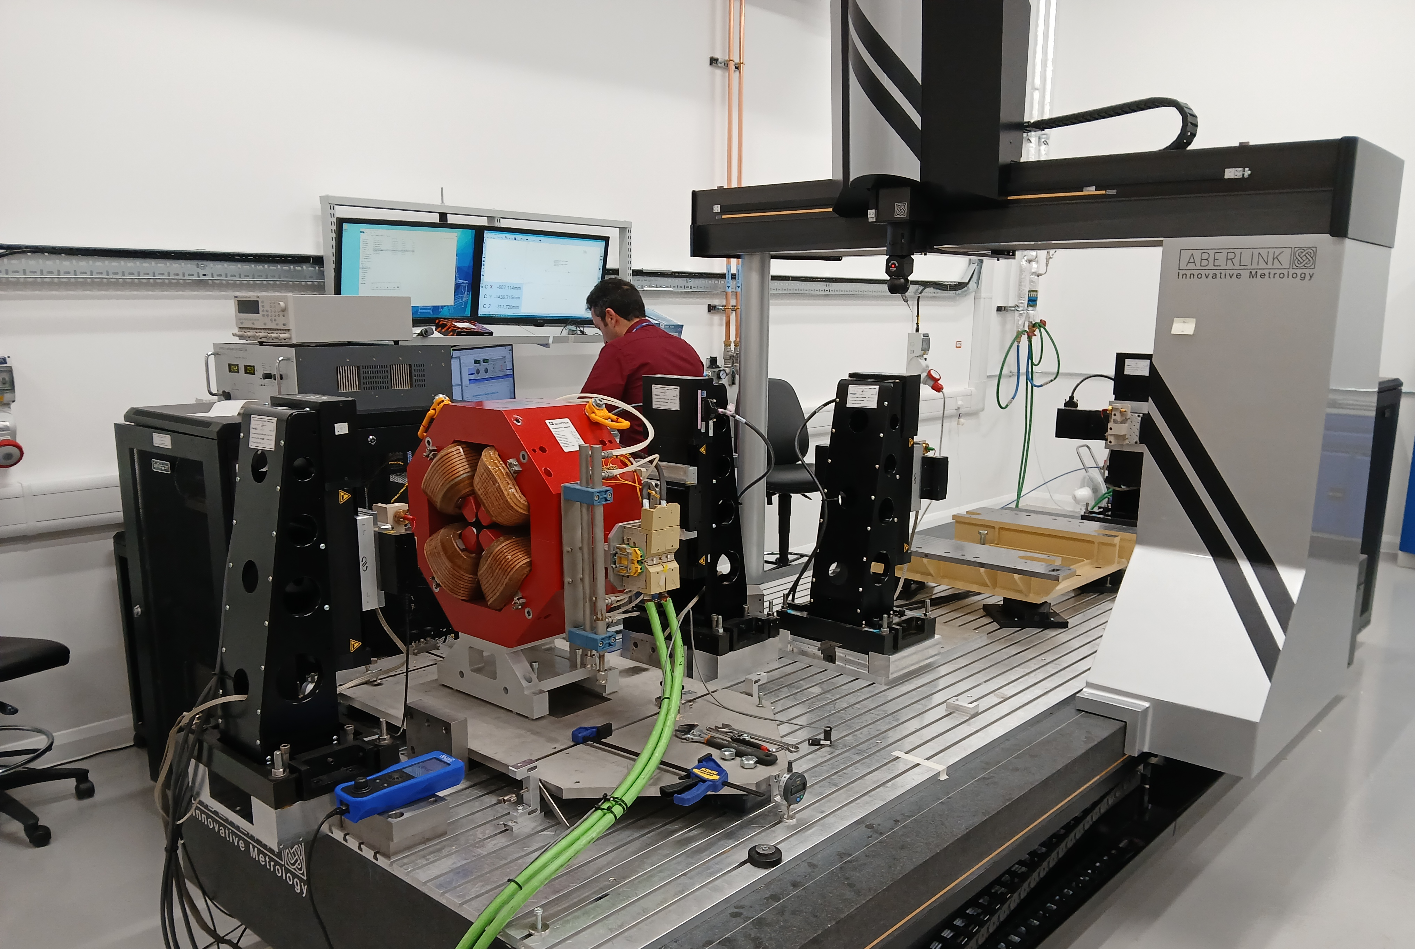
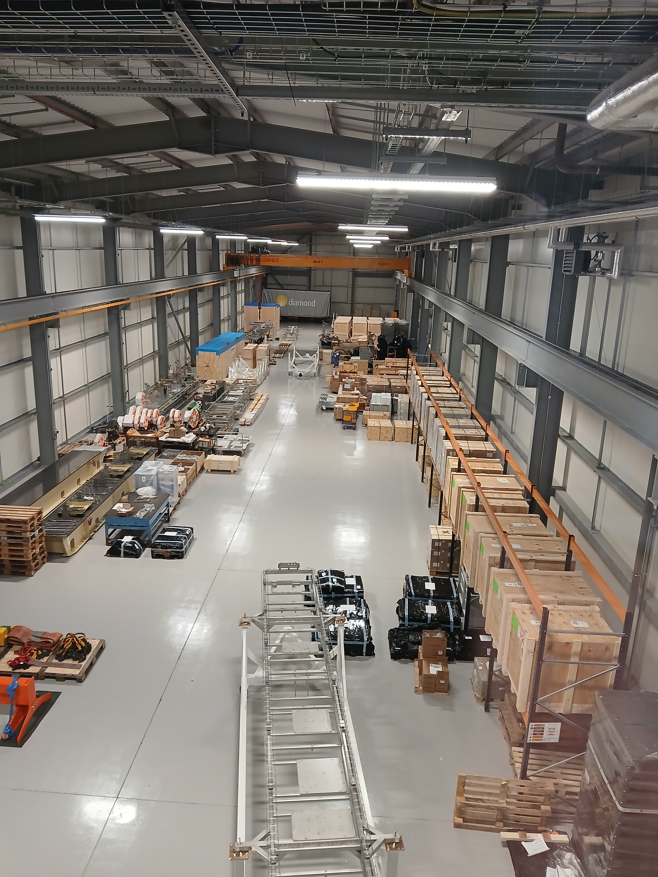
Diamond Extension Building
DEB2 storage area
Office space
Magnet measurement bench
Kitchen / rest area
Vacuum assembly area
Ian Martin, Light Sources, JAI AB, 16/04/2026

Slide 7
Kick-and-cancel injection scheme
Straight I01
Straight K01
Novel injection scheme planned for Diamond-II:
Enables transparent top-up injection
Minimises transverse wakefield effects and interaction with multi-bunch feedback allowing more charge to be accumulated
Upgrade path for future high-brightness lattices: can move to kick-and-aperture sharing injection
Key components
6 × short stripline kickers
±20 kV, 3 ns pulsers,
>2 kicks per 5 Hz injection cycle, tuneable delay
Septum magnet(s) with low leakage field:
  DC PM/EM main septum (7.4 degrees)
  Pulsed final thin septum (1.1 degrees)
Septum plate
Turn = -3
Kick from striplines
Stored bunch
Injected bunch
Turn = 0
I01
K01
magnets
striplines
septum
Δμ_{x} ~ 90 deg
Ian Martin, Light Sources, JAI AB, 16/04/2026

Slide 8
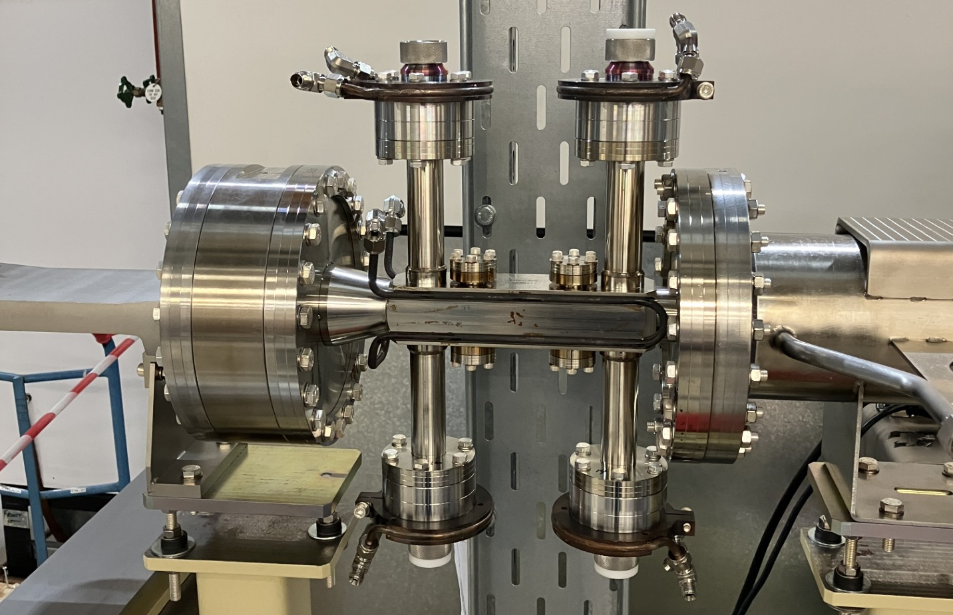
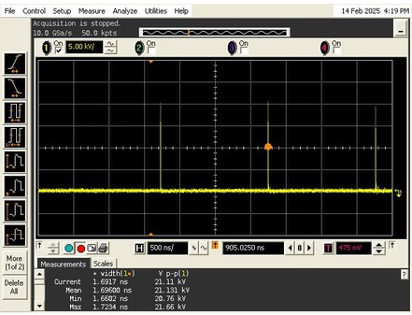
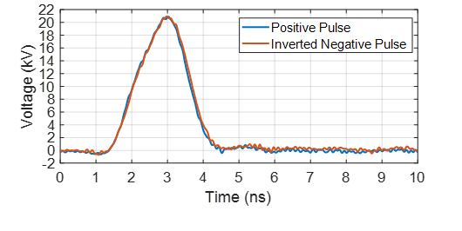
Kick and cancel injection scheme
Prototype stripline kickers moved from Diamond transfer line to storage ring
Prototype 3 ns, ±20 kV pulser delivered by local company (Kentech Instruments)
Cabling / feed-throughs / attenuators chosen and tested
Finalising design of Diamond-II striplines
2 ns
1.5 µs
21 kV
3 ns
<1 ns
>1 ns
<1 ns
Ian Martin, Light Sources, JAI AB, 16/04/2026

Slide 9
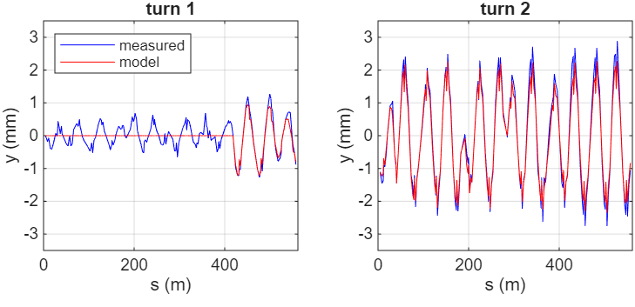
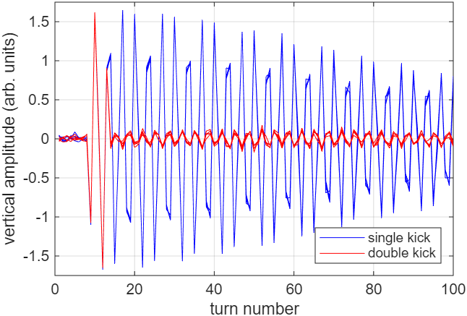
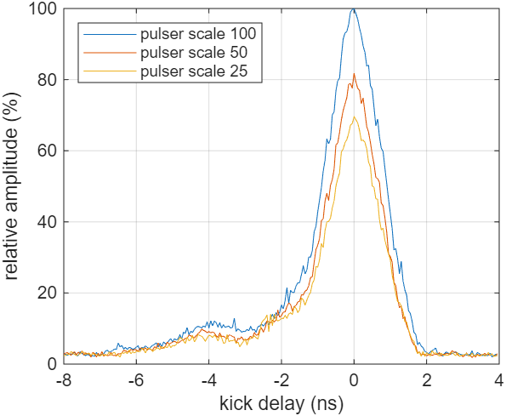
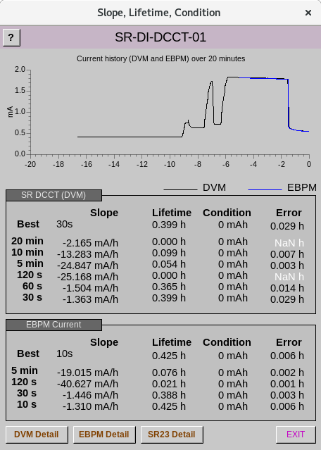
Kick and cancel injection scheme
Kick Calibration
Cancellation after 5 turns
Impact on Stored Bunch
  Amplitude of kick ~10-15% stronger than simple parallel-plate model prediction
Anticipate further suppression:
adjust amplitude of 1st and 2nd kicks
compensate for tune-shift with amplitude
Impact on Trailing Bunches
Impact on High-Charge Bunches
    Single kick causes bunch to become unstable
Pulse decay and reflections disturb 2 trailing bunches (cancelled after 3 turns)
Current (mA)
    Double kick preserves full bunch charge
time (min)
Ian Martin, Light Sources, JAI AB, 16/04/2026

Slide 10
Commissioning Plan
Phase | Months | Activities | Operations schedule
1 | Dec. ’28-Feb. ’29 | Machine commissioning & vacuum conditioning | 09:00-23:00 machine (6d/w) 23:00-09:00 + weekends vacuum conditioning
2 | Mar.-May ‘29 | Beamlines and machine commissioning, vacuum conditioning. | 09:00-16:00 beamlines 16:00-23:00 machine 23:00-09:00 + weekends vacuum conditioning
3 | Jun.-Sep. ‘29 | Regular beamline X-ray commissioning & first early Users | User mode: beamlines 6 days/week machine 1 day/week
4 | Oct.’29-Mar.’30 | 1st regular Allocation Period (AP46) | User mode: beamlines 6 days/week machine 1 day/week
Ian Martin, Light Sources, JAI AB, 16/04/2026

Slide 11
Commissioning Plan
Parameter | Phase 2 | Phase 3 | Phase 4
Start date | 1/3/29 | 1/6/29 | 1/10/29
Machine Parameters
Beam current | ≥ 100 mA | 300 mA | 300 mA
Filling pattern | Commissioning | Standard | Standard + hybrid
Horizontal emittance | ≤ 250 pm | ≤ 160 pm | ≤ 160 pm
Vertical emittance | ≤ 20 pm | 8 pm | 8 pm
Operational Systems
Beam dump & collimators | ✓ | ✓ | ✓
Top-up | 4-kicker | Kick & Cancel | Kick & Cancel
IDs commissioned | ✓ | ✓ | ✓
Orbit feedback | FOFB (100 Hz) | FOFB (100 Hz) | FOFB (1 kHz)
Tune feedback | ✓ | ✓ | ✓
Multi-bunch feedback |  | ✓ | ✓
Emittance feedback |  | ✓ | ✓
Third harmonic cavity |  | ✓ | ✓
Ian Martin, Light Sources, JAI AB, 16/04/2026

Slide 12
Diamond-II Timeline
Sep 2029 ​
First Phase of beamlines become operational
July 2023 Approval for Diamond-II Project and start of funding
Dec 2028 ​
Start of storage ring beam commissioning ​​​
Mar 2030 ​​
End of the Diamond-II project ​
Mar 2023
Mar 2024
Mar 2025
Mar 2026
Mar 2027
Mar 2028
Mar 2029
2023/24 FY
2024/25 FY
2025/26 FY
2026/27 FY
2027/28 FY
2028/29 FY
2029/30 FY
Q1 | Q2 | Q3 | Q4
Q1 | Q2 | Q3 | Q4
Q1 | Q2 | Q3 | Q4
Q1 | Q2 | Q3 | Q4
Q1 | Q2 | Q3 | Q4
Q1 | Q2 | Q3 | Q4
Q1 | Q2 | Q3 | Q4
Dec 2025
Completion of the Diamond Extension Building ​
Jan 2028
Girder assembly complete​
Jan 2030
First User on a Flagship Beamline
Dec 2027 ​
Start of the dark period ​​
June 2029
End of the dark period; start of regular beamline X-ray commissioning
Aug 2026
Start of main girder assembly​
Ian Martin, Light Sources, JAI AB, 16/04/2026

Slide 13
Updates from JAI Members
Ian Martin, Light Sources, JAI AB, 16/04/2026

Slide 14
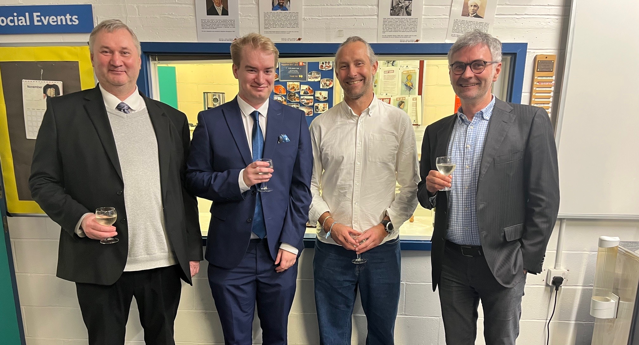
PhD Student: Alec Clapp (Viva Nov`25, Completed Mar`26)
“Feasibility study on the use of incoherent Cherenkov Diffraction Radiation to develop a non-invasive BPM”
Electron beam passes between two quartz targets
ChDR is emitted by target and collected by collimators
Light propagates though fibre optic feedthroughs to PMT
Demonstration of a 1D, dual pick-up ChDR BPM using pick-ups at visible wavelengths
A. Clapp et al., Proc. of IBIC’2024, Beijing, China, TUP33
Image participants (left to right): Pavel Karataev, Alec Clapp, Thibaut Lefevre (CERN, External examiner), Matthew Wing (UCL, Internal Examiner).
https://www.royalholloway.ac.uk/research-and-education/departments-and-schools/physics/news-physics/2025-11-13-congratulations-to-dr-alec-clapp/
Supervisors: P. Karataev and L. Bobb
Ian Martin, Light Sources, JAI AB, 16/04/2026

Slide 15
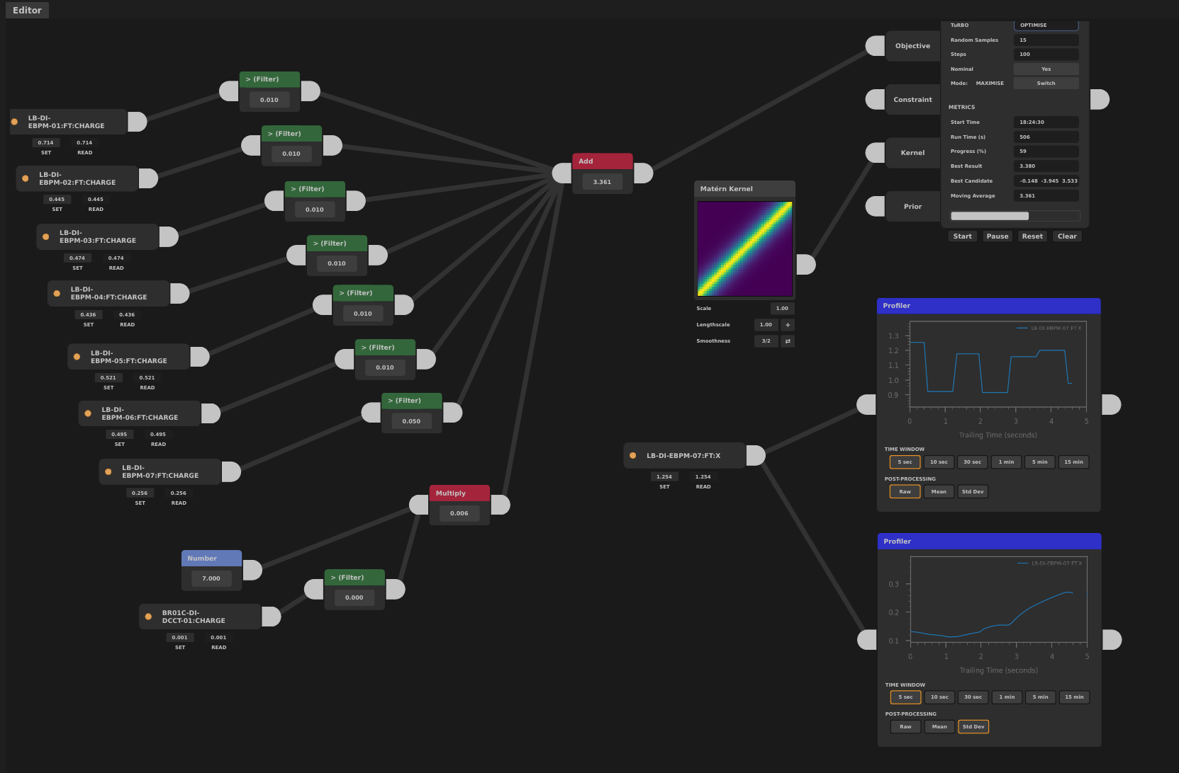
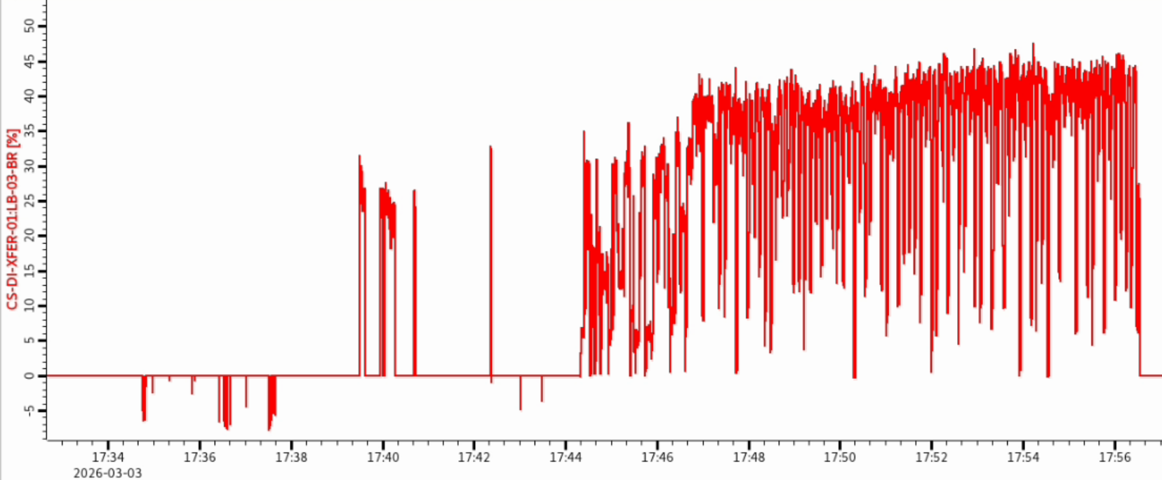
DPhil Student: Shaun Preston (started 2023)
“Optimising Injection at Diamond Light Source with Sample Efficient Bayesian Optimisation”
Main topic of study is to develop a Gaussian Process Optimiser (GPO), targeting online tasks (sample efficiency for sequential measurements key!)
Topics investigated:
Kernel composition (behaviour of system being modelled)
Acquisition function (where to sample next)
Pre-conditioning with random sampling / known ‘good’ solutions
Training neural network on model to use as a ‘prior’ for optimisation
Use of variational auto-encoders to reduce degrees of freedom
Guiding the optimisation: weighting with charge, position limits on BPMs
Progress over the last 12 months:
Maximise LTB and BTS transfer efficiency
Different variables: H/V steerers, pulsed magnets, quadrupoles
Developed an interactive tool for control room optimisation tasks
Interactive GUI
Optimisation (45%)
Initial sampling
BR Inj. Eff. (%)
Starting values (25%)
10 minutes
Supervisors: P. Burrows and I. Martin
Ian Martin, Light Sources, JAI AB, 16/04/2026

Slide 16
DPhil Student: Corey Lehmann (started 2023)
“Fast Beam Loss Monitor System for Diamond-II and Machine Learning Applications”
Fast BLMs have been calibrated and installed in the Diamond storage ring
Neural network models developed to match losses against known ID states
Example of a 24-hour period of Test data for the Collimator BLD
Red shaded areas indicate where anomalies are detected from the measured and predicted data being sufficiently diverged.
values predicted by a 1x32 NN model
true measured values
C. Lehmann, et al., Proc. IBIC 2025, Liverpool, UK, Sep. 2025, pp. 58-61. doi:10.18429/JACoW-IBIC2025-MOPCO04
Supervisors: P. Burrows and L. Bobb
Ian Martin, Light Sources, JAI AB, 16/04/2026

Slide 17
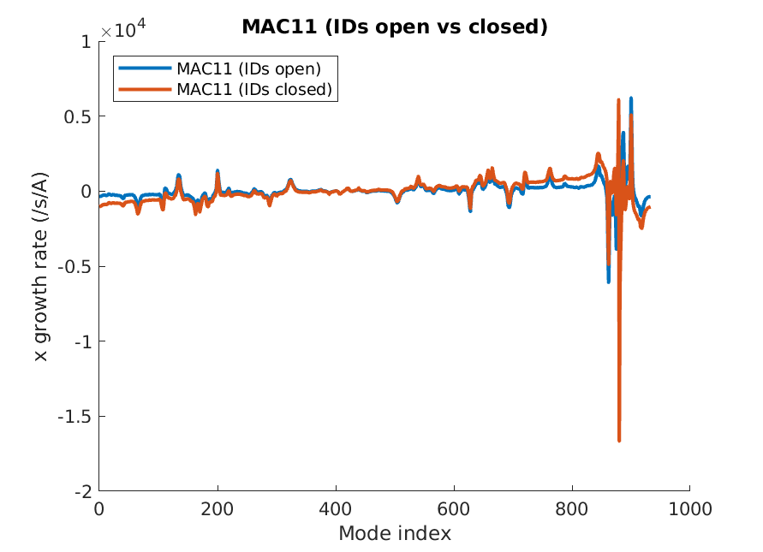
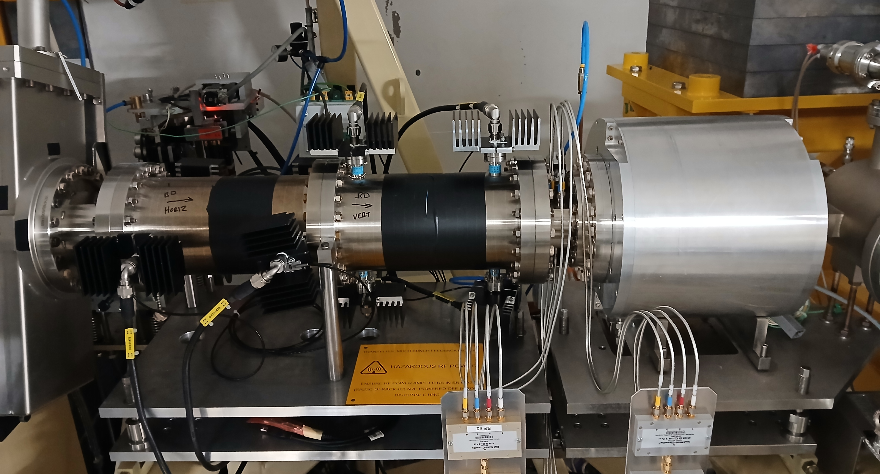
Joint JAI/DLS PDRA: Milica Rakic (starts May(?) 2026)
“Collective Effects Studies for Diamond-II”
striplines
Diamond-II studies:
Update single and multi-bunch threshold estimates with latest impedance database and vacuum pressure profile
Collective effects / multi-bunch feedback impact on kick-and-cancel injection
New topics: impact of space charge and IBS, optics errors
Diamond machine development:
Characterisation and optimisation of existing multi-bunch feedbacks
Cross-checking / validation of Diamond-II studies
Long-term monitoring of instability thresholds / machine impedance / IDs
General simulation updates:
Implementation of collective effects in PyAT, adoption of Xsuite
Comparison of particle tracking results with Vlasov-solvers
Resistive wall
collimators
Simulated horizontal coupled-bunch growth rates for Diamond-II
Diamond Multi-bunch feedback
Supervisors: P. Burrows and I. Martin
Ian Martin, Light Sources, JAI AB, 16/04/2026

Slide 18
Conclusions
JAI continues to be active in many areas of light source design and operation:
Enhanced performance / special operating modes / facility design
Photon / electron beam diagnostics
Exploitation of machine learning and related techniques
Directly supports and well-integrated with Diamond-II Project.
Collaborations / synergies with ISIS, ILC and Ada Lovelace Centre
Providing training and expertise in light sources for next generation of accelerator physicists:
Three PhD/DPhil Studentships (RHUL and Oxford)
Joint Diamond / JAI PDRA working on Diamond-II
Ian Martin, Light Sources, JAI AB, 16/04/2026

