Slide 1
Intense Hadron Beams
D. J. Kelliher
With contributions from J. Appleby, C. Jolly, T-J. Kuo, A. Oeftiger, D.W. Posthuma de Boer, C. Rogers, N. Steerenberg, F. Straniero, H. Wakeling
JAI Advisory Board Meeting
2026-04-16

Slide 2
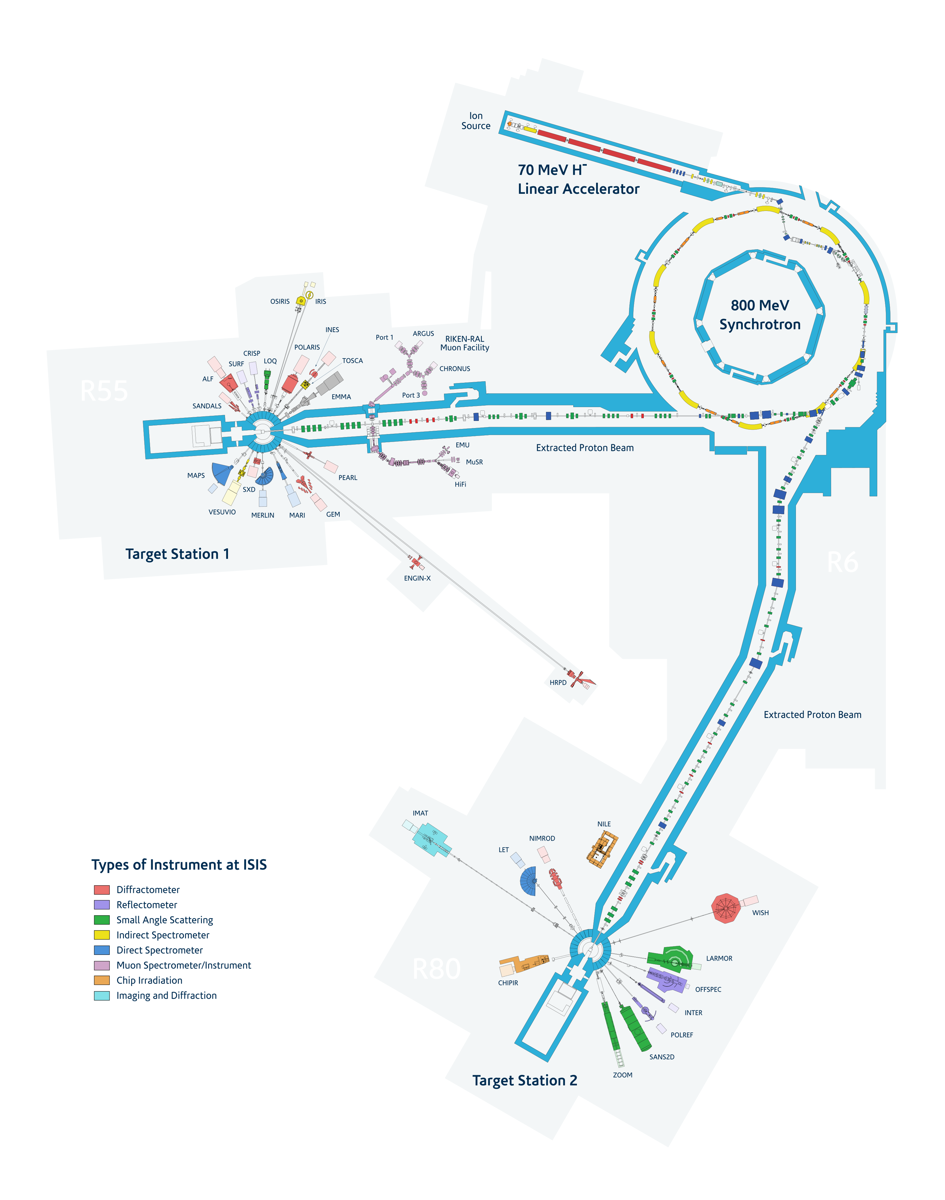
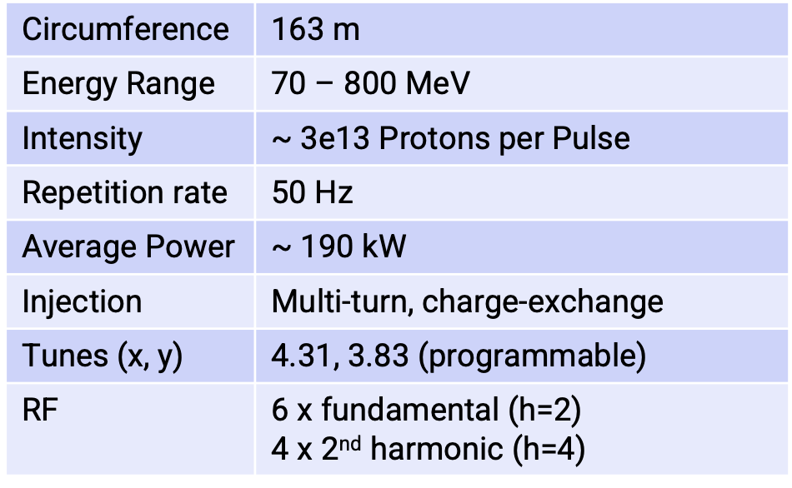
The ISIS Neutron and Muon Source
High intensity machine that comprises
  70 MeV H- injector (RFQ+DTL)
  800 MeV RCS
  Two tungsten targets for neutron spallation + graphite target for muon production.

Slide 3
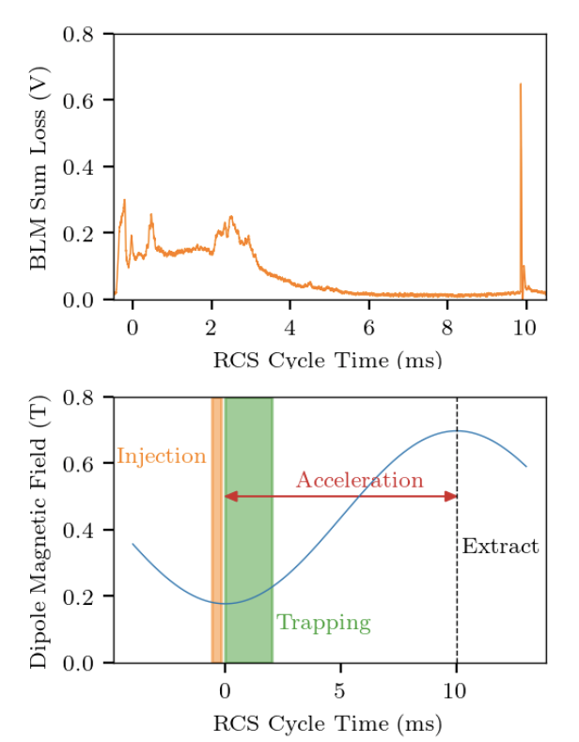
Intensity Effects in ISIS
Research focuses on reducing beam loss in the current machine.
Losses early in the cycle are caused by factors such as
Longitudinal losses during non-adiabatic capture.
Crossing resonances with space charge tune spread .
Coherent vertical instability (head-tail)
Mitigating these sources of beam loss will allow the machine to run at higher intensities
An upgraded MEBT including an electrostatic chopper will allow clean injection.
A program to reduce impedance sources that drive instabilities is underway.
A detailed study space charge in the RCS and how to optimize the working point is underway.

Slide 4
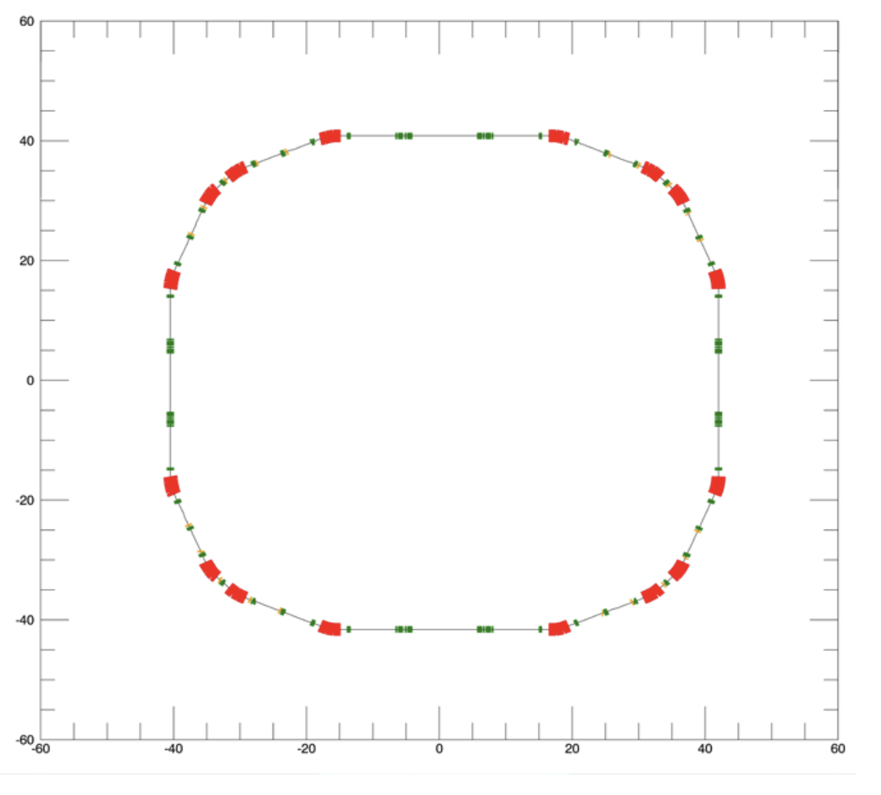
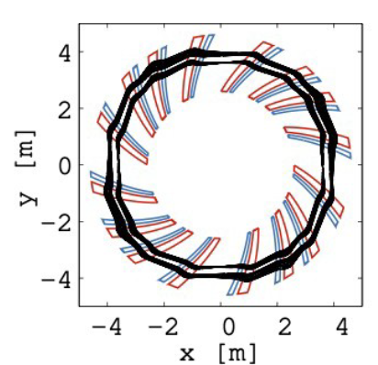
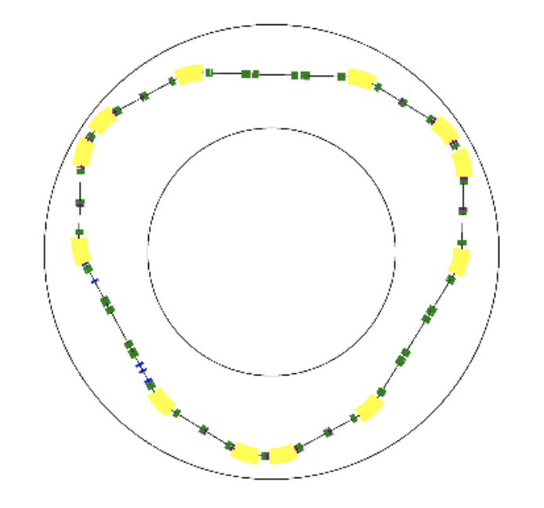
ISIS-II
Research aims to ensure a sustainable future for ISIS, including a potential MW-class successor, ISIS-II.
Accumulator ring, RCS and Fixed Field Alternating Gradient accelerator (FFA) options for ISIS-II have been extensively studied.
An FFA offers potential advantages in terms of sustainability, operational flexibility and reliability. The CDR for a prototype FFA ring, the 12MeV FETS-FFA, was completed in 2025.
ISIS-II RCS in the existing ISIS hall
Greenfield ISIS-II AR/RCS
FETS-FFA

Slide 5
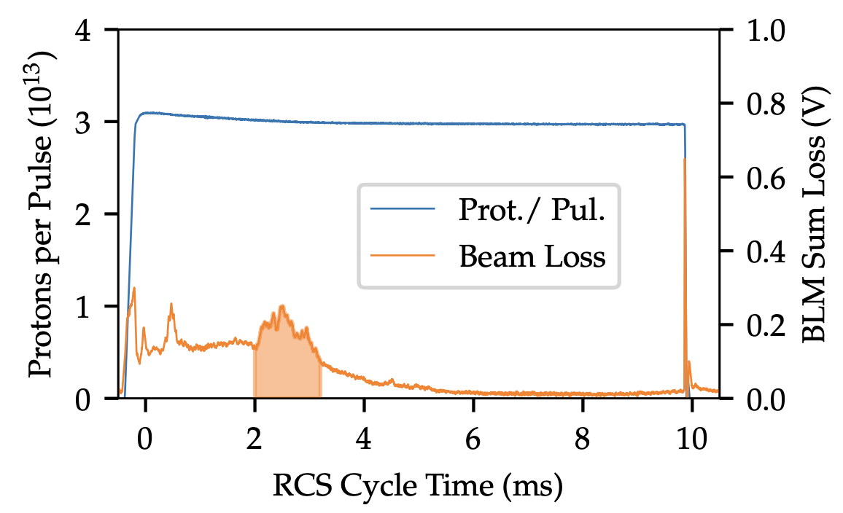
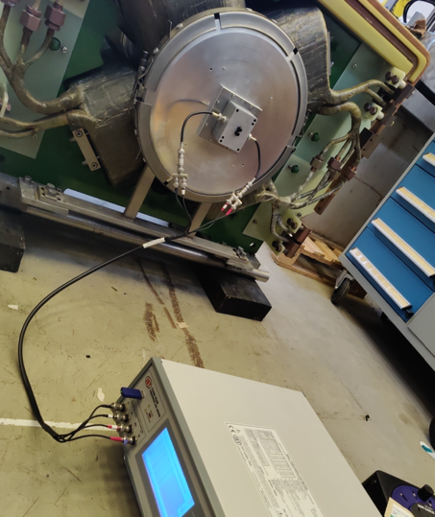
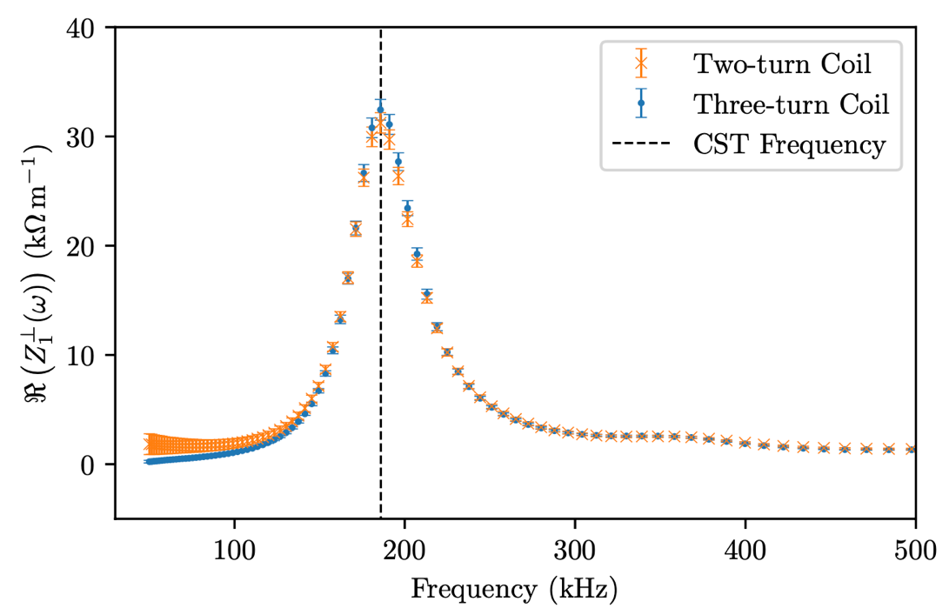
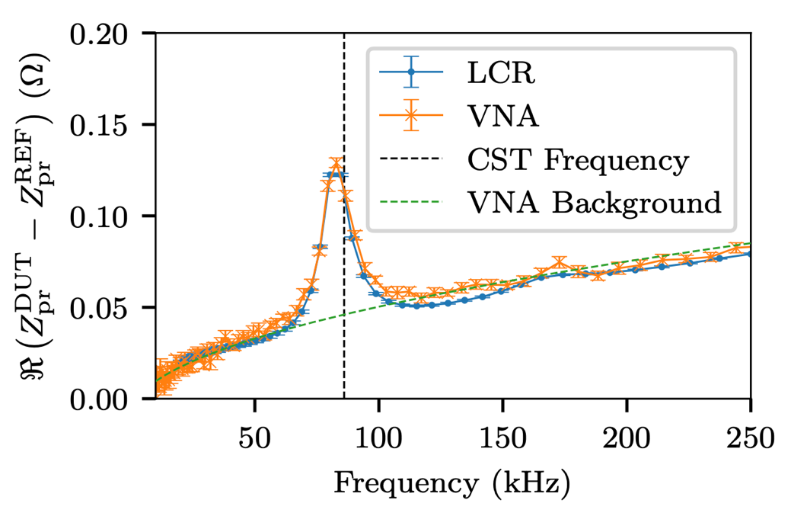
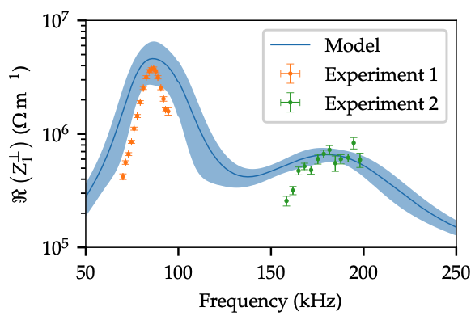
Coherent Instabilities on ISIS
D. W. Posthuma de Boer (JAI Student/ISIS), B. Foster (JAI), C. M. Warsop (ISIS), A. Oeftiger (JAI)
In recent years, beam loss due to a coherent instability has limited the intensity of ISIS.
  First observed around 1988, it resembles a head-tail mode-1 with growth times of ~100 µs, but mode 2 or 3 are predicted with growth rates of ms.
Simulations and lab measurements confirm large resonator impedances are present on RF screens.
  Developed impedance model based on CST simulations with adjustments for lower Q resonators observed in measurement.
Coasting beam impedance measurements agree with key predictions of the model.
  Two peaks centered around 85 and 200 kHz, with amplitude of ~ MOhm/m for β=1.

Slide 6
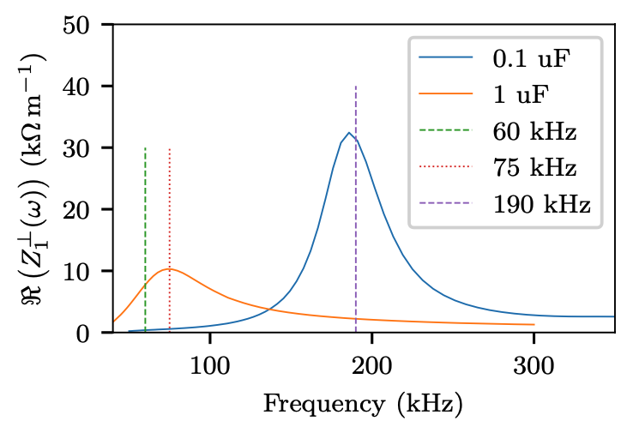
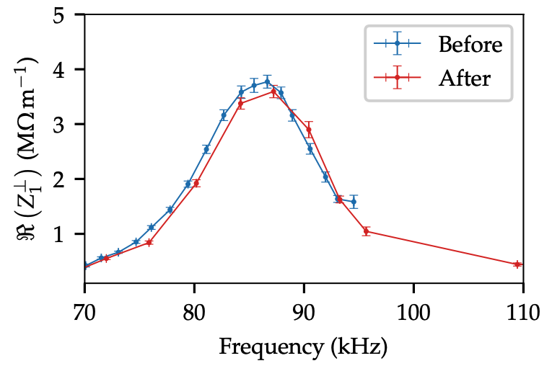
Coherent Instabilities on ISIS
D. W. Posthuma de Boer (JAI Student/ISIS), B. Foster (JAI), C. M. Warsop (ISIS), A. Oeftiger (JAI)
Mitigation method demonstrated in the lab by optimising capacitances in the RF screen structures.
Modified RF screens with optimised capacitances have been installed on ~6% of screens at ISIS for a trial.
  Impact assessed with beam based impedance measurements.
  See early evidence of reduced impedance at the 90kHz peak.
  Further optimisation and measurements are required.
Most recent results presented at HB2025 (10.18429/JACoW-HB2025-THCBC02)
  Also invited to deliver plenary talk, with title
  ”The Challenges of Instabilities and Impedances on High Intensity Hadron Machines.”
Thesis will be submitted in coming weeks.

Slide 7
Working points and Space Charge Limit
J. Appleby (JAI Student), A. Oeftiger (JAI), S. Machida (ISIS)
Started DPhil in October 2024.
Finding the maximum achievable beam intensity and space charge limit for space-charge dominated accelerators e.g. ISIS, J-PARC
  Resonance stopbands increase with intensity
  Dependant on working point / betatron tune
Ongoing studies to create a metric that can characterise this limit, to improve existing operations and inform future accelerators e.g. ISIS-II
  Fig 2 shows initial work into this, showing the limits of ISIS operation due to a quadrupole gradient error
This metric can be used to test and compare new methods of increasing intensity, such as split-integer tunes or alternative beam distributions.
Fig 1 (Top): The k1 strengths for the trim quadrupoles required to achieve a specific tune in tune space on ISIS.
Fig. 2 (Right): The maximum absolute tracked vertical position over 10k turns as a function of set vertical tune Qy and a quadrupole gradient error K1L.

Slide 8
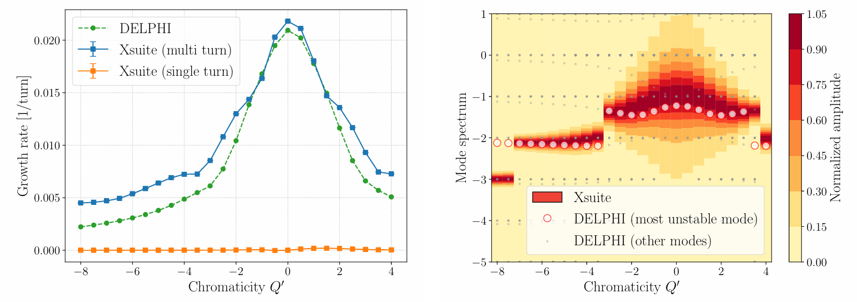
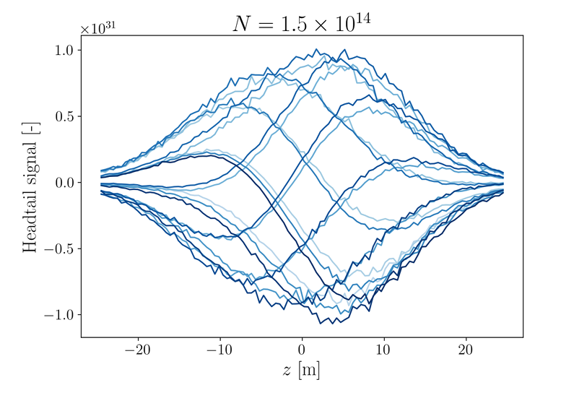
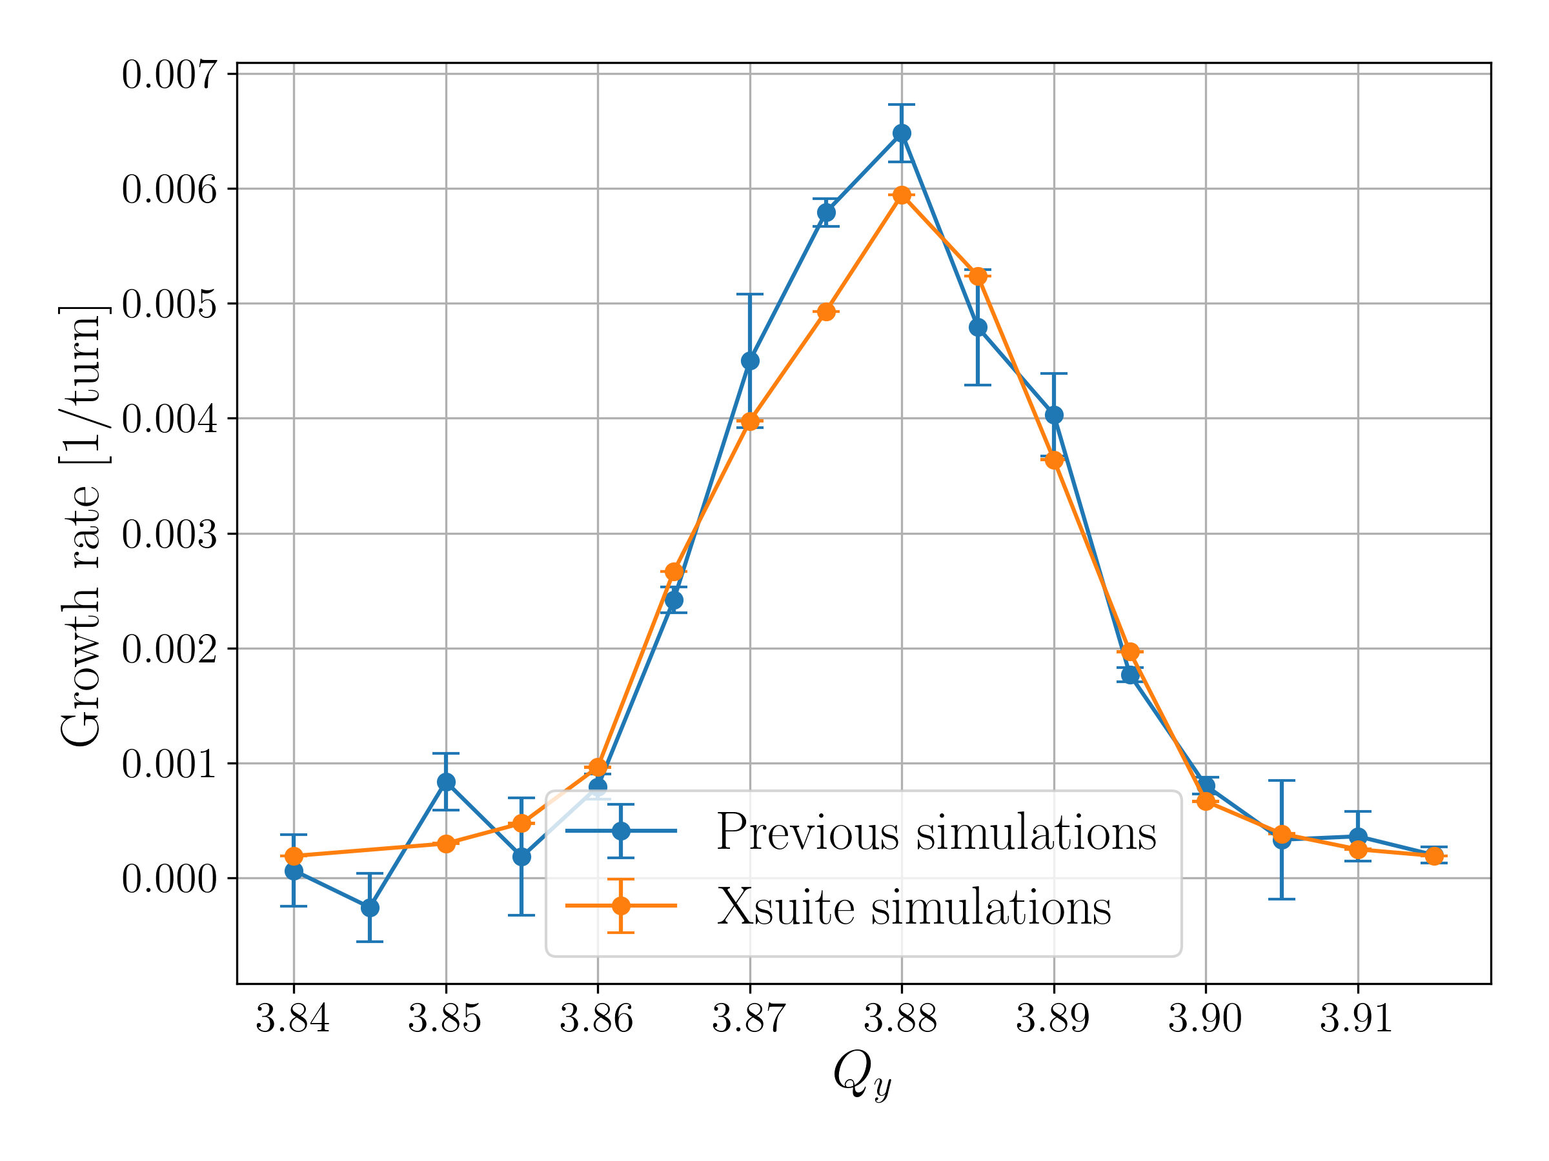
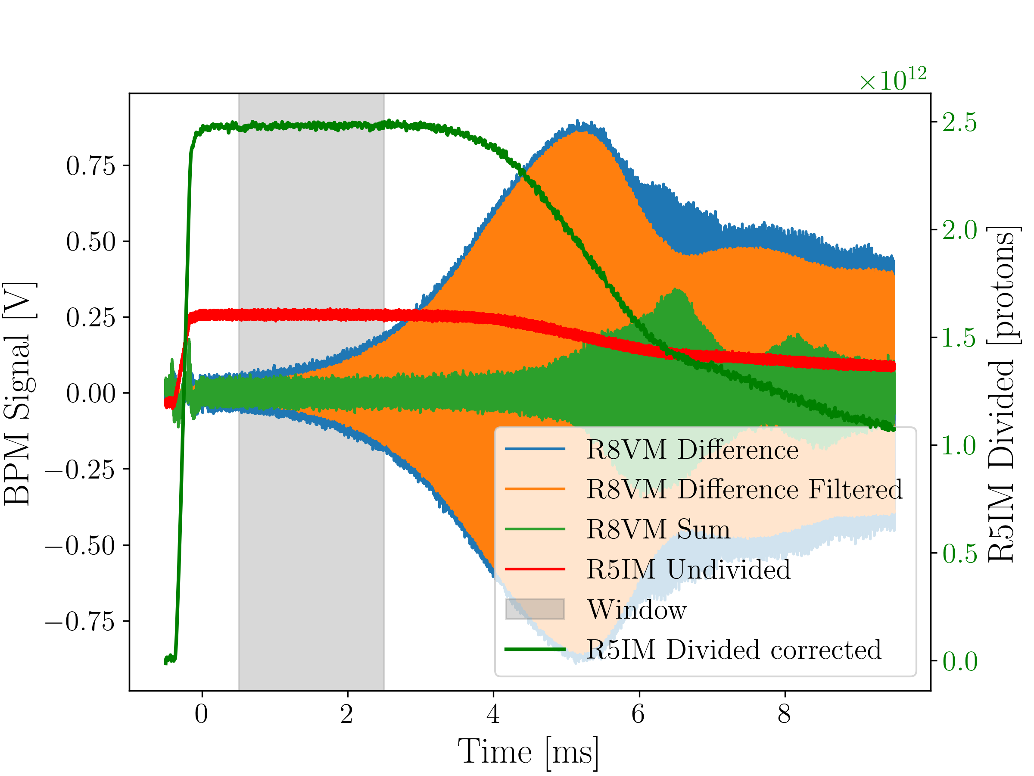
Head-tail Instabilities at ISIS
N. Steerenberg (Visiting EPFL Masters Student), A. Oeftiger (JAI), D. W. Posthuma de Boer (ISIS), R. Williamson (ISIS)
MSc thesis:
  Model head-tail instabilities with bunched & coasting beams at ISIS RCS based on new impedance model (David PdB’s thesis) in Xsuite
    Challenges for modelling: wakefields oscillate for >100 turns, non-ultrarelativistic regime at v<c
  Identify main intensity limitation mechanisms in different beam dynamical regimes through parametric simulation scans
  (multi-turn rigid instability vs. transverse mode coupling instability vs. head-tail instability)
  Study semi-analytical results from Vlasov eigenfunction solver (DELPHI, developed for LHC) and compare to tracking results (newly established Xsuite model)
  Analyse experimental growth rate measurements of coasting
  beam instabilities at ISIS RCS and validate model predictions
Successfully defended Master thesis in September 2025
  Noa is now at SLAC for a small research project on
  Bayesian Optimisation, starting a PhD project at PSI (CH) /
  University of Zurich
Growth rates (left) and mode spectrum (right) for various chromaticities, comparing tracking results (Xsuite) to semi-analytical Vlasov eigenfunction analysis (DELPHI)
Travelling wave intra-bunch pattern seen in transverse mode coupling instability
Head-tail instabilities predicted by new Xsuite model compared to established model (Rob Williamson’s thesis)
Growth rate measurements with coasting beams at ISIS RCS

Slide 9
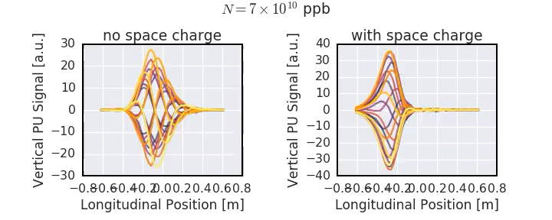
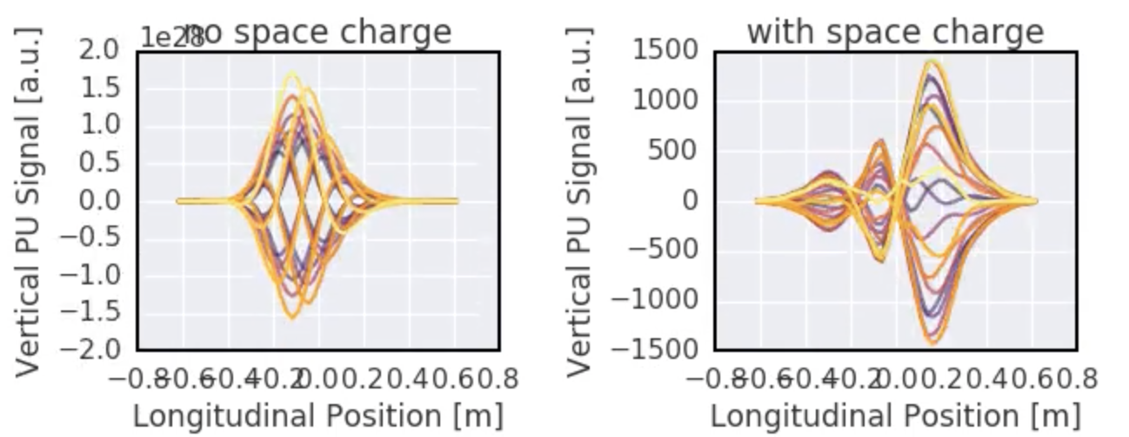
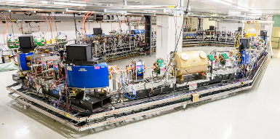
Coherent Stability with Space Charge
F. Straniero (JAI Student), A. Oeftiger (JAI), R. Williamson (ISIS)
CERN SPS Example: simulated intra-bunch motion for head-tail instability -- left without space charge effects, right same parameters but with space charge included.
With push for ultimate beam intensity and beam brightness in circular accelerators, density (or space charge) effects are observed to alter well-studied instability dynamics (at times large beam losses)
Francesco started DPhil in October 2025, project goals:
  Investigate and characterise the impact of direct space charge on head-tail instability predictions for ISIS RCS beams: intrinsic Landau damping vs. additional instability mechanisms
  Develop new mitigation techniques for existing accelerators like the ISIS RCS and identify optimal design strategies and parameter ranges (∆Q_{SC}/Q_{s}) for future high-intensity accelerators, aiming to exploit beneficial aspects of direct space charge
  Collaborate with Fermilab’s IOTA team which will study coherent stability during IOTA’s first Proton Run in 2027
First steps: extend recently developed Xsuite model with space charge (Noa Steerenberg’s thesis) and investigate impact on ISIS coasting beam predictions

Slide 10
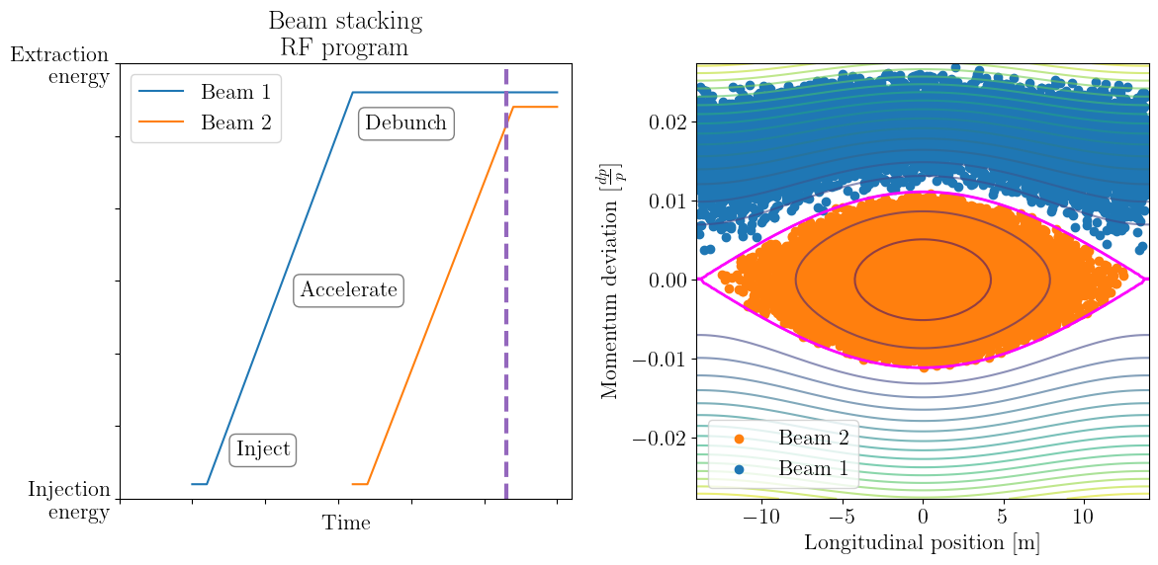
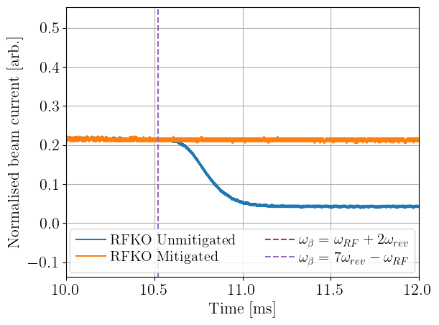
Beam Stacking and RF Knockout
C. Jolly (JAI Student), P. Burrows(JAI), A. Oeftiger (JAI), C. Rogers (ISIS)
By using symmetrically placed RF cavities, the loss caused by RF knockout can be mitigated.
Beam stacking allows an FFA to approach the space charge intensity limit at the extraction energy.
Stacking of two beams already demonstrated at the KURNS FFA.
RF knockout (RFKO) can cause beam loss during stacking.
Experimental demonstration of mitigation of RF knockout at ISIS → Lossless beam stacking is possible!
Paper submitted to PRAB!

Slide 11
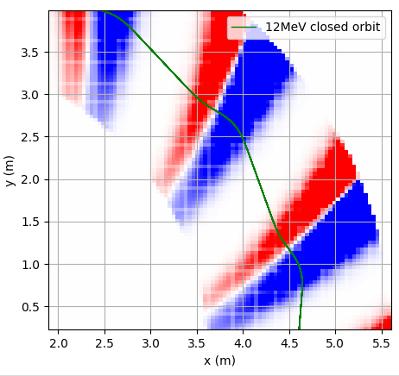
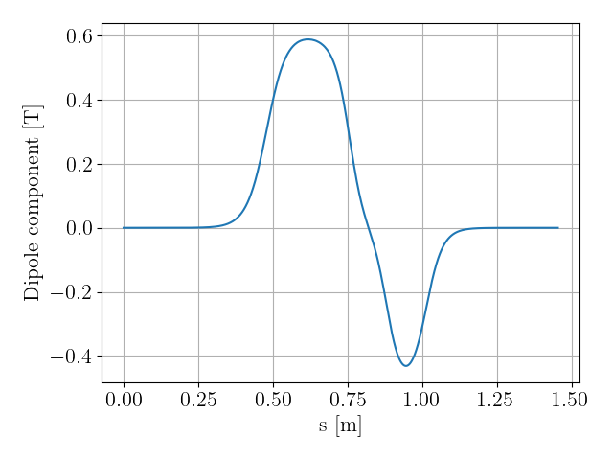
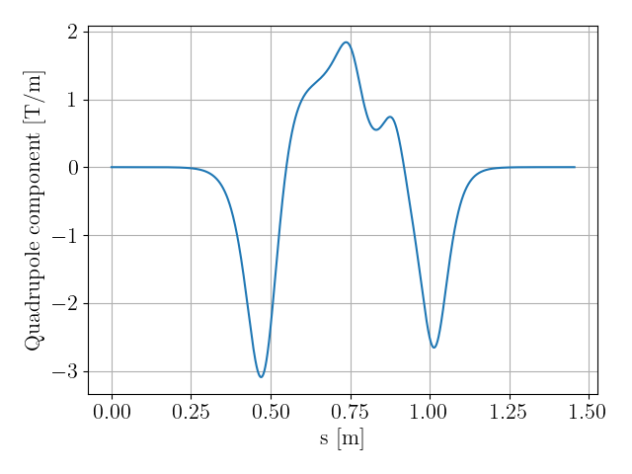
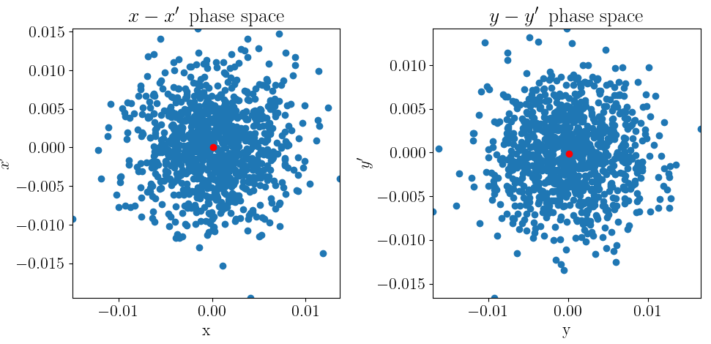
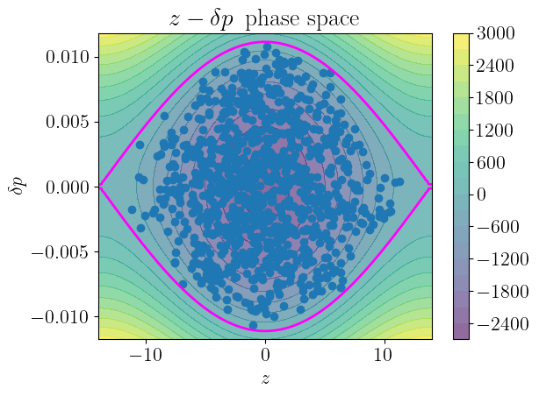
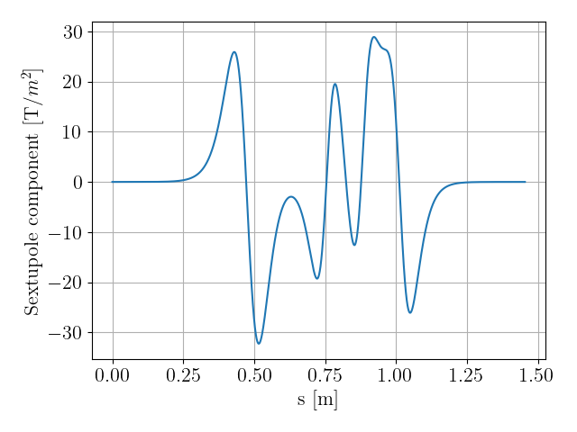
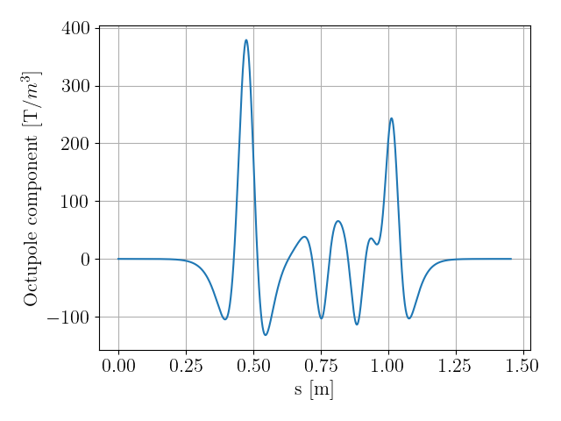
Space Charge in FFAs
C. Jolly (JAI Student), P. Burrows (JAI), A. Oeftiger (JAI), C. Rogers (ISIS)
New approach using differential algebra maps and harmonic analysis could enable space-charge simulations of FFAs:
Use the code MAD-NG and the multipoles to generate a differential algebra map for the FFA cell
Complex combined function FFA field is decomposed into multipoles: e.g:
Quadrupole
Dipole
Sextupole
Octupole
Tracking through the FFA in the beam-frame means that existing space-charge tools can be used.
This the first time self-consistent space charge has been modelled in FFAs!

Slide 12
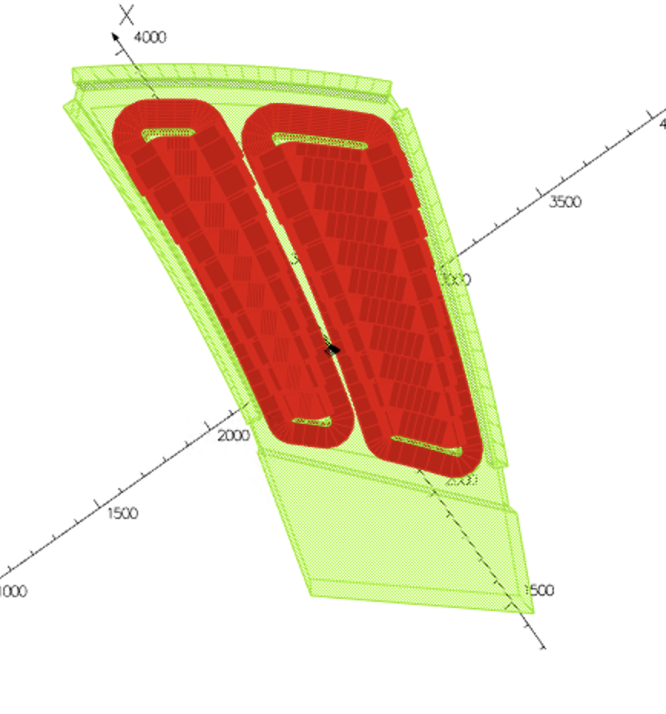
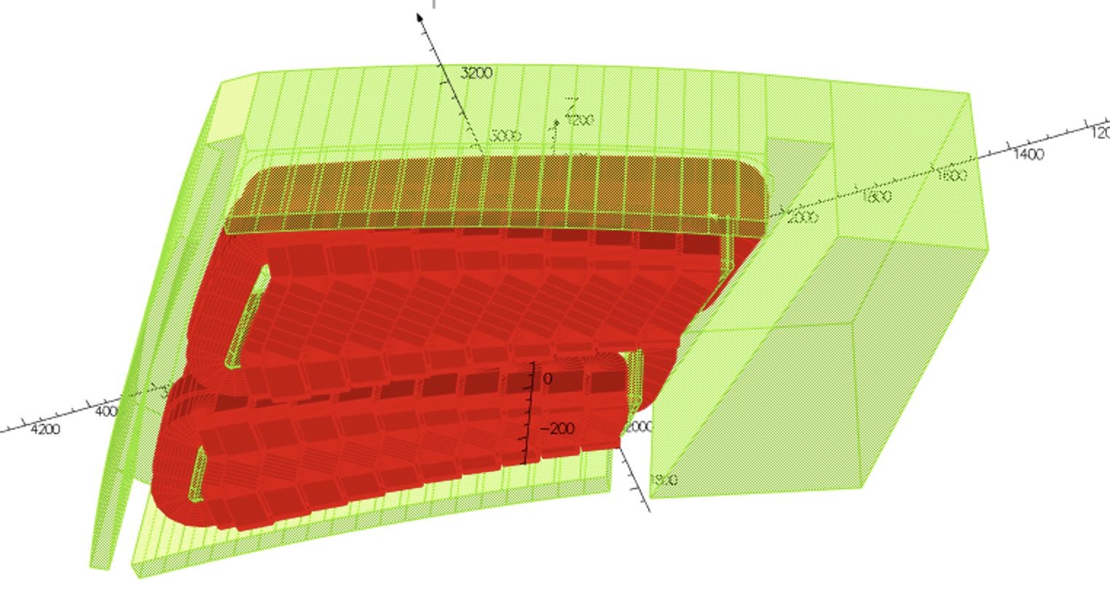

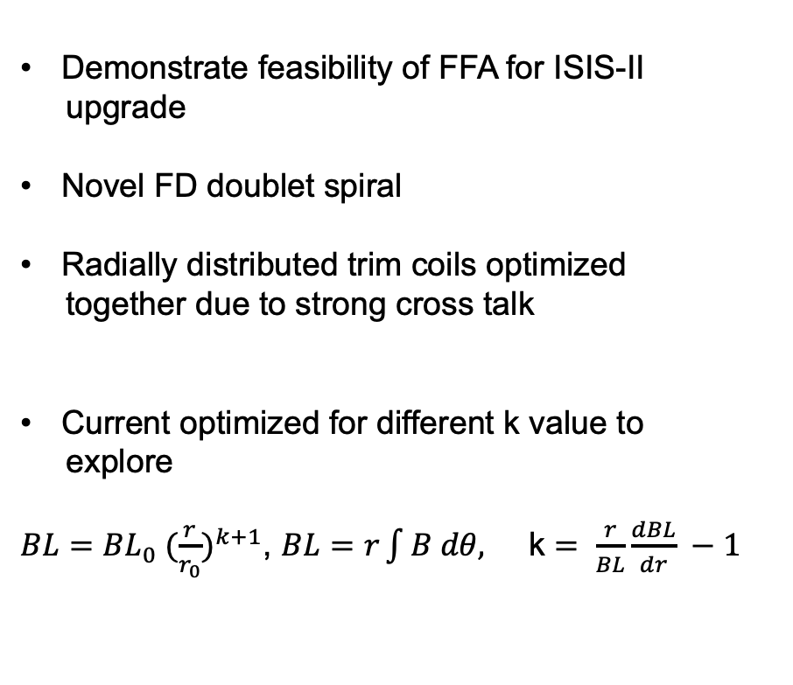
Design of magnet for FETS-FFA
T-J. Kuo (JAI Student), J.Pasternak (JAI/ISIS), J.-B. Lagrange (ISIS)
Demonstrate feasibility of FFA for ISIS-II
upgrade
Novel FD doublet spiral
Radially distributed trim coils optimized
together due to strong cross talk
Current optimized for different k value to
explore
$BL={BL}_{0} {(\frac{r}{r_{0}})}^{k+1}$, $BL=r\int{B dθ, }$ k $= \frac{r}{BL}\frac{dBL}{dr} −1$
Target cell tune variation achieved!

Slide 13

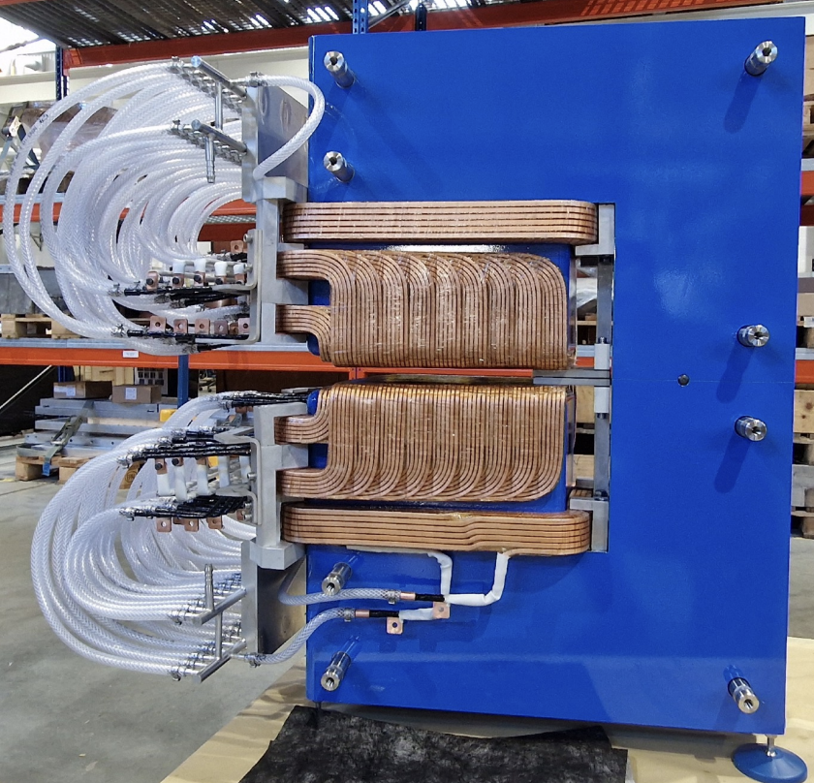
Design of magnet for FETS-FFA - Prototype radial sector magnet
T-J. Kuo (JAI Student), J.Pasternak (JAI/ISIS), J.-B. Lagrange (ISIS)
Smaller in size, without the spiral angle. Coils are designed in the same way and will allow us to test the working principles of trim coils and correction schemes
Magnetic field measurements to commence imminently!

Slide 14
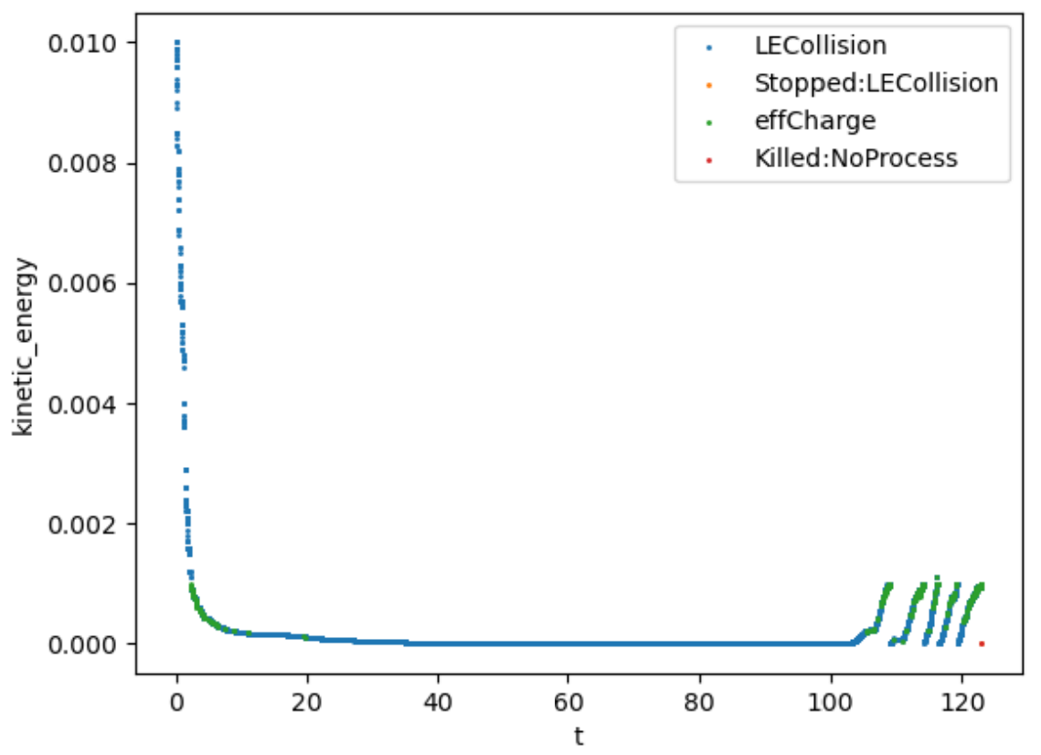
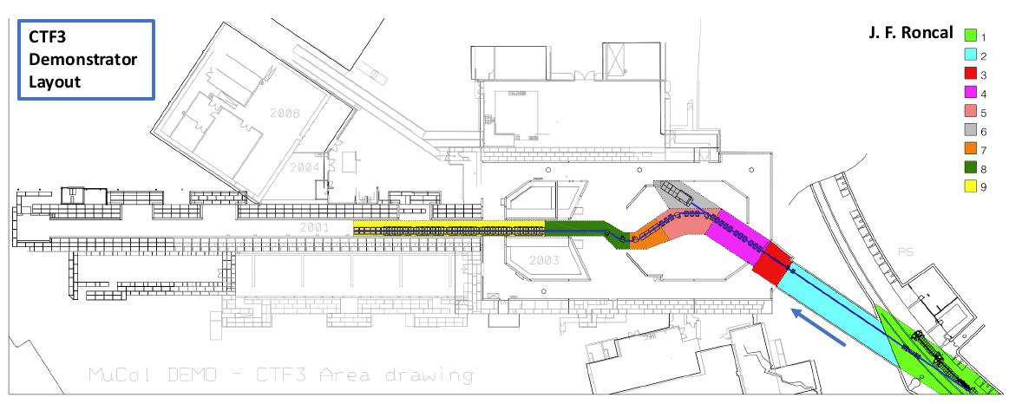
JAI-ISIS collaboration on Muon Beams
P. Jurj (JAI Postdoc), R. Kamath (JAI Student), J.-B. Lagrange (ISIS), J. Pasternak (Imperial/ISIS), C. T. Rogers (ISIS)
Studying possible low energy muon beam cooling system for ISIS
  Aim to improve efficiency by order of magnitude compared to existing schemes
  Studying bespoke low energy physics models to interface with Geant4
Strong collaboration on muon collider
  Coordinating muon cooling Demonstrator effort
  Leveraging previous MICE collaboration
Participation in the NuSTORM facility design.
Kinetic Energy [MeV]
Time [ns]

Slide 15
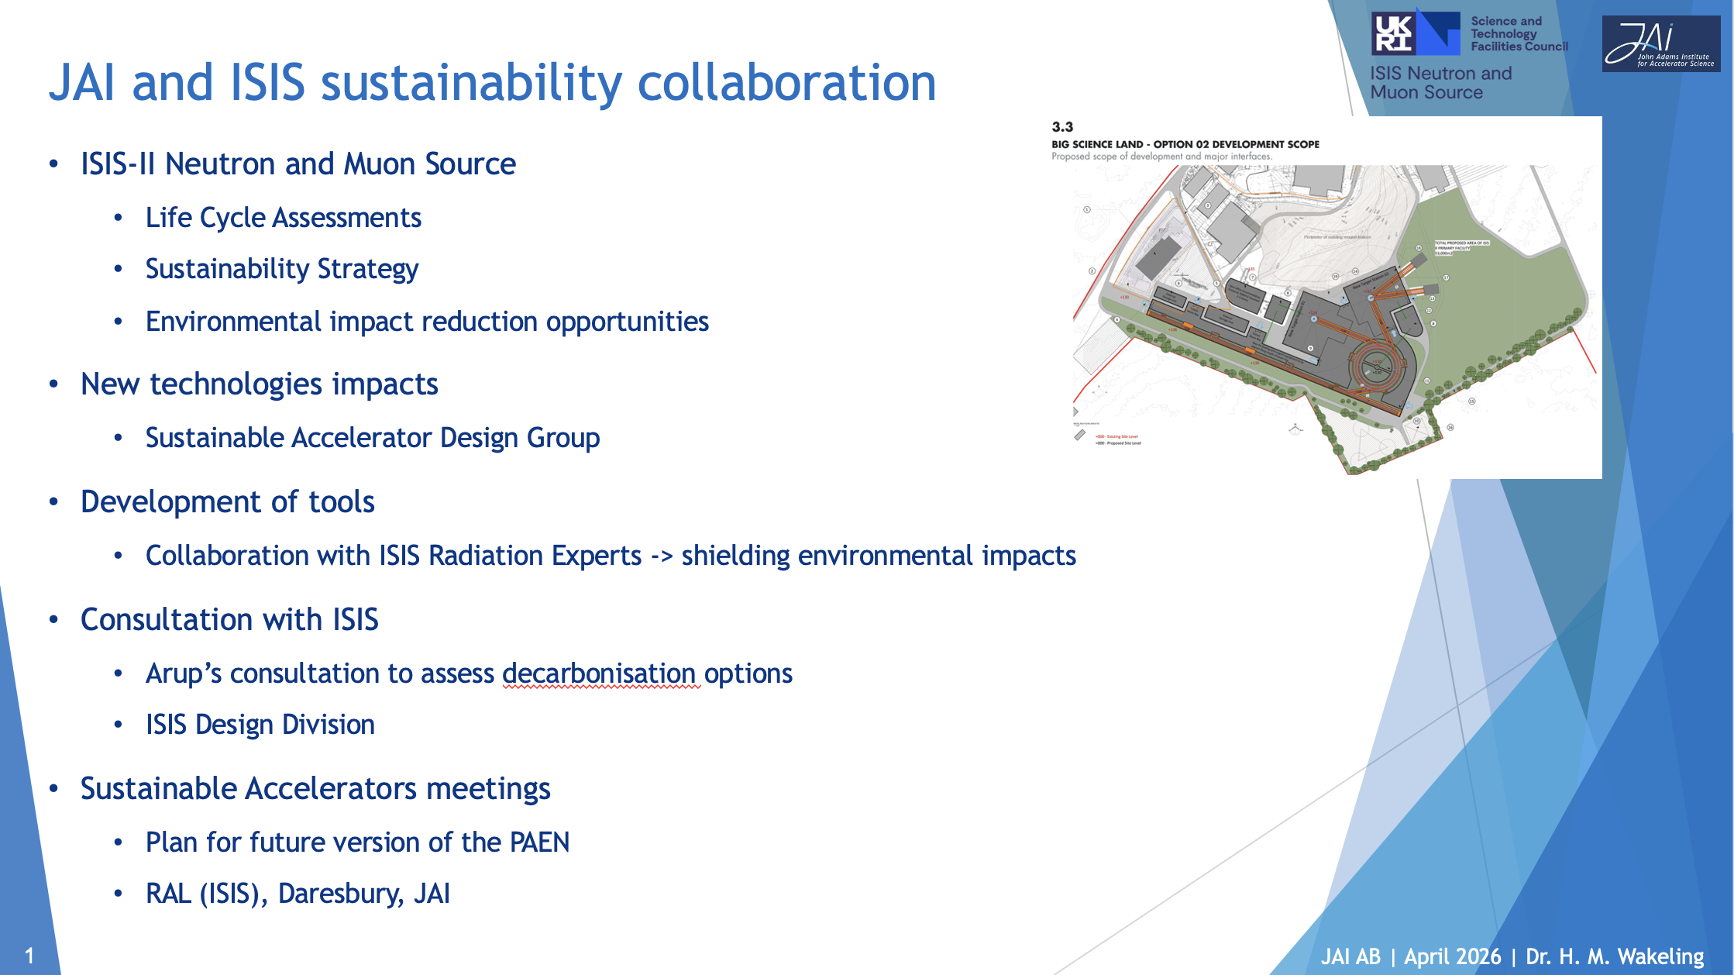
14
Presentation by Hannah Wakeling later today.

Slide 16
JAI Lectures
Several ISIS staff are lecturers on the JAI Graduate Accelerator Physics Programme.
Current ISIS lecturers are listed below:
Lecturer | Topic
David Kelliher | Hamiltonian Dynamics
Billy Kyle | Longitudinal Dynamics
Sunil Patel | Vacuum and Surface Science
David Posthuma de Boer | Diagnostics
Oli Tarvainen | Particle Sources
Rob Williamson | Instabilities
See presentation by Emmanuel Tsesmelis.

Slide 17
Conclusion
A major focus of R&D at ISIS is to increase the achievable beam intensity by understanding and mitigating sources of beam loss such as coherent instabilities and space charge.
JAI students and faculty make a very significant contribution to this task by tackling various aspects of the problem in detail.
JAI plays a critical role in R&D relevant for future ISIS upgrades.
The JAI-ISIS collaboration spans hadron and muon beams, supporting next generation accelerator design and operation. The partnership serves as a vital pipeline training PhD students and early-career researchers in high intensity accelerator physics.

