Slide 1
Particle Physics Colliders and Beamlines
Adrian Oeftiger & Stephen Gibson
JAI Advisory Board, 16 April 2026

Slide 2
Overview
CERN’s High-Luminosity LHC
  Machine protection & diagnostics
  Nonlinear dynamics
  Data-driven modelling
  Coherent stability
Future electron-positron Higgs Factories
  Linear colliders and leading contributions + ATF3
  FCCee IP feedback + BPM diagnostics
More Colliders and Fixed-Target Facilities
  Facility for Antiproton and Ion Research
  Electron-Ion Collider
  Muon Collider & NuSTORM

Slide 3

1. CERN’s High Luminosity
Large Hadron Collider

Slide 4

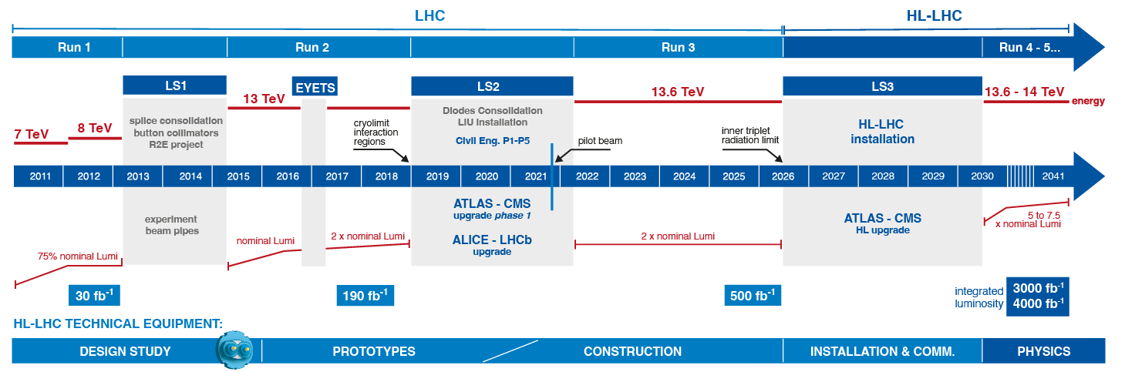
HL-LHC-UK Project & funding
Long history of UK contributions to HL-LHC
Major collaborative project funded from multiple sources:
  Accelerator Institute grants
  CERN
  STFC project grant
  University contributions
UKRI PPAN prioritisation exercise: HL-LHC-UK phase 3 proforma submitted in March 2026:
  Minimal programme: Manchester, Lancaster, STFC, Southampton
  Full programme:+ Liverpool, Dundee, Royal Holloway, Oxford
Without phase 3 STFC project grant, ongoing work can only continue with limited support of institute grants

Slide 5
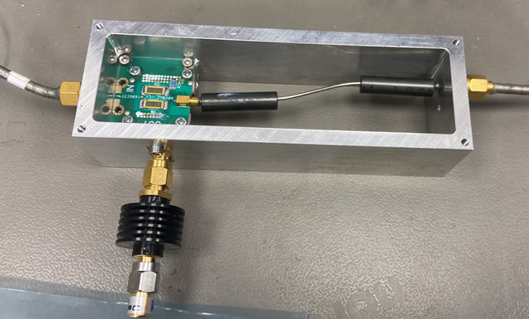
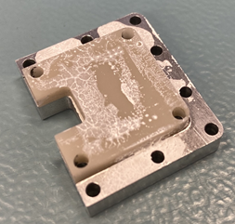
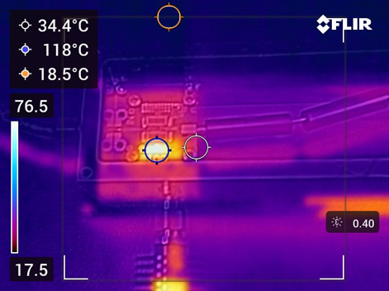
LHC BPM consolidation
Weida Zhang, Philip Burrows
BPM prototype design in Oxford:
  BPM design requires combining pickup signals at very high strength
  Bulk resistors (as large as 2512 package size) have to be used
  Wideband nature of the pulses requires careful design and simulation of the circuit EM property
  Thin PCB substrate is chosen for allowing heat transferring from resistive components to enclosure
  AlN (Aluminium Nitride) ceramic is used as intermedium heatsink for
    Avoiding non-all-ground bottom layer to have direct contact with metal heatsink, which maintains the EM property of the circuit
    Providing 170W/(mK) thermal conductivity to relay the heat to metal enclosure
    close to final design: >2000 need to be manufactured!
Prototype combiner
Heat sink
Thermal simulations

Slide 6
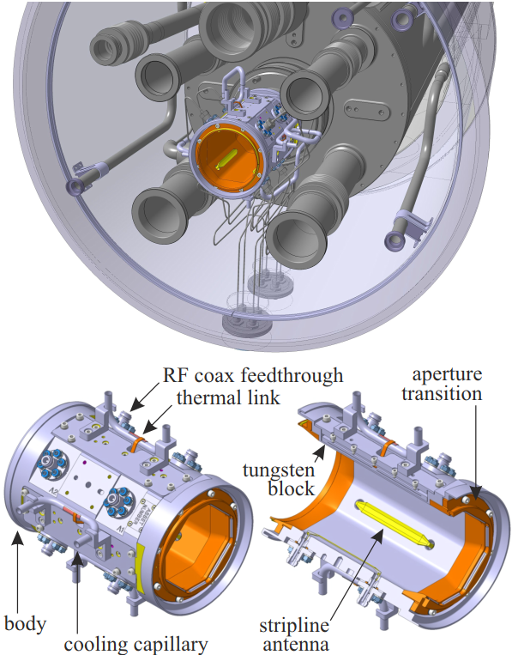
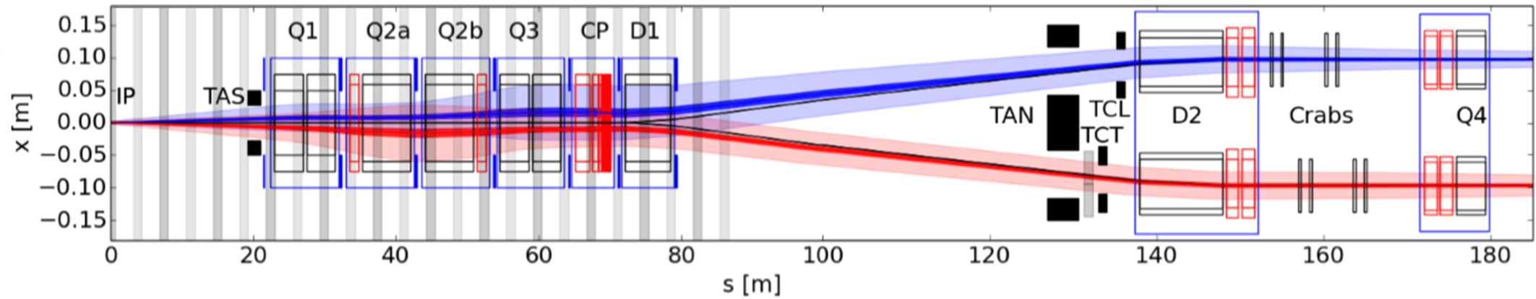
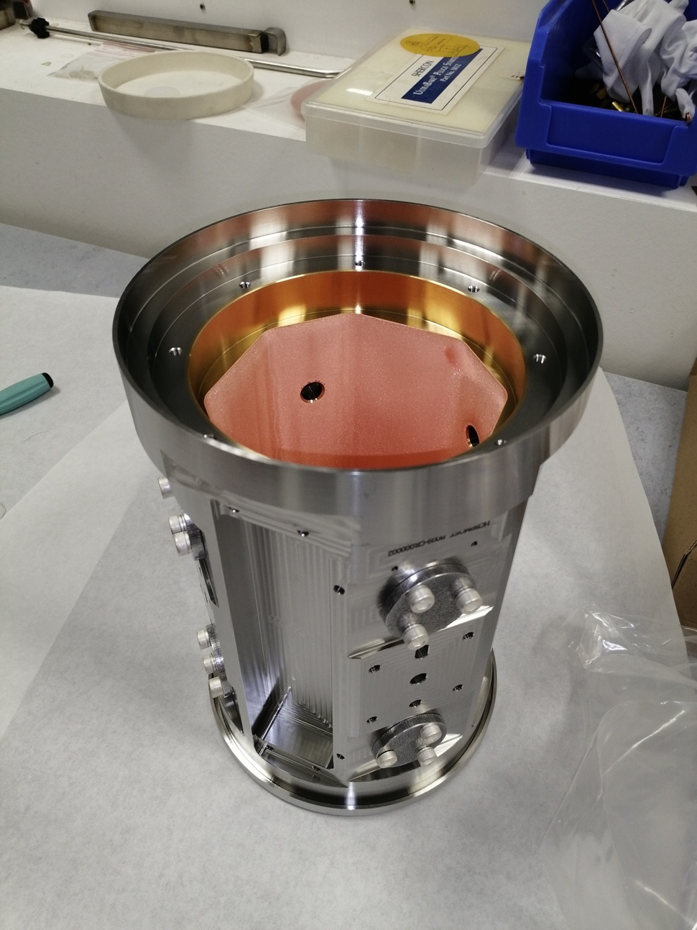
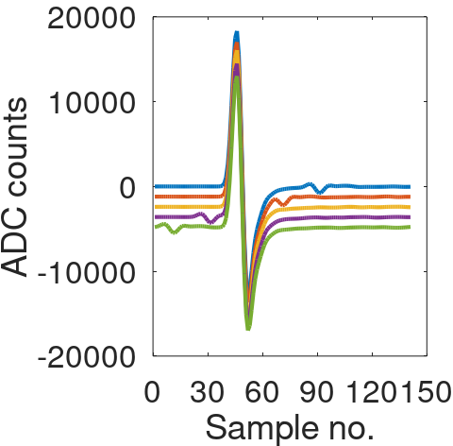

HL-LHC Interaction Region BPMs
HL-LHC-UK Task 3.3 complete
Stripline pickups sensitive to beam direction for the cryogenic combined beam sections
New electronics on state-of-the-art RFSoC chip
Counter beam compensation algorithm applied to two-beam waveforms:
beam 1
beam 2
Coated pre-series body at CERN
Details in IPAC23: THPL089 & THPL119
+ IBIC20 WEPP12 and IBIC21 MOPP24:

Slide 7
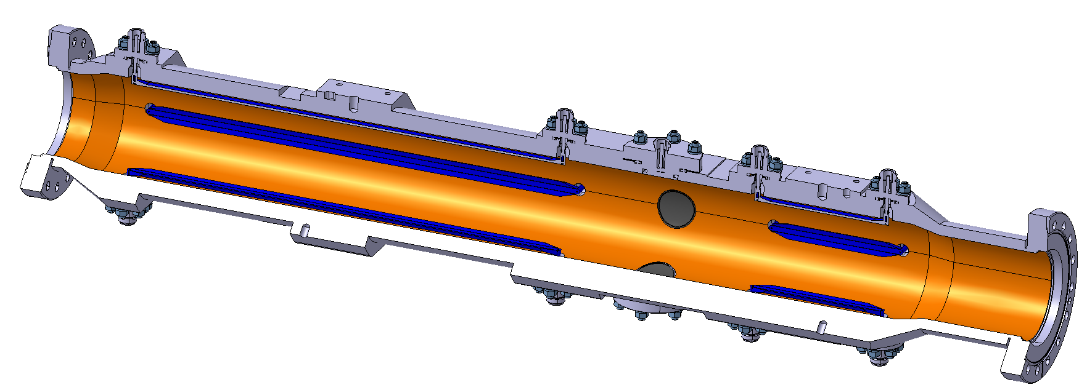
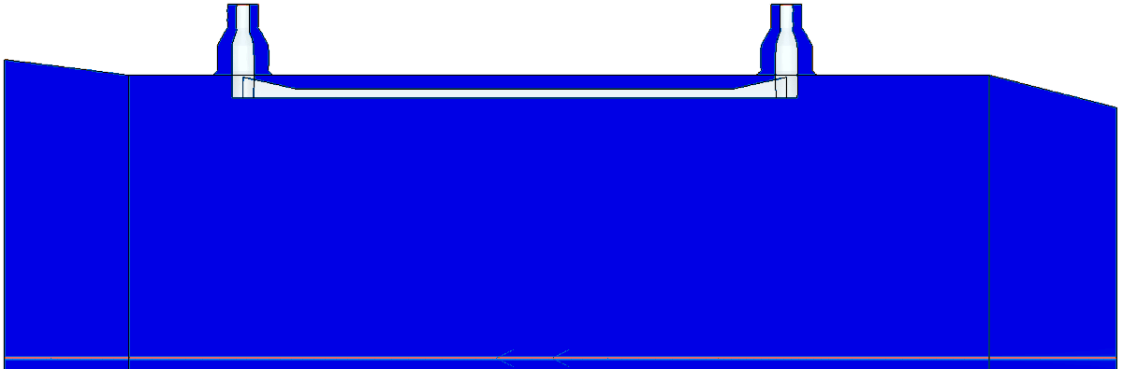
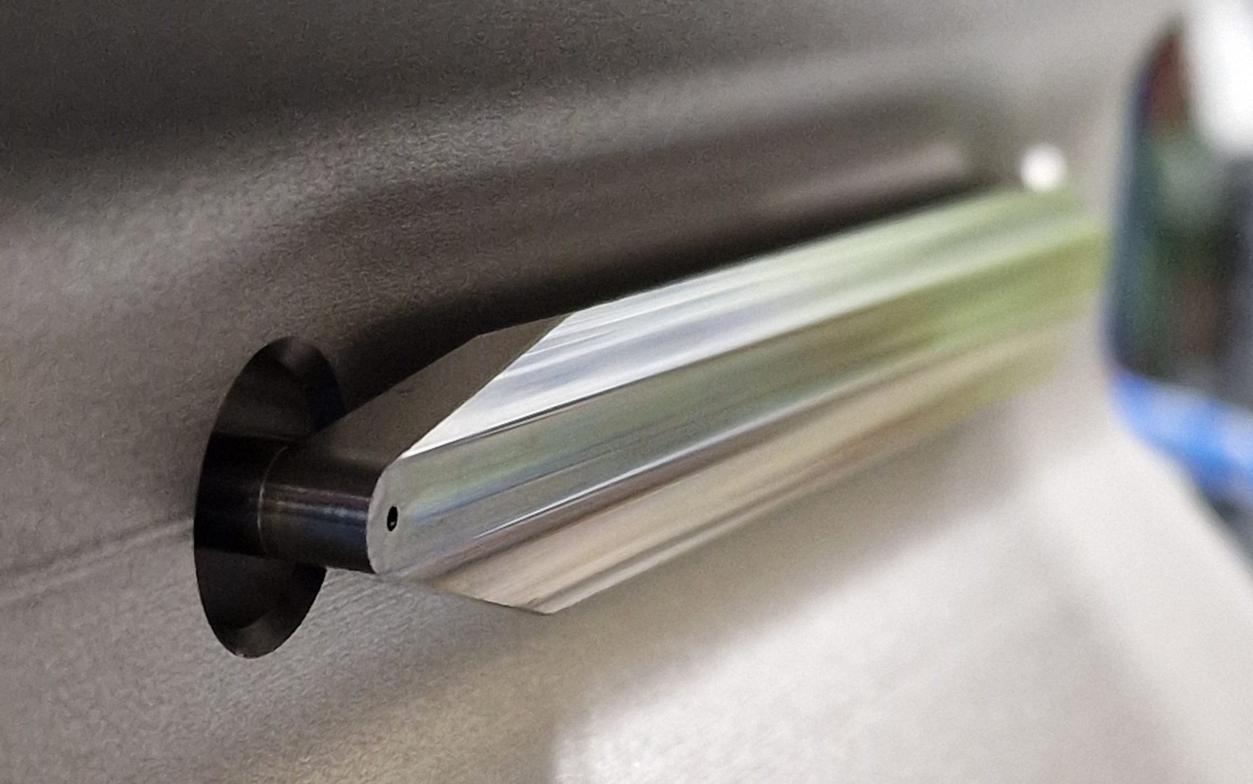
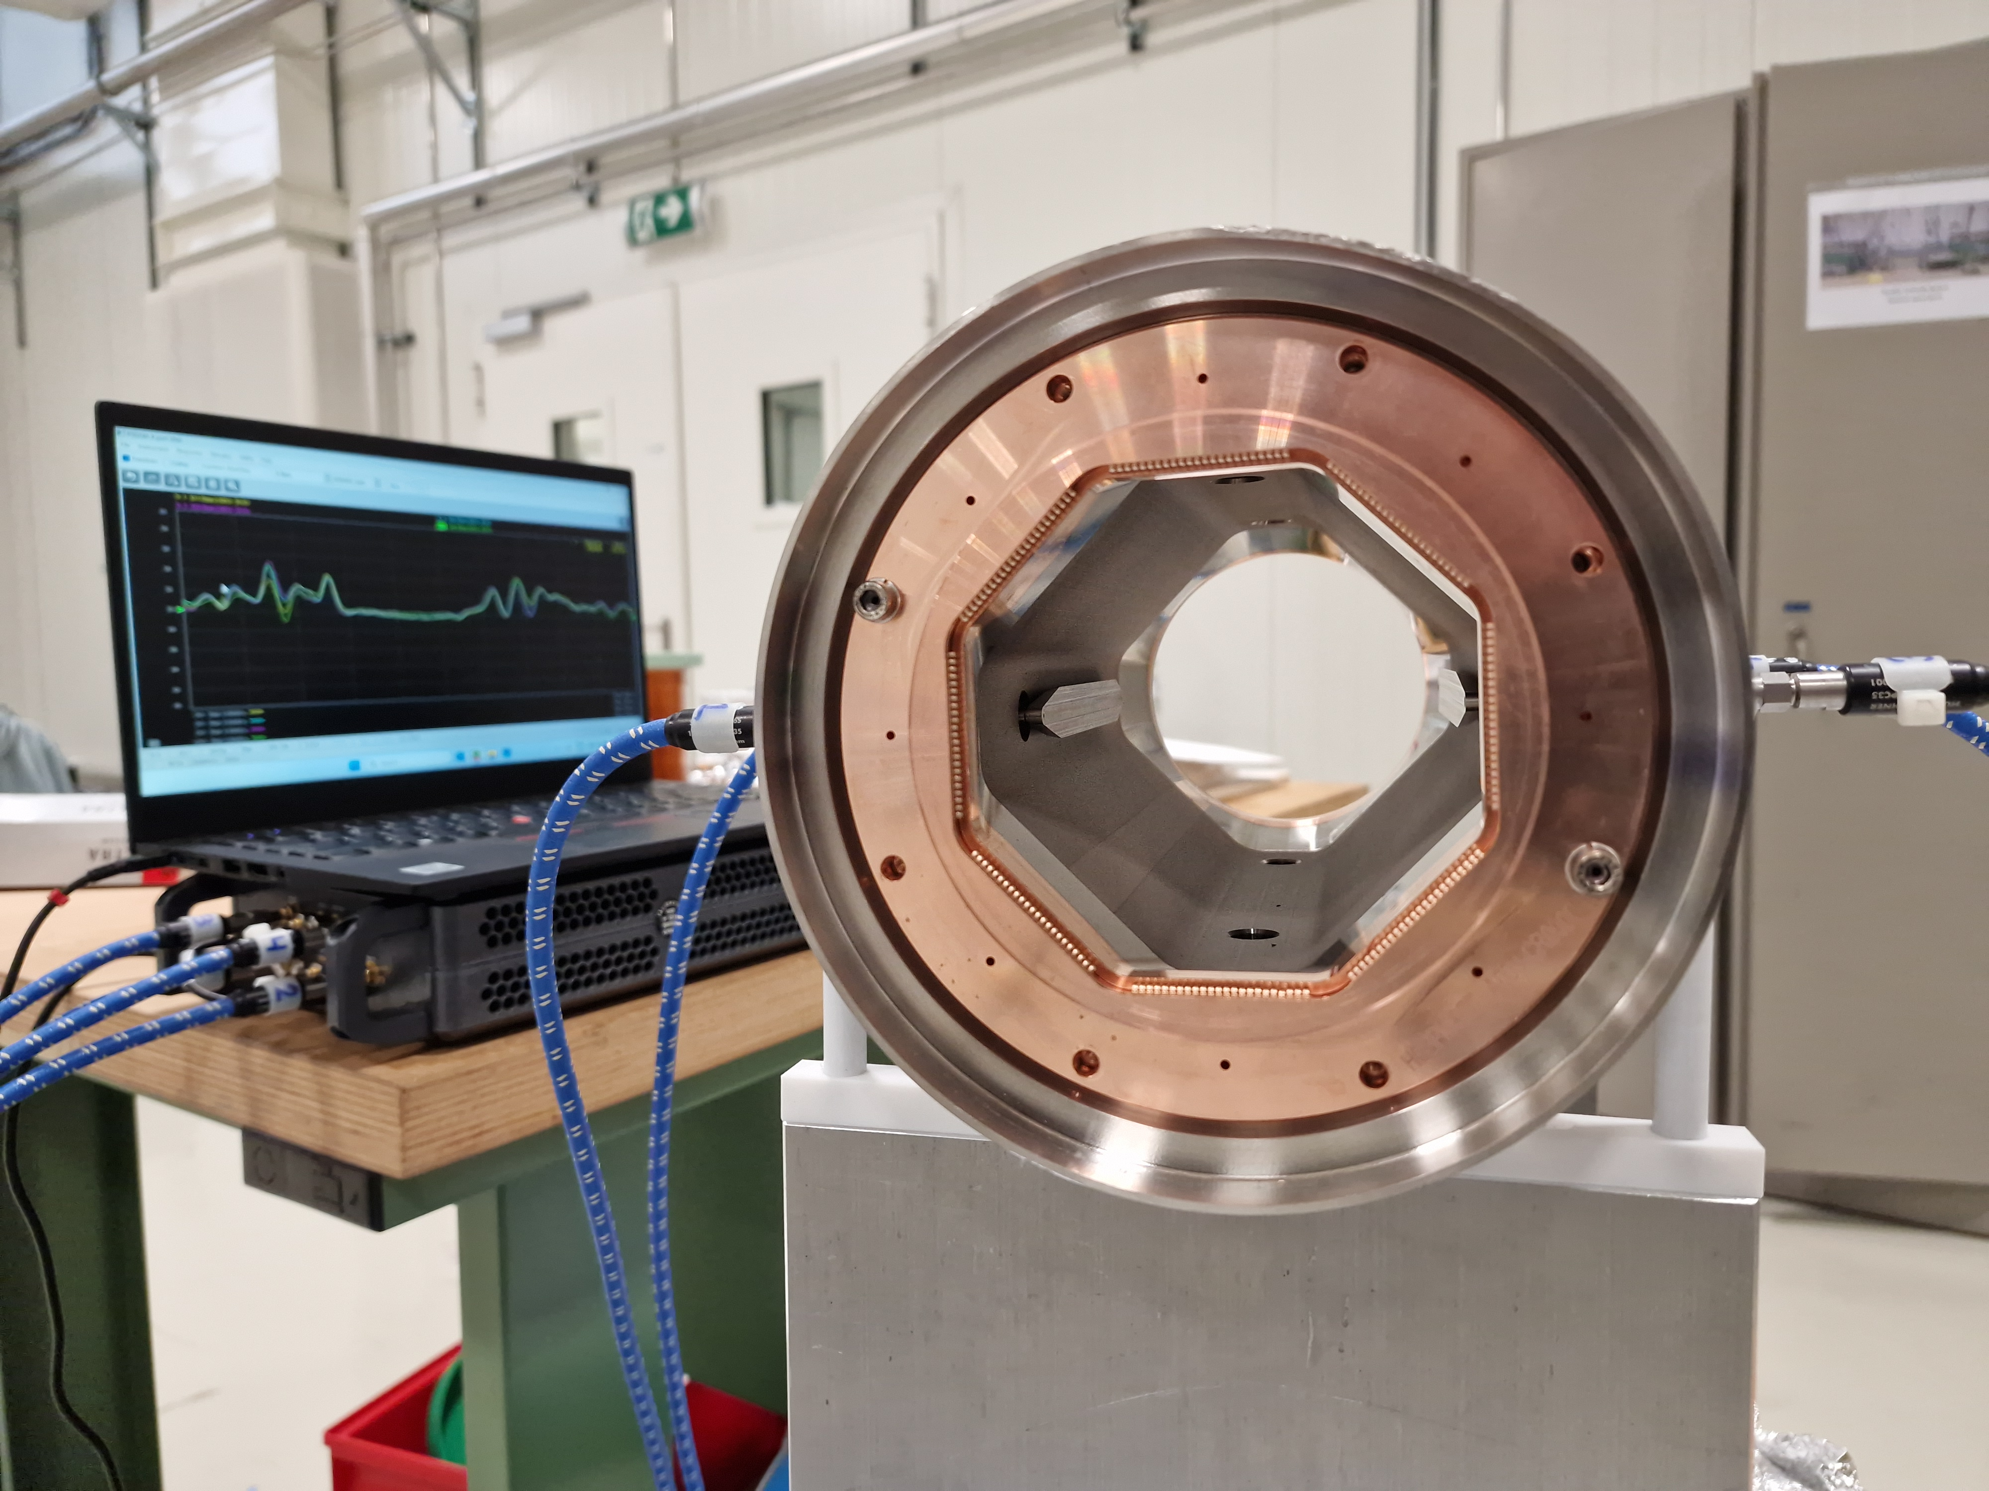
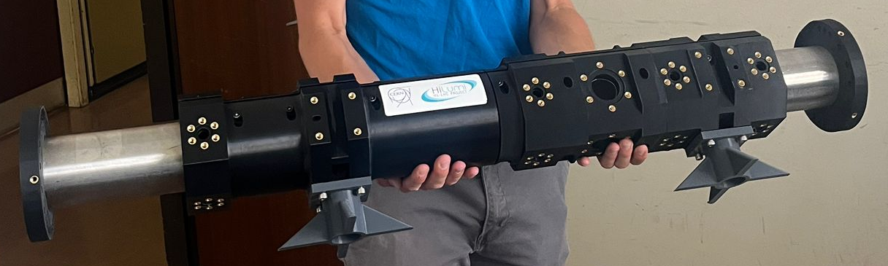
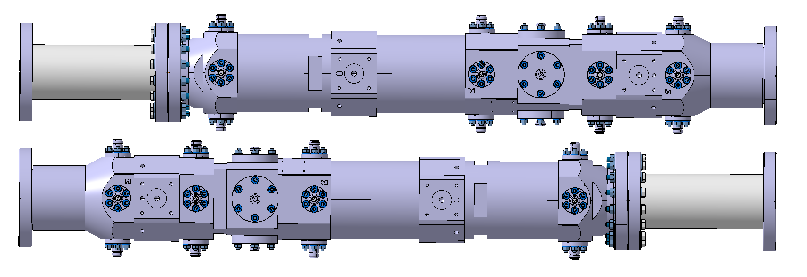
HL-LHC Crab Cavity BPMs
Multi-purpose pick-ups required for Crab Cavity diagnostics, placed at high beta functions and favourable phase advance
RHUL-CERN responsible for high-bandwidth BPMs for direct monitoring of residual crabbing and instabilities
Stripline BPMs now HLLHC baseline
Elongate HT-like stripline:
  Same approach as the LHC HT pick-ups: use the latest stripline BPM design but make the electrode longer (400 mm). BW limited by hybrid.
HL-LHC stripline
RF lab measurements

Slide 8
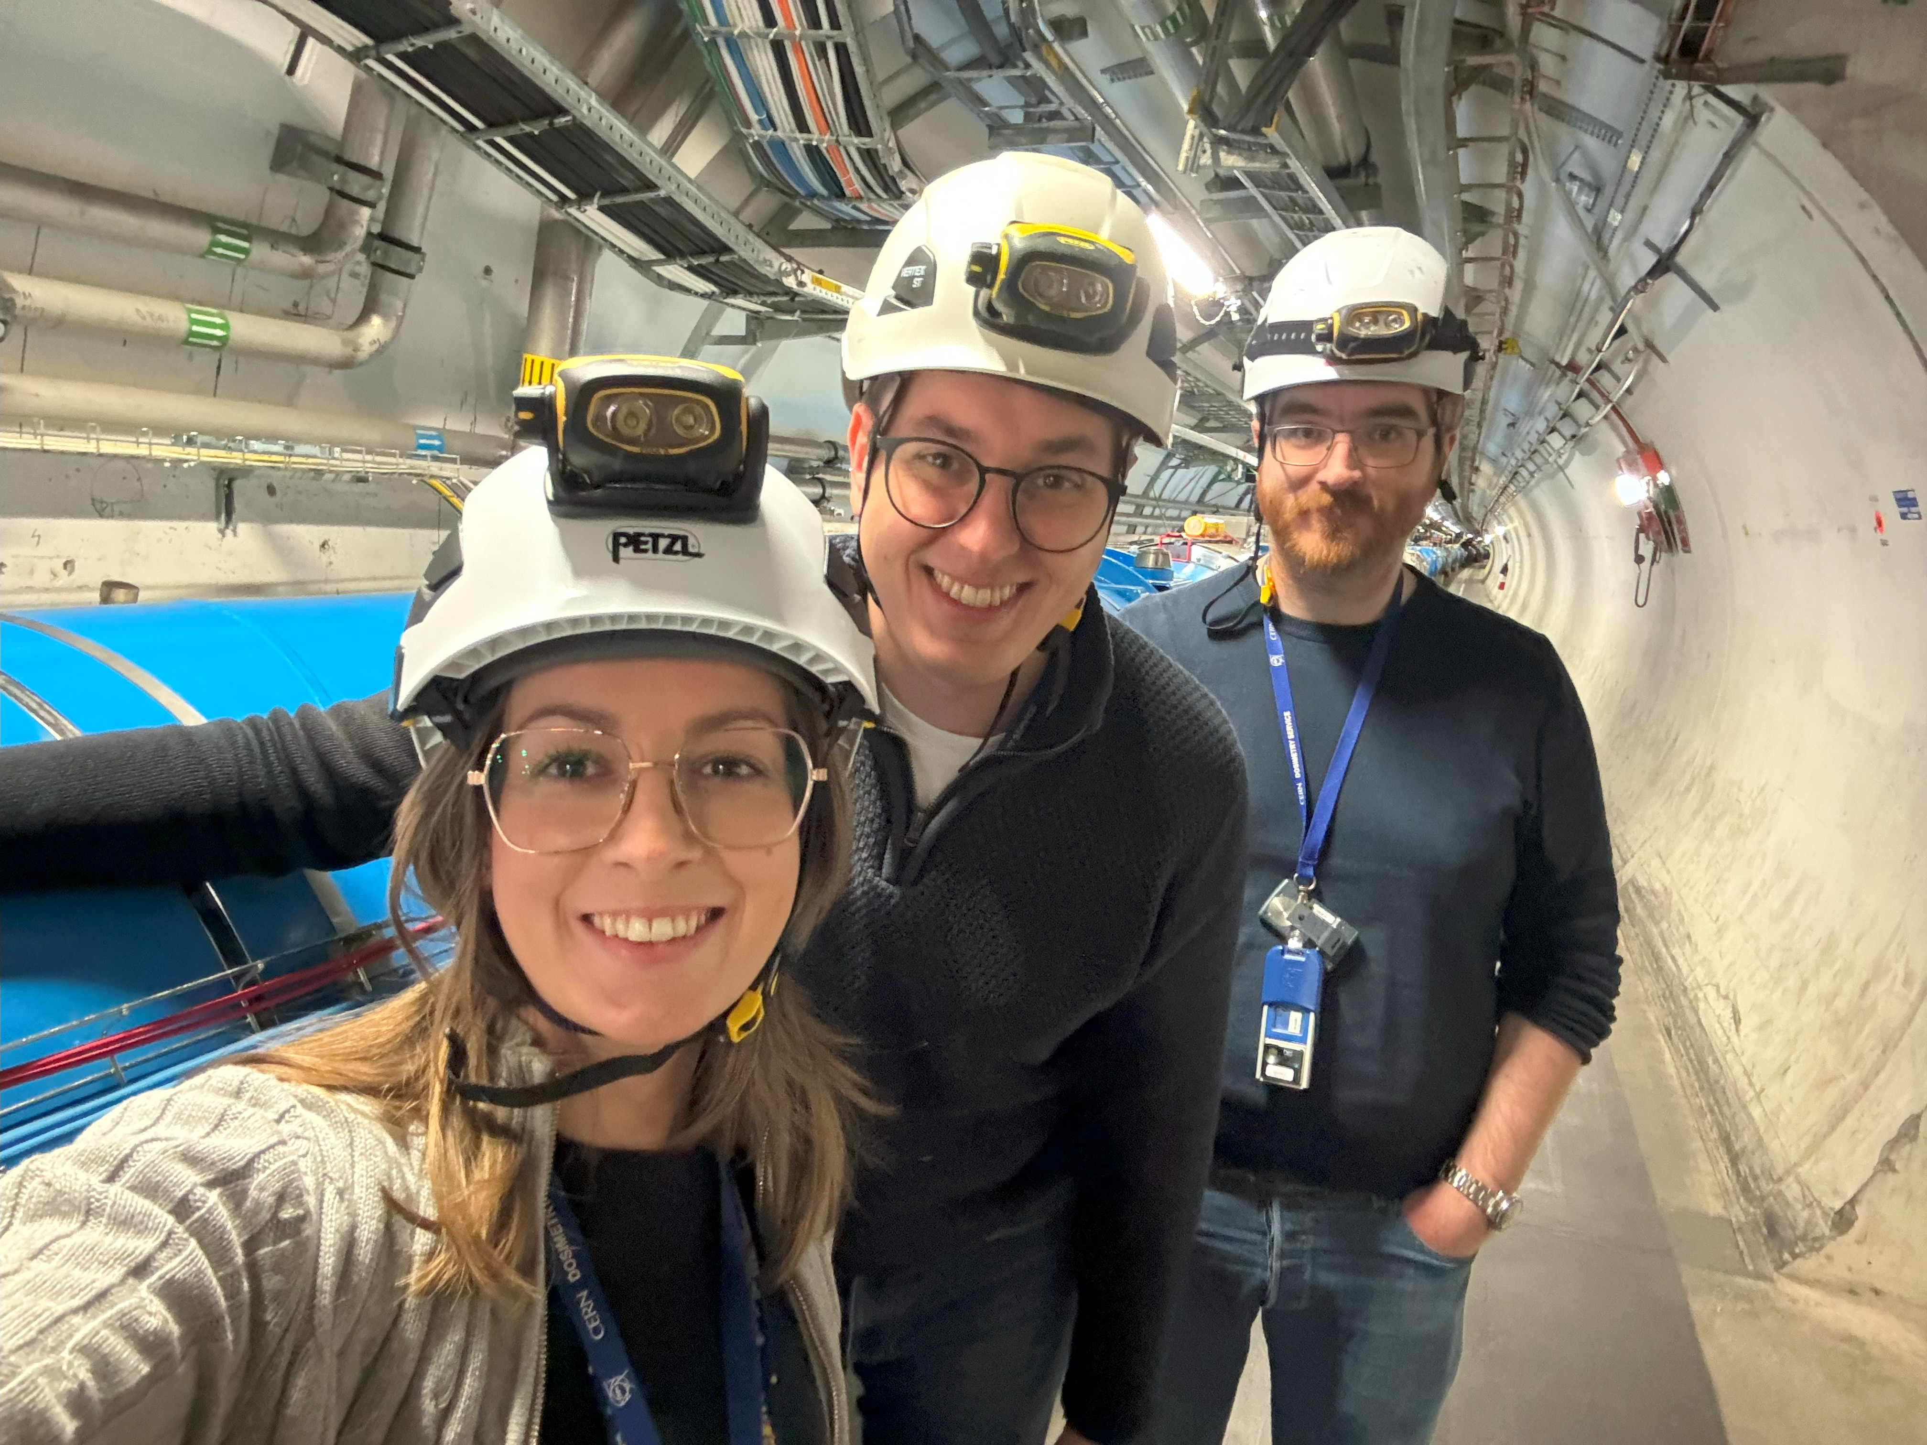
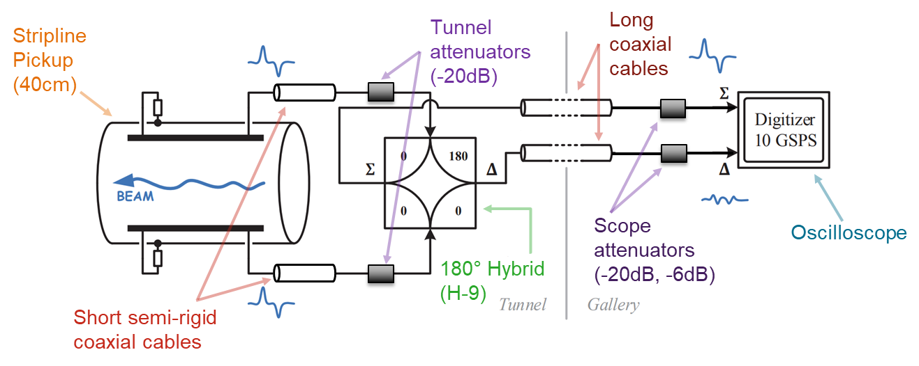
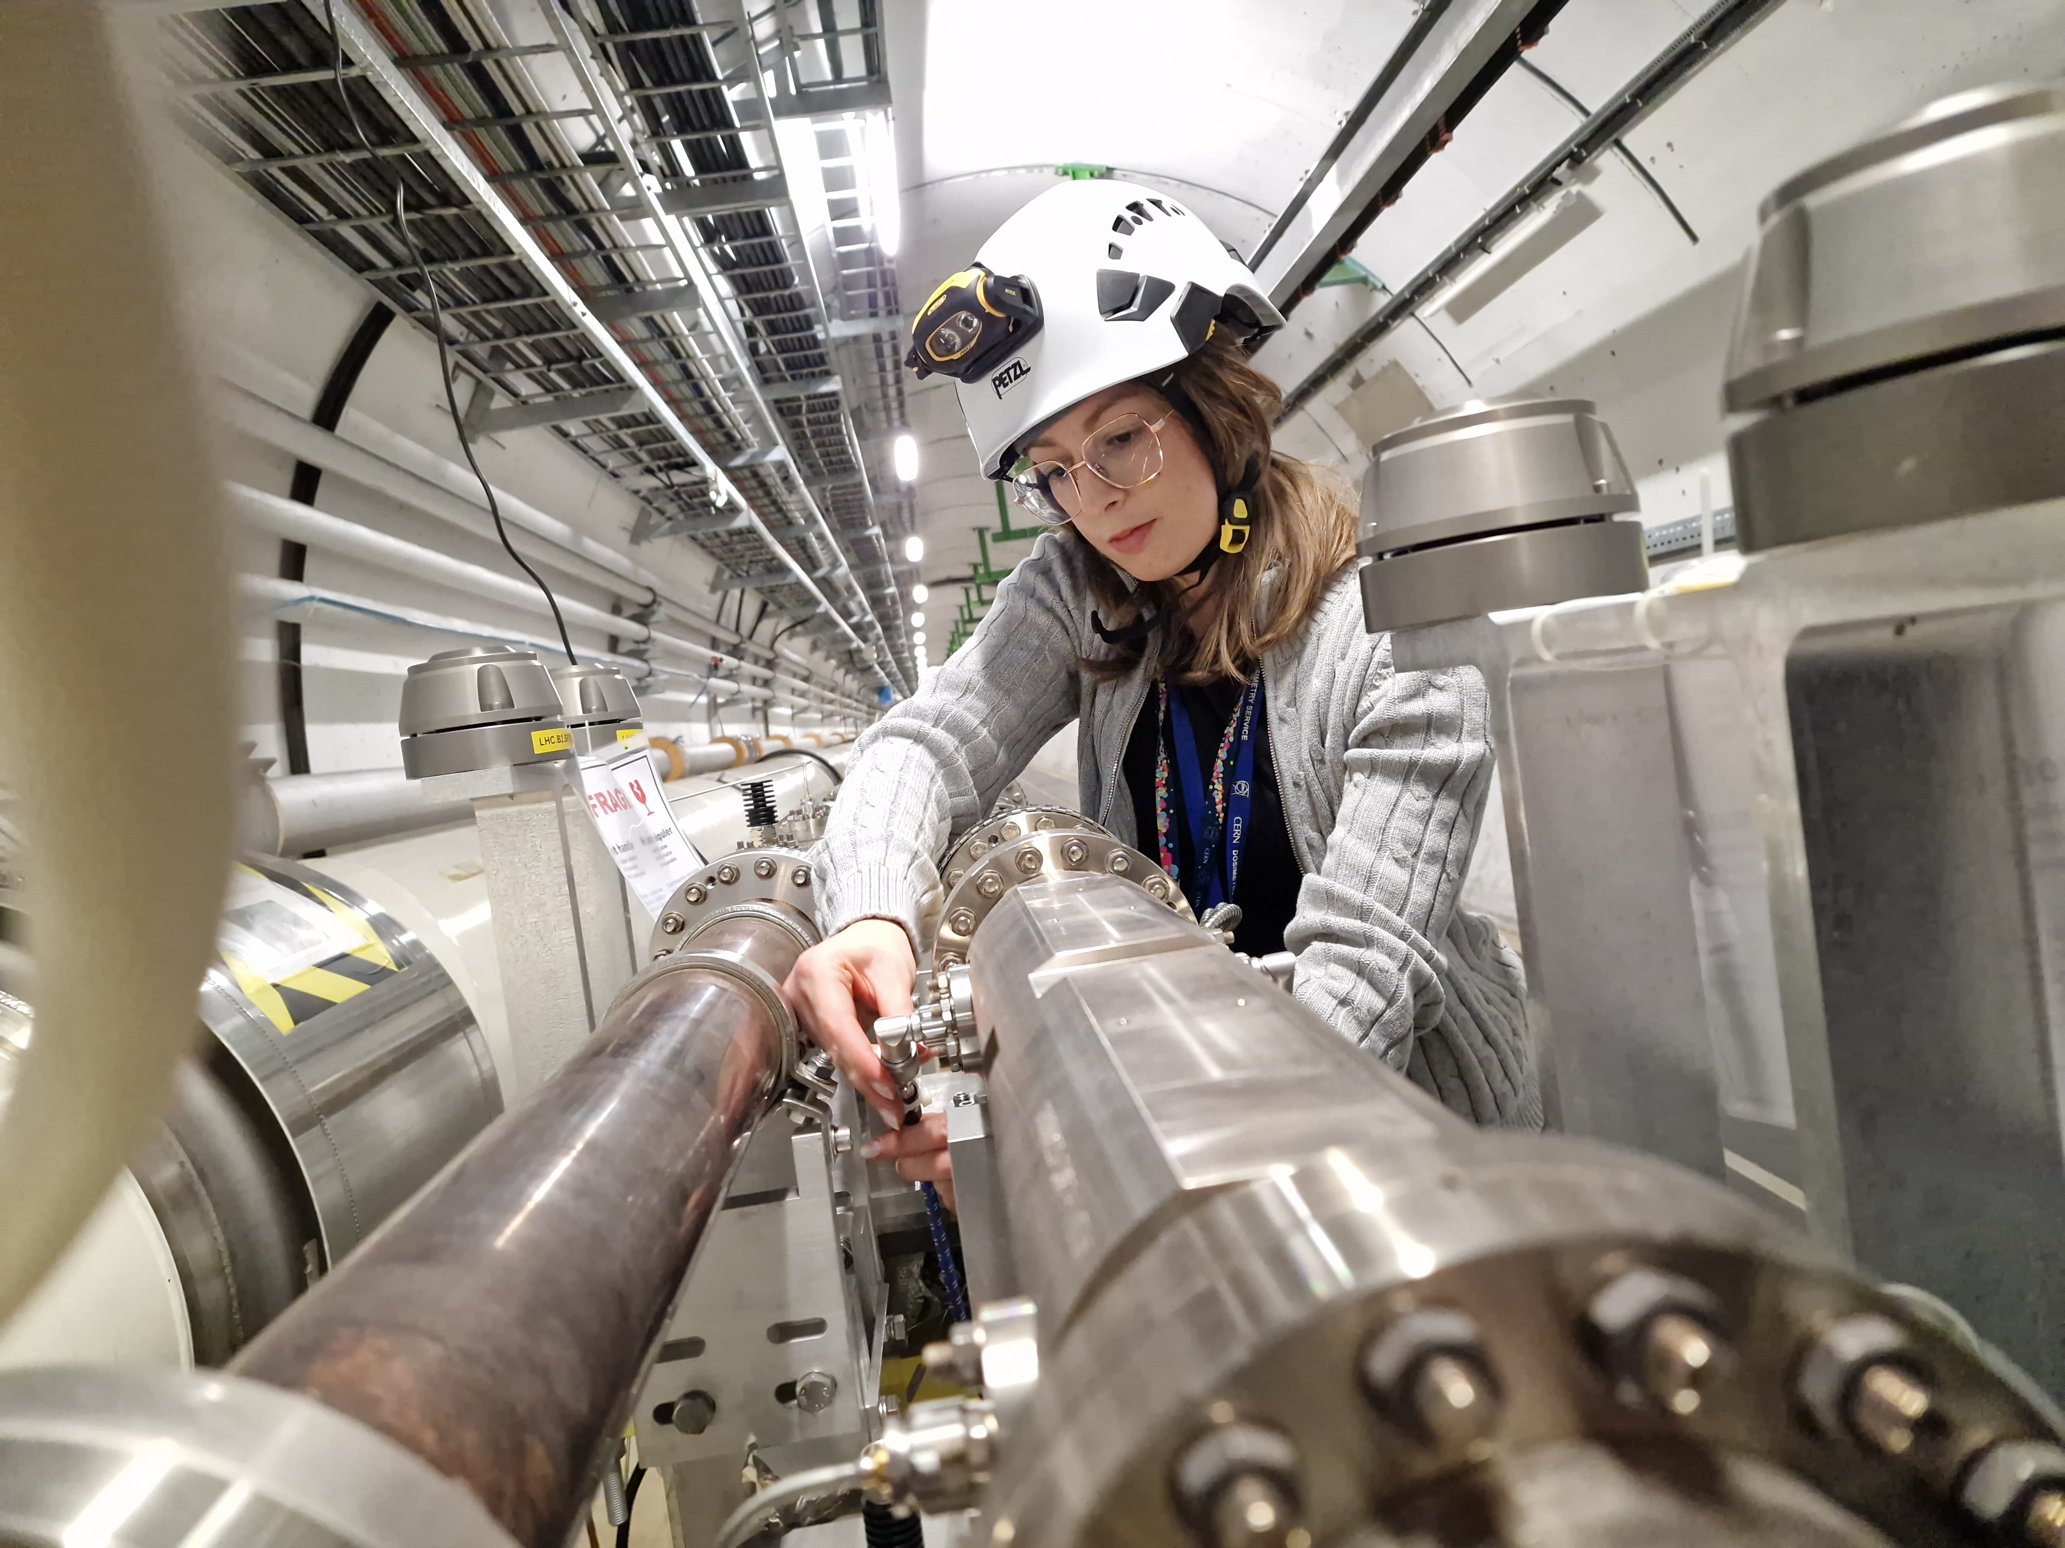
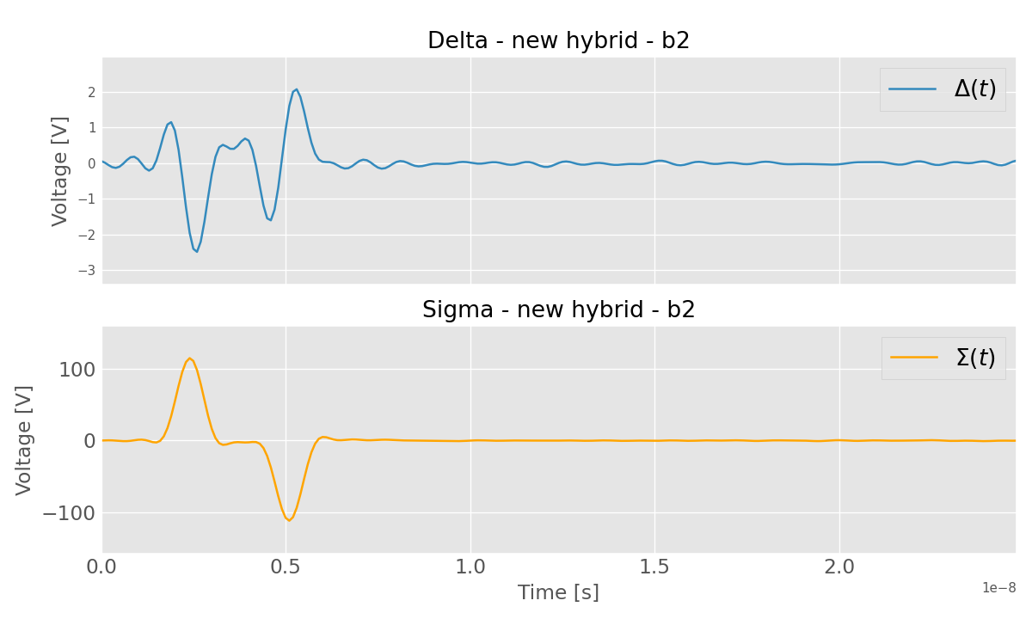


2025 studies with LHC IP4 Head-Tail pickup
RHUL-CERN PhD student: Giusy Passarelli contributing to design studies with M. Krupa.
Development of a new procedure for correction of imperfections of the front-end RF electronics
All existing head-tail monitors, including front-ends, measured and modelled
Technique validated offline using beam data, further computational optimization possible

Slide 9
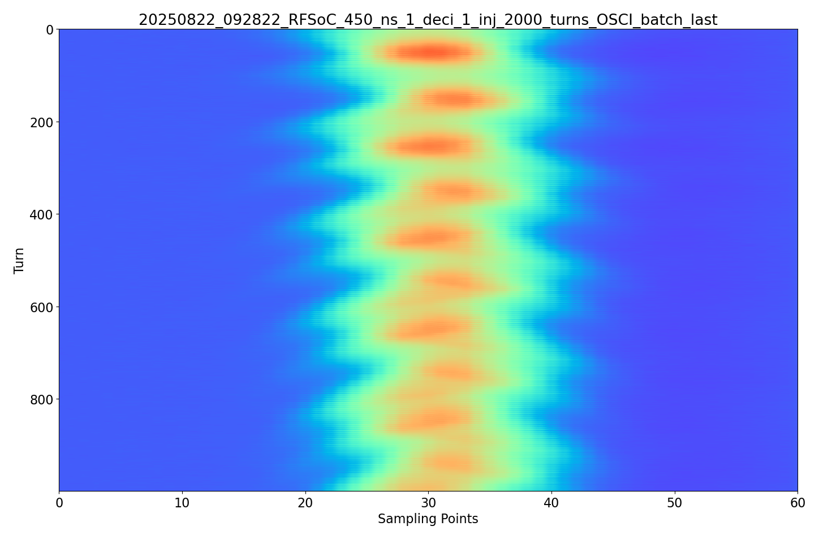
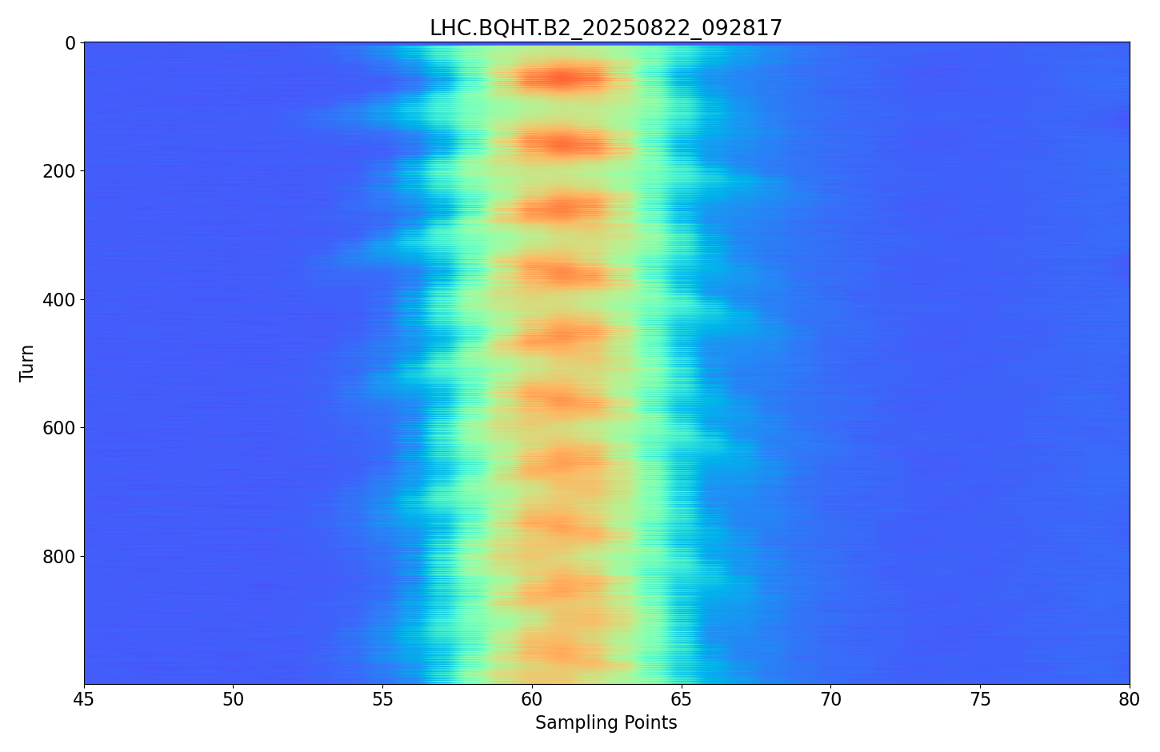
Expected performance
Signal digitizer remains the bottleneck of the system
  Commercial high-end oscilloscopes used currently
New digitizer will be procured as late as possible to leverage (slow) technology progress
  Current technologies do not fully meet the WP13 specification
Electro-optical time-stretching read-out techniques under consideration to replace the traditional RF front-end
Promising results from EO Modulator Time Stretch prototype tests at CERN: see Andreas Schlögelhofer’s talk at HL-LHC annual meeting:
Digital Σ-signal from electrodes
Analog Σ-signal from hybrid
EOMTS
Head-Tail
bunch #1
in last train
bunch #1
in last train
alignment on unmodulated laser pulses
→ relative timing between consecutive turns
alignment on bunch profiles themselves

Slide 10
Electro-Optic BPM principle
First results published in Nature Scientific Reports:
Arteche, A. et al. First difference mode interferometer demonstration for a high-bandwidth Electro-Optic Beam Position Monitor.
Sci Rep 15, 43410 (2025). doi:10.1038/s41598-025-08786-6
Σ = Σ_{L} + Σ_{R}
position = Δ/Σ
Encode the time-varying bunch signal onto a laser beam using an electro-optic crystal in the pickup:
The electric-field of the passing bunch modulates the refractive index that induces a linear phase shift in light passing through the crystal by the Pockels effect.
A fibre-coupled Mach-Zehnder interferometer around the crystal transforms the phase shift into an intensity modulation, which is measured by a fibre-coupled fast photodetector.
EO Team: A. Arteche, M. Bosman, D. Harryman, S. Gibson, T Levens, T. Lefevre

Slide 11
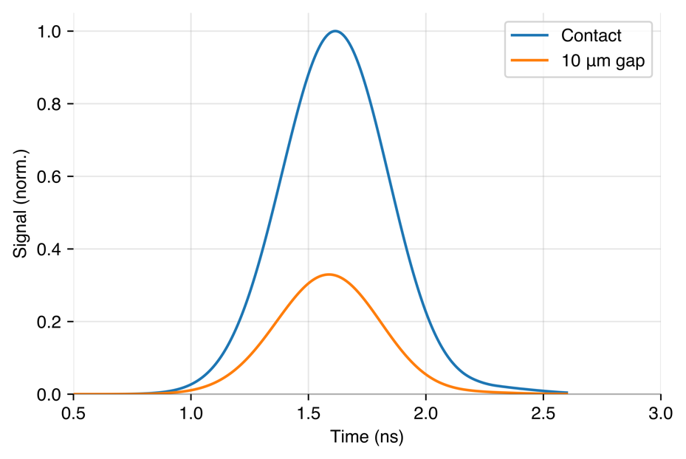
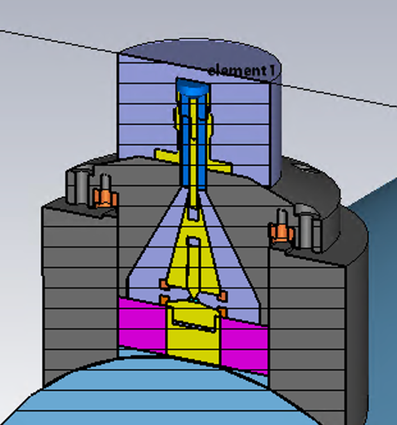
Electro-Optic BPM development
doi:10.18429/JACoW-IBIC2024-TUP46
At the time of the technology review in January 2025:
  EO-BPM signals follow the fast evolution of SPS bunch during injection: sensitive to both longitudinal shape and transverse position.
  Known difference between left and right EO pickups results in mixture of sum and difference signals in the interferometer difference signal. Combination of HT sum and difference signals reproduces the EO signal.
EOBPM developments in 2025/26:
  Adjustable pick-up designed to tune and set the sensitivity of pick-up to beam field signal, installed in June 2025 Technical Stop. --> Max Bosman, IBIC2025
  Improved operations with EO-modulator phase control in all three interferometers + new IQ technique --> Dan Harryman, IBIC 2025
  Fibre splitter tree reconfiguration in January 2026 YETS, to correct fibre lengths for timing mis-match, and test IQ technique in situ.
Signal response sensitive to pickup assembly tolerances:
10 dB
LNB
EO Team: A. Arteche, M. Bosman, D. Harryman, S. Gibson, T Levens, T. Lefevre

Slide 12
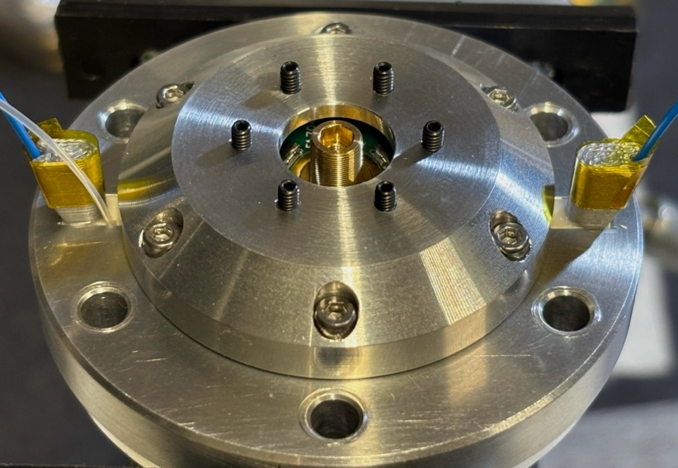
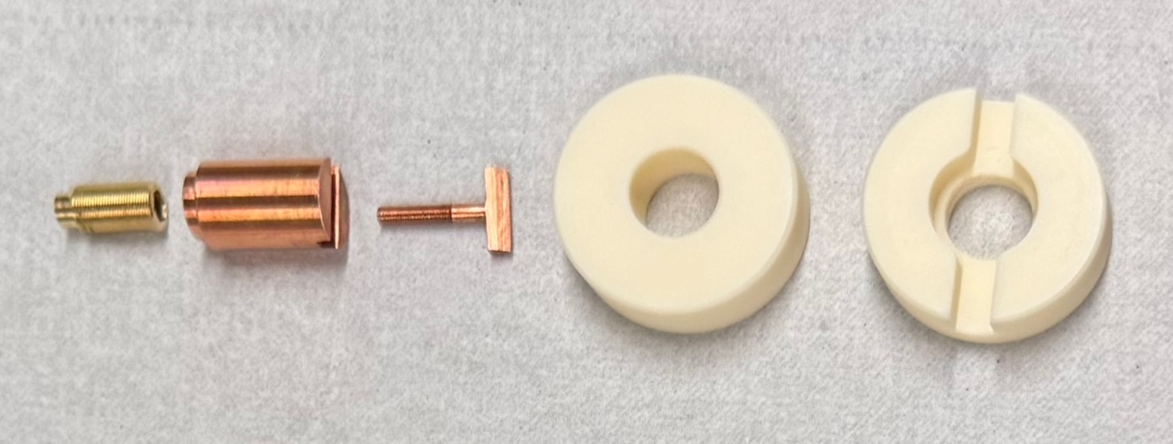
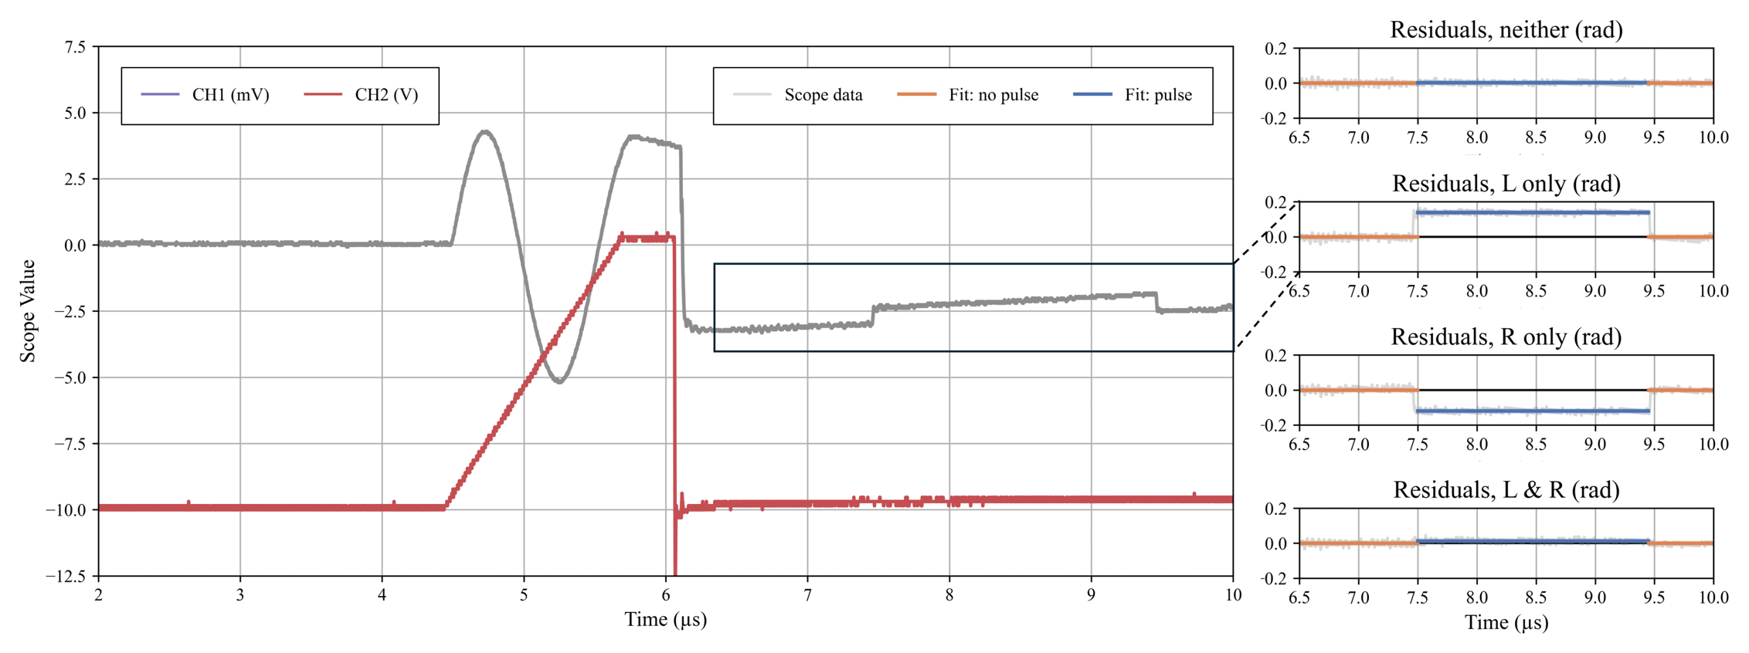
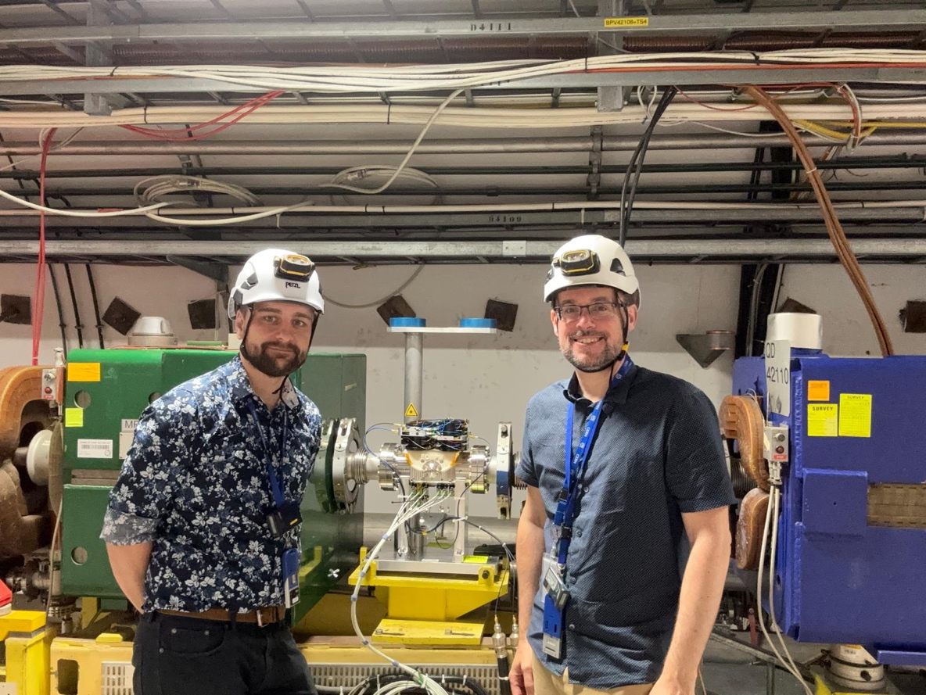
EOBPM: Adjustable pickups, balanced in situ:
New adjustable EO pick-up design features:
  Cylindrical housing with improved impedance matching
  Differential micrometer to set position of top electrode
  Retractable wire to inject calibration signals to beam electrode:
10 V pulse injected into both pickups separately, and at the same time, and micrometers adjusted to balance signal response:
EO Team: A. Arteche, M. Bosman, D. Harryman, S. Gibson, T Levens, T. Lefevre
June 2025 installation of new adjustable EO pickups

Slide 13
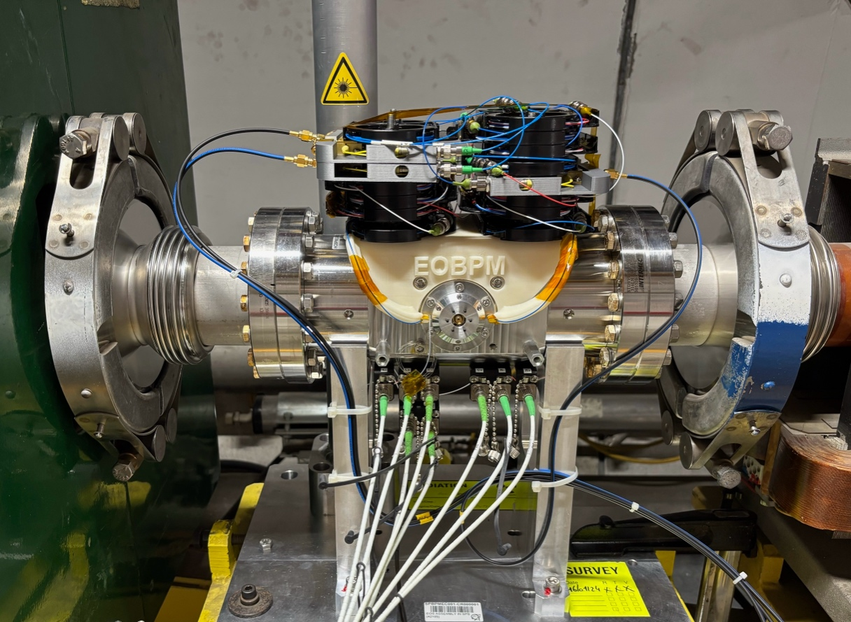
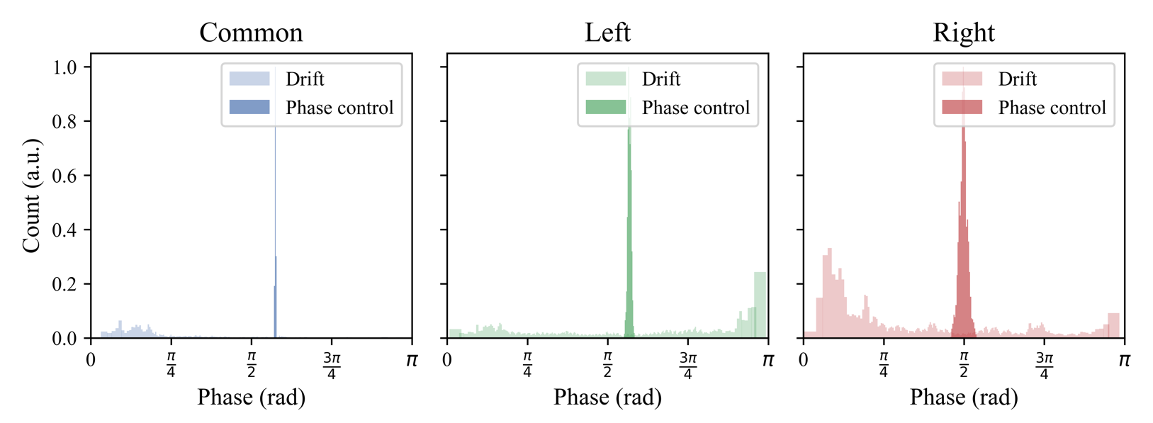
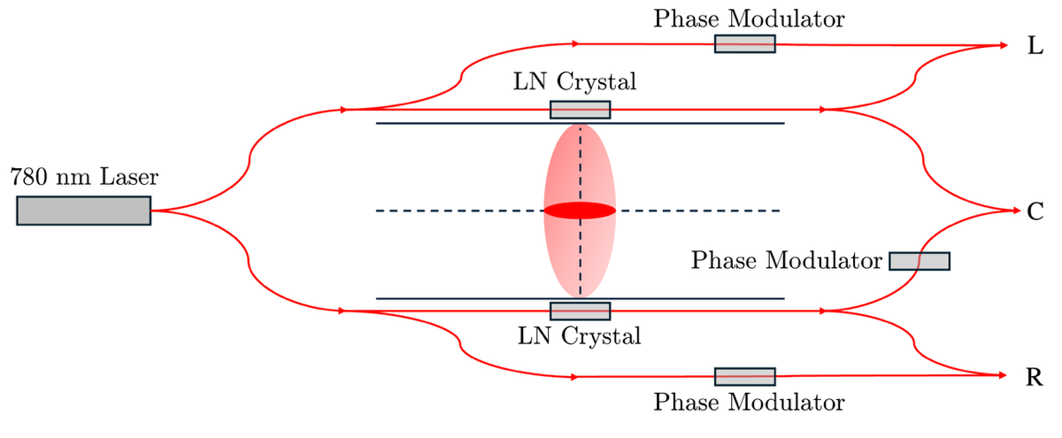
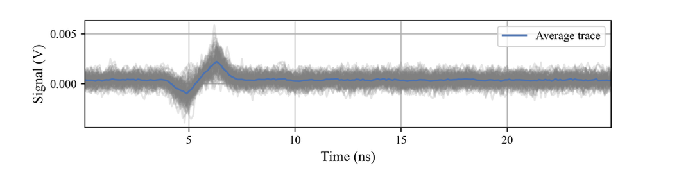
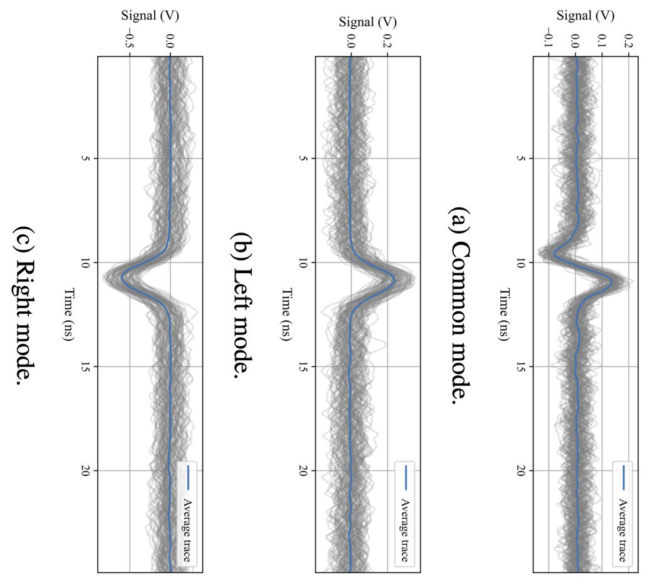
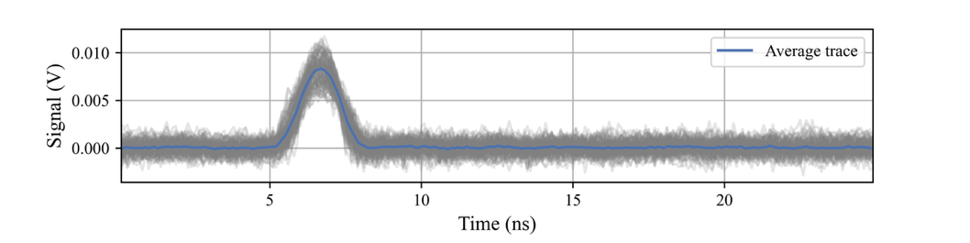
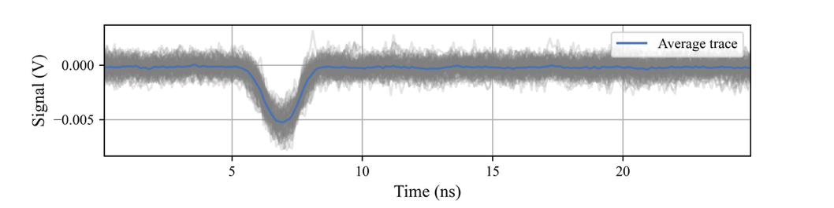
EOBPM: balanced pickups, with phase control
Addition of 3 phase modulators enables smooth control of interferometer phase:
For the first time, signal seen simultaneously on all three modes.
Further adjustments in September 2025: common mode more balanced, side modes stronger.
Common mode here shows timing mismatch in optical difference signal, due to fibre length mis-match: corrected in YETS, Jan 2026
Max Bosman’s thesis analysis (preliminary):
shows much improved absolute offset
EO Team: A. Arteche, M. Bosman, D. Harryman, S. Gibson, T Levens, T. Lefevre

Slide 14
HL-LHC collimation challenges:
Björn Lindström,
L. Bertolozzi et al
HL-LHC beam intensity and brightness produces significant challenges
  Protons per bunch: 1.15e11 (design) → 1.6e11 (now) → 2.2e11 (HL)
Impedance scales with bunch charge and can cause beam instabilities:
  Image charges induced, act back on beam
→ instabilities → increased octupoles → reduced beam lifetime
  Collimators main source of impedance
Collimator leakage (absolute) scales with beam intensity
  → increased quench risk, in IR7 DS
  Mitigation with TCLDs collimators installed between 11T dipoles was de-scoped
Limitations mainly from Betatron Collimation (IR7)
Change of IR7 Optics mitigates both!

Slide 15
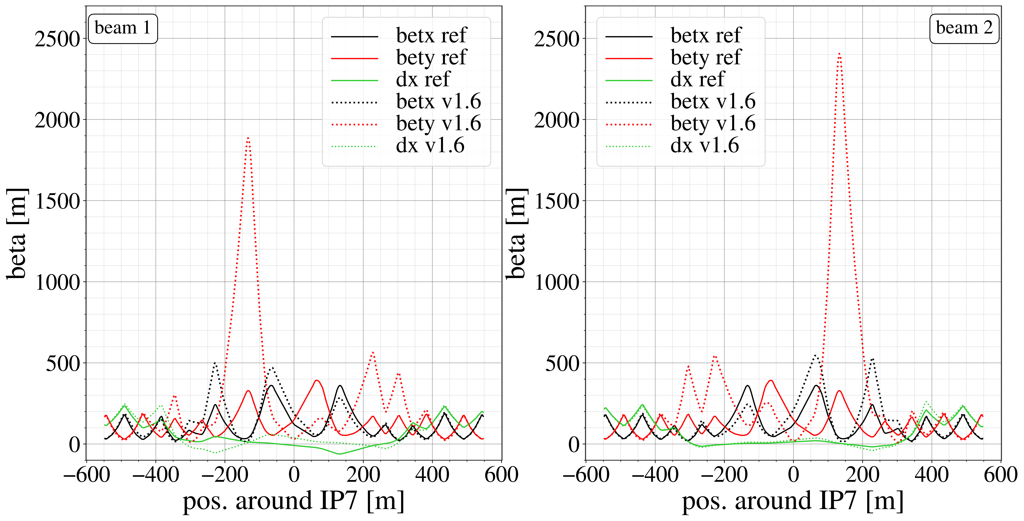
Optics Design
Björn Lindström,
L. Bertolozzi et al
Final optics for 2025/2026 LHC cycle:

Slide 16
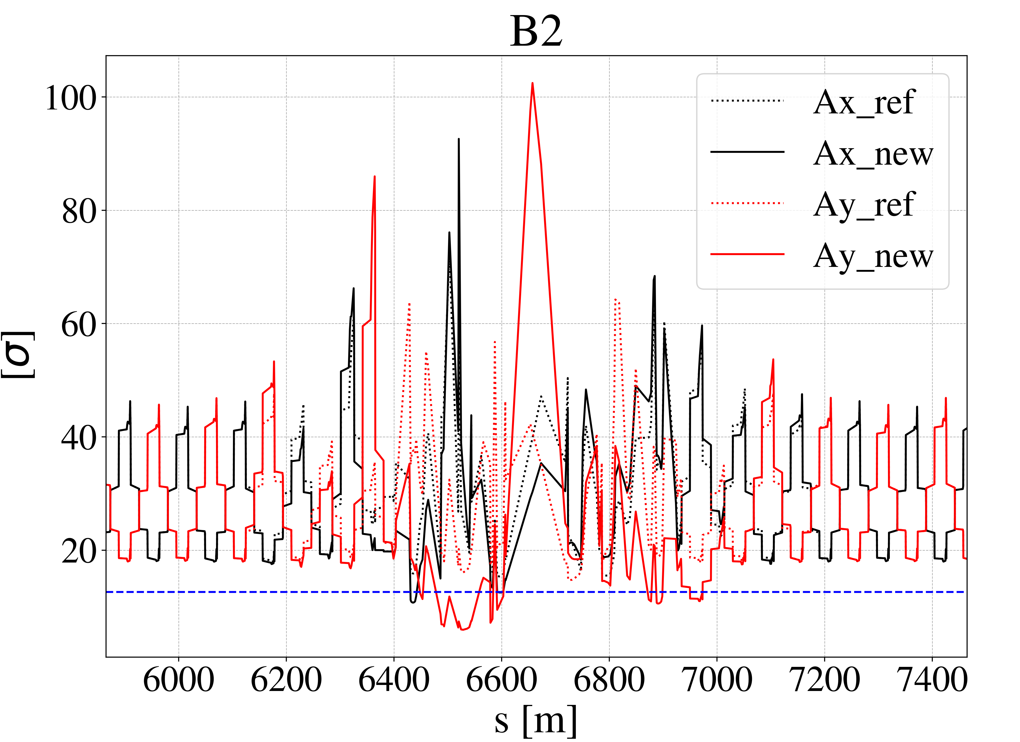
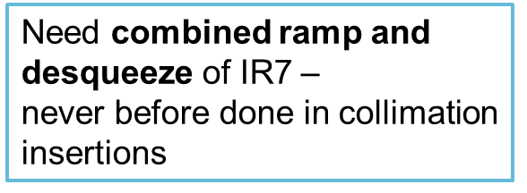

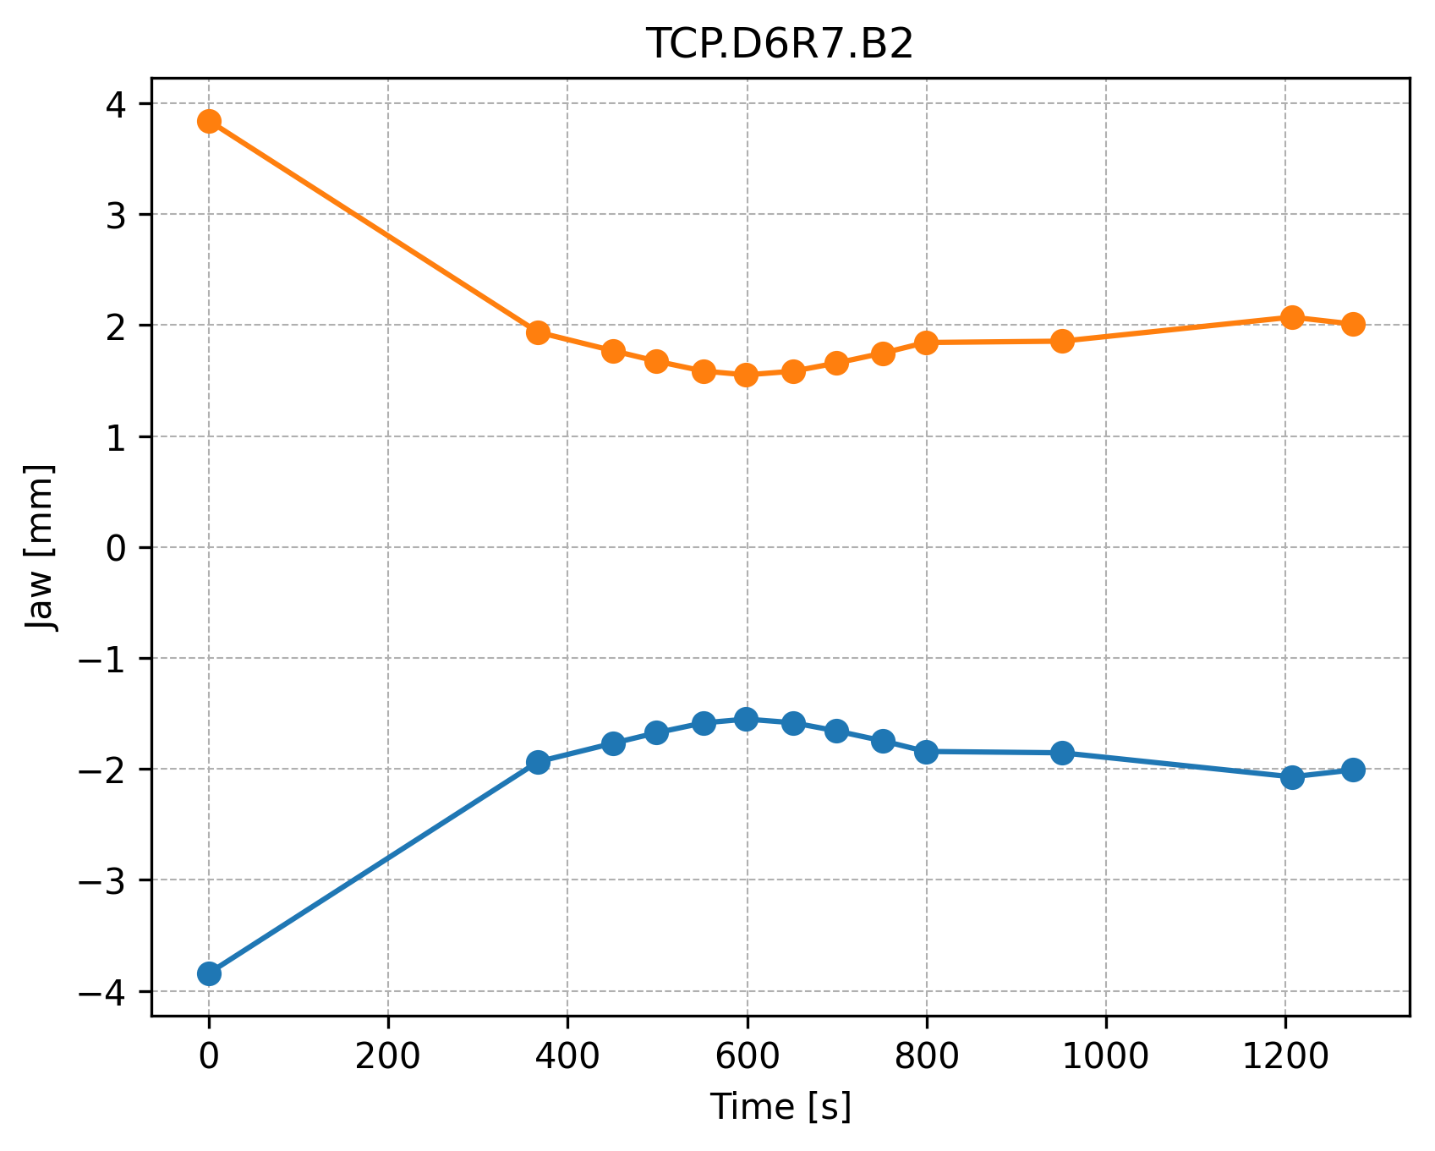
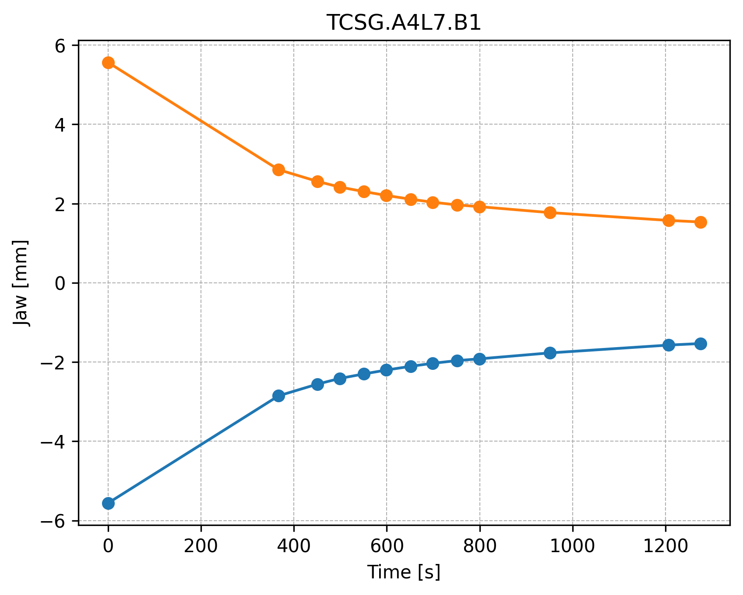
Aperture
Björn Lindström,
L. Bertolozzi et al
Large beta function and dispersion → Not enough aperture at injection energy
Need optics in place before flat top:
Collimator jaw movement during ramp
Non-monotonic movement for some collimators → gap values at flat top are potentially affected by backlash creates backlash
Monotonicity can be achieved by inserting the optics transition earlier in the ramp

Slide 17
Experimental MDs in 2025
Björn Lindström,
L. Bertolozzi et al
MD15146 – ramp and desqueeze with high intensity beams ✓
MD17383 – squeezed β∗, TCT losses and experiment background ✓

Slide 18
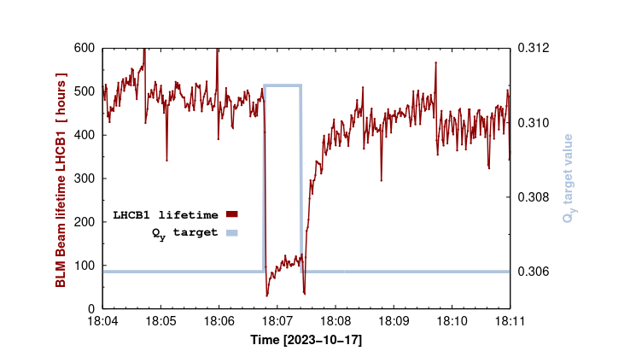
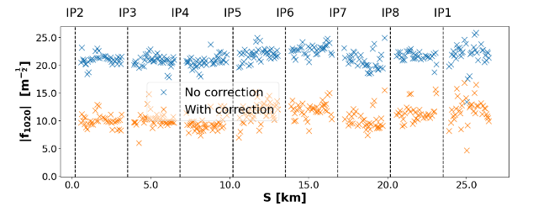
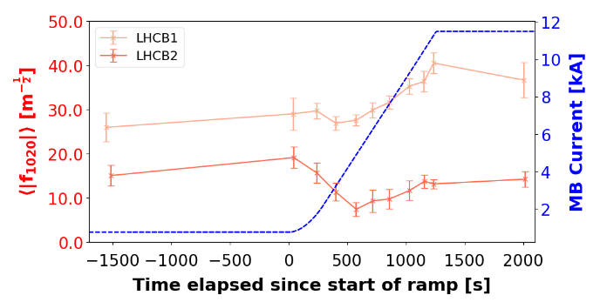
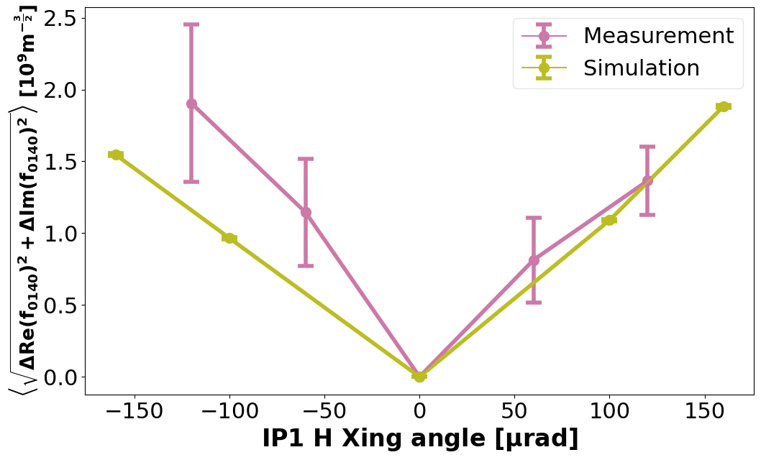
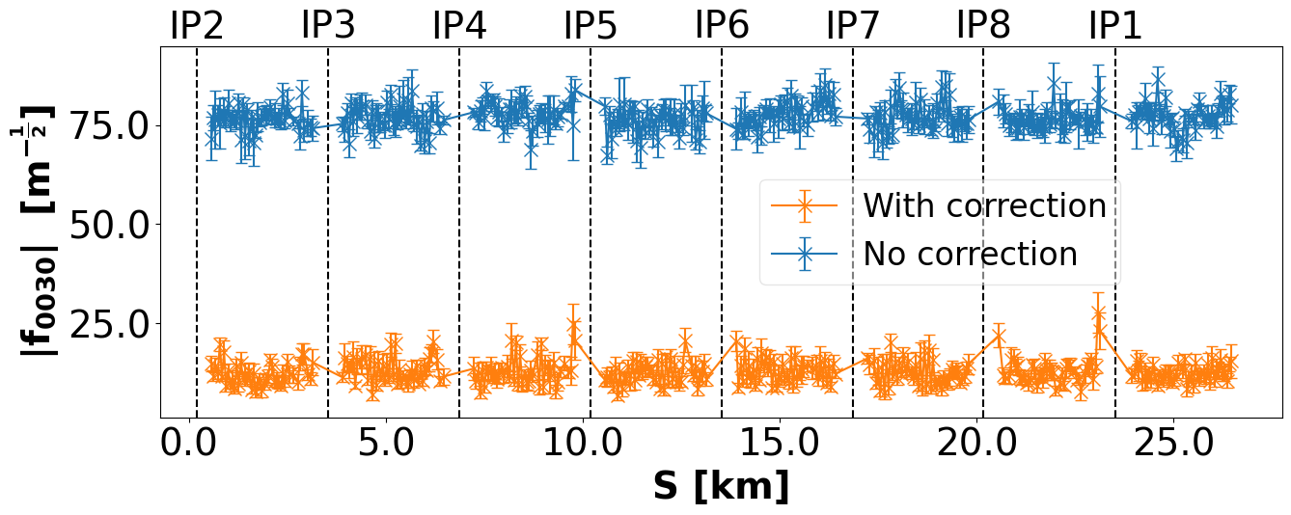
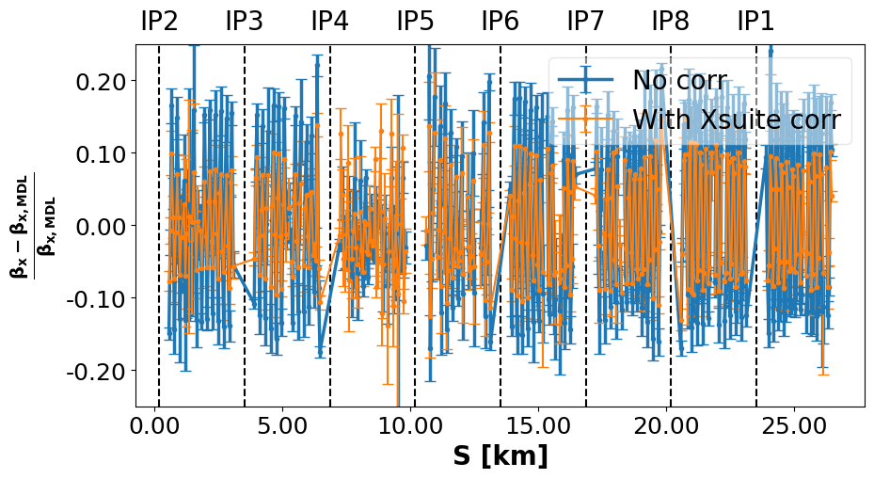
Nonlinear Dynamics for LHC
Sasha Horney PhD (Philip Burrows, Ewen Maclean)
Resonance identification & impact:
  Identification of sources, resonance driving terms (RDT)
  Beta-beating and amplitude detuning analysis
  Lifetime and dynamic aperture improvement
Key achievements so far:
  Identified & corrected resonance at LHC injection, in operation since 2024
  Measured sextupole RDT decay along LHC acceleration ramp for first time
  Gravitational tides & effect on LHC, HL-LHC, FCC
New results on LHC since last AB:
  Implemented first nonlinear RDT correction including
  Long-Range Beam-Beam (LRBB)
  First benchmarking and correction of higher-order errors (via feed-down)
Thesis submitted in April 2026
Measured sextupole RDT vs. distance along LHC at injection
Measured lifetime (red) and set tune (grey) vs. time
Measured sextupole RDT (red) and
dipole current (blue) vs. time
First dodecapole
order RDT control
First correction of nonlinear RDTs
and beta-beating including LRBB

Slide 19
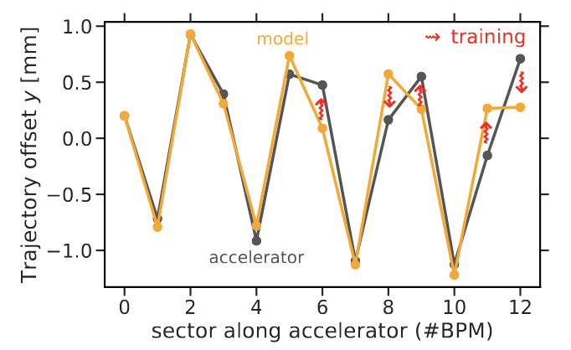
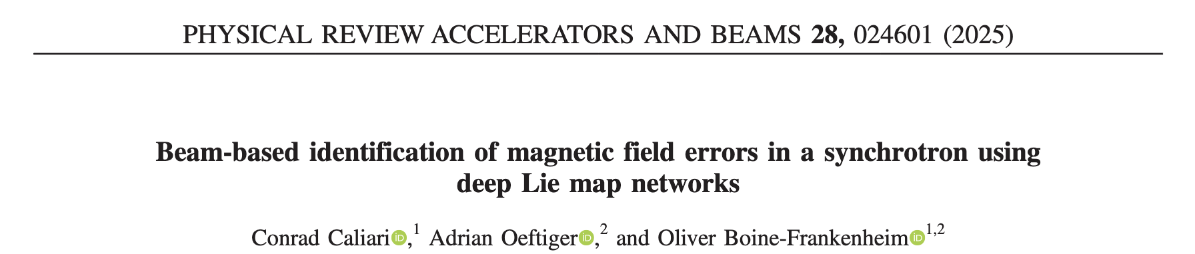

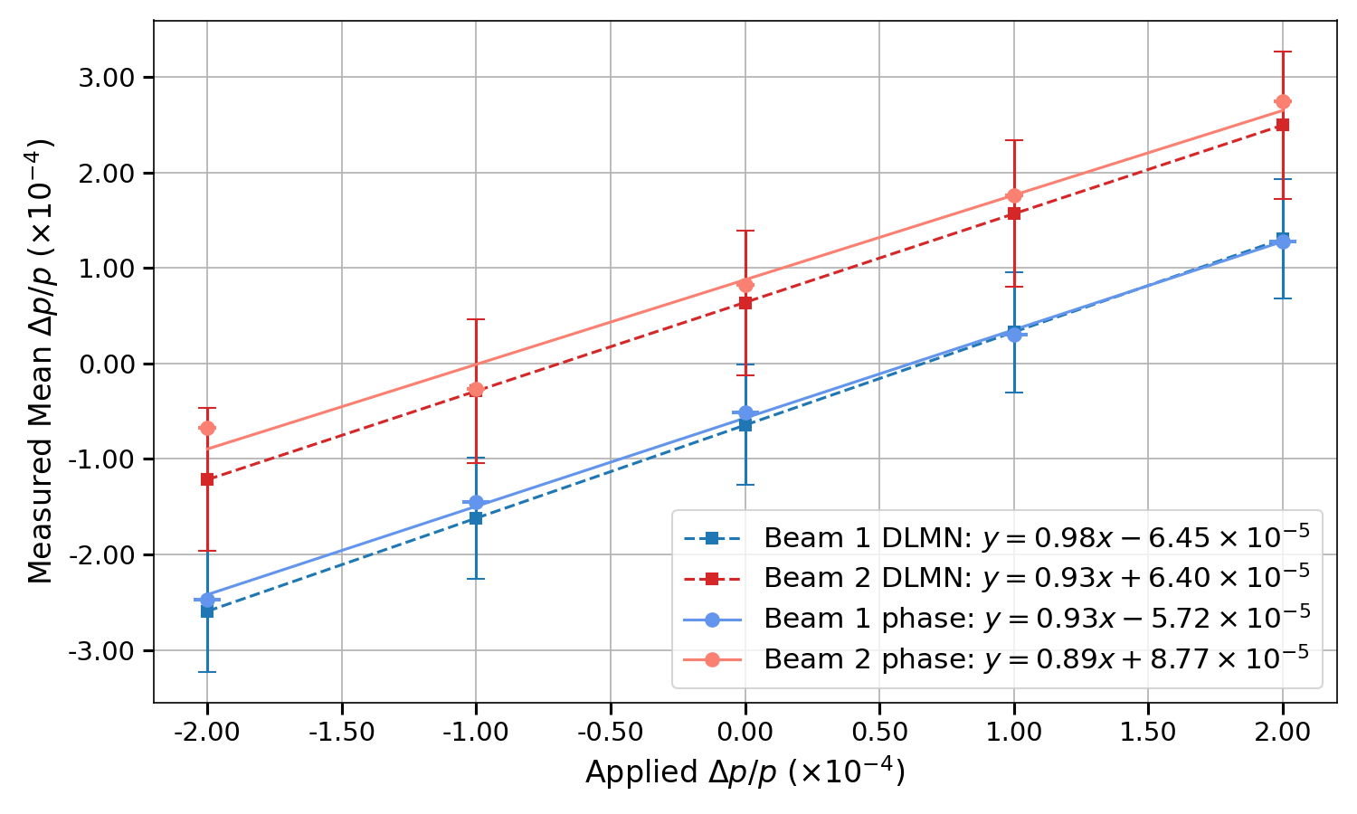
Data-driven Modelling: Control Nonlinearities
Adrian Oeftiger & CERN collaborators
Modelling & correcting nonlinear optics in Collider Rings key to high performance:
  CERN LHC experience: beam-based measurements + correction essential (Run 2+3)
  Recently developed data-driven modelling approach:
  Deep Lie Map Networks
    Differentiable simulations + measured turn-by-turn BPM data
    + stochastic gradient descent = “learn” multipoles in lattice
New results in collaboration with CERN
(Joshua Gray, Kyriakos Skoufaris):
  LHC: measuring energy-induced optics distortions (using DLMN via MAD-NG framework)
    DLMN-based reconstruction outperforms state-of-the-art approach (global phase response matrix) ⟶ 2 IPAC’26 publications
Plans:
  PhD student R. Simpson to start at Oxford in 2026:
  include collective effects in DLMN (ISIS + GSI/FAIR funded)
DLMN training procedure, learn multipoles to
fit predicted trajectory to measured one
Arc-by-arc reconstruction of energy-induced
optics distortion in CERN’s LHC [IPAC’26]:
more accurate energy offset measurements with DLMN

Slide 20
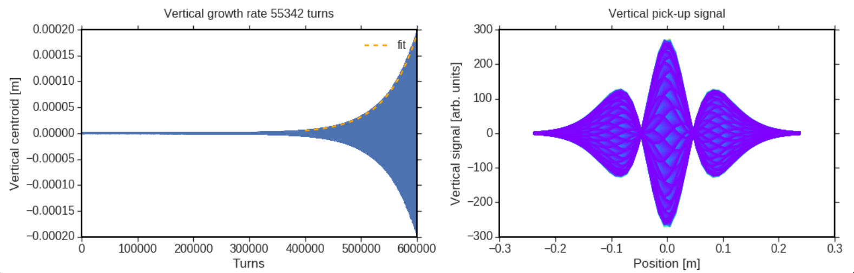
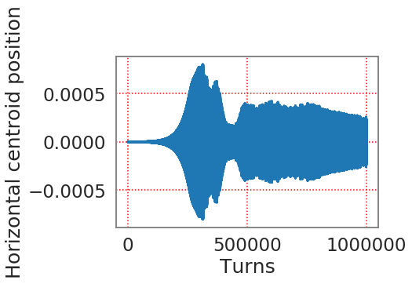
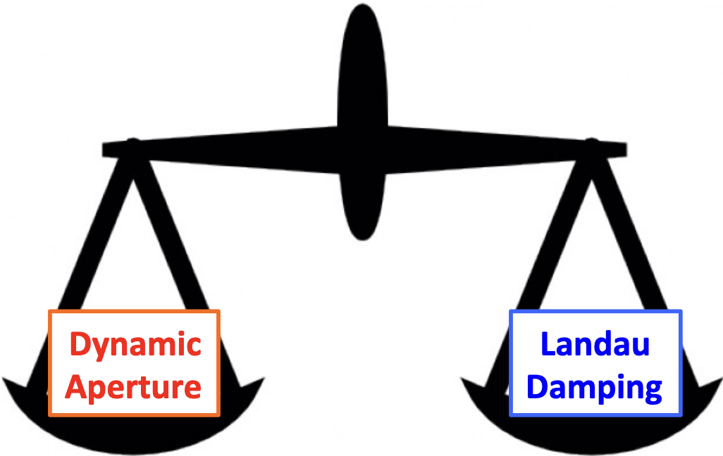
Beam Stability vs. Beam Lifetime?
Adrian Oeftiger & Hadron Beam Physics Group
Today, main strategy to mitigate instabilities in hadron Colliders:
  Passive: Landau damping via octupoles
  (+ high chromaticity)
  Active: feedback (only lower frequencies)
    high frequencies of intra-bunch instabilities challenging for feedbacks
    passive strategy for head-tail and e-cloud instabilities!
Head-tail instability in LHC with feedback but without octupoles
[Oeftiger, HL WP2 2018]
Measured offset [m]
Problematic: beam stabilisation at the expense of beam lifetime
  Octupoles provide detuning with increasing amplitude: tails!
    Octupole nonlinearities affect dynamic aperture (DA)
    CERN LHC Run 2: Landau octupoles provided key DA degradation
  In view of future colliders: alternative stabilisation approaches?
    New PDRA (STFC-funded)

Slide 21




Beam Stability vs. Beam Lifetime!
Max Topp-Mugglestone, Adrian Oeftiger
New PDRA, Max Topp-Mugglestone, started at Oxford in Feb 2026:
Investigate alternative instability mitigation approaches
    Active: Landau electron lenses (e-lenses)
      FCC-hh: Landau damping with one 2m-long e-lens = >1000 octupoles!
      No impact expected on DA! (Detuning through beam core, not tails!)
      Dual use possible with 2 cathodes:
      active halo control (hollow e-beam) + Landau damping (Gaussian e-beam)
    Passive: Direct space charge
Plans:
  HL-LHC simulations: study DA for e-lens and characterise instabilities
  LHC experiments: drive space-charge-induced Landau Damping study
  Contribute to Fermilab’s IOTA experiments with Landau e-lens
  Design Landau e-lens proof-of-principle experiment for SPS/LHC
DA impact for HL-LHC:
octupoles (left) vs. e-lens (right)
Landau electron lens to be studied at IOTA!
First results, Dynamic Aperture
computations for HL-LHC (March ‘26)

Slide 22




2. Future electron-positron Higgs factories

Slide 23
Overview: Future Higgs Factories
JAI has a very strong background in key technologies and systems for any collider:
Beam delivery system, machine-detector interface, luminosity beam-collision feedback,
beam dynamics, instrumentation, alignment systems …
Maintaining a strategic position that covers options for the collider:
ESPPU: Burrows co-convenor of Preparatory Group on Accelerator Science & Technology,
member of European Strategy Group, and
co-convenor of ESG WG 2a – Assessment of Large-Scale Accelerator Projects at CERN
FCCee: Emily Howling PhD on FCCee main ring BPMs (Burrows/Gasior)
Jack Salvesen PhD on IP feedback system (Burrows/Zimmermann)
ILC: JAI continues to play leading role in International Development Team (IDT):
WG2: Accelerator: Burrows UK lead
WG3: Physics/detectors: Burrows on Steering Group
ATF3: Bett/Korysko re-commissioning beamline
CLIC: Burrows (Spokesperson 2014-20) on Steering Committee
LC Vision: Linear collider facility for CERN – Burrows on Steering Group
CEPC: Foster chairs International Advisory Board

Slide 24


Commissioning of Orbit Feedback at ATF3
Doug Bett, Philip Burrows
Visits to KEK supported via EAJADE
Nanobeam production at KEK/ATF3:
FONT orbit feedback studies
The ATF3 upgrade aims to deliver operation at higher charges with more stable beam conditions overall
Recent studies have aimed to take advantage of the improved resolution and more highly correlated bunches to deliver improved performance of the bunch-by-bunch feedback system
beam size
[um]
FB off
Feedback performance increases as a function of charge, though the charges attained for this study are not significantly higher than observed in past studies
Bunch corrected to <0.5 µm at both BPMs, consistent with a resolution of 350 nm
FB on
charge

Slide 25




IP Feedback Systems for FCCee
John Salvesen PhD (Philip Burrows, Frank Zimmermann)
FCCee design being informed by extensive FONT design work for Linear Colliders,
and by operating experience from SuperKEKb iBump FB system
FB input signals analysis:
beam-beam deflection, luminosity degradation, beamstrahlung.
10.18429/JACoW-IPAC2024-THPG31
FB performance analysis:
machine stability with offsets (IPAC’25)
10.18429/JACoW-IPAC2025-THPS012
SuperKEKB iBump FB in operation:
two dedicated MD periods
10.18429/JACoW-IPAC2025-THPS011
Visits to KEK supported via EAJADE
Schematic overview of iBump Feedback System
Luminosity as a function of incident beam offset
Outgoing centroid beam deflection as a function
of incident beam offset
Experimental results for calibration of
SuperKEKB iBump FB

Slide 26


IP Feedback Systems for FCCee
John Salvesen PhD (Philip Burrows, Frank Zimmermann)
Analytic IP Feedback Model derived
Integral linear prediction feedback identified as a leading candidate for FCC-ee
Issues identified regarding FCC-ee parameter sets (now revised)
Tracking simulations including IP feedback for both FCC-ee and SuperKEKB developed
Models developed in Xsuite
Including strong-strong beam-beam, quantum synchrotron radiation and full lattice tracking
Performance of feedback evaluated
Thesis submitted in March 2026, CERN-QUEST starts in May 2026, named BELLE-II subgroup
co-coordinator “Simulations and Modelling”
FCC-ee with driven sinusoidal error
Top: without IP feedback
Bottom: with IP feedback

Slide 27
FCCee Main Ring BPMs
Emily Howling PhD (Philip Burrows, Marek Gasior)
~ 10,000 arc BPMs! ⟹ cost effectiveness
Design specs must take account of
differing beam parameters vs. operating energy
Button BPM: optimising button geometry
Pickup layout must accommodate
synchrotron radiation winglets in beampipe
CST simulated voltage output (time domain wake)
+ impedance (frequency domain)
Thesis will be submitted in 2026

Slide 28




FCCee Main Ring BPMs
Emily Howling PhD (Philip Burrows, Marek Gasior)
Nominal design developed. Initial thermal studies show high heating ~200 C max – design iteration will continue to improve this.
Non-standard geometries studied with CST simulation show promise, particularly elliptical button.
Benchmarking studies of existing BPMs at AWAKE, CLEAR and SwissFEL have informed estimates of performance in reality, given simulation results.
Fig 3: Elliptical button with ratio 4 modelled in CST, sliced at z=0.
Fig 1: A cross-section of the CST model of the current nominal pickup design.
Fig 4: Wake loss factors for different ratio elliptical buttons for two different FCCee operational modes, simulated in CST.
Fig 5: Example benchmarking measurement and simulation results of LHC BPM at CLEAR (top) and PSI broadband pickup at SwissFEL (bottom).
Fig 2: Wake impedance spectrum for nominal design, simulated in CST.

Slide 29





3. More Colliders and Fixed-Target Facilities
EIC

Slide 30








Coherent Stability + Beam Lifetime @GSI/FAIR
Adrian Oeftiger & GSI/FAIR collaborators
Facility for Antiproton and Ion Research @GSI campus (DE):
  Soon to deliver p+ .. U28+ beams for fundamental physics
  Collective effects ⟶ major limit for heavy-ion operation!
  New: established single-bunch stability in FAIR SIS100
    JAI presented talk at IPAC’25, Taipei (TW): 10.18429/JACoW-IPAC2025-THAN2
    Developed complete 6D high-fidelity simulation model including the lattice,
    detailed apertures, self-consistent space charge and beam-coupling impedance
  Developed octupole scheme for Landau damping of coupled-bunch
  instabilities with strong space charge at sufficient Dynamic Aperture
    presented at IPAC’25 and HB’25, Huizhou (PCR)
Original commissioning plans
(before fire incident Feb 2026)
Available low-loss tune areas, high-fidelity simulations
Effective Dynamic Aperture vs. octupole strength

Slide 31






Data-driven Modelling and Uncertainty
Adrian Oeftiger & TU Darmstadt collaborators
Need for accelerator models with uncertainty quantification:
  Important for Digital Twins, high-fidelity simulation models,
  accurate accelerator control, active-learning driven design, …
  New results in collaboration with TU Darmstadt (Victoria Isensee):
  Development of physics-informed Gaussian Process kernel model
    Presented at IPAC’25, Taipei (TW): 10.18429/JACoW-IPAC2025-THPM017
    Enables sample-efficient Bayesian Optimisation approaches to establish accelerator models
Plans:
  2027: Kick off EC-funded (10 MEur) TwinRise project on
  Digital Twins (from accelerators to medical applications)
  New JAI PDRA (TwinRise) to start in 2027:
  develop physics-informed beamline/accelerator twins
Many accelerator setups: different global
orbit distortions (blue), indistinguishable
in measurements (zero orbit at red points)
Physics-informed Gaussian Process model
intrinsically includes uncertainty via distributed
degrees of freedom (e.g. misaligned quadrupoles)
Bayesian Optimisation to establish uncertainty-quantified
accelerator model with high sample efficiency

Slide 32







Coherent Stability @EIC
Adrian Oeftiger & Mike Blaskiewicz (BNL)
Electron-Ion Collider @BNL campus (US):
  Deep inelastic scattering with proton/ion beams,
  currently under construction
  Cooling ⟶ key element for performance
    Requires low momentum spread, low RF voltage ⇒ slow synchrotron motion
    Small vertical beam size (10x smaller emittance than horizontal plane)
    Coherent stability with strong space charge becomes a central issue
  JAI contributes detailed simulation studies to develop
  beam stabilisation schemes to mitigate emittance growth
Parameter scans characterising unstable behaviour in simulations
Example of fast instability, 10x emittance growth
Simulated intra-bunch motion during instability

Slide 33
Muon Collider developments
Paul Jurj, Rohan Kamath (PhD)
UK contributing to MuCol WP4 Muon Production & Cooling (led by Chris Rogers, RAL) and WP8 Cooling cell Integration.
Paul Jurj and Rohan Kamath are applying BDSIM to model a baseline lattice design for 6D cooling.
New cooling lattice (Jurj et al) and cell
design
nuSTORM:
Preparation of realistic fluxes and synthetic beams will be in Kamath’s thesis.

Slide 34

Summary & Outlook
JAI active in technology pillars of EU accelerator strategy & accelerator roadmaps
Major collaborative UK effort on HL-LHC project continues, with multiple contributions on beam diagnostics, machine protection, beam dynamics and
data-driven modelling.
BDSIM is proving useful for mission critical studies of muon flux at FASER, and a growing Physics Beyond Colliders programme.
JAI expertise in beam dynamics & diagnostics also applied on FCC developments
UK leading muon cooling channel design & simulations, building on historic efforts.
  JAI is making key contributions to future colliders and beamlines!

