Slide 1
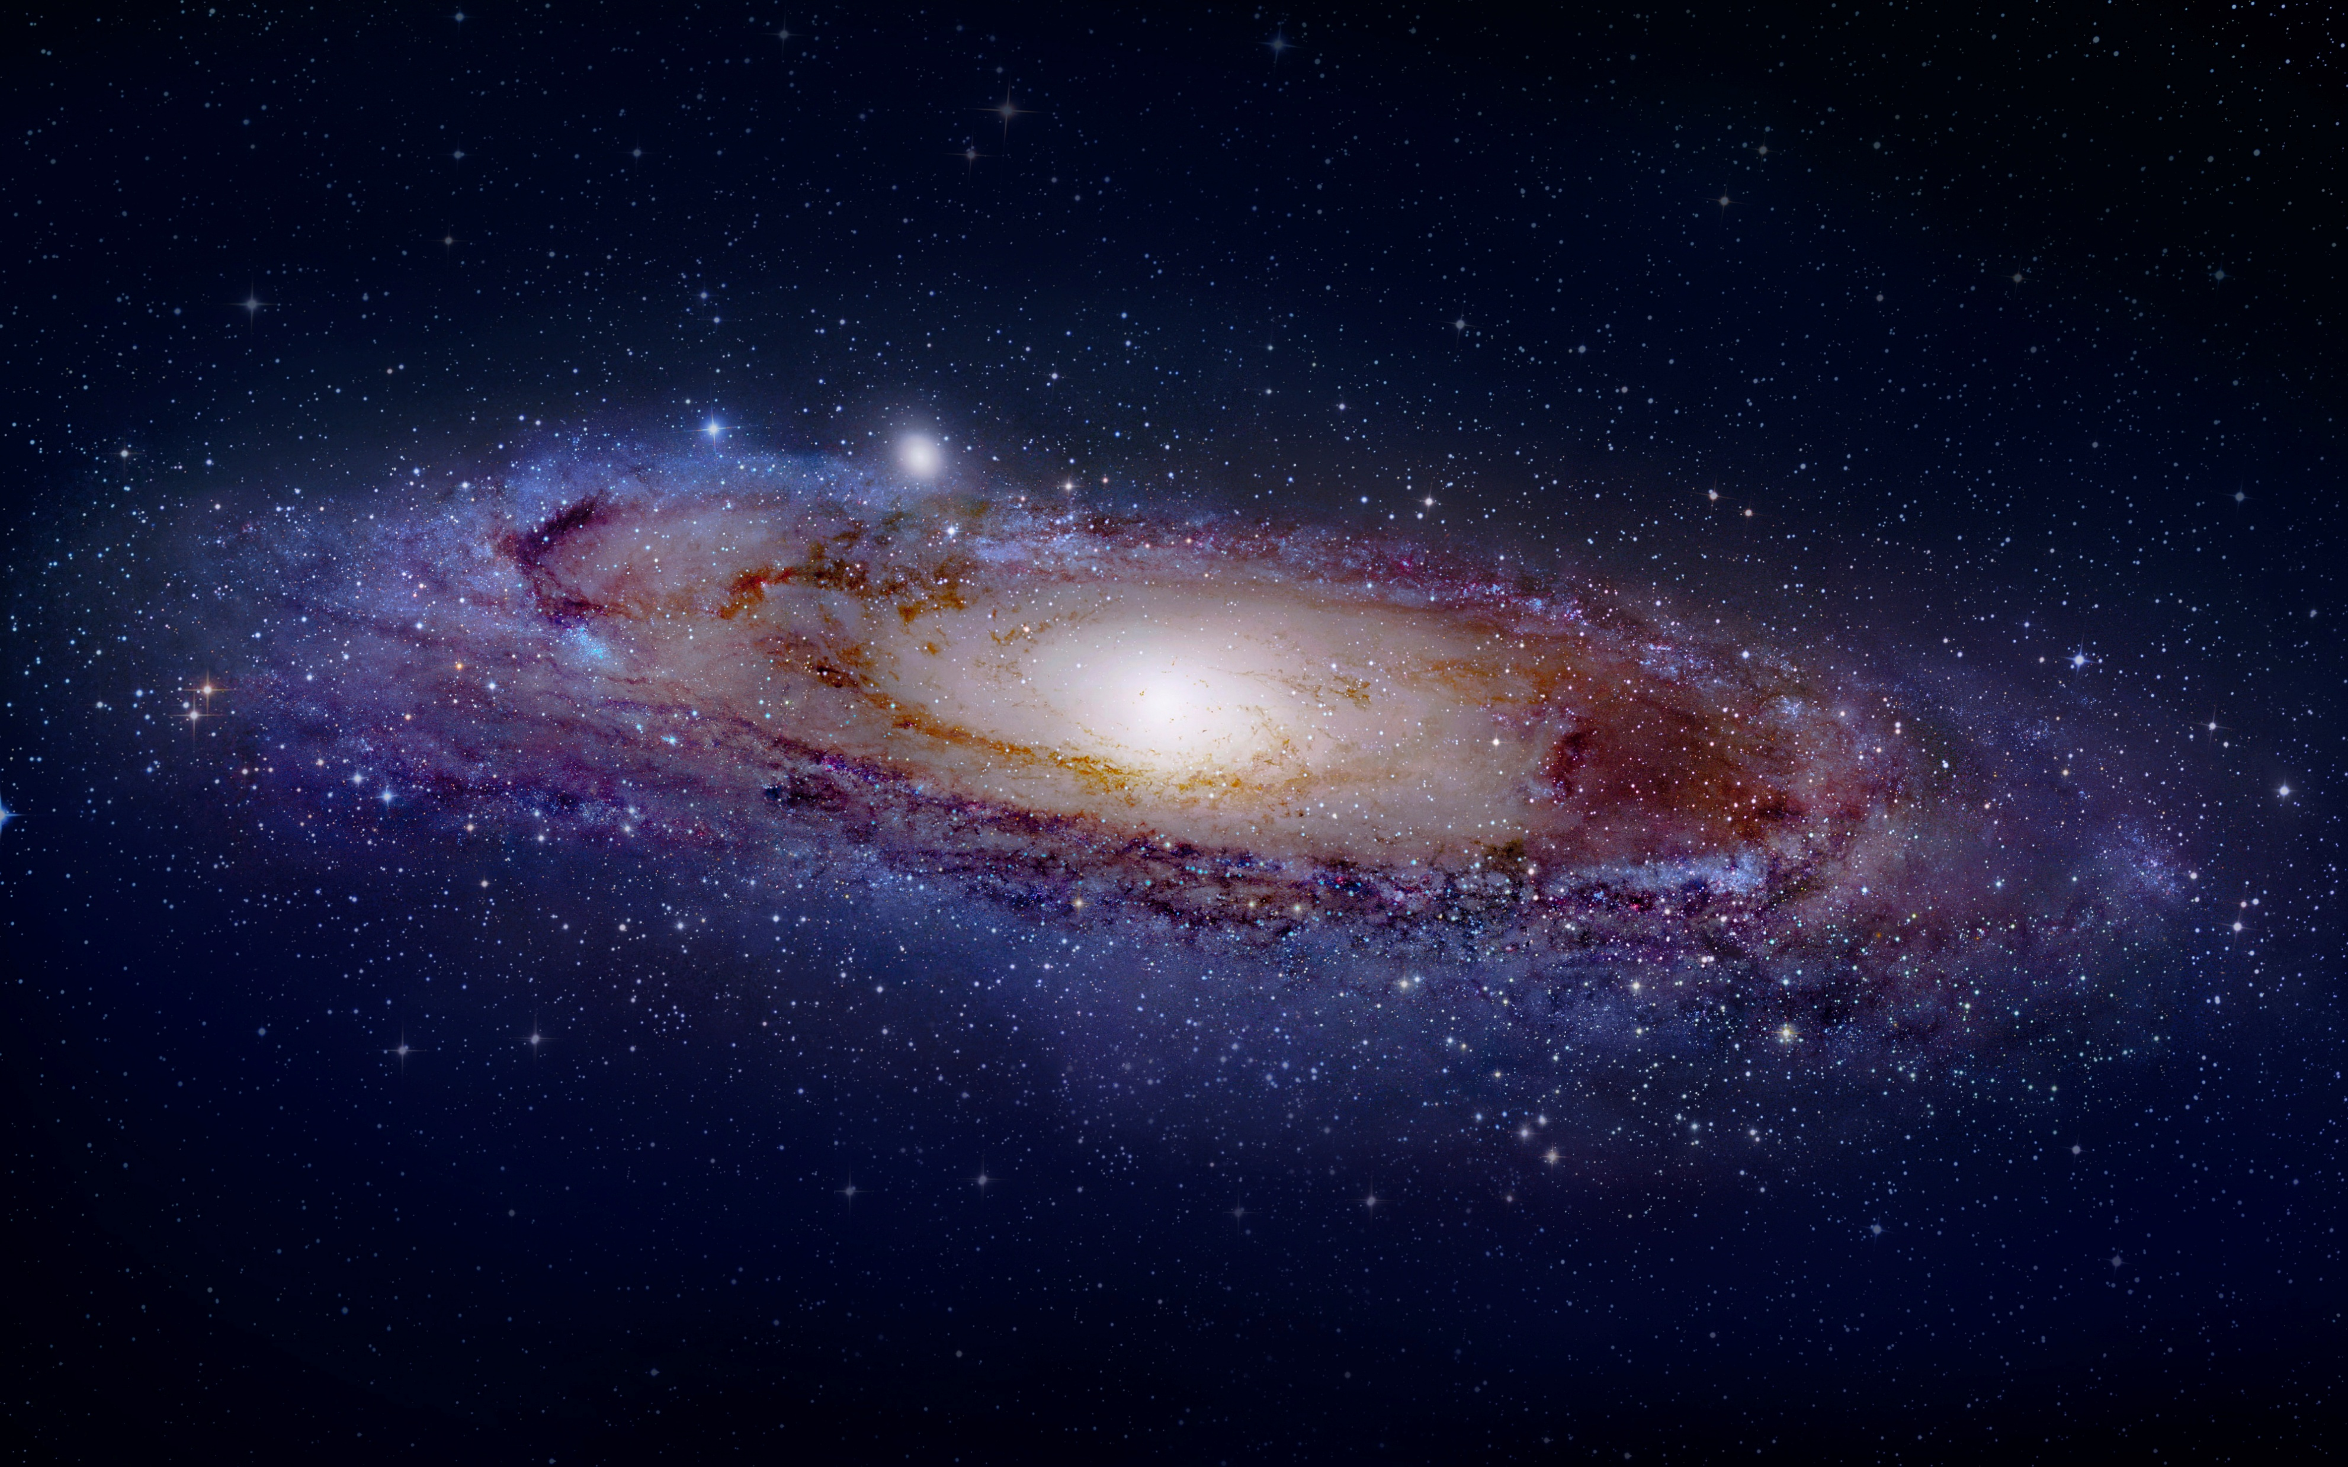
A Novel Method to Probe Cosmic Neutrino Background
Shun Zhou
Institute of High Energy Physics, Beijing
Sydney-CPPC Zoom Seminar, March 26, 2026

Slide 2
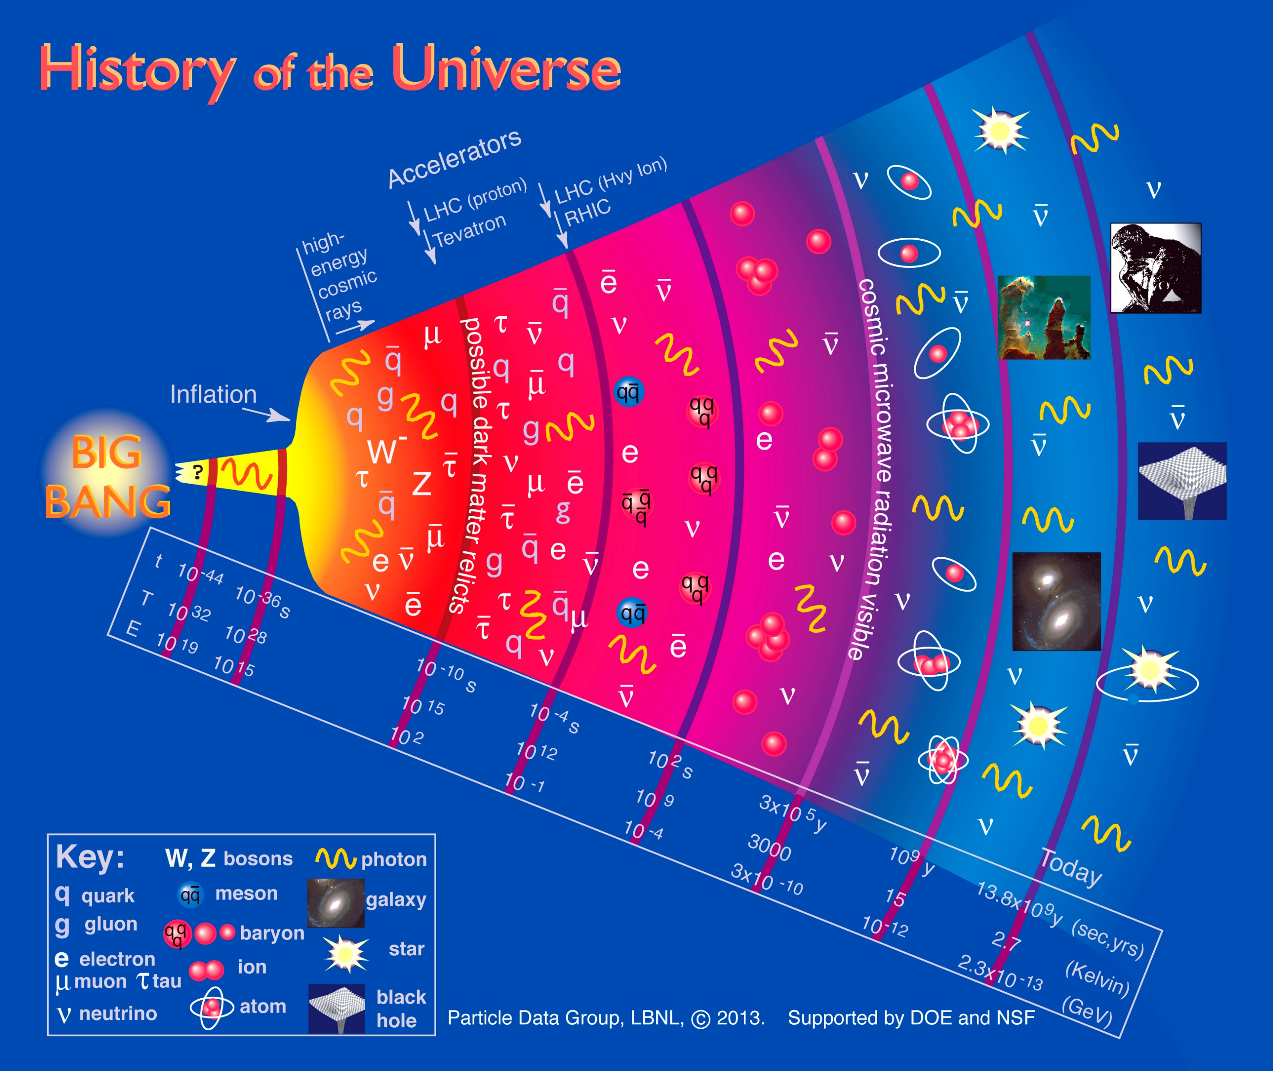
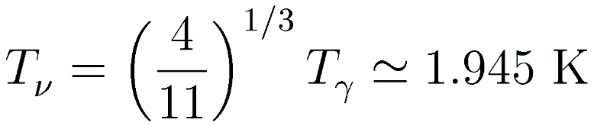
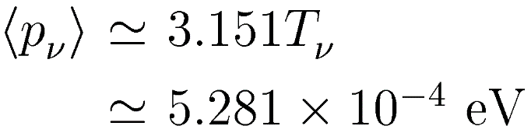
Relic neutrinos from the Big Bang
Cosmic ν Background (CνB or CNB)
neutrino decoupling@ t =1 second
Cosmic Microwave Background (CMB)
photon decoupling@ t =10⁵ years
Why is the CνB detection important?
test standard model of cosmology
evolution of the early Universe (1s)
probe ν masses & Majorana nature
Why is the CνB detection difficult?
Temperature today
Mean momentum today
the only source of non-relativistic ν’s

Slide 3
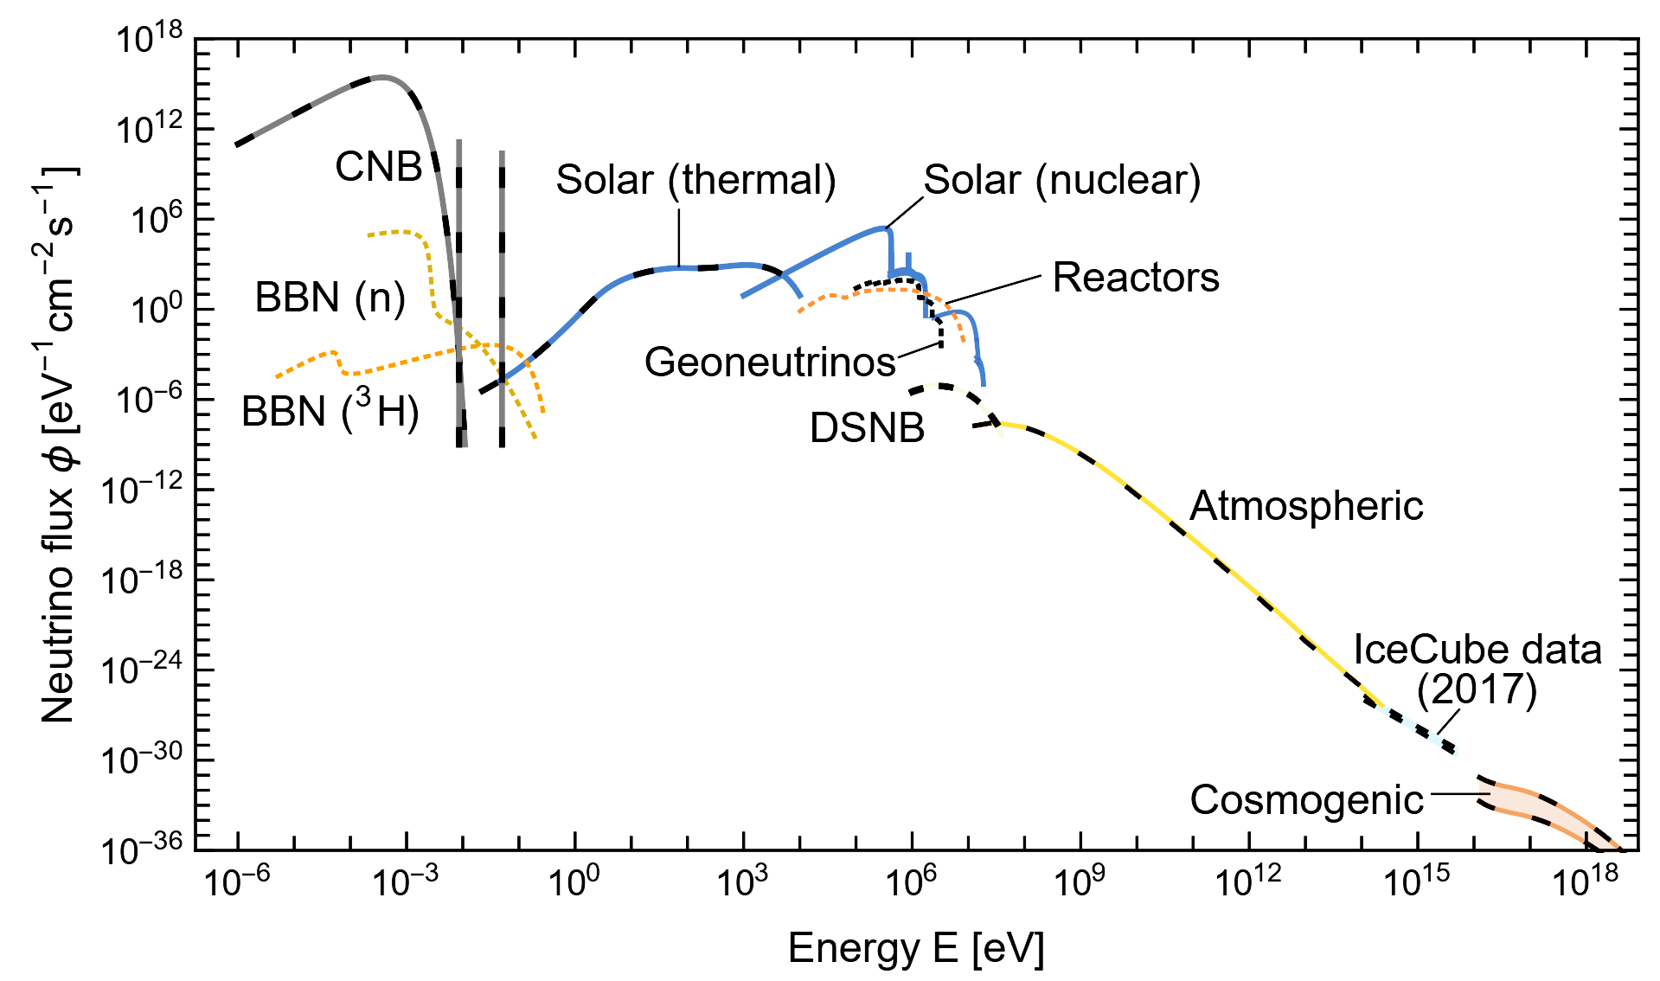
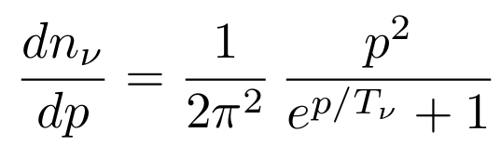
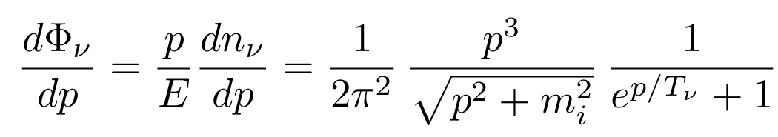
Relic neutrinos from the Big Bang
Vitagliano, Tamborra & Raffelt, Rev. Mod. Phys, 2020
number density:
112 neutrinos+antineutrinos cm⁻³ per flavor

Slide 4
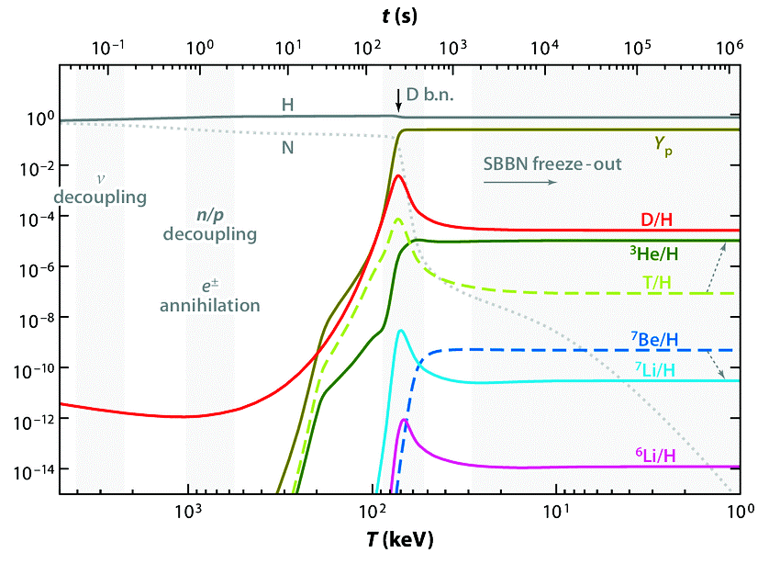
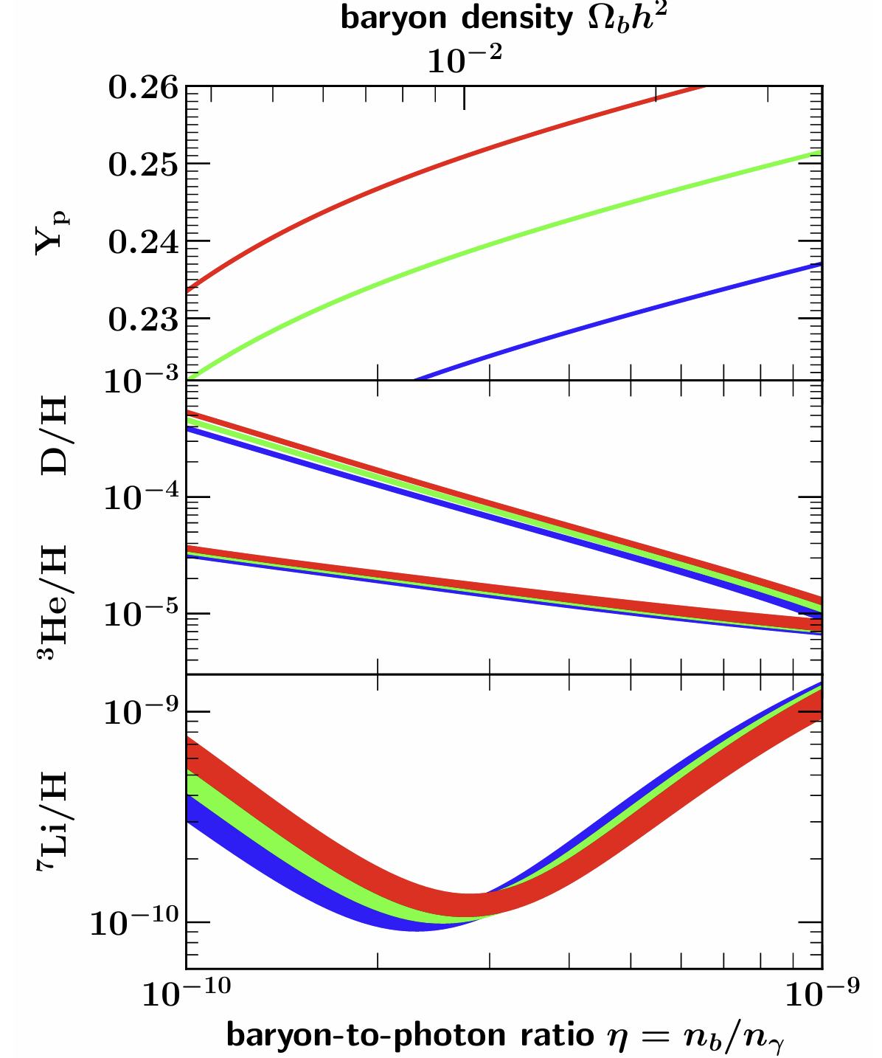
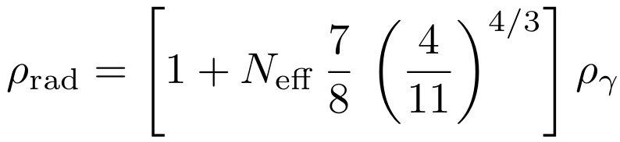




Big Bang Nucleosynthesis (BBN): indirect evidence for CνB
Fields et al., JCAP, 2020
$$N_{\text{eff}}=4$$
$$3$$
$$2$$
Standard value:
Effective number of neutrino generations:
Drewes et al., 2402.18481

Slide 5
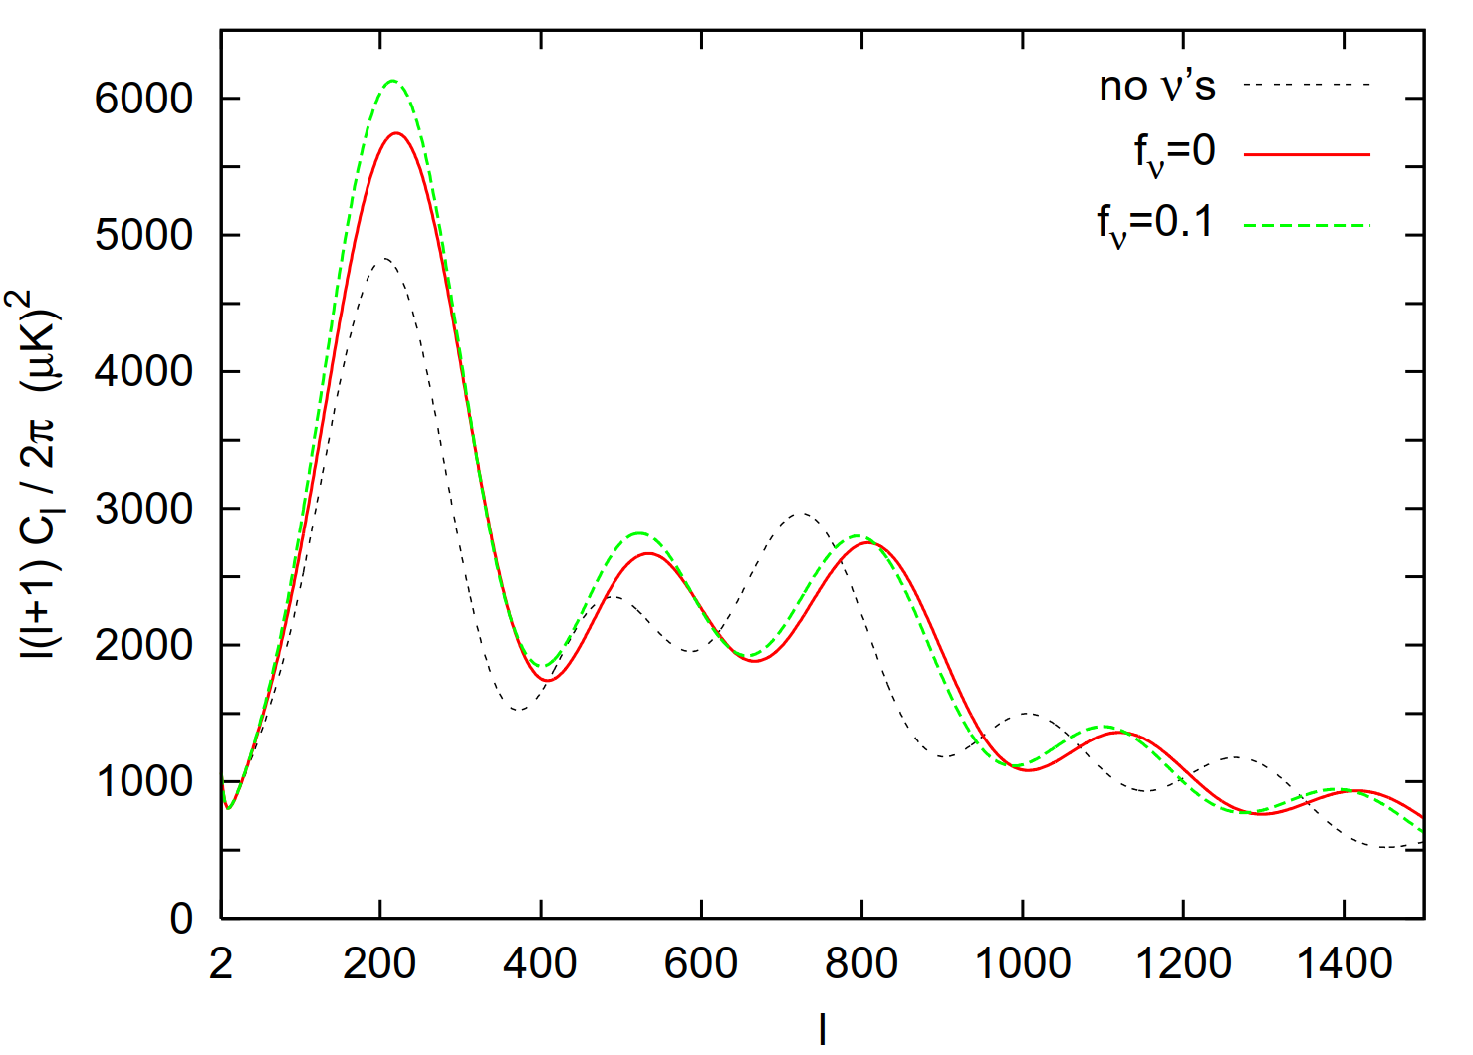
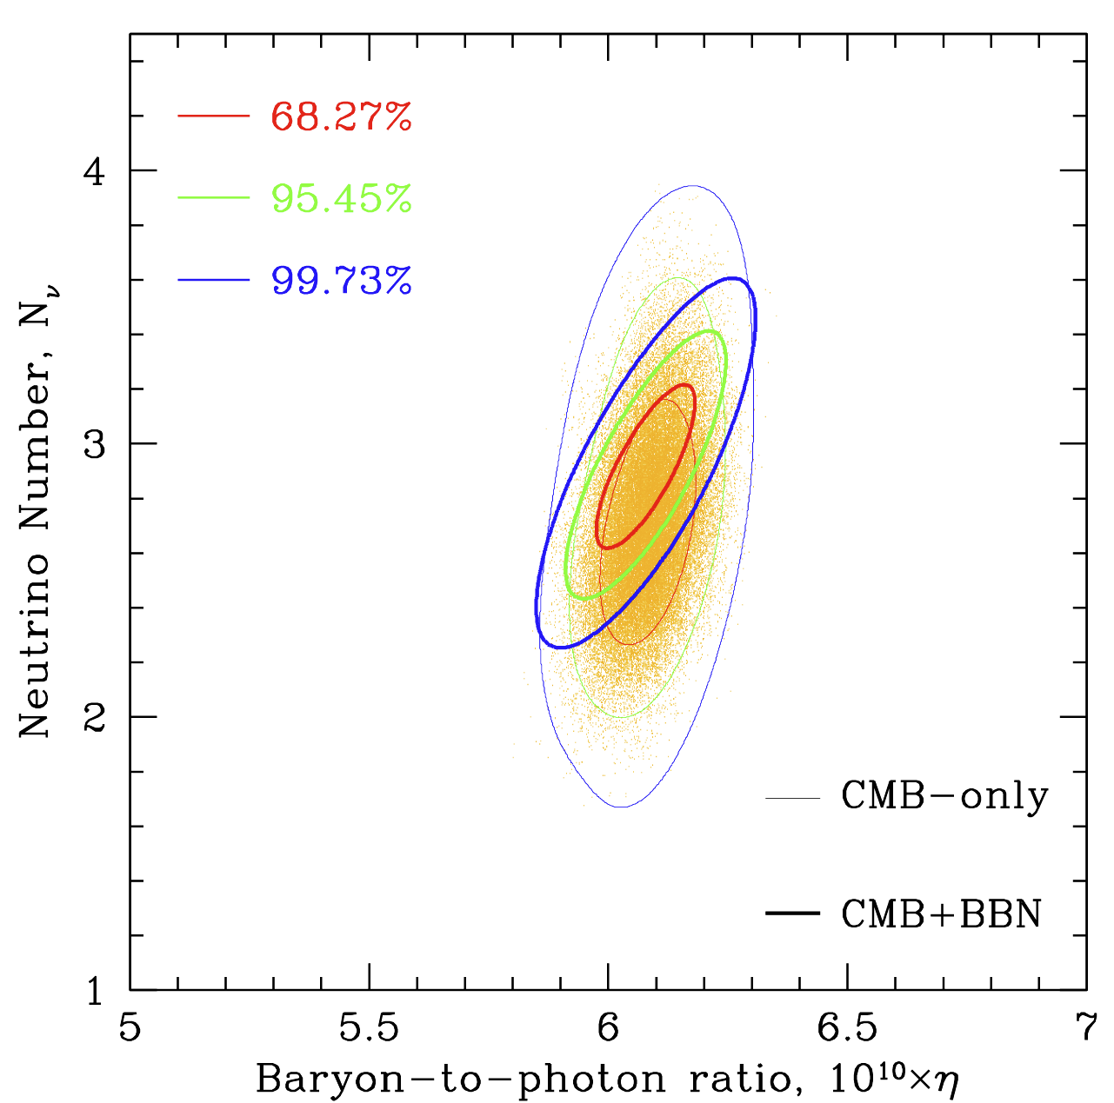
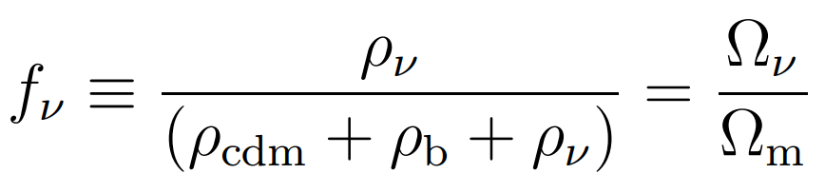
CMB: indirect evidence for CνB
3 massless neutrinos
Fields et al., JCAP, 2020
Lesgourgues & Pastor, Phys. Rept., 2006
Energy density fraction:
sensitive to effective number & neutrino masses

Slide 6
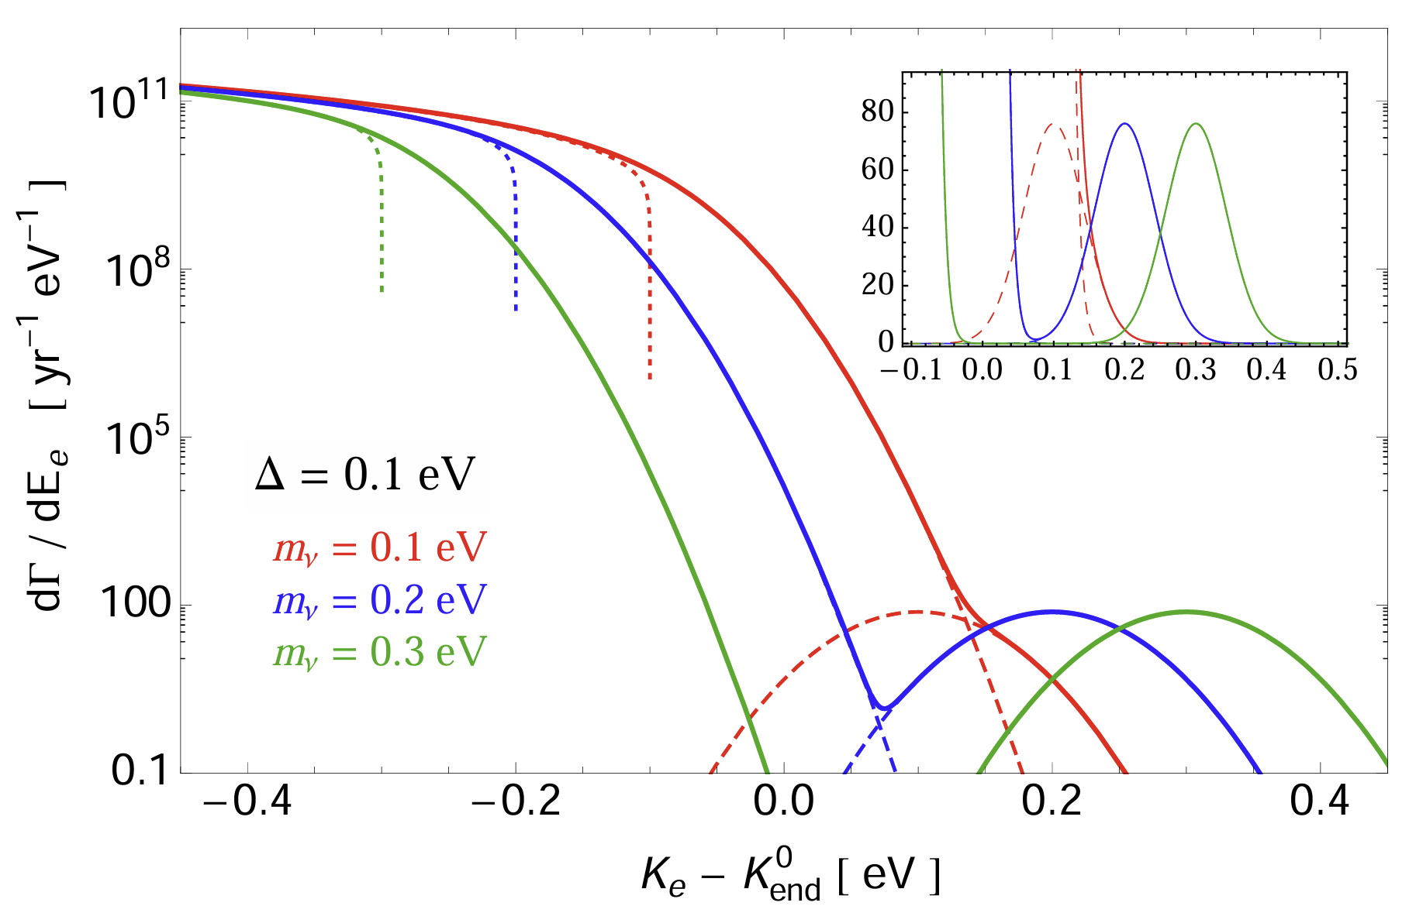
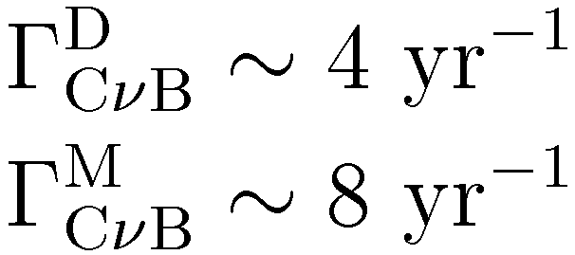
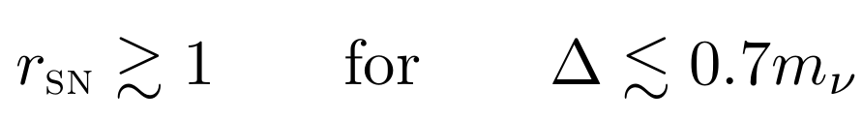

Summary of Direct-detection Methods
Capture on tritium
Long et al, arXiv:1405.7654
Weinberg, 62
Irvine & Humphreys, 83
ν_{e} + ³H → ³He + e⁻
³H → ³He + e⁻ + ${\overline{\text{ν}}}_{\text{e}}$
no energy threshold
PTOLEMY
Betts et al, arXiv:1307.4738
★ first experiment
★ 100 g of tritium
★ graphene target
★ planned energy resolution 0.15 eV
signal-to-background ratio:
★ CνB capture rate
D = Dirac
M = Majorana
cf. only 60 μg tritium in KATRIN

Slide 7
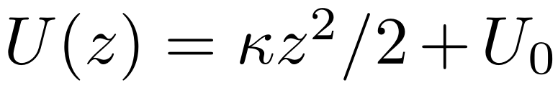
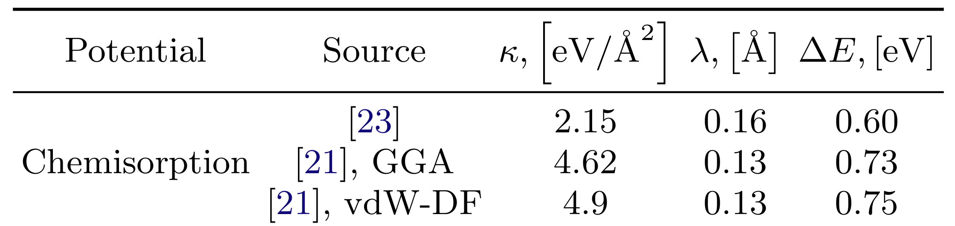
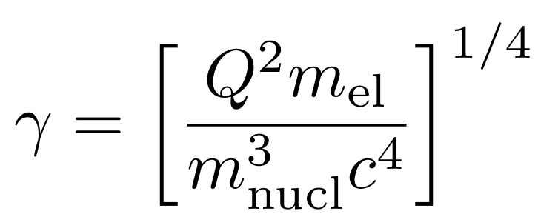
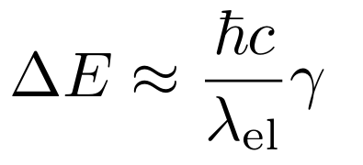
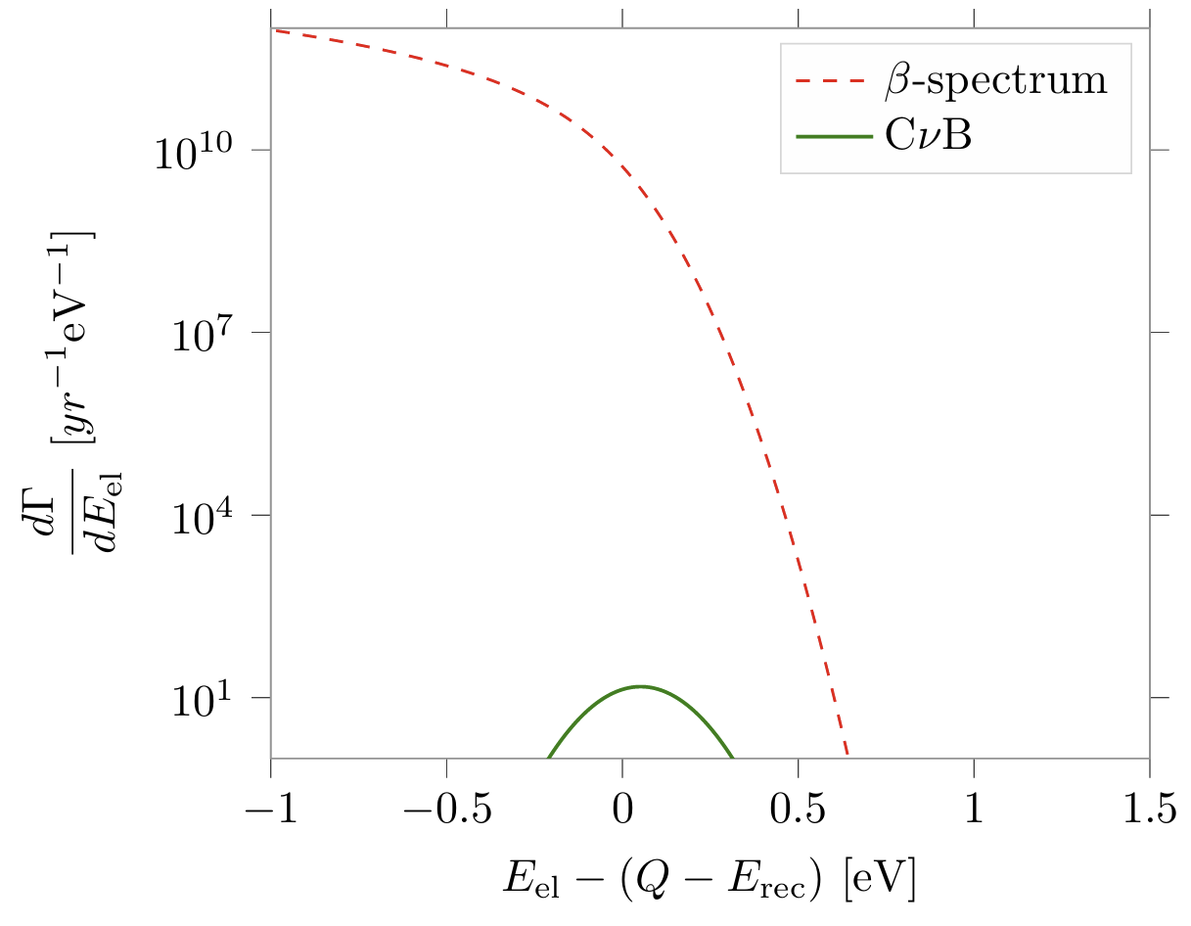
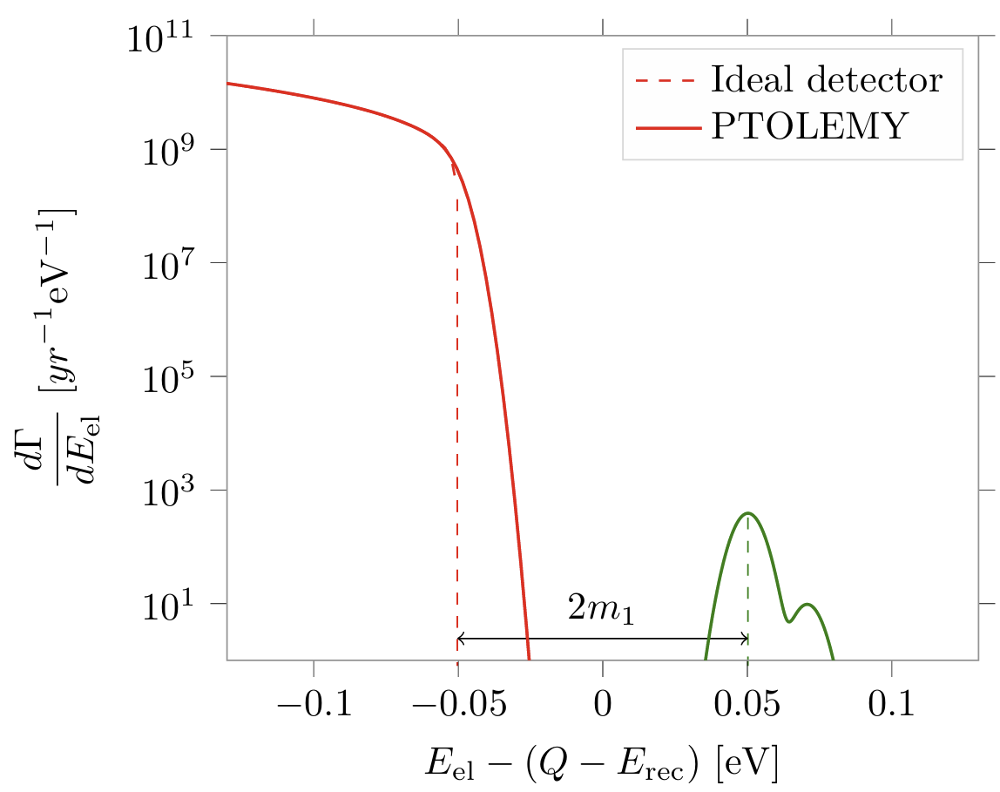

Challenges for PTOLEMY
Potential perpendicular to the graphene
localized nuclei cannot be at rest
uncertainty in electron energy
Cheipesh et al, arXiv:2101.10069

Slide 8
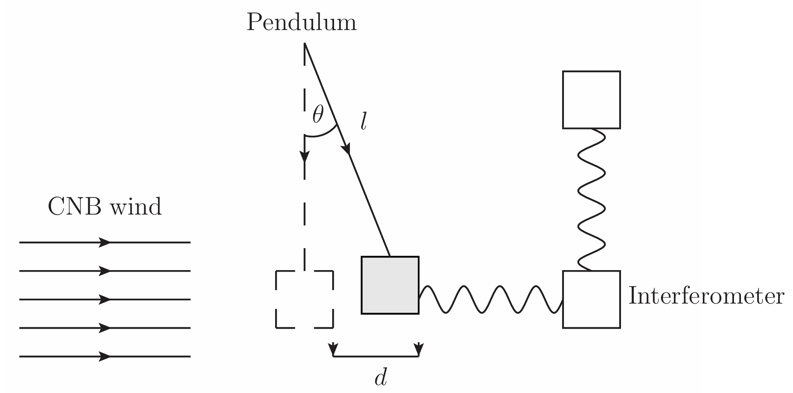
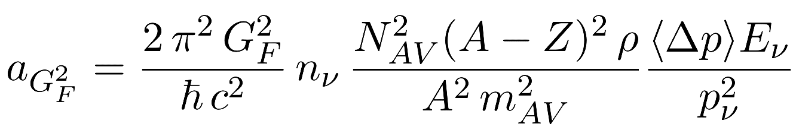
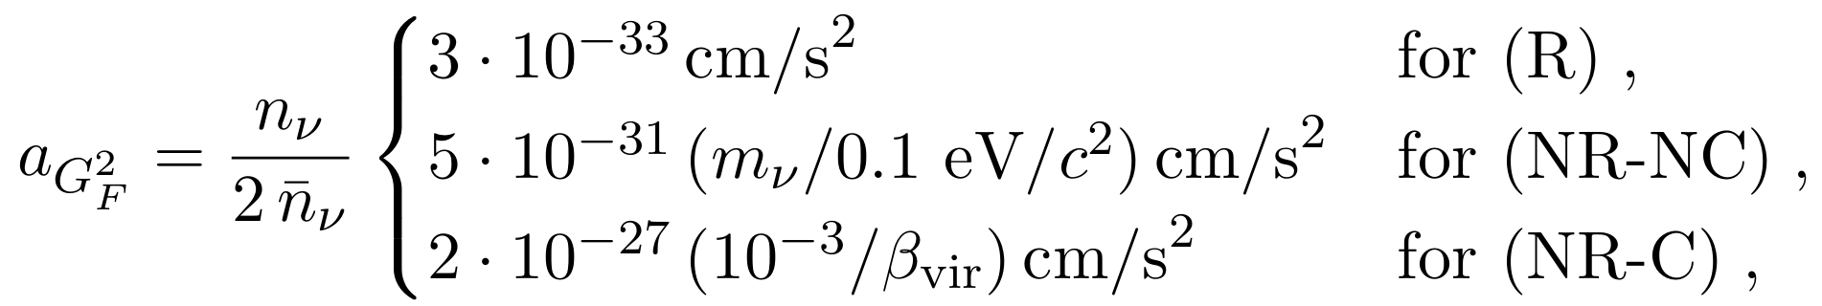



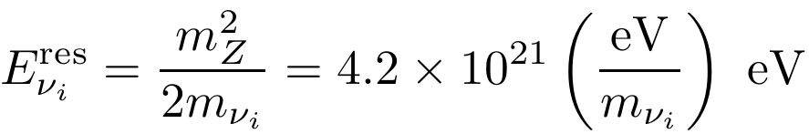
Laser Interferometers
Domcke & Spinrath, arXiv:1703.08629
Acceleration of the test mass
relevant parameters for lead:
smaller by more than 10 orders of magnitude
★ Coherent scattering of CνB with nuclei: enhancement
★ Cross section of weak interactions suppressed by G_{F}*G_{F}
★ Average momentum transfer from CνB to the test mass
★ Current sensitivity a_{min} = 10⁻¹⁶ cm s⁻² & future 10⁻¹⁸ cm s⁻²
Z-burst: EHE neutrinos
Weiler, PRD, 1982

Slide 9
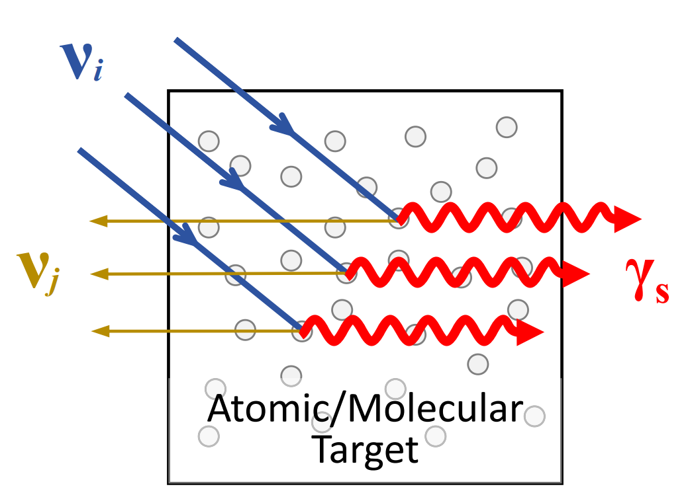
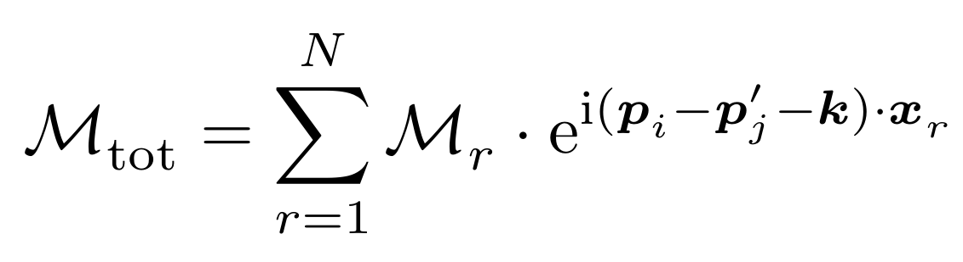

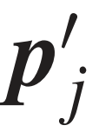

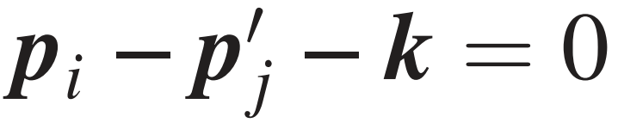
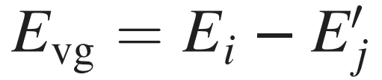
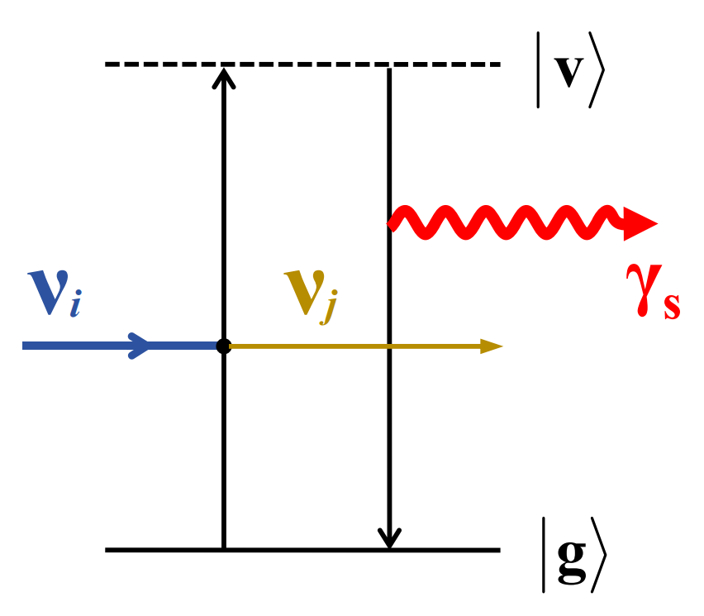
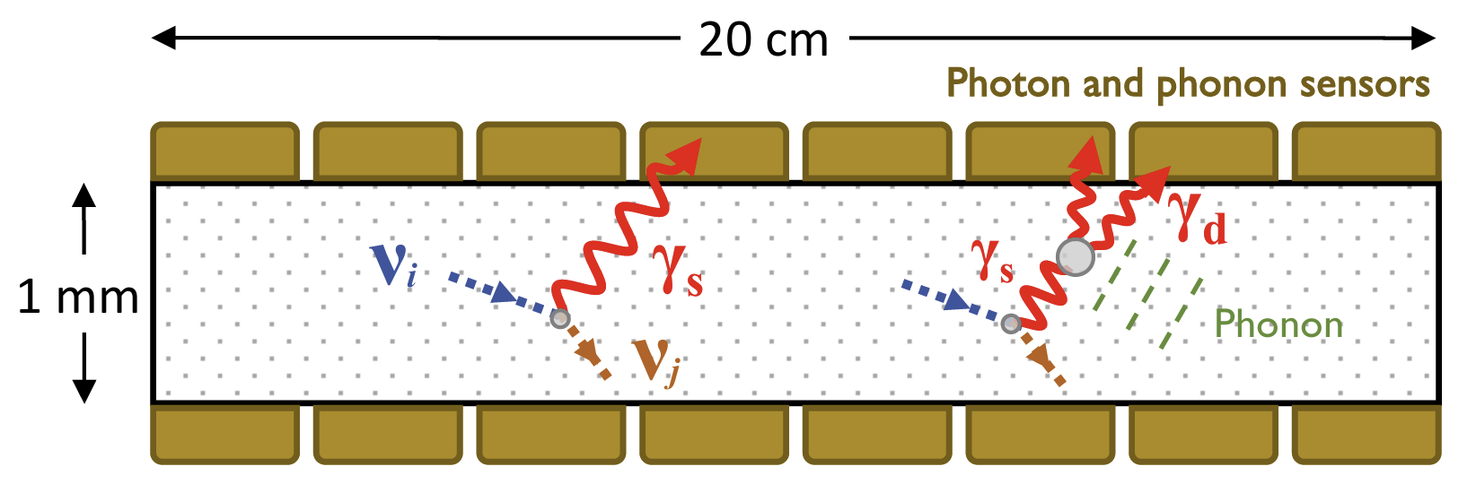



A New Method: parametric fluorescence
 Coherent scattering
G.Y. Huang & S. Zhou, 2507.10868
phase matching
the amplitudes for each radiant added coherently, leading to the enhancement by a factor of N (number of radiants)
 On resonance
further resonant enhancement of the emission rate
 Detection

Slide 10
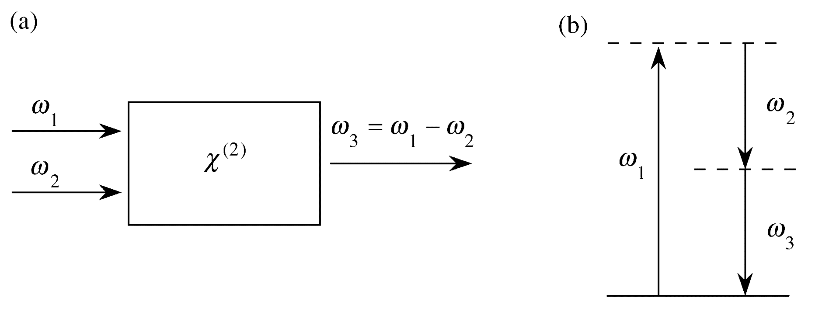
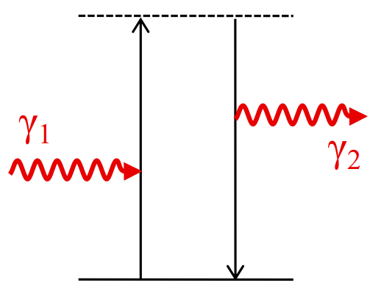
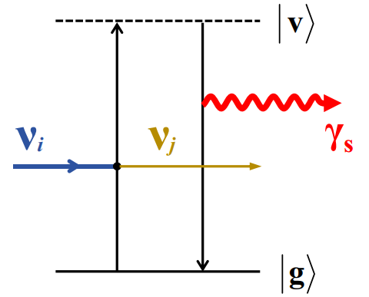
Theoretical Framework
Response of the dielectric medium to the applied electric field
Nonlinear Optics
Boyd, 2008
Parametric fluorescence
polarization
linear and nonlinear susceptibilities
Byer & Harris, 1968
The quantum state of the atom remains the same
second-order susceptibility
The virtual states are involved and no energy transfer to the media
linear susceptibility
Frequency-difference generation
Lower-frequency input photons are created optical parametric amplification
Occurs also without lower-frequency photons

Slide 11
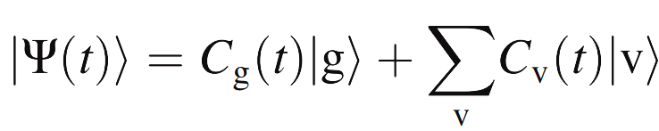
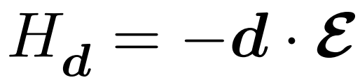

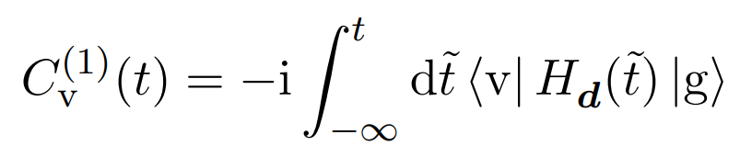
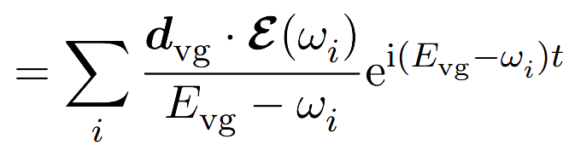
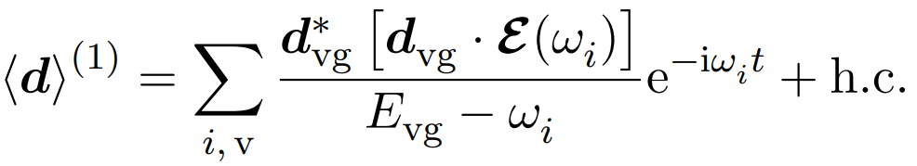

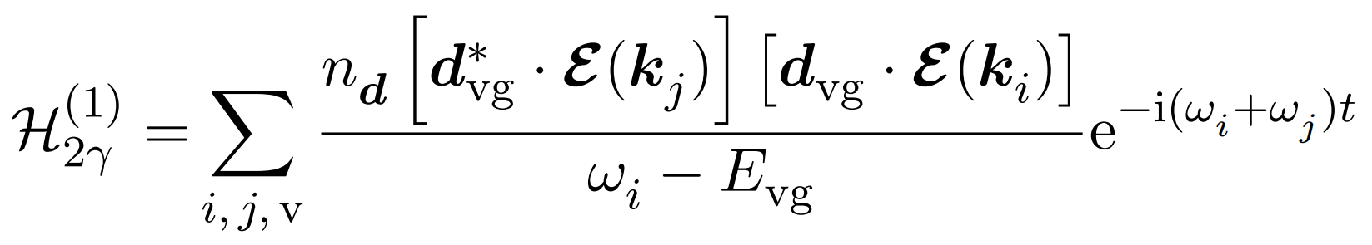
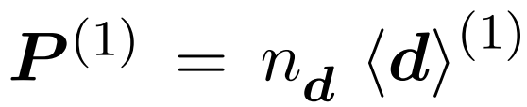

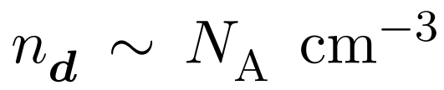
Theoretical Framework
Calculating the susceptibilities in quantum mechanics
Nonlinear Optics
Boyd, 2008
electric-dipole interaction
first-order result for the transition coefficient
expected value of the electric-dipole operator
polarization density
dipole density in the medium
Now take the perturbation to be neutrino fields

Slide 12
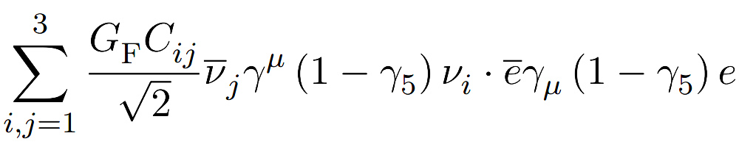
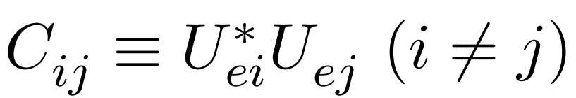


A. Emission Rate
Weak interaction
Only charged-current interaction contributes to the off-diagonal transition
In the non-relativistic limit of electrons:
E1-transition Hamiltonian
M1-transition Hamiltonian
Neutrino current:
Dirac case
Majorana case

Slide 13
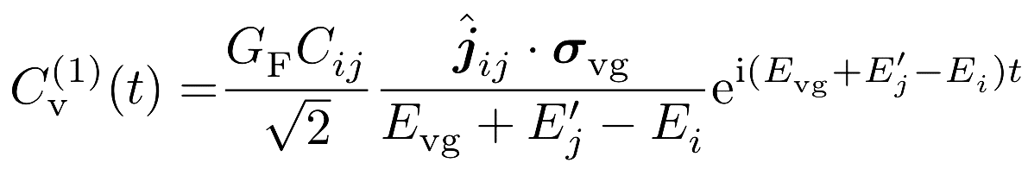
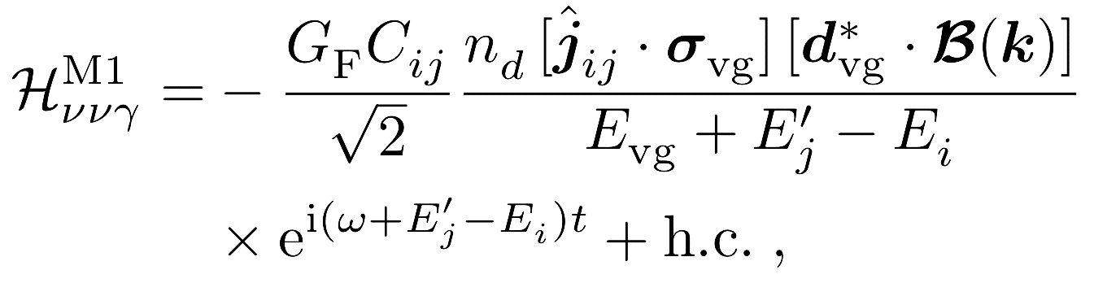
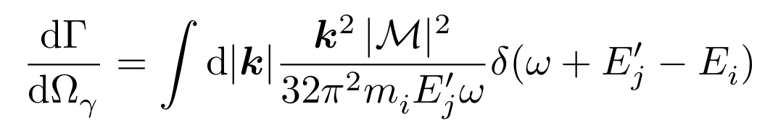


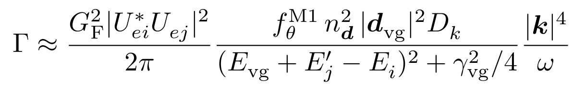





A. Emission Rate
M1-transition: optimistic case
coefficient under the perturbation by neutrinos
Effective Hamiltonian:
Differential rate:
Total rate:
damping rate
depending on photon dispersion in media and neutrino masses
spontaneous decay
dephasing
Bohr magneton

Slide 14




B. Momentum Dispersion
The heaviest neutrino is not at rest
away from resonance
Slow light technique: reduce the impact of momentum dispersion
Three-level system: transparency to reduce the attenuation

Slide 15



Summary and Outlook
The existence of CνB receives robust evidence from the BBN, CMB and LSS observations, but a direct detection is still lacking
All the existing ideas towards a real detection are facing difficulties, and new ones are being proposed and studied seriously
Sasao & Yoshimura
New technologies developed in the AMO may find applications to the detection of CνB and dark matter
Garcia del Castillo, Pierobon, Sengupta & Wong, PRD, 2026

