Slide 1
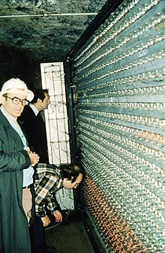



‘Physics then and now – the life and work of Don Perkins’ - 14 March 2024
Proton Decay and
much more
Professor Mark Thomson
Professor of Experimental Particle Physics
University of Cambridge
Executive Chair of STFC
thomson@hep.phy.cam.ac.uk
mark.thomson@stfc.ukri.org

Slide 2
This short presentation
Very much a personal reflection rather than a deeper scientific exploration
but the scientific story is really interesting, particularly looking back
I will try to give a historical perspective on how the search for proton decay shaped neutrino physics today
and of course, Don Perkins was a leading figure in this area

Slide 3
Why am I here?
Part of the answer:
The proton lifetime is significantly longer than the lifetime of the Universe

Slide 4
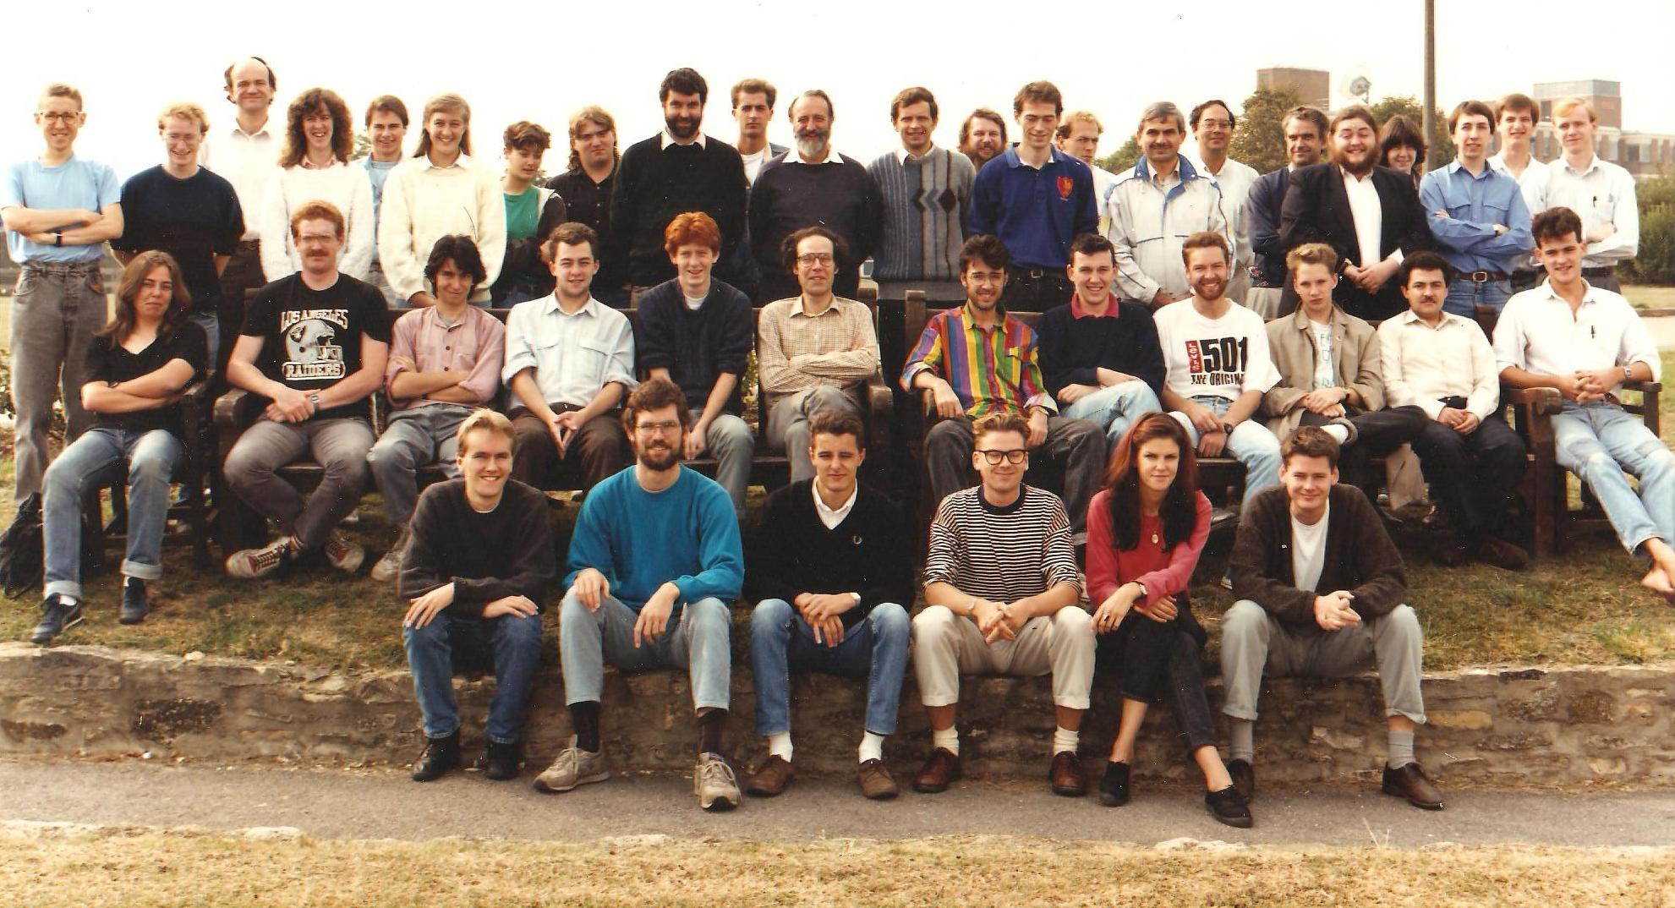
Why am I here today?
Probably more relevant:
In 1985 I started my D.Phil. in Experimental Particle Physics at Oxford and decided to work on the Soudan-2 underground experiment in Minnesota

Slide 5
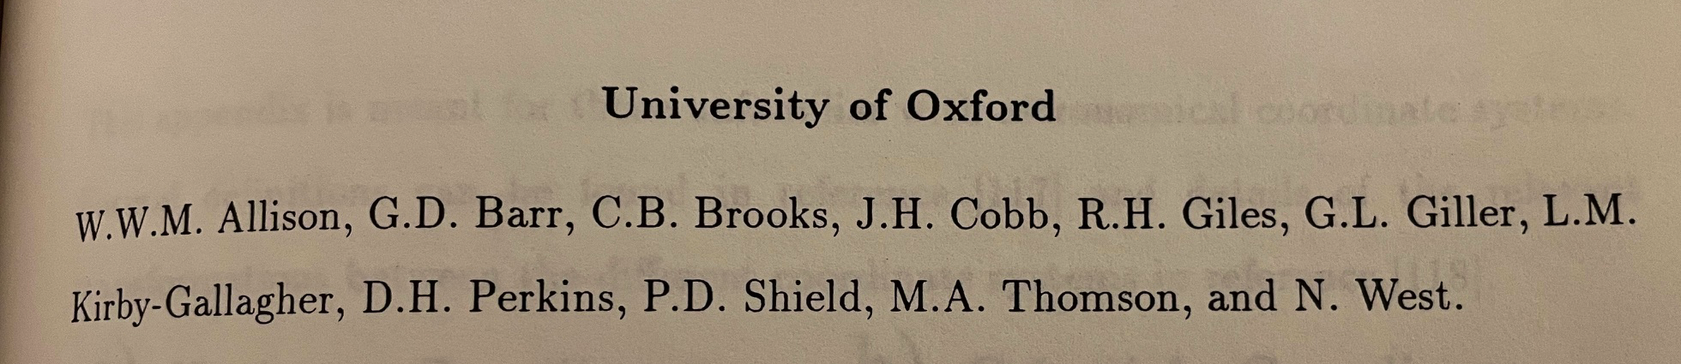
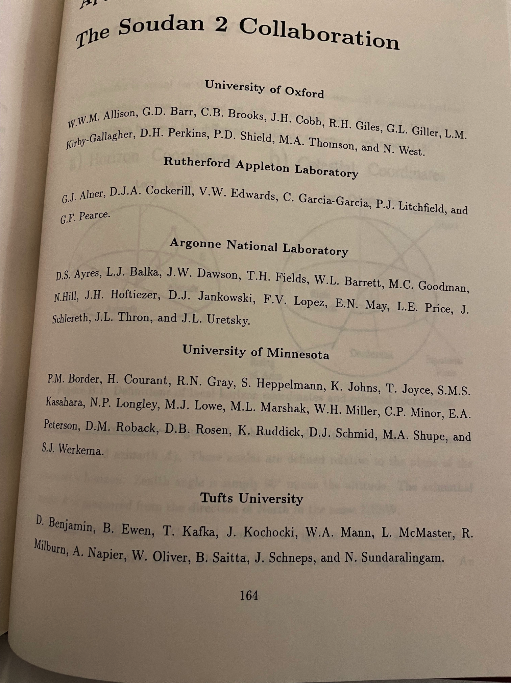
Why go underground
What was the attraction with Soudan-2?
Small collaboration
Hands-on detector and electronics technology
A great team at Oxford including…
Ultimately, it was the science
Astroparticle Physics / Particle Astrophysics before it was “a big thing”

Slide 6

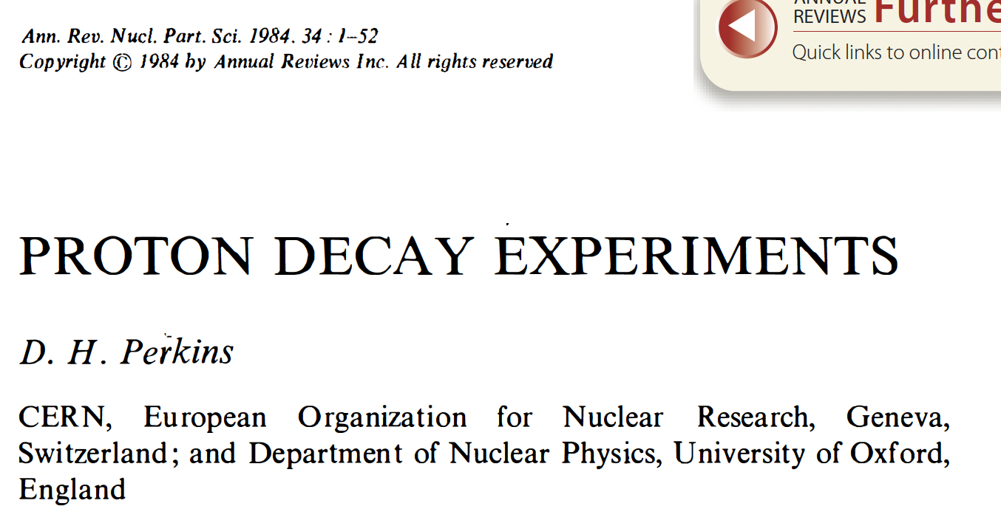
Proton Decay in 1984
Proton decay was a hot topic

Slide 7




Proton Decay in 1984
Proton decay was a hot topic
What else was hot in 1984?

Slide 8
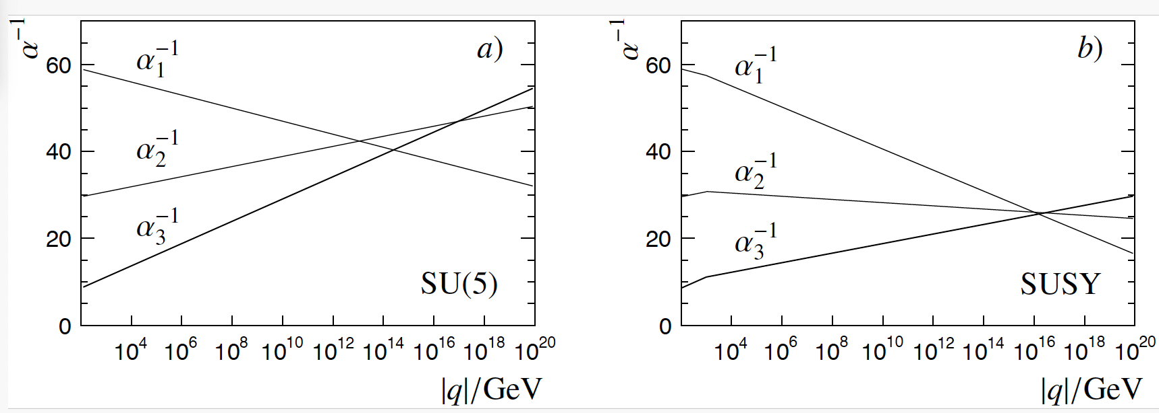
Why was proton decay the hot topic?
Looking back to 1984 (if we dare)…
Discovery of W & Z in 1983, firmly established the gauge theory of SU_{L}(2) x U(1) as the principle for a unified electroweak theory.
In the late 1970s / early 1980s the SU(3) gauge theory of QCD had also been confirmed by experiment
The experimental data at the time suggested that the strengths of the three main forces converged at a scale of ~10¹⁴ GeV

Slide 9
Why was proton decay a hot topic?
Looking back to 1984…
Georgi and Glashow brought these ideas together in the context of the SU(5) Grand Unified Theory
  quarks and leptons were placed in the same multiplet structure
  a new force mediated by a super-heavy gauge bosons, imaginatively named X and Y
    M_{X} ~ 10¹⁵ GeV
  As a consequence, Baryon Number not conserved and the proton should decay
      Worth remembering that Baryon Number non-conservation is one of the three Sakharov’s conditions necessary for the observed matter-antimatter asymmetry in the Universe

Slide 10
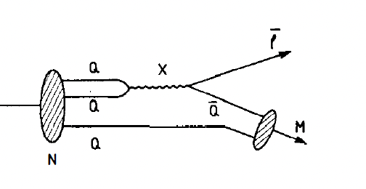
Proton decay
Proton decay
In vanilla SU(5) Grand Unified Theory the underlying process is:
  u d  X  e⁺ u
Resulting proton process with a final state of a positron and a neutral meson, e.g.
  p  e⁺ π⁰
Other models were (and still are) available, Supersymmetric GUTs generally predict the final state lepton to be a neutrino, e.g.
  p  K⁺ ν_{τ}

Slide 11
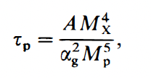
Proton lifetime
Proton decay
Simple dimensional arguments give
Taking, A~1, α_{g} ~ 1/40 and M_{X} ~ 10¹⁵ GeV suggests a proton lifetime of
  τ_{p} ~ 10³¹ years

Slide 12
The experimental challenge
The experimental challenge
Looking for signatures such as p  e⁺ π⁰ and p  K⁺ ν_{τ}
with a proton lifetime of >10³¹ years
The experimental strategy
a) watch one proton for 10³¹ years – neither very practical not interesting
b) watch > 10³¹ protons for a few years
  in this case the challenge is being able to see a single decay within a mass of ~1000 tons
Looking for two distinct signatures:
  p  e⁺ π⁰  e⁺γγ : relativistic electromagnetically interacting particles
  p  K⁺ ν_{τ} : “slow” kaon, which decays

Slide 13
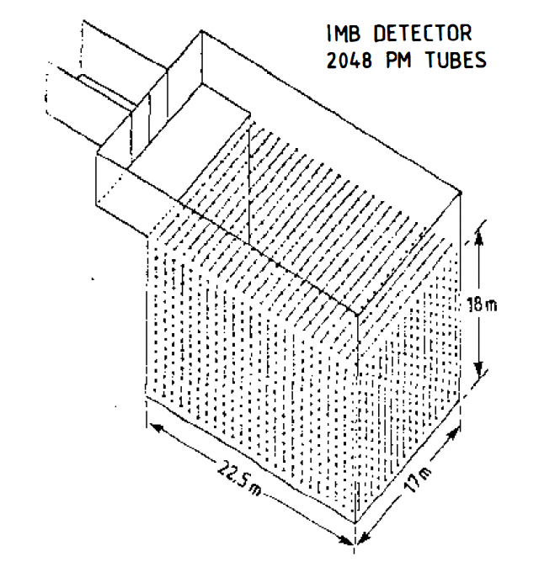
The experimental approach
Two main experimental approaches
To look for pdk signatures in a large volume
  p  e⁺ π⁰  e⁺γγ : relativistic electromagnetically interacting particles
  p  K⁺ ν_{τ} : “slow” kaon, which decays
Water Cherenkov detectors, e.g.
the IMB detector in the US
and the Kamioka nucleon decay experiment, Kamiokande, in Japan
Tracking calorimeters, e.g.
FREJUS and NUSEX in Europe
and Soudan-1 in the US

Slide 14
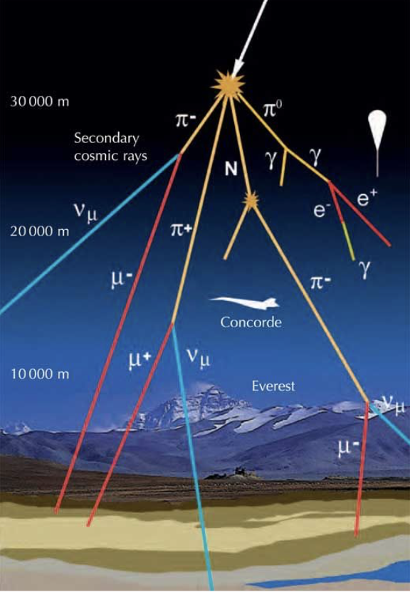
Backgrounds
Searching for a “single proton decay” in a very large detector is a challenge
Cosmic-ray induced background, e.g. spallation neutrons, can fake a signal
need to go deep underground
But always left with atmospheric neutrinos
pdk searches changed particle physics
large underground experiments
sensitive to (otherwise not very interesting) neutrino-induced backgrounds

Slide 15
Stepping forward to 1986
The experimental situation in 1986
“At the time of this conference five experiments (KOLAR, NUSEX, FREJUS, IMB and KAMIOKANDE designed to discover nucleon decay take data, located all around the world but only in the northern hemisphere. One more experiment is being constructed (SOUDAN 2) and two projects are under serious discussions (SUPERKAMIOKANDE, ICARUS), however nucleon decay has not been dicovered yet.” H. Meyer (from the FREJUS collaboration)
Three now familiar experimental techniques
Tracking calorimeters …………………… MINOS
Water Cherenkov detectors …………. Super-Kamiokande ……….. Hyper-Kamiokande
Liquid Argon TPC …………………………………………………………………… DUNE

Slide 16
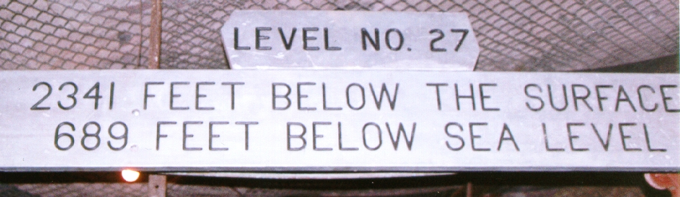
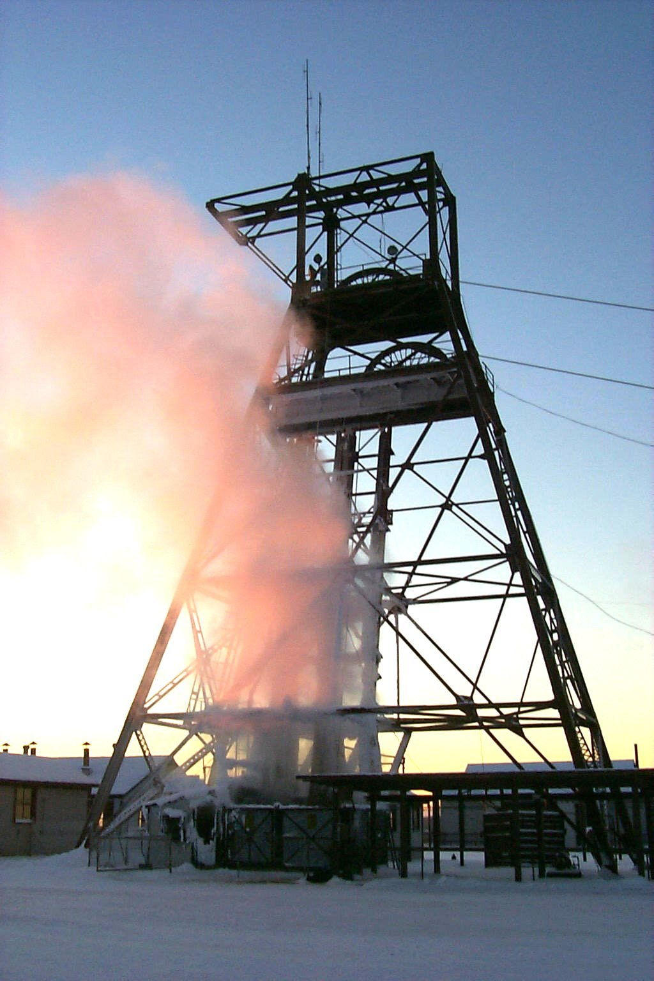
Soudan-2: my D.Phil. 1989-1991
Located in deepest darkest Minnesota…
nearest large town, Ely, Mn
As an aside… main options for projects were
ZEUS at DESY
  Hamburg nightlife
Delphi at CERN
  mountains and skiing
Soudan-2 in Minnesota
  snow (but no mountains), 3.2 beer
  A great and interesting group of scientists, including Don
Photo by Jerry Meier

Slide 17
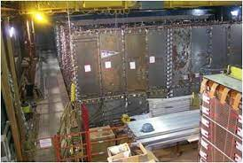
Soudan-2: the detector
Half a mile underground in a former Iron mine
Photo by Jerry Meier

Slide 18
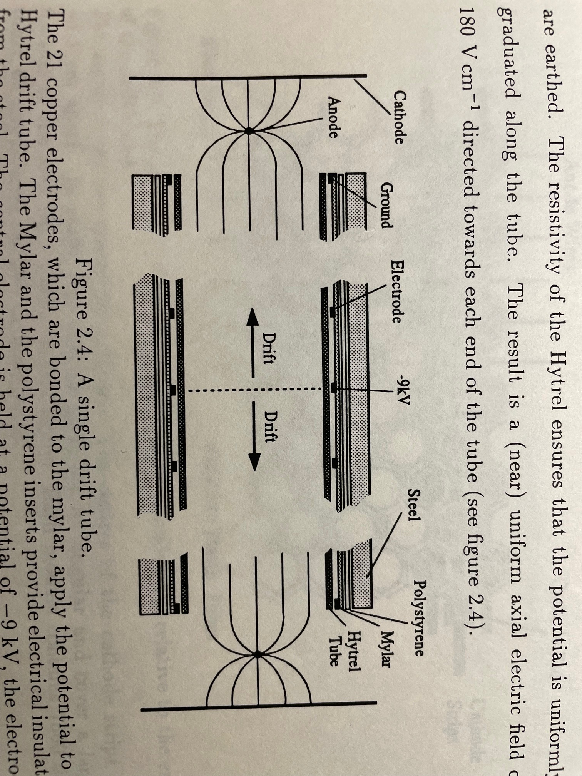
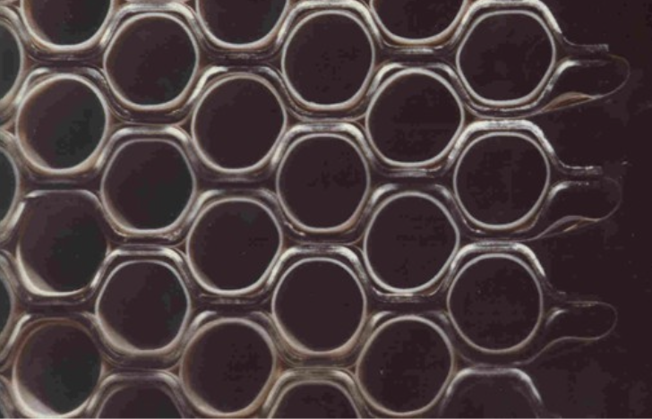
Soudan-2: the detector
“Slow-drift (0.6 cm s⁻¹)” Time Projection Chamber
Basic detector element was a 1.5cm resistive drift tube
The tubes were sandwiched in a corrugated honeycomb structure made from 1.5mm steel plates
  providing the bulk of the mass of the detector
Photo by Jerry Meier

Slide 19
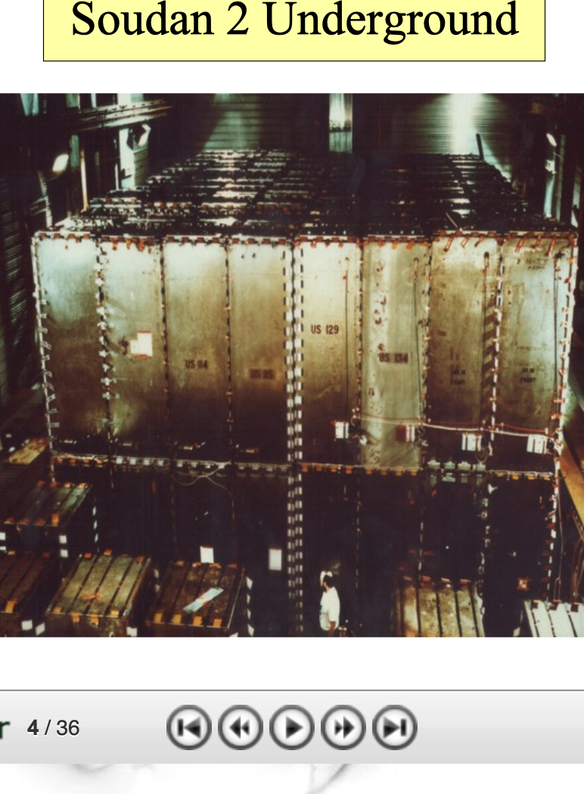
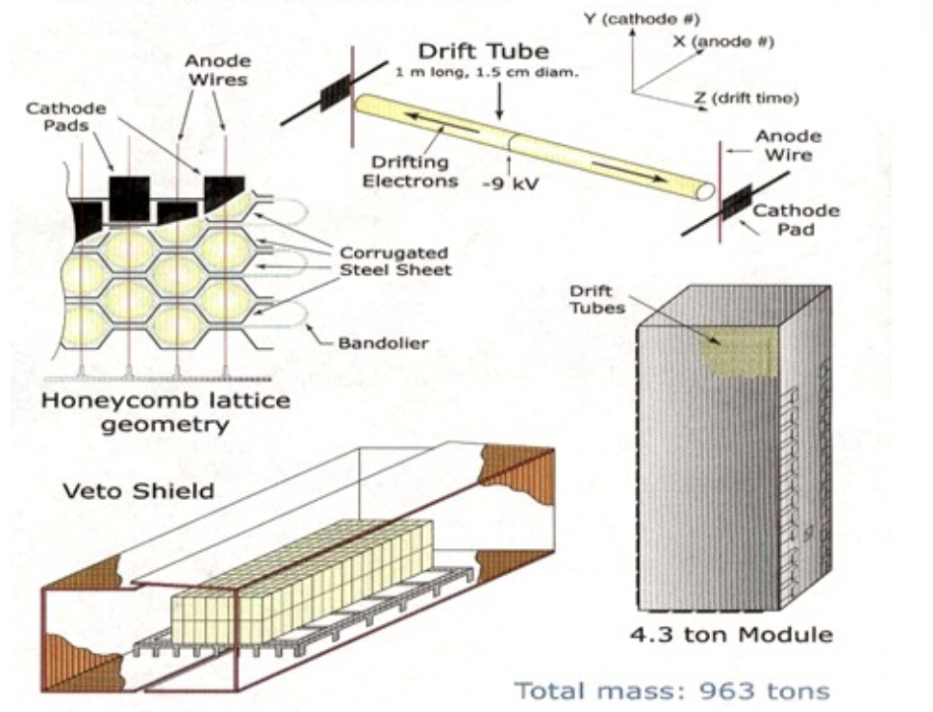
Soudan-2: the detector
“Slow-drift (0.6 cm s⁻¹)” Time Projection Chamber
256 modules, each of a mass of 4.3 tons
Photo by Jerry Meier

Slide 20
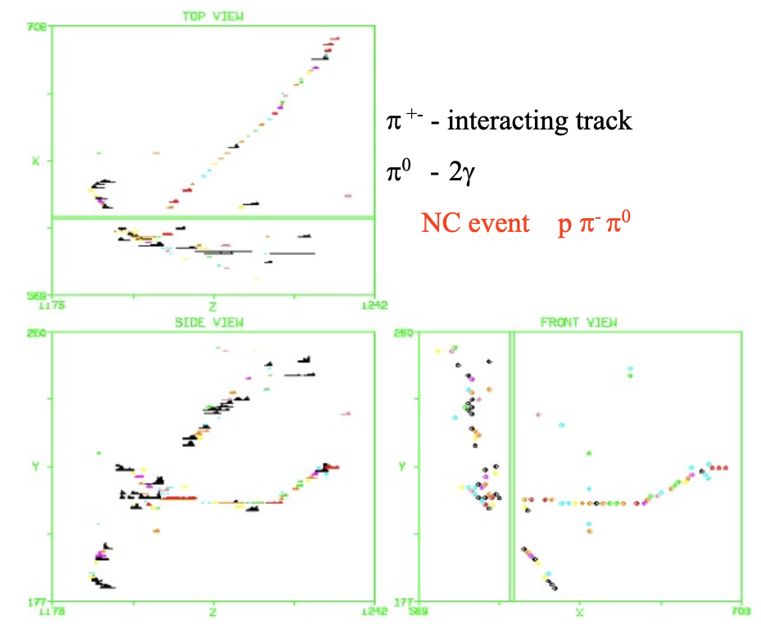
Soudan 2: 1989 - 2001
Soudan 2 was designed to study proton decay
Fine granularity tracking calorimeter with ~1 cm³ voxels
Low thresholds (gas detection)
Good particle ID and two track resolution
Projective 3D imaging
Photo by Jerry Meier

Slide 21
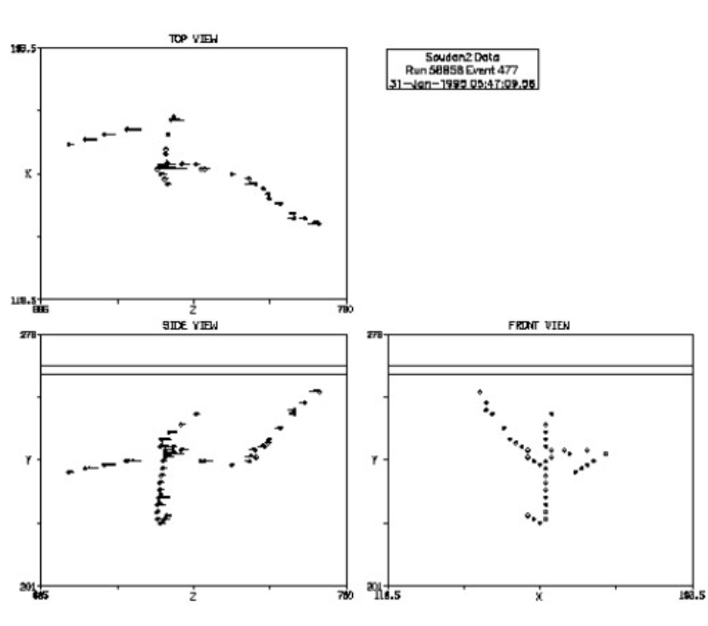
Soudan 2 – proton decay results
Multiple decay topologies explored
All channels had some level of expected neutrino background
Observed candidates were consistent with the background
Most stringent lifetime limit (channel-dependent):
  τ_{p} > 6x10³² years
Today the best limits come from Super-Kamiokande
More scalable technology leading to a 22 kton fiducial mass
τ_{p} > ~10³⁴ years
Photo by Jerry Meier

Slide 22
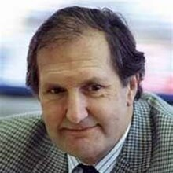

Proton decay – the legacy
Coffee discussions
One of the most enjoyable aspects of being in the Oxford physics department was the discussions over coffee
  myself, John Cobb (my supervisor), Don Perkins and often Mike Bowler
Discussion topics included proton decay and cosmic ray physics, but become increasingly focused on neutrinos and neutrino oscillations
  hints from multiple experiments that not all was right with rate of neutrino backgrounds
  the background was becoming the signal for neutrino oscillations
Photo by Jerry Meier

Slide 23
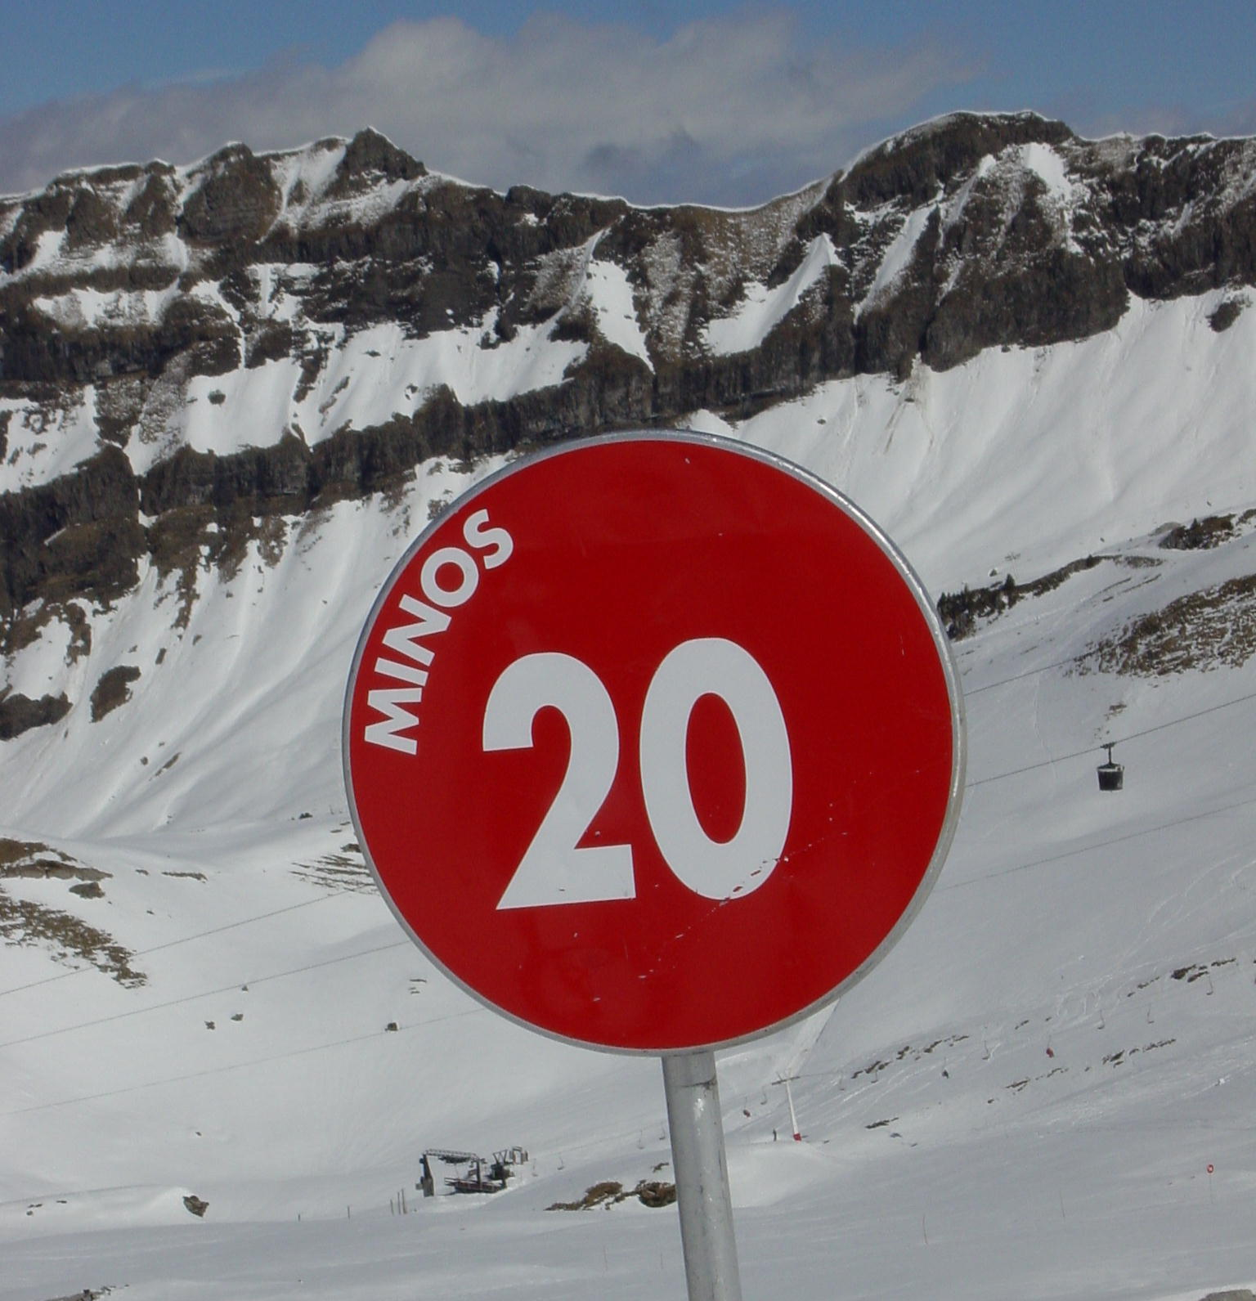
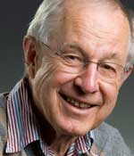
Proton decay – the legacy
One could argue that Soudan 2 seeded the now strong UK neutrino activity with Fermilab
Members of the Soudan 2 collaboration played a major role in the development of the concept of
  P-875: A long baseline neutrino oscillation experiment at Fermilab
Resulted in the formation of the MINOS collaboration following the demise of the SSC in 1993
  In turned out that the distance between the Soudan mine and Fermilab was just about right to study neutrino oscillations with the mass differences suggested by atmospheric neutrino anomalies
Photo by Jerry Meier

Slide 24
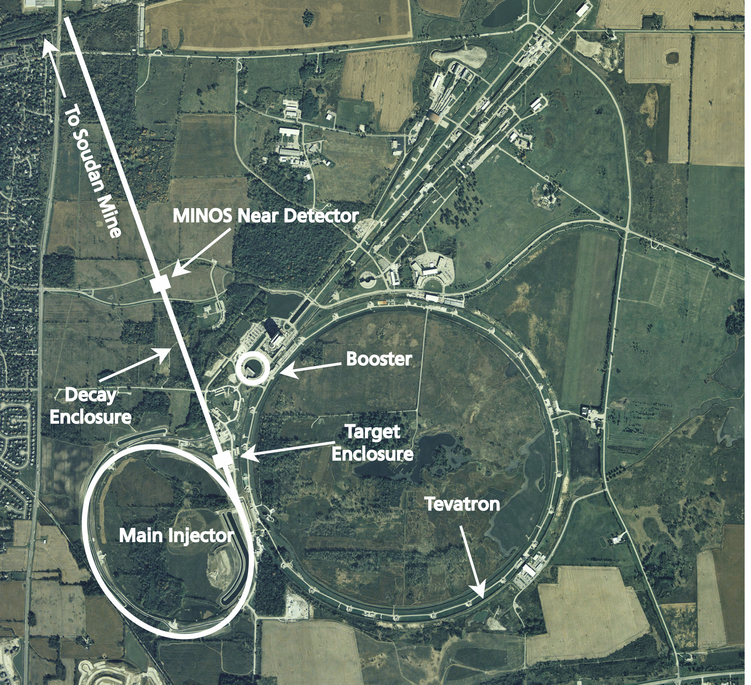
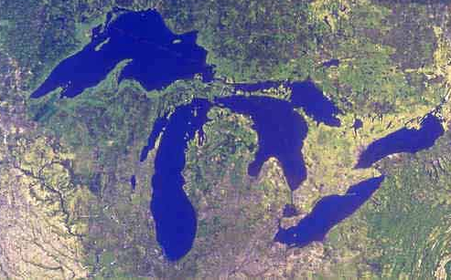
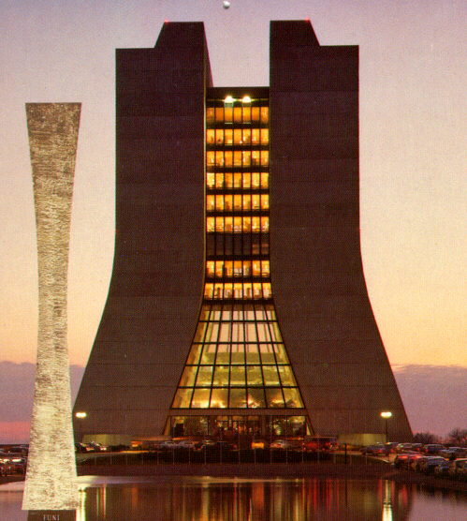
MINOS
Second generation long-baseline neutrino oscillation expt. (after K2K)
Neutrino beam from 120 GeV protons from the Fermilab Main Injector
Two detectors
  1000 ton NEAR detector at Fermilab, 1km from beam
  5400 ton FAR detector, 735km from beam in the Soudan mine
Soudan Mine,
Minnesota
735 km
Fermilab

Slide 25
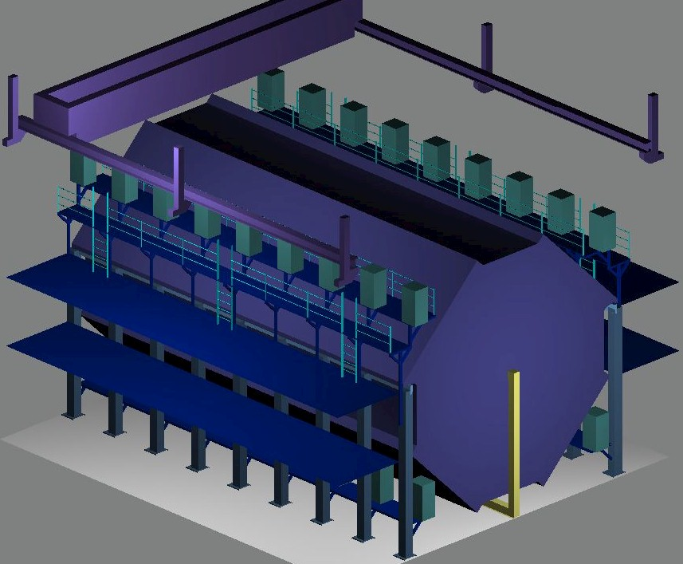
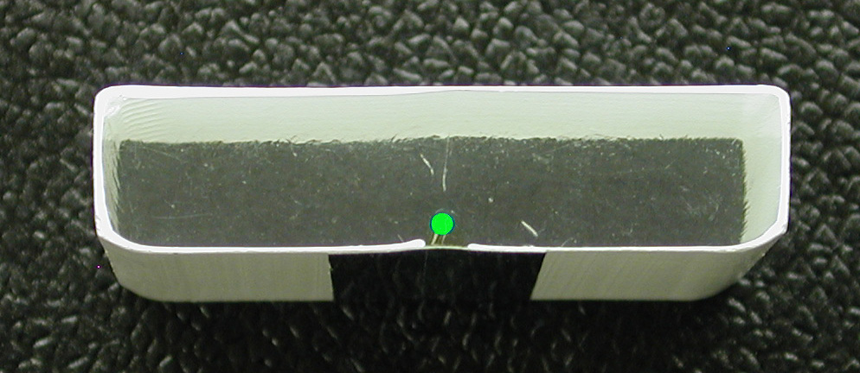
MINOS Detector
Fairly simple concept – for mass
8m octagonal steel and scintillator tracking calorimeter
  2 sections of 15m in length
  484 planes of steel and scintillator
  2.54 cm (1”) steel + 1 cm scintillator strips of 4cm width
  Alternate planes with orthogonal trip orientations to give 3D tracking
  Magnetised with a central coil
One Supermodule of the Far Detector…
Two Supermodules total.

Slide 26
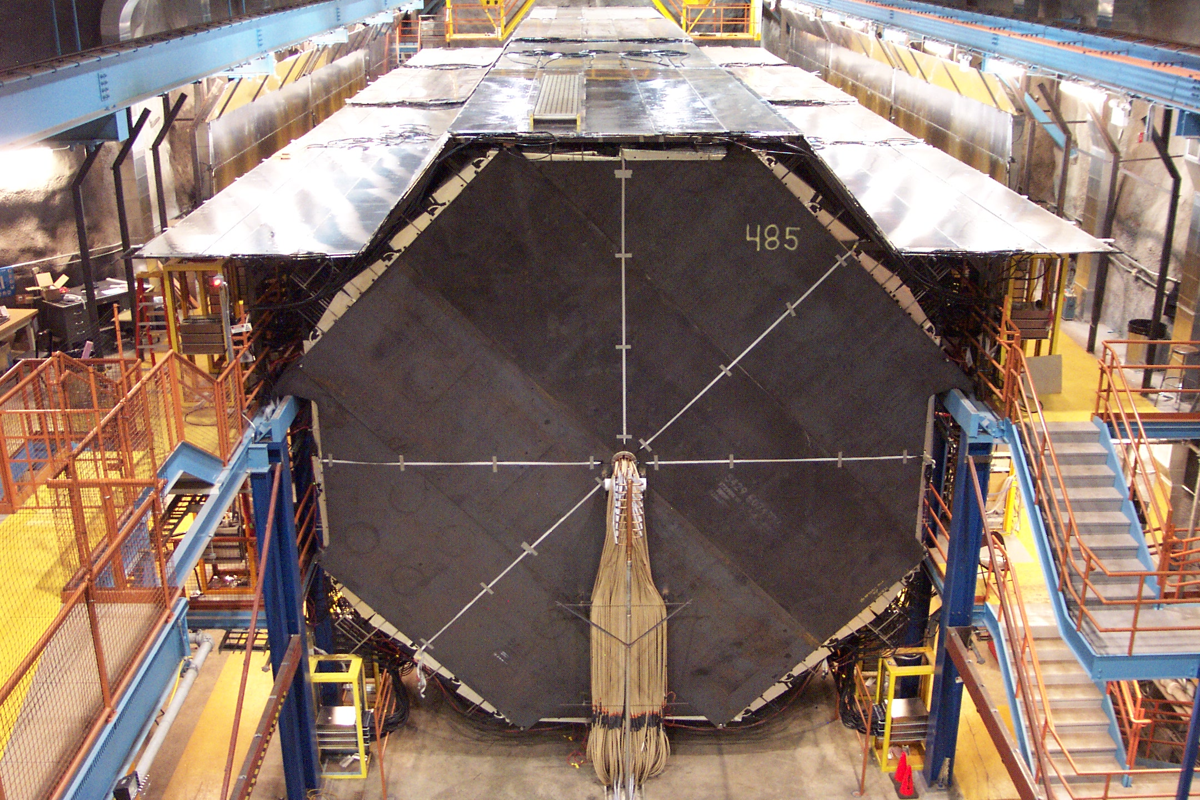
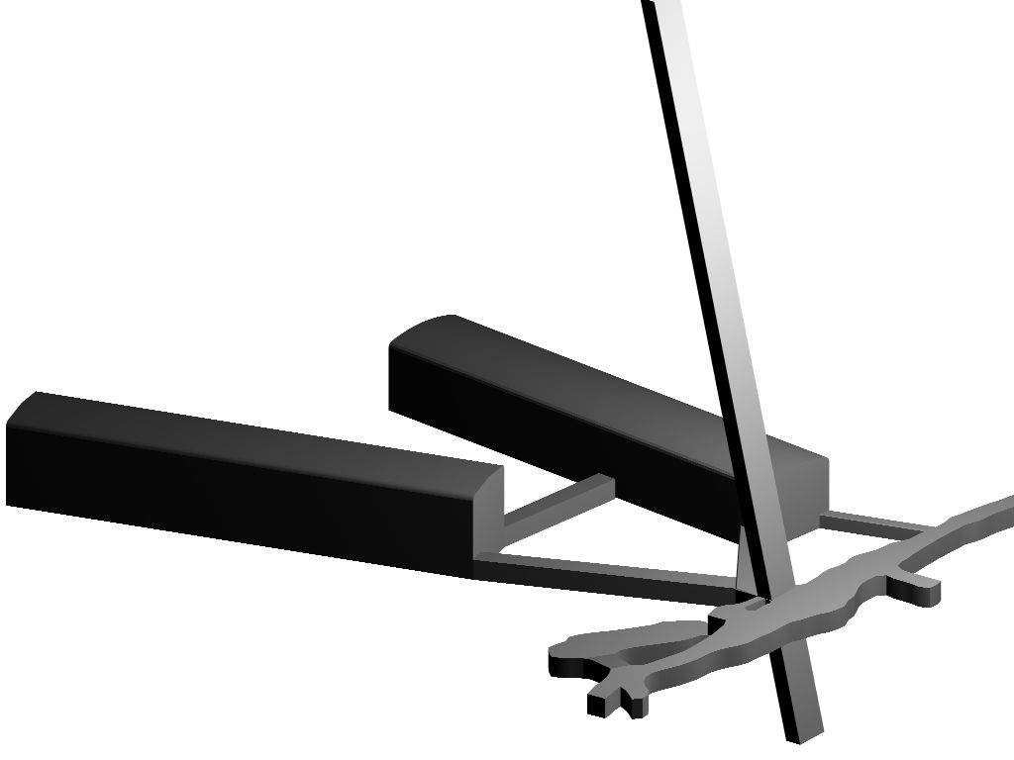
MINOS: 2003 - 2016
Veto Shield
Soudan 2
MINOS
Coil

Slide 27
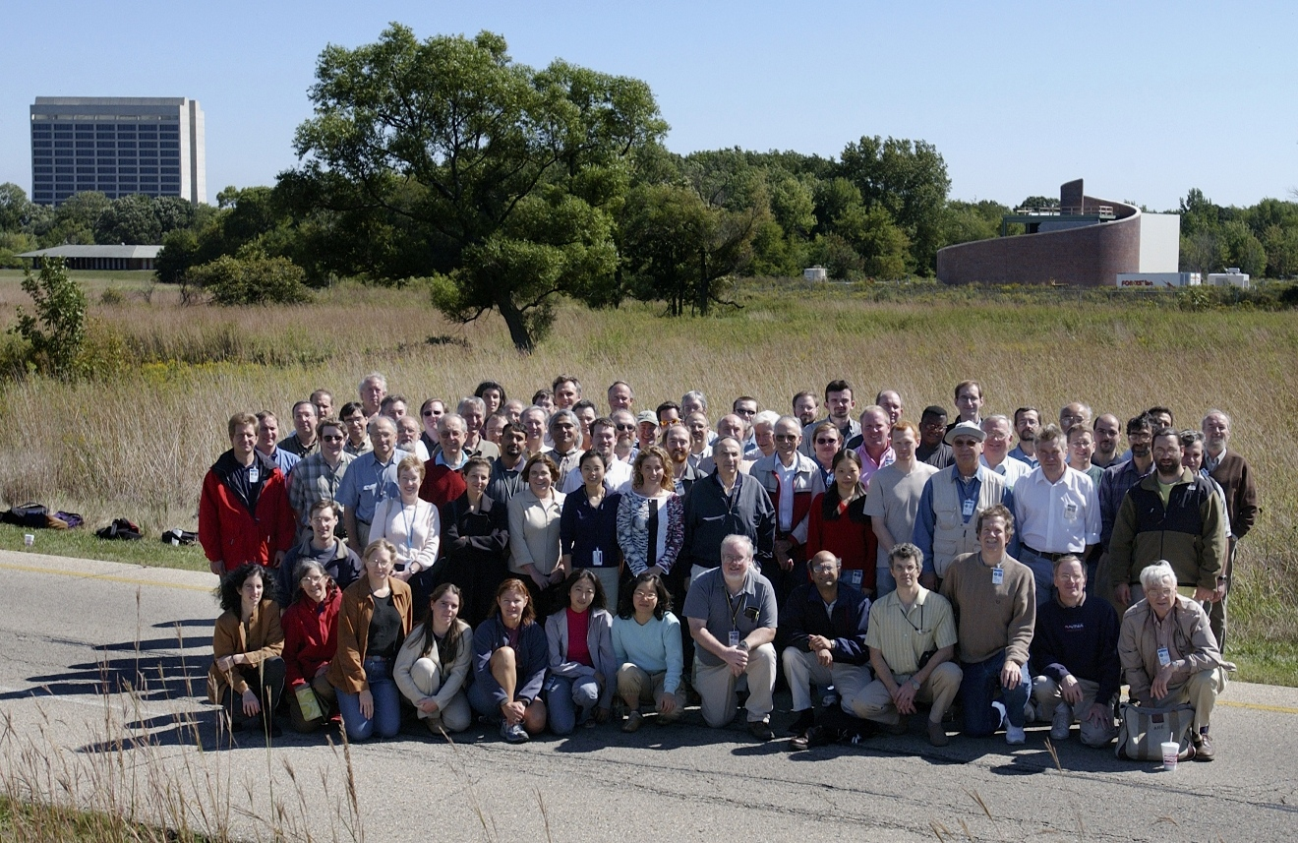




MINOS and the UK
The UK was a major player in MINOS
Soudan 2 collaborators (Oxford and RAL) were joined by Sussex and UCL
and Cambridge in 2000, when I returned from my sabbatical from neutrinos at CERN
in parallel with T2K, this was the start of a major uplift in neutrino physics in the UK
27 institutions
175 scientists
Argonne • Athens • Benedictine • Brookhaven • Caltech • Cambridge • Campinas . Fermilab • Harvard • IIT • Indiana
Minnesota-Twin Cities • Minnesota-Duluth • Oxford • Pittsburgh • Rutherford
Sao Paulo • South Carolina • Stanford • Sussex • Texas A&M
Texas-Austin • Tufts • UCL • William & Mary

Slide 28
The Legacy of MINOS and Soudan
The strong engagement of the UK in MINOS underpinned the UK’s involvement in the future US neutrino programme: LBNF/DUNE
Around 2013 a few of us, including myself and colleagues from Oxford, were starting to a look beyond MINOS and in particular the Fermilab Liquid Argon TPC programme
  Oxford and Cambridge joined MicroBooNE in 2013
  The UK DUNE consortium formed ~2014
  In 2015 was elected as one of the first co-spokespersons of DUNE
  In 2017, Minister Joe Johnson signed the UK – US Science and Technology collaboration framework and announced the UK government investment of £65m in LBNF/DUNE
Today the UK is a major partner in the ~$3Bn LBNF/DUNE project
  along with Hyper-K and other investments, neutrino physics in the UK has never looked so exciting

Slide 29
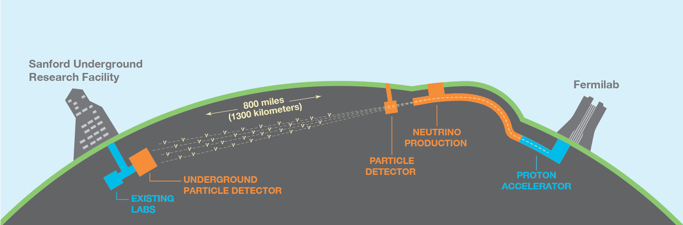
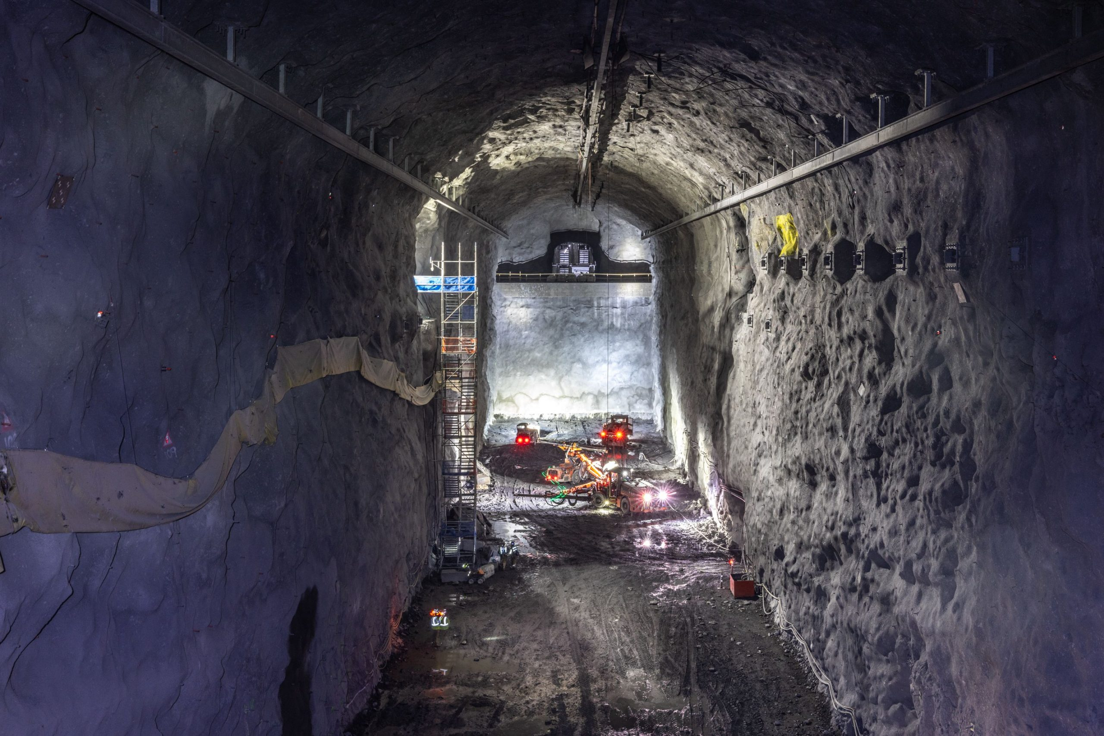
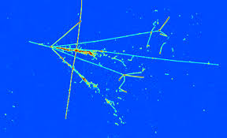
Looking to the future: DUNE ~2030-
The MW+ class neutrino beam from Fermilab to South Dakota
Excavation of caverns to host the DUNE detectors is complete
  Each of the four large caverns will (ultimately?) host the vast 17000 ton liquid argon TPCs
  Image neutrino interactions in exquisite

Slide 30
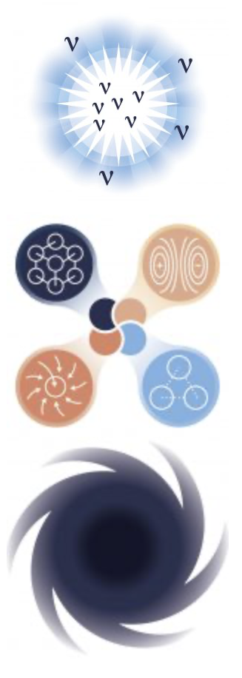
DUNE Physics Headlines
Three top-level scientific goals:
Origin of Matter: Neutrino Oscillations: determine the mass hierarchy and discover CP violation in the neutrino sector
Unification of Forces: Search for and hopefully discover proton decay – coming full circle back to the early days of Soudan
Black Hole Formation: Observe thousands of neutrinos from a galactic supernova, probing the process of stellar collapse, neutron star formation and maybe even black hole formation

Slide 31
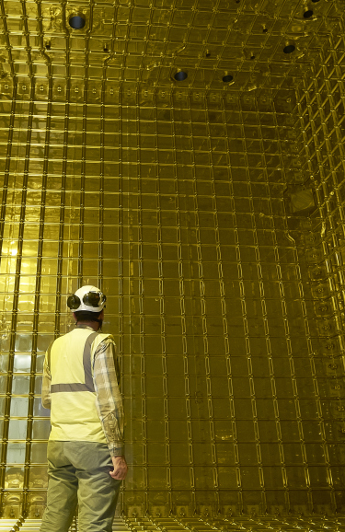
Closing thought
The early pdk experiments have left a massive legacy in the UK
Don was a major part of this story

