Slide 1
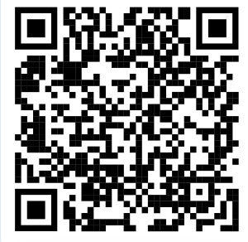
SCALES Code of Conduct
Respect & inclusivity: foster a safe, welcoming, and inclusive environment across all identities and career stages.
Constructive communication: critique ideas, not people; encourage open dialogue, active listening, and equal participation.
Scientific integrity: ensure proper credit, avoid plagiarism or data falsification, and use shared resources responsibly.
Responsibility & professionalism: act ethically, respect confidentiality, and handle conflicts with civility.
Zero tolerance for misconduct: no harassment, discrimination, abuse of resources, or scientific malpractice.
Points of Contact available: designated WG representatives and the EDI Coordinator handle concerns confidentially and fairly.
Point of Contacts present at this event: …

