Slide 1


WG4
THE BIGGER PICTURE – EDI & OUTREACH ACROSS THE COMMUNITY
Group report
Melissa Mendes & Andrea Richaurd

Slide 2



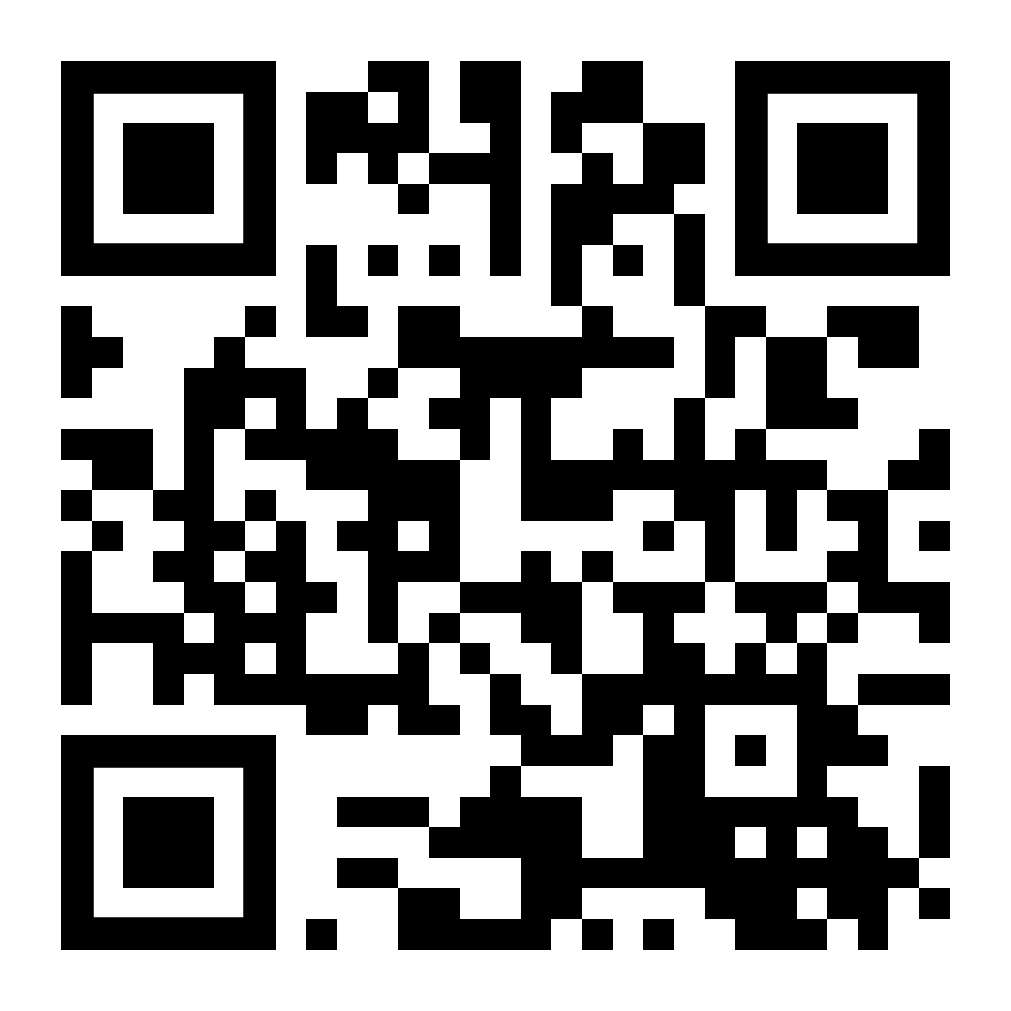
WG4 mission
Completed activities
Ongoing activities
Future activities
Get involved!
WG4 membership: https://e-services.cost.eu/action/CA24139/working-groups/apply
WG4 mailing list: https://groups.google.com/g/scales-wg4
contact: melissa.mendes@tu-darmstadt.de, andrea.richaud@upc.edu
1

Slide 3
WG4 mission
Equity, diversity, and inclusion
  Build a visible, inclusive, and connected community across Europe
Outreach and public engagement
  Integrate the cold atoms, helium and neutron star groups with a shared language
Support for early career researchers
WG4 membership
WG4 mailing list
2

Slide 4
Completed activities
Code of conduct drafting and implementation
Point of contact training
Support in website creation (https://camk.pl/SCALES/index.html)
Hiring graphic designer for logo development
Practical support for EDI and outreach presence in events
WG4 membership
WG4 mailing list
3

Slide 5
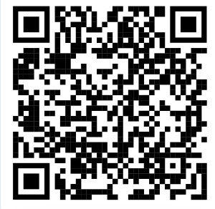
SCALES Code of Conduct
Respect & inclusivity: foster a safe, welcoming, and inclusive environment across all identities and career stages.
Constructive communication: critique ideas, not people; encourage open dialogue, active listening, and equal participation.
Scientific integrity: ensure proper credit, avoid plagiarism or data falsification, and use shared resources responsibly.
Responsibility & professionalism: act ethically, respect confidentiality, and handle conflicts with civility.
Zero tolerance for misconduct: no harassment, discrimination, abuse of resources, or scientific malpractice.
Points of Contact available: designated WG representatives and the EDI Coordinator handle concerns confidentially and fairly.
Point of Contacts present at this event: Marco Antonelli, Bryn Haskell, Gary Liu, Melissa Mendes, Armin Vahdat
https://camk.pl/SCALES/code-of-conduct.html

Slide 6
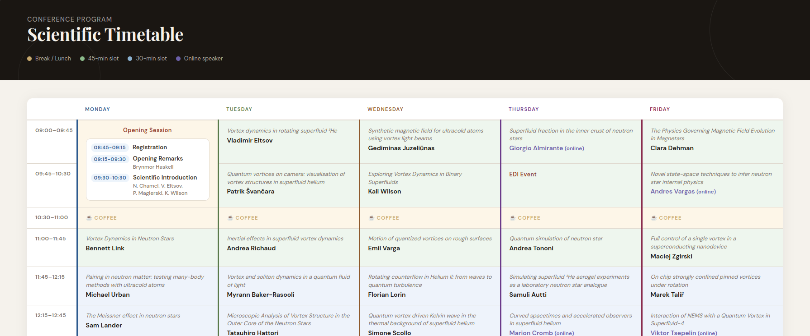
EDI and outreach in events
For example in WG1
WG4 membership
WG4 mailing list
4

Slide 7
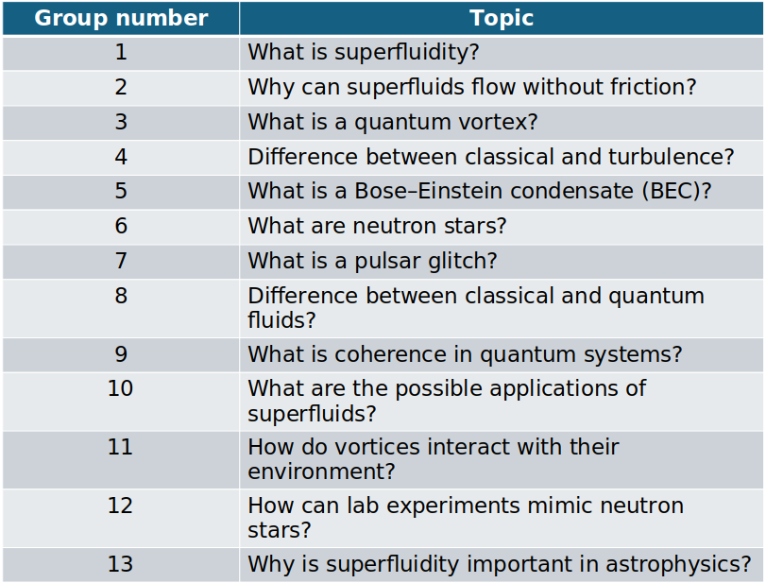
For example WG1 meeting
Work in small groups to create one single slide to explain a topic to a general audience.
Your slide should include:
One clear idea
Very little text
At least one visual (sketch, diagram, etc)
WG4 membership
WG4 mailing list
5

Slide 8
Ongoing activities
Building a database of EDI/outreach speakers for future events
Building a database of facilitators and workshop moderators (outreach/support early career researchers)
Support material for organizers regarding code of conduct violations and reports
WG4 membership
WG4 mailing list
6

Slide 9
Ongoing activities
Yearly meeting of point of contact volunteers
Support to a shared cloud, members-only, area within the website
Development and dissemination of educational material
WG4 membership
WG4 mailing list
7

Slide 10
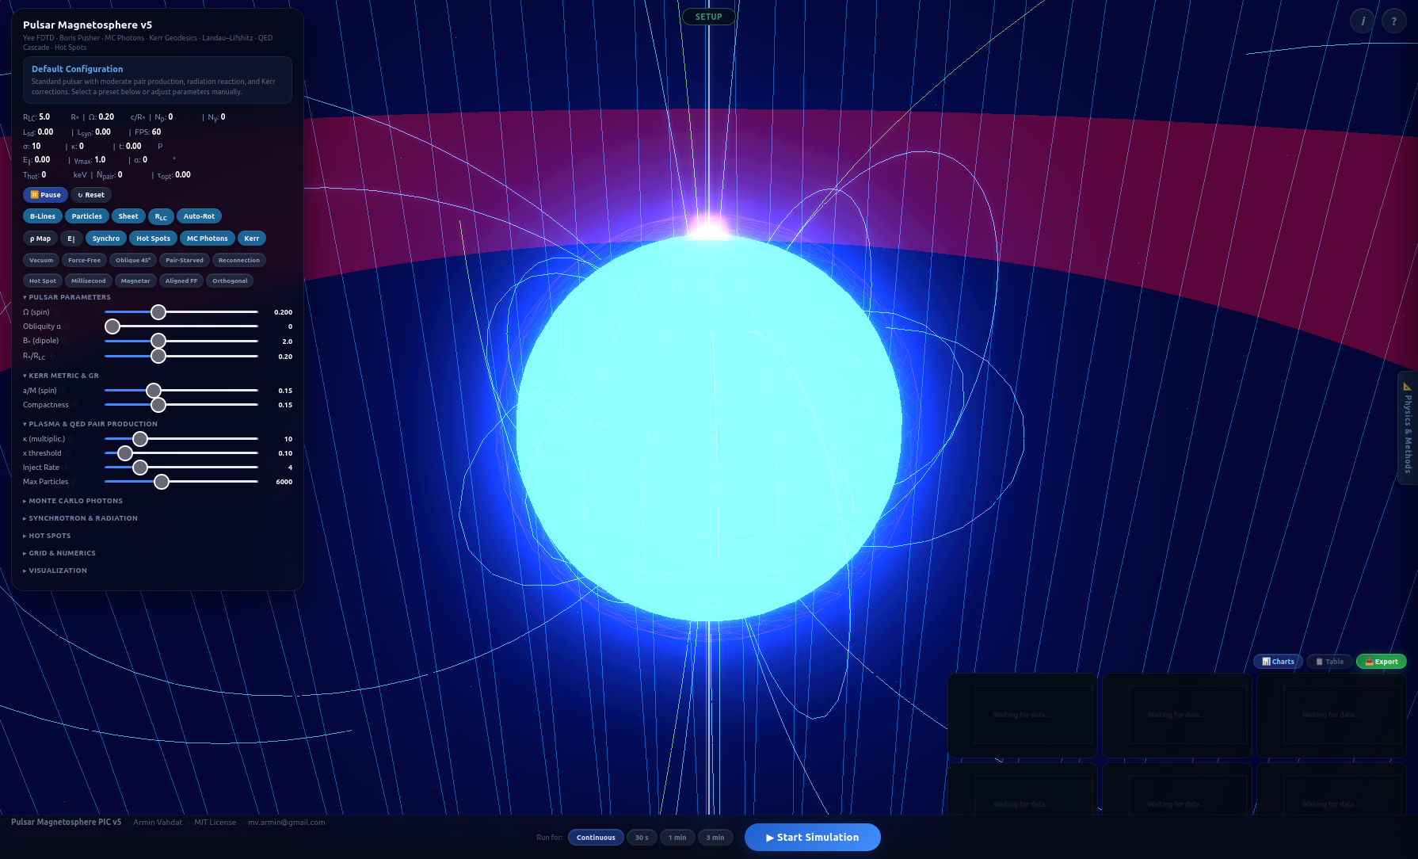
Interactive Pulsar Magnetosphere Simulation
by Armin Vahdat, https://pulsarpic.netlify.app/
interactive, browser-based simulation of a pulsar magnetosphere, intended mainly for outreach and teaching
WG4 membership
WG4 mailing list
8

Slide 11
Future activities
Expand the database of speakers and facilitators for future events
Development and dissemination of educational material
  Expand the website with links and external resources
Organize volunteers and share responsibilities
Creation and management of social media channels
WG4 membership
WG4 mailing list
9

Slide 12
Get involved!
WG4 membership: https://e-services.cost.eu/action/CA24139/working-groups/apply
WG4 mailing list: https://groups.google.com/g/scales-wg4
WG4 co-leaders: Melissa Mendes - melissa.mendes@tu-darmstadt.de
Andrea Richaud - andrea.richaud@upc.edu
1

