Slide 1
Beyond the thousands
Lessons from simulating a neutron star with 10⁵ quantized vortices
Part of the work done in collaboration with Prof. Ali M. Alpar and Dr. Erbil Gügercinoğlu
25 June, 2026
Coimbra, Portugal
Ananth
Ashoka University
Advised by
Prof. Dipankar Bhattacharya

Slide 2
Itinerary
What a neutron star is (not)
The heart of the computational setup
Enhancements to the setup
Applications

Slide 3
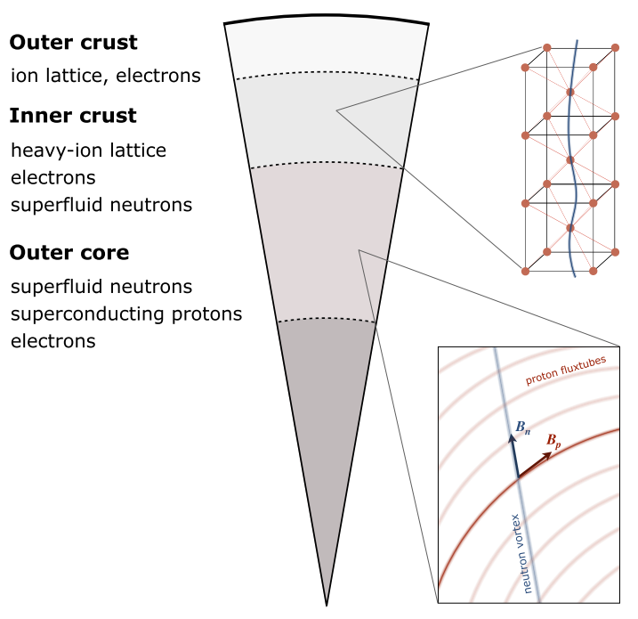
What a neutron star is (not)
Alpar (1989), Sauls (1989), Andersson et al. (2006)
Not a 2D slice
Not a neatly partitioned sphere
  Continuous difference in density
  Simplified to 4 layers of which 2 are relevant to glitches
  Inner crust has nuclear sites, electrons, and neutron superfluid (singlet)
  Outer core has superconducting protons and neutron superfluid (triplet)
  Rotating superfluids have quantized vortices
  Quantized vortices prefer some spatial regions over others
Does not contain an array of uniform straight vortices
Does not experience a constant spin-down torque
The neutron star superfluid is
a collection of 2D point vortices
in an environment with a greater number of pinning sites
acted upon by a constant external torque.
Antonopoulou et al. (2022)

Slide 4
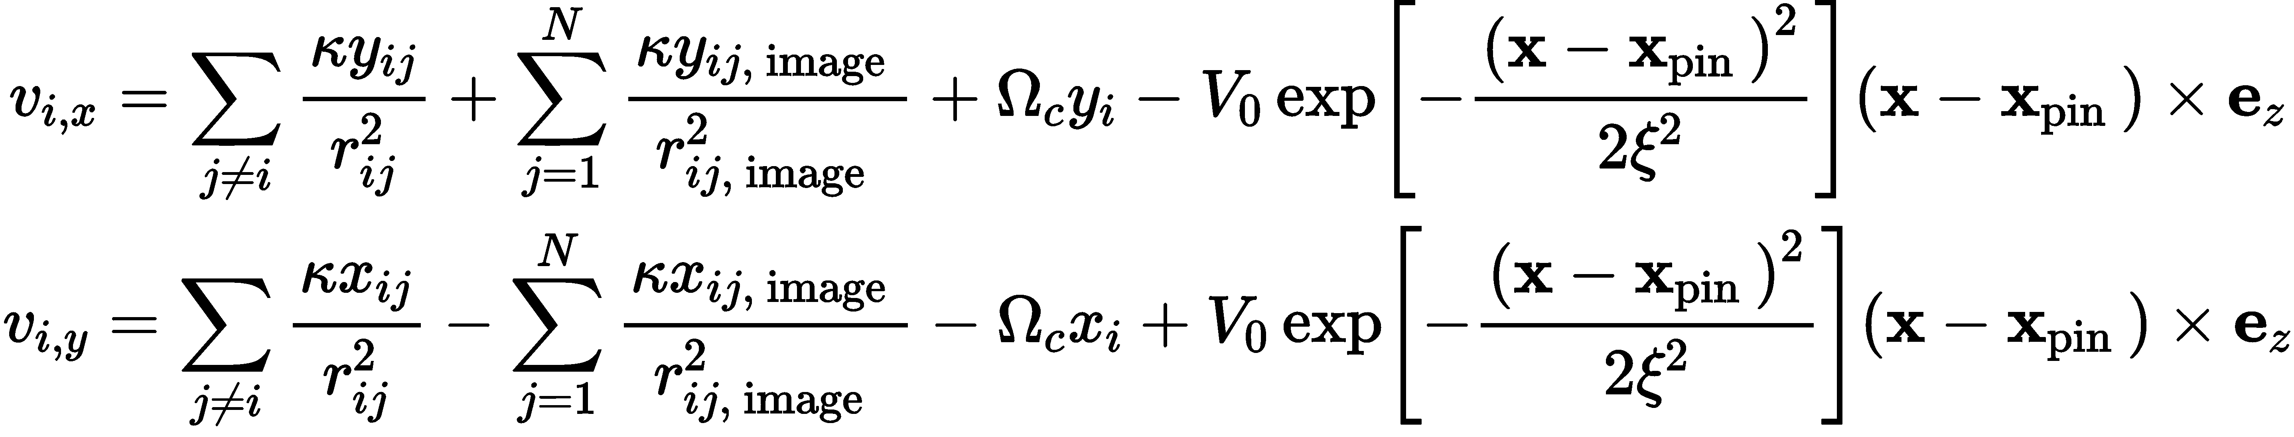
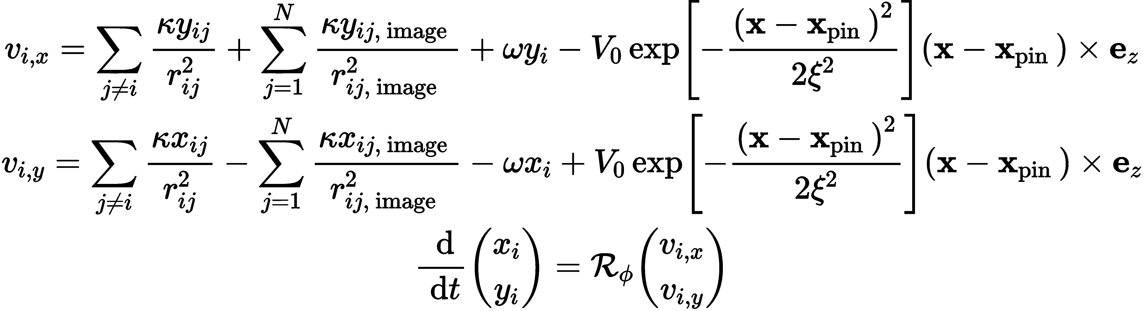
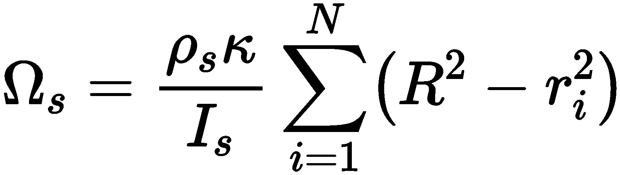
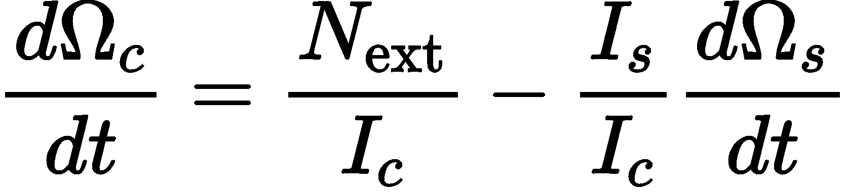


The heart of the computation
Howitt et al. (2020)
Equations of motion
Superfluid velocity
Conservation of angular momentum
Antonopoulou et al. (2022)

Slide 5
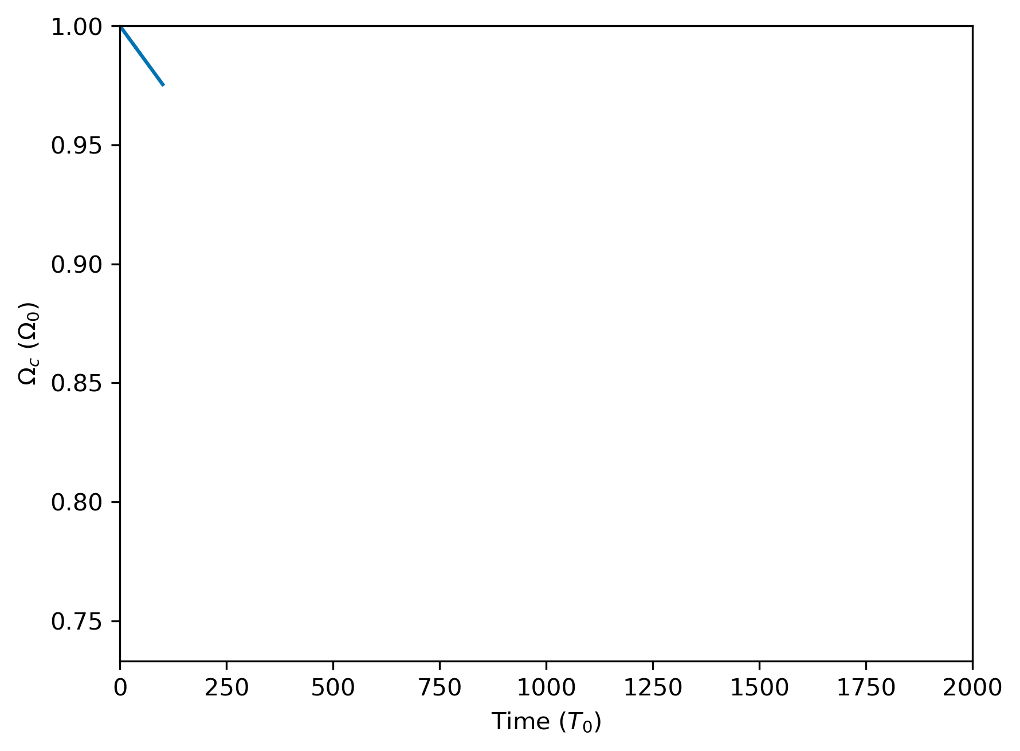
A pulsar slows down
Simulation

Slide 6
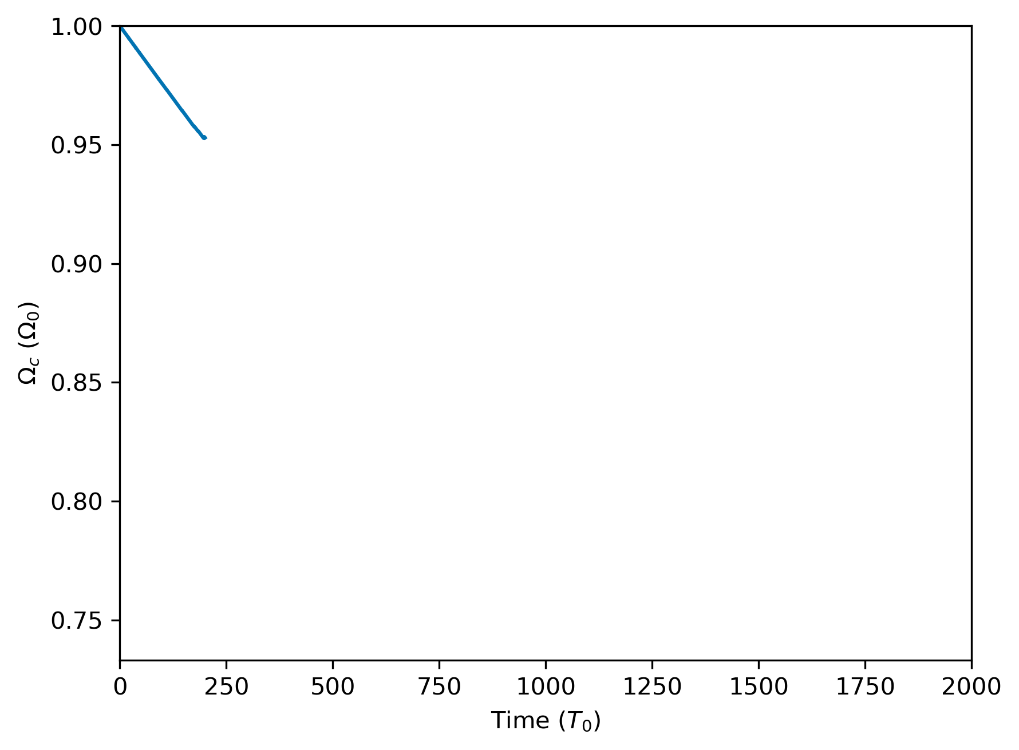
A pulsar slows down
Simulation

Slide 7
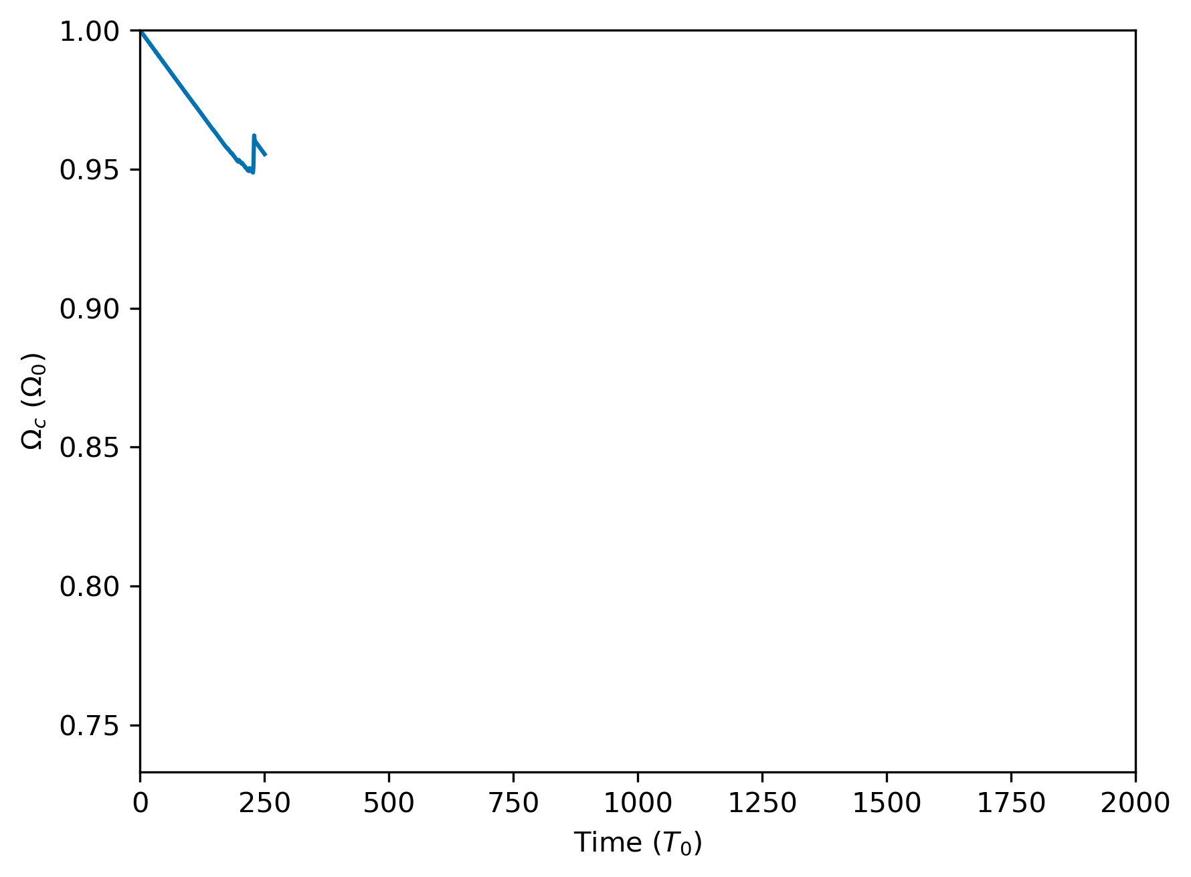
A pulsar slows down, speeds up
Simulation

Slide 8
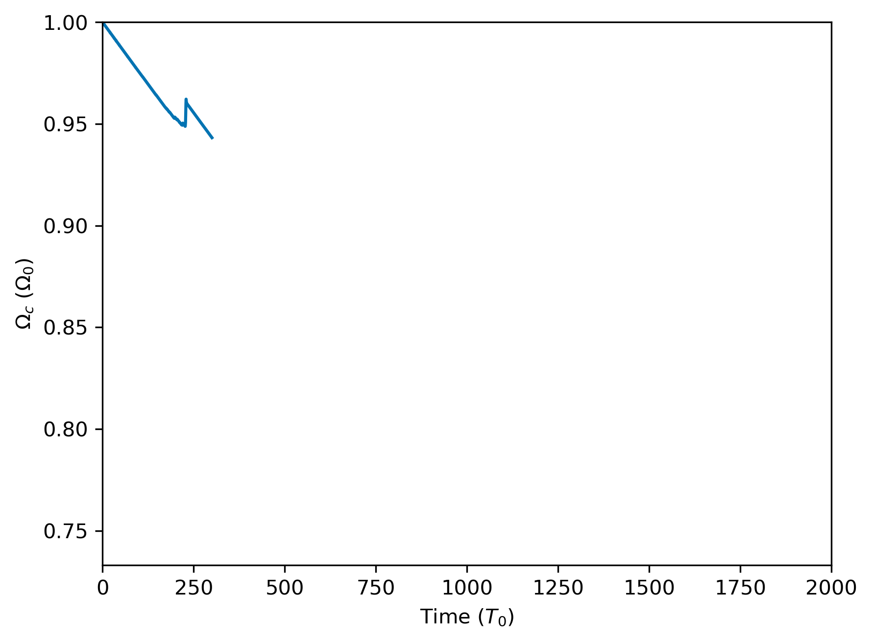
A pulsar slows down, speeds up, continues slowing
Simulation

Slide 9
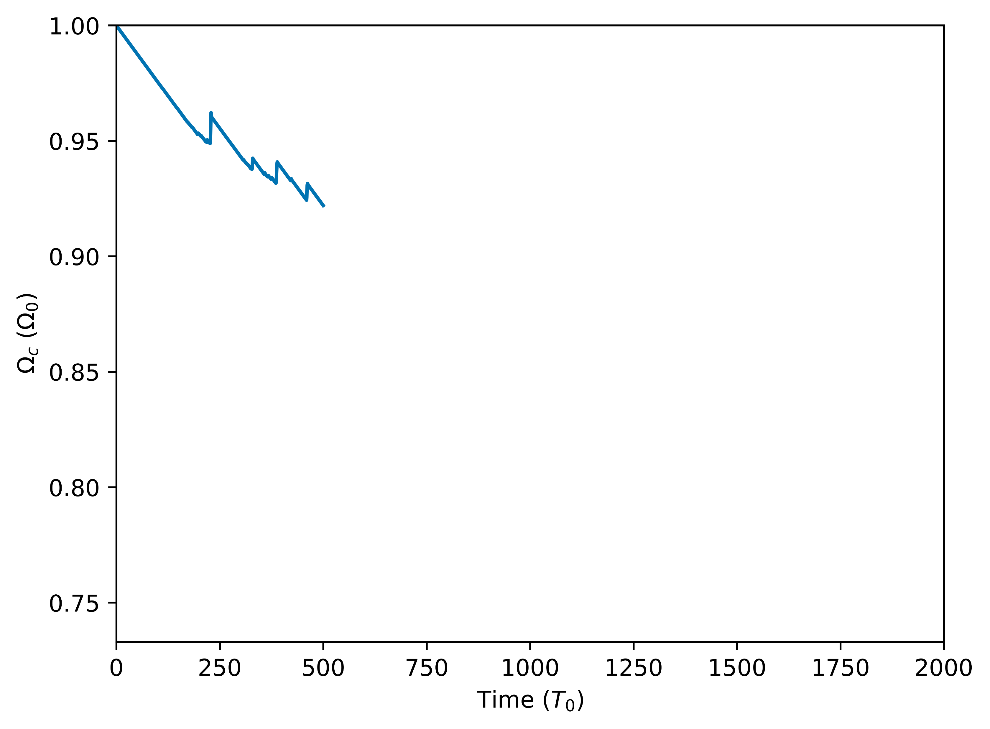
A pulsar slows down, speeds up, continues slowing, and repeats
Simulation

Slide 10
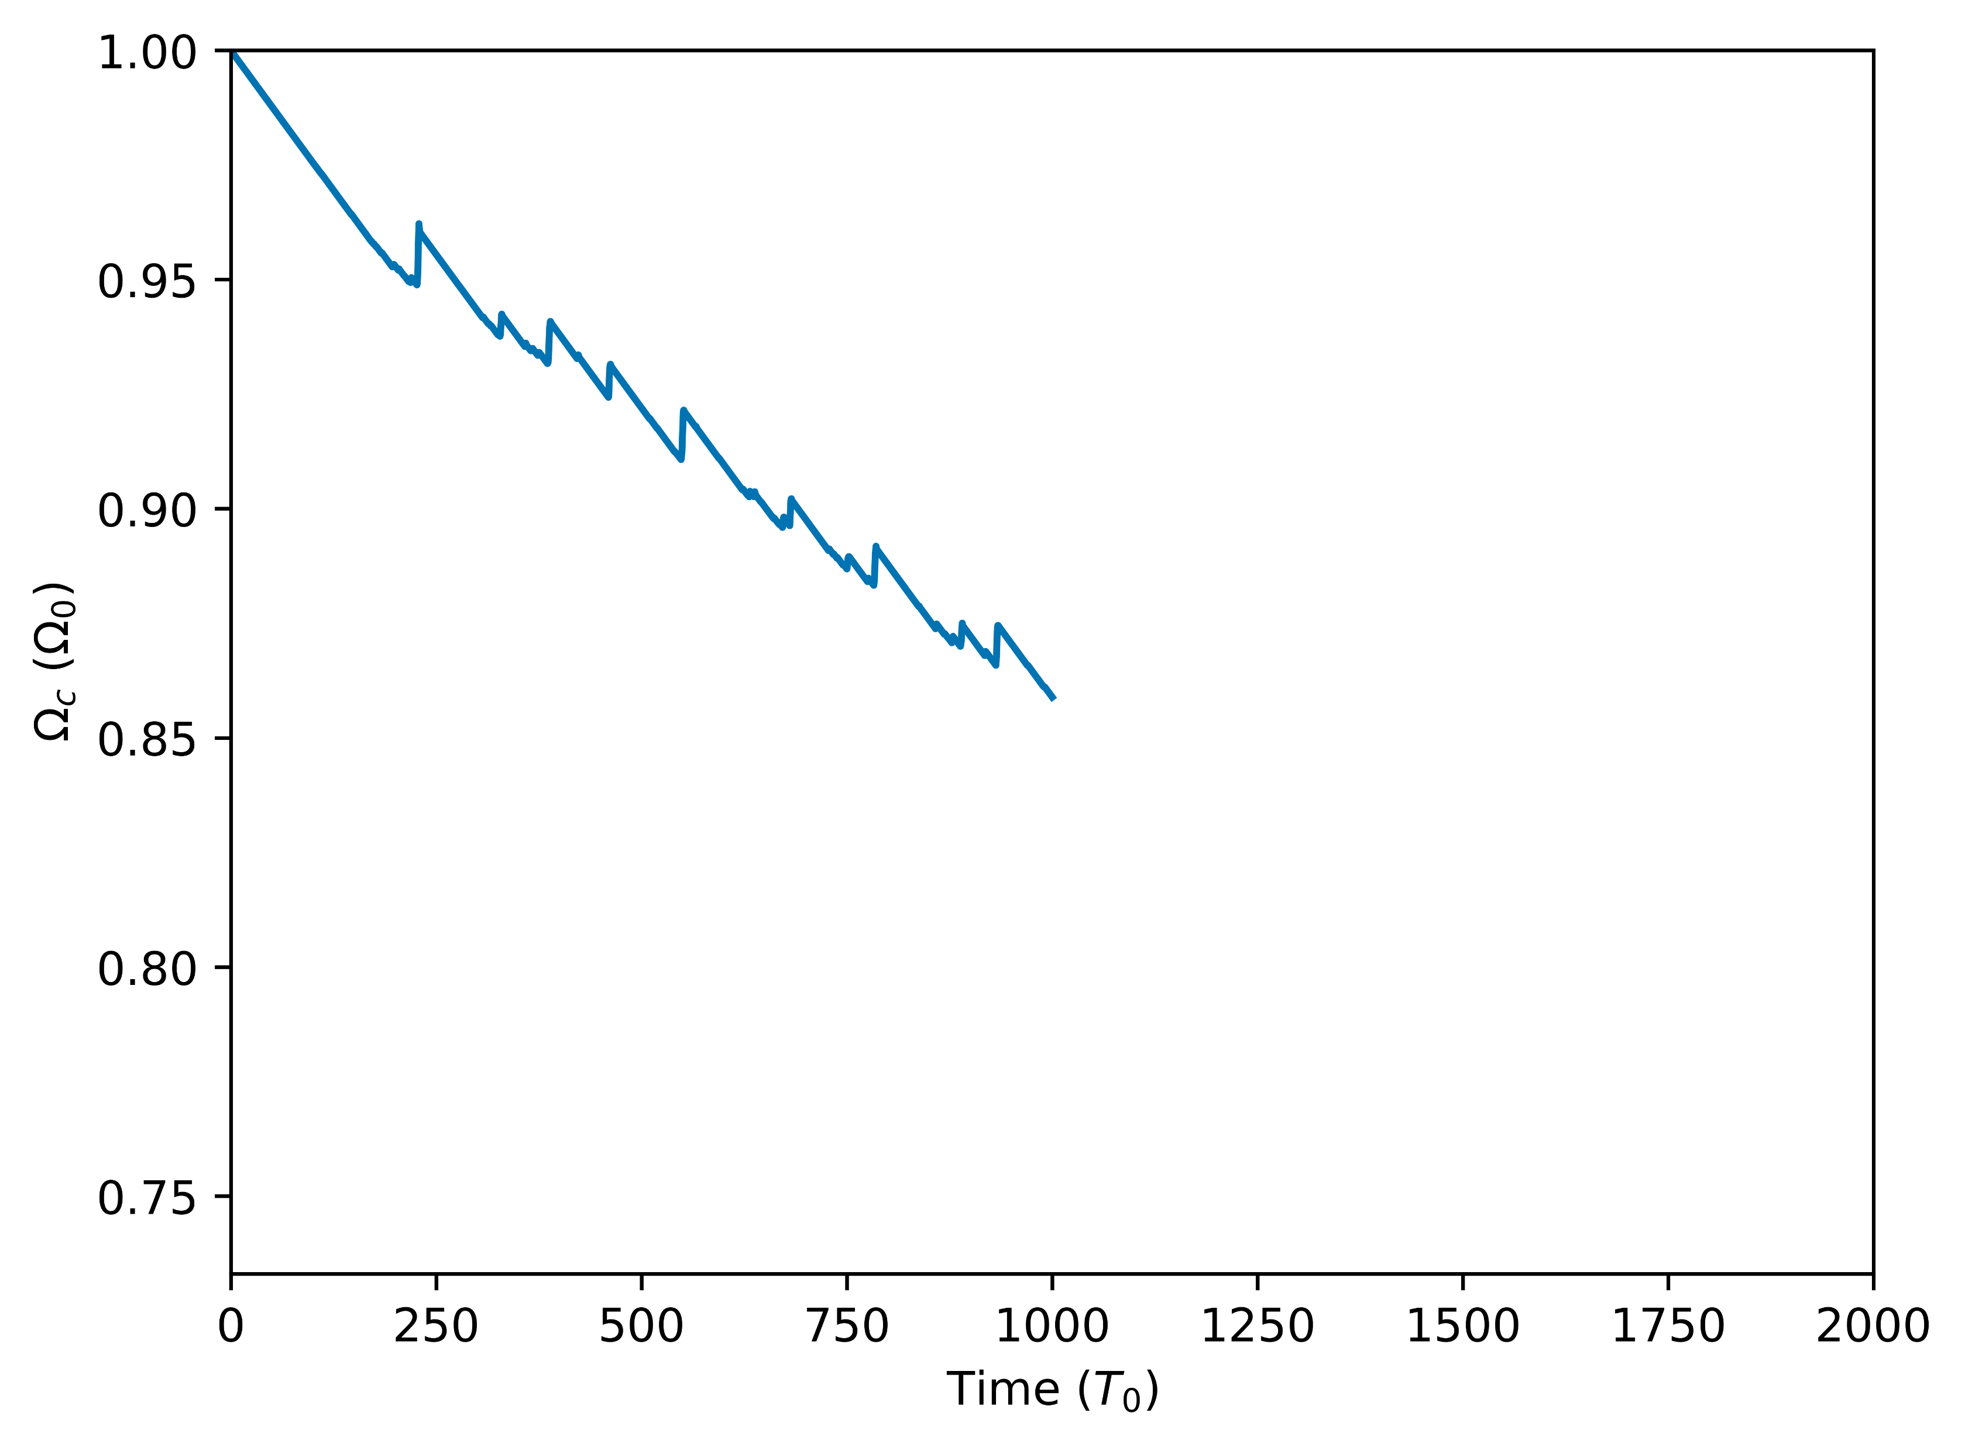
A pulsar slows down, speeds up, continues slowing, and repeats
Simulation

Slide 11
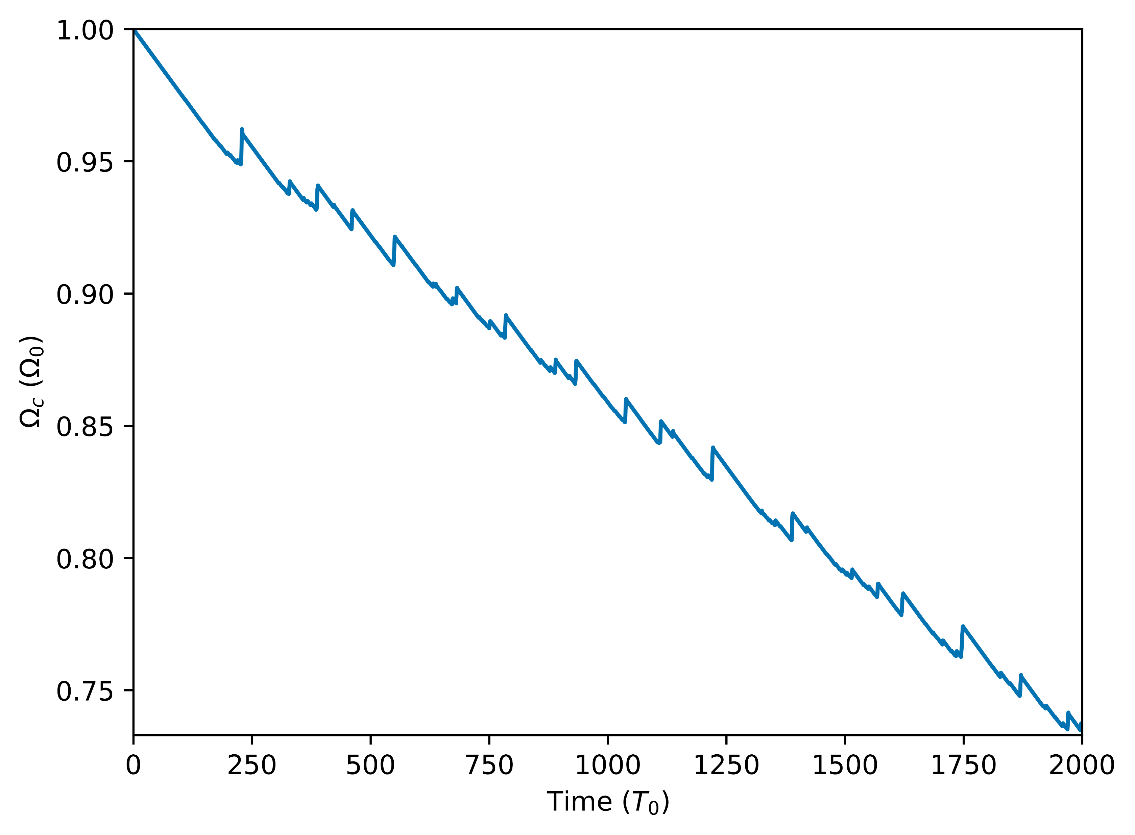
A pulsar slows down, speeds up, continues slowing, and repeats
Simulation

Slide 12
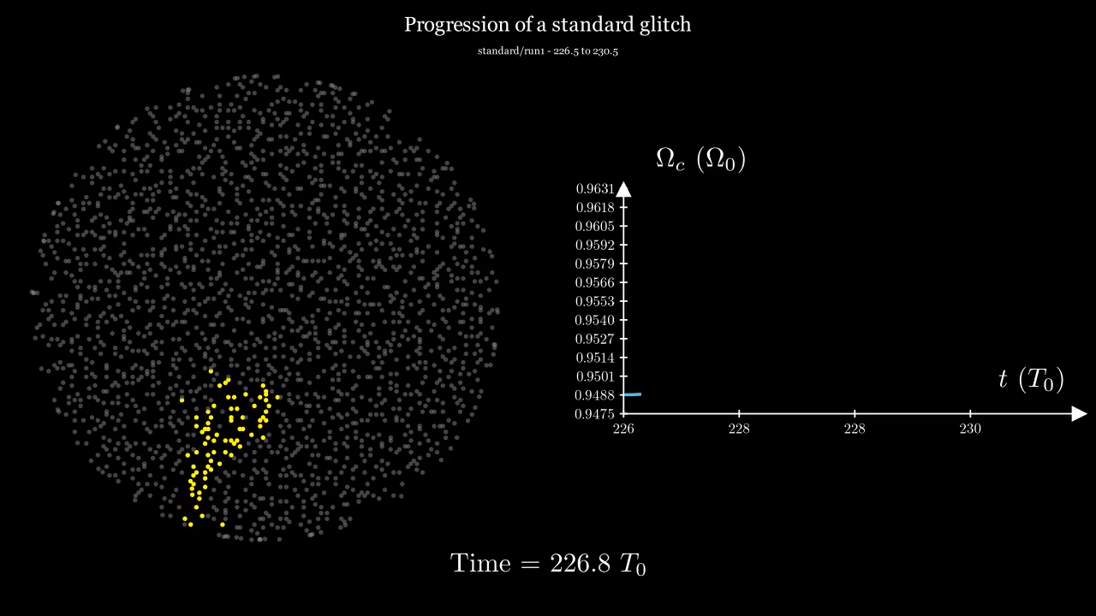

Slide 13
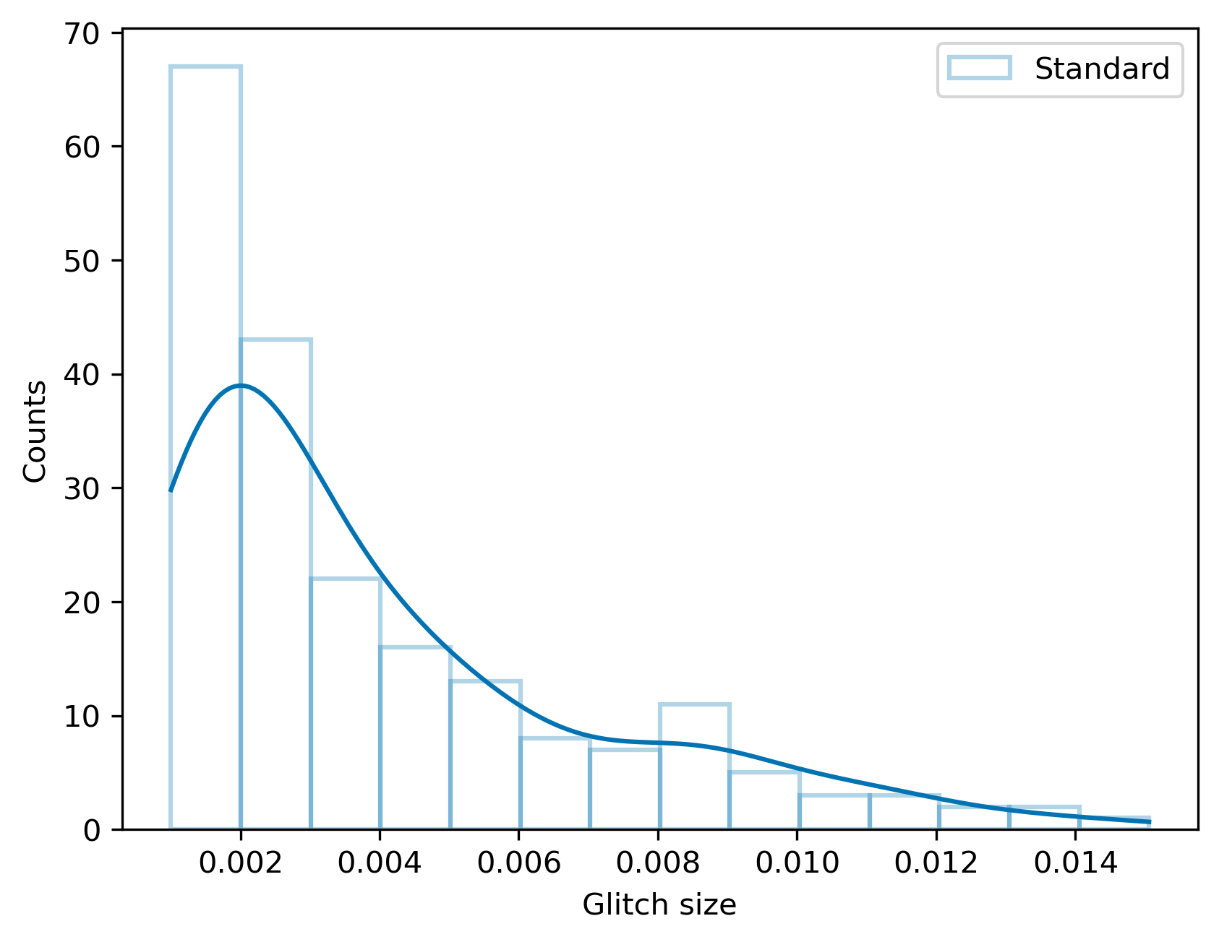
Glitch size
Simulation

Slide 14
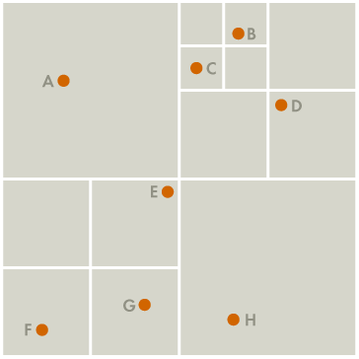
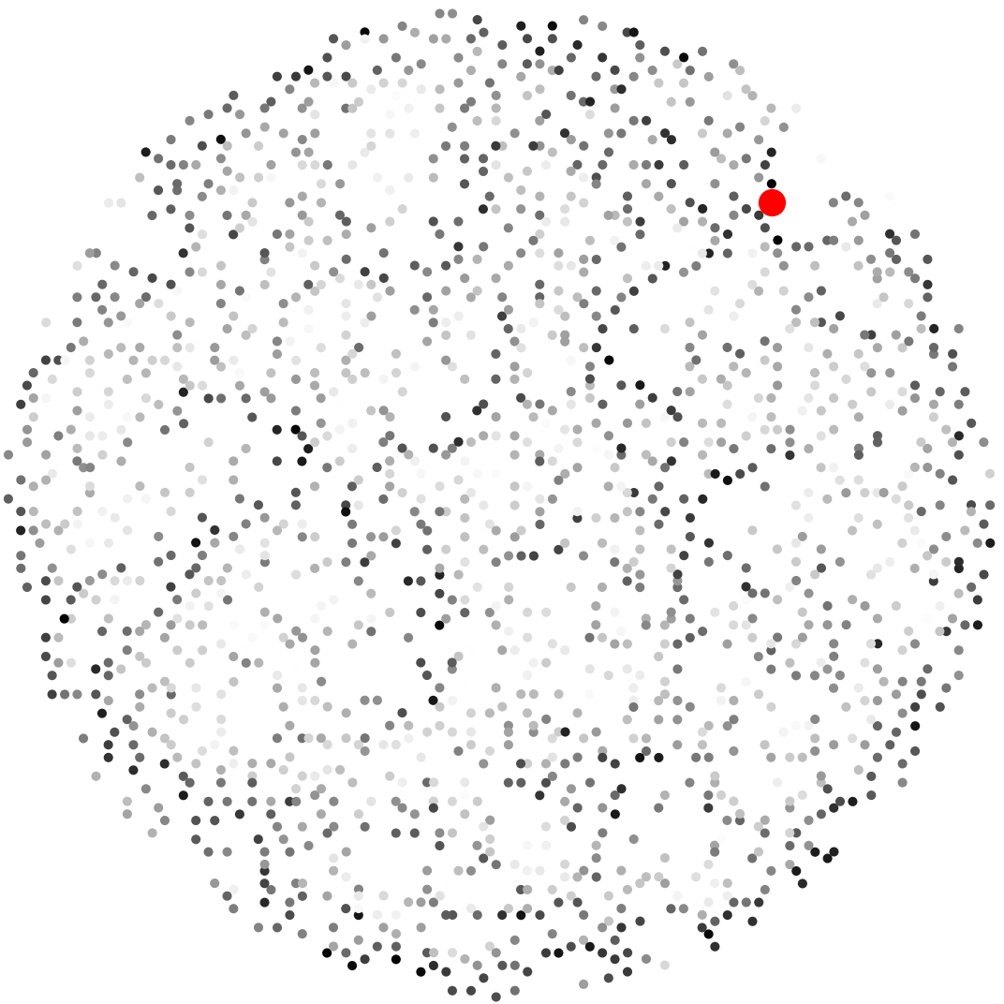
Barnes-Hut enhancement
Barnes et al. 1986
R
100.R

Slide 15
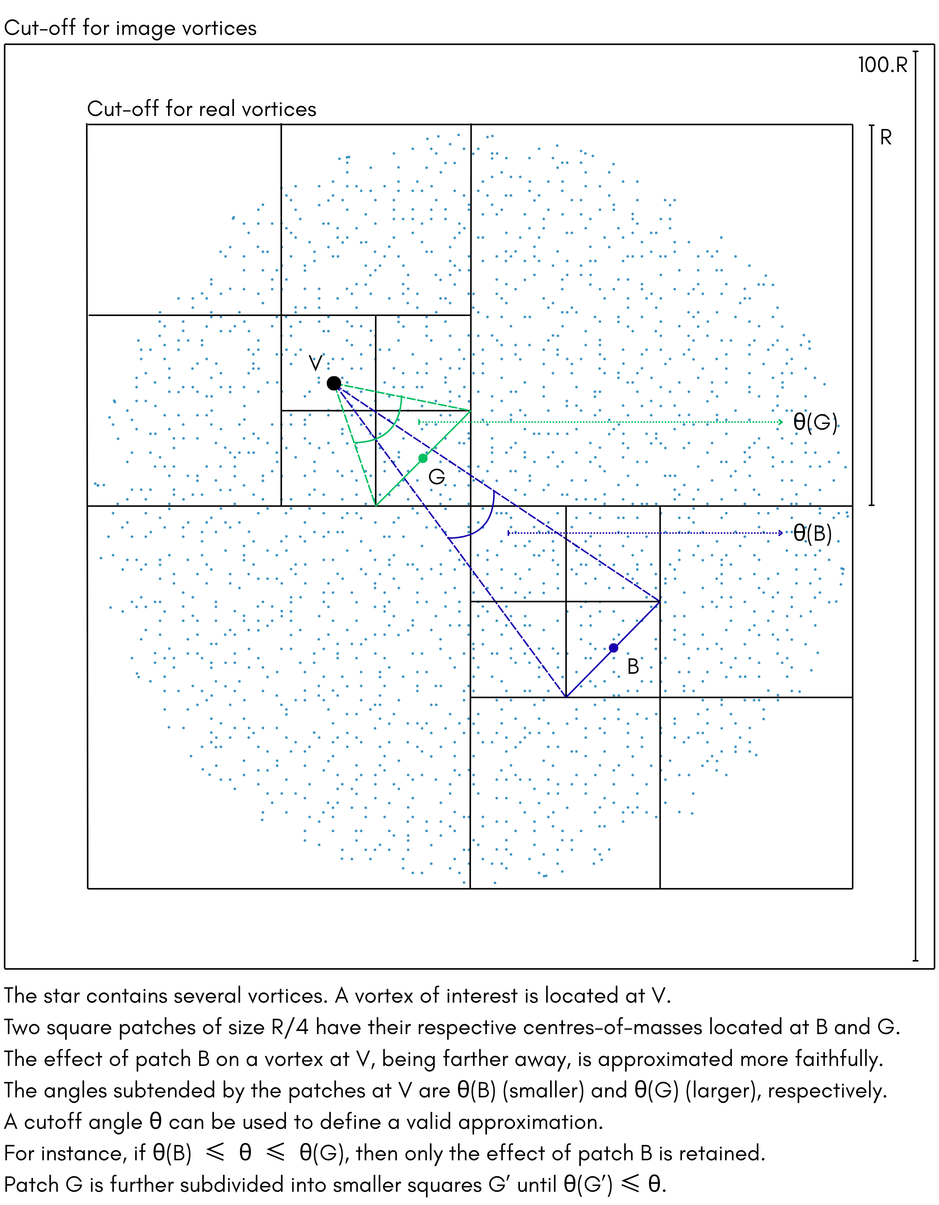
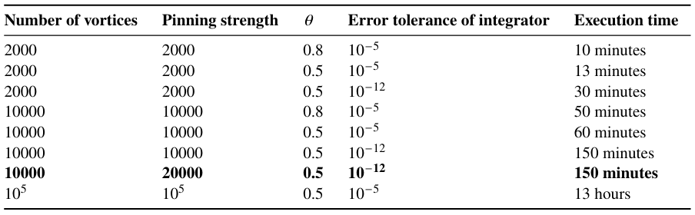
Barnes-Hut enhancement
Barnes et al. 1986
https://github.com/ananth-94/vortexsimulator

Slide 16
Vortex Traps

Slide 17
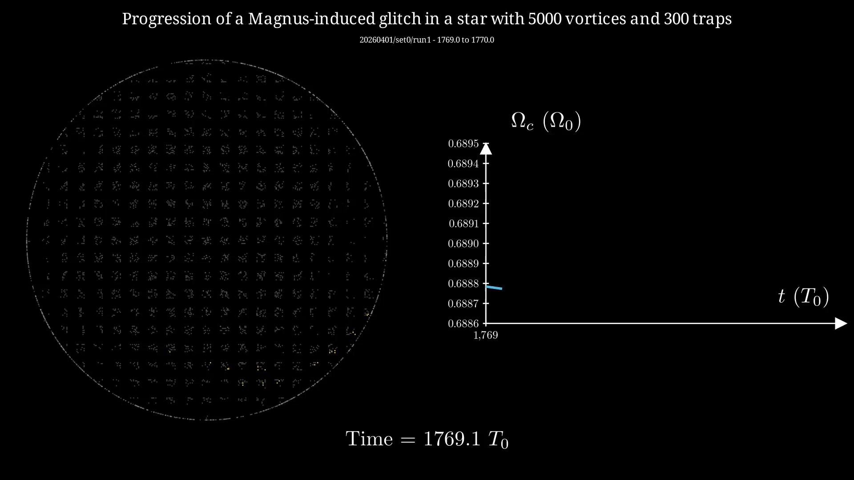

Slide 18


Slide 19
Array evolution

Slide 20
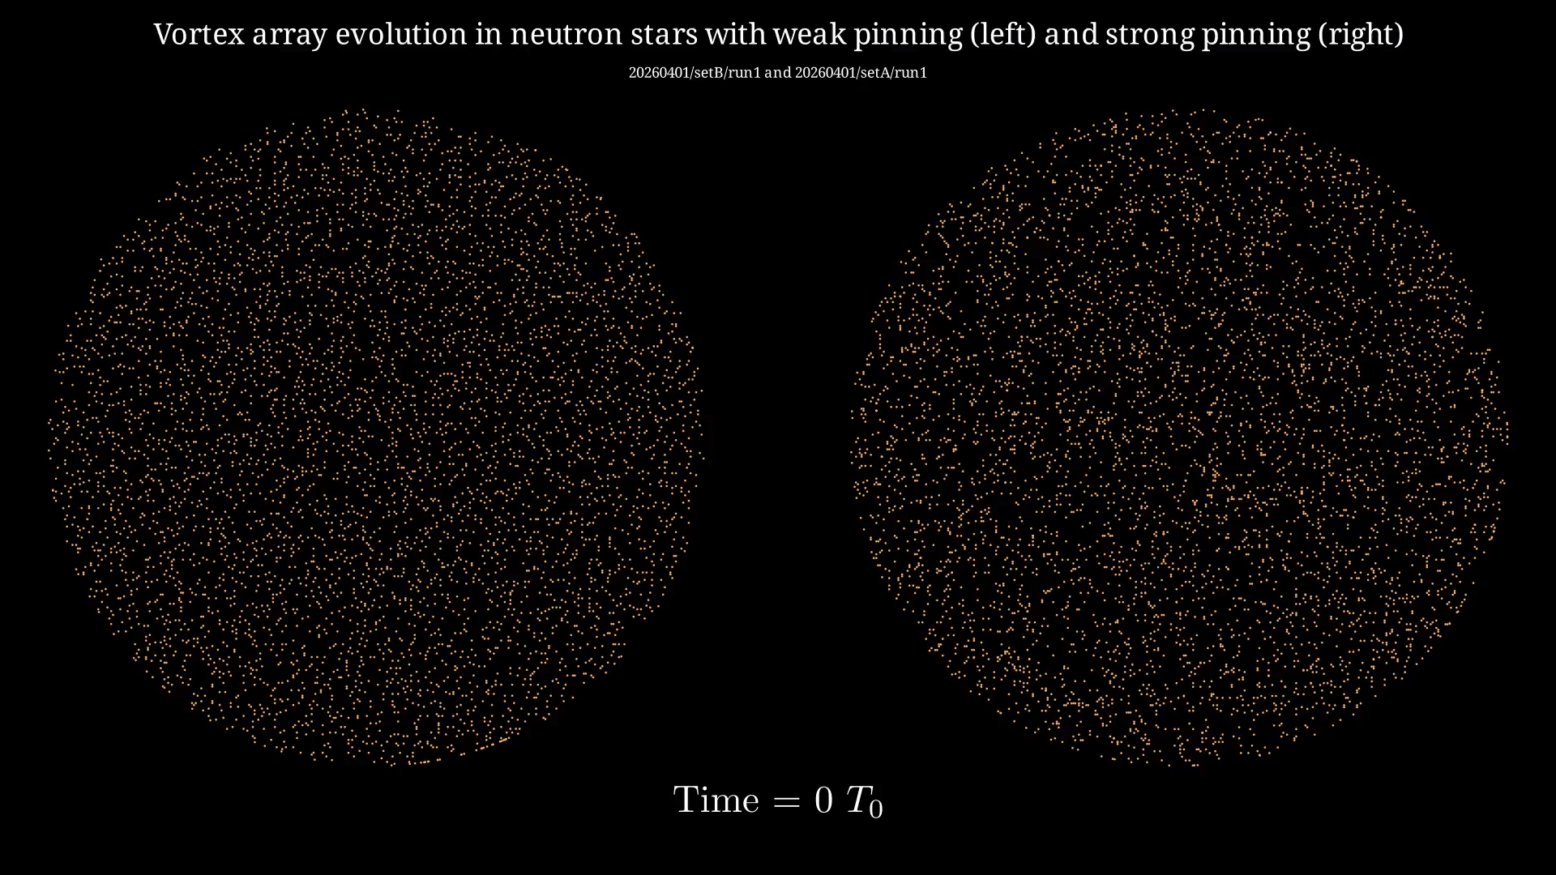

Slide 21
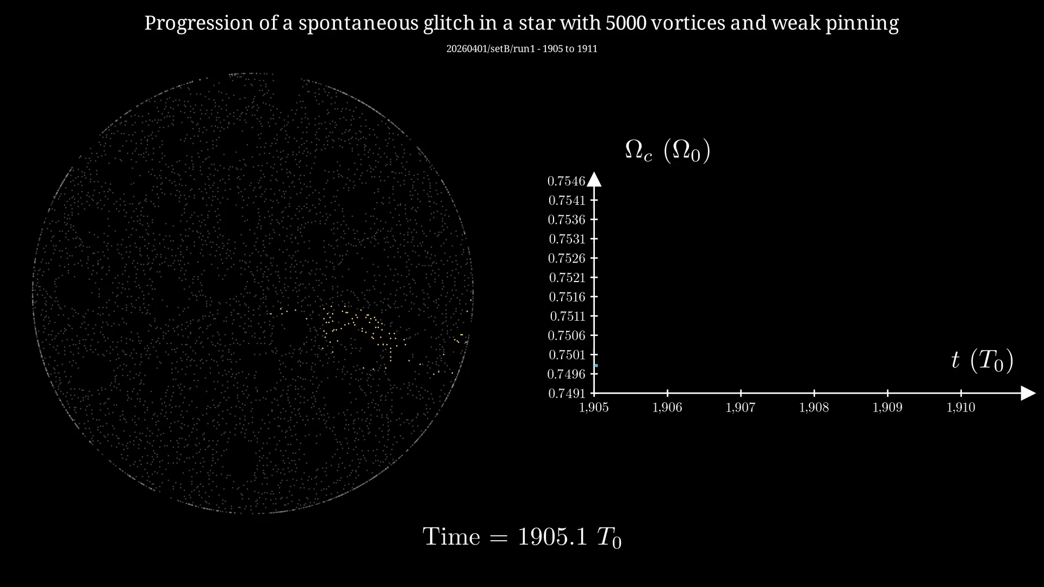

Slide 22
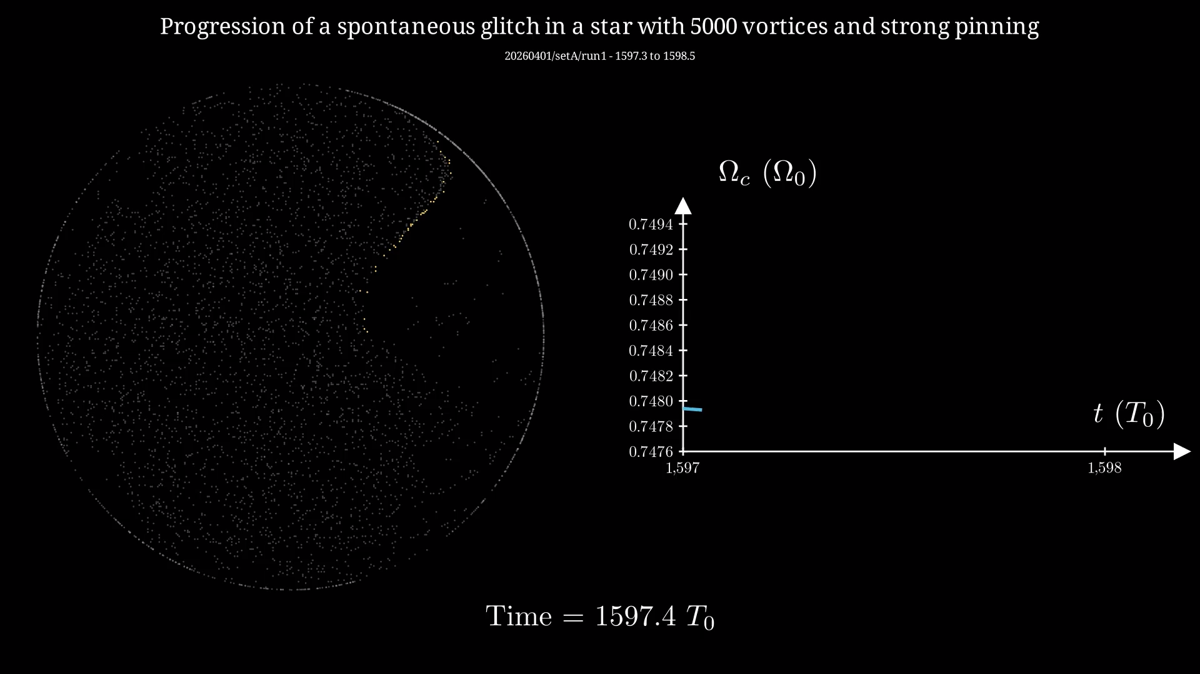

Slide 23
Thank you
A part of the work presented here soon to be available as pre-print
Pulsar glitches in the presence of vortex traps, TBD
The relevant codes are openly available at
https://github.com/ananth-94/vortexsimulator
Part of my PhD work not presented here available online as
On Bactrian glitch-size distributions, MNRAS, April 2025

Slide 24
Additional material

Slide 25
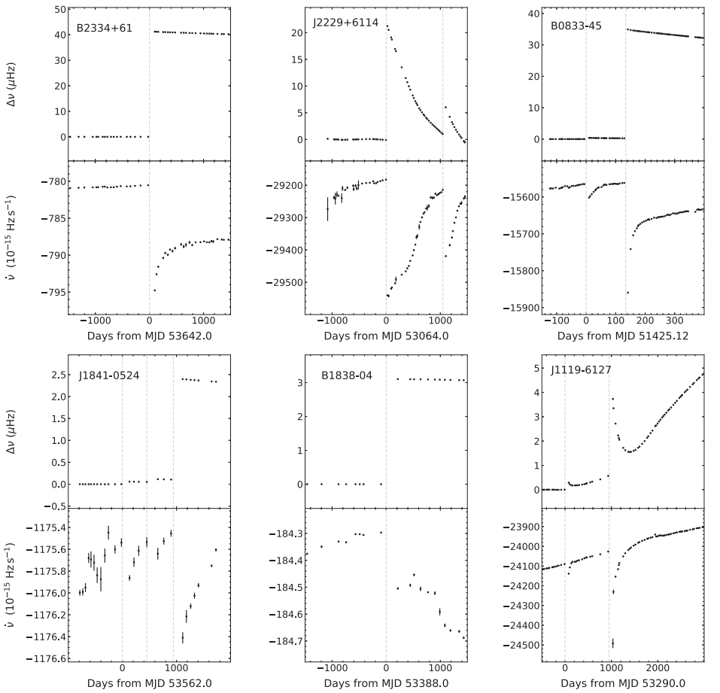
Glitces
Observations
Antonopoulou et al. (2022)

Slide 26
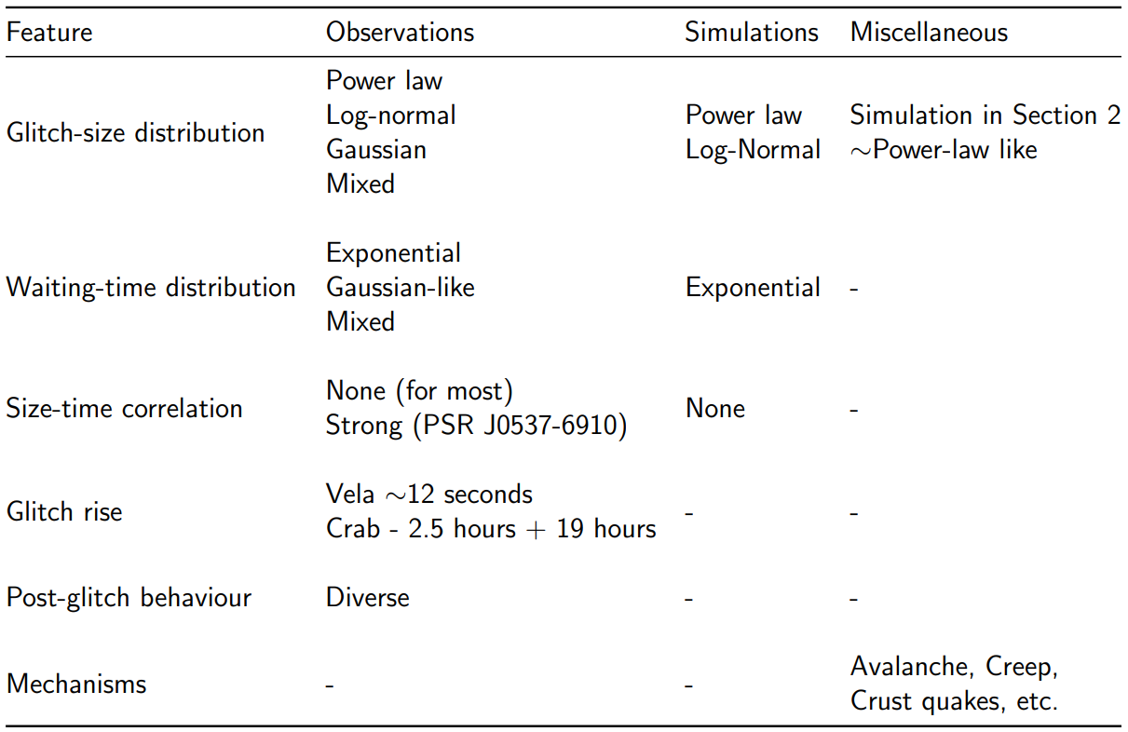
How diverse? Yes
Antonopoulou et. al 2022
Haskell et. al 2015
One physics – Many numbers?

Slide 27
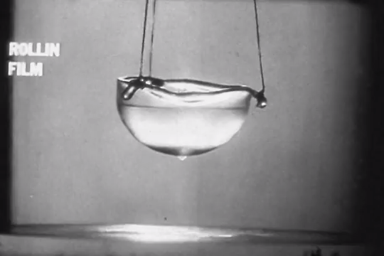
Slippery stuff
Leitner

Slide 28
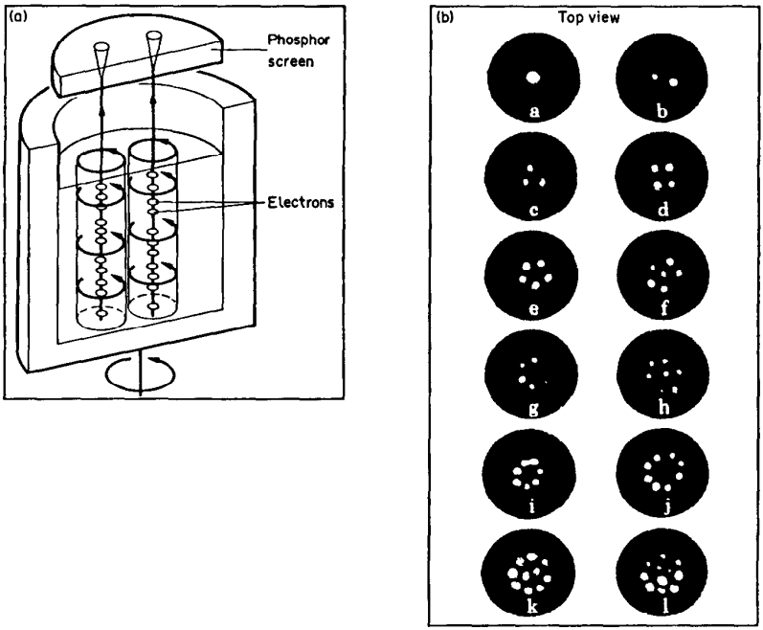
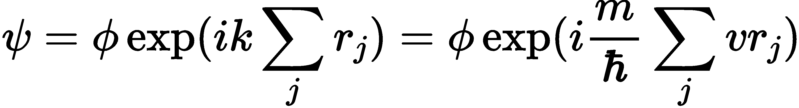
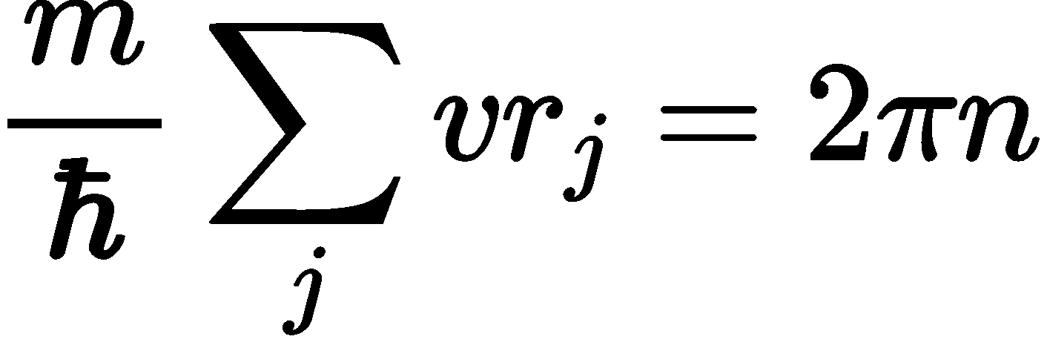
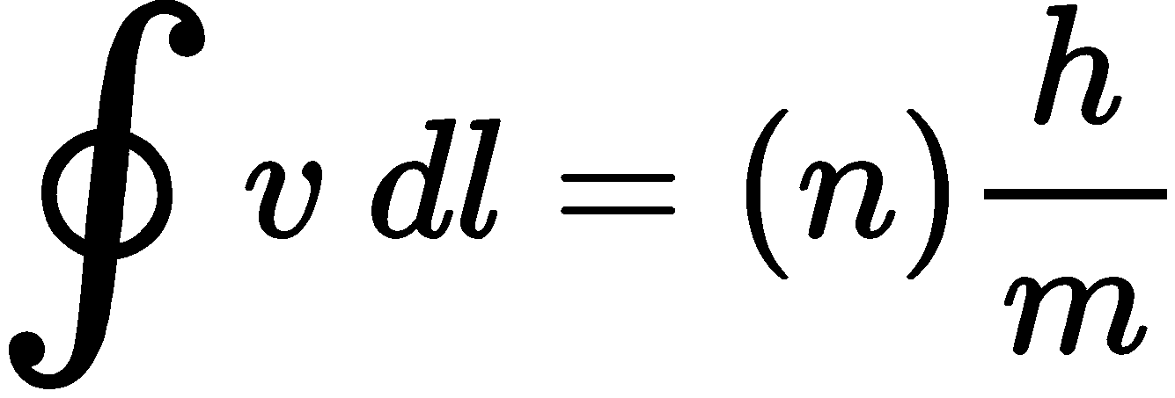
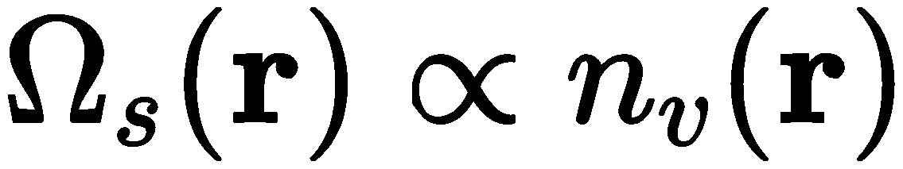
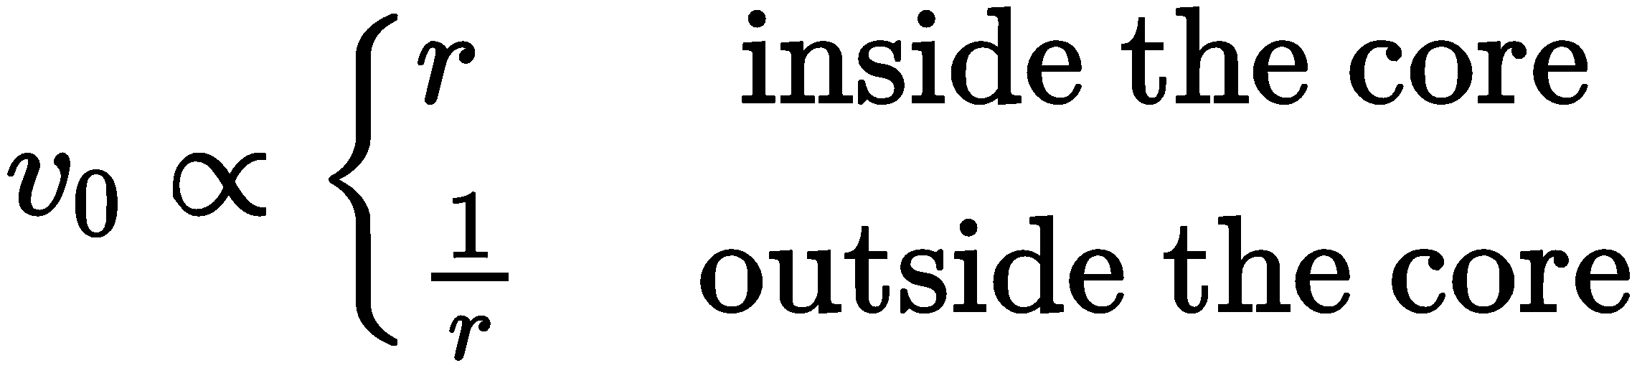

Quantized vortices
Lane 1962, Packard et al. 1980
Batch of superfluid :
Circular displacement
Bose statistics
Unchanged $ψ$
Singularity
Coherence length
Finite core
Rankine vortex

Slide 29
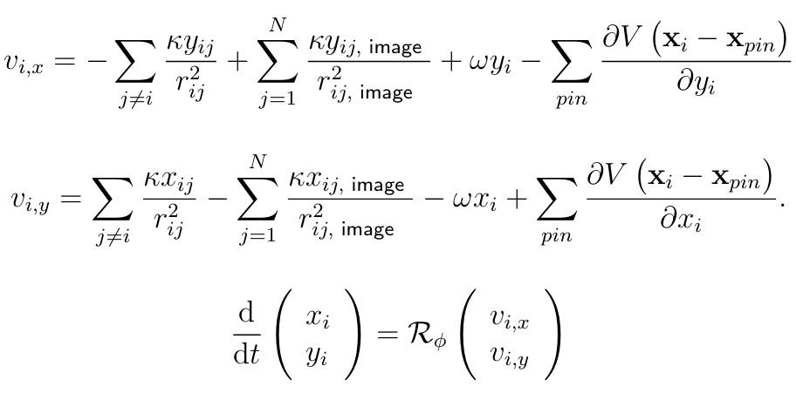
NEUTRON STAR
Howitt et al. (2020)
Antonopoulou et al. (2022)

Slide 30
Glitch size
Simulation

Slide 31
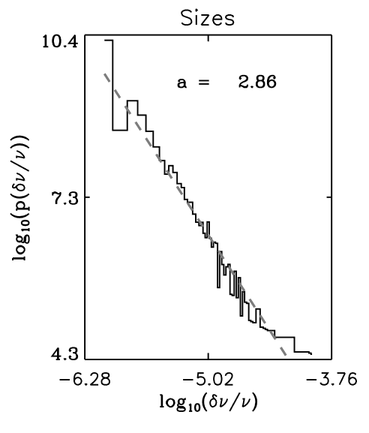
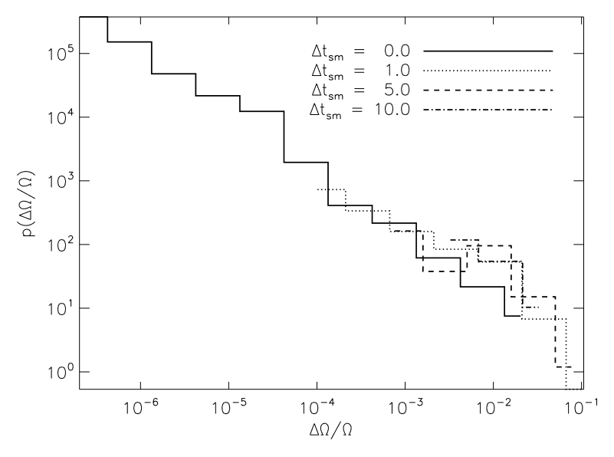
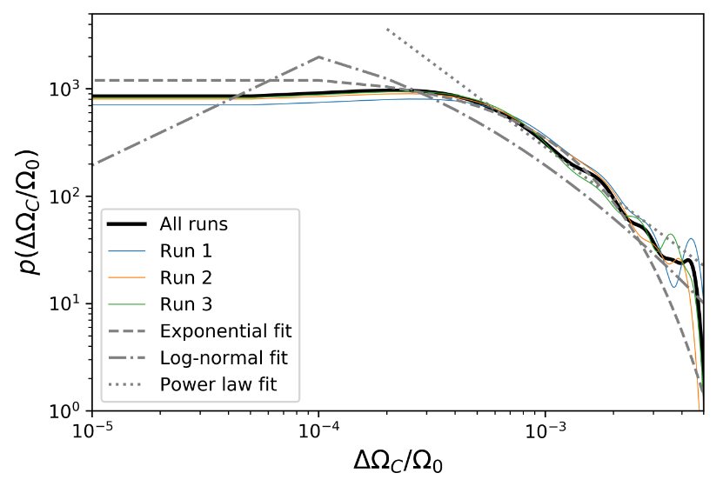
Existing models
Theory
Warszawski et al. (2008)
Warszawski et al. (2011)
Howitt et al. (2020)

Slide 32
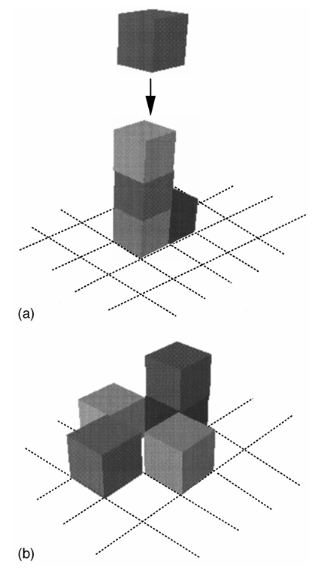
Bak-Tang-Wiesenfeld Sandpile
Power Law
Dickman et al. (1998)

Slide 33
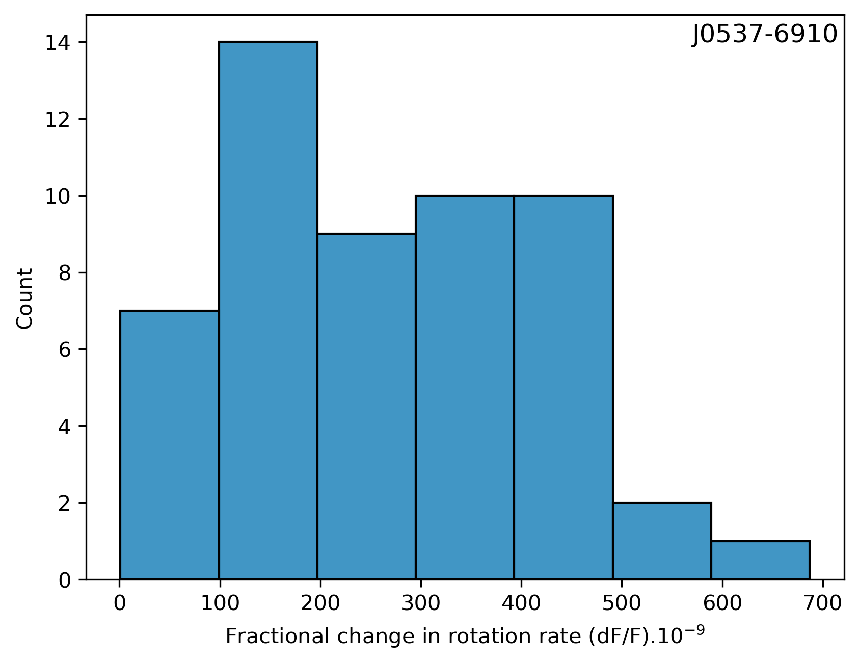
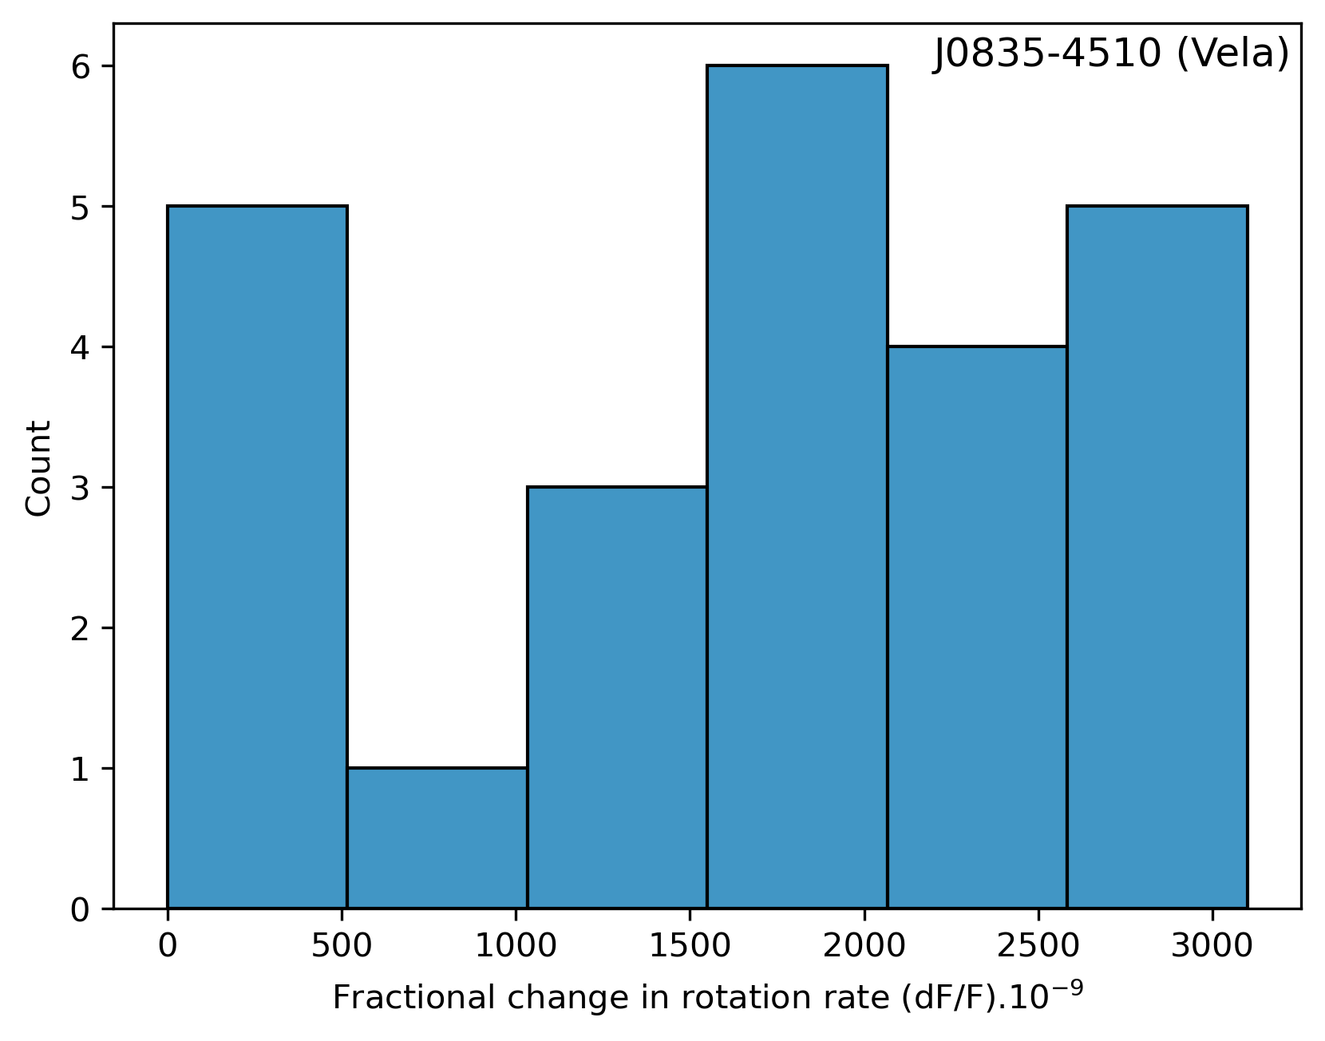
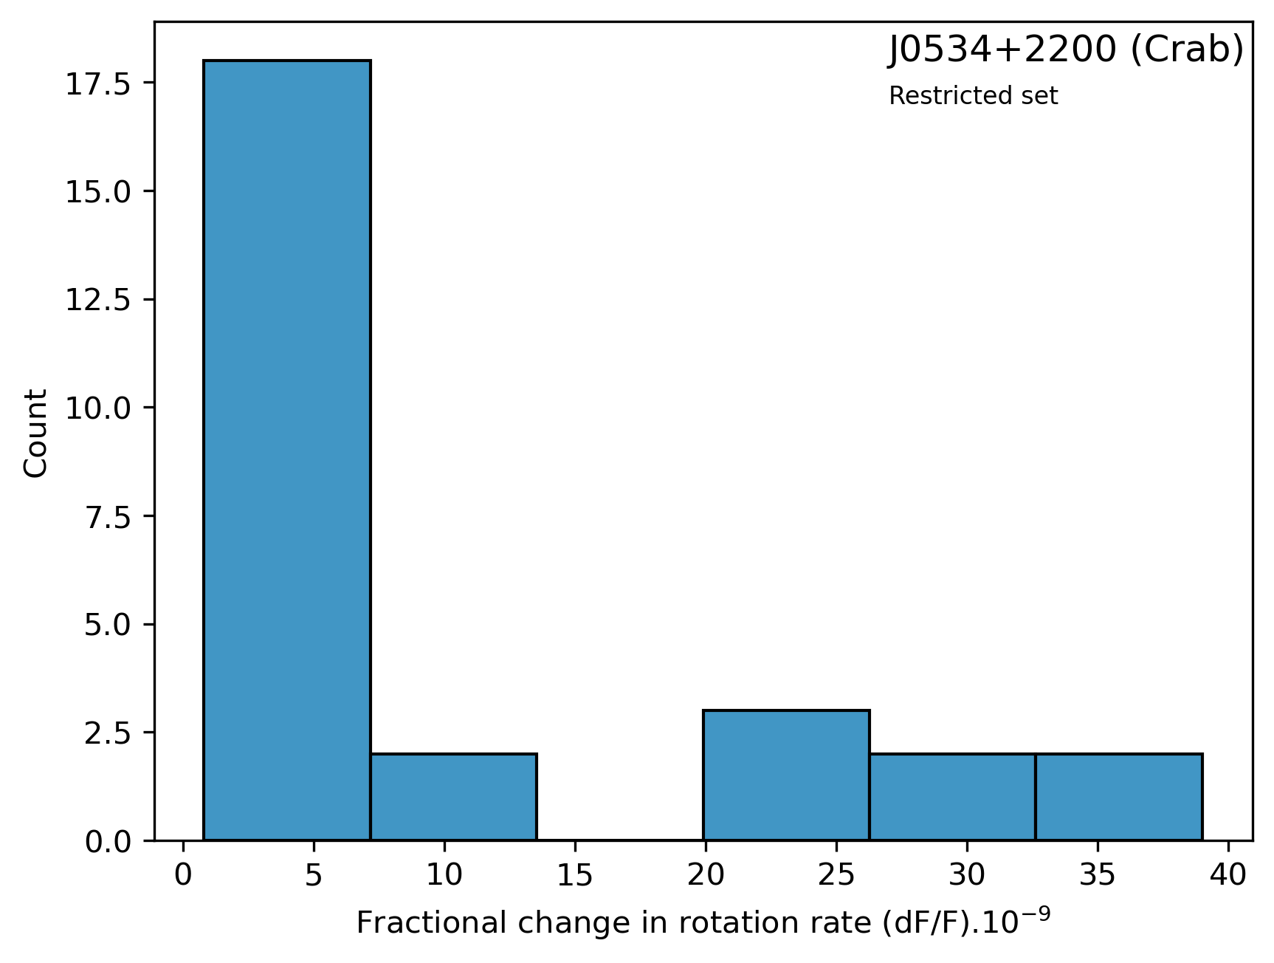
Glitch distributions
Observations
Jodrell Bank

Slide 34
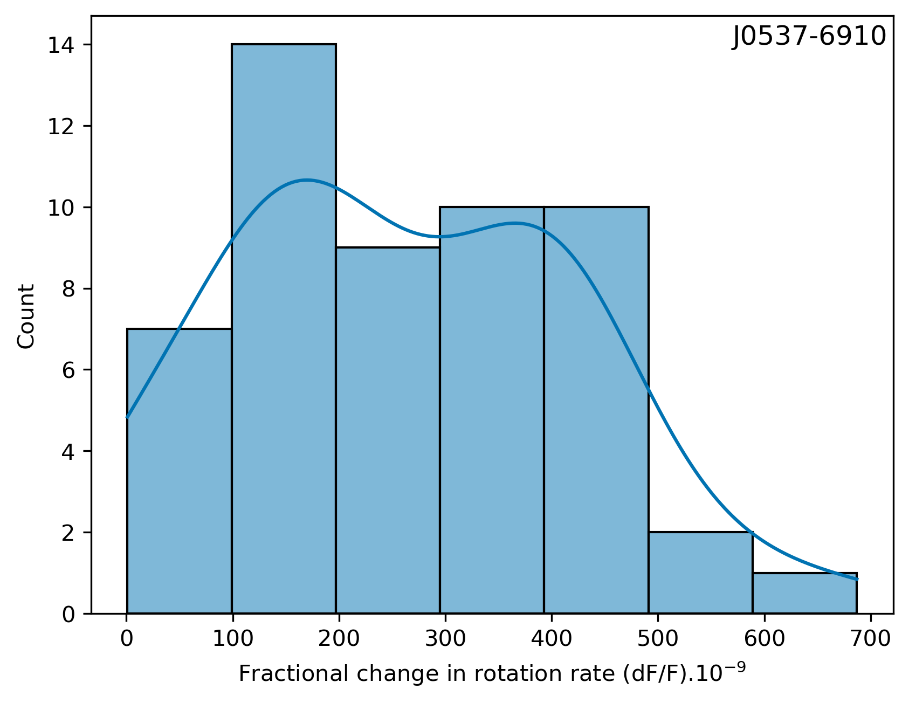
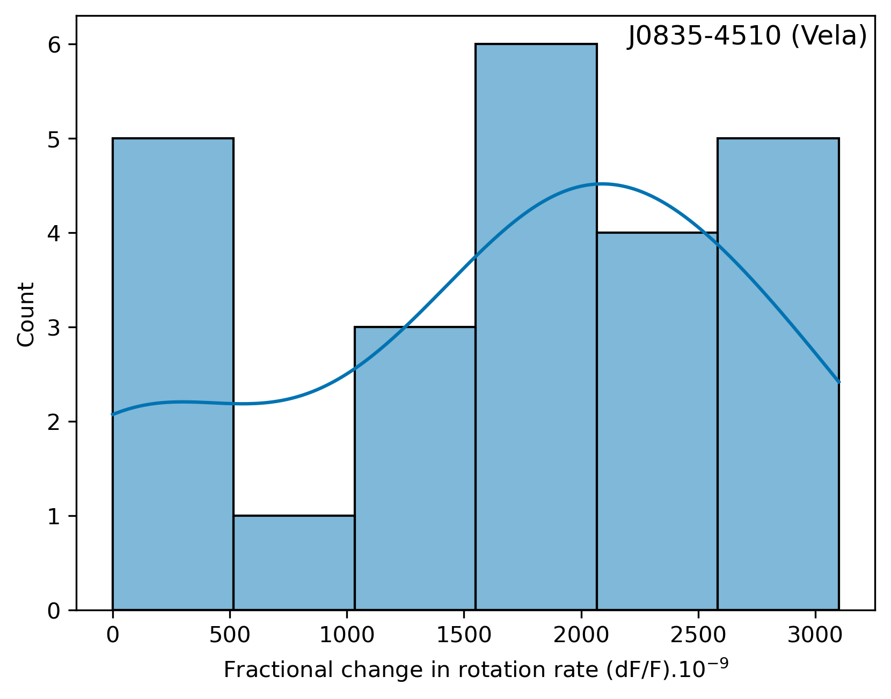
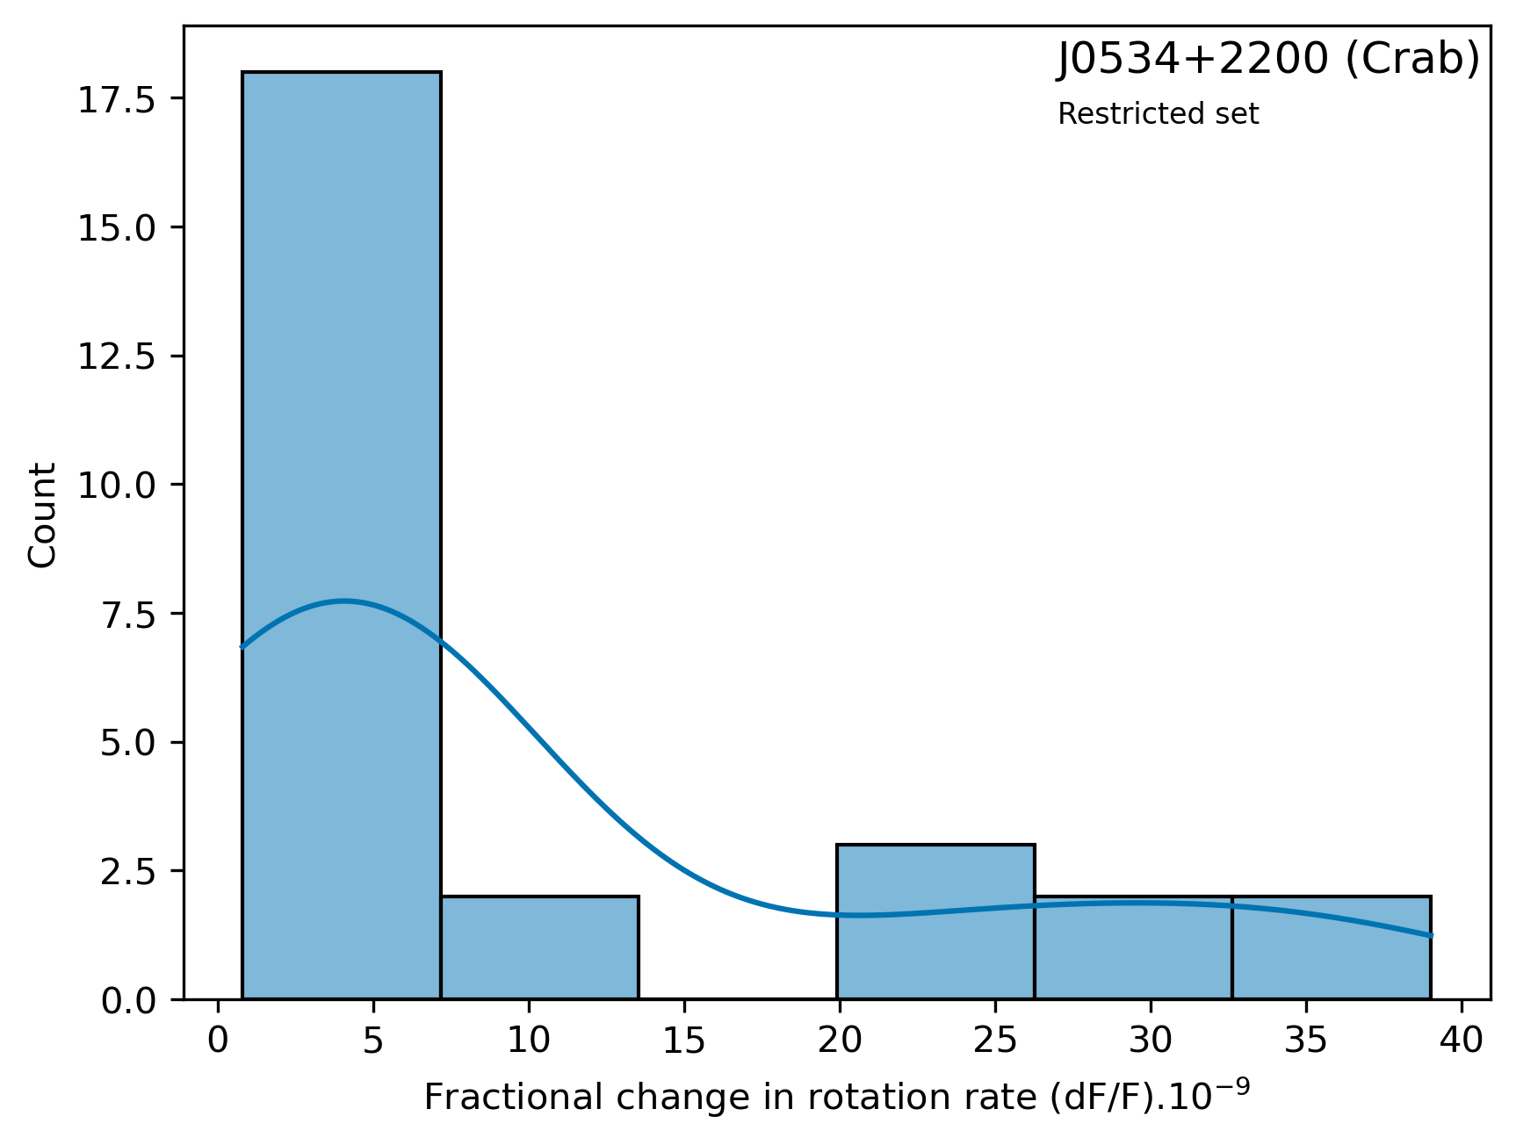
Glitch distributions
Observations
Jodrell Bank

Slide 35
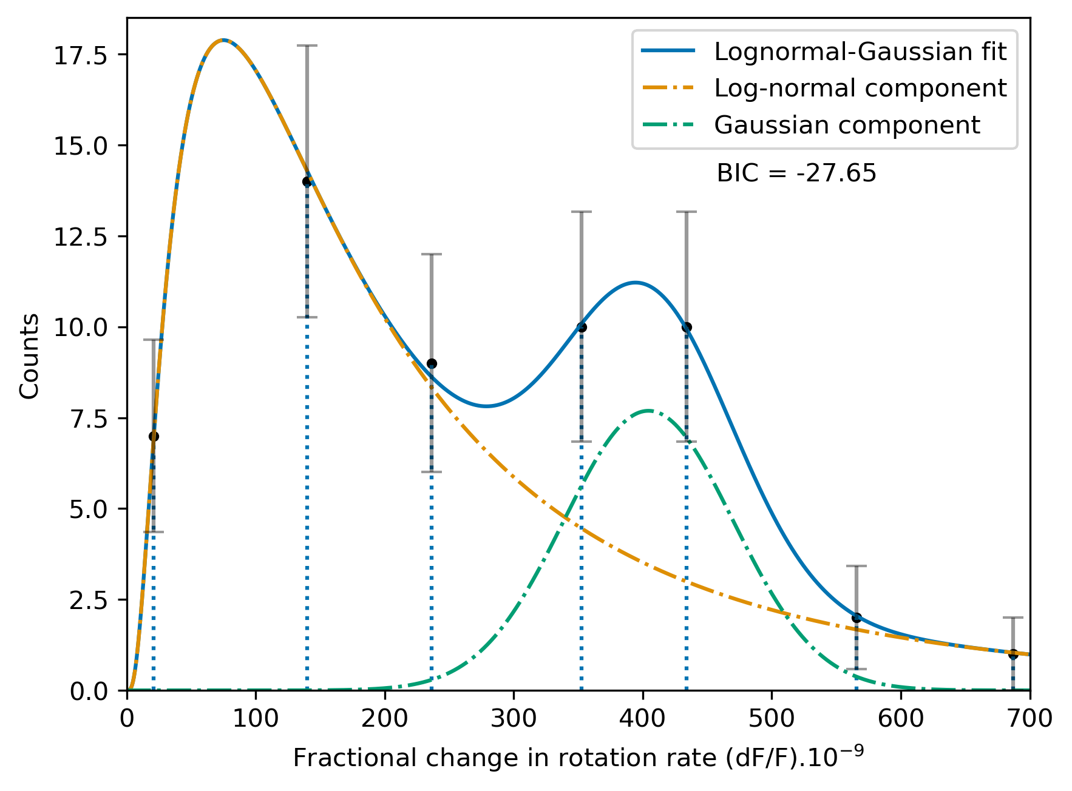

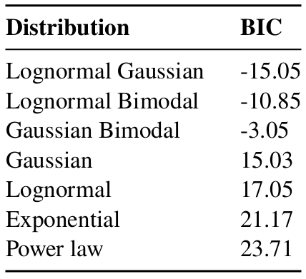
Glitch size distribution for PSR J0537-6910
Observation
Dataset
Model
Parameters
The lesser the better

Slide 36
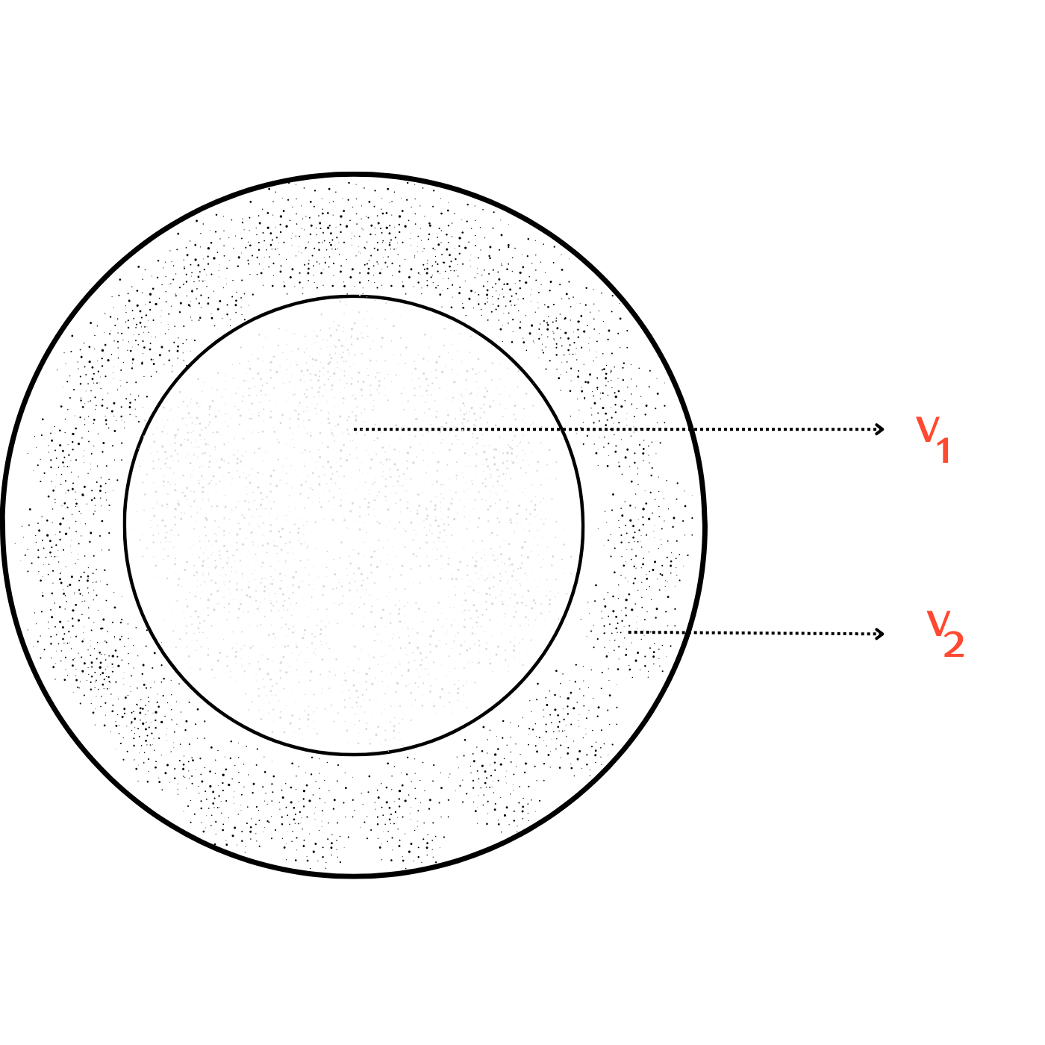
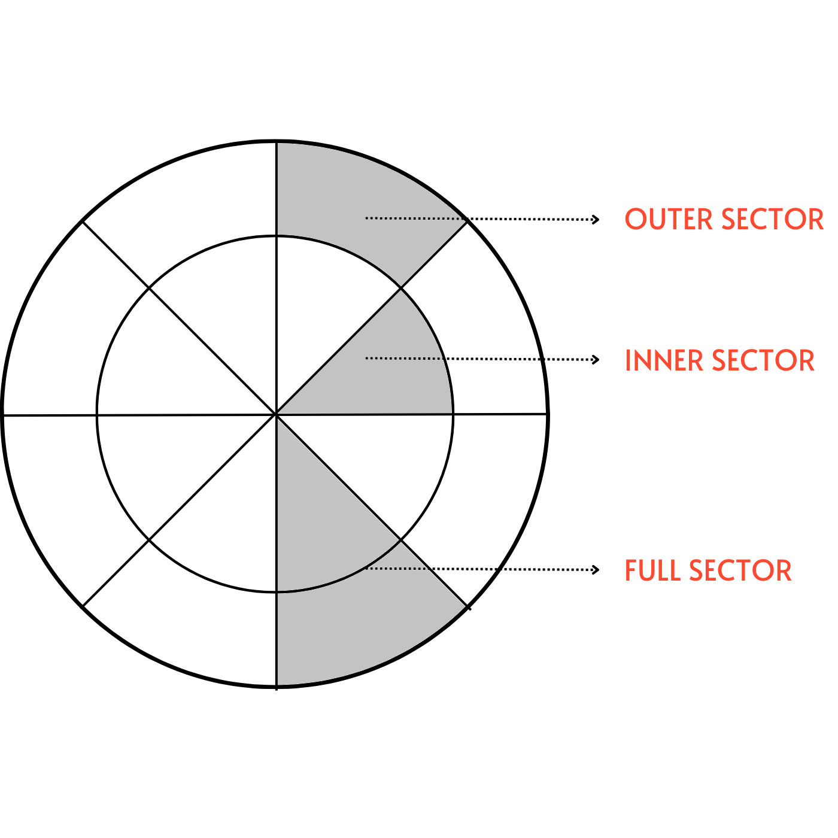
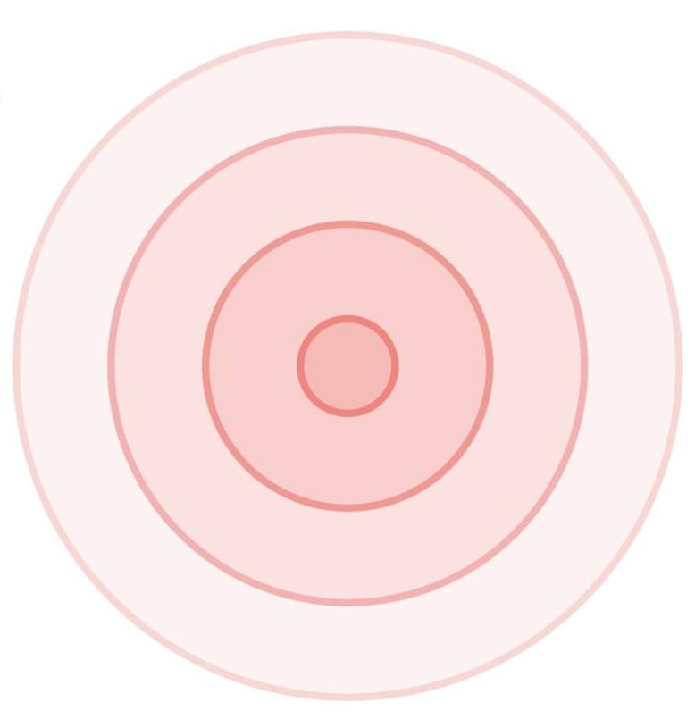
Three paradigms
Structural variations
Local disturbances
Global disturbances
Sauls (1989)
Srinivasan et al. (1990)
Ruderman (1969)
Peralta et al. (2006)
McDermott (1988)
Hoye, Gundrum K. (1999)

Slide 37
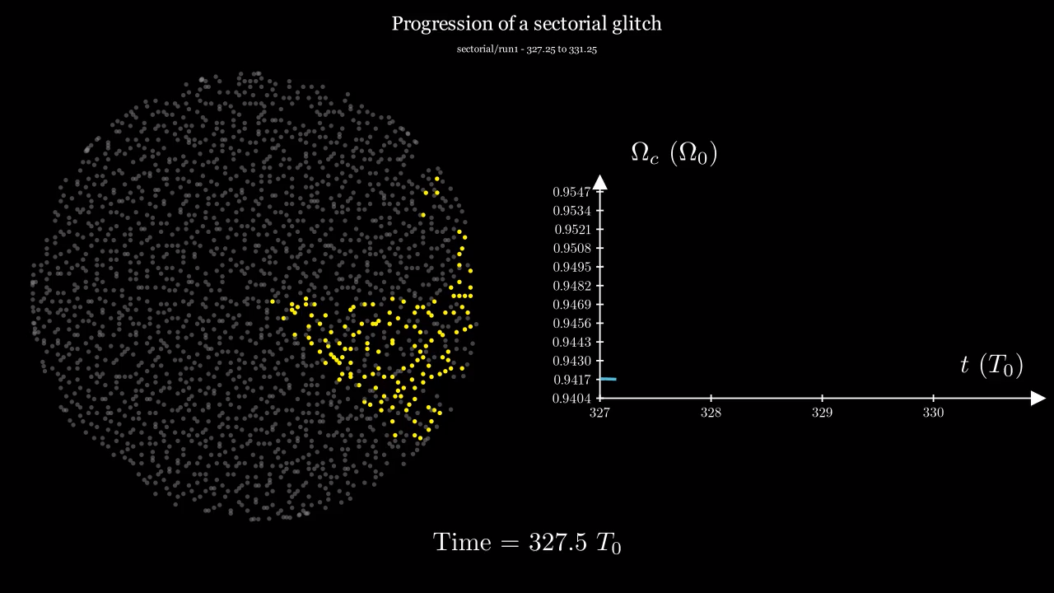

Slide 38
Three paradigms
Structural variations
Local disturbances
Global disturbances
Sauls (1989)
Srinivasan et al. (1990)
Ruderman (1969)
Peralta et al. (2006)
McDermott (1988)
Hoye, Gundrum K. (1999)

Slide 39
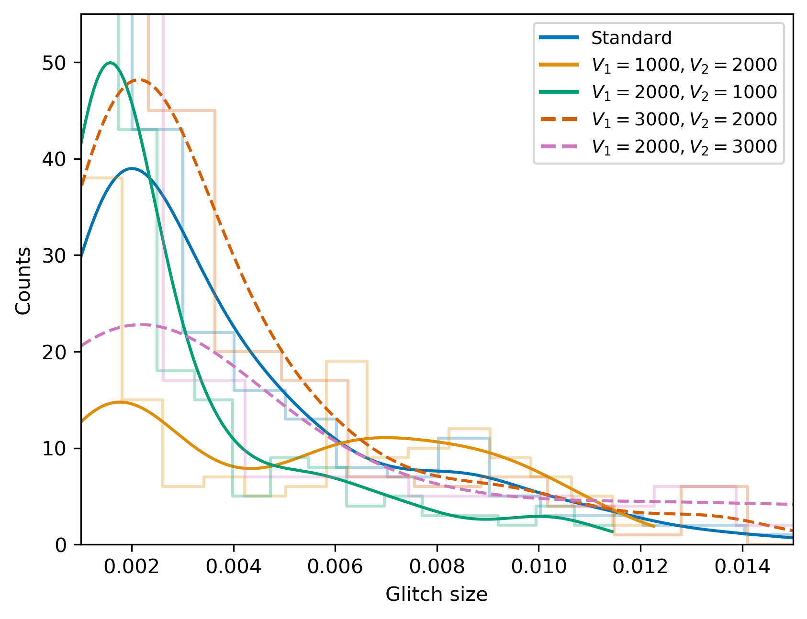


Three paradigms
Study published
Structural variations
Local disturbances
Global disturbances
Sauls (1989)
Srinivasan et al. (1990)
Ruderman (1969)
Peralta et al. (2006)
McDermott (1988)
Hoye, Gundrum K. (1999)
Bimodal
Weak
None

Slide 40

Alternate hypothesis
Ashton et al. (2019)
Avalanche model questioned by regularity of glitches
Crustquakes questioned by spin-up numbers
Perhaps a hybrid model?
2016 vela glitch
Vortex traps
Better computational scheme vital
Gugercinoglu et al. (2020)

Slide 41
Barnes-Hut algorithm
Barnes et al. 1986

Slide 42
Barnes-Hut algorithm
Barnes et al. 1986

Slide 43

Benchmark
Array energy
Percentage error in array energy (Barnes-Hut vs Exact) is ${6×10}^{−3}.$

Slide 44


Slide 45


Slide 46




Triggered traps

Slide 47








Glitch size distributions
Pre-print ready
Expectation upon triggering 1 Trap
Modification
Amplification

Slide 48
What sets scale

Slide 49

Small N
Warszawski et al. 2018

Slide 50


Large N
Study underway
Pinning influence = 0.1 * a
Pinning influence = 0.5 * a

Slide 51
An observation
Pulsar | Radius (km) | Period (ms) | Biggest Glitch | Number of vortices | Smallest Glitch | Number of vortices
Crab | 10 | 33.50 | 0.52e-06 | 3.07e11 | 0.80e-09 | 4.76e08
Vela | 16 | 89.33 | 3.09e-06 | 1.76e12 | 0.20e-09 | 1.14e08
J0537-6910 | 10 | 16.00 | 0.68e-06 | 8.57e11 | 1.00e-09 | 1.25e09
The number of vortices involved in the biggest and smallest glitches are very similar across three stars.
What sets this number? How do so many well-separated vortices collectively exit?

Slide 52

Vortex tangles
Haskell et al. 2020
Post glitch relaxations in Vela and PSR J0537-6910 suggest turbulence
Implies a tangled array of vortices
Can such a tangle set the desired scale?
Vela 1975
Vela 1996

Slide 53




Vortex tangles
Haskell et al. 2020, Andersson et al. 2006, Barenghi 2008, Eltsov et al. 2006
Post glitch relaxations in Vela and PSR J0537-6910 suggest turbulence
Implies a tangled array of vortices
Can such a tangle set the desired scale?
Axial heat flow experiment and Donnelly-Glaberson (DG) criterion

Slide 54




Twisted vortex state
Eltsov et al. 2006
Helical bundle of vortices could exist in equilibrium
An exact solution for uniform twist
Solenoidal vortex bundle
Assume a simpler bundle of solenoids
Assume that the areal density of vortices is constant
The net flow along the axis, at the centre, is found to be
n, the number of turns per unit length
N, the number of vortices in the bundle

Slide 55


Twisted vortex state
Study underway
Twist creates axial flow
Donnelly-Glaberson instability sets in when the axial flow exceeds the threshold speed
For a bundle of a given twist, an upper bound exists on the number of vortices
Typical parameters, with the assumption that the crust fits one full twist, yield $N \sim 5.7×{10}^{7}$
Much remains to be understood

Slide 56
Summary, Caveats, and Future work
Not all is well in the statistics - Power-laws and scale invariance cannot be taken for granted
Due justification is required - Consider statistics alongside rise and relaxation profiles
Hybrid mechanisms maybe necessary - Computational setup established
3D effects and collective movement - Further avenue to understand various scales in neutron stars
Small size observational data
No temperature
No explicit crust-core difference
No pinning in 3D calculations
What are the implications of structural organization for the neutron star core?
That is, how does the magnetic field evolve in different stars?

Slide 57
Thank you
Part of the work available online as
On Bactrian glitch-size distributions, MNRAS, April 2025
Another part of the work soon to be available as pre-print
Pulsar glitches in the presence of vortex traps, TBD
Two other presented aspects are currently under study
The relevant codes are openly available at
https://github.com/ananth-94/vortexsimulator

