Slide 1
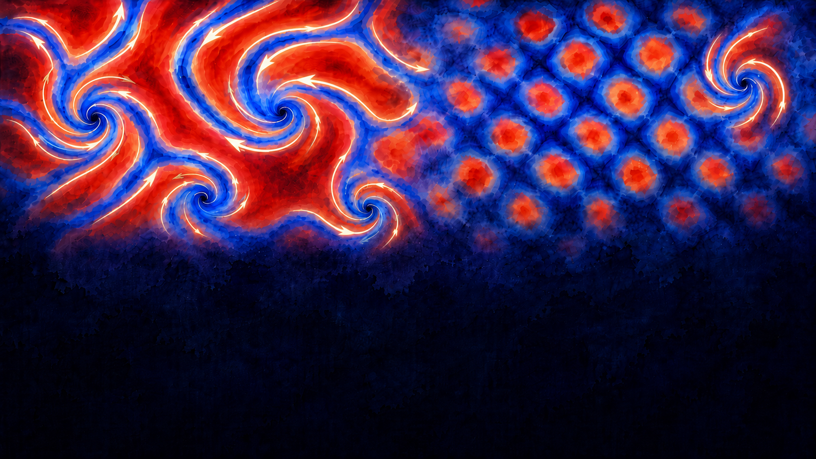
Structure and Dynamics of Pairing Field in Inhomogeneous Fermi Superfluids
Buğra Tüzemen
Institute of Physics of the Polish Academy of Sciences

Slide 2
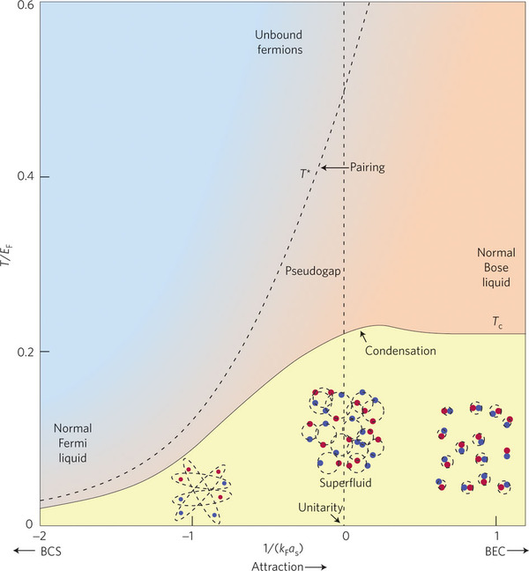

Ultracold Fermi gas
BCS regime:
  Weakly interacting limit (|Δ| << ε_{F})
  Long coherence length (ξ >> k_{F}⁻¹)
  Spatially extended Cooper pairs
BEC regime:
  Coherence length ξ << k_{F}⁻¹
  Tightly bound dimers (|Δ| >> ε_{F}), molecular condensate
Unitary Fermi gas (UFG):
  Strongly interacting regime (|Δ| ~ ε_{F}/2)
    Neutron stars $\left|Δ\right|≤ε_{F}/5$
    Atomic nuclei $\left|Δ\right|≤ε_{F}/30$
    He3 and electronic systems $\left|Δ\right|≤ε_{F}/100$
  Strong pairing correlations with short coherence length (ξ ~ k_{F}⁻¹)
  Dilute system: interaction range r_{e} << k_{F}⁻¹ << |a_{s}|
  Energies, gaps, and thermodynamics depend only on density, up to universal constants
    Bertsch parameter ξ≈0.37
    Superfluid critical temperature Tc/TF ≈ 0.167 at unitarity)

Slide 3
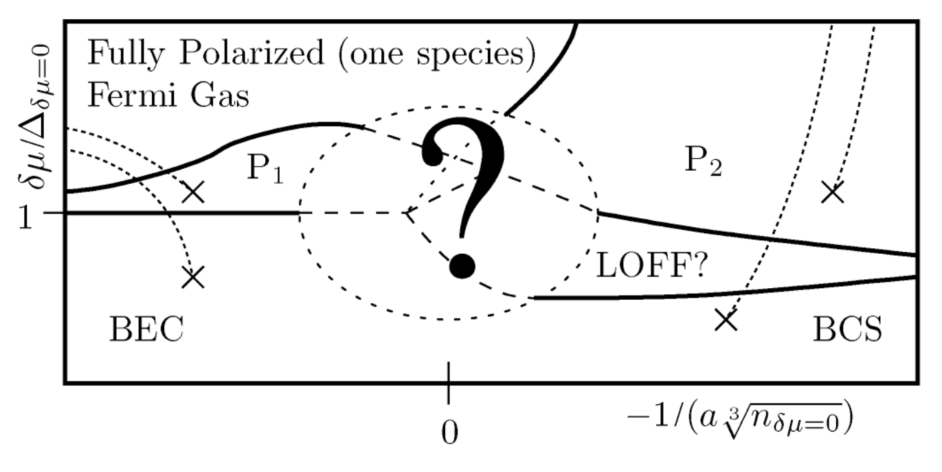

Spin-imbalanced gas
Chandrasekhar–Clogston limit
  Critical spin imbalance beyond which BCS superfluidity is suppressed in favour of a polarized normal phase
$$\tilde{μ_{c}}=\frac{\left|Δ_{0}\right|}{\sqrt{2}} \tilde{μ}=\frac{μ_{↑}−μ_{↓}}{2}$$

Slide 4
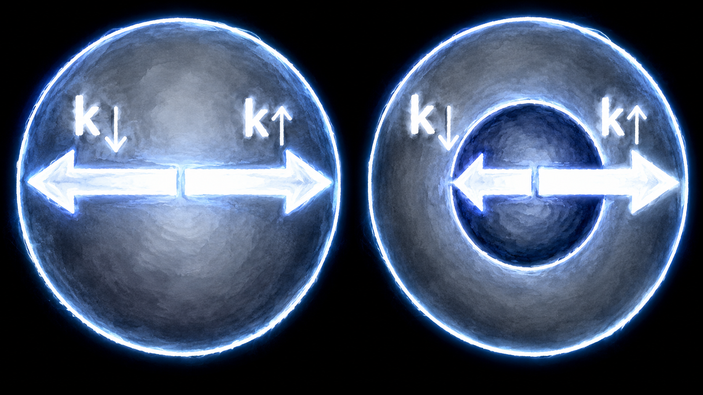

Spin-imbalanced gas
Chandrasekhar–Clogston limit
  Critical spin imbalance beyond which BCS superfluidity is suppressed in favour of a polarized normal phase
$$\tilde{μ_{c}}=\frac{\left|Δ_{0}\right|}{\sqrt{2}} \tilde{μ}=\frac{μ_{↑}−μ_{↓}}{2}$$
FFLO state (Fulde–Ferrell–Larkin–Ovchinnikov)
Finite-momentum pairing: (k+q/2,↑) with (−k+q/2,↓)
Arises from Fermi surface mismatch
Leads to spatial modulation of the pairing field
    $∆(r)\sim \left|∆\right|e^{iq.r}$ $∆(r)\sim \left|∆\right|\cos{q.r}$
Conventional BCS Pairing
Zero-momentum pairing: (k,↑) with (−k,↓)
Pairs form across the Fermi surface
Requires balanced spin populations

Slide 5
Spin-imbalanced gas
Chandrasekhar–Clogston limit
  Critical spin imbalance beyond which BCS superfluidity is suppressed in favour of a polarized normal phase
$$\tilde{μ_{c}}=\frac{\left|Δ_{0}\right|}{\sqrt{2}} \tilde{μ}=\frac{μ_{↑}−μ_{↓}}{2}$$
FFLO state (Fulde–Ferrell–Larkin–Ovchinnikov)
Finite-momentum pairing: (k+q/2,↑) with (−k+q/2,↓)
Arises from Fermi surface mismatch
Leads to spatial modulation of the pairing field
    $∆(r)\sim \left|∆\right|e^{iq.r}$ $∆(r)\sim \left|∆\right|\cos{q.r}$
Conventional BCS Pairing
Zero-momentum pairing: (k,↑) with (−k,↓)
Pairs form across the Fermi surface
Requires balanced spin populations
The FFLO phase occupies only a sliver of the phase diagram.
Highly symmetric, periodic modulations of the pairing field
Ginzburg-Landau studies show it is unstable against pairing fluctuations — deviations from regular structures are energetically favored (Radzihovsky et al., PRL 103, 2009; PRA 84, 2011)
Open question:
What does the system actually do when it cannot order?

Slide 6
Our approach
Unitary Fermi gas at thermal equilibrium (focus on T=0)
Microscopic TDDFT: full quasiparticle structure, no perturbative approximations
No constraints imposed on the pairing field
Random initial perturbation mimics pairing fluctuations
The system decides what structures form
Starting point
What does the system spontaneously produce?
and
How does it behave dynamically?

Slide 7
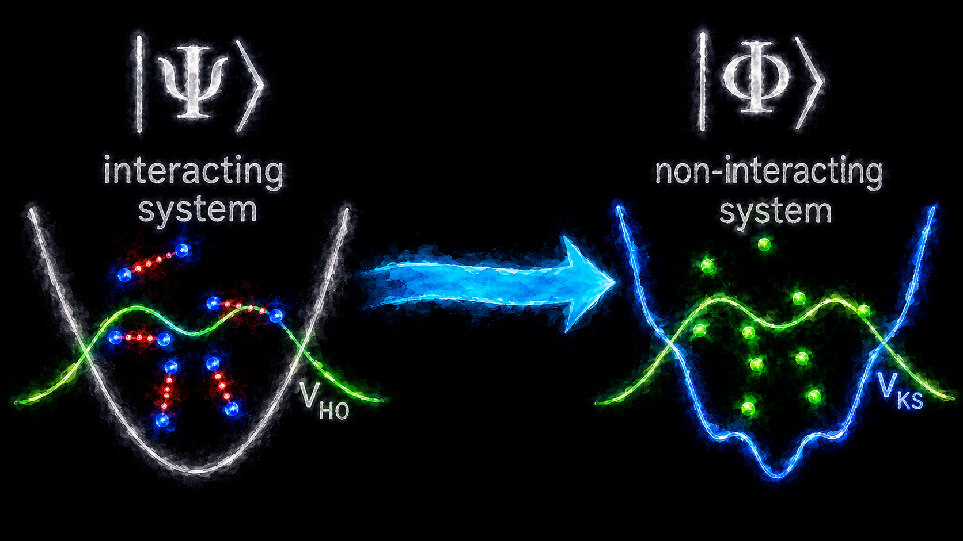




DFT as a Framework for Fermi Superfluids
Schrödinger
DFT
$$iℏ\frac{∂Ψ}{∂t}=\left(\hat{H_{\text{int}}}+\hat{U_{\text{ext}}}\right)Ψ$$
$$\hat{H_{\text{int}}}=\hat{T}+\hat{V}$$
$$E\left[n\right]=F\left[n\right]+\int{n\left(r\right)U_{\text{ext}}\left(r\right)} dr$$
$$F\left[n\right]=T\left[n\right]+V\left[n\right]+…$$
■ HK (1964): ground-state observables are functionals of the ground-state density
■ KS (1965): practical extraction of energy and one-body observables
■ RG (1984): extends HK to time-dependent systems
► Deriving the Hamiltonian is easy
► Solving many-body Schrödinger eq. is hard
► Deriving E_{int} is hard
► Solving equations of motion is "easy"
KEY PAPERS ENABLING DFT FOR SUPERFLUIDS
Oliveira, Gross, Kohn (1988)
DFT for Superconductors
PRL 60, 2430 (1988)
Wacker, Kümmel, Gross (1994)
TDDFT for Superconductors
PRL 73, 2915 (1994)
Bulgac (2002) ★ SLDA
Local DFT with pairing correlations
Phys. Rev. C 65, 051305(R) (2002)
General superfluid DFT
✗ Non-local pairing: integro-differential eqs.
✗ Beyond reach even for exascale systems
✗ Requires approximation to be tractable
SLDA approach
✓ Purely local — coupled PDEs only
✓ Tractable at petascale
✓ Crucial for practical numerical treatment

Slide 8









Superfluid Local Density Approximation
Energy density functional
Density definitions
$$E\left[n,τ,ν\right]=\int{d^{3}r} ε\left[n\left(r\right),τ\left(r\right),ν\left(r\right)\right]$$
$$n_{σ}\left(r\right)=\sum_{n}{{\left|v_{n,σ}\left(r\right)\right|}^{2}f_{β}\left(−E_{n}\right)}$$
$$ε\left[n\left(r\right),τ\left(r\right),ν\left(r\right)\right]=α\frac{ℏτ\left(r\right)}{2m}+β\frac{3ℏ^{2}{\left(3π^{2}\right)}^{2/3}}{10m}n{\left(r\right)}^{5/3}+g_{\text{eff}}ν{\left(r\right)}^{†}ν\left(r\right)$$
$$τ_{σ}\left(r\right)=\sum_{n}{{\left|∇v_{n,σ}\left(r\right)\right|}^{2}f_{β}\left(−E_{n}\right)}$$
BdG quasiparticle equations
$$ν\left(r\right)=\sum_{n}{v_{n,↓}^{∗}\left(r\right)} u_{n,↑}\left(r\right)\frac{f_{β}\left(−E_{n}\right)−f_{β}\left(E_{n}\right)}{2}$$
$$\left(\begin{matrix}h\left(r\right) & Δ\left(r\right) \\ Δ^{∗}\left(r\right) & −h^{∗}\left(r\right)\end{matrix}\right)\left(\begin{matrix}u_{n}\left(r\right) \\ v_{n}\left(r\right)\end{matrix}\right)=E_{n}\left(\begin{matrix}u_{n}\left(r\right) \\ v_{n}\left(r\right)\end{matrix}\right)$$
Parameters: From experiments and/or ab initio methods (QMC)
$$h\left(r\right)=−\frac{δε}{δτ\left(r\right)}∇^{2}+\frac{δε}{δn\left(r\right)}+V_{\text{ext}}\left(r\right)$$
$α$: effective mass parameter. It captures interaction-induced mass renormalization.
$β$: mean-field energy parameter. Accounts for interaction corrections to the Thomas-Fermi kinetic energy. At unitarity, it is fixed by the Bertsch parameter.
$g$_{eff} : renormalized coupling, fixed by scattering length a_{s}
$$−α\frac{ℏ^{2}}{2m}∇^{2}+β\frac{ℏ^{2}{\left(3π^{2}\right)}^{2/3}}{2m}n{\left(r\right)}^{2/3}$$
$$Δ\left(r\right)=−\frac{δε}{δν^{∗}\left(r\right)}=g_{\text{eff}} ν\left(r\right)$$
BdG + EDF solved self-consistently:
ρ, ν → Δ → new u_{n}, v_{n} → converge

Slide 9


Time dependent problem
TD-SLDA: Equations of Motion
two-component spin, four-spinor quasiparticle wavefunctions:
$$iℏ\frac{∂}{∂t}\left(\begin{matrix}u_{n,↑}\left(r,t\right) \\ u_{n,↓}\left(r,t\right) \\ v_{n,↑}\left(r,t\right) \\ v_{n,↓}\left(r,t\right)\end{matrix}\right)=\left(\begin{matrix}h_{↑}\left(r,t\right) & 0 & 0 & Δ\left(r,t\right) \\ 0 & h_{↓}\left(r,t\right) & −Δ\left(r,t\right) & 0 \\ 0 & −Δ^{∗}\left(r,t\right) & −h_{↑}^{∗}\left(r,t\right) & 0 \\ Δ^{∗}\left(r,t\right) & 0 & 0 & −h_{↓}^{∗}\left(r,t\right)\end{matrix}\right)\left(\begin{matrix}u_{n,↑}\left(r,t\right) \\ u_{n,↓}\left(r,t\right) \\ v_{n,↑}\left(r,t\right) \\ v_{n,↓}\left(r,t\right)\end{matrix}\right)$$
TDASLDA Energy Density Functional
ε_{TDASLDA} includes effective mass (α↑,↓), mean-field (D), pairing (g_{eff}), and current (j) terms for spin-asymmetric configurations:
$$ℰ_{\text{𝒯𝒟𝒜𝒮ℒ𝒟𝒜}}=\frac{ℏ^{2}}{m}\left(α_{↑}\frac{τ_{↑}}{2}+α_{↓}\frac{τ_{↓}}{2}+D\right)+g_{\text{eff}}ν^{†}ν+\left(1−α_{↑}\right)\frac{{\left|j_{↑}\right|}^{2}}{2n_{↑}}+\left(1−α_{↓}\right)\frac{{\left|j_{↓}\right|}^{2}}{2n_{↓}}$$
Current density:
$$j_{σ}\left(r\right)=\frac{i}{2}\sum_{\left|E_{k}\right|<E_{c}}{\left[v_{n,σ}^{∗}\left(r\right)∇v_{n,σ}\left(r\right)−v_{n,σ}\left(r\right)∇v_{n,σ}^{∗}\left(r\right)\right]f_{β}\left(−E_{n}\right)}$$

Slide 10

Computation – W-SLDA Toolkit
Geometry & dimensionality
1D, 2D, 3D lattice grids supported
Periodic, Dirichlet, hard-wall BC – any kind of trap
SLDA extended to any negative scattering length not just UFG

Slide 11
Computation – W-SLDA Toolkit
Geometry & dimensionality
System size
1D, 2D, 3D lattice grids supported
Periodic, Dirichlet, hard-wall BC – any kind of trap
SLDA extended to any negative scattering length not just UFG
Typical: 64³–100³ spatial lattice
k_{F}·dx ≈ 1 - lattice size resolves the Fermi wavelength
~ 10000–30000 particles

Slide 12
Computation – W-SLDA Toolkit
Geometry & dimensionality
System size
1D, 2D, 3D lattice grids supported
Periodic, Dirichlet, hard-wall BC – any kind of trap
SLDA extended to any negative scattering length not just UFG
Typical: 64³–100³ spatial lattice
k_{F}·dx ≈ 1 - lattice size resolves the Fermi wavelength
~ 10000–30000 particles
Static solver
Kohn-Sham / BdG eigenvalue problem
Self-consistent loop: ρ, ν → Δ → H → ρ, ν
ASLDA: spin-↑/spin-↓ independently

Slide 13
Computation – W-SLDA Toolkit
Geometry & dimensionality
System size
1D, 2D, 3D lattice grids supported
Periodic, Dirichlet, hard-wall BC – any kind of trap
SLDA extended to any negative scattering length not just UFG
Typical: 64³–100³ spatial lattice
k_{F}·dx ≈ 1 - lattice size resolves the Fermi wavelength
~ 10000–30000 particles
Static solver
Time-dependent solver
Kohn-Sham / BdG eigenvalue problem
Self-consistent loop: ρ, ν → Δ → H → ρ, ν
ASLDA: spin-↑/spin-↓ independently
Real-time evolution via split-operator FFT
GPU mandatory — CPU-only infeasible
ASLDA doubles quasiparticle count

Slide 14
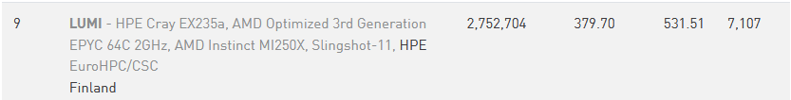
Computation – W-SLDA Toolkit
Geometry & dimensionality
System size
1D, 2D, 3D lattice grids supported
Periodic, Dirichlet, hard-wall BC – any kind of trap
SLDA extended to any negative scattering length not just UFG
Typical: 64³–100³ spatial lattice
k_{F}·dx ≈ 1 - lattice size resolves the Fermi wavelength
~ 10000–30000 particles
Static solver
Time-dependent solver
Kohn-Sham / BdG eigenvalue problem
Self-consistent loop: ρ, ν → Δ → H → ρ, ν
ASLDA: spin-↑/spin-↓ independently
Real-time evolution via split-operator FFT
GPU mandatory — CPU-only infeasible
ASLDA doubles quasiparticle count
More is Different
Theory = HPC
Executable Theory
BdG/DFT describes many coupled wavefunctions, not a single order parameter
Spin-resolved densities, currents, quasiparticle states in vortex cores.
That information is not in simpler theories by construction
The system size where the interesting physics happens is also the size that requires leadership-class machines.
No GPU cluster → no result.
W-SLDA Toolkit: physics, numerics, and HPC built together. The functional itself keeps evolving as the physics expands into new regimes. The toolkit is not a finished product. New physics always means new theory and new code. That is by design.

Slide 15
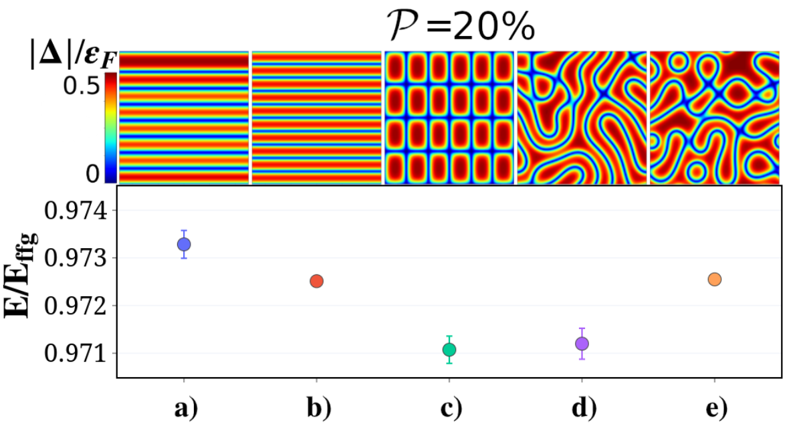


Back to physics: The spin-imbalanced Fermi superfluid
System setup
Initialization
Quasi-2D: periodic BC in x-y, plane-wave expansion along z
In a harmonic trap: excess spins accumulate at the edge, pushing the superfluid core to the center.
Interactions remain fully 3D
No intrinsic mechanism breaks pairing-field symmetry
Random complex perturbation seeds Δ(r) fluctuations
Ordered structures obtained by phase imprinting
$$Δ\left(r\right)=−g_{\text{eff}}ν\left(r\right)+Δ_{\text{ext}}\left(r\right)θ\left(τ−\text{it}\right)$$
What we scan
Observables
Wide range of polarization
Temperature
Background superflow
Confinement
Spatial profile of pairing field |Δ(r)|
Density contrast between spin components
Phase pattern of Δ(r)
Energy comparison: ordered vs. disordered at same P
$$𝒫=\left(N_{↑}−N_{↓}\right)/\left(N_{↑}+N_{↓}\right)$$

Slide 16
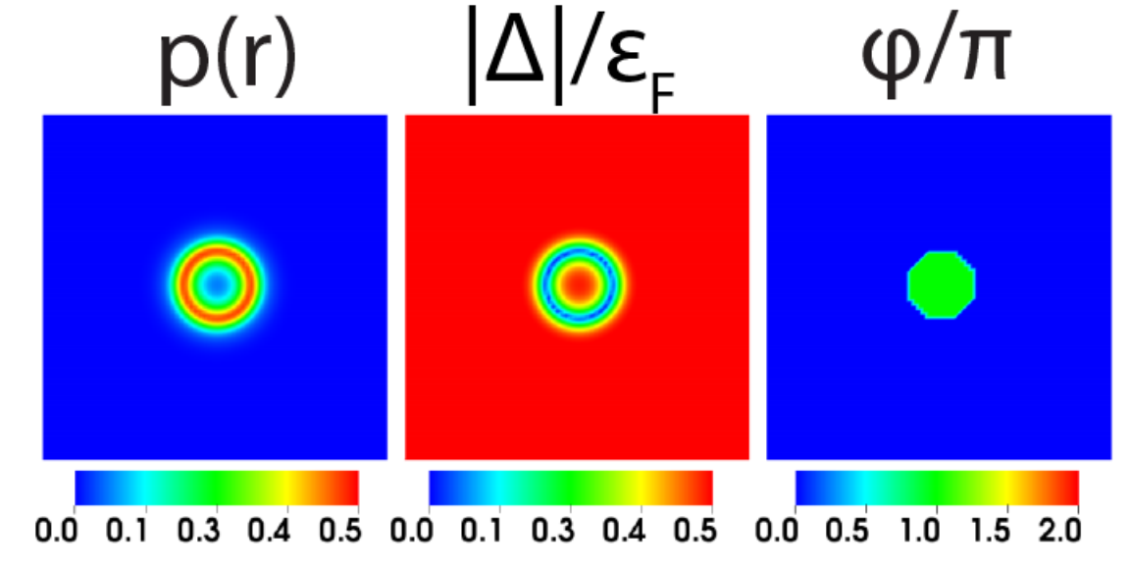
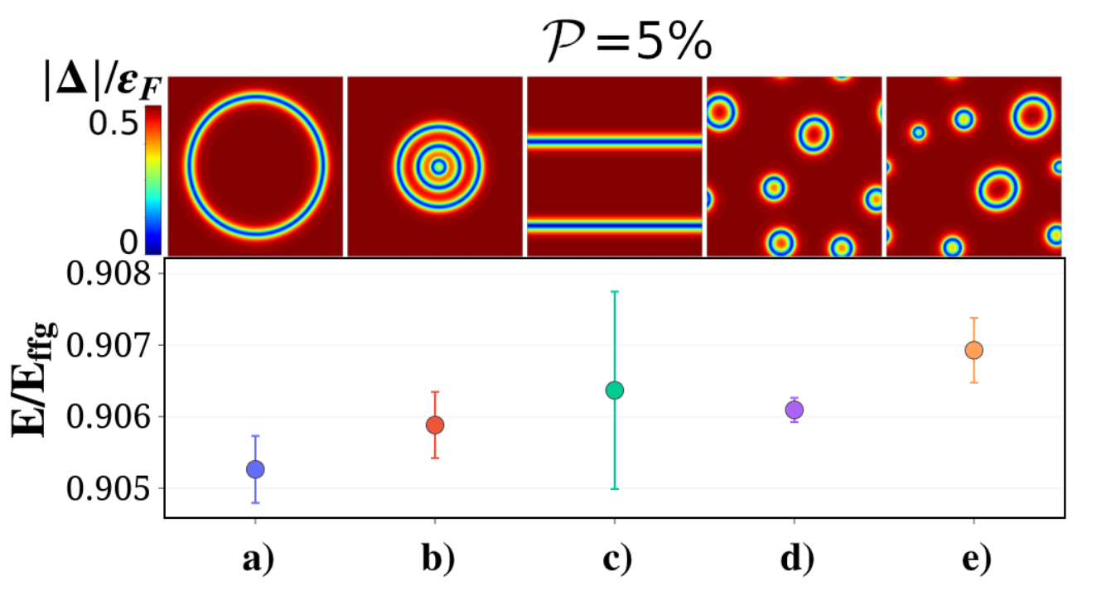
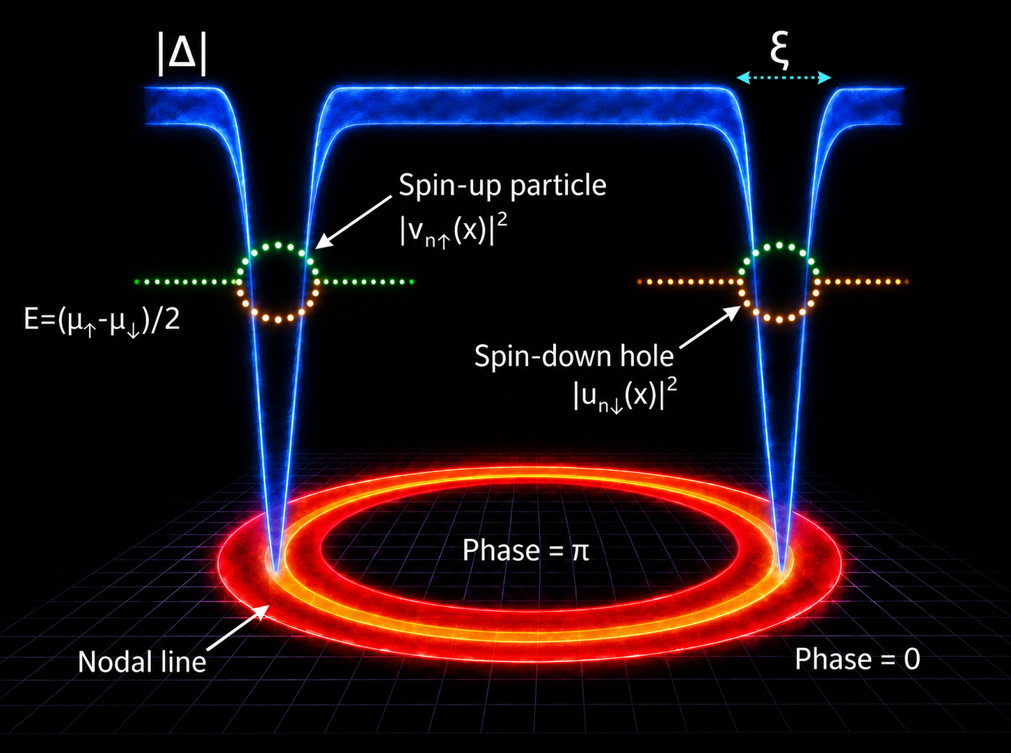
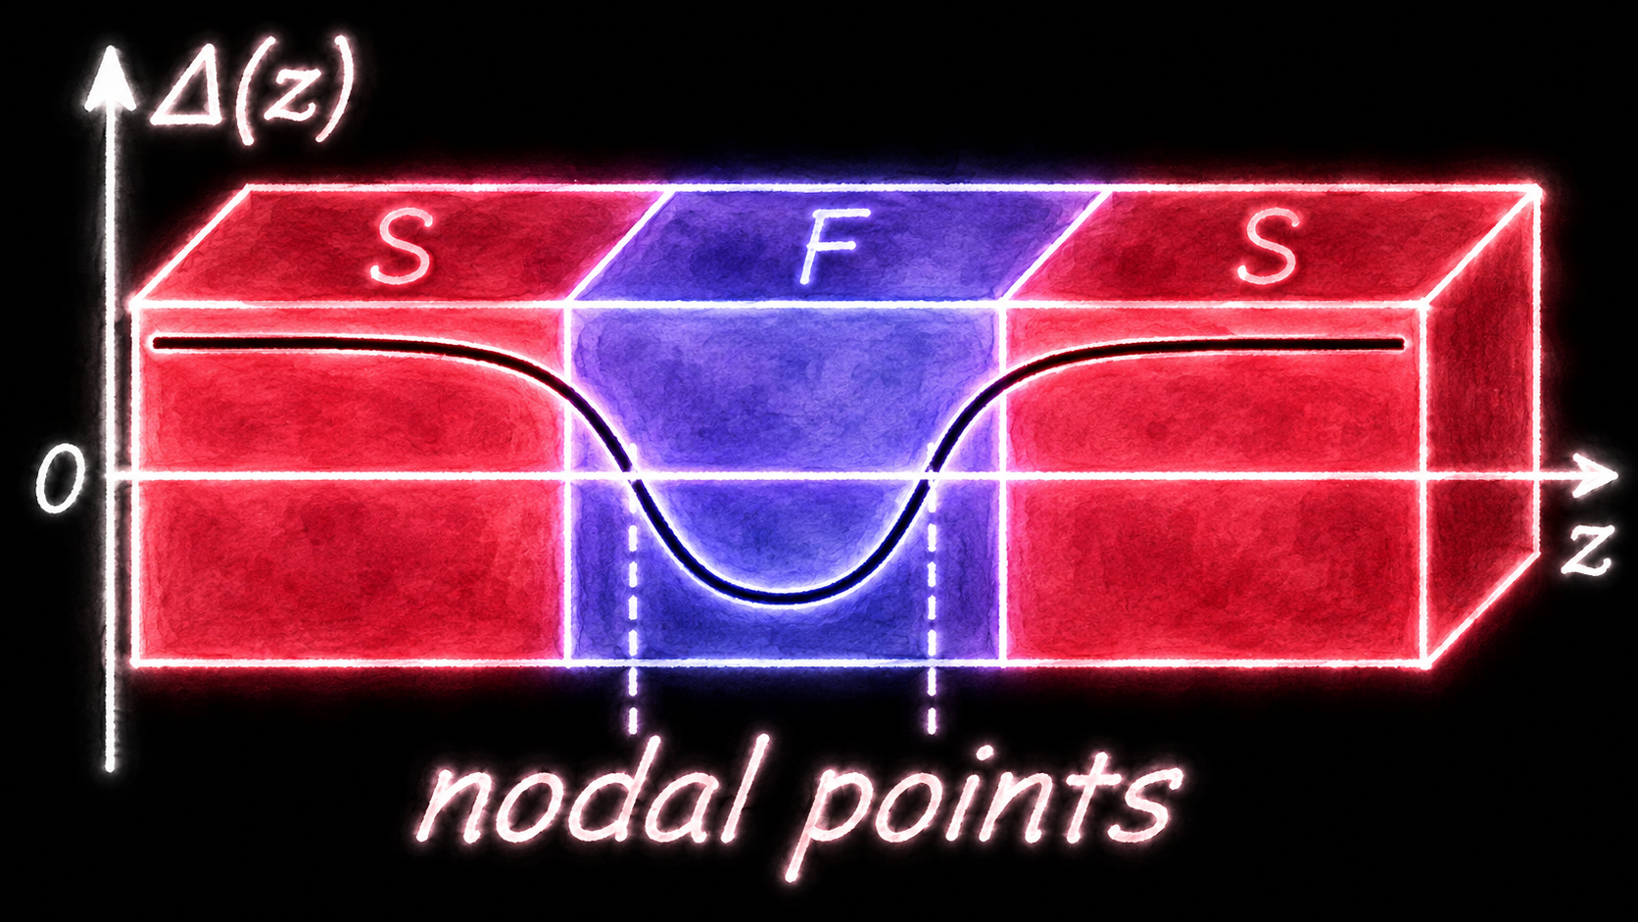
Energy Landscape of the Imbalanced Superfluid:
Ordered vs Disordered States
imprinted
random seed
Low P (~5%): single ferron is the clear ground state
Magierski, BT, Wlazłowski, Phys. Rev. A 100, 033613 (2019)
BT, Kukliński, Magierski, Wlazłowski, Acta Physica Polonica B 51, 595 (2020)
Magierski, BT, Wlazłowski, Phys. Rev. A 104, 033304 (2021)
BT, Zawiślak, Wlazłowski, Magierski, New J. Phys. 25, 033013 (2023)
SFS junction: Andreev bound states form inside the normal region with energies below the gap.

Slide 17
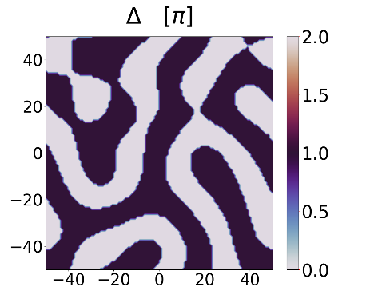
Energy Landscape of the Imbalanced Superfluid:
Ordered vs Disordered States
imprinted
random seed
imprinted
random seed
Low P (~5%): single ferron is the clear ground state
Medium P (~20%): many structures sit at comparable energies, no clear winner
Magierski, BT, Wlazłowski, Phys. Rev. A 100, 033613 (2019)
BT, Kukliński, Magierski, Wlazłowski, Acta Physica Polonica B 51, 595 (2020)
Magierski, BT, Wlazłowski, Phys. Rev. A 104, 033304 (2021)
BT, Zawiślak, Wlazłowski, Magierski, New J. Phys. 25, 033013 (2023)

Slide 18
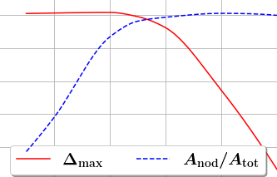
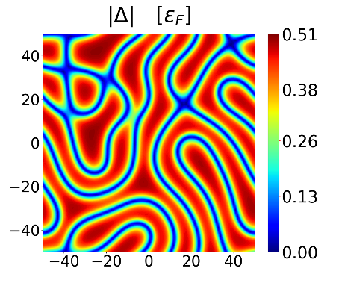






To higher polarization
0.5
0.5
0.4
0.4
0.3
$$A_{\text{nod}}/A_{\text{tot}}$$
$$\left|Δ\right|/ε_{F}$$
0.3
0.2
0.2
0.1
0.1
$$A_{\text{nod}}=\int{δ\left(\arg\left[Δ\left(r\right)\right]−π\right)} dr$$
0
0
10
20
30
40
50
$$𝒫\left[\%\right]$$
$$A_{\text{tot}}=\left(N_{x}×N_{y}\right)dx^{2}$$
When $A_{\text{nod}}/A_{\text{tot}}≈0.5$ the system reaches to a threshold and starts to develop and order
In the high polarization regime, the pairing gets weaker

Slide 19
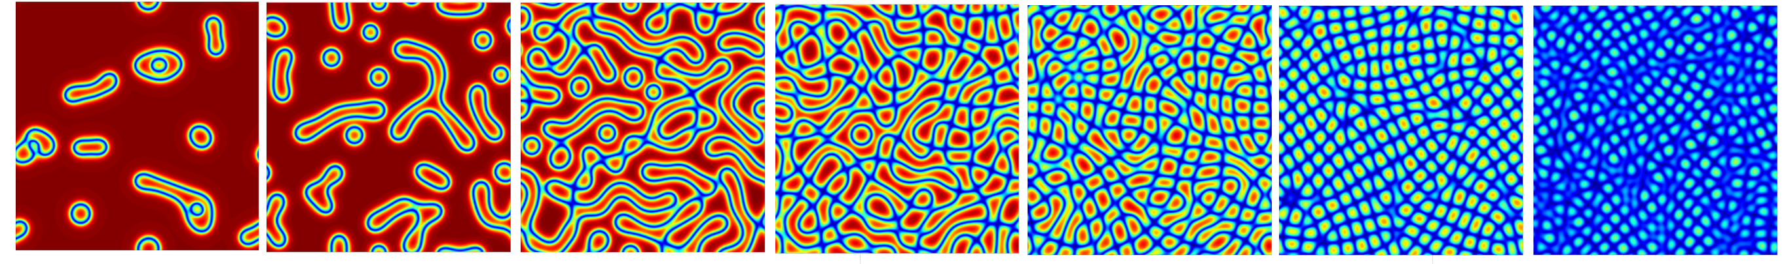
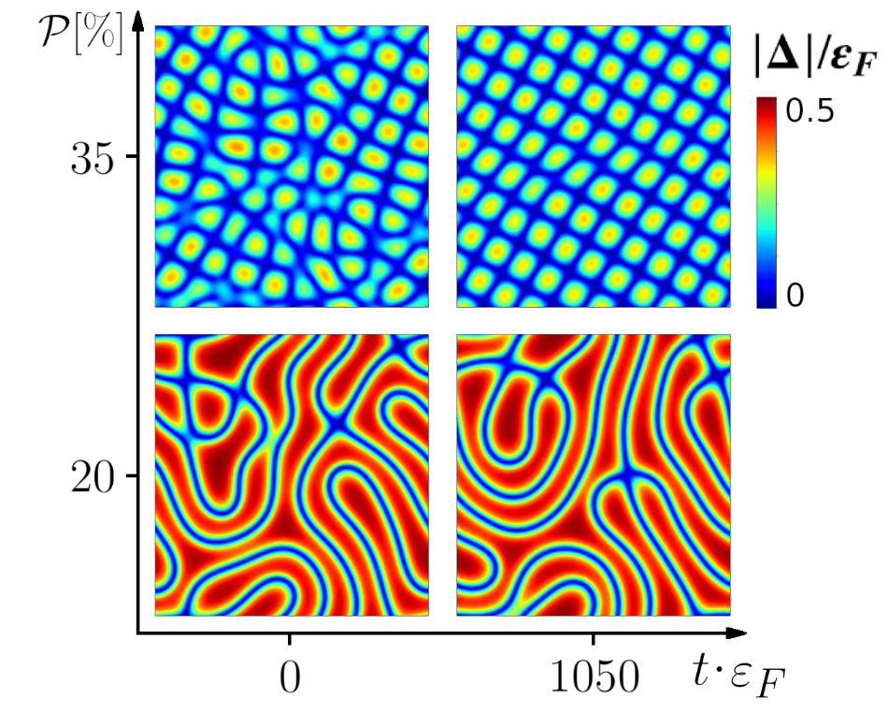


To higher polarization
0.5
0.5
0.4
0.4
0.3
$$A_{\text{nod}}/A_{\text{tot}}$$
$$\left|Δ\right|/ε_{F}$$
0.3
0.2
0.2
0.1
0.1
$$A_{\text{nod}}=\int{δ\left(\arg\left[Δ\left(r\right)\right]−π\right)} dr$$
0
0
10
20
30
40
50
$$𝒫\left[\%\right]$$
$$A_{\text{tot}}=\left(N_{x}×N_{y}\right)dx^{2}$$
$$\left|Δ\right|/ε_{F}$$
0.5
0
$$𝒫\left[\%\right]$$
5
10
20
25
30
35
40

Slide 20



Relaxation of the nodal lines
$$𝒫\left[\%\right]$$
$$\left|Δ\right|/ε_{F}$$
The presented structures do not necessarily form a stable minima.
These configurations can evolve into one another.
In medium polarization regime, it evolves into another however keeps the same liquid-crystal-like structure.
In high polarization regime, it develops order where it shows a density modulation and the global phase coherence resembling a supersolid.
0.5
35
0
25
0
10
$$t [ms]$$

Slide 21
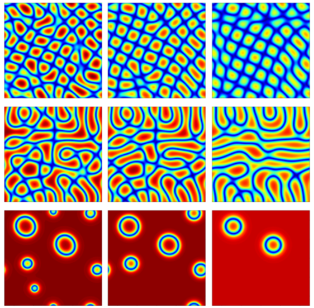
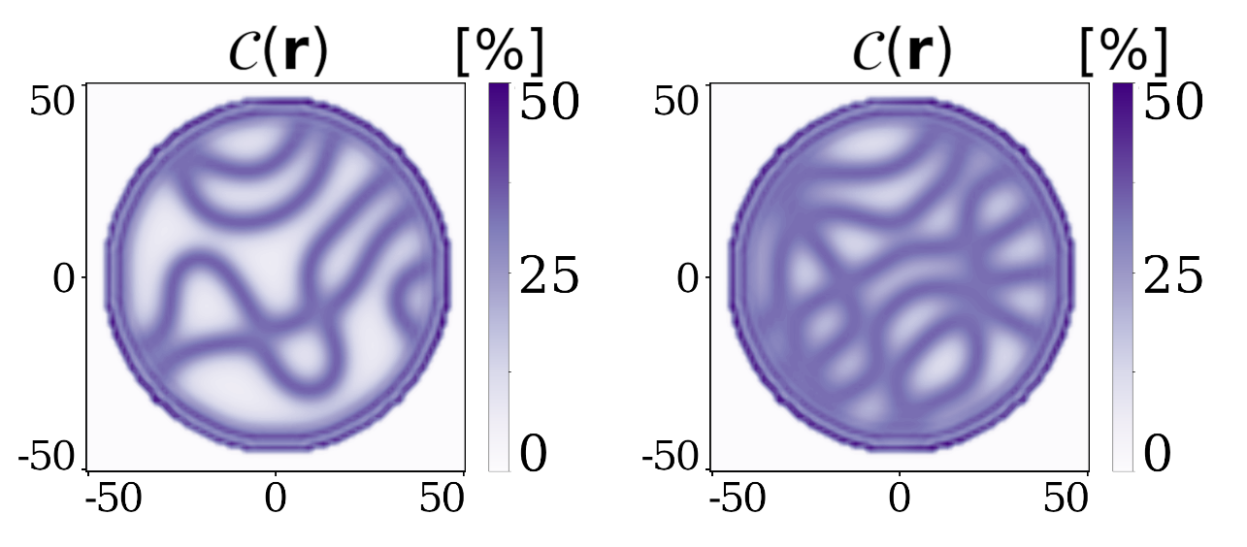





Robustness of the structures
$$𝒫\left[\%\right]$$
Cylindrical hard walls
$$\left|Δ\right|/ε_{F}$$
$$T/T_{c}=0.32$$
30
0.5
25
0
5
$$𝒫= 25\%$$
$$𝒫= 30\%$$
$$C\left(r\right)=\left[n_{↑}\left(r\right)−n_{↓}\left(r\right)\right]/\left[n_{↑}^{\left(\text{bulk}\right)}+n_{↓}^{\left(\text{bulk}\right)}\right]$$
0
0.12
0.25
$$T/T_{c}$$

Slide 22
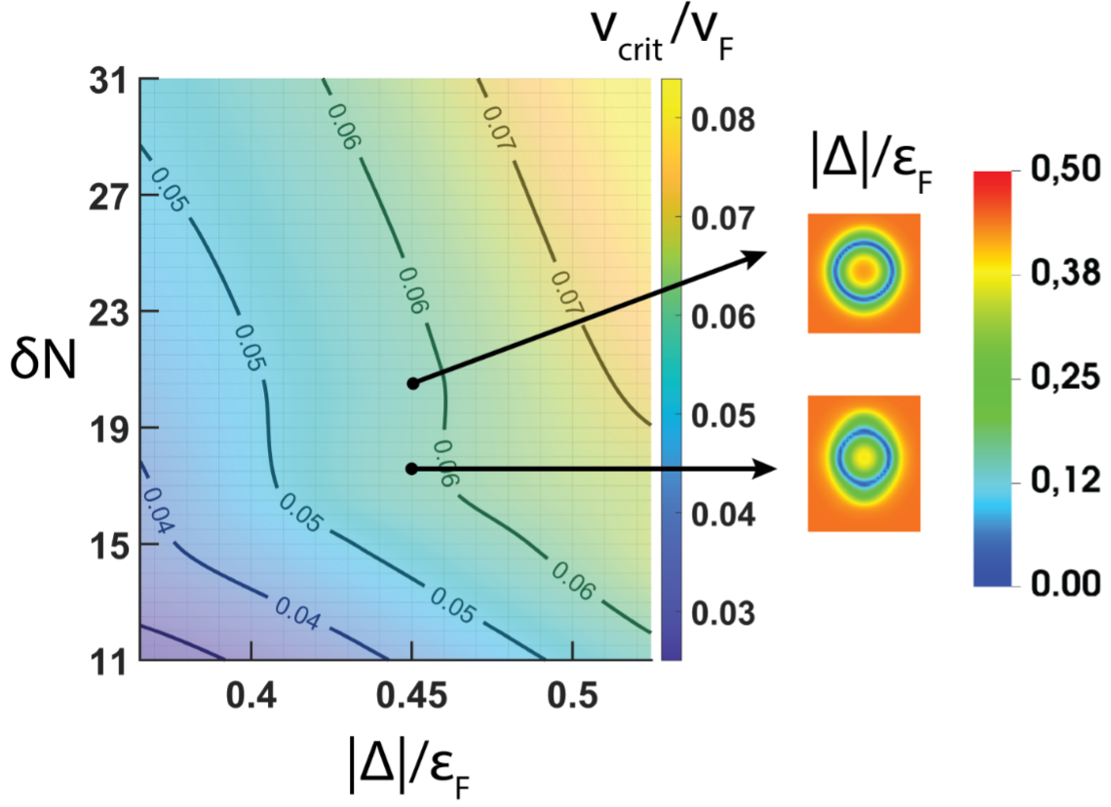
Robustness of the structures
$$𝒫\left[\%\right]$$
$$\left|Δ\right|/ε_{F}$$
30
0.5
25
0
5
0
0.12
0.25
$$T/T_{c}$$

Slide 23
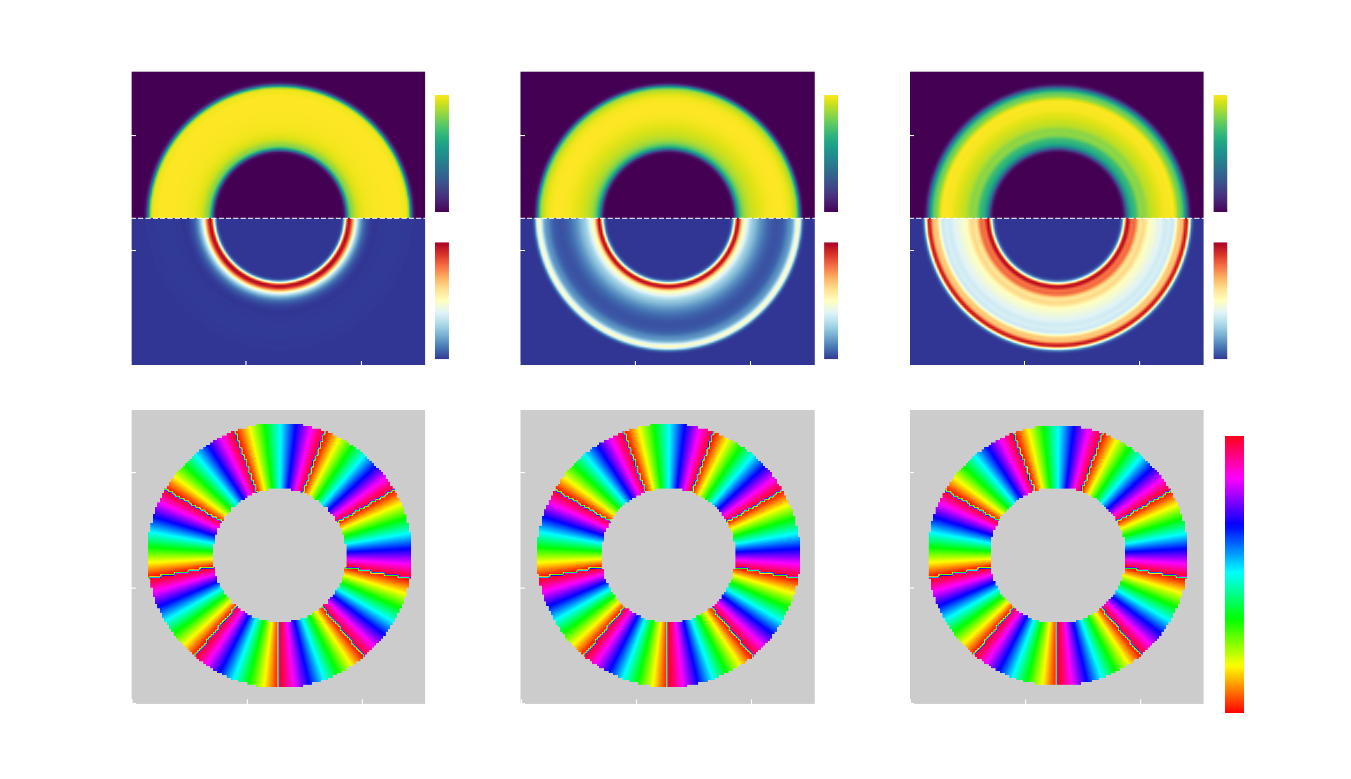
Persistent currents in the presence of spin-imbalance

Slide 24
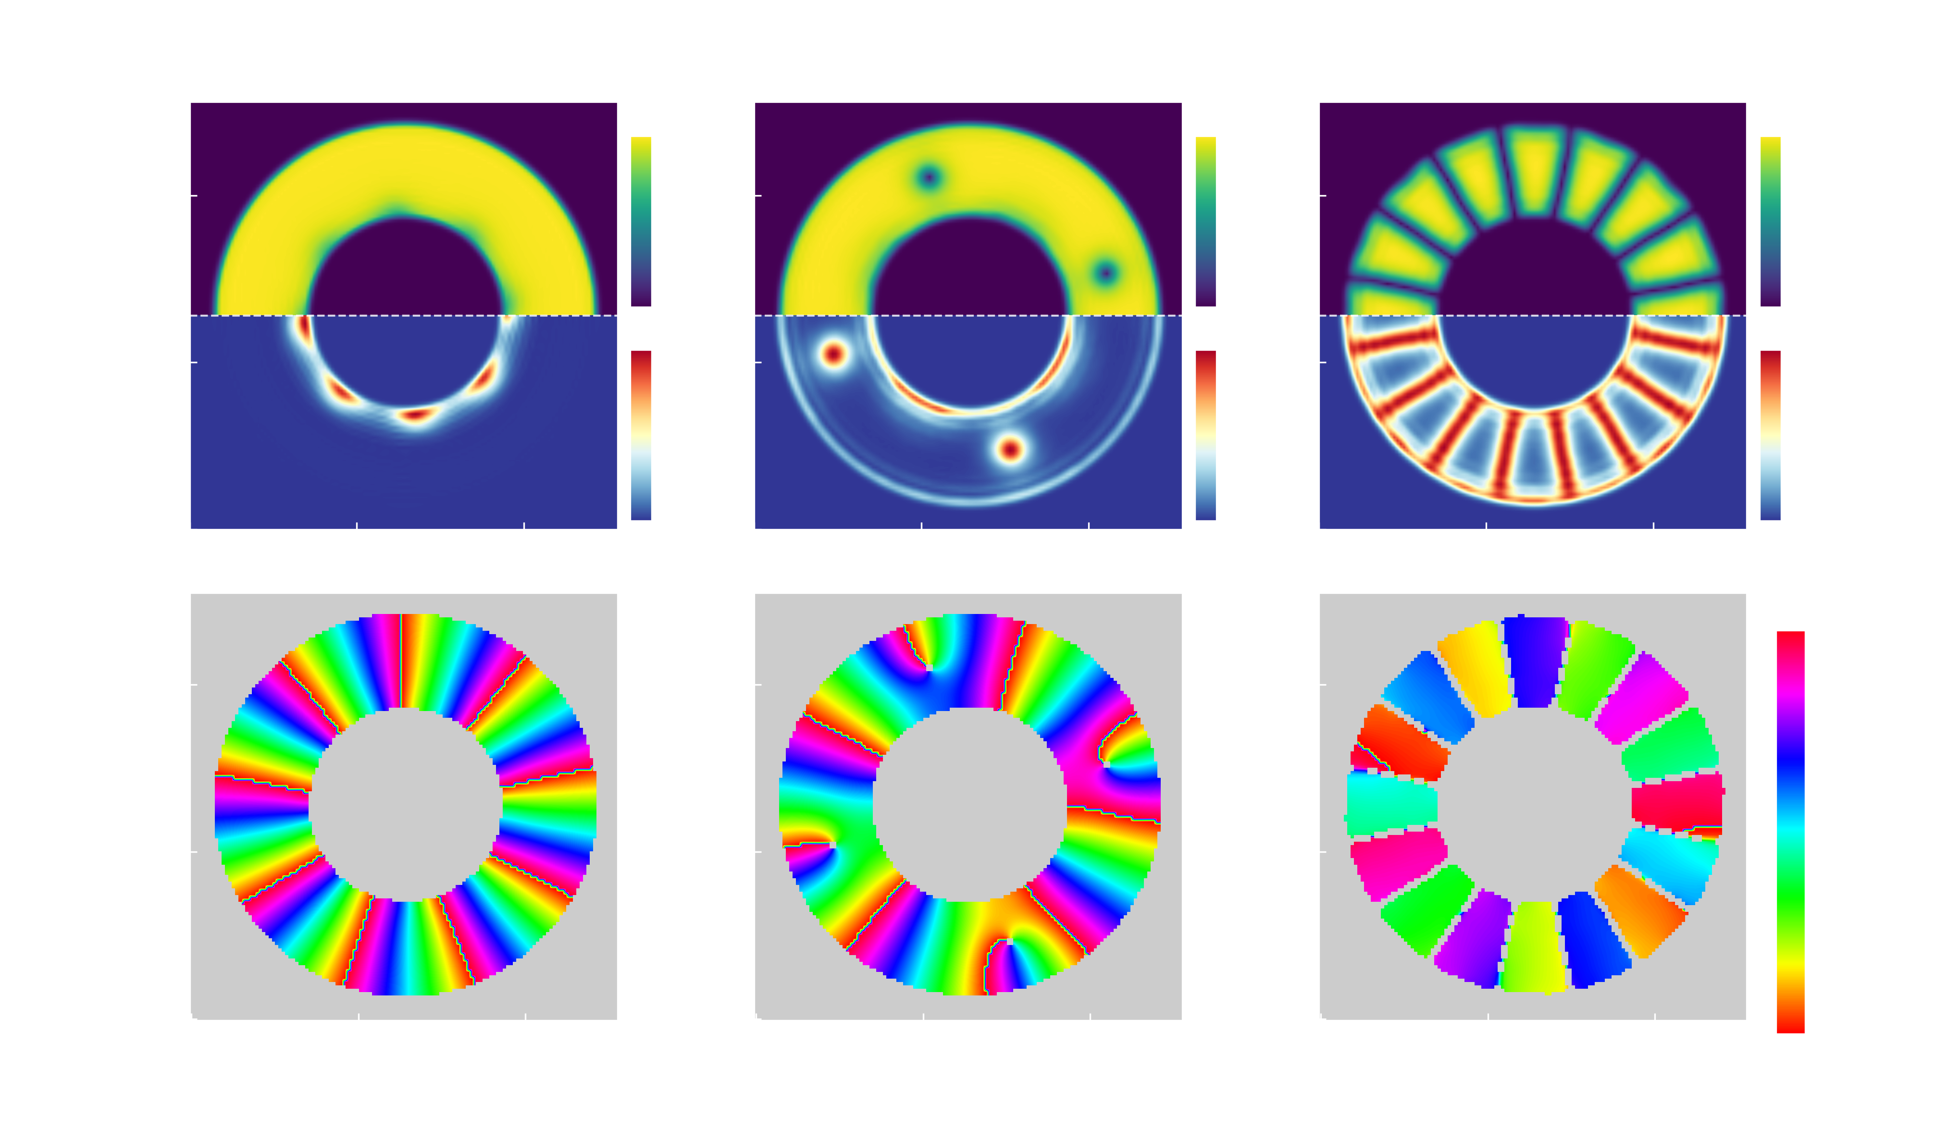
Persistent currents in the presence of spin-imbalance

Slide 25
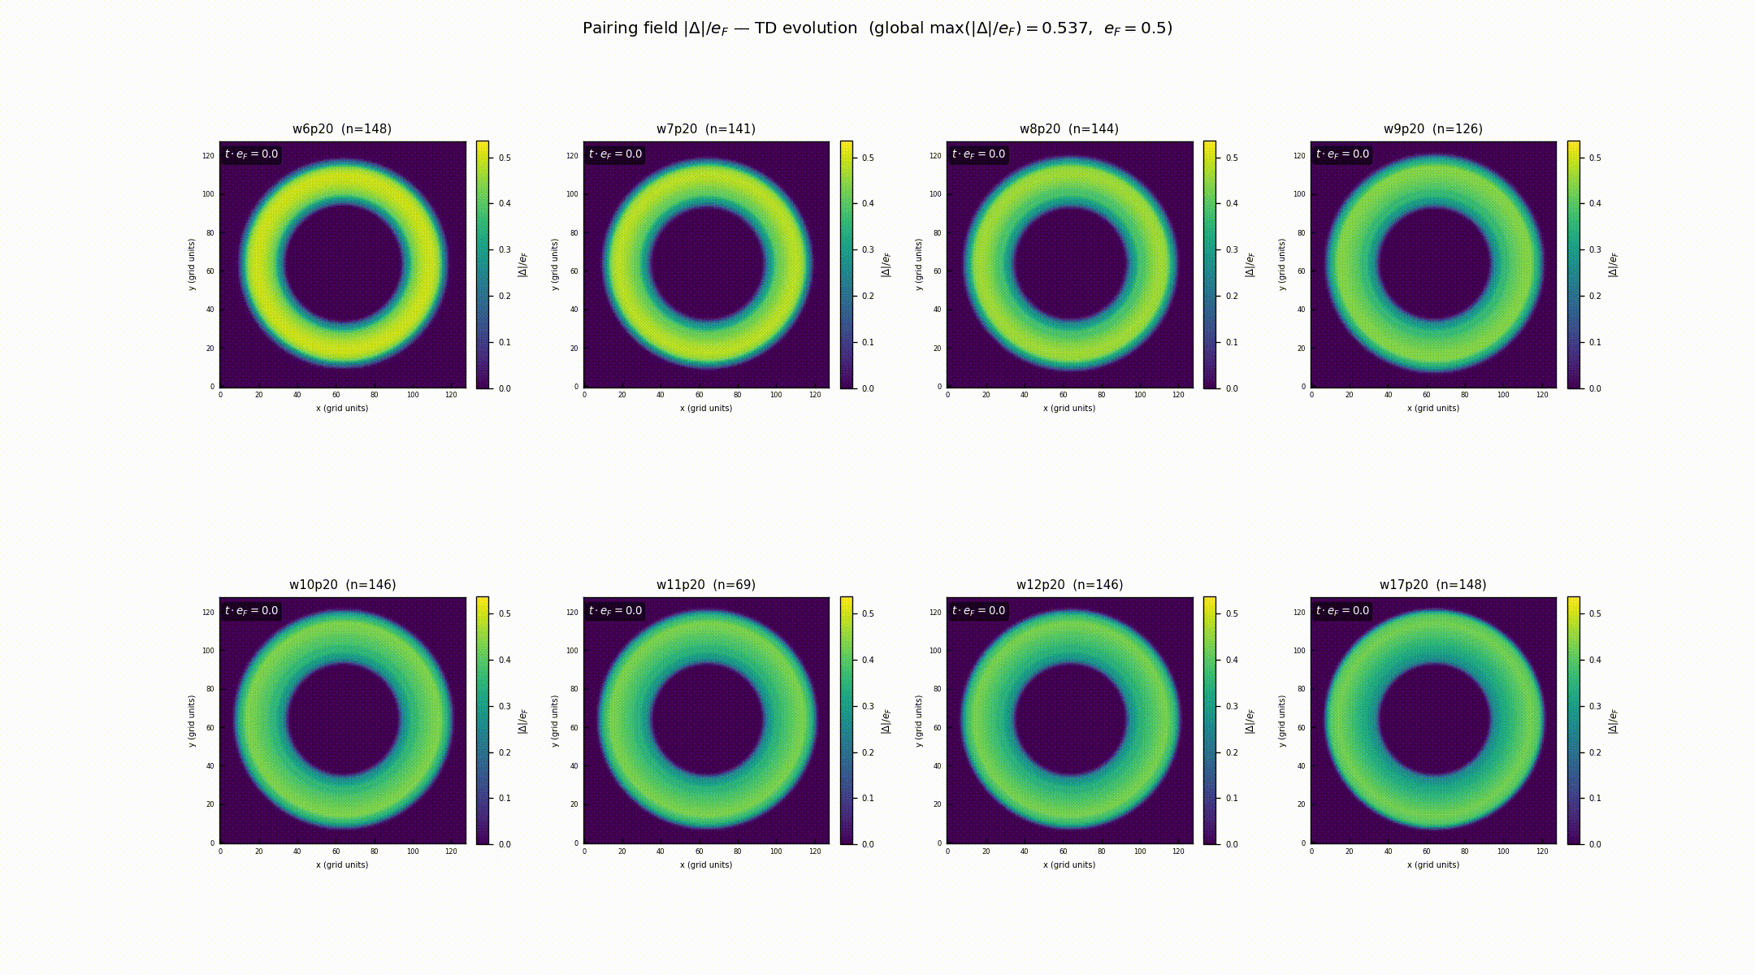
Persistent currents in the presence of spin-imbalance

Slide 26
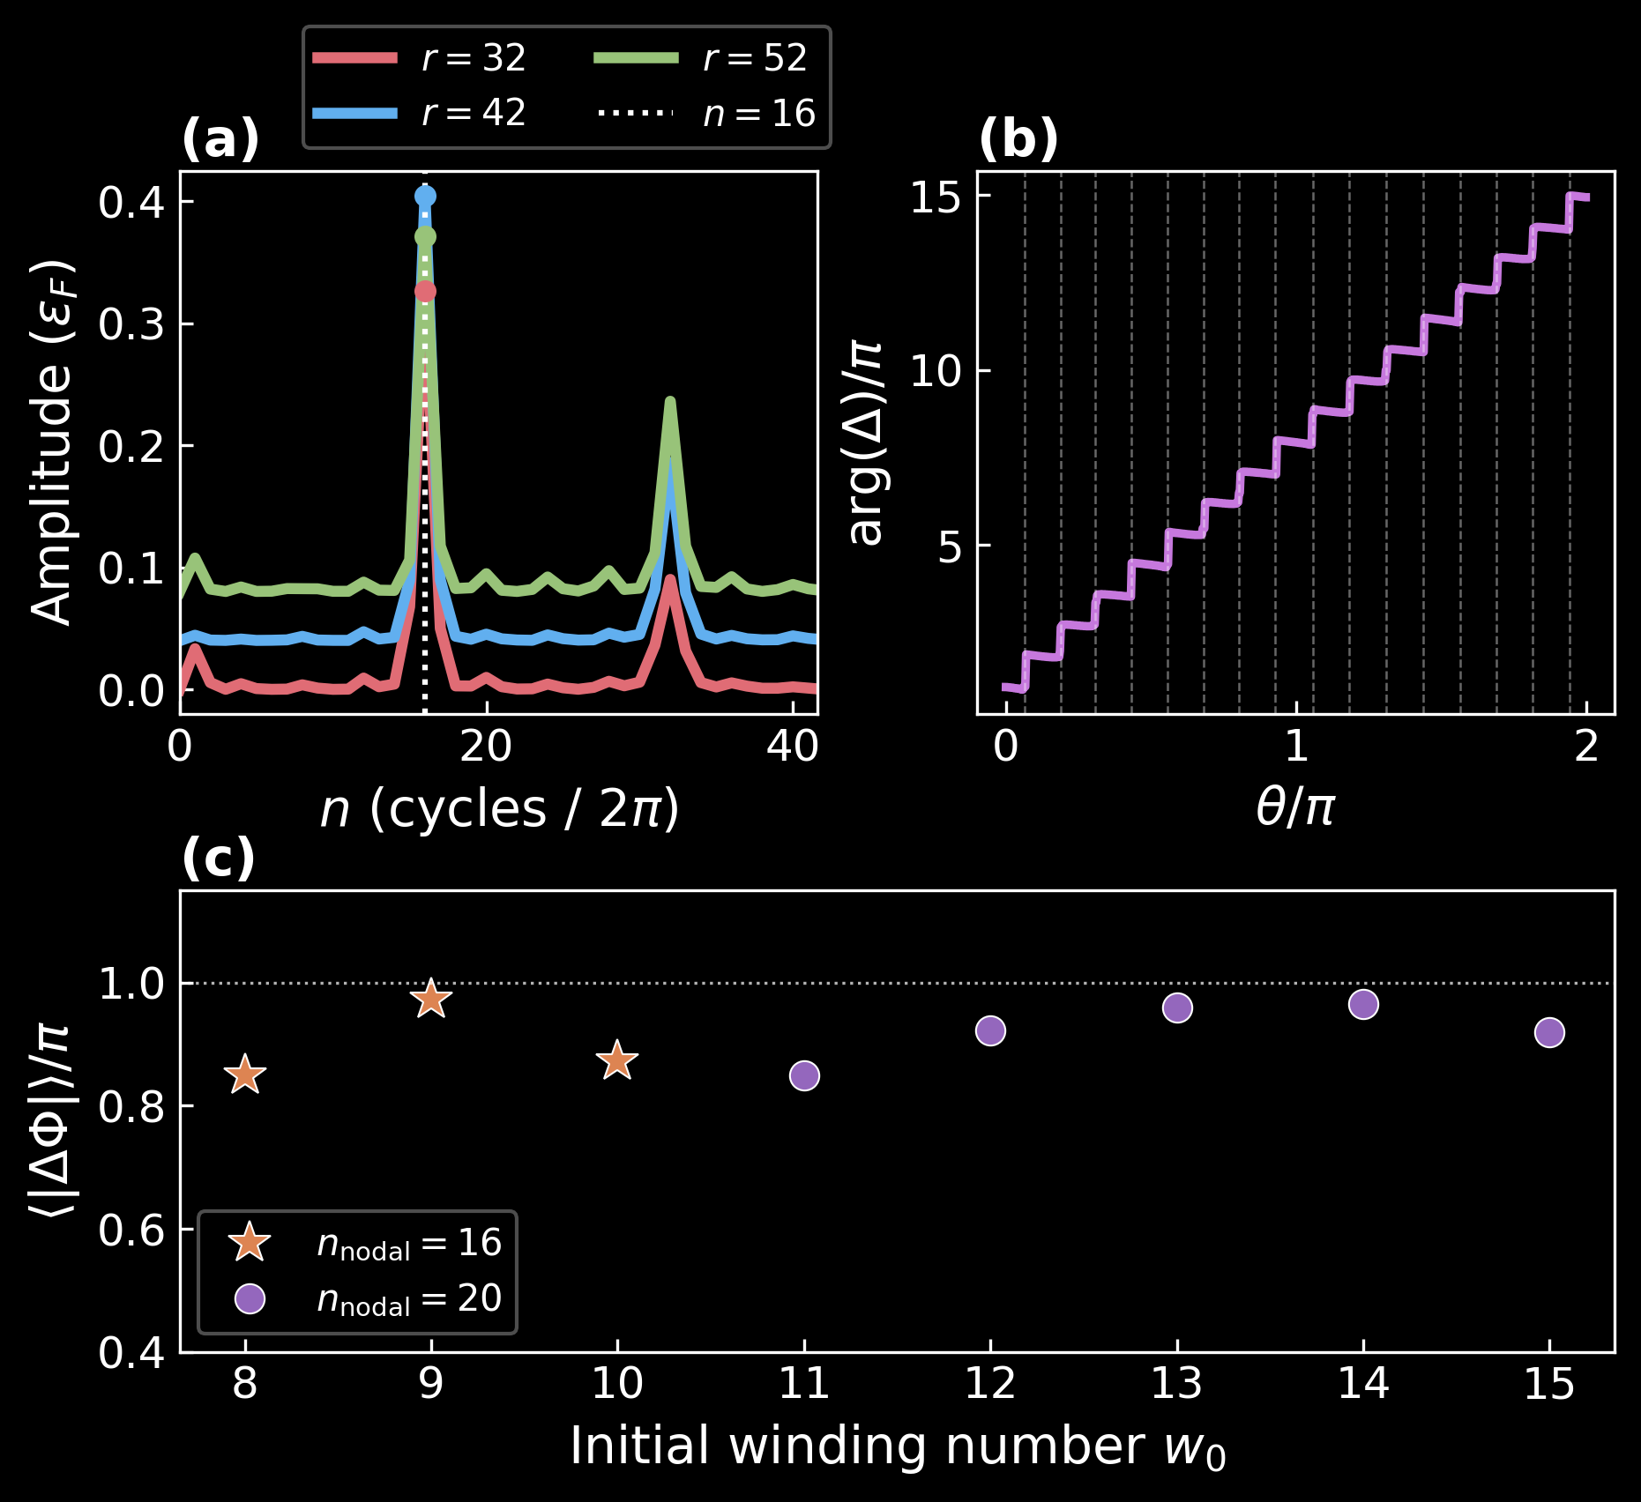
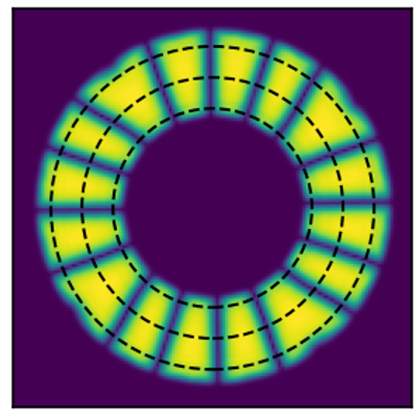
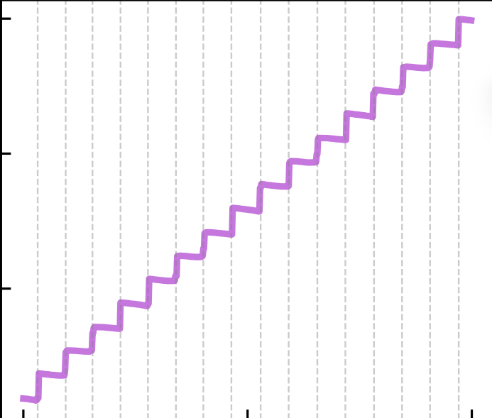
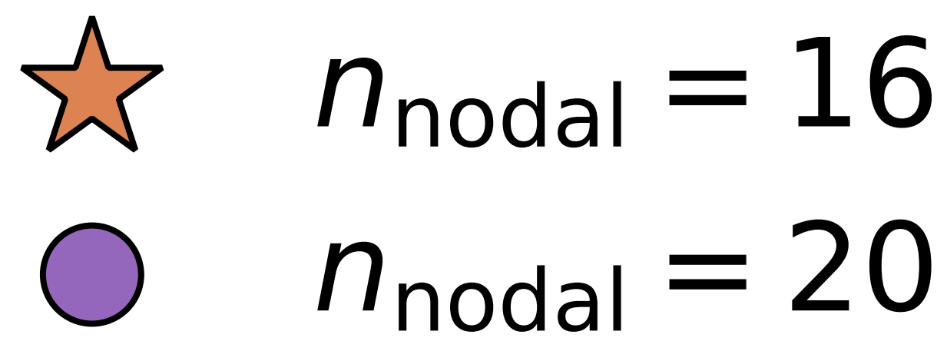

Persistent currents in the presence of spin-imbalance
pattern is not set by Fermi surface mismatch
modulation wavevector differs from FFLO prediction by a factor of ~3.6
continuous translational symmetry broken spontaneously $→$ no external imprinting

Slide 27
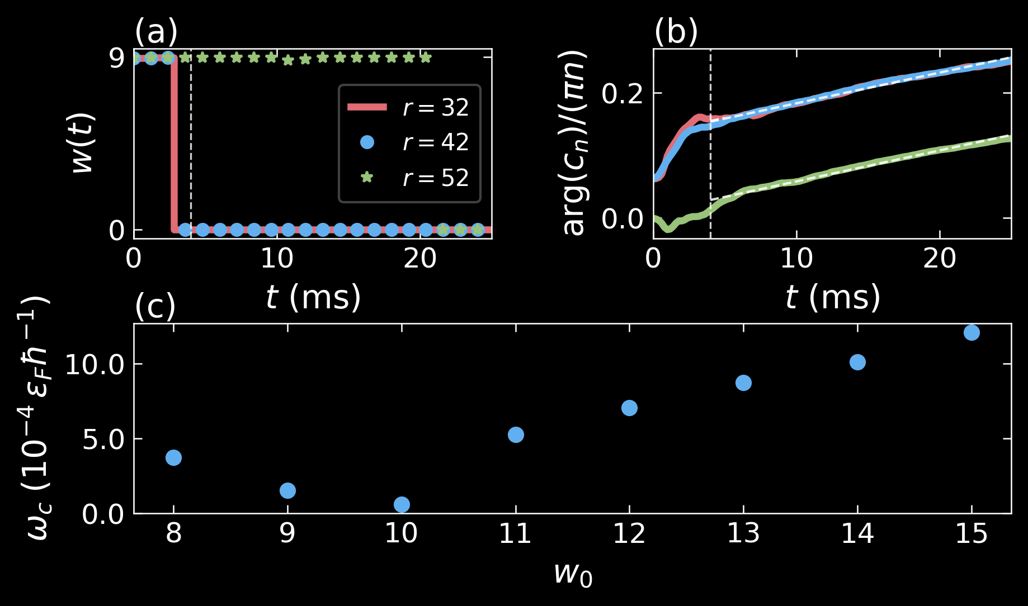
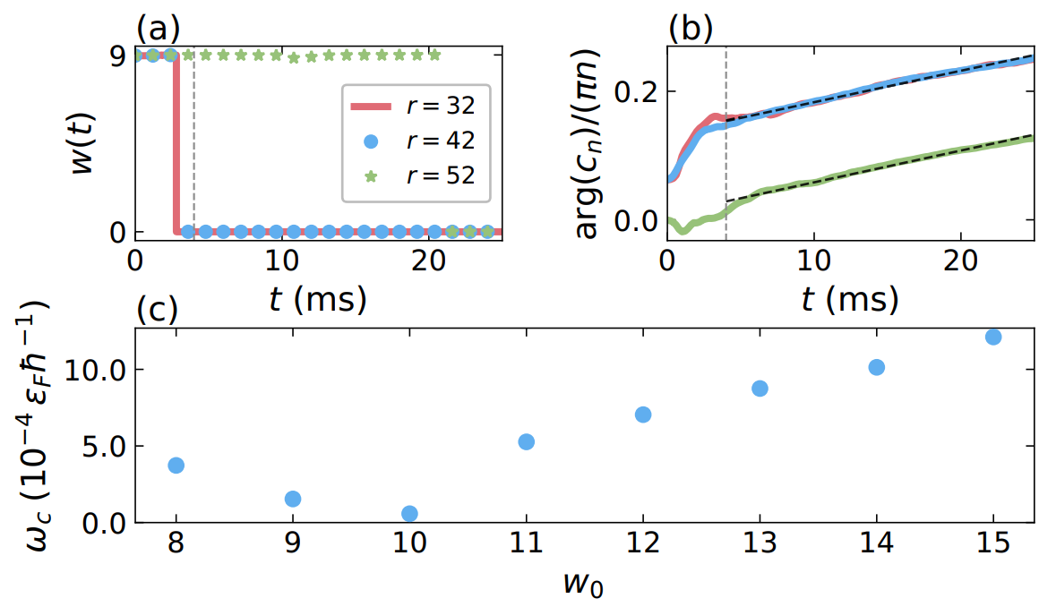


Persistent currents in the presence of spin-imbalance
The nodal pattern rotates at constant angular velocity $→$ rigid body rotation
At a fixed R, the pairing field amplitude on the ring rotates at angular velocity $ω_{c}$, we have the following pairing profile: $\left|Δ\left(θ,t\right)\right|=f\left(θ−ω_{c}t\right)$
We can get the angular velocity from the Fourier analysis
$$c_{n}\left(t\right)=\int_{0}^{2π}{f\left(θ−ω_{c} t\right)} e^{−inθ} \text{d}θ$$
$$=e^{−inω_{c}t} c_{n}\left(0\right)$$
$$ω_{c}=−\frac{1}{n}\frac{\text{d}}{\text{dt}}\arg{c_{n}t}$$
This identifies as the collective coordinate associated with the translational Goldstone mode

Slide 28
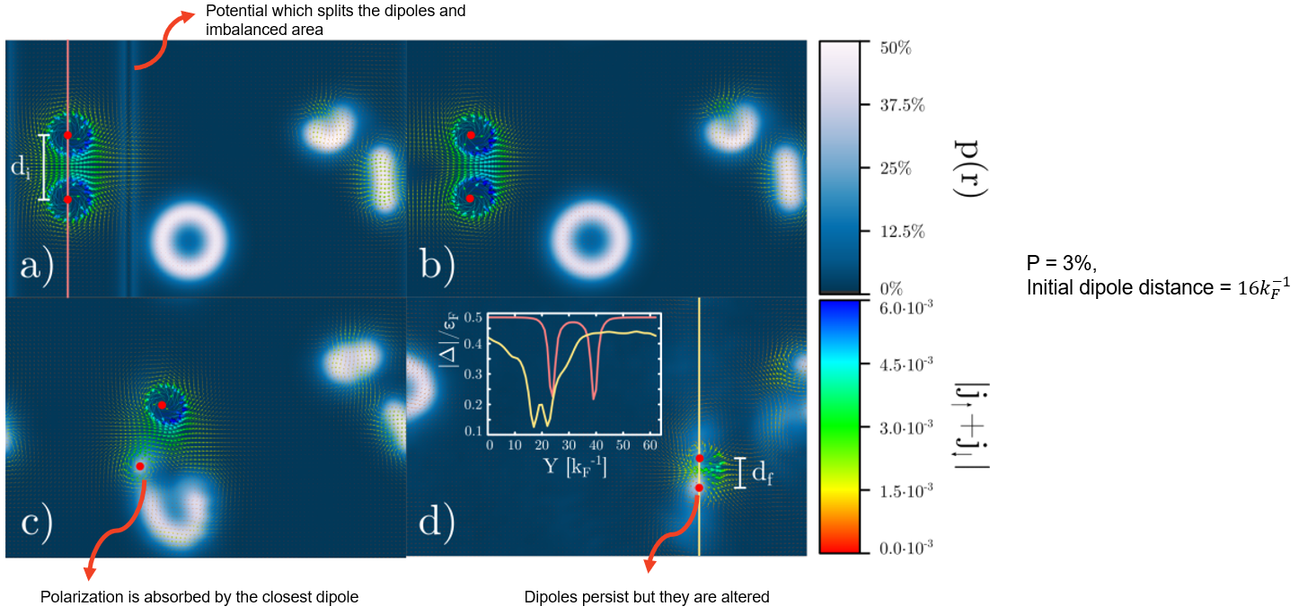
Vortex dynamics in spin-imbalanced gas
Andrea Barresi PhD. Thesis, 2024

Slide 29
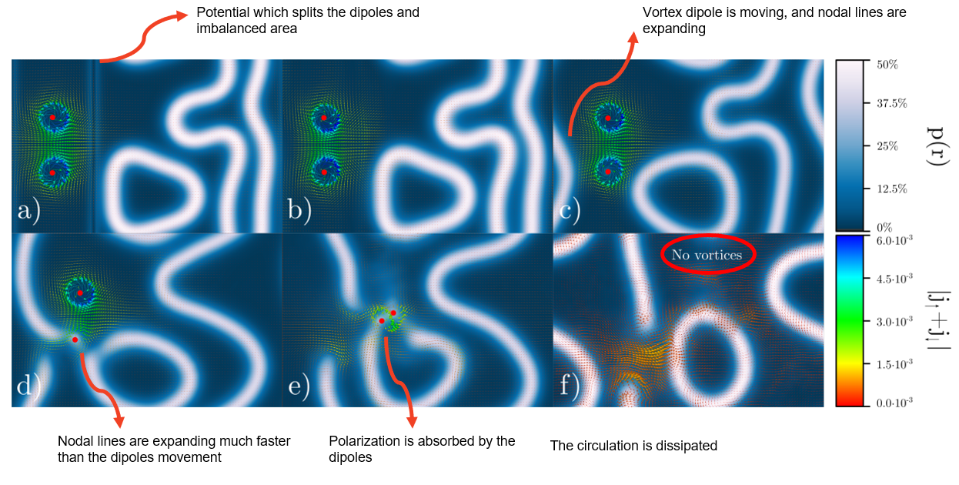
Andrea Barresi PhD. Thesis, 2024

Slide 30
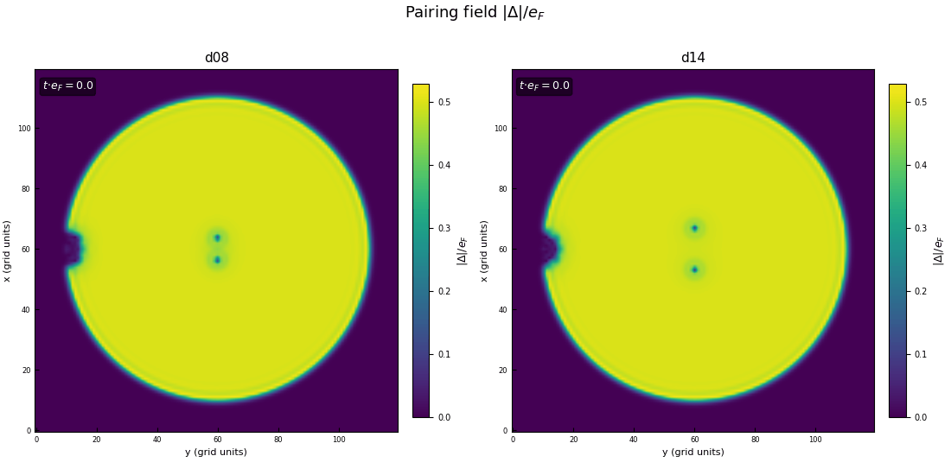
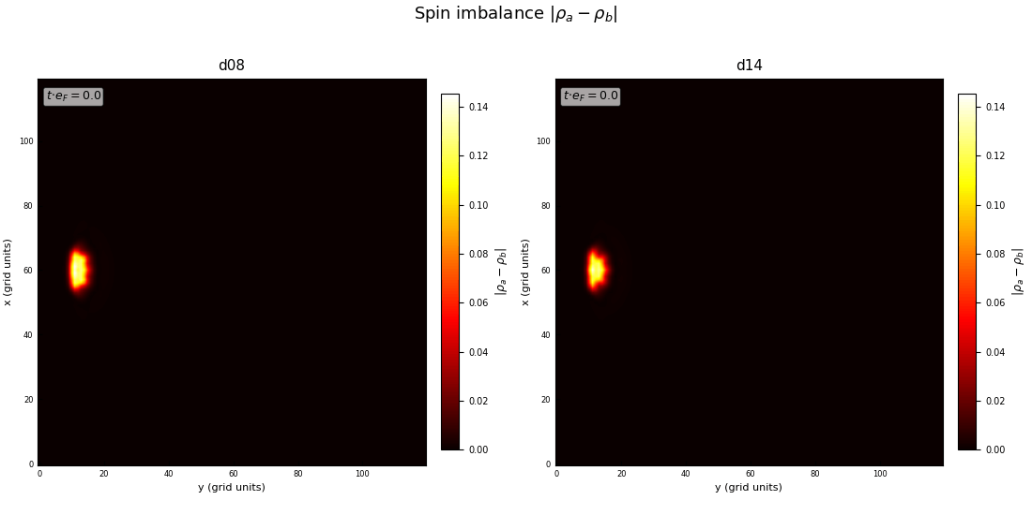
Spin transport through vortex dipole
We create a polarized region near the boundary by locally raising the chemical potential difference between the spin components.
A vortex dipole is then launched from the disk center toward the boundary, where it splits and the two vortices travel along the edge in opposite directions.
On entering the polarized region, the vortices absorb excess spin particles and experience enhanced dissipation, causing the dipole to gradually shrink.

Slide 31
Take home messages
Spin imbalance does not select a clean FFLO state. At low polarization the ferron is the ground state; at intermediate polarization, ordered and disordered structures sit at near-degenerate energies
A vortex dipole is a controllable, local probe of this inhomogeneous superfluid.
With persistent current, imbalance opens a new decay/self-organization channel
The resulting nodal pattern is not ordinary FFLO; its wavevector is constrained by the imposed winding.
The pattern rotates as a collective sliding coordinate of the broken translational symmetry
The same competition between pairing and spin imbalance that produces disorder in a box can produce order in a ring with persistent currents.

Slide 32





Thank you!
Piotr Magierski (Warsaw University of Technology)
Gabriel Wlazłowski (Warsaw University of Technology)
Klejdja Xhani (Politecnico di Torino)
Andrea Barresi (Warsaw University of Technology)
Tomasz Zawiślak (Universita di Trento)
Jakub Sosnowski (Warsaw University of Technology)

