Slide 1
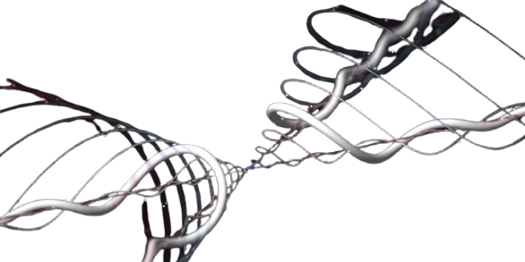
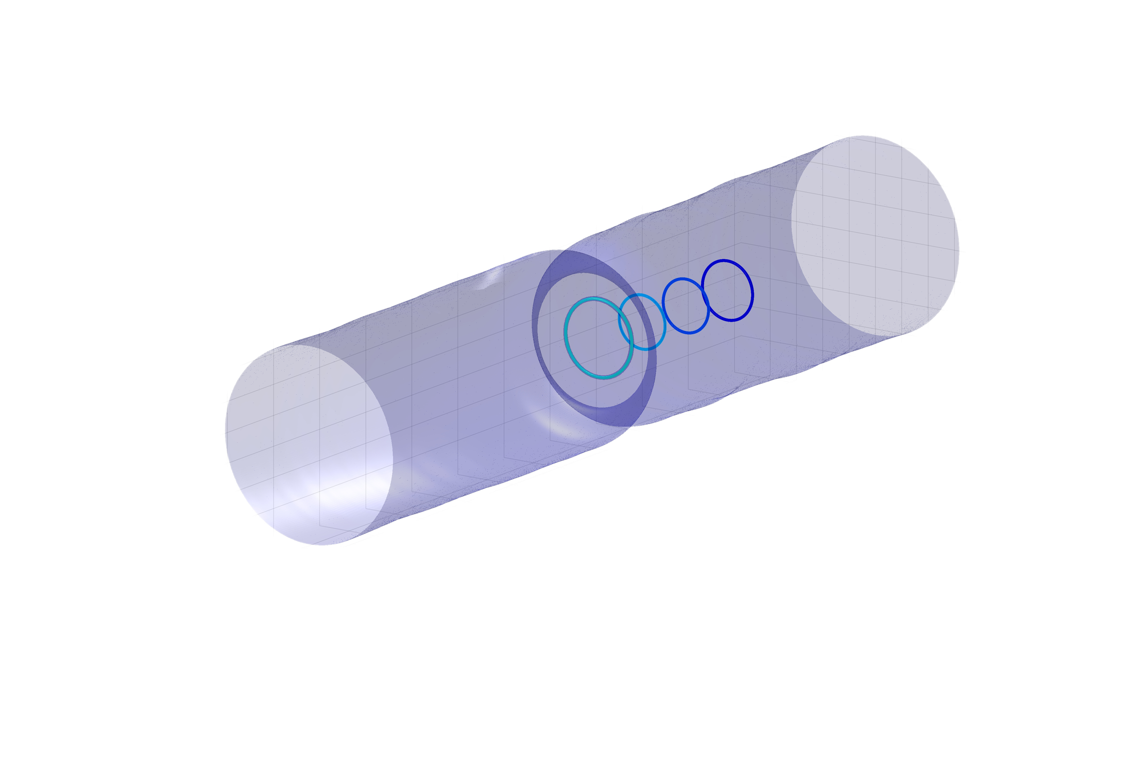

Reproducible nucleation and control of stable quantum vortex rings in Bose-Einstein condensates
G. Iori, K. Xhani, W.J. Kwon, D.E. Galli, L. Galantucci
Giorgia Iori
rd
Università degli Studi di Milano
June 23 , 2026

Slide 2
Reproducible nucleation and control of stable quantum vortex rings in Bose-Einstein condensates
G. Iori, K. Xhani, W.J. Kwon, D.E. Galli, L. Galantucci
How can we generate and manipulate 3D quantum vortices?
Giorgia Iori
rd
Università degli Studi di Milano
June 23 , 2026

Slide 3
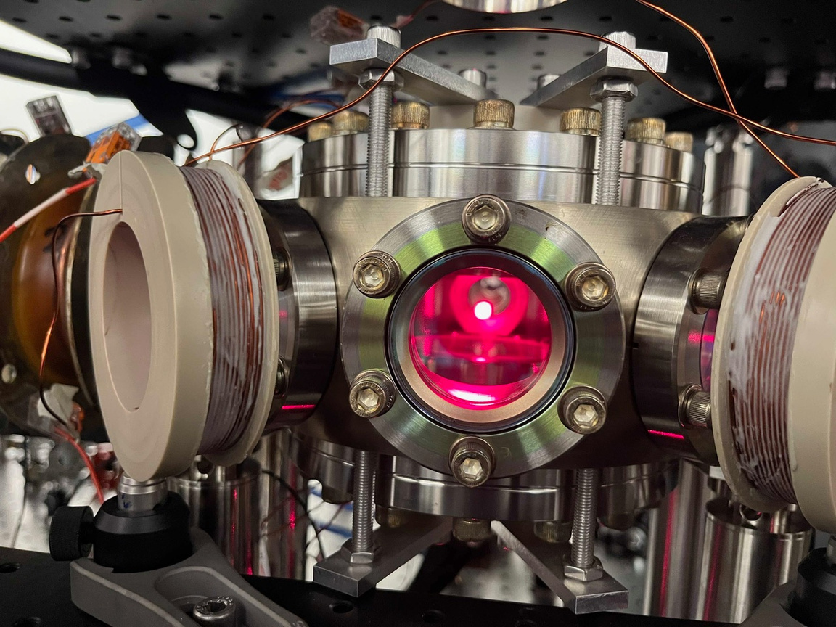
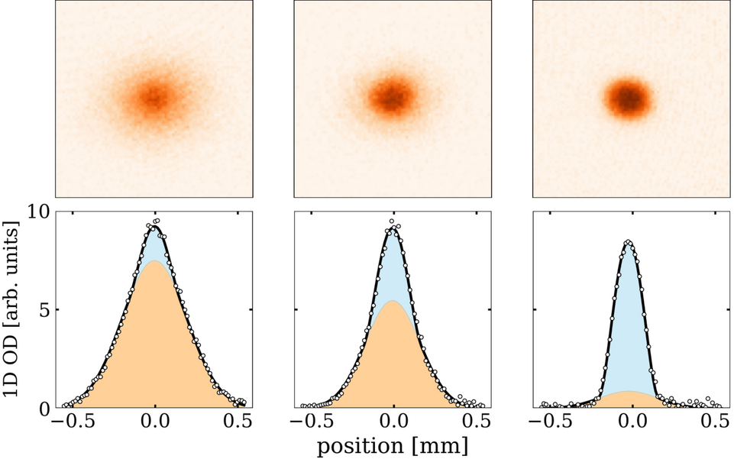
Motivation
Woo Jin Kwon’s ultracold lab has recently opened in Milan!
1

Slide 4
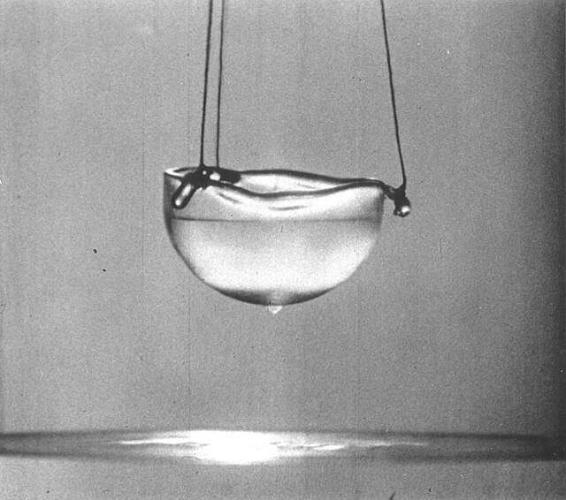
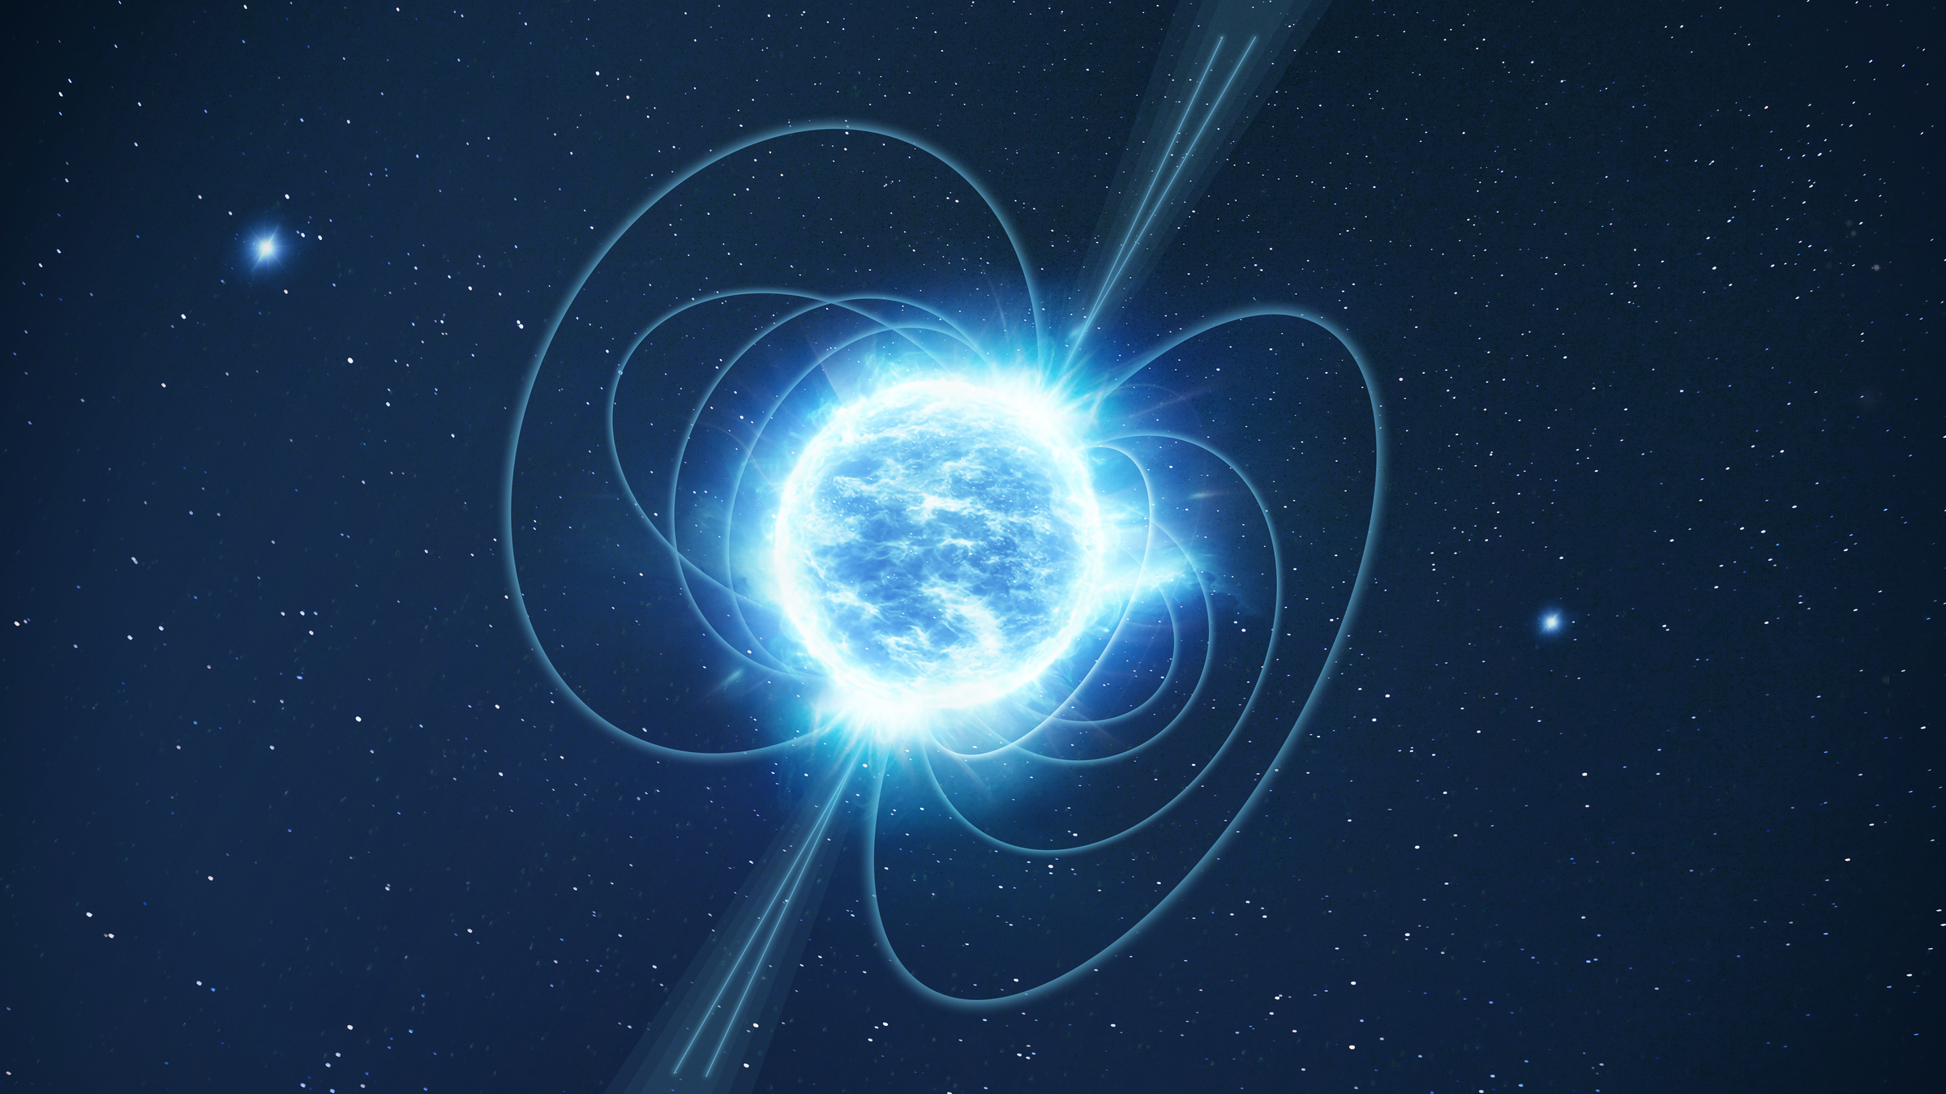
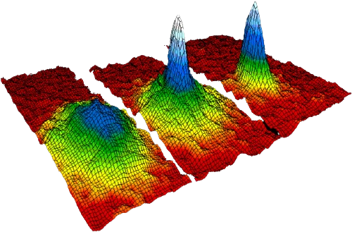

Relevance
C. F. Barenghi et al., Quantum Turbulence, CUP (2023)
B. Haskell et al., Int. J. Mod. Phyics D 24, 530008 (2015)
superfluid helium
interior of neutron stars
Quantum fluids
ultracold atomic gases
polariton condensates
A. C. White et al., PNAS 111, 4719 (2014)
R. Panico et al., Nature Photonics 17, 451 (2023)
2

Slide 5
Relevance
M. Tinkham, Introduction to Superconductivity (1996)
S. R. Stalp et al., Phys. Rev. Lett. 82, 4831 (1999)
M. La Mantia and L. Skrbek, Europhys Lett 105, 46002 (2014)
L. Galantucci, J. Fluid Mech. 1022, F1 (2025)
superfluid helium
interior of neutron stars
superconductors
Quantum fluids
turbulence
ultracold atomic gases
polariton condensates
2

Slide 6
Relevance
Controlled vortex dynamics
3

Slide 7
Relevance
Platform for exploring fundamental physics of a broad range of systems in a clean and tunable environment
Controlled vortex dynamics
3

Slide 8
Relevance
Controlled vortex dynamics
How far have we come?
What is still missing?
3

Slide 9
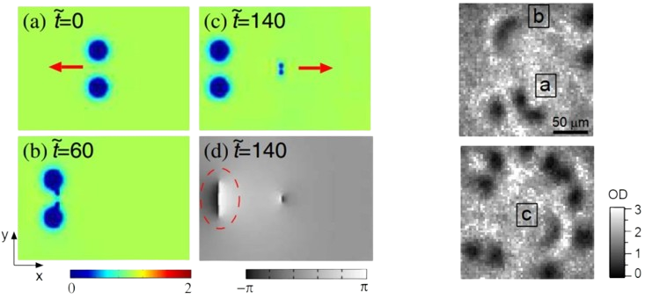
A road to controlling quantum vortices
2D
Numerical protocol for controlled nucleation of vortex dipoles
T. Aioi et al., Phys. Rev. X 1, 021003 (2011)
4

Slide 10
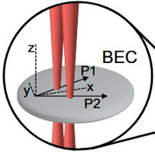
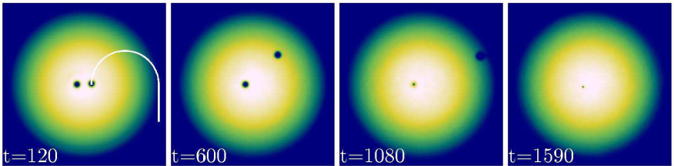
A road to controlling quantum vortices
2D
Numerical protocol for controlled nucleation of vortex dipoles
T. Aioi et al., Phys. Rev. X 1, 021003 (2011)
Protocol for engineering many-vortex distributions: chopsticks method
B. Gertjerenken et al., Phys. Rev. A 93, 023604 (2016)
E.C. Samson et al., Phys. Rev. A 93, 023603 (2016)
4

Slide 11
A road to controlling quantum vortices
2D
Numerical protocol for controlled nucleation of vortex dipoles
T. Aioi et al., Phys. Rev. X 1, 021003 (2011)
Protocol for engineering many-vortex distributions: chopsticks method
B. Gertjerenken et al., Phys. Rev. A 93, 023604 (2016)
E.C. Samson et al., Phys. Rev. A 93, 023603 (2016)
Experimental ad-hoc generation and manipulation of vortex dipoles
W.J. Kwon et al., Nature 600, 64–69 (2021)
4

Slide 12
A road to controlling quantum vortices
2D
Numerical protocol for controlled nucleation of vortex dipoles
T. Aioi et al., Phys. Rev. X 1, 021003 (2011)
Protocol for engineering many-vortex distributions: chopsticks method
B. Gertjerenken et al., Phys. Rev. A 93, 023604 (2016)
E.C. Samson et al., Phys. Rev. A 93, 023603 (2016)
Control achieved in 2D
Experimental ad-hoc generation and manipulation of vortex dipoles
W.J. Kwon et al., Nature 600, 64–69 (2021)
4

Slide 13
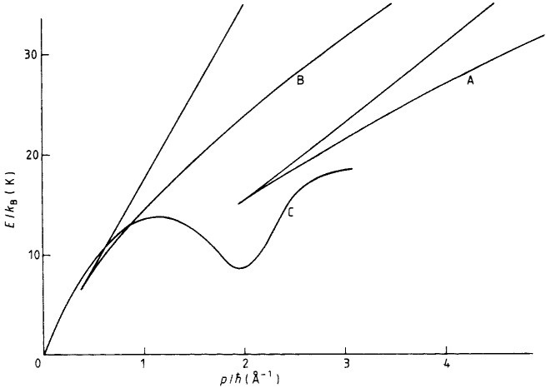
A road to controlling quantum vortices
3D
Study and classification of solitary waves
C.A. Jones, P.H. Roberts, J. Phys. A: Math. Gen. 15 2599 (1982)
5

Slide 14
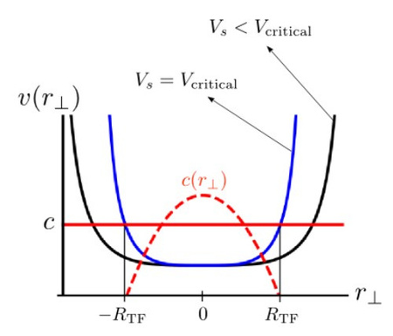
A road to controlling quantum vortices
3D
Study and classification of solitary waves
Numerical study of instability condition and dynamics with a constriction across the flow
C.A. Jones, P.H. Roberts, J. Phys. A: Math. Gen. 15 2599 (1982)
F Piazza et al., New J. Phys. 13 043008 (2011)
5

Slide 15
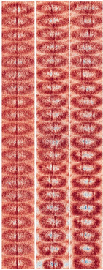
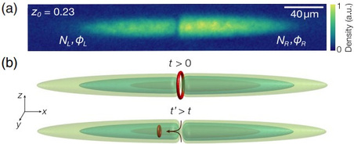
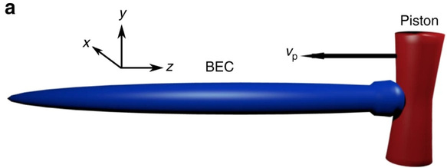
A road to controlling quantum vortices
3D
Study and classification of solitary waves
Numerical study of instability condition and dynamics with a constriction across the flow
C.A. Jones, P.H. Roberts, J. Phys. A: Math. Gen. 15 2599 (1982)
Generation of vortices stochastically, through Josephson junctions or by means of quantum pistons
F Piazza et al., New J. Phys. 13 043008 (2011)
S. Serafini et al., Phys. Rev. Lett. 115, 170402 (2015)
A. Burchianti et al., Phys. Rev. Lett. 120, 025302 (2018)
M.E. Mossman et al., Nat. Commun. 9, 4665 (2018)
5

Slide 16
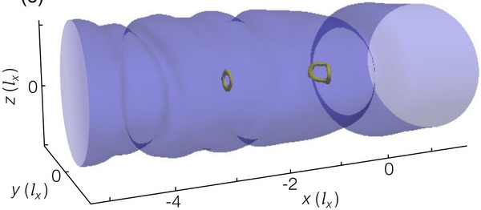
A road to controlling quantum vortices
3D
Study and classification of solitary waves
Numerical study of instability condition and dynamics with a constriction across the flow
C.A. Jones, P.H. Roberts, J. Phys. A: Math. Gen. 15 2599 (1982)
Generation of vortices stochastically, through Josephson junctions or by means of quantum pistons
F Piazza et al., New J. Phys. 13 043008 (2011)
Numerical and experimental study on vortex nucleation and dynamics in
trapped condensates
S. Serafini et al., Phys. Rev. Lett. 115, 170402 (2015)
A. Burchianti et al., Phys. Rev. Lett. 120, 025302 (2018)
M.E. Mossman et al., Nat. Commun. 9, 4665 (2018)
K. Xhani et al., Phys. Rev. Lett. 124, 045301 (2020)
K. Xhani et al., New J. Phys. 22, 123006 (2020)
V. Singh, et al., arXiv:2511.05645 (2025)
5

Slide 17
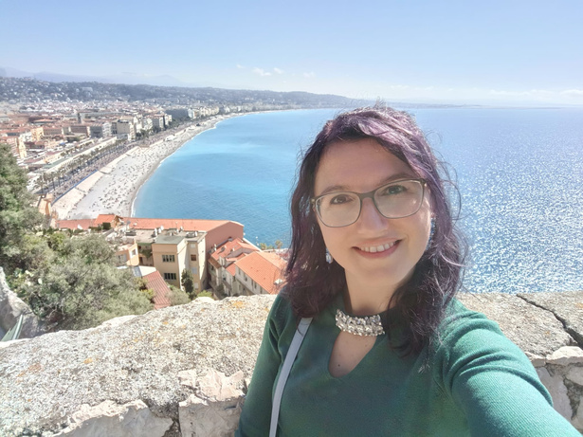
A road to controlling quantum vortices
3D
Study and classification of solitary waves
Numerical study of instability condition and dynamics with a constriction across the flow
C.A. Jones, P.H. Roberts, J. Phys. A: Math. Gen. 15 2599 (1982)
Generation of vortices stochastically, through Josephson junctions or by means of quantum pistons
F Piazza et al., New J. Phys. 13 043008 (2011)
Numerical and experimental study on vortex nucleation and dynamics in
trapped condensates
S. Serafini et al., Phys. Rev. Lett. 115, 170402 (2015)
A. Burchianti et al., Phys. Rev. Lett. 120, 025302 (2018)
M.E. Mossman et al., Nat. Commun. 9, 4665 (2018)
K. Xhani et al., Phys. Rev. Lett. 124, 045301 (2020)
K. Xhani et al., New J. Phys. 22, 123006 (2020)
V. Singh, et al., arXiv:2511.05645 (2025)
Remember my talk?
K. Xhani
5

Slide 18
A road to controlling quantum vortices
3D
Study and classification of solitary waves
Numerical study of instability condition and dynamics with a constriction across the flow
C.A. Jones, P.H. Roberts, J. Phys. A: Math. Gen. 15 2599 (1982)
Generation of vortices stochastically, through Josephson junctions or by means of quantum pistons
F Piazza et al., New J. Phys. 13 043008 (2011)
Numerical and experimental study on vortex nucleation and dynamics in
trapped condensates
S. Serafini et al., Phys. Rev. Lett. 115, 170402 (2015)
A. Burchianti et al., Phys. Rev. Lett. 120, 025302 (2018)
M.E. Mossman et al., Nat. Commun. 9, 4665 (2018)
K. Xhani et al., Phys. Rev. Lett. 124, 045301 (2020)
K. Xhani et al., New J. Phys. 22, 123006 (2020)
V. Singh, et al., arXiv:2511.05645 (2025)
Direct complete control of stable vortex rings in 3D is still missing!
5

Slide 19
Aim of the work
3D
Let’s develop a protocol for the controlled generation and manipulation of stable vortex rings in 3D dilute BECs!
Direct complete control of stable vortex rings in 3D is still missing!
6

Slide 20
Aim of the work
3D
  Control over nucleation position, size, shape and propagation speed
  Control over emission frequency
  Create excitations on demand on the ring
Let’s develop a protocol for the controlled generation and manipulation of stable vortex rings in 3D dilute BECs!
6

Slide 21
System and idea of the work
7

Slide 22
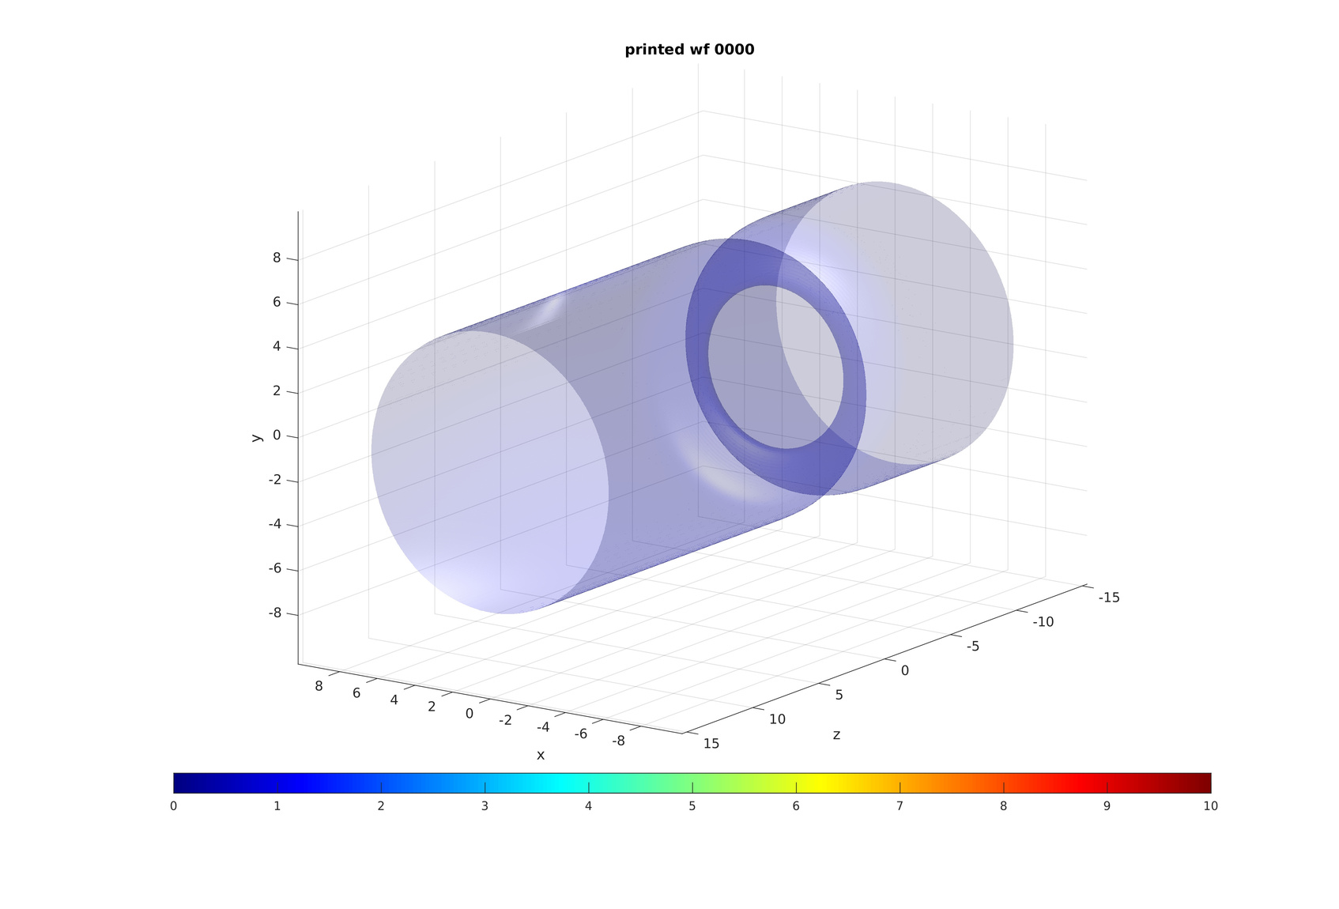
System under investigation
Dilute trapped Bose-Einstein condensate
Modelling Lithium-6 with
8

Slide 23
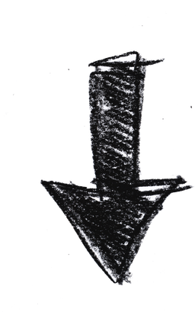
System under investigation
Dilute Bose-Einstein condensate in the shape of a cylinder, subject to a static cylindrical harmonic potential:
Modelling Lithium-6 with
Radial trapping frequency:
BEC radial size:
9

Slide 24
System under investigation
Dilute Bose-Einstein condensate in the shape of a cylinder, subject to a static cylindrical harmonic potential:
Modelling Lithium-6 with
BEC length along z-axis:
BEC radial size:
9

Slide 25
System under investigation
Dilute Bose-Einstein condensate in the shape of a cylinder, subject to a static cylindrical harmonic potential:
Units of
10

Slide 26
Modelling the BEC dynamics
Model the dynamics of the trapped BEC with the mean-field Gross-Pitaevskii approach, where the order parameter follows the GPE:
11

Slide 27
Modelling the BEC dynamics
Model the dynamics of the trapped BEC with the mean-field Gross-Pitaevskii approach, where the order parameter follows the GPE:
Interaction strength:
External potential:
Chemical potential:
11

Slide 28
Introduction of a time-dependent barrier
Dilute Bose-Einstein condensate in the shape of a cylinder, subject to a static cylindrical harmonic potential:
We add a time-dependent Gaussian repulsive barrier:
Barrier’s height:
Barrier’s width:
Controllable centre position:
12

Slide 29
Introduction of a time-dependent barrier
Dilute Bose-Einstein condensate in the shape of a cylinder, subject to a static cylindrical harmonic potential:
We add a time-dependent Gaussian repulsive barrier:
Penetrable obstacle:
12

Slide 30
Introduction of a time-dependent barrier
Dilute Bose-Einstein condensate in the shape of a cylinder, subject to a static cylindrical harmonic potential:
We add a time-dependent Gaussian repulsive barrier:
Constriction transverse to the cylinder axis
12

Slide 31
Introduction of a time-dependent barrier
Dilute Bose-Einstein condensate in the shape of a cylinder, subject to a static cylindrical harmonic potential:
We add a time-dependent Gaussian repulsive barrier:
BEC radial size at barrier’s centre:
12

Slide 32
Idea
Sweep the barrier along the cylinder axis, moving its centre position with a gradually ramped-up velocity from an initial position :
13

Slide 33
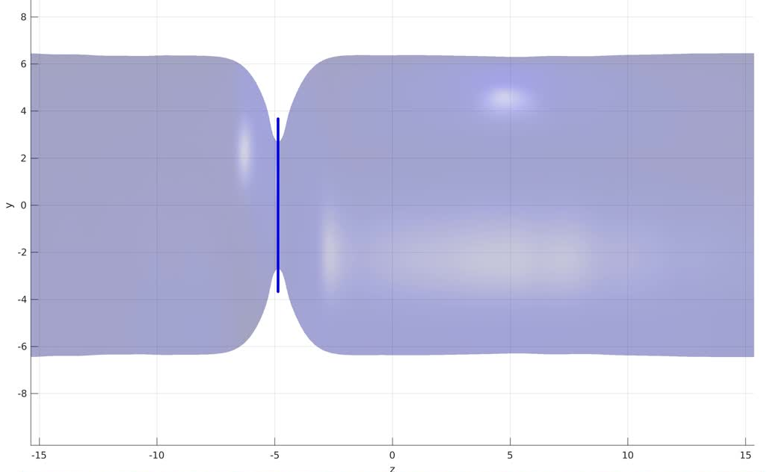
Idea
Sweep the barrier along the cylinder axis, moving its centre position with a gradually ramped-up velocity from an initial position :
Start barrier motion along the positive z-direction at t=0
The region where the density is depleted moves along the axis
13

Slide 34
Idea
Sweep the barrier along the cylinder axis, moving its centre position with a gradually ramped-up velocity from an initial position :
The local sound speed of the system lowers where density is depleted
14

Slide 35
Idea
Sweep the barrier along the cylinder axis, moving its centre position with a gradually ramped-up velocity from an initial position :
The local sound speed of the system lowers where density is depleted
Linked to the existence of a crititical velocity for vortex nucleation!
14

Slide 36
Idea
Sweep the barrier along the cylinder axis, moving its centre position with a gradually ramped-up velocity from an initial position :
The local sound speed of the system lowers where density is depleted
Linked to the existence of a crititical velocity for vortex nucleation!
At the barrier’s centre, near the boundary, the relative velocity between the barrier and the condensate is maximized
14

Slide 37
Idea
Sweep the barrier along the cylinder axis, moving its centre position with a gradually ramped-up velocity from an initial position :
The local sound speed of the system lowers where density is depleted
Linked to the existence of a crititical velocity for vortex nucleation!
Sweet spot for vortex nucleation:
At the barrier’s centre, near the boundary, the relative velocity between the barrier and the condensate is maximized
14

Slide 38
Idea
Sweep the barrier along the cylinder axis, moving its centre position with a gradually ramped-up velocity from an initial position :
Sweet spot for vortex nucleation:
15

Slide 39
Idea
Sweep the barrier along the cylinder axis, moving its centre position with a gradually ramped-up velocity from an initial position :
Sweet spot for vortex nucleation:
Cylindrical symmetry:
vortices are rings
15

Slide 40
Idea
Sweep the barrier along the cylinder axis, moving its centre position with a gradually ramped-up velocity from an initial position :
When the barrier’s speed exceeds the critical velocity for vortex nucleation, a vortex ring is generated
Sweet spot for vortex nucleation:
15

Slide 41
Vortex nucleation and dynamics
16

Slide 42
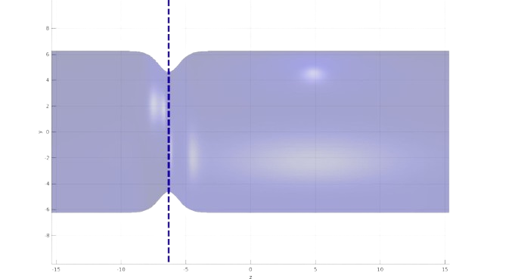
Vortex nucleation and subsequent dynamics
What happens when we move the barrier along the condensate axis?
17

Slide 43
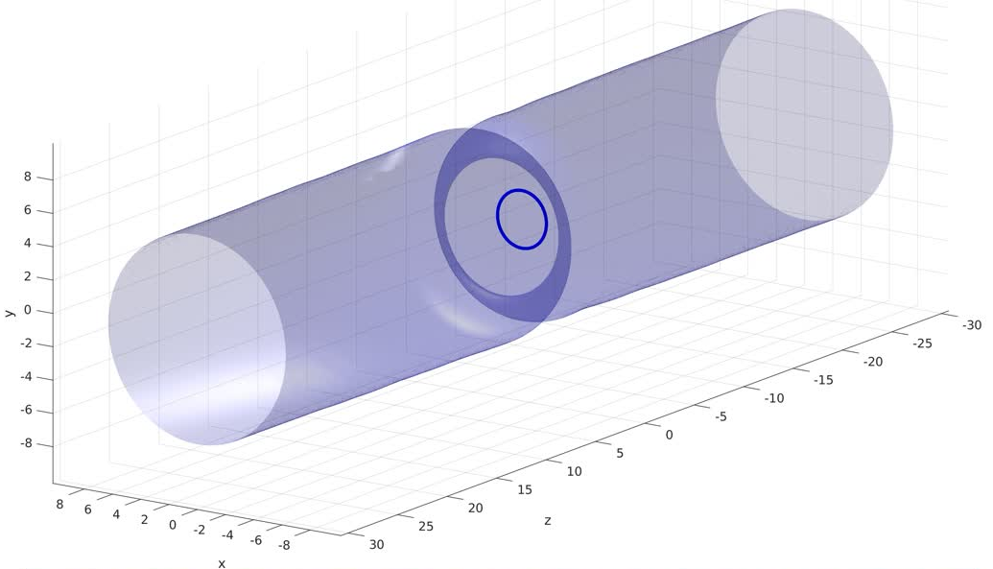
Vortex nucleation and subsequent dynamics
Stages of nucleation and evolution
A vortex ring nucleates at the barrier’s edge
18

Slide 44
Vortex nucleation and subsequent dynamics
Stages of nucleation and evolution
A vortex ring nucleates at the barrier’s edge
The ring shrinks across the barrier while propagating opposite to the barrier’s motion
18

Slide 45
Vortex nucleation and subsequent dynamics
Stages of nucleation and evolution
A vortex ring nucleates at the barrier’s edge
The ring shrinks across the barrier while propagating opposite to the barrier’s motion
The ring reaches and asymptotic regime with constant radius and velocity
18

Slide 46
Vortex nucleation and subsequent dynamics
Stages of nucleation and evolution
... And start again with another ring!
Periodic generation
18

Slide 47
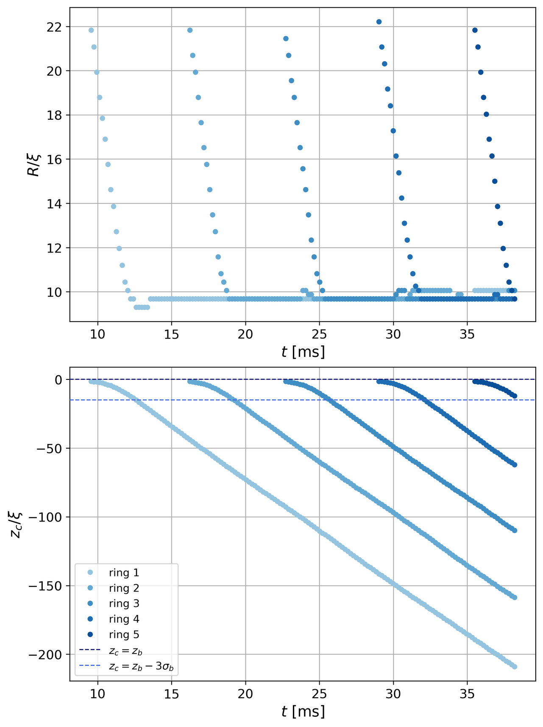
Vortex nucleation and subsequent dynamics
Evolution of radius and position
19

Slide 48
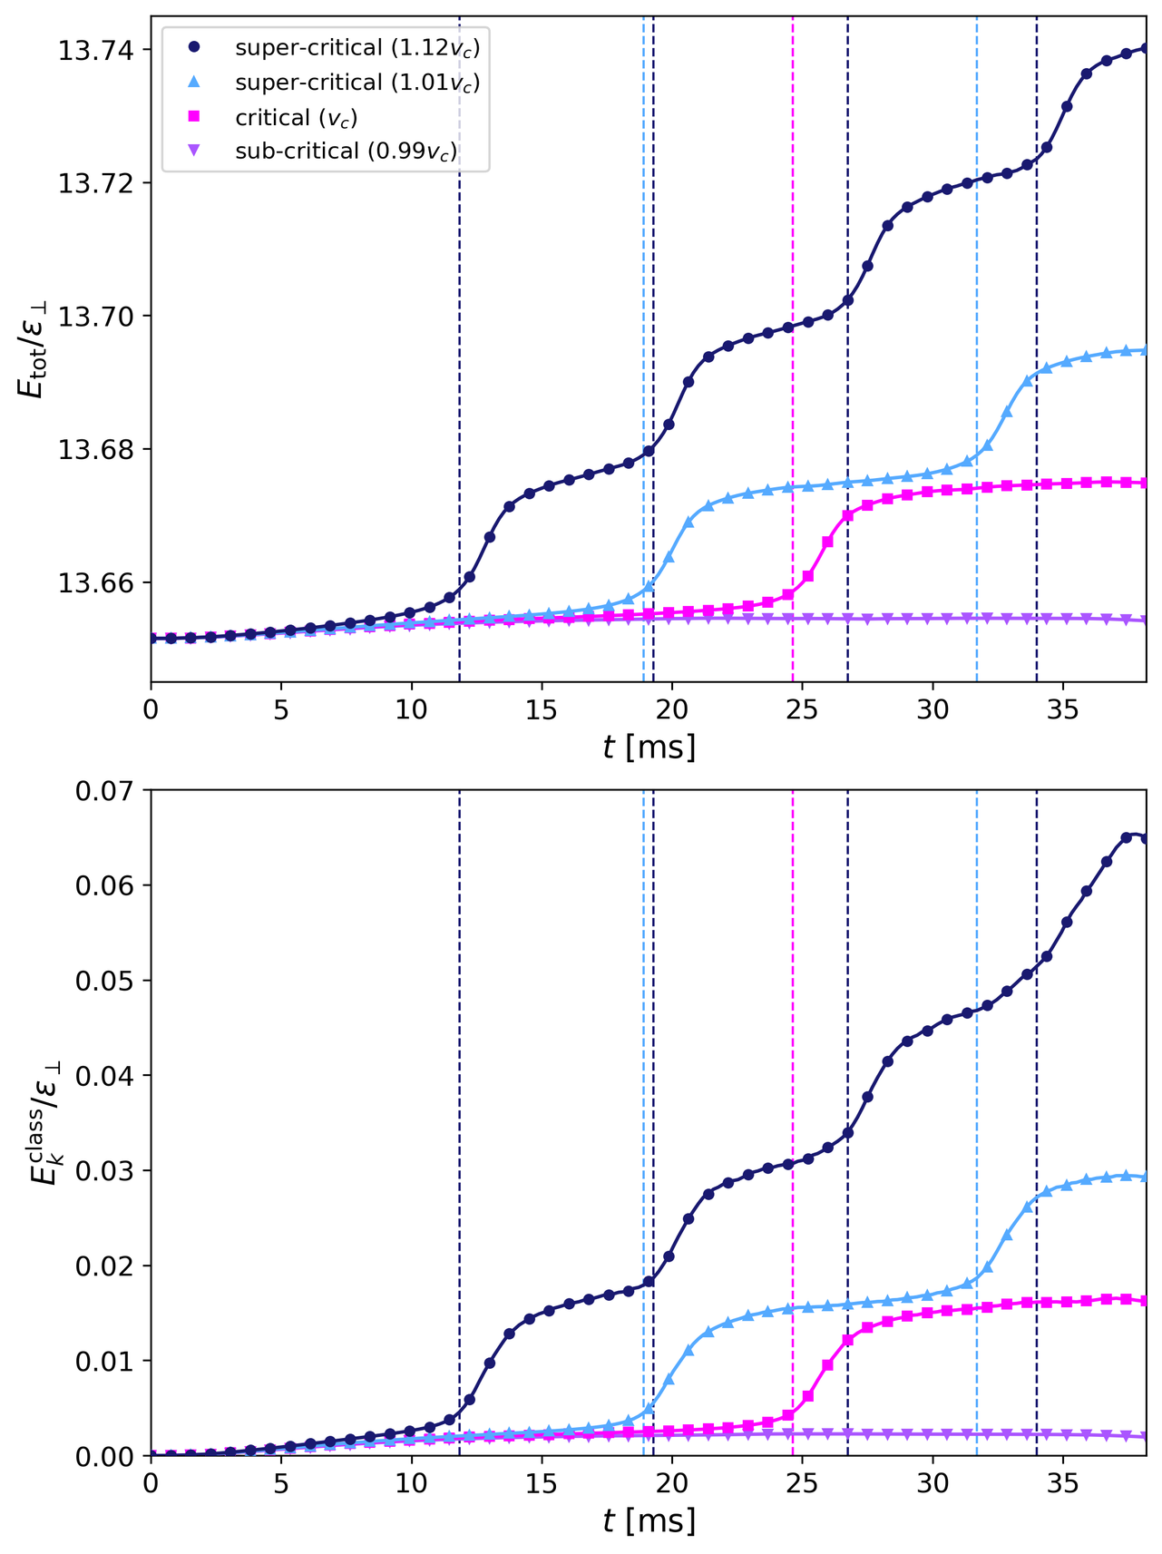
Vortex nucleation and subsequent dynamics
Energy analysis
20

Slide 49
Vortex nucleation and subsequent dynamics
Energy analysis
Vortex nucleation
Energy injection
20

Slide 50
Searching for the critical velocity
What are the conditions needed to trigger the nucleation of a vortex ring?
21

Slide 51
Searching for the critical velocity
Change barrier’s parameters (height and width)
22

Slide 52
Searching for the critical velocity
Change barrier’s parameters (height and width)
Vary barrier’s maximum velocity until a vortex is generated
22

Slide 53

Searching for the critical velocity
Change barrier’s parameters (height and width)
Vary barrier’s maximum velocity until a vortex is generated
This is the critical velocity for this specific barrier
22

Slide 54

Searching for the critical velocity
Change barrier’s parameters (height and width)
Vary barrier’s maximum velocity until a vortex is generated
This is the critical velocity for this specific barrier
Rings emission frequency
Increase barrier’s speed beyond the critical velocity
Rings radii and propagation speeds
22

Slide 55
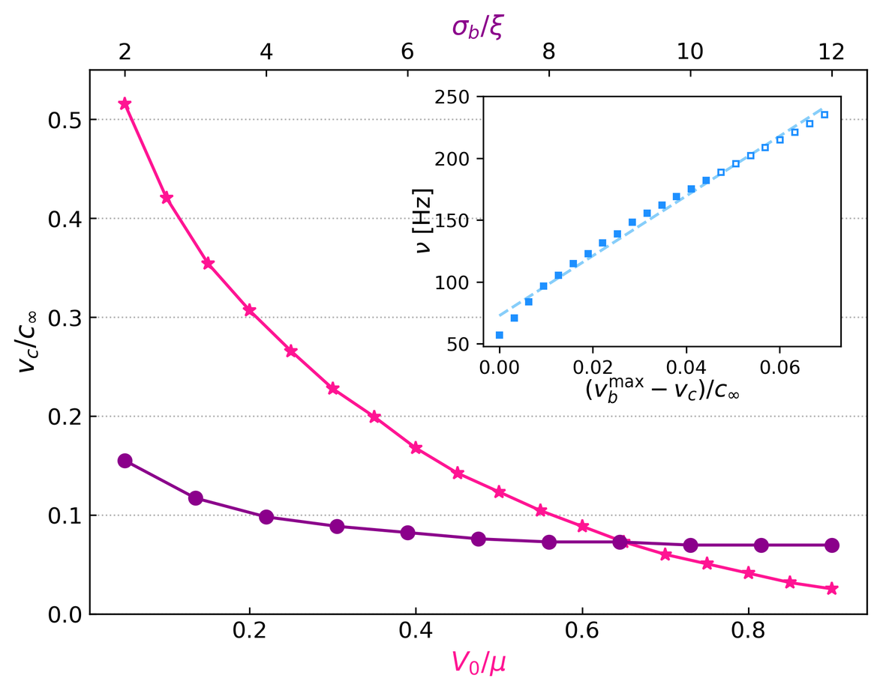
Searching for the critical velocity
Fix width, change height:
For a higher barrier’s intensity, a smaller velocity is
needed to exceed the local critical velocity and nucleate the vortex ring
23

Slide 56
Searching for the critical velocity
Fix width, change height:
Fix height, change width:
Varying the width is not relevant once it exceeds the typical size of a vortex core .
23

Slide 57
Searching for the critical velocity
Vortex emission frequency increases linearly with barrier’s speed
Fix width and height, change velocity:
23

Slide 58
Searching for the critical velocity
Leapfrogging events!
Fix width and height, change velocity:
23

Slide 59
Searching for the critical velocity
Fix width, change height:
Fix height, change width:
Fix width and height, change velocity:
Control over the nucleation of one or multiple vortices!
23

Slide 60
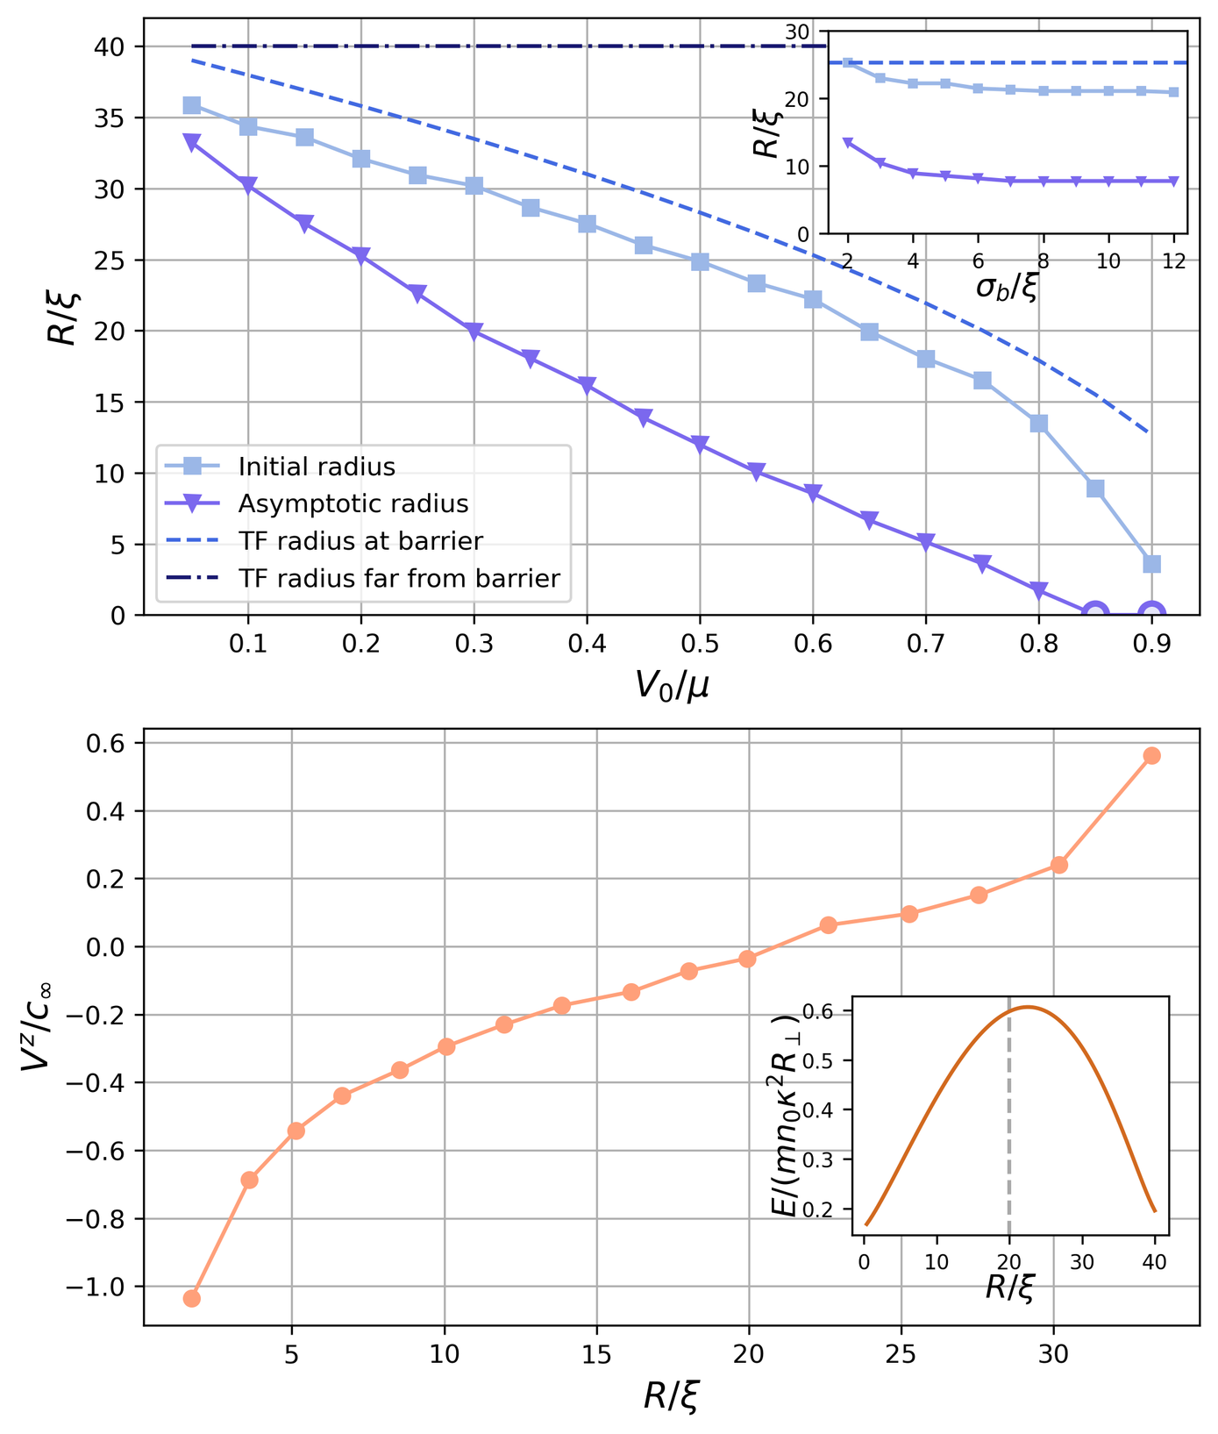
Vortex ring analysis after nucleation: radius
Fix width, change height:
A higher barrier’s intensity generates a tighter constriction
24

Slide 61
Vortex ring analysis after nucleation: radius
Fix width, change height:
Fix height, change width:
Varying the width is not relevant once it exceeds the typical size of a vortex core .
24

Slide 62
Vortex ring analysis after nucleation: radius
Fix width, change height:
Fix height, change width:
Control over the size of the generated vortex rings!
24

Slide 63
Vortex ring analysis after nucleation: speed
Let each ring reach its asymptotic regime and see how the propagation speed at that stage varies for rings of different sizes
25

Slide 64

Vortex ring analysis after nucleation: speed
Non-homogenous density
Presence of boundaries
Different from
25

Slide 65
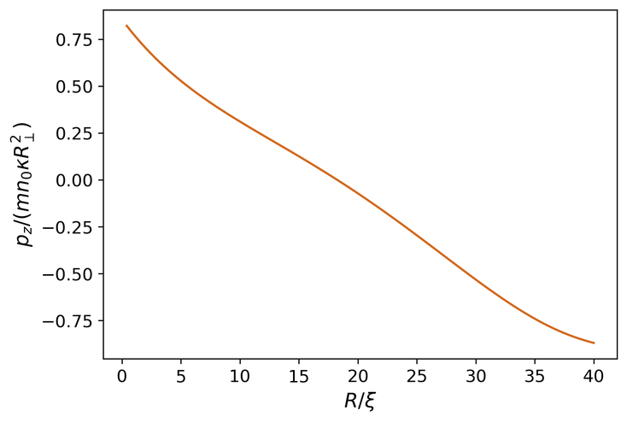
Vortex ring analysis after nucleation: speed
25

Slide 66
Vortex ring analysis after nucleation: speed
Let each ring reach its asymptotic regime and see how the propagation speed at that stage varies for rings of different sizes
Control over the propagation speed of the generated vortex rings!
25

Slide 67
Triggering excitations on the rings
26

Slide 68
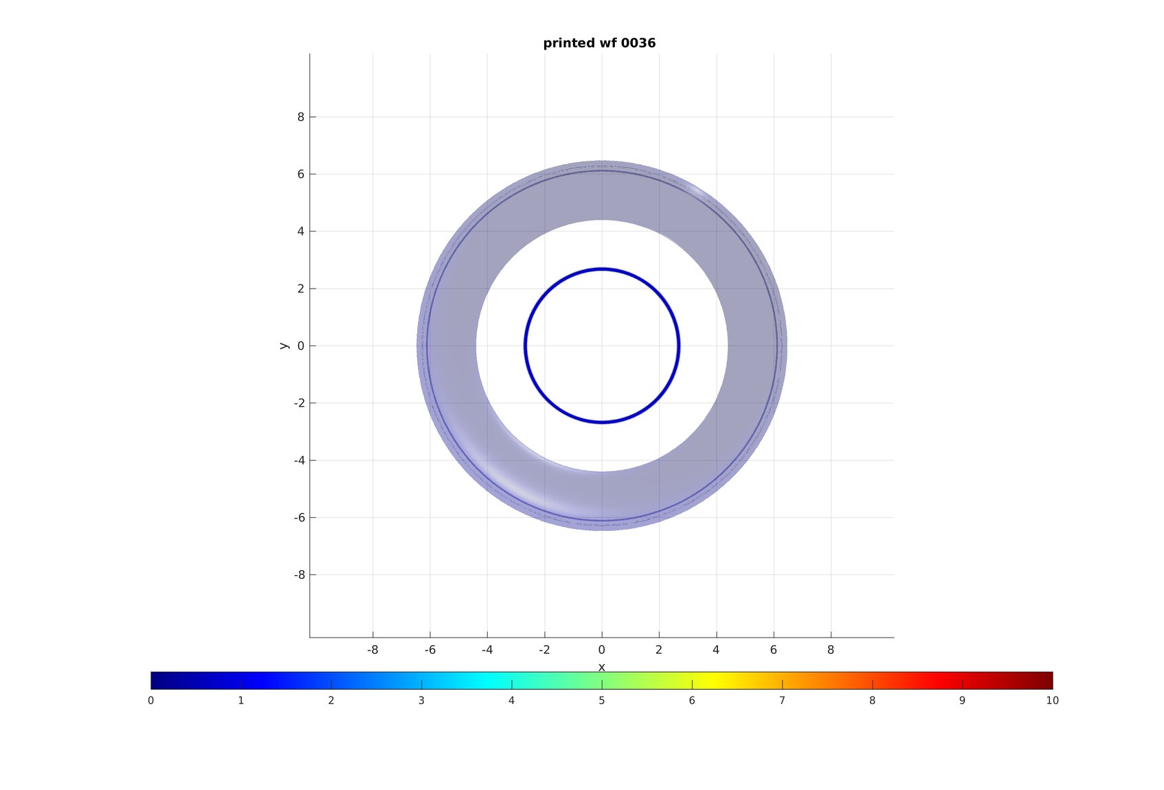
Triggering excitations on the ring
How can we create excitations on the rings?
y
r
0
0
x
27

Slide 69
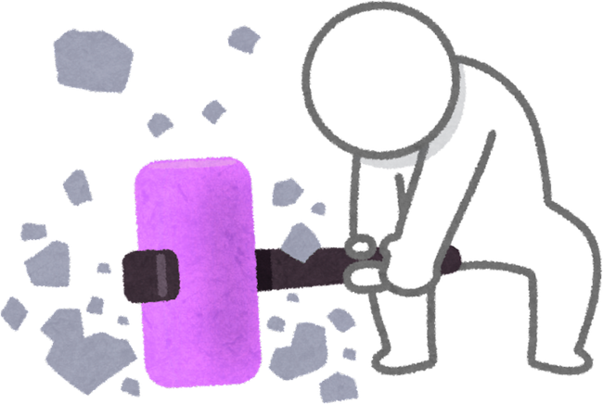
Triggering excitations on the ring
How can we create excitations on the rings?
Break the symmetry!
y
r
0
0
x
27

Slide 70
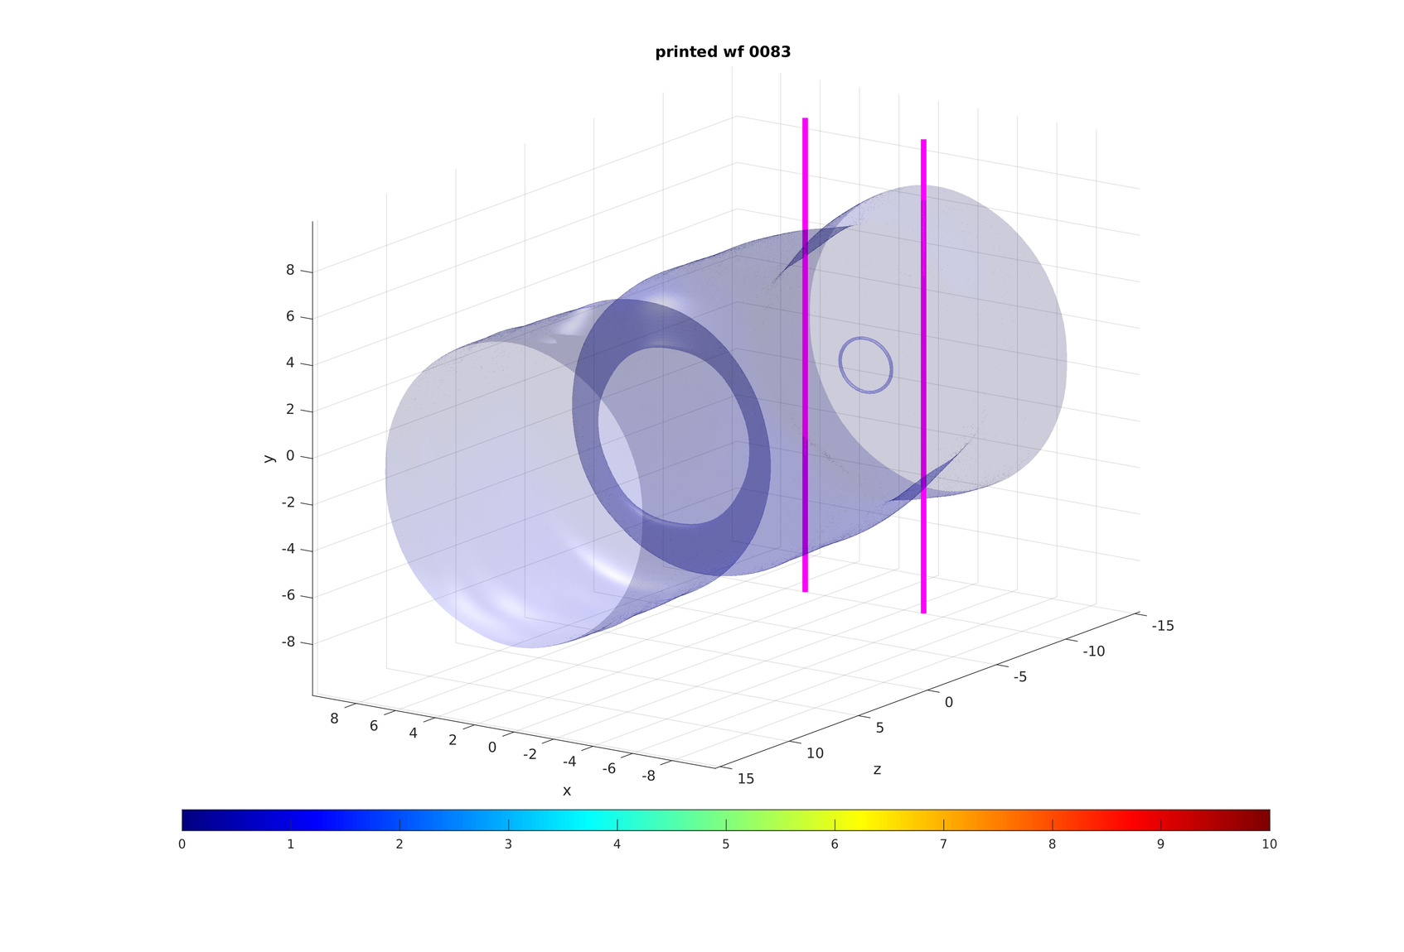
Kelvin waves
How can we create excitations on the rings?
Break the symmetry!
Two local vertical repulsive potentials downstream:
Height:
Width:
Centre position:
28

Slide 71
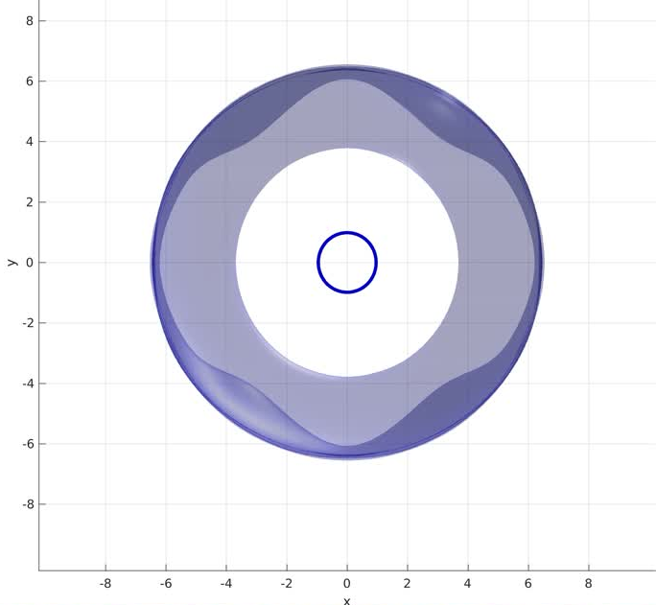
Kelvin waves
How can we create excitations on the rings?
Break the symmetry!
28

Slide 72
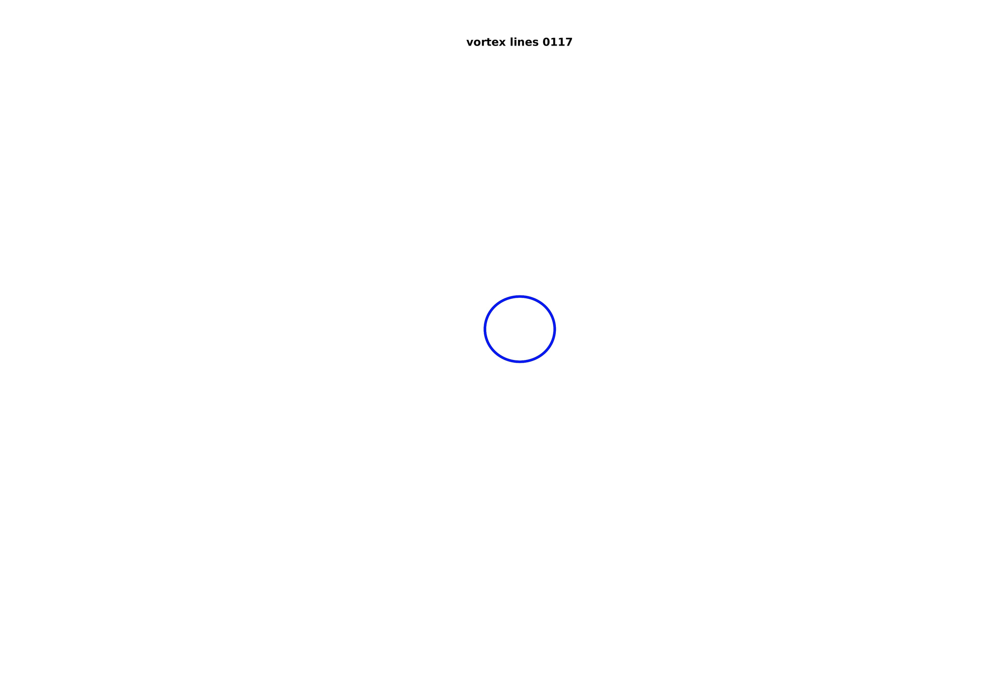

Kelvin waves
How can we create excitations on the rings?
Break the symmetry!
The ring becomes elliptical and a Kelvin wave of mode m=2 starts propagating
28

Slide 73
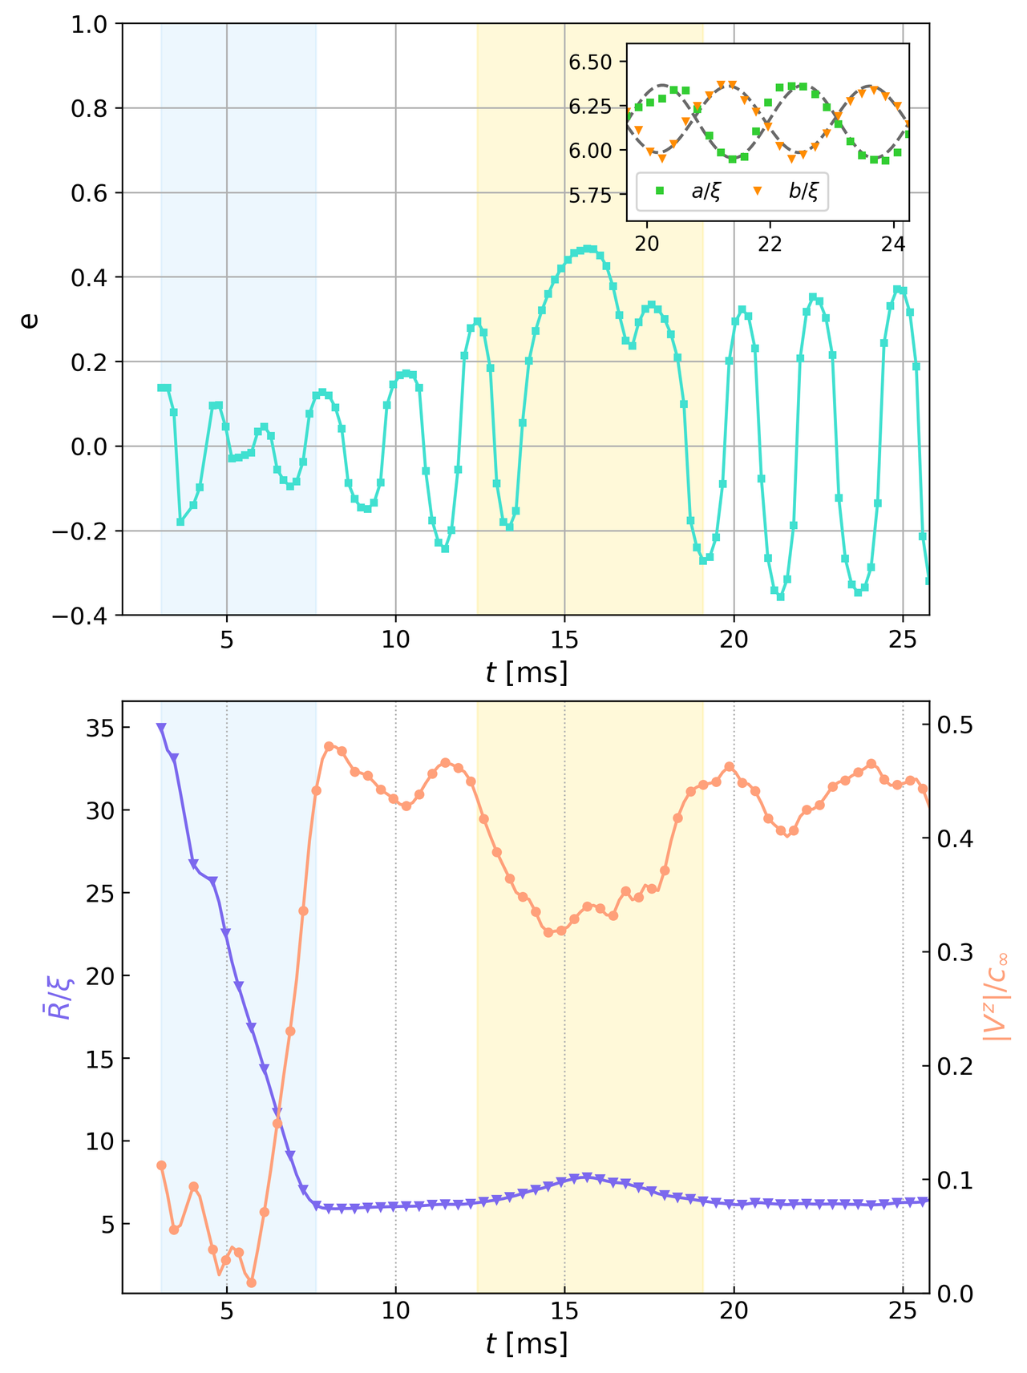
Kelvin waves
Break the symmetry!
The ring becomes elliptical and a Kelvin wave of mode m=2 starts propagating
29

Slide 74
Kelvin waves
Break the symmetry!
The ring becomes elliptical and a Kelvin wave of mode m=2 starts propagating
We can create excitations on demand!
29

Slide 75
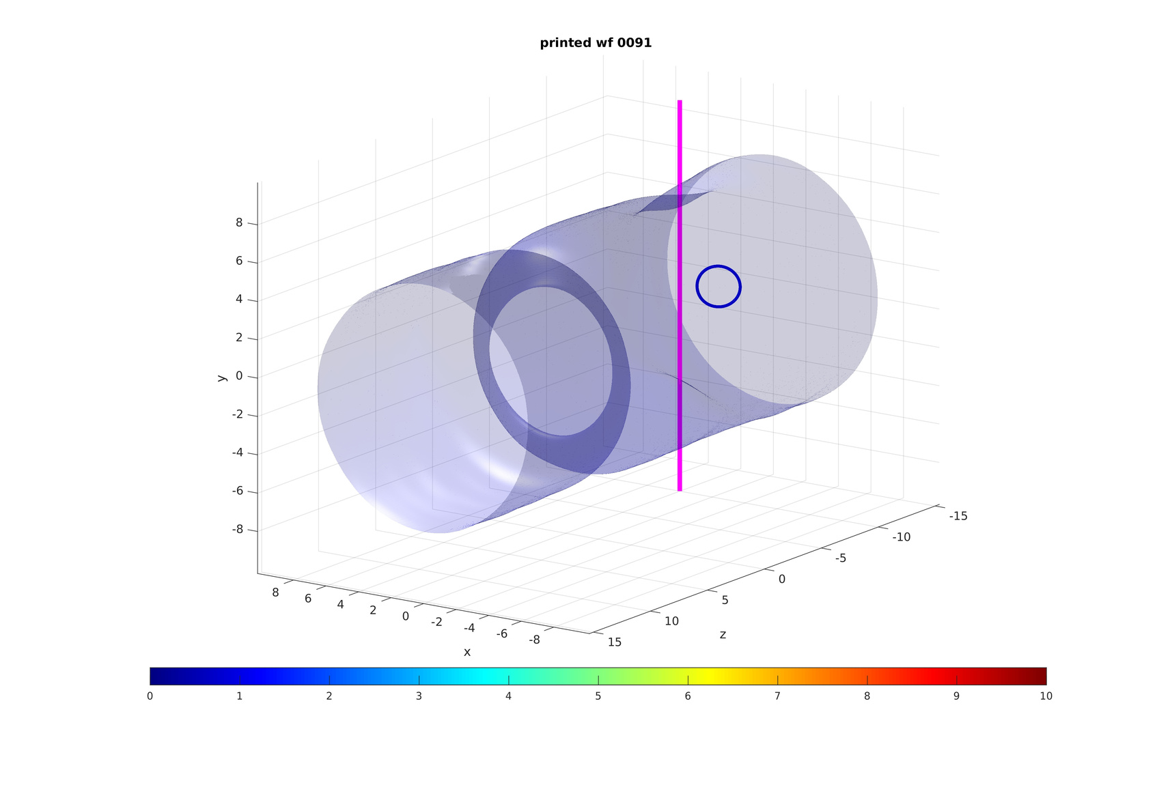
Destabilization of the ring
What else can we do?
Break the symmetry!
One off-centre local vertical repulsive potential downstream:
Height:
Width:
Centre position:
30

Slide 76

Destabilization of the ring
What else can we do?
Break the symmetry!
30

Slide 77
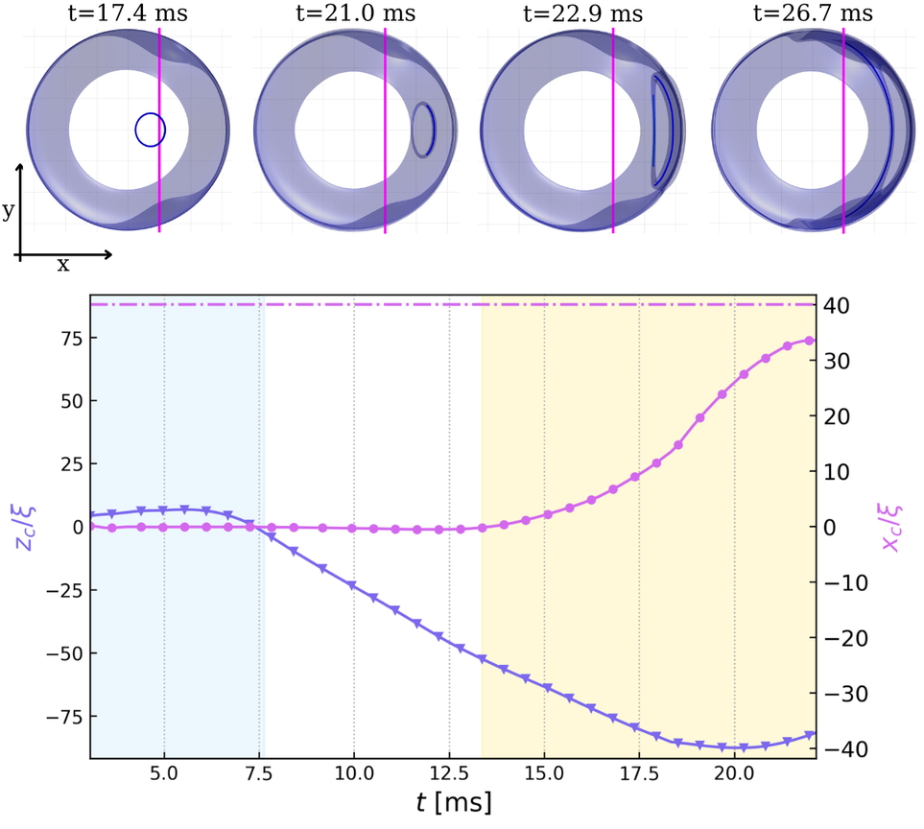
Destabilization of the ring
Break the symmetry!
The ring starts bending toward the beam until it crashes onto the boundary
31

Slide 78
Destabilization of the ring
Break the symmetry!
The ring starts bending toward the beam until it crashes onto the boundary
We can destabilize the ring on demand!
31

Slide 79
Conclusions and future perspective
32

Slide 80
Conclusions and future perspective
  Control over nucleation position, size, shape and propagation speed
  Control over emission frequency
  Create excitations on demand on the ring
32

Slide 81

Conclusions and future perspective
  Control over nucleation position, size, shape and propagation speed
  Control over emission frequency
  Create excitations on demand on the ring
G. Iori et al., Phys. Rev. Research 8, L022043 (2026)
32

Slide 82
Conclusions and future perspective
  Control over nucleation position, size, shape and propagation speed
  Control over emission frequency
  Create excitations on demand on the ring
Stay tuned for the experiment!
G. Iori et al., Phys. Rev. Research 8, L022043 (2026)
32

Slide 83
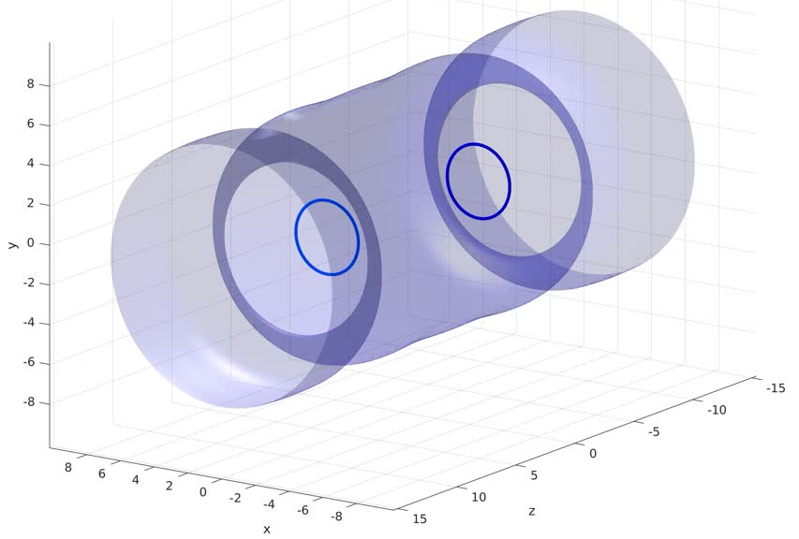
Conclusions and future perspective
Looking ahead
This is only the beginning of another journey...
33

Slide 84
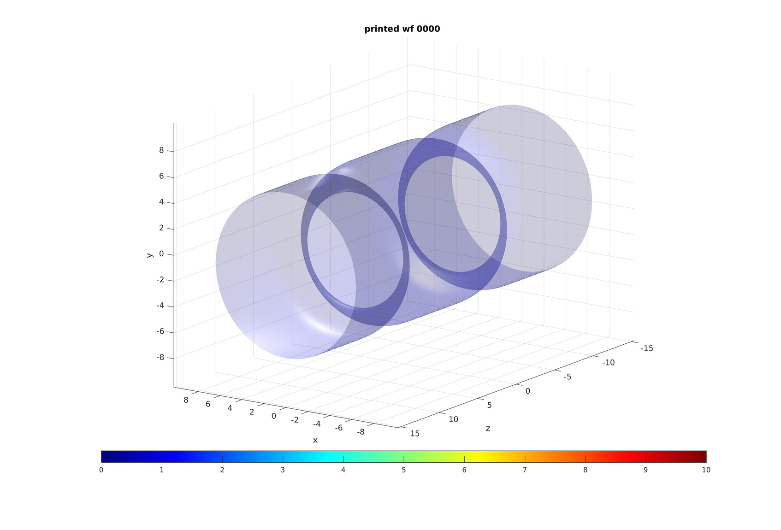

Conclusions and future perspective
Looking ahead
This is only the beginning of another journey...
33

Slide 85

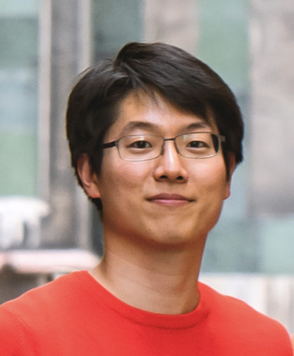
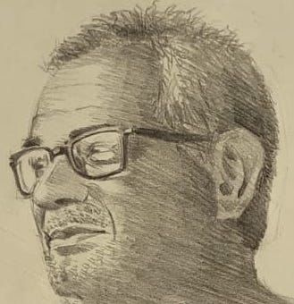
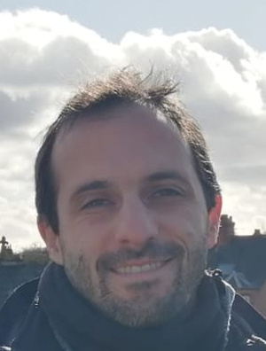
Acknowledgements
Klejdja Xhani
Woo Jin Kwon
Davide Galli
Luca Galantucci

Slide 86
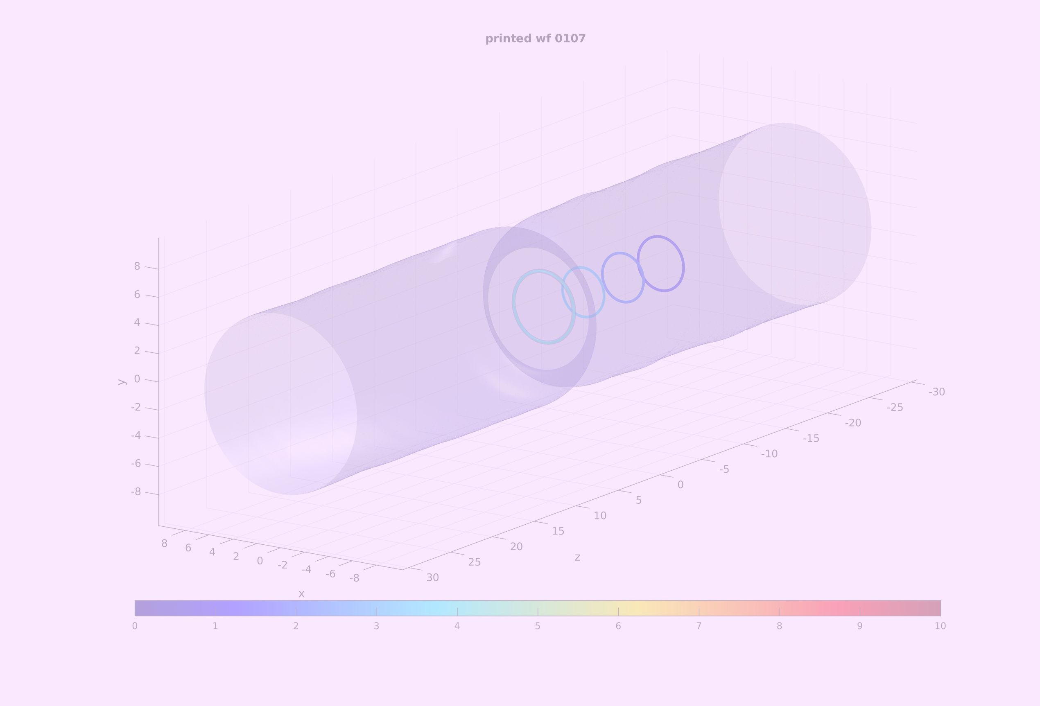


Slide 87

Numerical framework
Algorithm for vortex tracking:
based on the pseudo-vorticity
Work in periodic boundary conditions
C. Rorai et al., J. Fluid Mech. 808, 641 (2016)
A. Villois et al, J. Phys. A 49, 415502 (2016)
Numerical resolutions:

Slide 88
Exploiting the cylindrical symmetry
y
r
Cylindrical symmetry
0
External potential:
0
x

Slide 89

Exploiting the cylindrical symmetry
y
r
Cylindrical symmetry
0
External potential:
0
x
The three-dimensional problem is reduced to a two-dimensional problem!
Describe the system in cylindrical coordinates

Slide 90
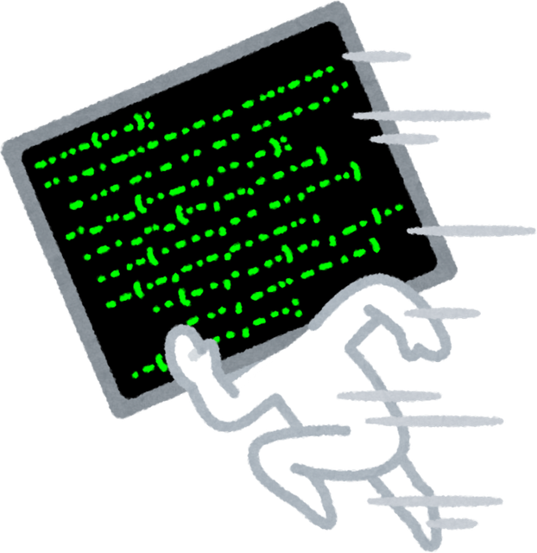
Exploiting the cylindrical symmetry
y
r
Cylindrical symmetry
0
External potential:
0
x
Computational time reduces from days to minutes!
Describe the system in cylindrical coordinates

Slide 91
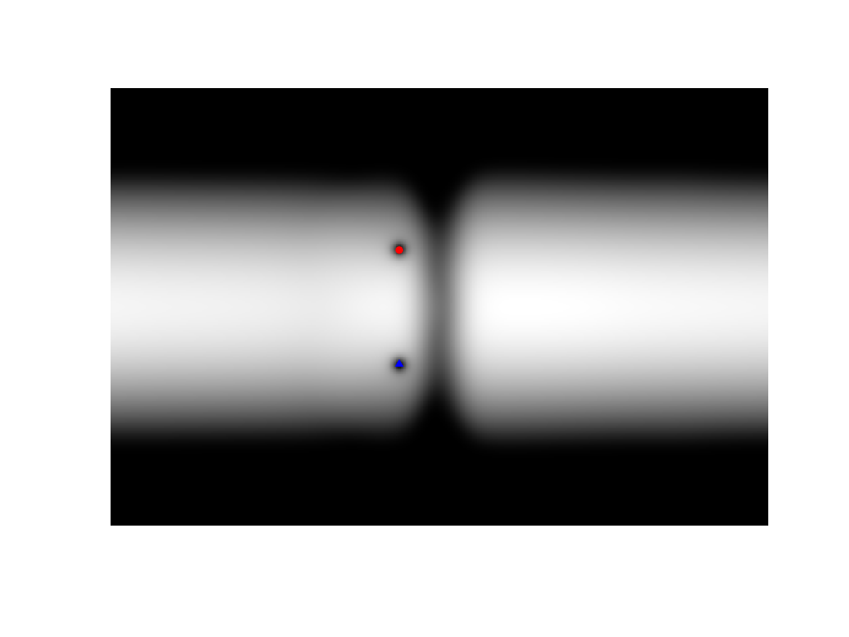
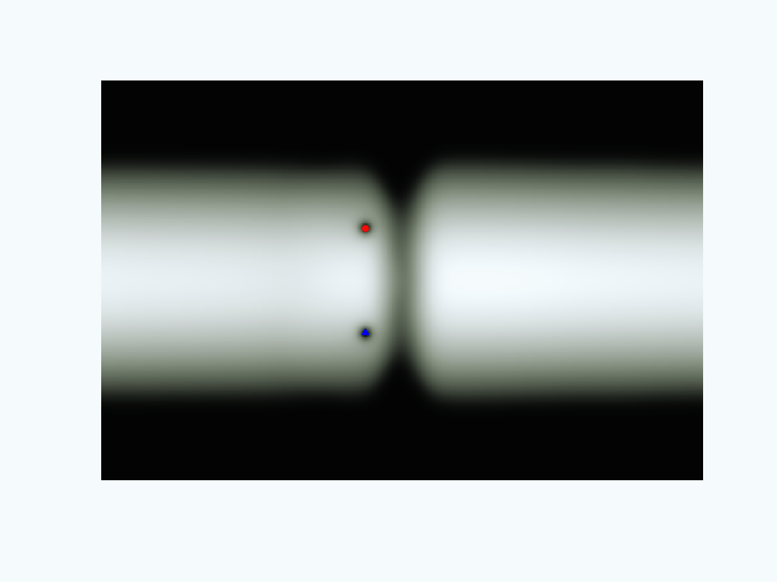
Exploiting the cylindrical symmetry
r
0
z
0
Computational time reduces from days to minutes!
Describe the system in cylindrical coordinates

Slide 92
Vortex ring analysis after nucleation: speed
Difference with homogeneous channel?

Slide 93
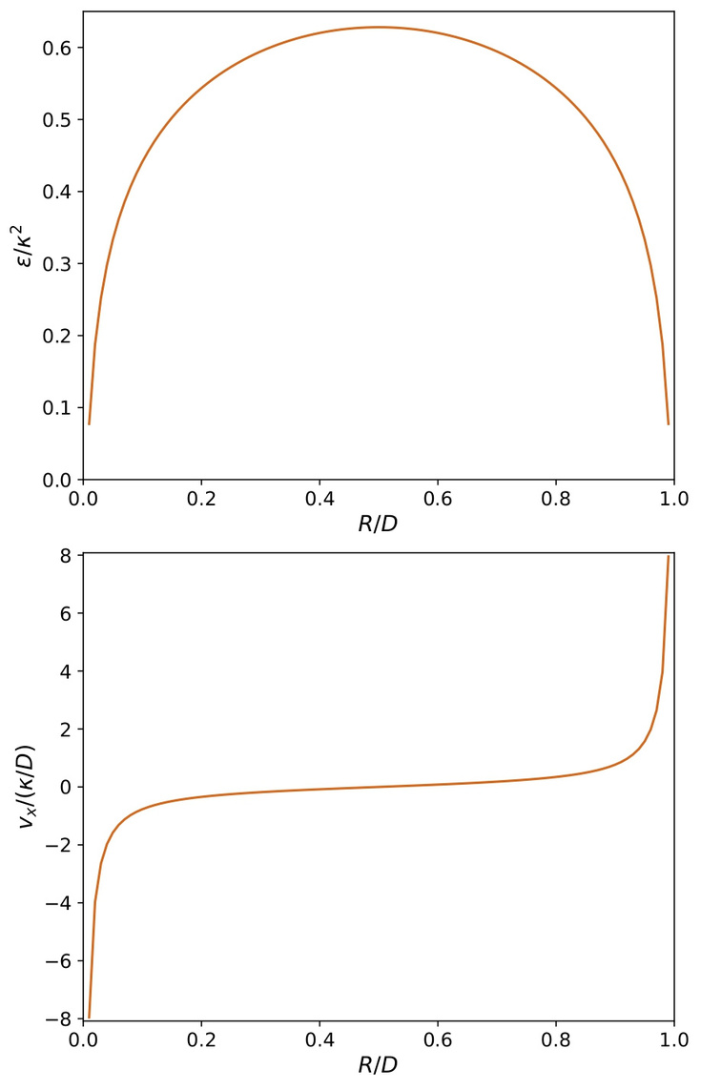
Vortex ring analysis after nucleation: speed
Homogeneous channel
Difference with homogeneous channel?

Slide 94
Vortex ring analysis after nucleation: speed
Homogeneous channel
Difference with homogeneous channel?

Slide 95
Leapfrogging
Leapfrogging events!
Fix width and height, change velocity:

Slide 96
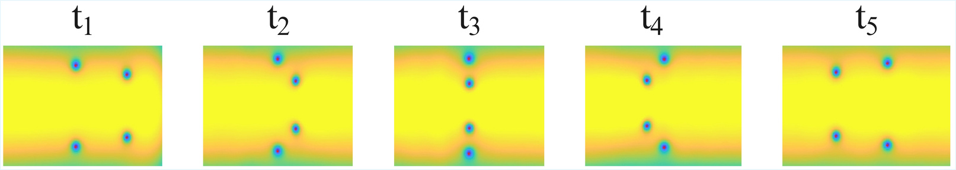
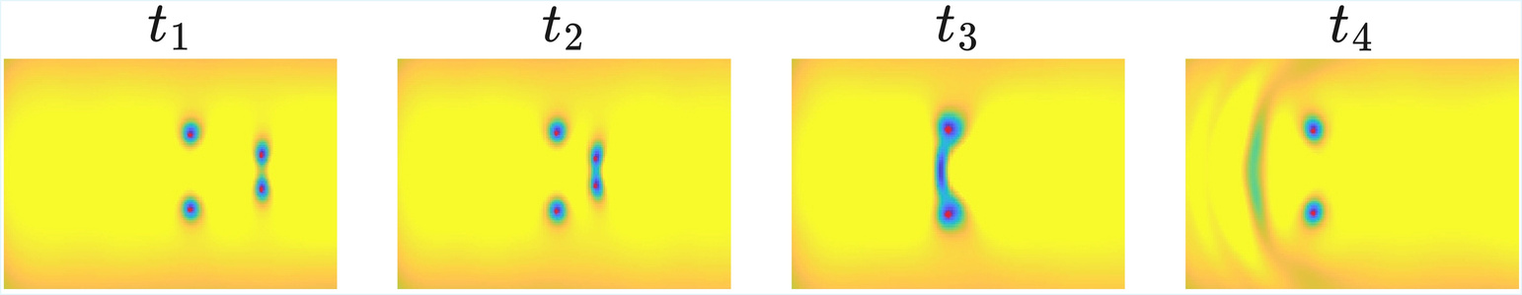
Leapfrogging
Leapfrogging events!

Slide 97
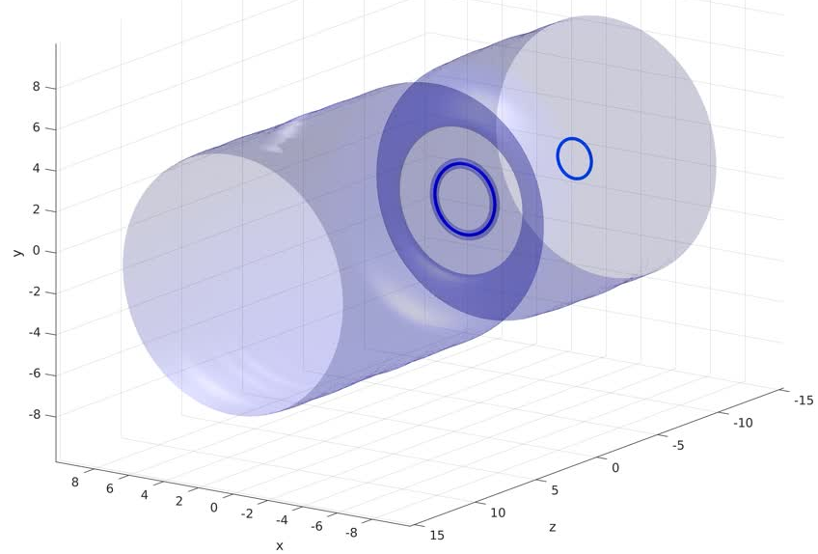
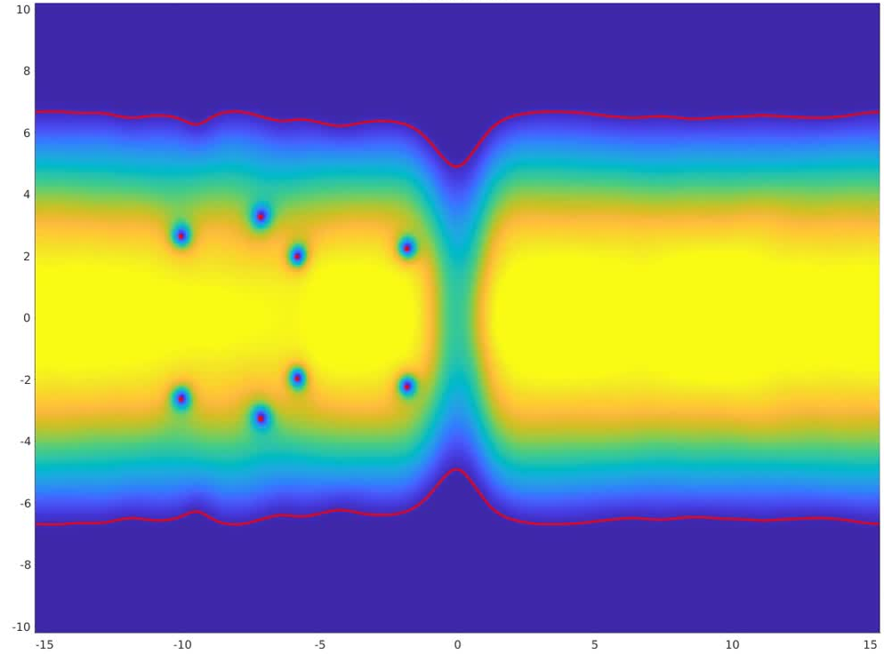
Leapfrogging
Some examples...

