Slide 1
Vortex pinning in a spin-triplet superfluid
Riku Rantanen, Rida Alrahmanlokman Shahin, and Vladimir Eltsov

Slide 2
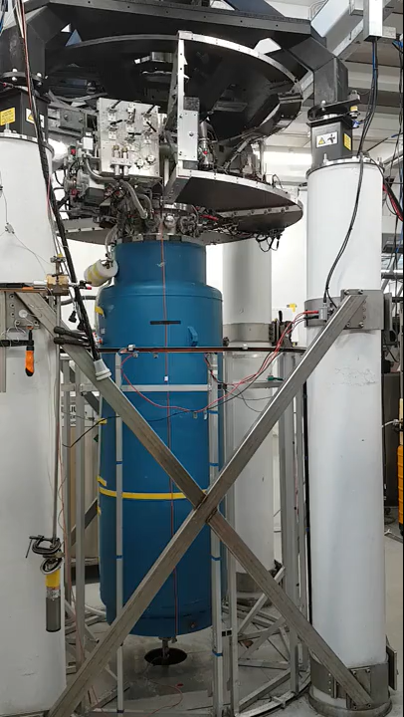
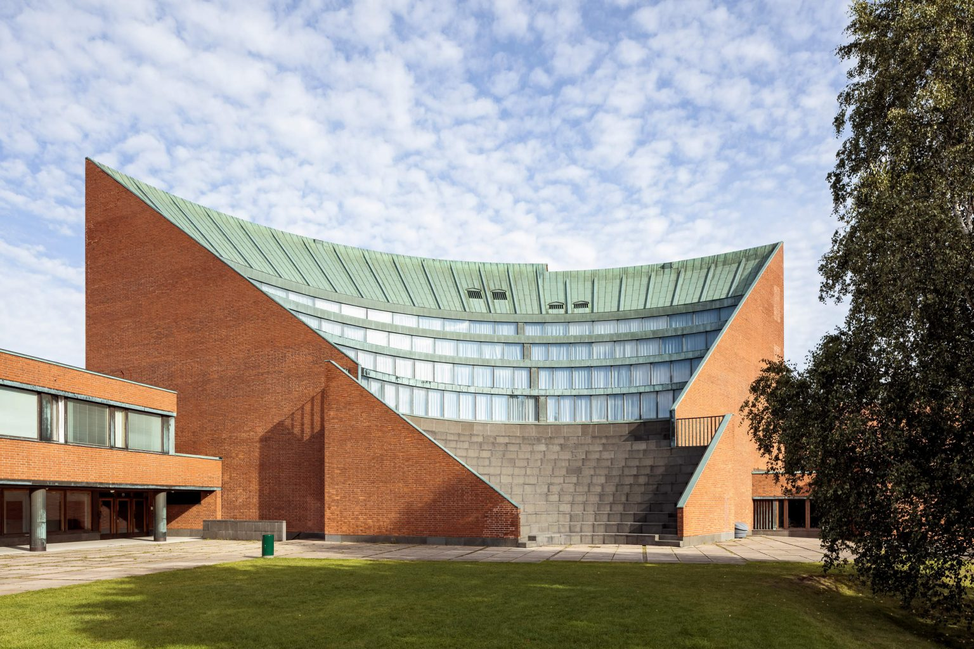
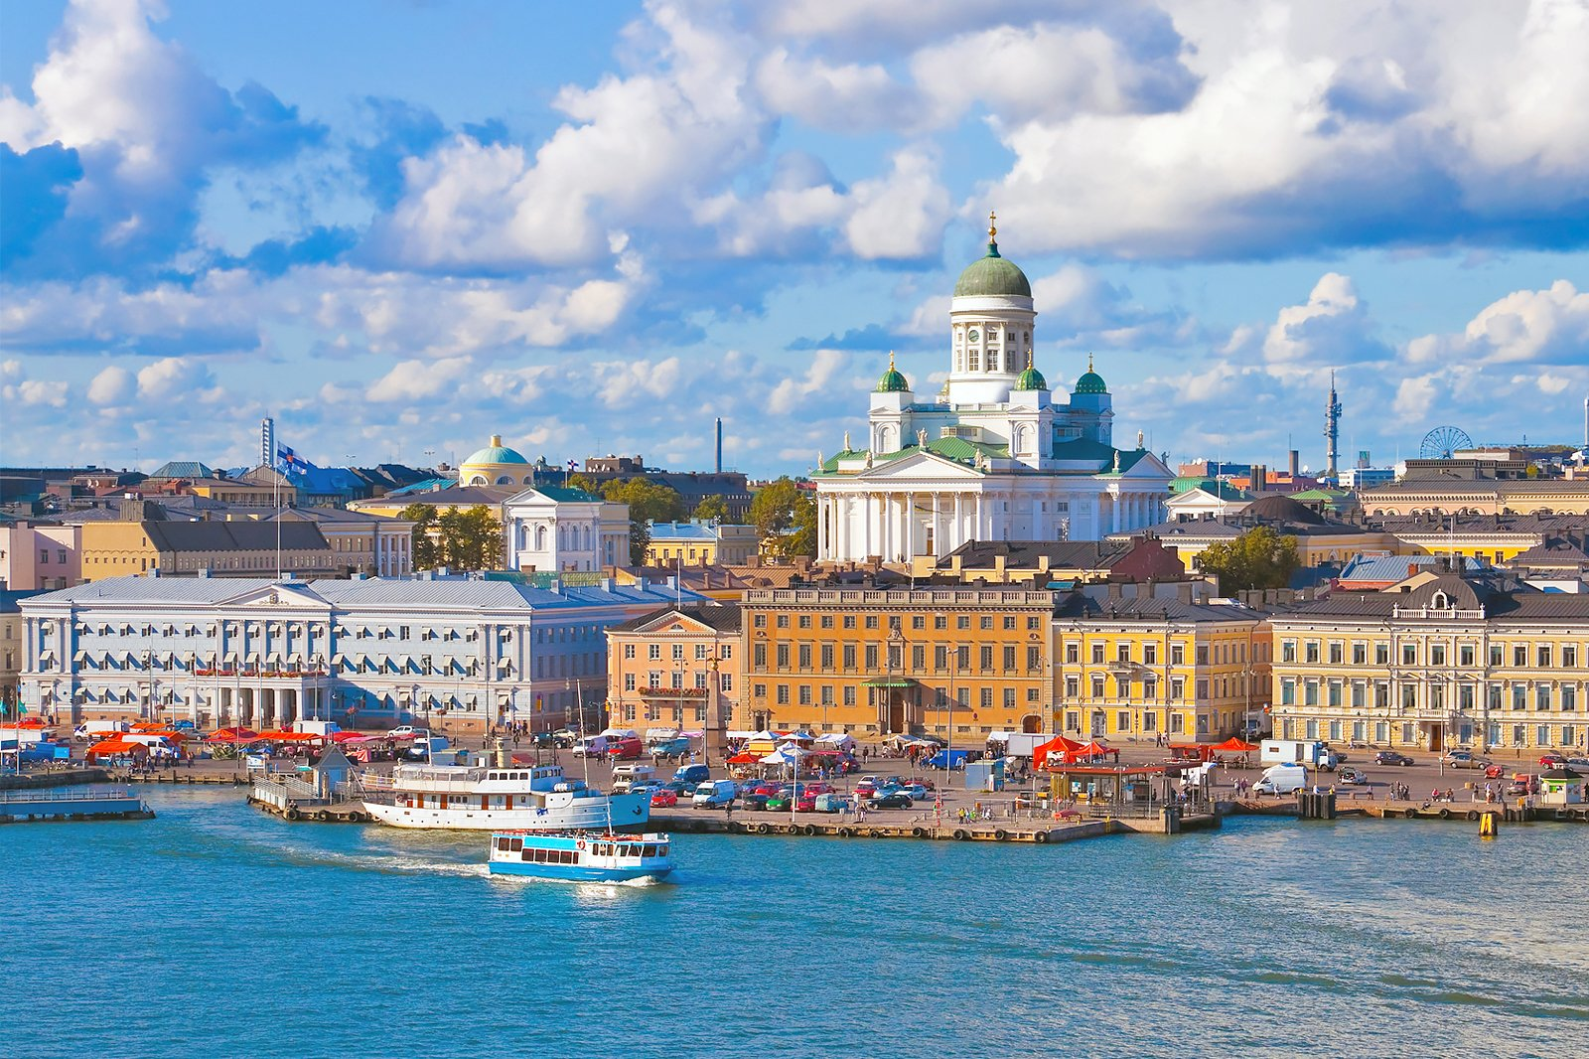
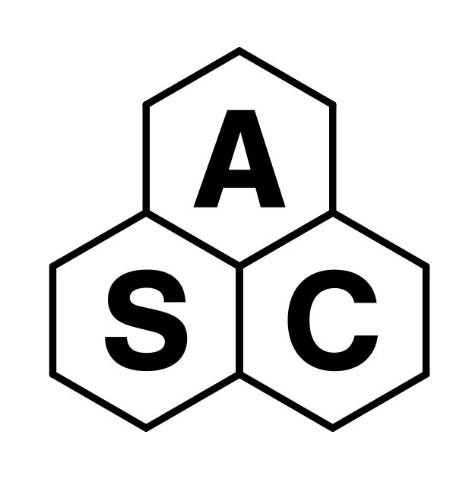
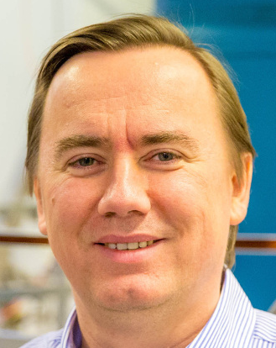


ROTA group – Topological Quantum Fluids
Aalto University (Helsinki, Finland)
Superfluid ³He and ⁴He
Unique rotating cryostat with temperatures as low as 140µK
Vortices, quantum turbulence, magnon BECs, time crystals
Vladimir Eltsov
Notes:
Introduction, ROTA group, rotating cryostat, laboratory for neutron star experiments

Slide 3
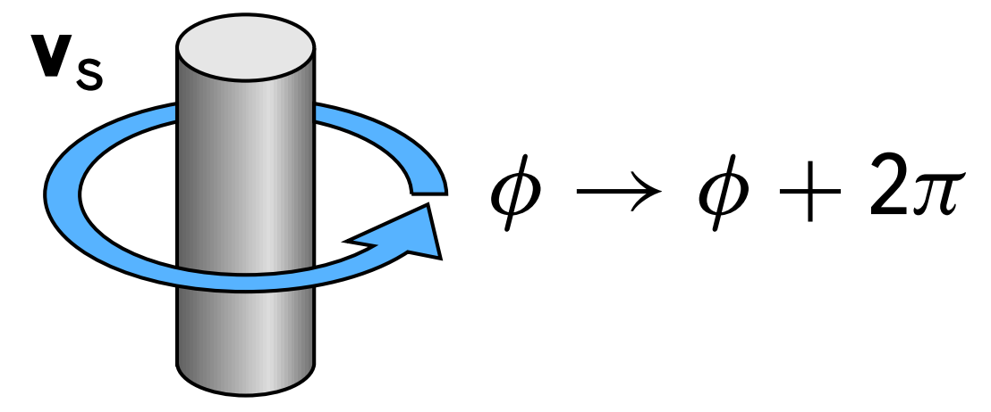
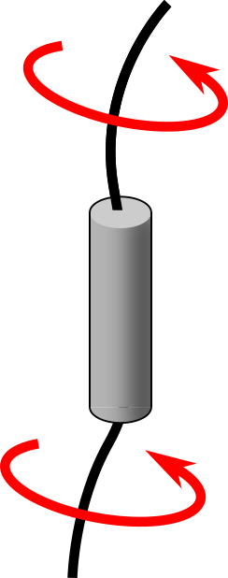
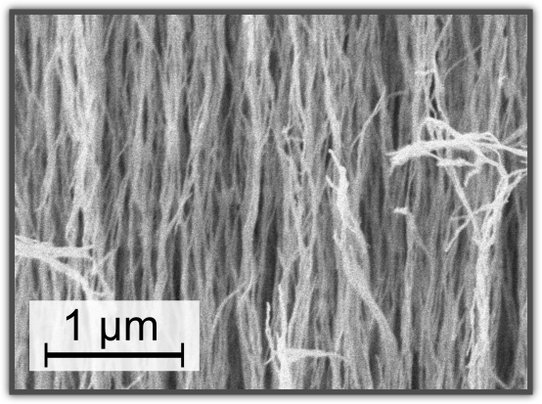
Outline
Introduction: Superfluid ³He
Part 1: Vortices in superfluid ³He
Part 2: Vortex pinning in ³He
Notes:
Outline:
Roughly two parts, first on vortices in 3He more generally, second on vortex pinning studies

Slide 4
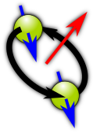
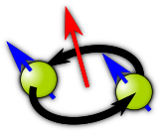
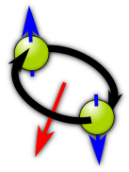
Superfluid ³He
Fermionic superfluid
Spin-triplet p-wave Cooper pairs
Notes:
Superfluid 3He intro, phase diagram, order parameter, etc.

Slide 5
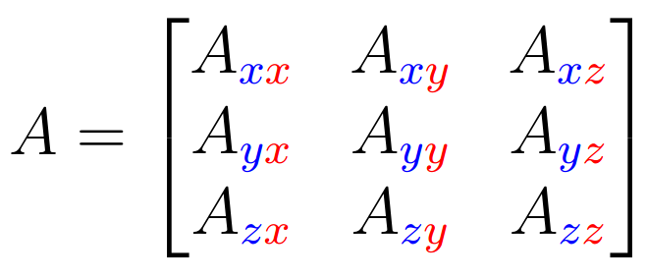
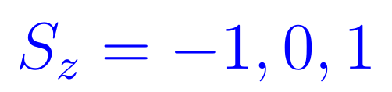
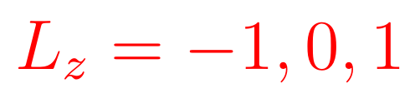
Superfluid ³He
Fermionic superfluid
Spin-triplet p-wave Cooper pairs
In addition to phase coherence, pairing breaks rotational symmetry SO(3) in orbital and spin space
Broken symmetry state described by a 3 x 3 complex order parameter matrix
Notes:
Superfluid 3He intro, phase diagram, order parameter, etc.

Slide 6
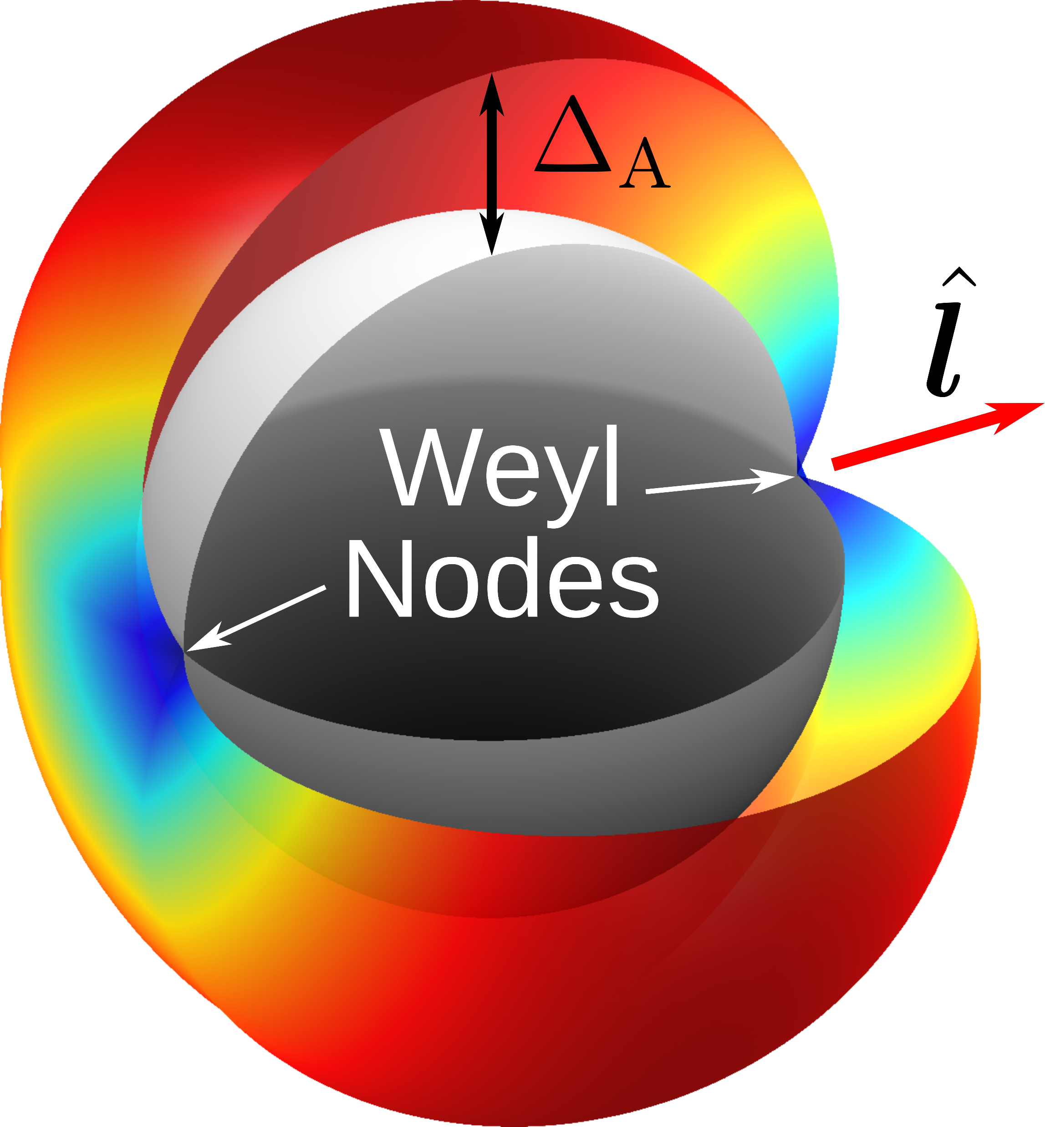
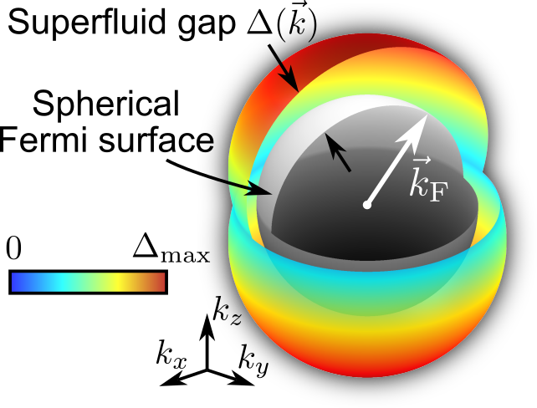
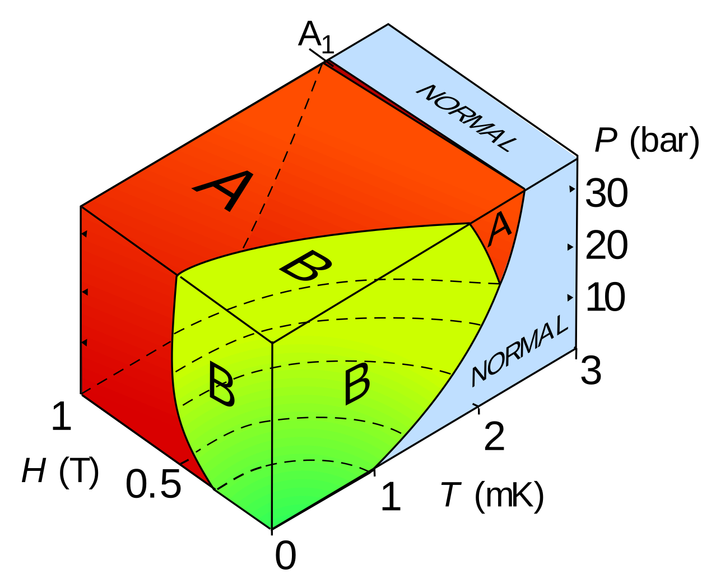
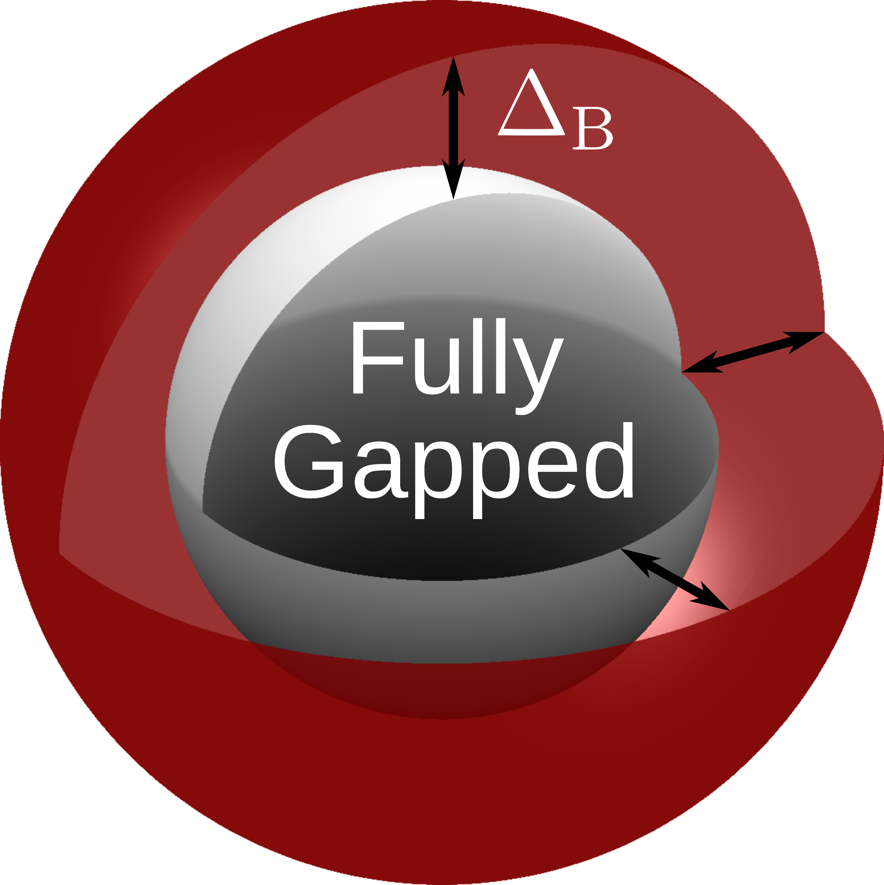
Superfluid ³He
Fermionic superfluid
Spin-triplet p-wave Cooper pairs
A Phase
In addition to phase coherence, pairing breaks rotational symmetry SO(3) in orbital and spin space
B Phase
Broken symmetry state described by a 3 x 3 complex order parameter matrix
Notes:
Superfluid 3He intro, phase diagram, order parameter, etc.

Slide 7
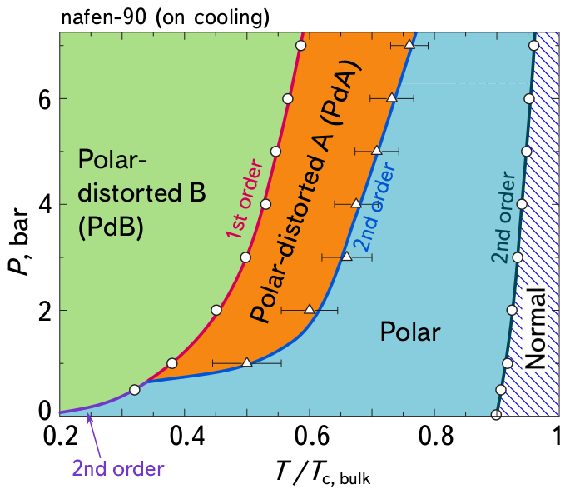
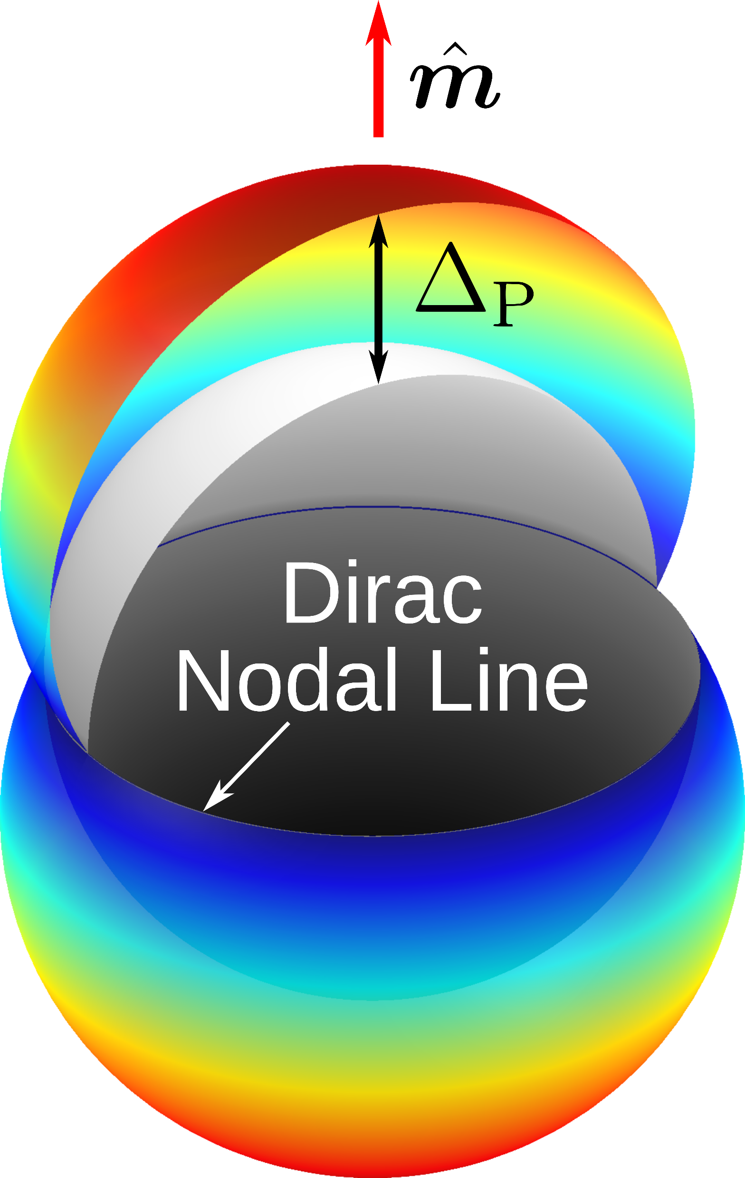
Superfluid ³He
Fermionic superfluid
Spin-triplet p-wave Cooper pairs
A Phase
In addition to phase coherence, pairing breaks rotational symmetry SO(3) in orbital and spin space
New phases stabilized in confinement:
B Phase
Broken symmetry state described by a 3 x 3 complex order parameter matrix
“nafen”
Polar phase
Notes:
Superfluid 3He intro, phase diagram, order parameter, etc.

Slide 8
Part 1: Vortices in superfluid ³He

Slide 9
Quantized vortices
Conventional superfluids:
(⁴He, s-wave superconductors, etc.)
Order parameter is a single scalar
Superfluid velocity
Irrotational
Notes:
Vortex intro, simple and multicomponent

Slide 10
Quantized vortices
Conventional superfluids:
(⁴He, s-wave superconductors, etc.)
Order parameter is a single scalar
Superfluid velocity
Irrotational
Superfluid
suppression in
the core costs
energy!
Only one type of vortex possible!
Notes:
Vortex intro, simple and multicomponent

Slide 11
Quantized vortices
Multicomponent order parameter:
(³He, unconventional superconductors, neutron stars?)
Conventional superfluids:
(⁴He, s-wave superconductors, etc.)
For example
,
Order parameter is a single scalar
Superfluid velocity
Irrotational
Superfluid
suppression in
the core costs
energy!
Only one type of vortex possible!
Notes:
Vortex intro, simple and multicomponent

Slide 12
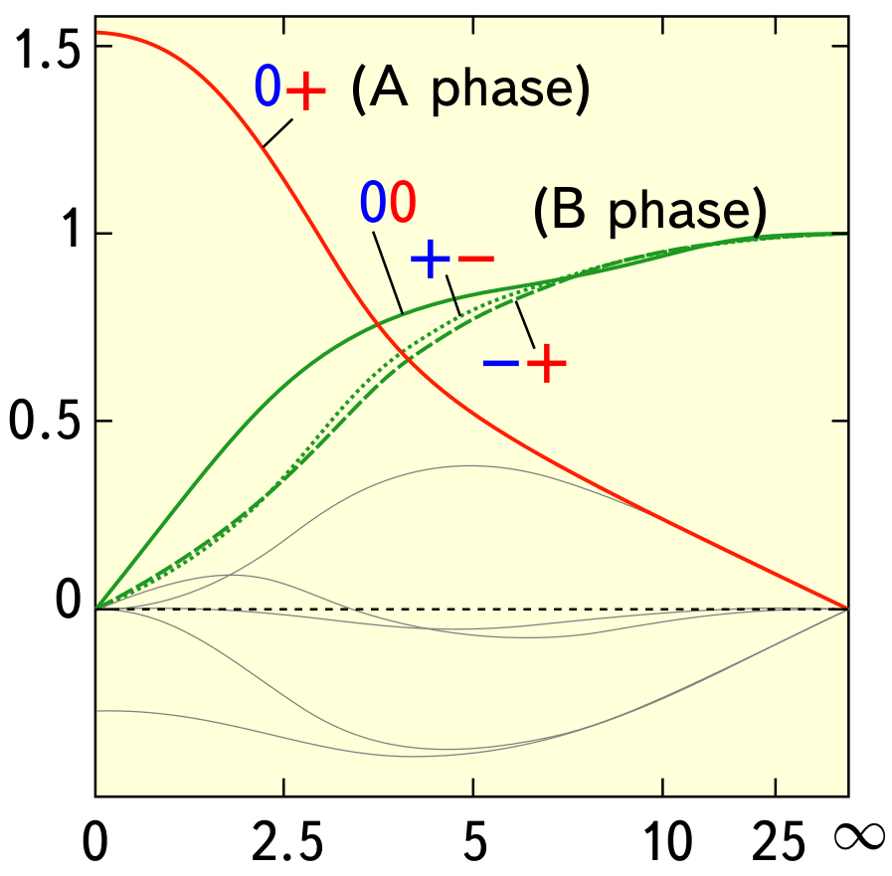
Quantized vortices
Multicomponent order parameter:
(³He, unconventional superconductors, neutron stars?)
Conventional superfluids:
(⁴He, s-wave superconductors, etc.)
For example
,
Order parameter is a single scalar
Cores are generally not singular
Superfluid velocity
Irrotational
Suppression compensated by other components
Superfluid
suppression in
the core costs
energy!
Components with winding are suppressed
Only one type of vortex possible!
Notes:
Vortex intro, simple and multicomponent

Slide 13
Quantized vortices
Multicomponent order parameter:
(³He, unconventional superconductors, neutron stars?)
Conventional superfluids:
(⁴He, s-wave superconductors, etc.)
For example
,
Order parameter is a single scalar
Cores are generally not singular
Superfluid velocity
Irrotational
Suppression compensated by other components
Superfluid
suppression in
the core costs
energy!
Components with winding are suppressed
Only one type of vortex possible!
Superflow not necessarily irrotational
Notes:
Vortex intro, simple and multicomponent

Slide 14
Vortices in the Polar phase

Slide 15
Vortices in the Polar phase
Strands fix direction of
weakly oriented by magnetic field
and spin-orbit interaction

Slide 16
Vortices in the Polar phase
Strands fix direction of
weakly oriented by magnetic field
and spin-orbit interaction
Two degrees of freedom:
Phase and angle of in the plane perpendicular to

Slide 17
Vortices in the Polar phase
Split into spin up and spin down superfluids:
Phase:
Angle of :
Strands fix direction of
weakly oriented by magnetic field
and spin-orbit interaction
Two degrees of freedom:
Phase and angle of in the plane perpendicular to

Slide 18
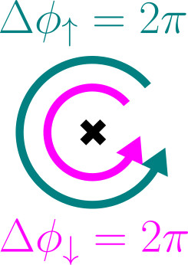
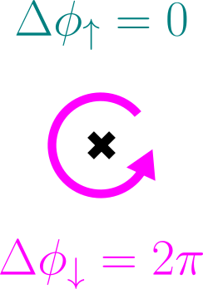
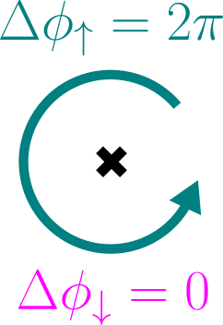
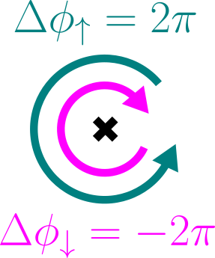
Vortices in the Polar phase
Split into spin up and spin down superfluids:
Phase:
Angle of :
Four possibilities:
Strands fix direction of
weakly oriented by magnetic field
and spin-orbit interaction
Two degrees of freedom:
Phase and angle of in the plane perpendicular to

Slide 19
Vortices in the Polar phase
Split into spin up and spin down superfluids:
Phase:
Angle of :
Four possibilities:
Strands fix direction of
weakly oriented by magnetic field
and spin-orbit interaction
Single-quantum vortex
Singular, no superfluidity in the core
Equal winding in both components:
Phase winds by 2π
Uniform
Two degrees of freedom:
Phase and angle of in the plane perpendicular to

Slide 20
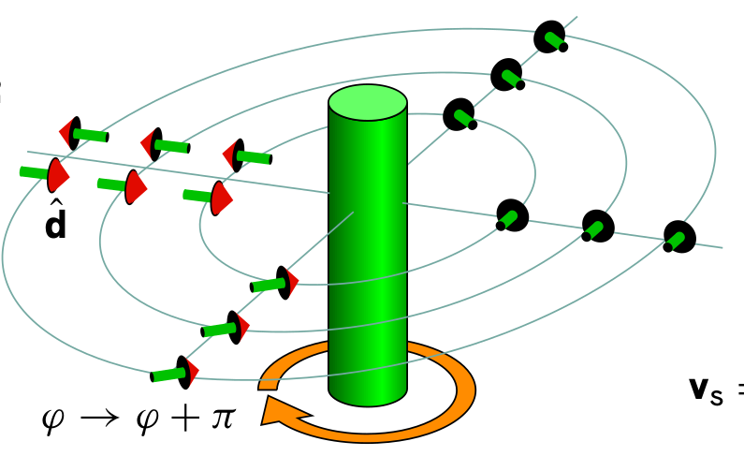
Vortices in the Polar phase
Split into spin up and spin down superfluids:
Phase:
Angle of :
Four possibilities:
Strands fix direction of
weakly oriented by magnetic field
and spin-orbit interaction
Half-quantum vortex
Non-singular
Winding in only one component:
Phase winds by π
rotates by π
Two degrees of freedom:
Phase and angle of in the plane perpendicular to

Slide 21
Vortices in the Polar phase
Split into spin up and spin down superfluids:
Phase:
Angle of :
Four possibilities:
Strands fix direction of
weakly oriented by magnetic field
and spin-orbit interaction
Spin vortex
Non-singular, “Soft core”
No phase winding
winds by 2π
Spin currents around vortex
Two degrees of freedom:
Phase and angle of in the plane perpendicular to

Slide 22
Vortices in the Polar phase
Split into spin up and spin down superfluids:
Phase:
Angle of :
Four possibilities:
Strands fix direction of
weakly oriented by magnetic field
and spin-orbit interaction
Half-quantum
vortex
Single-quantum
vortex
Spin vortex
Two degrees of freedom:
Phase and angle of in the plane perpendicular to

Slide 23
Vortices in the B phase

Slide 24

Vortices in the B phase
Cooper pair total angular momentum
Order parameter describes relative
orientation of spin and orbital spaces

Slide 25
Vortices in the B phase
Cooper pair total angular momentum
Order parameter describes relative
orientation of spin and orbital spaces
Leggett angle:
only weakly oriented by magnetic field and surfaces

Slide 26
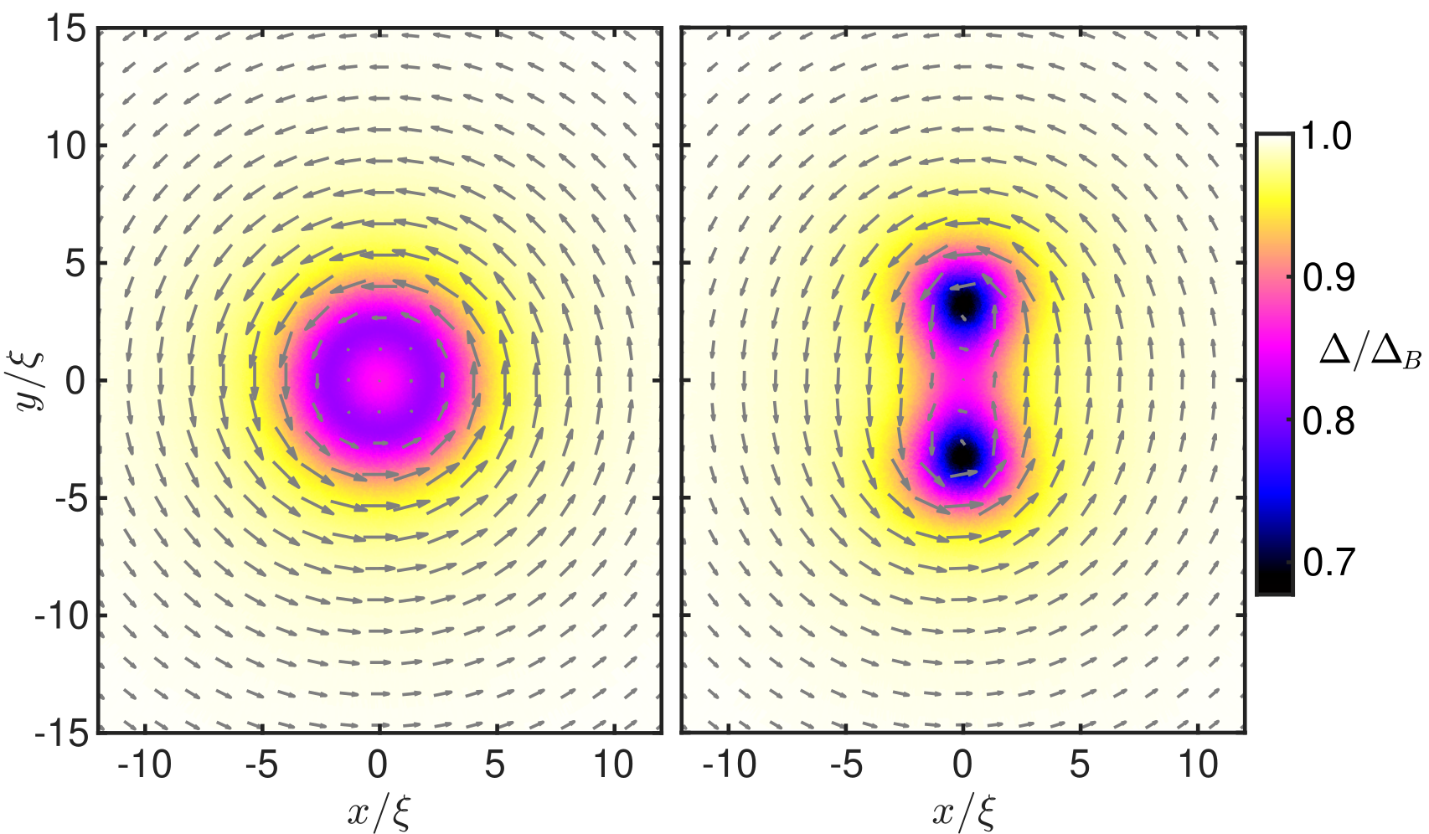
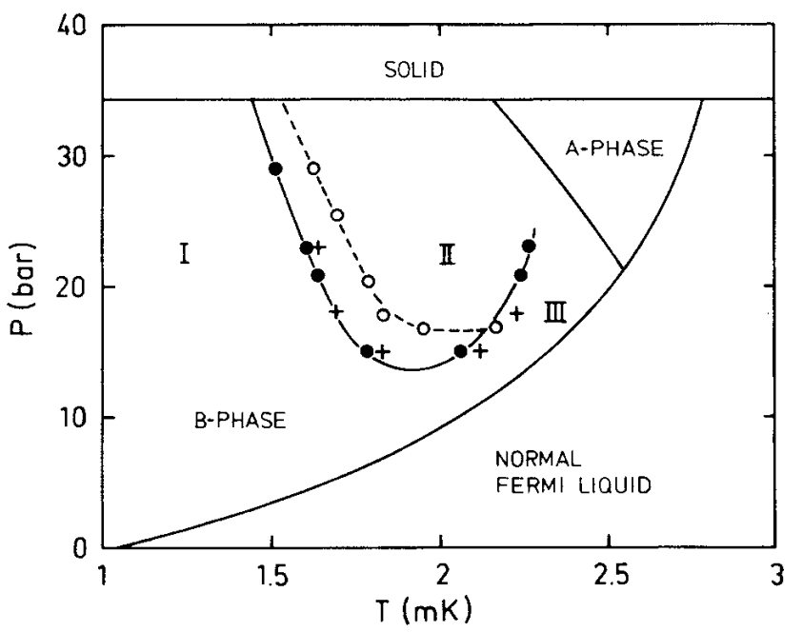
Vortices in the B phase
Two distinct single-quantum vortices:
“A-phase-core” vortex
Cooper pair total angular momentum
2π phase winding
Different core structures
Order parameter describes relative
orientation of spin and orbital spaces
“Double-core” vortex
Leggett angle:
only weakly oriented by magnetic field and surfaces
Rantanen & Eltsov, PRR 6, 043112 (2024)
Pekola et al., PRL 53, 584 (1984)

Slide 27
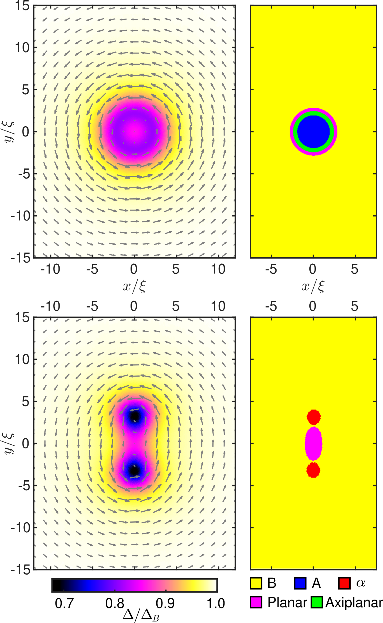
Vortices in the B phase
Two distinct single-quantum vortices:
“A-phase-core” vortex
Cooper pair total angular momentum
Order parameter describes relative
orientation of spin and orbital spaces
Axially symmetric, core filled with A phase
Leggett angle:
Interface between bulk B and core A phase energetically expensive
Only stable at high temperatures and pressures
only weakly oriented by magnetic field and surfaces
Rantanen & Eltsov, PRR 6, 043112 (2024)

Slide 28
Vortices in the B phase
Two distinct single-quantum vortices:
“Double-core” vortex
Cooper pair total angular momentum
Core splits into two subcores
Can be thought of as
a bound pair of HQVs
Order parameter describes relative
orientation of spin and orbital spaces
Lone HQVs are not stable in the B phase due to presence of spin-0 component
Leggett angle:
only weakly oriented by magnetic field and surfaces
Rantanen & Eltsov, PRR 6, 043112 (2024)

Slide 29
Vortices in the B phase
Two distinct single-quantum vortices:
“Double-core” vortex
Cooper pair total angular momentum
Core splits into two subcores
Can be thought of as
a bound pair of HQVs
Order parameter describes relative
orientation of spin and orbital spaces
Lone HQVs are not stable in the B phase due to presence of spin-0 component
Colors indicate
suppression
Three-core structure
Leggett angle:
Spin-0 component acts as “glue”
preventing further
splitting
only weakly oriented by magnetic field and surfaces
Rantanen, JLTP 222, 59 (2026)

Slide 30
Vortices in the B phase
Two distinct single-quantum vortices:
“Double-core” vortex
Cooper pair total angular momentum
Extended structures
possible with pinning
Pinning sites
“Kibble wall” instead
of point-like vortex
in spin-0 component
Order parameter describes relative
orientation of spin and orbital spaces
Colors indicate
suppression
Three-core structure
Leggett angle:
Spin-0 component acts as “glue”
preventing further
splitting
only weakly oriented by magnetic field and surfaces
Rantanen, JLTP 222, 59 (2026)

Slide 31
Vortices in the B phase
Mäkinen et al., J. Phys.: Cond. Matt. 35, 214001 (2023)
Spin and spin-mass vortices
Cooper pair total angular momentum
Order parameter describes relative
orientation of spin and orbital spaces
No phase winding, either or
(or both) rotate around axis
Spin vortex gets “pinned” on phase vortex
Leggett angle:
only weakly oriented by magnetic field and surfaces

Slide 32
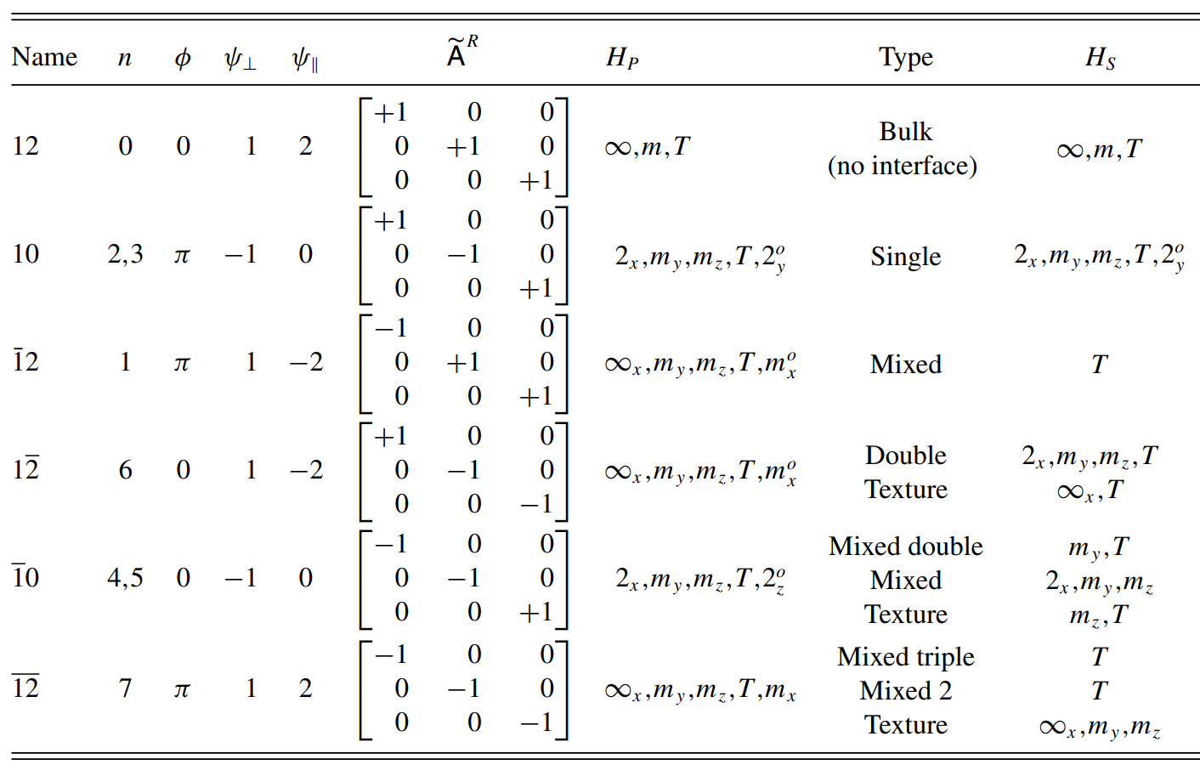
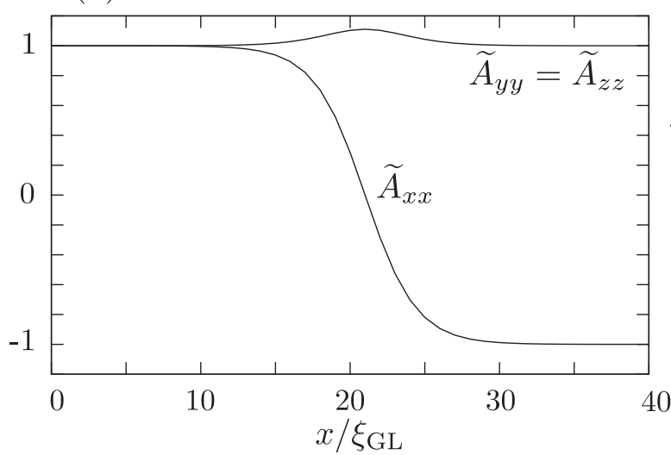
Vortices in the B phase
Mäkinen et al., J. Phys.: Cond. Matt. 35, 214001 (2023)
Spin and spin-mass vortices
Cooper pair total angular momentum
Order parameter describes relative
orientation of spin and orbital spaces
No phase winding, either or
(or both) rotate around axis
Spin vortex gets “pinned” on phase vortex
Domain walls
Variety of different types of domain walls are possible
Leggett angle:
only weakly oriented by magnetic field and surfaces
Silveri et al., PRB 90, 184513 (2014)

Slide 33
Vortices in the A phase

Slide 34
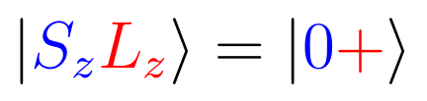
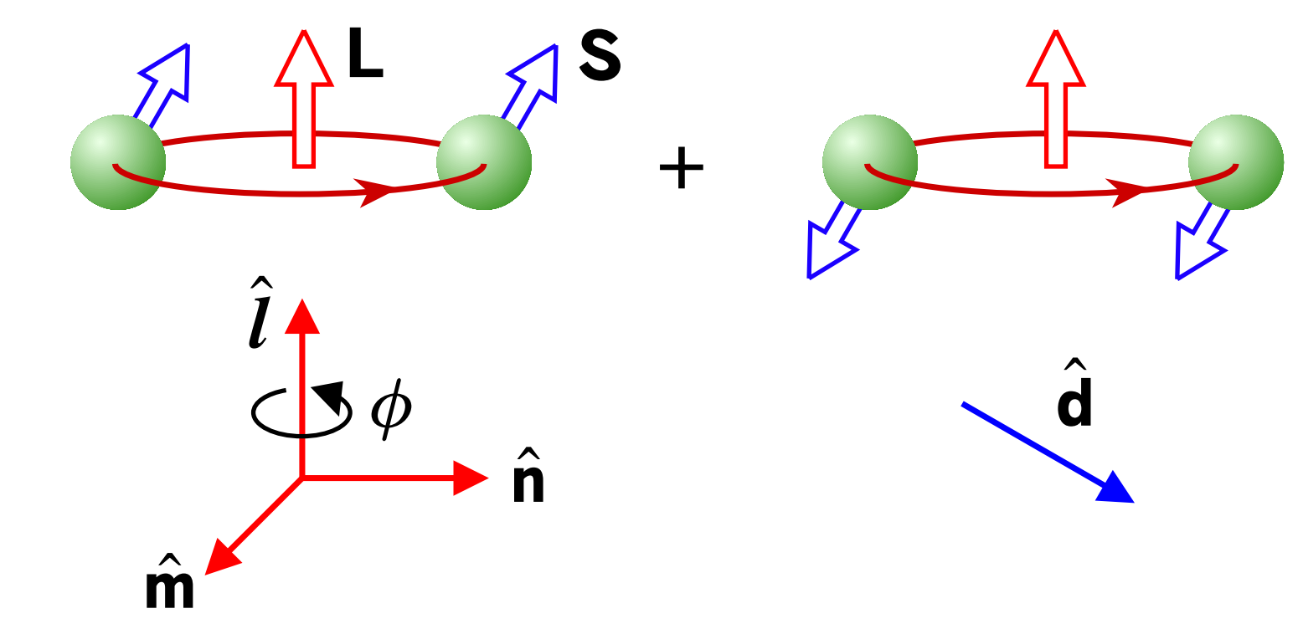
Vortices in the A phase
Chiral phase with defined angular momentum direction

Slide 35
Vortices in the A phase
Chiral phase with defined angular momentum direction

Slide 36
Vortices in the A phase
Chiral phase with defined angular momentum direction
Mermin-Ho relation:

Slide 37
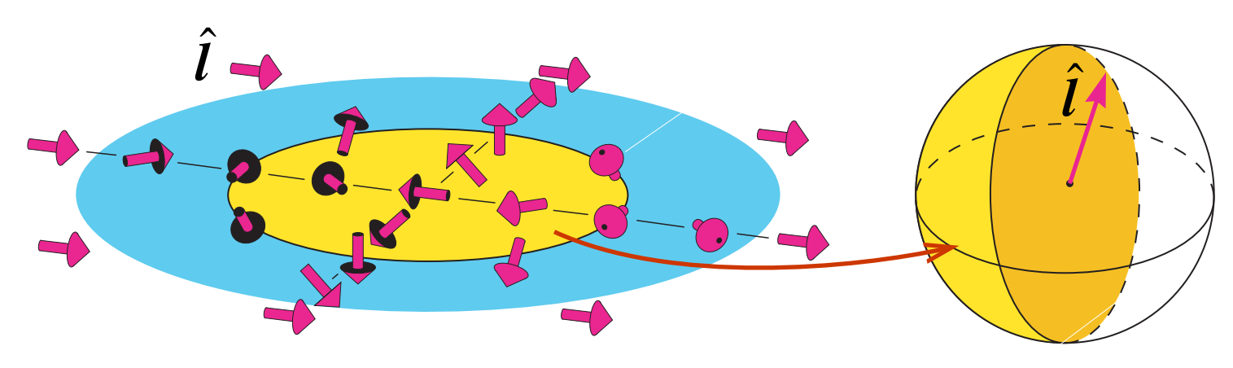
Vortices in the A phase
Chiral phase with defined angular momentum direction
Mermin-Ho relation:

Slide 38
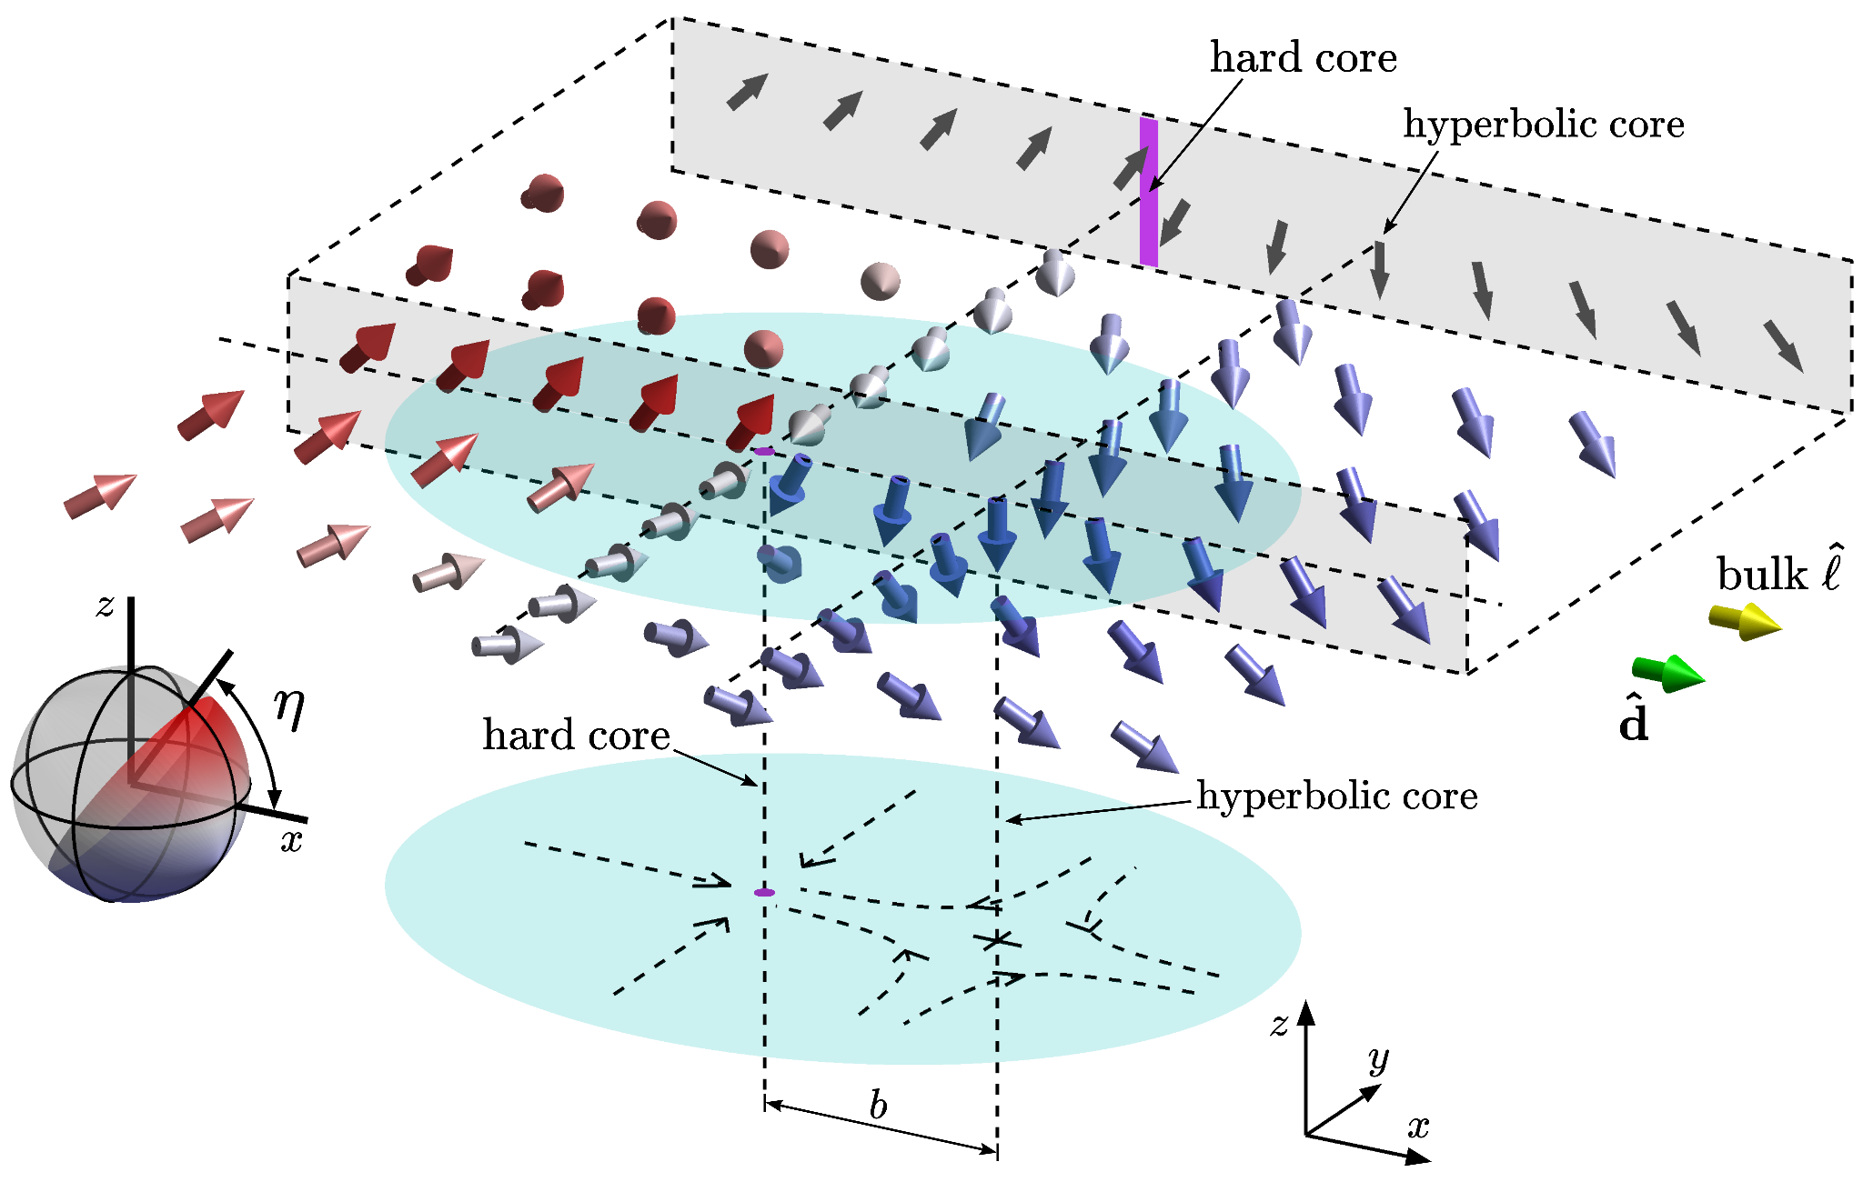
Vortices in the A phase
Single-quantum vortex:
Chiral phase with defined angular momentum direction
Rantanen et al., JLTP 220, 88 (2025)
Vorticity carried in vector texture
Only observed when rotating during transition
Mermin-Ho relation:

Slide 39
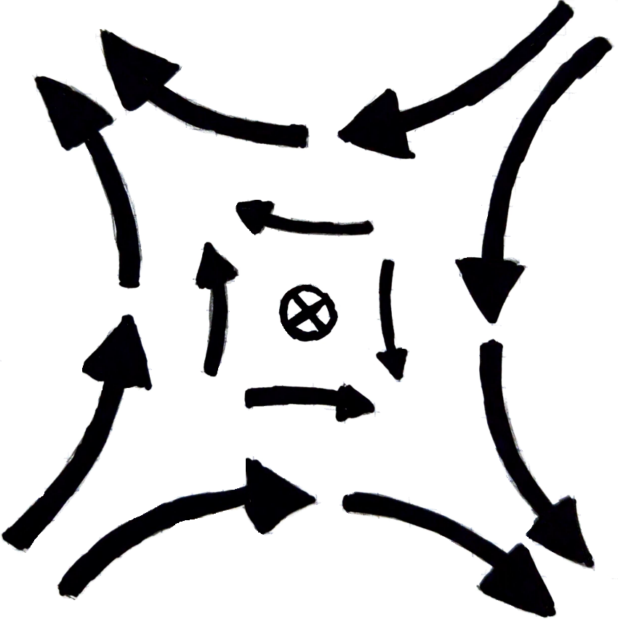
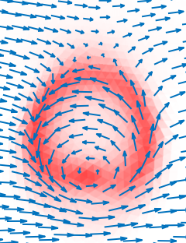
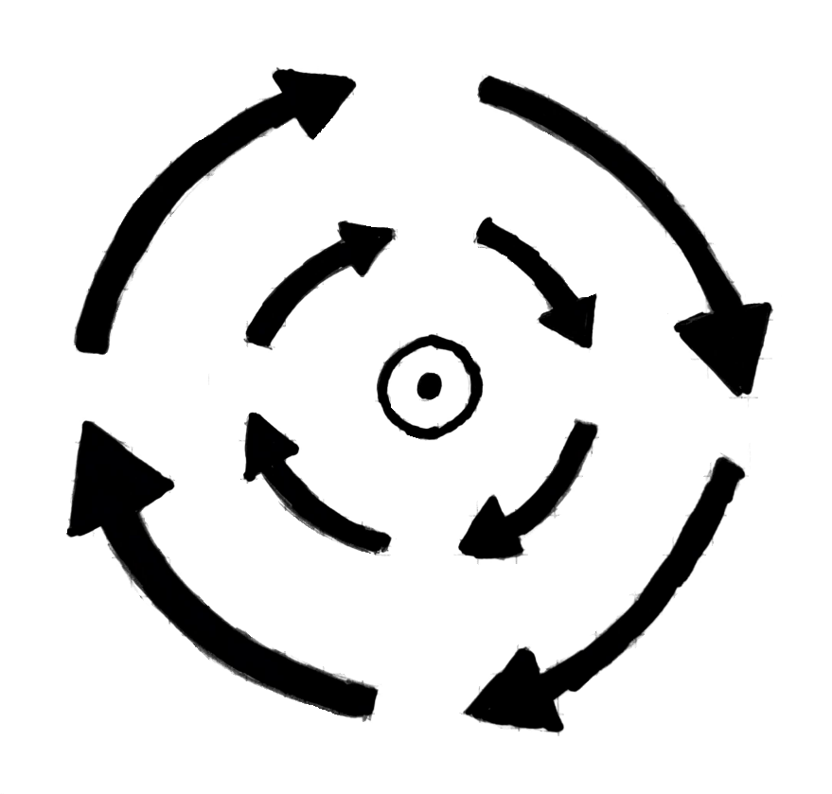
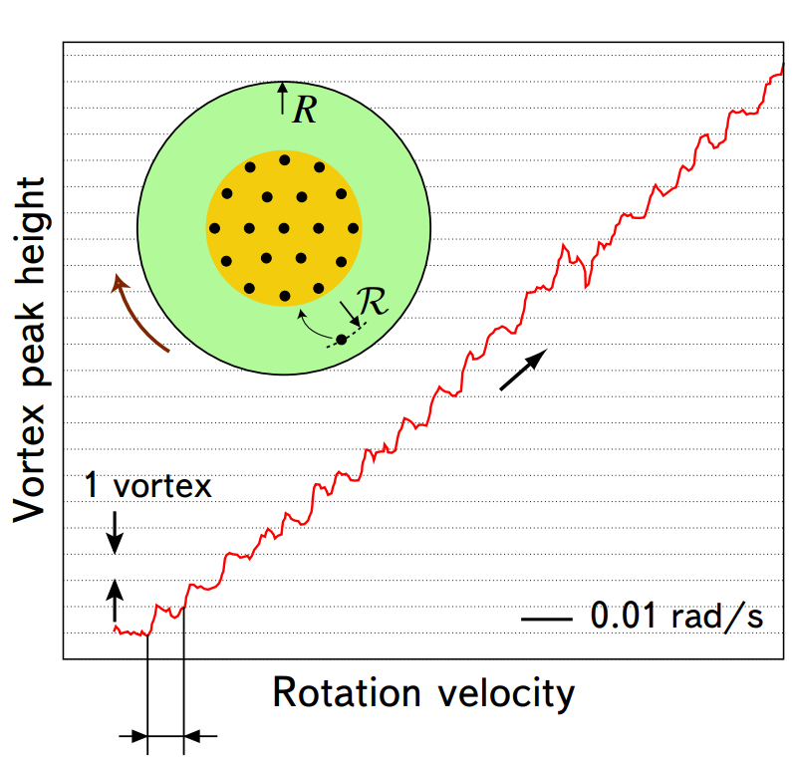
Vortices in the A phase
Double-quantum vortex:
Arrows:
Color:
Chiral phase with defined angular momentum direction
Each meron carries one quantum of circulation
“merons”
Rantanen & Eltsov., PRB 107, 104505 (2023)
Higher energy than SQVs, but easier to nucleate
“Skyrmion” or “Bimeron”
Mermin-Ho relation:

Slide 40
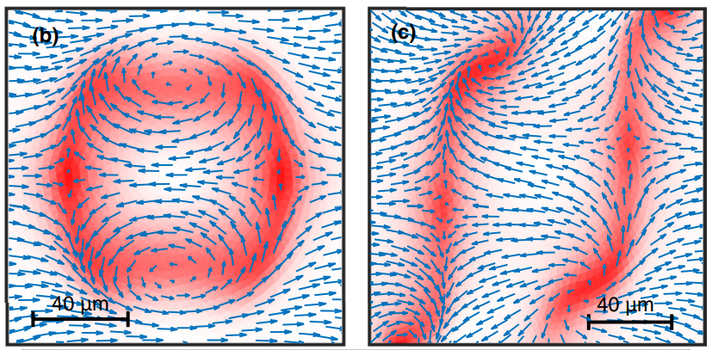
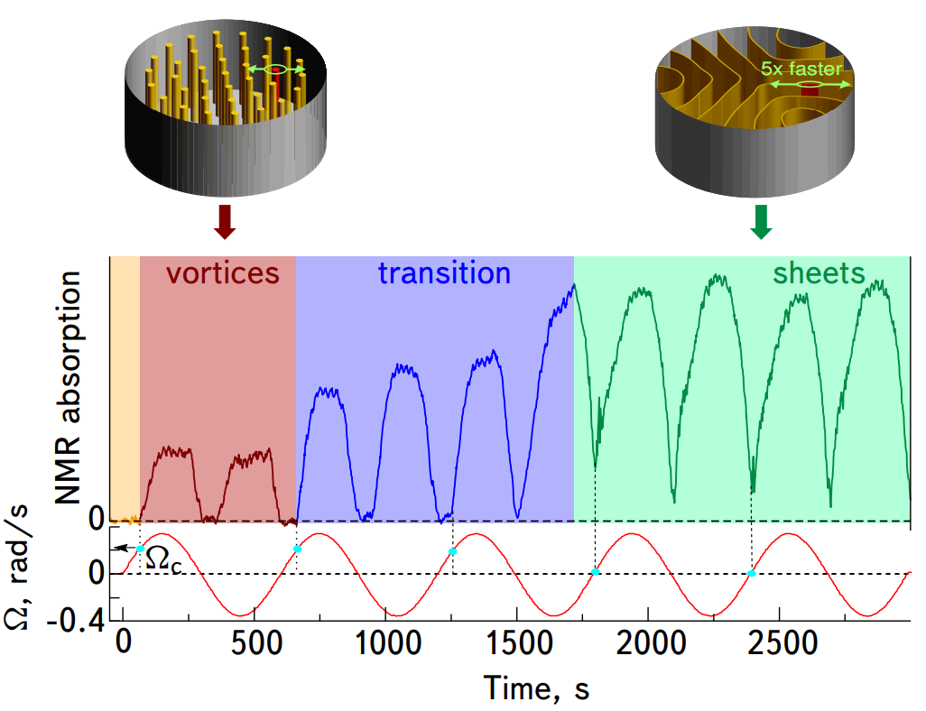
Vortices in the A phase
Vortex sheet:
Planar object carrying vorticity
Chiral phase with defined angular momentum direction
Chain of merons
DQV: smallest sheet
Closed Open
Rantanen & Eltsov., PRB 107, 104505 (2023)
Created by rapidly oscillating rotation
Mermin-Ho relation:

Slide 41
Vortices in superfluid ³He

Slide 42
Part 2: Vortex pinning in superfluid ³He

Slide 43
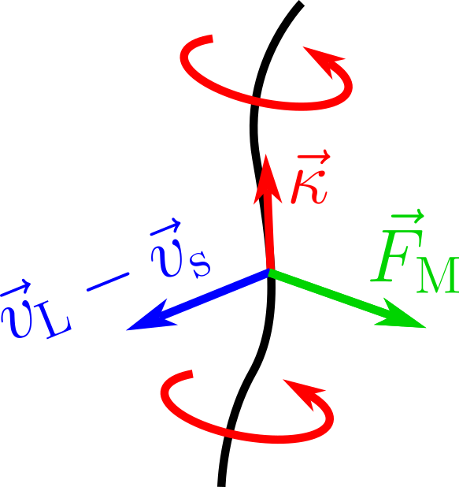
Vortex pinning
Free vortices move, pushed by the Magnus force
Circulation
Velocity of
vortex line
Superfluid
velocity

Slide 44
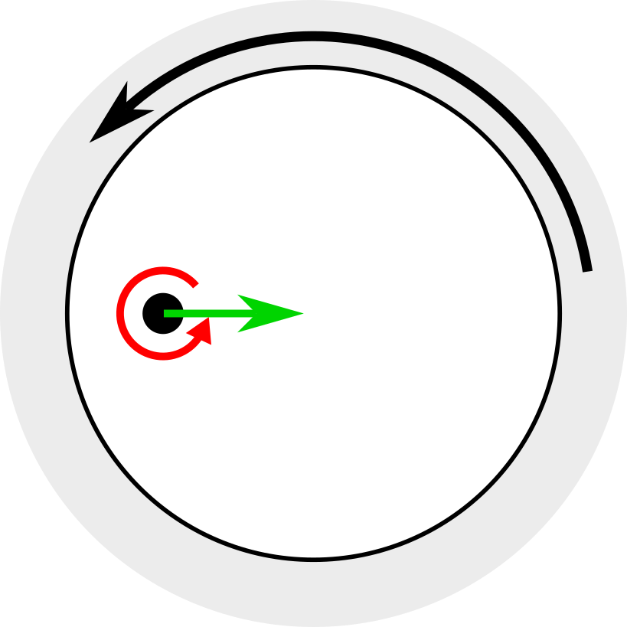
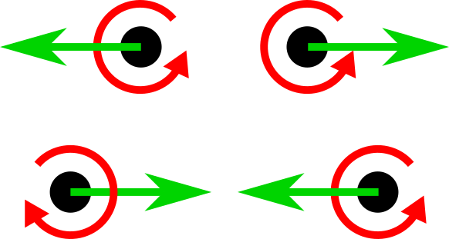
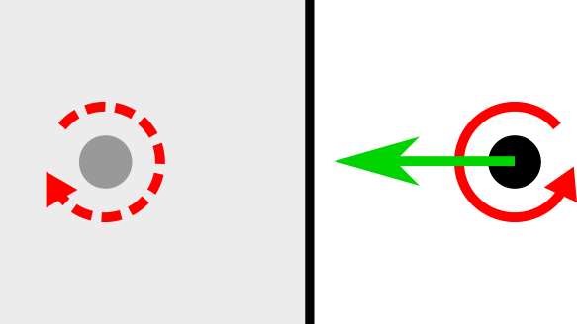
Vortex pinning
Free vortices move, pushed by the Magnus force
Circulation
Velocity of
vortex line
Superfluid
velocity
Ω
External rotation
Interaction between vortices
Attraction to images

Slide 45
Vortex pinning
Vortices can be pinned on objects
Free vortices move, pushed by the Magnus force
Vortex is unable to move until force exceeds a critical threshold
Circulation
Velocity of
vortex line
Superfluid
velocity
Ω
External rotation
Interaction between vortices
Attraction to images

Slide 46
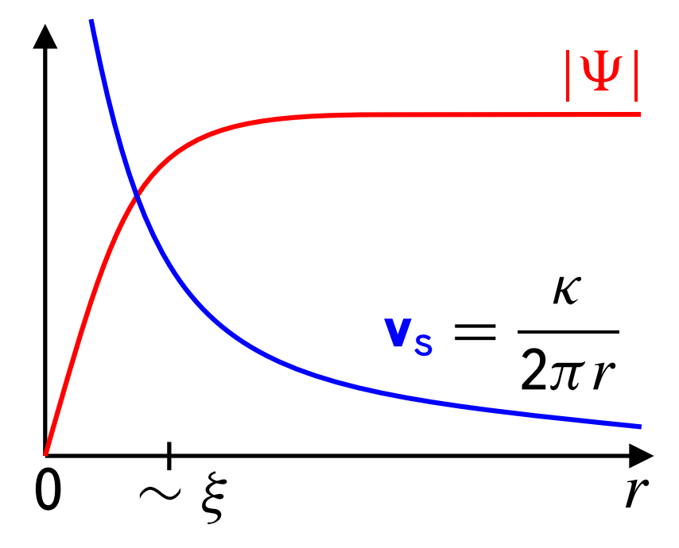
Vortex pinning
Vortices can be pinned on objects
Free vortices move, pushed by the Magnus force
Vortex is unable to move until force exceeds a critical threshold
Circulation
Velocity of
vortex line
Superfluid
velocity
Ω
Simple picture:
Part of the core is displaced by pinning site
External rotation
Interaction between vortices
Attraction to images

Slide 47
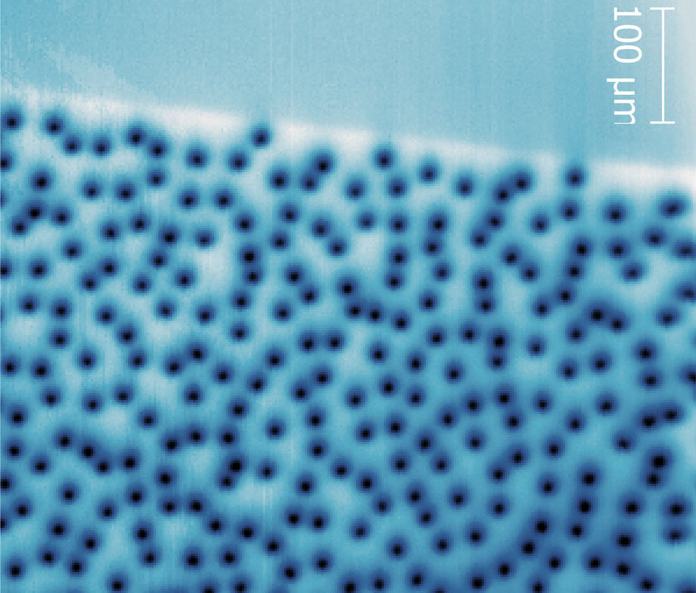
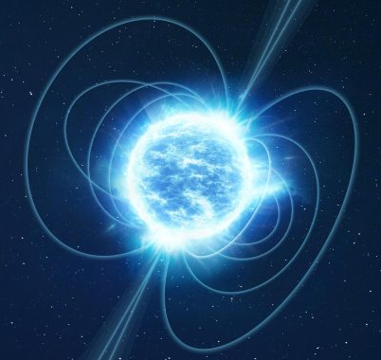
Vortex pinning
Vortices can be pinned on objects
Free vortices move, pushed by the Magnus force
Vortex is unable to move until force exceeds a critical threshold
Circulation
Velocity of
vortex line
Superfluid
velocity
Ω
Simple picture:
Part of the core is displaced by pinning site
Relevance:
External rotation
Interaction between vortices
Attraction to images
Superconductors
Neutron star glitches

Slide 48
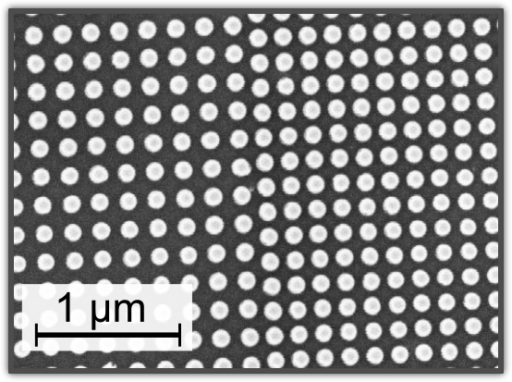
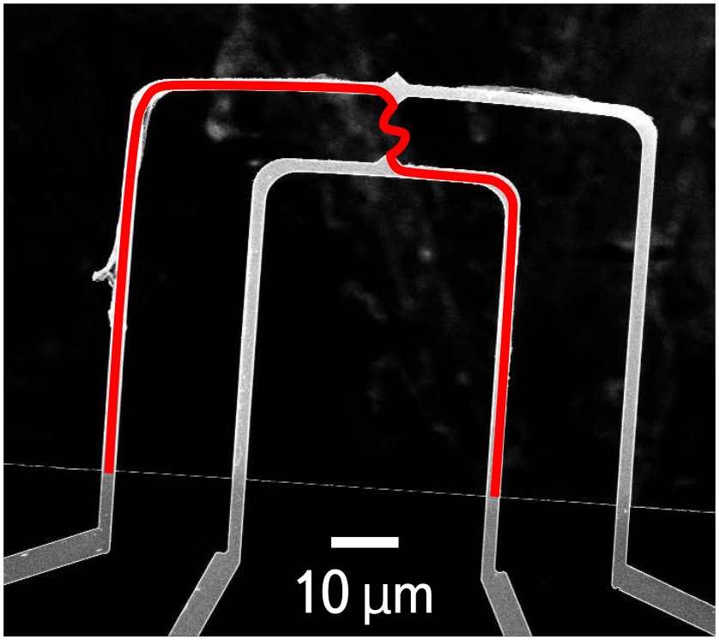
Pinning in ³He
Mesoscopic:
Nanofabricated substrates and devices
Microscopic:
Chemically grown nanomaterials
Silicon pillars less than
100 nm in diameter
Nanomechanical devices
micrometers in size
“nafen” Al₂O₃ strands
with ~8 nm diameters
Notes:
Point impurity model (qualitative), mesoscopic geometry model (quantitative)

Slide 49
Pinning in ³He
Mesoscopic:
Nanofabricated substrates and devices
Microscopic:
Chemically grown nanomaterials
Silicon pillars less than
100 nm in diameter
Nanomechanical devices
micrometers in size
“nafen” Al₂O₃ strands
with ~8 nm diameters
Energy from
point impurities:
Scattering cross sections
Strand direction
Notes:
Point impurity model (qualitative), mesoscopic geometry model (quantitative)

Slide 50

Pinning in ³He
Mesoscopic:
Nanofabricated substrates and devices
Microscopic:
Chemically grown nanomaterials
Silicon pillars less than
100 nm in diameter
Nanomechanical devices
micrometers in size
“nafen” Al₂O₃ strands
with ~8 nm diameters
Objects modeled as
actual geometry
Energy from
point impurities:
Specular boundary
conditions
Scattering cross sections
Strand direction
Notes:
Point impurity model (qualitative), mesoscopic geometry model (quantitative)

Slide 51



Point impurity model
Single-quantum
vortex
Randomly generated impurities
Denser regions can
pin topological objects
Phase winding
Polar phase
Notes:
Point impurities: pinned vortices, domain walls, spin vortices and disgyrations

Slide 52


Point impurity model
Spin vortices
Phase transitions can generate
spin vortices in Polar phase
Polar phase
Arrows show direction of
Notes:
Point impurities: pinned vortices, domain walls, spin vortices and disgyrations

Slide 53


Point impurity model
Two half-quantum
vortices
After cooling to B phase,
domain walls form
Just like vortices, domain
walls are strongly pinned
“Kibble wall”
connecting HQVs
B phase
Spin soliton
between HQVs
Arrows show direction of
Notes:
Point impurities: pinned vortices, domain walls, spin vortices and disgyrations

Slide 54

Point impurity model
Two half-quantum
vortices
After cooling to B phase,
domain walls form
Just like vortices, domain
walls are strongly pinned
“Kibble wall”
connecting HQVs
B phase
Spin soliton
between HQVs
Arrows show direction of
Notes:
Point impurities: pinned vortices, domain walls, spin vortices and disgyrations

Slide 55

Point impurity model
Two half-quantum
vortices
After cooling to B phase,
domain walls form
Just like vortices, domain
walls are strongly pinned
“Kibble wall”
connecting HQVs
B phase
Spin soliton
between HQVs
Arrows show direction of
Notes:
Point impurities: pinned vortices, domain walls, spin vortices and disgyrations

Slide 56

Point impurity model
Two half-quantum
vortices
After cooling to B phase,
domain walls form
Just like vortices, domain
walls are strongly pinned
“Kibble wall”
connecting HQVs
B phase
Spin soliton
between HQVs
Arrows show direction of
Notes:
Point impurities: pinned vortices, domain walls, spin vortices and disgyrations

Slide 57

Point impurity model
Two half-quantum
vortices
After cooling to B phase,
domain walls form
Just like vortices, domain
walls are strongly pinned
“Kibble wall”
connecting HQVs
B phase
Spin soliton
between HQVs
Arrows show direction of
Notes:
Point impurities: pinned vortices, domain walls, spin vortices and disgyrations

Slide 58

Point impurity model
Two half-quantum
vortices
After cooling to B phase,
domain walls form
Just like vortices, domain
walls are strongly pinned
“Kibble wall”
connecting HQVs
B phase
Spin soliton
between HQVs
Arrows show direction of
Notes:
Point impurities: pinned vortices, domain walls, spin vortices and disgyrations

Slide 59

Point impurity model
Two half-quantum
vortices
After cooling to B phase,
domain walls form
Just like vortices, domain
walls are strongly pinned
“Kibble wall”
connecting HQVs
B phase
Spin soliton
between HQVs
Arrows show direction of
Notes:
Point impurities: pinned vortices, domain walls, spin vortices and disgyrations

Slide 60

Point impurity model
Two half-quantum
vortices
After cooling to B phase,
domain walls form
Just like vortices, domain
walls are strongly pinned
“Kibble wall”
connecting HQVs
B phase
Spin soliton
between HQVs
Arrows show direction of
Notes:
Point impurities: pinned vortices, domain walls, spin vortices and disgyrations

Slide 61

Point impurity model
Two half-quantum
vortices
After cooling to B phase,
domain walls form
Just like vortices, domain
walls are strongly pinned
“Kibble wall”
connecting HQVs
B phase
Spin soliton
between HQVs
Arrows show direction of
Notes:
Point impurities: pinned vortices, domain walls, spin vortices and disgyrations

Slide 62

Point impurity model
Two half-quantum
vortices
After cooling to B phase,
domain walls form
Just like vortices, domain
walls are strongly pinned
“Kibble wall”
connecting HQVs
B phase
Spin soliton
between HQVs
Arrows show direction of
Notes:
Point impurities: pinned vortices, domain walls, spin vortices and disgyrations

Slide 63

Point impurity model
Two half-quantum
vortices
After cooling to B phase,
domain walls form
Just like vortices, domain
walls are strongly pinned
“Kibble wall”
connecting HQVs
B phase
Spin soliton
between HQVs
Arrows show direction of
Notes:
Point impurities: pinned vortices, domain walls, spin vortices and disgyrations

Slide 64

Point impurity model
Two half-quantum
vortices
After cooling to B phase,
domain walls form
Just like vortices, domain
walls are strongly pinned
“Kibble wall”
connecting HQVs
B phase
Spin soliton
between HQVs
Arrows show direction of
Notes:
Point impurities: pinned vortices, domain walls, spin vortices and disgyrations

Slide 65

Point impurity model
In the A phase, impurities orient
Defects in texture don’t
carry phase winding, but
are pinned by impurities
A phase
Single-quantum
vortex
Notes:
Point impurities: pinned vortices, domain walls, spin vortices and disgyrations

Slide 66
Point impurity model
“Disgyrations”
In the A phase, impurities orient
Defects in texture don’t
carry phase winding, but
are pinned by impurities
A phase
Single-quantum
vortex
Notes:
Point impurities: pinned vortices, domain walls, spin vortices and disgyrations

Slide 67

Point impurity model
“Disgyrations”
In the A phase, impurities orient
Defects in texture don’t
carry phase winding, but
are pinned by impurities
A phase
Arrows show direction of
Single-quantum
vortex
Notes:
Point impurities: pinned vortices, domain walls, spin vortices and disgyrations

Slide 68
Mesoscopic pinning
Depinning from a single pillar
with increasing Ω
Ω
R = 30 µm
20 µm

Slide 69

Mesoscopic pinning
Depinning from a single pillar
with increasing Ω
Ω
R = 30 µm
20 µm
10 nm $≤ ≤$ 100 nm
20 nm $≤ ≤$ 220 nm

Slide 70
Mesoscopic pinning
Depinning from a single pillar
with increasing Ω
Ω
R = 30 µm
20 µm
10 nm $≤ ≤$ 100 nm
20 nm $≤ ≤$ 220 nm
Excellent match over
wide range of parameters!

Slide 71
Mesoscopic pinning
Calculated energy barriers using
the Nudged Elastic Band method
Vortex leaves in fractions
Depinning from a single pillar
with increasing Ω
Ω
R = 30 µm
20 µm
10 nm $≤ ≤$ 100 nm
20 nm $≤ ≤$ 220 nm
Excellent match over
wide range of parameters!

Slide 72
Mesoscopic pinning
Calculated energy barriers using
the Nudged Elastic Band method
Vortex leaves in fractions
Depinning from a single pillar
with increasing Ω
Ω
R = 30 µm
20 µm
10 nm $≤ ≤$ 100 nm
20 nm $≤ ≤$ 220 nm
Excellent match over
wide range of parameters!

Slide 73
Mesoscopic pinning
Calculated energy barriers using
the Nudged Elastic Band method
Vortex leaves in fractions
Depinning from a single pillar
with increasing Ω
Ω
R = 30 µm
20 µm
10 nm $≤ ≤$ 100 nm
20 nm $≤ ≤$ 220 nm
Excellent match over
wide range of parameters!
Strange scaling for length scale, triplet physics?

Slide 74



Mesoscopic pinning
Ω
Depinning in an array of
pillars with spacing D
D (µm)
D
$$T=0.60T_{c}$$
Depinning velocity (cm/s)
Decreasing pillar spacing
suppresses gap in plane
$$T=0.80T_{c}$$
Pinning force is reduced
for smaller spacings
Vortices jump from
pillar to pillar
Suppression

Slide 75

Rotation sweep
Cylinder filled with ~8000 pillars
Increasing rotation rapidly up to 20 krad/s, then decreasing back to 0 krad/s
Defect to initiate nucleation
Amplitude of 00 component
Phase of 00 component
Blue = B phase
Red = A phase

Slide 76

Summary
Superfluid ³He is an excellent model system for studying topology
A multicomponent order parameter can support a wide variety of different vortex structures
Impurities can pin other kinds of topological objects in addition to regular vortices
Pinning force depends on coherence length and size of object:

