Slide 1
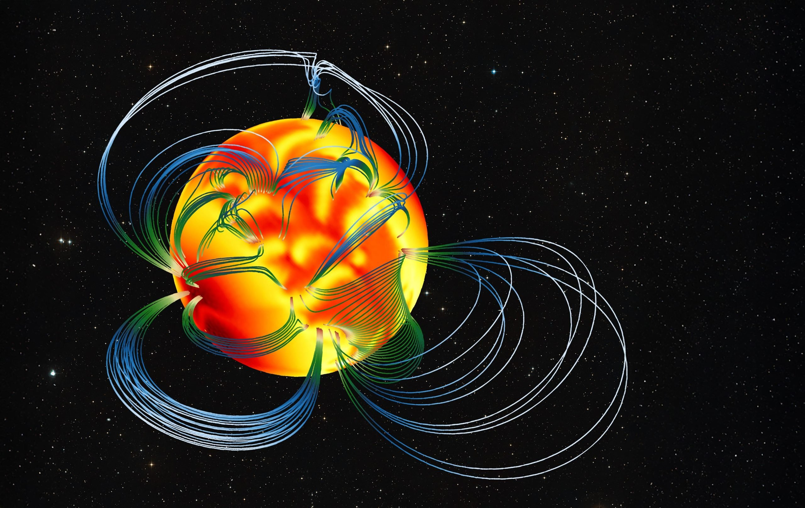


Tayler-Spruit dynamo, low-field magnetars and central compact objects
Andrei P. Igoshev
Rainer Hollerbach, Toby Wood, Jerome Guilet,
Raphael Raynoud, Paul Barrere
Nicolas Moraga
24/06/2026

Slide 2


Research group at Newcastle University, UK
Superconductivity in neutron star cores
Main objective: to model magnetic field evolution in superconducting neutron stars cores
Recent side project: hydrodynamic model for pulsar glitches
Dr Nicolas Moraga
Charlie Perkins
Thursday 17:30

Slide 3
Outline
Magnetised NS - how do we know about magnetic fields? Extremes: magnetars, low-B magnetars/CCOs
How are these magnetic fields formed? Magnetic relaxation/fossil field hypothesis
Dynamo as a process
Proto-NS
- convective, Taylor-Spruit
Astrophysical fluid dynamics
Connection between low-B magnetars and dynamo
CCOs
Superconducting core simulations (?)

Slide 4
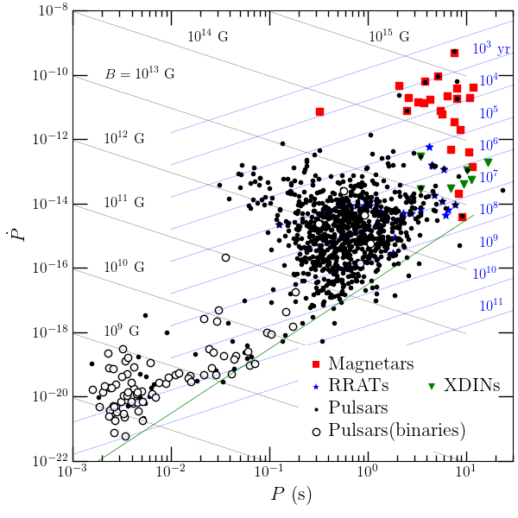


Neutron stars & their magnetic fields
Neutron stars (NSs) are compact (~10 km) remnants of the stellar evolution. A mass of NS is $≈1.4M_{⊙}$. NSs have extreme magnetic fields (${10}^{8}−{10}^{14}$ G).
Main observational characteristics for neutron stars are their period and period derivatives.
$P$ and $\overset{·}{P}$ indicate poloidal, dipolar magnetic field strength $B_{p}$
$$B∝\sqrt{P\overset{·}{P}}$$
http://neutronstars.utk.edu
Review on magnetic field evolution: Igoshev, Popov & Hollerbach (2021)
Review on techniques: Pons, Dehman & Vigano (2026)

Slide 5
XDINS
MSP
Neutron
stars
CCO
Magnetar
http://neutronstars.utk.edu
Pulsar
AXP
SGR
low-B
NS zoo,
Harding (2013);
Borghese (2024)

Slide 6
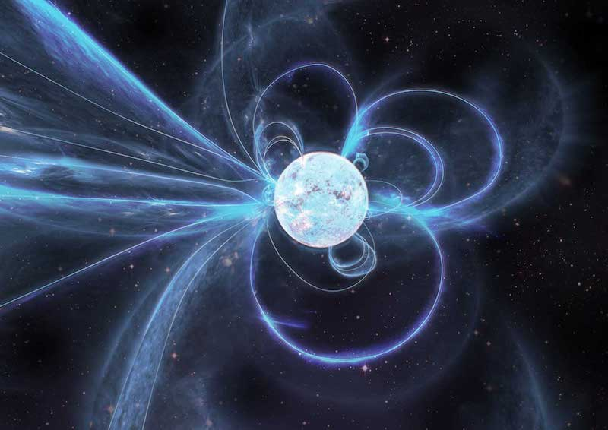
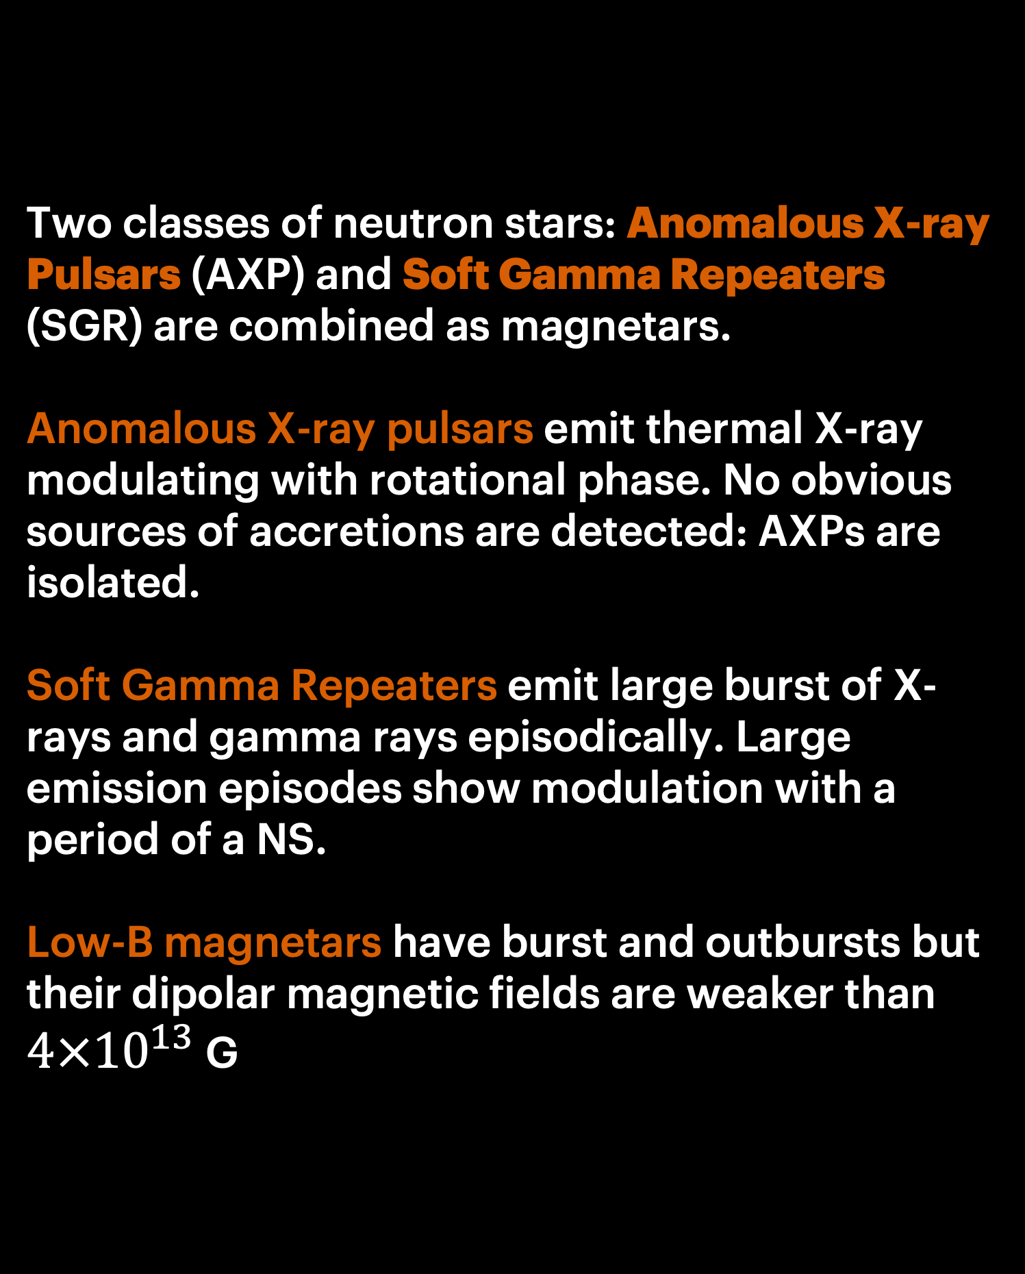
Magnetars
Two classes of neutron stars: Anomalous X-ray Pulsars (AXP) and Soft Gamma Repeaters (SGR) are combined as magnetars.
Anomalous X-ray pulsars emit thermal X-ray modulating with rotational phase. No obvious sources of accretions are detected: AXPs are isolated.
Soft Gamma Repeaters emit large burst of X-rays and gamma rays episodically. Large emission episodes show modulation with a period of a NS.
Low-B magnetars have burst and outbursts but their dipolar magnetic fields are weaker than $4×{10}^{13}$ G
Carl Knox/OzGrav

Slide 7
Magnetars
Magnetars are defined now based on their transient behaviour i.e. as sources with burst and outbursts in X-ray.
Carl Knox/OzGrav

Slide 8
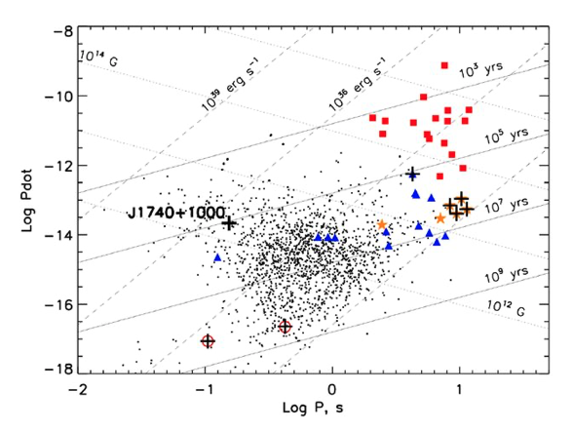
Soft X-ray emission
Kargaltsev et al. (2012)

Slide 9
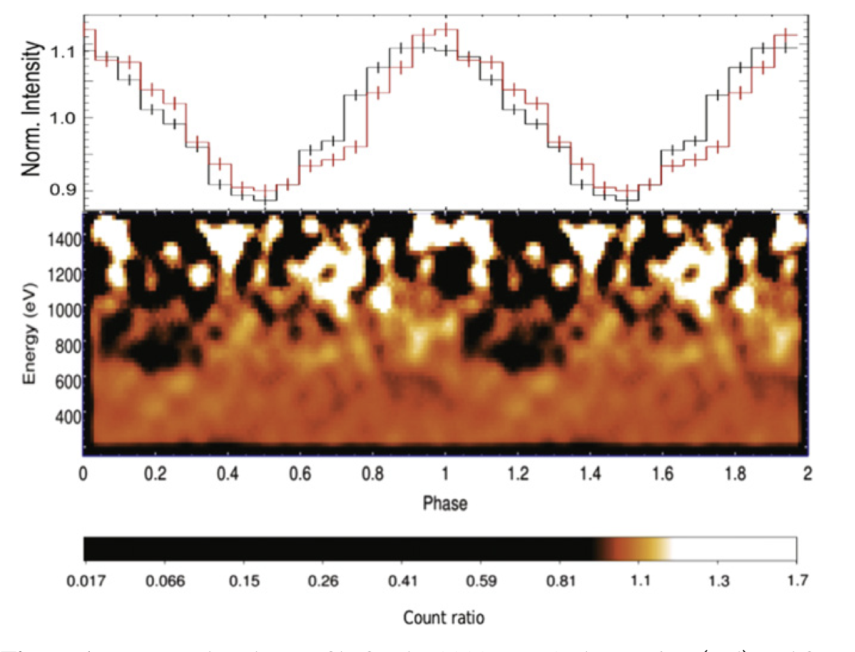
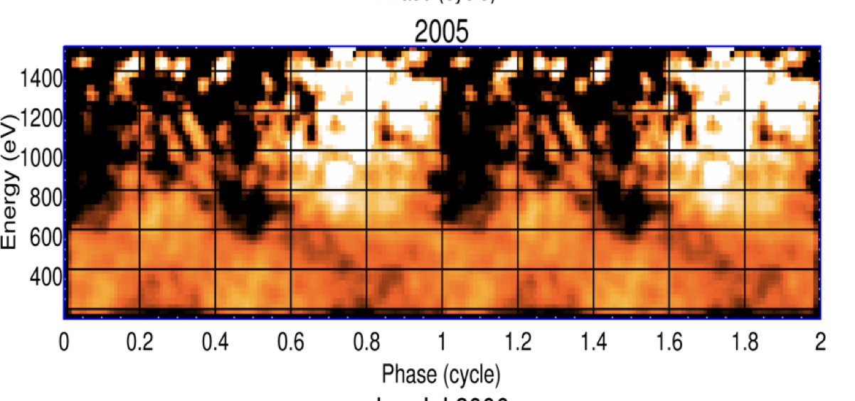
XDINS and their tangled magnetic fields
X-ray spectra is well described with thermal blackbody but in some cases absorption features are present.
Some of these objects have phase dependant absorption features which could be produced by proton cyclotron resonant scattering in a localised loop near NS surface with magnetic field ~5 times stronger than dipolar estimate. Similar is found for low-B magnetars
RX J0720.4–3125; Borghese+ (2015)
RX J1308.6+21275; Borghese+ (2017)

Slide 10
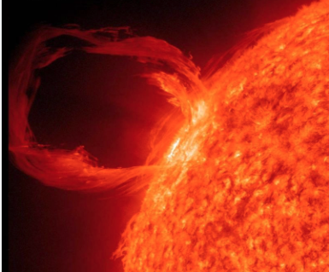
XDINS and their tangled magnetic fields
X-ray spectra is well described with thermal blackbody but in some cases absorption features are present.
Some of these objects have phase dependant absorption features which could be produced by proton cyclotron resonant scattering in a localised loop near NS surface with magnetic field ~5 times stronger than dipolar estimate. Similar is found for low-B magnetars
X-ray photon
RX J0720.4–3125; Borghese+ (2015)
RX J1308.6+21275; Borghese+ (2017)

Slide 11
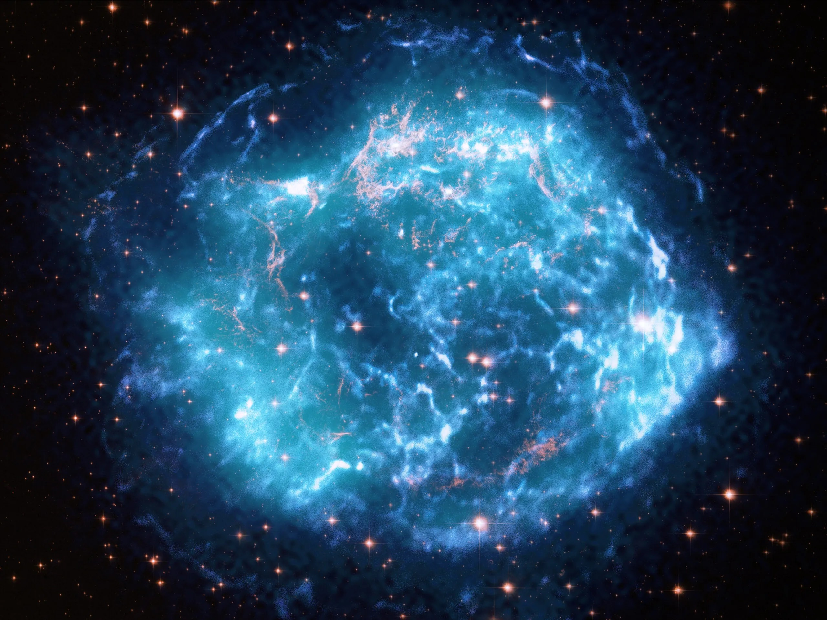

Central compact objects (CCOs)
A handful of young isolated NSs discovered in close vicinity to geometric centra of supernova remnants. (de Luca 2017)
CCOs emit only thermal X-ray radiation. No radio emission was discovered.
Periods and period derivatives are measured in three cases. Periods are typical for normal radio pulsars. Period derivatives are very small ~${10}^{−17}$s/s.

Slide 12
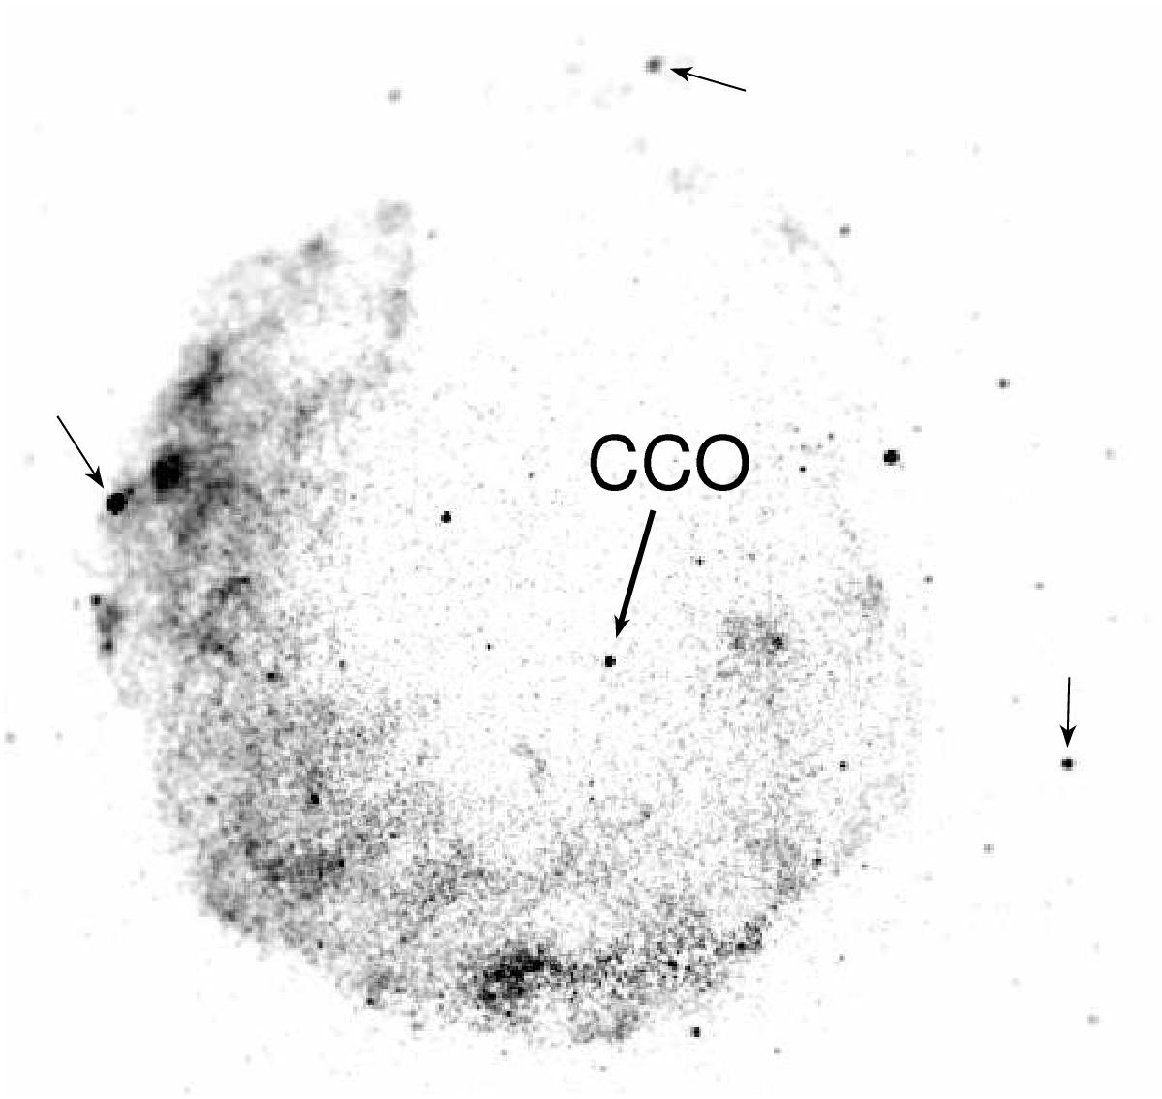

Central compact objects (CCOs)
PF ~ 9-11% in two cases, 64% in one case
Thermal emission of CCOs is stronger than expected based on isolated NS cooling: $L_{bol}/\overset{·}{E}>10$
CCO have hidden magnetic fields Hidden = multipolar or toroidal magnetic fields which cannot be measured though spin-down.
Klochkov, Suleimanov, Sasaki & Santangelo (2016)

Slide 13
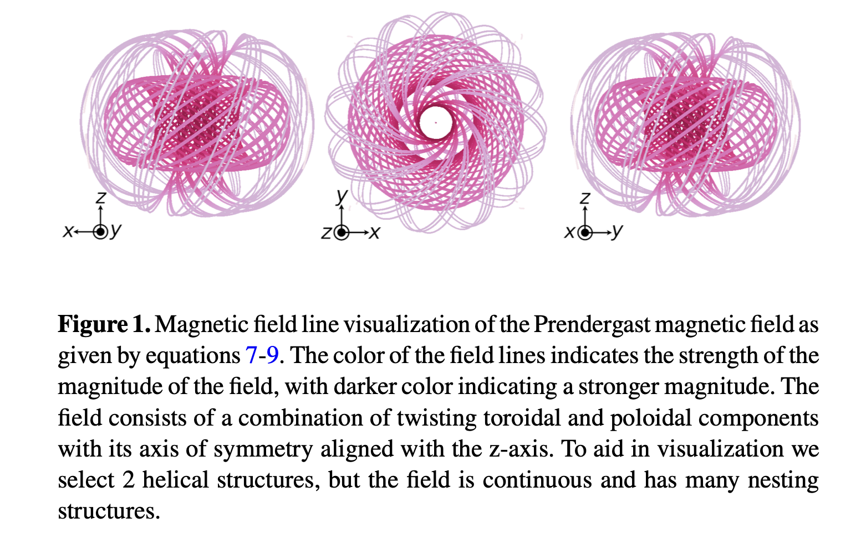
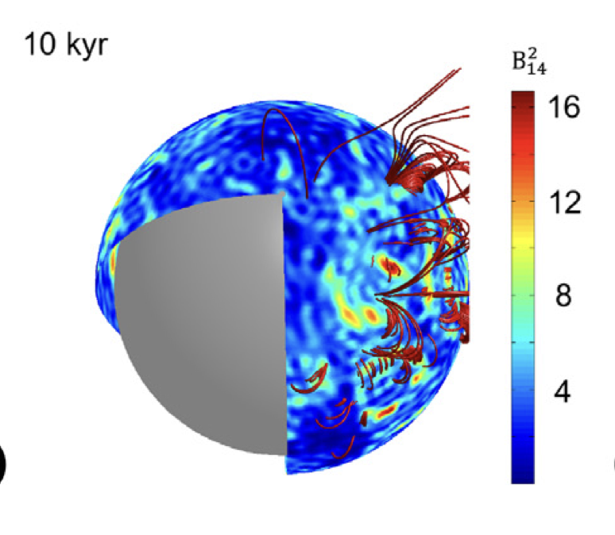
Hidden magnetic field scenario
Strong subsurface magnetic fields buried during the SN explosion (Muslimov & Page 1995, Vigano & Pons 2012). Alternatively, small scale magnetic fields (Igoshev, Gourgouliatos & Hollerbach 2021; Gourgouliatos, Hollerbach, Igoshev 2020).
Gourgouliatos et al. (2020)
Kaufman et al. (2022)
Prendergast

Slide 14

Magnetic fields of neutron stars are complex
Magnetars probably have strong toroidal fields in the crust.
Some low-B magnetars as well as some X-ray Dim Isolated Neutron Stars have individual arcs of strong poloidal magnetic fields.
CCOs have hidden magnetic fields which are either buried or small scale poloidal.

Slide 15
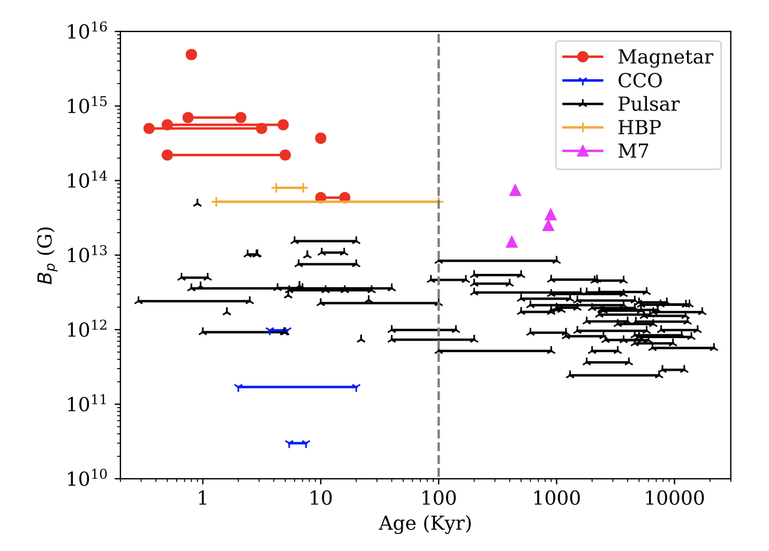
Magnetic field evolution problem
Ages by association to SNR
Ages by separation from Galactic plane
XDINS
Review by Igoshev, Popov & Hollerbach (2021)

Slide 16
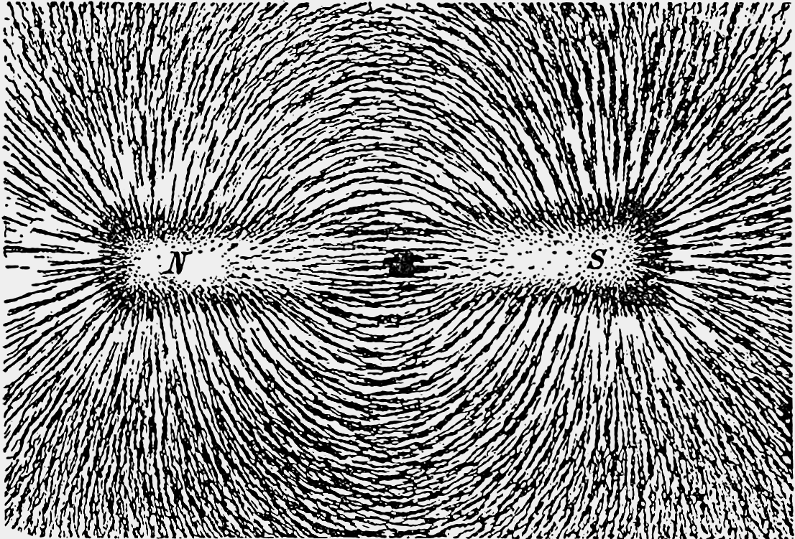
Formation of magnetic fields

Slide 17
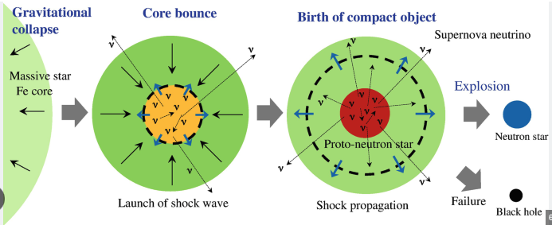
From supernova to NS

Slide 18






From supernova to NS
Massive star
Shock
Proto-NS
$$ν$$
$$ν$$
Fe core
$$p^{+}+e^{−}→n+ν$$
Fall back
$$ν$$

Slide 19
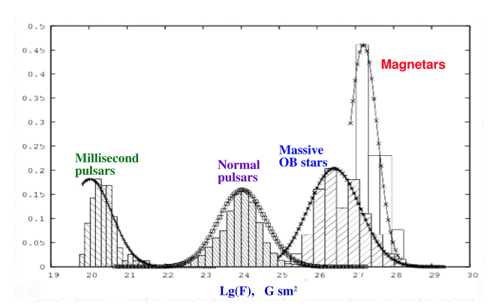
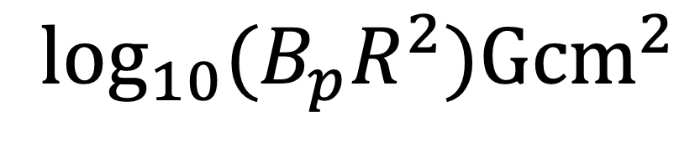
Formation of strong magnetic fields
Fossil hypothesis: magnetic field of a massive star (NS progenitors) is amplified when the magnetised core collapses.
Dynamo hypothesis: there are two regions in the proto-neutron star where convection is possible. The cooling of neutron star proceed slow enough which allows multiple dynamical overturns. (See e.g. Thompson & Murray 2001)
$$\log_{10}(B_{p}R^{2}){Gcm}^{2}$$
Ferrario and Wickramasinghe (2006)
Igoshev & Kholtygin (2011)
Makarenko, Igoshev & Kholtygin (2021)

Slide 20
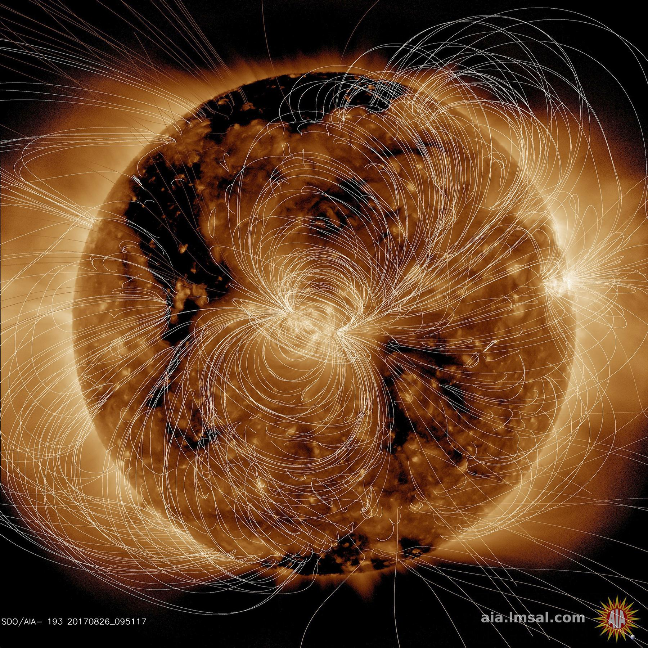
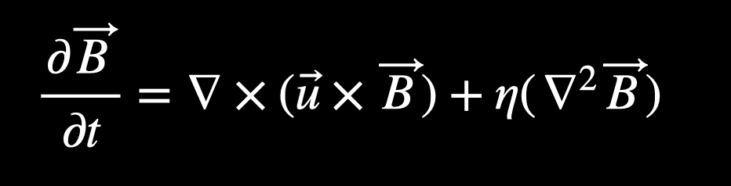

Dynamo in MHD
Induction equation:
Some fluid velocity $\overset{}{u}$ which advects fields amplifying it.
Large regular velocities develop as a result of an instability:
1. Convective
2. Magneto-rotational
3. Tayler-Spruit
NASA / GSFC / Solar Dynamics Observatory

Slide 21
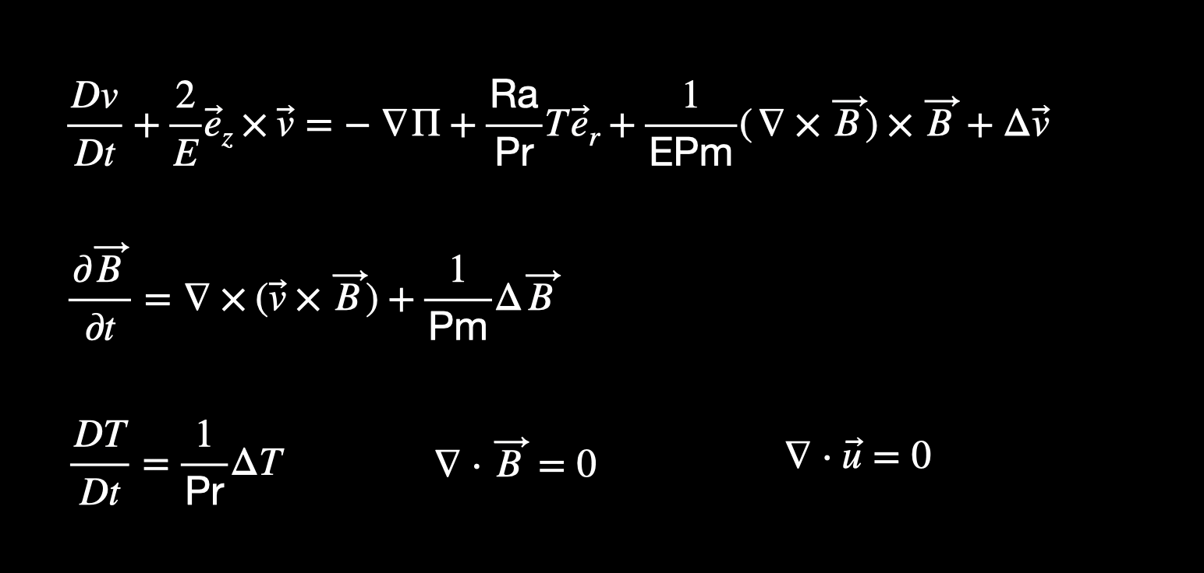
Proto-NS simulation: Boussinesq approximation

Slide 22
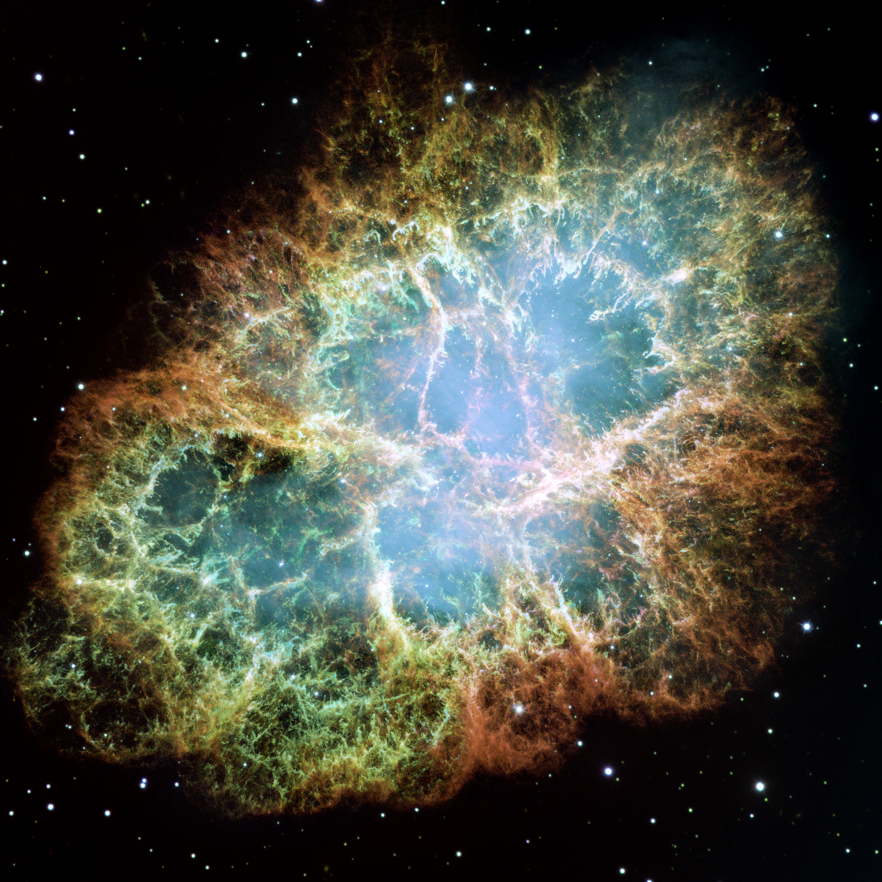
Supernova explosion and proto-NS
Crab Nebula/NASA, ESA, J. Hester and A. Loll

Slide 23
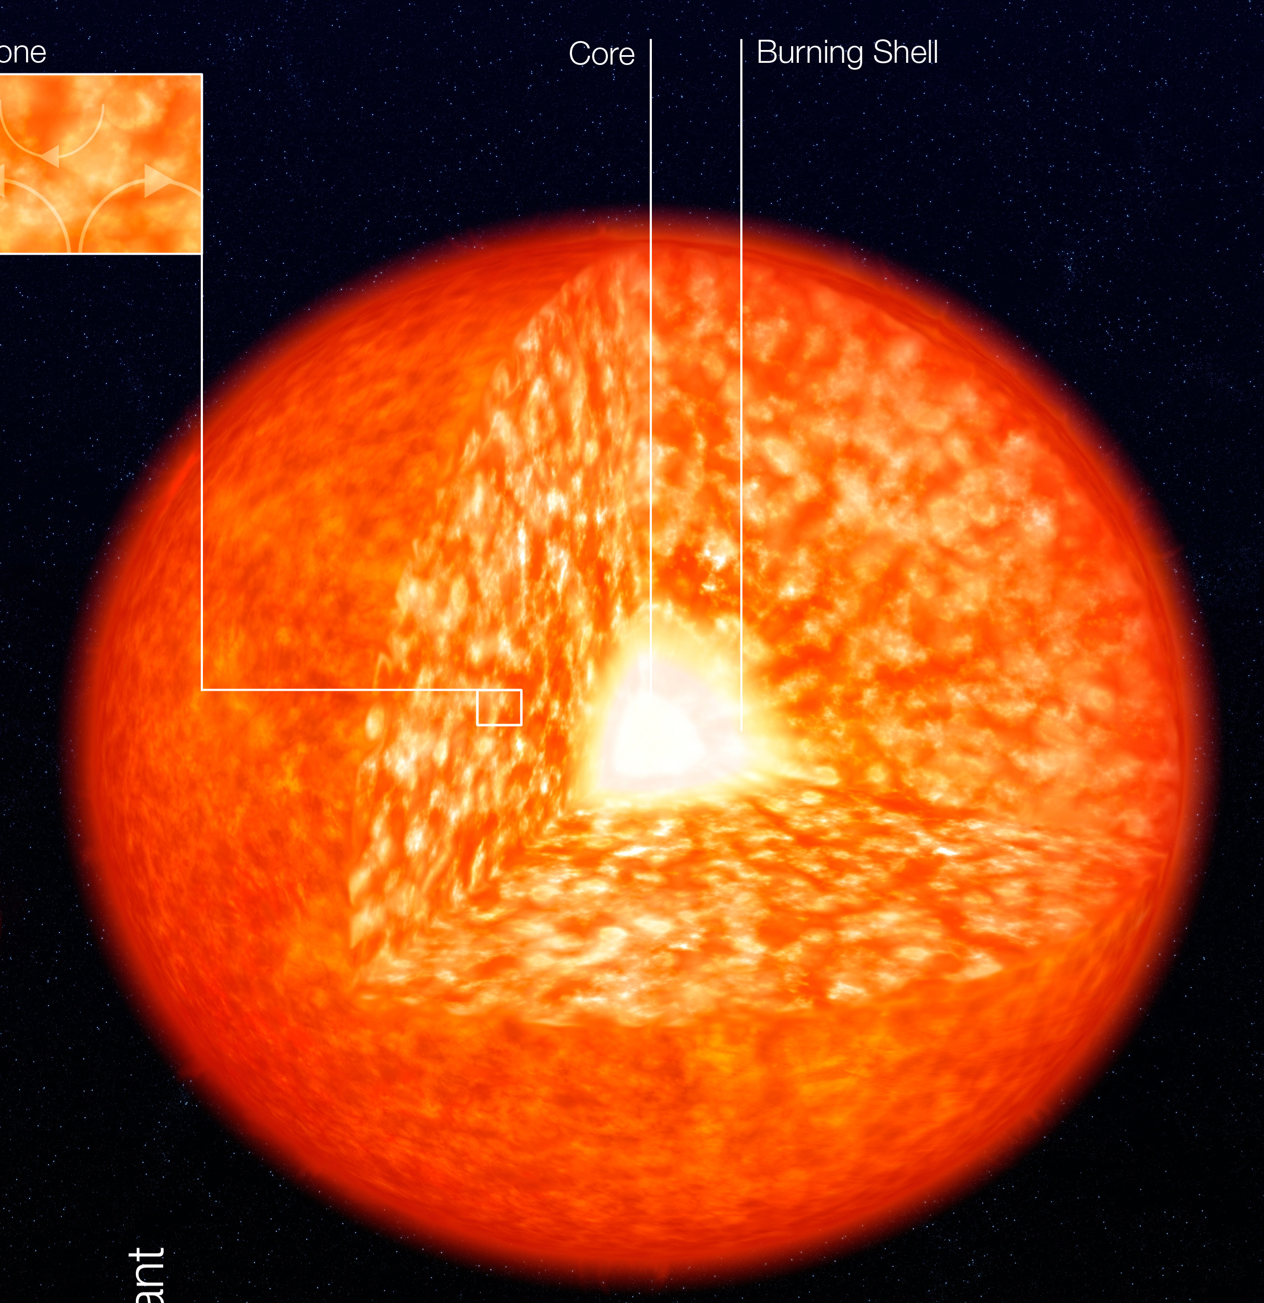
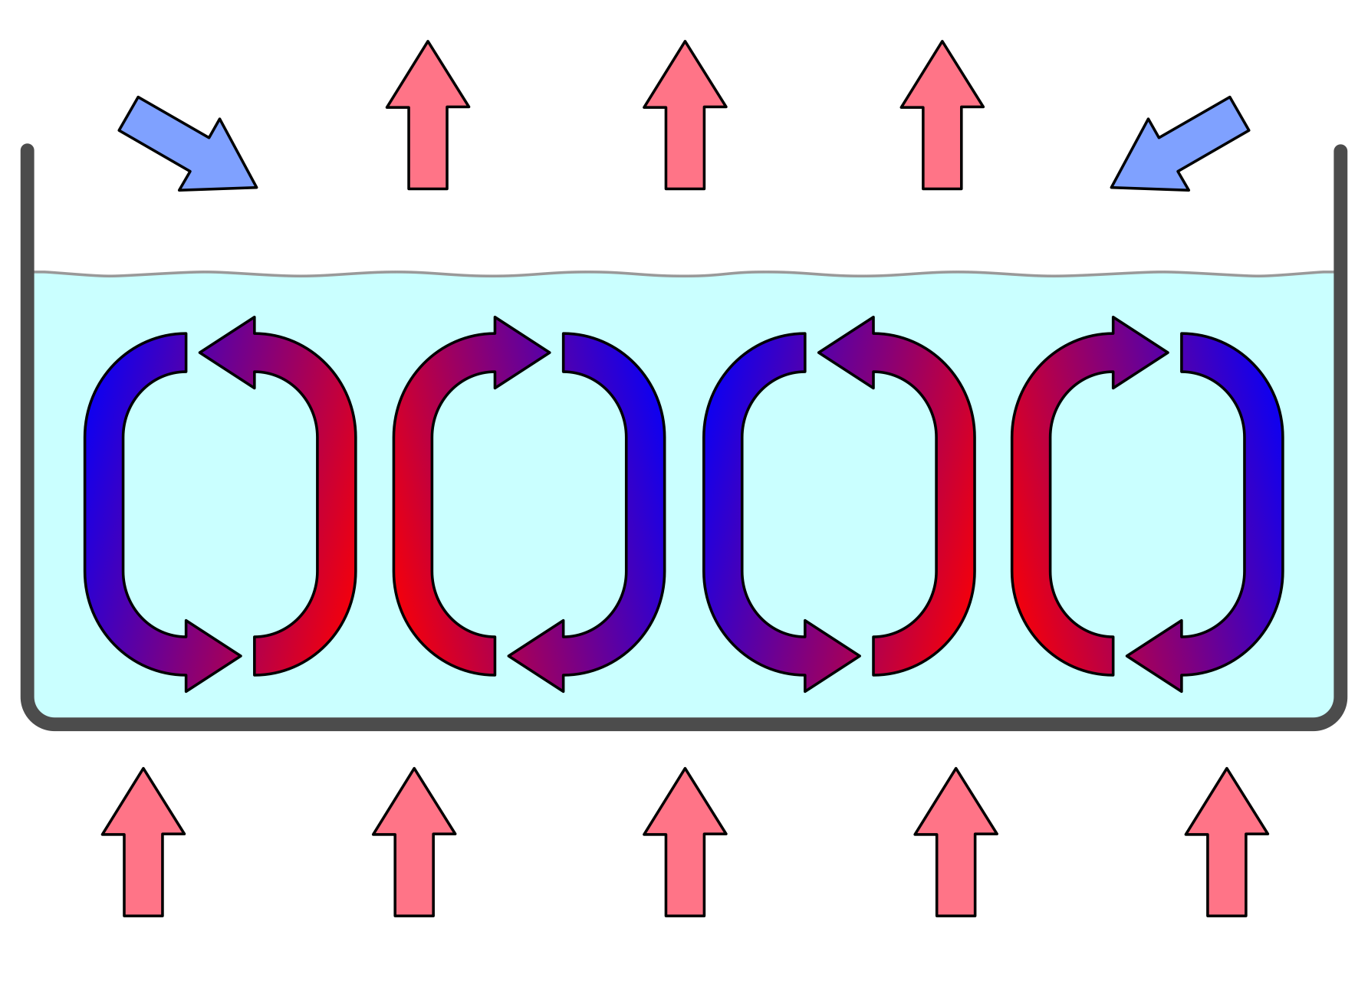
Convective instability
Cold
Hot
ESO

Slide 24
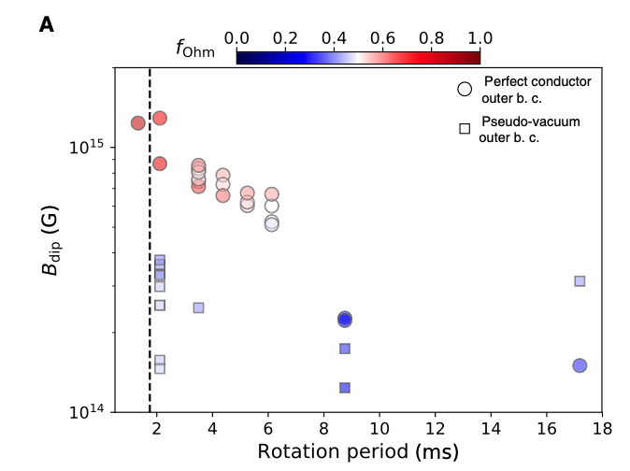
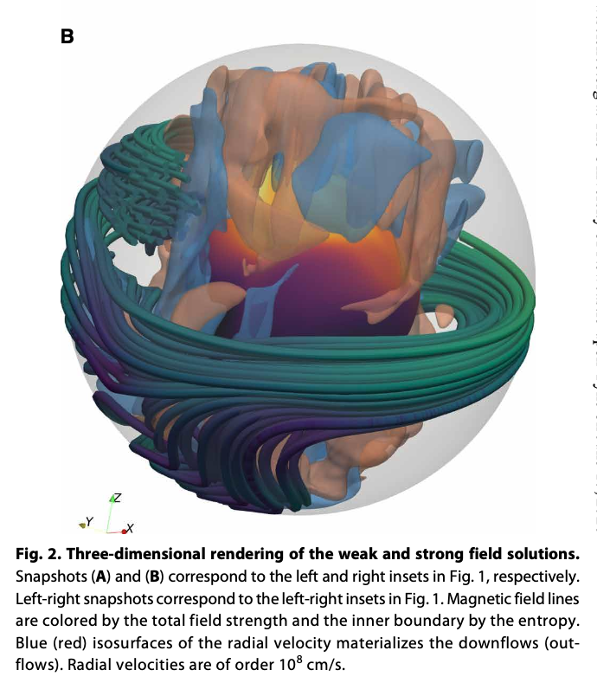
Convective instability
Raynaud et al. (2020)

Slide 25
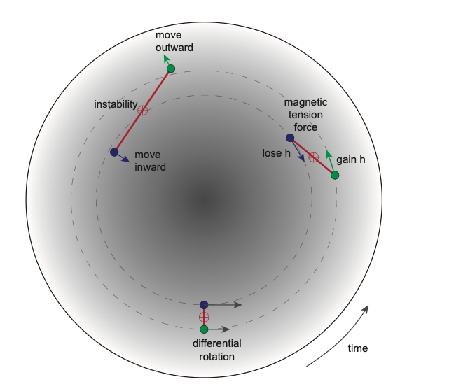
Magneto-rotational instability
Reboul-Salze et al. (2022)
Armitage (2022). ArXiv: 2201.07262

Slide 26
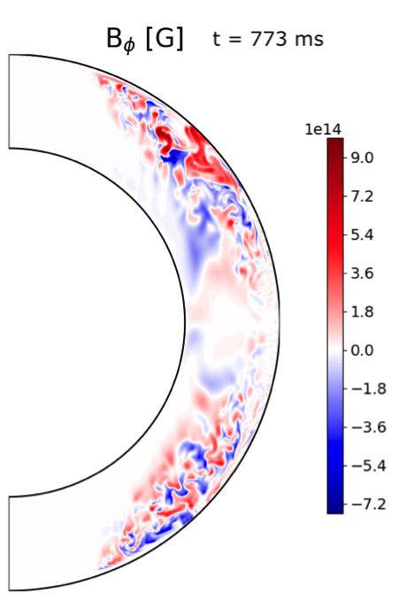
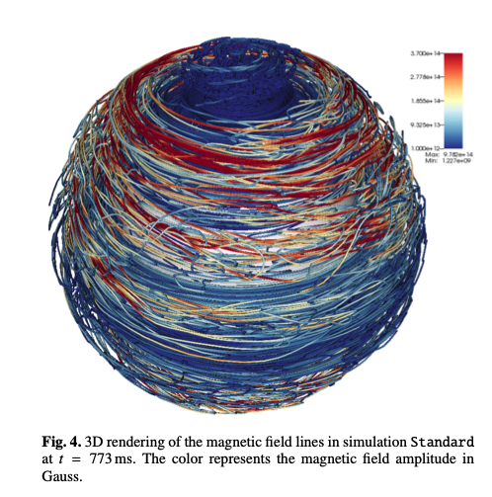
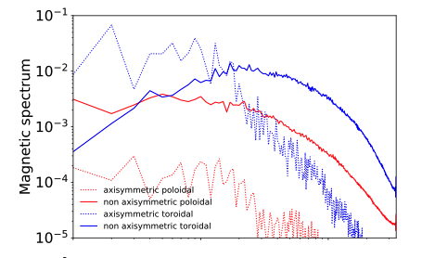
Magneto-rotational instability
Small-scale magnetic field predominantly toroidal.
Reboul-Salze et al. (2022)

Slide 27
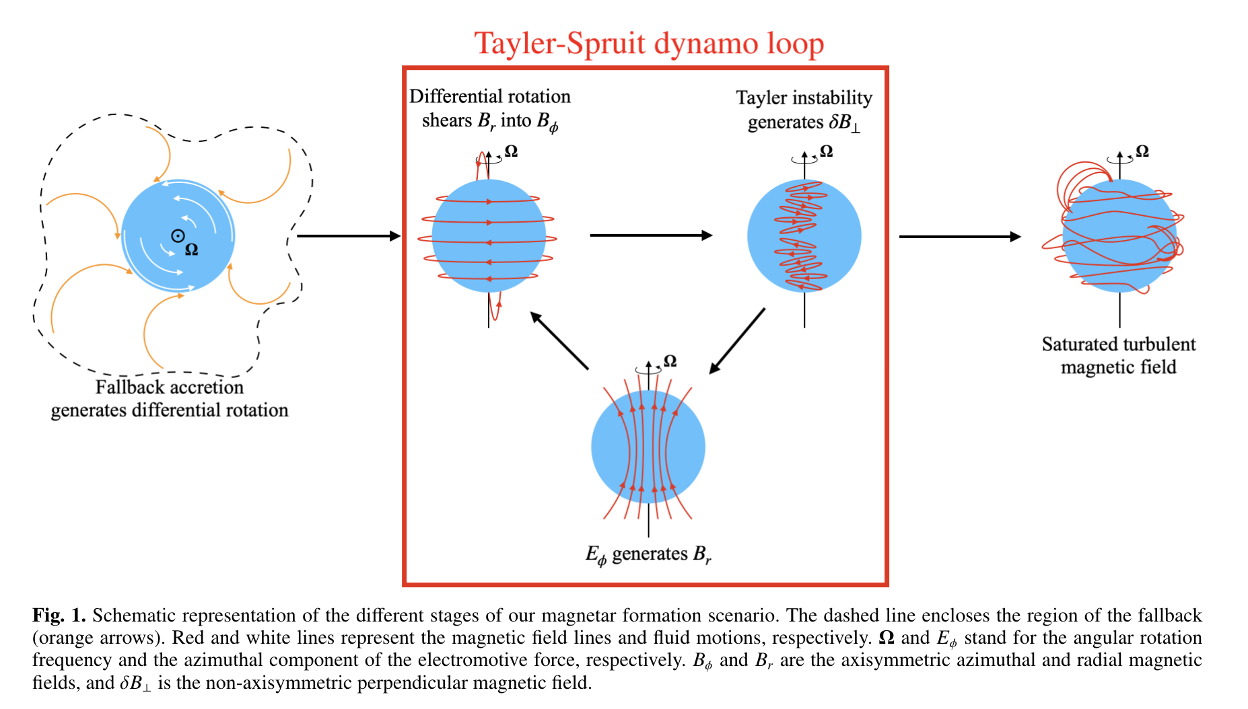
Tayler-Spruit instability

Slide 28
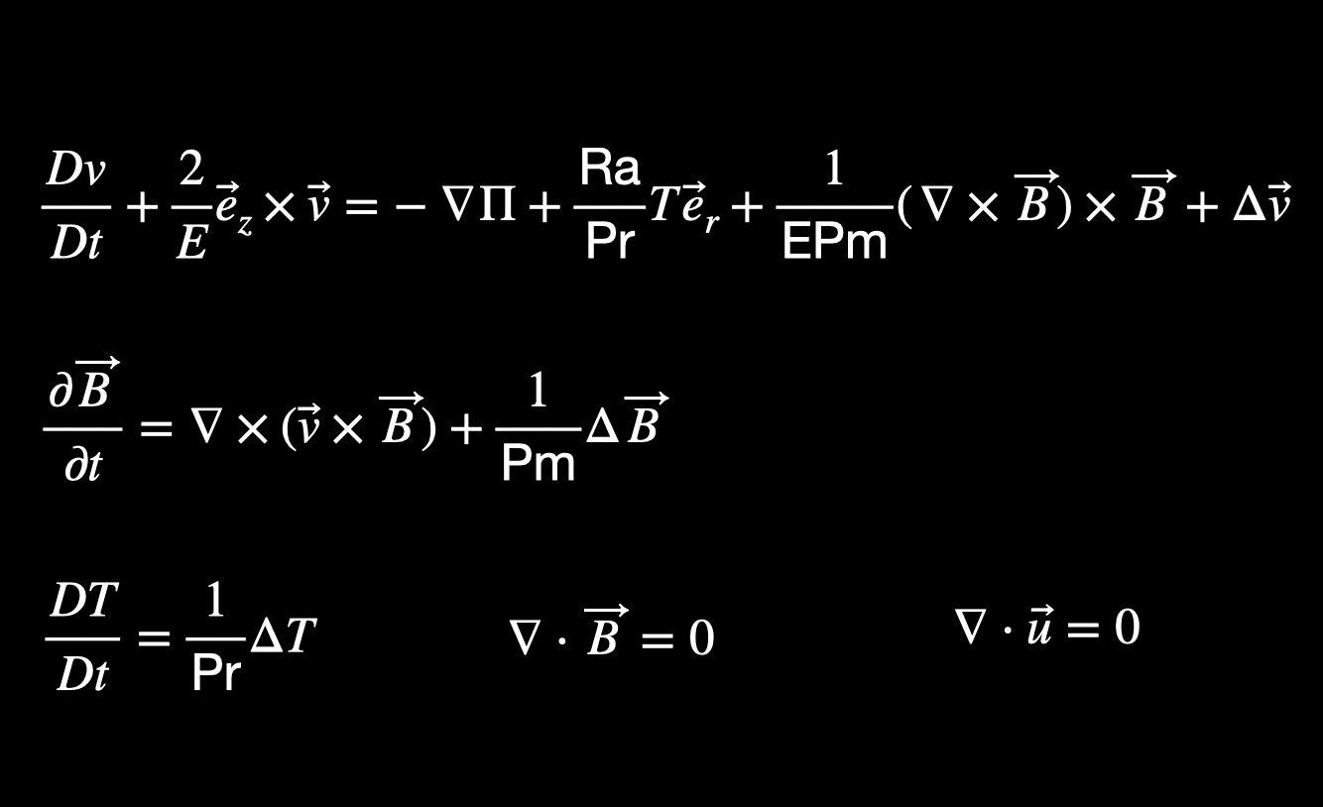

Proto-NS simulation: Boussinesq approximation
DNS simulation with stable stratification in Boussinesque approximation.
Spherical Taylor-Couette configuration with positive shear
No-slip and insulating boundary conditions.
Ekman number $E={10}^{−5}$, magnetic Prandtl number $Pm=1$.
Ratio of Brunt-Väisälä frequency to the outer angular frequency $N/Ω_{0}=0.1$
Rossby number $Ro=1−Ω_{i}/Ω_{o}=0.75$

Slide 29
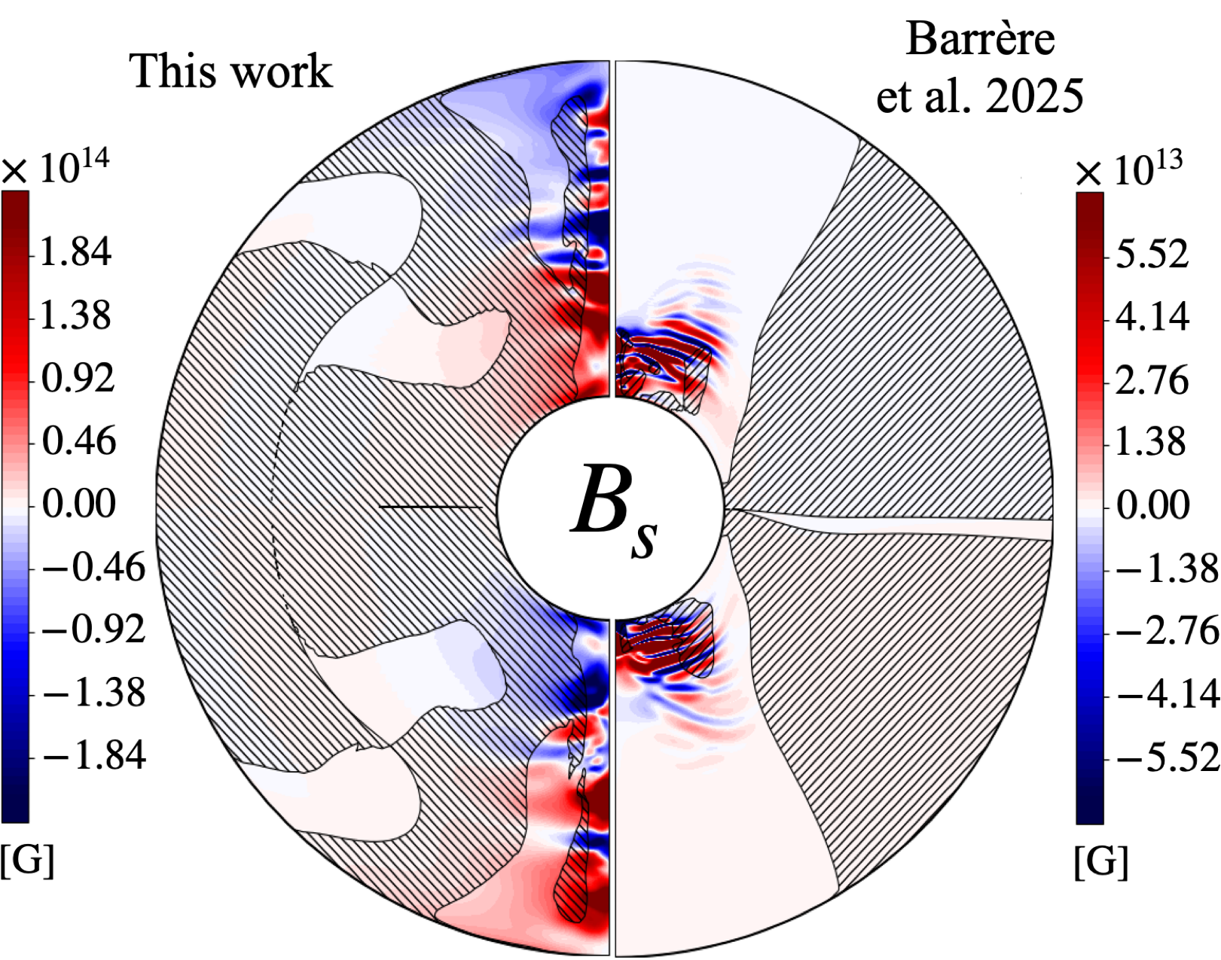
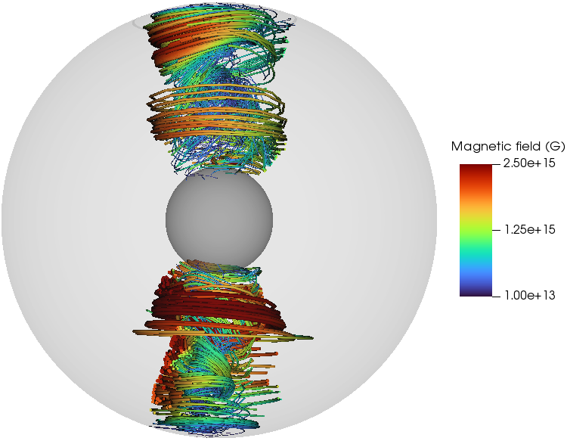
Tayler-Spruit dynamo for proto-NS
New work
Barrère, Guiltet, Raynaud & Reboul-Salze (2023)
Barrère et al. (2025)

Slide 30
Proto-neutron star - exists ~30 seconds
Could have dynamo operating
Neutron star - evolves on Myr timescale
Cooling from inside via neutrino emission - no dynamo

Slide 31
Two stages simulations
Dynamo - ~30 seconds
Full MHD code - Bousinesques/anelastic
Relaxation - ~ 1 Myr
eMHD code

Slide 32
Magnetic relaxation
Fields which we see now even if they are formed in a dynamo, relaxed over time

Slide 33
Magnetic field evolution
in neutron star crust

Slide 34
Formation of strong magnetic fields
Dynamo could be caused by proton-neutron star convection (Thompson & Duncan 1993; Raynaud+2020), magnetorotational instability (Reboul-Salze+2021,2022).
New mechanism is the Tayler-Spruit dynamo (Spruit 2002; Barrère+2022,2023).
Barrère, Guiltet, Reboul-Salze, Raynaud & Janka (2022)

Slide 35
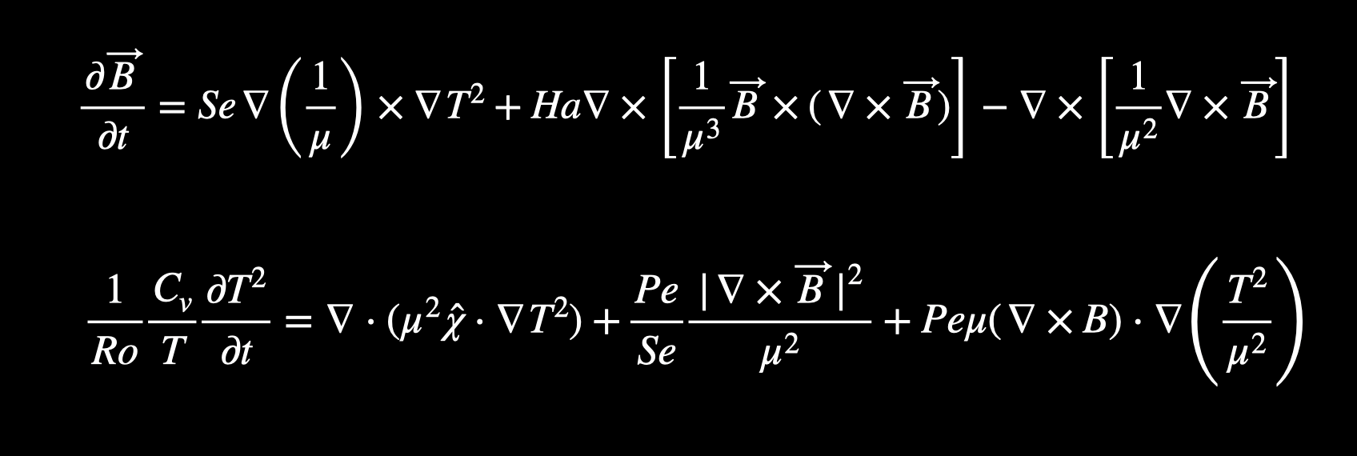
Magneto-thermal evolution of neutron stars
We use the modified PARODY code to solve two equations simultaneously using the spectral decomposition for angular variables and finite difference scheme for radial direction.
The equations are solved in a spherical shell which represents the neutron star crust. The shell extends for approximately 1 km in depth.
PARODY code
Magnetic induction
Thermal diffusion
De Grandis et al. (2020)
Igoshev et al. (2021), Nature Astronomy
Igoshev et al. (2021), ApJ

Slide 36
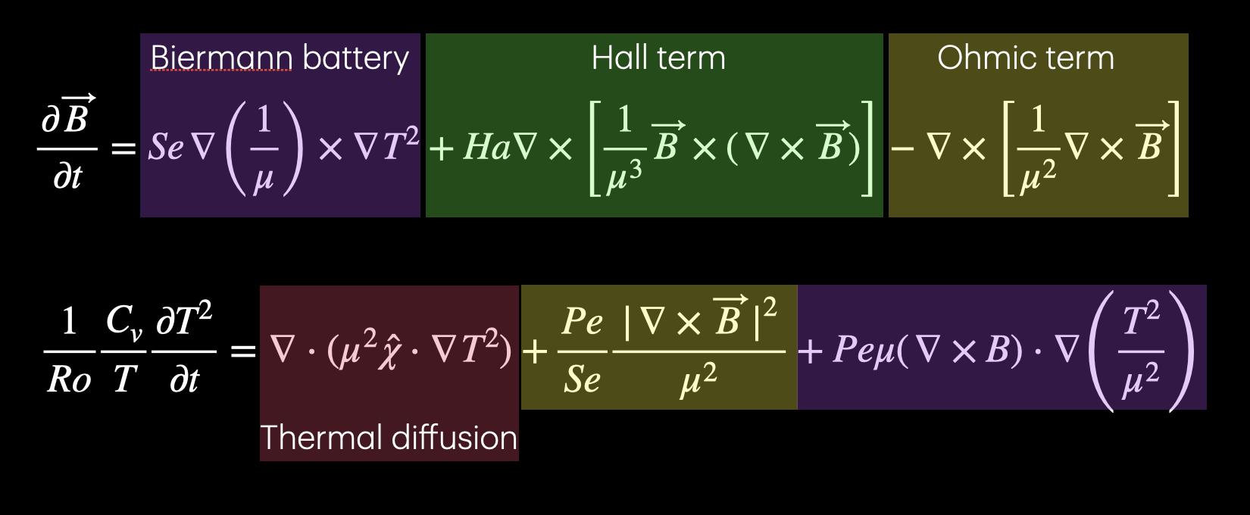


Magneto-thermal evolution of neutron stars
We use the modified PARODY code to solve two equations simultaneously using the spectral decomposition for angular variables and finite difference scheme for radial direction.
The equations are solved in a spherical shell which represents the neutron star crust. The shell extends for approximately 1 km in depth.
PARODY code
Biermann battery
Hall term
Ohmic term
$$\frac{∂\overset{⃗}{B}}{∂t}=Se∇\left(\frac{1}{μ}\right)×∇T^{2}+Ha∇×\left[\frac{1}{μ^{3}}\overset{⃗}{B}×(∇×\overset{⃗}{B})\right]−∇×\left[\frac{1}{μ^{2}}∇×\overset{⃗}{B}\right]$$
Magnetic induction
$$\frac{1}{Ro}\frac{C_{v}}{T}\frac{∂T^{2}}{∂t}=∇⋅(μ^{2}\overset{̂}{χ}⋅∇T^{2})+\frac{Pe}{Se}\frac{|∇×\overset{⃗}{B}|^{2}}{μ^{2}}+Peμ(∇×B)⋅∇\left(\frac{T^{2}}{μ^{2}}\right)$$
Thermal diffusion
Thermal diffusion

Slide 37
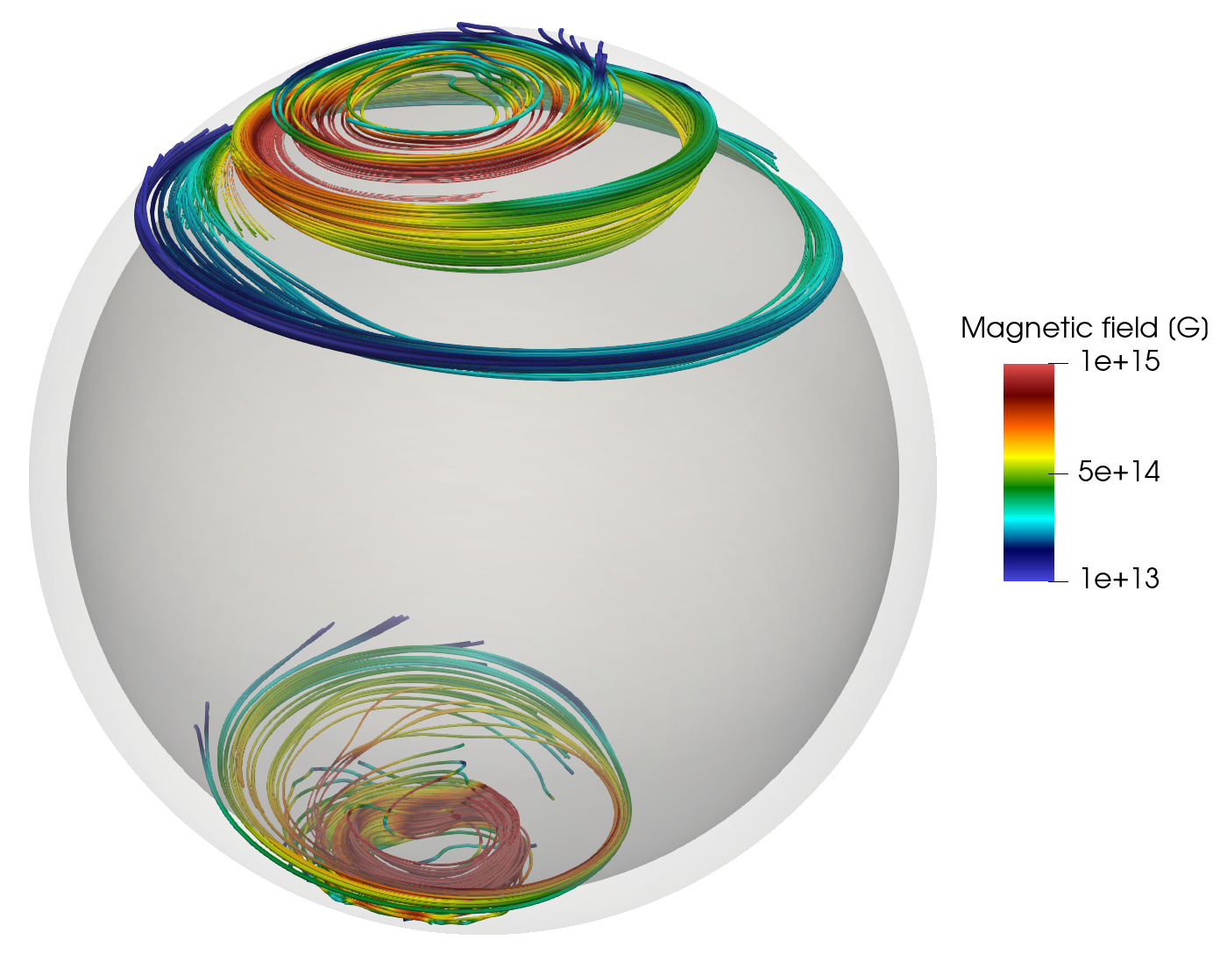

Initial and boundary condition
Upper boundary condition:
  $∇×B=0$ Force-free
  $\frac{π^{2}k_{B}^{2}}{6e^{2}}\overset{⃗}{r}⋅\overset{̂}{χ}⋅∇T_{b}^{2}=σ_{B}T_{s}^{4}$ where ${\left(\frac{T_{s}}{{10}^{6}}\right)}^{2}=\left(\frac{T_{b}}{{10}^{8}}\right)$ Blackbody emission from the atmosphere
Lower boundary condition
  $B_{r}=0$ the Meissner condition
  $\frac{∂T}{∂t}=0$ no cooling
crust

Slide 38
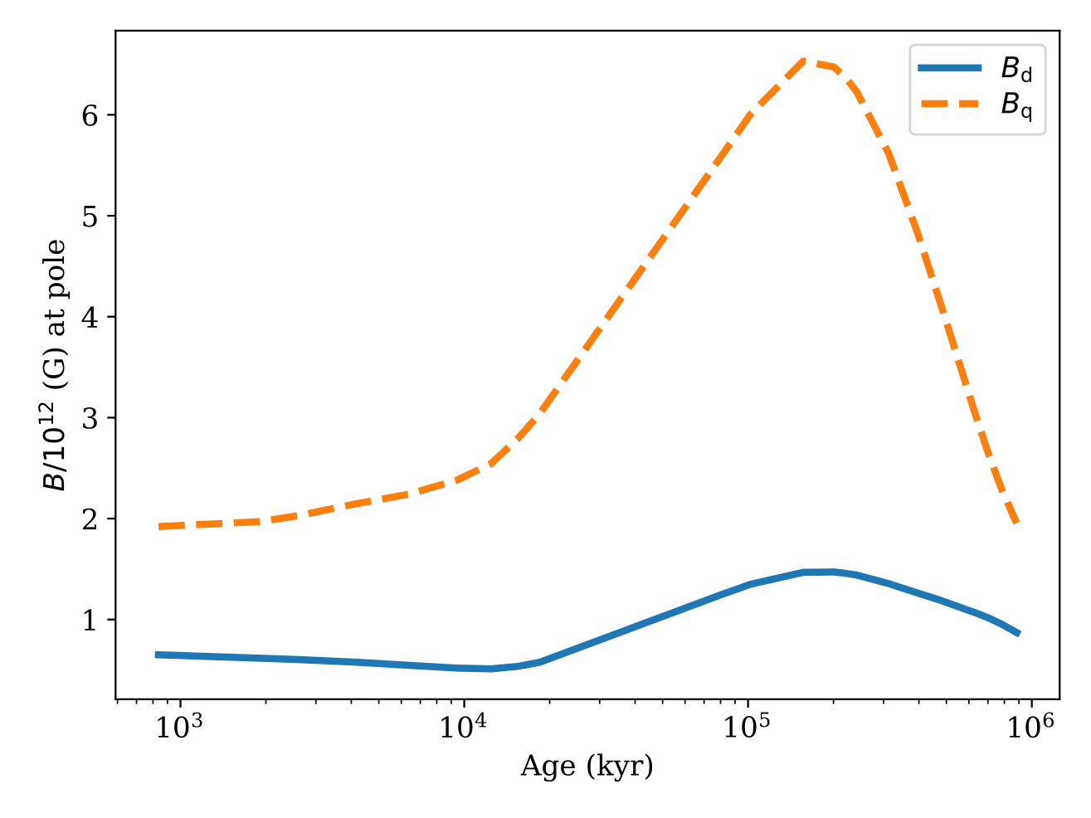
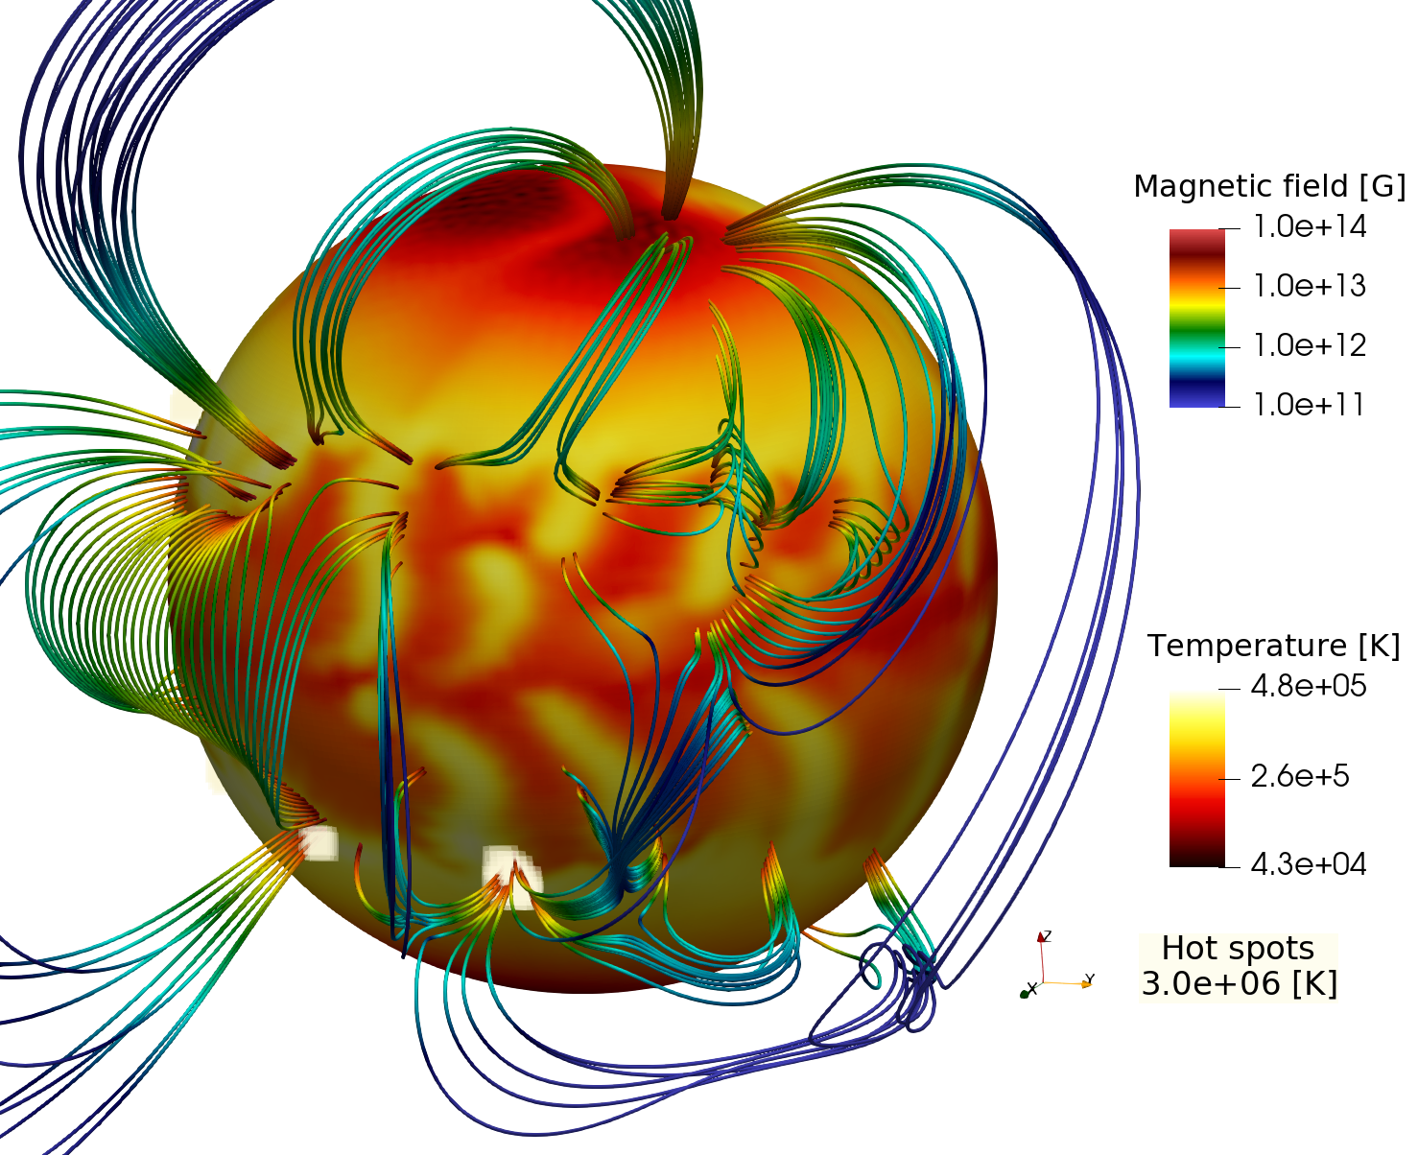

External magnetic field
Age 200 kyr
Magnetic field structure is dominated by small scale fields. A system of magnetic arcs is formed.
Magnetic field strength at the footpoints of individual arcs reaches ${10}^{14}$ G, the dipolar field stays low $≈{10}^{12}$ G.
Hot regions are large and have insufficient temperature to be detected as quiescent emission.
Surface can be heated by magnetospheric currents $\overset{⃗}{J}=\overset{⃗}{∇}×\overset{⃗}{B}$, force-free condition $\overset{⃗}{∇}×\overset{⃗}{B}=μ\overset{⃗}{B}$ which means $J_{r}∝B_{r}$ Regions with the strongest radial magnetic field can be heated by magnetospheric currents. Detailed future modelling is necessary.

Slide 39
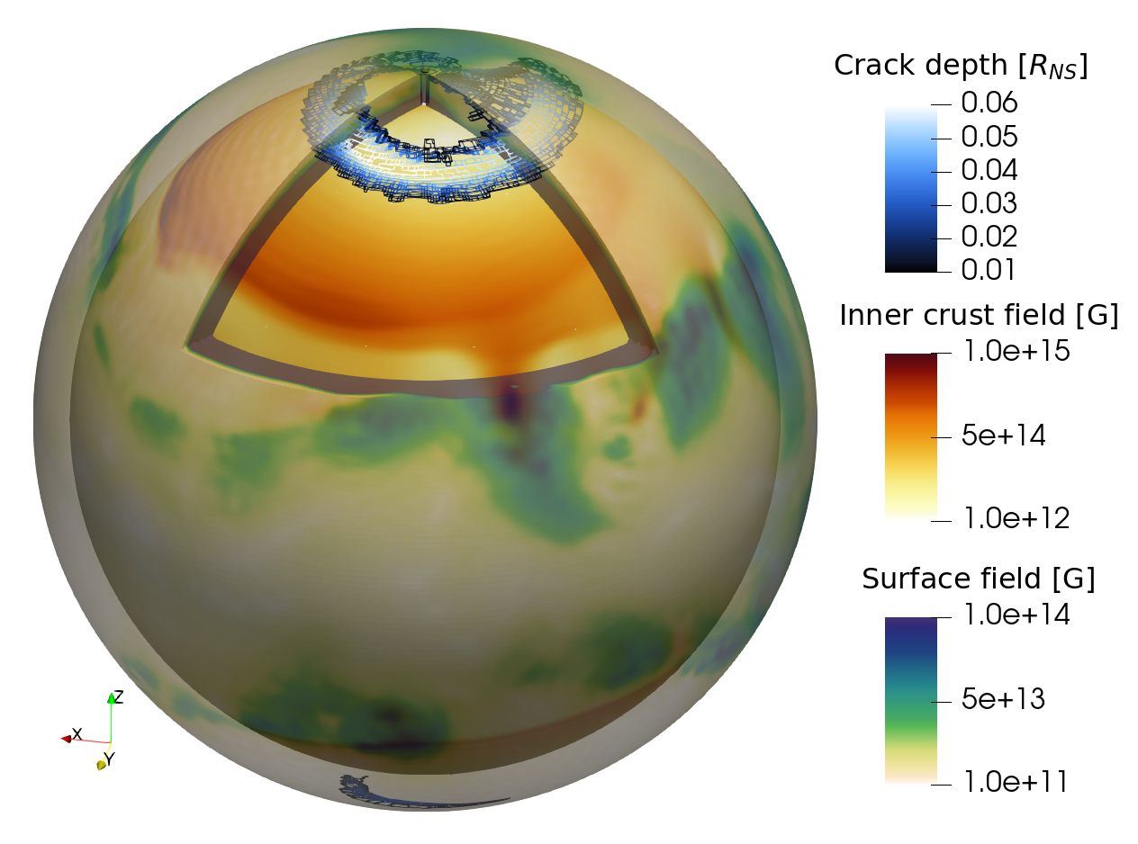

Is it a magnetar?
Crust yielding criterion
Crust will fail near the original magnetic pole and can trigger outbursts similar to magnetar outburst with energies up to $2×{10}^{39}$ erg.
Lander & Gourgouliatos (2019) model

Slide 40
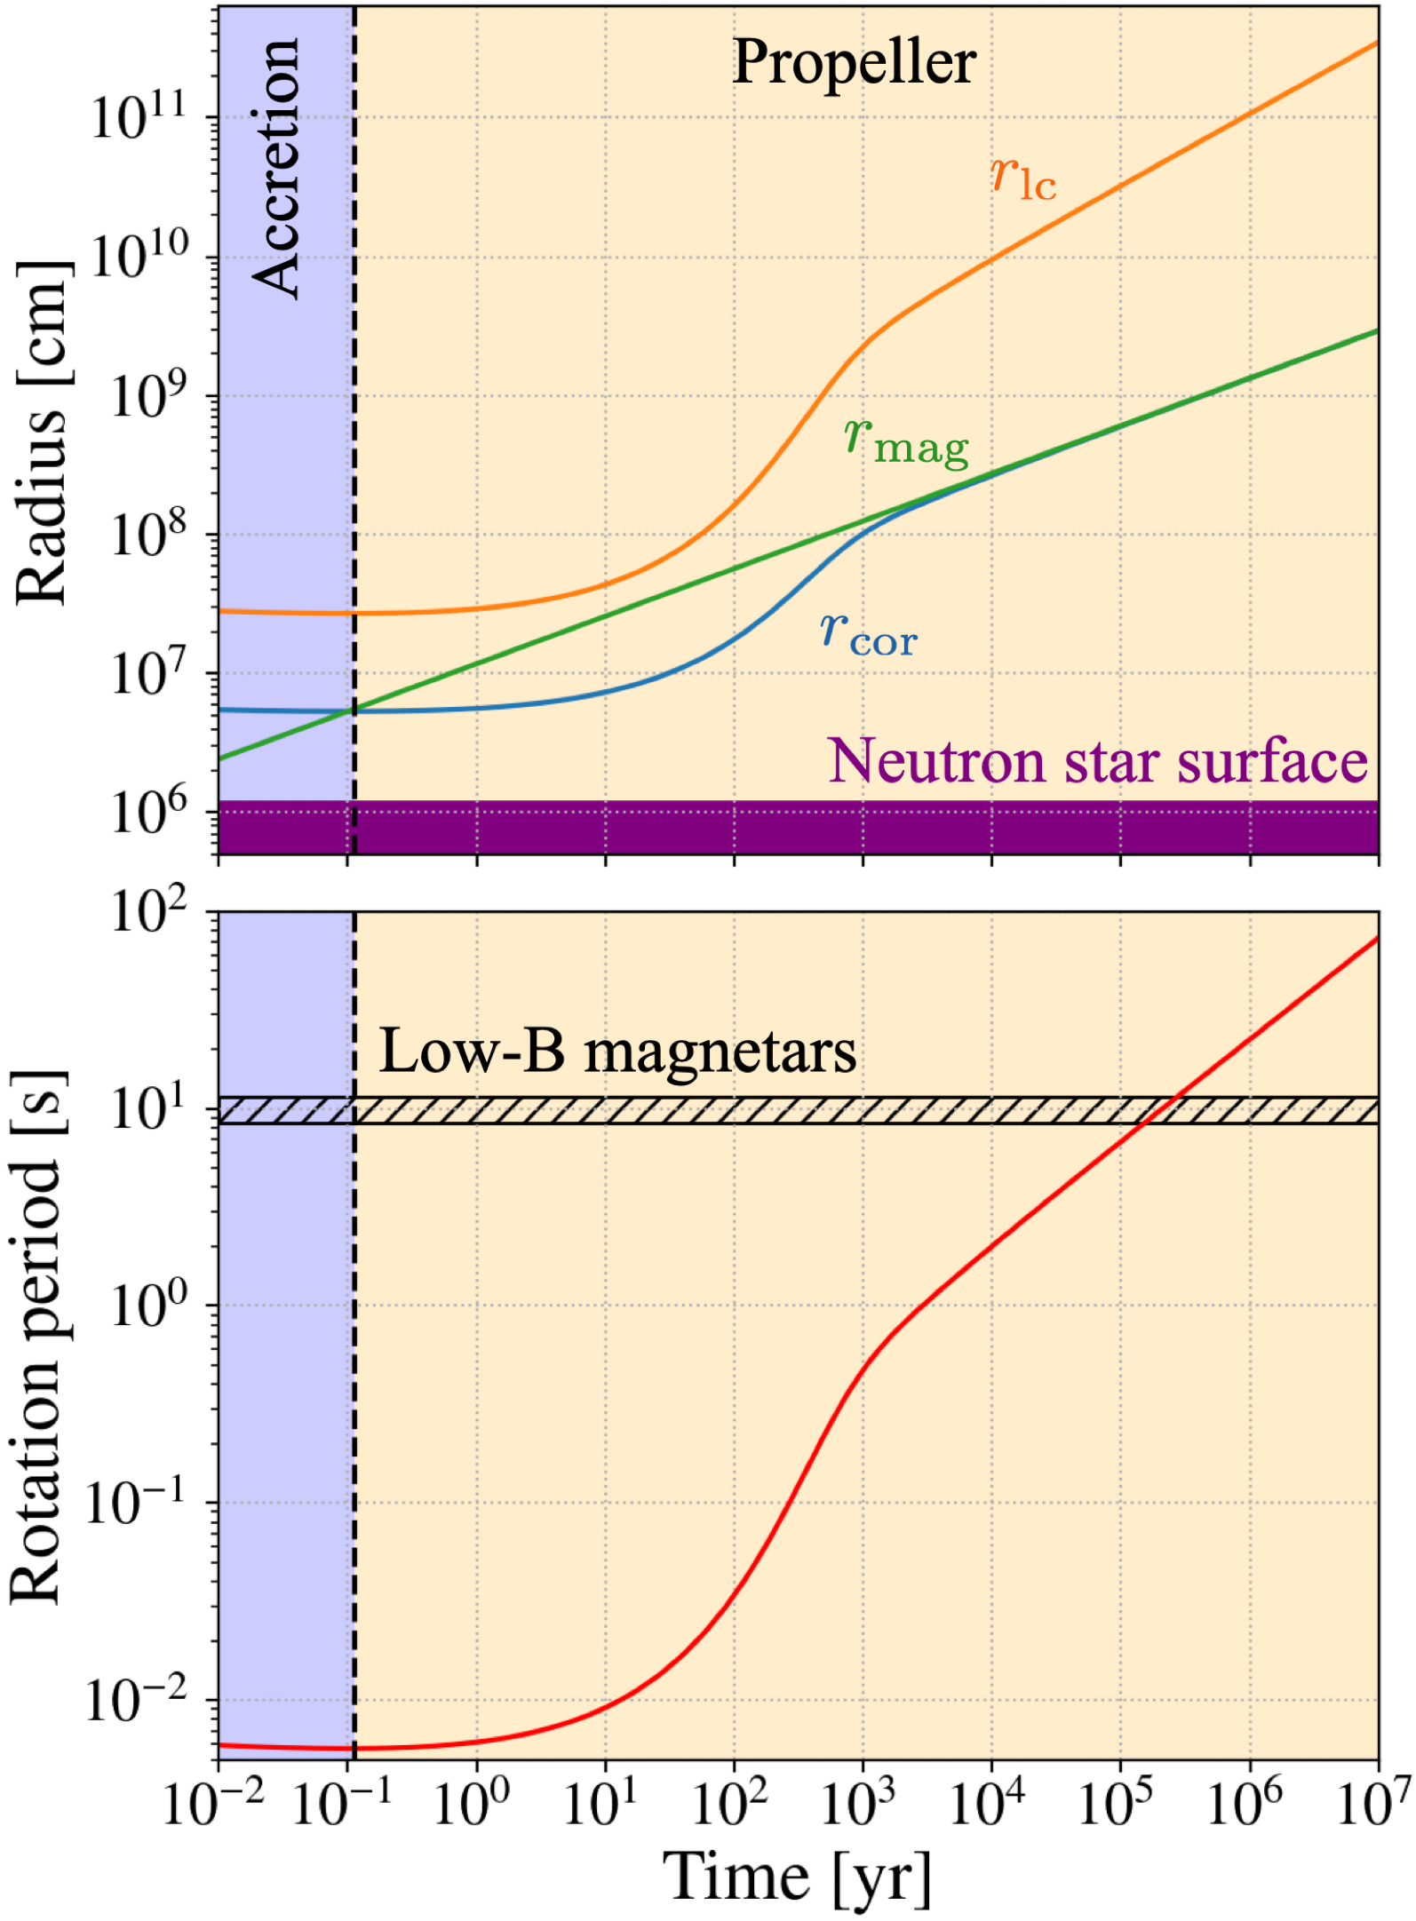

Spin period
Fallback disk
Long periods $>1$sec cannot be reached using the dipolar braking.
Tayler-Spruit dynamo requires significant fallback accretion to operate.
If fallback continues, it will decelerate neutron star in the propeller regime. The neutron star reaches spin periods $∼10$ sec by 200 kyr.
Simulations based on Gompertz et al. (2014) and Ronchi, Rea, Graber et al. (2022) but with ${\overset{·}{M}}_{0}=6.5×{10}^{29}$ g/s based on TS dynamo simulations.

Slide 41
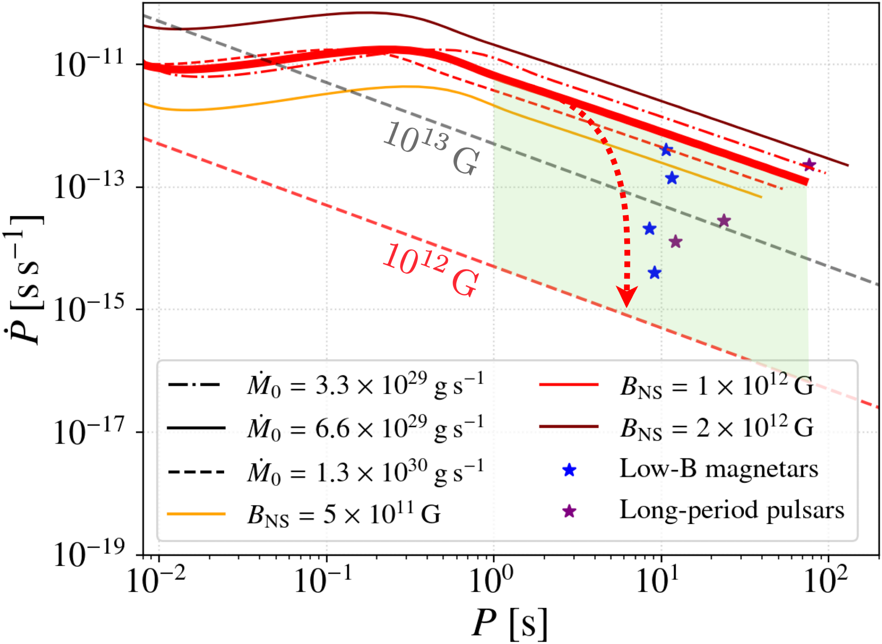
Spin period
Fallback disk
The period derivative depends on the state of the fallback disk. If the fallback disk is partially (completely) depleted, the period derivative is closer to magnetospheric spin-down.
At older ages these objects could turn into long-period pulsars.

Slide 42
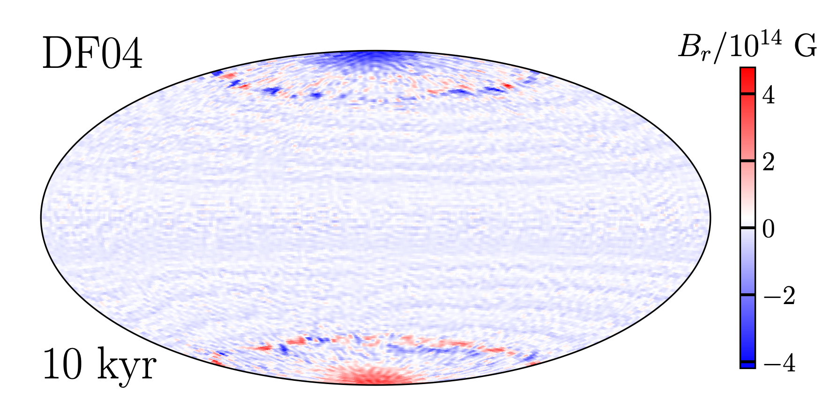
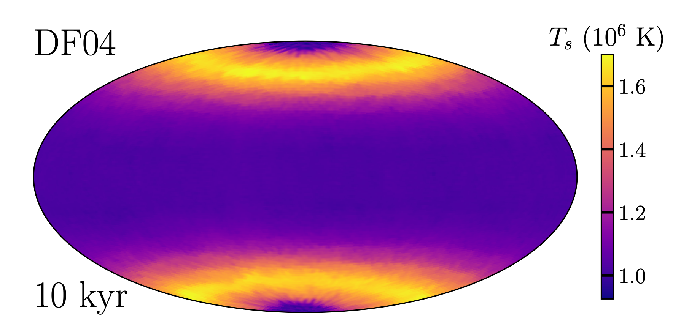
New volumetric forcing

Slide 43
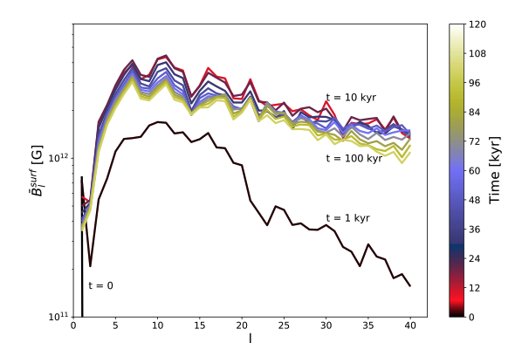
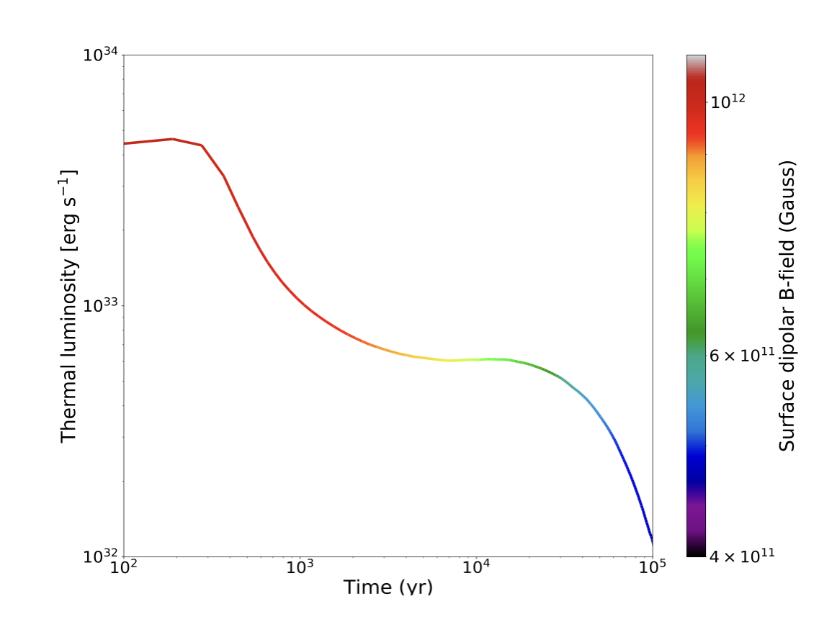
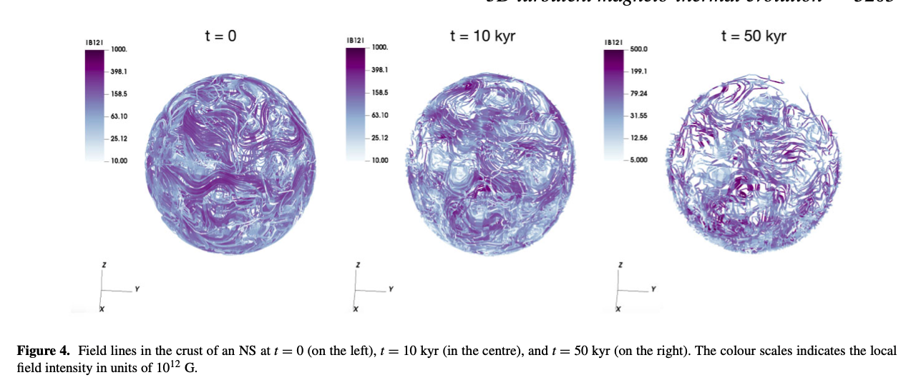
MRI dynamo
Dehman et al. (2023) found no growth of dipolar magnetic field, however X-ray luminosities are enhanced and could explain CCOs.

Slide 44
Core superconductivity

Slide 45
MHD-like approach
Our model rely on Hall-Vinen-Bekharevich-Khalatnikov (HVBK) two-fluid model for describing superfluid/superconductor as a sum of a few fluids. We closely follow prescription developed by Glampedakis, Andersson & Samuelsson (2011) with simplifications by Graber, Andersson, Glampedakis & Lander (2015).

Slide 46
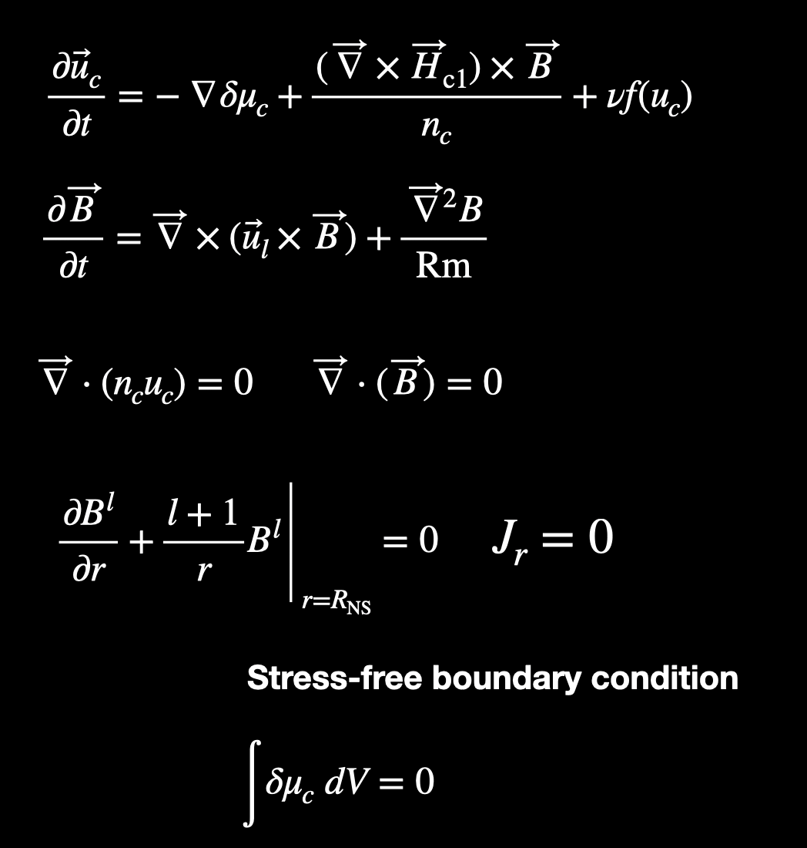
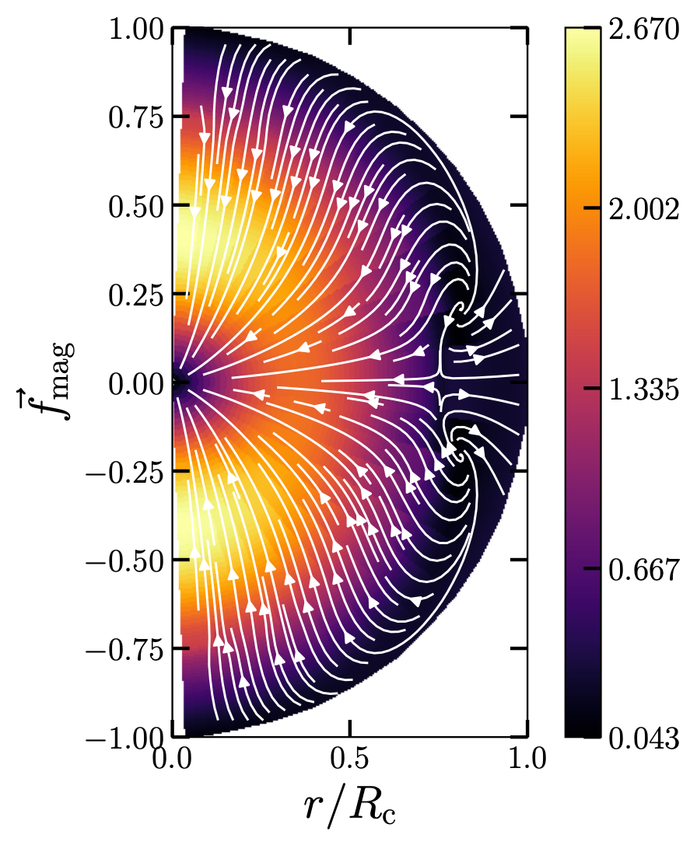
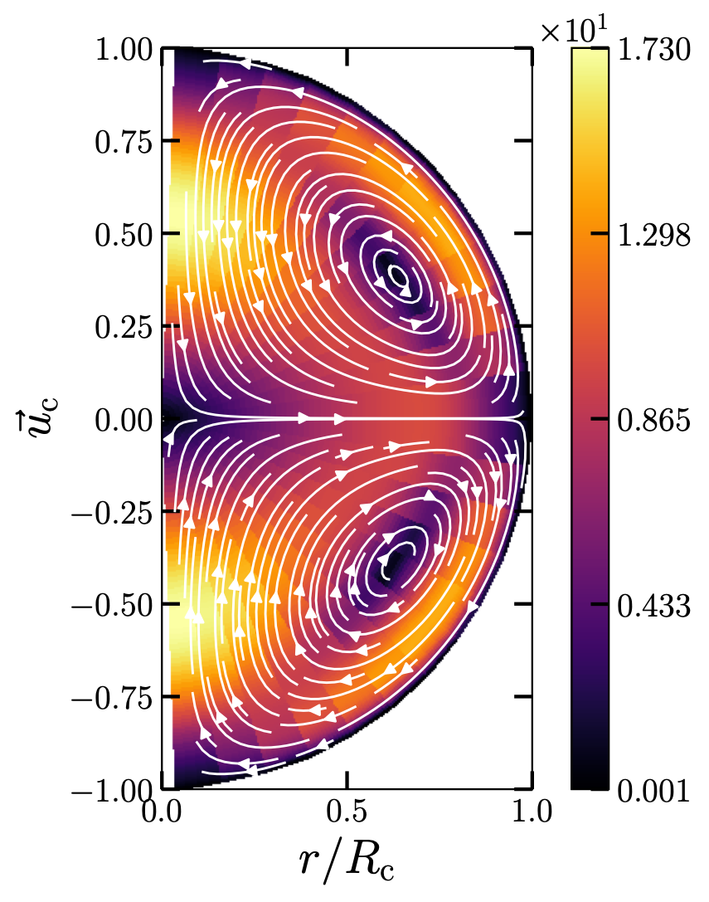








Single fluid system
$u_{l}$ is the vortex velocity
Ohmic term is for numerical stability
$$\frac{∂{\overset{⃗}{u}}_{c}}{∂t}=−∇δμ_{c}+\frac{(\overset{⃗}{∇}×{\overset{⃗}{H}}_{c1})×\overset{⃗}{B}}{n_{c}}+νf(u_{c})$$
$$\frac{∂\overset{⃗}{B}}{∂t}=\overset{⃗}{∇}×({\overset{⃗}{u}}_{l}×\overset{⃗}{B})+\frac{{\overset{⃗}{∇}}^{2}B}{Rm}$$
Viscosity due to electron - electron scattering
$$\overset{⃗}{∇}⋅(n_{c}u_{c})=0$$
$$\overset{⃗}{∇}⋅(\overset{⃗}{B})=0$$
$${\frac{∂B^{l}}{∂r}+\frac{l+1}{r}B^{l}|}_{r=R_{NS}}=0$$
$$J_{r}=0$$
Stress-free boundary condition
$$∫δμ_{c}dV=0$$

Slide 47


Boundary conditions
Vacuum
Pseudo-vacuum
$${\frac{∂B^{l}}{∂r}+\frac{l+1}{r}B^{l}|}_{r=R_{NS}}=0$$
$$B_{φ}=B_{θ}=0$$
Field lines approaches surface orthogonally

Slide 48
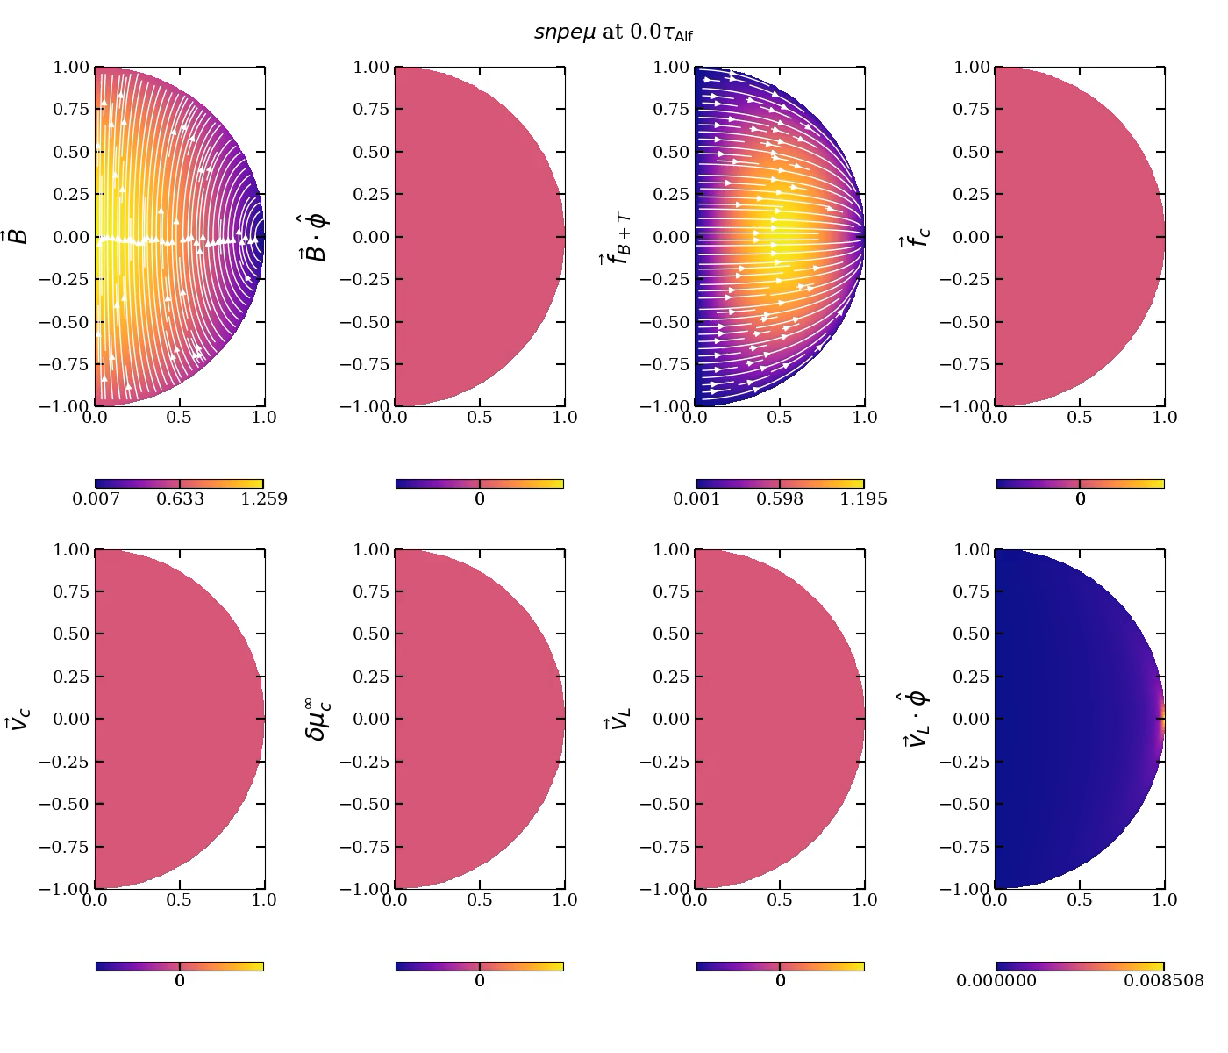
2D axial symmetry
Evolution towards stable configurations

Slide 49

2D axial symmetry
Evolution towards stable configurations

Slide 50

Energy evolution

Slide 51


3D simulations
$$v_{l}=v_{c}$$

Slide 52
Summary and future work
Magnetic fields of neutron stars are very complicated and might be the key to understand the NS diversity.
Different types of neutron stars such as magnetars, XDINS, CCOs might be produced due to different type of dynamo mechanisms active at the proto-NS stage
Convective dynamo combined with fast rotation might be responsible for classical magnetars; Tayler-Spruit for low-B magnetars and MRI for Central Compact Objects.
Magnetic field evolution in the core is just started to be explored. Non-trivial interactions between the core and crust might lead to different energetic phenomena

