Slide 1

Modeling neutron star glitches triggered by superfluid vortex avalanches
In collaboration with
Author: Alessandro Costanzo
Advisor: Prof. Brynmor Haskell

Slide 2
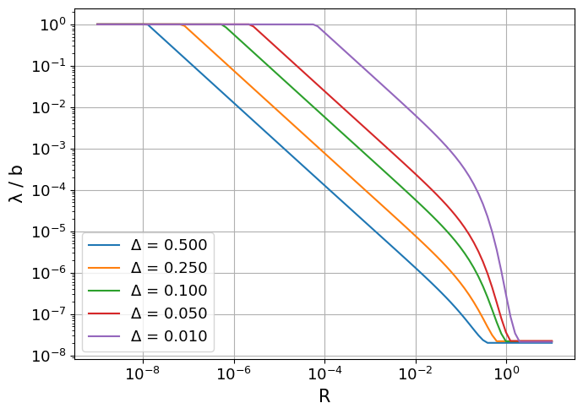
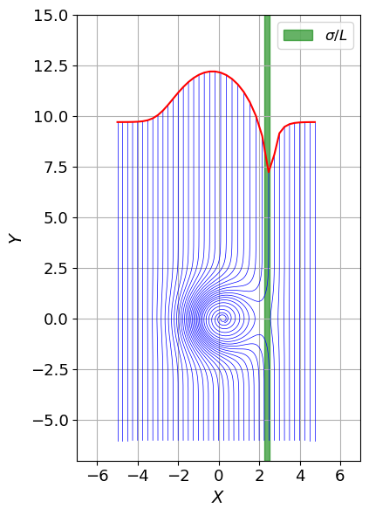

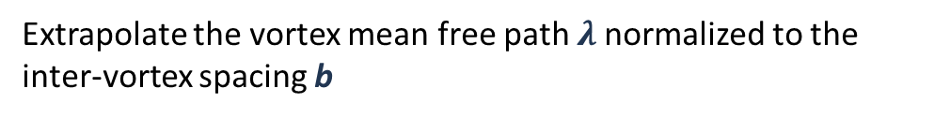
Neutron stars and superfluidity
Adopted method
General approach
Developing a code to simulate vortex trajectories
around a pinning in order to:
Evaluate the capture cross section $σ$ per unit length of the vortex L
Extrapolate the vortex mean free path $λ$normalized to the inter-vortex spacing b
Studied extensions
$Δ$: distance from pinning critical condition
$\frac{λ}{b}=1:$vortex-vortex interaction is allowed
The model has been extended to study the effects of
Massive vortices
Gaussian pinning potential
Velocity and position-dependent damping

Slide 3

Neutron stars and superfluidity
Results
Massive vortices
Integration of the trajectories including an inertial mass
$$ρ_{n}κ\hat{k}×\left(v_{l}−v_{n}\right) + ρ_{n}κR\left(v_{p}−v_{l}\right) +f_{p}=\tilde{m}a_{l}$$
$$ξ$$
$$\tilde{m }=πξ^{2}ρ_{c}$$
(see A. Richaud, M. Caldara, M. Capone, P. Massignan, and G. Wlazłowski. Dynamical signature of vortex mass in fermi superfluids.)

Slide 4
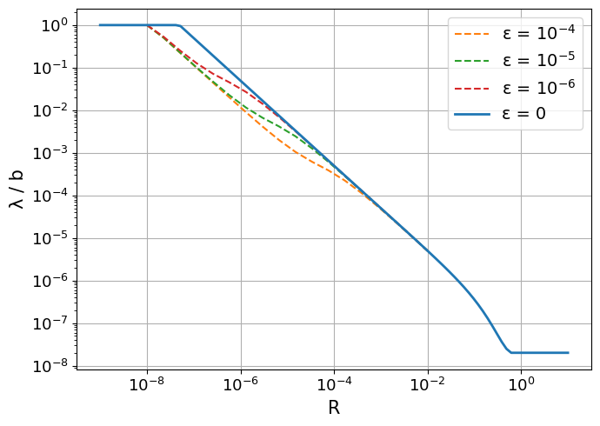
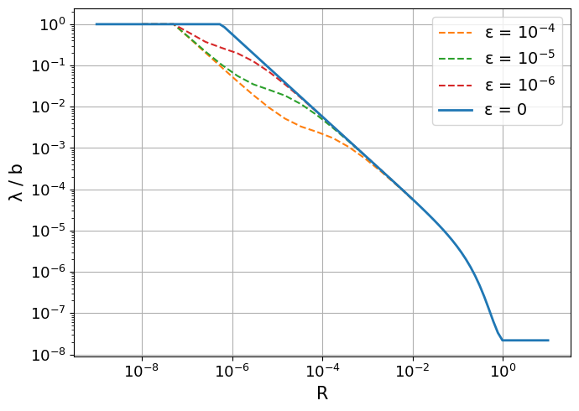
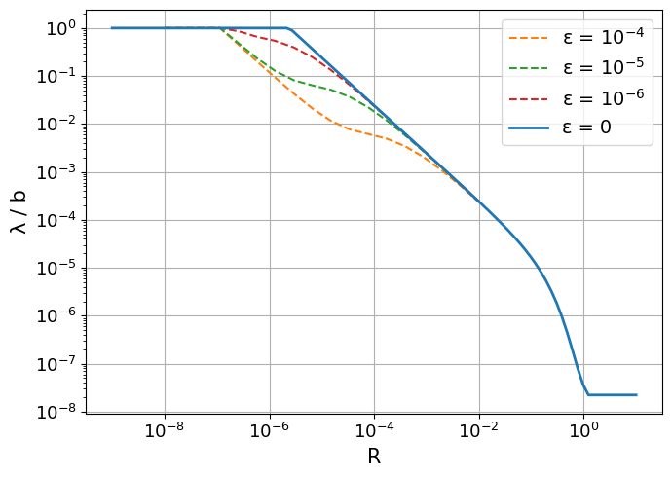

Neutron stars and superfluidity
Results
Massive vortices
$$ε=\frac{A\tilde{m}}{{\left(ρκ\right)}^{2}}$$
Adimensional parameter
Negligible effect on the mean free path
For the calculated values of the vortex inertial mass

Slide 5
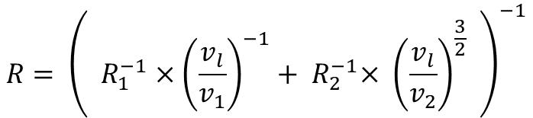
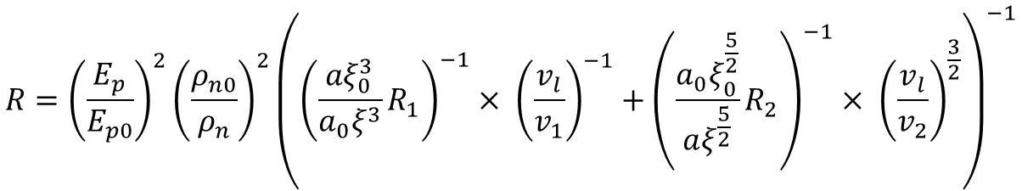
Neutron stars and superfluidity
Results
Velocity-dependent damping
Crustal phonons excitation
Self consistent expression
$$R= {\left( R_{1}^{−1}×{\left(\frac{v_{l}}{v_{1}}\right)}^{−1}+{ R}_{2}^{−1}× {\left(\frac{v_{l}}{v_{2}}\right)}^{\frac{3}{2}} \right)}^{−1}$$
Interpolating the two main dissipation mechanisms
Kelvons-mediated damping
Generalization of the expression
Quasiparticle representing a quantized oscillation of a vortex line
For different sets of parameters
$$R={\left(\frac{E_{p}}{E_{p0}}\right)}^{2}{\left(\frac{ρ_{n0}}{ρ_{n}}\right)}^{2}{\left({\left(\frac{aξ_{0}^{3}}{a_{0}ξ^{3}}R_{1}\right)}^{−1}× {\left(\frac{v_{l}}{v_{1}}\right)}^{−1}+{\left(\frac{a_{0}ξ_{0}^{\frac{5}{2}}}{aξ^{\frac{5}{2}}}R_{2}\right)}^{−1}× {\left(\frac{v_{l}}{v_{2}}\right)}^{\frac{3}{2}}\right)}^{−1}$$
Introduction of the spatial dependence
(see T. Celora, V. Khomenko, M. Antonelli, and B. Haskell. The effect of non-linear mutual friction on pulsar glitch sizes and rise times.)
Based on the potential shape

Slide 6
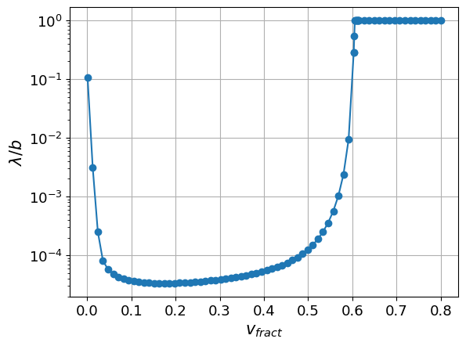
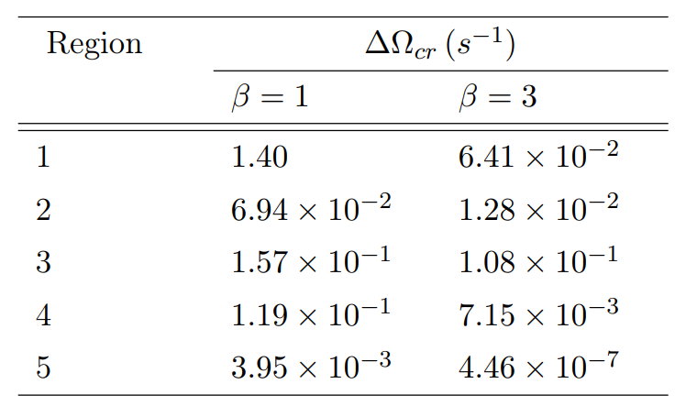
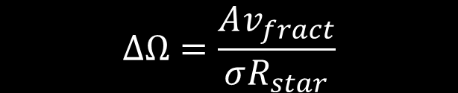
Neutron stars and superfluidity\
Results
Glitch modeling
Evaluation of the critical condition for avalanches
Gaussian pinning potential
Velocity-dependent and space-dependent drag parameter
Neglected mass contribution
$$ΔΩ=\frac{Av_{fract}}{σR_{star}}$$
Accumulated velocity lag between normal component and superfluid
Density
Depth

Slide 7
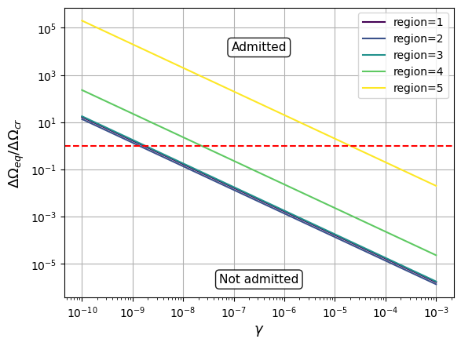
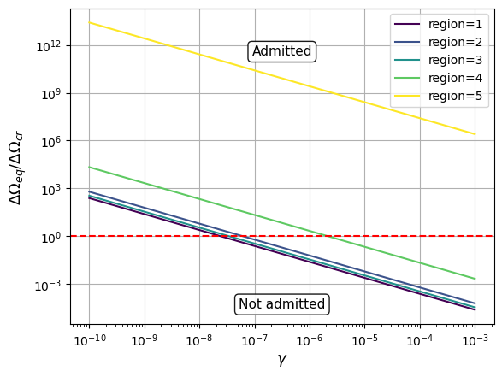
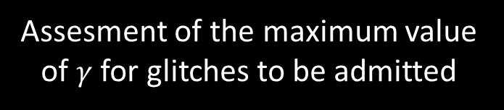
Neutron stars and superfluidity\
Results
Glitch modeling
Presence of a fraction $γ$ of free vortices
Assesment of the maximum value of $γ$ for glitches to be admitted
Creep phenomenon balancing the components at $ΔΩ_{eq}$
Suppression of glitches if $ΔΩ_{eq}<ΔΩ_{cr}$

Slide 8
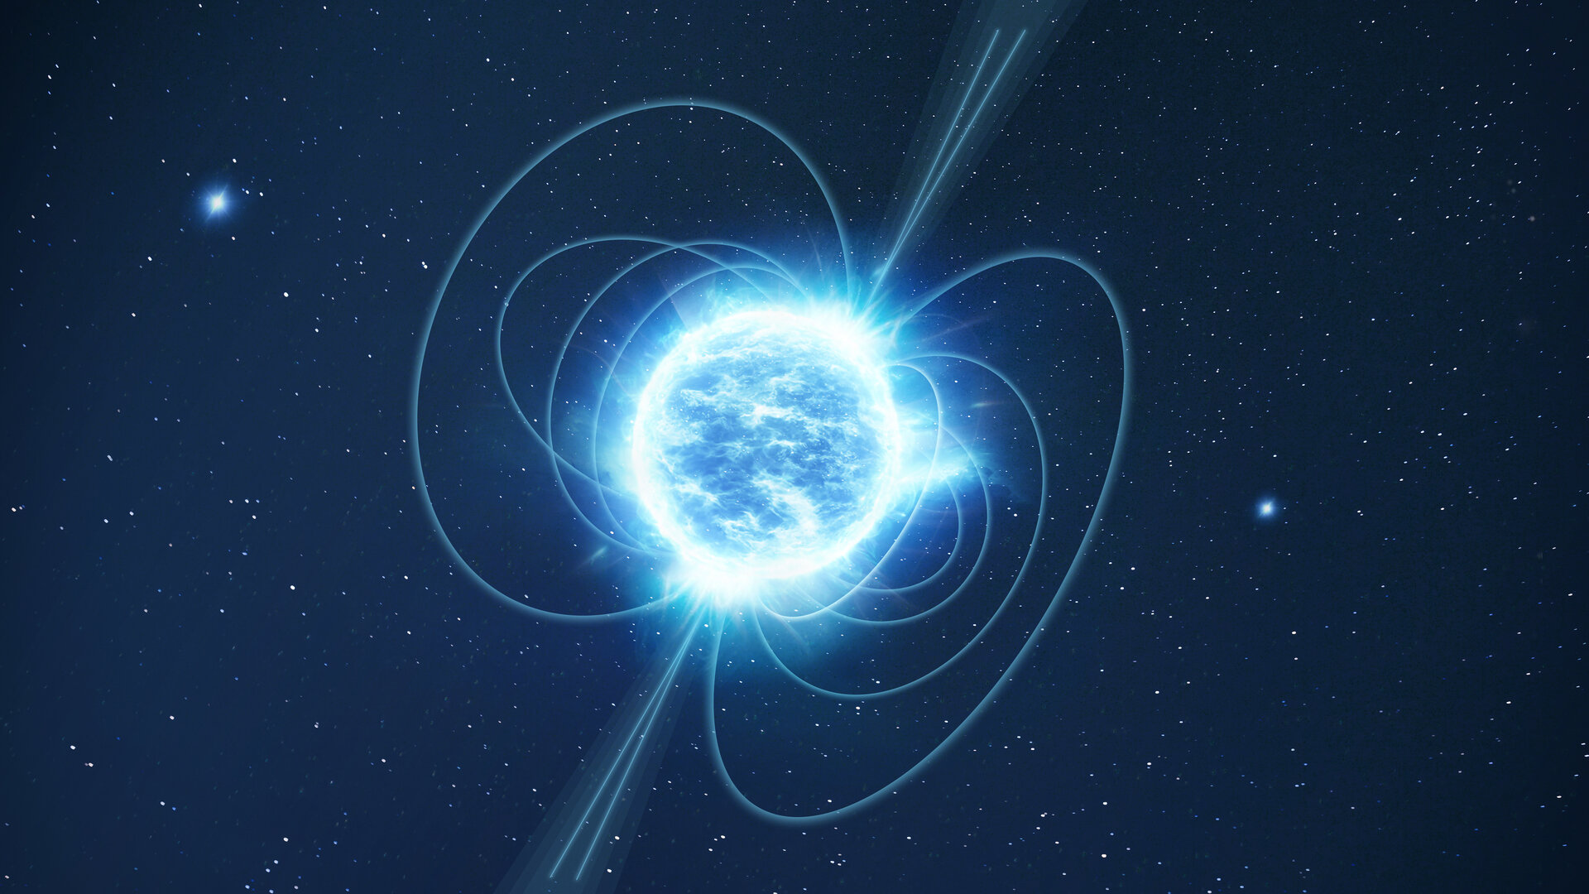
Thank you for your attention!

