Slide 1

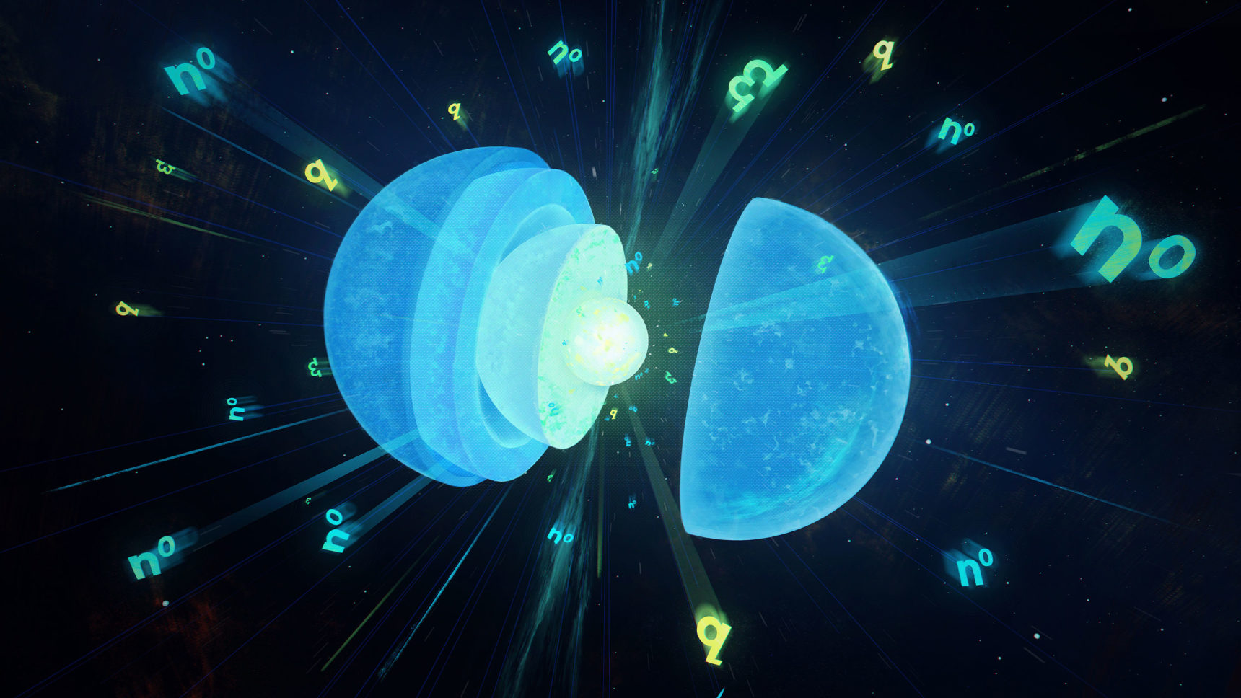





Gary (I-Kang) Liu
Julie Thomas
Carlo Barenghi
Andrew Baggaley
Toby Wood
Maciej Rebisz for Quanta Magazine

Slide 2
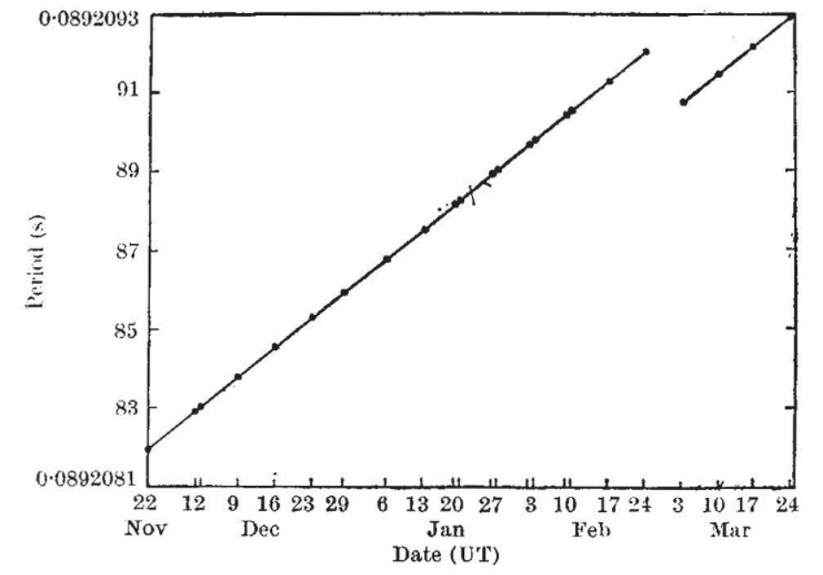
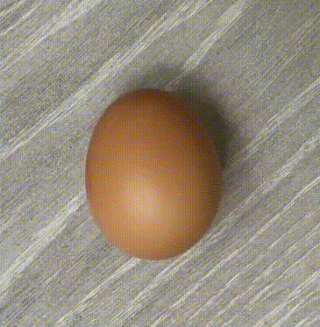


Neutron Star Interior
Maciej Rebisz for Quanta Magazine
$$M≈{1.4M}_{⊙}$$
Atmosphere
Hydrogen, Helium, Carbon
$$R≈10 km$$
Outer Core
Neutron Superfluid (p-wave)
Proton Superconductor
Outer Crust
Ions, Electrons
Inner Core
Unknown
Inner Crust
Ions, Nuclear Lattices/Pasta
Neutron Superfluid (s-wave)
Reichley & Downs,
Nature 22, 229 (1969)

Slide 3
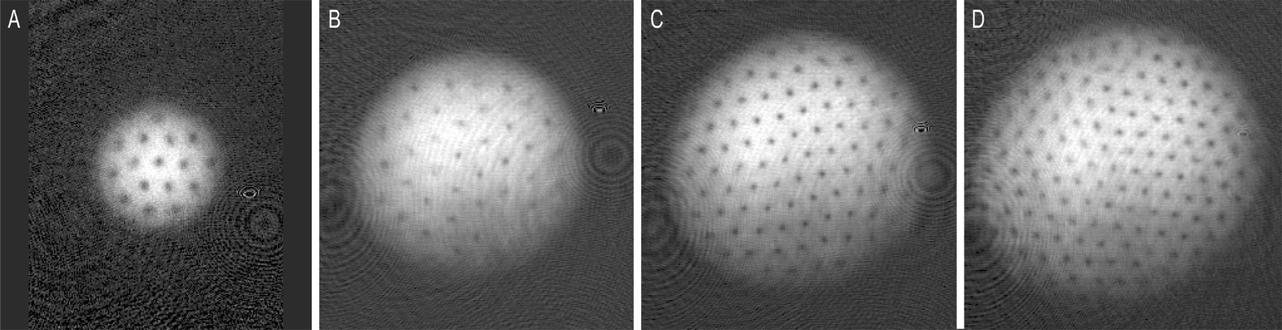
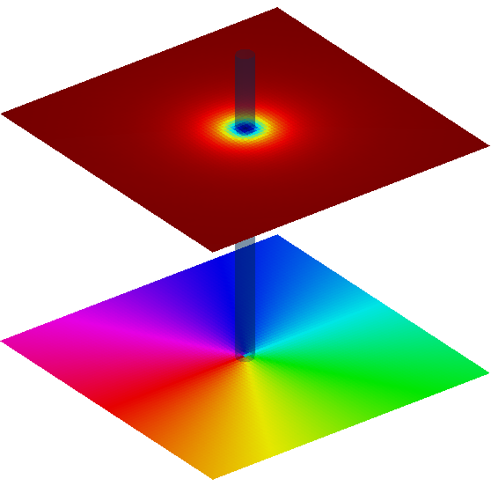
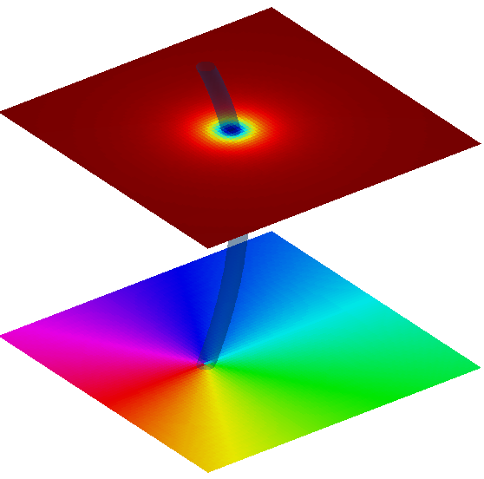
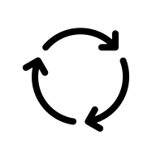










Quantum Vortices
Macroscopic superfluid wavefunction $Ψ\left(r,t\right)=\sqrt{n\left(r,t\right)}e^{iφ\left(r,t\right)}$
Irrotational, $v=\frac{ℏ}{m}∇φ ⇒∇×v=0$
Phase defect, $φ=κθ⇒$ $v=\frac{ℏ}{m}\frac{κ}{r}\hat{θ}$
More is Different
Abo-Shafer et al., Science 292, 476 (2001)
$$ρ$$
$$s$$
$$s_{∥}$$
$$s_{⊥}$$
$$N_{v}=16$$
$$N_{v}=32$$
$$φ$$
$$N_{v}=80$$
$$N_{v}=130$$

Slide 4
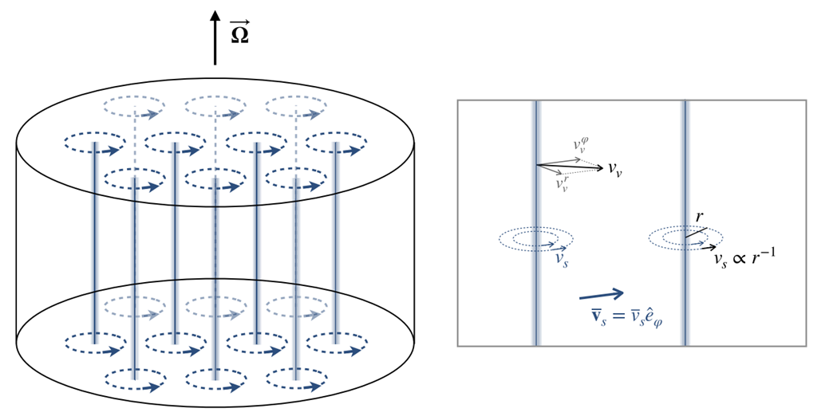
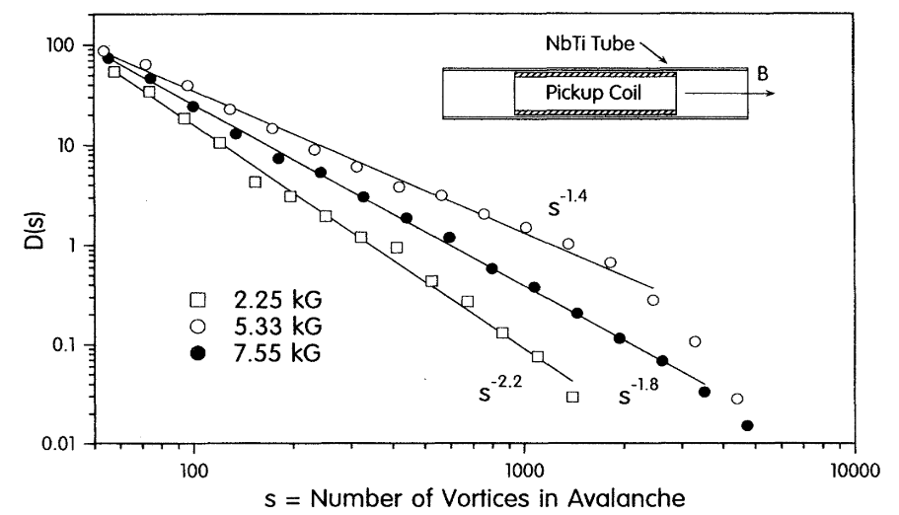
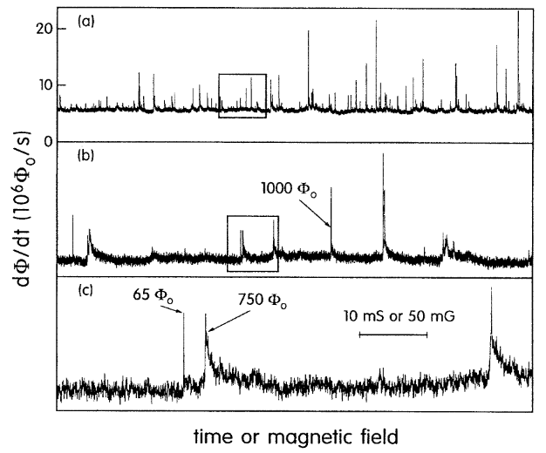
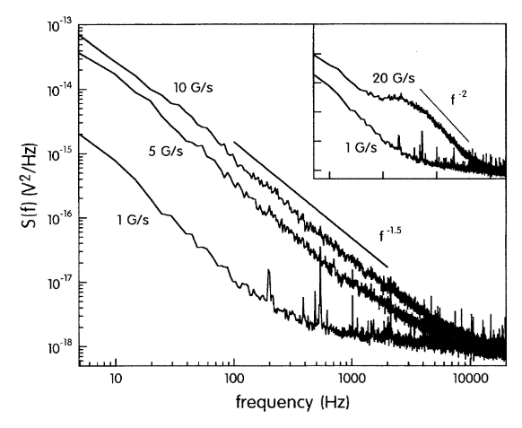
Glitches and Vortex Pinning and Avalanches
Analogy with type-II superconductor
Field, Witt, Nori, PRL 74, 7 (1995)
Antonopoulou, Haskell, Espinoza,
Rep. Prog. Phys. 85, 126901 (2022)

Slide 5
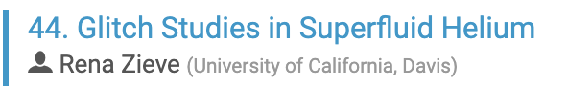

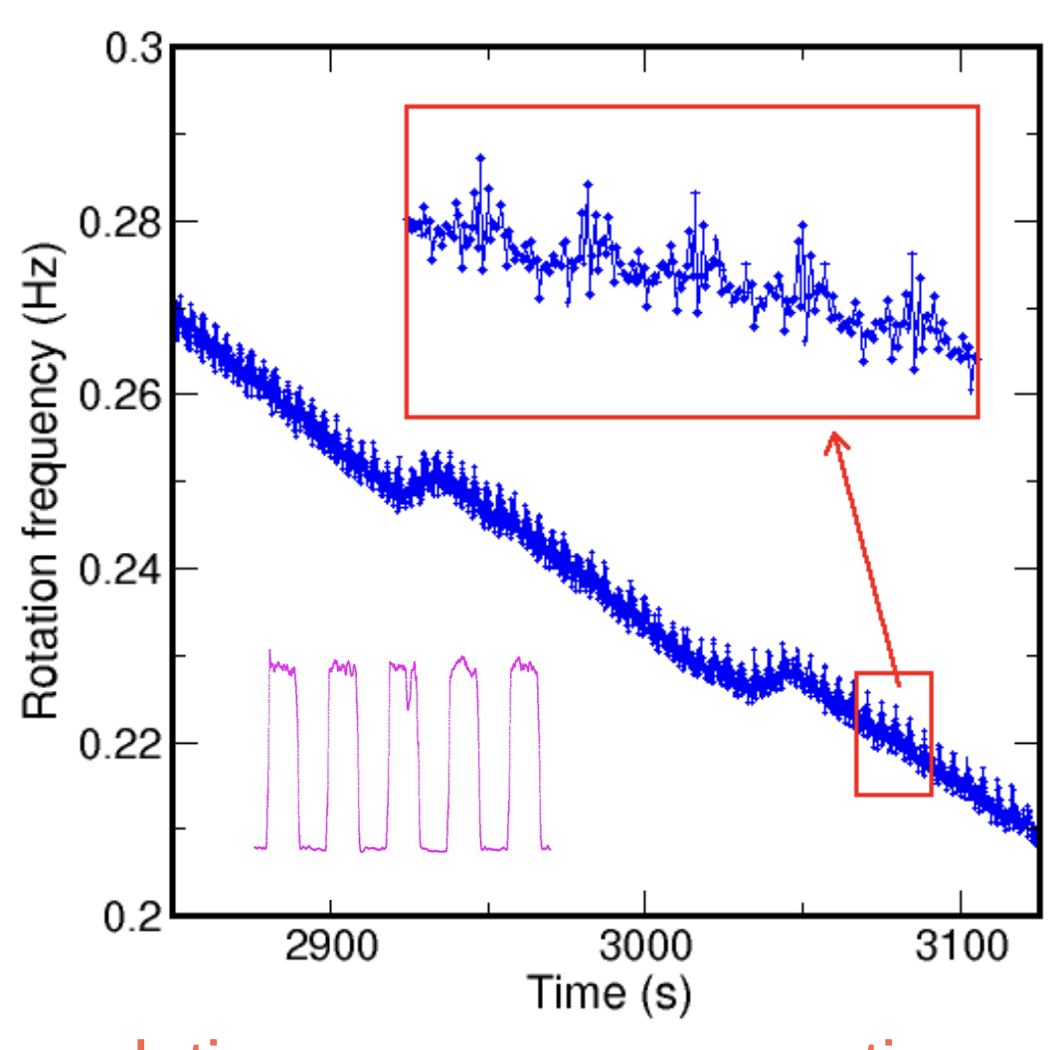

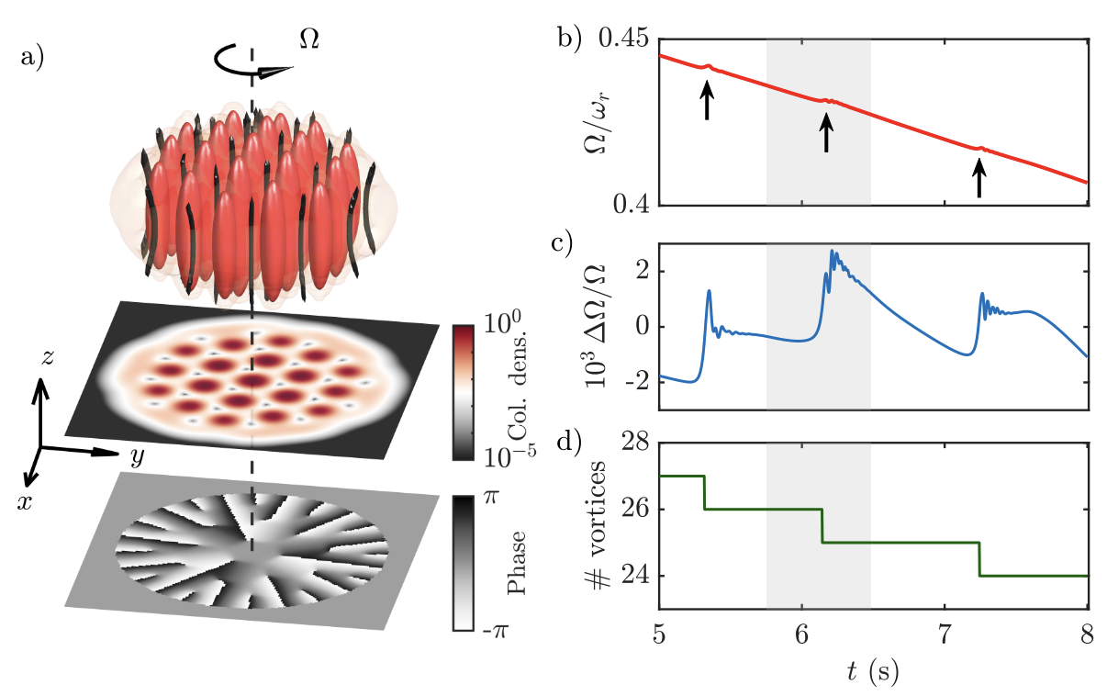

Glitches and Vortex Pinning and Avalanches

Slide 6

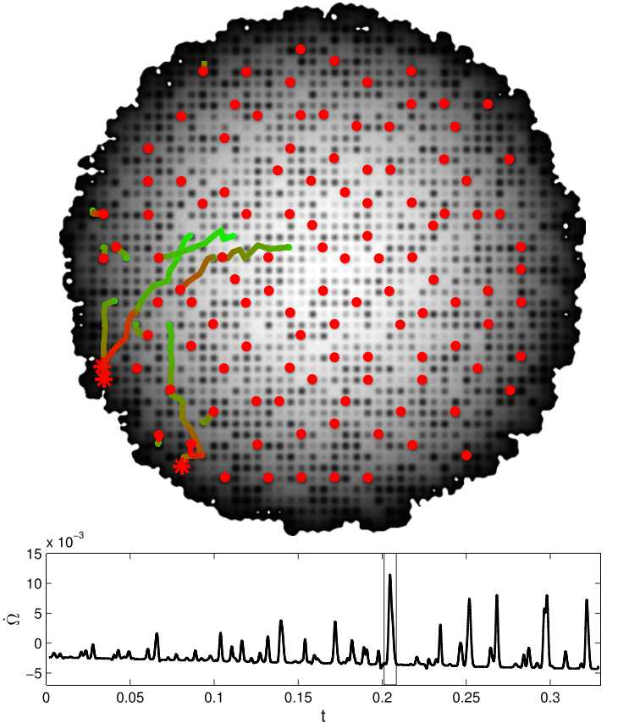
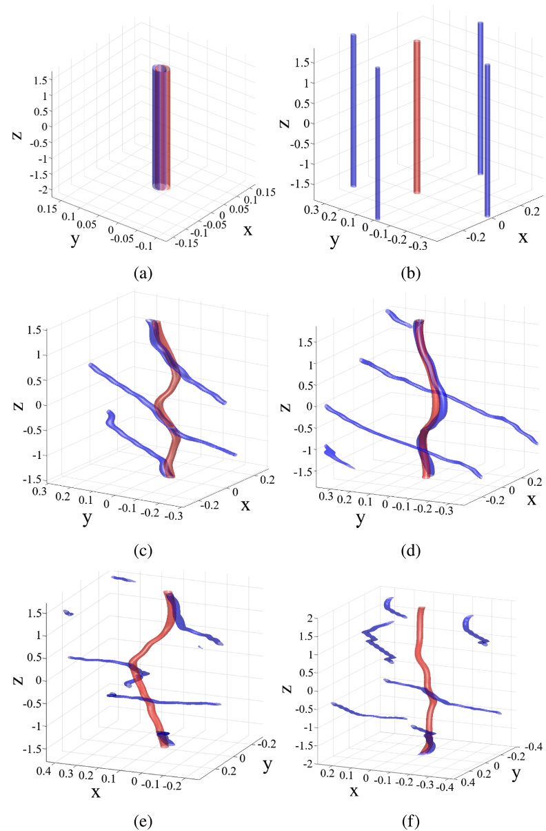
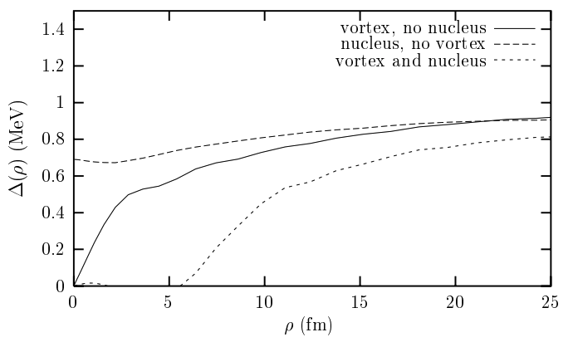

Superfluid Modelling
Gross-Pitaevskii Model
Warszawski & Melatos, MNRAS 415, 1611 (2011)
Ginzburg-Landau Model
Wood & Graber, Universe 8, 228 (2022)
Melatos’ group, MNRAS (2017, 2018, 2024)
Sub-Mesoscopic
Analogy by C. Barenghi (2014)
HFB/BdG Models
Ø. Elgarøy et al., AA 370, 939 (2001)
$$ξ≈[10,100] fm$$

Slide 7

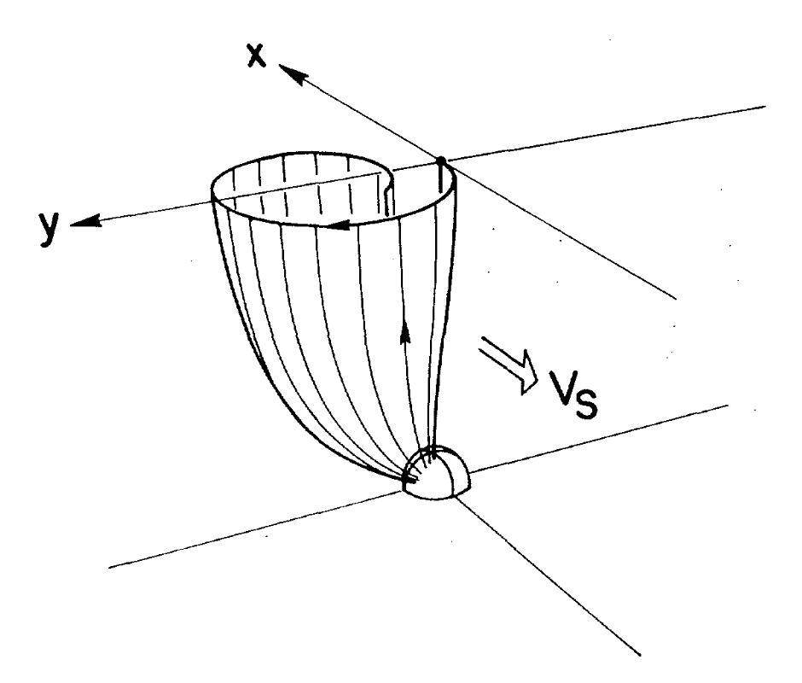
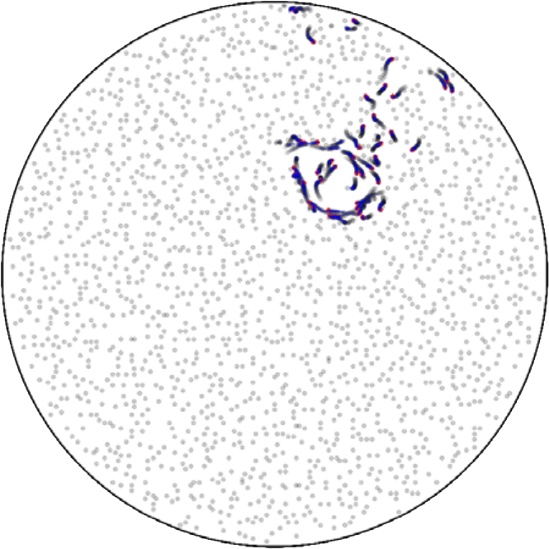
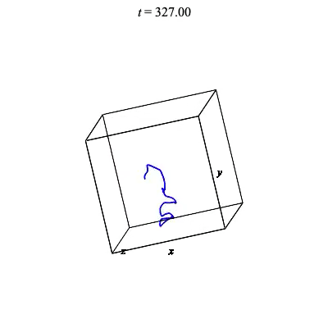

Superfluid Modelling
Point Vortex Model
Howitt et al., MNRAS 498, 320 (2020)
S. V. Anantharaman & D. Bhattacharya, MRNAS 539, 3645 (2025)
Vortex Filament Method
Schwarz, PRL 47, 251 (1987)
Link & Levin, ApJ 941, 148 (2022)
Mesoscopic
Analogy by C. Barenghi (2014)
$$ξ≈[10,100] fm≪R$$

Slide 8
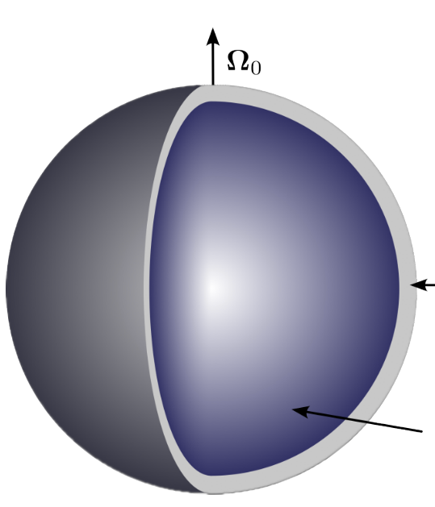
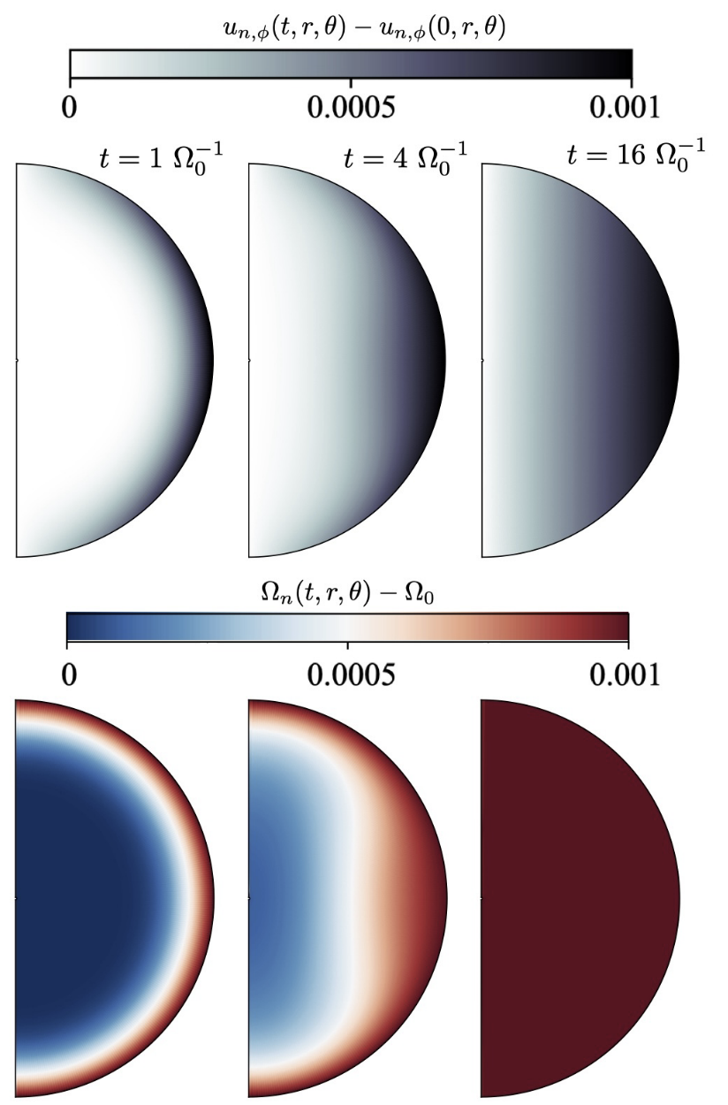
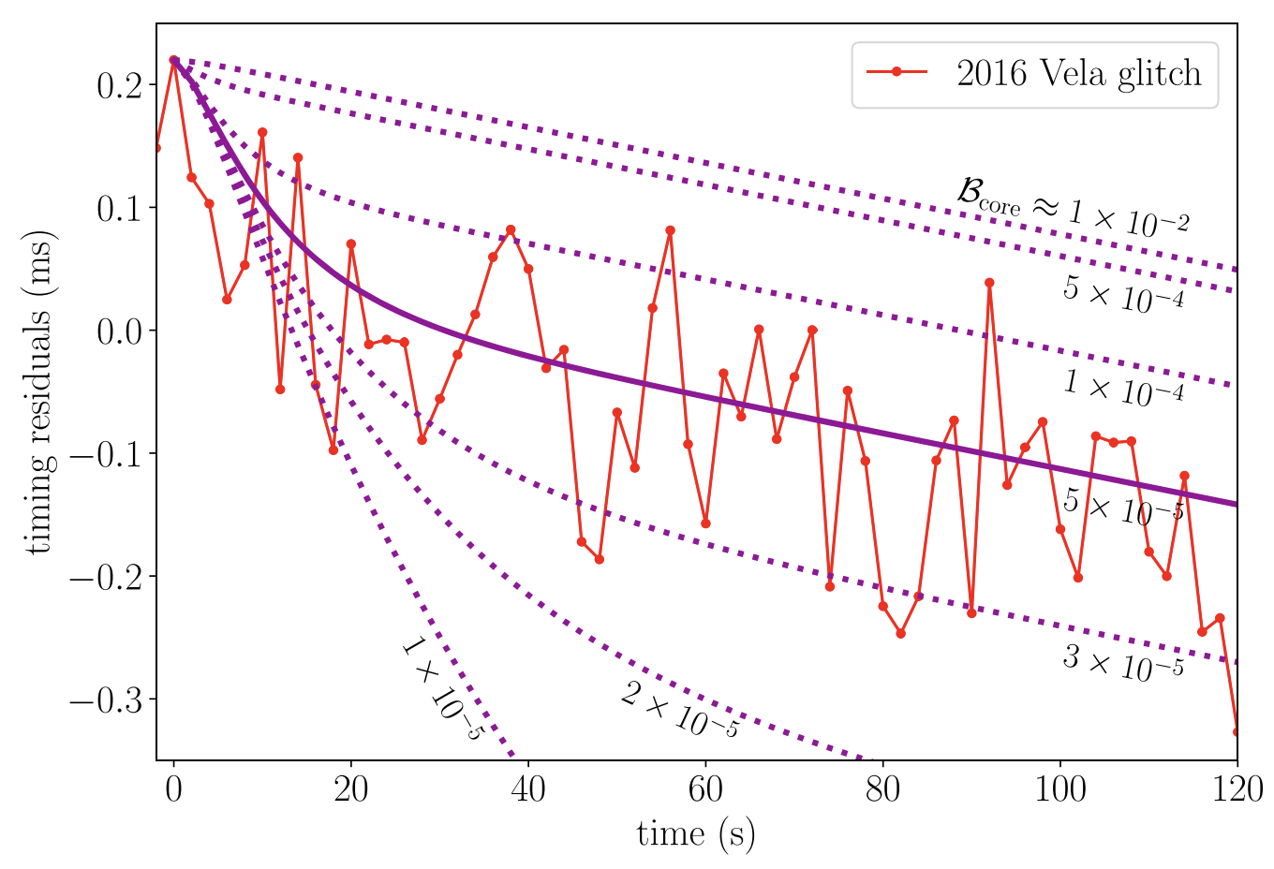
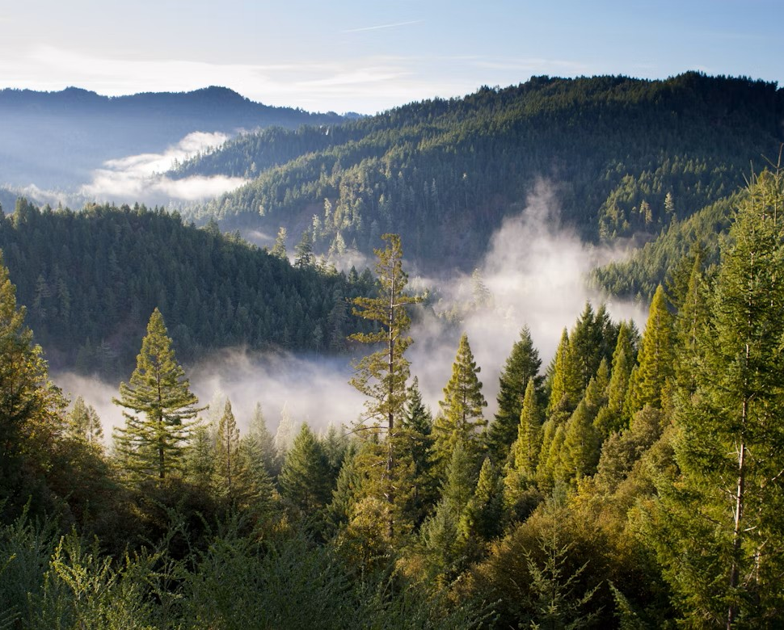
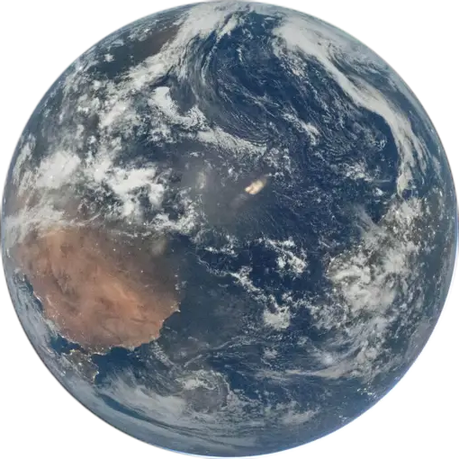

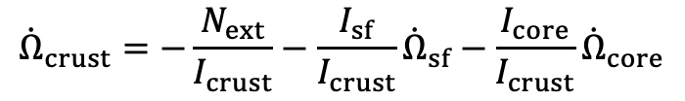
Superfluid Modelling
Macroscopic
HBVK Model
Fuentes & Graber, ApJ 974, 300 (2024)
Multi-component Models
Graber+, ApJ 865, 23 (2018)
Pizzochero+, A&A 636, A101 (2020)
Tu & Li, arXiv:2510.20791
Analogy by C. Barenghi (2014)
$${\dot{Ω}}_{crust}=−\frac{N_{ext}}{I_{crust}}−\frac{I_{sf}}{I_{crust}}{\dot{Ω}}_{sf}−\frac{I_{core}}{I_{crust}}{\dot{Ω}}_{core}$$
$${\dot{Ω}}_{sf}=2B_{sf}Ω_{sf}\left(Ω_{sf}−Ω_{crust}\right)$$
$${\dot{Ω}}_{core}=2B_{core}Ω_{core}\left(Ω_{core}−Ω_{crust}\right)$$

Slide 9




Toward Larger Scales
${10}^{7}−{10}^{18}$ Vortices for a glitch
Sub-Mesoscopic
Gross-Pitaevskii Model
Warszawski & Melatos, MNRAS 415, 1611 (2011)
BdG Model
Avogadro et al., PRC 75, 912795(R) (2007)
Ø. Elgarøy et al., AA 370, 939 (2001)
Ginzburg-Landau Model
Wood & Graber, Universe 8, 228 (2022)
Mesoscopic
Point Vortex Model
Howitt et al., MNRAS 498, 320 (2020)
Vortex Filament Method
Schwarz, PRL 47, 251 (1987)
Macroscopic
HBVK Model
Fuentes & Graber, ApJ 974, 300 (2024)
Multi-component Models
Graber+, ApJ 865, 23 (2018)
Pizzochero+, A&A 636, A101 (2020)
Tu & Li, arXiv:2510.20791
Simulation-Based
Inference

Slide 10
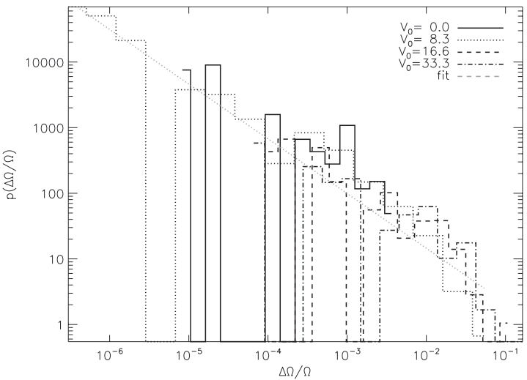



Glitches and Vortex Pinning and Avalanches
Dissipative Gross-Pitaevskii model (dGPE)
$$iℏ∂_{t}ψ\left(r,t\right)=\left(1−iγ\right)\left[−\frac{ℏ^{2}∇^{2}}{2m}+V\left(r,t\right)+g{\left|ψ\left(r,t\right)\right|}^{2}−Ω\left(t\right){\hat{L}}_{z}−μ\right]ψ\left(r,t\right)$$
$$I_{c}\frac{dΩ}{dt}=−\frac{d\left\langle {\hat{L}}_{z}\right\rangle }{dt}+N_{EM}$$
$${\left(\frac{ΔΩ}{Ω}\right)}^{−a}$$
$$a∈(0.8,1.2)$$
Warszawski & Melatos, MNRS 415, 1611 (2011)
Melatos, Douglas & Simula, Ap 807, 132 (2015)

Slide 11

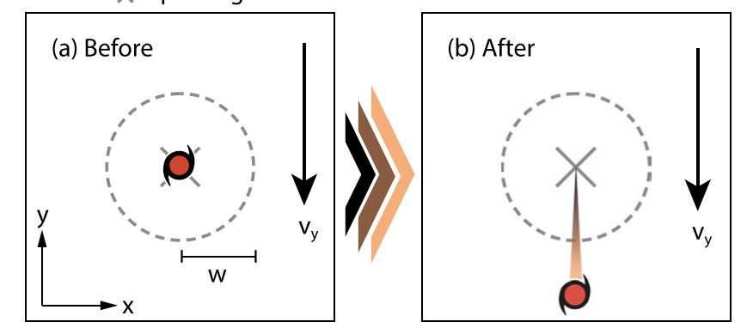
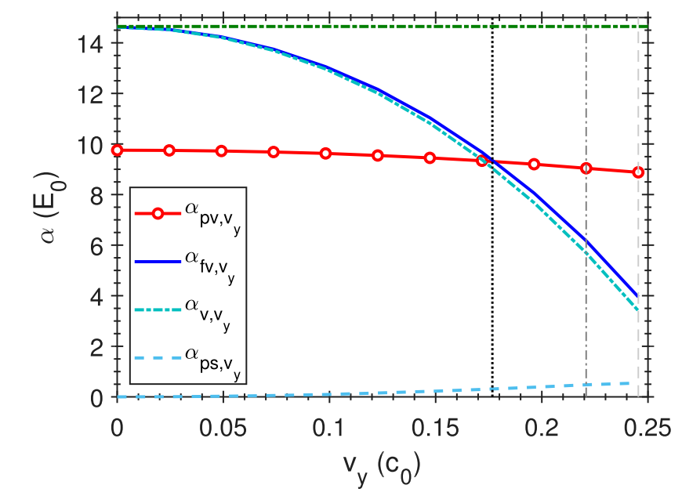
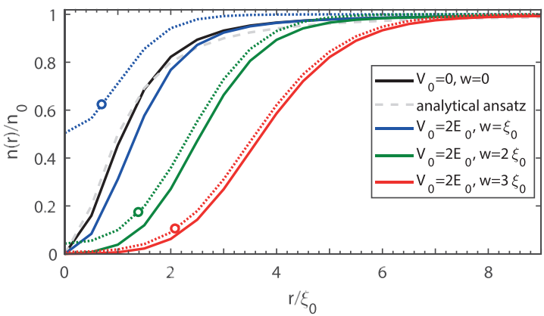



Glitches and Vortex Pinning and Avalanches
Vortex Pinning
$$v_{c,adiabatic}$$
$$v_{c,kick}$$
$$v_{c,energy}$$
Liu, Prasad, Baggaley,
Barenghi, Wood, JLTP (2024)

Slide 12
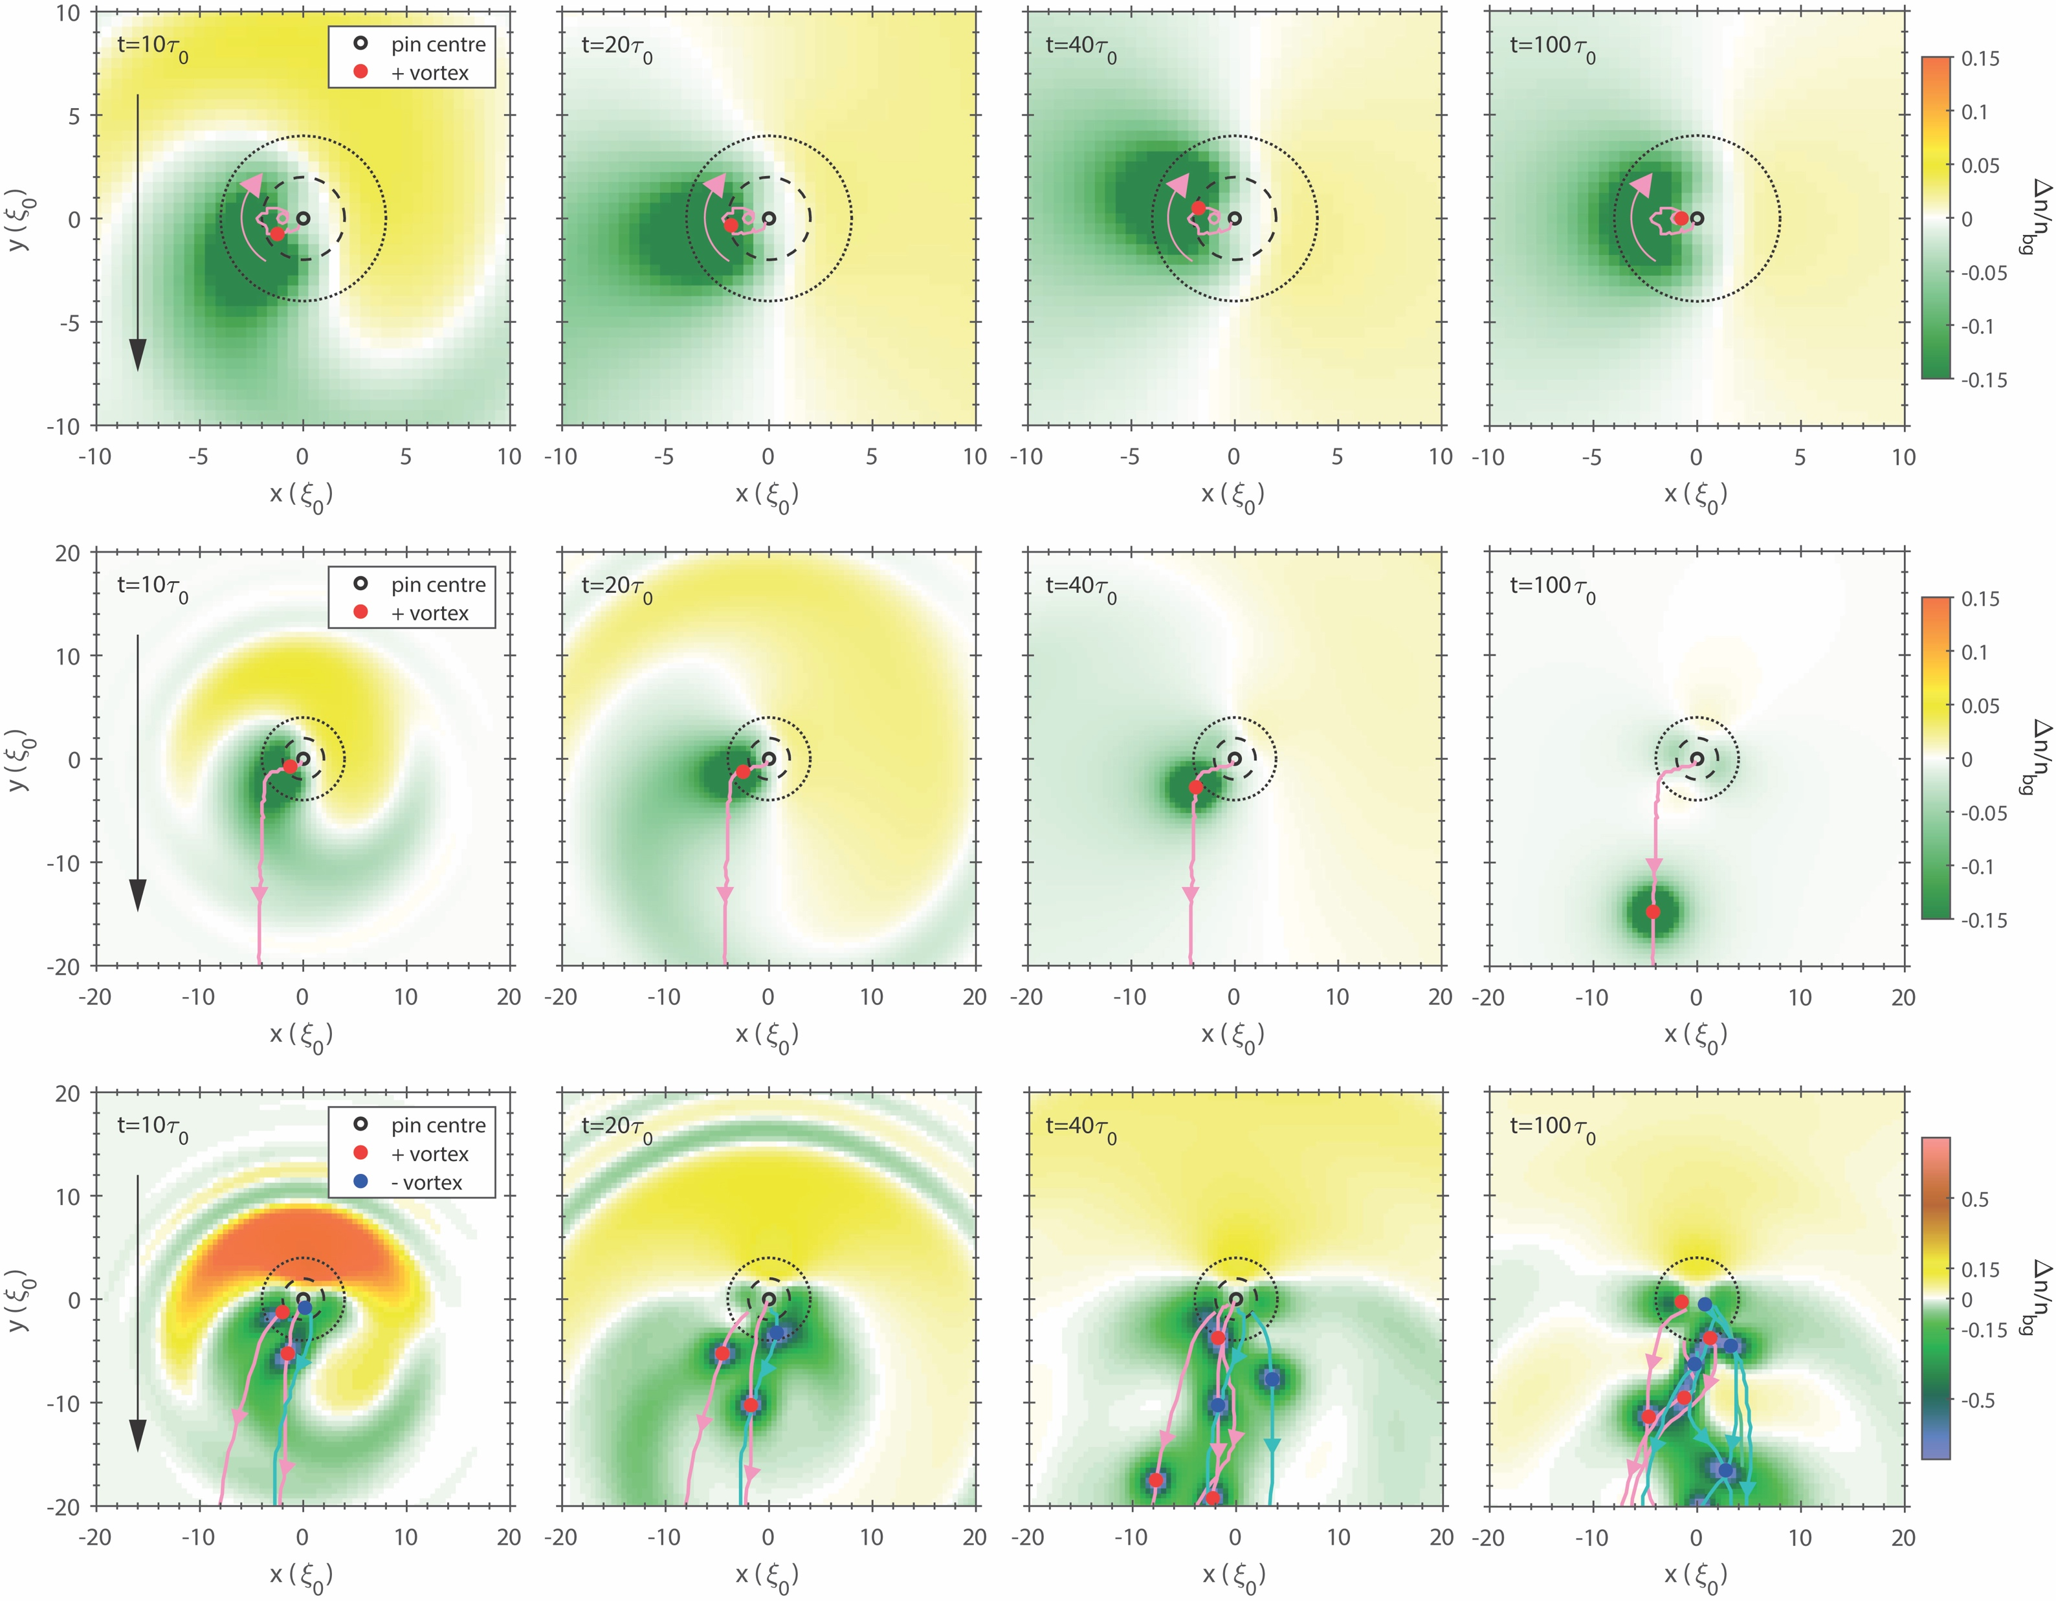
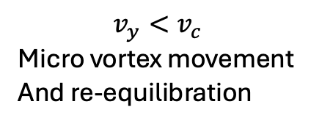
Glitches and Vortex Pinning and Avalanches
$$v_{y}<v_{c}$$
Micro vortex movement
And re-equilibration

Slide 13
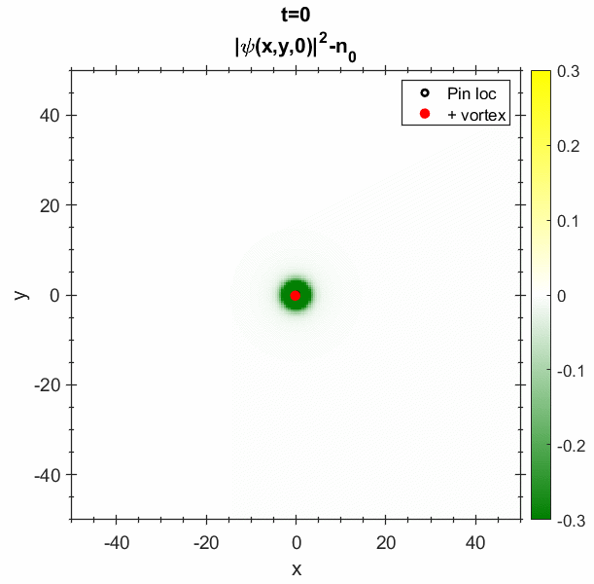
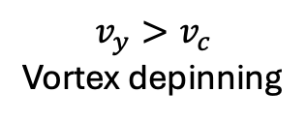
Glitches and Vortex Pinning and Avalanches
$$v_{y}<v_{c}$$
Micro vortex movement
And re-equilibration
$$v_{y}>v_{c}$$
Vortex depinning

Slide 14
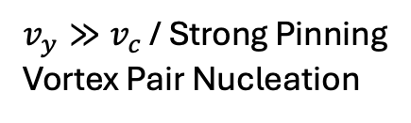
Glitches and Vortex Pinning and Avalanches
$$v_{y}<v_{c}$$
Micro vortex movement
And re-equilibration
$$v_{y}>v_{c}$$
Vortex depinning
$v_{y}≫v_{c}$ / Strong Pinning
Vortex Pair Nucleation

Slide 15
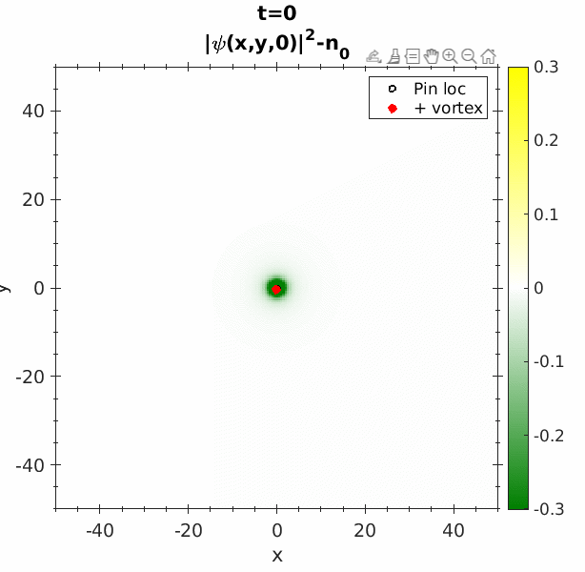
Glitches and Vortex Pinning and Avalanches
$$v_{y}<v_{c}$$
Micro vortex movement
And re-equilibration
$$v_{y}>v_{c}$$
Vortex depinning
$v_{y}≫v_{c}$ / Strong Pinning
Vortex Pair Nucleation

Slide 16
Glitches and Vortex Pinning and Avalanches
$$v_{y}<v_{c}$$
Micro vortex movement
And re-equilibration
$$v_{y}>v_{c}$$
Vortex depinning
$v_{y}≫v_{c}$ / Strong Pinning
Vortex Pair Nucleation

Slide 17
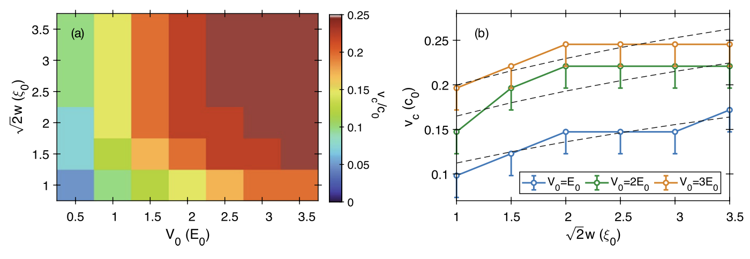
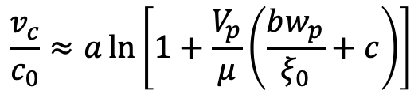
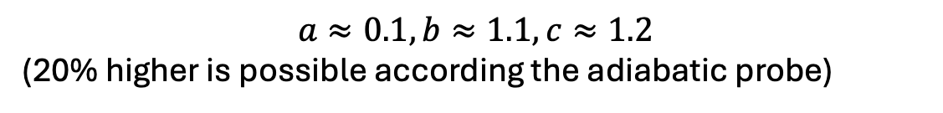
Glitches and Vortex Pinning and Avalanches
Critical Vortex Depinning Velocity
Liu, Prasad, Baggaley, Barenghi, Wood, JLTP (2024)
$$\frac{v_{c}}{c_{0}}≈a\ln\left[1+\frac{V_{p}}{μ}\left(\frac{bw_{p}}{ξ_{0}}+c\right)\right]$$
$$a≈0.1, b≈1.1, c≈1.2$$
(20% higher is possible according the adiabatic probe)

Slide 18
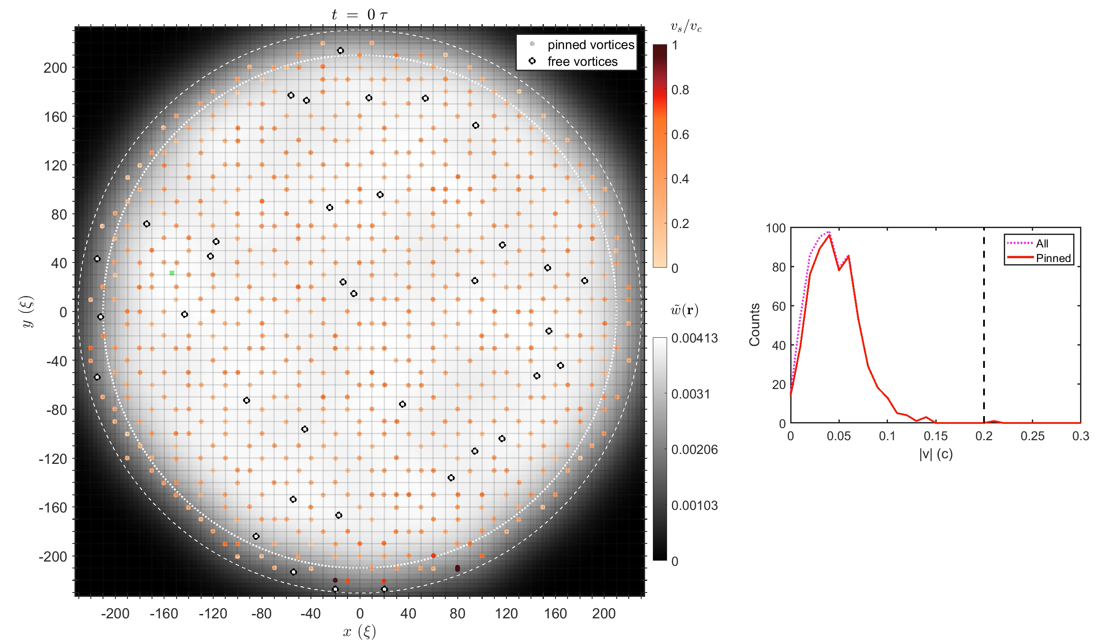

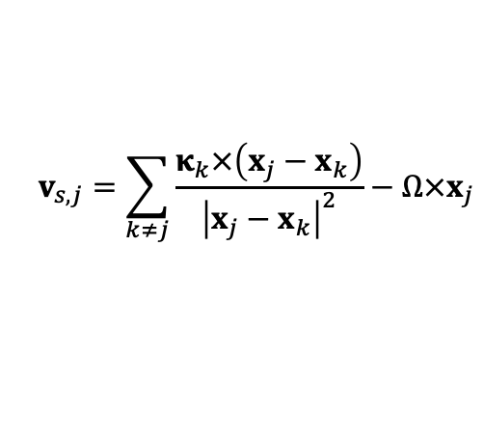
Superfluid Modelling
Slowly linearly decreasing
Gross-Pitaevskii model
$$iℏ∂_{t}ψ\left(r,t\right)=\left(1−iγ\right)\left[−\frac{ℏ^{2}∇^{2}}{2m}+V\left(r,t\right)+g{\left|ψ\left(r,t\right)\right|}^{2}−Ω\left(t\right){\hat{L}}_{z}−μ\right]ψ\left(r,t\right)$$
Pinning vs Magnus forces
$$F_{M}=κ×\left(v_{s}−\frac{dx}{dt}\right)$$
$$v_{s,j}=\sum_{k≠j}{\frac{κ_{k}×\left(x_{j}−x_{k}\right)}{{\left|x_{j}−x_{k}\right|}^{2}}}−Ω×x_{j}$$
ApJ 984, 83 (2025)

Slide 19
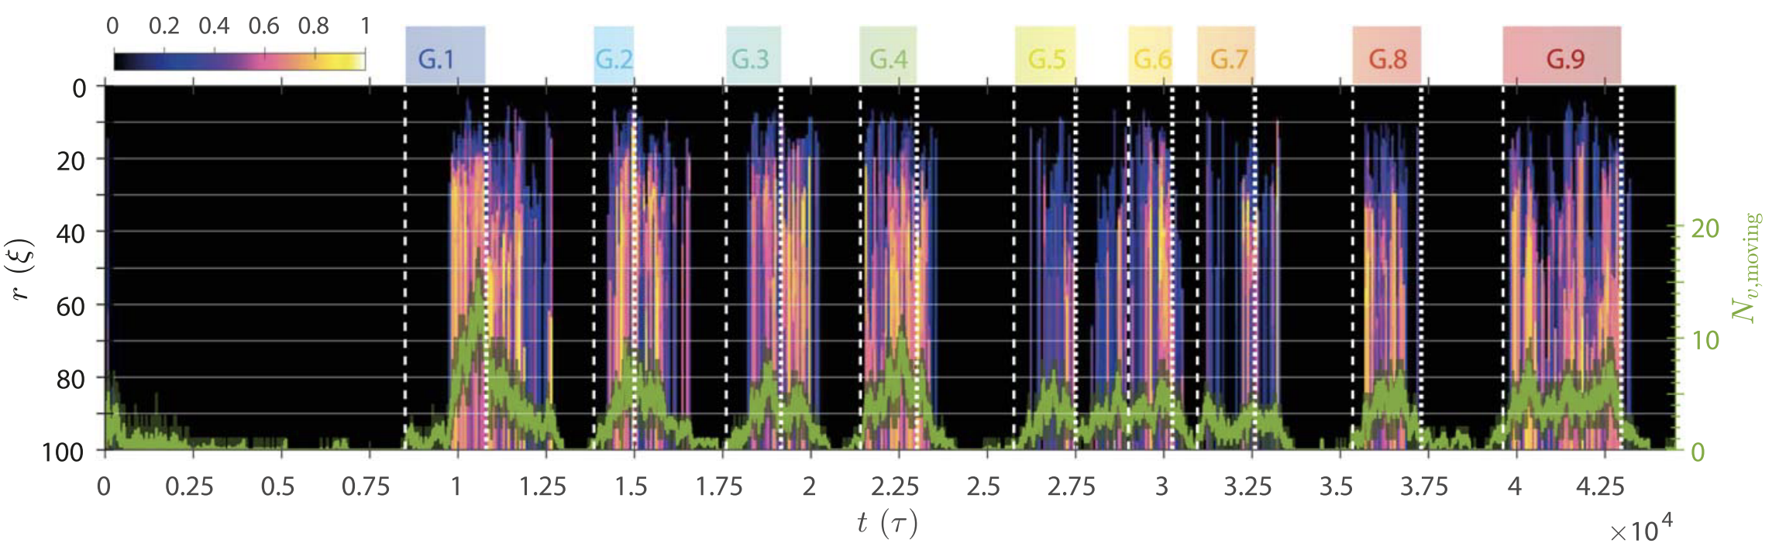
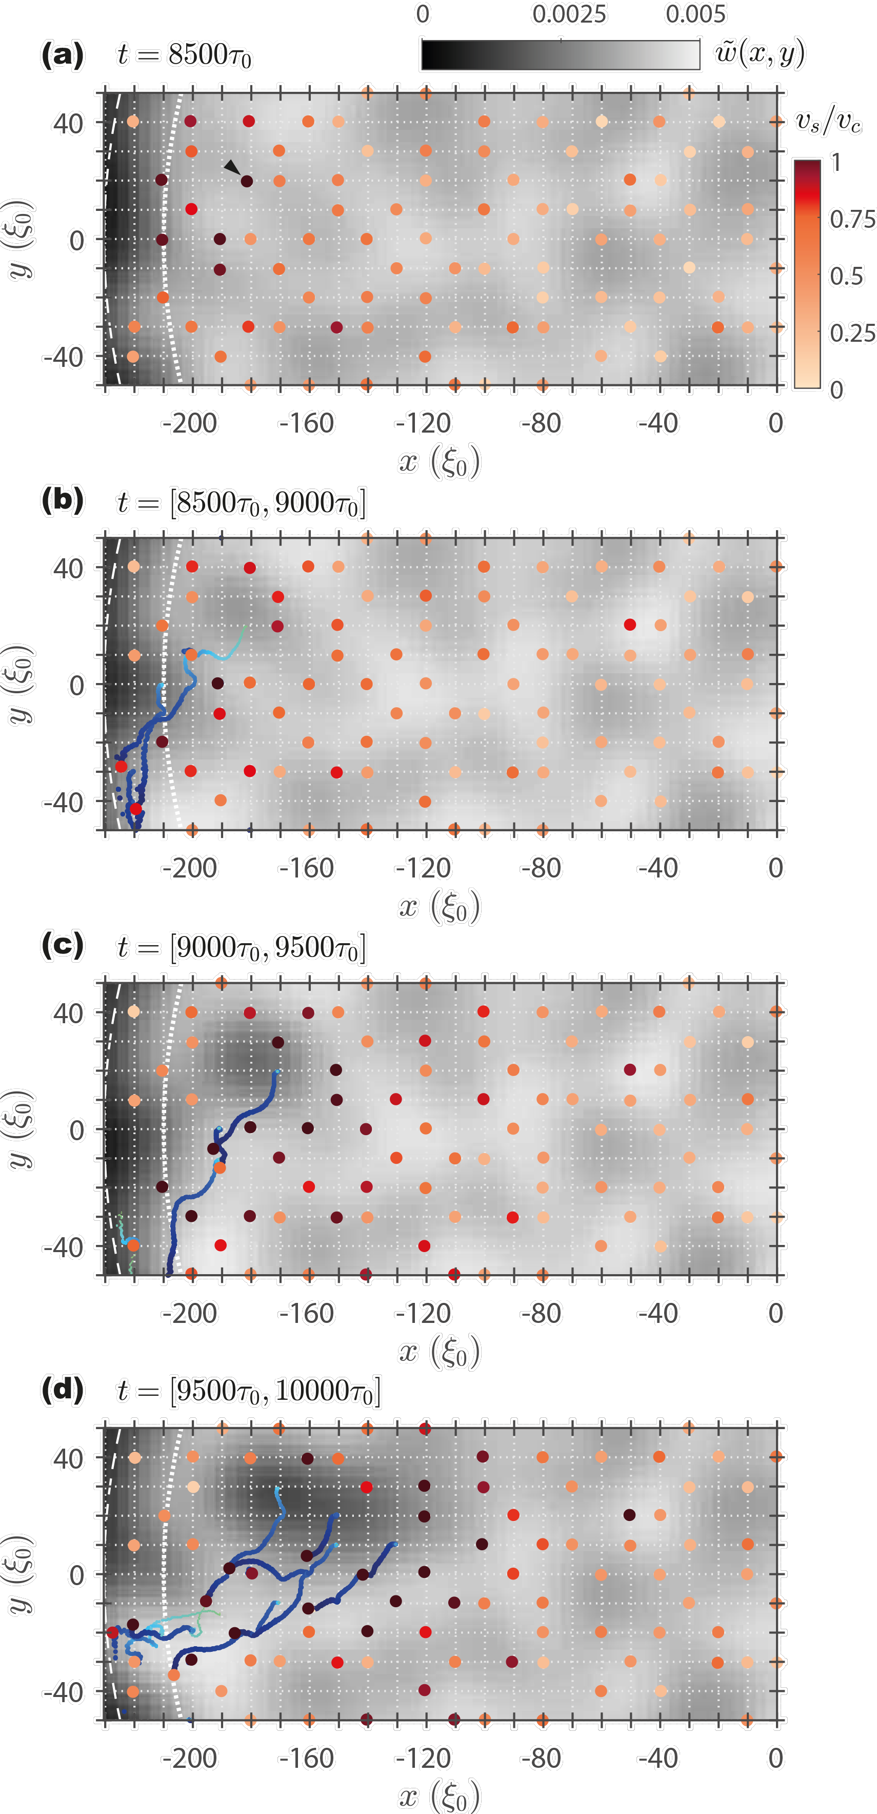
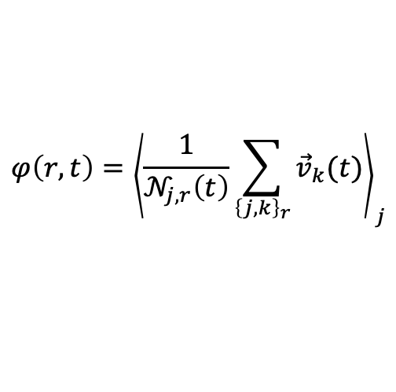
Vortex Collective Motion
$$φ\left(r,t\right)={\left\langle \frac{1}{𝒩_{j,r}\left(t\right)}\sum_{{\left\{j,k\right\}}_{r}}{{\vec{v}}_{k}(t)}\right\rangle }_{j}$$

Slide 20

Vortex Collective Motion
$$φ\left(r,t\right)={\left\langle \frac{1}{𝒩_{j,r}\left(t\right)}\sum_{{\left\{j,k\right\}}_{r}}{{\vec{v}}_{k}(t)}\right\rangle }_{j}$$
$$φ$$

Slide 21
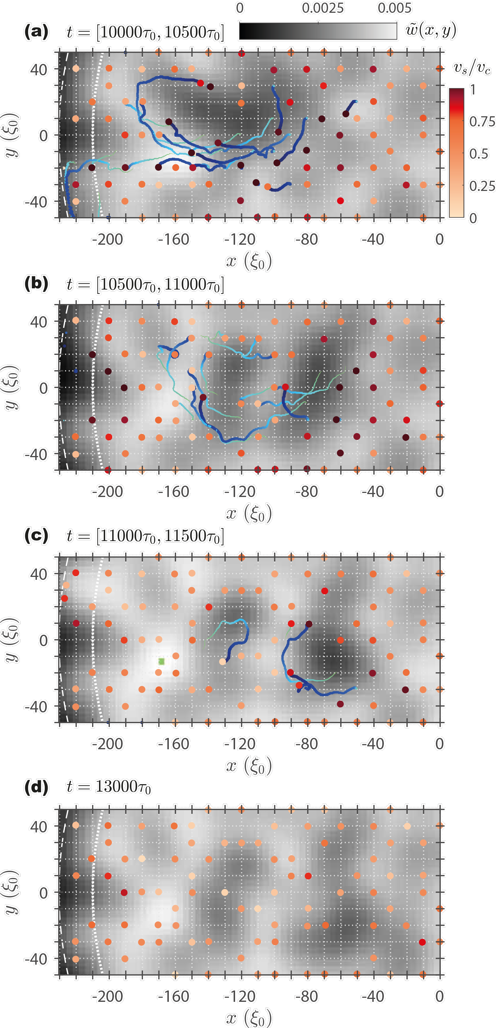
Vortex Collective Motion
$$φ\left(r,t\right)={\left\langle \frac{1}{𝒩_{j,r}\left(t\right)}\sum_{{\left\{j,k\right\}}_{r}}{{\vec{v}}_{k}(t)}\right\rangle }_{j}$$
$$φ$$

Slide 22
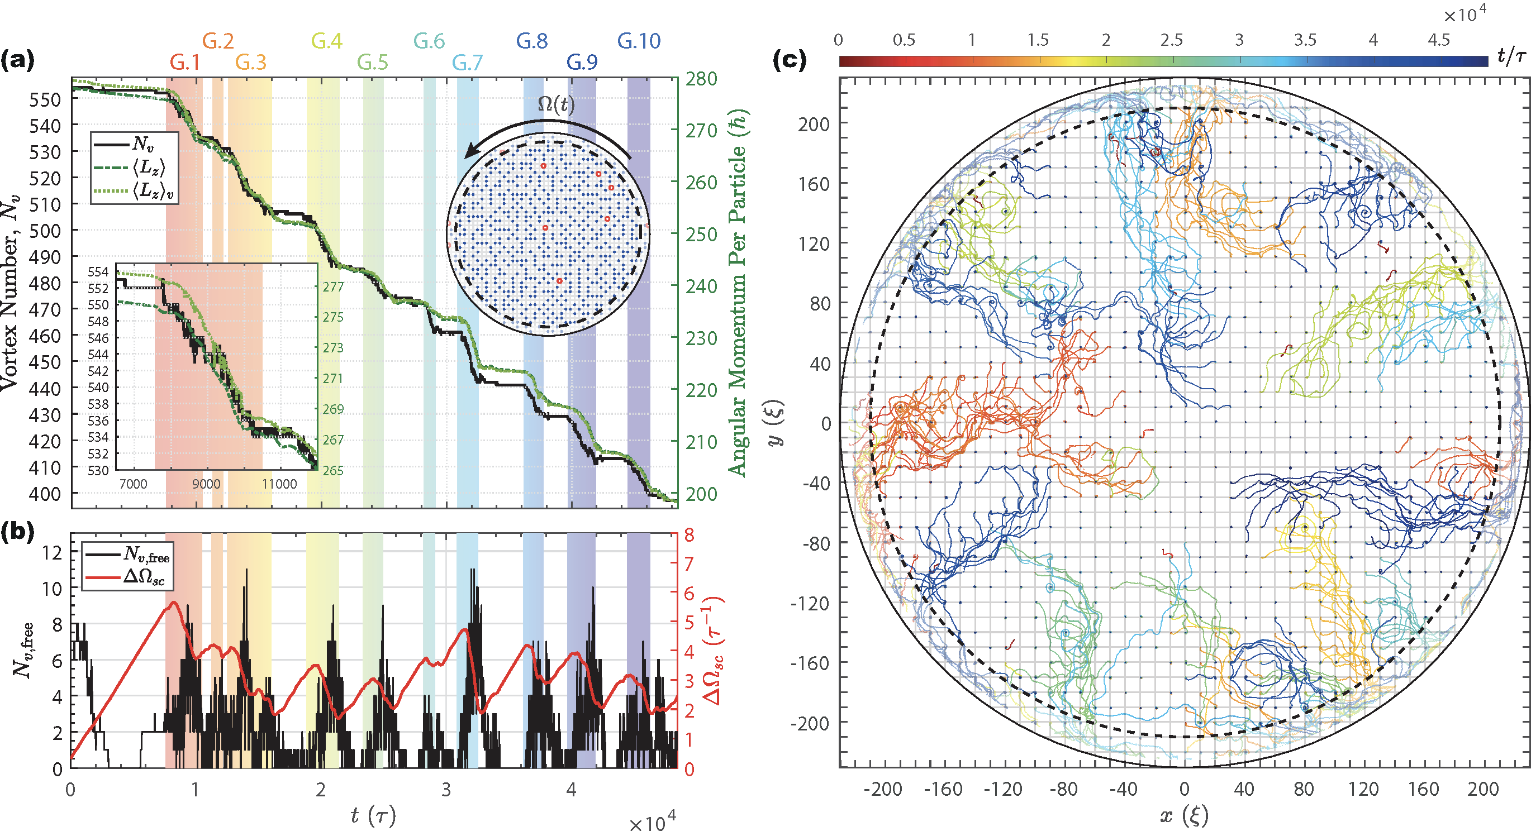
Glitches and Vortex Pinning and Avalanches
ApJ 984, 83 (2025) * In Preparation

Slide 23
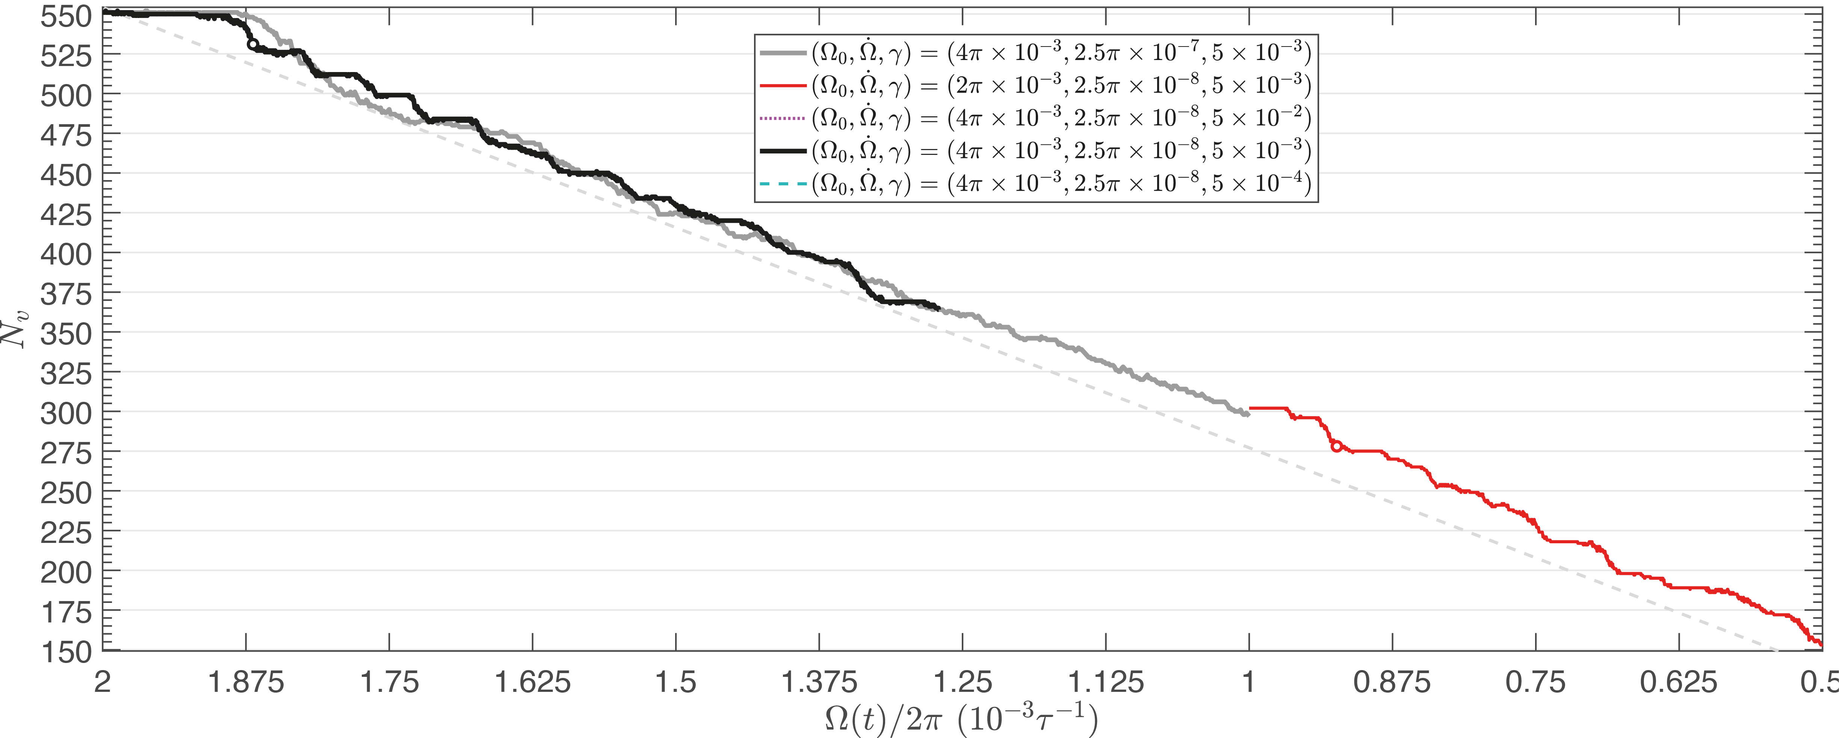
Parameter sensitivity
Slower spinning down rate to create step-like drops in vortex number

Slide 24
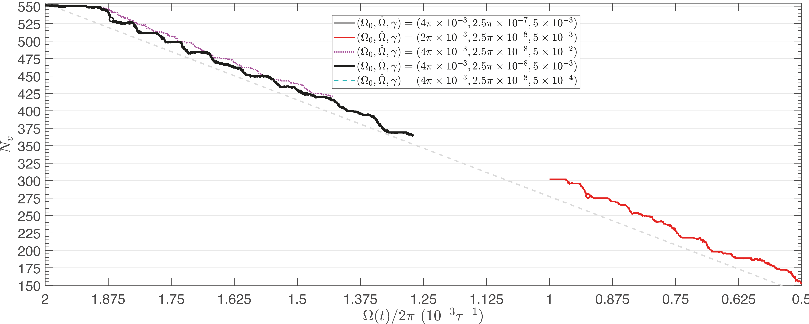
Parameter sensitivity
Glitches prefer lower dissipation

Slide 25

Parameter sensitivity
Slower spinning down rate to create step-like drops in vortex number

Slide 26

Parameter sensitivity

Slide 27






Vortex Avalanche Statistics
Preliminary Results
$$N_{avl}≈255$$
Liu et al., in preparation
$$L_{z}=ℏ\sum_{j}{1−\frac{r_{v,j}^{2}}{R^{2}}}$$
A. L. Fetter, Phys. Rev. 138, 42 (1965)
Better statistic is needed….

Slide 28










Mesoscopic Simulation
Point-Vortex Model
$$z_{k}=x_{k}+iy_{k}$$
$$−\frac{ℏ}{m}\frac{s}{r}\hat{φ}$$
$$v_{s,k}=i\frac{ℏ}{m}\sum_{j≠k}{\frac{s_{j}\left(z_{k}−z_{j}\right)}{{\left|z_{k}−z_{j}\right|}^{2}}}−i\frac{ℏ}{m}\sum_{j}{\frac{s_{j}\left(z_{k}−z_{j}^{′}\right)}{{\left|z_{k}−z_{j}^{′}\right|}^{2}}+iF_{pin}\left(z_{k}\right)+iΩ_{c}\left(t\right)z_{k}}$$
$$F_{pin}\left(z\right)=−∇_{z}V_{pin}\left(z\right)$$
$$U_{pin}\left(z\right)=−V_{p}\exp\left[−\frac{d_{p}}{w_{p}}\left(\sin^{2}{\frac{πx}{d_{p}}}+\sin^{2}\frac{πy}{d_{p}}\right)\right]$$
B. Link and Y. Levin, ApJ 941, 148 (2022)
$$\frac{dz_{k}}{dt}=\left(1−α^{′}\right)v_{s,k}−iαv_{s,k}$$
$$\frac{dz_{k}}{dt}=e^{−iφ}v_{s,k}$$
$$α=\sin{φ}$$
$$α^{′}=1−cos{φ}$$

Slide 29

Mesoscopic Simulation

Slide 30







Mesoscopic Simulation
PVM mapping
$$\frac{dz}{dt}=\frac{ℏ}{m}\left[i\left(1−α^{′}\right)\frac{z}{R^{2}−{\left|z\right|}^{2}}+α\frac{z}{R^{2}−{\left|z\right|}^{2}}\right]$$
$$\frac{d\left|z\right|}{dt}=α\frac{\left|z\right|}{R^{2}−{\left|z\right|}^{2}}$$
$$⟹R\ln\left|z(t)\right|−\frac{{\left|z(t)\right|}^{2}}{2}=\frac{αℏ}{m}t+Const.$$
$$\frac{d arg\left[z\right]}{dt}=\left(1−α^{′}\right)\frac{ℏ}{m}\frac{1}{R^{2}−{\left|z\right|}^{2}}$$
dGPE: $γ=5×{10}^{−3}$

Slide 31


Mesoscopic Simulation
Point-Vortex Simulations
$$\frac{dz}{dt}=\frac{ℏ}{m}\left[i\left(1−α^{′}\right)\frac{z}{R^{2}−{\left|z\right|}^{2}}+α\frac{z}{R^{2}−{\left|z\right|}^{2}}\right]$$
$$\frac{d\left|z\right|}{dt}=α\frac{\left|z\right|}{R^{2}−{\left|z\right|}^{2}}$$
$$⟹R\ln\left|z(t)\right|−\frac{{\left|z(t)\right|}^{2}}{2}=\frac{αℏ}{m}t+Const.$$
$$\frac{d arg\left[z\right]}{dt}=\left(1−α^{′}\right)\frac{ℏ}{m}\frac{1}{R^{2}−{\left|z\right|}^{2}}$$
dGPE: $γ=5×{10}^{−3}$

Slide 32



Superfluid Modelling (Preliminary)
PVM: Mutual Friction Coefficients
  Howitt’s approach
Howitt et al., MNRAS 498, 320 (2020)
$$\frac{dz_{k}}{dt}=e^{−iφ}v_{s,k}$$
$$φ=0.05$$

Slide 33


Superfluid Modelling (Preliminary)
PVM: Mutual Friction Coefficients
  Howitt’s approach
Howitt et al., MNRAS 498, 320 (2020)
$$\frac{dz_{k}}{dt}=e^{−iφ}v_{s,k}$$
$$φ=0.1$$

Slide 34
Superfluid Modelling (Preliminary)
PVM: Mutual Friction Coefficients
  Howitt’s approach
Howitt et al., MNRAS 498, 320 (2020)
$$\frac{dz_{k}}{dt}=e^{−iφ}v_{s,k}$$
$$φ=0.1$$

Slide 35
Superfluid Modelling (Preliminary)
PVM: Mutual Friction Coefficients
  Howitt’s approach
Howitt et al., MNRAS 498, 320 (2020)
$$\frac{dz_{k}}{dt}=e^{−iφ}v_{s,k}$$
$$φ=0.1$$

Slide 36


Superfluid Modelling (Preliminary)
PVM: Mutual Friction Coefficients
  Howitt’s approach
Howitt et al., MNRAS 498, 320 (2020)
$$\frac{dz_{k}}{dt}=e^{−iφ}v_{s,k}$$
$$φ=0.15$$

Slide 37




$$φ=0.05$$
$$φ=0.1$$
$$φ=0.15$$

Slide 38

Superfluid Modelling (Preliminary)
PVM – Finding larger glitches

Slide 39




On-going works: 3D Simulation
Vortex Depinning in 3D
Liu et al., in progress

Slide 40


On-going works: 3D Simulation
J. Thomas et al., in preparation
N. A. Keepfer et al., Phys. Rev. B 102, 144520 (2020)

Slide 41

On-going works: 3D Simulation

Slide 42

Concluding Remarks
Vortices can be depinned due to the Magnus force.
Vortex avalanches occur locally and temporally with the emergence of vortex channels during glitches.
The post-glitch dynamics smooth the vortex density.
Reproduction of GPE-like dynamics in the PVM with similar statistic behaviours can be achieved with fine-tunings.
A simple PVM tends to have smaller glitches compared with that in GPE.
Larger glitches can be found when the pinning is stronger.
In progress…
Larger glitches/avalanches
Vortex depinning analysis
3D simulation
Thank You
Gary.Liu@rhul.ac.uk

