Slide 1

Probing the Stability of
Neutron Star Magnetic Fields
through
Configurational Entropy
Davide Castellani
Collaborators: Prof. Brynmor Haskell (UniMi)
Dott. Raj Kishor Joshi (CAMK PAN)
Prof. Sebastiano Bernuzzi (FSU Jena)
SCALES 1st General Meeting
University of Coimbra, PT 23/06/2026

Slide 2
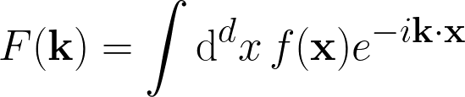
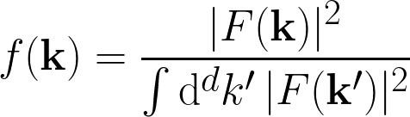

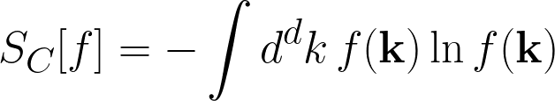

Overview and definitions
Configurational entropy:
From Gleiser and Stamatopoulos (2012), consider f(x) ∈ L²(R^{d}):
Fourier transform
Modal fraction
CE
Magnetic field model:
Following Haskell et al. (2008) → analytical solution of the hydro-magnetic equilibrium
with
M. Gleiser and N. Stamatopoulos, Phys. Lett. B, vol. 713, pp. 304-307, July 2012
B. Haskell et al., MNRAS, vol. 385, pp. 531-542, Mar. 2008

Slide 3
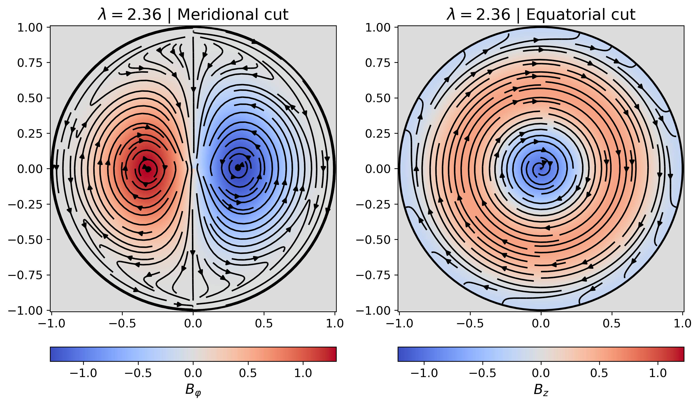
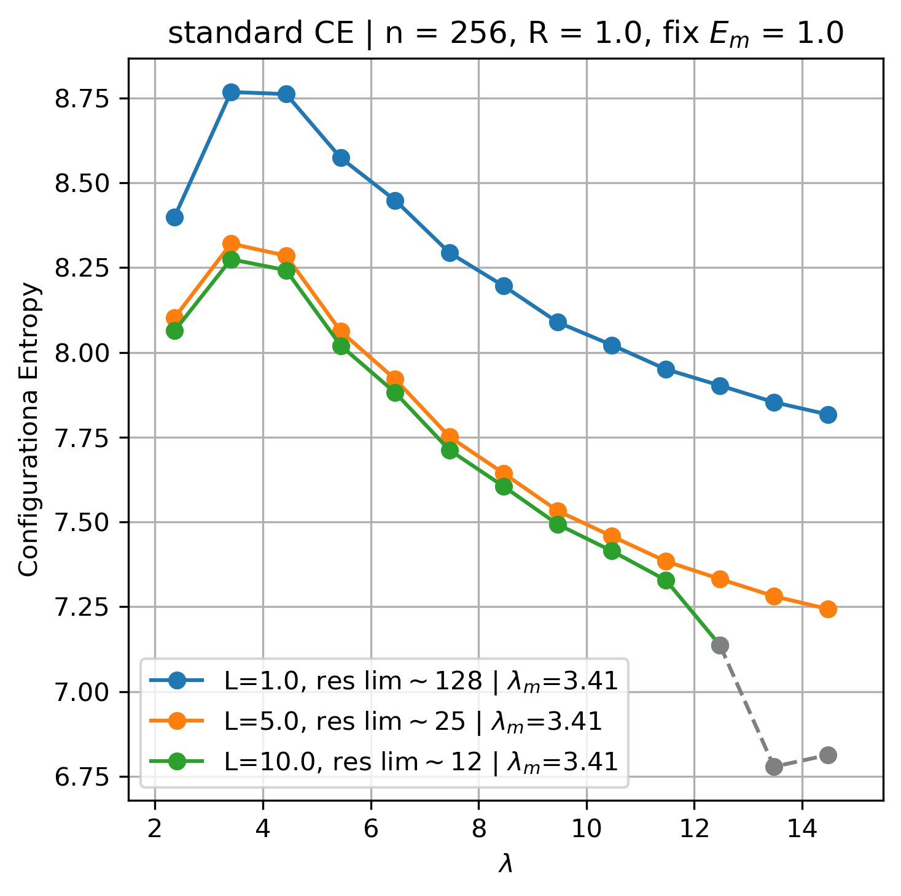
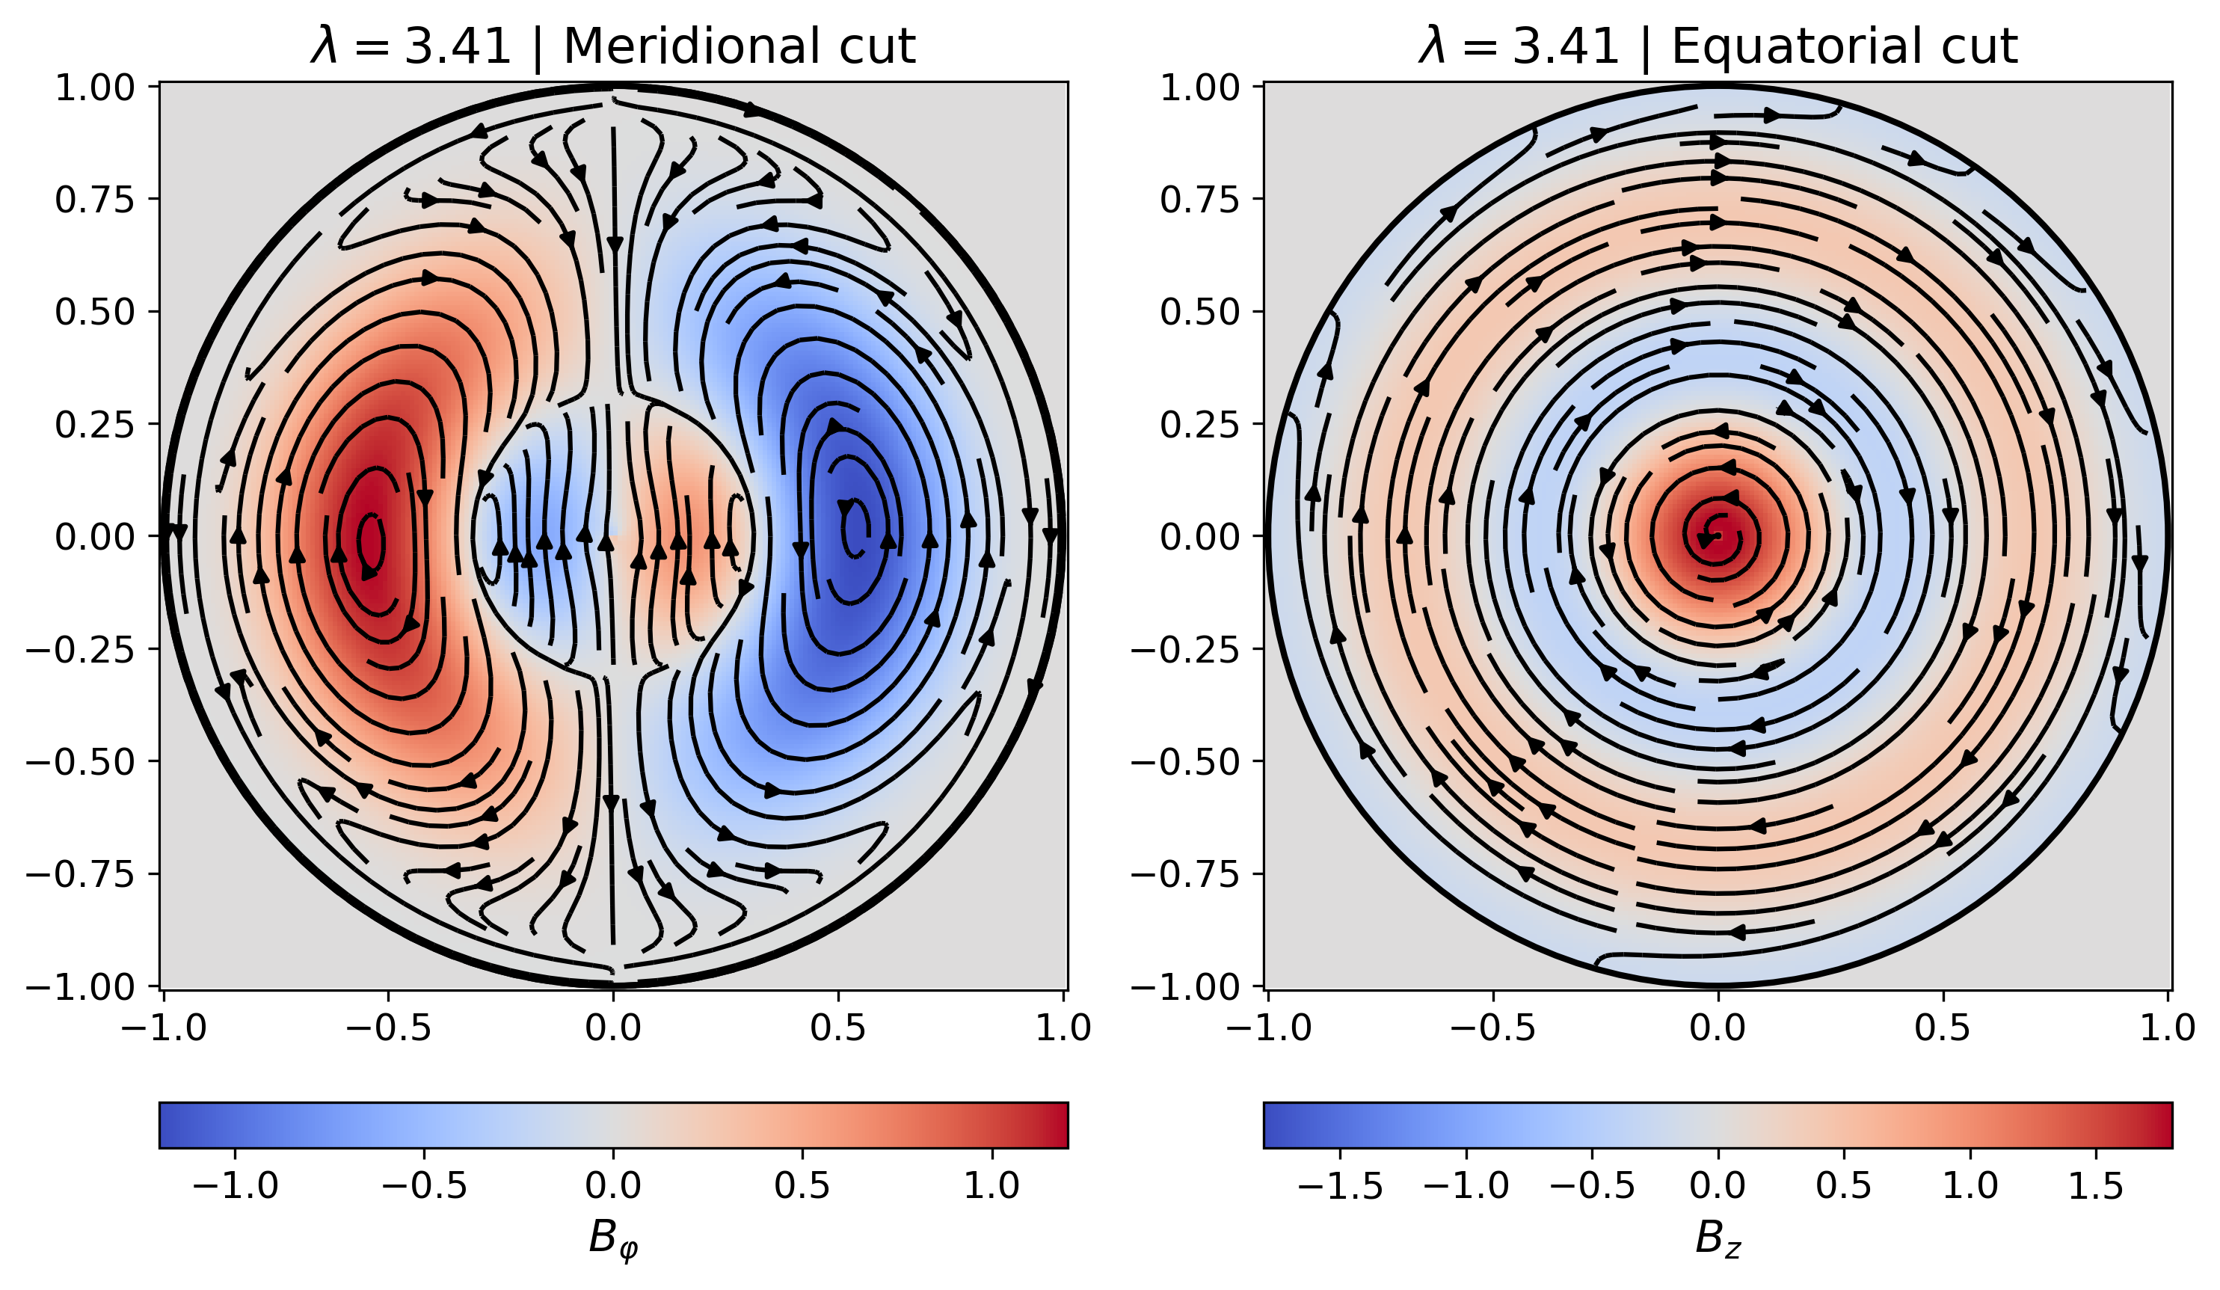


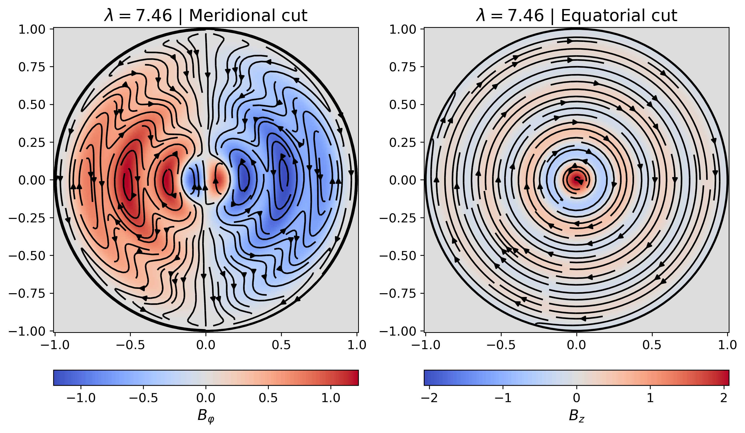
CE results

Slide 4
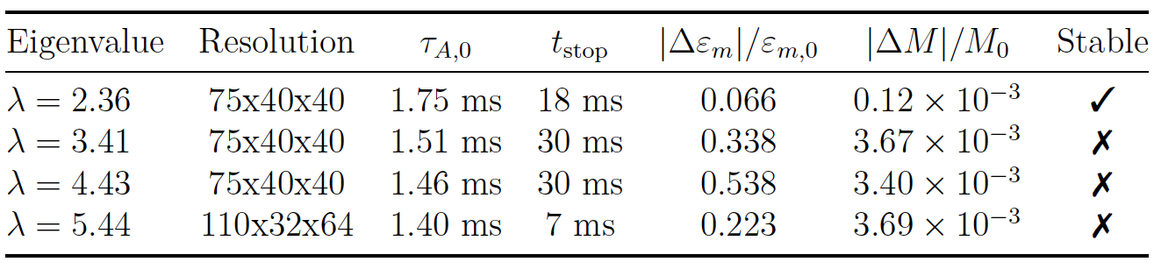
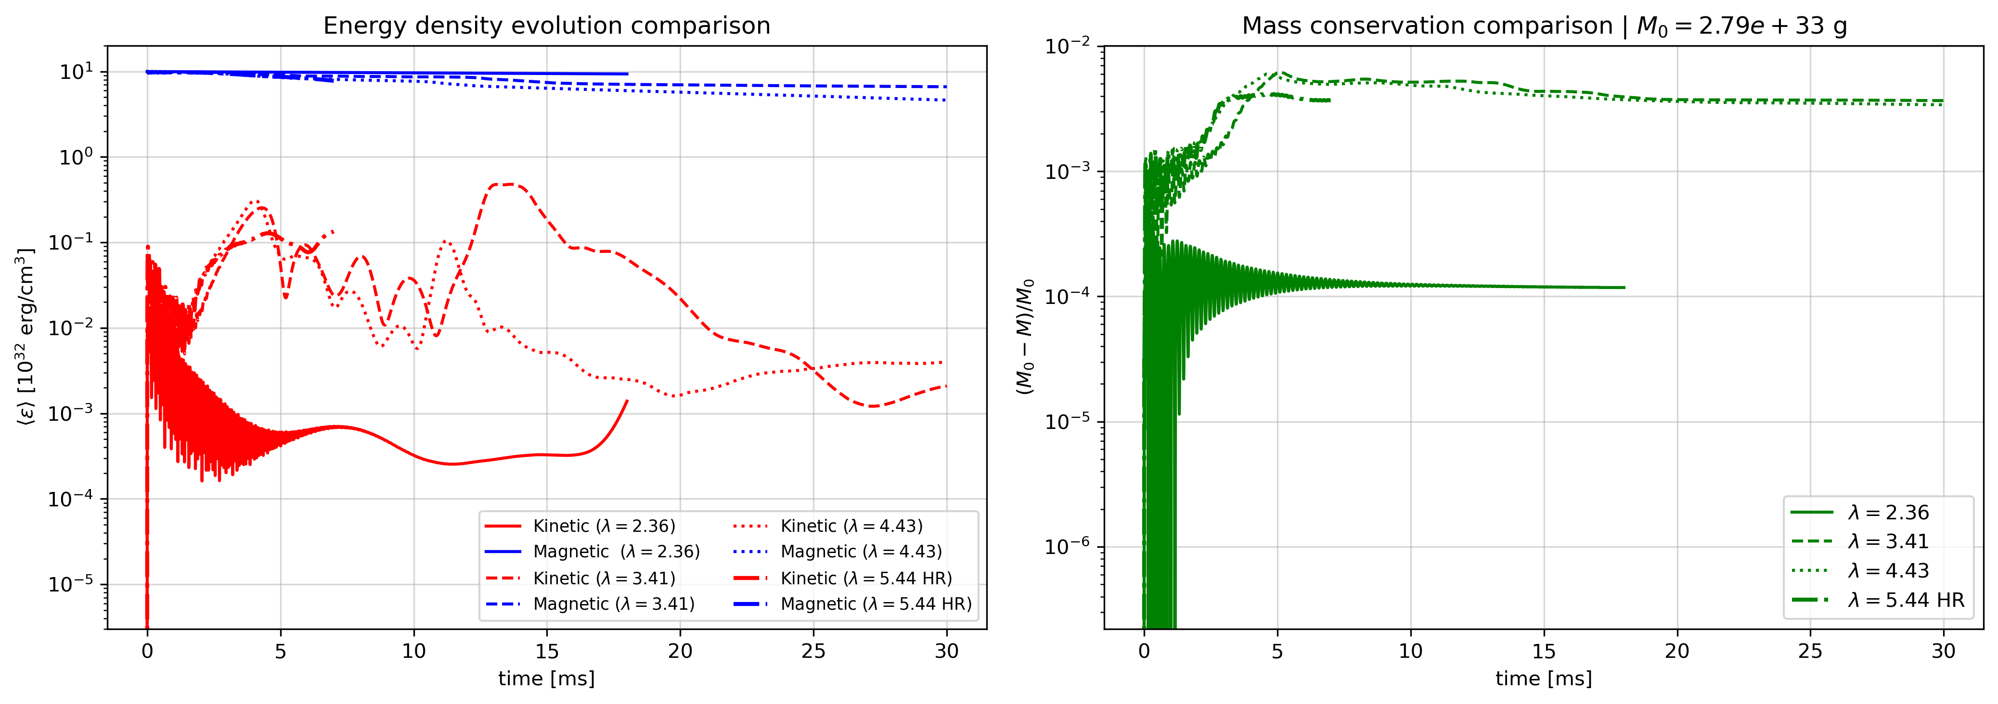
Simulations summary

Slide 5
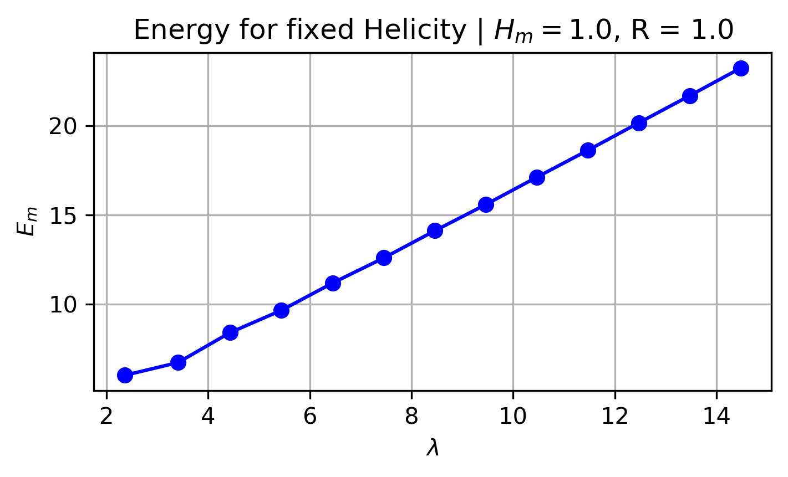

Discussion and conclusions
Consistent with Taylor relaxation:
λ = 2.36 represents this minimum energy state
CE able to capture the transition between stable and unstable configurations
useful tool to study more complex numerical models from simulations
Toroidal component of the field cannot be arbitrarily strong or complex → likely results in instabilities
of interest for CW astronomy
J. B. Taylor, Phys. Rev. Lett., vol. 33, pp. 1139-1141, Nov. 1974

