Slide 1
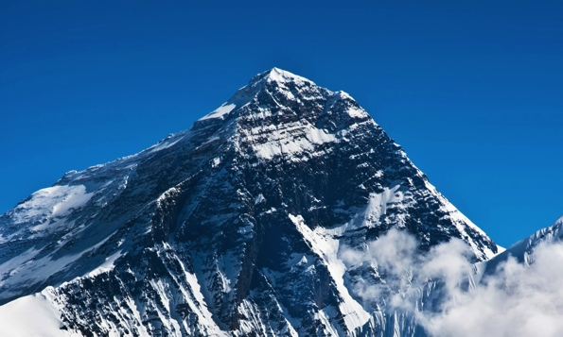
Magnus mountains
Yashaswi Gangwar & Ian Jones
University of Southampton
25th June 2026
Based on Gangwar & DIJ, in preparation

Slide 2
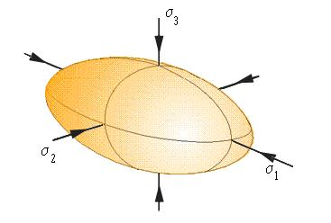
Gravitational waves from mountains
A triaxial neutron star, rotating steadily, emits gravitational waves:
Spin
frequency
Distance to
source
Dimensionless asymmetry
in moment of inertia tensor
Notes:
For Earth, epsilon approx 2 x 10^(-5).

Slide 3
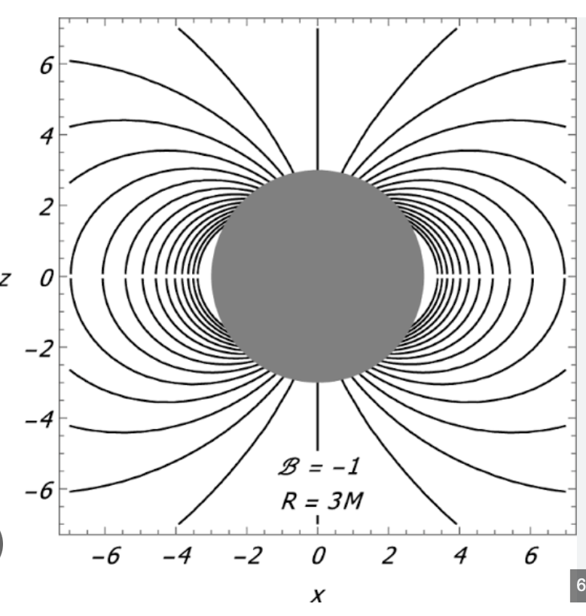
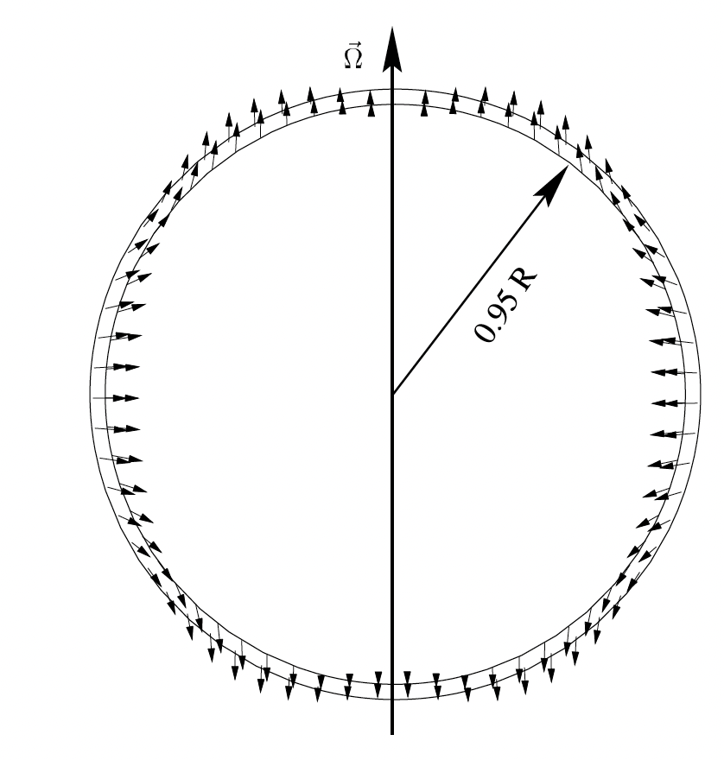

Two types of mountain
Magnetic Mountains
Elastic Mountains
Stochastic backgrounds
  Sustained by Lorentz ($\vec{j} × \overset{⃑}{B}$) forces
  Definitely exist, but likely small:
  Sustained by elastic forces in solid crust
  Size limited by strength of crust:

Slide 4
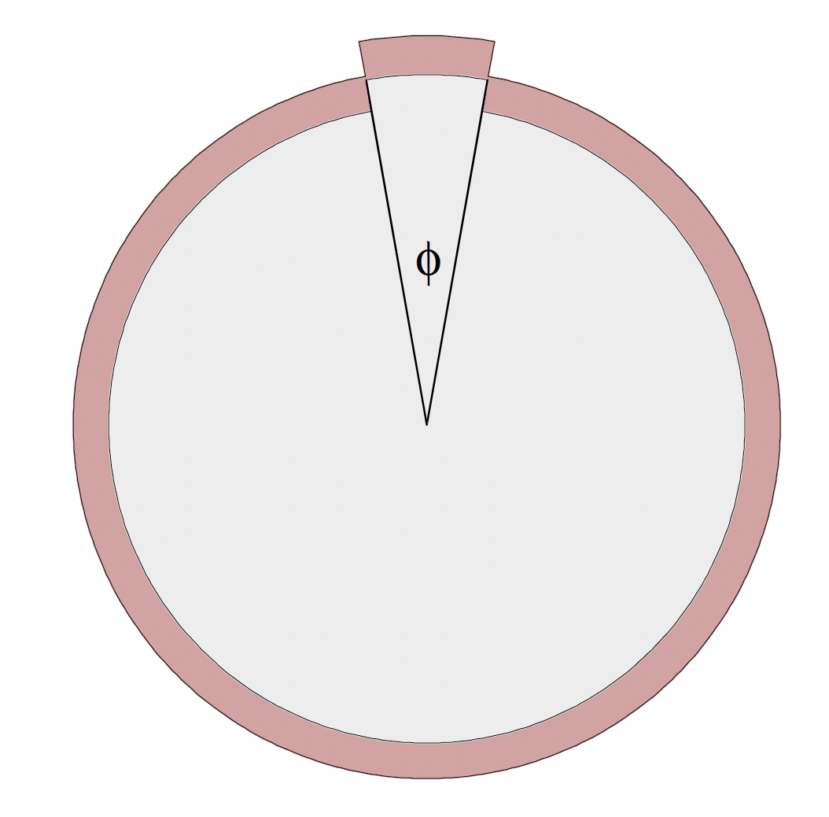
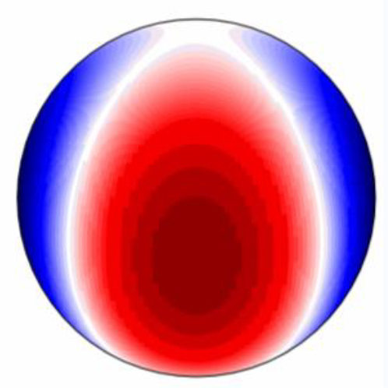
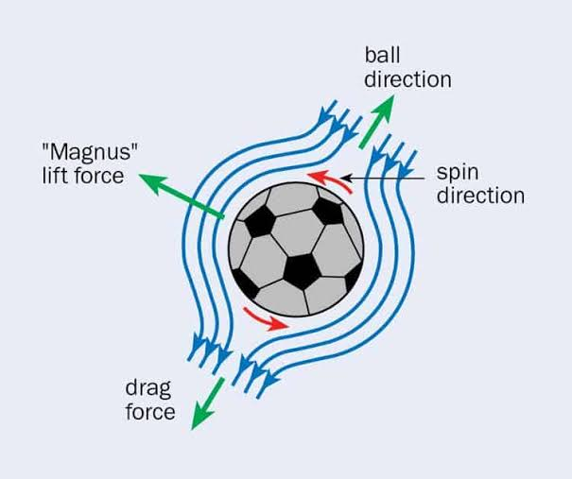
What creates an elastic mountain?
Asymmetric cracking in spinning-up or spinning-down star
Temperature asymmetries
Asymmetric Magnus forces
“Magnus mountain”
Stochastic backgrounds
Image credit Fattoyev+ (2018)
Image credit Hutchins (2023)

Slide 5
What creates an elastic mountain?
Asymmetric cracking in spinning-up or spinning-down star
Temperature asymmetries
Asymmetric Magnus forces
“Magnus mountain”
Stochastic backgrounds
Image credit Fattoyev+ (2018)
Image credit Hutchins (2023)
THIS TALK!

Slide 6
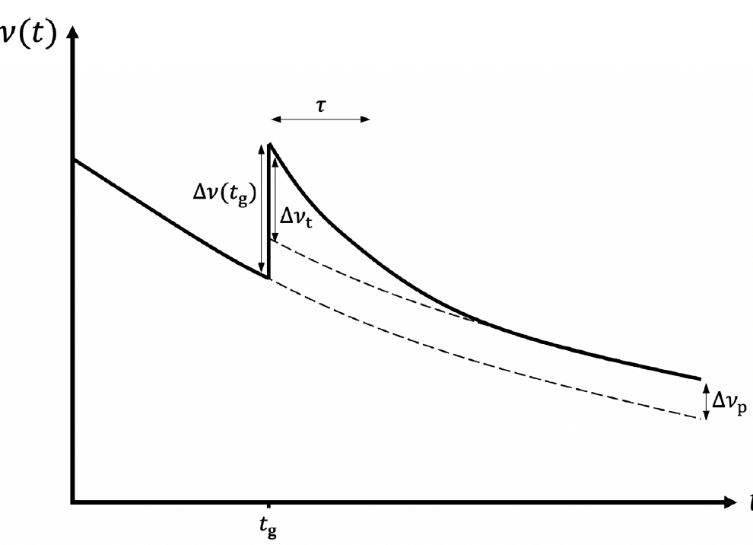
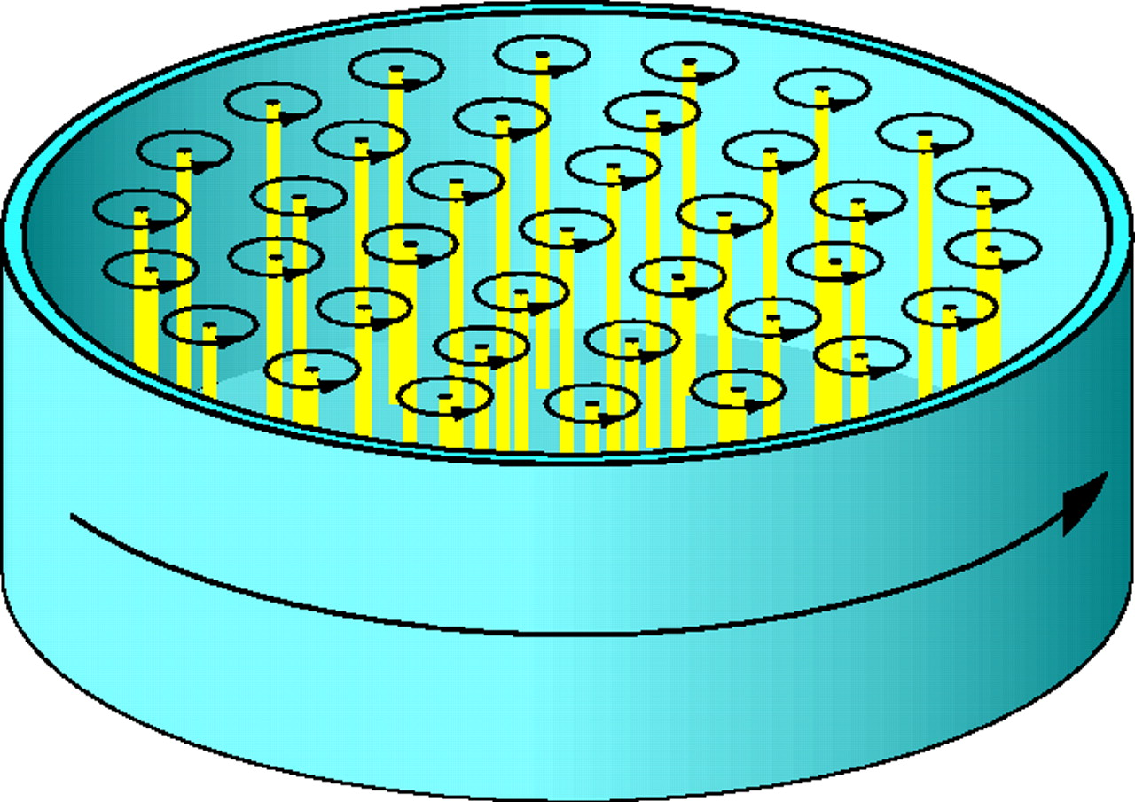
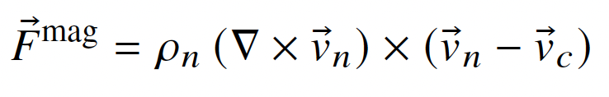
Axisymmetric pinning: pulsar glitches
Stochastic backgrounds
Velocities of both neutrons and crust assumed axisymmetric $⟹$ Magnus force axisymemtric

Slide 7
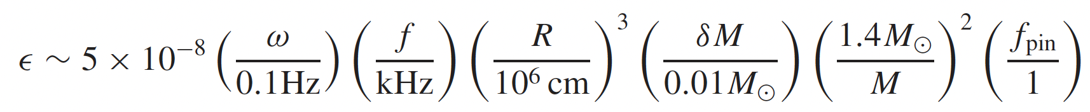
Non-axisymmetric pinning: Magnus mountains
Non-axisymmetric pinning
Non-axisymmetric Magnus force
“Magnus Mountain”
First proposed in DIJ (2002), with back-of-the-envelope estimate based on
pinning in the inner crust:
Stochastic backgrounds

Slide 8
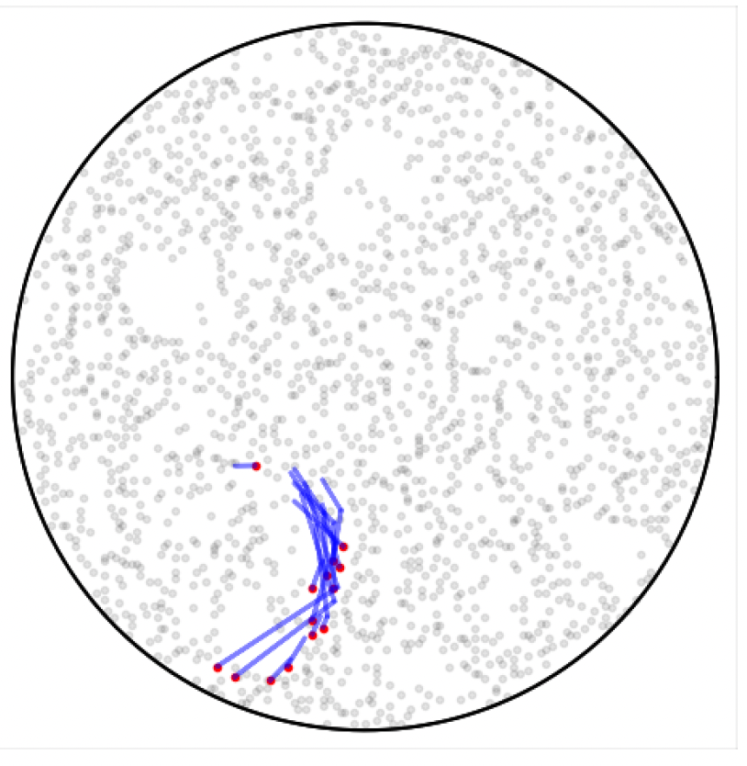
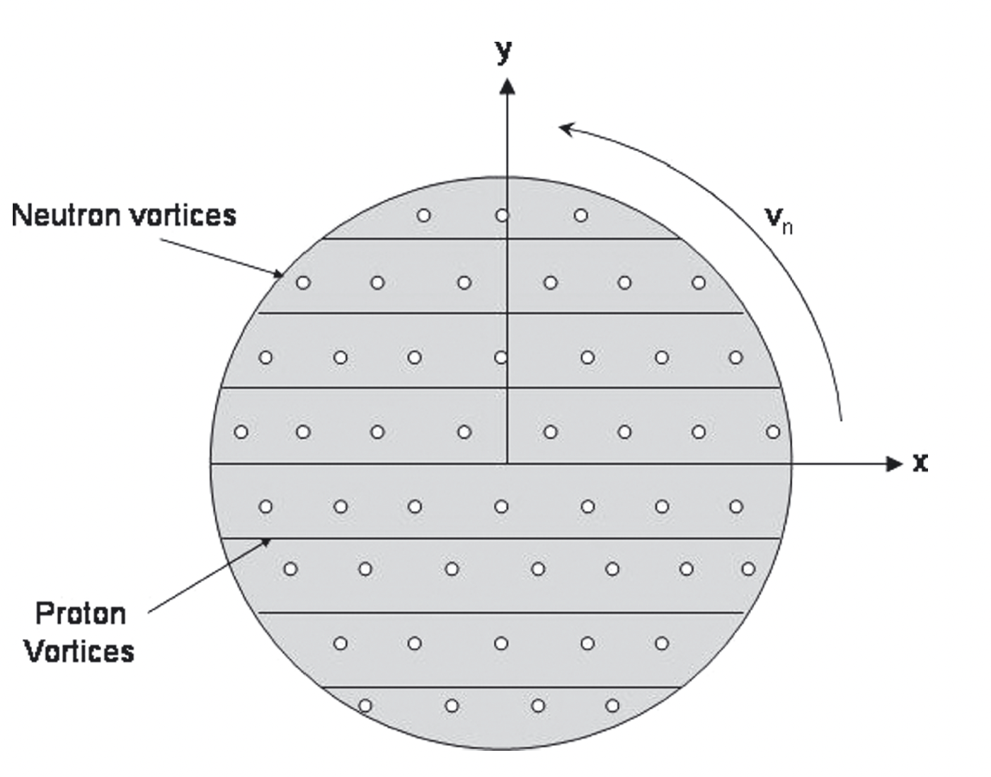
Why would the pinning be non-axisymmetric?
Asymmetric unpinning/re-pinning at glitches,
e.g. Cheunchitra+ (2024):
Asymmetric interaction between
vortices and magnetic fluxtubes,
e.g. Sidery & Alpar (2009):
Stochastic backgrounds

Slide 9
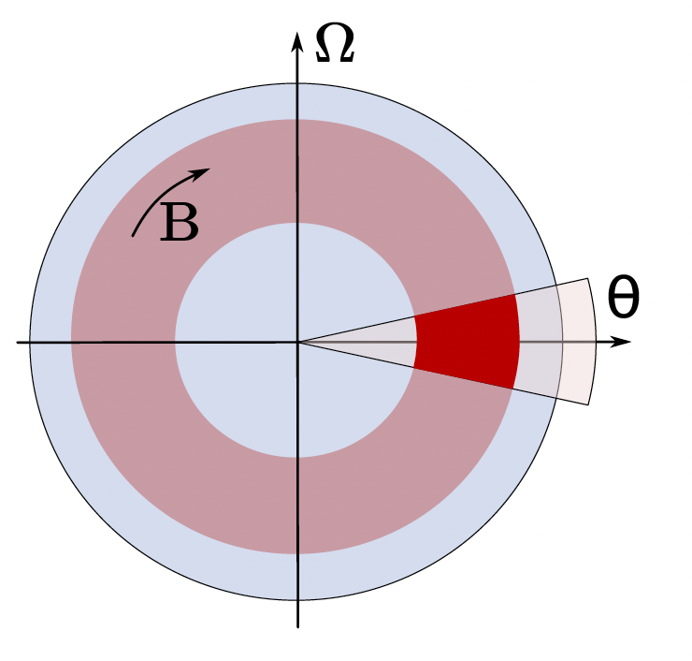
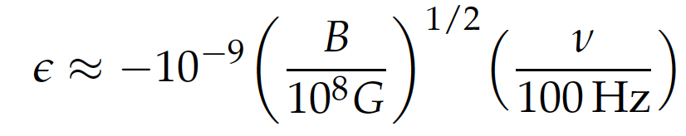
State-of-the-art: Haskell+ (2022)
Haskell, Antonelli & Pizzochero (2022)
considered a spherical incompressible star.
Assumed perfect pinning in two
diametrically opposed regions.
Found mass and mass-current quadrupoles
were zero, but nevertheless used pressure
perturbation to estimate:
Stochastic backgrounds

Slide 10
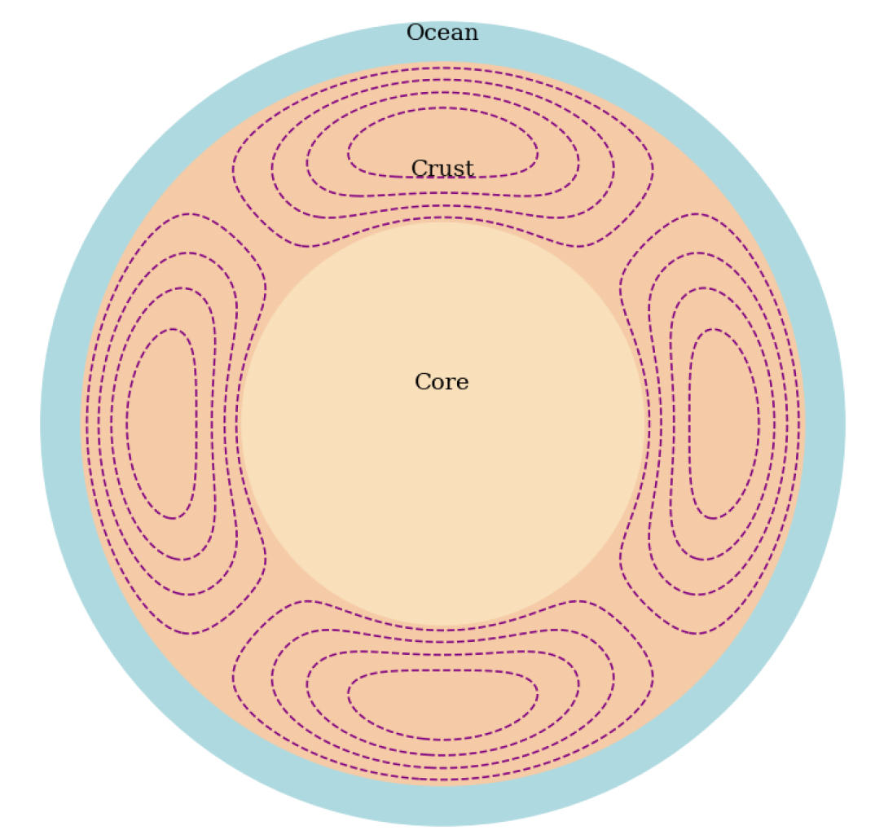
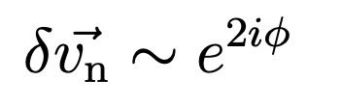
Going further: Yashaswi Gangwar’s PhD
Modelled two-component compressible
self-gravitating rotating cylinder.
Outer part of proton fluid has non-zero
shear modulus (i.e. the crust).
By hand, added a velocity perturbation
to the neutron superfluid:
Find unexpected cancellation, no
mass-current quadrupole.
Stochastic backgrounds

Slide 11

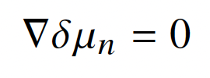

Balancing the forces on the neutron fluid
For the superfluid neutrons:
Find Coriolis force exactly balances Magnus force, leaving
Stochastic backgrounds
$⇒$ no density perturbation in the neutron fluid
$⇒$ no mass quadrupole from neutron superfluid

Slide 12
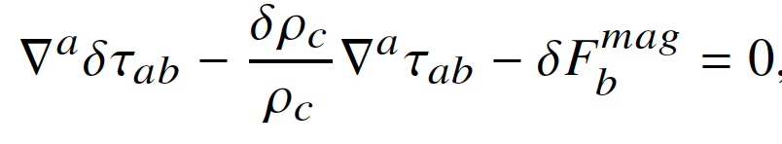
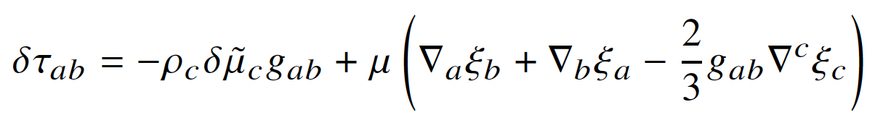


Balancing the forces on the crust
For the crust:
where $τ_{ab}$ is the stress tensor, so that
Stochastic backgrounds
We solved numerically to obtain the density perturbation $δρ_{c}$ and
the crustal displacement $\vec{ξ}$.

Slide 13
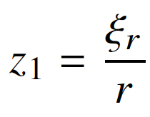
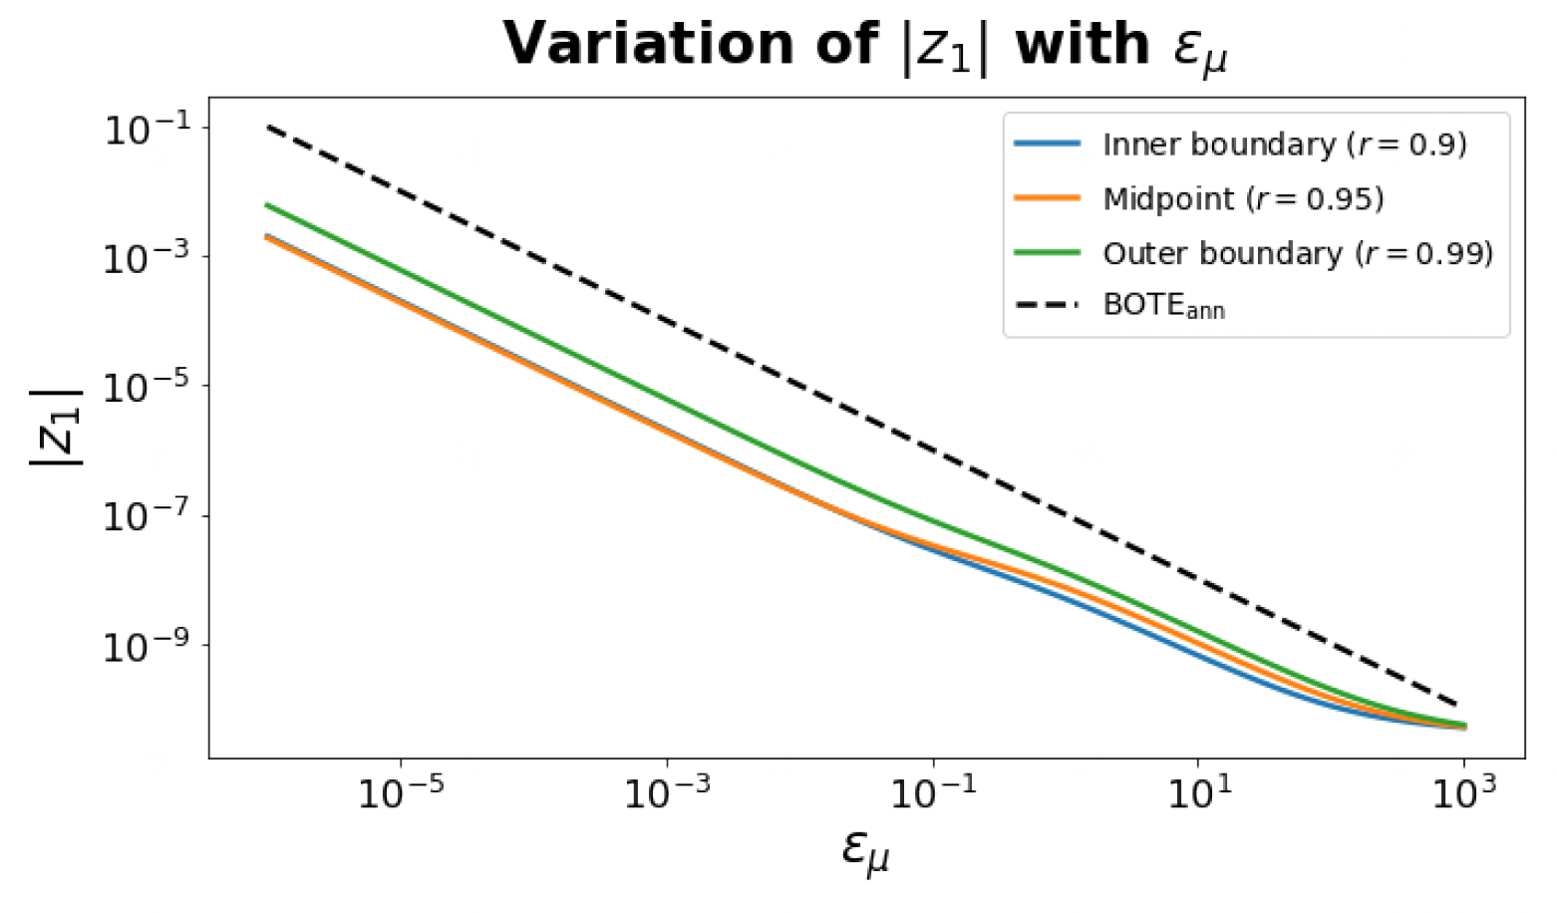
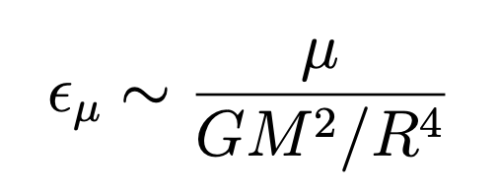

Results: varying the crust’s shear modulus
Stochastic backgrounds
Chose $δv_{n} \sim {10}^{4}$ cm/s , based on Seveso+ (2015)
Stiffer crusts lead to smaller mountains, as expected.

Slide 14
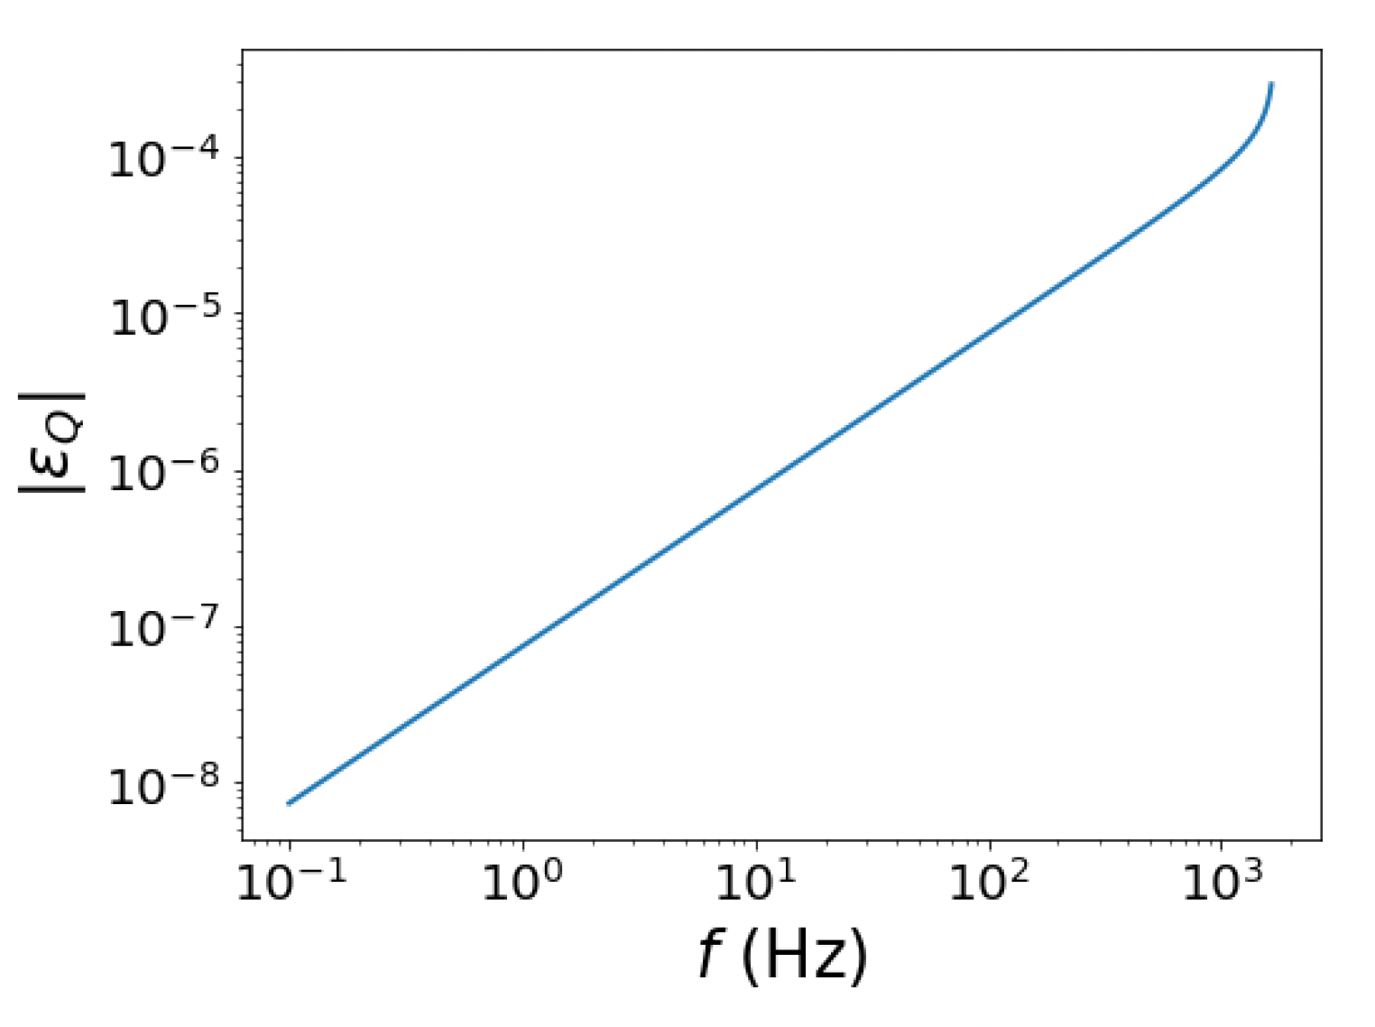


Main result: the ellipticity
Plot has:
$$ε_{μ}= {10}^{−5}$$
$δv_{n} \sim {10}^{4}$ cm/s
Stochastic backgrounds
Ellipticity approximately linear in spin frequency, as expected.
Reaches $ε_{Q} \sim {10}^{−5}$ for fast (cylindrical!) stars.

Slide 15
Summary
Calculations so far highly idealized.
Areas for improvement include:
  Spherical geometry with compressible fluids
  First-principles calculation of vortex asymmetry
  Proper 3-d vortex model, allowing for bending
  Calculation in general relativity
  Use of realistic equations of state
Magnus mountains promising in terms of gravitational wave emission
Stochastic backgrounds

