Slide 1



Investigating the nuclear matter equation of state with neutron stars
Melissa Mendes
TU Darmstadt
SCALES 1st General Meeting | M Mendes

Slide 2
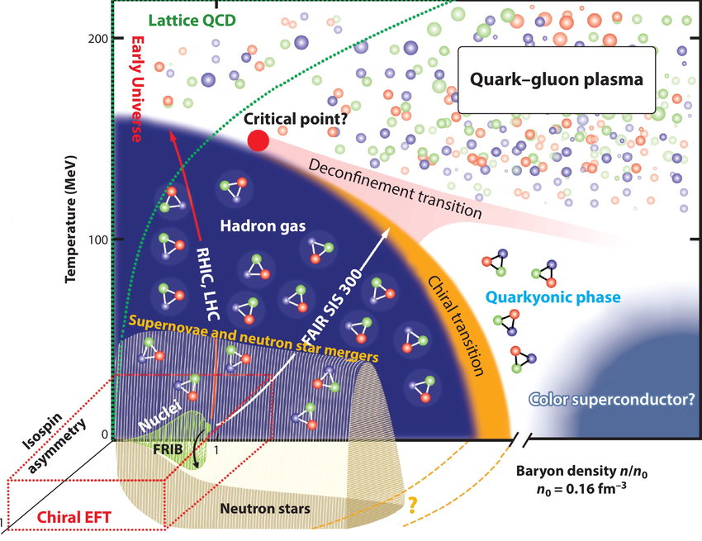
QCD phase diagram
Neutron stars are interesting systems to investigate the nuclear matter equation of state
Including nuclear pairing and its potentially observable astro signatures
Figure from Drischler et al, Annu. Rev. Nucl. Part. Sci. (2021), arxiv:2101.01709
SCALES 1st General Meeting | M Mendes

Slide 3
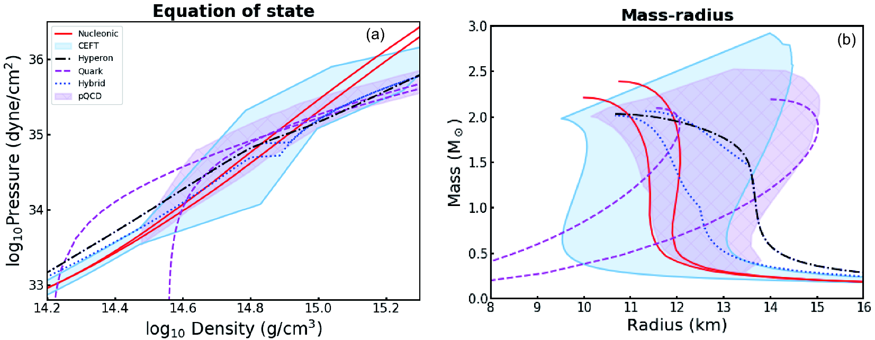
Constraining equation of state (EOS) with NS observables
Mass-radius observations can constrain the nuclear matter EOS (in beta-equilibrium)
Figure from Watts et al, Sci China Phys Mech Astron(2019), arxiv:1812.04021
See also Margueron et al (2025), arxiv: 2506.20434
and Semposki et al (2025), arxiv: 2505.18921
SCALES 1st General Meeting | M Mendes

Slide 4
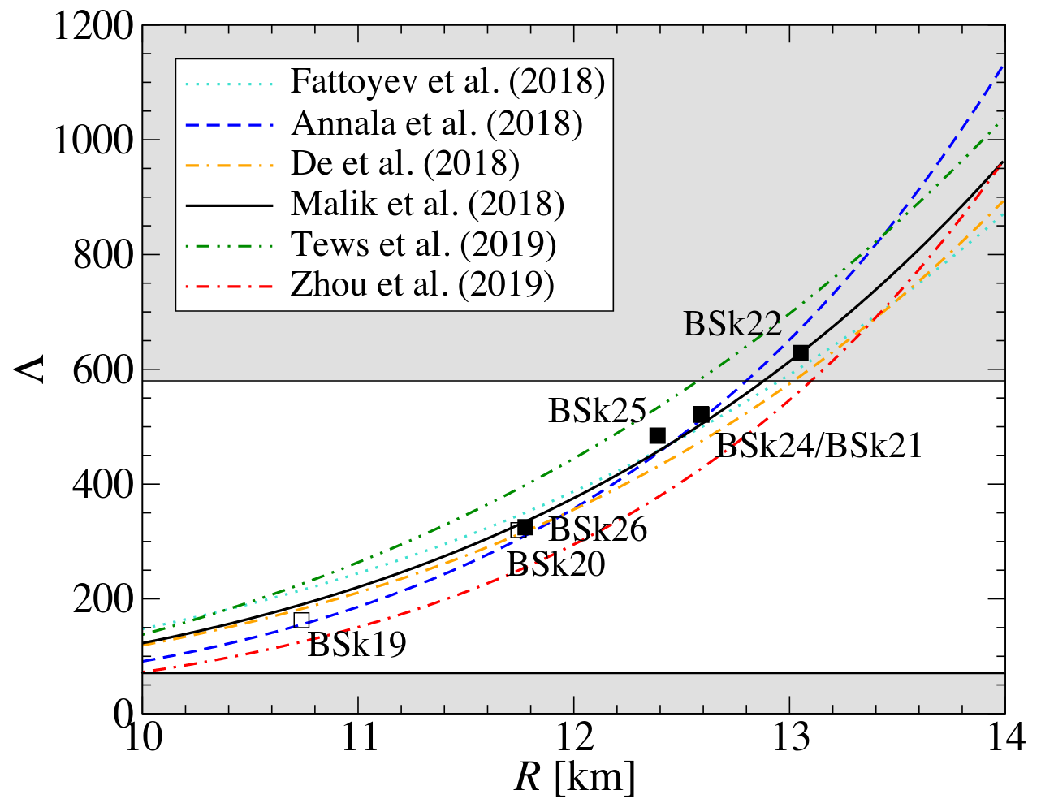
Constraining equation of state (EOS) with NS observables
Tidal deformability -mass-radius observations can constrain the nuclear matter EOS (in beta-equilibrium)
Modified figure from Watts et al, Science China Physics, Mechanics & Astronomy (2019), arxiv:1812.04021;
Perot et al, Phys. Rev. C (2019), arxiv: 1910.13202
See also Margueron et al (2025), arxiv: 2506.20434
and Semposki et al (2025), arxiv: 2505.18921
SCALES 1st General Meeting | M Mendes

Slide 5

Outline
  EOS information from luminosity observations
  (Very brief) primer on observational techniques
  Recent χEFT and perturbative quantum chromodynamic (pQCD) calculations
  Bayesian framework and EOS construction
  Implications for dense matter EOS and inference of EOS parameters
}
Based on: MM, HG et al, 2026 (Submitted to ApJ), arxiv: 2605.18560
Raaijmakers, …, MM, … et al, 2025 (JOSS), https://doi.org/10.21105/joss.06003
Mauviard, …, MM, … et al, 2025 (ApJ), arxiv: 2506.14883
Rutherford, MM, Svensson et al, 2024 (ApJL), arxiv: 2407.06790
MM et al, 2024 (PRD), arxiv: 2408.05287
MM et al, 2022 (ApJ), arxiv: 2208.04262
NEoST
SCALES 1st General Meeting | M Mendes

Slide 6
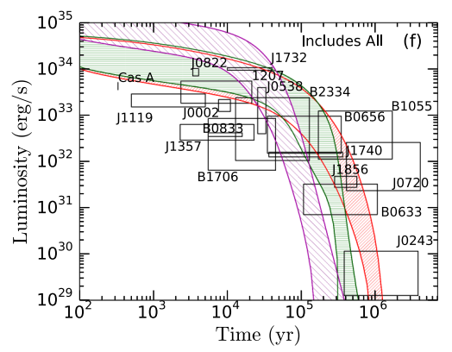
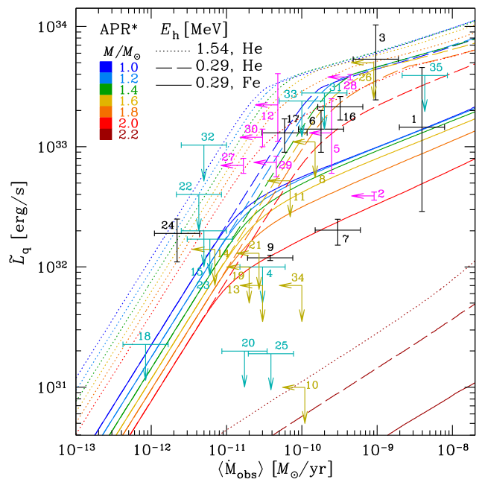
NS luminosities
See also Jain et al, PRL (2025) and Ong et al, PRC (2024)
Isolated neutron stars
Transiently-accreting neutron stars
Figure from Beloin et al, 2018 (PRC), arxiv:1612.04289
Figure from Potekhin et al, 2023 (MNRAS), arxiv:2303.08716
SCALES 1st General Meeting | M Mendes

Slide 7
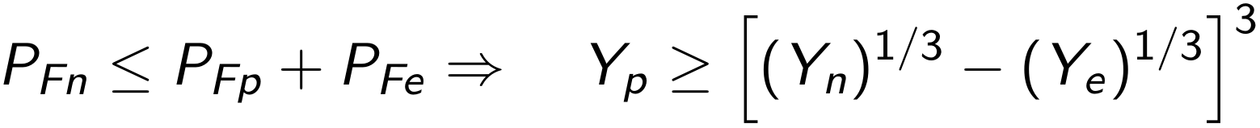
NS cooling primer
Neutron stars cool by the emission of photons and neutrinos, in reactions like β-decay and e- capture:
which only happen when energy and momentum are conserved, that is,
direct Urca (dUrca) threshold
Overall, luminosity data can constrain microphysical EOS ingredients (Y_{p}, effective nuclear masses, nuclear pairing, etc) through thresholds and emissivities
See also C. Dehman’s talk
for details on how magnetic fields also play an important role
SCALES 1st General Meeting | M Mendes

Slide 8
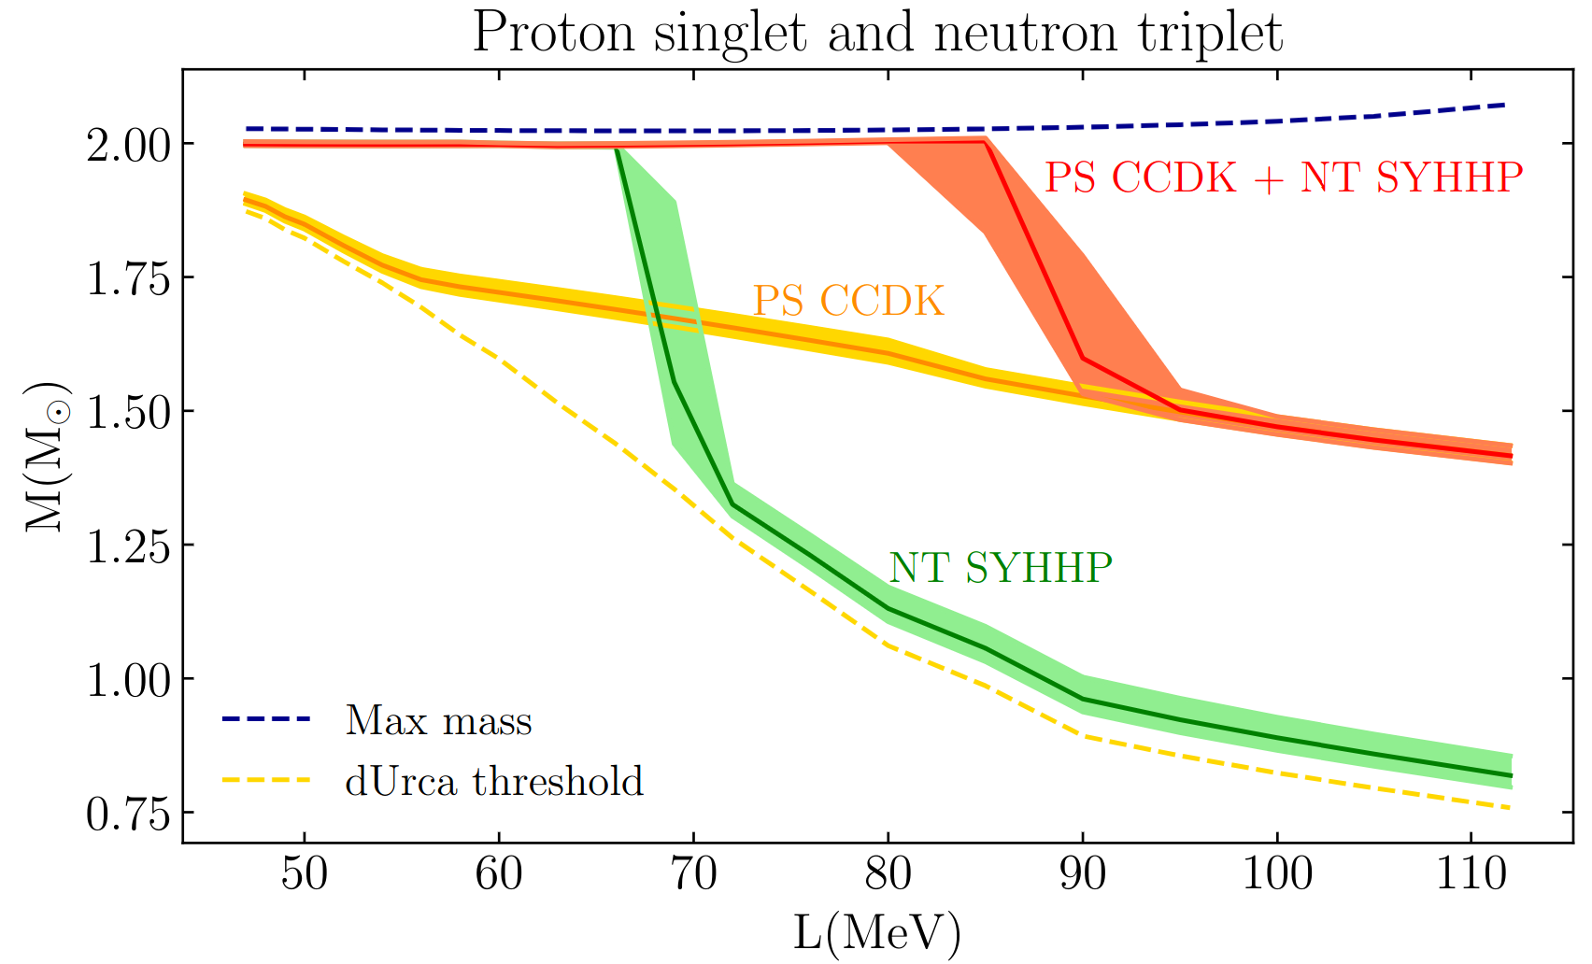
For example
NS luminosity data and cooling simulations can eliminate EOS as viable candidates
but results are very model-dependent
Figure from MM et al, 2022 (ApJ), arxiv: 2208.04262
excluded
SCALES 1st General Meeting | M Mendes

Slide 9
Outline
  EOS information from luminosity observations
  (Very brief) primer on observational techniques
  Recent χEFT and perturbative quantum chromodynamic (pQCD) calculations
  Bayesian framework and EOS construction
  Implications for dense matter EOS and inference of EOS parameters
}
Based on: MM, HG et al, 2026 (Submitted to ApJ), arxiv: 2605.18560
Raaijmakers, …, MM, … et al, 2025 (JOSS), https://doi.org/10.21105/joss.06003
Mauviard, …, MM, … et al, 2025 (ApJ), arxiv: 2506.14883
Rutherford, MM, Svensson et al, 2024 (ApJL), arxiv: 2407.06790
MM et al, 2024 (PRD), arxiv: 2408.05287
MM et al, 2022 (ApJ), arxiv: 2208.04262
NEoST
SCALES 1st General Meeting | M Mendes

Slide 10
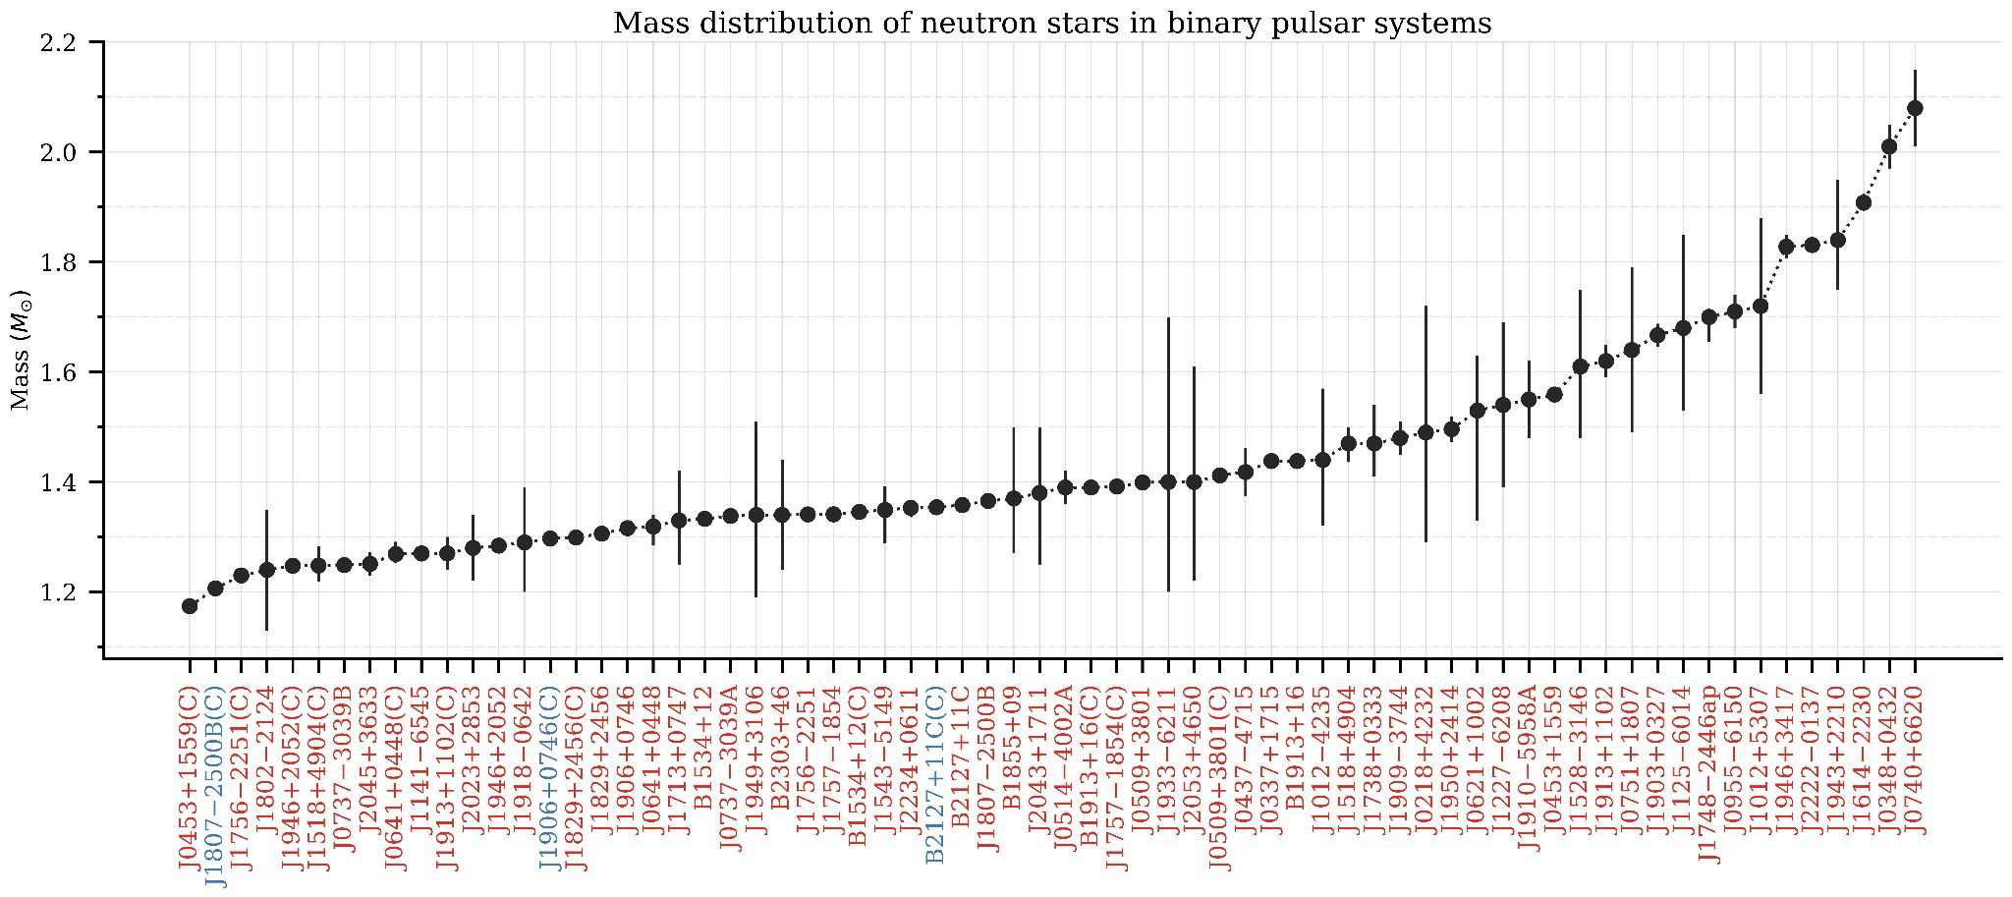
Chandra and XMM
Have been fundamental in measuring NS masses, especially of rotation-powered pulsars
Figure from https://www3.mpifr-bonn.mpg.de/staff/pfreire/NS_masses.html
SCALES 1st General Meeting | M Mendes

Slide 11
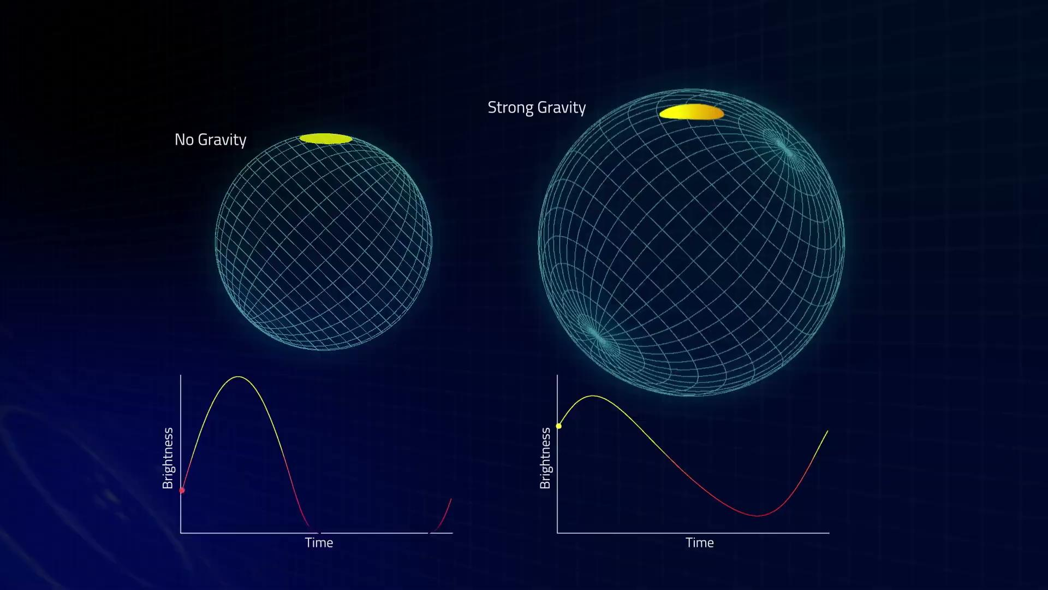
Pulse profile modeling - NICER
Proportional effect to the stars’ compactness (M/R)
Simultaneous constraint on neutron star mass and radius
But non-trivial hot-spot modelling
Animation from https://svs.gsfc.nasa.gov/vis/a020000/a020200/a020268/Lensing.1080.mp4
SCALES 1st General Meeting | M Mendes

Slide 12
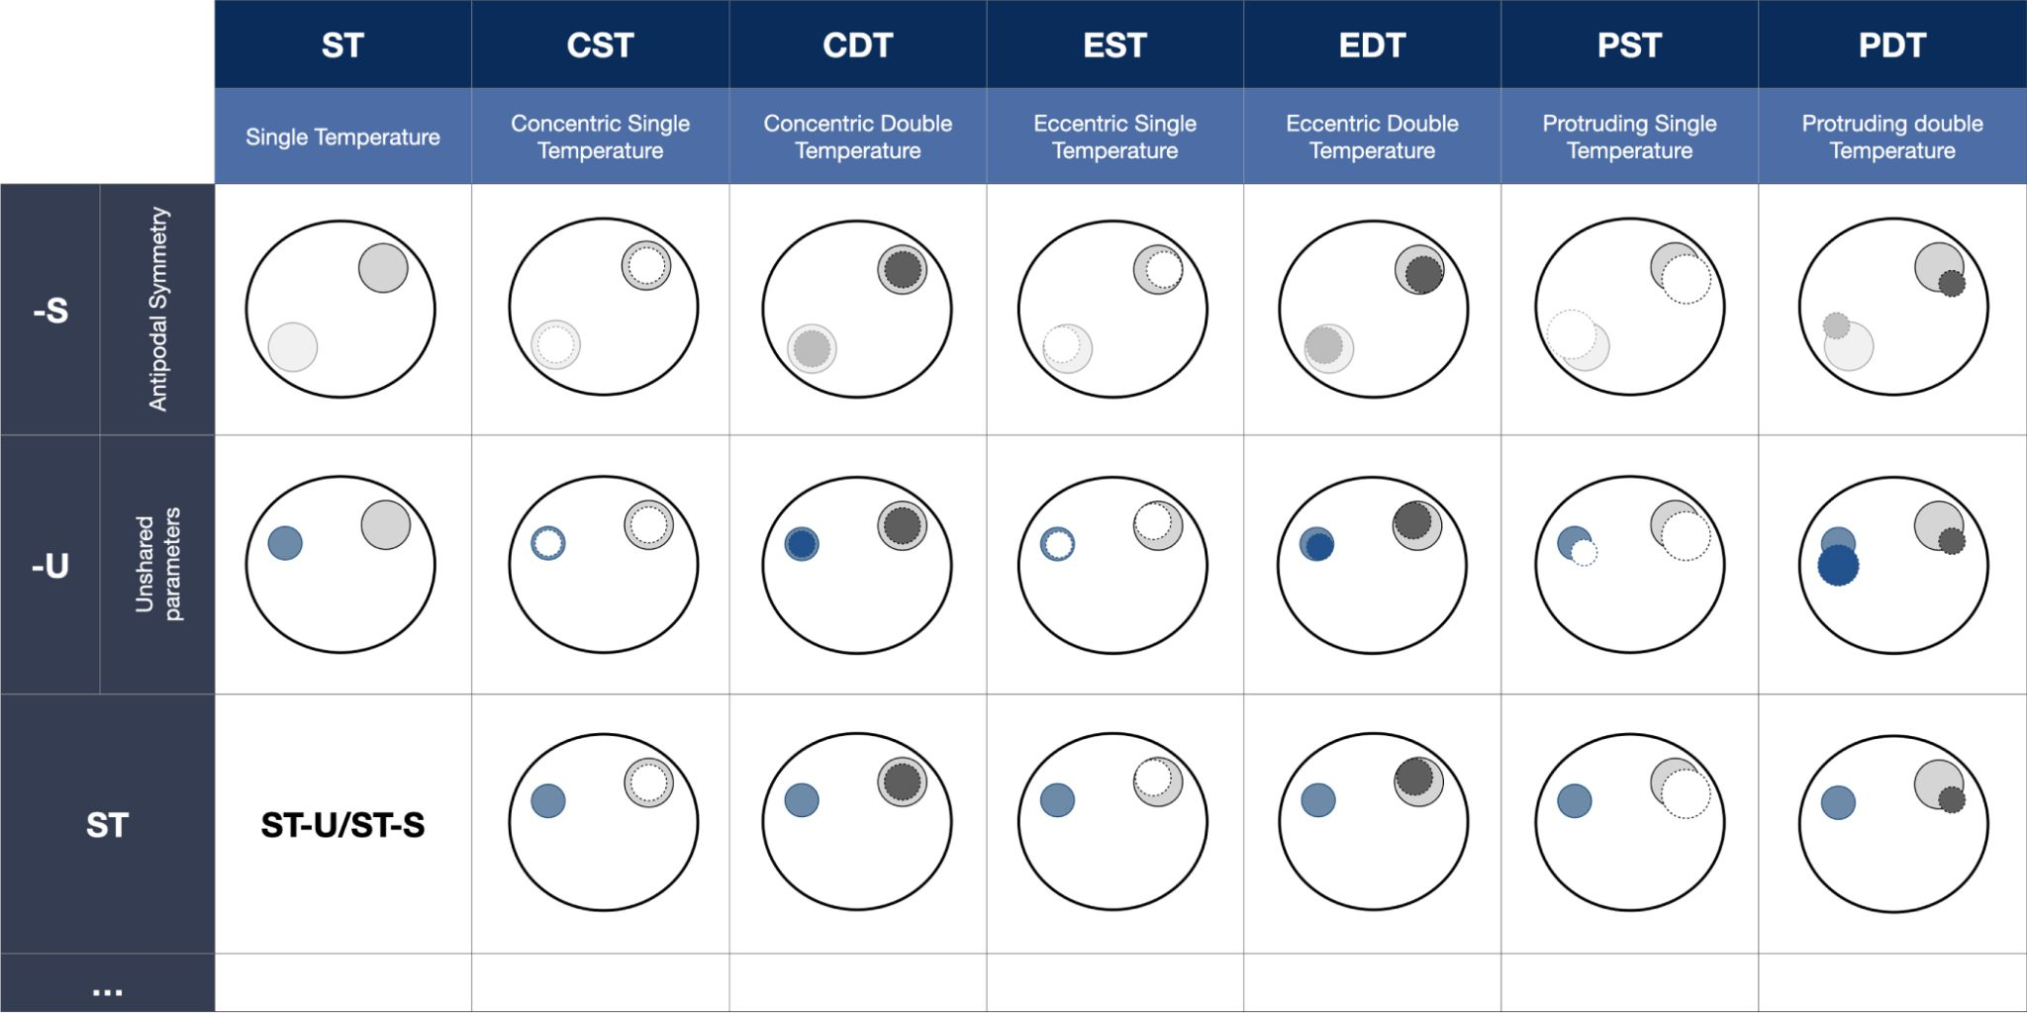
Non-trivial hot-spot modeling
Large number of parameters needed to describe hot spots
Hot spots for rotation-powered pulsars as result of magnetic field configuration
Figure from Vinciguerra et al, APJ (2023), arxiv:2308.08409
SCALES 1st General Meeting | M Mendes

Slide 13
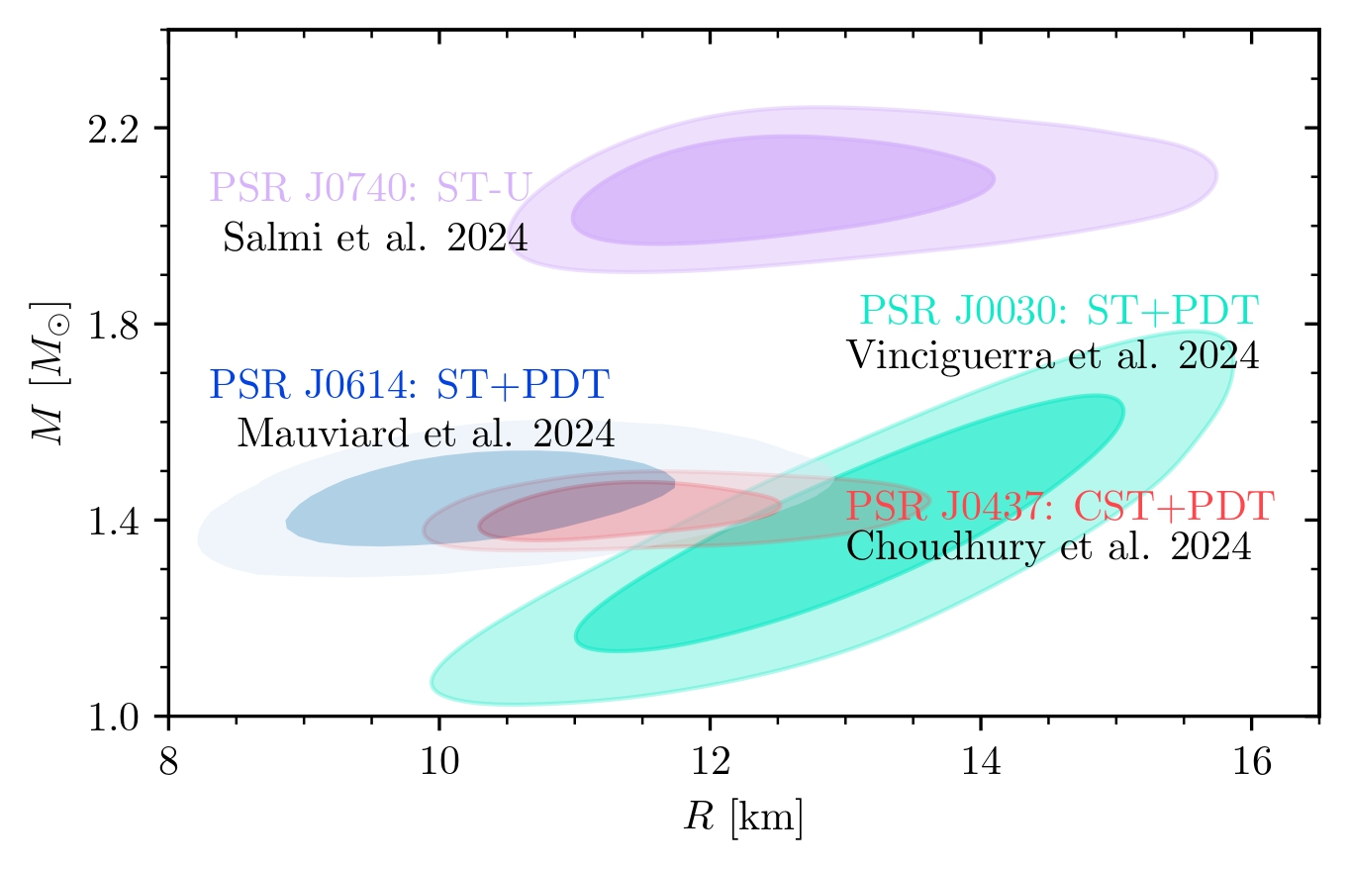
Recent data from NICER
Already including mass constraints from radio observations and background constraints (when available)
Modified figure from Mauviard, …, MM, … et al, ApJ (2025), arxiv: 2506.14883
SCALES 1st General Meeting | M Mendes

Slide 14
Outline
  EOS information from luminosity observations
  (Very brief) primer on observational techniques
  Recent χEFT and perturbative quantum chromodynamic (pQCD) calculations
  Bayesian framework and EOS construction
  Implications for dense matter EOS and inference of EOS parameters
}
Based on: MM, HG et al, 2026 (Submitted to ApJ), arxiv: 2605.18560
Raaijmakers, …, MM, … et al, 2025 (JOSS), https://doi.org/10.21105/joss.06003
Mauviard, …, MM, … et al, 2025 (ApJ), arxiv: 2506.14883
Rutherford, MM, Svensson et al, 2024 (ApJL), arxiv: 2407.06790
MM et al, 2024 (PRD), arxiv: 2408.05287
MM et al, 2022 (ApJ), arxiv: 2208.04262
NEoST
SCALES 1st General Meeting | M Mendes

Slide 15
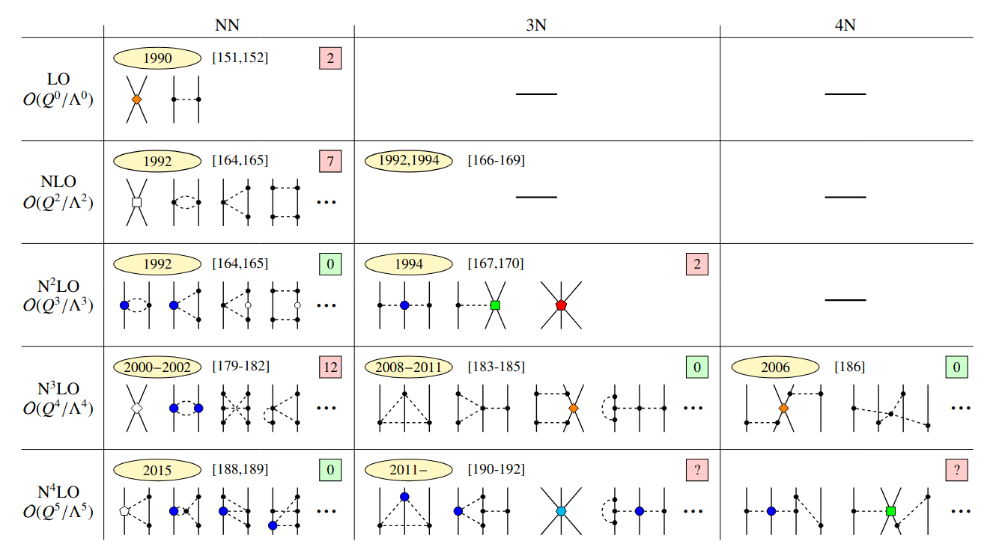
Chiral effective field theory
Ab initio calculations can determine the EOS at low densities
Figure from Hebeler, Phys.Rept. (2021), arxiv:2002.09548
SCALES 1st General Meeting | M Mendes
Notes:
densidade de saturação=

Slide 16
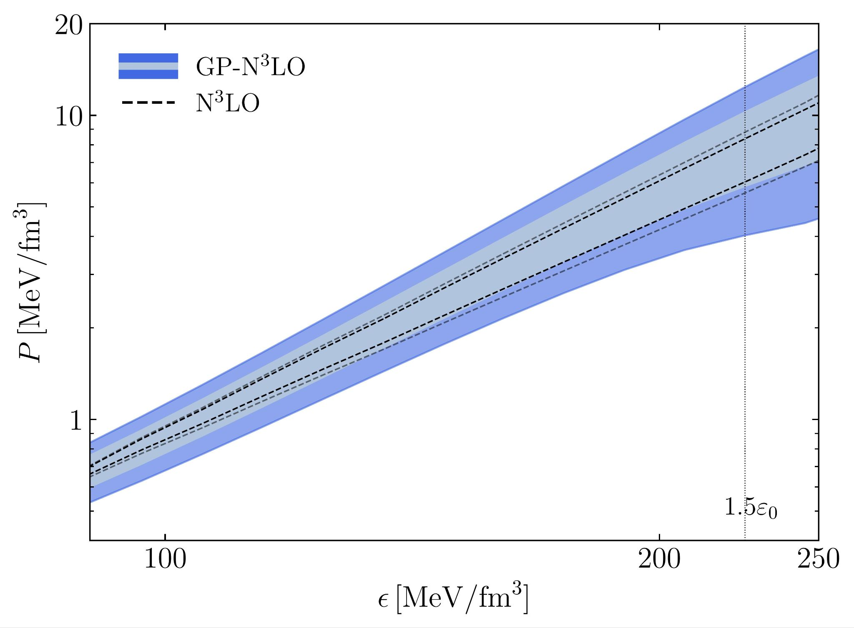
Recent χEFT EOS implementation
Broader pressure range covered with χEFT EOS with uncertainty quantification (GP-N³LO)
Modified figure from MM, HG et al, 2026 (Submitted to ApJ), arxiv: 2605.18560
SCALES 1st General Meeting | M Mendes

Slide 17
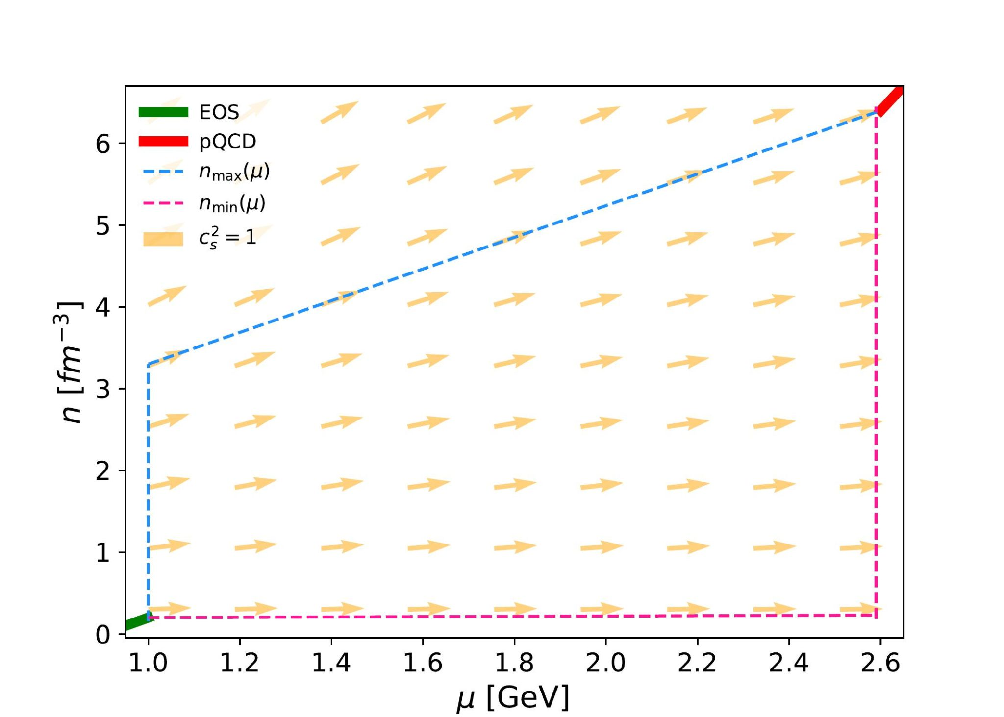
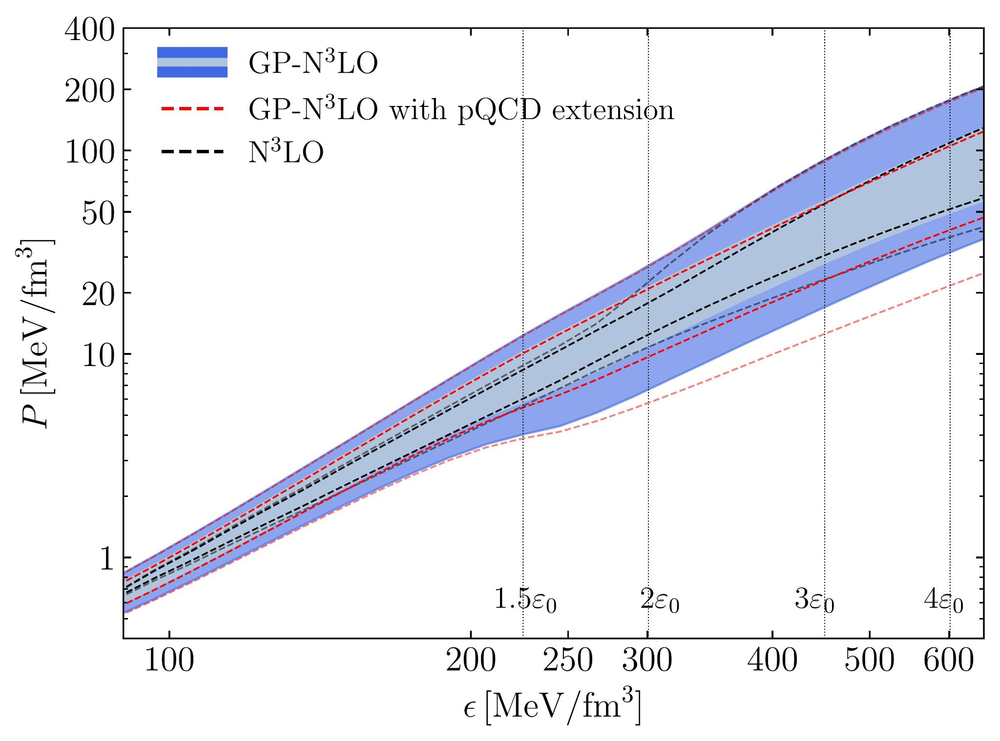
pQCD implementation
Extension procedure built by A. Hensel
EOS extensions built to respect pQCD constraints
Further expands prior space, especially at high densities
Modified figure from Komoltsev and Kurkela, PRL (2022), arxiv:2111.05350
Modified figure from MM, HG et al, 2026 (Submitted to ApJ), arxiv: 2605.18560
SCALES 1st General Meeting | M Mendes

Slide 18
Outline
  EOS information from luminosity observations
  (Very brief) primer on observational techniques
  Recent χEFT and perturbative quantum chromodynamic (pQCD) calculations
  Bayesian framework and EOS construction
  Implications for dense matter EOS and inference of EOS parameters
}
Based on: MM, HG et al, 2026 (Submitted to ApJ), arxiv: 2605.18560
Raaijmakers, …, MM, … et al, 2025 (JOSS), https://doi.org/10.21105/joss.06003
Mauviard, …, MM, … et al, 2025 (ApJ), arxiv: 2506.14883
Rutherford, MM, Svensson et al, 2024 (ApJL), arxiv: 2407.06790
MM et al, 2024 (PRD), arxiv: 2408.05287
MM et al, 2022 (ApJ), arxiv: 2208.04262
NEoST
SCALES 1st General Meeting | M Mendes

Slide 19
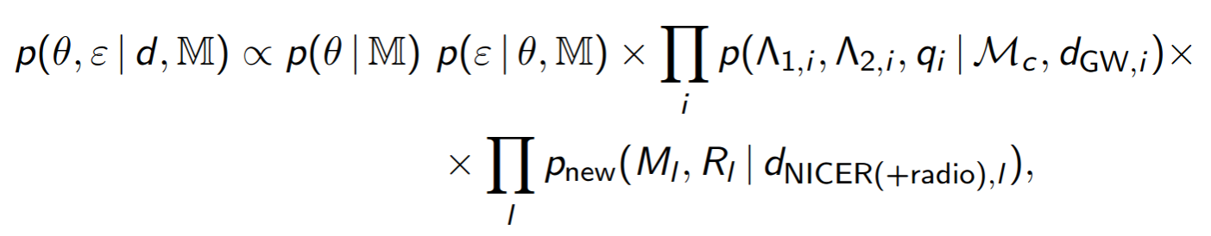
Bayesian framework
Following previous works, (Raaijmakers et al, 2020; 2019), posterior distributions of all EOS parameters (θ) and central energy density (ε):
with radio mass measurements included through NICER M-R likelihoods when available
See NEoST: https://xpsi-group.github.io/neost/overview.html
Posterior
Prior
NEoST
SCALES 1st General Meeting | M Mendes

Slide 20
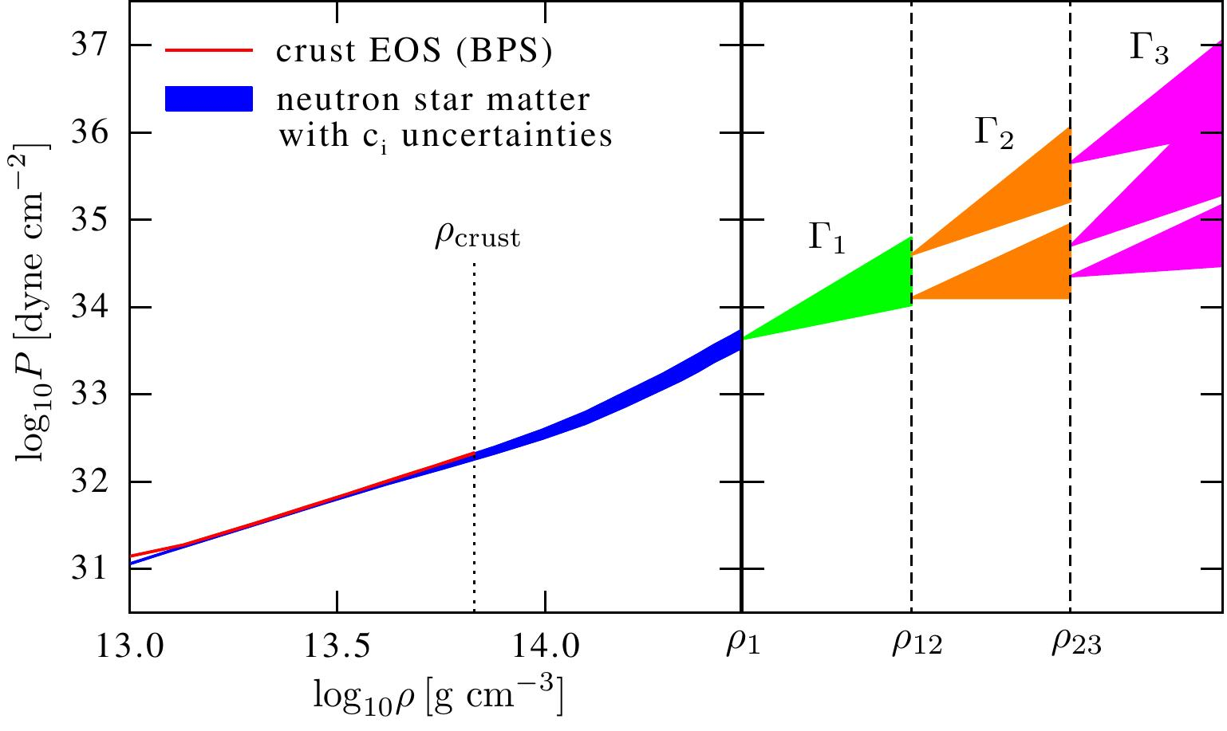
Piecewise polytropic
parametrization (PP)
3 independent polytropes, respecting causality, following Read et al, PRD (2009), arxiv: 0812.2163
Figure from Hebeler et al, ApJ (2013) arxiv:1303.4662
SCALES 1st General Meeting | M Mendes

Slide 21
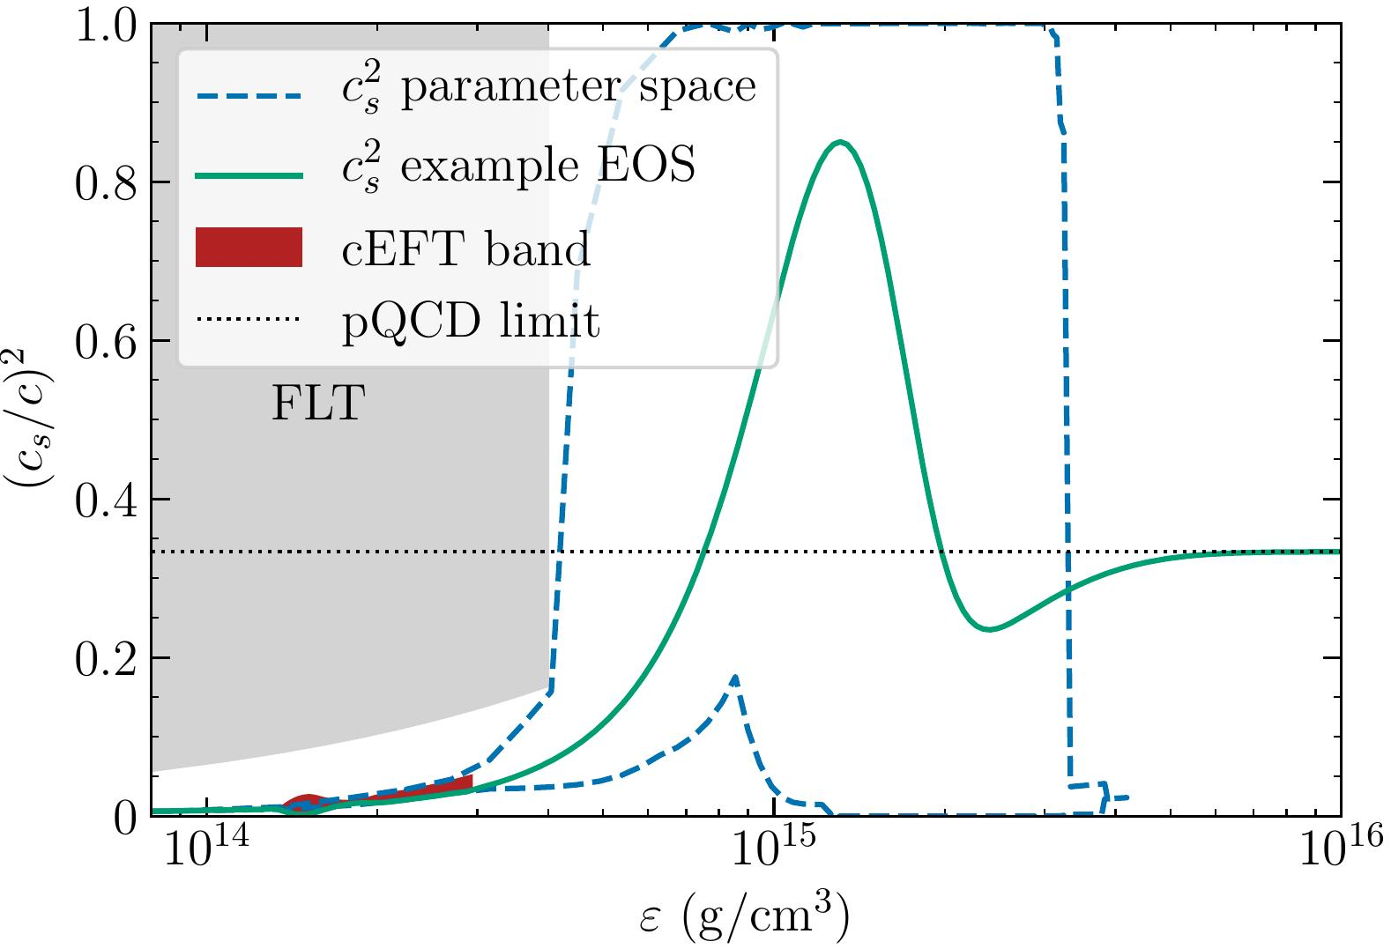
Speed of sound
parametrization (CS)
Analytical expression to speed of sound, limited by
Fermi liquid theory
causality
lim_{n≥50 n0} c_{s}²→ 1/3
From Greif et al, MNRAS (2019) arxiv: 1812.08188
SCALES 1st General Meeting | M Mendes

Slide 22
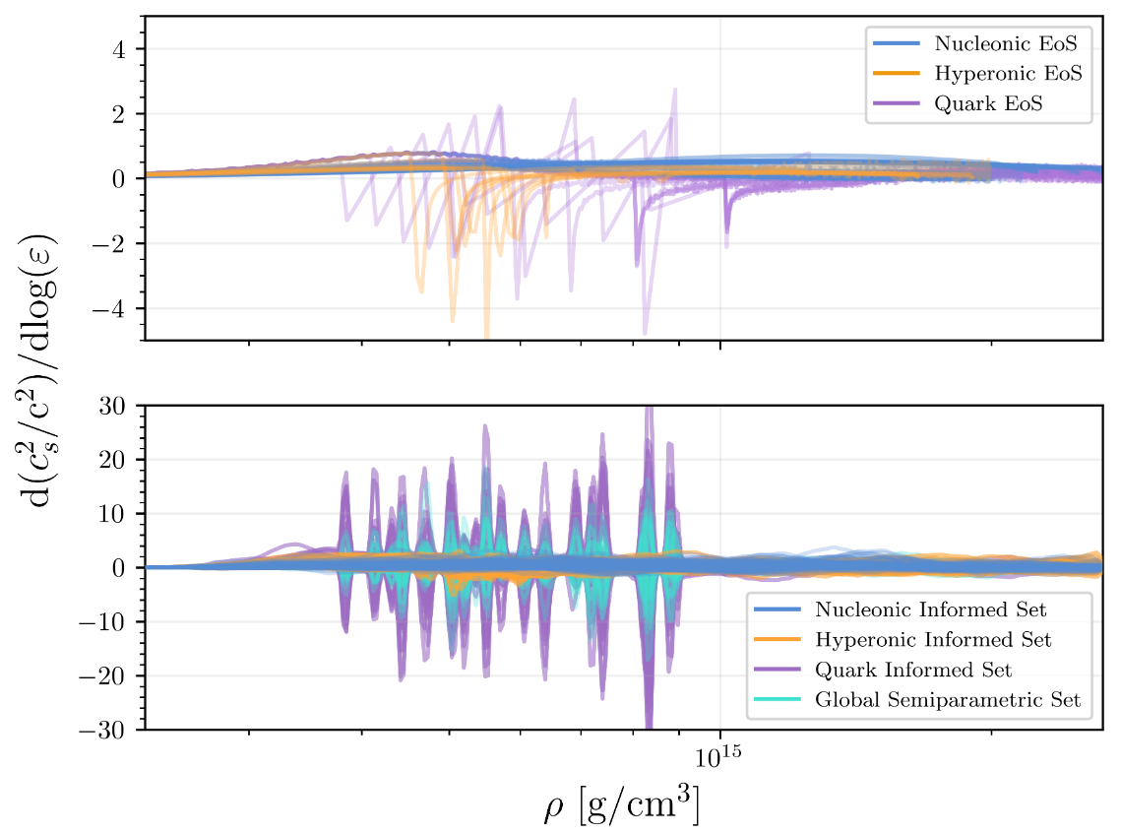
Semiparametric with Gaussian Processes
Figure from Sunny et al, Class.Quant.Grav. (2025), arxiv: 2507.032032
Coming soon
SCALES 1st General Meeting | M Mendes

Slide 23
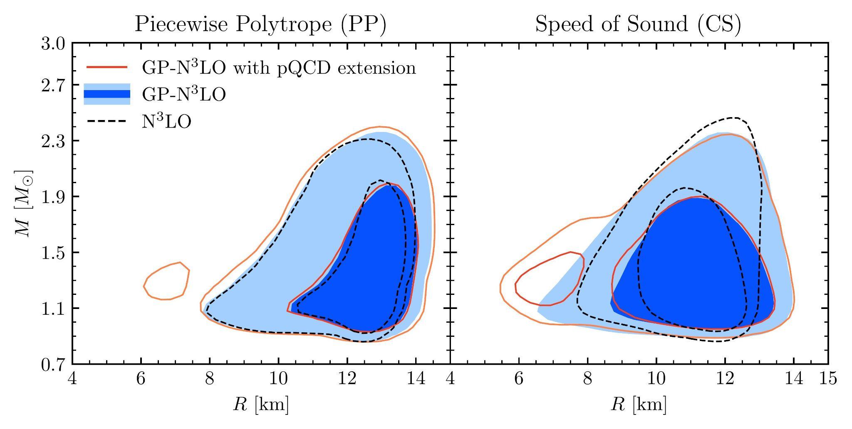
Mass-Radius (MR) priors
Radii around 10-14 km
Both the new treatment of the cEFT EOS and pQCD extensions expand MR priors
Modified figure from MM, HG et al, 2026 (Submitted to ApJ), arxiv: 2605.18560
SCALES 1st General Meeting | M Mendes

Slide 24
Outline
  EOS information from luminosity observations
  (Very brief) primer on observational techniques
  Recent χEFT and perturbative quantum chromodynamic (pQCD) calculations
  Bayesian framework and EOS construction
  Implications for dense matter EOS and inference of EOS parameters
}
Based on: MM, HG et al, 2026 (Submitted to ApJ), arxiv: 2605.18560
Raaijmakers, …, MM, … et al, 2025 (JOSS), https://doi.org/10.21105/joss.06003
Mauviard, …, MM, … et al, 2025 (ApJ), arxiv: 2506.14883
Rutherford, MM, Svensson et al, 2024 (ApJL), arxiv: 2407.06790
MM et al, 2024 (PRD), arxiv: 2408.05287
MM et al, 2022 (ApJ), arxiv: 2208.04262
NEoST
SCALES 1st General Meeting | M Mendes

Slide 25
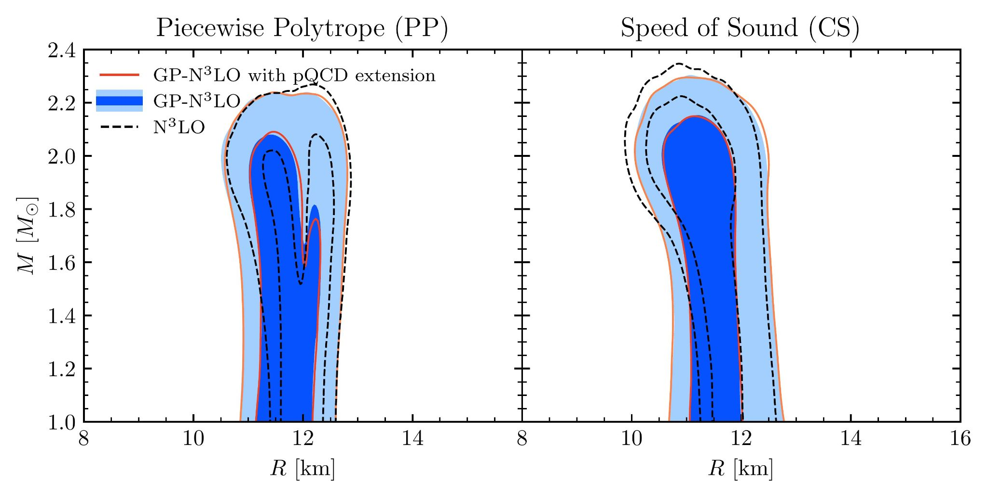
Constrained EOS
New cEFT implementation broadens the radius, especially for low mass stars
Minor differences to the posterior without pQCD constraints
From MM, HG et al, 2026 (Submitted to ApJ), arxiv: 2605.18560
SCALES 1st General Meeting | M Mendes

Slide 26
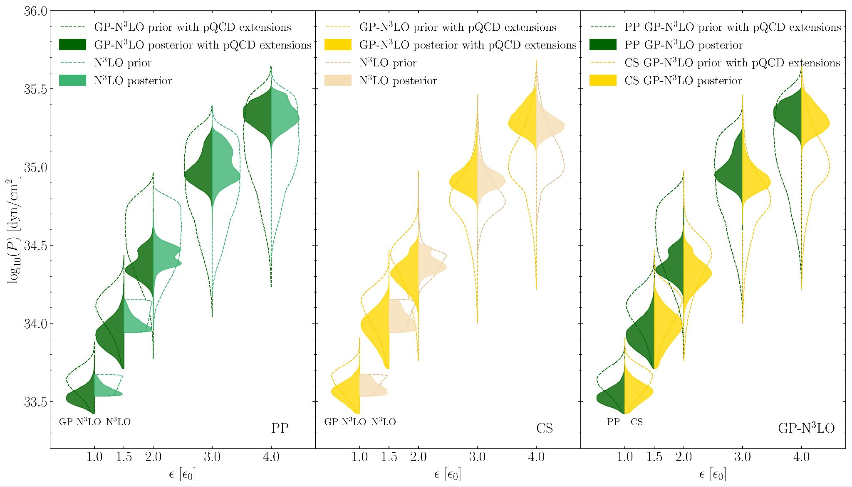
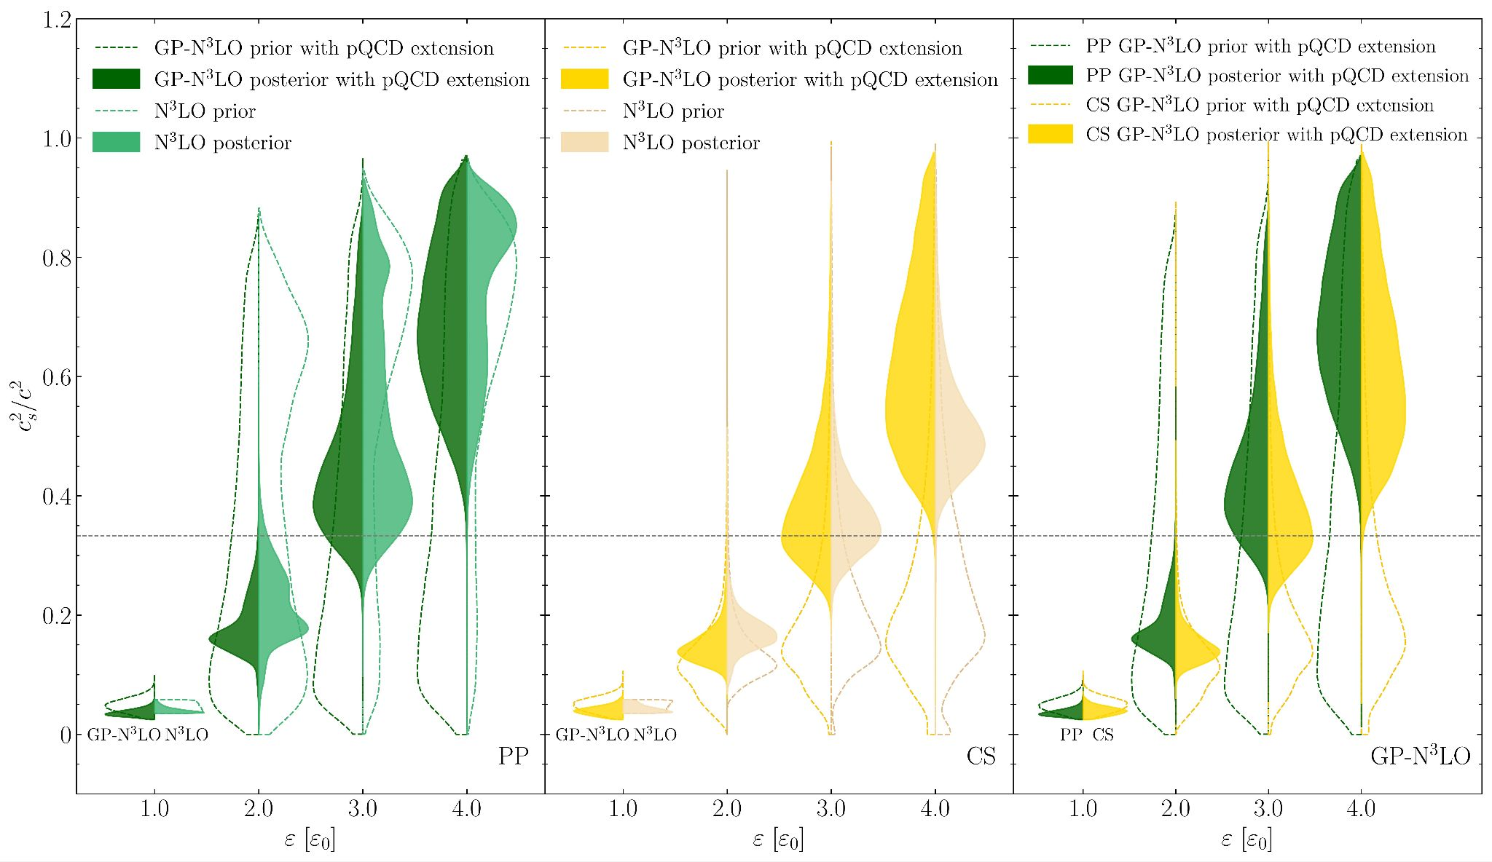
P-E and c_{s}² x E
Broadening of pressure posterior beyond cEFT range
Minimal impact of pQCD extension
Consistent results for PP and CS parameterizations
Bimodal-like tendency for all posteriors
Figure modified from MM, HG et al, 2026 (Submitted to ApJ), arxiv: 2605.18560
SCALES 1st General Meeting | M Mendes

Slide 27
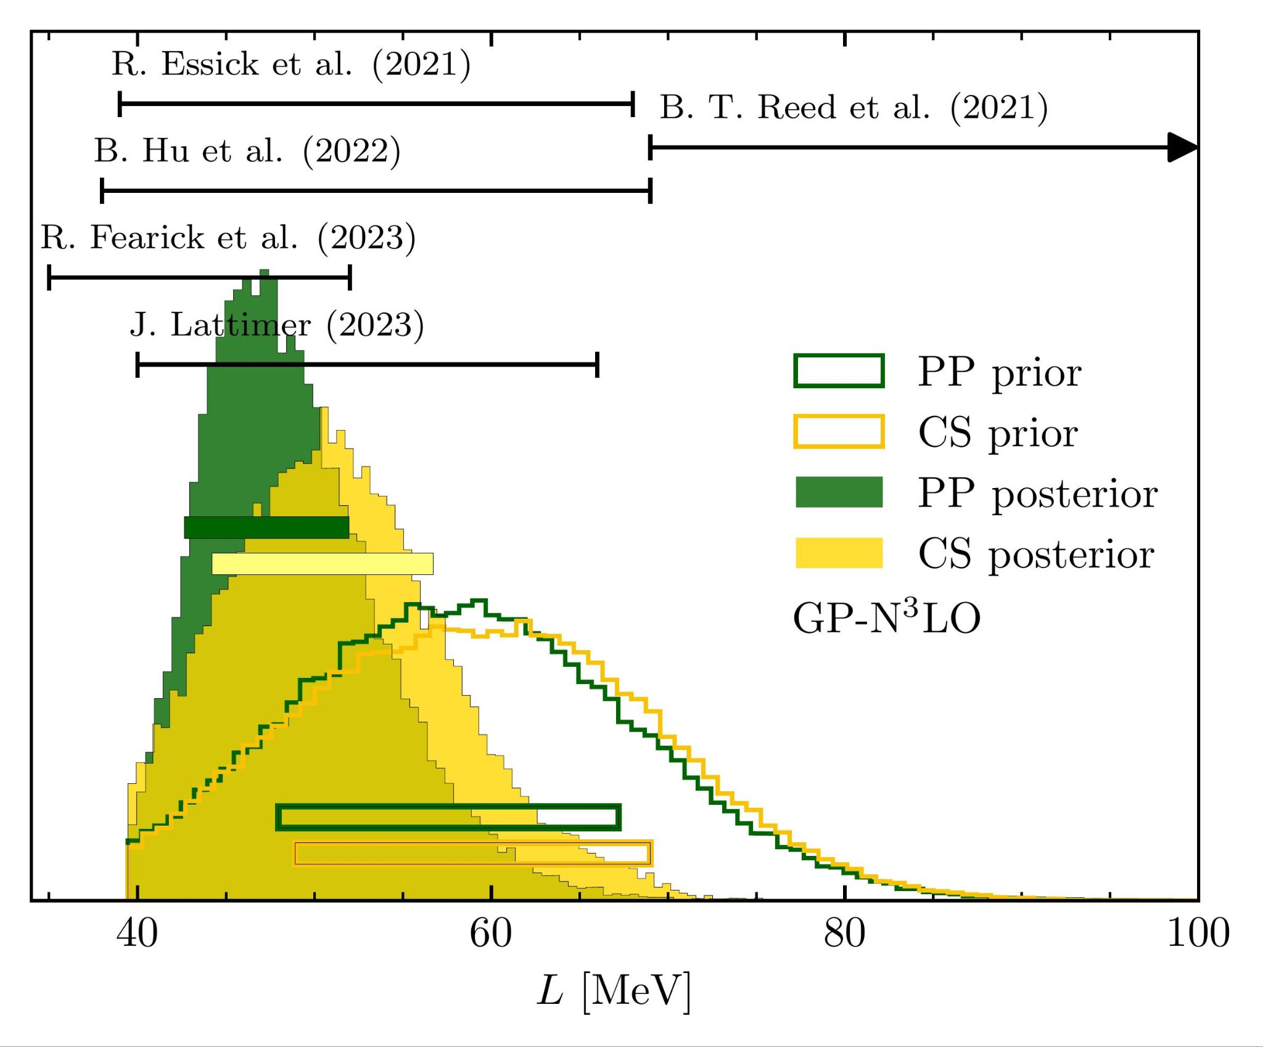
L parameter inference
Astrophysical data informs the value of L, the slope of symmetry energy
L_{68% Prior PP} = 48.0 - 67.2 MeV
L_{68% PP} = 42.6 - 52.0 MeV
L_{68% Prior CS} = 48.9 - 69.0 MeV
L_{68% CS} = 44.2 - 56.7 MeV
From MM, HG et al, 2026 (Submitted to ApJ), arxiv: 2605.18560
SCALES 1st General Meeting | M Mendes

Slide 28
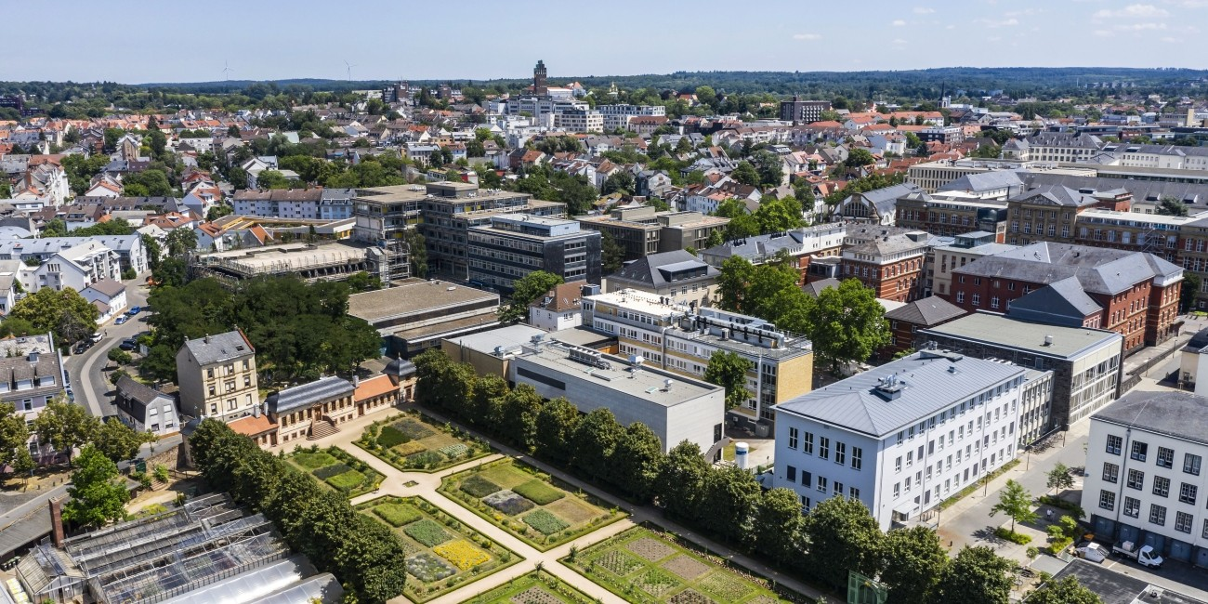
Summary
Astrophysical data significantly constrains the EOS in high density, low temperature region (especially if combined: mass, radius, tidal, luminosities…)
Ab initio calculation updates can easily be integrated into EOS inference frameworks, including uncertainty quantification of cEFT EOS
Inference of EOS parameters, such as L, statistically meaningful and astro informed
Amount and precision of observations only increases! More astrophysical and laboratory data expected soon
Thank you!
melissa.mendes@tu-darmstadt.de
Special thanks to A. Hensel, H. Göttling, I. Svensson, K. Hebeler,
A. Schwenk
SCALES 1st General Meeting | M Mendes

Slide 29
Additional slides
SCALES 1st General Meeting | M Mendes

Slide 30
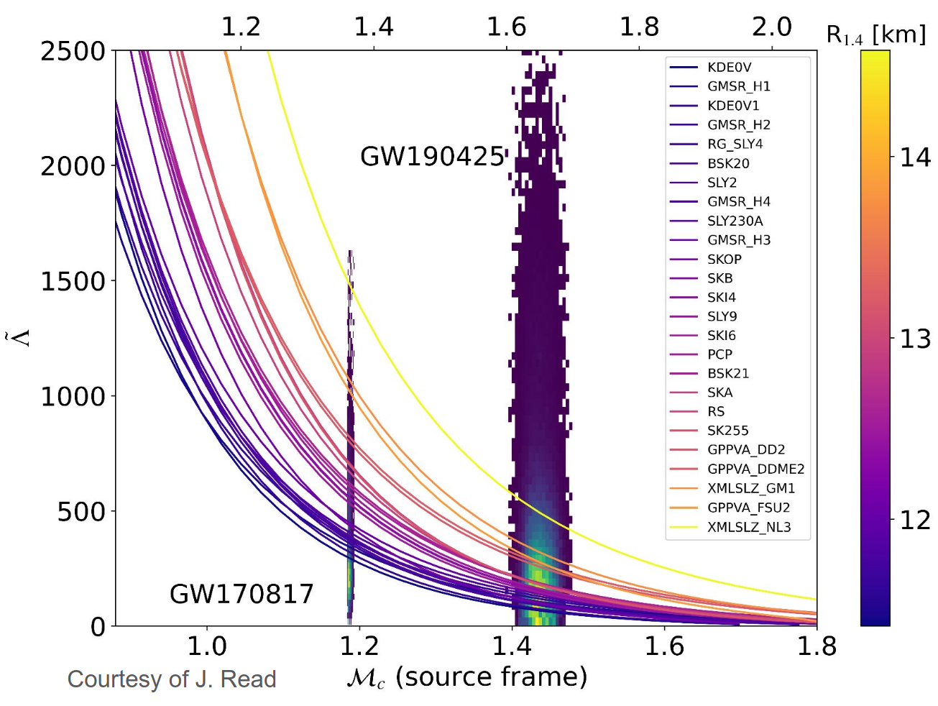
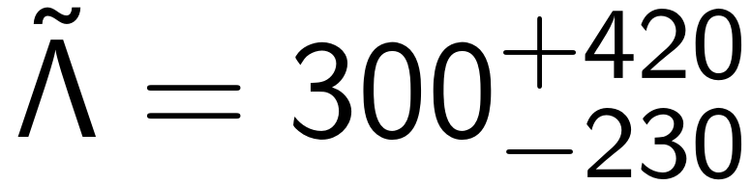
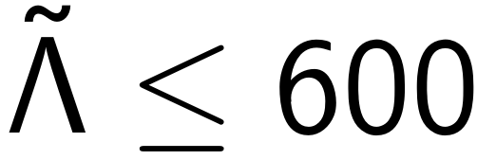
BNS Gravitational Waves
GW170817 much more constraining
GW190425
Figure from J. Read, L. Suleiman’s slides on behalf of LVK collaboration at Nuclei in the Cosmos 2025 - https://indico.icc.ub.edu/event/341
SCALES 1st General Meeting | M Mendes

Slide 31
NICER telescope primer
Neutron star Interior Composition ExploreR (NICER)
X-ray telescope, aboard the International Space Station since 2017
Needs rotating sources with f > 100 Hz
Inferences depend on model for the surface emission, with free parameters:
  mass, radius, spin rate, temperature distribution, beaming function or atmosphere model, observer inclination, distance, interstellar hydrogen column density and a background model
Targets:
5-10% precision level for PSR J0437-4715, PSR J0030+0451, PSR J1231+1411
Plus PSR J0740+6620, PSR J0614-3329, PSR J1614-2230
SCALES 1st General Meeting | M Mendes

Slide 32
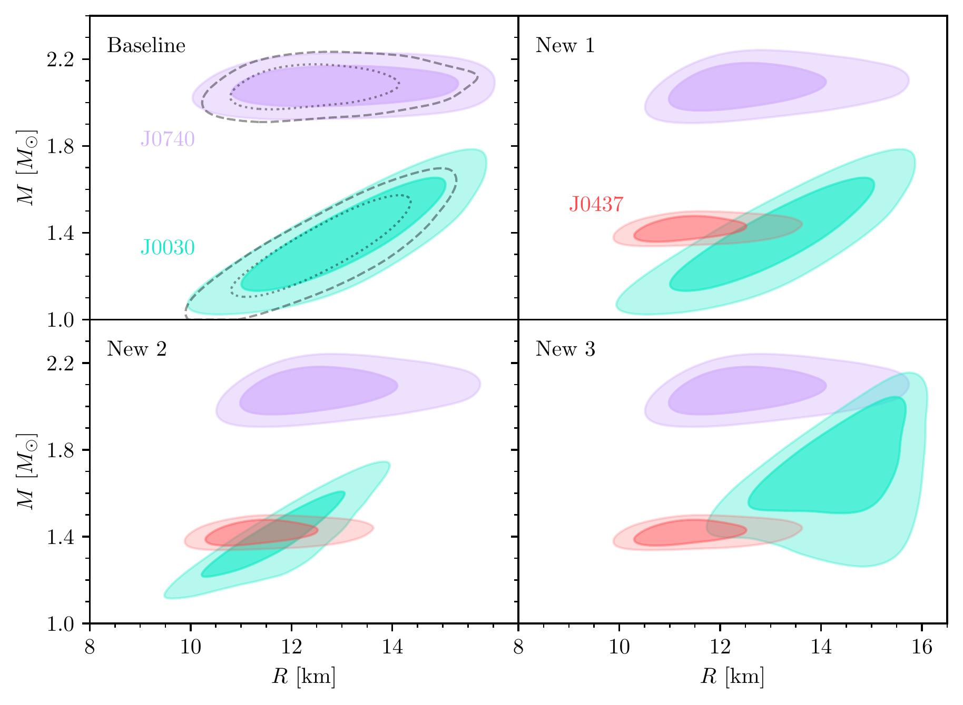
Rutherford et al NICER data
Some possible MR data contours depending on hot spot modelling
Plus GW170817 and GW190425
From Rutherford, MM, Svensson et al, ApJL (2024), arxiv:2407.06790
SCALES 1st General Meeting | M Mendes

Slide 33
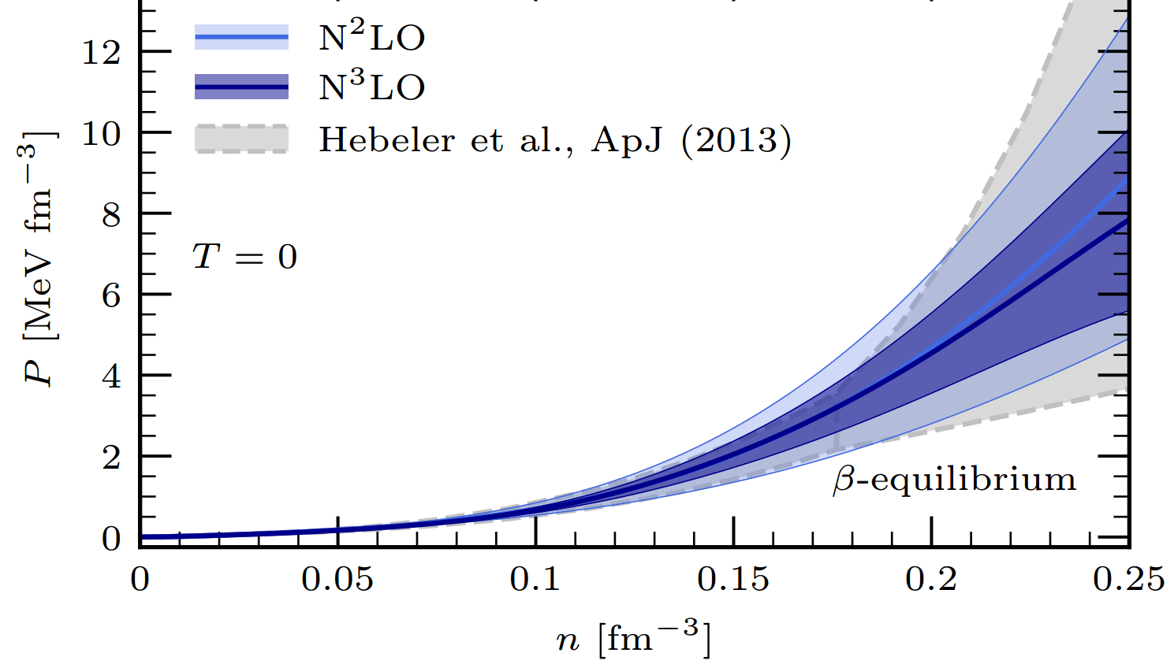
Recent χEFT EOS calculations
Based on asymmetric matter calculations and improved uncertainty quantification, for both next-to-next-to (N²LO) and next-to-next-to-next-to (N³LO) leading order
Figure from Keller et al, PRL (2023), arxiv:2204.14016
SCALES 1st General Meeting | M Mendes

Slide 34
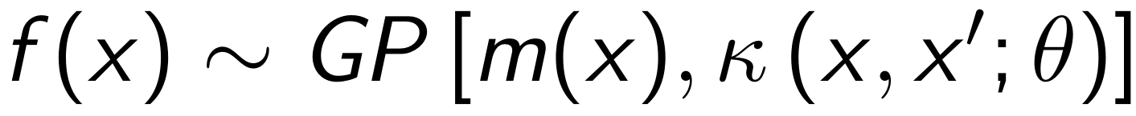
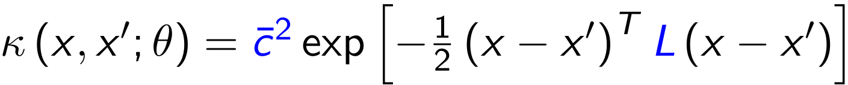
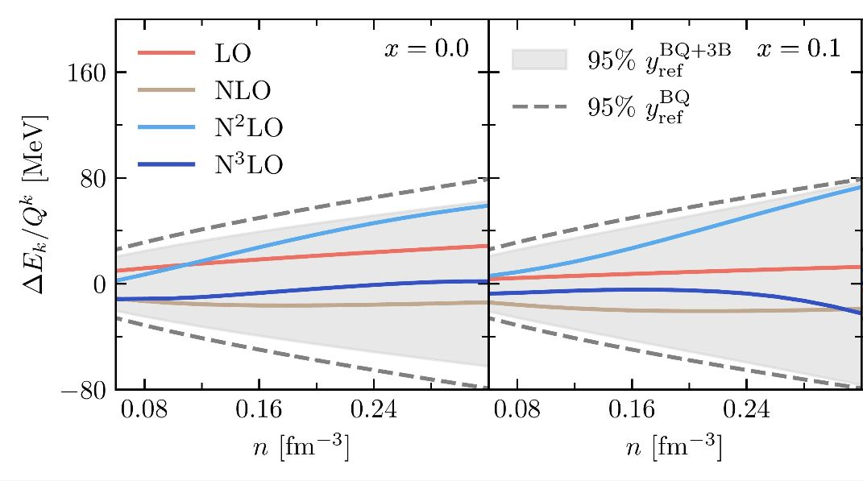
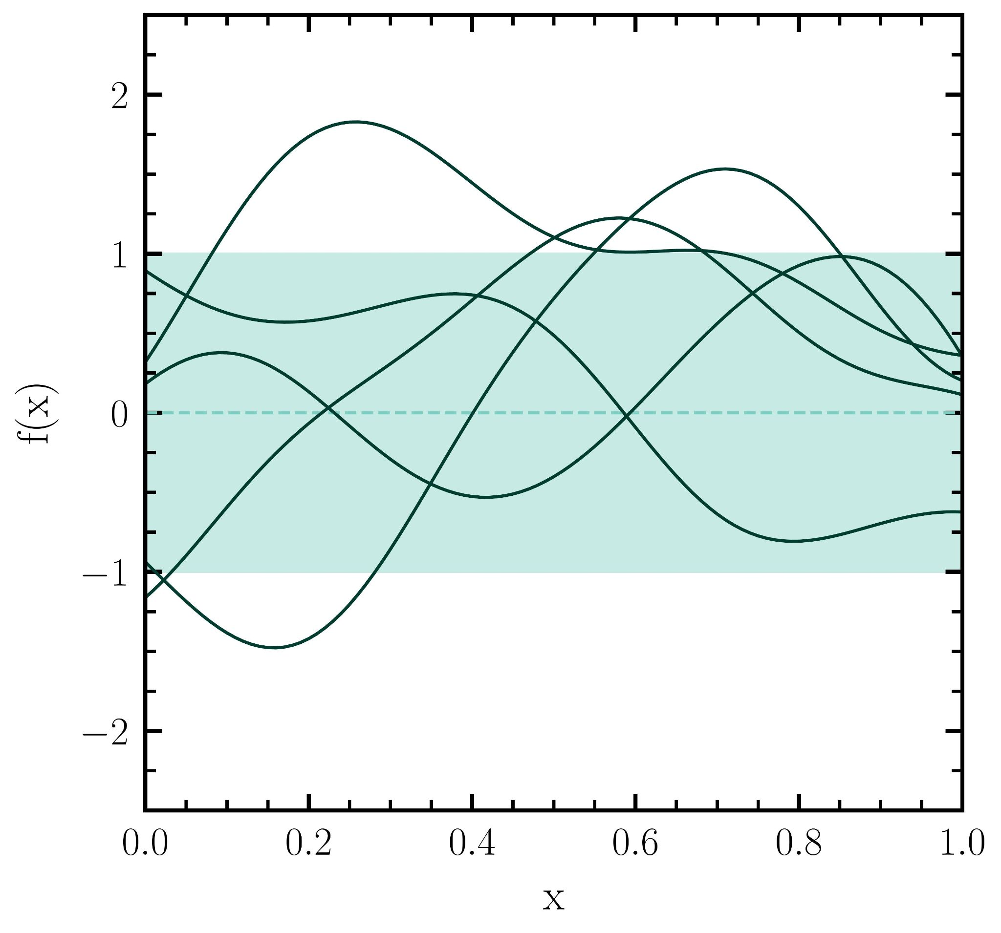
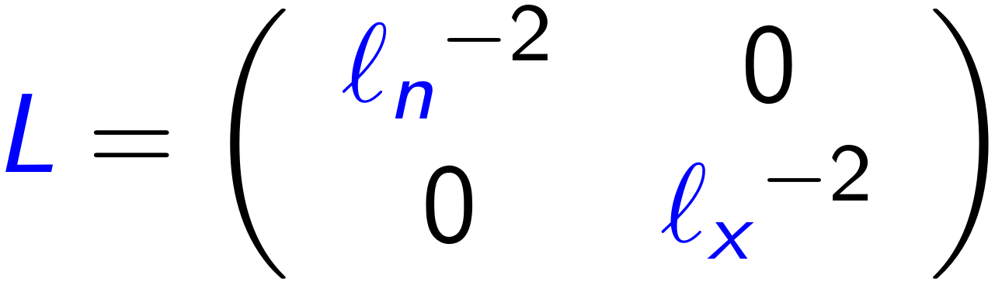
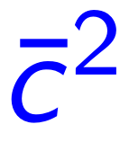
Gaussian processes (GP)
Calculations performed by H. Göttling
where
Modified figure from Göttling et al (2025), in preparation
GP for uncertainty quantification following Drischler et al., PRC (2020); Melendez et al., PRC (2019)
hyperparameters , ℓ determined from expansion coefficients
SCALES 1st General Meeting | M Mendes

Slide 35
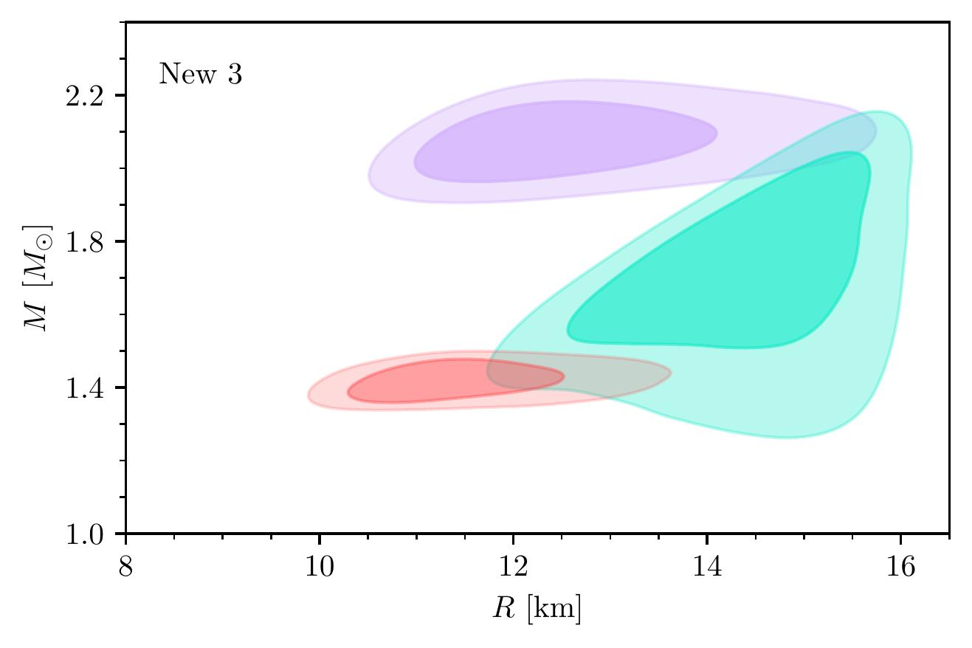
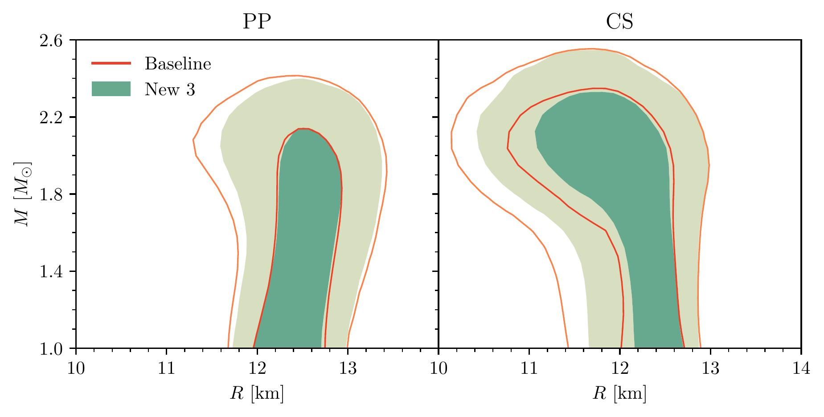
New 3 contours
From Rutherford, MM, Svensson et al, ApJL (2024) arxiv:2407.06790
SCALES 1st General Meeting | M Mendes

Slide 36
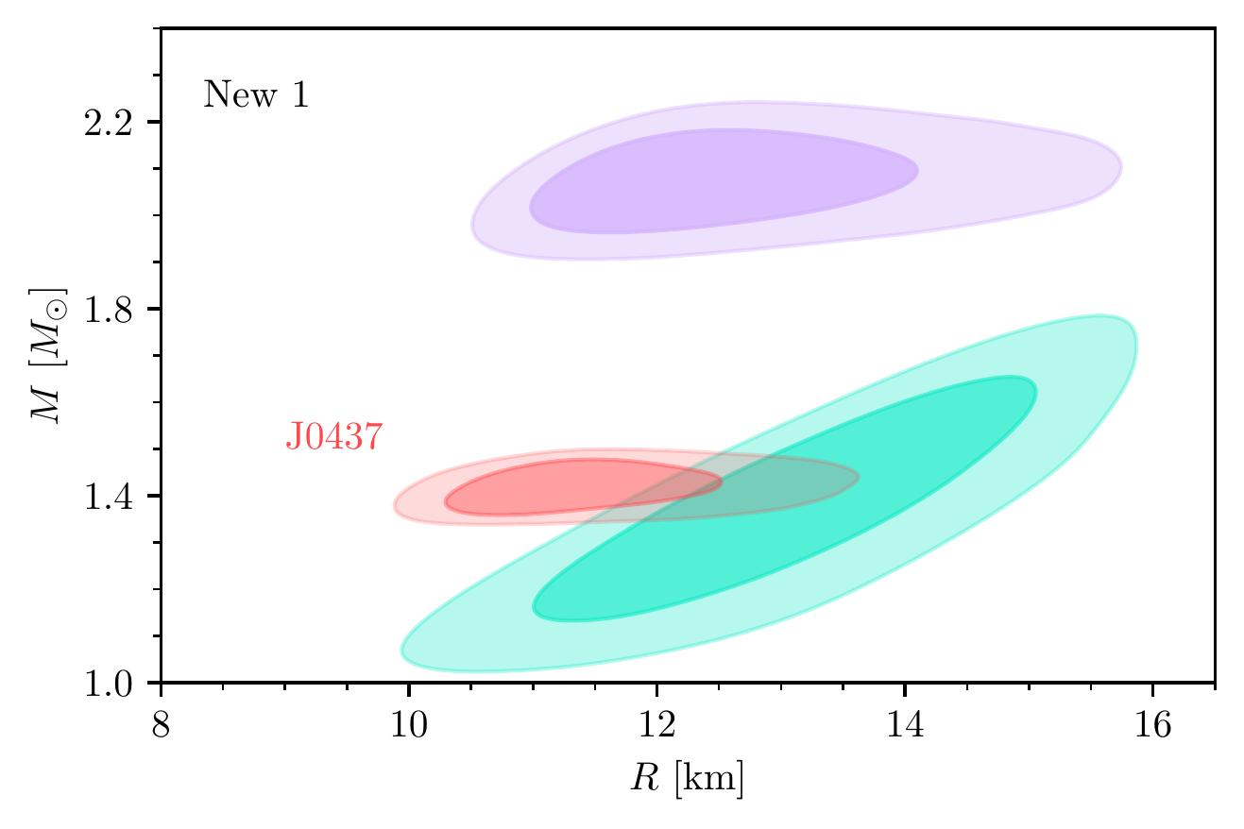
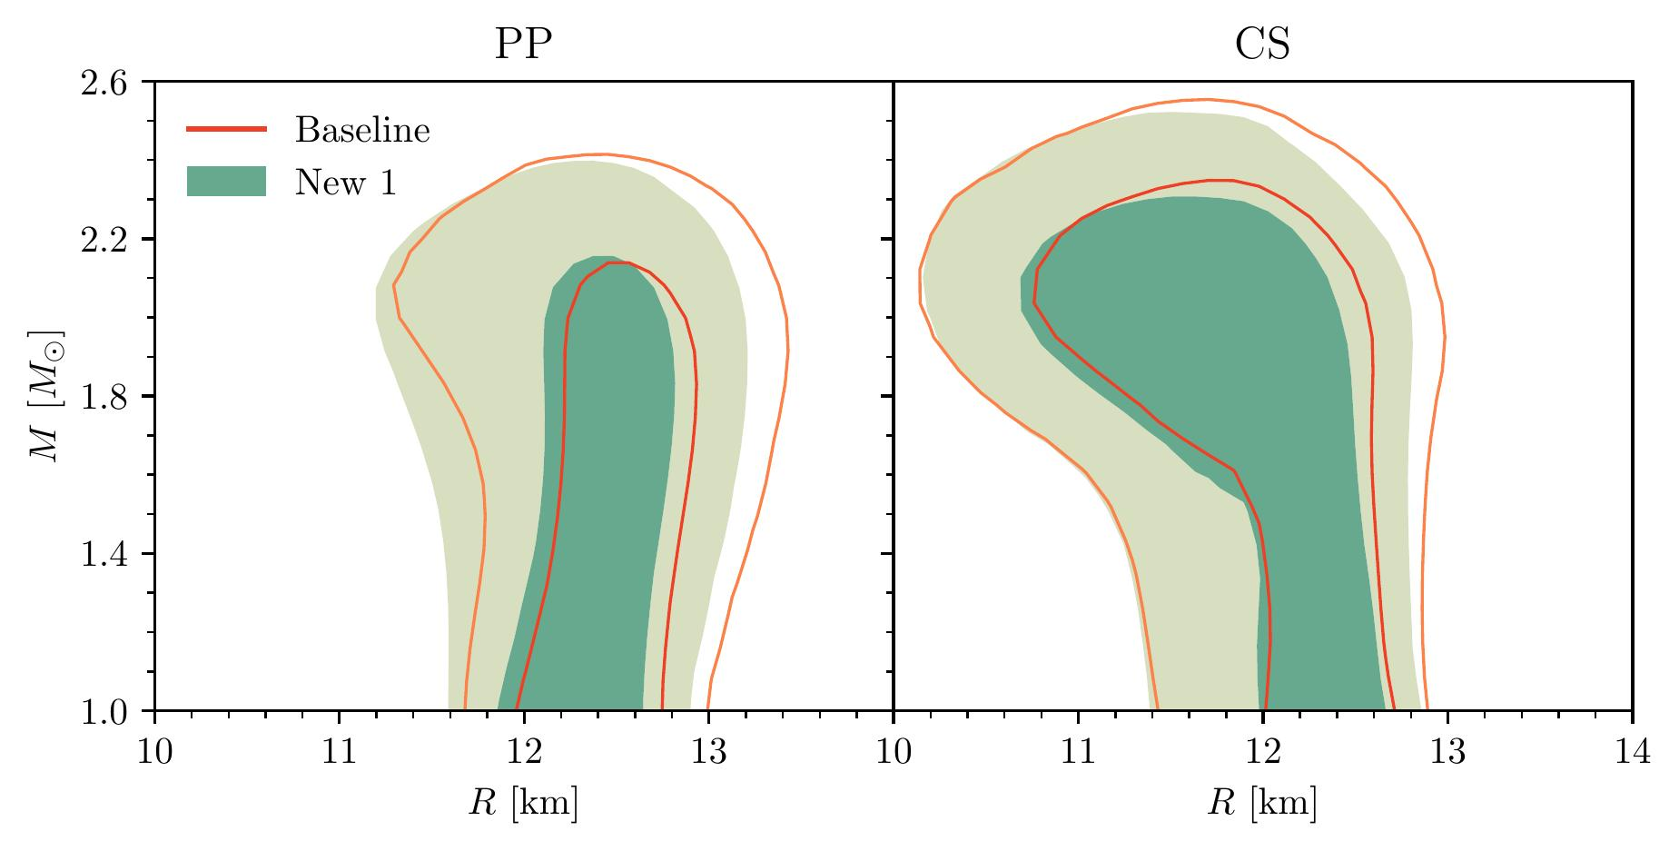
Other hot spot scenarios
From Rutherford, MM, Svensson et al, ApJL (2024), arxiv:2407.06790
SCALES 1st General Meeting | M Mendes

Slide 37
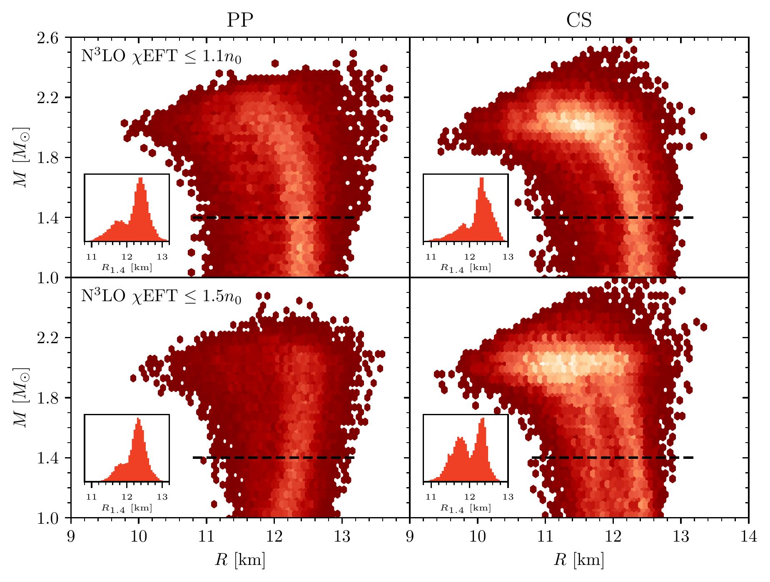
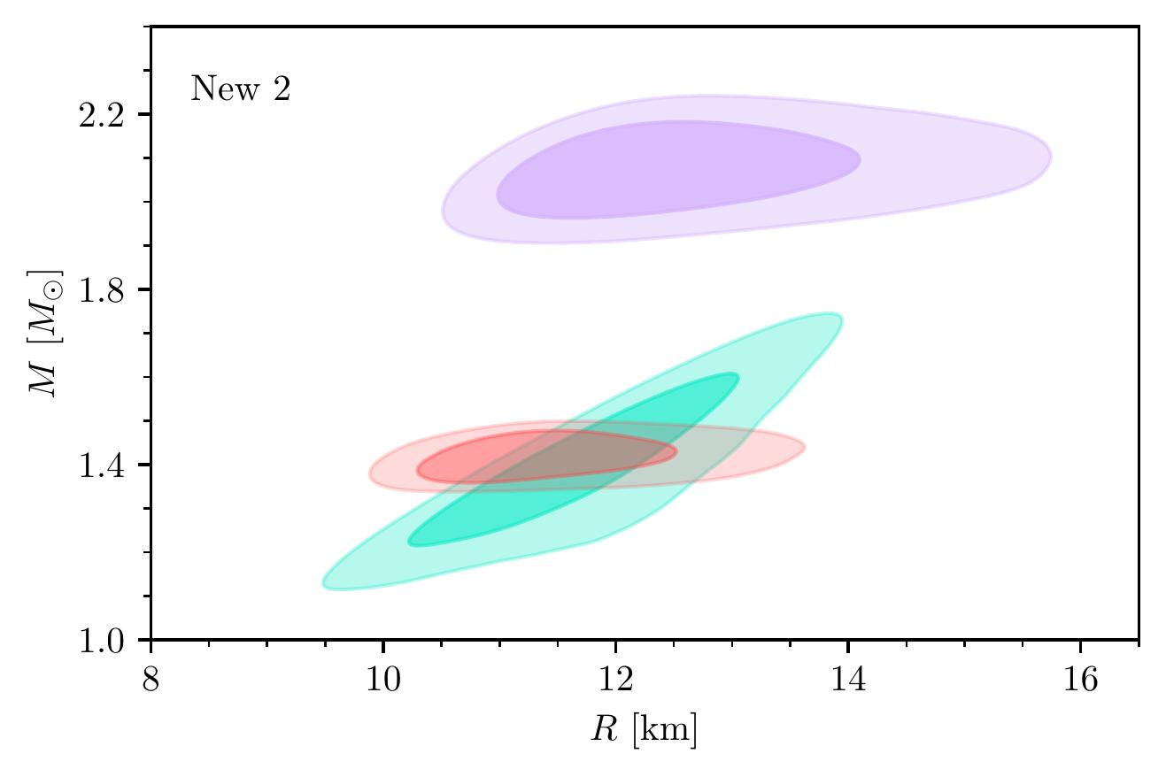
Most likely M-R
Consistent results for PP and CS parameterizations
Bimodal-like tendency for all posteriors
From Rutherford, MM, Svensson et al, ApJL (2024), arxiv:2407.06790
SCALES 1st General Meeting | M Mendes

Slide 38
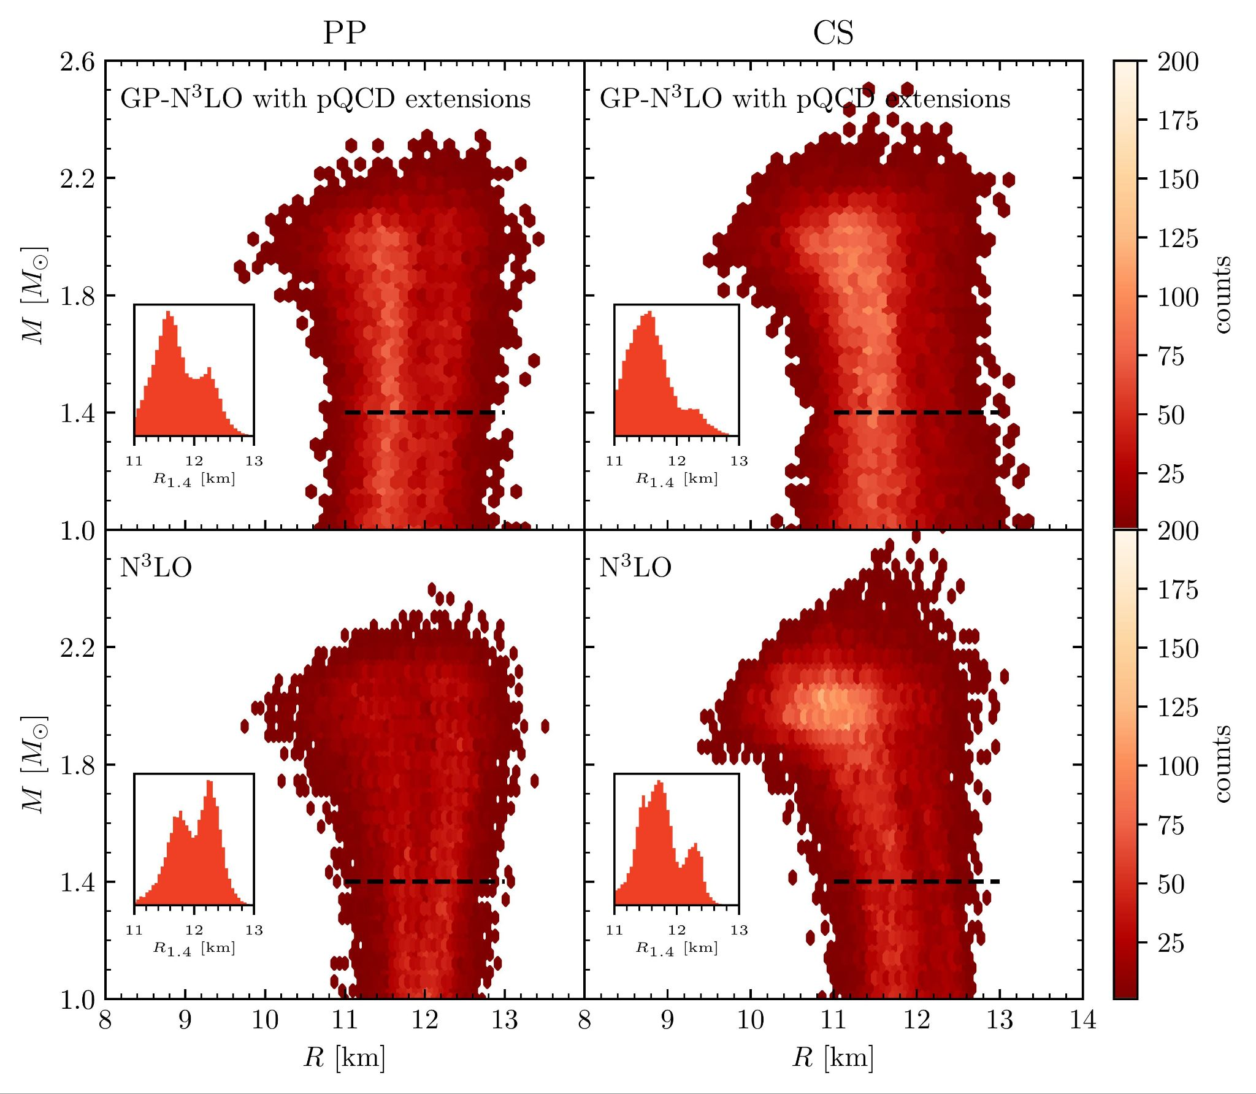
Most likely M-R
Bimodal-like tendency still present with new cEFT implementation and pQCD extensions
From MM, HG et al, 2026 (Submitted to ApJ), arxiv: 2605.18560
SCALES 1st General Meeting | M Mendes

Slide 39
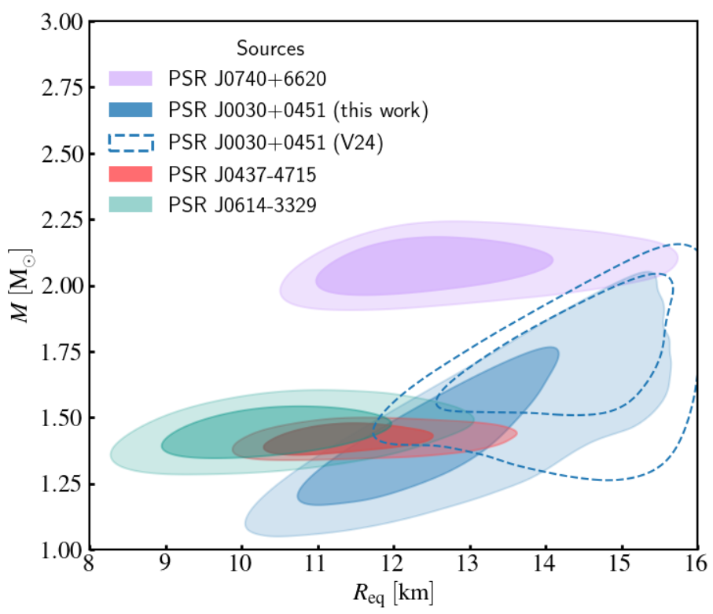
Recent data from NICER
Reanalysis with more accumulated data
Figure from Kini et al (2026), arxiv: 2602.23743
SCALES 1st General Meeting | M Mendes

Slide 40
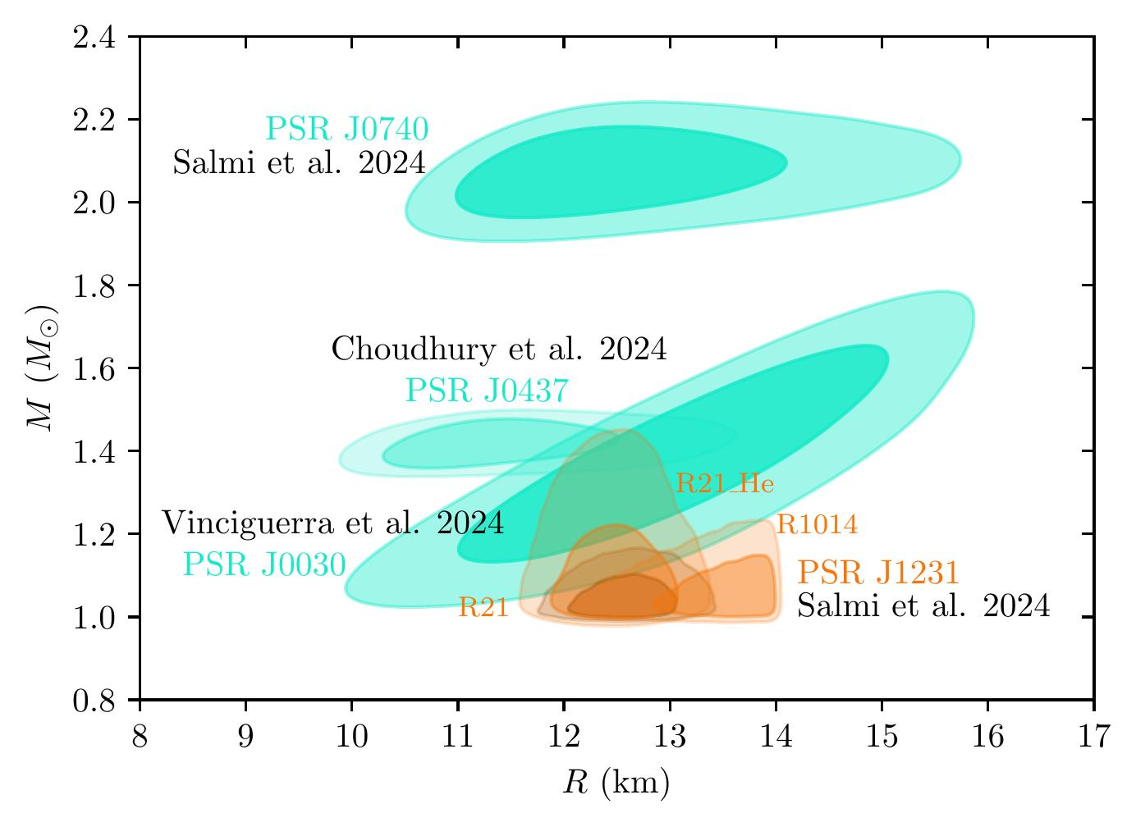
Other NICER released data
SCALES 1st General Meeting | M Mendes

Slide 41
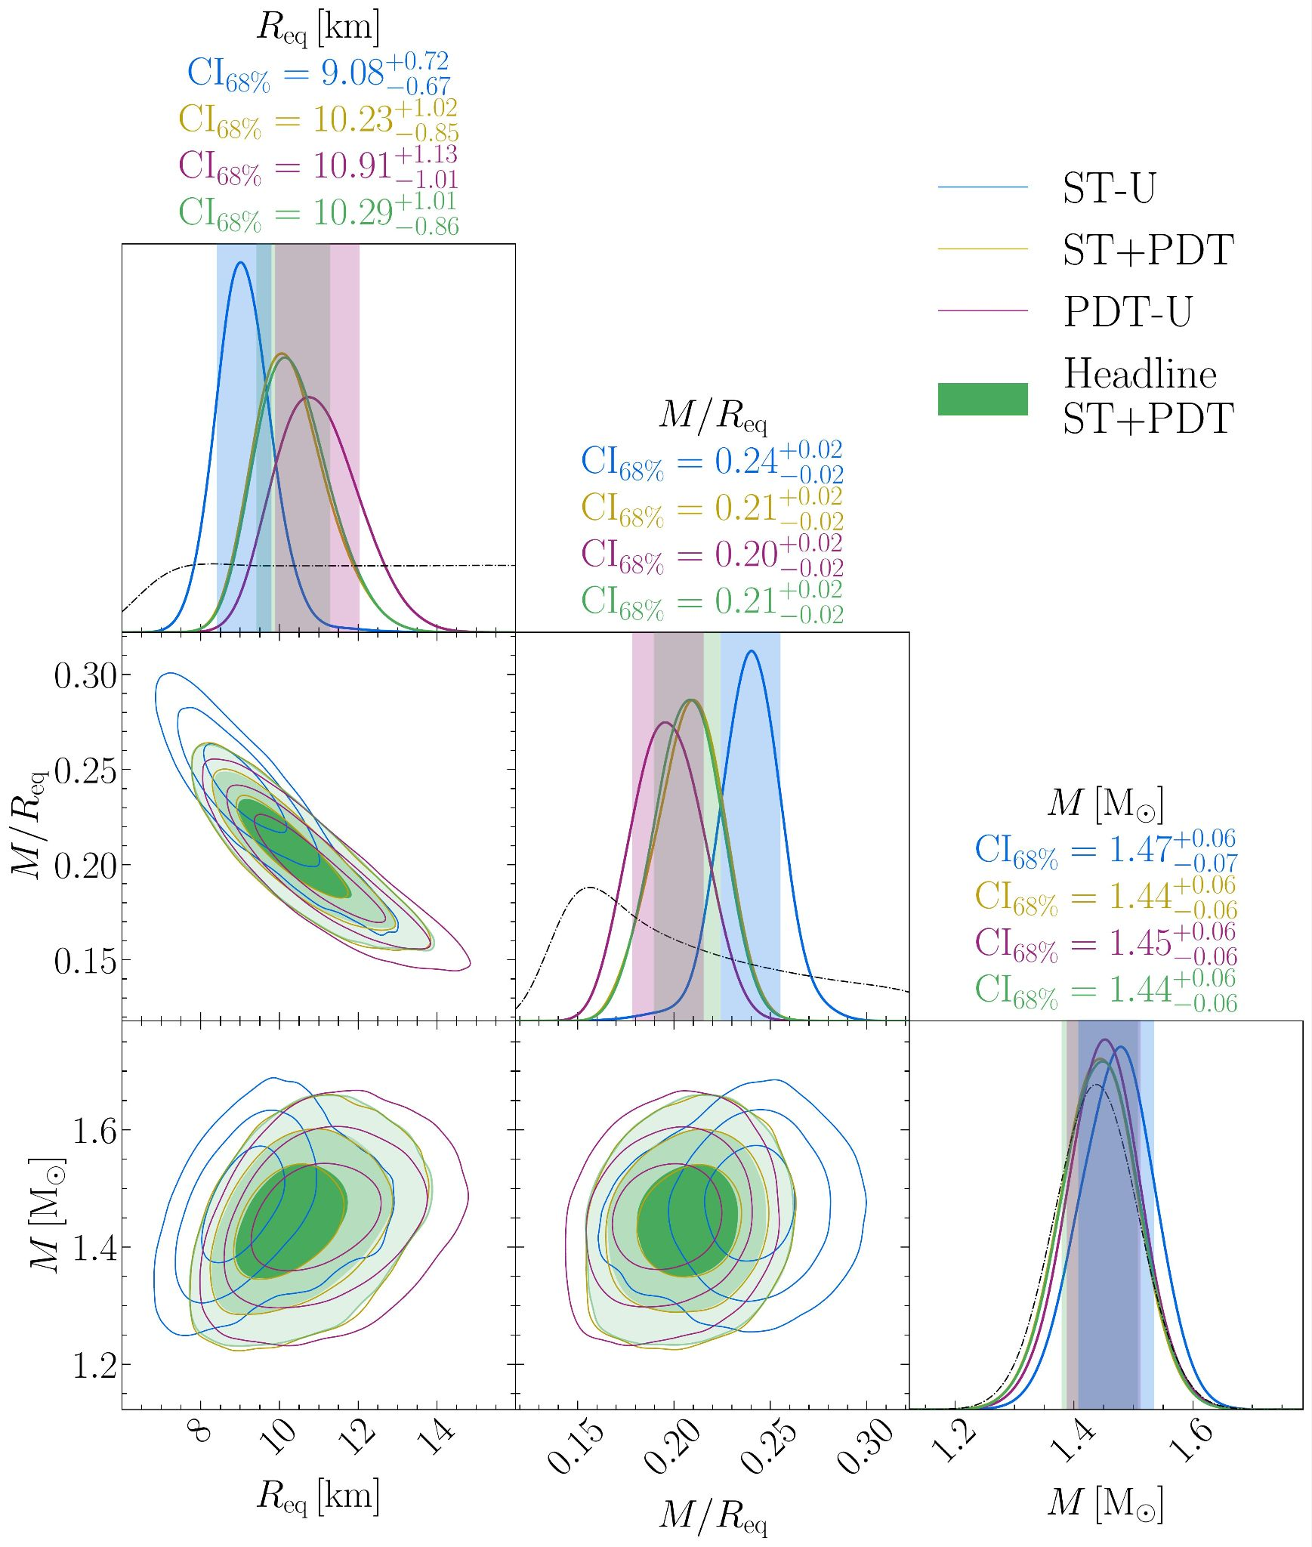
Other hot spot models for J0614
Figure from Mauviard, … MM, … et al, ApJ (2025), arxiv:2506.14883
SCALES 1st General Meeting | M Mendes

Slide 42
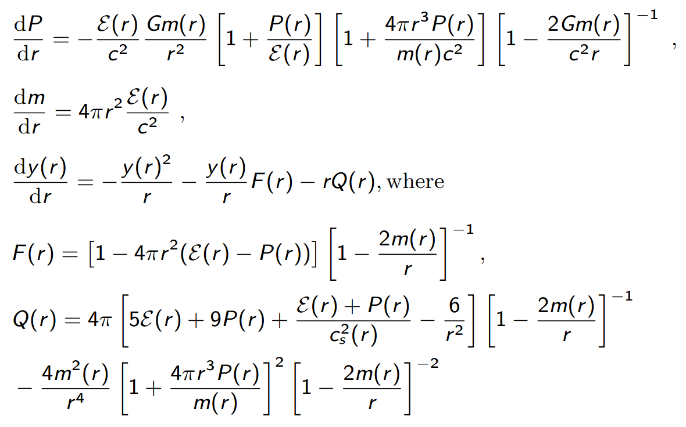
TOV equations I
SCALES 1st General Meeting | M Mendes

Slide 43
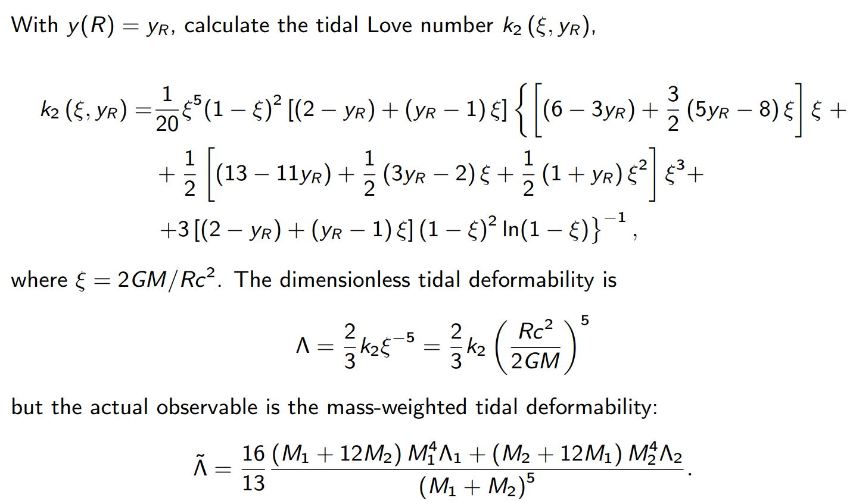
TOV equations II
SCALES 1st General Meeting | M Mendes

Slide 44
PP parametrization equation
Each polytrope given by p(ρ) = K ρ^{Γ}
such that ε(p) = (1 + a)(p/K)^{1/Γ} + p/(Γ−1)
Parameter ranges are:
For χ_{EFT} up to 1.1n₀,
Γ₁: [1, 4.5], Γ₂: [0, 8], Γ₃: [0.5, 8], ρ₁₂: [1.5, 8.3], ρ₂₃: [1.5, 8.3]
For χ_{EFT} up to 1.5n₀,
Γ₁: [0, 8], Γ₂: [0, 8], Γ₃: [0.5, 8], ρ₁₂: [2, 8.3], ρ₂₃: [2, 8.3]
SCALES 1st General Meeting | M Mendes

Slide 45
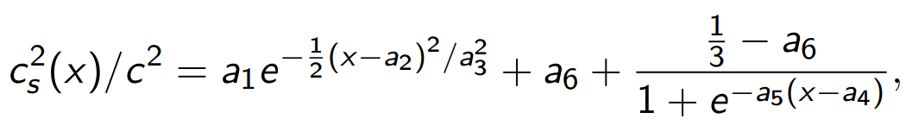
CS parametrization equation
High density EOS given by
a₆ to match χ_{EFT} band.
Fermi liquid theory (FLT) limit is c_{s}² FLT(1.5 n₀)/c² ≤ 1/m_{N}² (3π²n)^{2/3}
With a₁:[0.1,1.5], a₂:[1.5,12], a₃:[0.05,2], a₄:[1.5,37], a₅:[0.1,1]
a₁ outside this range fails maximum mass constraint or causality
SCALES 1st General Meeting | M Mendes

Slide 46
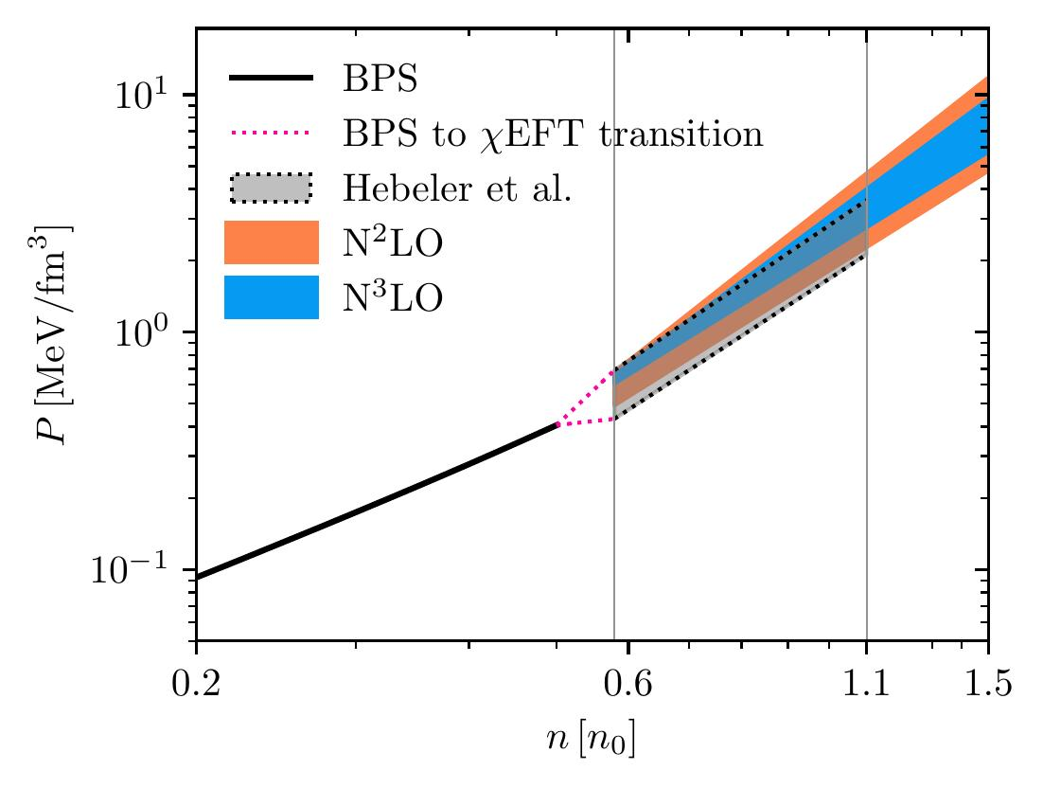
Crust and outer core
BPS EOS to model crust and polytropic fit (P = K n^{Γ} ) for χEFT
Extended to both 1.1n₀ and 1.5 n₀
From Rutherford, MM, Svensson et al, ApJL (2024), arxiv:2407.06790
SCALES 1st General Meeting | M Mendes

Slide 47


pQCD implementation details
where
with Λ renormalization scale
In NEoST, LogX uniformly sampled from [0.5, 2]
Figure from A. Hensel Master’s thesis
SCALES 1st General Meeting | M Mendes

Slide 48

Most likely M-R with GP-N3LO
We calculate
∆R = R_{2.0} − R_{1.4}
∆R > 0 suggests a stiffening of the EOS
Small dependence on high-density extension
From MM, HG et al, 2026 (Submitted to ApJ), arxiv: 2605.18560
SCALES 1st General Meeting | M Mendes

Slide 49

Corresponding P-E curves
Broadening of pressure posterior beyond cEFT range
Minimal impact of pQCD extension
From MM, HG et al, 2026 (Submitted to ApJ), arxiv: 2605.18560
SCALES 1st General Meeting | M Mendes

Slide 50
c_{s}² x E
Potentially useful for investigations of phase transitions
From MM, HG et al, 2026 (Submitted to ApJ), arxiv: 2605.18560
SCALES 1st General Meeting | M Mendes

Slide 51




EOS parametrization
,
with symmetry energy:
such that
We explore the correlation between β-equilibrated matter and pure neutron matter to infer L
Figure from Reinhard and Nazarewicz, PRC (2016), arxiv:1601.06324
SCALES 1st General Meeting | M Mendes

Slide 52

L parameter inference
Posterior suggests that L is not prior dominated
GW data is crucial!
From MM, HG et al, 2026 (Submitted to ApJ), arxiv: 2605.18560
SCALES 1st General Meeting | M Mendes

Slide 53

L parameter inference 1.1
Low pressure cut not so sharp if cEFT extended until 1.1 n₀ with L≳30.4 MeV
From MM, HG et al, 2026 (Submitted to ApJ), arxiv: 2605.18560
SCALES 1st General Meeting | M Mendes

Slide 54

Future for luminosity constraints
Future measurements could actually constrain EOS+ nuclear pairing models
Figure from MM et al, 2022 (ApJ), arxiv: 2208.04262
SCALES 1st General Meeting | M Mendes

