Slide 1

Investigating pinning
in Neutron Stars with simulations and laboratory experiments
based on : Autti, Graber and Haskell: arXiv:2604.18016 (PRR in review)
  Brynmor Haskell

Slide 2
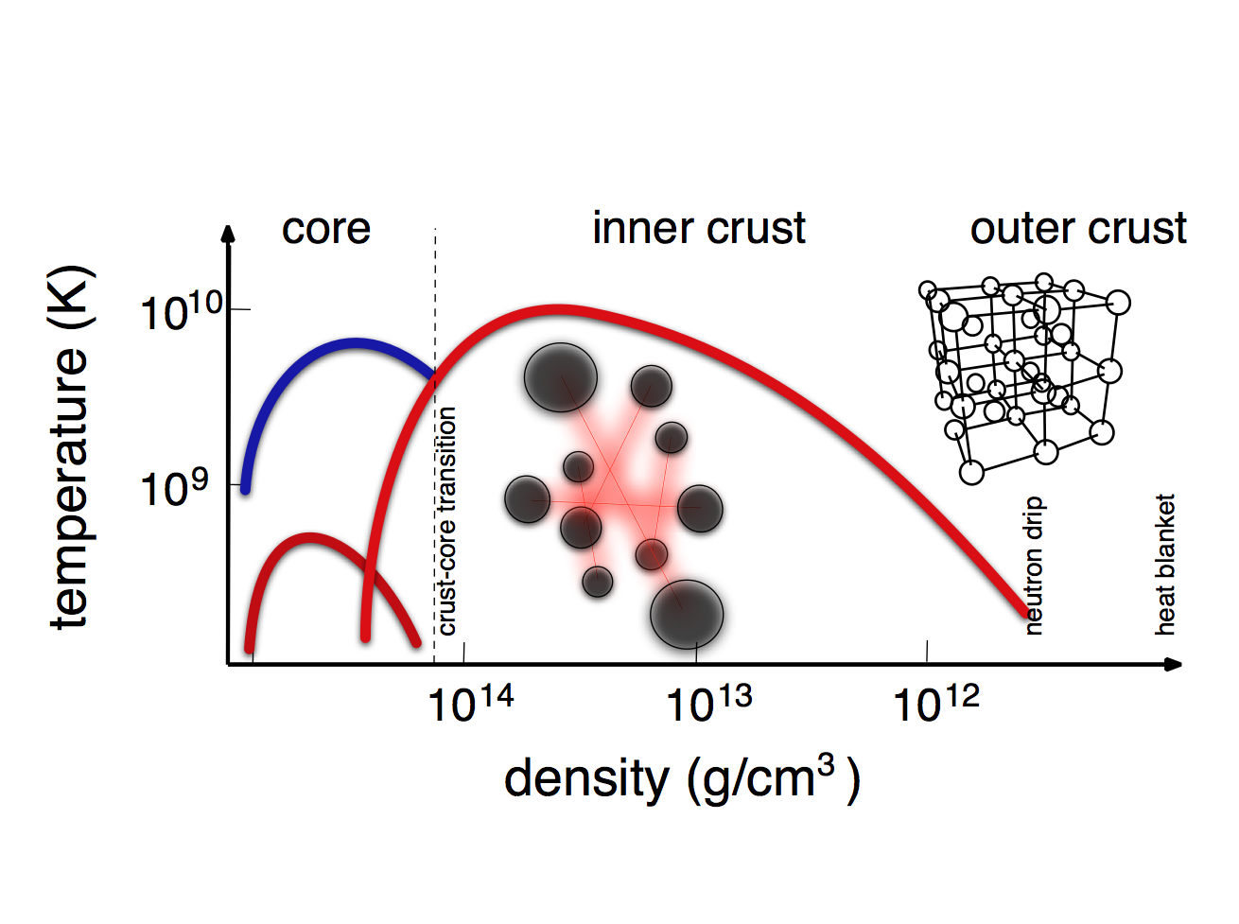
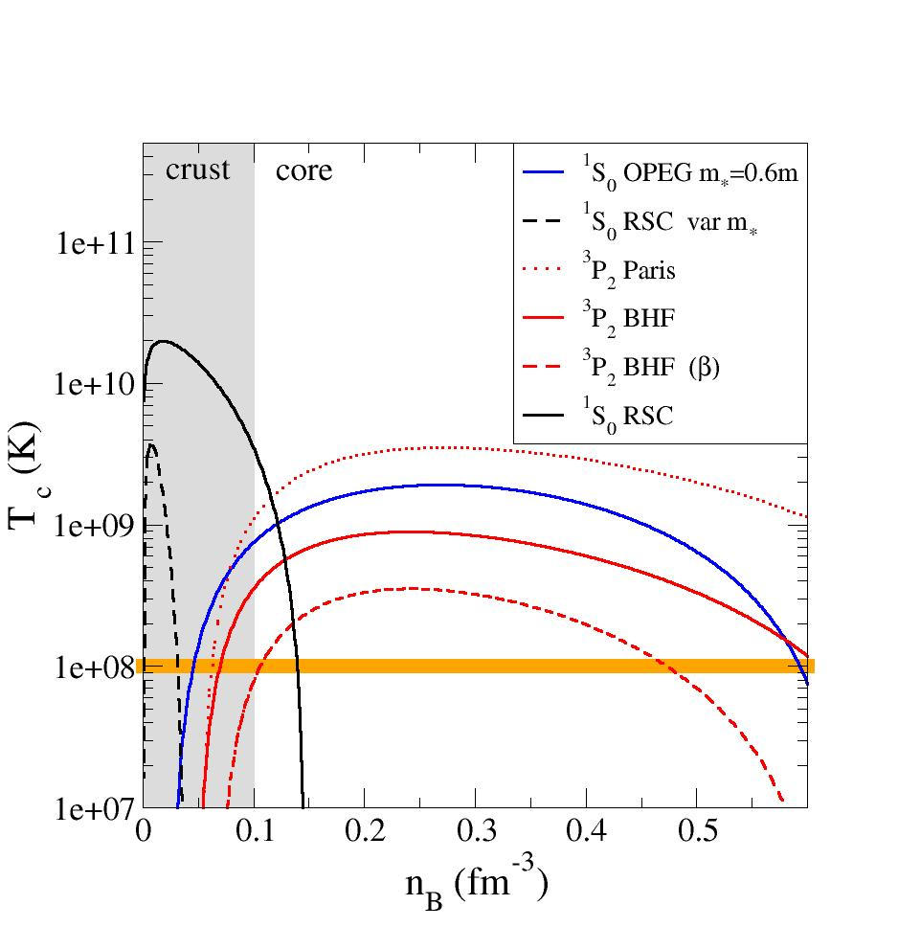
Superfluids in neutron stars
(courtesy of Nils Andersson)
Pairing calculations confirm that mature neutron stars are expected to be superfluid
(see Haskell & Sedrakian 2018 for a review)

Slide 3






Pulsar glitches
First Vela glitch 1969
Time of Arrival (TOA) registered for each pulse
Pulsar spins down due to the emission of EM (and GW?) radiation
Sudden jumps - ‘glitches’ - in frequency observed
(see Antonopoulou, Haskell & Espinoza 2022 for a review)

Slide 4
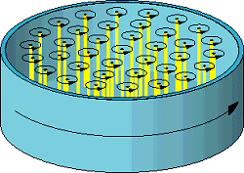
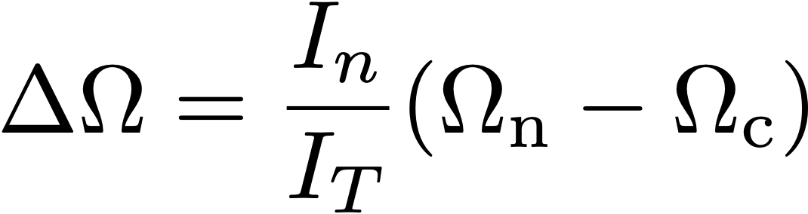


What is happening?
Superfluids rotate by forming quantised vortices
Vortex density determines spin : vortices must move out to spin down the fluid!
MoI of superfluid reservoir
Observed
Magnus Force
Internal lag before the glitch
Depends on pinning force

Slide 5
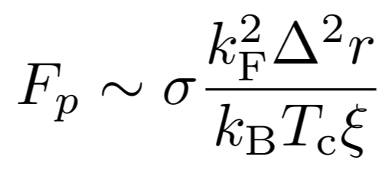
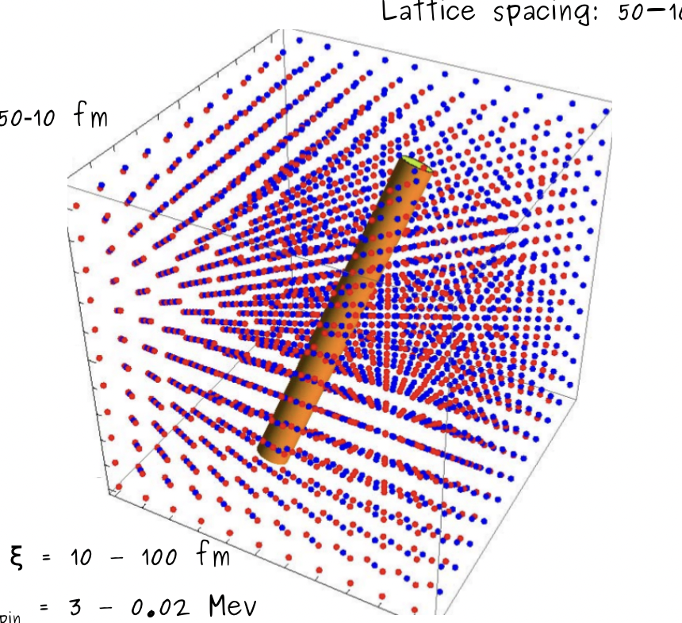
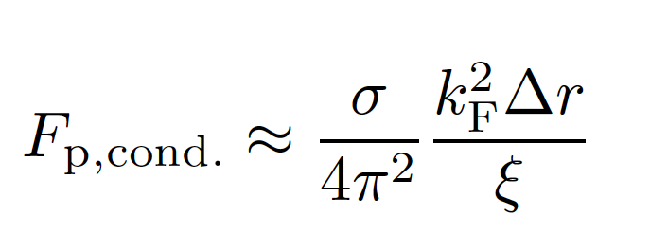
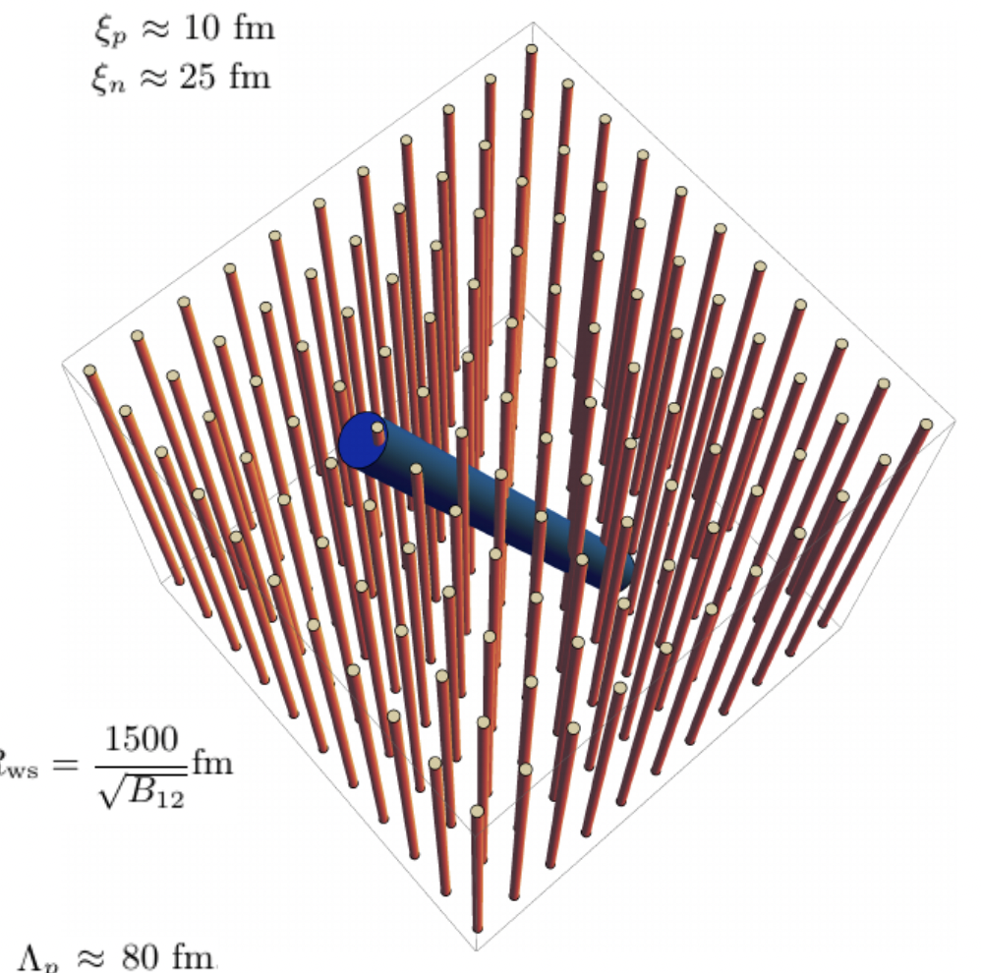

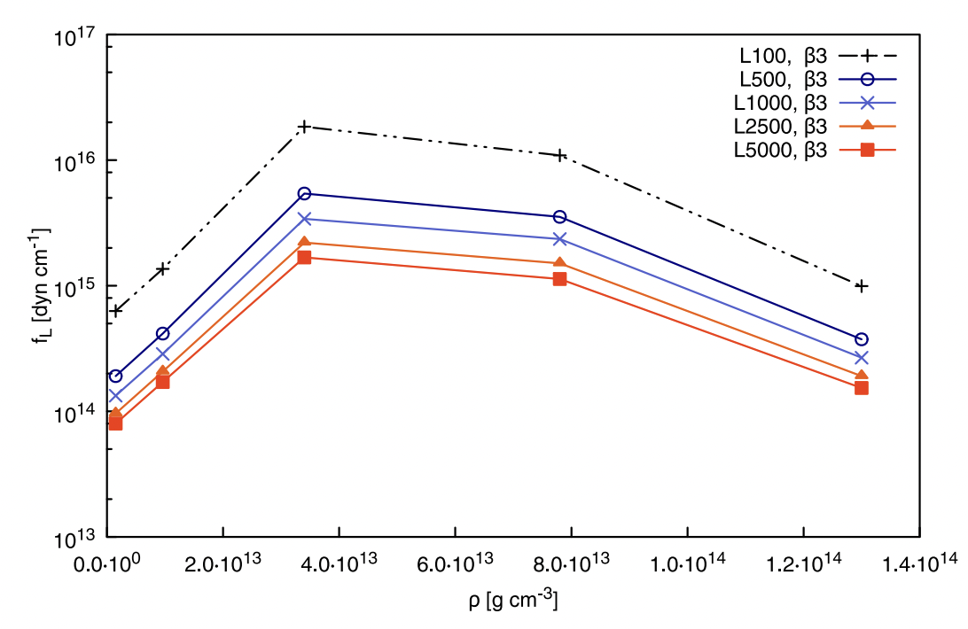
Crust and core pinning
Crust
Core
Pinning to superconducting fluxtubes
Pinning possibly stronger, depends on B topology
(Order parameter)
[Link 2003, Sidery & Alpar 2009]
(See poster by Davide Castellani on B field configurations!)
Pinning due to ions in the crust
First estimates due to Alpar et al. (1981, 1982, 1984)
If vortex rigid - significant reduction (Seveso et al. 2016)
Vortices not rigid? See Daniel Pęcak’s talk
But possibility of vortex avalanches for strong pinning - see poster by Alessandro Costanzo
(Figure by Marco Antonelli)

Slide 6
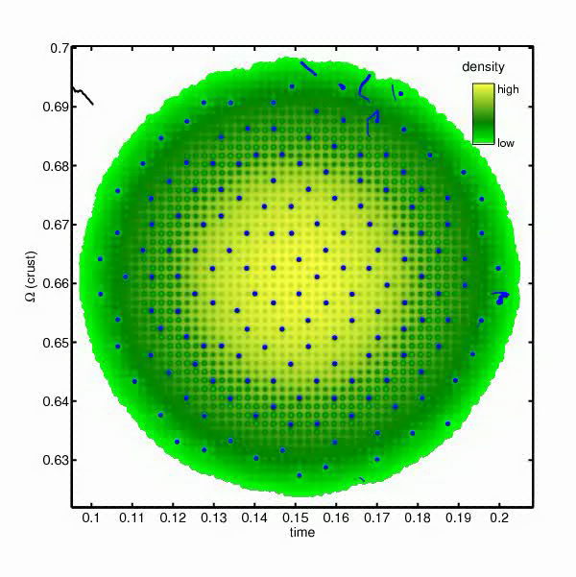
Vortex avalanches
Simulation by Jack Lönnborn, Melbourne - Lönnborn, Melatos & Haskell (2019), MNRAS 487, 702

Slide 7
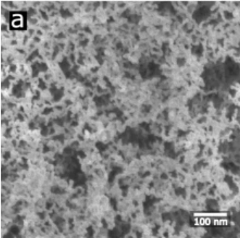
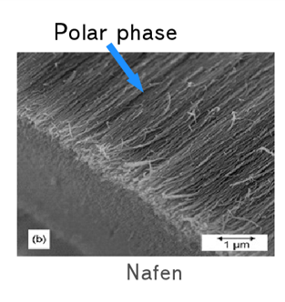
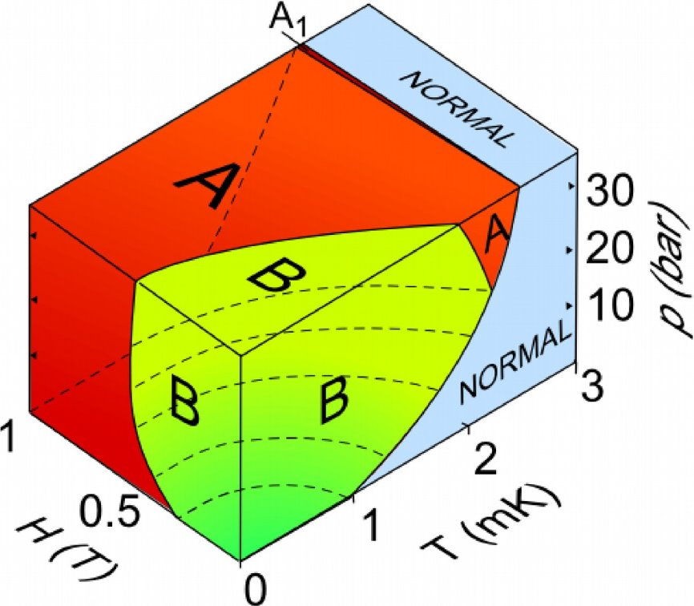
Superfluid ³He in Aerogels
Fermi system, Cooper pairing with S=1 L=1 (p-wave triplet state)
Order parameter is a 3x3 complex matrix
3 Superfluid phases in bulk, several other phases in restricted geometries
a) ”Crust-like" silica aerogel, 98% open, 5nm inter-connected spheres, disordered, B phase at 30 bar, cylindrical container
b) "Core-like" Nafen aerogel, 94% open, 10nm strands, polar phase at p=7bar, box container

Slide 8
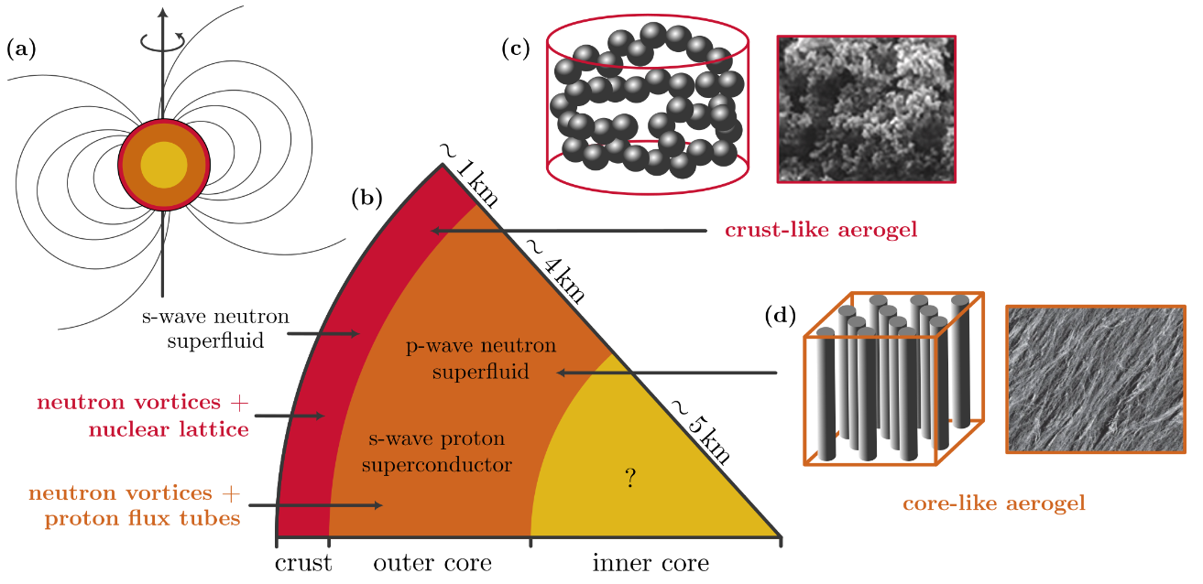
Neutron stars and ³He experiments
(Courtesy of Samuli Autti)

Slide 9
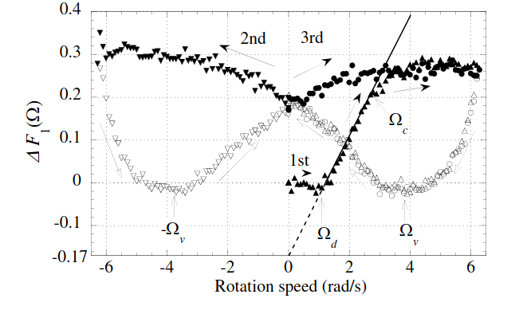
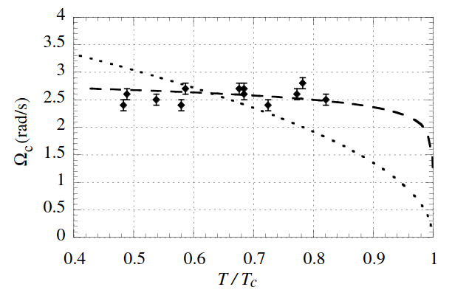
Vortices in crust like aerogels
PRL 94, 075301 (2005)

Slide 10
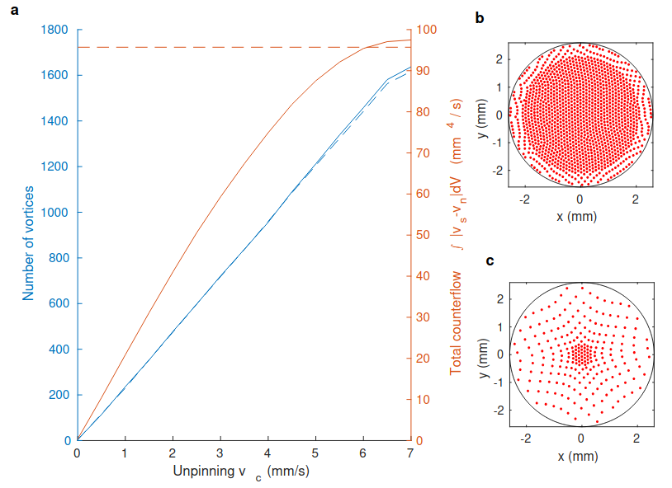



Point vortex simulations
2D point vortex simulation (original by Risto Hänninen)
Vortices can move only if F_{m}>F_{p} ---> v_{c,p} , used as fitting parameter
No hysteresis in pinning/depinning
Pinning sites available continuously
Two other critical velocities: bulk nucleation v_{c,n} , entrance through outer boundary v_{c,e} ; these can sometimes be included ad hoc
Specific values of mutual friction parameters α, α' are not important in most cases
Vortex unpinning:
Bulk nucleation:
Entrance from boundary:

Slide 11


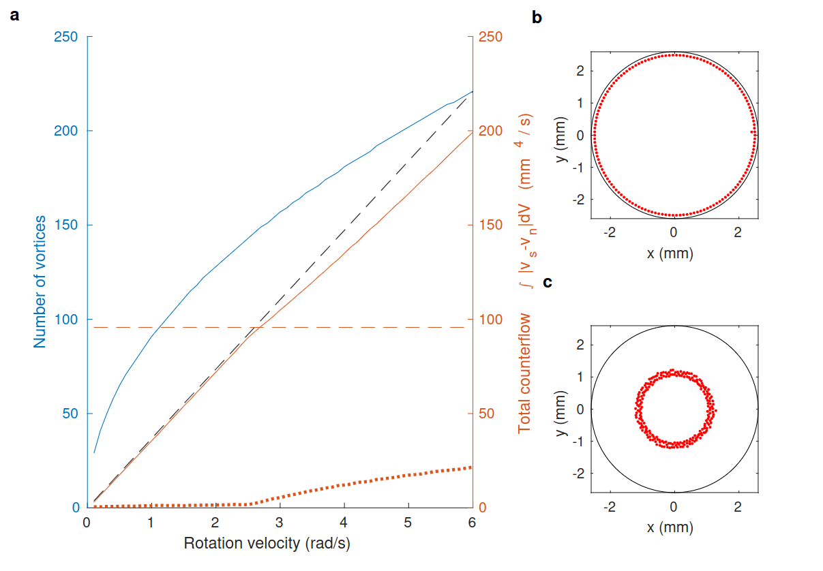
Spin up and spin-down simulations
Vortices enter the system first
Consistent with strong pinning
Corresponds to strongest NS estimates!
[Nature Commun. 10, 237 (2019)], SM​
Spin-down
Spin-up

Slide 12
Vortices in core-like aerogels

Slide 13
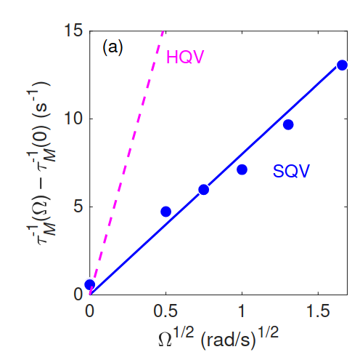
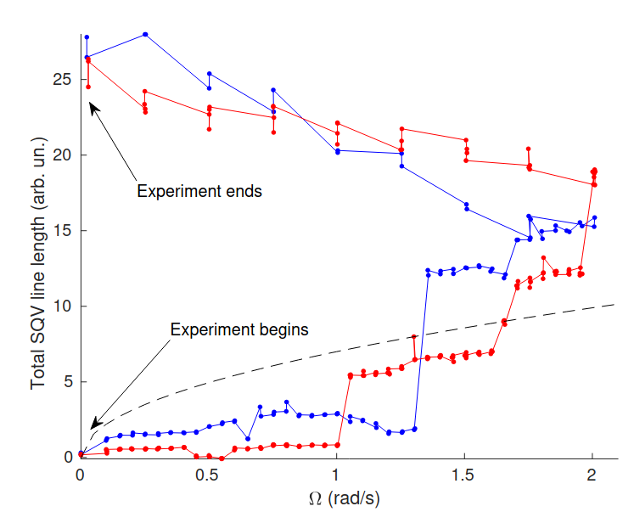
Vortices in core-like aerogels
[PRL 127, 115702 (2021)]
[PRR 2, 033013 (2020)]

Slide 14
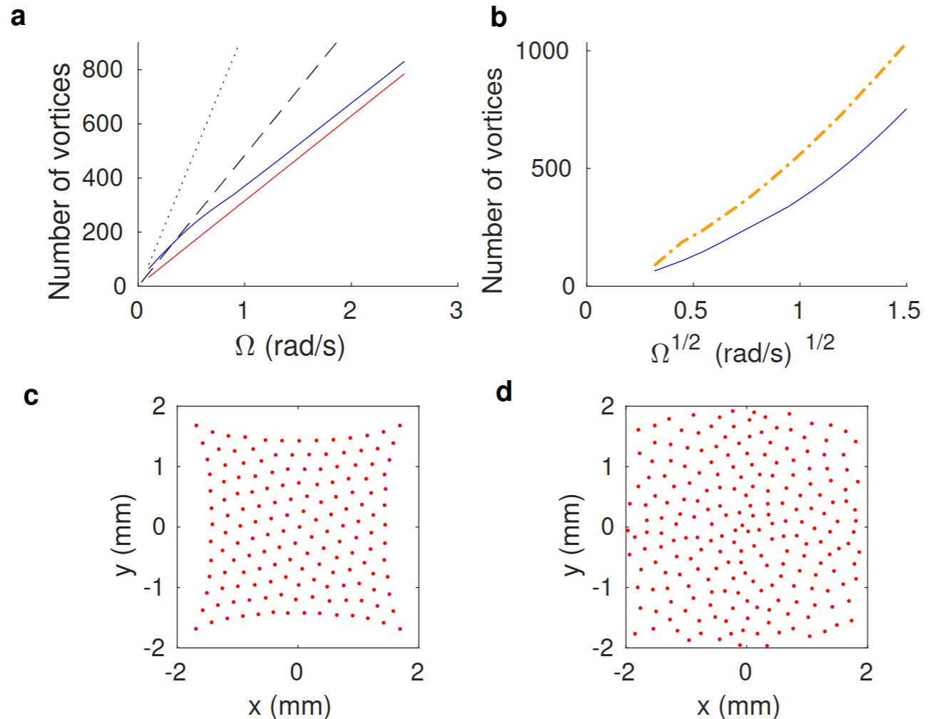
Simulations of vortices in core-like aerogels
high T α, α'
high T + v_{c,p} = 0.1mm/s
Different α, α'
pinning explains scaling of vortex number

Slide 15
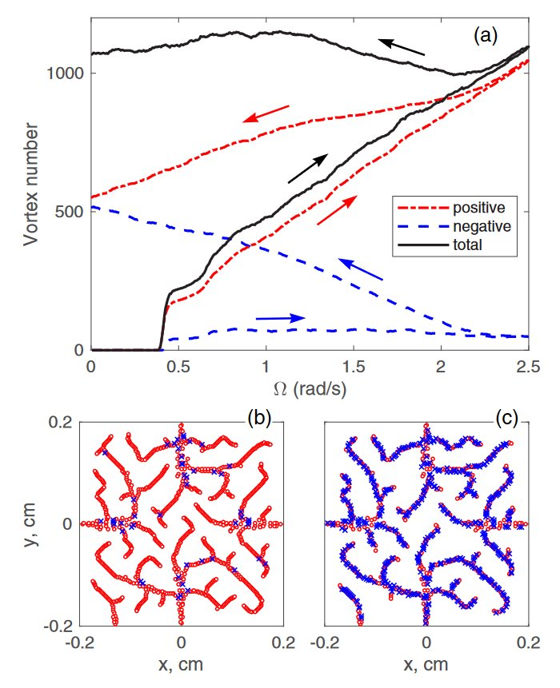


Spin up and spin down in core-like aerogels
Vortices nucleation ‘avalanches’ explain the behaviour
[PRR 2, 033013 (2020)]

Slide 16
Extrapolation to neutron stars
NS crust:
v_{c,p} ~ 10⁷ m/s at the inner crust edge
v_{c,p} ~ 10⁵ m/s near the crust-core bdr.
Rapid rotation 1000 rad/s --> v=10⁷ m/s
NS core:
v_{c,p} ~ 5x10⁶
Bulk nucleation
In both phases v_{c,n} not larger than ~κ/(2πξ) ∼ 10⁶ m/s!
Taking this at face value, vortices won't be able to escape the crust and nucleation will take place instead! Also, no turbulence etc bulk phenomena.
But possibility of vortex avalanches for strong pinning - see poster by Alessandro Costanzo

Slide 17
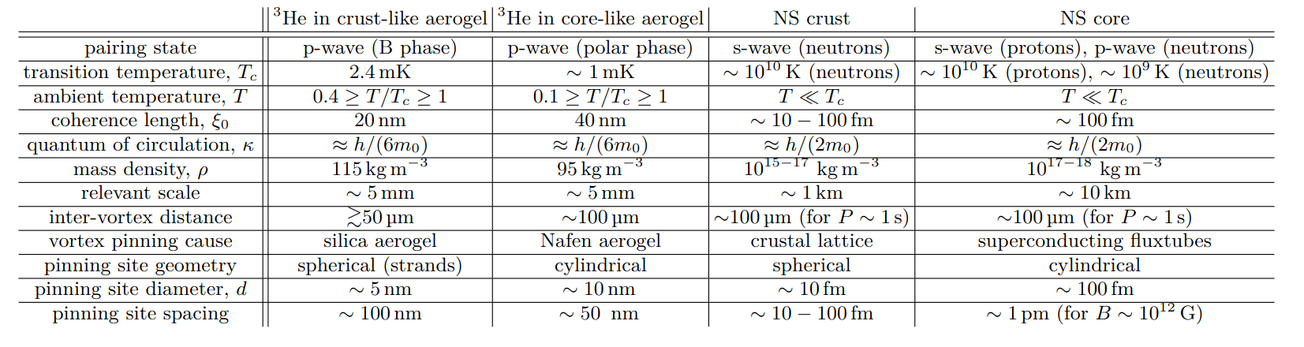
Conclusions
Helium 3 and aerogels provide a platform to study superfluity in a NS ‘setting’
Extrapolations require caution - but pinning appears strong
Consistent (maybe) with TDDFT simulation results - strong (interstitial) pinning and low tension
Vortex (anti-vortex) nucleation in the core and motion through the crust?
Need to model density dependence and local effects (and hydro)
[PRR in review, arXiv: 2604.18016]

Slide 19
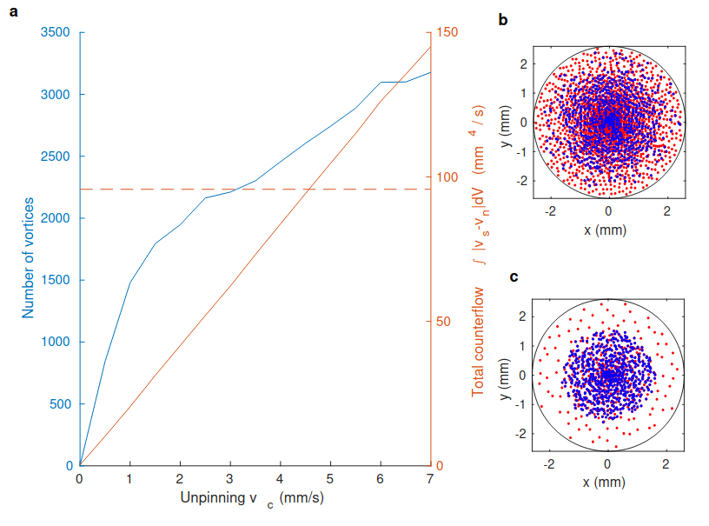


Slide 20
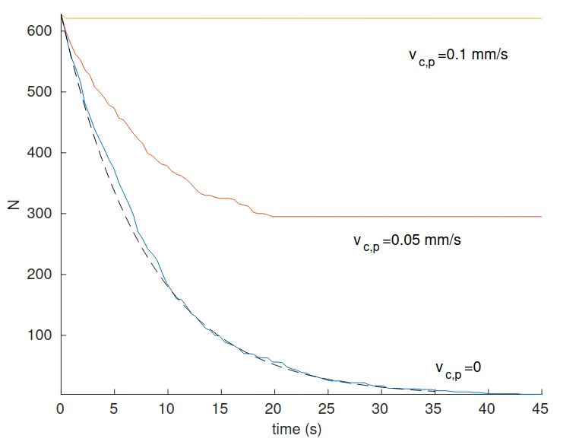
Freezing KZ vortices in place
Array of random vortex polarities and locations in the box
Here α=5, α'=0.95. Increasing the temperature (mutual friction) slows down the annihilation
vc=0.1mm/s reached at perhaps T=0.999Tc, that is, in a fraction of relaxation time even in slowest cooldowns

