Slide 1



Persistent Gravitational Radiation from Glitching Pulsars
Thippayawis (Tong) Cheunchitra
With Andrew Melatos, Julian Carlin, and George Howitt
arXiv: 2401.05600
SCALES 1st General Meeting - 26/06/2026

Slide 2
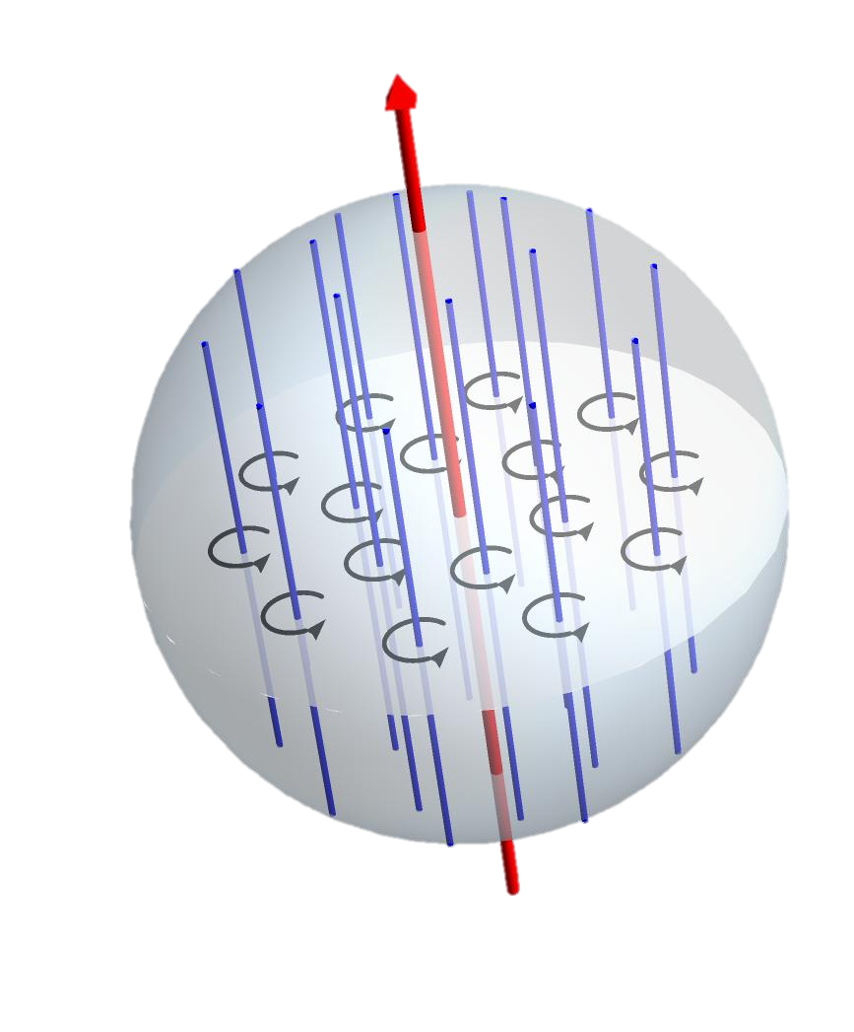
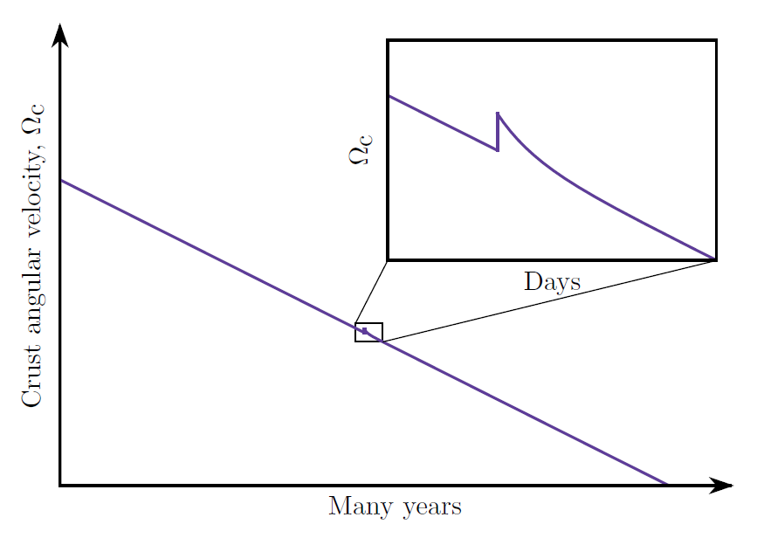
Superfluids In NS & Glitches
Pulsar Glitches
Superfluid vortices
Avalanches
Credit: Julian Carlin
Observational hints: size-waiting time distribution, e.g. Melatos 2008, Howitt & Melatos 2018
1/13

Slide 3
Vortex Avalanches
Electromagnetic braking → NS Crust spins down
Vortices pinned → Magnus force builds up
One vortex depins
Vortex knock-on → avalanche
Transfers angular momentum to crust → Glitch!
1/13

Slide 4
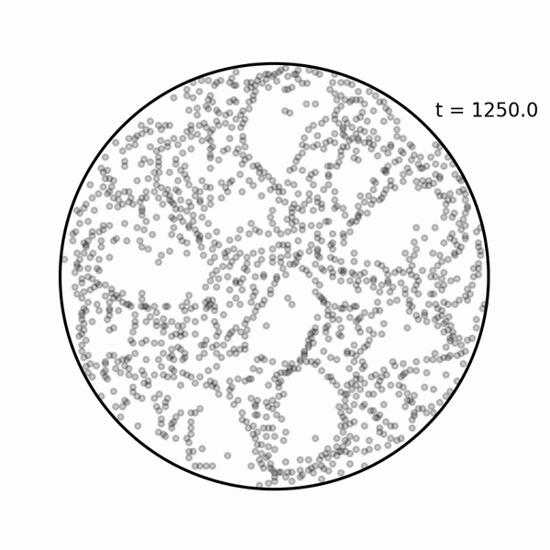
Vortex Avalanches
Can study this in several ways, e.g.
Cellular Automata [1]
Gross-Pitaevskii Solvers [2]
N-body simulations [3]
[1] Warszawski & Melatos (2008)
[2] Warszawski & Melatos (2011, 2012), Drummond & Melatos (2017, 2018), Thong et al. (2023), Liu et al. (2025), (and many more!)
[3] Howitt et al. (2020), Anantharaman & Bhattacharya (2025)
1/13

Slide 5
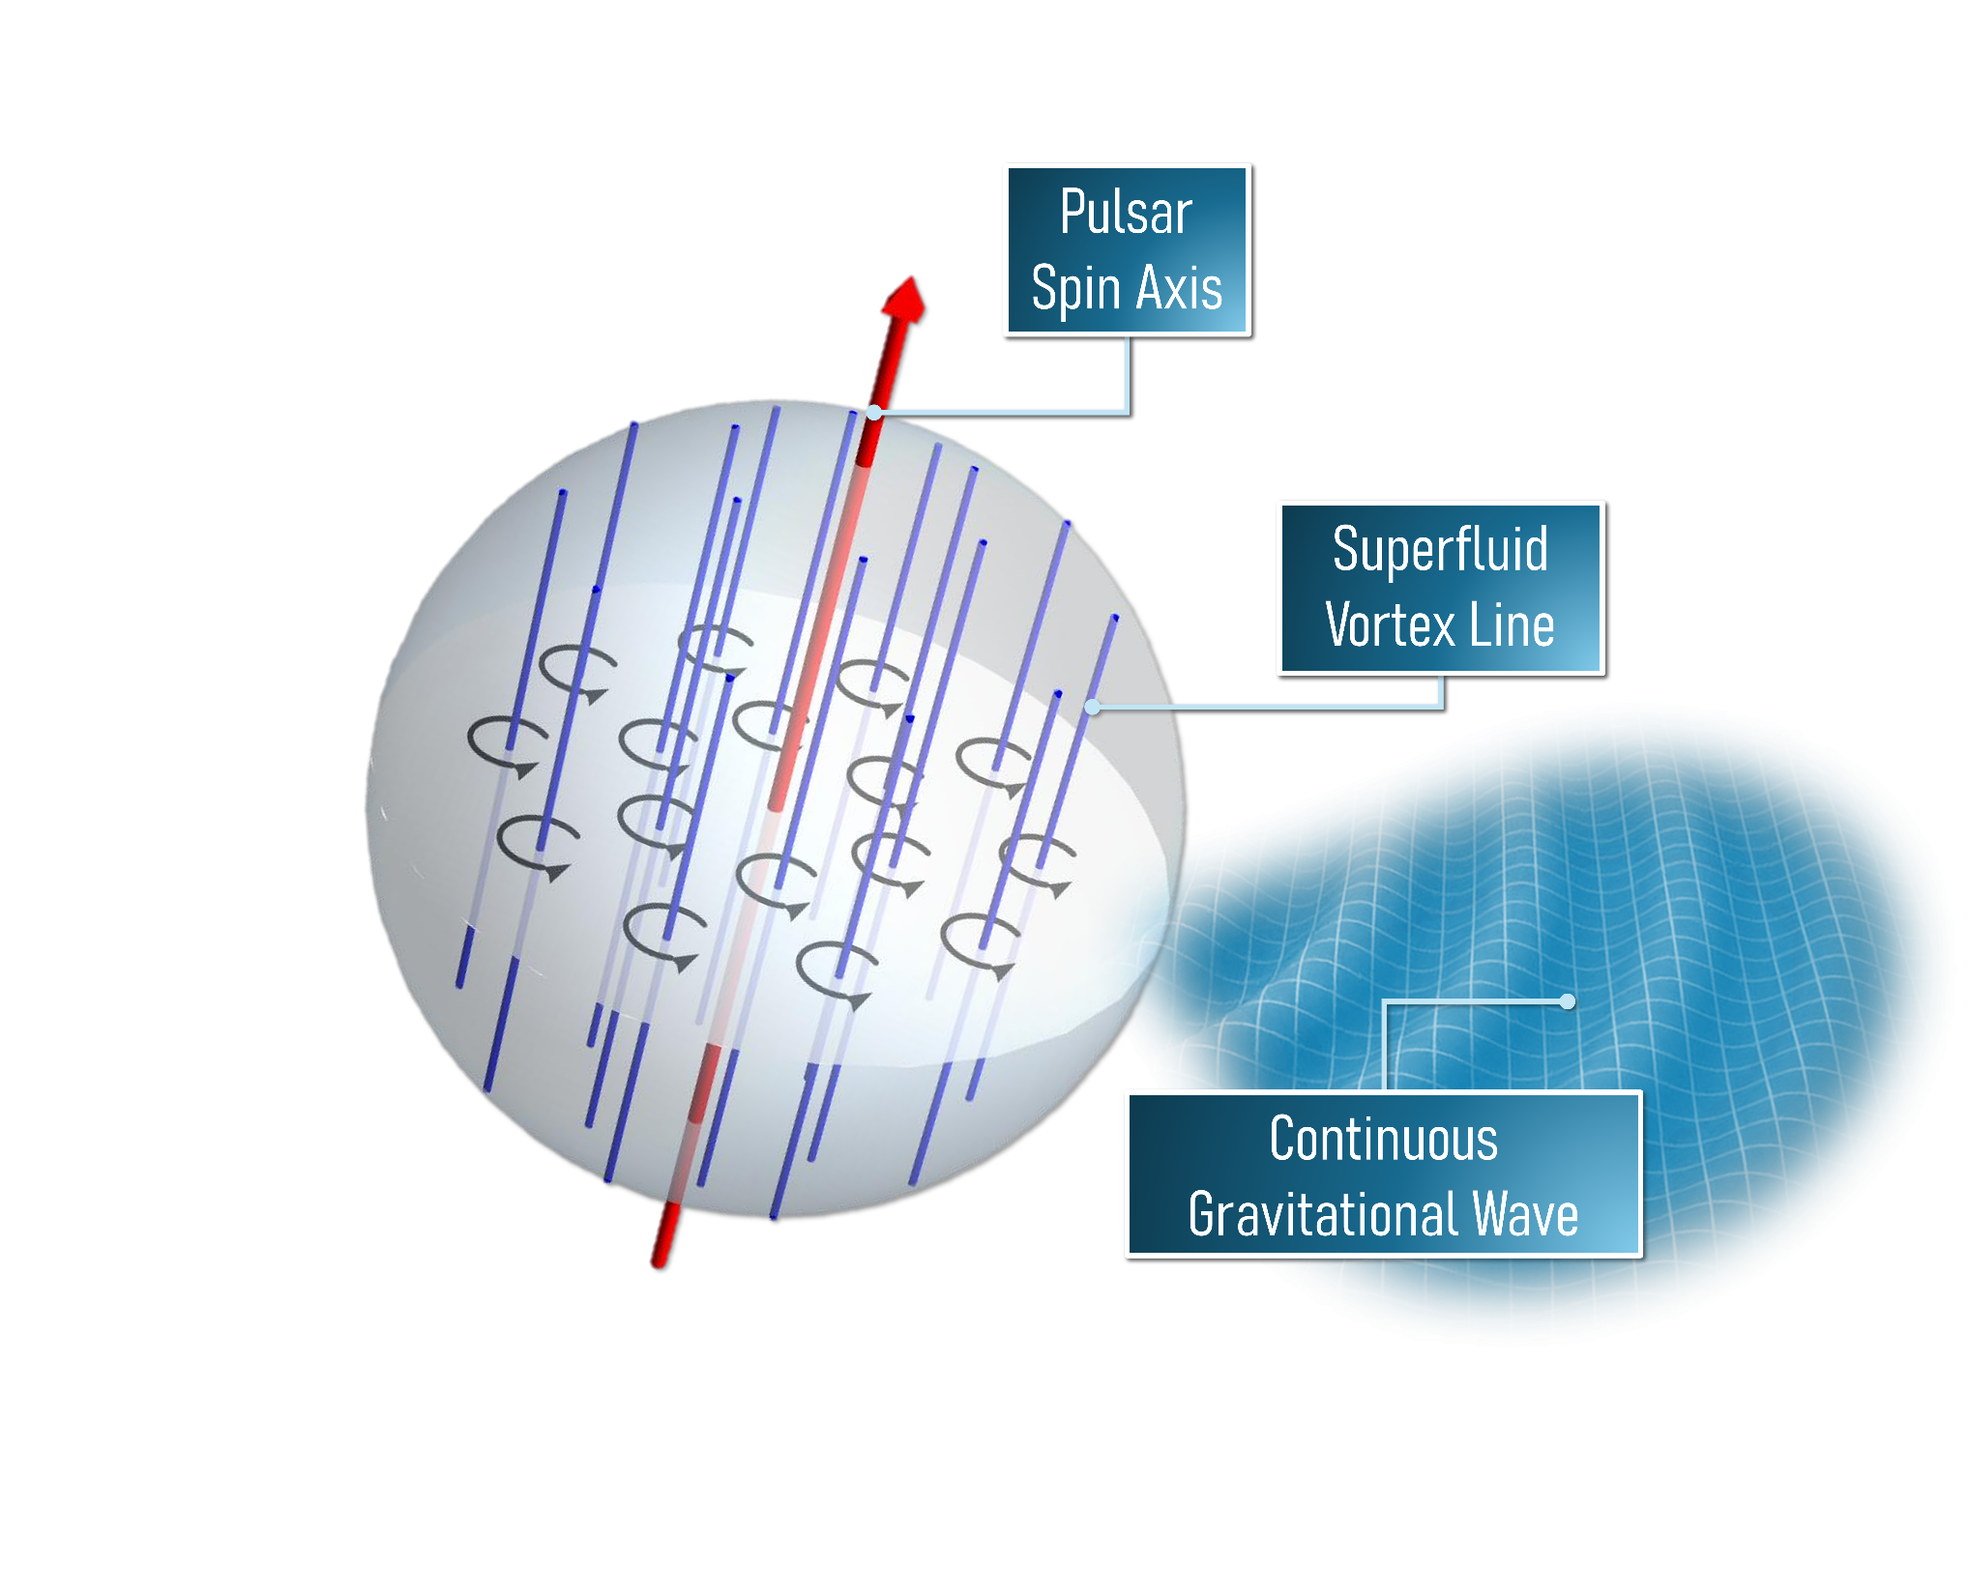
So what?
Between avalanches, current is fixed & asymmetric
Fixed current quadrupole moment, rotating
NS emits continuous gravitational waves!
How strong is it?
Challlenge: no analytic theory for avalanche statistics!
1/13

Slide 6
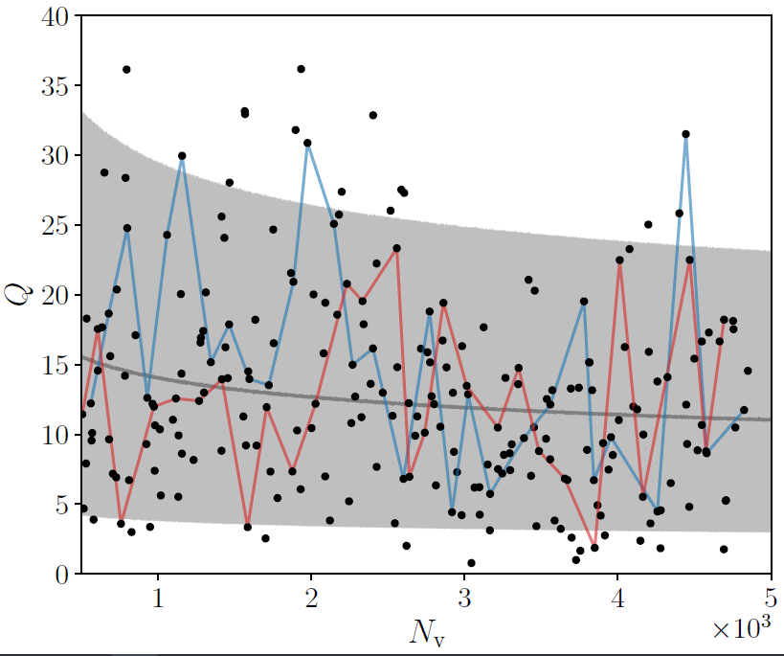
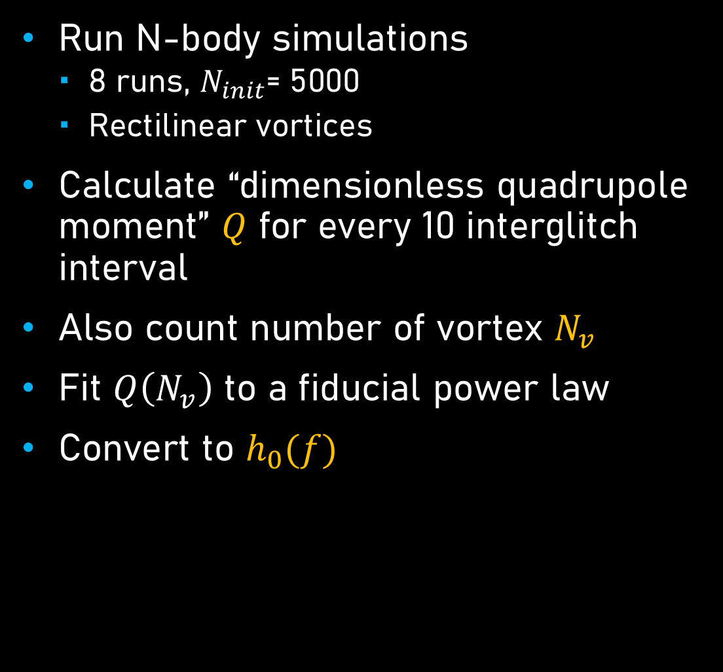
N-body Simulation Scaling
Run N-body simulations
  8 runs, $N_{init}$= 5000
  Rectilinear vortices
Calculate “dimensionless quadrupole moment” $Q$ for every 10 interglitch interval
Also count number of vortex $N_{v}$
Fit $Q\left(N_{v}\right)$ to a fiducial power law
Convert to $h_{0}(f)$
Cheunchitra et al. 2024
1/13

Slide 7
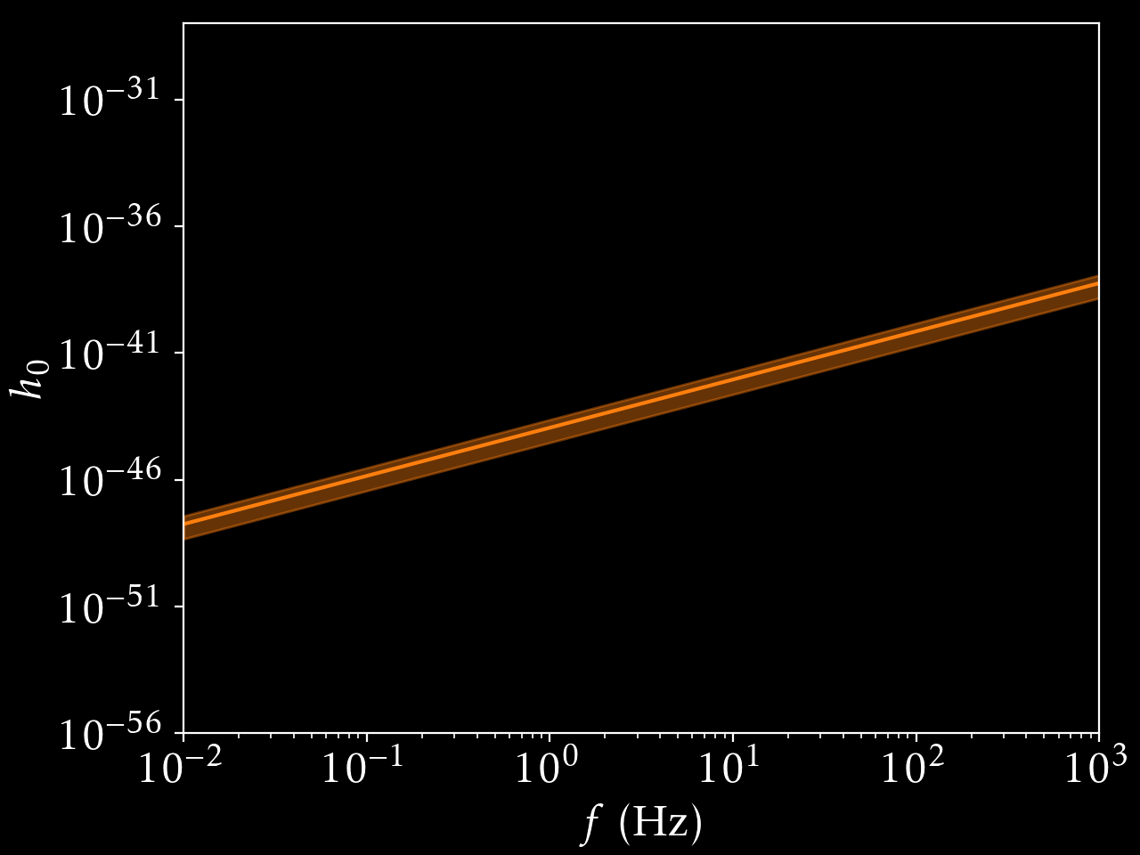

N-body Simulation Scaling
Feynman-Onsager: $N_{v}∝Ω$
So $Q\left(N_{v}\right) → h_{0}\left(f\right)$
But…
  In neutron stars, $N_{v}∼{10}^{17}$
  In our simulations, $N_{v}∼{10}^{4}$
For safety, compute some sanity checks
1/13

Slide 8
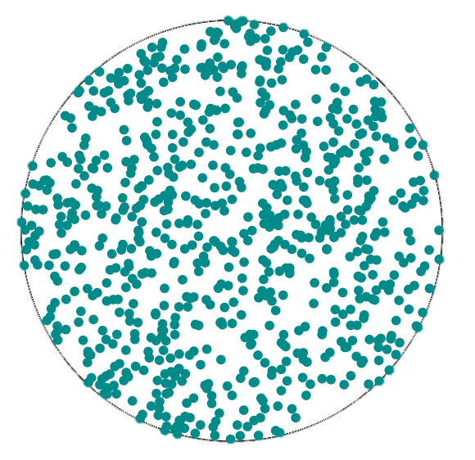
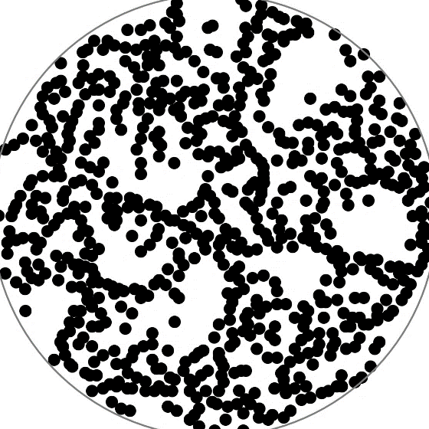
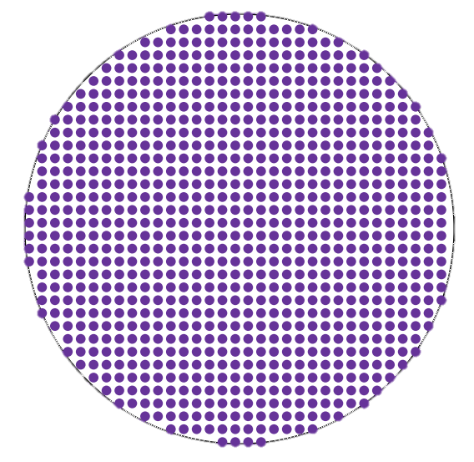
Limiting Cases
Vortex avalanche occurs when there is balance between pinning and repulsion
Pinning-dominated
Equal probability per area
Repulsion-dominated
Regularly-spaced
“Real star”/N-body
1/13

Slide 9
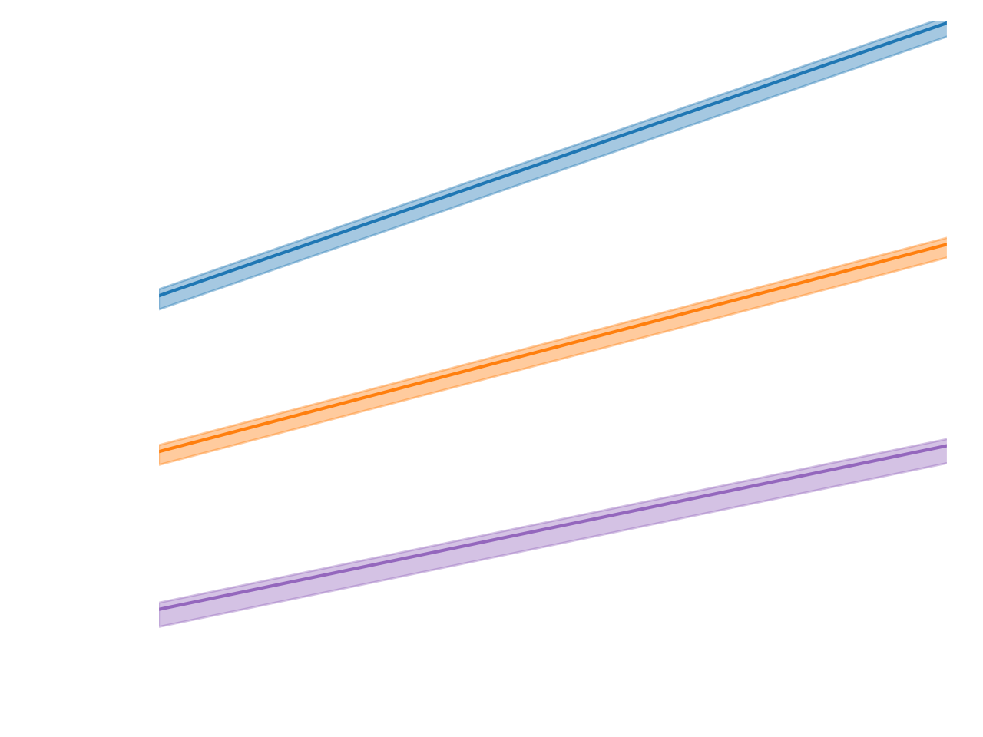
Limiting Cases
Pinning-dominated
N-body
Repulsion-dominated
1/13

Slide 10

Observing the GW
LIGO Band
Most optimistic: $h_{0}∼{10}^{−31}$
  LVK upper-limit: $h_{0}∼{10}^{−25}$
But…
1/13

Slide 11
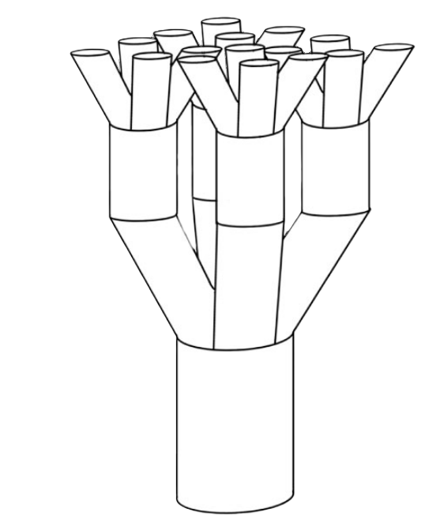

Flux Branching
Thong & Melatos (2024, 2025)
Vortices could pin to magnetic flux tubes, which cluster together due to flux branching
Clustering ~ opposite to repulsion
Increase $h_{0}$ to $∼{10}^{−25}$ (with a few uncertainties)
Clustering
No repulsion
Max repulsion
1/13

Slide 12


Summary
Glitches → asymmetric vortex arrays → GW
We calculate current quadrupole with N-body simulation, and get $h_{0}\left(f\right)$ scaling
Developed analytic scalings for limiting cases
Signal is weak but could tell us about NS microphysics!
arXiv: 2401.05600
1/13

