Slide 1
Belle II Particle Discovery MBI Vienna
Belle II IMC 2026

Slide 2
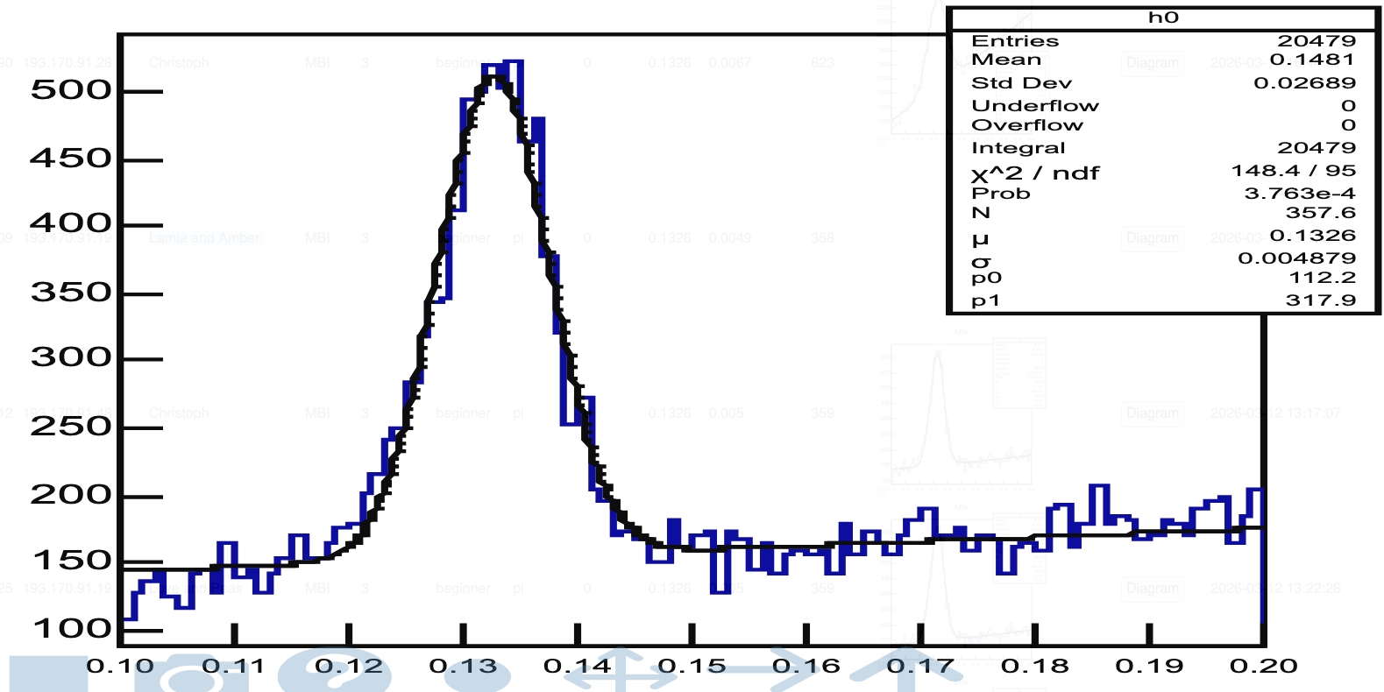
Pi0 → gamma gamma
Mass = 0.1326 GeV
Width = 0.0049 GeV
Discovery: Lamia and Amber

Slide 3
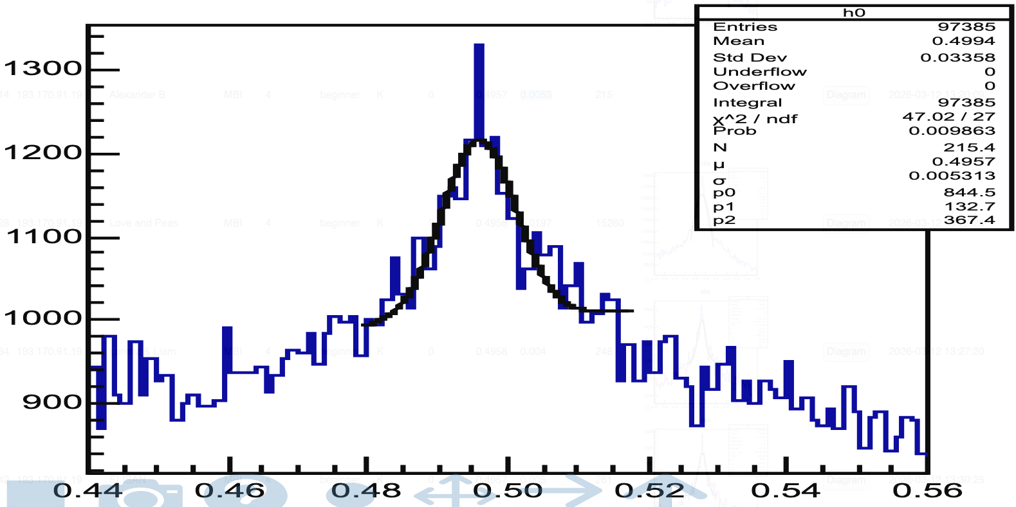
KS0 → pi+ pi-
Mass = 0.4957 GeV
Width = 0.0053 GeV
Discovery: Alexander B

Slide 4
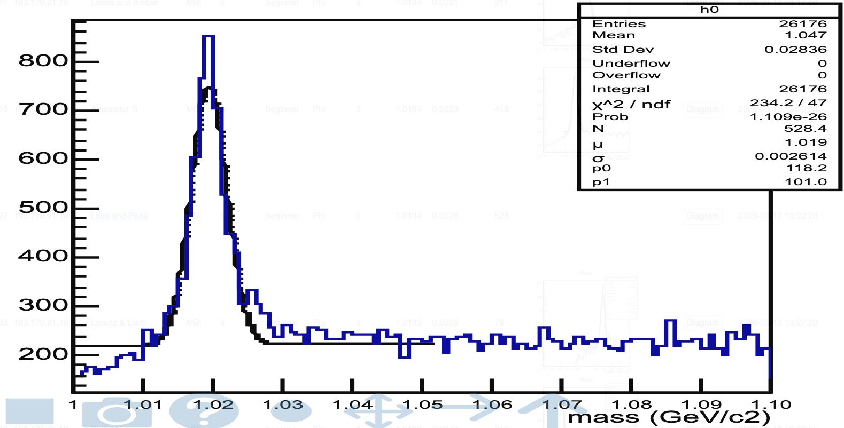
Phi → K+ K-
Mass = 1.0194 GeV
Width = 0.0026 GeV
Discovery: Love and Peas

Slide 5
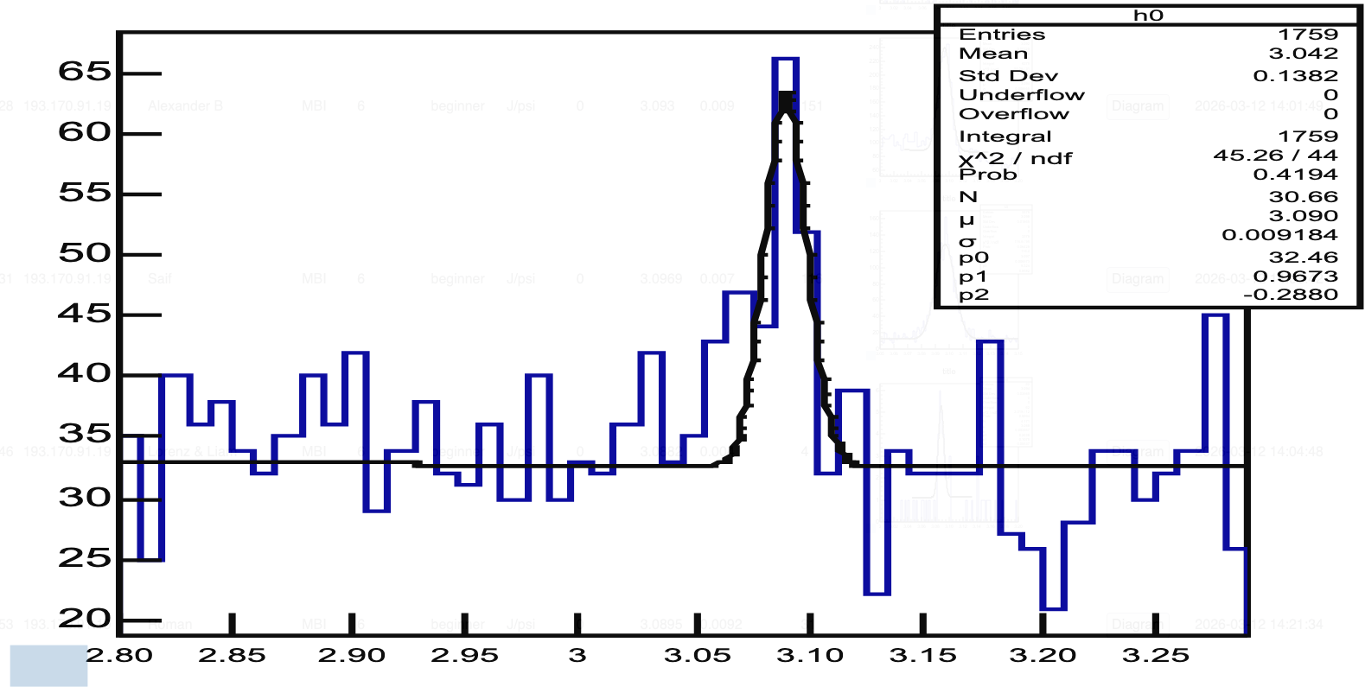
J/psi → e+ e-
Mass = 3.0895 GeV
Width = 0.0092 GeV
Discovery: Roman

Slide 6
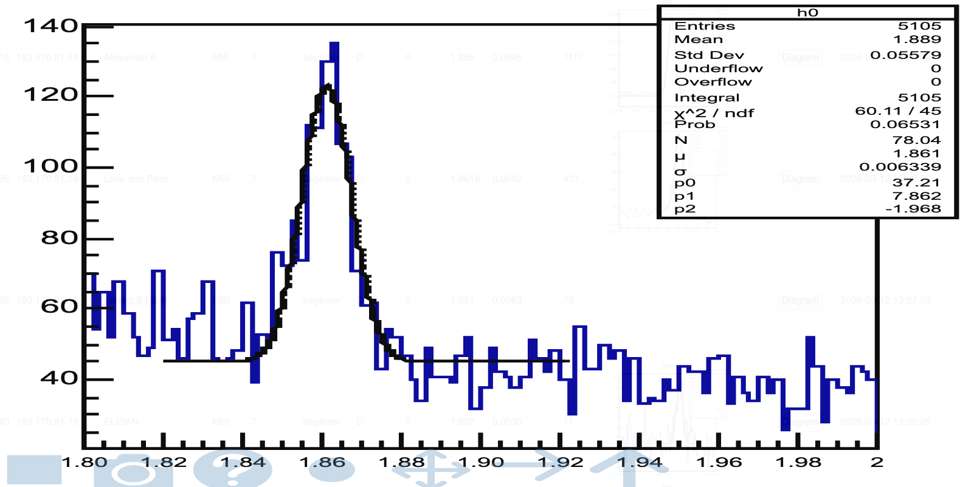
D0 → K- pi+
Mass = 1.861 GeV
Width = 0.0063 GeV
Discovery: Lorenz & Liam

Slide 7
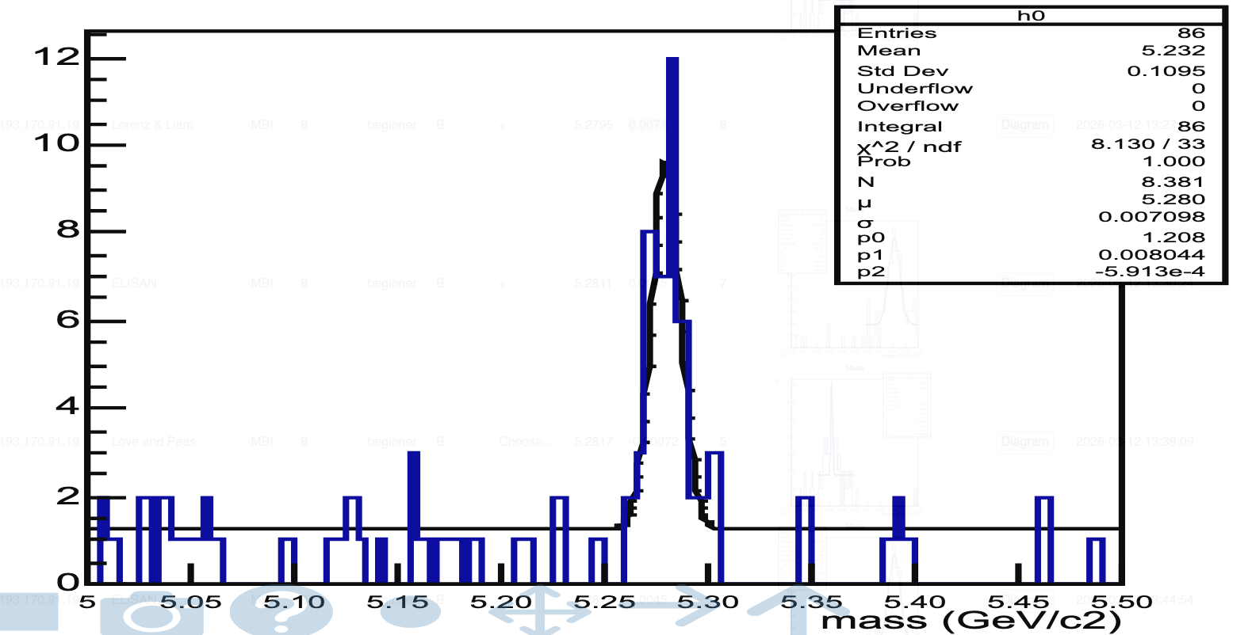
B+ → J/psi(mu+ mu-) K+
Mass = 5.2795 GeV
Width = 0.0071 GeV
Discovery: Lorenz & Liam

Slide 8
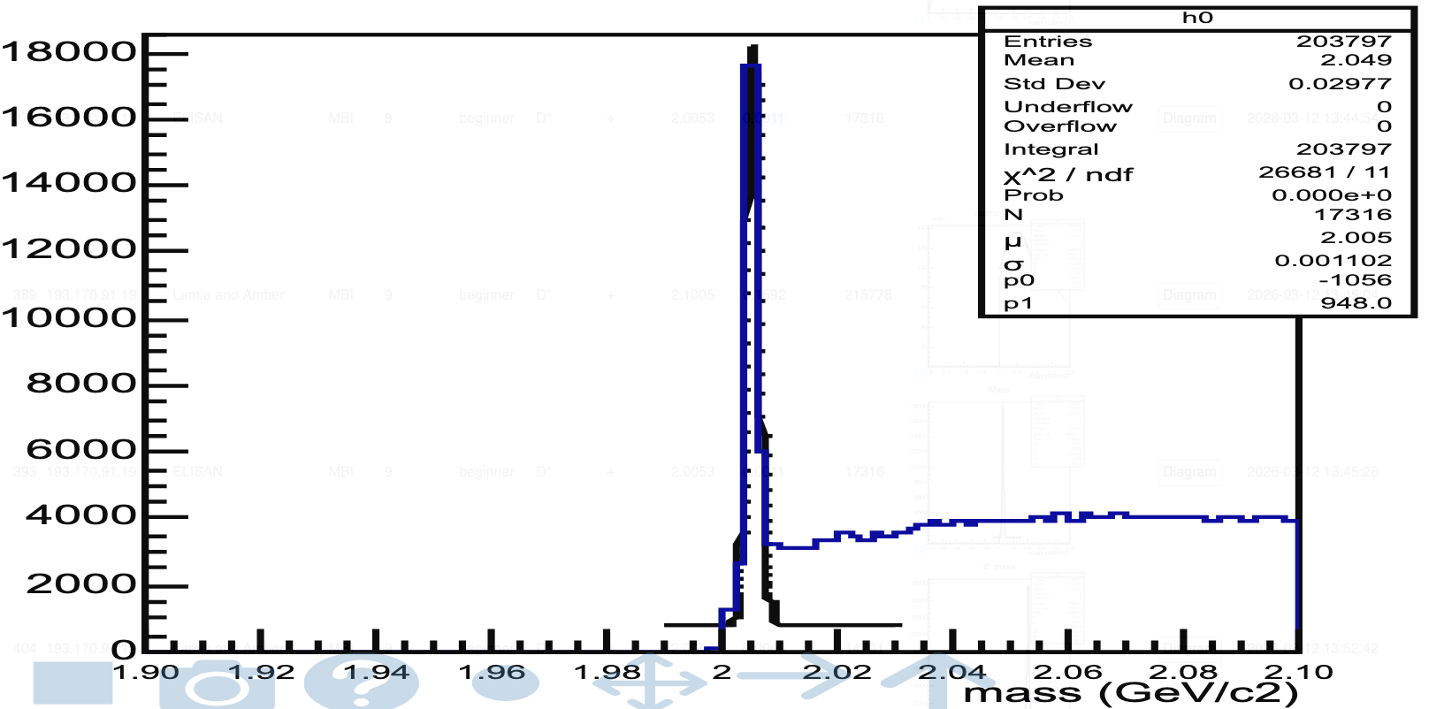
D*+ → D0 (K- pi+) pi+
Mass = 2.0053 GeV
Width = 0.0011 GeV
Discovery: ELISAN

Slide 9
Thank you very much!

