Slide 1
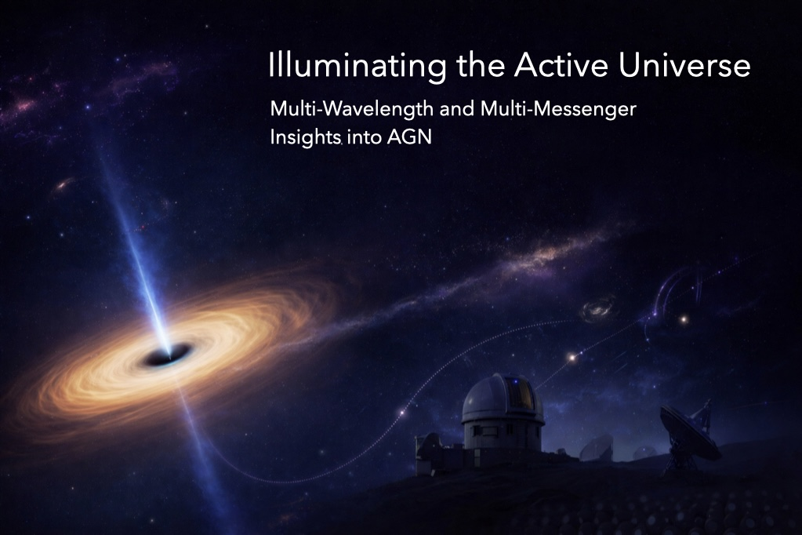
WELCOME !

Slide 2
Workshop programme
Day 1: Monday, 14th
- Afternoon: Blazars
- Welcome reception
Day 2: Tuesday, 15th ​ ​
- Morning: X-ray AGN, Radio AGN
- Afternoon: AGN emission
Day 3: Wednesday, 16^{th​}
- Morning: Multimessenger, AGN Jets
- Group photo at 12:40
– Afternoon: AGN environments
- Social dinner at 19:30, Augustiner Stammhaus, Garching
Day 4: Thursday, 17th
- Morning: AGN feedback, AGN evolution
- End of meeting at 12:40
- Lunch

Slide 3
Talk guidelines
Updated conference programme online
Invited talks: 25 + 5 min
Contributed talks: 17 + 3 min
For the speakers:
  please upload you presentation before your session on the dedicated link (info sent also by email), strongly preferred option,
  OR bring your slides to the session chair before your session to transfer with USB key

Slide 4
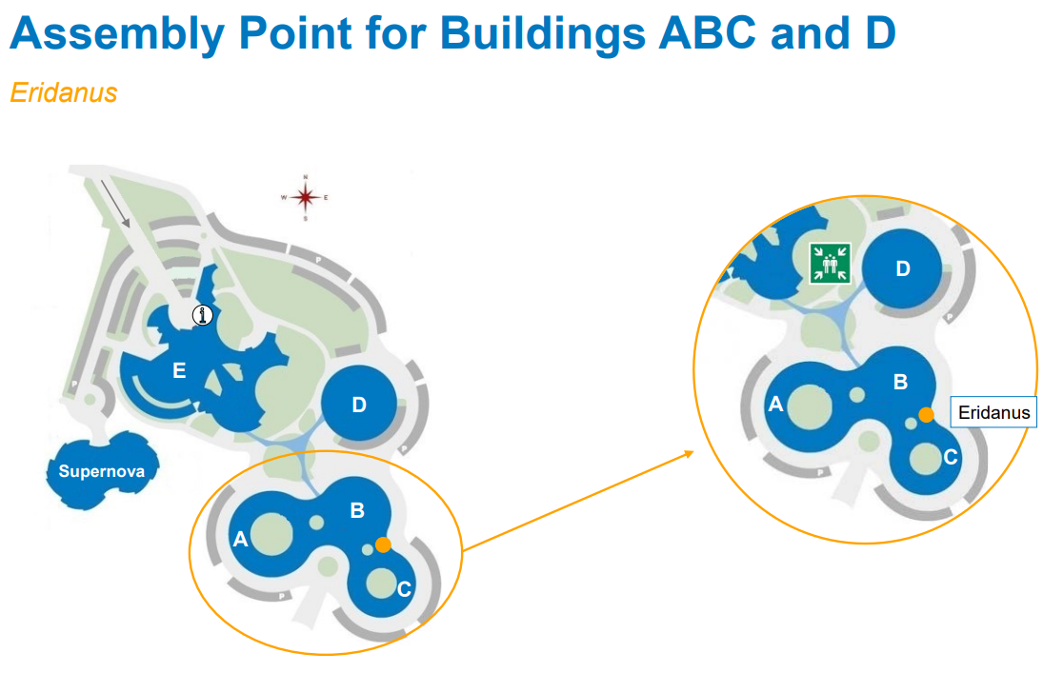
Safety information
Evacuation route:
  In Eridanus: in case of fire please evacuate via the two doors at the front/down of the room;
  In the Lobby (where the posters and coffee/food is): please evacuate through the big glass doors.
Safety area: the parking lot around the building.

Slide 5
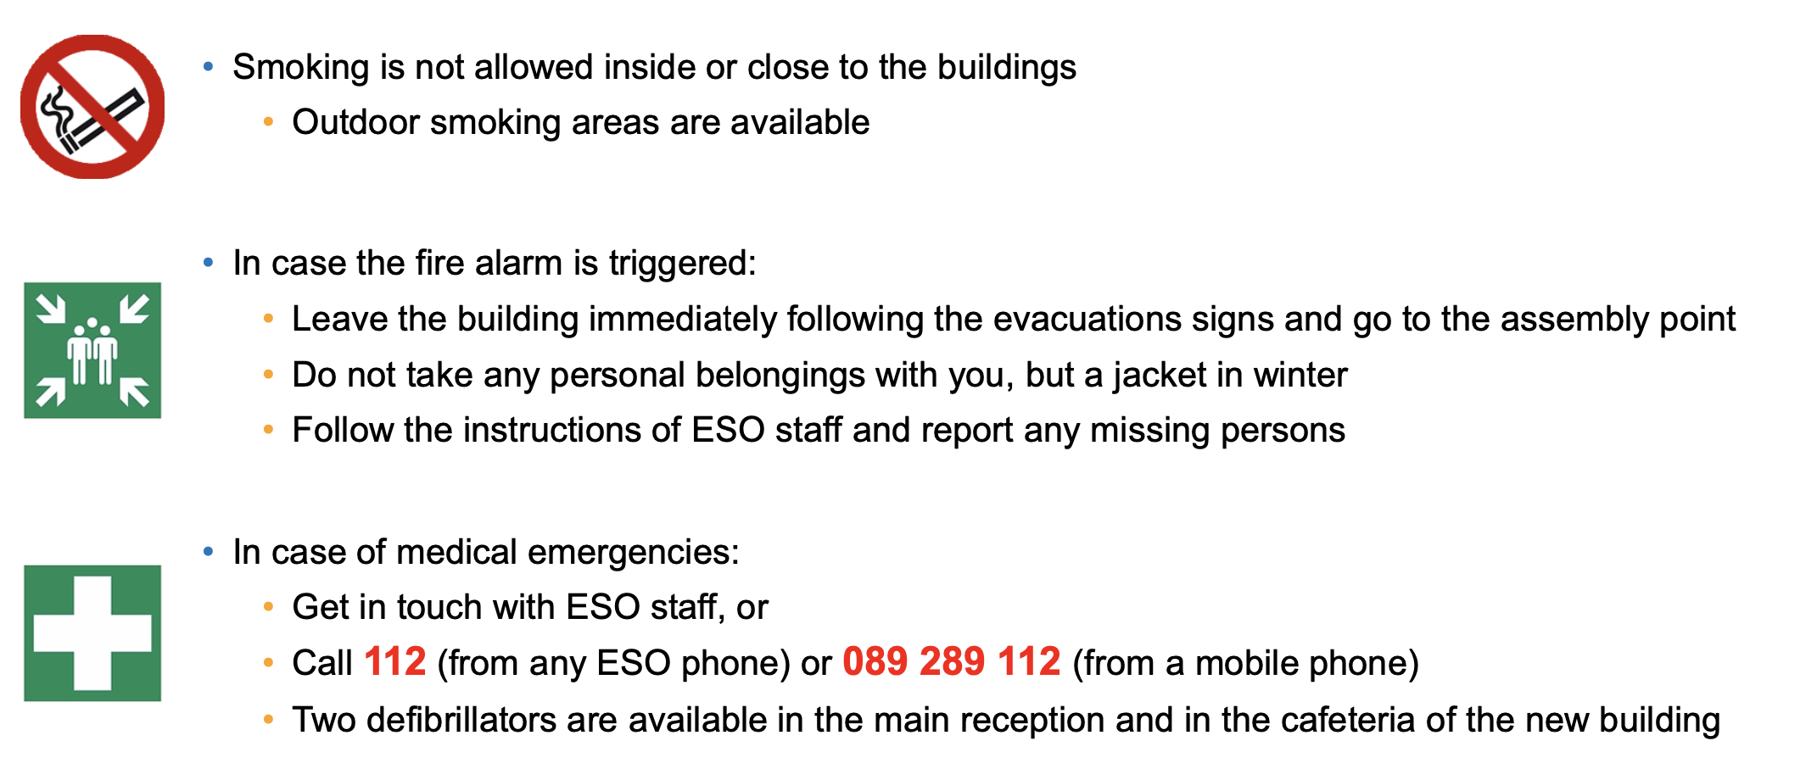
Safety information

Slide 6
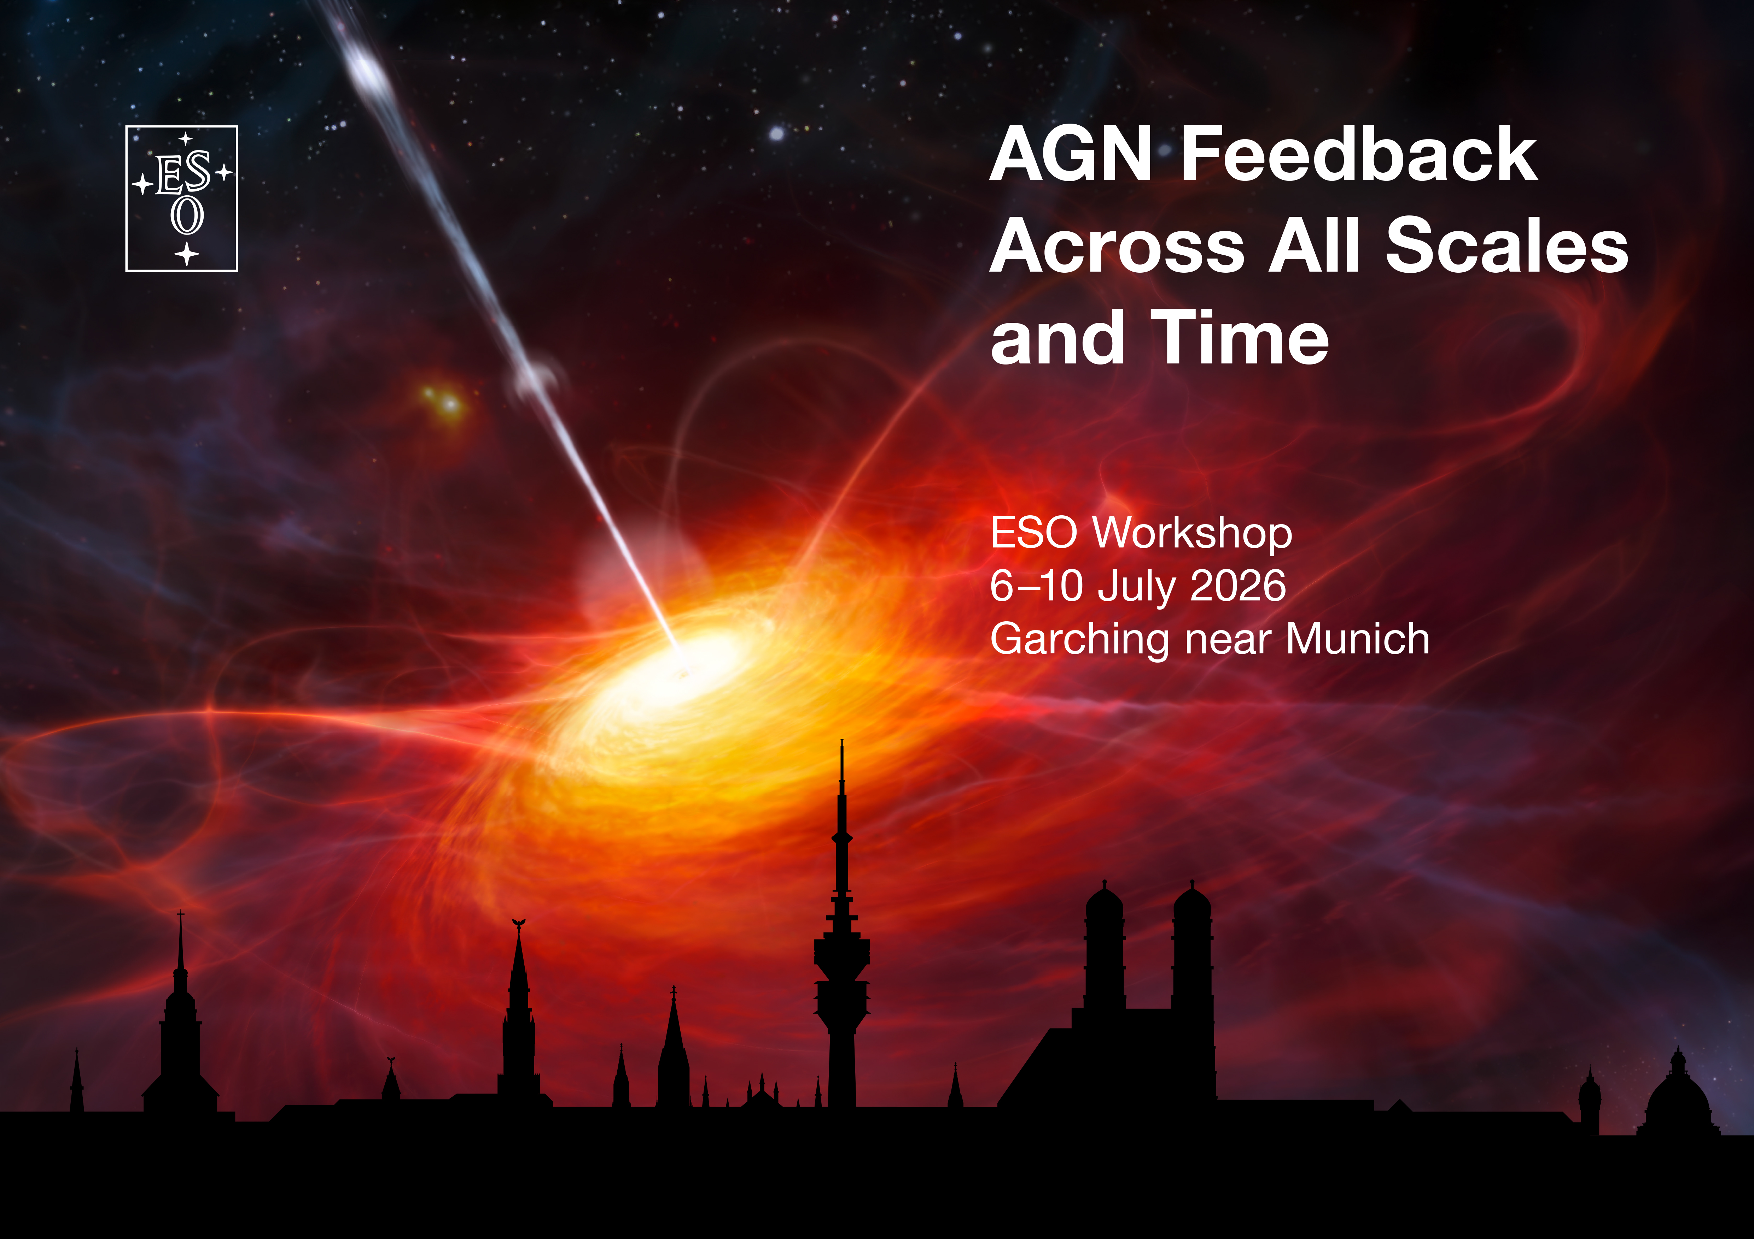
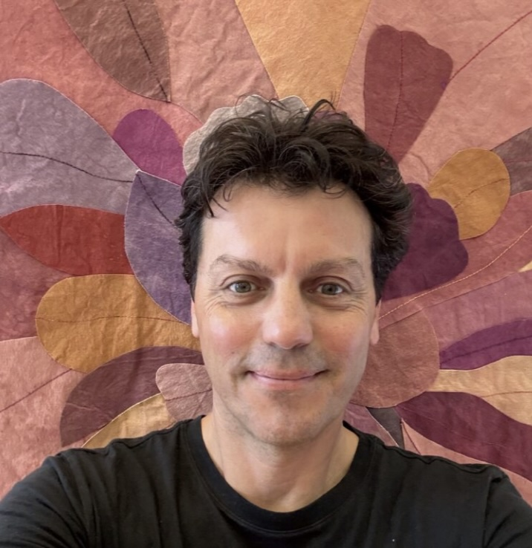
Code of conduct
ESO is committed to creating a work environment that is safe, professional and of mutual trust where diversity and inclusion are valued, and where everyone is entitled to be treated with courtesy and respect. ESO organisers commit to making conferences, workshops, and all associated activities productive and enjoyable for everyone. We will not tolerate harassment of participants in any form.
We ask that all participants read the Code of Conduct & Chair Guidelines on the workshop’s website.
In case of problems, please reach out to the designated contacts:
Green batch
Vincenzo Mainieri
(vmainier@eso.org)

Slide 7
ENJOY THE WORKSHOP!

