Slide 1

Restarted Jets: Dynamics, Particle Acceleration and Emission.
Prathamesh Ratnaparkhi
IUCAA, Pune
Collaborators:
Dipanjan Mukherjee, Gianluigi Bodo, Paola Rossi, Marisa Brienza, and Raffaella Morganti
Illuminating the Active Universe, Sep 16 2026,
ESO

Slide 2
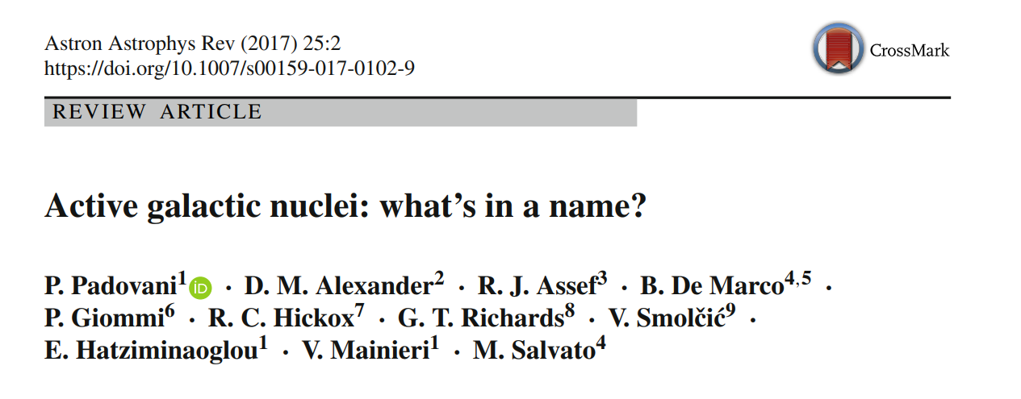
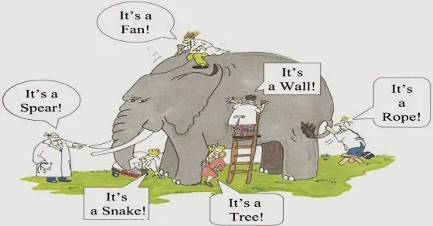
There is only one animal in the AGN zoo: It is an accreting supermassive black hole.

Slide 3
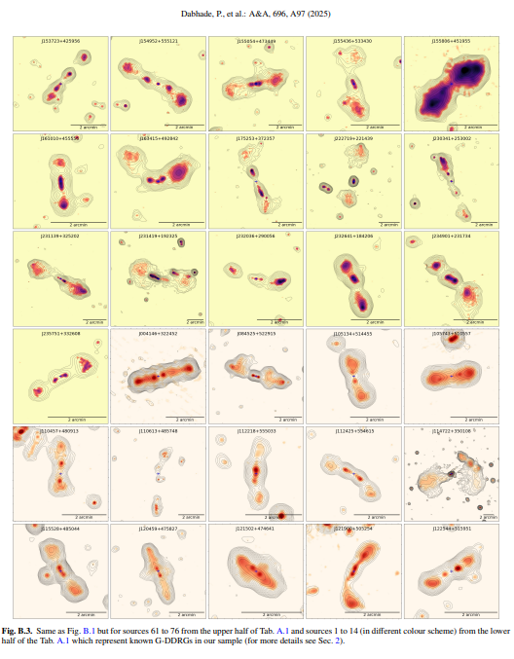
Restarted Jets
About 10% (1% ?) of AGN are jetted,
A few hundred cases of Restarted Jets have been observed.
Causes of Restart:
Cooling Flow - Feedback Loop.
Accretion Disc Instabilities.
Mergers …

Slide 4
Science Questions
Additional Results
Are instabilities efficient at filling the cavity left by the previous episode?
How do power, magnetic field affect the instabilities?
What is the source of emission for the new jet: fresh particles or old, re-accelerated particles?
How the conditions in the old cocoon shape the dynamics of the new jet?
For additional results, please refer to our papers:
Paper 1 : Numerical Simulations of Restarted Jets - I. Dynamics
Ratnaparkhi et. al. 2026
Paper 2 : Numerical Simulations of Restarted Jets II: Particle Acceleration and
Emission
Ratnaparkhi et. al. 2026 (to be submitted)

Slide 5
How do we attack the problem?
Technical Details
Fluid simulations with lagrangian particles.
3 Simulations with 2 restarted cases each.
 | Magnetisation | Power (erg / s)
Sim A | 0.1 | 10⁴⁵
Sim B | 0.05 | 10⁴⁵
Sim C | 0.05 | 10⁴⁴
Vastly different scales for particle acceleration and fluid simulations. How to bridge the gap?

Slide 6

Lagrangian Particles
Advection
Adiabatic cooling/ heating
Synchrotron and IC CMB cooling
Shock Acceleration

Slide 7
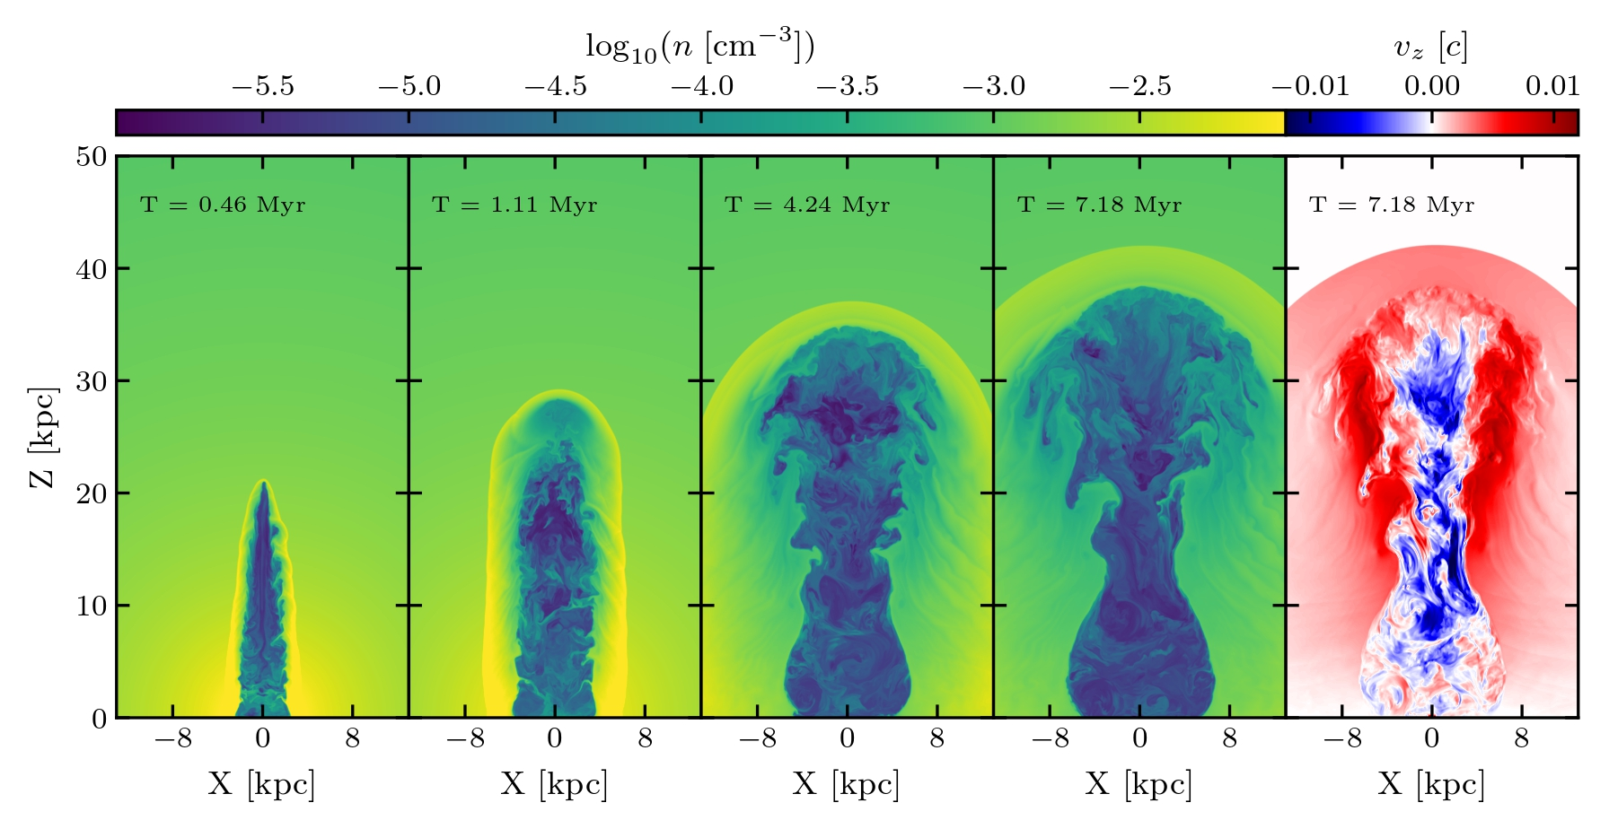
Dynamical Stages
Ratnaparkhi et. al. 2026

Slide 8
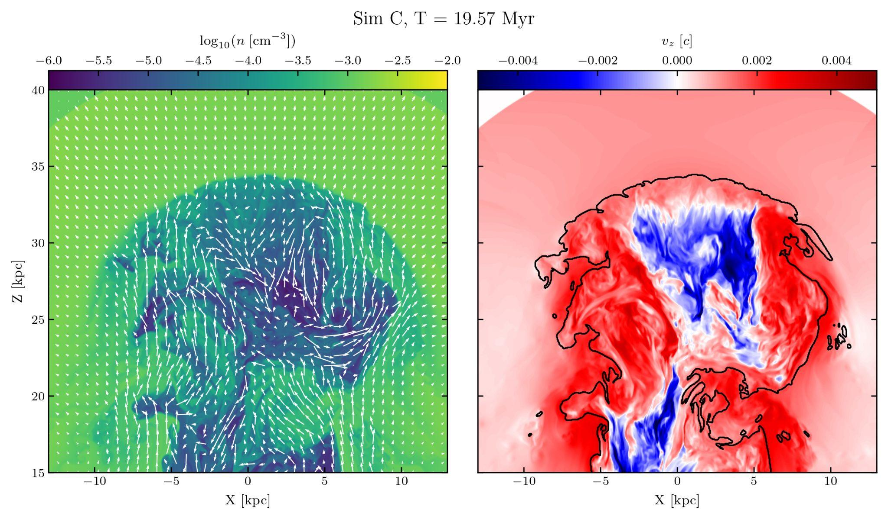
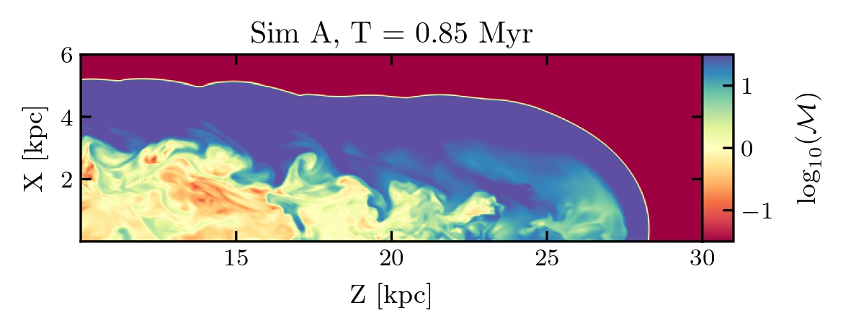
The Role of Instabilities
Ratnaparkhi et. al. 2026

Slide 9
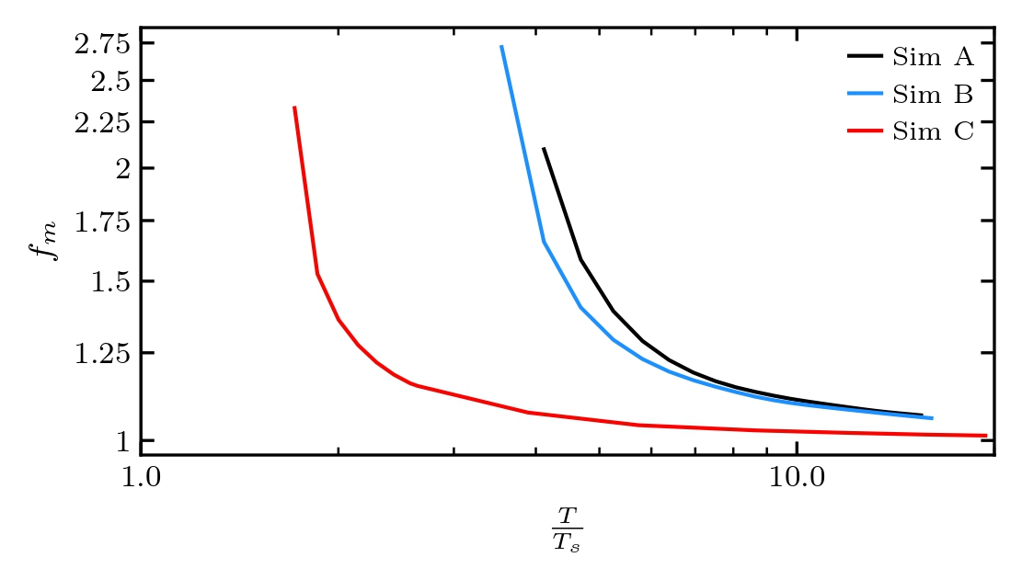
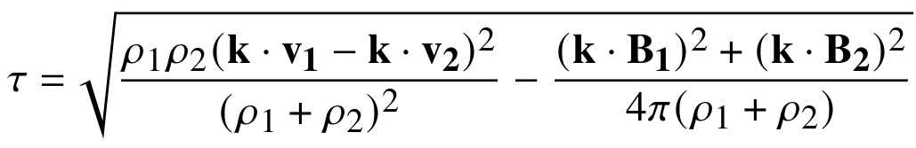
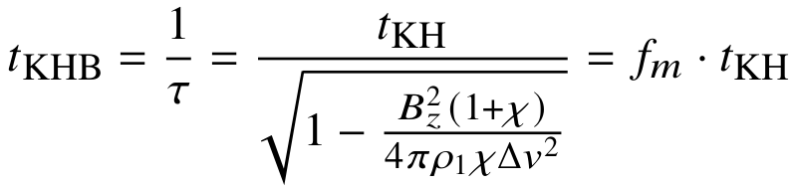
Role of Magnetic Field
Ratnaparkhi et. al. 2026
Instabilities lead to mass entrainment. Sim C > Sim B > Sim A

Slide 10
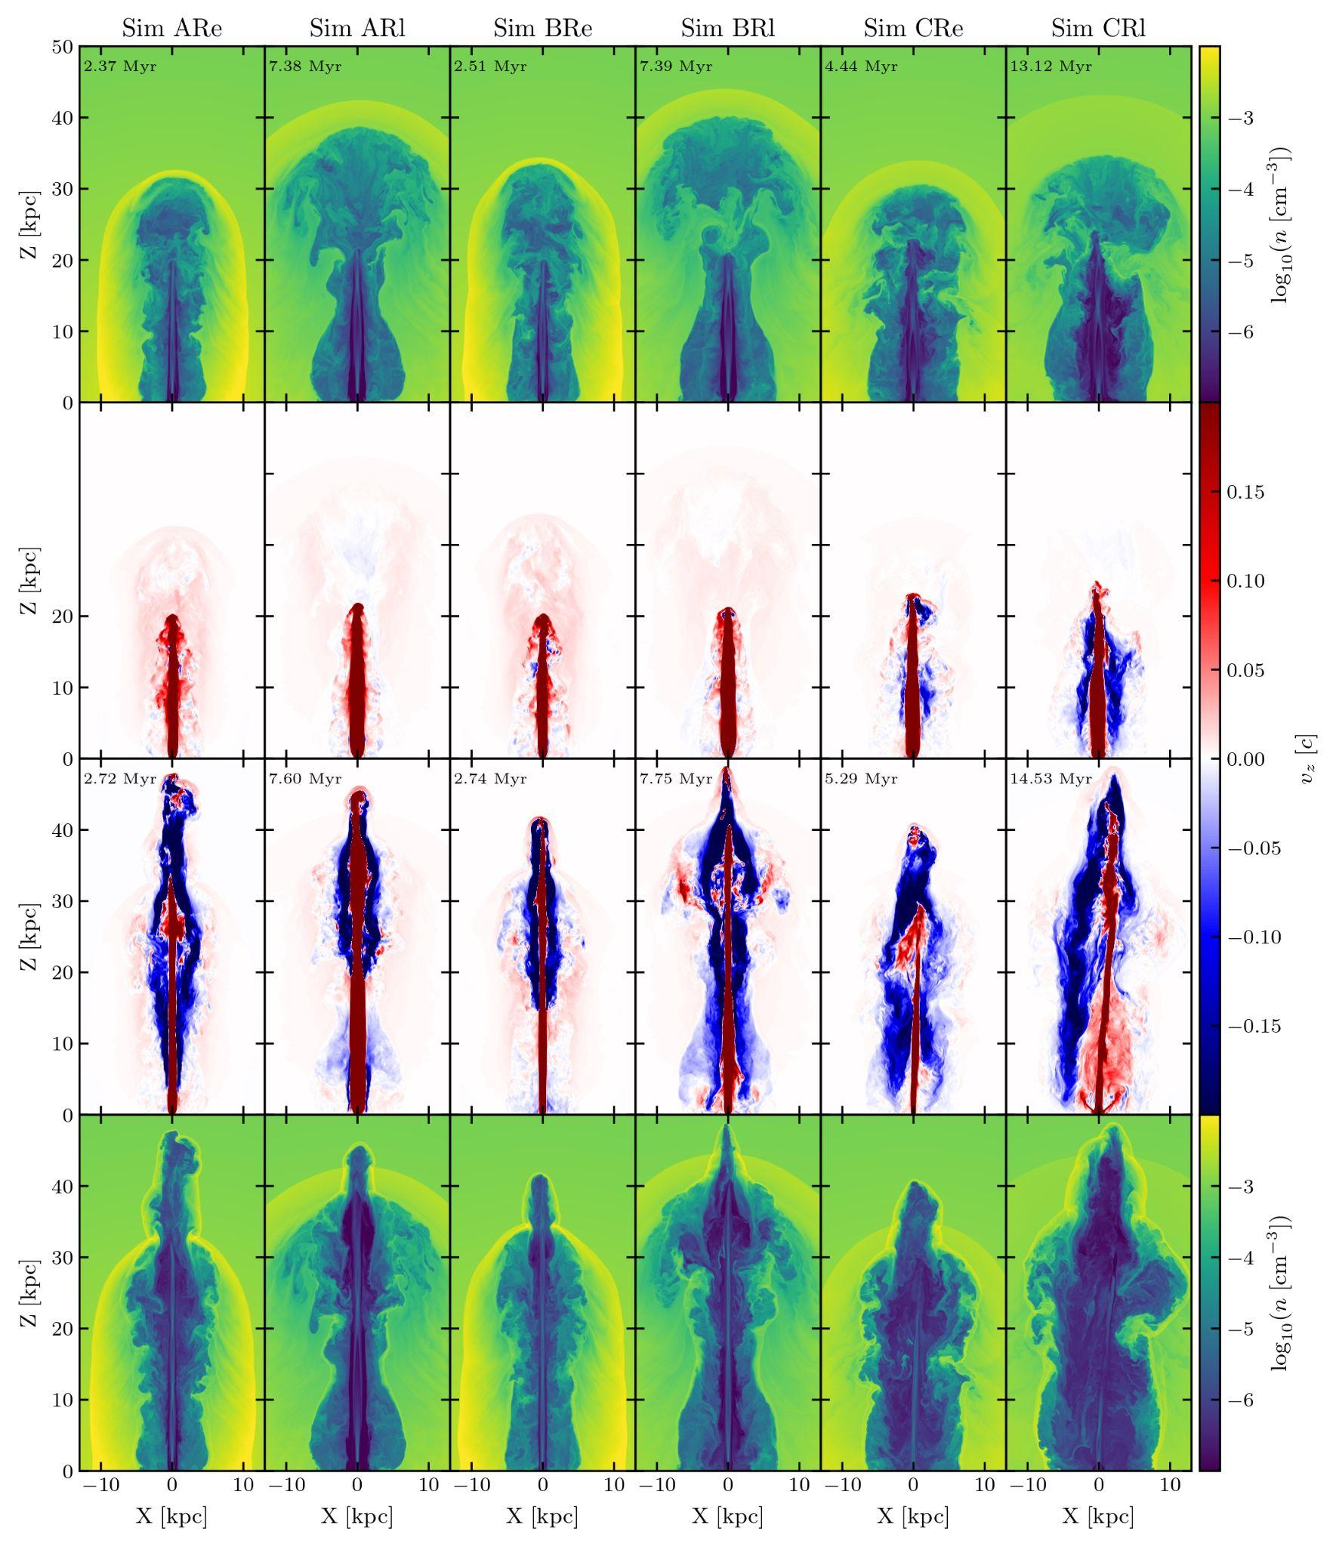
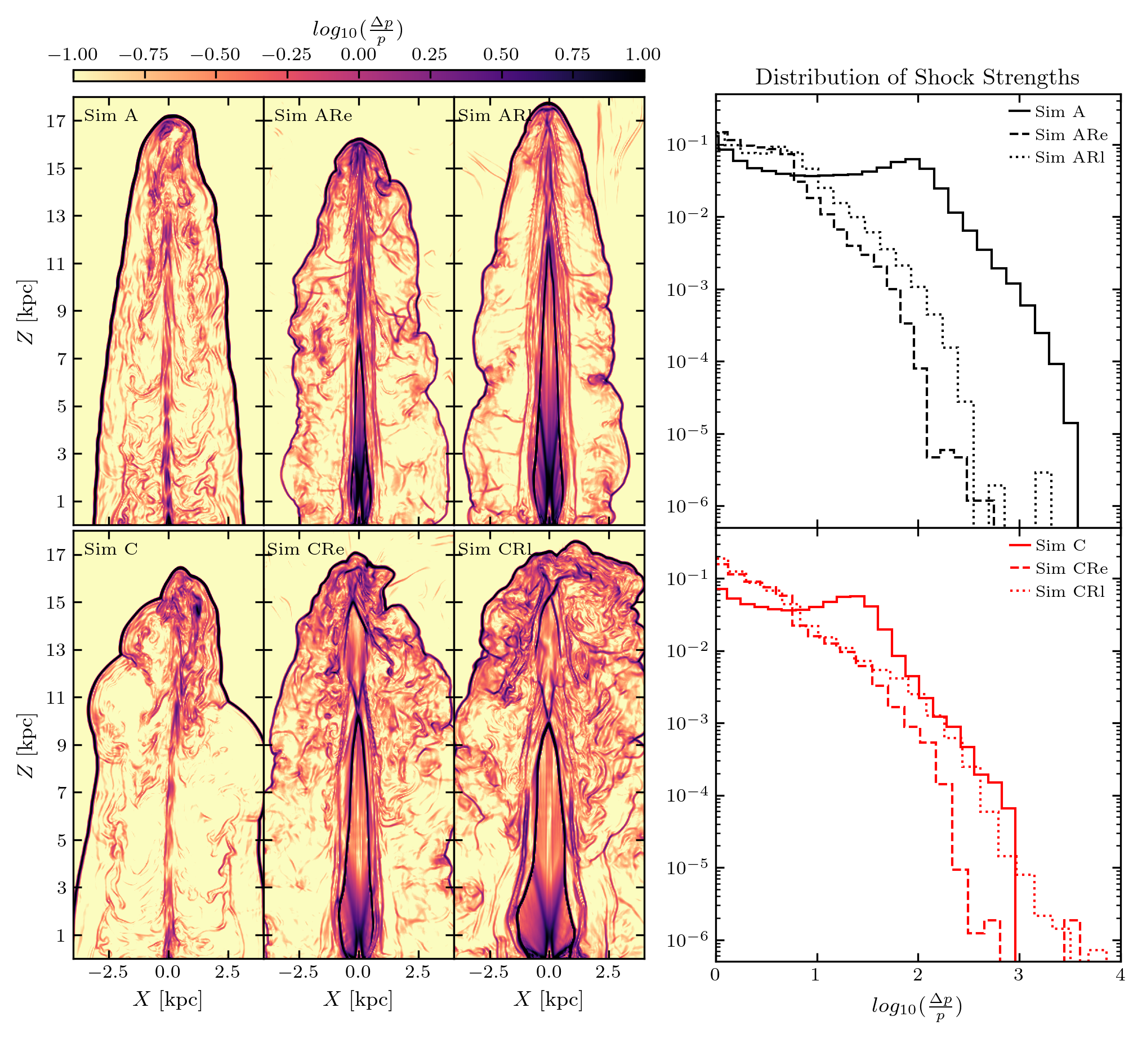
Dynamics of Restarted jet
Ratnaparkhi et. al. 2026
When do backflows form?
How bow shock strength depend on restart time?

Slide 11
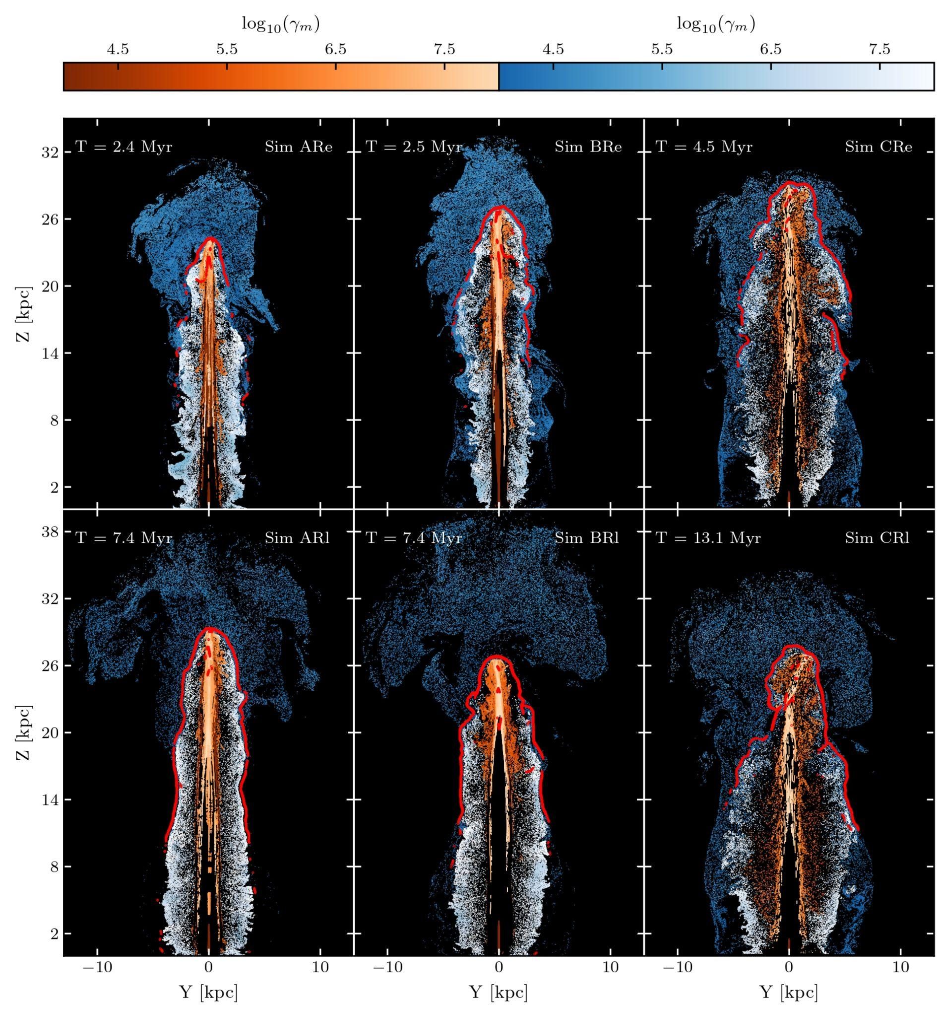
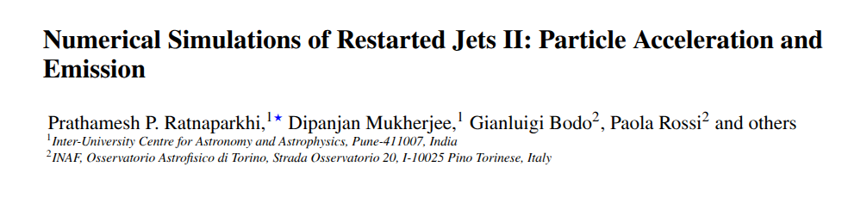
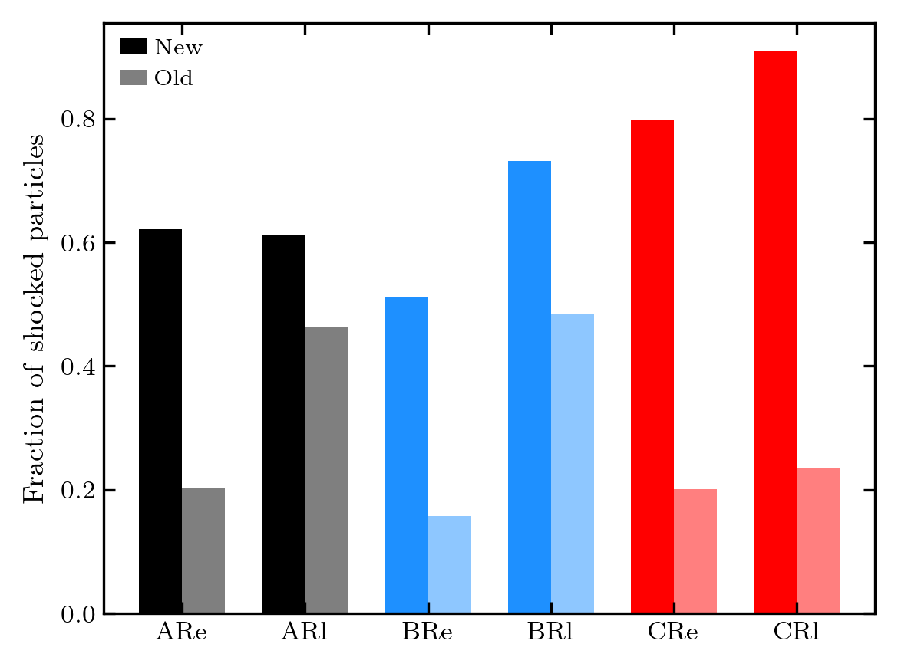
Particle Acceleration
Ratnaparkhi et. al. 2026, b (in prep)

Slide 12
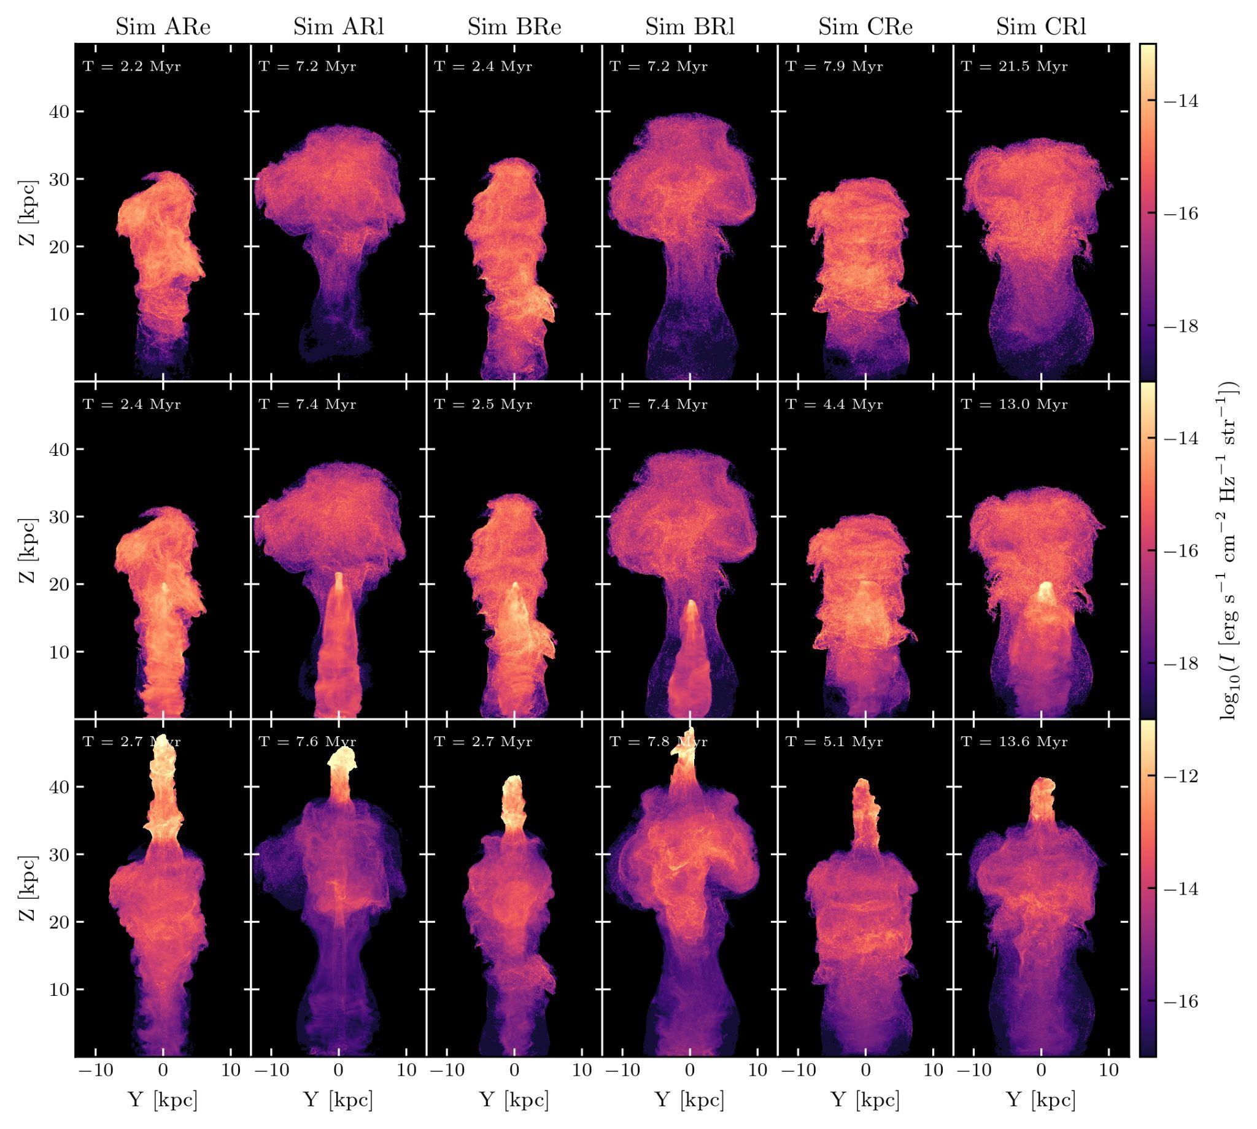
Emission
Ratnaparkhi et. al. 2026, b (in prep)

Slide 13
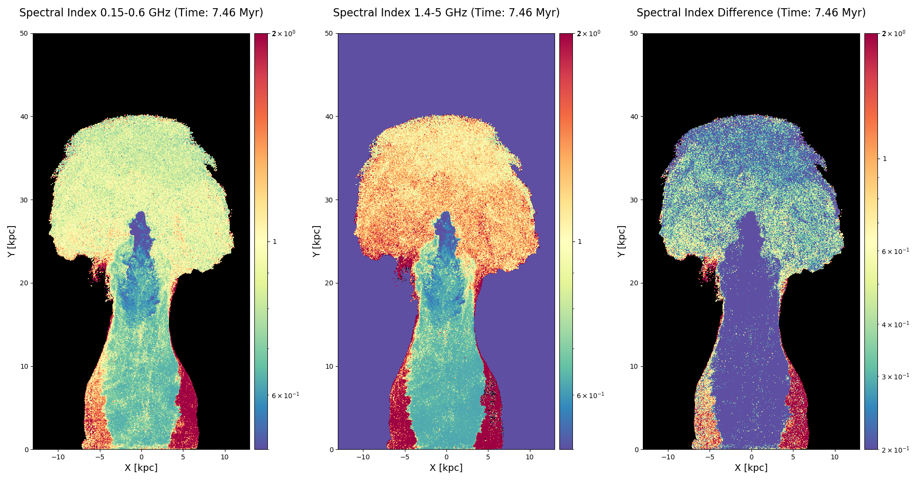
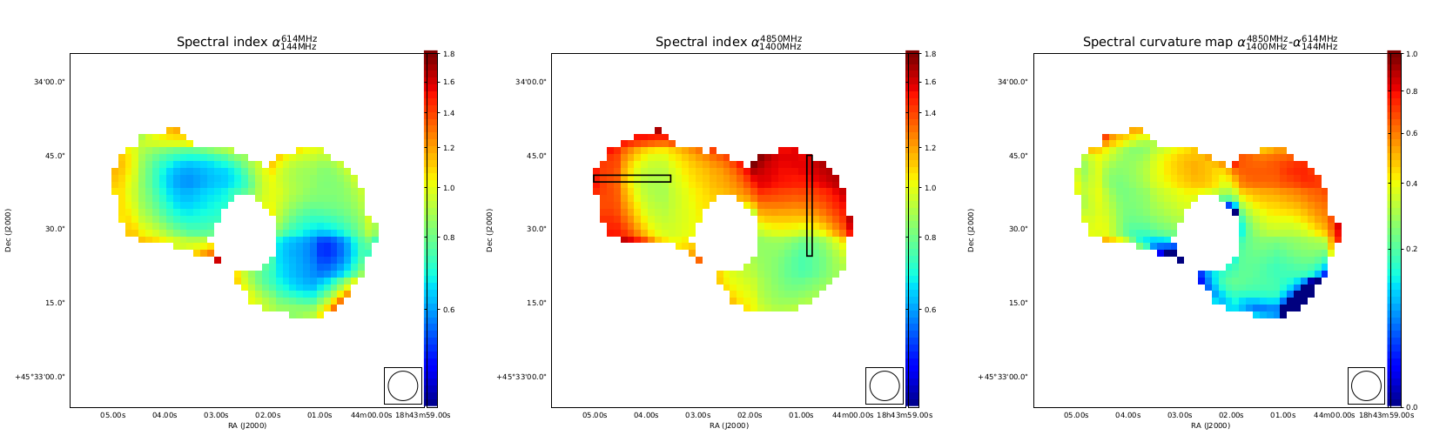
3C388
M. Brienza et al, 2020.

Slide 14
Key Takeaways
Other projects
Instabilities can cause entrainment of matter.
Magnetic fields can suppress entrainment.
Turbulence or Clumpiness in the old cocoon can disrupt the bow shock.
Synchrotron Self Compton
Particle acceleration (hadronic)

Slide 15

Thank You!

Slide 16
Extra Slides

Slide 17
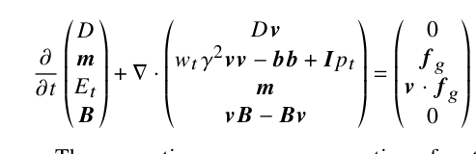
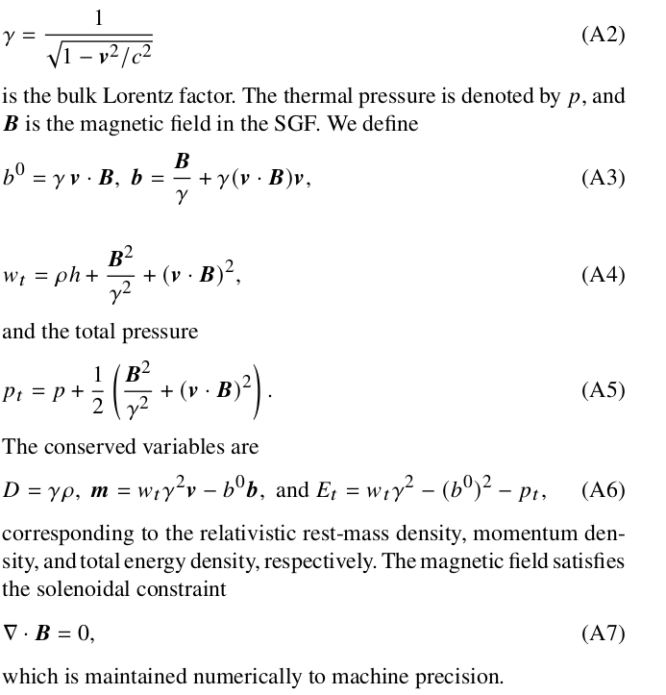
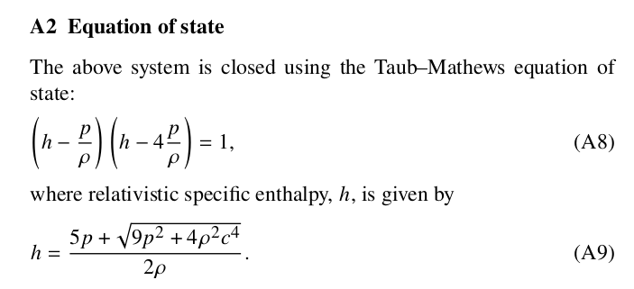
RMHD equations

Slide 18
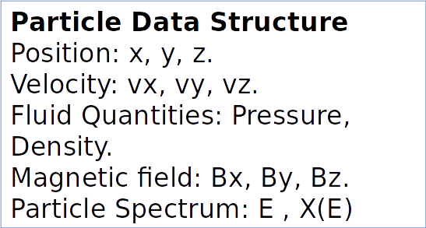
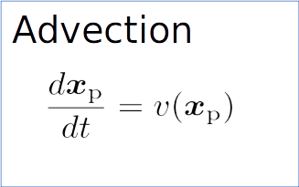
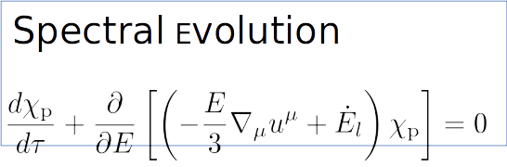
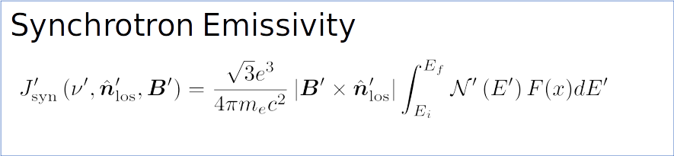
Shock Acceleration
1. Flag shocked zones based on Div(V) and pressure criteria.
2. Find the shock normal using co-planarity theorem.
3. Find shock speed using conservation of mass flux.
5. Calculate shock compression ratio.
6. Update the particle spectrum to a new power law based on r, existing energy in nonthermal particles, synchrotron cooling timescales.
Vaidya, B. et al, 2018

Slide 19
Additional Results.
Compression Wave
Speed of LJM.
Evolution of size and shape.
Role of Buoyancy.
Back

Slide 20
Technical Details.
Resolution
Solver limiter divergence cleaning.
Simulation set-up
Initial and boundary conditions
Back

