Slide 1



The curious case of the FR0s Jet morphology
ESO seminar 15/09/2026
PhD University of Cagliari, INAF-OAC
LEONARDO PENNA

Slide 2
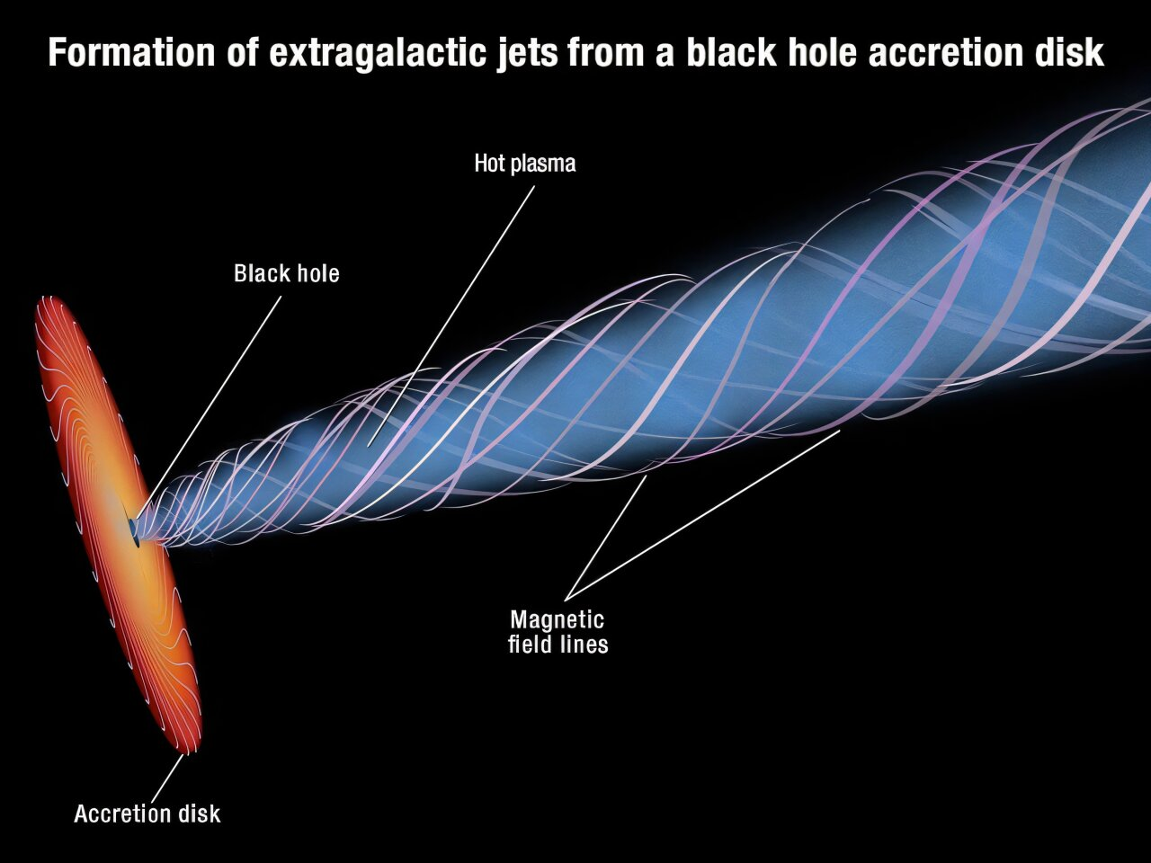
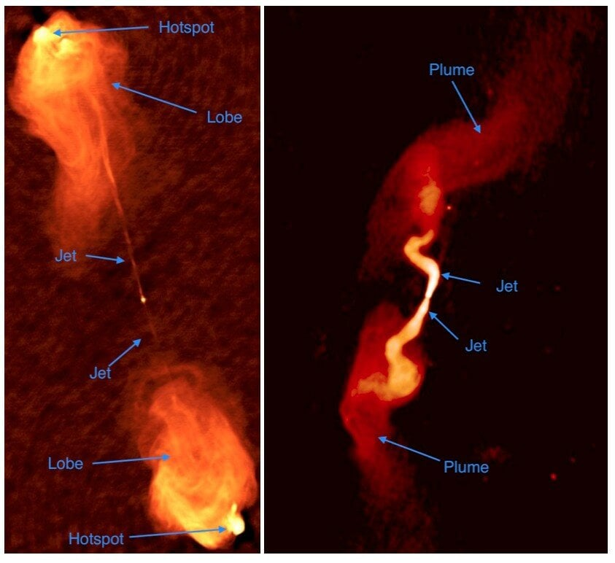
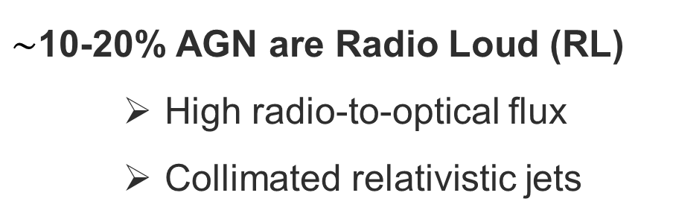
RLAGN, RGs
$\sim$10-20% AGN are Radio Loud (RL)
    High radio-to-optical flux
    Collimated relativistic jets
(Urry & Padovani 1995)
NASA, ESA, A. Feild
NRAO/AUI
Radio Galaxies, Morphology (Fanaroff & Riley, 1974)
FR Is
  Edge darkened
FR IIs
  Edge-brightened
  More collimated jets
FRI 3C31
FRII CygnusA

Slide 3
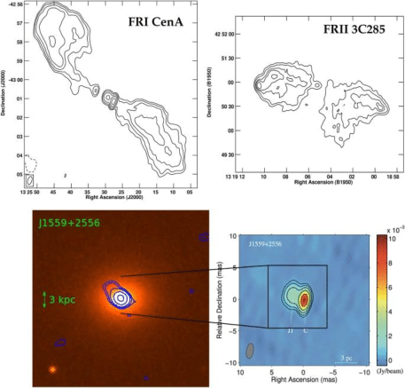

Adding the FR0
Baldi et al. (2023)
FR 0s:
  Mostly Compact (< few kpc)
  low-luminosity RLAGN in ETGs
  Inefficient low-accretion
Where are the Jets?
  mas-scale (VLBI):
  $≳\text{8}\text{0\%}$ resolved → pc-scale jets

Slide 4
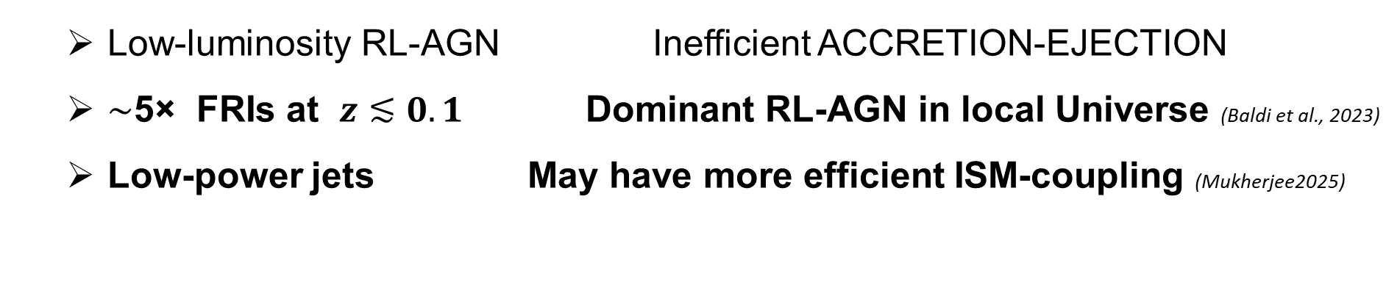
Adding the FR0
WHY FR0s ARE IMPORTANT?
  Low-luminosity RL-AGN Inefficient ACCRETION-EJECTION
  $\sim$5× FRIs at $z≲0.1$ Dominant RL-AGN in local Universe (Baldi et al., 2023)
  Low-power jets May have more efficient ISM-coupling (Mukherjee2025)
WHY FR0s LACK EXTENDED EMISSION?
  Dynamic scenario
Young/Recurrent RGs
  Static scenario
Intrinsically compact

Slide 5


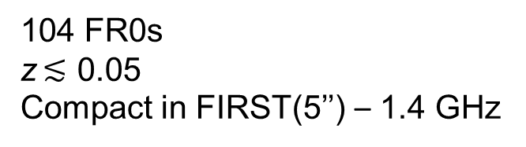
The Dataset
27 FR0s with LOFAR, VLA
FR0CAT
104 FR0s
z$≲$ 0.05
Compact in FIRST(5’’) – 1.4 GHz
(Baldi et al. 2018)
LOFAR
0.15 GHz
6.0’’
VLA
1.5 GHz
1.5’’
VLA
4.5 GHz
0.6’’
VLA
7.5 GHz
0.4’’
$\sim$6.0 kpc
$\sim$0.3 kpc

Slide 6
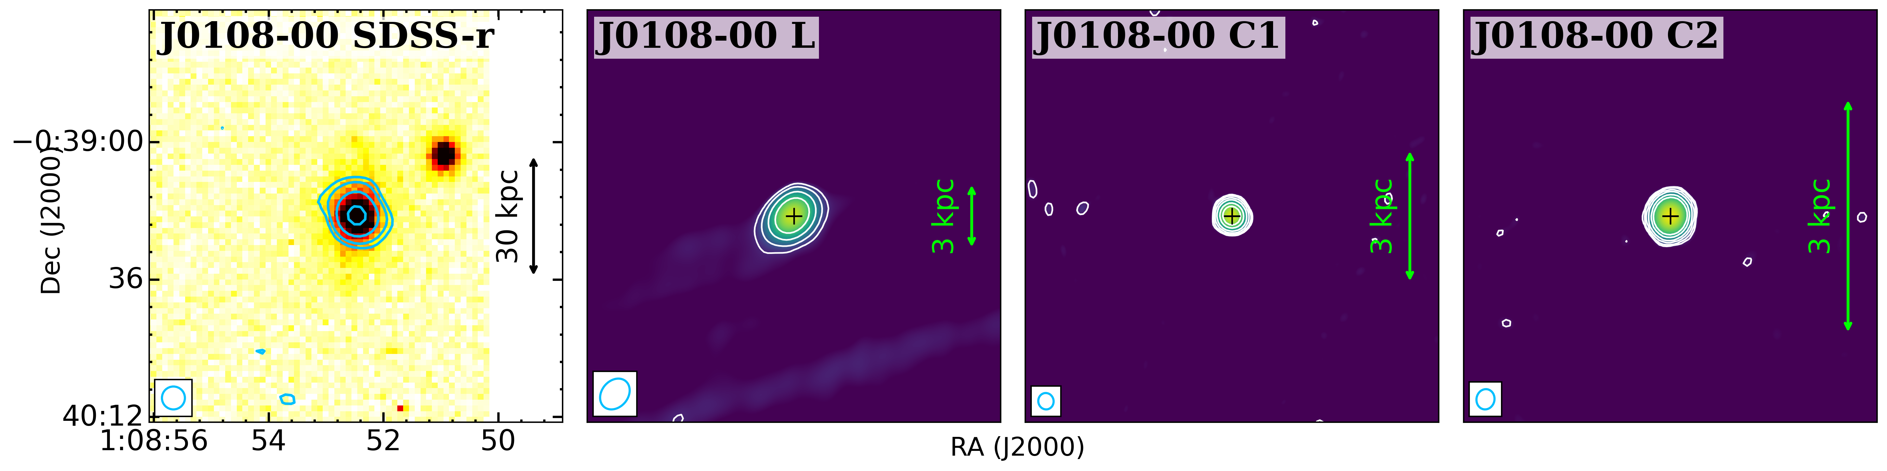
The Dataset
27 FR0s with LOFAR, VLA
AIMs
Morphology
Spectral properties
Accretion – Ejection
LOFAR – 0.15 GHz
VLA – 1.5 GHz
VLA – 4.5 GHz
VLA – 7.5 GHz
Penna et al. to be subm.
$\sim$6.0 kpc
$\sim$0.3 kpc

Slide 7
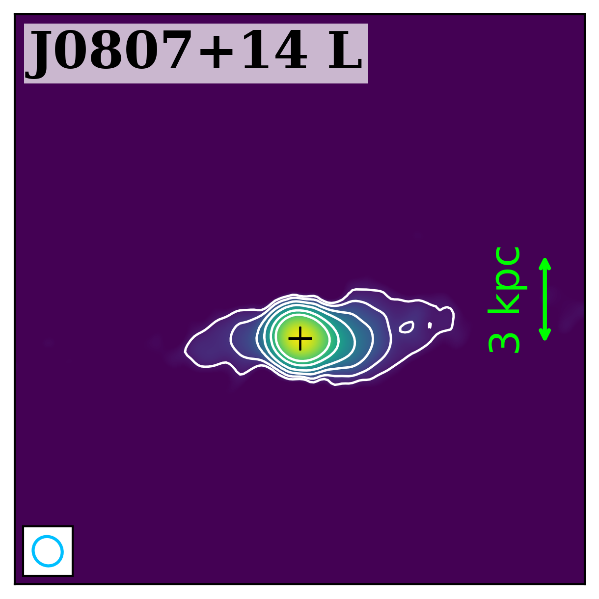
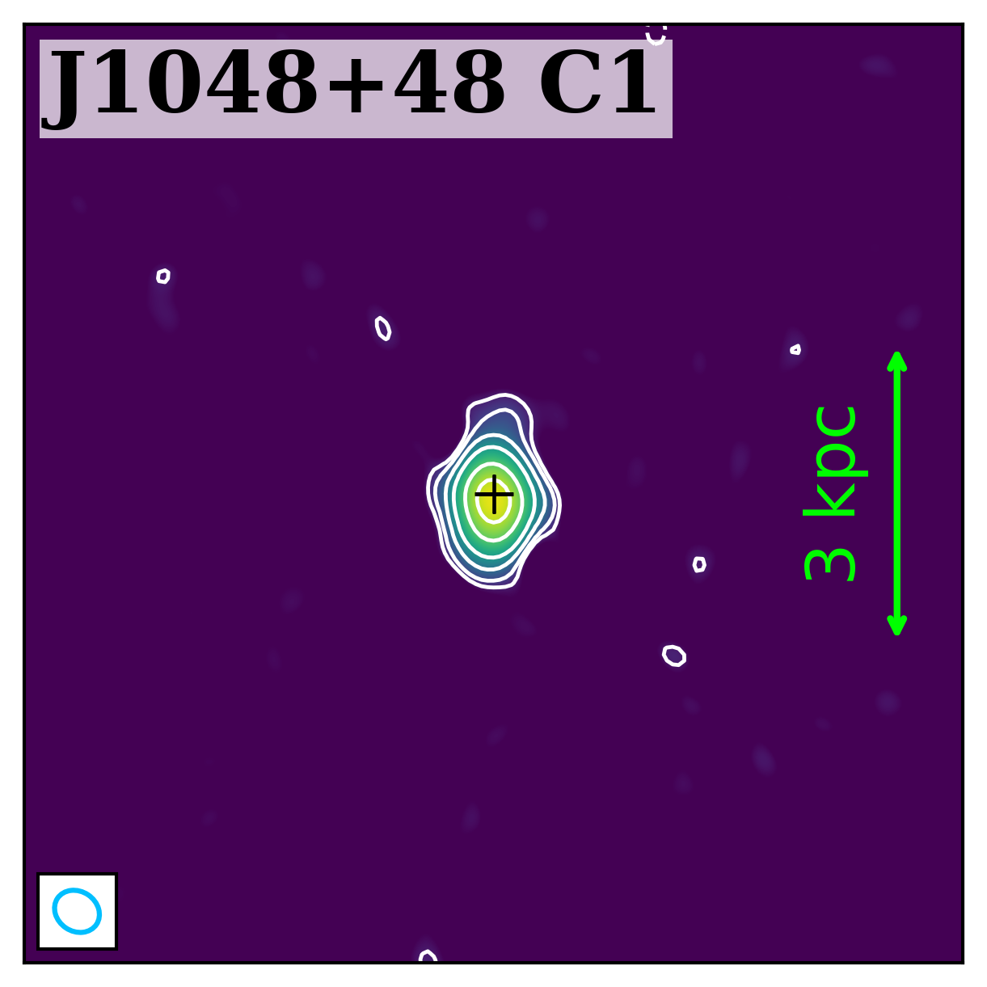
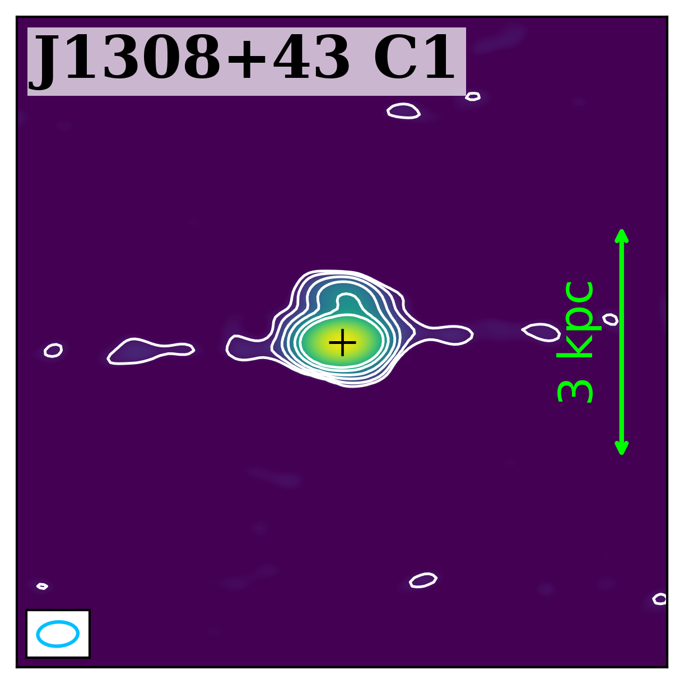
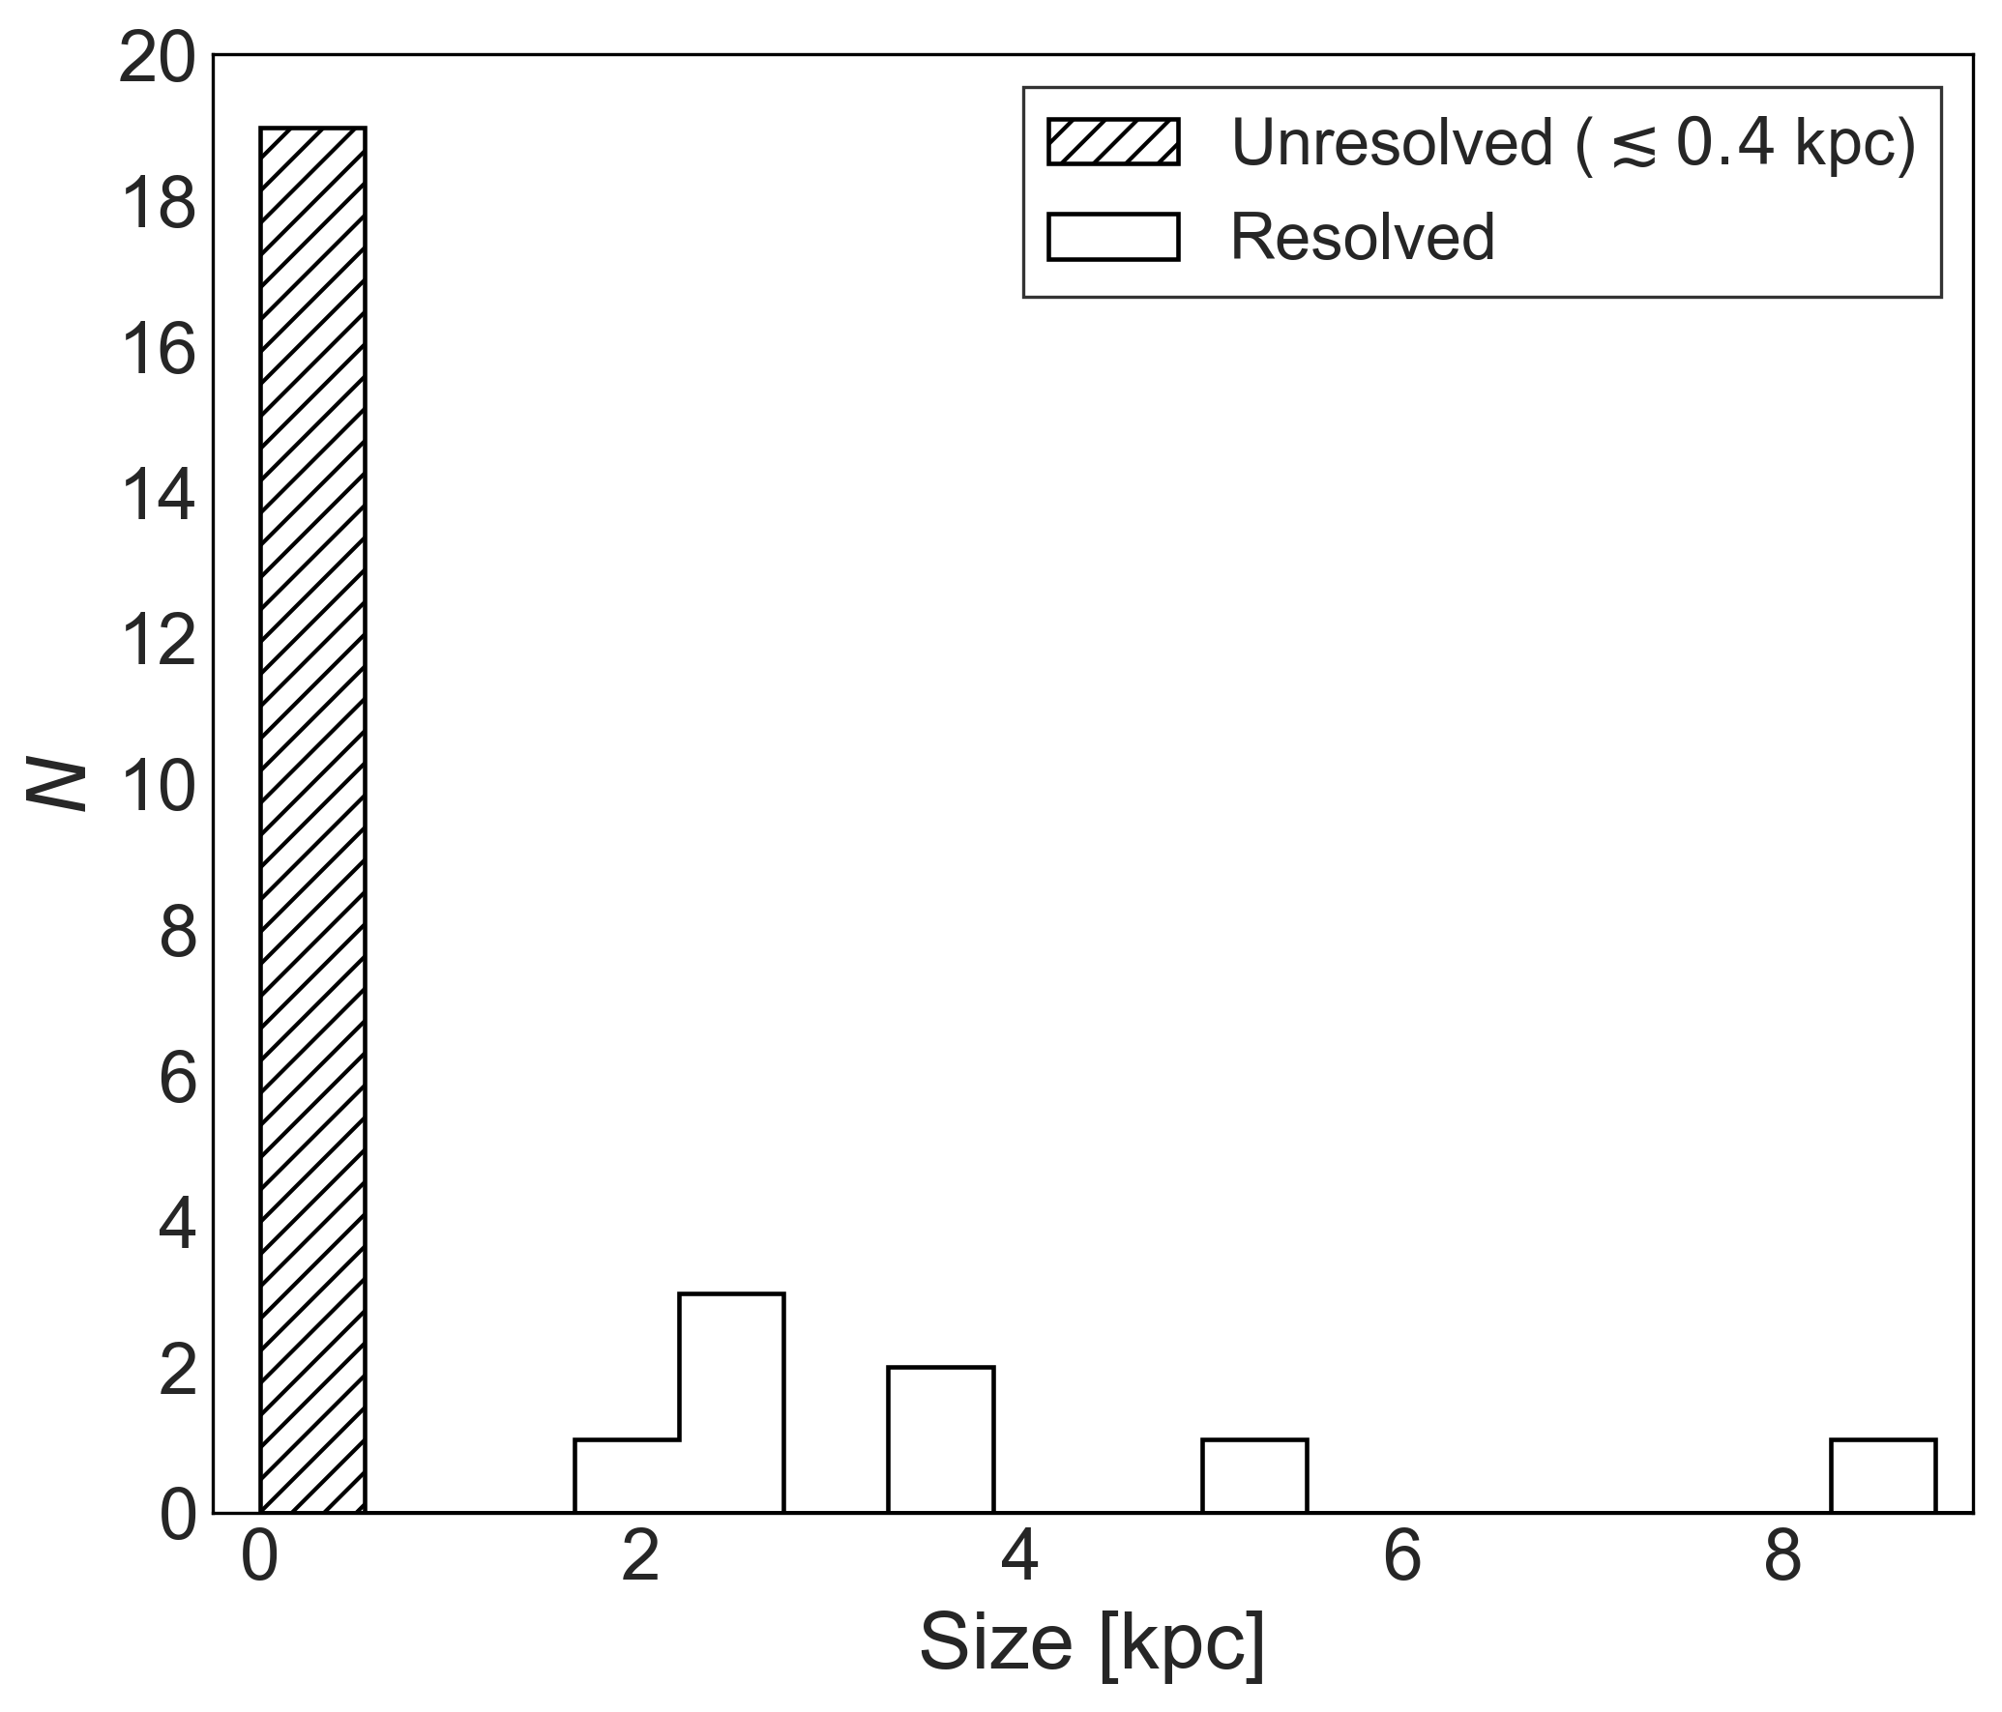
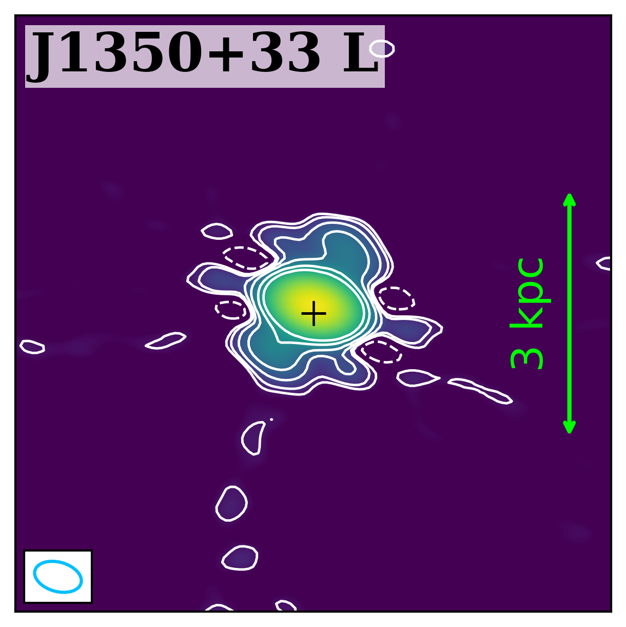
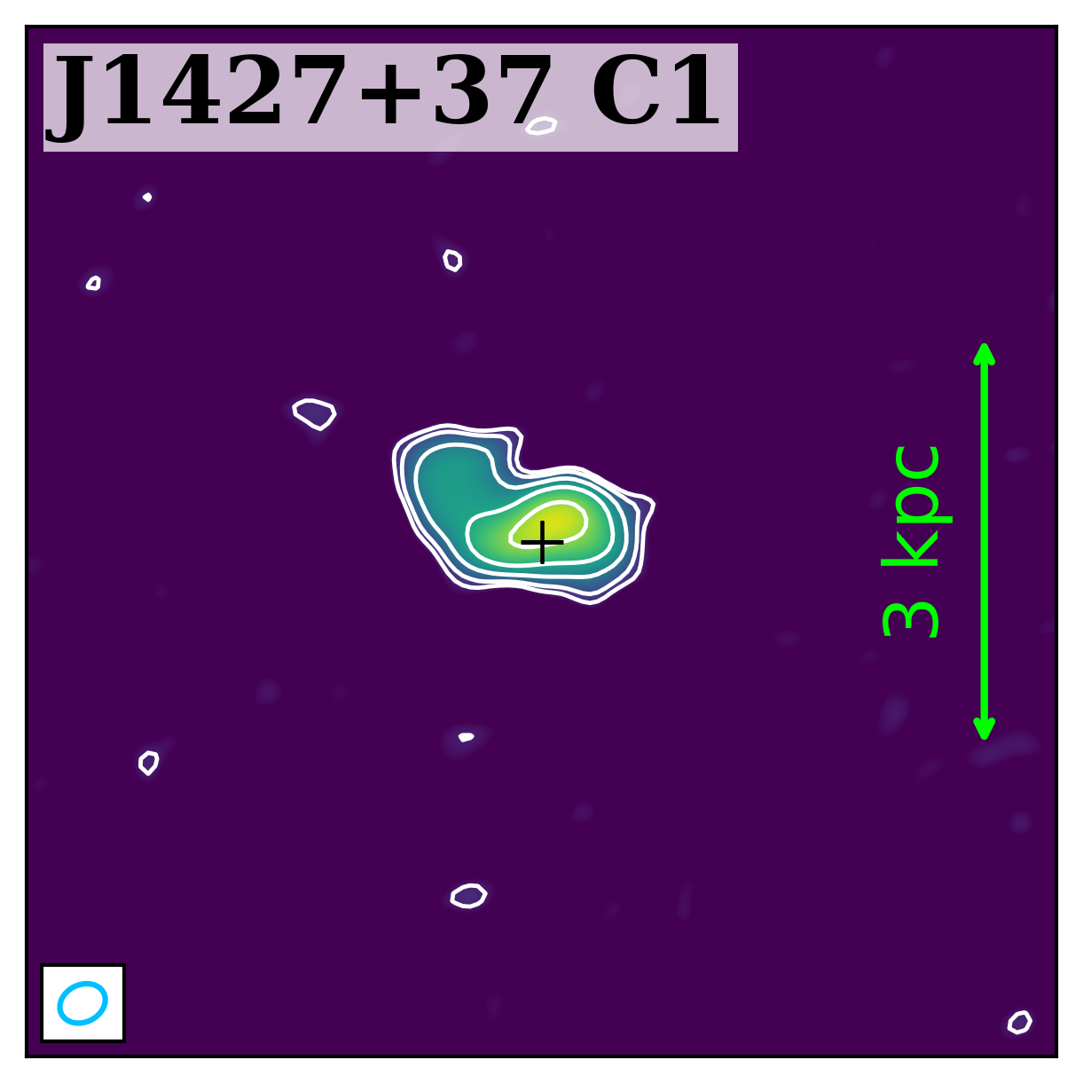
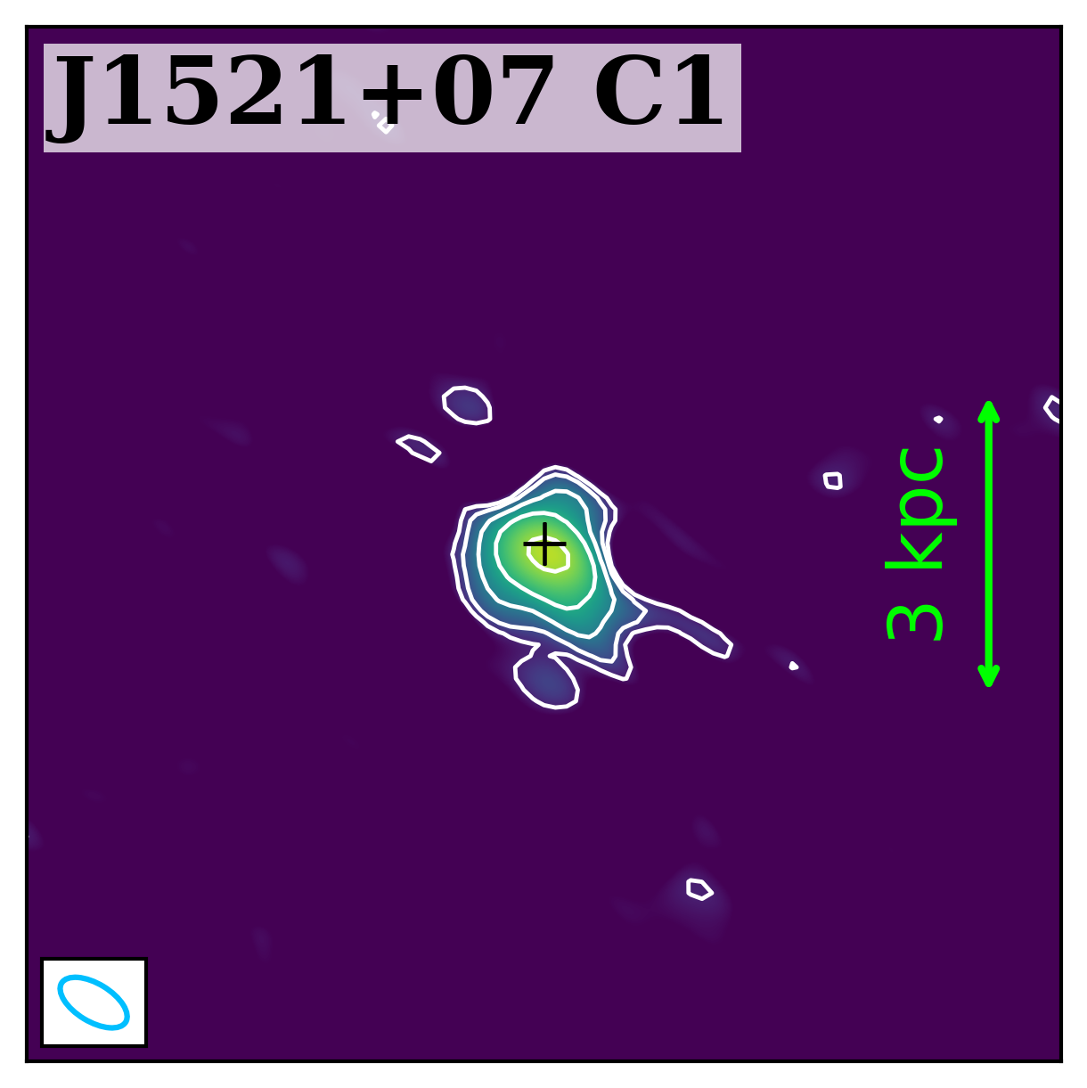
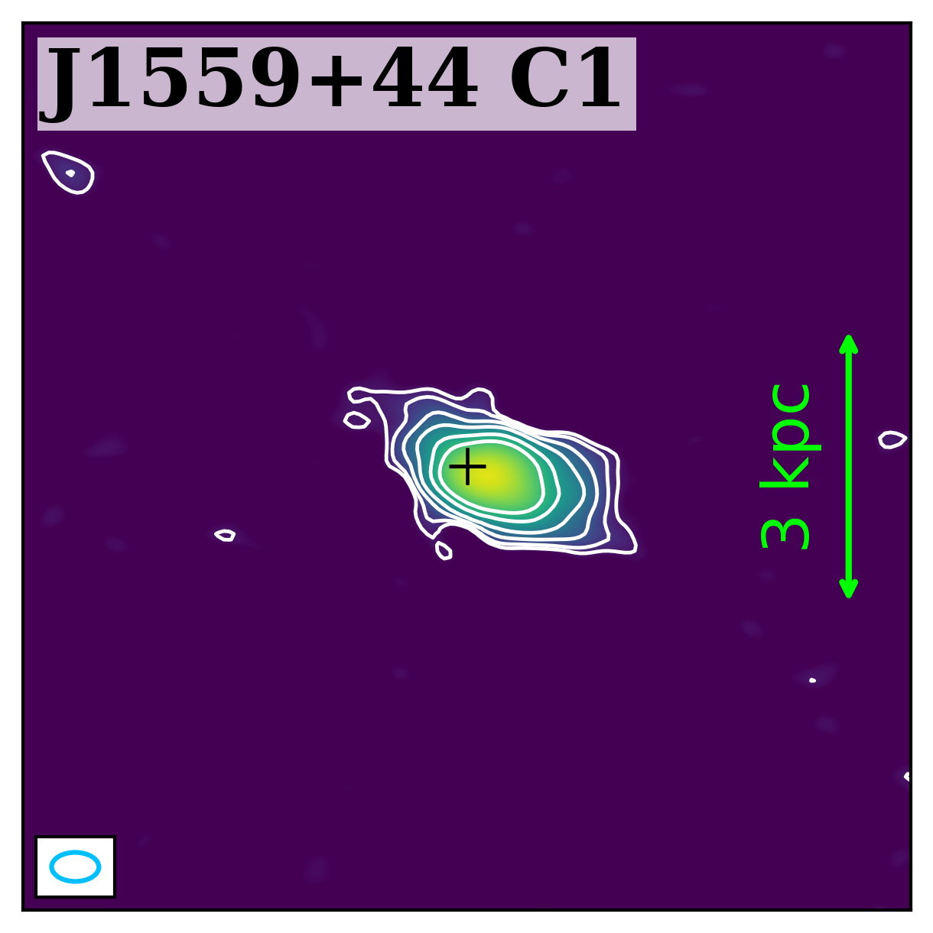
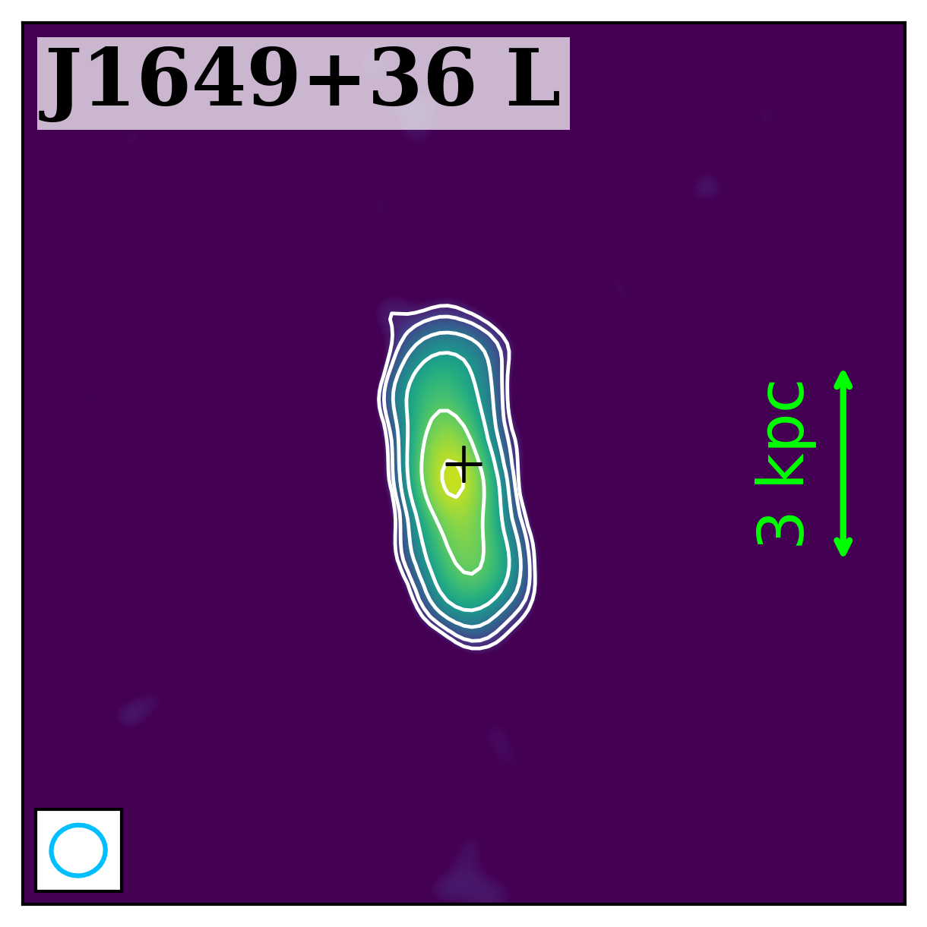
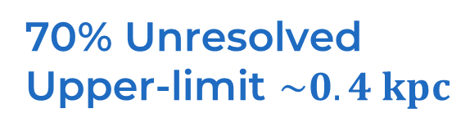
Morphology
70% Unresolved
Upper-limit $\sim 0.4 kpc$
Penna et al. to be subm.
Penna et al. to be subm.

Slide 8
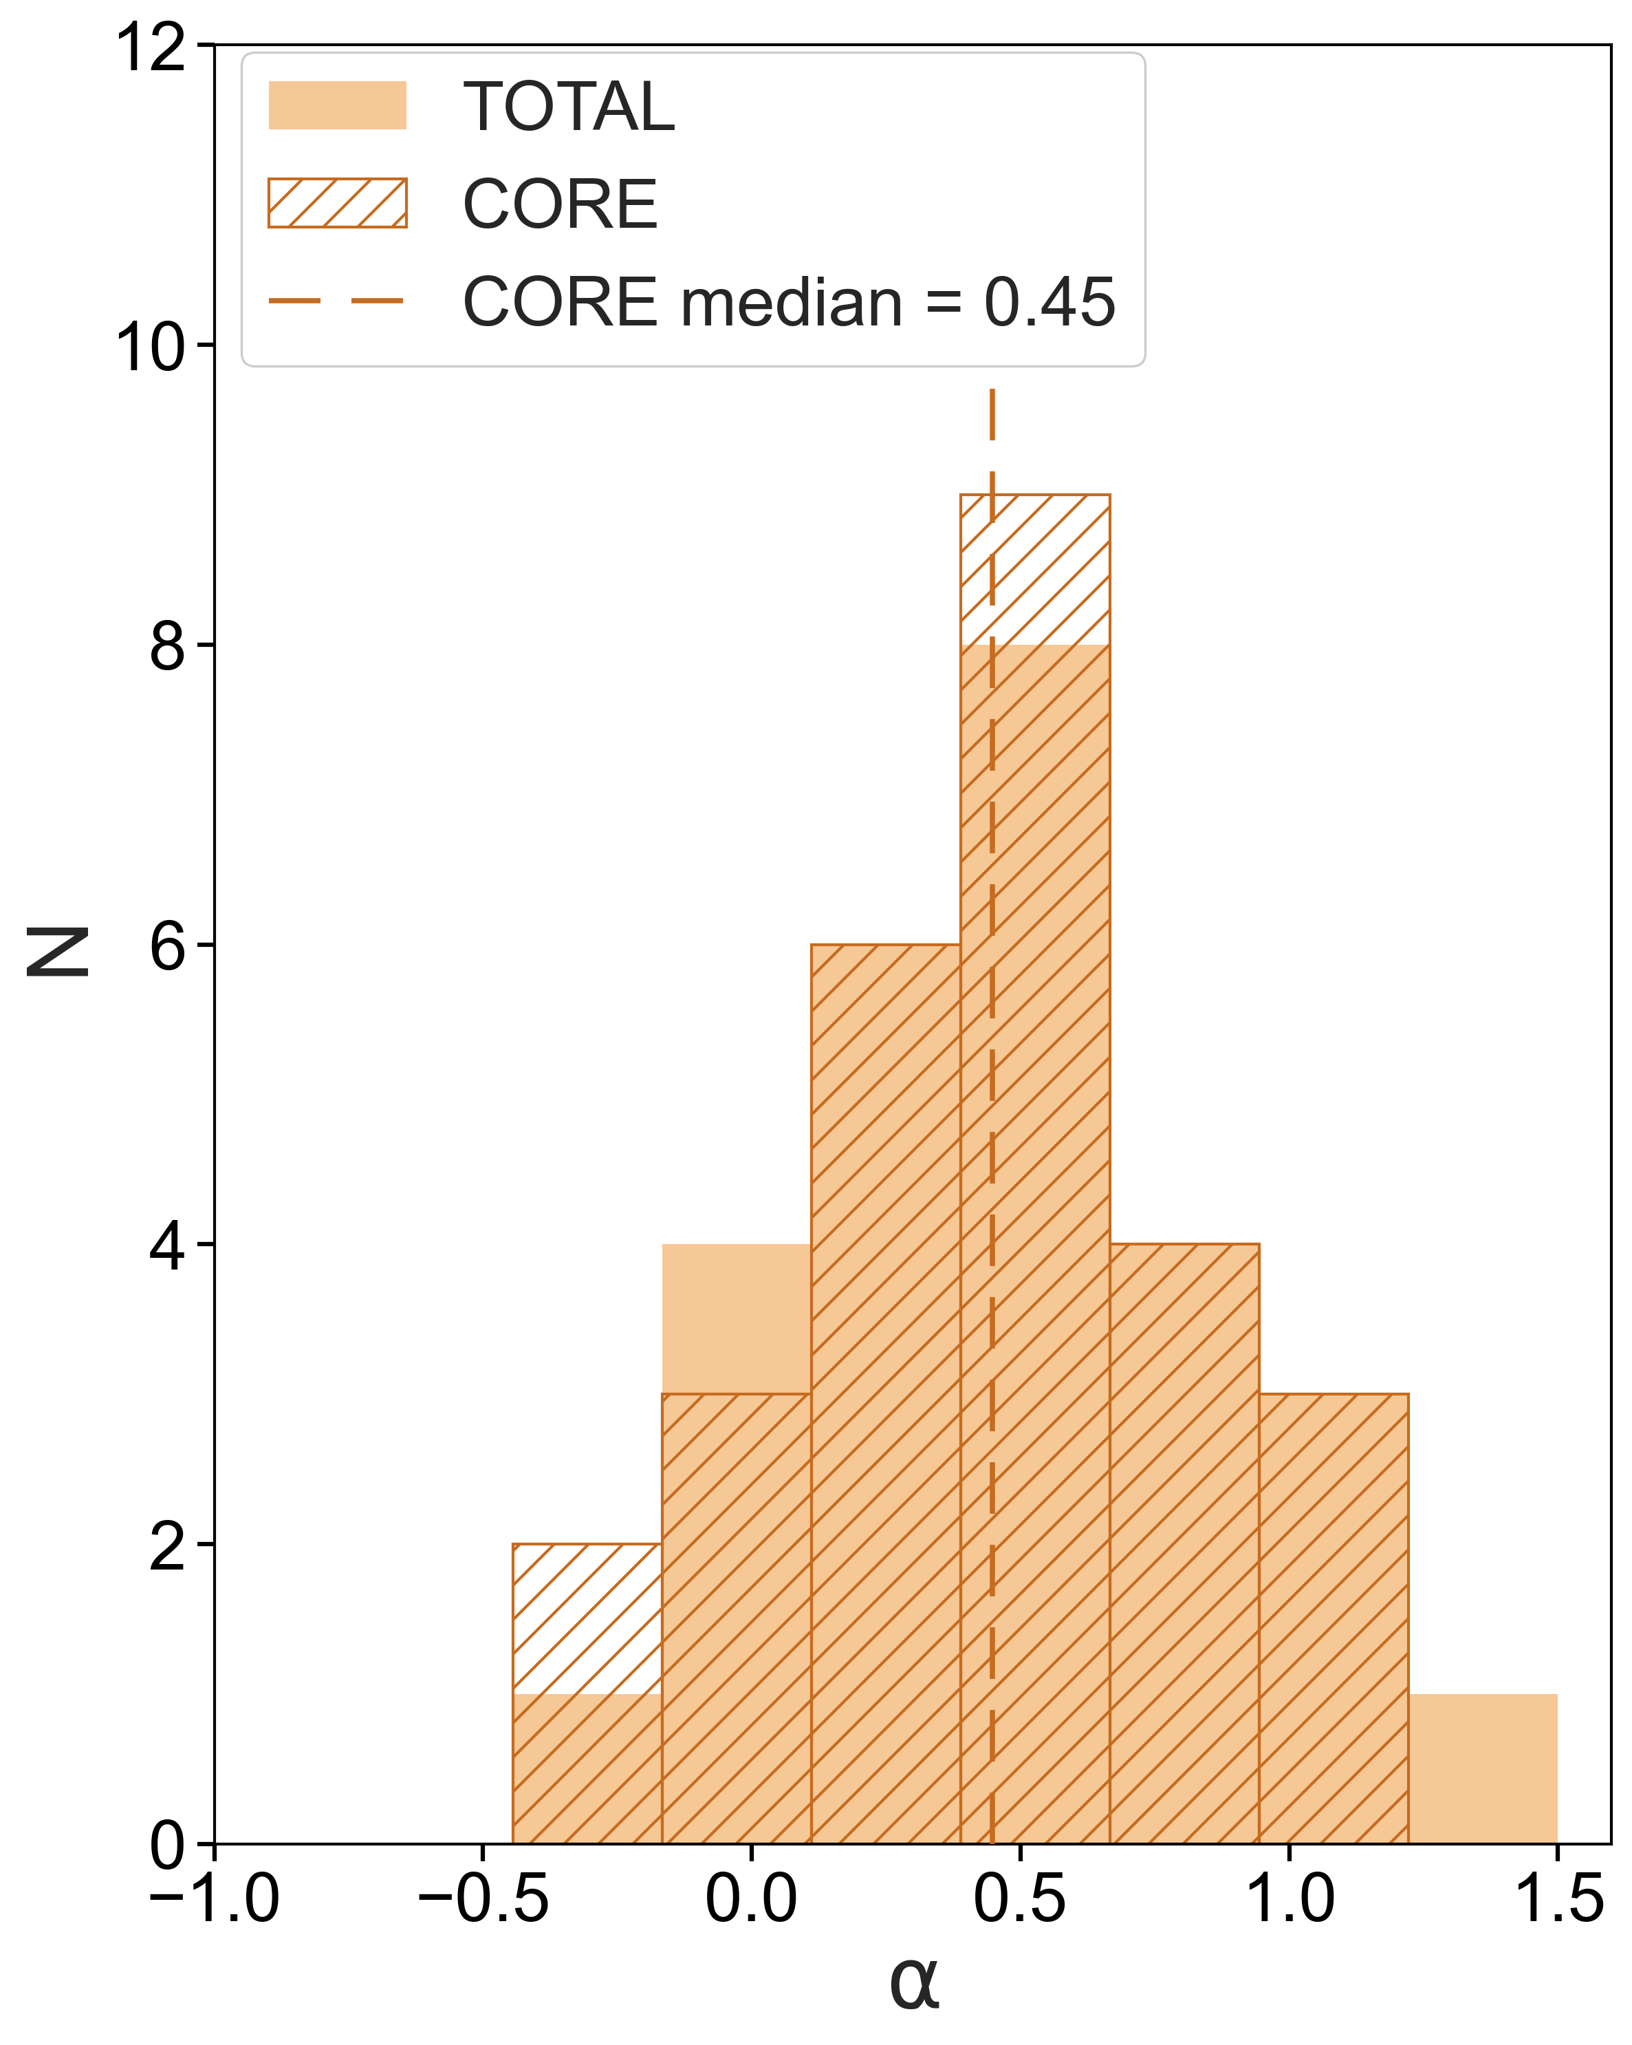
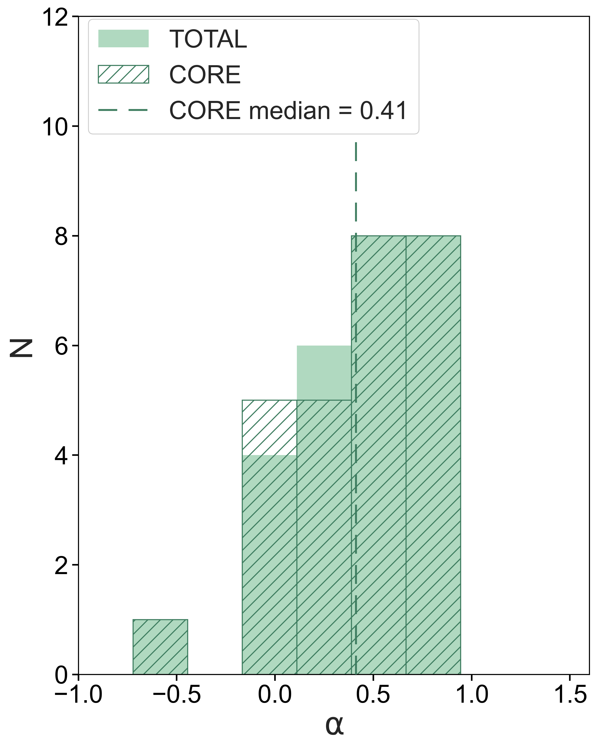
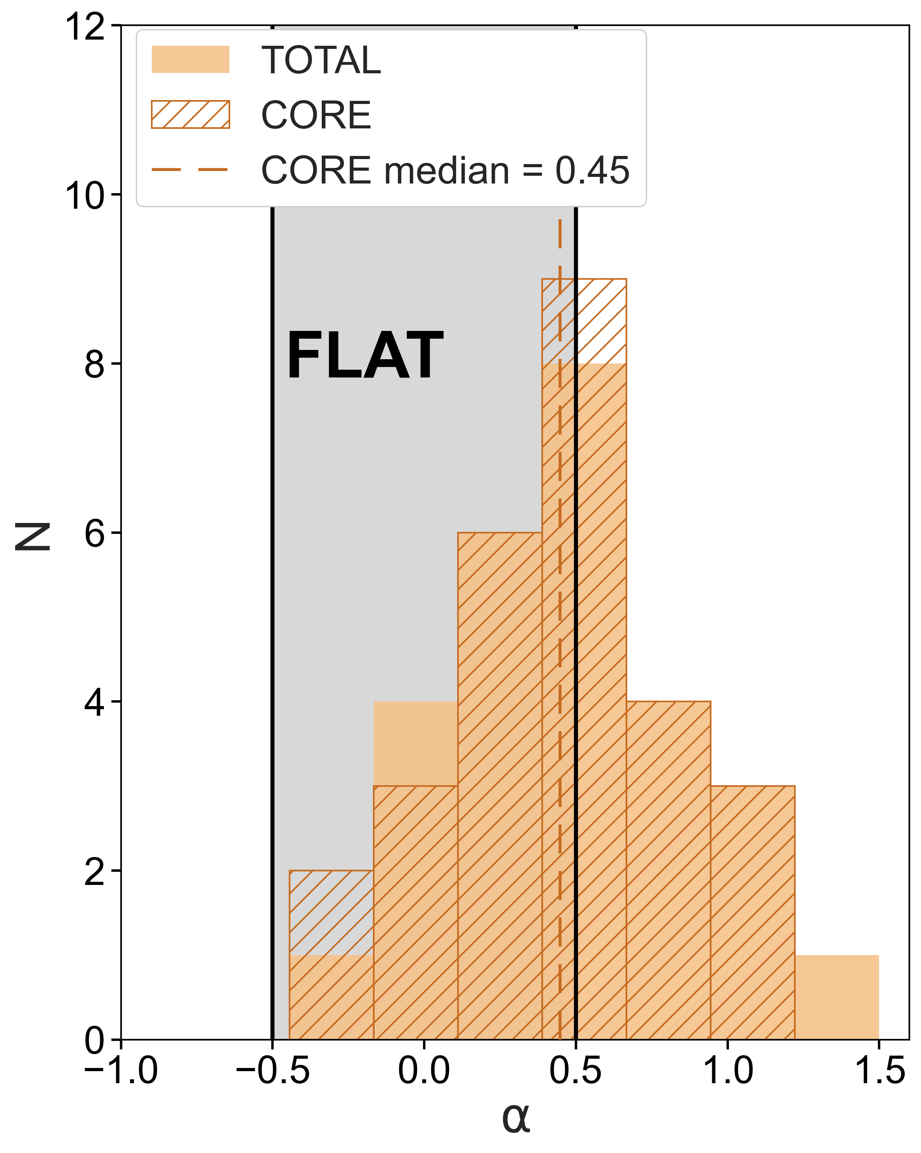
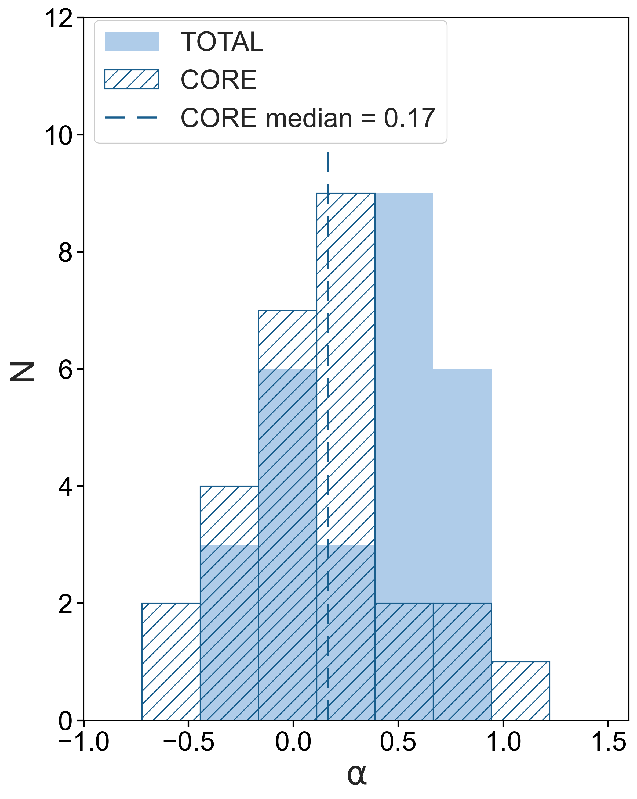
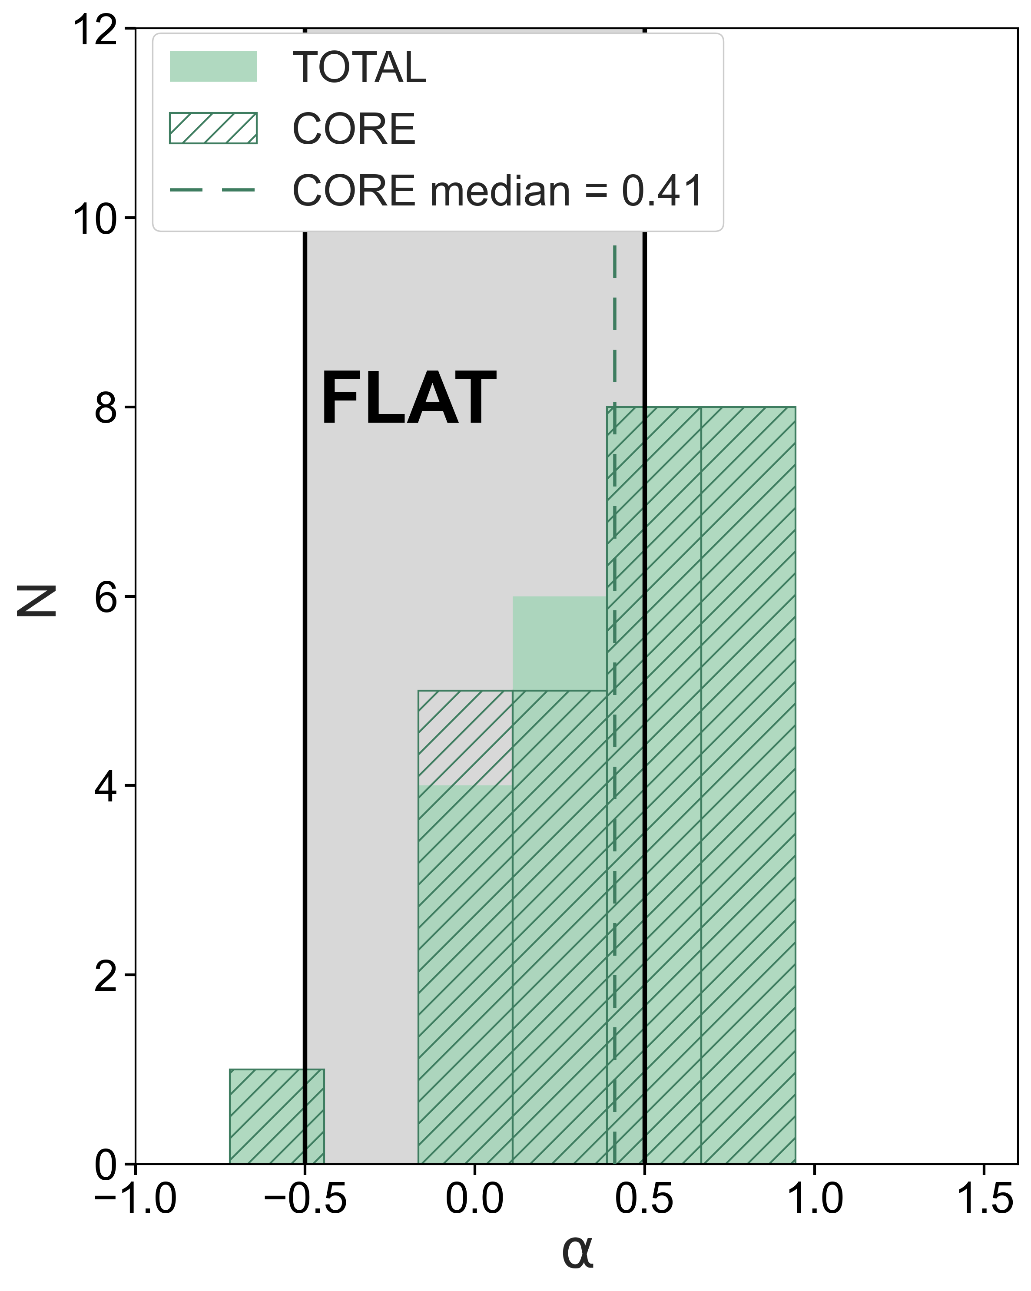
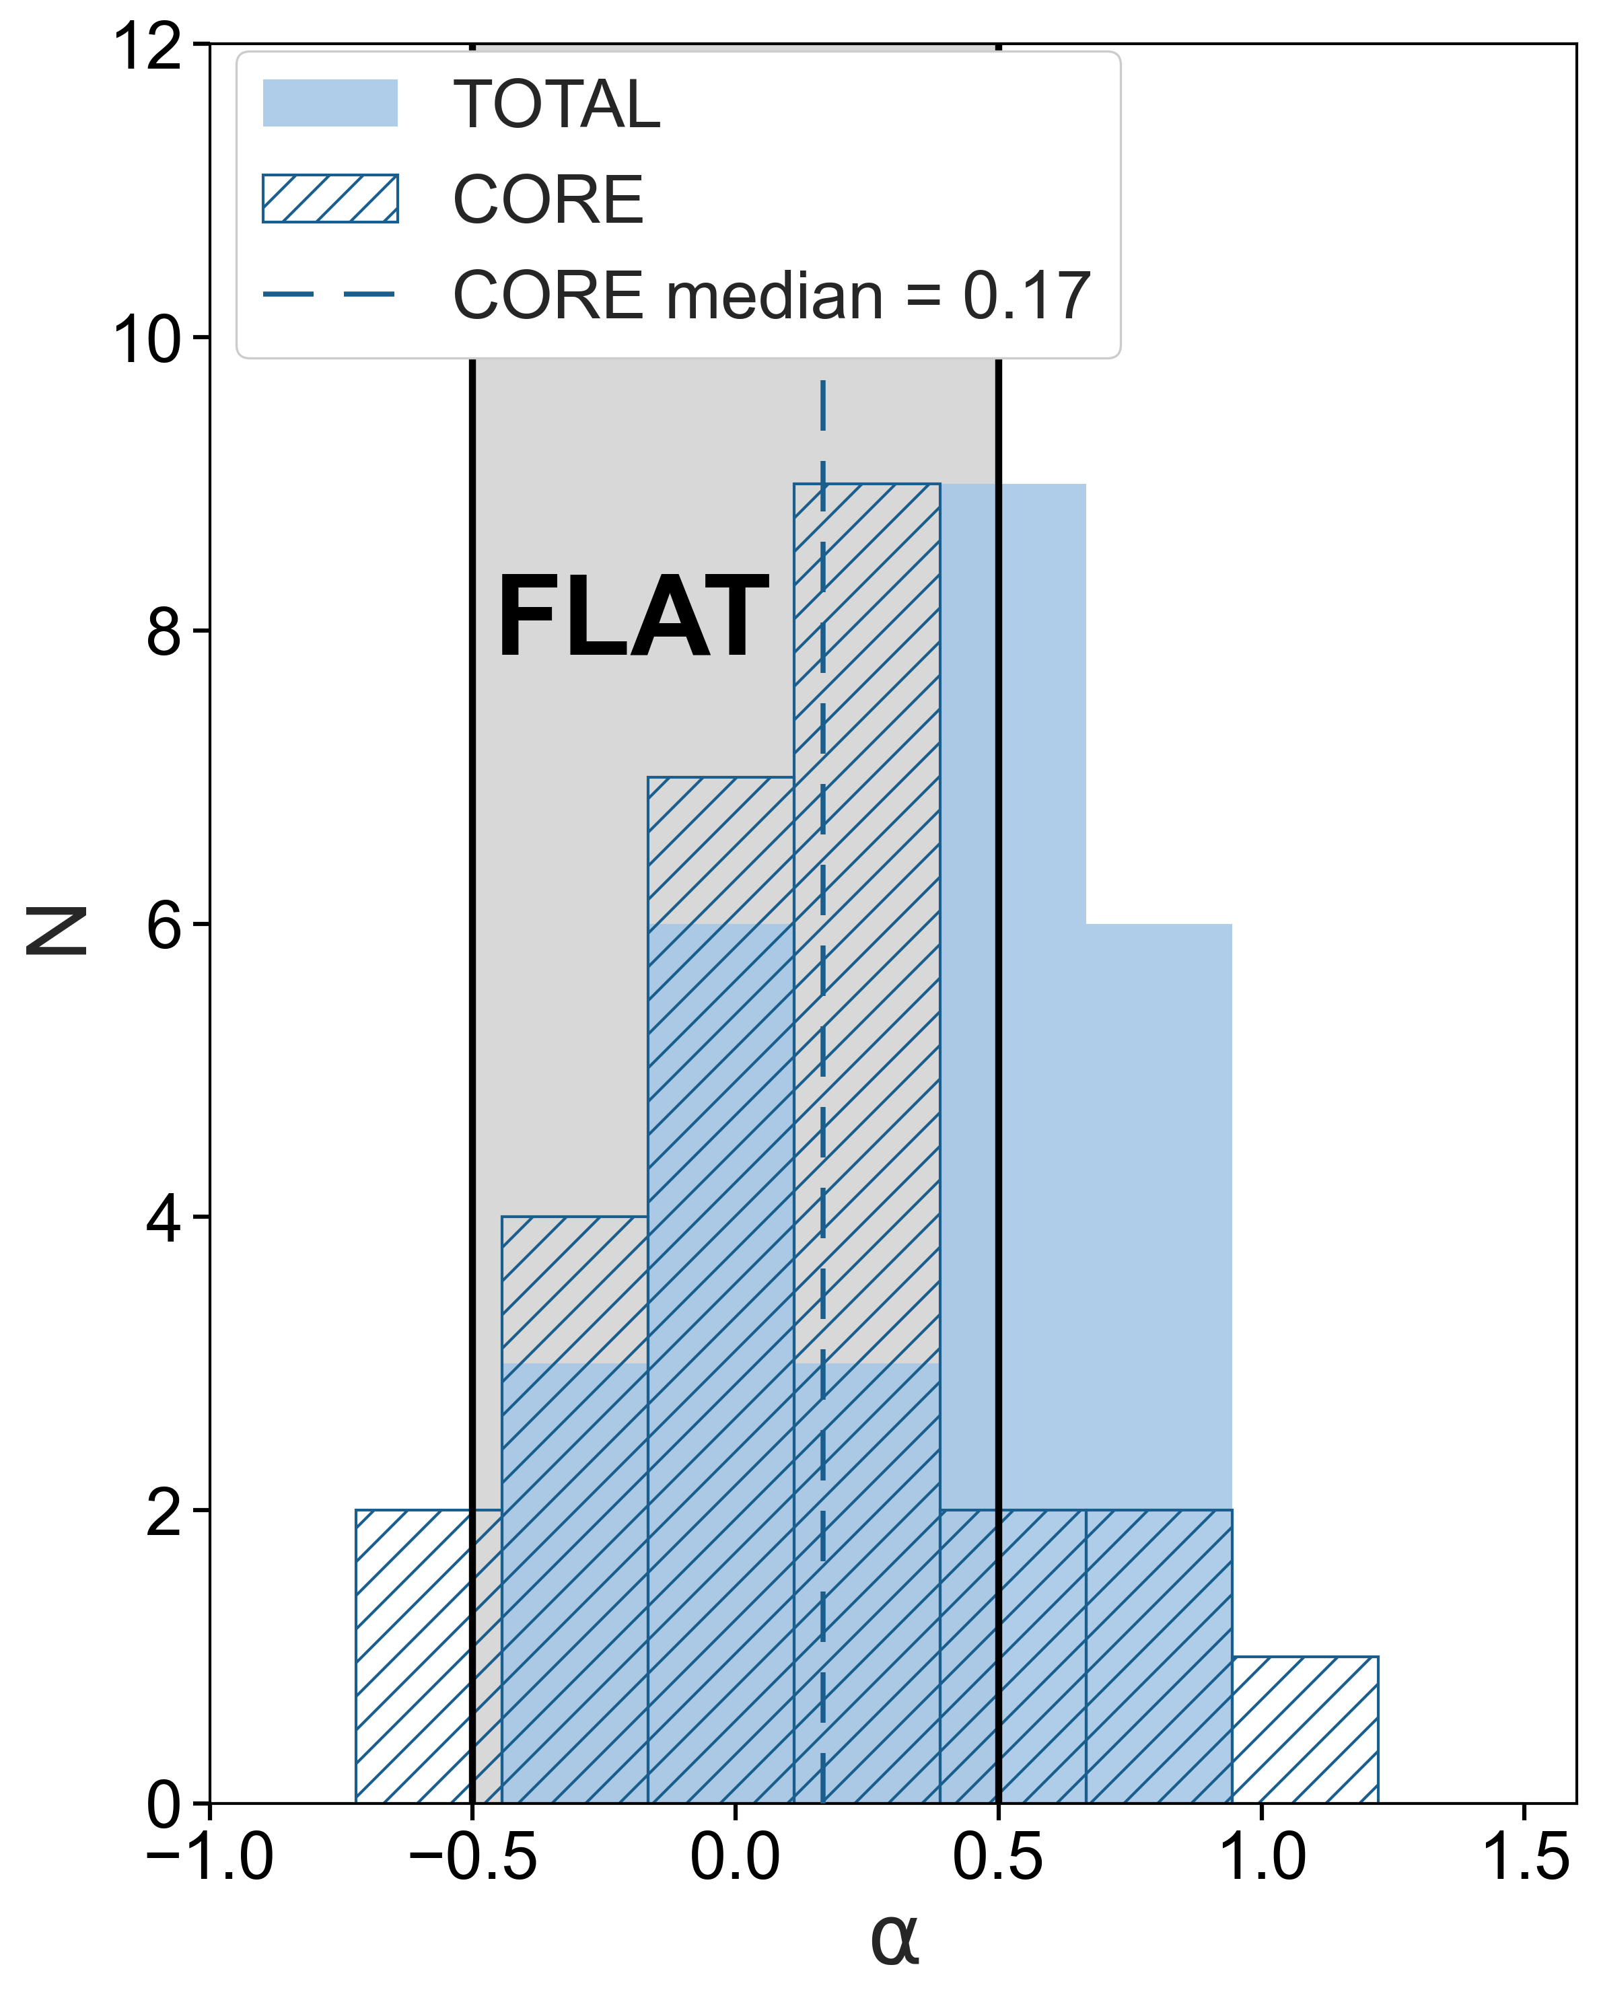
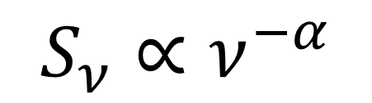
Spectal Index
$$S_{ν}∝ν^{−α}$$
Penna et al. to be subm.
0.15 – 1.5 GHz
1.5– 4.5 GHz
4.5 – 7.5 GHz
CORE:
5 steep
10 steep
11 steep

Slide 9
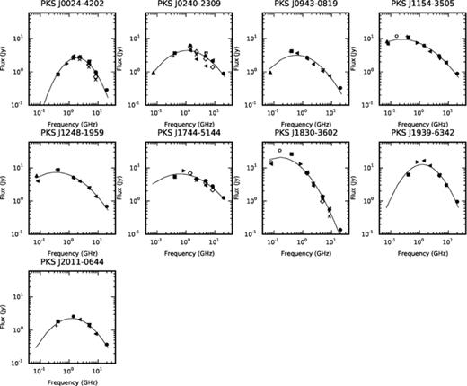
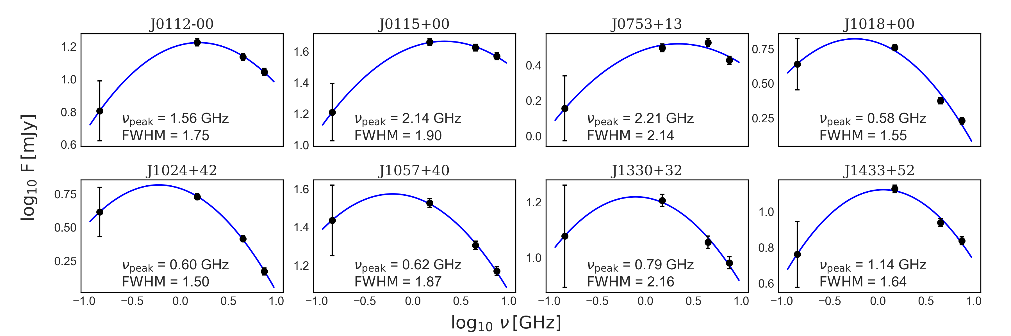
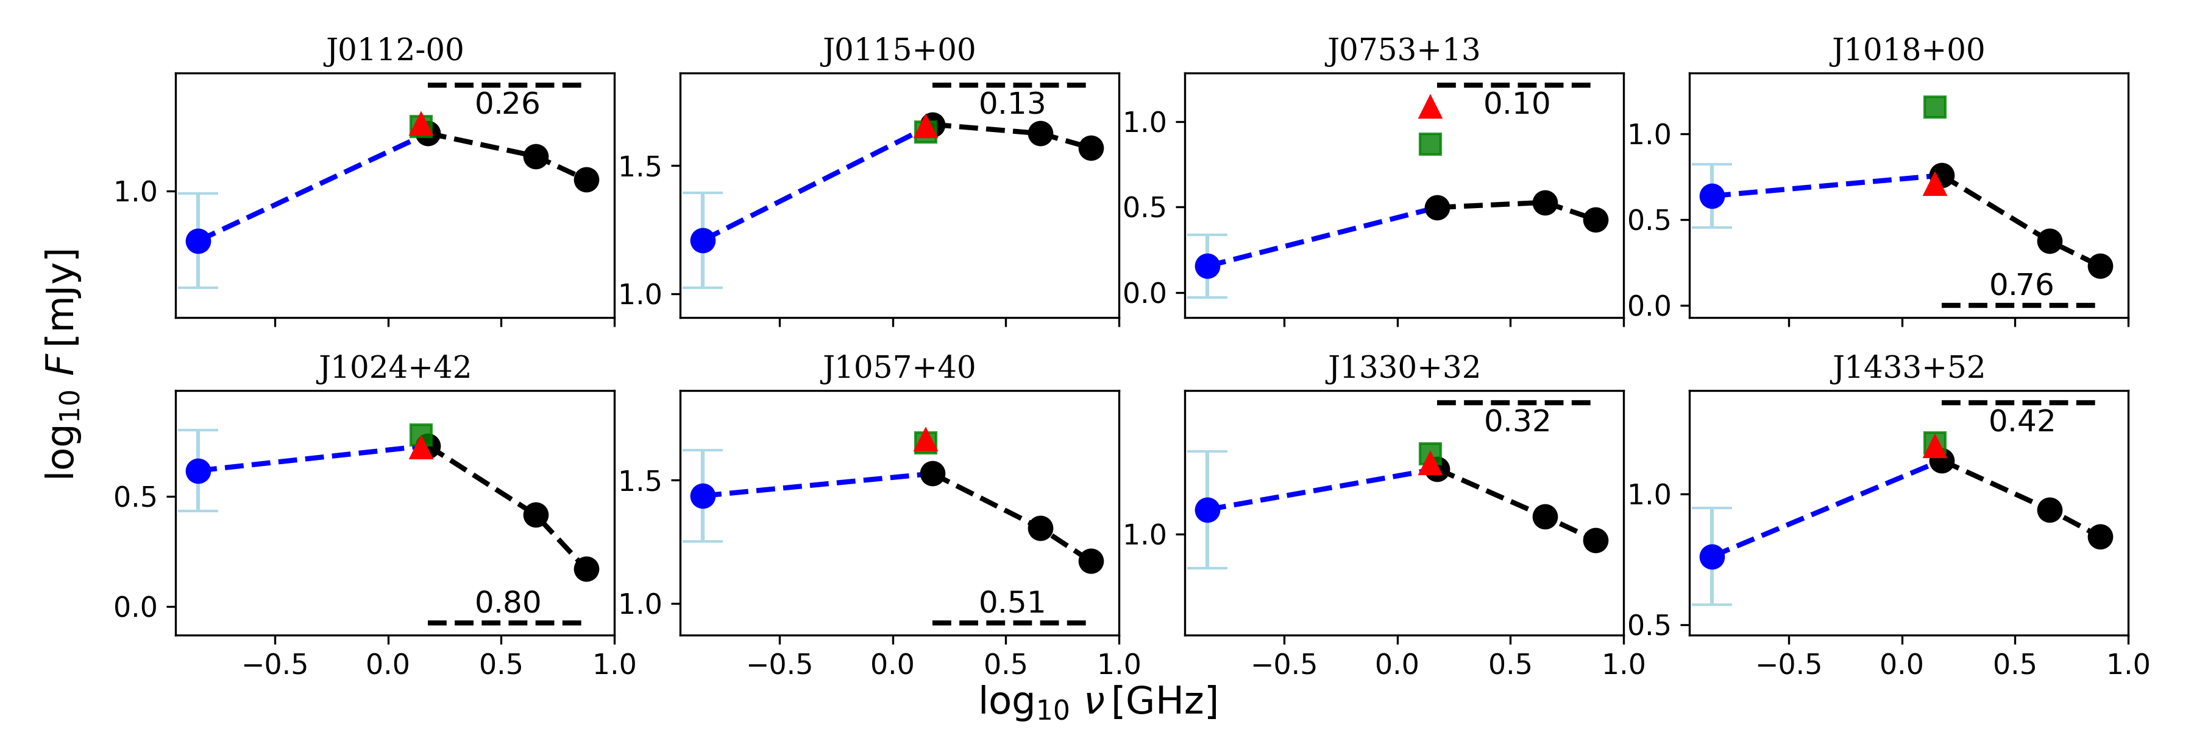
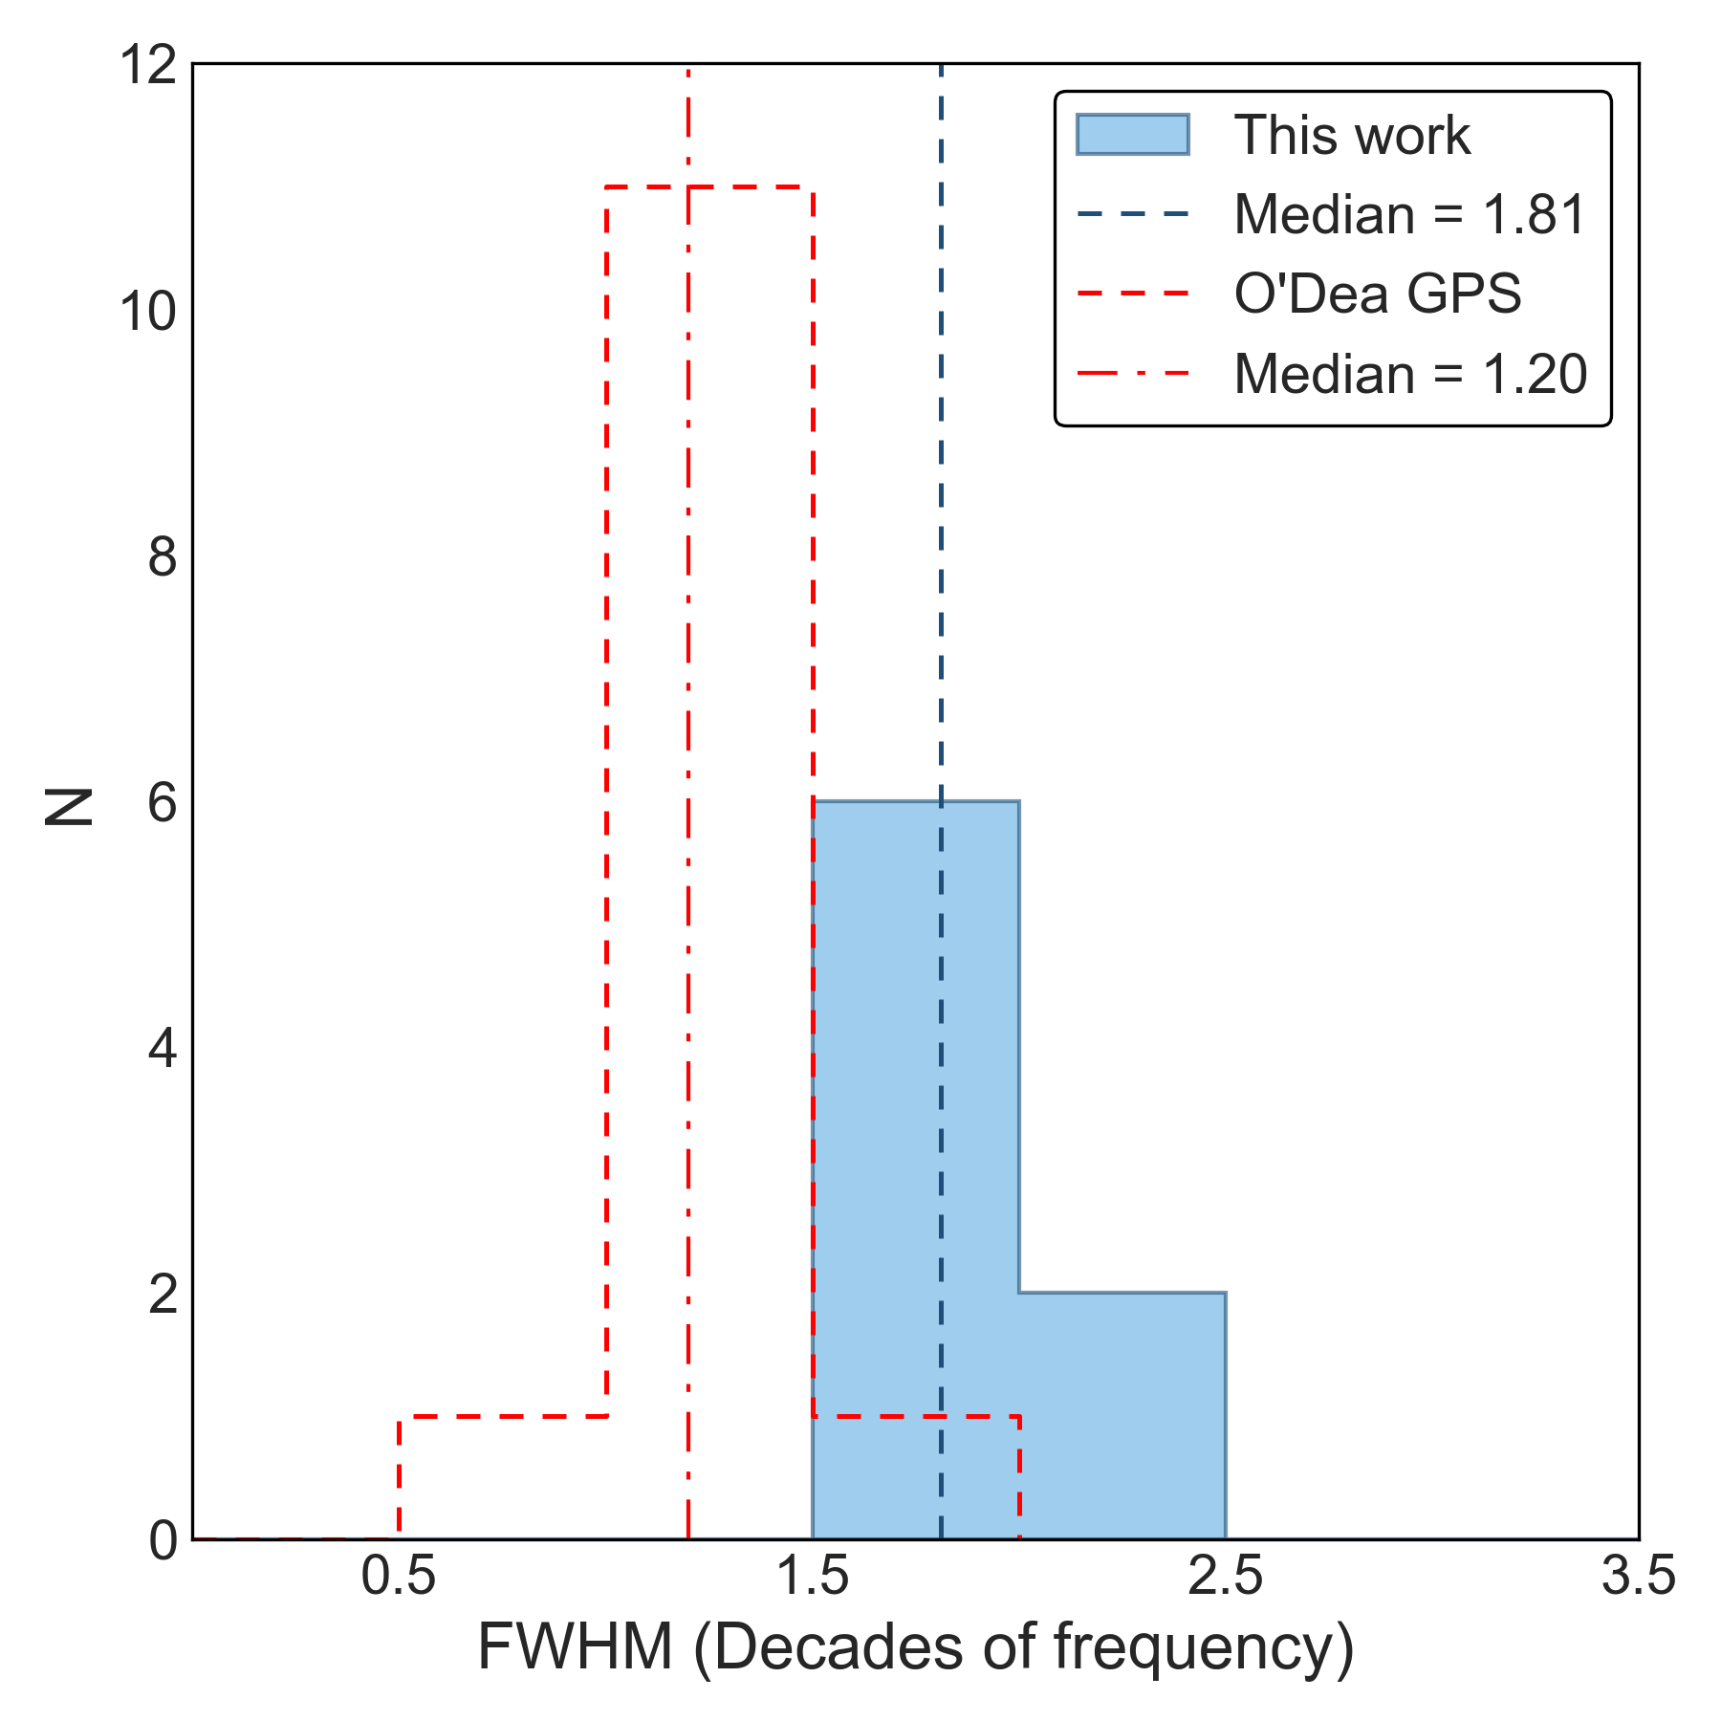
Are they Young RGs?
GPS source Spectrum
Testing the dynamic scenario
$$\log{S}\left(ν\right)=\log{S_{m}}−b{\left(\log{ν}−\log{ν_{m}}\right)}^{2}$$
K. E. Randall et al 2011
Penna et al. to be subm.
Mostly NOT young RGs, possible 10–15%
Penna et al. to be subm.

Slide 10
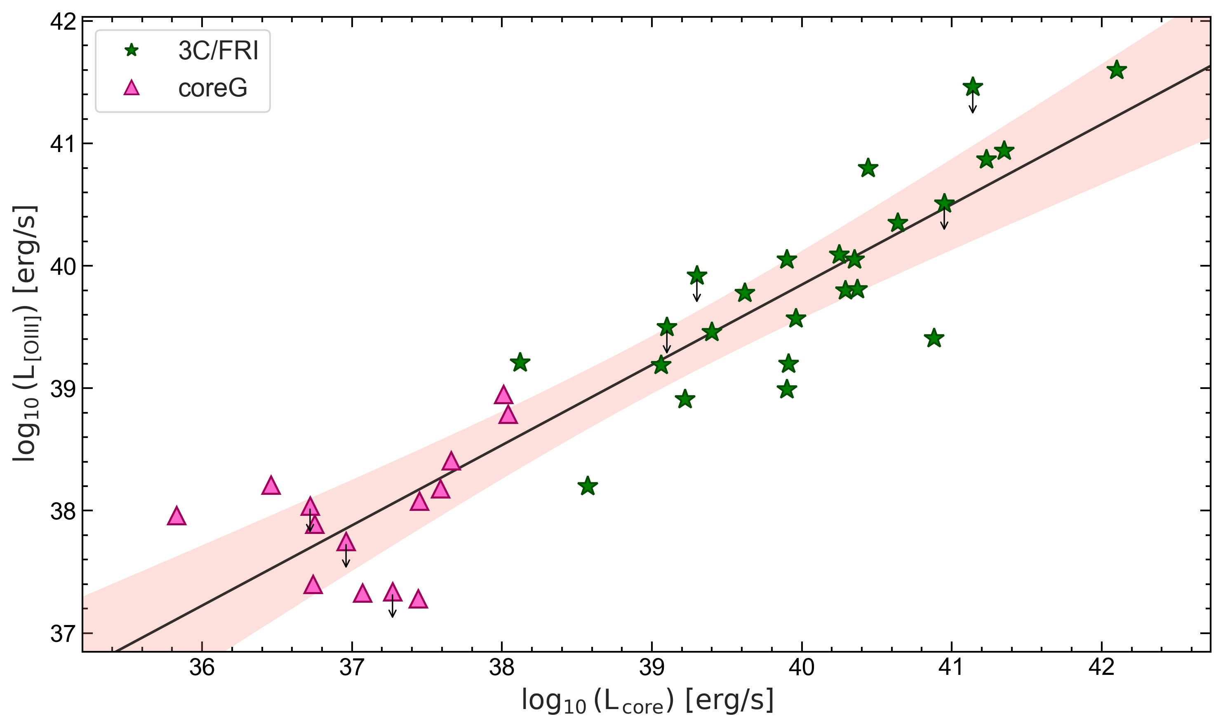
Accretion – Ejection
[OIII] luminosity proxy accretion
Core luminosity
proxy ejection
Penna et al. to be subm.

Slide 11
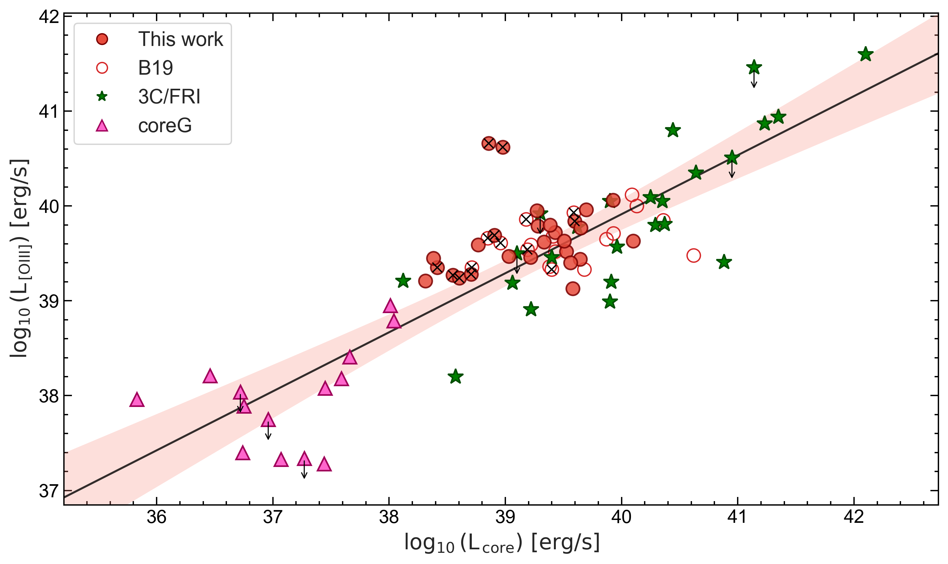
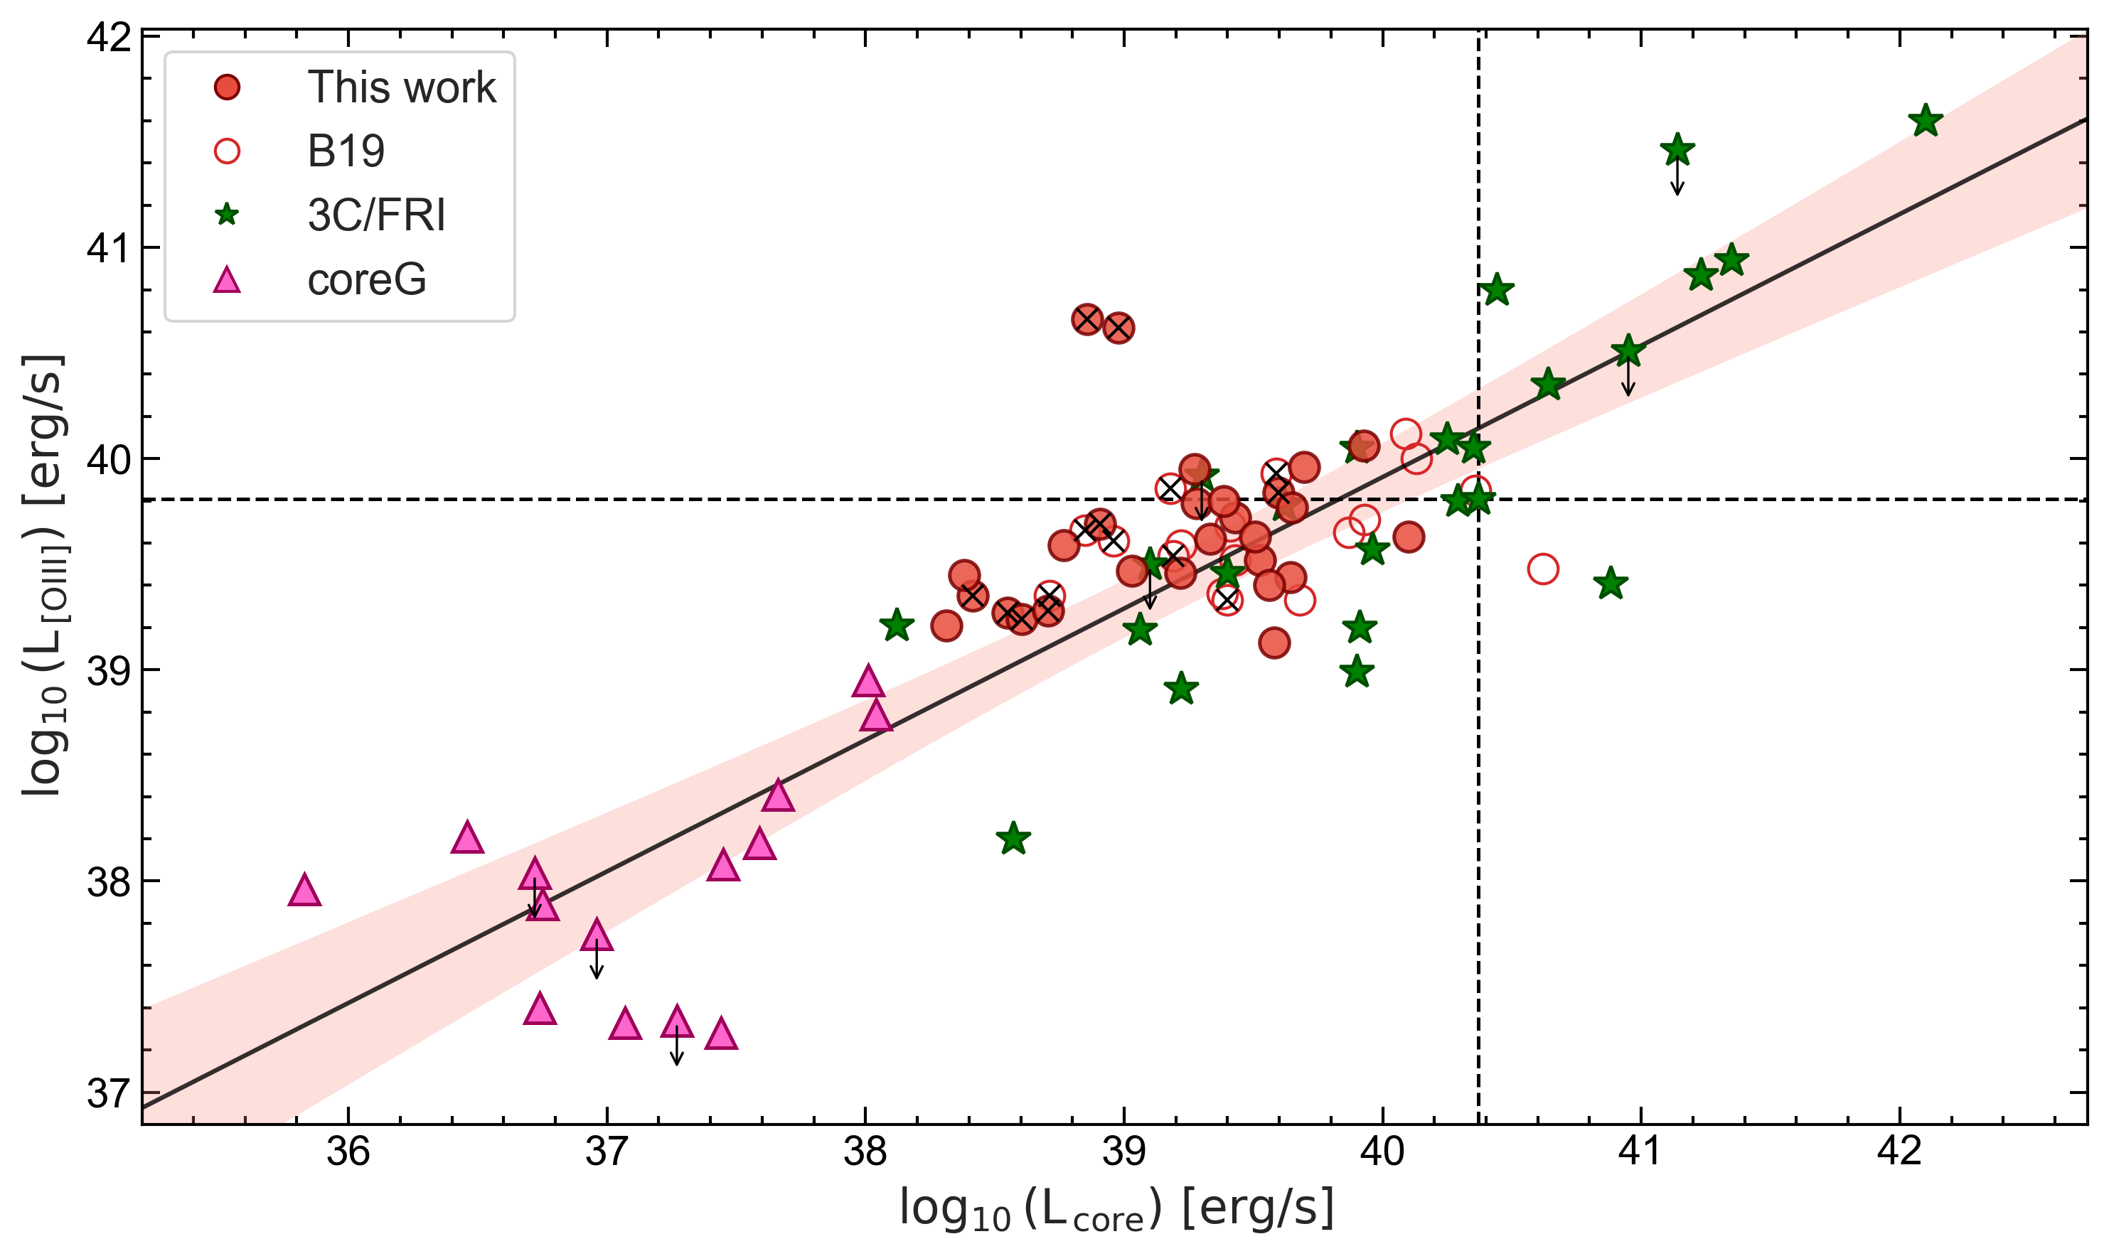
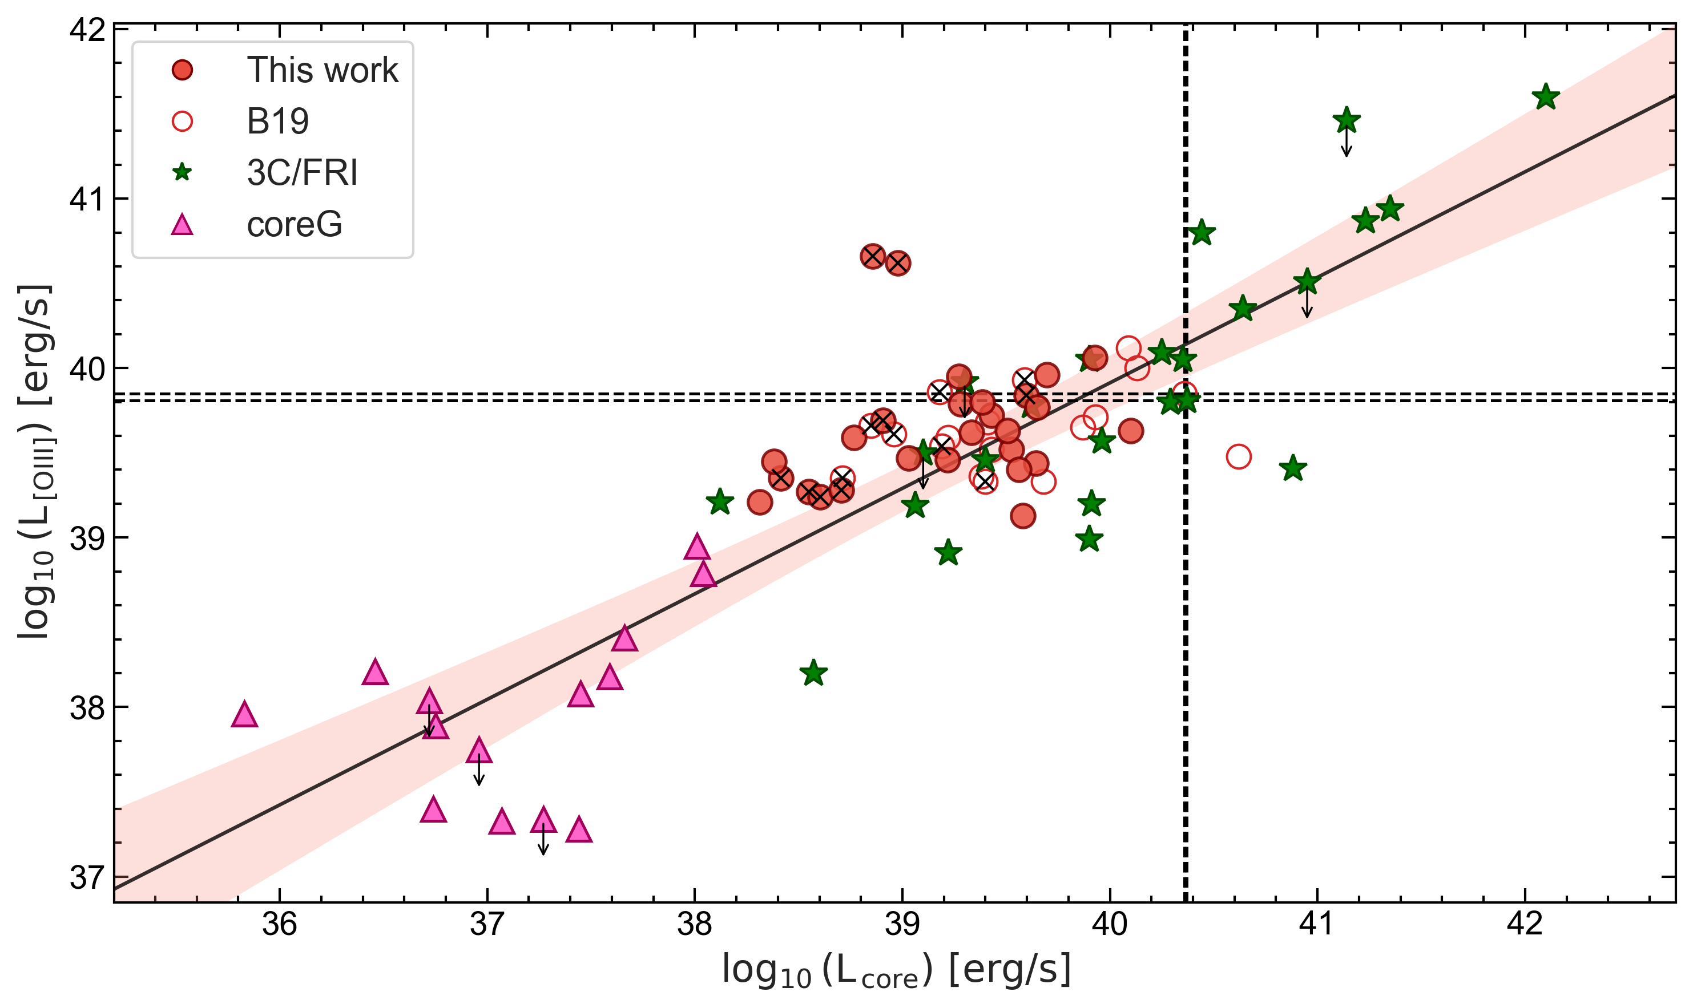
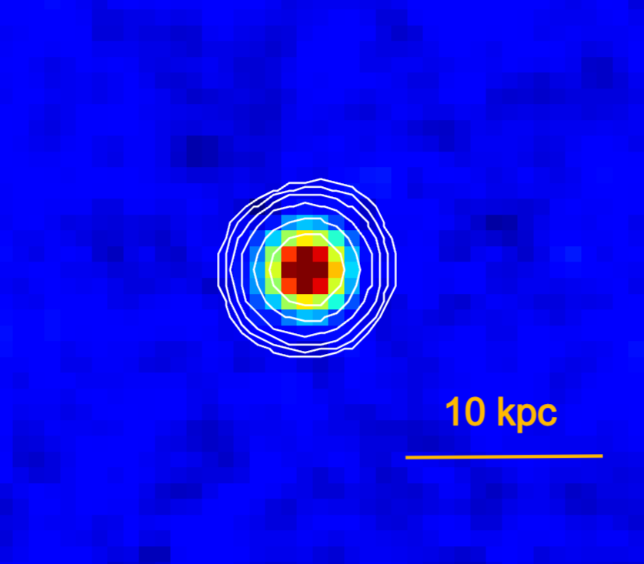
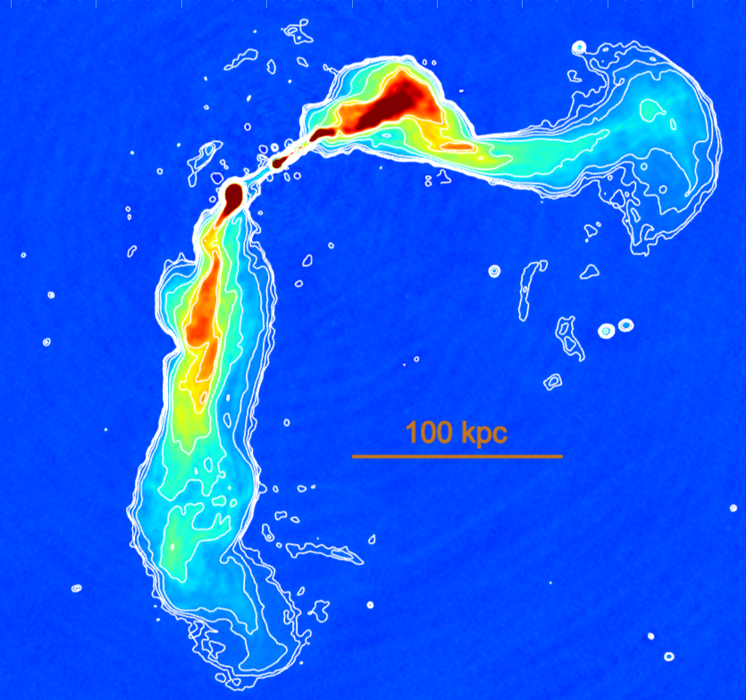
Accretion – Ejection
Penna et al. to be subm.
3C465

Slide 12
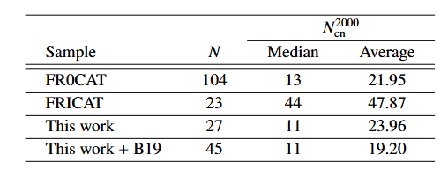
Cosmological Neighbours
Cosmological Neighbours
FR0
FRI
Penna et al. to be subm.
Capetti et al, 2020

Slide 13

Conclusions
FR0s: compact RLAGN, few exceptions
Dynamic scenario
  Core SEDs
  mostly NOT YOUNG
Compact because young or recurrent phase of RLAGN
  ACCRETION-EJECTION:
1) Not due to $line of sight$,
2) similar engine to FRIs, but:
  MORPHOLOGY
  mostly COMPACT
Static scenario
  CORE EMISSION
  mostly FLAT
Compact because Intrinsic properties
e.g. low BH spin, weak B, jet composition

Slide 14
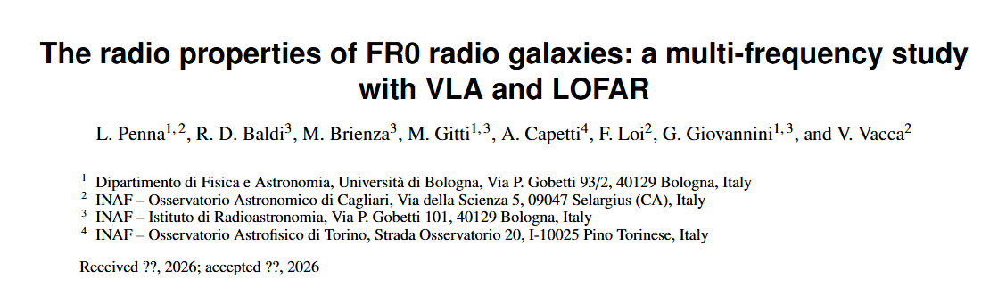
Thanks!

Slide 16
Extra Slides

Slide 17
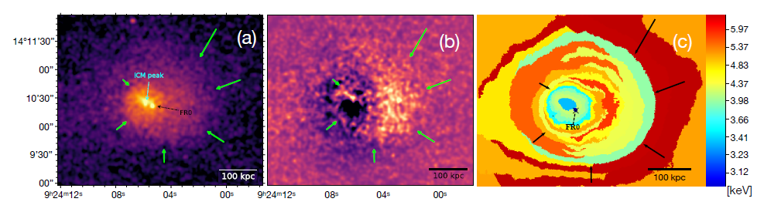
Environment 1: X-RAY & feedback
Ubertosi et al, 2021
The position of a pair of X-ray cavities is consistent with a sloshing-influenced uprise of the bubbles,
Need for deeper observations.

Slide 18
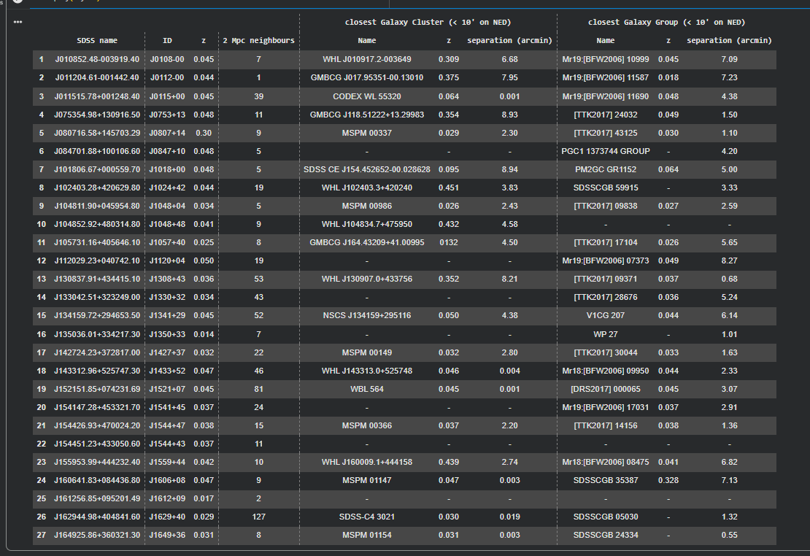

Slide 19
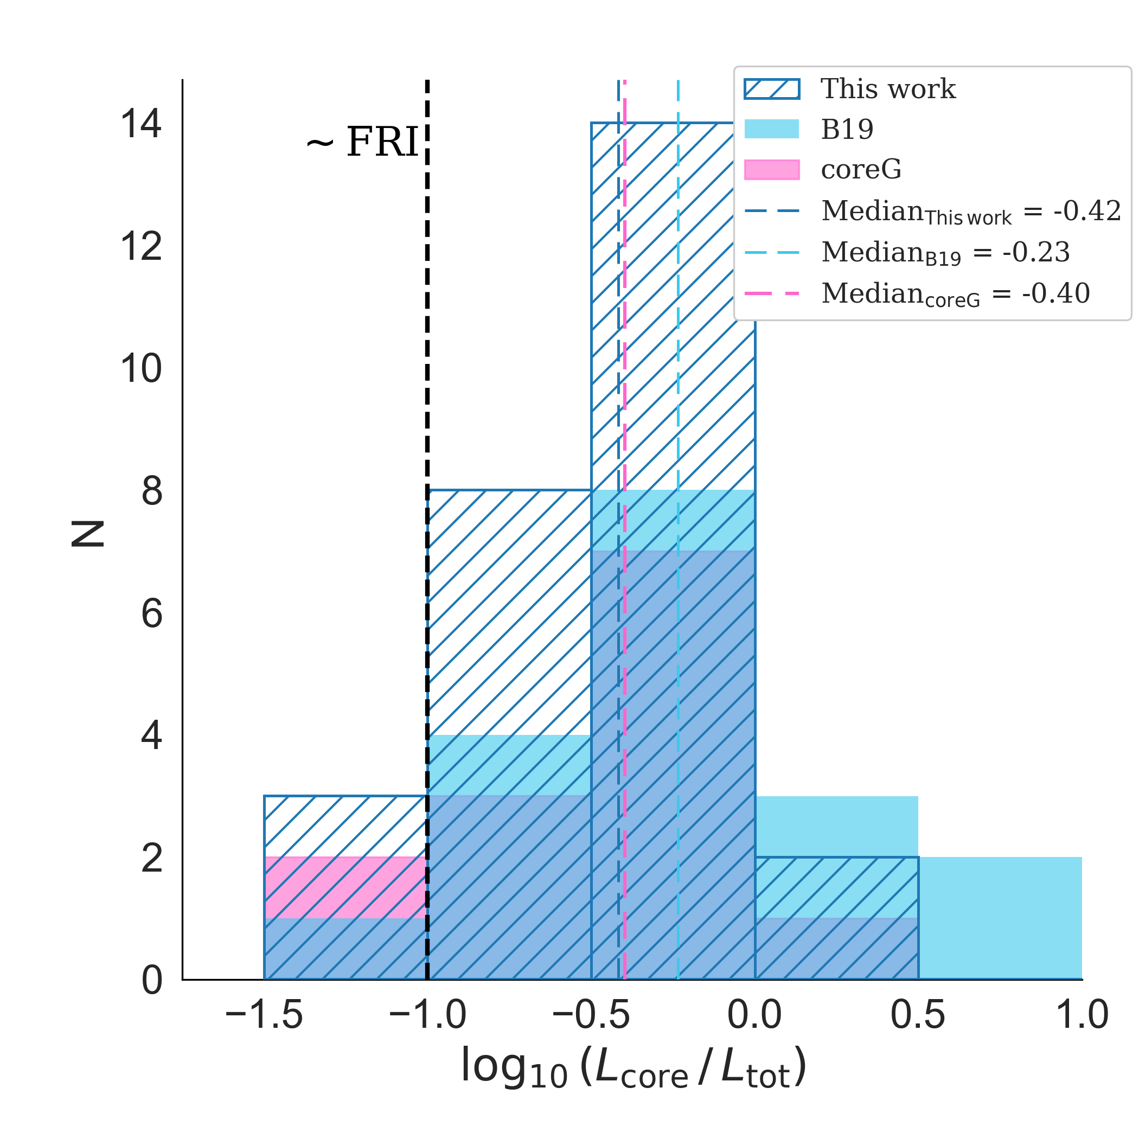
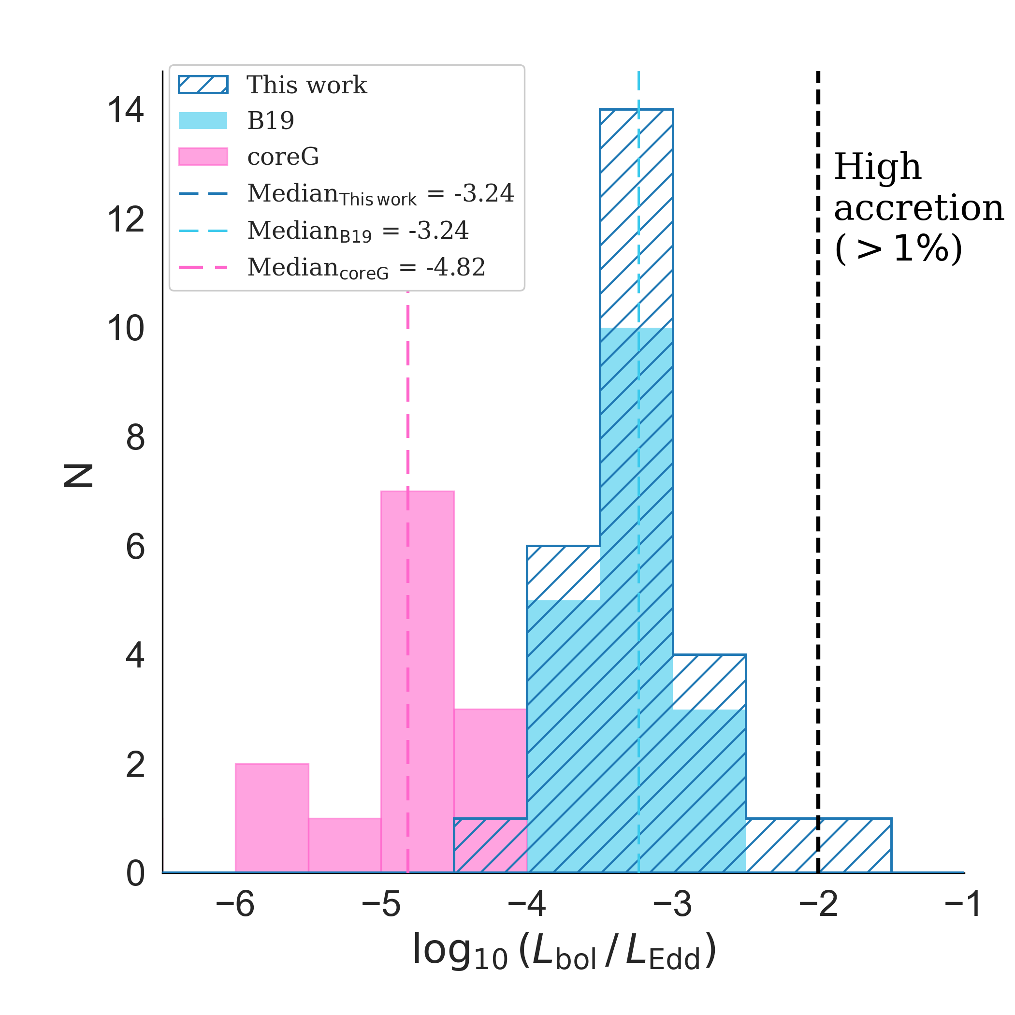
Core dominance + Accretion
Core Dominance
Eddington Ratio
RQ
Penna et al. to be subm.

Slide 20
Future Works
Complete FR0CAT sample with high-resolution VLA (1.5 - 4.5 - 7.5 GHz)
Multi-frequency observations (e.g. X-ray, gamma-ray)
VLBI (eMERLIN, EVN, VLBA) → morphology, jet velocity, jet-sidedness
→ variability and duty cycle (through multi-epoch campaigns)
Pc to kpc-scale follow up → fraction that retains more powerful jets → feedback
Expand MHz–GHz observations → presence of optically thin component
→ help misclassification of young RGs as FR0s

Slide 21
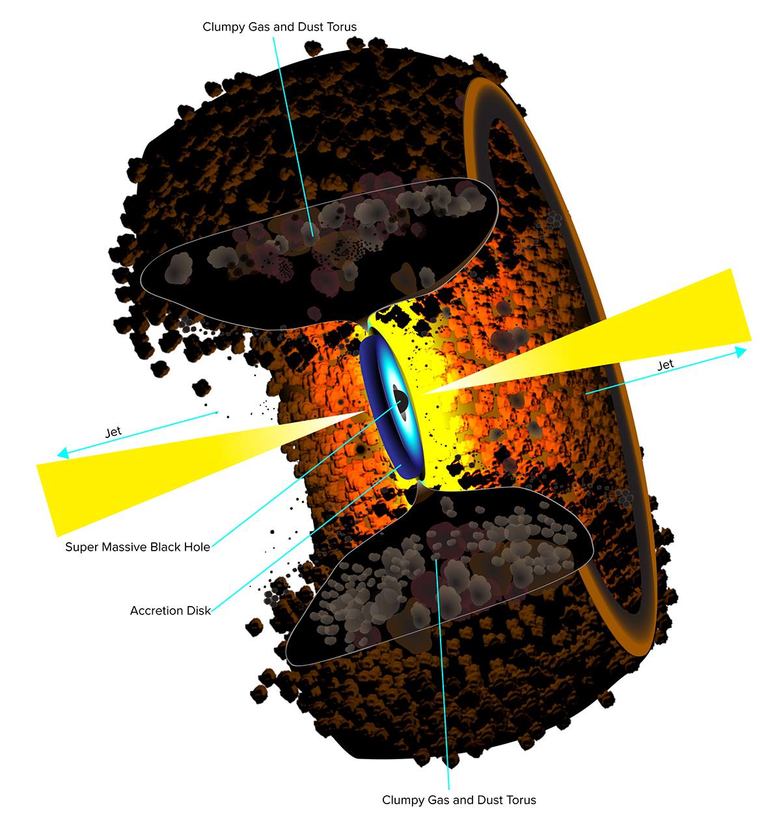
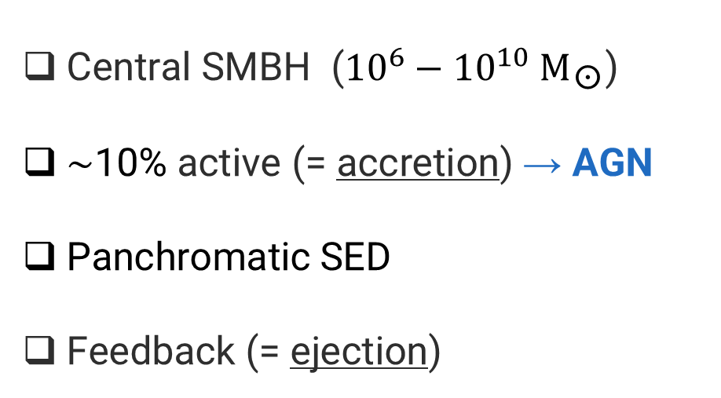
AGN, RLAGN, RG
Central SMBH (${10}^{6}−{10}^{10}{ M}_{\text{☉}}$)
$\sim$10% active (= accretion) → AGN
Panchromatic SED
Feedback (= ejection)
SMBH-host coevolution
B. Saxton NRAO/AUI/NSF

Slide 22
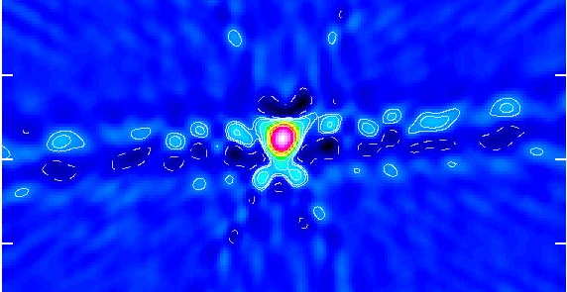
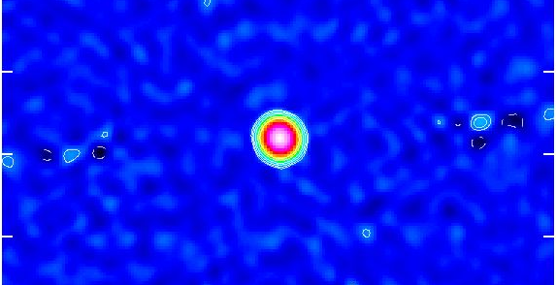
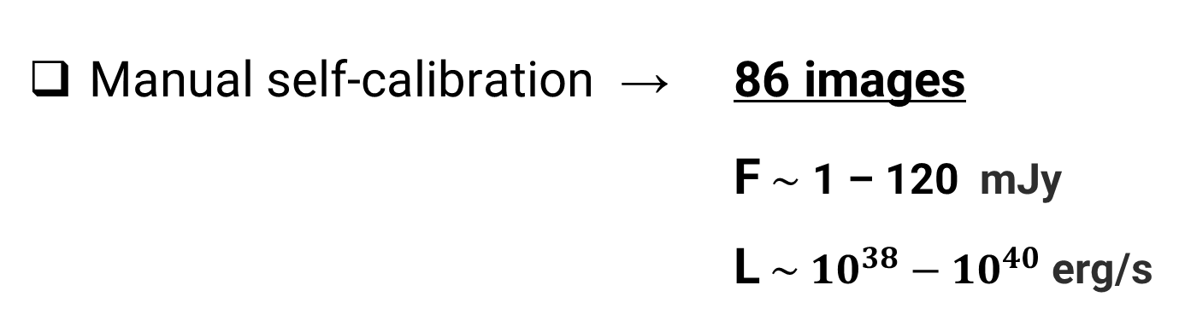
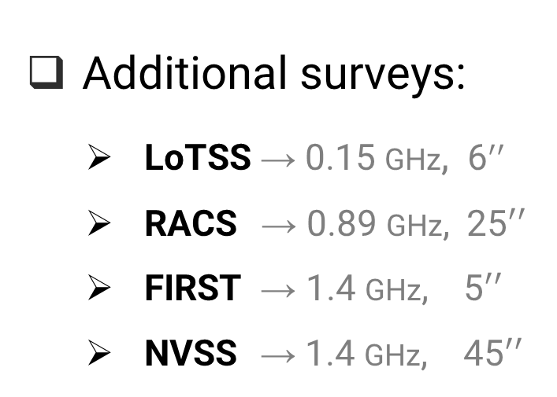
Data Reduction
A priori calibration with VLA pipeline
Manual self-calibration → 86 images
F$\sim$ 1 – 120 mJy
  L$\sim {{ 10}^{38} − 10}^{40}$ erg/s
SELFCAL
Additional surveys:
  LoTSS → 0.15 GHz, 6$′′$
  RACS → 0.89 GHz, 25$′′$
  FIRST → 1.4 GHz, 5$′′$
  NVSS → 1.4 GHz, 45$′′$
SEDs
0.15 – 7.5 GHz
0.3 – 45 arcsec

Slide 23
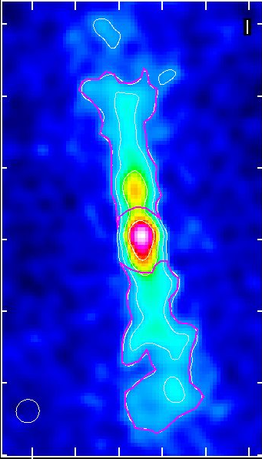
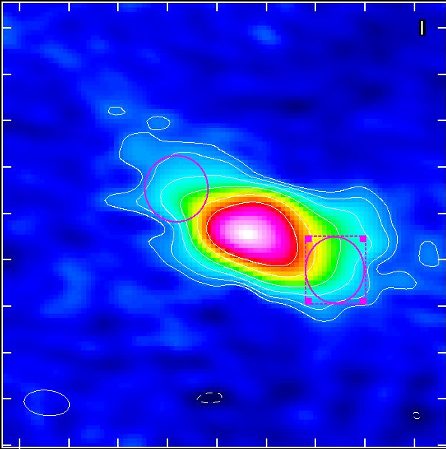
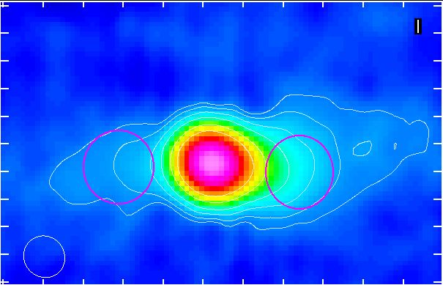
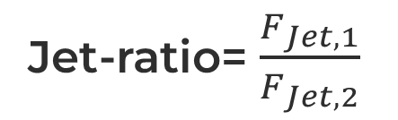
Jet-Sidedness
Average jet-ratio
Jet-ratio= $\frac{F_{Jet, 1}}{F_{Jet, 2}}$
Sample | VLA | LOFAR
Project 2 | 1.45 | 1.37
B19 (baldi et al 2019) | 1.43 | -
Project 1 | 1.23 | 1.16
Penna et al. to be subm.

