Slide 1
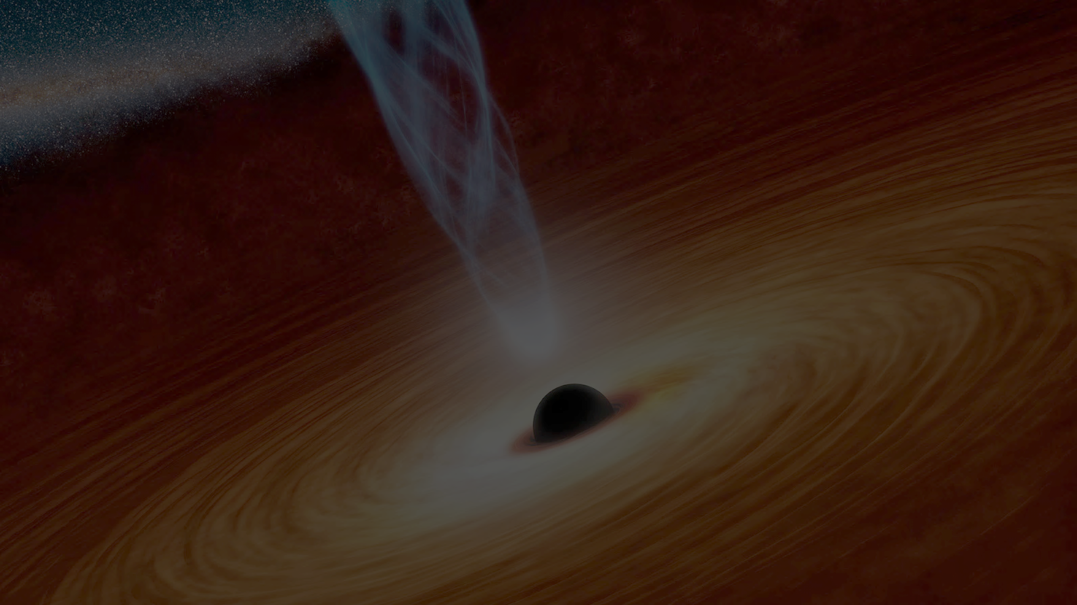
Black hole - host galaxy coevolution in IMBH regime
Kirill Grishin
(LUX Laboratory, Paris Observatory, CNRS)
on behalf of:
Igor Chilingarian, Ivan Katkov, Victoria Toptun, Françoise Combes, Ivan Zolotukhin, Franz Bauer, Evgenii Rubtsov, Mariia Demianenko, Liana Osipova, Fedor Kolganov, Daniel Fabricant, Roberto Soria, Alister W. Graham

Slide 2
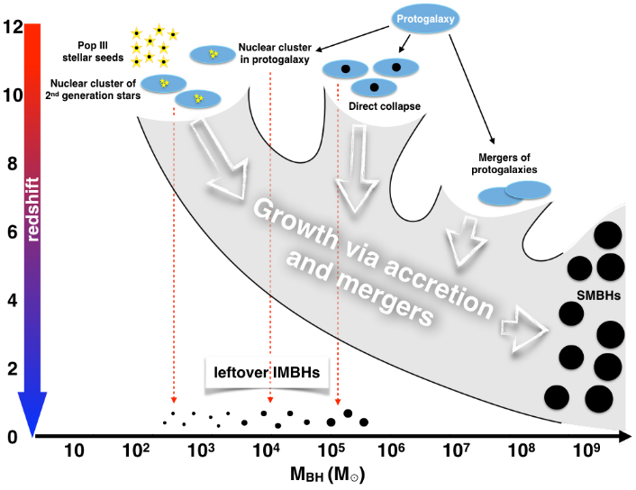
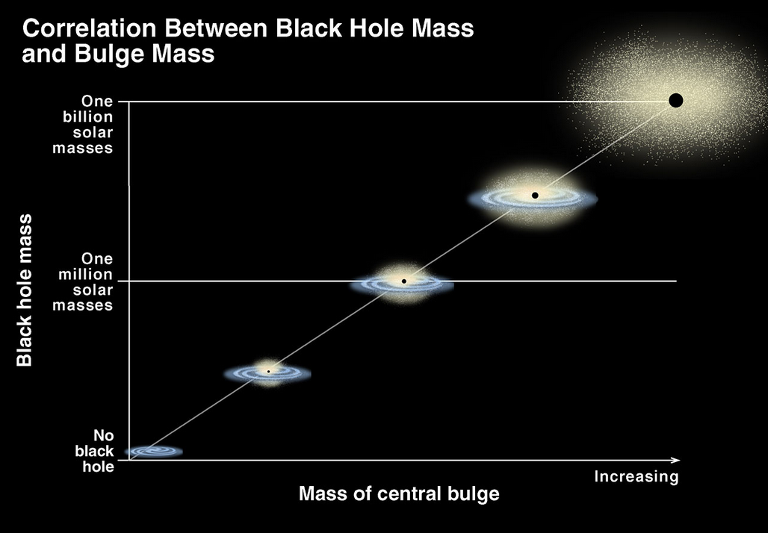
What are the IMBHs and why are they important
The most of massive galaxies are expected to host a Supermassive Black Hole (SMBH) in its center. The main questions: how these SMBHs were formed/what were their seeds and how they grew/evolved over the cosmic time.
  IMBHs in the local Universe can help if (we assume that) they evolve now similarly to high-z IMBHs
  Search for low-z type-I AGN powered by IMBHs in SDSS
  Spectroscopic selection + multi-wavelength follow-up
Mezcua 2017
?
K. Cordes, S. Brown (STScI)

Slide 3
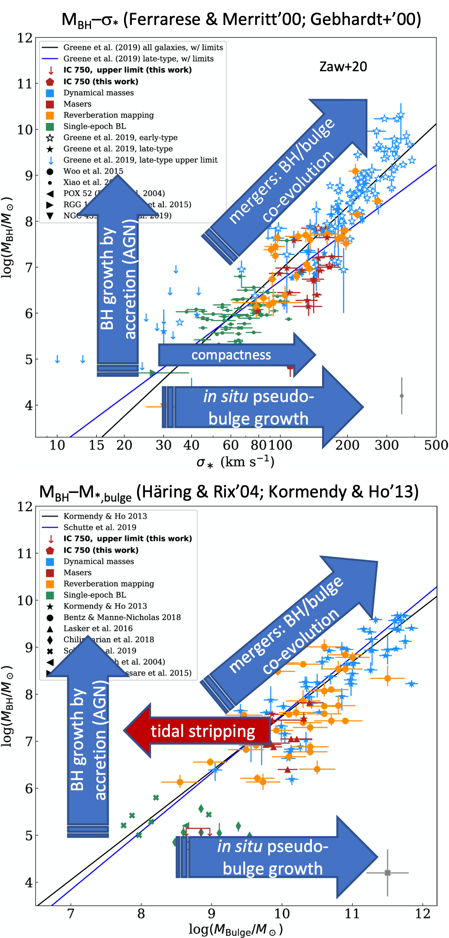
Central BH and host galaxy coevolution
A pseudo-bulge growing in situ (Kormendy & Kennicutt’04): no correlation with BH expected, usually pseudo-bulges are more massive then expected for such M_{BH}.
With mergers, bulge and BH grow similarly, leading to a correlation between M_{BH} and M_{bulge}, σ*
In accretion-dominated case M_{BH} is larger than expected for such a bulge
Tidal stripping reduces M_{bulge}, but does not affect much σ*

Slide 4
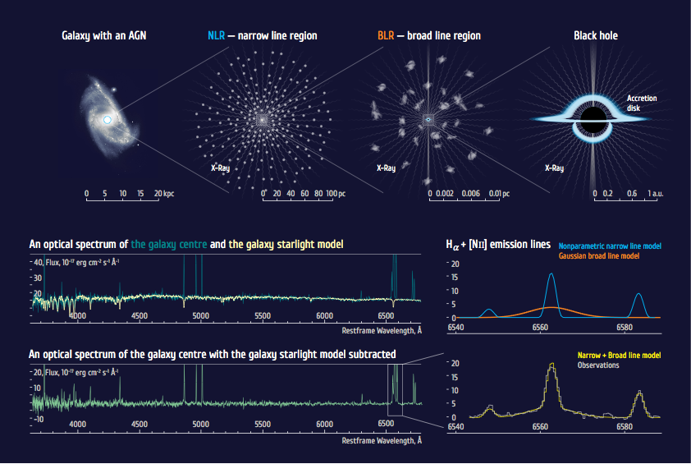

Slide 5
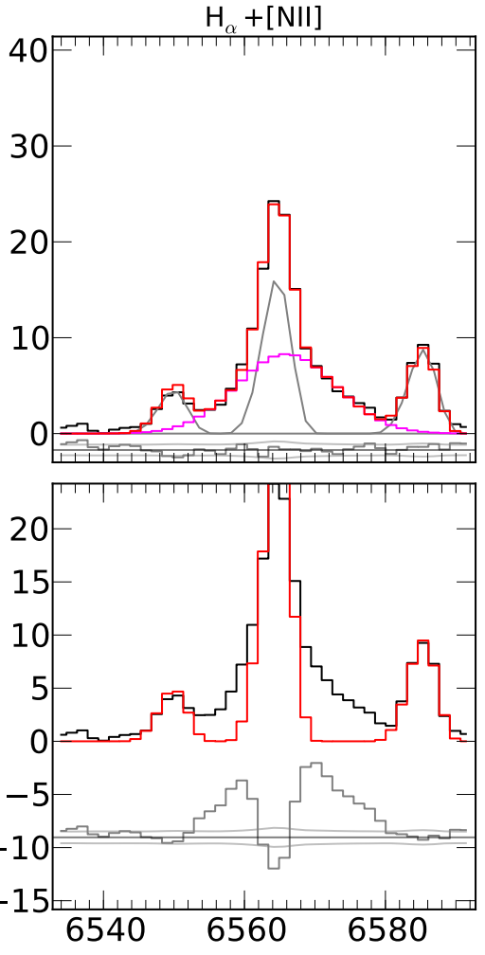
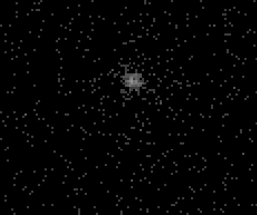
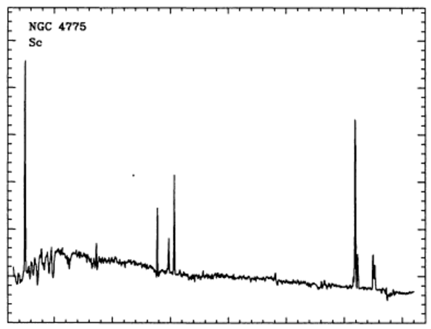
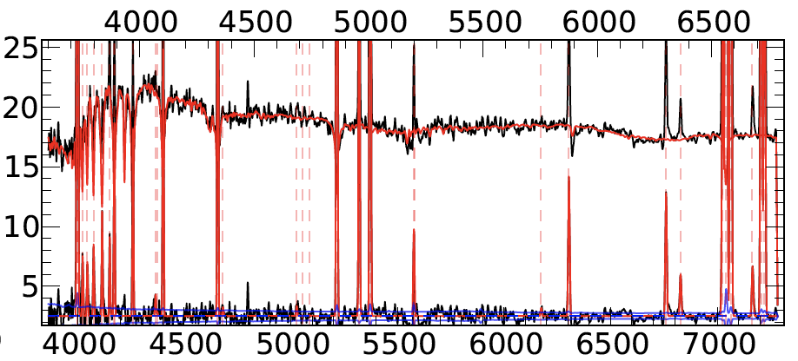
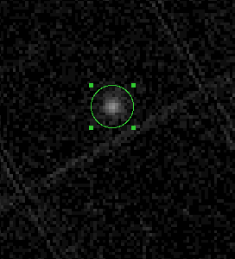
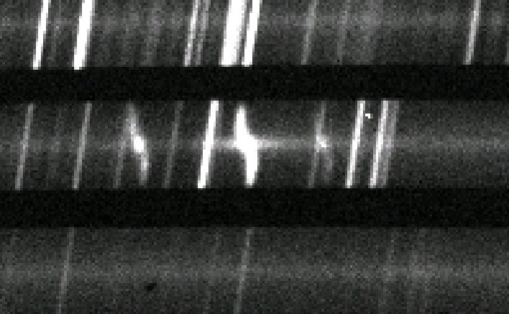
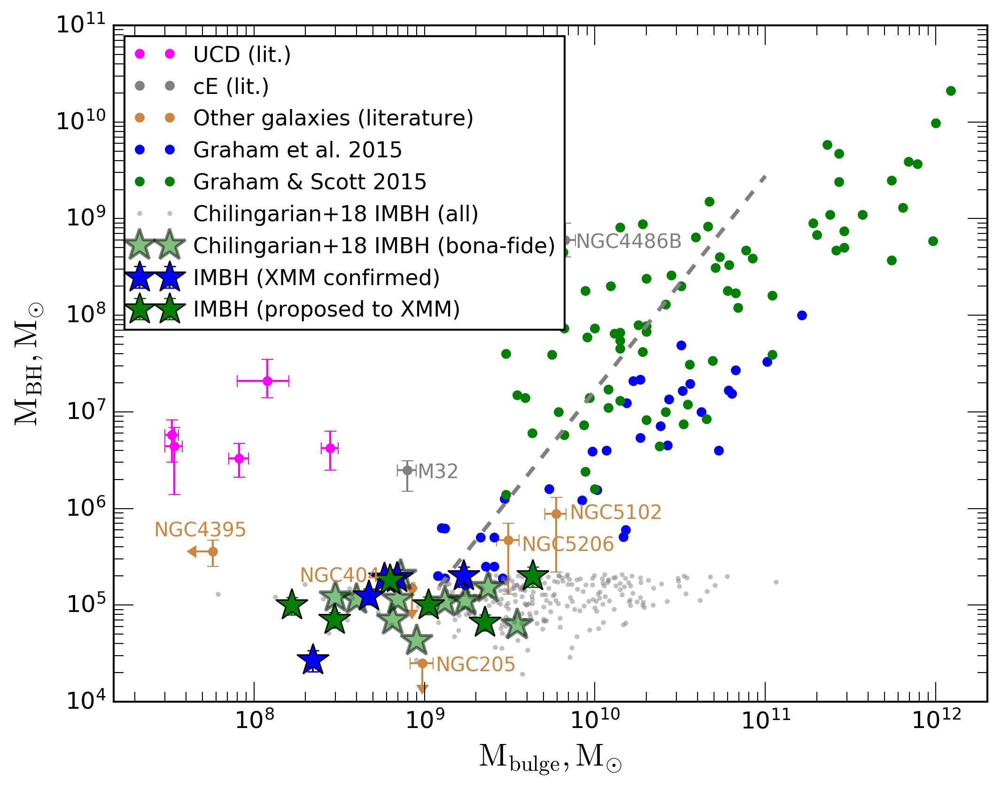
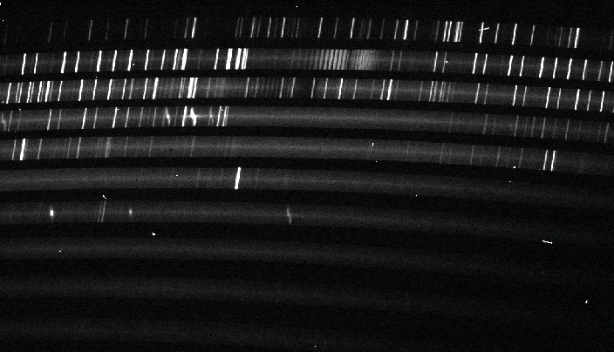
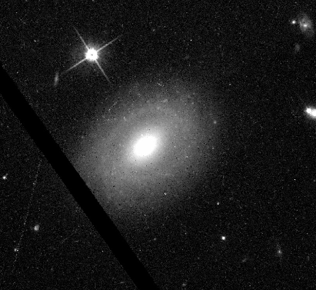
far-UV
Stellar continuum model + emission lines
AstroSat UVIT
Input galaxy spectra
Search for active IMBHs
detecting broad-line signatures in galaxy spectra (optical type-I AGN) in RCSED spectra, then following them up
ApJ, Vol. 863, 1 (2018)
Monte-Carlo simulations
Candidates
Filter
M_{BH}
soft X-ray
Testing with several epochs
Literature
XMM Newton
Virtual Observatory, data archives, X-ray upper limits
high-res optical
BLR
H𝛼
Follow-up spectroscopy (optical/NIR):
Magellan (MagE, FIRE), Keck (ESI), VLT (X-Shooter)
HST

Slide 6
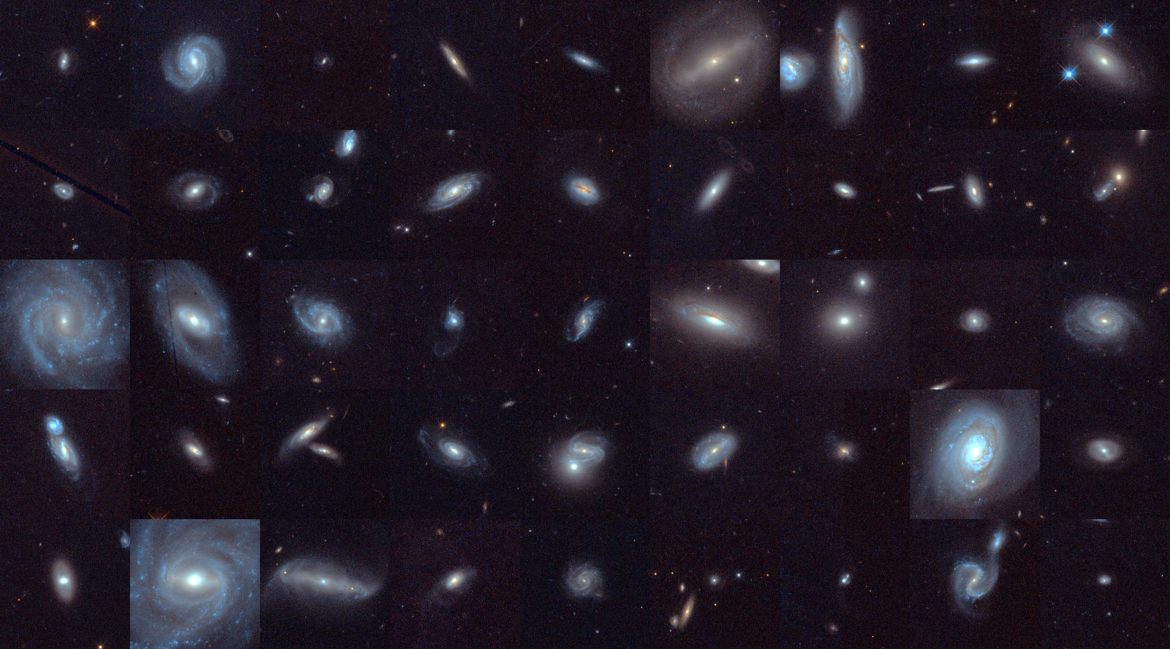
Our dedicated follow-up campaign with HST

Slide 7
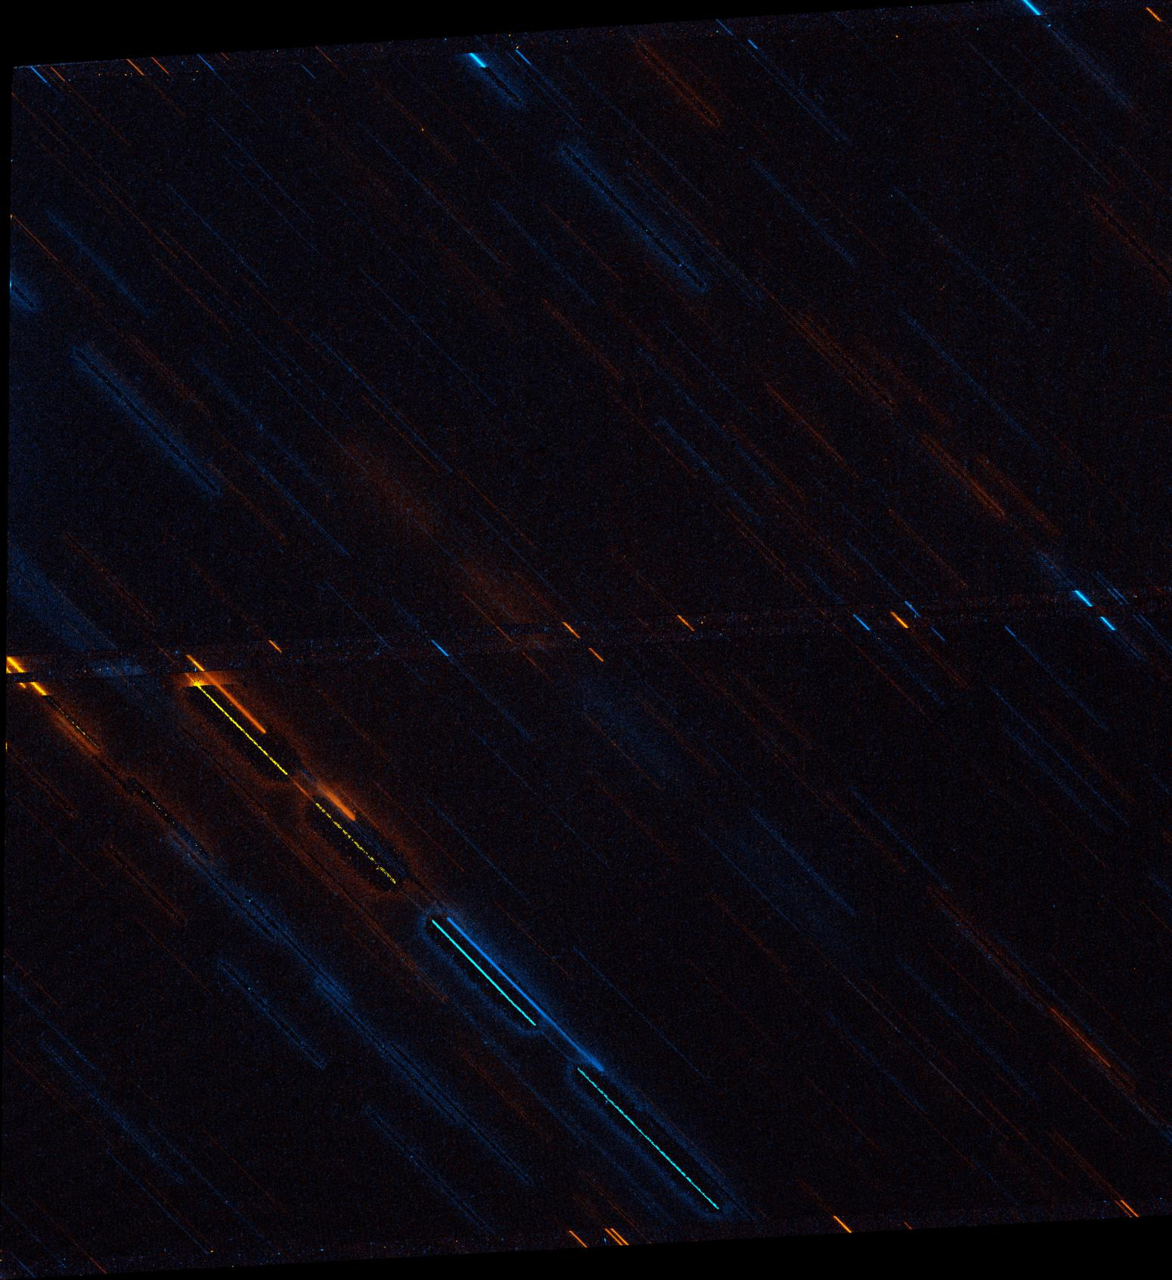
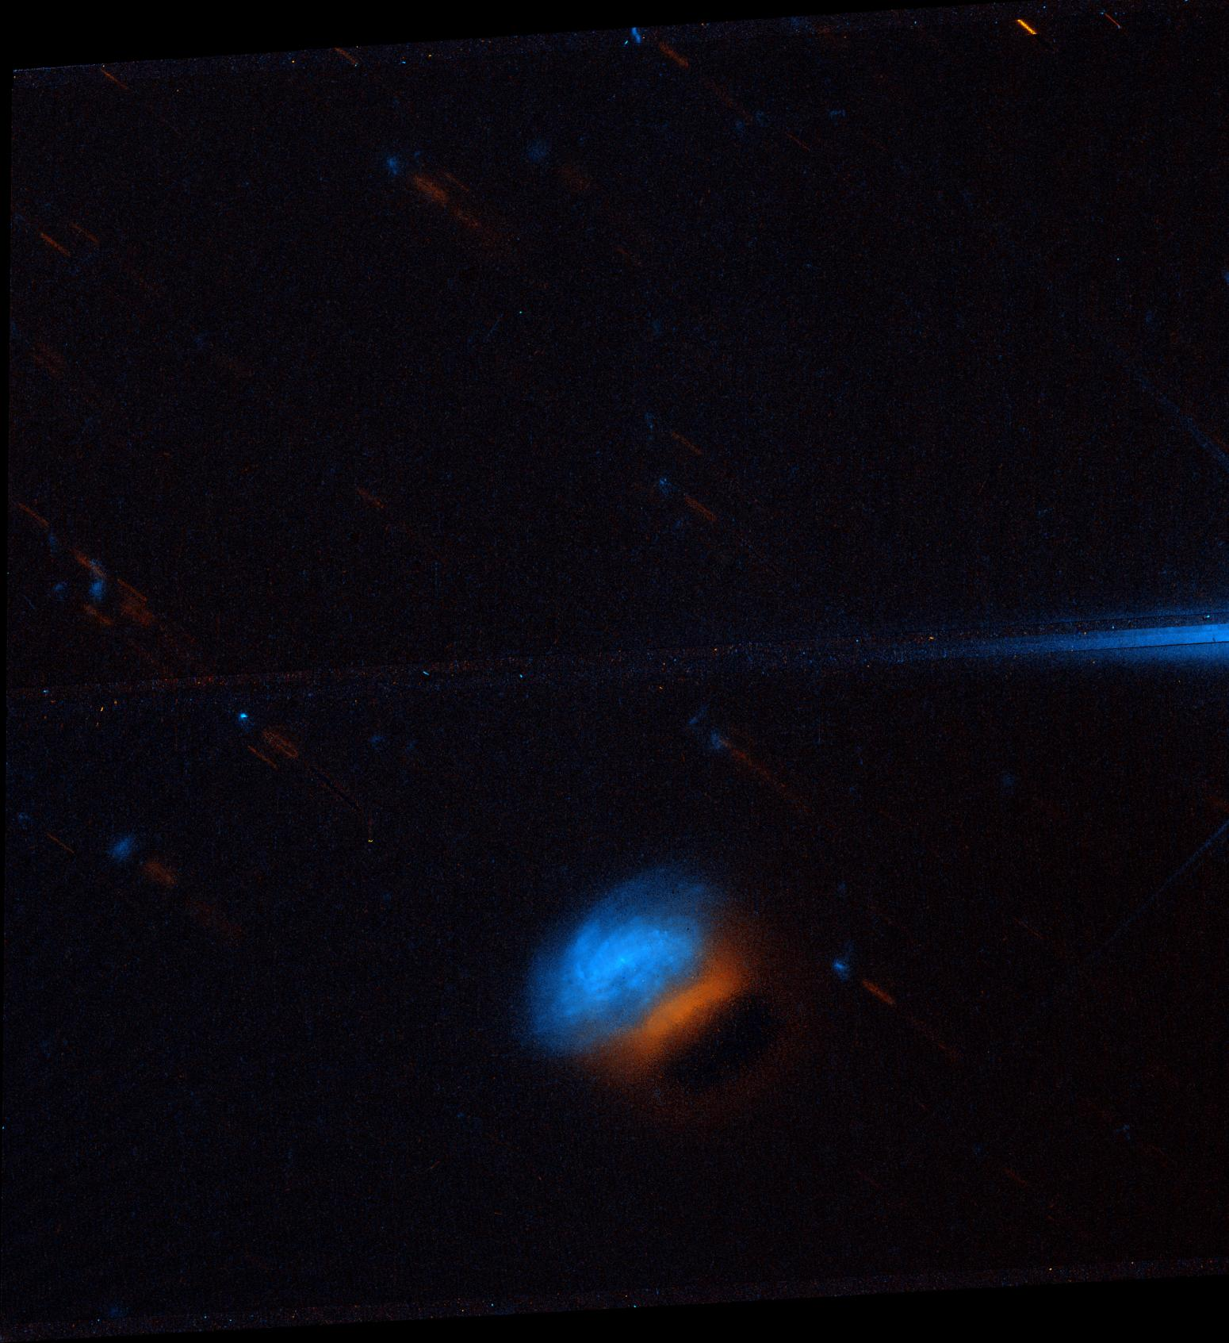
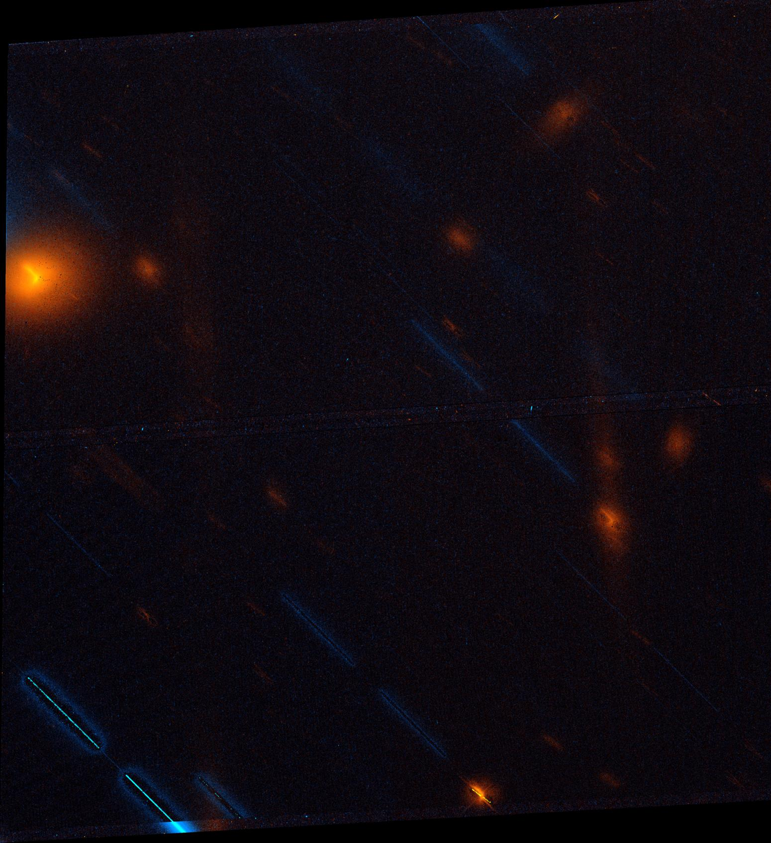
Sometimes it does not go well…

Slide 8
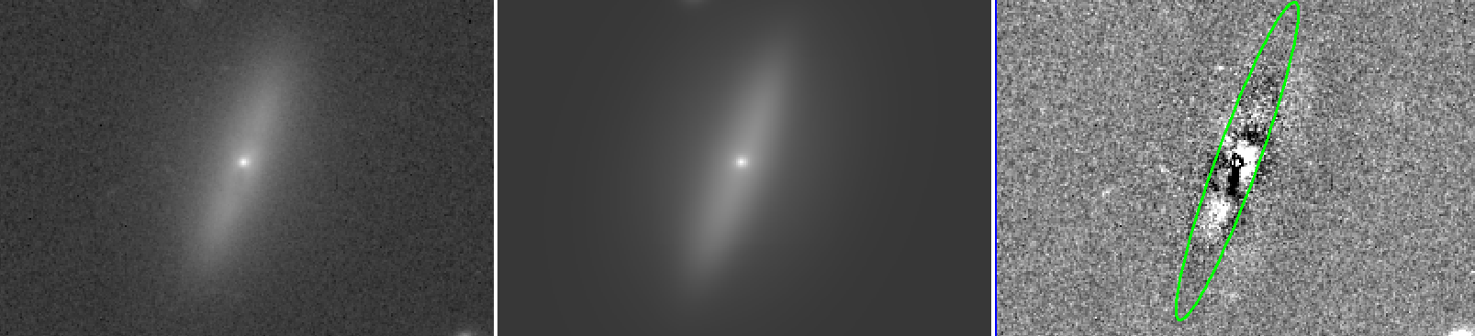
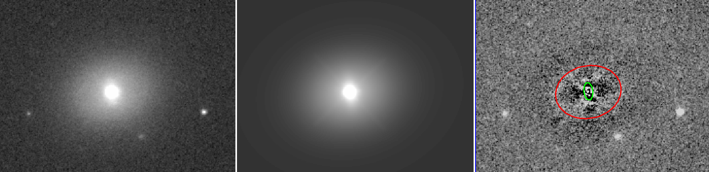
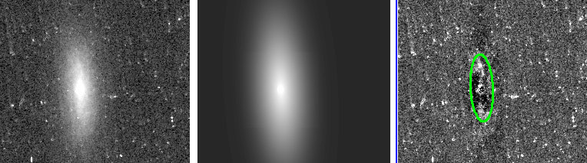
High-resolution imaging follow-up + archives: HST
Out of ~1800 objects with M_{BH} < 10⁶ M☉ 76 have archival HST data.
We performed 2D modelling (GalFit) for all galaxies observed using WFC3 that do not show prominent spirals (e.g. elliptical galaxies).
In the modelling procedure we mask bright stars and dust lanes in the galaxies.
HST Snapshot program for up-to 83 orbits, 3 bands (F300X/F475W/F814W)

Slide 9
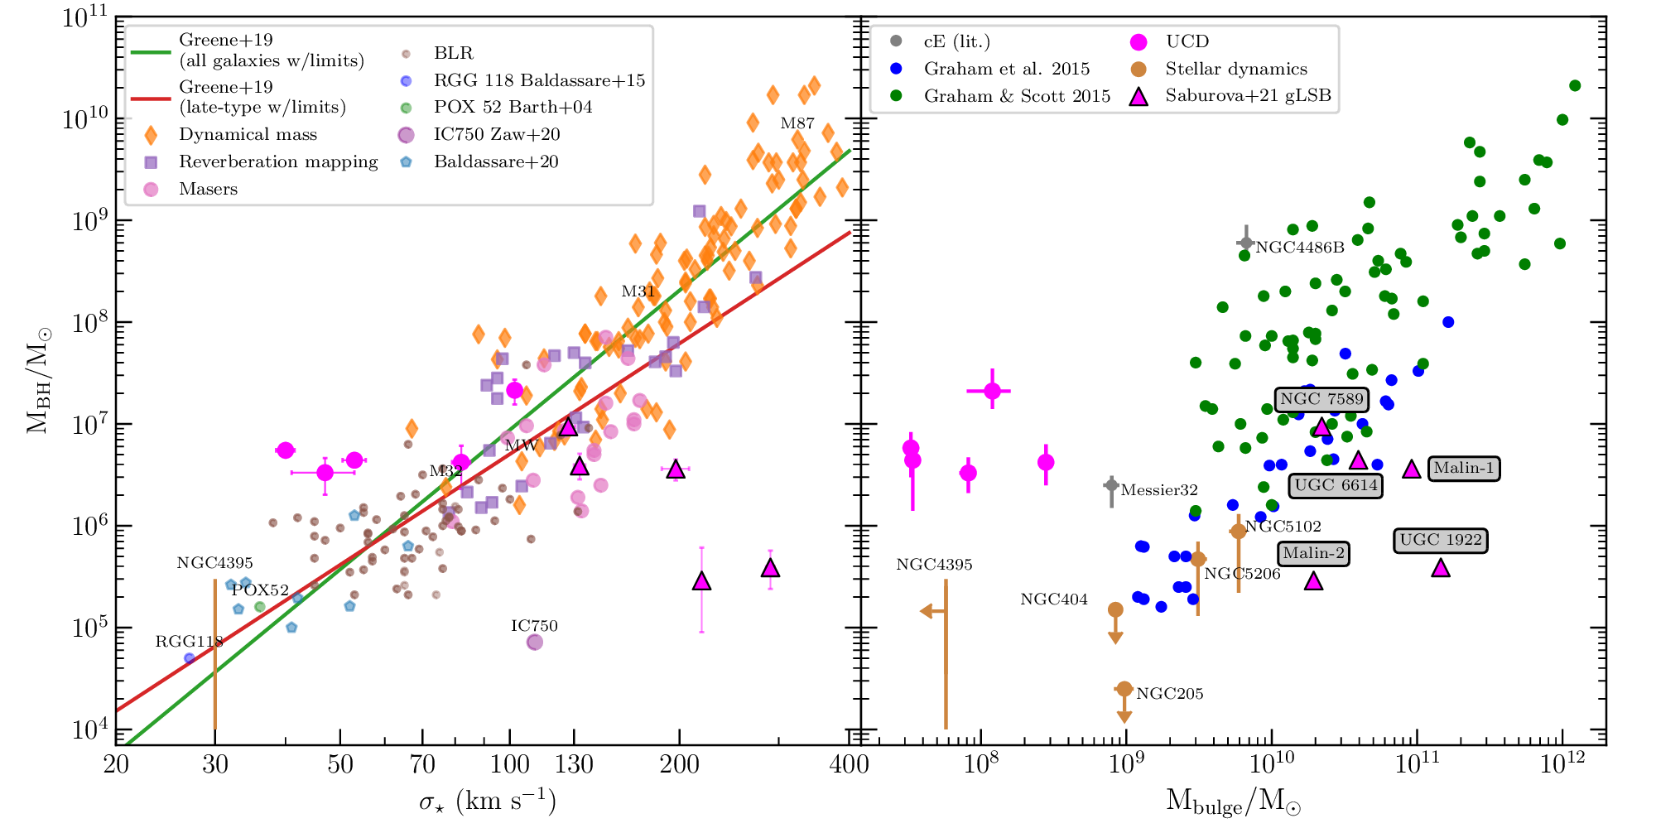
BH-Host scaling relations: literature

Slide 10
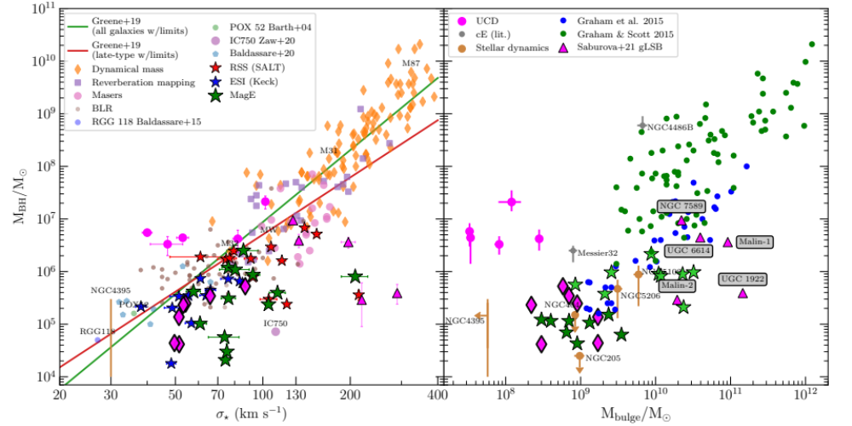
BH-Host scaling relations: our recent observations

Slide 11
Do IMBHs follow M_{BH}-M_{*,bulge} relation?
The position of IMBHs/their hosts on the scaling relation suggests the coevolution between central BH and hosting spheroids.
  But don’t we lose anything?
  Some hints that the situation can be more complicated:
  We know at least one IMBH hosted by a nearby bulgeless galaxy – NGC 4395. How many similar objects do we lose because of selection?
  We know also opposite cases with bulges, which are more massive than expected from M_{BH}-M_{bulge}. These bulges are likely formed through the secular evolution

Slide 12
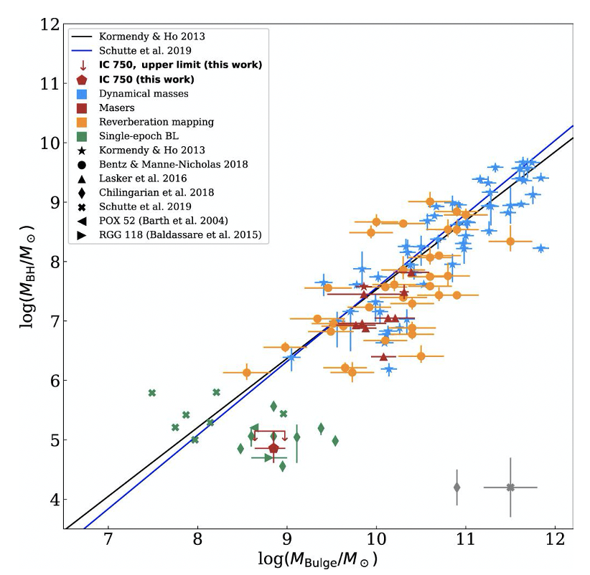
Do IMBHs follow M_{BH}-M_{*,bulge} relation?
The position of IMBHs/their hosts on the scaling relation suggests the coevolution between central BH and hosting spheroids.
  But don’t we lose anything?
  Some hints that the situation can be more complicated:
  We know at least one IMBH hosted by a nearby bulgeless galaxy – NGC 4395. How many similar objects do we lose because of selection?
  We know also opposite cases with bulges, which are more massive than expected from M_{BH}-M_{bulge}. These bulges are likely formed through the secular evolution
?
?

Slide 13
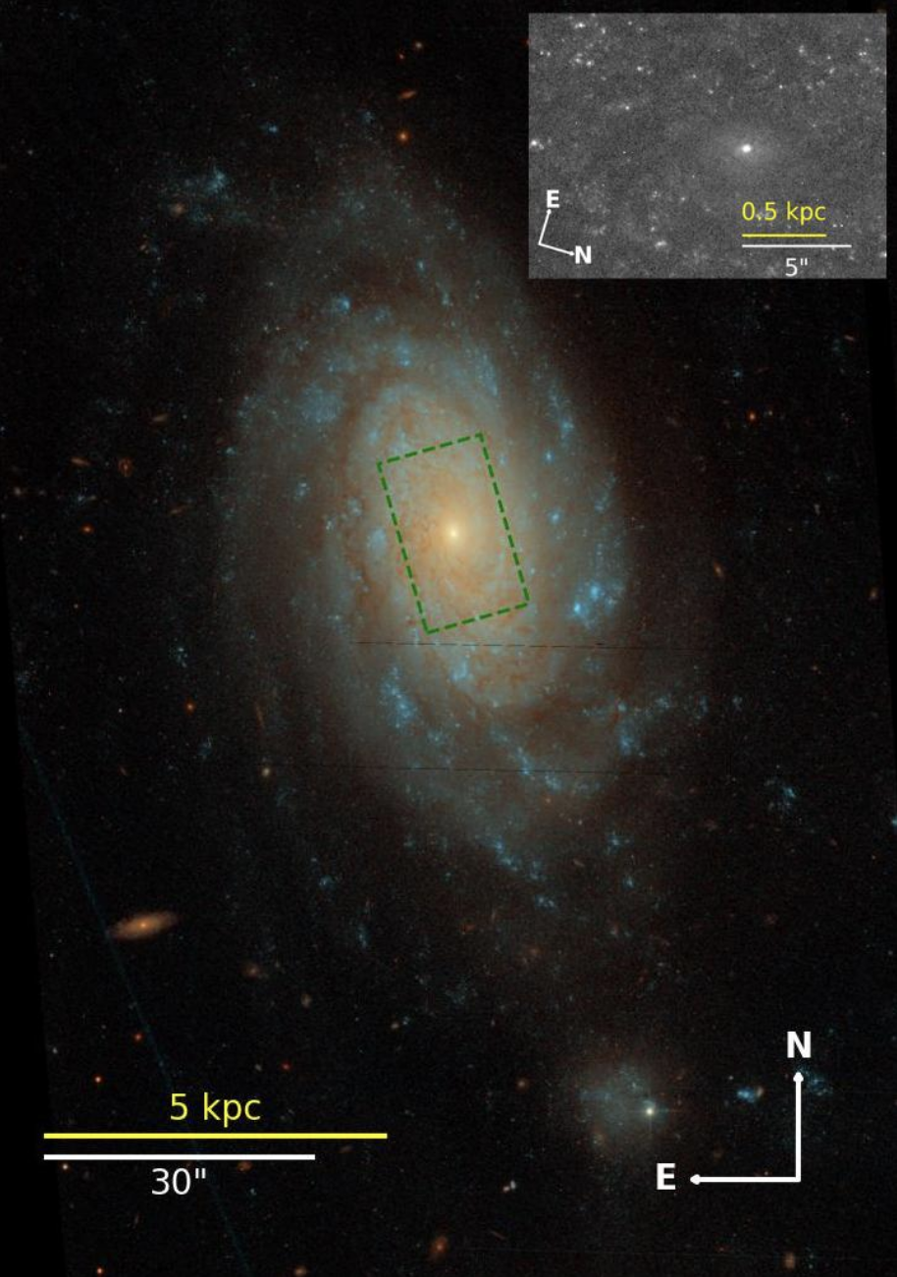
NGC 3259: a case-study of IMBH identification biases
(Grishin et al., 2025, A&A 702, A42)
NGC 3259 is located in a very sparse group of galaxies at D = 27 Mpc
M_{BH} = (2.0−4.9) × 10⁵ M☉
Multi-epoch spectroscopic and X-ray observations
Integral field unit (IFU) dataset with Binospec
Low X-ray luminosity
A perfect object for a case study of the biases in the detectability of galaxies with IMBHs

Slide 14
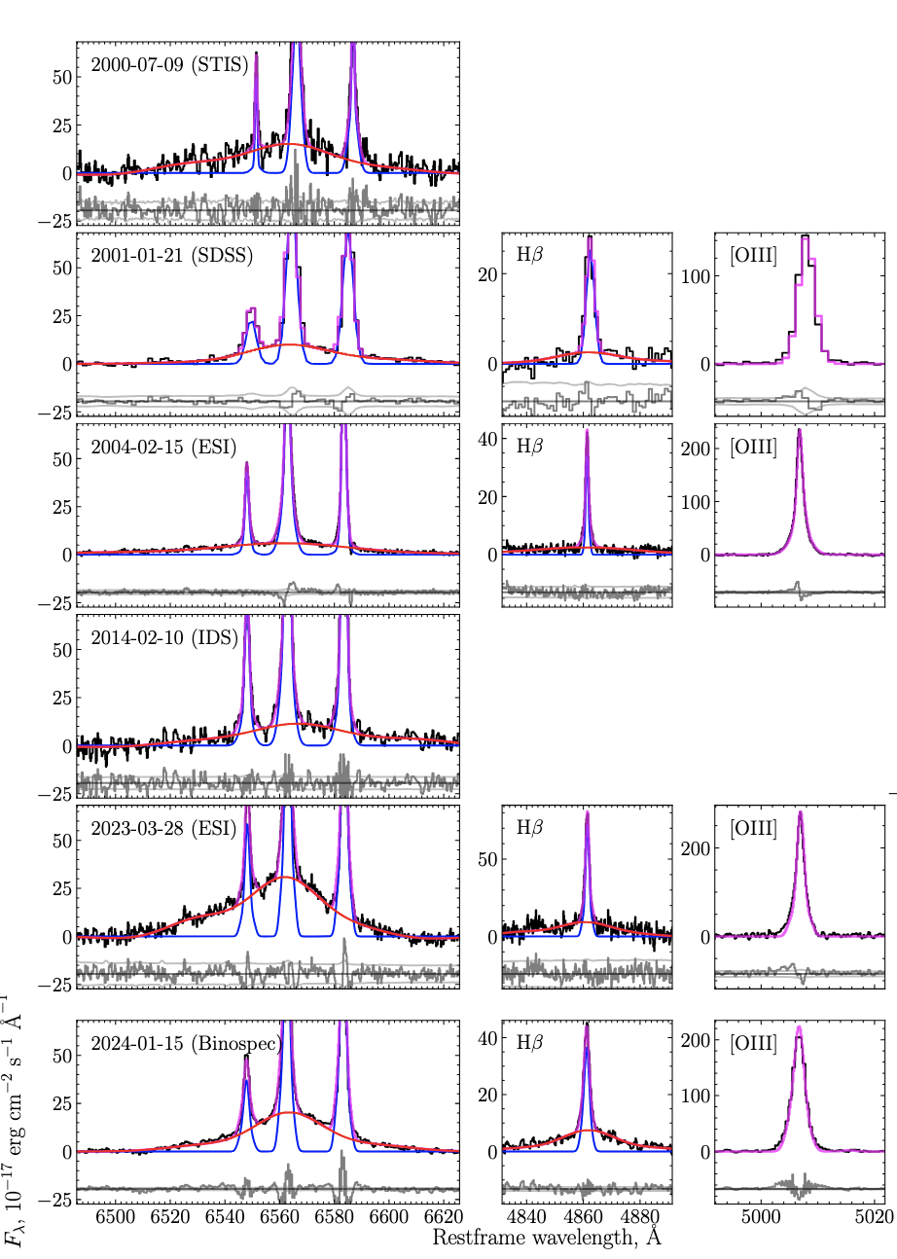
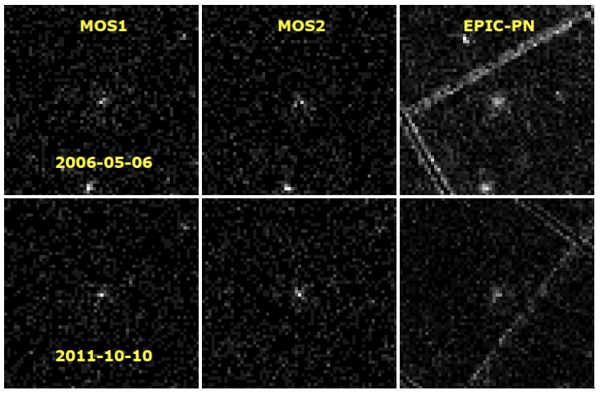
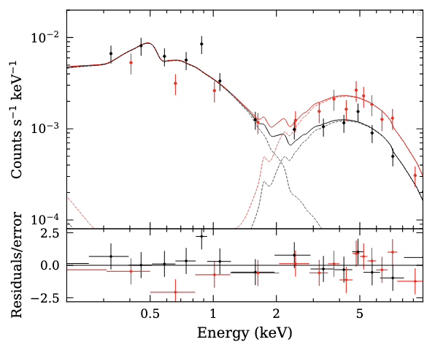
Multi-epoch observations: optical spectra and X-ray
(Grishin et al., 2025, A&A 702, A42)
+ ongoing follow-up campaign with IFU

Slide 15
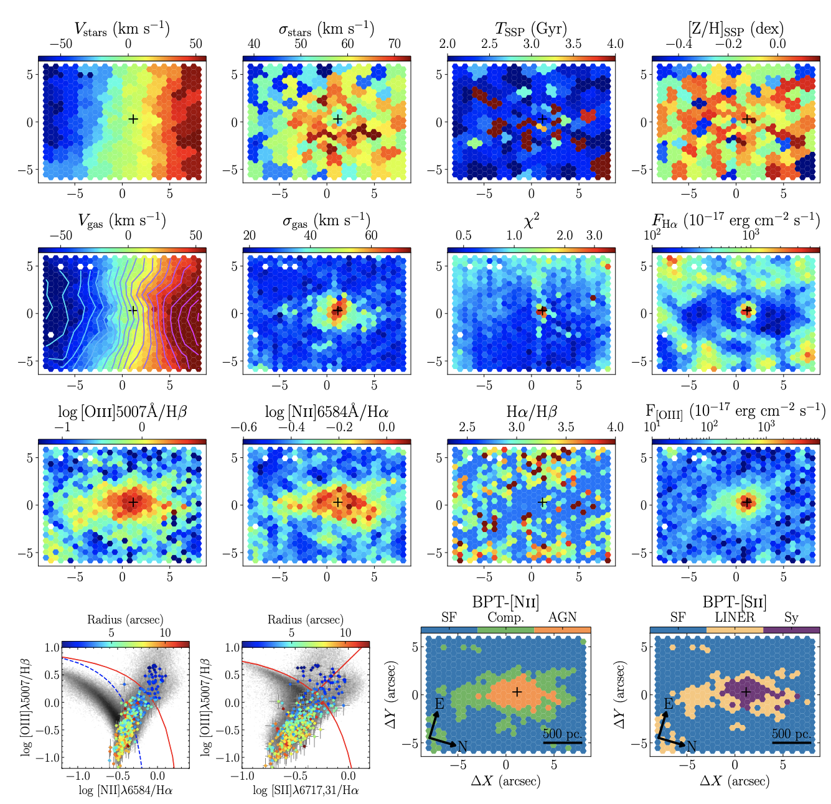
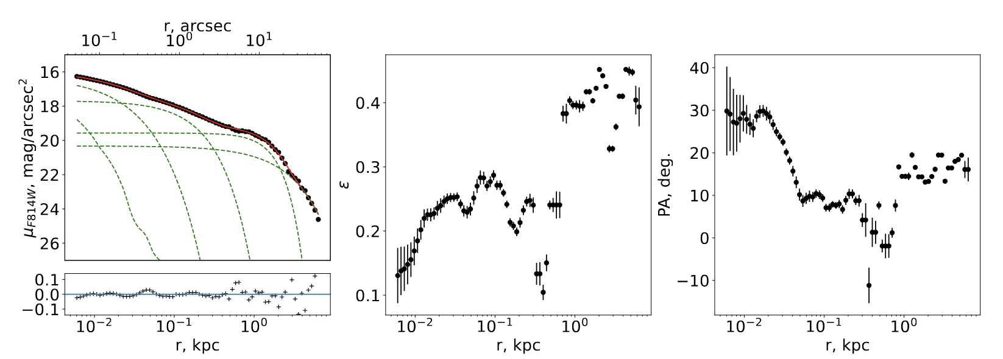
NGC 3259: central part
(Grishin et al., 2025, A&A 702, A42)
NGC 3259 does not follow the M_{BH} – M_{*,bulge} scaling relation, suggesting a dominant role of accretion in black hole growth and secular processes in pseudo-bulge evolution
Hα deficit in the inner 500 pc region may indicate the influence of a bar
S-shaped isovelocity contours (isovels) are also consistent with bar-driven dynamics.
However, infrared images show no clear signatures of a bar.

Slide 16
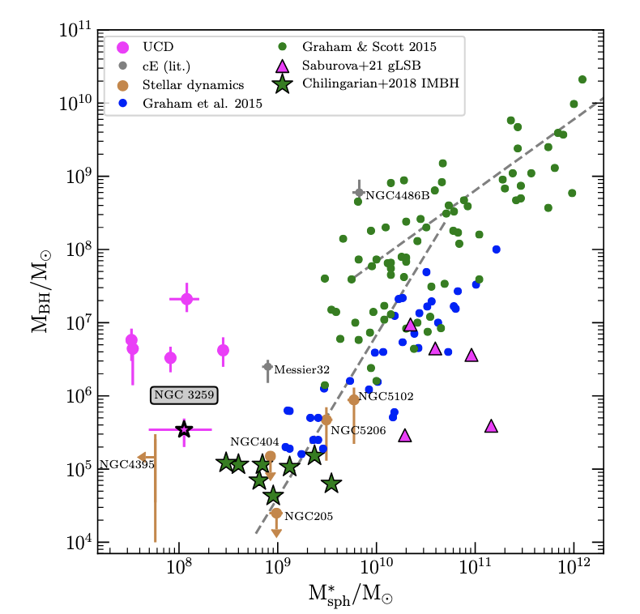
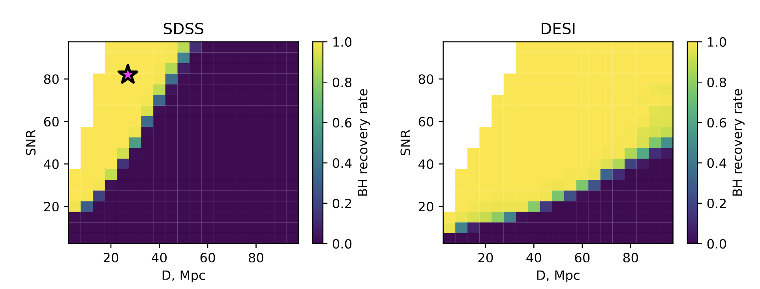
What do we learn from NGC 3259?
(Grishin et al., 2025, A&A 702, A42)
In SDSS NGC 3259-like objects can be detected only to 40-50 Mpc
With DESI the maximum distance would be 3.5−4 times larger, but one needs a S/N similar to SDSS per spaxel, which is usually not a case for DESI.
Low accretion rate and, hence, low X-ray luminosity prevents it from identification in X-ray surveys like eRASS.
In some cases, a low accretion rate and secular pseudo-bulge formation may be correlated — for example, through the presence of a bar — potentially introducing biases in sample analyses.

Slide 17
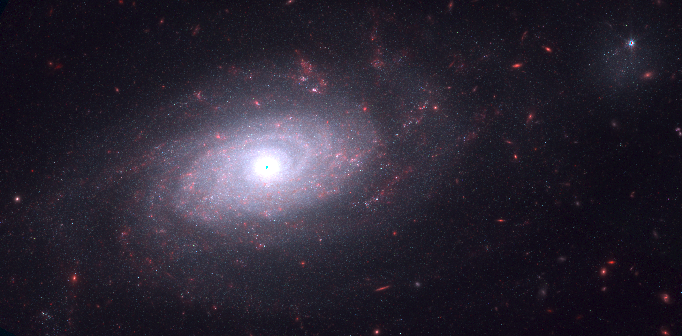
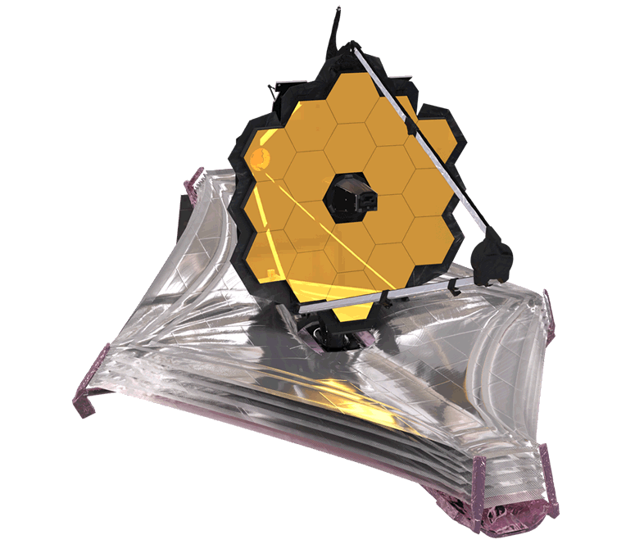
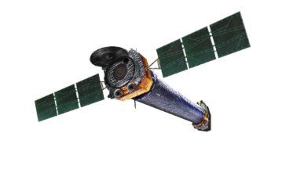
What do we learn from NGC 3259?
(Grishin et al., 2025, A&A 702, A42)
In SDSS NGC 3259-like objects can be detected only to 40-50 Mpc
With DESI the maximum distance would be 3.5−4 times larger, but one needs a S/N similar to SDSS per spaxel, which is usually not a case for DESI.
Low accretion rate and, hence, low X-ray luminosity prevents it from identification in X-ray surveys like eRASS.
In some cases, a low accretion rate and secular pseudo-bulge formation may be correlated — for example, through the presence of a bar — potentially introducing biases in sample analyses.
New data: JWST+Chandra!

Slide 18
Conclusions
Intensively accreting IMBHs and low-mass SMBH (M_{BH} < 10⁶ M☉) tend to follow M_{BH}-M_{bulge} scaling relation
However, the location of currently observed IMBHs on the M_{BH}-M_{bulge} does not immediately imply bulge-BH coevolution of all IMBHs as low accretion rate and the absence of bulge-BH may have the same reason, in case of NGC 3259 – potential presence of the bulge in the past
Ongoing and future surveys, like DESI and 4MOST will drastically change this situation and substantially help us with the identification of low-accreting systems

