Slide 1

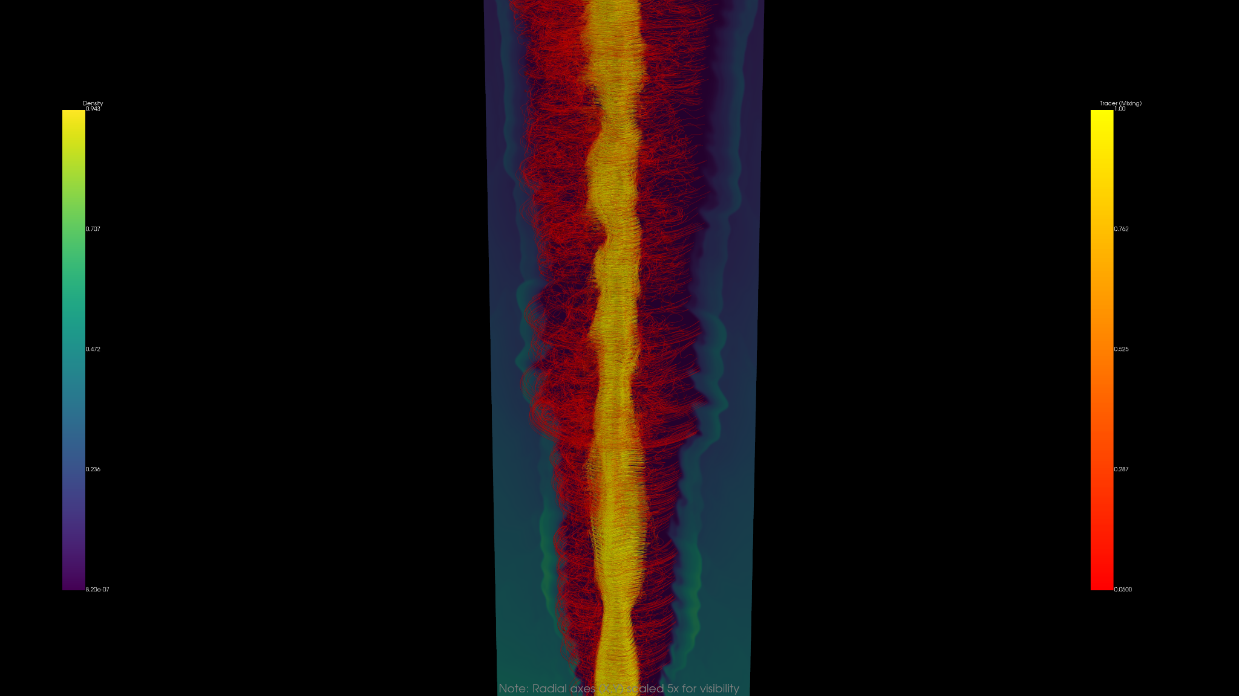


“Recollimation shocks and nonlinear dynamics in relativistic AGN jets”
Stella S. Boula
Collaborators: F. Tavecchio, G. Bodo, N. Vlahakis, P. Coppi
INAF – Osservatorio di Brera
14/09/2026
Illuminating the Active Universe: Multi-Wavelength and Multi-Messenger Insights into AGN

Slide 2
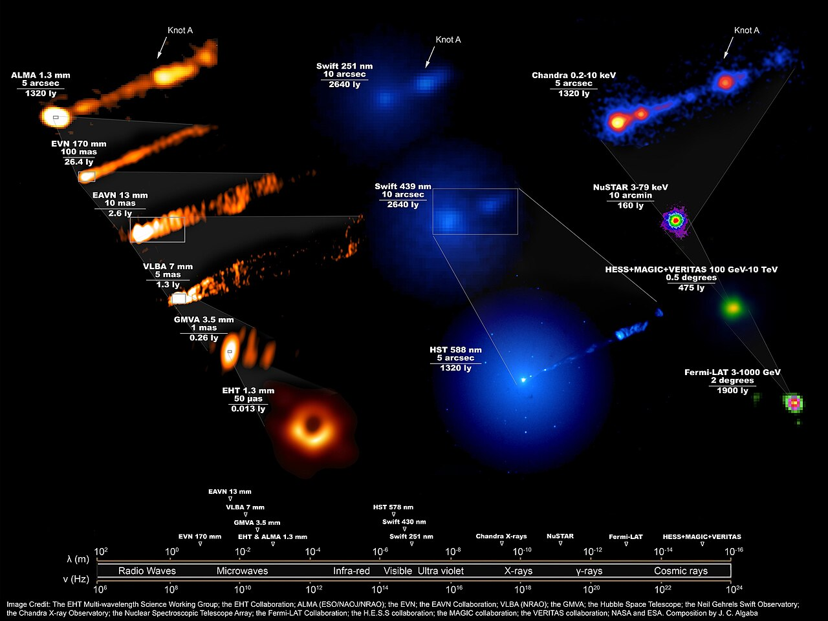

Slide 3
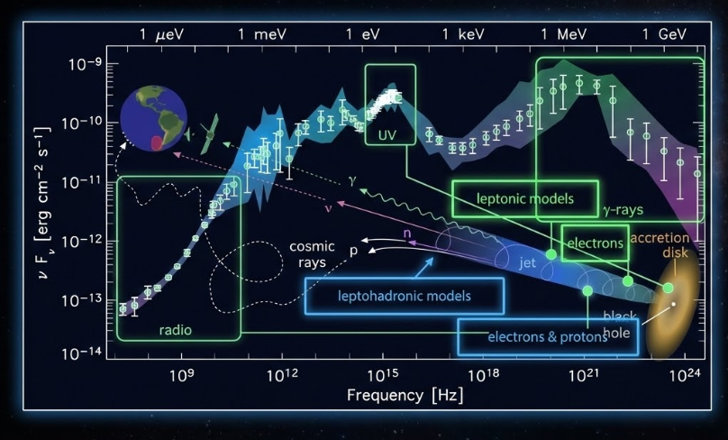
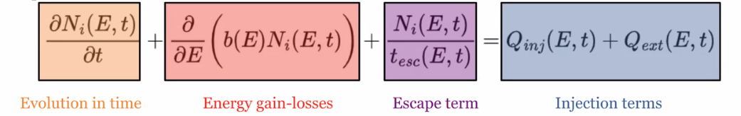
Rani et al., 2019

Slide 4
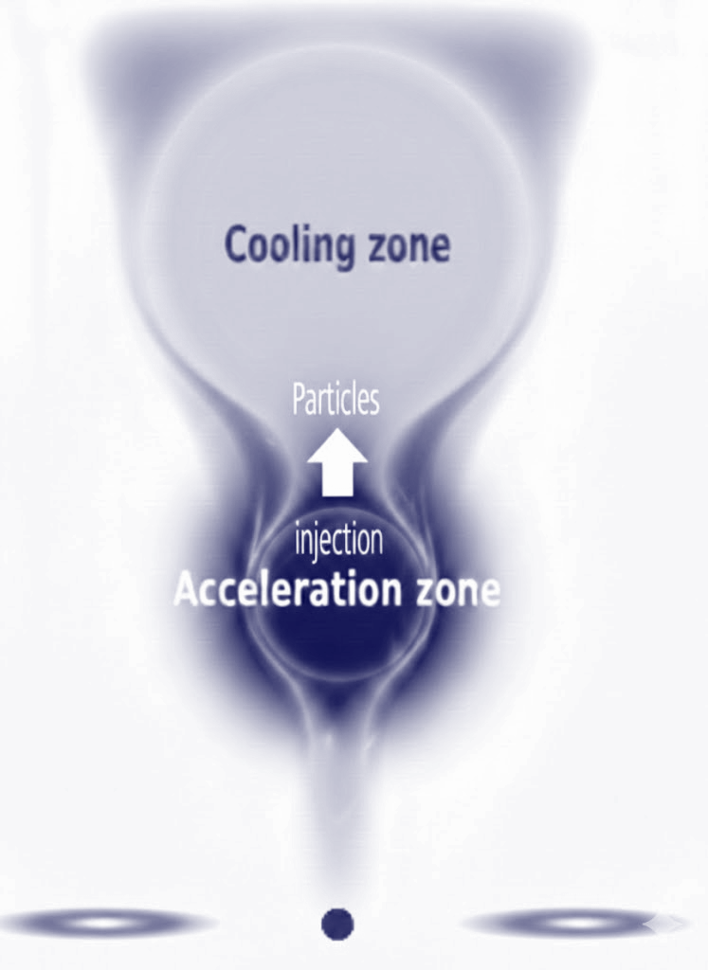
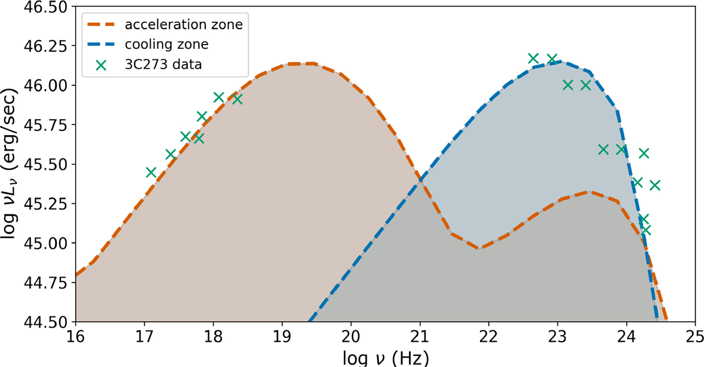

BL Lacs
FSRQs
U_{B}>U_{ext}
U_{B}<U_{ext}
U_{B}>U_{ext}
U_{B}>U_{ext}
Boula et al., 2026a

Slide 5
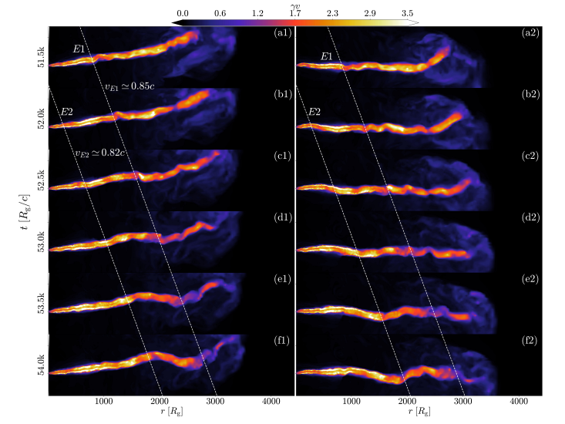
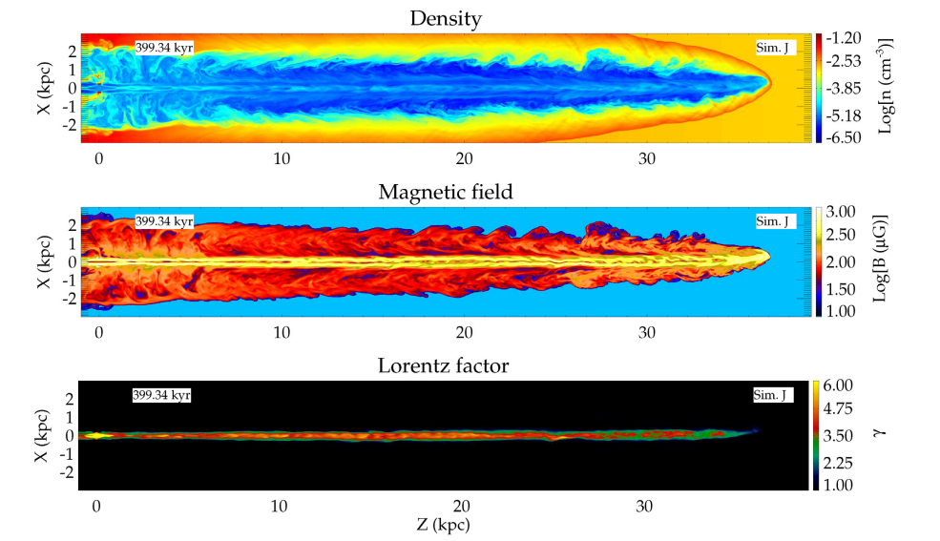
Jet Simulations
Lalakos et al., 2023
Mukherjee et al., 2020

Slide 6

The recollimation structure
The mechanism
Jet expansion
Jet pressure > External pressure Jet expands.
Medium pushback
External pressure drops slower than jet pressure Medium pushes back.
The result: Supersonic flow is forced to converge, creating stationary recollimation shocks.
Komissarov & Falle (1997)
Foundational hydrodynamic models of jet reconfinement.
Predicted a stable, repeating sequence of incident and reflected shocks (the "shock diamond" structure).
The model & key regions
Depicts the z-axis (propagation) and r-axis (radius).
v_{r} (initial jet): A conical flow begins expanding outward.
The sheath: The external medium exerts a pressure gradient (P) pointing inward, pushing back against the jet boundary.
The spine: The inner jet is forced to converge.
The recollimation point (z_{r}): The location where the flow lines converge, creating the first recollimation shock.
The stippled region (post-z_{r}): The heated, post-shock material that, in 2D models, forms the first "knot."

Slide 7
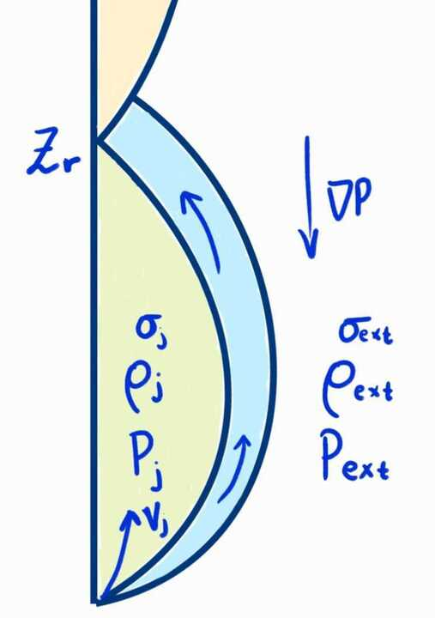
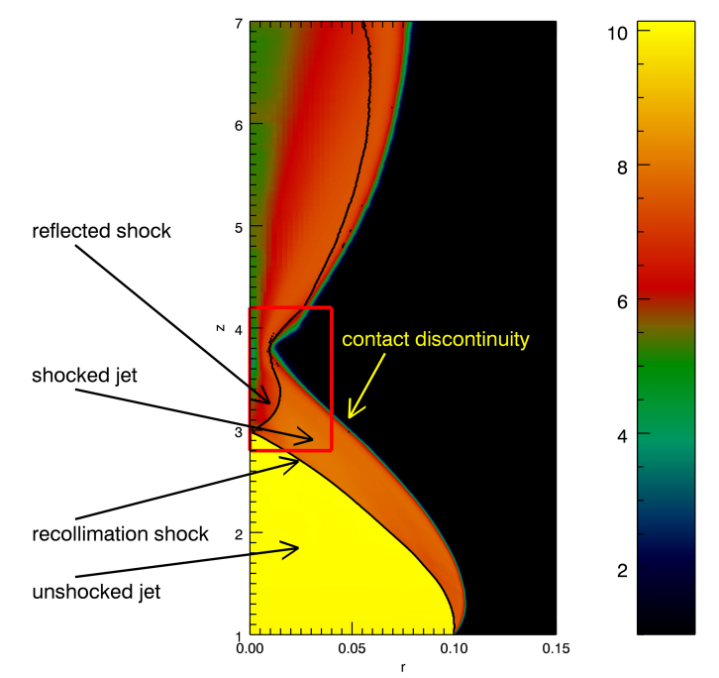

Analytical approach
Recollimation Point Position
The position of the recollimation point z_{r} (Komissarov & Falle 1997) can be written in terms of the parameters that characterize our setups:
Lorentz factor & external temperature
Density contrast & jet opening angle
δ= 1 -η /2 and μ= 0.7
Bodo & Tavecchio 2018

Slide 8
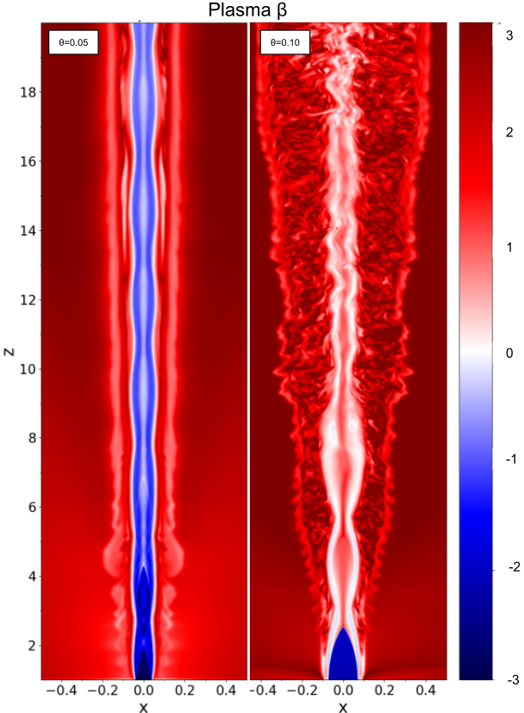
Magnetohydrodynamic (MHD) simulations
Global dynamics
Model full jet structure over parsec to kiloparsec scales: formation, collimation, propagation, and jet–environment interaction.
Long-term variability
Follow the evolution of shocks and turbulence over time, providing insight into long-timescale blazar variability.
Shock identification
Capture macroscopic shocks:
• Internal shocks (velocity variations)
• Recollimation shocks (pressure mismatches)
→ Potential particle acceleration sites
No microphysics of acceleration
Cannot self-consistently model particle injection or non-thermal spectra.
Particle energization must be assumed or informed by PIC/MC results.
Instability evolution
Resolve large-scale MHD instabilities (Kelvin–Helmholtz, current-driven), leading to turbulence and possible energy dissipation.
Plasma β
Boula et al., 2025
Gómez et al. 1997; Komissarov & Falle 1997;Mizuno et al. 2011; Rueda-Becerril et al. 2014; Diltz et al. 2015; Mizuno et al. 2015; Martí et al. 2016; Fromm et al. 2016; Bromberg & Tchekhovskoy 2016; Matsumoto et al. 2017; Barniol Duran et al. 2017; Martí 2019; Tavecchio et al. 2020; Kramer et al., 2024, Boula et al., 2025b, 2026b

Slide 9
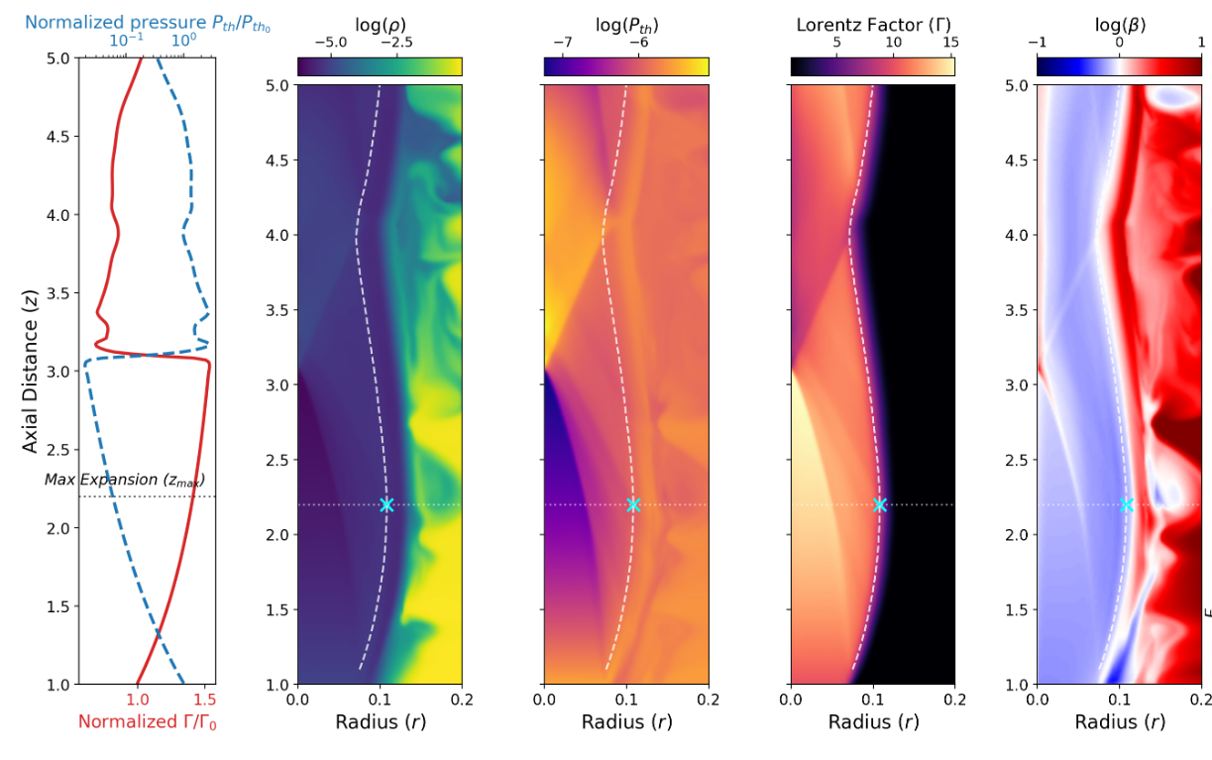
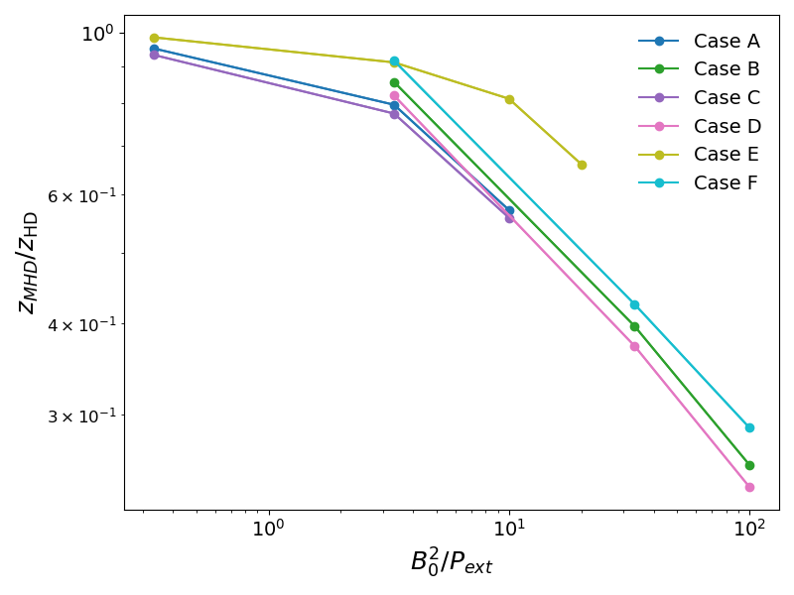

Anatomy of a magnetized recollimation shock
Cold, high magnetized jets: Almost absent recollimation shocks due to poloidal dominance.
Jet acceleration: Less expansion results in less acceleration.
Magnetization impact: Increased magnetization decreases recollimation points due to poloidal pressure and toroidal tension.
Pressure ratio: Higher pressure ratios allow freer jet expansion and larger recollimation distances, preserving jet structure.
Heavy jets: Recollimation at larger distances.
Boula et al., 2026b

Slide 10
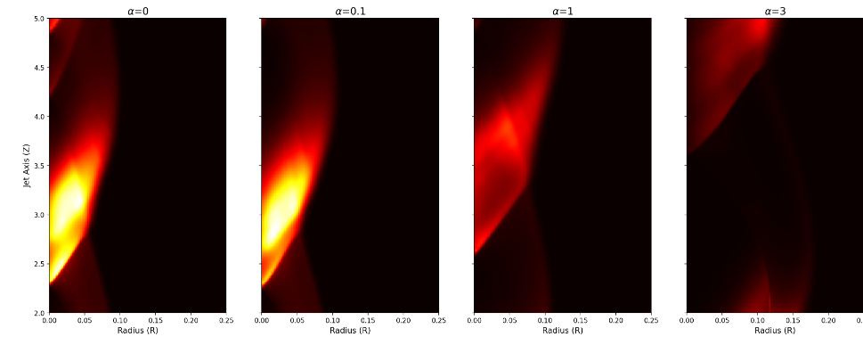
What about the magnetic field topology?
The model
Emissivity is tied to thermal pressure, magnetic pressure, and Doppler boosting:
ε_{obs} ∝ P_{th} P_{B} δ³
Emissivity profiles
Visualizing jet cross-sections for pitch parameter values α = 0, 0.1, 1, 3
Low magnetic pitch (0 & 0.1)
Strong shocks heavily compress the flow, producing bright, highly localized, and boosted emission knots.
High magnetic pitch (1 & 3)
Poloidal fields force the jet to expand, lowering downstream pressure and resulting in much weaker, diffuse emission.
Boula et al., 2026b

Slide 11
What are the jet instabilities?
Types of instabilities
Kelvin-Helmholtz (KHI)
Caused by shear at jet-ambient interface; prominent in hydrodynamic jets.
Current-Driven (CDI)
Arises in magnetized jets with strong toroidal components; distorts/disrupts the core.
Centrifugal (CFI)
Linked to local curvature, radius, and magnetization; localized and condition-dependent.
Why are they important?
Stability & Turbulence
Control jet stability, mixing, and the development of turbulence.
Energy & Shocks
Affect energy dissipation, shock formation, and particle acceleration.
Observational signatures
Influence polarization, variability, and emission signatures in AGN jets.
3D vs. 2D
2D simulations
Captures linear growth and shock interaction under symmetric assumptions.
3D simulations
Necessary for full nonlinear evolution (kink development, helical modes, turbulence onset).
Axisymmetry
Only 3D can capture non-axisymmetric modes (such as kink, KHI, and CFI).

Slide 12
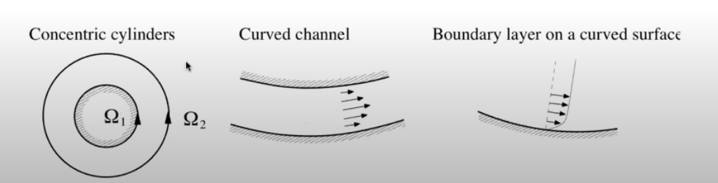
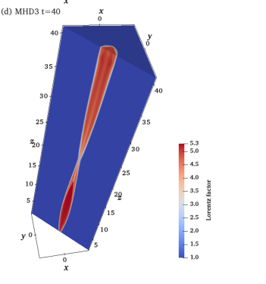


Centrifugal instability
Credit: K. Gourgouliatos
Matsumoto, Komissarov and Gourgouliatos, 2021, Boula et al., 2025b

Slide 13
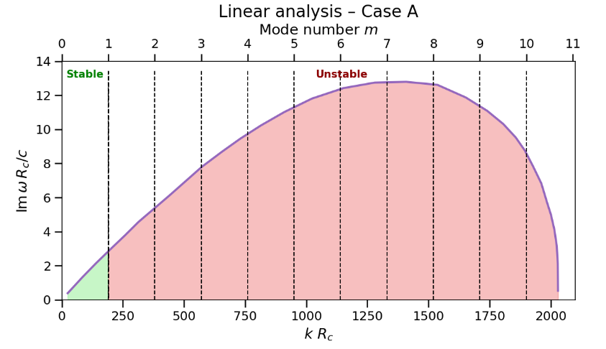
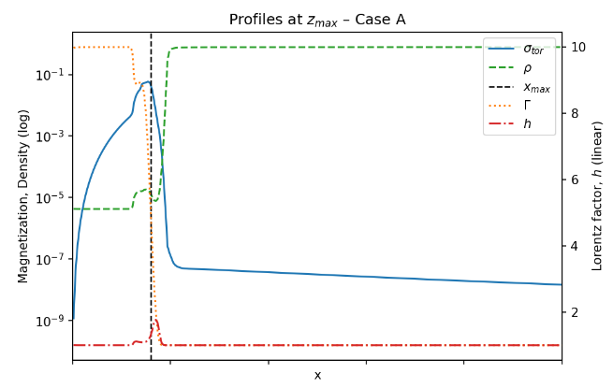
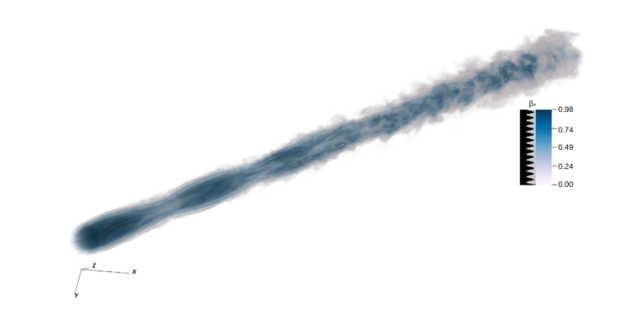
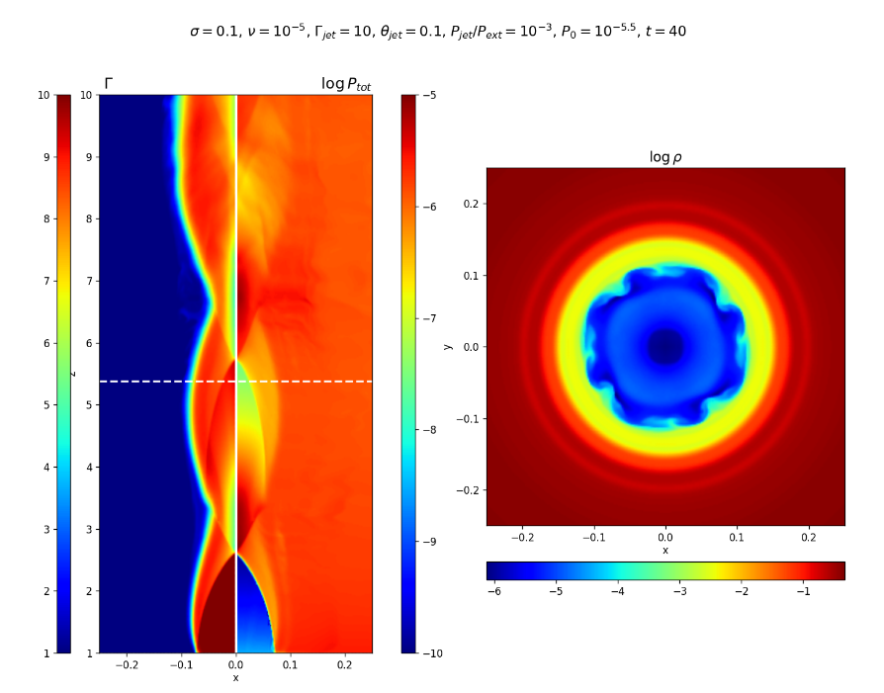
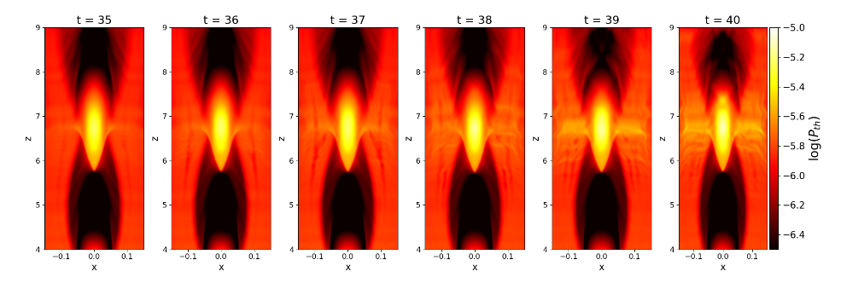
3D simulations and stability due to the magnetic fields
Matsumoto, Komissarov and Gourgouliatos, 2021, Boula et al., 2025b

Slide 14
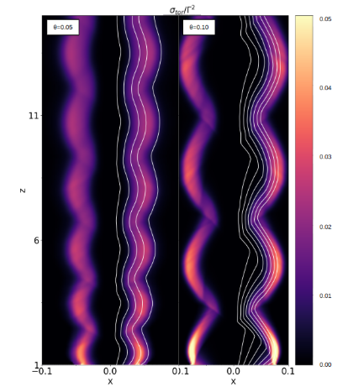
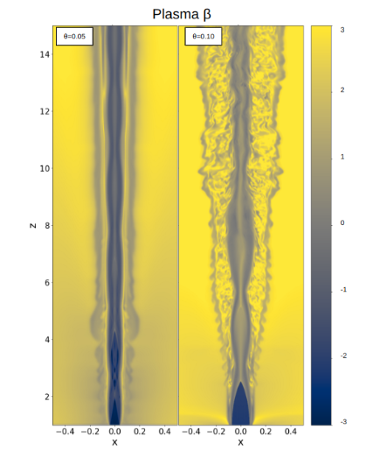
Stable vs Unstable Jets
Initial state (t = 0)
Evolved state (t = 80)
Comparison of jets with density parameter σ = 0.1, opening angles θ = 0.05 and 0.1, and Lorentz factors Γ = 5 and 10 respectively.
Boula et al., 2025b

Slide 15
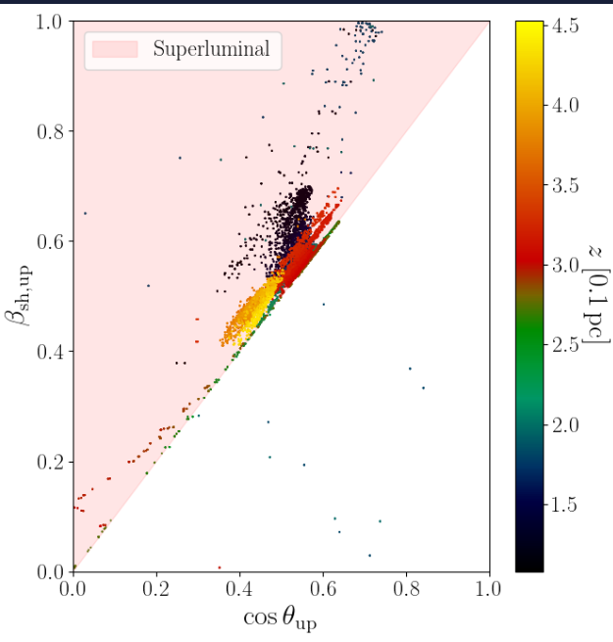
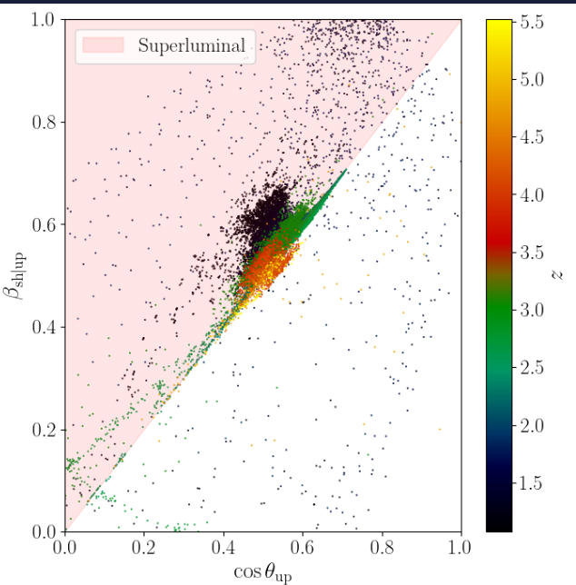
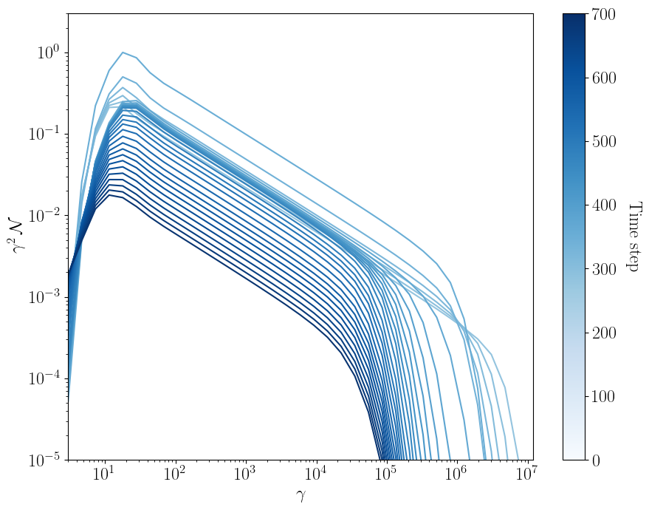
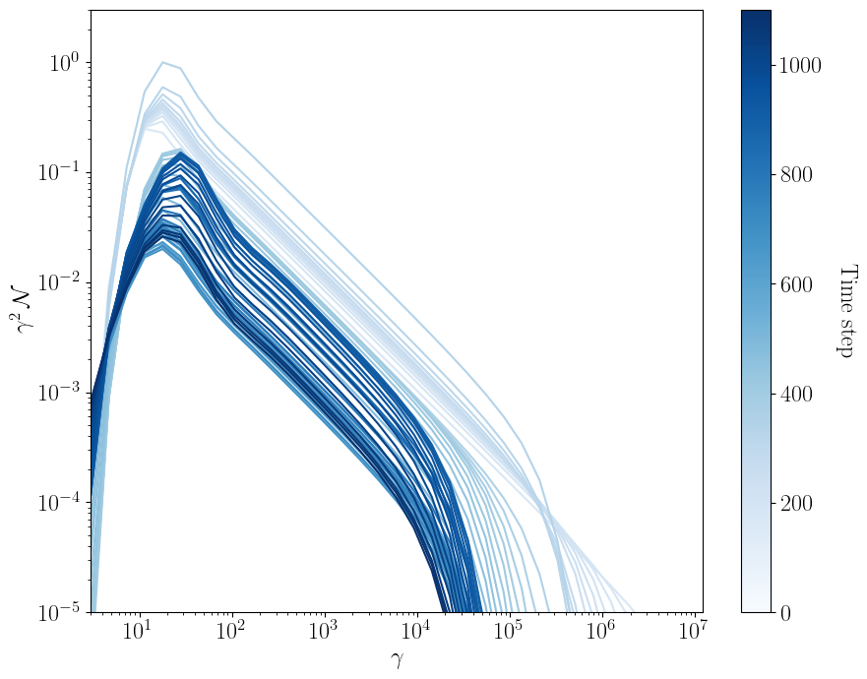
From 3D Simulations
t = 0
t = 93
Shock formation
Internal shocks commonly form from bulk velocity variations in the jet. Recollimation shocks arise as the jet adjusts to external pressure. Both are key sites for potential particle acceleration.
Turbulence & Dissipation
MHD instabilities generate turbulence, enabling stochastic acceleration. Magnetic energy dissipation (e.g., via reconnection) can energize particles.
Jet structure
Reveal the large-scale location and evolution of emission regions. Essential for interpreting multi-wavelength and polarization data.
Coupling with particle codes
RMHD + particle transport/radiation models yield synthetic SEDs and light curves. This connects global dynamics to observed blazar variability and spectra.
The method is described in Sciaccaluga et al., 2025
Boula et al., in prep

Slide 16
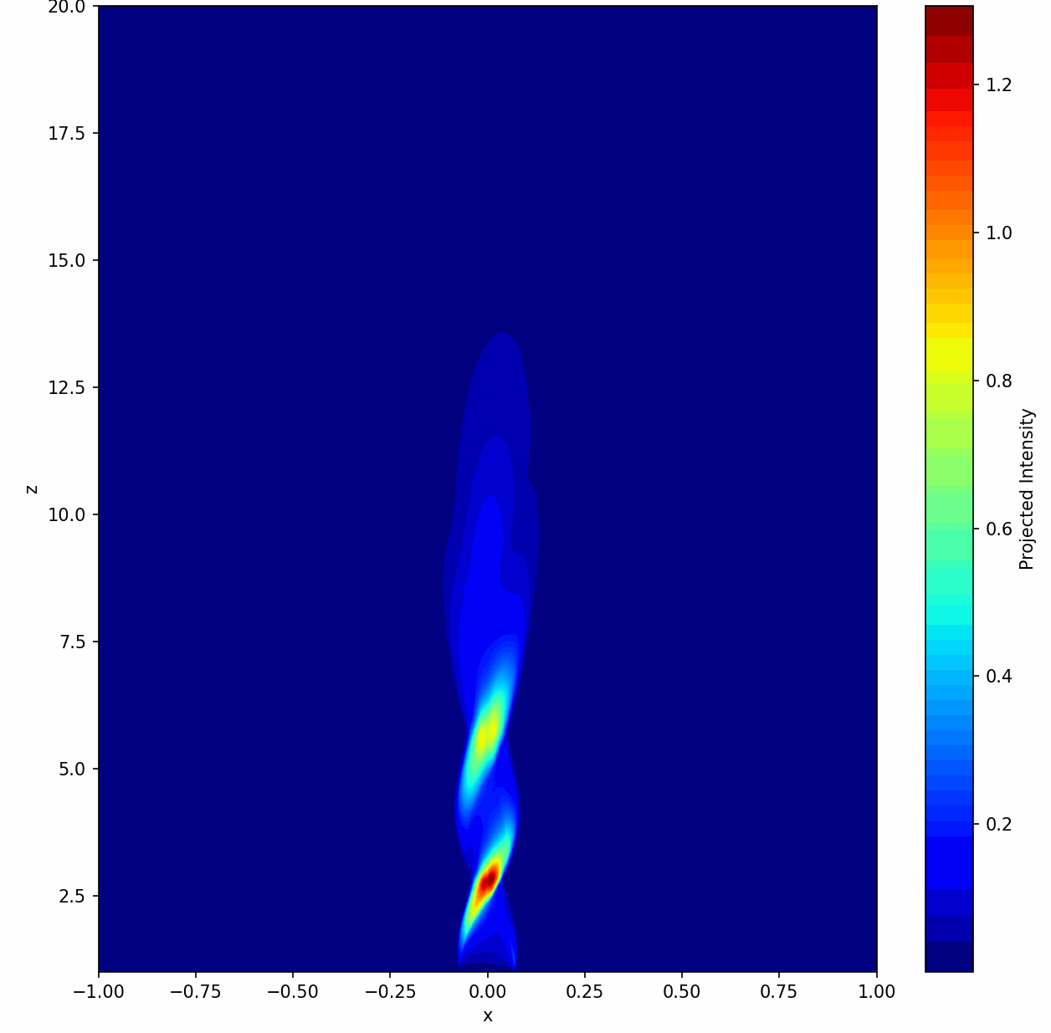
Boula et al., in prep

Slide 17
Take home messages
2D vs. 3D
2D simulations guide parameter choices but miss nonlinear effects / 3D is essential for full understanding.
3D dynamics reveal instabilities
Hydrodynamic jets quickly destabilize; magnetized jets remain stable longer, delaying kink onset.
Magnetization controls jet structure
Higher magnetization leads to earlier recollimation and suppresses instabilities, especially in cold jets.
CFI is local
Its growth depends on local jet properties (radius, curvature, Lorentz factor, σ), not just global parameters.
Pressure and inertia effects
High pressure ratios allow for more expansion; heavier jets recollimate further downstream.
Astrophysical relevance
Results help explain AGN jet variability, knot formation and polarization signatures.

Slide 18


Thank you!
styliani.boula@inaf.it
"Active Galactic Nuclei: what's in a name?"

Slide 19
Back up slides

Slide 20
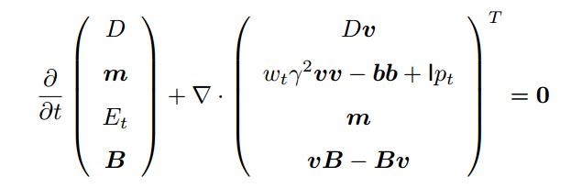
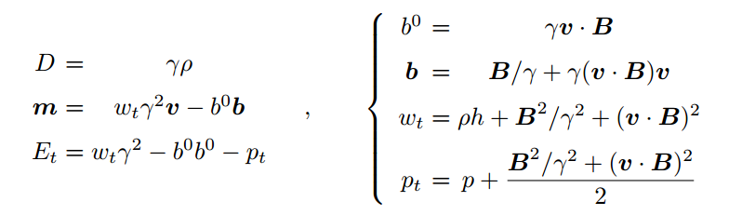
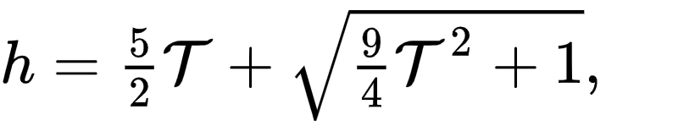
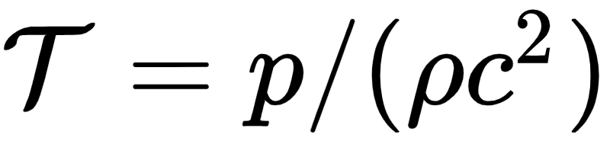
The RMHD Module
PLUTO
Explicit, Compressible Code (FV):
Shock capturing
High Mach number flows
Works in 1D, 2D, 3D
Modular Structure:
Physics modules
Time stepping
Interpolations
Riemann solvers
Supported Physics:
HD (Hydrodynamics)
MHD (Magnetohydrodynamics)
RHD (Relativistic Hydrodynamics)
RMHD (Relativistic Magnetohydrodynamics)
Geometry Support:
Cartesian
Cylindrical
Spherical
Additional Features:
Radiative losses
Mignone et al. 2005, 2007, 2019

Slide 21
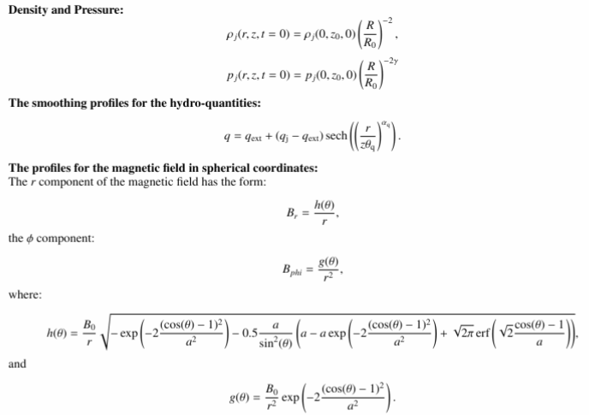

Slide 22
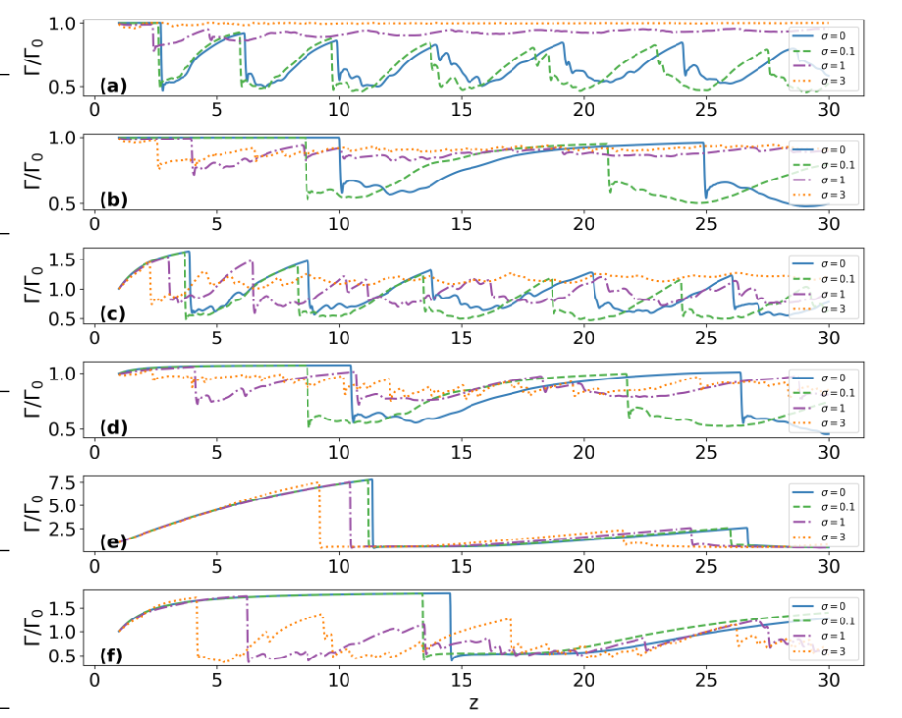
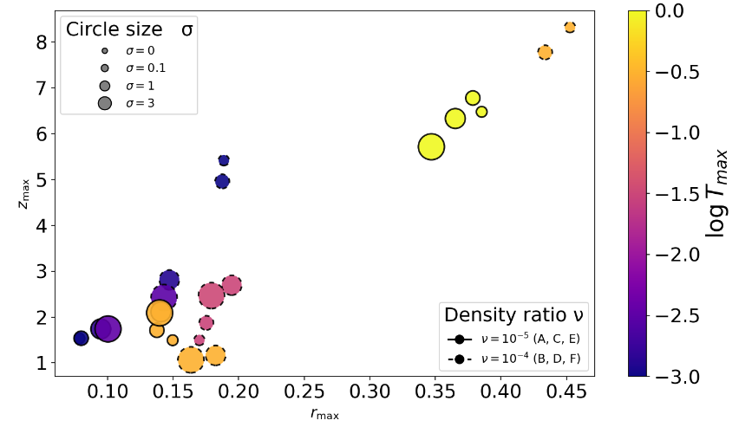
The role of the parameters

Slide 23
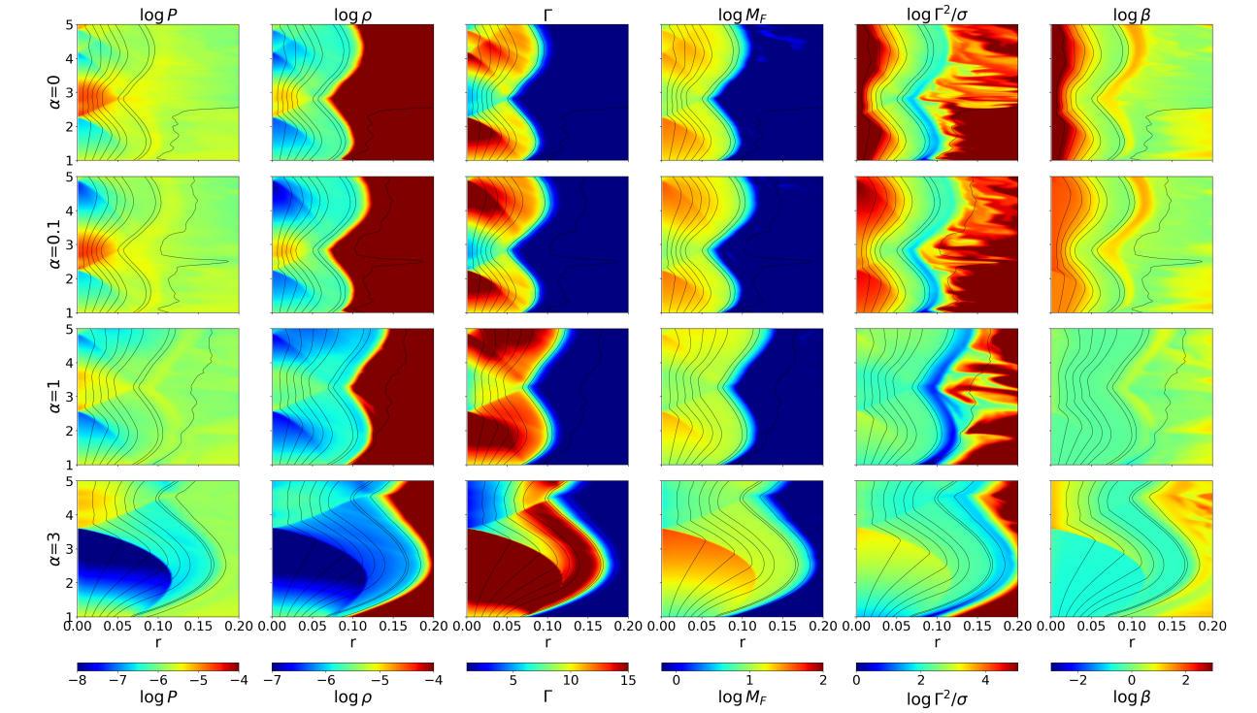
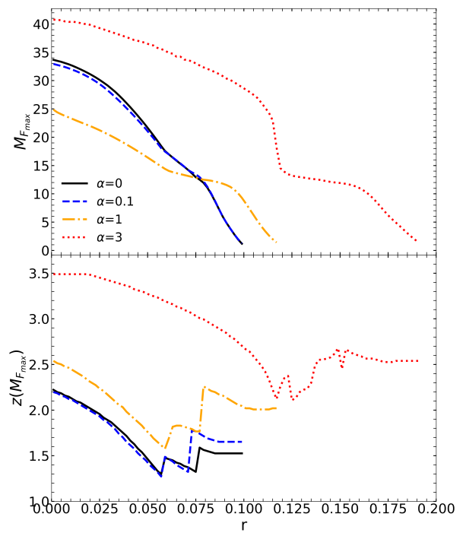
What about the magnetic field topology?
Boula et al., accepted for publication in A&A

Slide 24
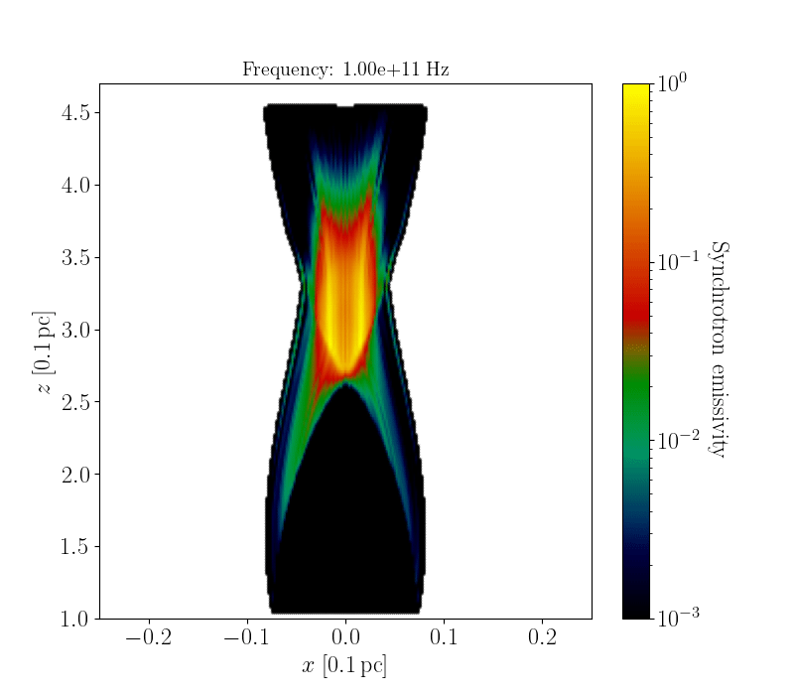



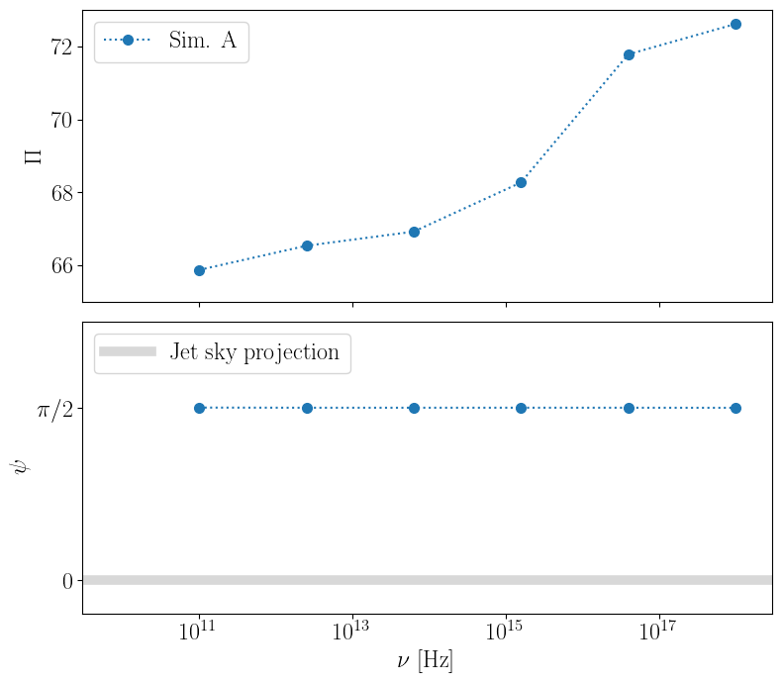
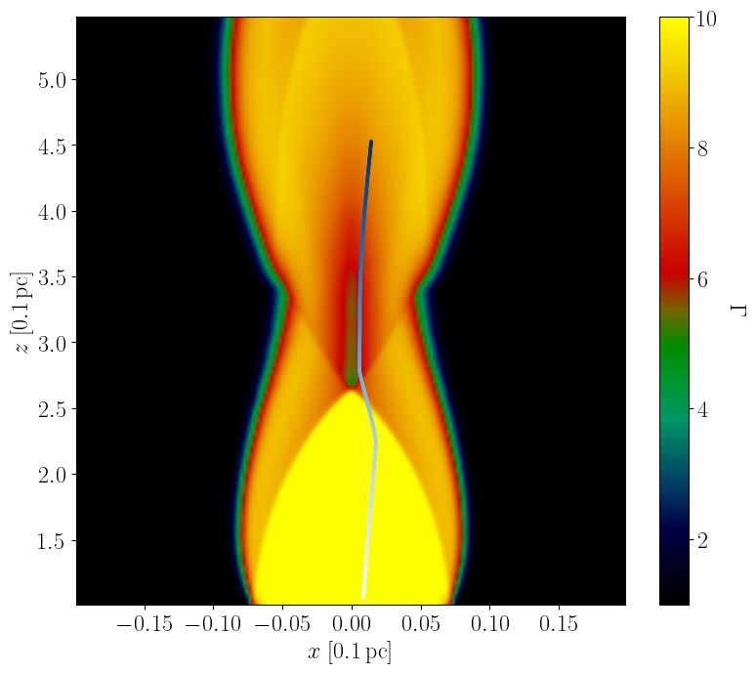
t = 0
Kirk 1994
Drury 1983, Keshet & Waxman 2005

Slide 25
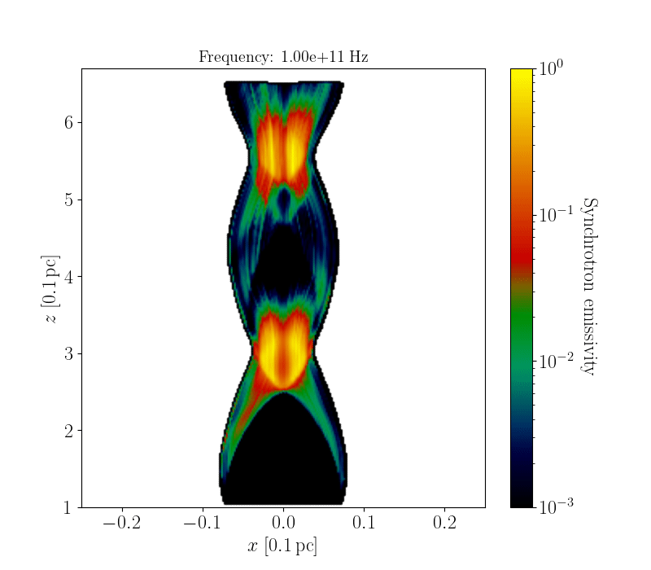
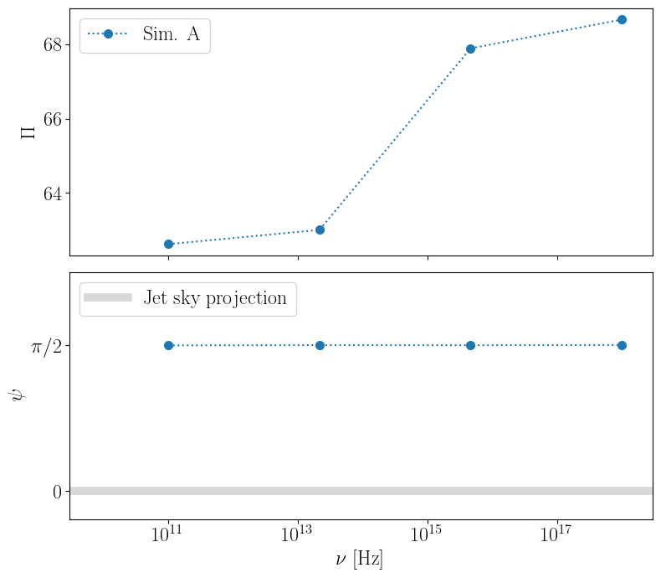
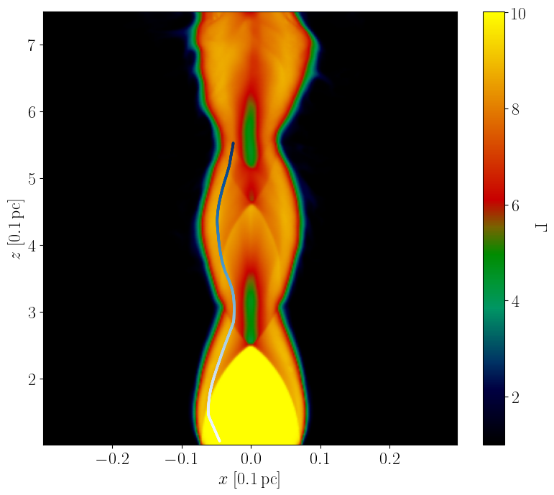
t = 93

